Slide 1
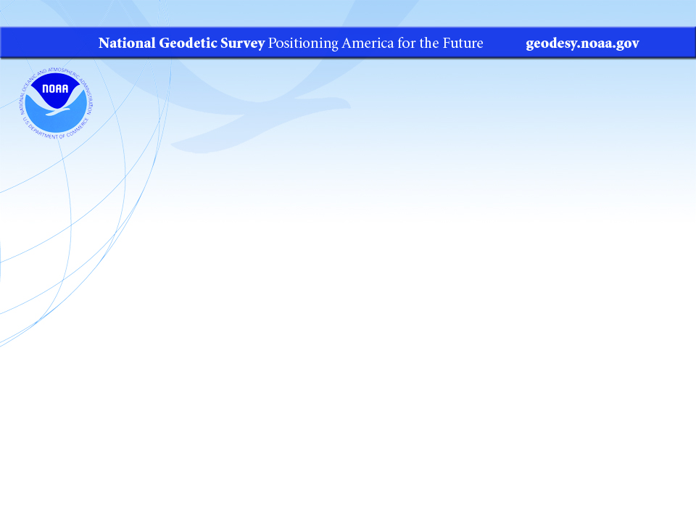
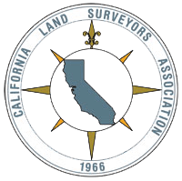
National Geodetic Survey (NGS): Regional Advisors Program
Dana Caccamise
Pacific Southwest Region (CA,NV) Geodetic Advisor
dana.caccamise@noaa.gov
NOAA’s National Geodetic Survey
geodesy.noaa.gov
California Land Surveyors Association (CLSA)
Webinar Series: September 20, 2017

Slide 2

Who is Dana Caccamise ? ( Day-nuh Kak-uh-Miss )
Dana Caccamise is:
NOAA’s National Geodetic Survey’s (NGS) Pacific Southwest Region Geodetic Advisor.
He assists the geospatial community throughout California and Nevada—including public- and private-sector surveyors, GIS professionals, engineers, and earth scientists—with proper application of the National Spatial Reference System.
Notes:
Answer to my most frequently asked question… Does he look smart?
Dana has been part of the NGS since 2014 and has graduate degrees in the fields of Earth Sciences, Geophysics, and Geodesy and currently resides in San Diego, California. The California Spatial Reference Center (CSRC), located at Scripps Institution of Oceanography (SIO) at the University California San Diego (UCSD), is hosting his position. Dana also holds a Research Associate position in the SIO’s Institute of Geophysics and Planetary Physics (IGPP).

Slide 3
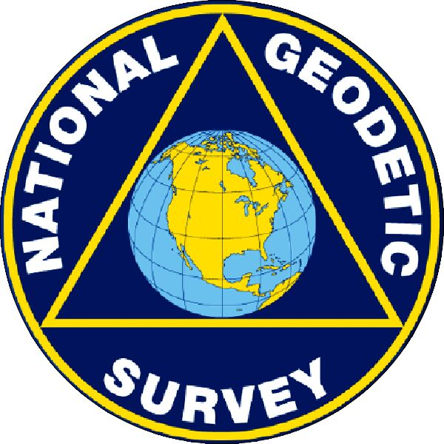
U.S. Department of Commerce National Oceanic & Atmospheric Administration’s National Geodetic Survey (NGS)
Mission: To define, maintain & provide access to the
“National Spatial Reference System (NSRS)”
to meet our Nation’s economic, social & environmental needs
NSRS is a consistent coordinate system
That defines:
& their time variations
(& National Shoreline, etc. throughout the USA)
Latitude
Longitude
Height
Scale
Gravity
Orientation
Notes:
Geodesy is the business of the National Geodetic Survey (NGS).
NGS develops and maintains the National Spatial Reference System, a national coordinate system that provides the foundation for transportation, navigation, land record systems, mapping and charting efforts, and a multitude of scientific and engineering applications.
This system defines position (latitude, longitude, and elevation), distances and directions between points, strength and direction of gravity (no, it is not simply “straight down”), shoreline, and how these change over time.
- NSRS benefit to the nation = $2.5B/year
est. 300K precision GPS users worldwide (2008); ¼ in US
- Very exciting to us at NGS to see how it has evolved over the years – now cm-accuracy capability / tracking with time

Slide 4



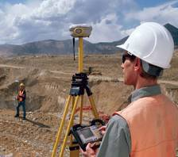
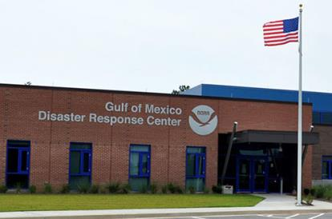
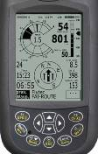

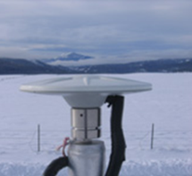



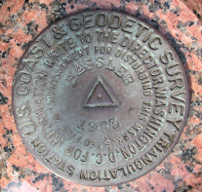
NGS Provides the Geospatial Infrastructure Critical to Our Economy through the NSRS
Aviation
Satellite
Operations
Precision Agriculture
Trucking and Shipping
Surveying and Mapping
Disaster Response
Personal Navigation
CORS
Navigation
Oil Exploration
Fishing and Boating
Survey Marks

Slide 5
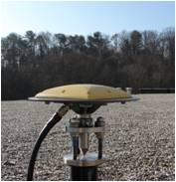
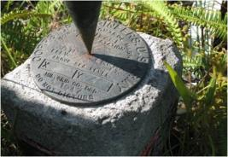

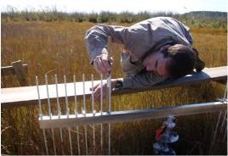
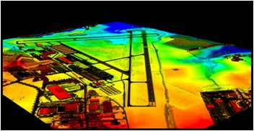
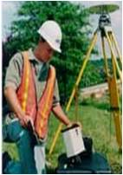
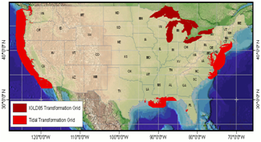
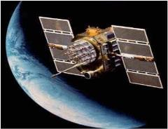
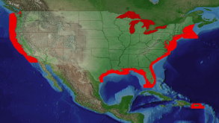
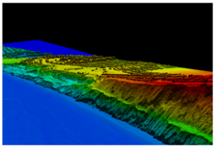
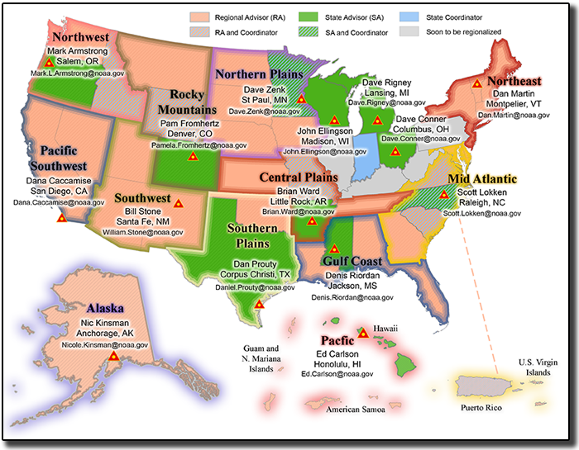
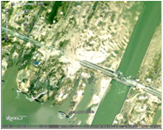

NGS Programs
Modernizing the NSRS
CORS
Height Modernization
GRAV-D
ECO
NGS Products and Services
Airport Surveys
OPUS
VDatum
GPS Satellite Orbits
Coastal Mapping
Regional Advisor Program
Emergency Response Imagery

Slide 6
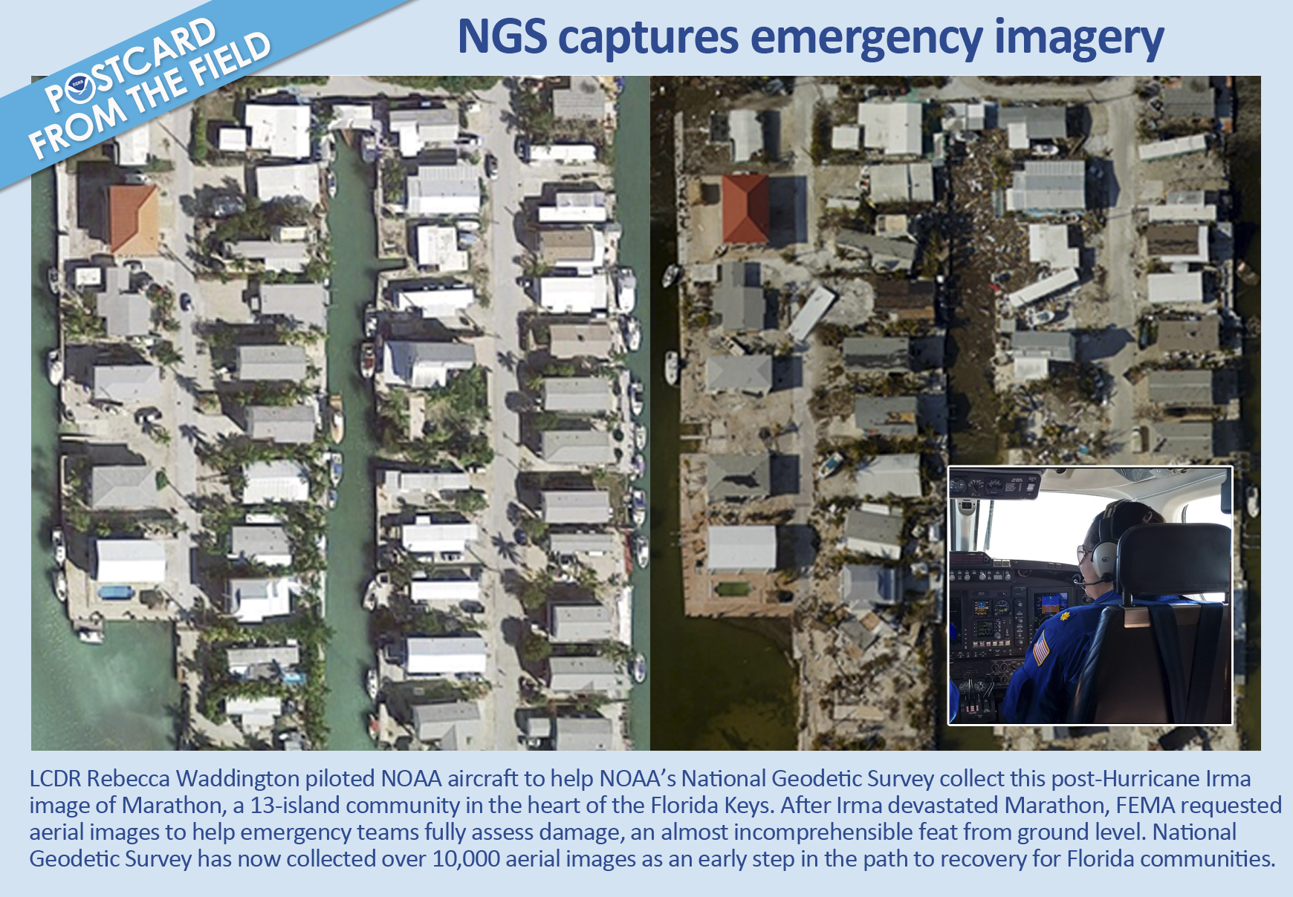
Notes:
Wanted to do a shout out to the Emergency crews for their constant work the last three weeks …. Lieutenant commander (LCDR) Waddington sent this card in..This is the resulting before and after emergency imagery in the heart of the Florida keys (Marathon) thanks to hurricane IRMA

Slide 7

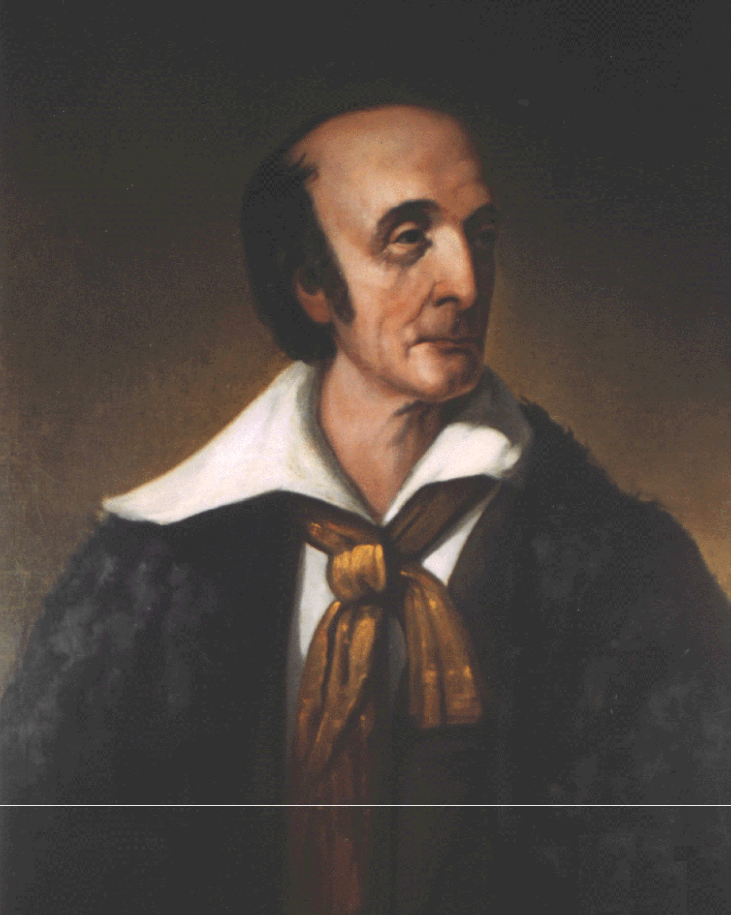


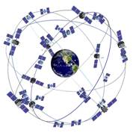
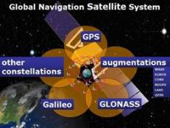
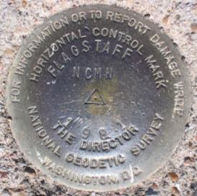
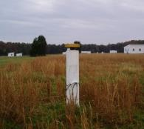
NGS and the NSRS continue to evolve!
The National Geodetic Survey (NGS) has been around a long time!
Our Nation’s first science agency.
1807
Thomas Jefferson
Survey of the Coast
1878
U.S. Coast and
Geodetic Survey
1970
NOAA is established
Ferdinand Hassler
First Director
The National Spatial Reference System continues to evolve with us.
GPS
Passive
Control
(Monuments)
Active
Control
(CORS)
GNSS
Notes:
NGS has been around a long time. For more than 210 years (now 2017), NGS and its predecessor agencies have collaborated with public and private organizations to establish reference stations at precisely determined locations.
In Fact I would say it was conceived from a thought experiment from the American Philosophical society. Today, it is an eminent scholarly organization of international reputation, originally made up from doctors, lawyers, clergymen, and merchants interested in science, and also many learned artisans and tradesmen like Franklin. This country's first learned society, the APS has played an important role in American cultural and intellectual life for over 250 years. Washington, Jefferson and Yes, Hassler were members.
I would argue that most of the members were surveyors, and that the country was founded on the shoulders of geodesy. Anyhow one of the first “survey and mapping projects were the “Lewis and Clark Exposition”. After L&C made it back alive, The country was 30 years young and Thomas Jefferson was president. And there were a lot of problems, one such problem was shipwrecks. Shipping was the major source of commerce and transportation. Since we ran away from home so to speak our mother country “Mother”, no longer felt obliged to provide us with infrastructure items such as maps. The APS studied this issue and the mission began.
We began on a mission established by Thomas Jefferson in 1807 to conduct a “Survey of the Coast” (as the United States Coast Survey).
(Pictured are Thomas Jefferson and Ferdinand Hassler, the first Superintendent of the Coast Survey). We were renamed the U.S. Coast and Geodetic Survey in 1878. NOAA was established in 1970.
Traditionally, precise positioning locations have been identified by setting a survey mark—usually a brass, bronze, or aluminum disk. Locations might also be identified by a deeply driven rod, or a prominent object, such as a water tower or church spire.
More recently, NGS has fostered a network of continuously operating reference stations (CORS), where each CORS includes a highly accurate receiver that continuously collects radio signals broadcast by Global Navigation Satellite System (GNSS) satellites.
GPS (United States) Compass (China) GLONASS (Russia) Galileo (European Union)

Slide 8
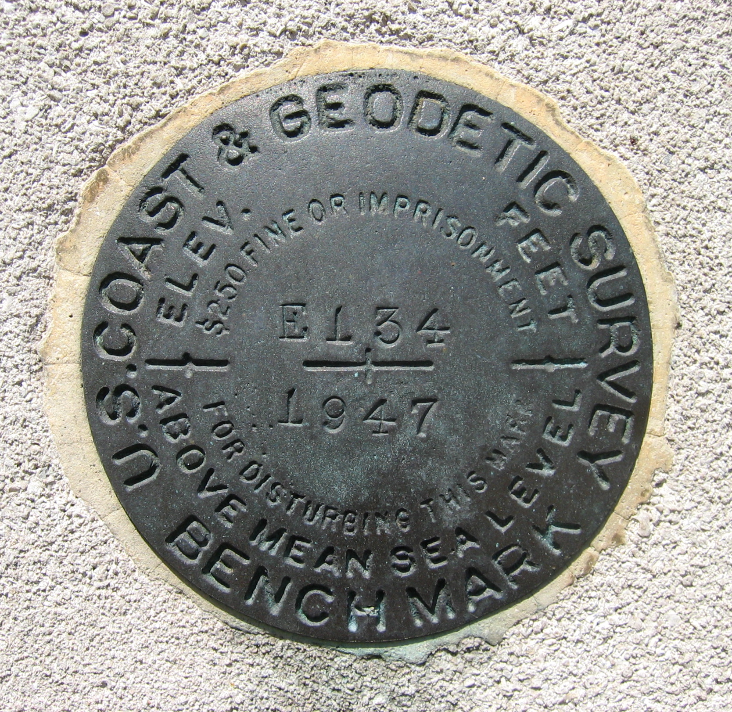
Looking Back …
We put a lot of brass in the ground
What began as a program to preserve
the marks continues to change over time…
Evolving technology, methods
Recognizing Earth’s true dynamic nature
Balancing budget/agency & constituent needs
Support to states and regions…
Originally resetting control to ensure access to the NSRS
Now assistance with planning, education and serving as a liaison for geospatial community and the National Geodetic Survey
With access to the NSRS still the primary concern
Notes:
The National Geodetic Survey, NOS, (formerly the C&GS), NOAA, has been responsible for establishing and maintaining the nation’s horizontal and vertical control networks for more than 160 years. These networks now consist of more than one an a half a (1.5) million marked control points in the U. S. as in the datasheet database

Slide 9

From Mark Maintenance to
State Advisors
Early 1950’s field personnel were permanently assigned to mark maintenance
Mid-1970’s the responsibility of 15 full-time field engineers who regularly recover; repair, or reset markers
Early 1980’s, budget cuts prompted evaluating program changes
NGS promotes State Advisor Program with 50/50 State-Federal cost sharing model
NGS provides geodetic expertise, state provides office and logistical support
About ½ of states participate
Anybody know this guy?
Notes:
History of the Mark Maintenance Program
Field personnel were permanently assigned to mark maintenance in the early 1950’s. Before this time, personnel were detailed from the nearest field party or regional field office with instructions to preserve the endangered mark as quickly and economically as possible.
During the 70’s, The maintenance of these networks were the responsibility of 15 full-time field engineers who regularly recover; repair, or reset markers in danger of being disturbed.
Answer Marvin Marker!
About 1960, the USC&GS created a cartoon character to help preserve survey marks. His name was
“Marvin Marker”.

Slide 10
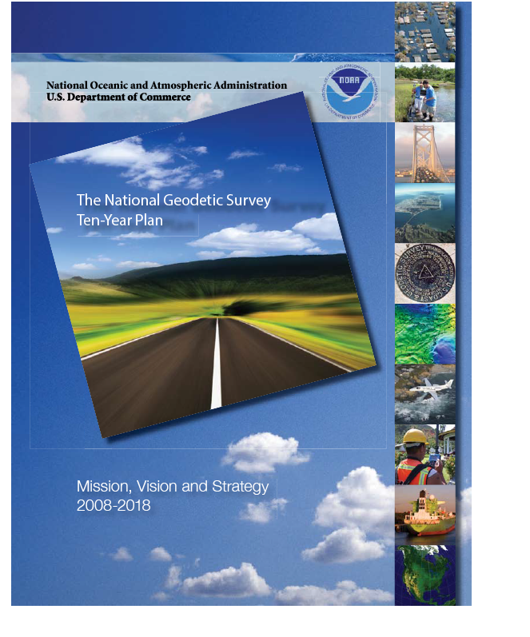
State to region transition
2008, NGS Ten-Year Plan – A new datum is coming!
2009, Study of State Advisor Program to investigate providing better support to all states with transition to the new datum. 3 plans suggested.
2010, NGS leadership decision to adopt a Regional Geodetic Advisor program
“Recognizing the need to broaden the State Advisor Program’s capacity building capability to meet user needs throughout the nation, while ensuring an efficient and effective management structure, the ESC recommends that the current state-based cost share model transitions over time to a regional NGS funded structure.”
NGS Executive Steering Committee, 2010
Notes:
State Advisor Objectives:
Conduct and contribute to technical and scientific meetings, training and other outreach activities to provide others the tools and specifications to contribute to use and enhance the value of the National Spatial Reference System. (NSRS)
Support national, regional and state related programs, agencies, and people through implementation and realization of the NOAA mission and goals.
Keep a wide range of users informed and apprised about the National Spatial Reference System and other programs and products offered by the NOAA
2008, NGS Ten-Year Plan – A new datum is coming!
2009, Study of State Advisor Program to investigate providing better support to all states with transition to the new datum. 3 plans suggested.
2010, NGS leadership decision to adopt a Regional Geodetic Advisor program
2013, NGS Ten-Year Strategic Plan objective:
“Achieve a fully staffed regional advisor program by 2016.

Slide 11
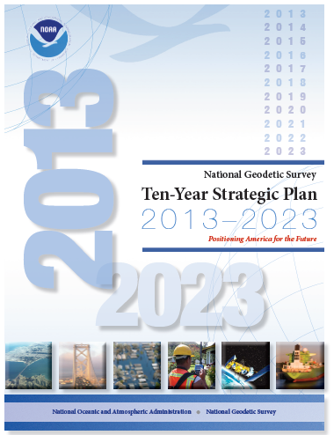
The National Geodetic Survey Ten-Year Plan
Support the users of the National Spatial Reference System.
Modernize and improve the National Spatial Reference System.
Expand the National Spatial Reference System stakeholder base through partnerships, education, and outreach.
Develop and enable a workforce with a supportive environment.
Improve organizational and administrative functionality.
2013, NGS Ten-Year Strategic Plan objective:
“Achieve a fully staffed regional advisor program by 2016.”
http://www.ngs.noaa.gov/web/news/Ten_Year_Plan_2013-2023.pdf
Notes:
The NGS “State Geodetic Advisor” program has engaged a long-standing cost-sharing partnership between NGS and various states. On many levels it is a success... However, the program has been a patchwork success and does not serve the nation equitably. Recognizing this imbalance… NGS determined to transition to a regional advisor program. The regional program will consist of a smaller cadre of advisors, all well-trained and dynamic educators capable of serving multi-state regions, and the new program will be run all at the cost to NGS alone.
NGS Ten-Year Strategic Plan, 2013
The NGS Ten-Year Plan was adopted at the beginning of 2013, including four major goals and an enterprise goal:
Goal 1: Support the Users of the National Spatial Reference System.
Goal 2: Modernize and Improve the National Spatial Reference System.
Goal 3: Expand the National Spatial Reference System Stakeholder Base through Partnerships, Education and Outreach.
Goal 4: Develop and Enable a Workforce with a Supportive Environment.
Enterprise Goal: Improve Organizational and Administrative Functionality.

Slide 12
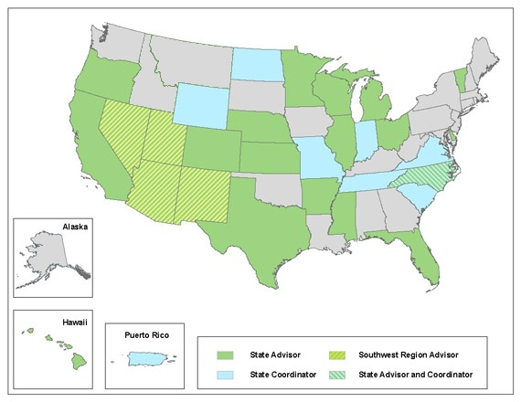
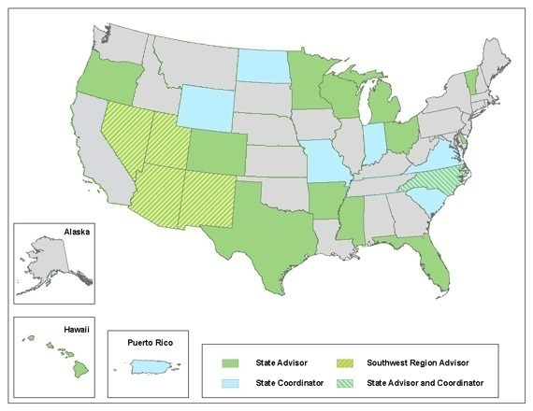
State to region transition
2012
2014
2011, Southwest Region established as prototype.
2011-2016, no new State Advisor partnerships
2015-2016, “Accelerated” Transition
Notes:
What did this transition look like? Starting in 2011…

Slide 13
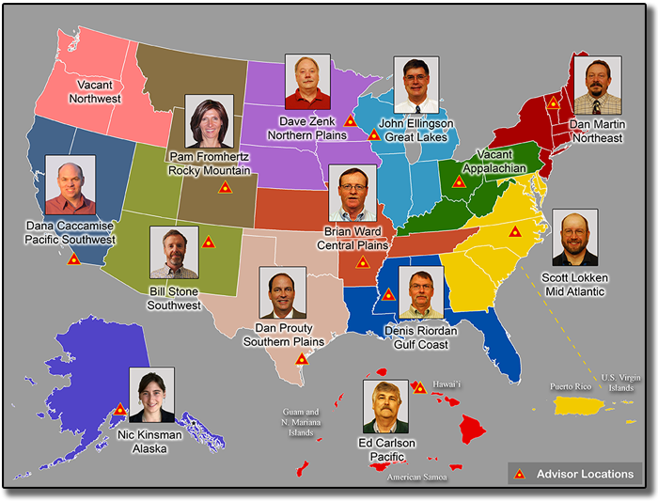
Regional Advisors
Regional Advisor Objectives:
To serve in a liaison role to regional constituents for the NGS, providing expert guidance and assistance to the public, academic and private sectors with managing the geodetic component of geospatial activities which are tied to the NSRS.
Further the mission of NGS and NOAA through collaboration across NGS divisions and with other entities of NOAA by serving as a subject matter expert in geodesy. Maintain awareness of current developments in geodetic science and technology, updates and improvements to geodetic reference systems, and application to geospatial activities.

Slide 14
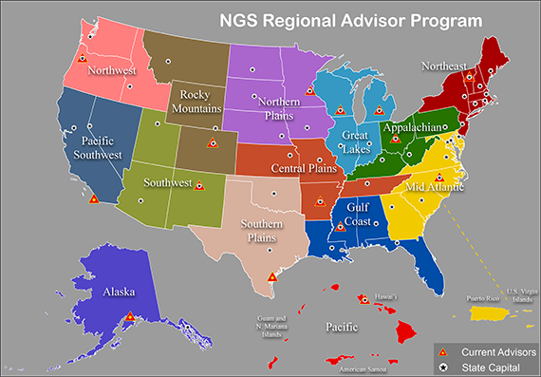
Regional Advisors
We have come full circle from
regional mark maintenance to regional advisors

Slide 15
State Geodetic Coordinators
Recognizing that a Regional Geodetic Advisor has a lot of ground to cover…
NGS recommends that each state/territory identify someone to serve as a Geodetic Coordinator.
They can be a state, academic or federal employees.
They should be recognized and supported by the state’s geospatial community.
They will serve as a primary point of contact for the Regional Advisor to coordinate geodetic activities

Slide 16
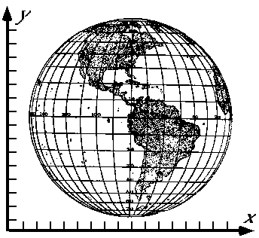
National Geodetic Survey Mission
To: 1) define 2) maintain & 3) provide access to the
National Spatial Reference System (NSRS)
to meet our Nation’s economic, social & environmental needs
Popular User Needs:
Continuously Operating Reference Stations (CORS)
Online Positioning User Service (OPUS) / OPUS-Projects
Passive Control (geometric & bench marks / elevation)
Geoid Models
Transformation Tools via NGS Geodetic Tool Kit (NADCON,VERTCON,GEOCON/11,HTDP)
Publishing (Bluebook) & Sharing (OPUS) Survey Results
Notes:
- NSRS benefit to the nation = $2.5B/year
est. 300K precision GPS users worldwide (2008); ¼ in US
- Very exciting to us at NGS to see how it has evolved over the years – now cm-accuracy capability / tracking with time

Slide 17
NGS Partners & Constituents
Federal
Bureau of Land Management US Army Corps of Engineers
Forest Service Int’l Boundary & Water Commission
National Park Service US Armed Forces
US Geological Survey National Guard
Bureau of Reclamation National Laboratories
Department of Energy National Geospatial-Intelligence Agency
State
Geological Surveys Departments of Transportation
Water Authorities Environment / Land Management
Geospatial Authority / Clearinghouse State Surveyor / Cartographer
Other
State GIS Councils / Committees State Surveying Organizations
Cities & Counties Regional Government Councils
Colleges, Universities Tribal Governments
Private Sector Firms / Contractors Railroads

Slide 18
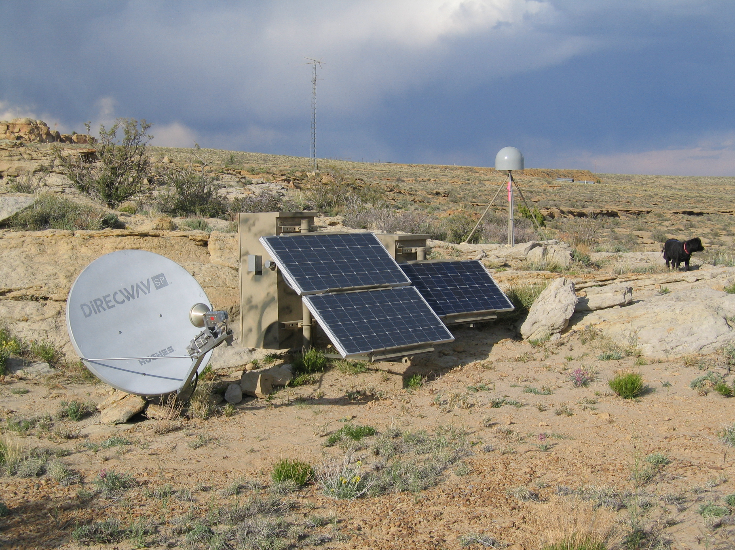
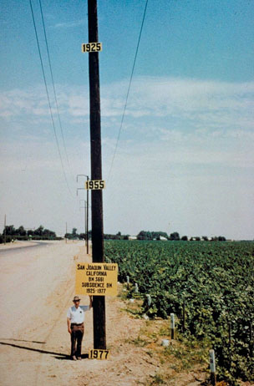
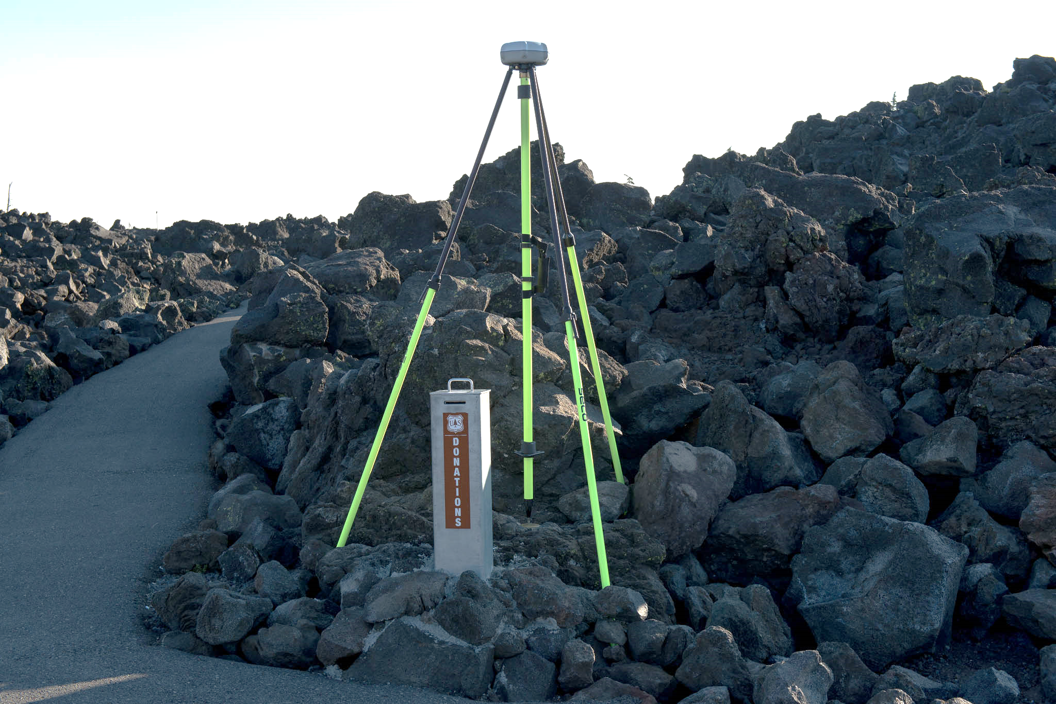
Partner & Constituent Activities
Installing CORS
Real-time GNSS Networks
Height Modernization
LiDAR Survey Control
Subsidence Monitoring
Mark Preservation
GPS on Bench Mark Data Collection
New Datums Preparation (2022 is coming!!)
Notes:
- NSRS benefit to the nation = $2.5B/year
est. 300K precision GPS users worldwide (2008); ¼ in US
- Very exciting to us at NGS to see how it has evolved over the years – now cm-accuracy capability / tracking with time

Slide 19

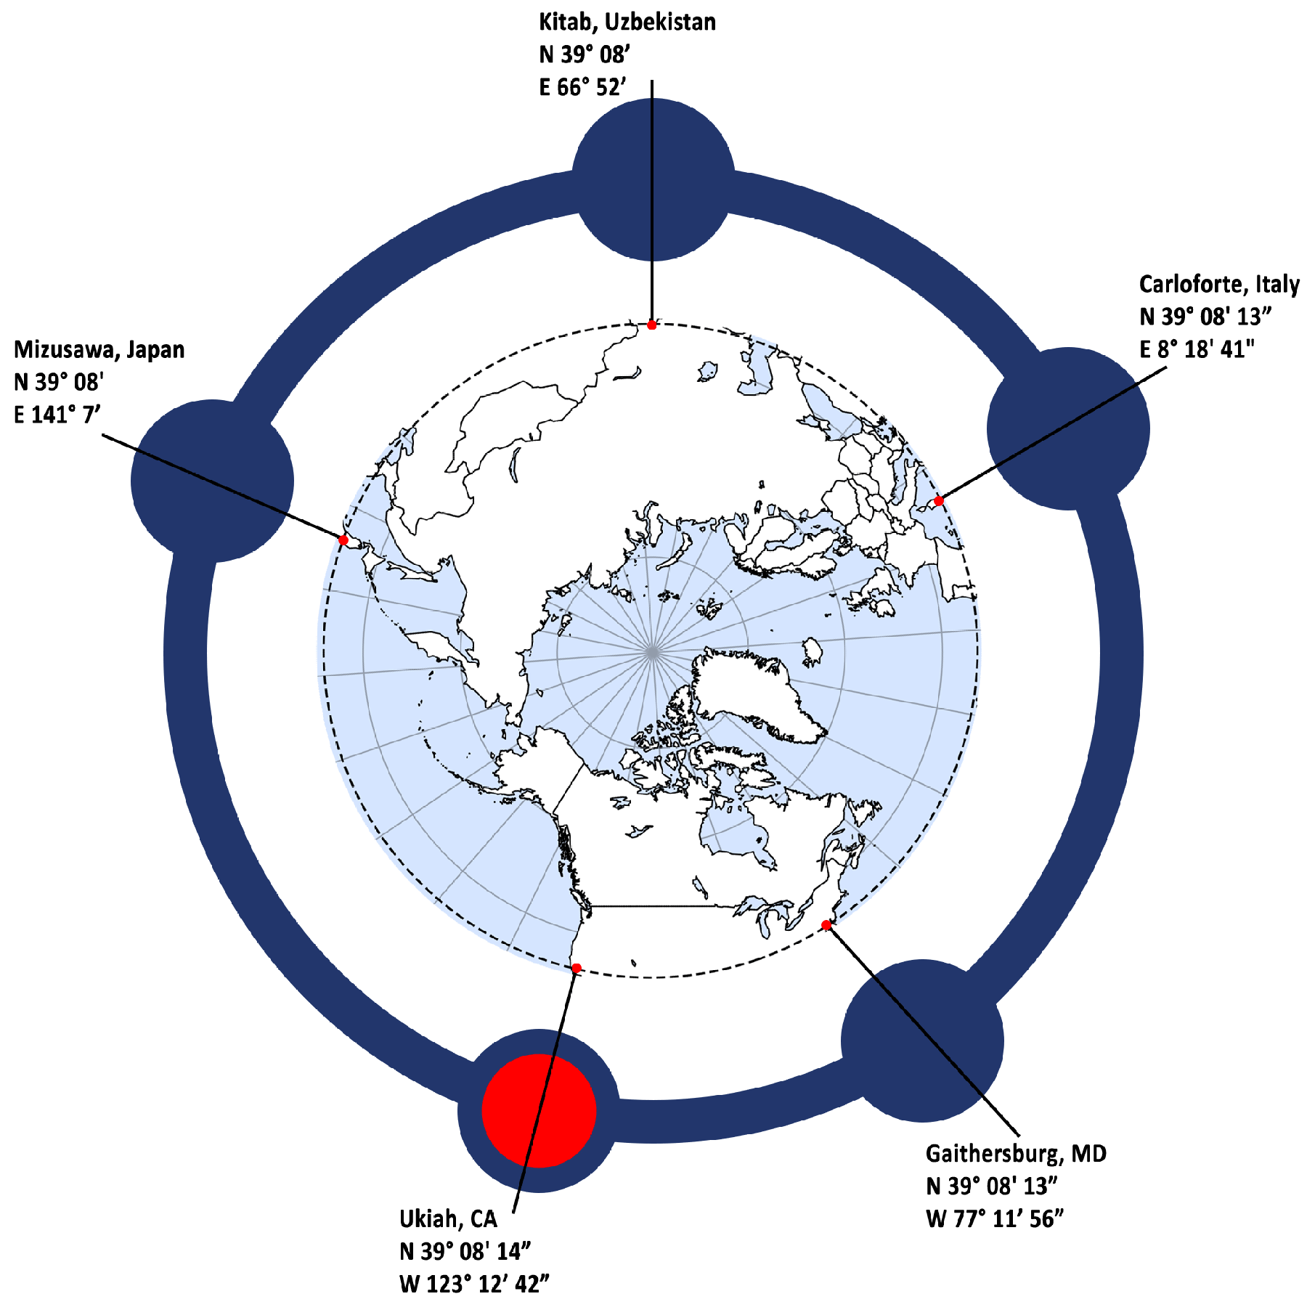
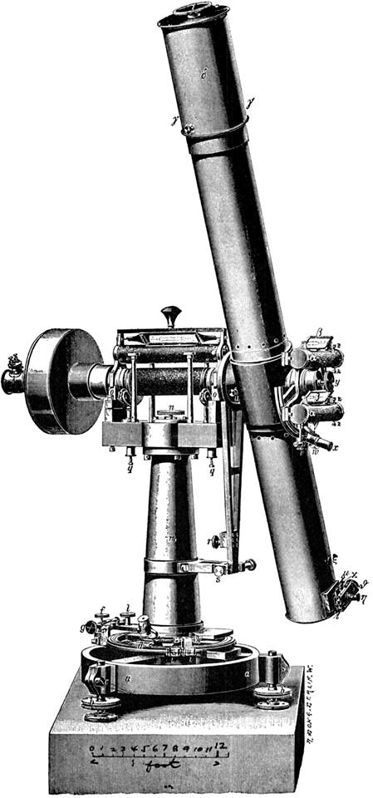
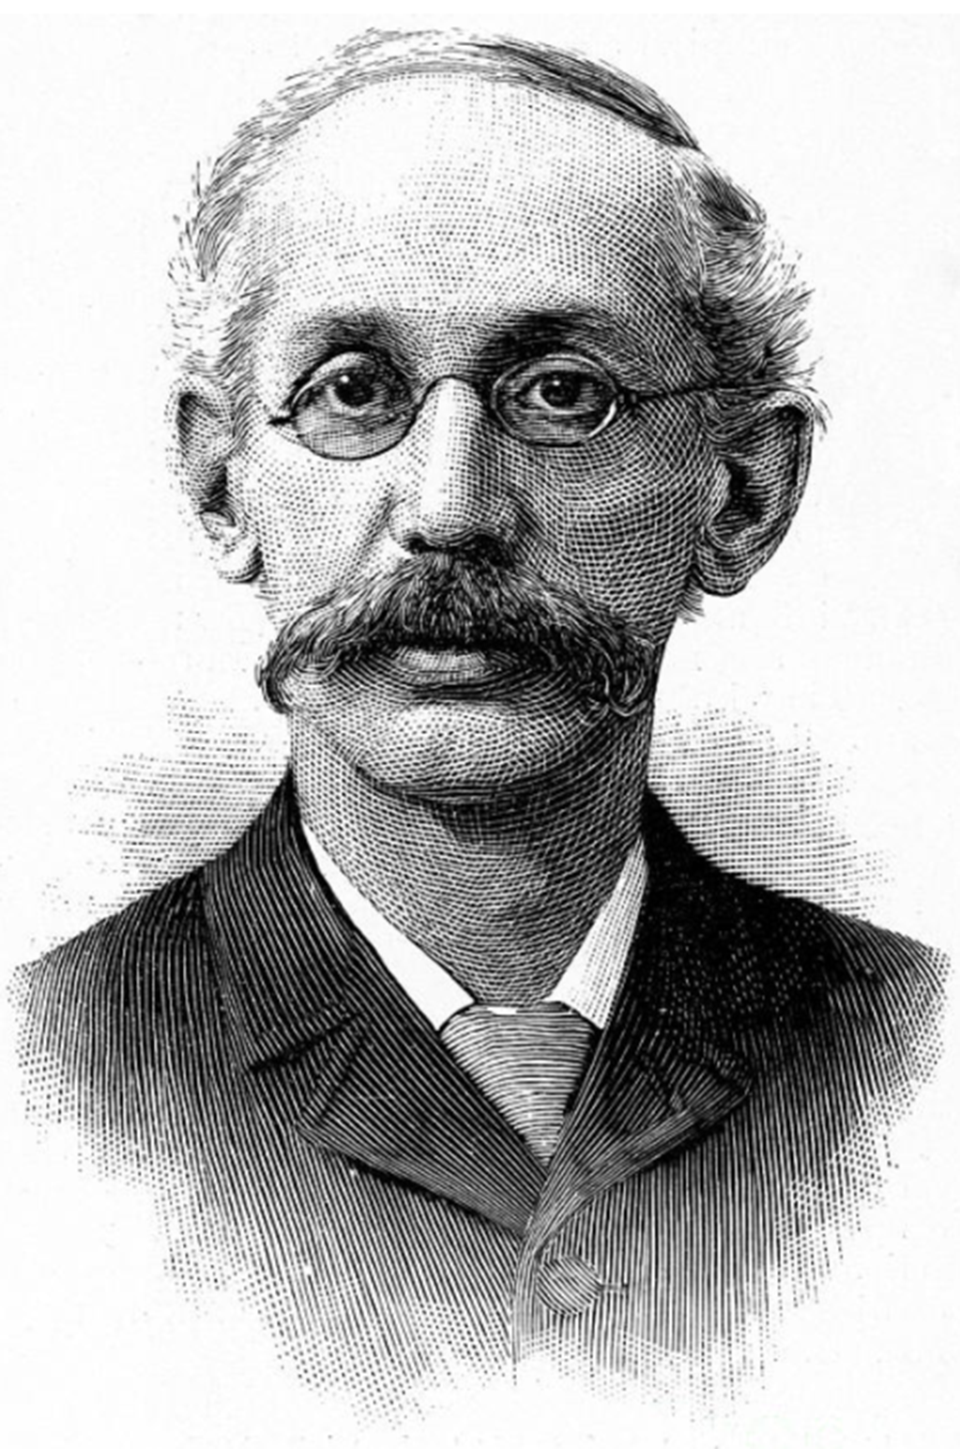
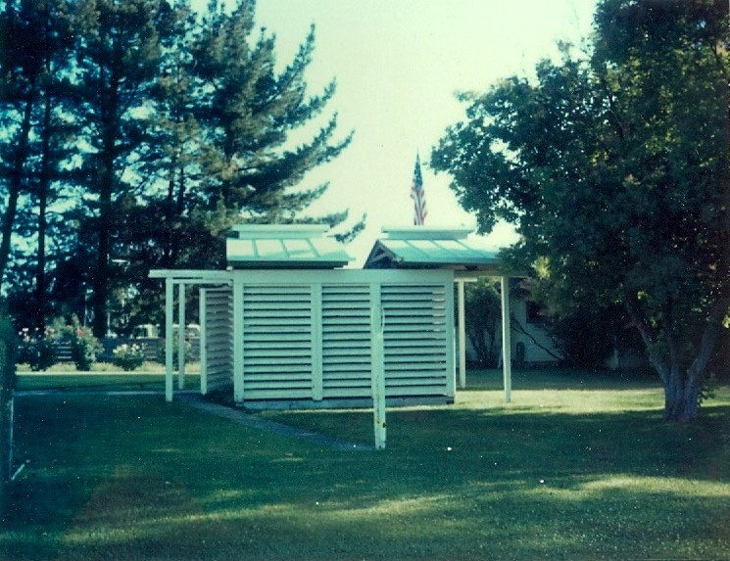
Notes:
Upcoming this Saturday the commemorative CLSA final point for Jas Arnold…
Continue to support geodetic historical activities such as the Ukiah latitude observatory

Slide 20
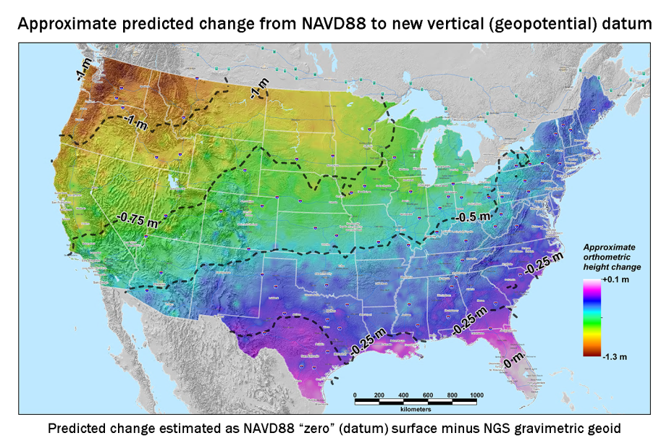
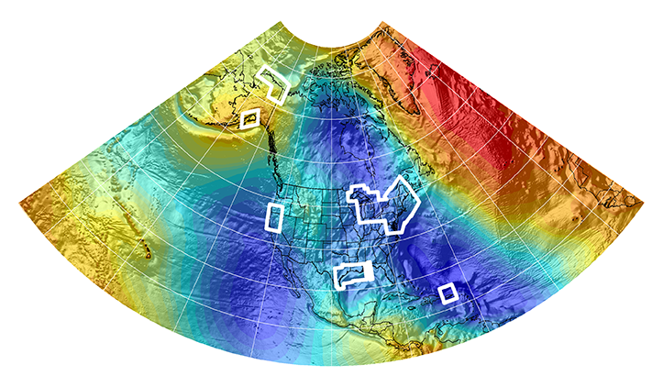

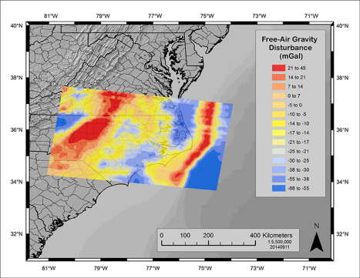
New Datums Are Coming in 2022!
NOAA’s National Geodetic Survey will release new geometric (horizontal) and geopotential (vertical) datums in 2022
The realization of the new datums will be through GPS/GNSS receivers and will replace the current datums:
NAD 83(geometric) and NAVD 88 (geopotential)
Target: 2-centimeter accuracy relative to sea level (orthometric heights) using GPS/GNSS and a geoid (gravity) model from NGS’ GRAV-D project.
NGS will provide the tools to easily transform between the new and old datums.
MORE INFO:
April 24-26, 2017 NGS Geospatial Summit: http://www.geodesy.noaa.gov/2015GeospatialSummit/
New Datums Webpage and Videos: http://www.geodesy.noaa.gov/datums/newdatums/NewDatums.shtml
Notes:
The new datums will be accessed via GNSS technology versus benchmarks
Current datums are not perfect and do not fully support current (and future) technology (such as GPS and Lidar)
New geopotential (vertical) datum to be released in 2022 will be a gravimetric geoid. Airborne gravity data for the geopotential datum collected by the Gravity for the Redefinition of the American Vertical Datum (GRAV-D) Project will allow for blending of data from satellite, altimetric, and surface sources. Both datums will be released together in 2022. As of December, 2014, GRAV-D is 40% complete.
Estimated Differences Between “Old” and “New” Datums:
Geometric Datum
Horizontal: 0.8 to 1.5 m in CONUS
Ellipsoidal heights: -0.2 to -1.6 m CONUS; AK 0 to 1.3 m
Geopotential Datum
Approx. +0.1 m (Florida) to -1.3 m (Washington)
More than 2 meters of change in Alaska
More info is available at the NGS New Datums Webpage. It has been four years since NGS held its first Geospatial Summit in 2010 to announce the replacement of the NAD 83(geometric) and NAVD 88 (geopotential) to other federal agencies within the mapping community. The April 2015 summit will provide an opportunity to share updates on the new geometric and geopotential datums to the general public allowing the opportunity to address their comments, questions and concerns to NGS.
Picture: Map reflects the type of height improvements users could expect if NAVD 88 were replaced with a geoid-based vertical datum. (This is only a large scale approximation and should not be used as an absolute guide. Each benchmark might have its own level of mismatch, for example from uplift or subsidence, not captured by this broad brush. Also, this is the difference between the zero level of NAVD 88 and the actual geoid. The difference between NAD 83 ellipsoid heights and ITRF/GRS-80 ellipsoid heights has NO influence on this graph and should not be part of the story.)
Picture: xGEOID14B. Beginning in 2014, the National Geodetic Survey will release annual gravimetric geoid models which incorporate all available gravity sources, including all airborne gravity collected through the GRAV-D project to that point. The image above shows the xGEOID14B model with the boxes showing the location of the input aerogravity data. These experimental geoid models will provide the public with the opportunity to evaluate how the geopotential (vertical) datum in their area will change when the new datums arrive.
Picture: GRAV-D data block for North Carolina. More than 40 percent of the U.S. and its territories have been covered by GRAV-D airborne data collection.

Slide 21
New Datum: What to do now ?
Move to newest realizations NAD 83(2011) epoch 2010.00 USGG12 (gravimetric geoid) / GEOID12B (hybrid geoid)
Obtain precise ellipsoid heights on NAVD 88 bench marks (OPUS-DB, contact NGS Geodetic Advisor) Improves hybrid geoid models and provides “hard points” in new vertical datum. Follow new NGS Guidelines when released.
Move from NGVD 29 to NAVD 88 Understand the accuracy of VERTCON in your area.
Move away from passive marks to GNSS Especially, move away from classical passive control.
Require/provide complete metadata for all mapping contracts How did they get the positions/heights? Document it!
Notes:
This slide is for more active users of the NSRS. So, we’ll be getting into a bit more technical detail than some need.

Slide 22
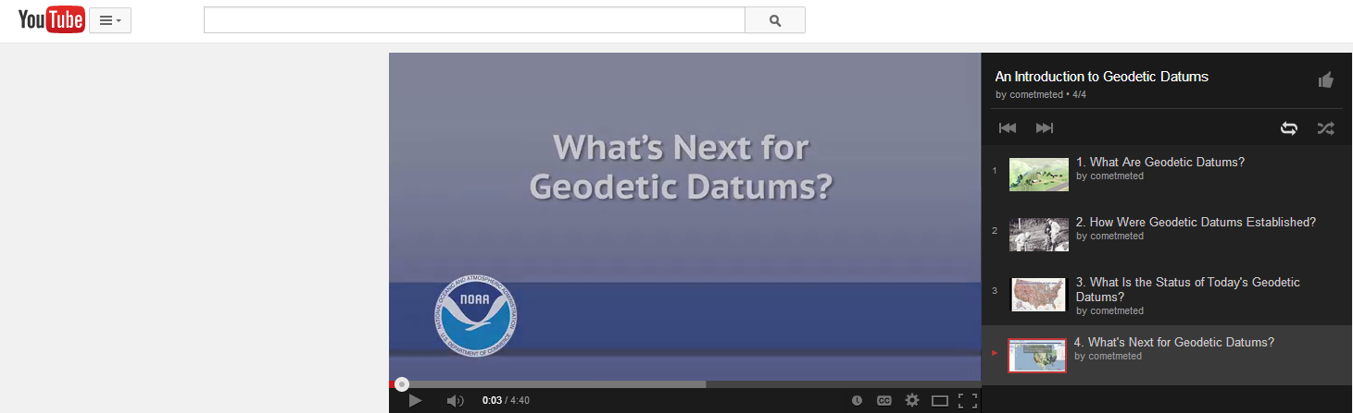
NGS Video Library Educational Videos about New Datums and more
http://www.ngs.noaa.gov/corbin/class_description/NGS_Video_Library.shtml

Slide 23
National Geodetic Survey (NGS): Geodetic Advisors Program
Dana Caccamise
Pacific Southwest Region (CA,NV) Geodetic Advisor
dana.caccamise@noaa.gov
NOAA’s National Geodetic Survey
geodesy.noaa.gov
California Land Surveyors Association (CLSA)
Webinar Series: September 20, 2017

Slide 24
Notes:
Thank goodness for Photoshop!

