Slide 1
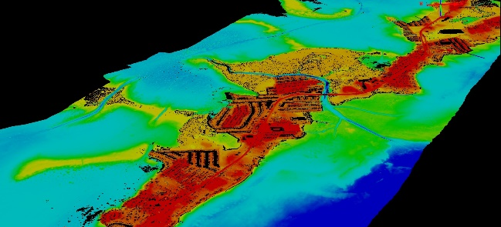
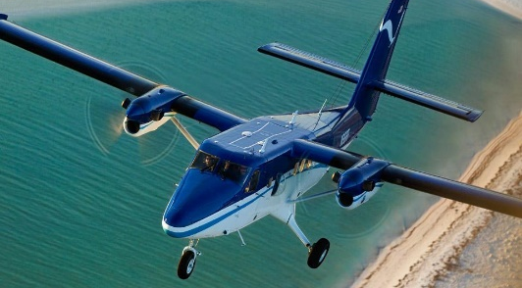
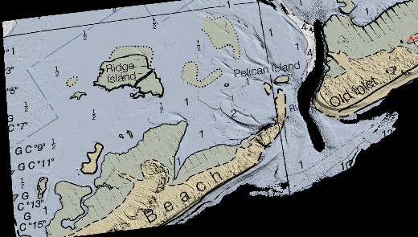
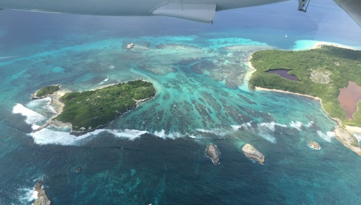
NGS Coastal Mapping Program Update
2017 National Surveying, Mapping & Geospatial Conference
Mike Aslaksen
Chief, Remote Sensing Division
National Geodetic Survey
March 13-17, 2017

Slide 2
Outline
Introduction and background
Coastal Mapping Program
  Products
  Accomplishments
  National Shoreline
  Airborne Lidar Bathymetry
  Coastal Oblique
  Emergency Response Imagery
Questions

Slide 3
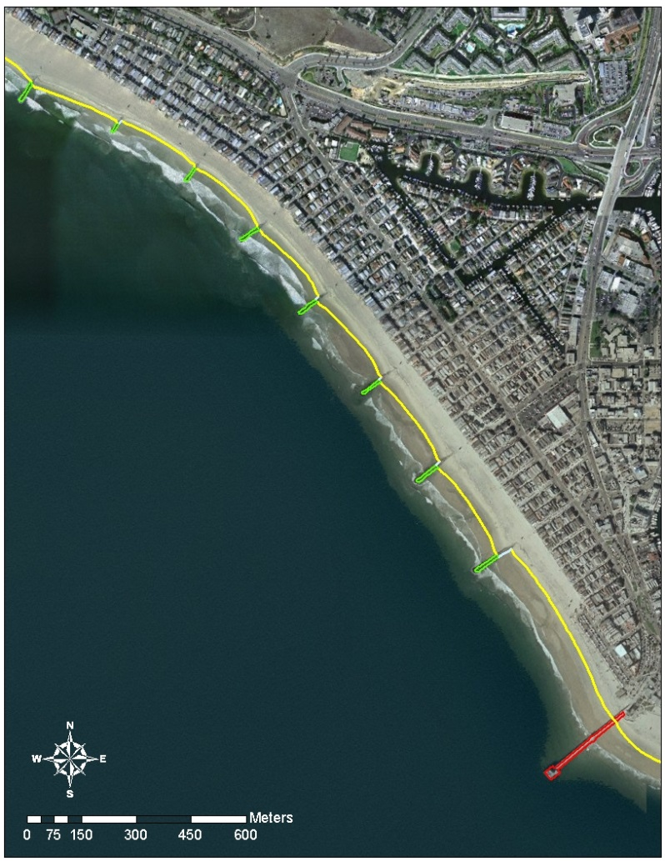
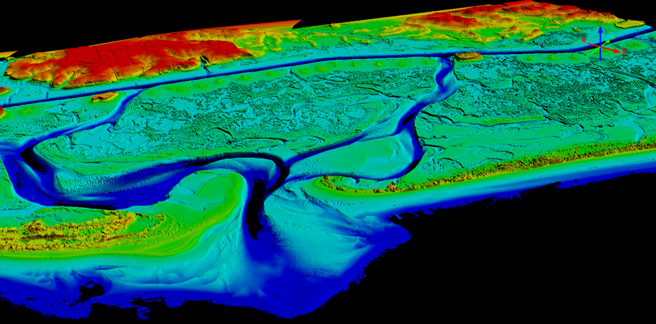
NOAA’s Coastal Mapping Program
Defines the National Shoreline and provides nearshore elevation data
NOAA nautical charts updates
Other important applications:
  Used in defining the United States’ territorial limits
  Coastal resource management
  Storm surge and coastal flooding modeling
  GIS analysis
  Benthic habitat mapping
Coastal Intelligence and Resiliency…
Notes:
NGS CMP products are one of the largest source of updates to NOAA Nautical Charts. Both the shoreline and nearshore bathymetry.
Data is also used as a baseline to determine boundaries for marine protected areas within the US.

Slide 4
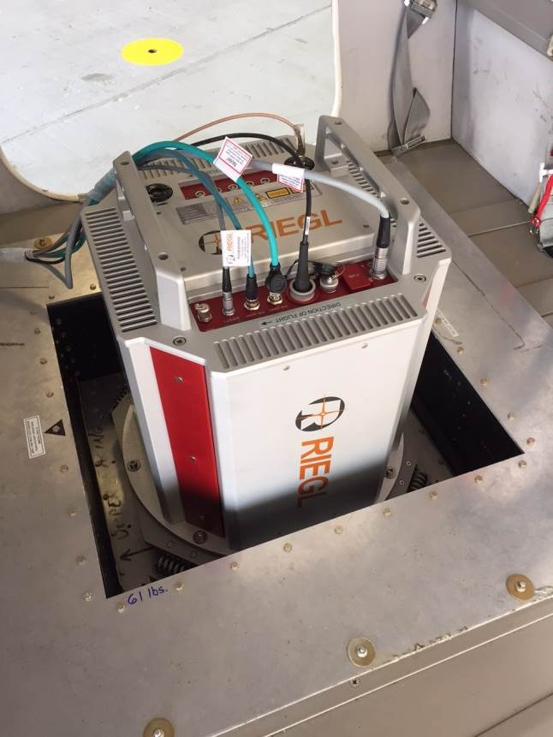
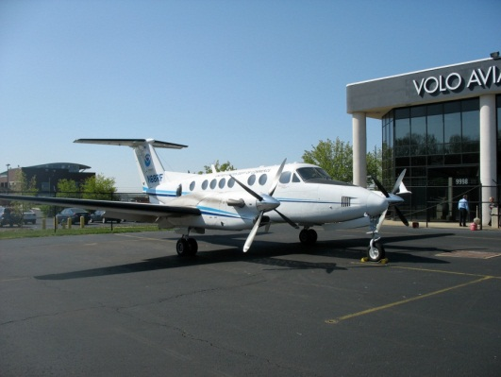
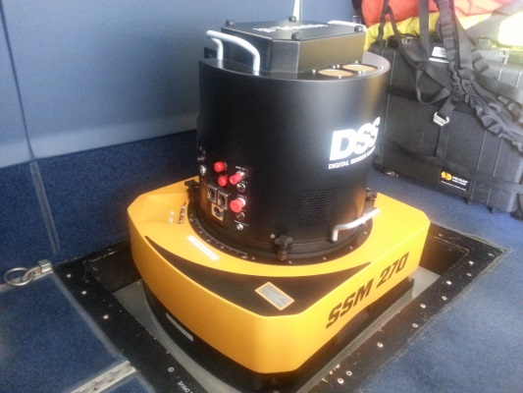
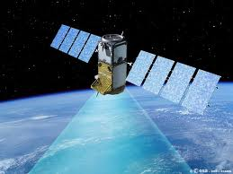
How do we do it?
NOAA and contract aircraft
Trimble DSS580 Dual Cam & DSS500 Dual Oblique Cam
  RGB & NIR cameras (NIR in DSS580 only)
  35cm GSD at 10,500’ flying height
  In-flight image processing
RIEGL LIDARs
  Topographic LIDAR (LMS-Q680i)
  Topobathymetric System (VQ-880G)
Satellite Imagery
  Commercial and USGOV systems
Private sector contracts
  Shoreline Mapping IDIQ contract
  3 Prime contractors
  Re-compete planned for fall 2018
Notes:
King Air – Long endurance for greater efficiency (fewer flights to acquire large area). Fast acquisition speed means more miles mapped per flight hour. Fast transit speed allows us to quickly move from one acquisition area to another.
Applanix DSS – Digital camera. Two cameras mounted fore and aft. One collects color (RGB – red, green, blue) imagery, the other collects Near Infrared (NIR). The sensor resolution is 80 megapixels. We map to a Ground Sample Distance (GSD) of 35cm. This is achieved when flying at an altitude of 10,500’ above ground level (AGL). We process the raw imagery in the air which saves time on the ground post flight. We also have a DSS 500 Oblique Camera system with dual oblique cameras (one port and one starboard) with look angles of 40 degrees. Total swath width of the DSS580 and DSS500 at 10,500 feet is around 8km.
LIDAR – Topographic LIDAR maps above water level only.

Slide 5
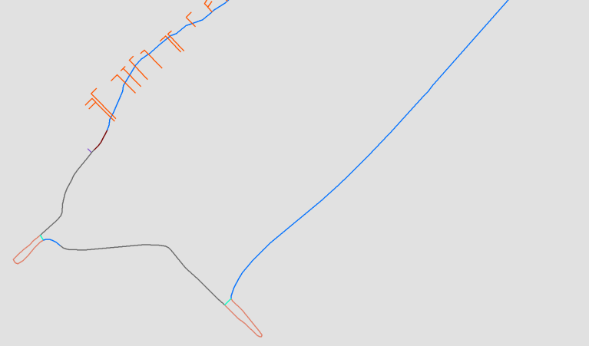
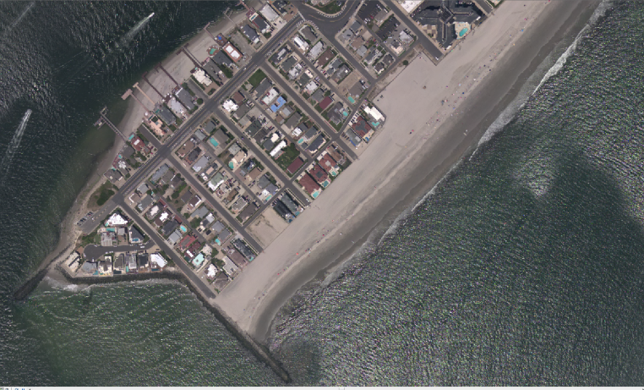
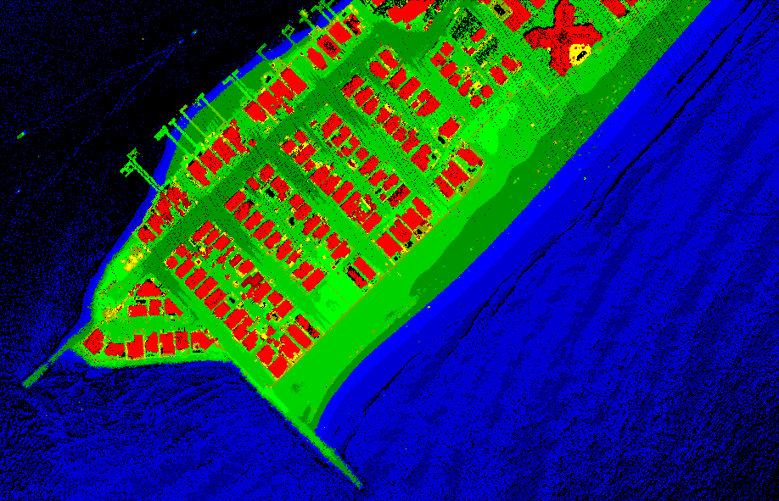
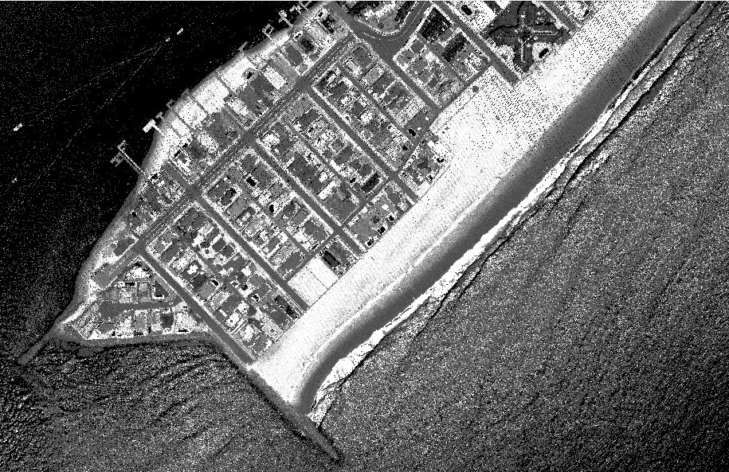
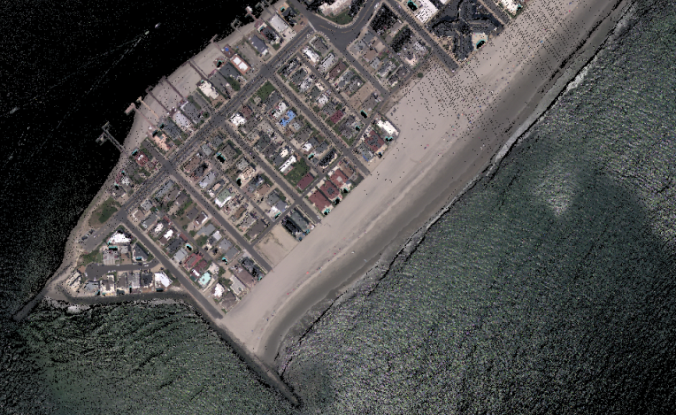
Products NGS delivers and derivatives
Shoreline
Ortho Mosaic Imagery
Lidar Point Cloud and DEMs
(elevation)
Lidar Point
Cloud
(intensity)
Map once use many times!
RGB
Colorized Lidar
Point Cloud

Slide 6
FY16 Metrics
9,107 miles* of shoreline compiled (5.5% of US)
Updated shoreline for >285 nautical charts
37 ports updated with new shoreline
35 ports analyzed for change (CSCAP)
400 sqnm of ALB data delivered
700 sqnm of ALB collected
*miles measured at 1:80,000 scale
NGS.Shoreline.Request@noaa.gov

Slide 7
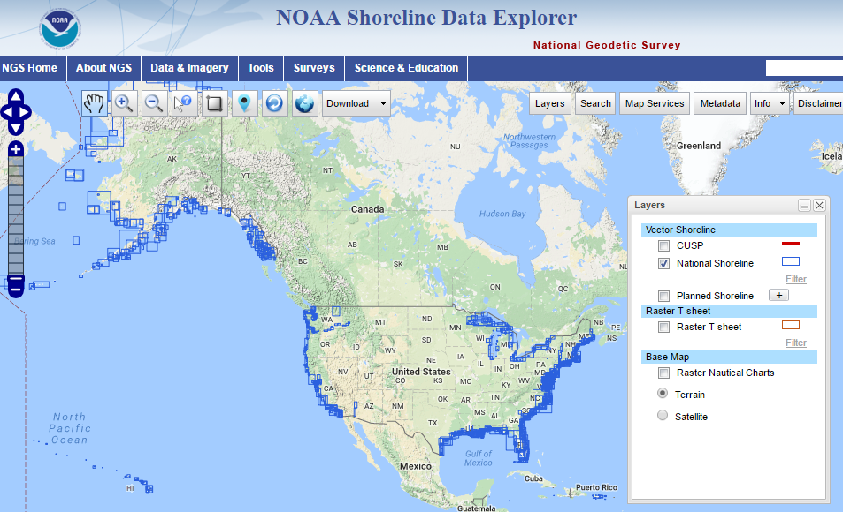
https://www.ngs.noaa.gov/NSDE/

Slide 8
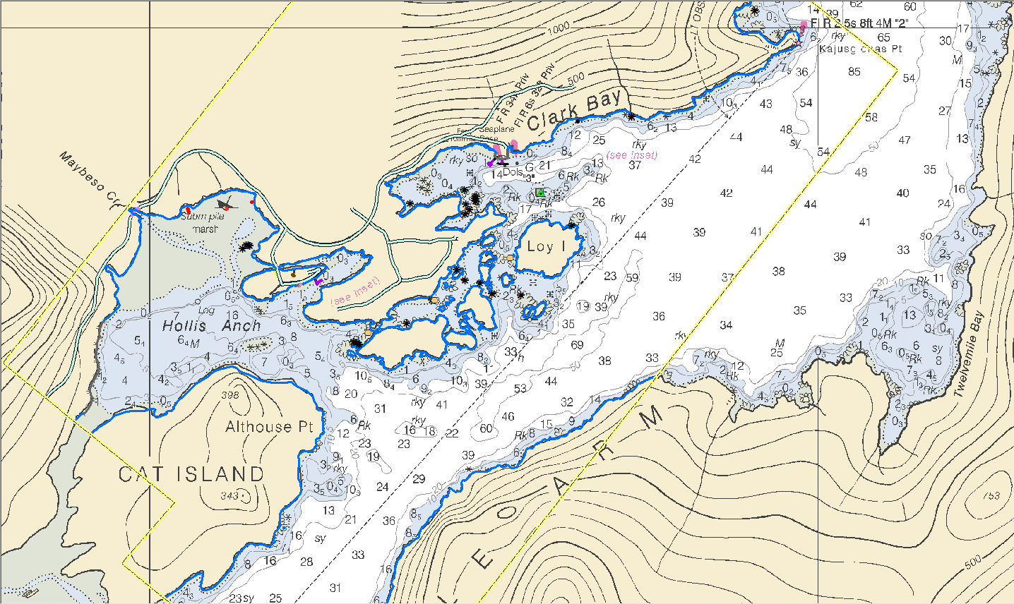
Geographic Cells
Notes:
Recent coastal mapping project in Alaska, AK1620-CM-N (GC11281), compiled from non-tide-coordinated color aerial imagery, in response to a request for updated shoreline to support a new large scale chart inset.

Slide 9
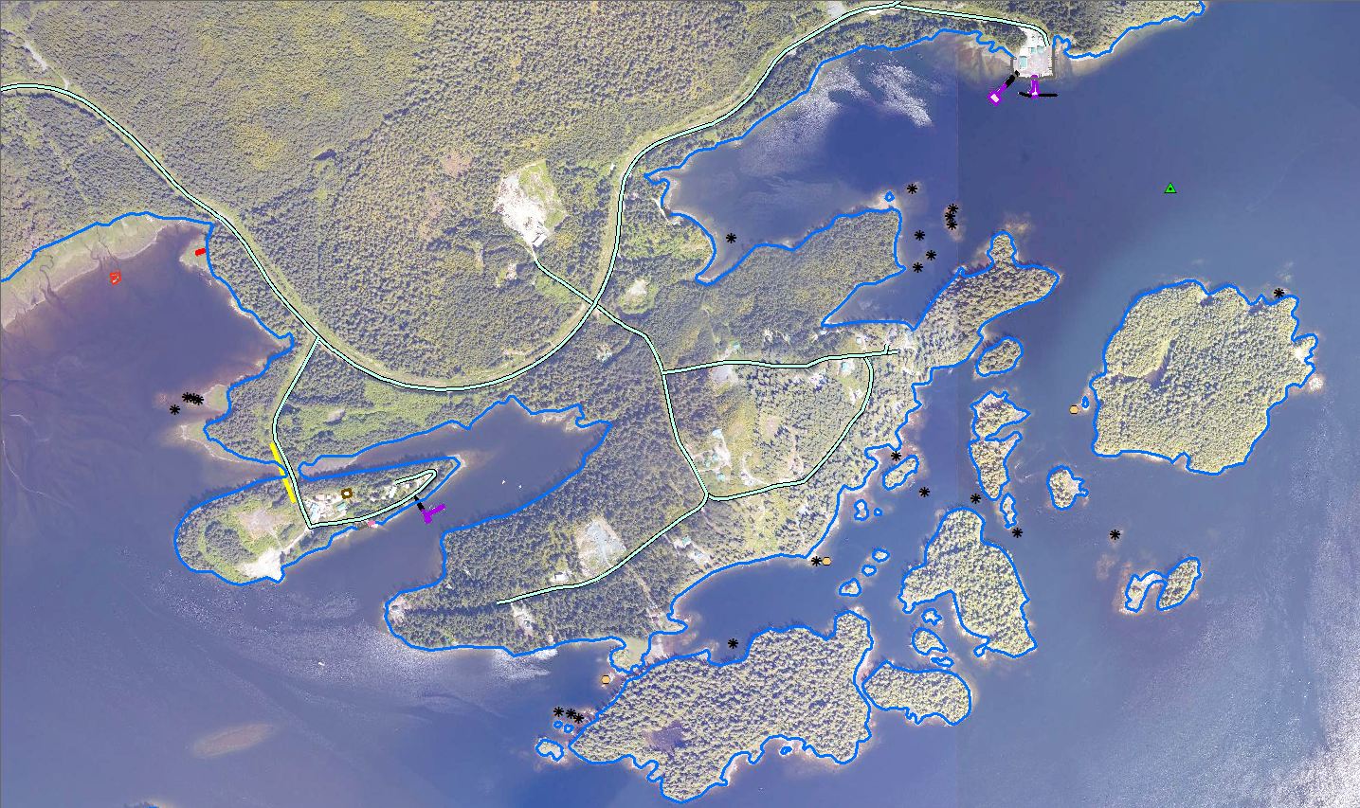
Fixed Pier
Rip Rap Shoreline
Road
Floating Pier
Daybeacon
Wrecks
Building
Overhead Cable
Covers/Uncovers Rock
Ramp
MHW Shoreline
Bare Rock
Notes:
The central part of the AK1620 project showing the various feature types compiled in GC11281, covering Clark Bay and Hollis Anchorage, superimposed over the project imagery.

Slide 10
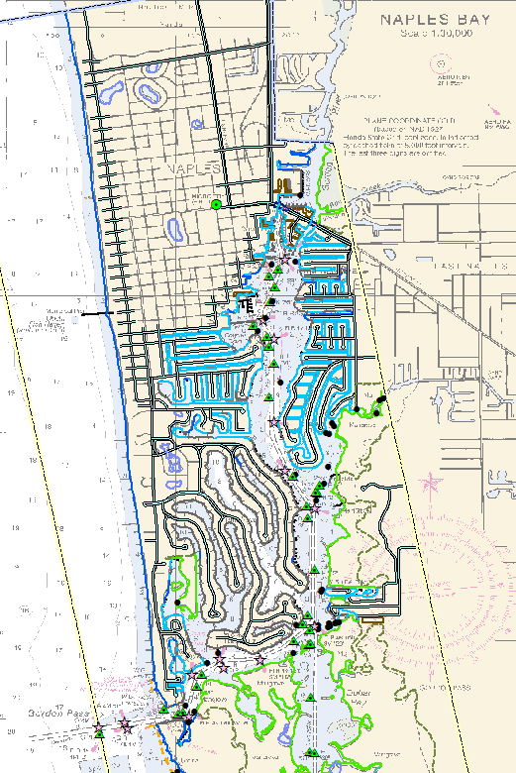
CMP Project with full shoreline compilation
Notes:
Recent coastal mapping project in Florida, FL1601A-CM-N (GC11267), compiled from non-tide-coordinated color aerial imagery (CUSP), in response to a request for updated shoreline in the Gordon Pass area.

Slide 11
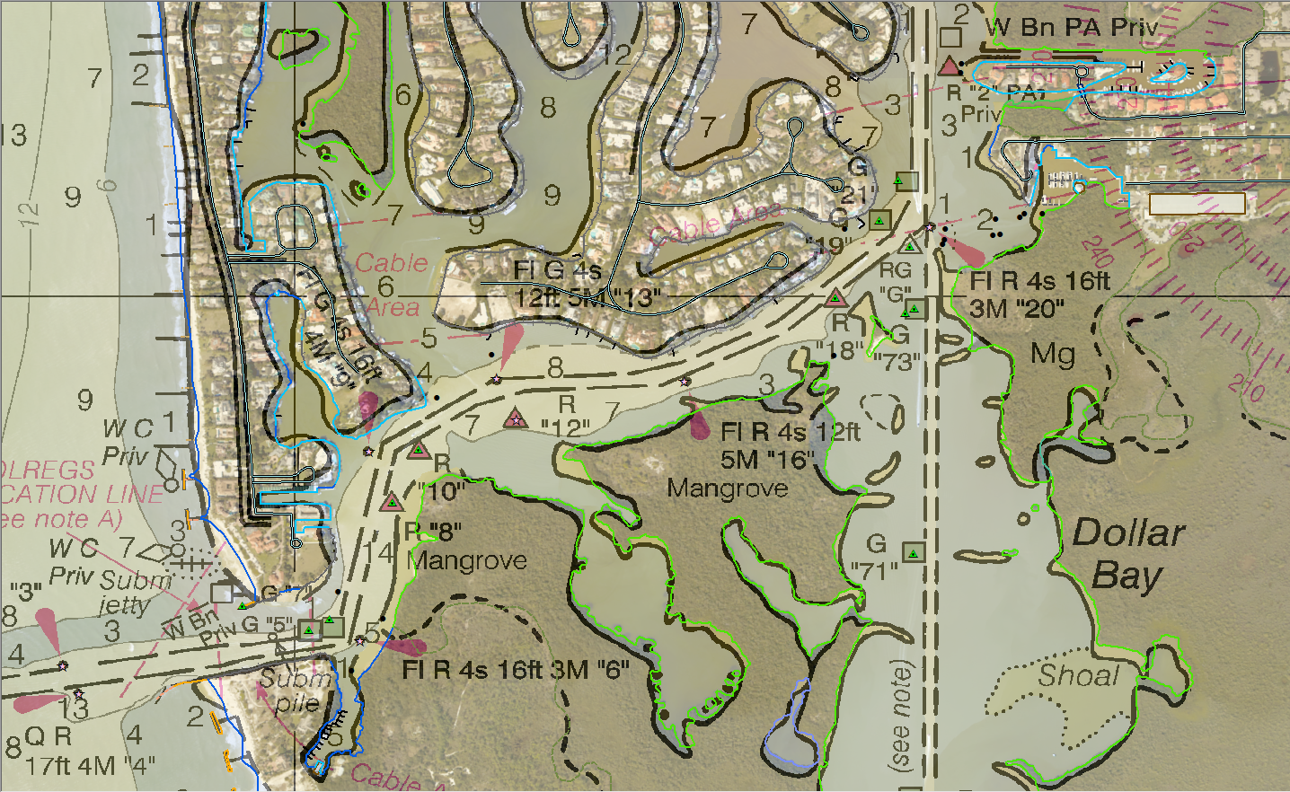
Notes:
The southern part of the FL1601A project, with the shoreline and other features compiled in GC11267, superimposed over the project imagery and the chart, showing changes in the Gordon Pass area.

Slide 12
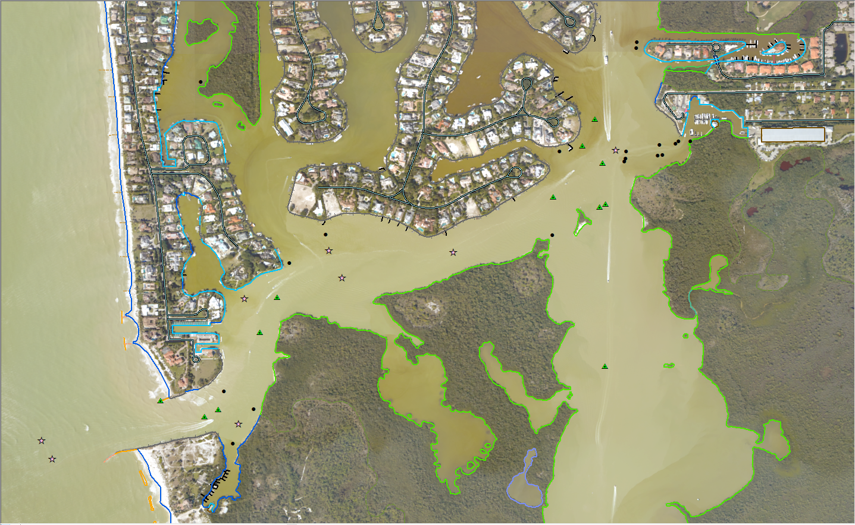
Notes:
Flip between this slide and the previous slide to see the changes from the charted shoreline.

Slide 13
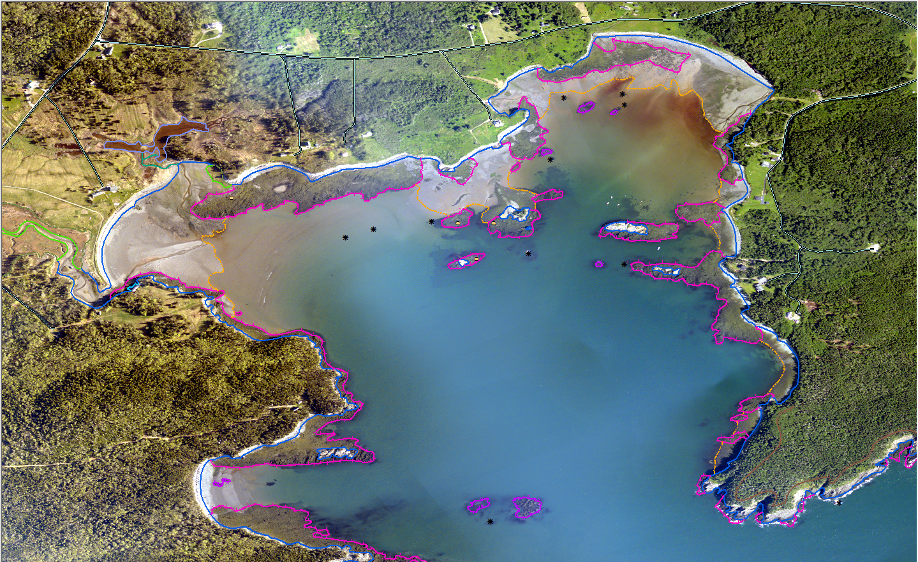

Bailey’s Mistake, ME
Notes:
Recent coastal mapping project near the eastern tip of Maine, ME1301C-CM-N (GC11137), compiled from MHW and MLLW tide-coordinated color and near-infrared aerial imagery. This shows a portion of the compiled features in the vicinity of the small cove “Bailey’s Mistake”, superimposed over the MLLW coordinated color imagery.
Flip between this slide and the next to illustrate the differences between color and IR imagery, particularly focusing on the MLLW Depth Contour line (orange dash-dot line)
Captain Bailey's Mistake
Words: Charlie Ipcar and Judy Barrows ©2001
After a news story by Bruce Kyle
Bangor Daily News, 9/16/95
Original event occurred near Lubec, Maine, in 1809
Tune: after Ian Robb’s The Old Rose & Crown, ©1977 SOCAN
----------------------------------------------------------
Good friends gather round, and the truth I'll relate,
How a cove near Lubec became Bailey's Mistake;
There was a bold captain whose name was Bailey,
And his ship ended up where 'twas not s'posed to be.
Chorus:
So here's to our captain, where e'er he may be,
A friend to the sailor on land and on sea;
Ye mariners all, weigh the risks that ye take,
Lest you be remembered like Bailey's Mistake.
He set sail from Boston, Downeast for Lubec,
With a cargo of lumber piled high on the deck;
He skirted Cape Ann with nary a fear,
And our crew gave a cheer as the Maine coast drew near.
As we closed on Lubec, we was socked in by fog,
But continued to sail by compass and log;
As our ship ghosted in, "Look sharp!" Bailey said,
"You'll soon see the narrows off West Quoddy Head."
But, alas, for poor Bailey, no narrows we found,
And in a large cove our ship ran aground;
Said Bailey, "As sailors, there's no way we can win;
Let's unload the lumber, build homes and move in."
So here's to old Bailey, who sailed the salt sea,
'Till his ship ended up where 'twas not s'posed to be;
He'd be sailing still could he just navigate,
But he's doing quite well selling prime real estate!
(no chorus after the final verse)

Slide 14
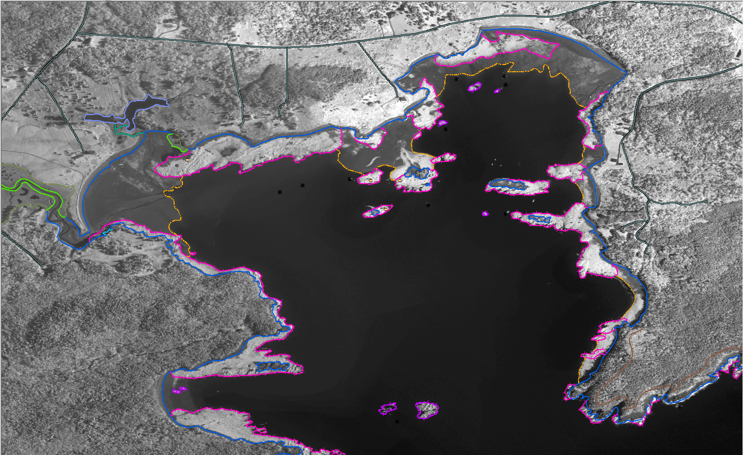
Road
MHW Shoreline
Marsh
MLLW Depth Contour
Ledge Covers/Uncovers
Reef Covers/Uncovers
Notes:
Various compiled features in Bailey’s Mistake, superimposed over the MLLW coordinated IR imagery.
Flip between this slide and the previous slide to illustrate the differences between color and IR imagery, particularly focusing on the MLLW Depth Contour line.

Slide 15
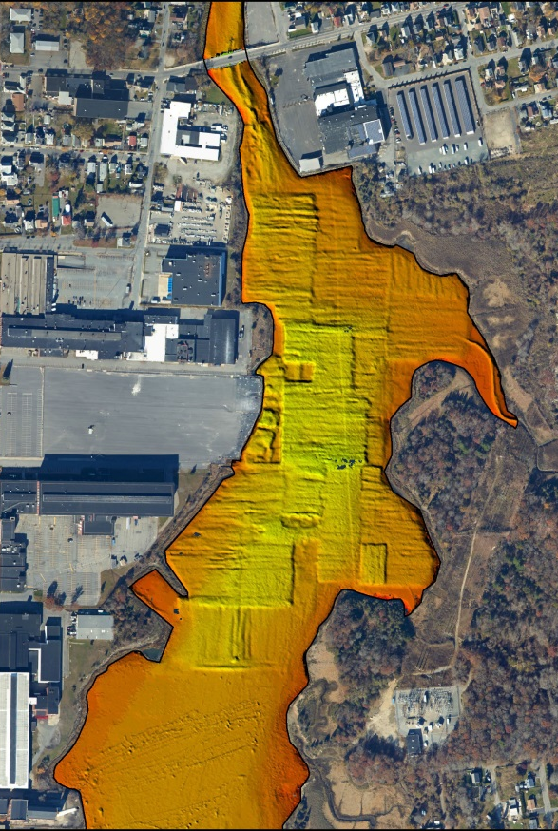
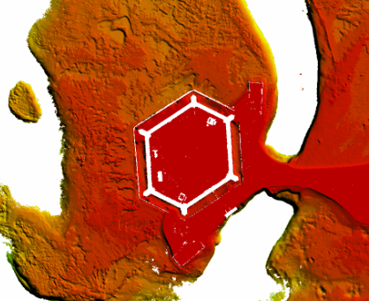
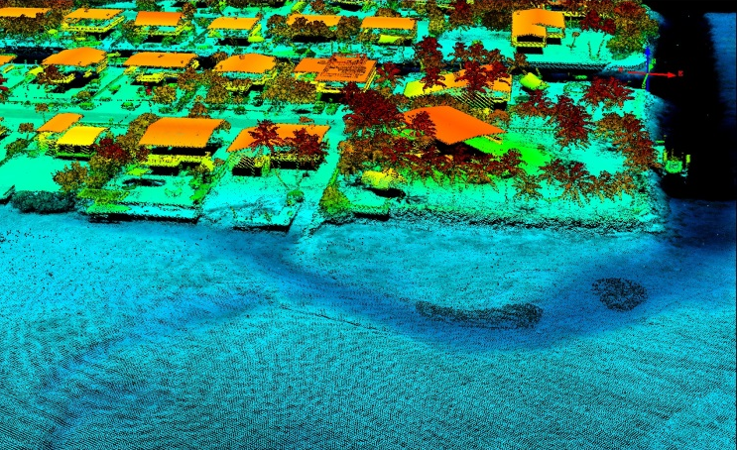
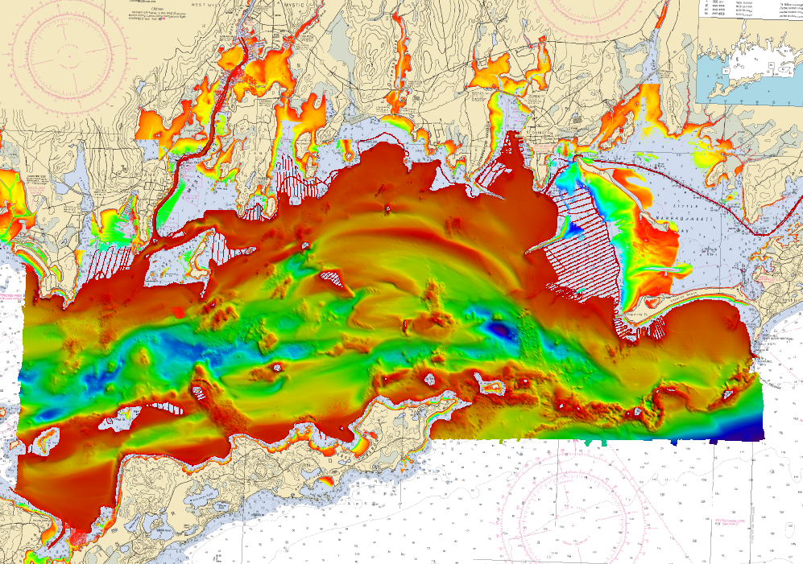
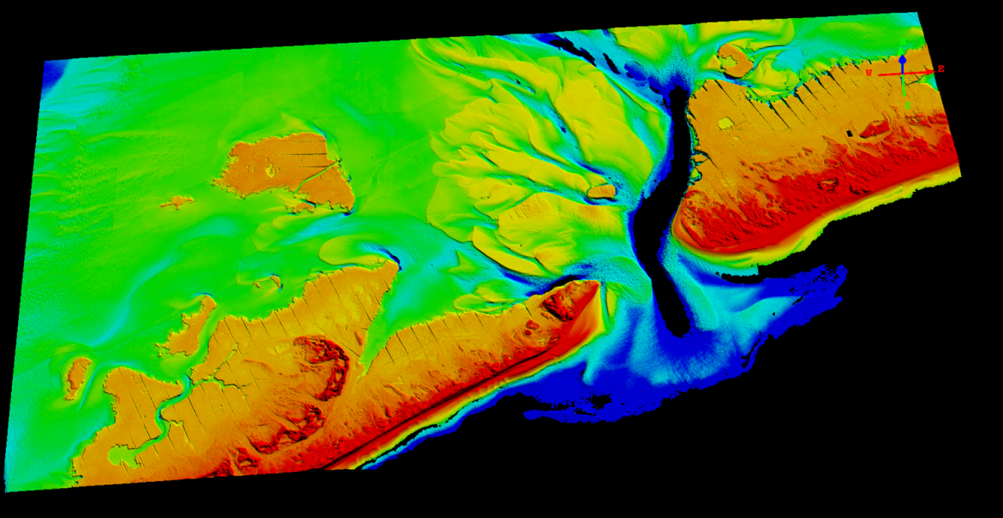
Airborne Lidar Bathymetry

Slide 16
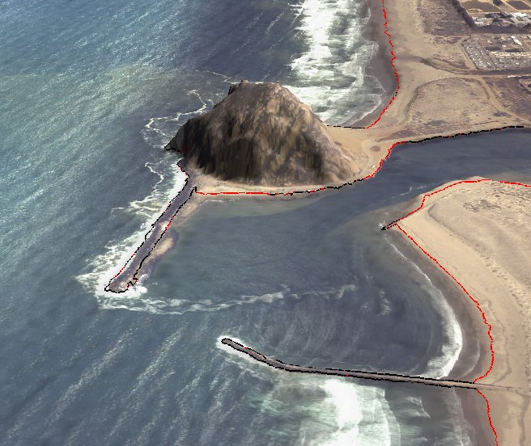
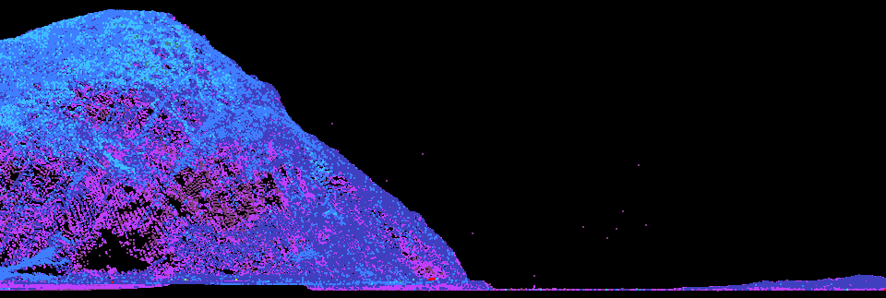
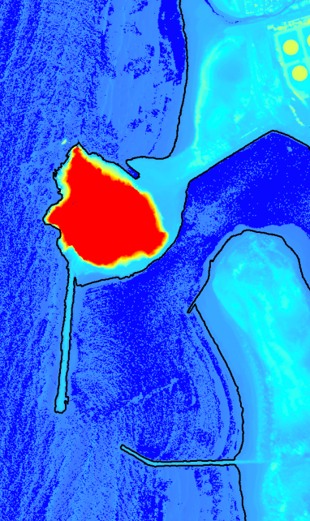
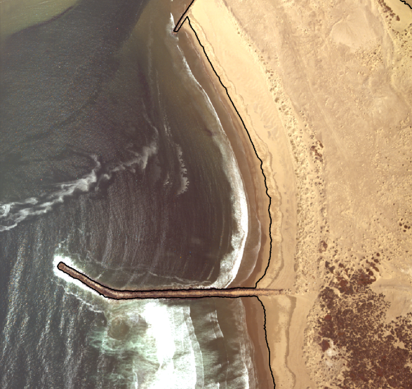
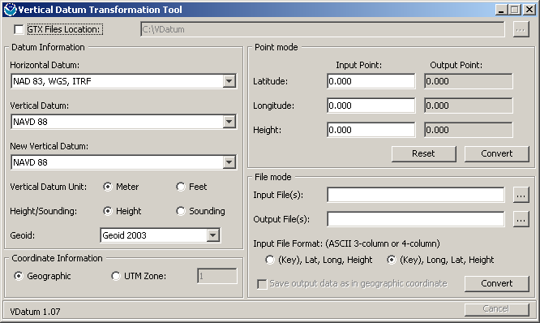
Lidar Shoreline Extraction
Lidar Point Cloud
VDatum
Contour Shoreline from DEM
Quality Control &
Feature Attribution
http://vdatum.noaa.gov/docs/est_uncertainties.html

Slide 17
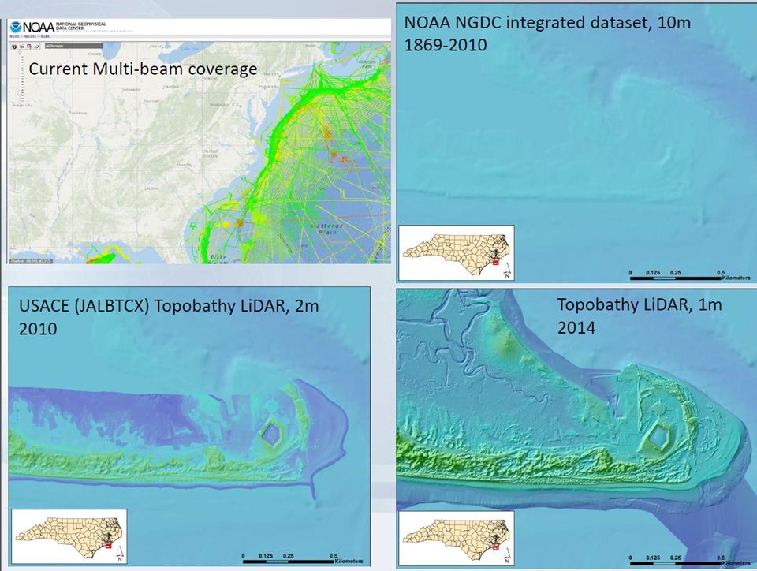
Slide credit: Quantum Spatial
Notes:
Credit Colin Cooper from Quantum Spatial

Slide 21
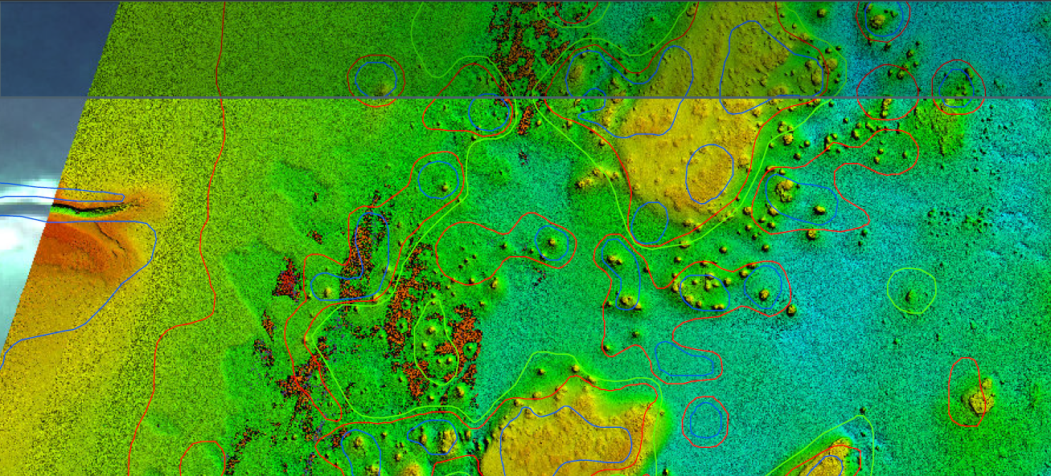

Slide 22
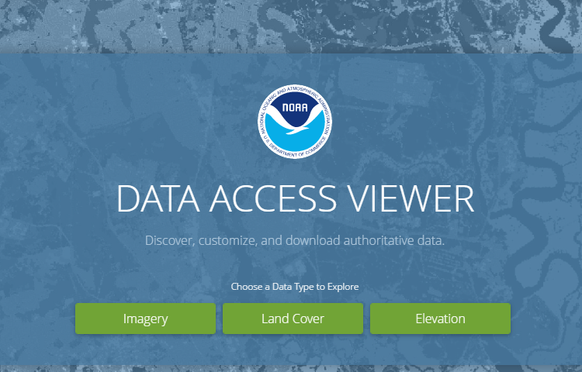
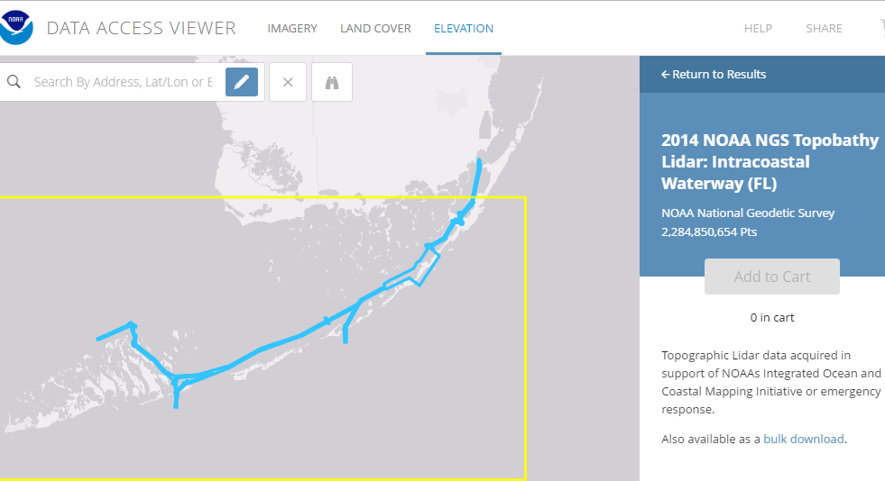
NOAA Digital Coast

Slide 23
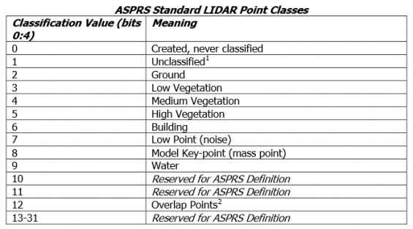
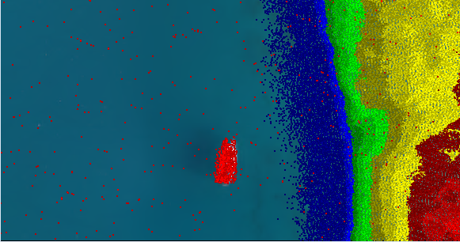
Lidar Data Formats
Topobathy lidar classified point-cloud data in ASPRS standard LAS 1.2 format, and topobathy DEMs (1-meter) in IMG format are provided to NOAA’s Digital Coast website for distribution to the public.
Notes:
Topobathy lidar point cloud data is classified and processed to standard ASPRS LAS 1.2 format, and 1-meter resolution DEMs are created in IMG format. These are sent to the Digital Coast web site for public distribution. In addition the DEMs are further processed to 5-meter grid spacing with shoal-biased depths, and delivered directly to the Office of Coast Survey (OCS) in GeoTIFF format, so they can generate soundings and depth contours for application to the nautical charts.

Slide 24
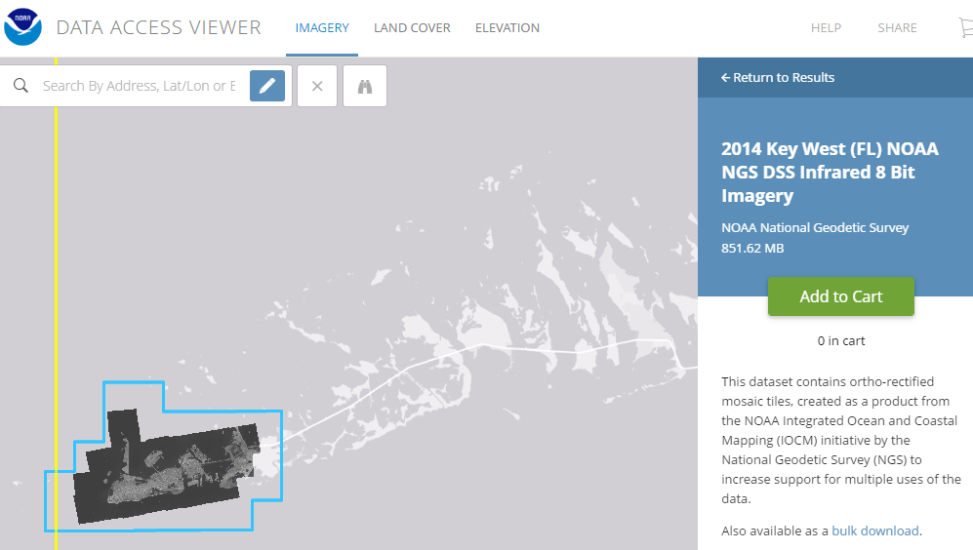
NOAA Digital Coast

Slide 25
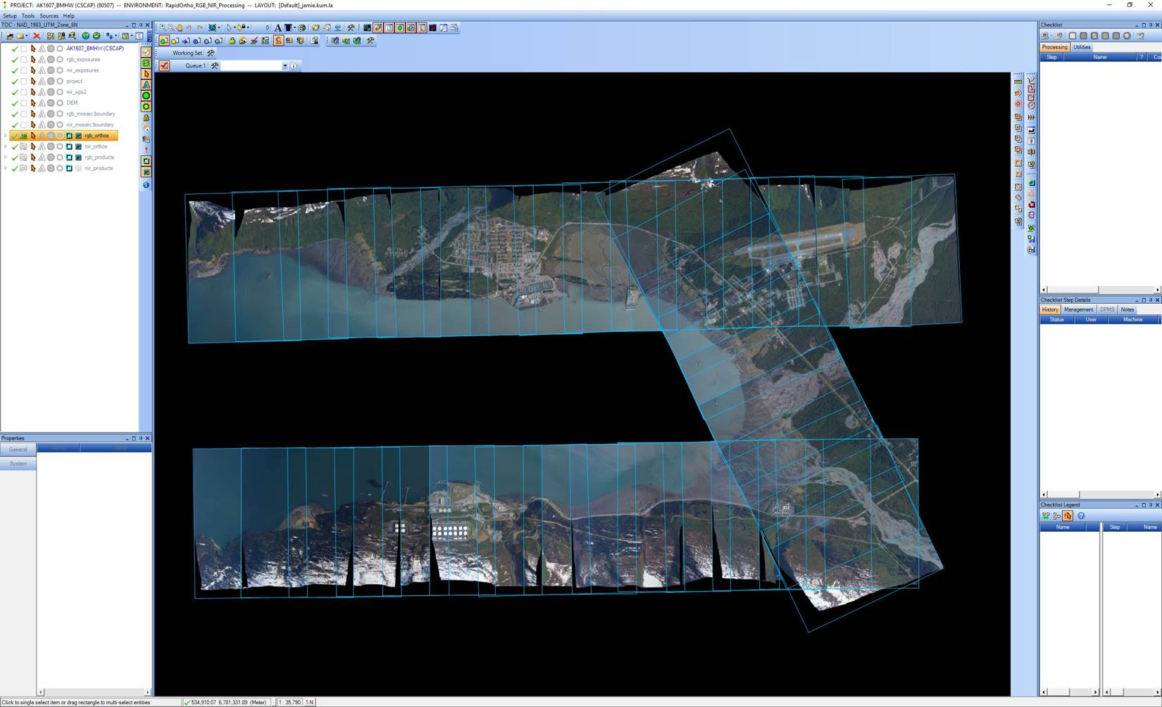
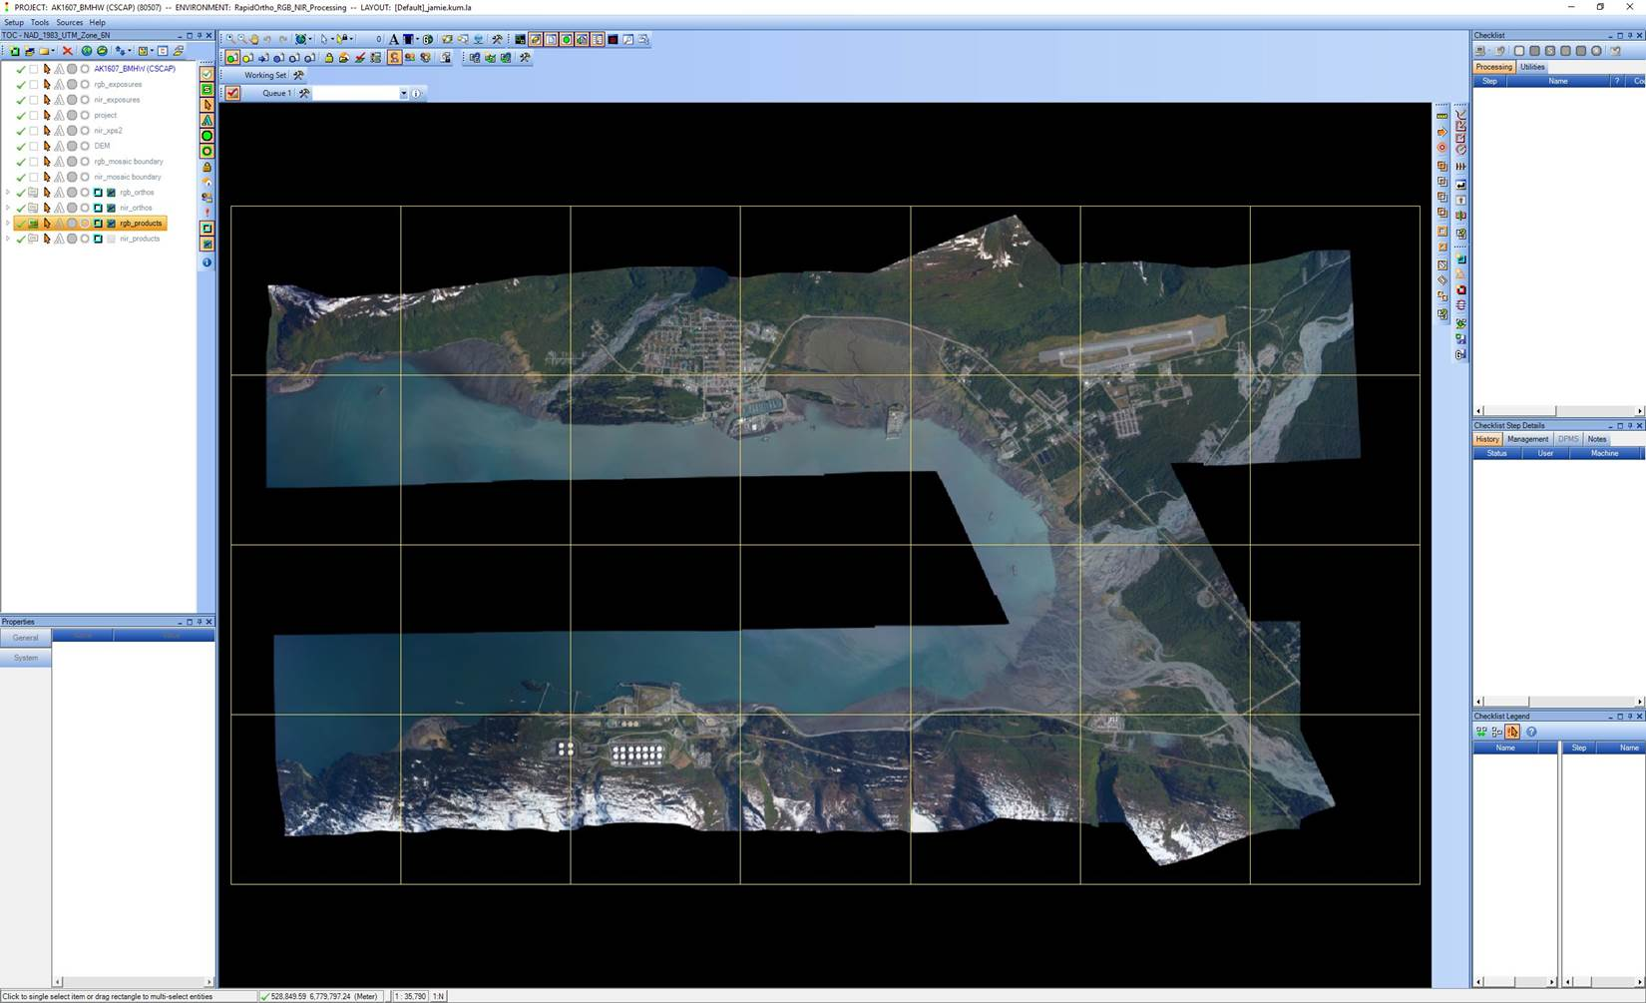
Orthoimagery Format
GeoCue is used as a workflow manager to coordinate the production of 2.5 km square orthomosaic tiles in GeoTiff format (UTM projection) using OrthoVista and RapidOrtho software.
Notes:
The aerial images are orthorectified and 2500 meter square orthomosaic tiles are produced in GeoTiff format. These are then sent to the Digital Coast web site for public distribution.

Slide 26
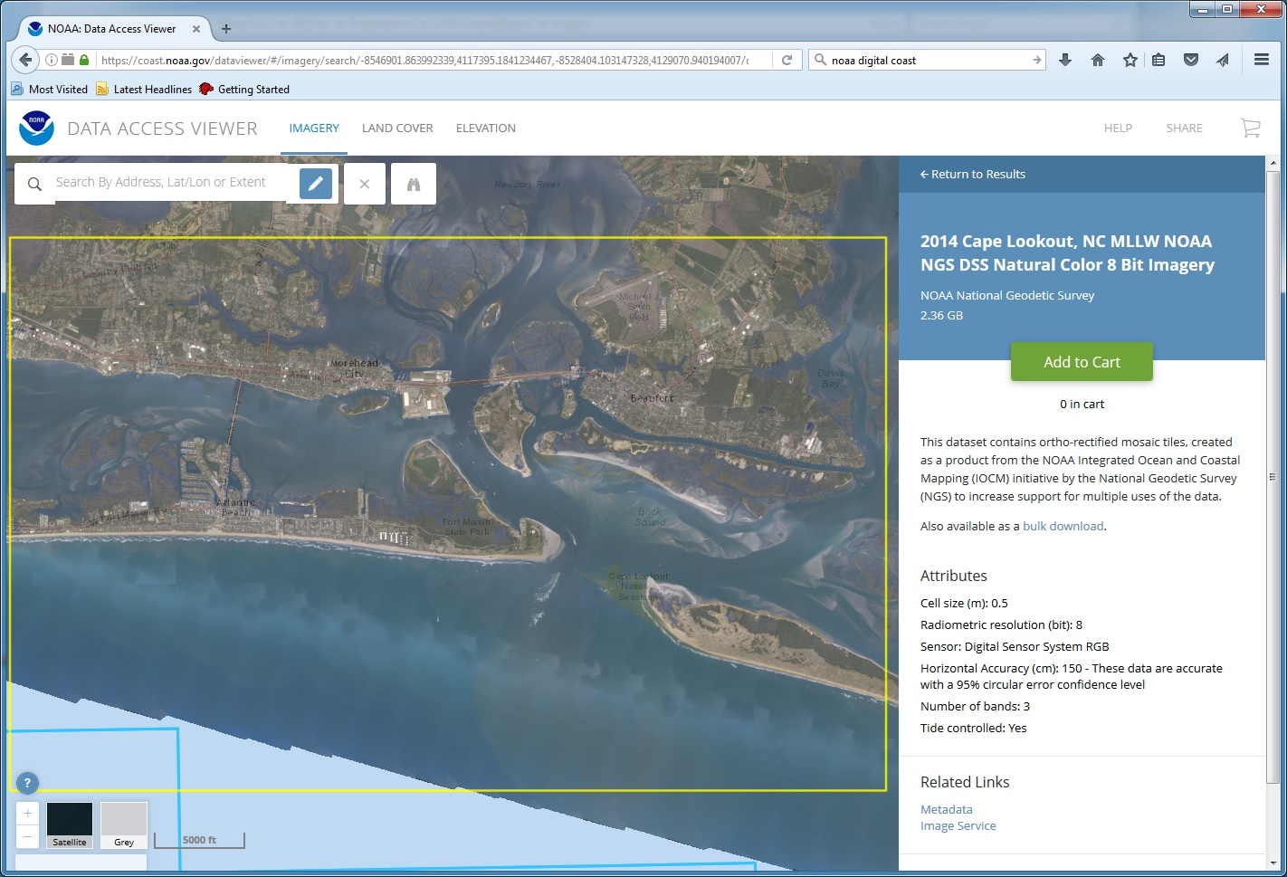
Orthomosaic Imagery on Digital Coast

Slide 27
Access to NGS Data on Digital Coast
Data Registry (Imagery and Lidar)
  https://coast.noaa.gov/dataregistry/search/collection
Data Access Viewer (Imagery and Lidar)
  https://coast.noaa.gov/dataviewer/#
Coastal Lidar Datasheet
  https://coast.noaa.gov/htdata/lidar1_z/geoid12a/data/

Slide 28
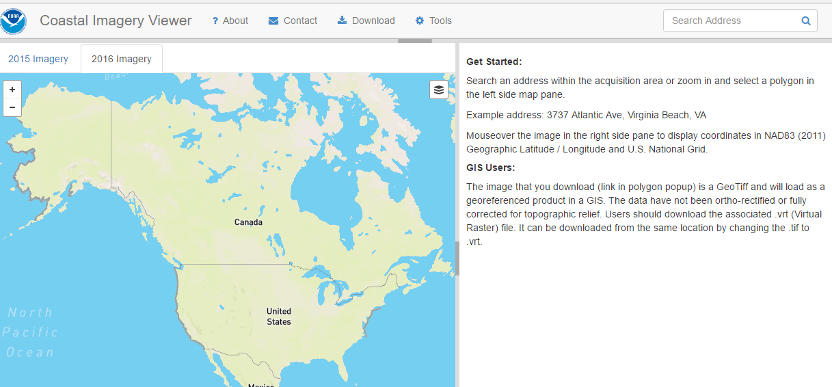
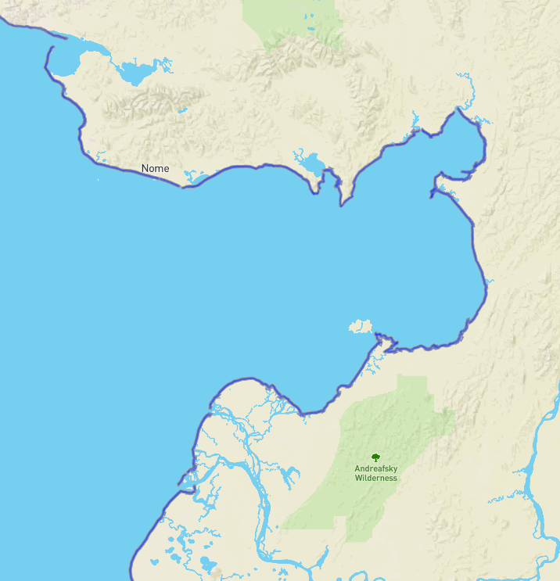
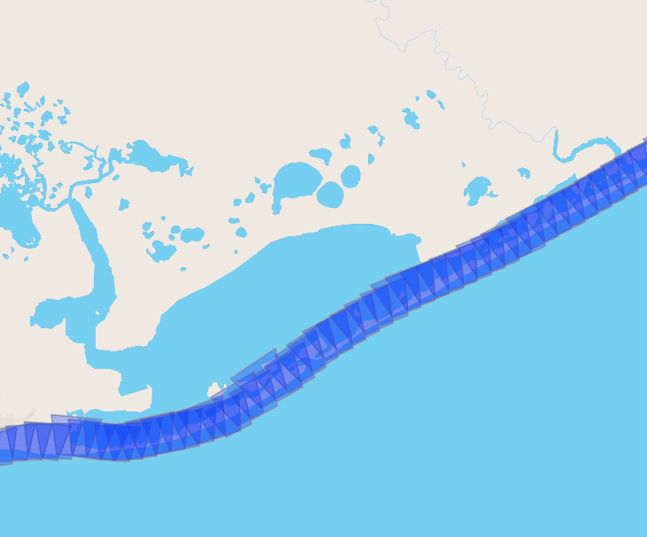
Coastal Oblique Imagery viewer
https://geodesy.noaa.gov/storm_archive/coastal/viewer/index.html

Slide 29
Oblique examples
Notes:
Norton Sound, AK

Slide 30
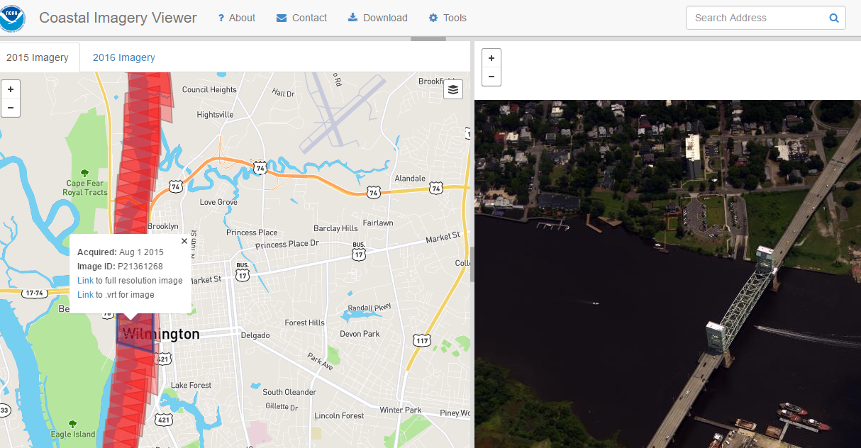

Slide 31
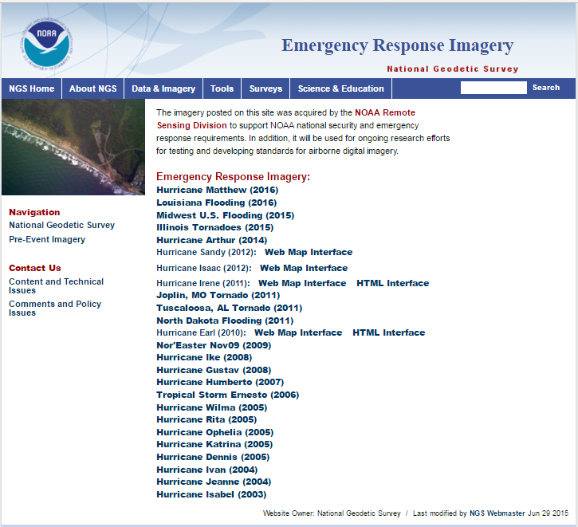
http://storms.ngs.noaa.gov/eri_page/index.html

Slide 32
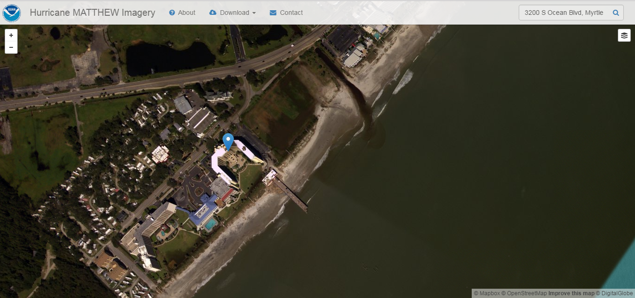
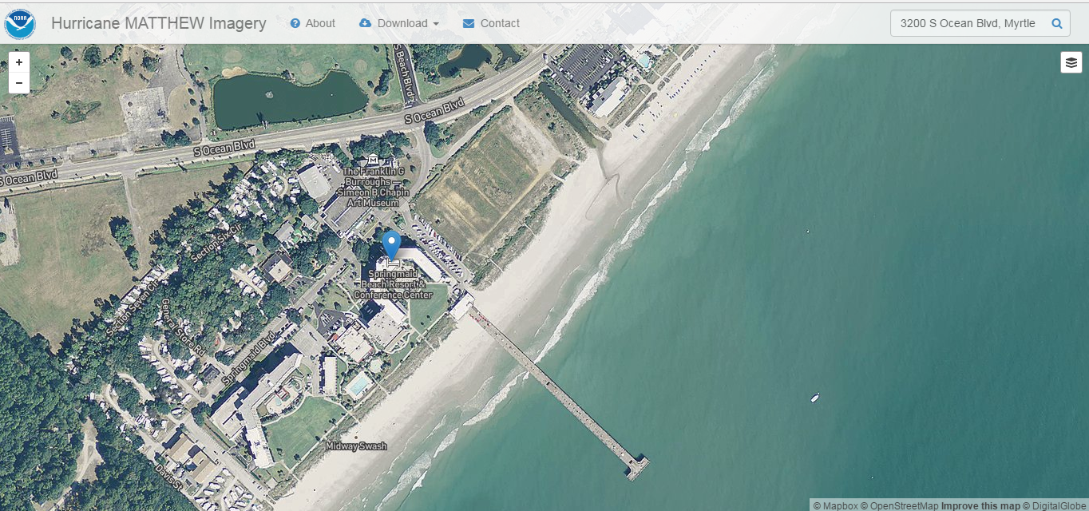

Slide 33
Questions?
Mike Aslaksen
Chief, Remote Sensing Division
NOAA National Geodetic Survey
mike.aslaksen@noaa.gov

Slide 34




Aquatic cages/oyster beds found with ABL
Notes:
RSD found these when we were making the DZ ortho of the Sandy contract data and there was a huge gap in the data (see top right image). this was because the contractors classified this data as IHO- objects which was one of the classes hydro was strangely not requesting from us) only bathy, ground and submerged features). I looked at the cheseapeake bay noaa site and didn't see anything on their maps until today (see last image attached). looks like they marked it south of the actual area.... Also MCD was not informed that these cages were being added until RSD notified them. You can see in the imagery that the boats in the left bottom image are adding more cages.

Slide 35


Uncharted object (man made?) near Sand Key, FL southwest of Key West, FL

Slide 36



Slide 37


Slide 38


Slide 39



Slide 40



Slide 41


Point density of the object ranged from ~12.5 to 13.5 pts per m²
Water depth: ~7.7m
Object height: 2m
~26m
~7m
~26m
~7.7 m
2 m

