Slide 1


National Geodetic Survey
In partnership with U.S. Fish and Wildlife Service
Malheur Wildlife Refuge
Recovery & Control Survey
NOAA’s National Geodetic Survey
geodesy.noaa.gov
Mark L. Armstrong, PLS, WRE
Oregon State Geodetic Advisor
mark.l.armstrong@noaa.gov

Slide 2
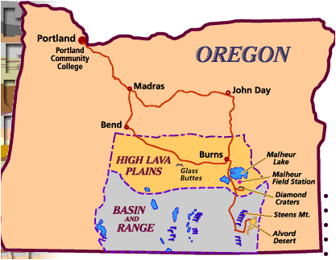
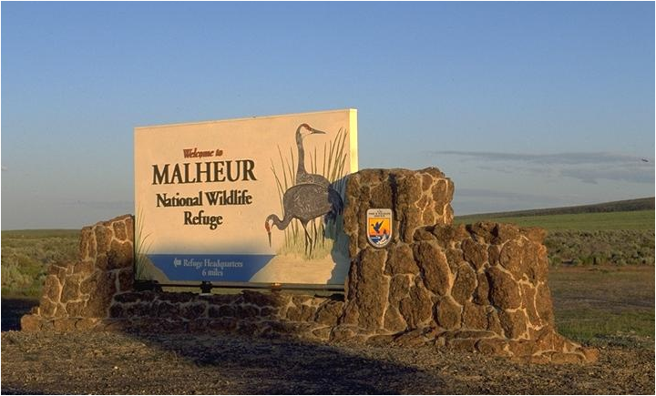

Slide 3
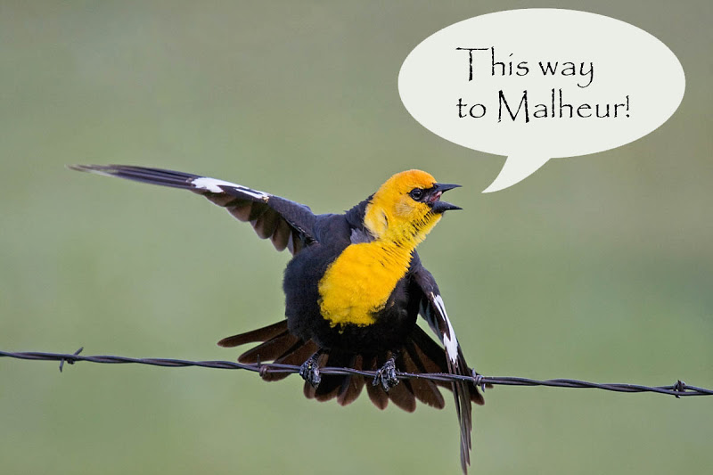

Slide 4
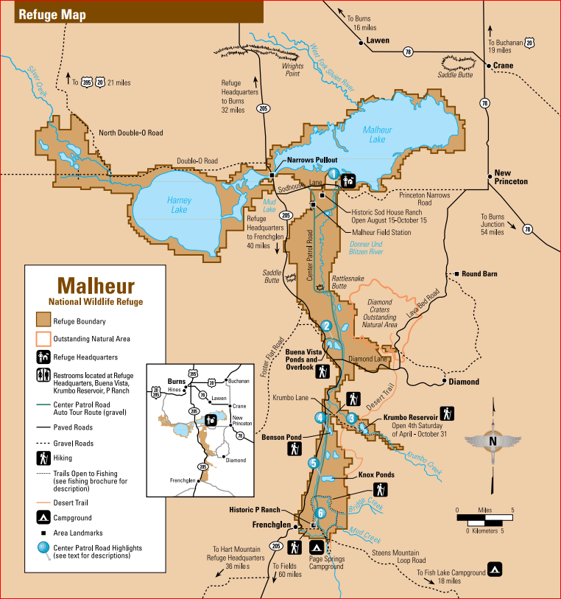
For more information on Malheur go here.
http://www.fws.gov/refuge/Malheur/
The Refuge was established in 1908 for the benefit of colonial nesting and migratory birds.
Ancestors of the Burns Paiute Tribe used lands encompassed by the refuge for generations.

Slide 5
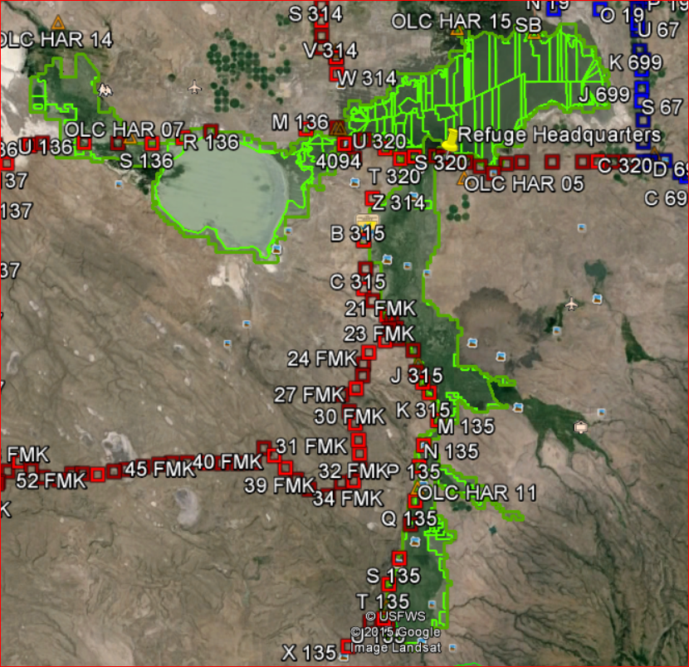
Malheur Wildlife Refuge
LOCATION AND SIZE
SE OF BURNS, OREGON
Area = 187,757 acres
N-S Dist.= 66 km
E-W Dist.= 62 km
1st & 2nd Order Level Lines
A few “shared” solutions from previous LIDAR survey

Slide 6
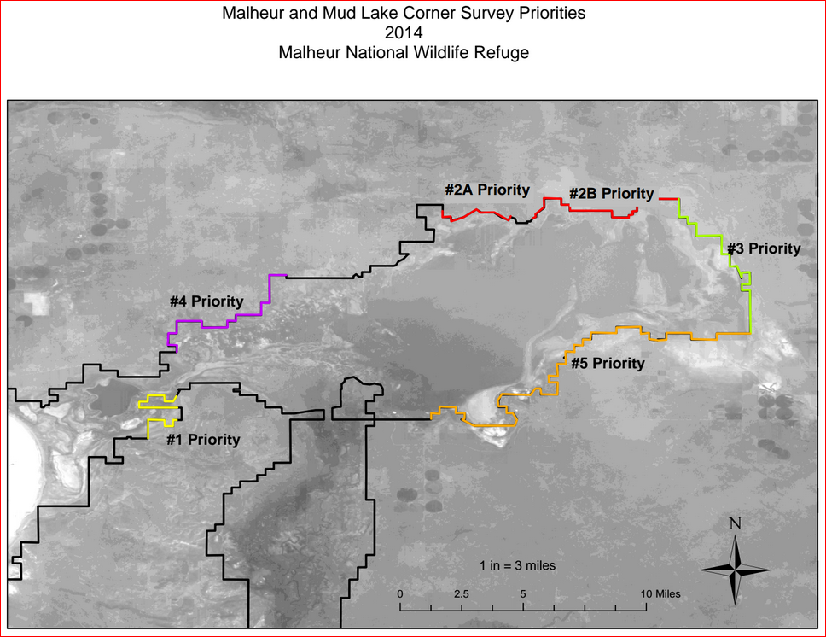
Priority areas are locations where wind driven ice destroyed ~ 60 miles of fence and original boundary monumentation during the winter of 2013/14.
Area of priority
August 2015

Slide 7
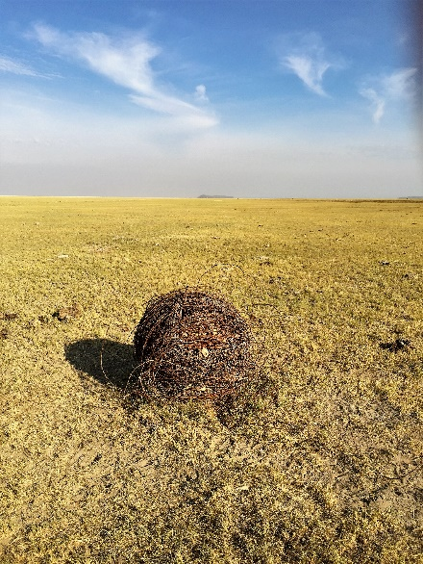
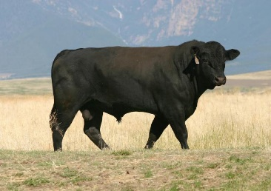
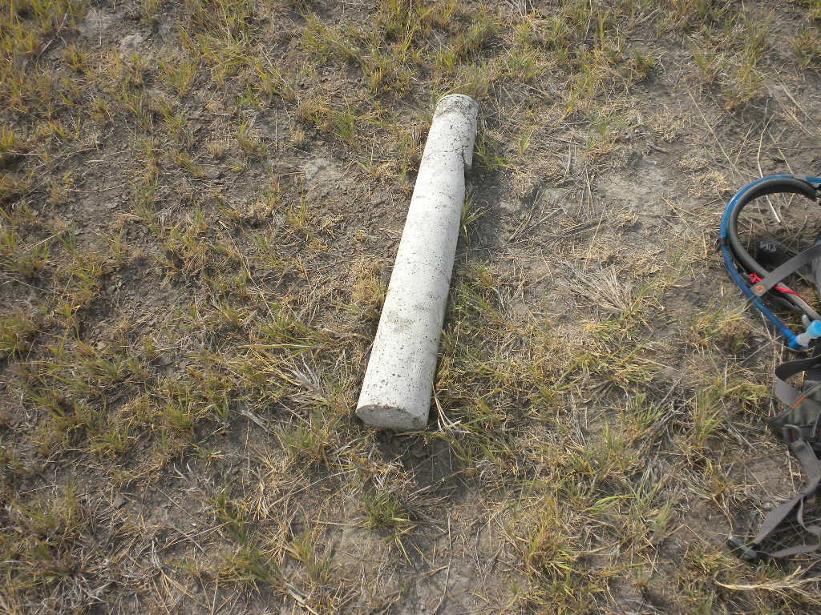
The problem and solution
The barbed wire refuge boundary fences and anchor posts are now down on the ground over large areas. To keep cows from getting tangled up in the wire much of the fencing has been rolled up into balls. Now adjacent cattle ranch cows have access to the refuge. The ranchers say they tell their cows to “get off the refuge” but they just don’t listen! mmoooo
Original boundary monument lifted out of the ground by ice.
The missing boundary monuments need to be re-established and the fence re-installed. This will likely take several years and until the scope is defined and survey contracts let, volunteer surveyors are helping to recover as many boundary monuments as possible. A huge challenge!

Slide 8
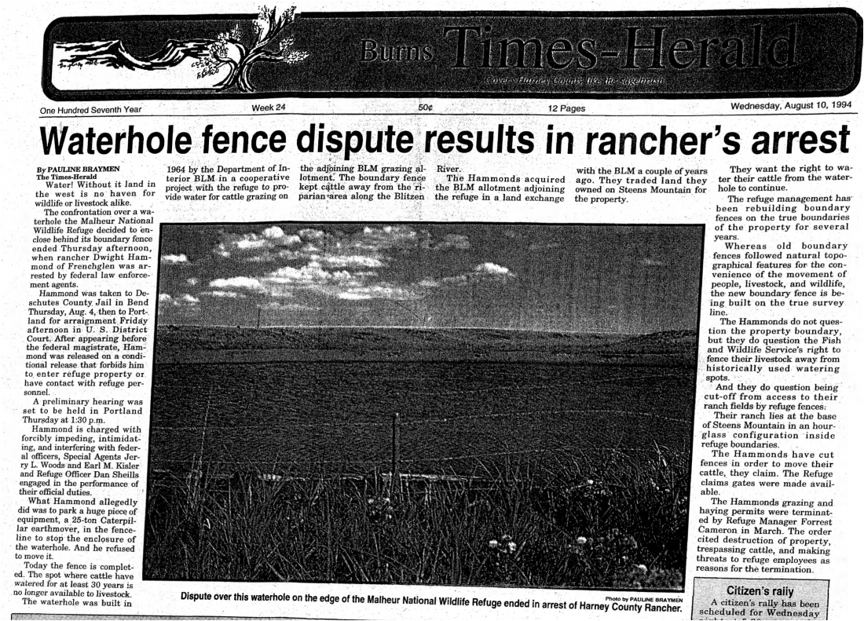
Fences make good neighbors

Slide 9
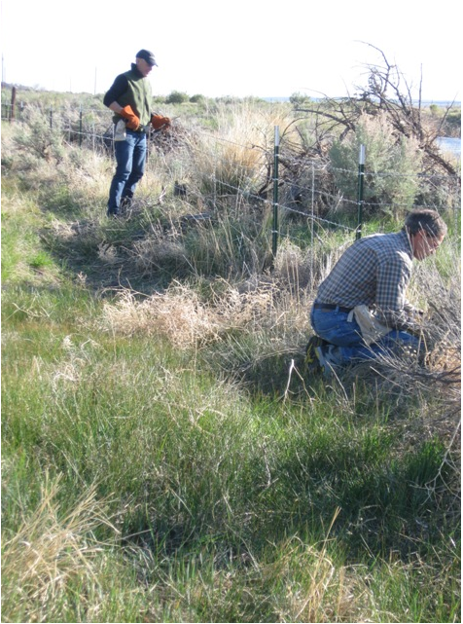
Volunteers repair refuge fence

Slide 10
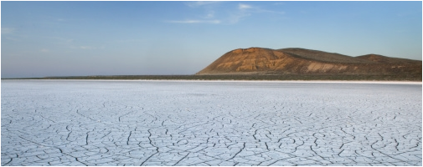
Winter 2013-2014 Frozen Lake

Slide 11
Refuge Access Limitations
Do to EXTREME FIRE DANGER no motorized vehicles were allowed access to the refuge while we were there. So we had to walk in on foot which limited what we could do in a few days.
The very large Canyon Creek fire was 75 miles north of the refuge and smoke was visible.
Most of the work involved recovering existing marks around the refuge that could be used for future survey control or setting new marks suitable for RTK surveying.
Approx. 20 marks were recovered or set and observed and shared with the OPUS database.

Slide 12
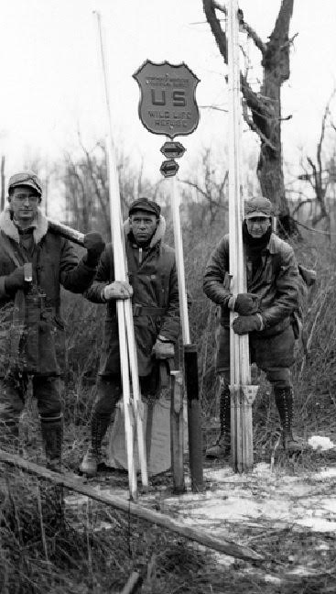
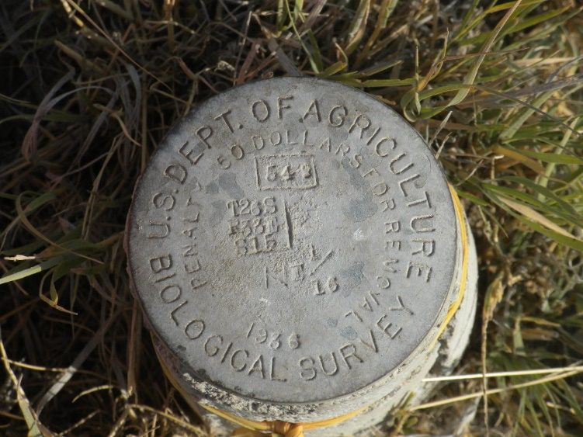
Original Surveys
GLO Surveys 1875 - 1877
Biological Survey 1930-1936
Monument # 549 is for NE 1/16 of Section 15, T26S, R33E set in 1936

Slide 13
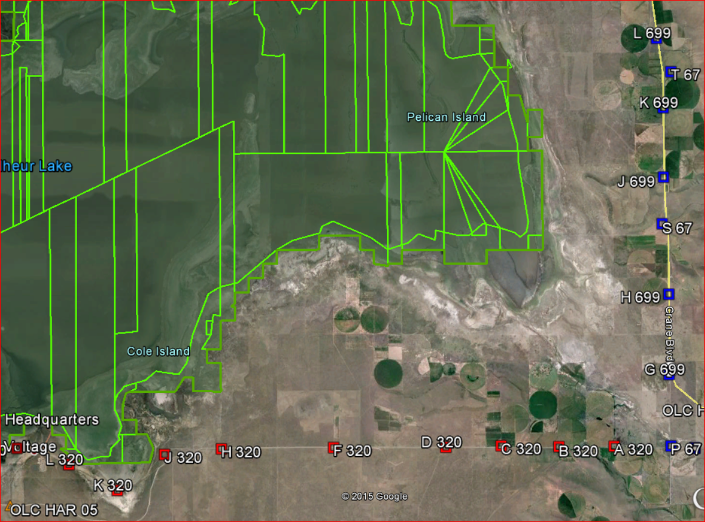
Refuge boundary is aliquot parts of a section and meander lines
Meander line
Section lines
1 Mile

Slide 14
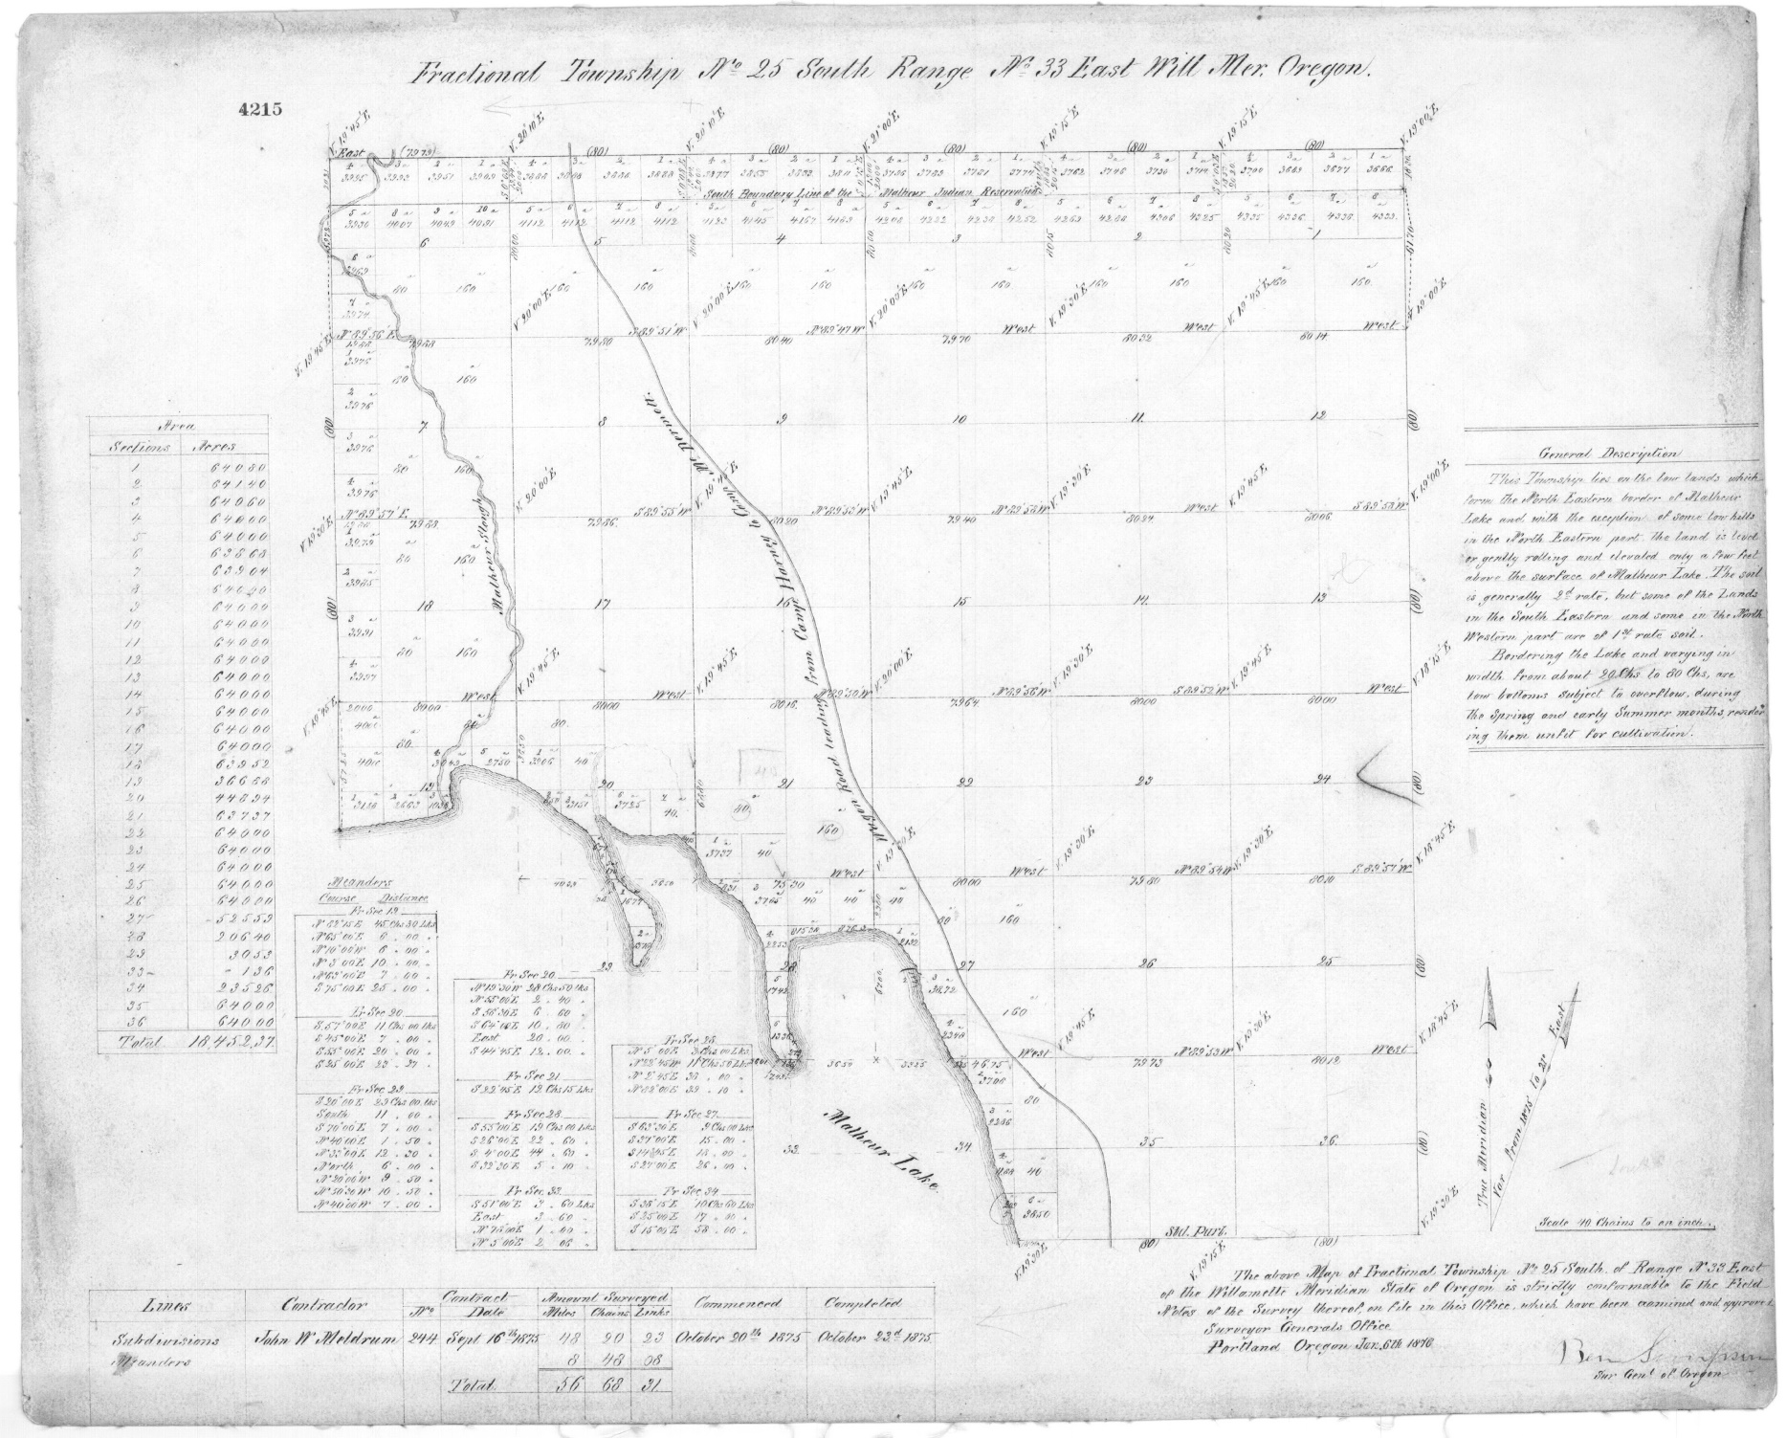
1875 GLO Survey Map

Slide 15
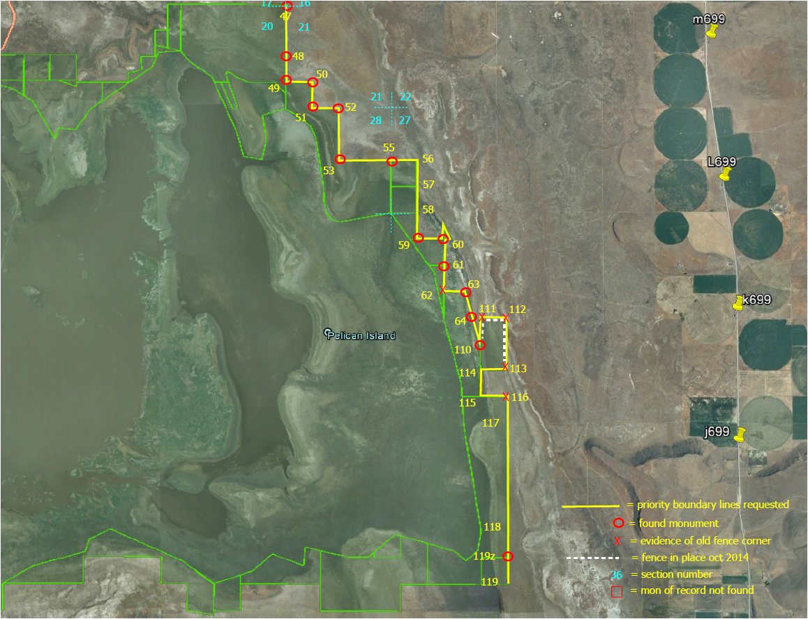
Boundary Search

Slide 16
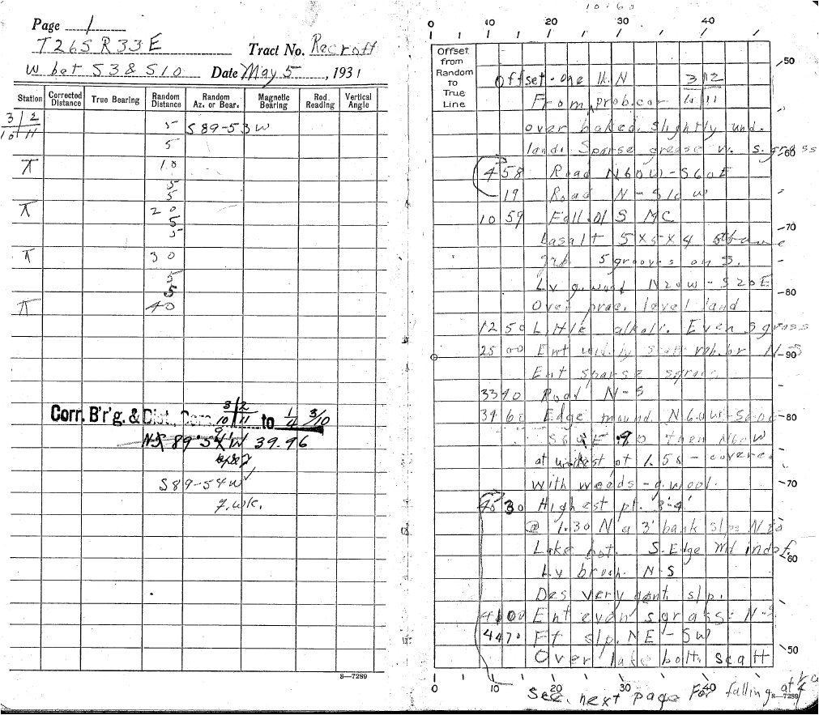
U.S. Biological Survey 1931-1936 Field Notes

Slide 17
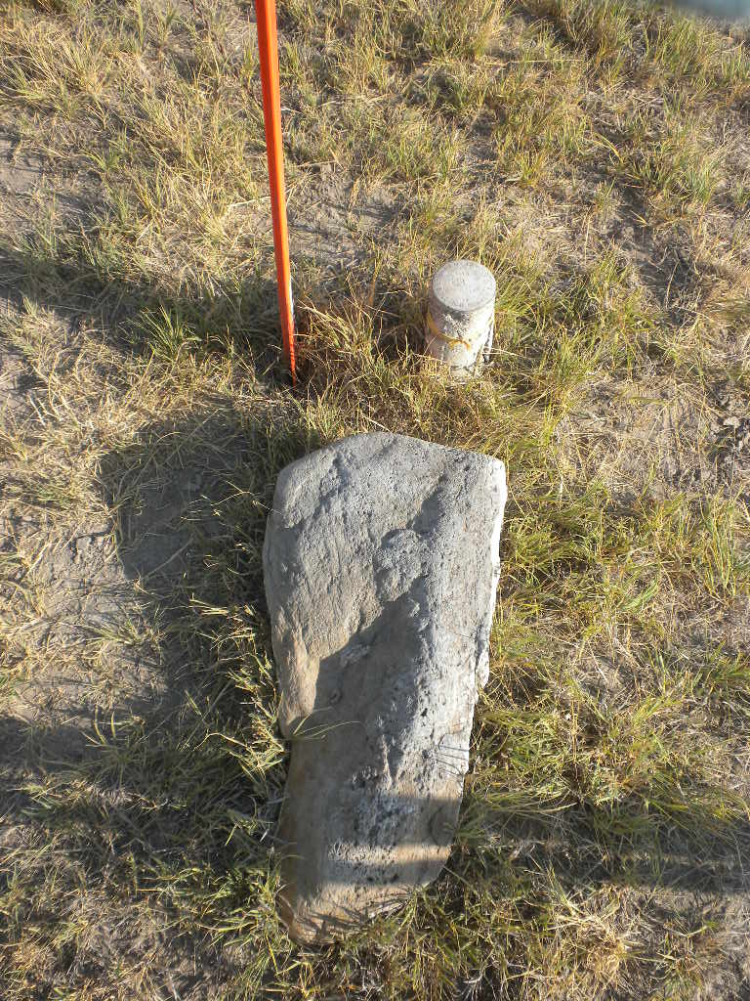
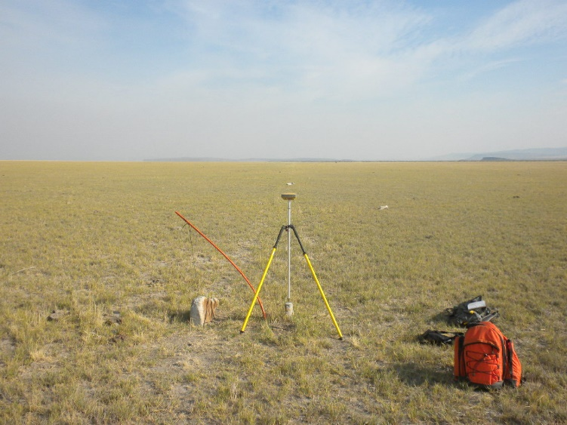
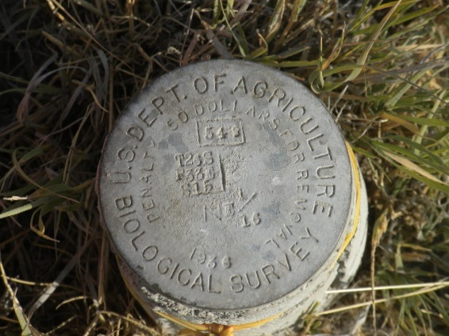
Corner Recovery
Monument # 549 - One of the few remaining undisturbed corner monuments – observed and shared with OPUS

Slide 18
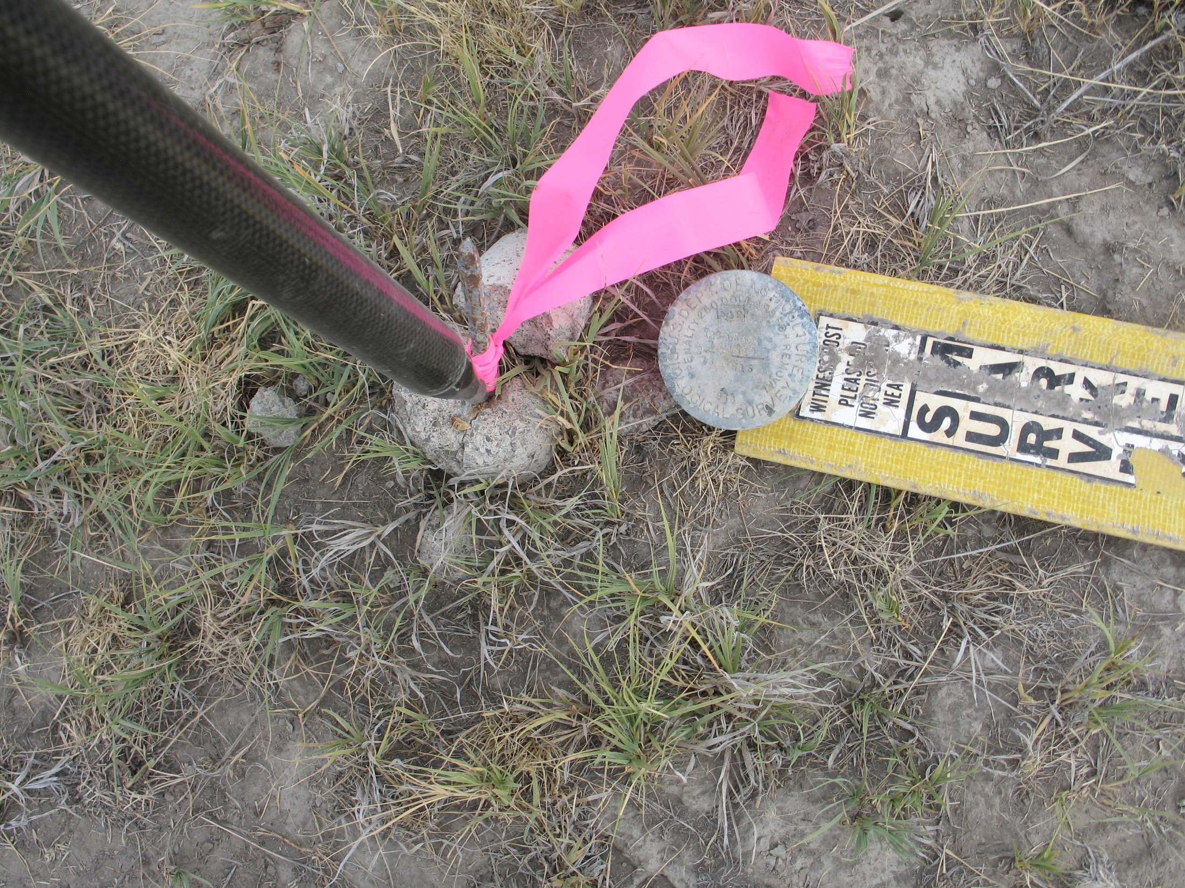
Recovered broken monument #548. The bottom portion was in tact and solid, but the disk had been broken off. The center of the remaining monument was tied for position

Slide 19
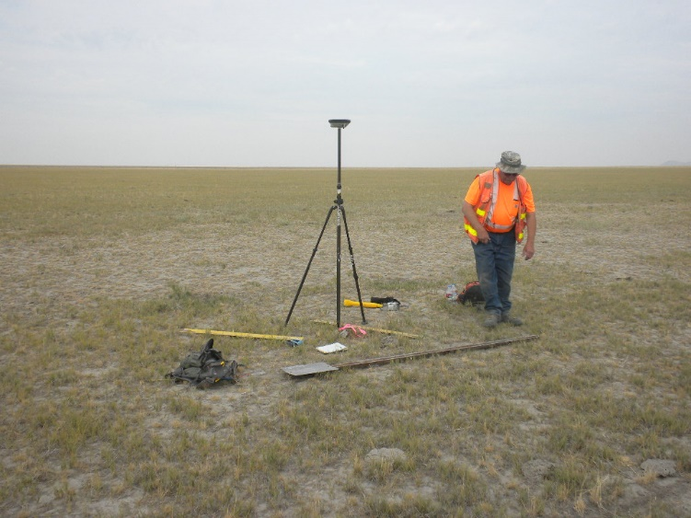
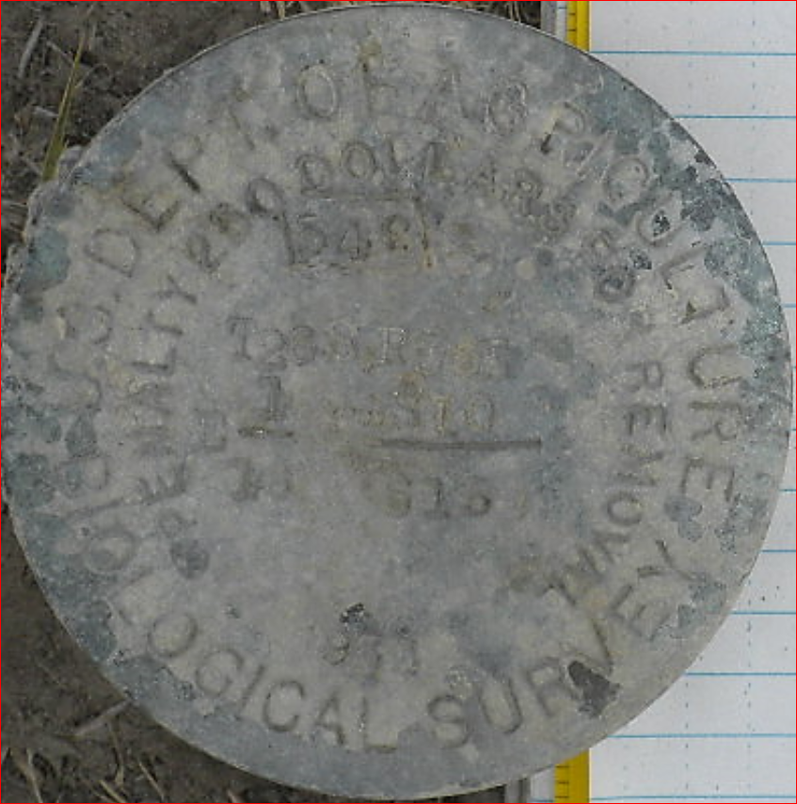
Mark # 548- E 1/16 Sec 10
Sec 15
Perfect GPS location!

Slide 20
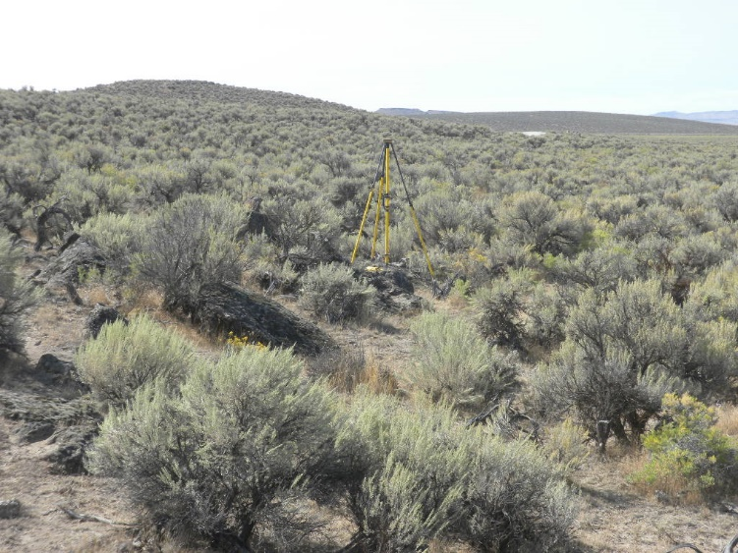
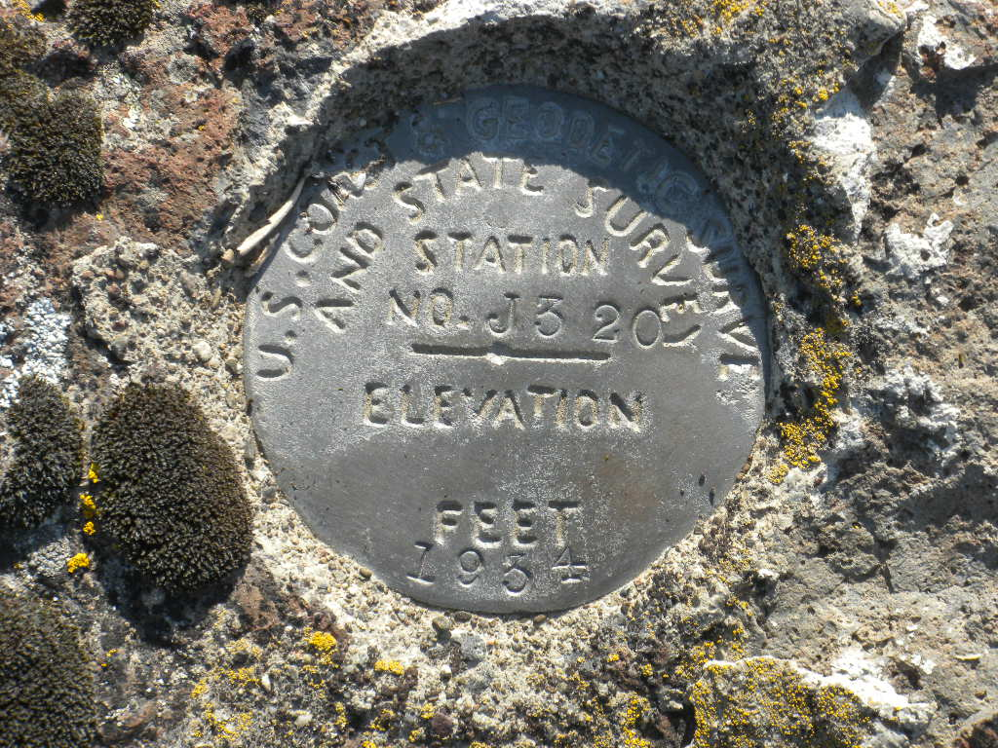
Bench Mark Recovery
J 320 – Found mark in bedrock as described in the IDB datasheet. The original road referenced in the description is now just a cow path. Two other parallel roads have been constructed through the years.
This is the first recovery since the mark was set in 1934. Mark was observed and shared with the OPUS database (next slide).

Slide 21
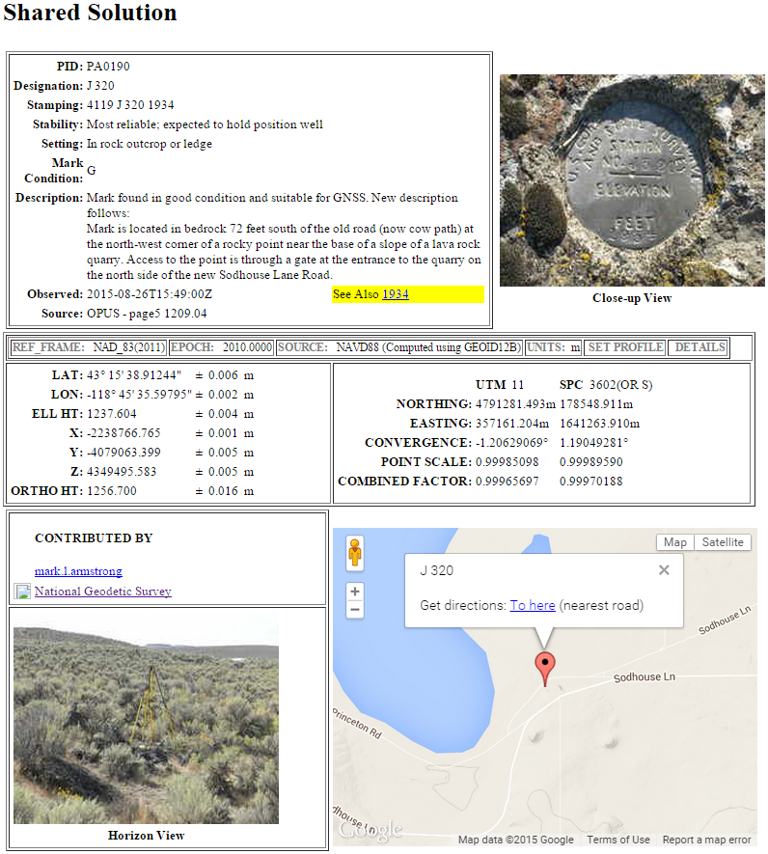
J 320 Shared Mark Page

Slide 22
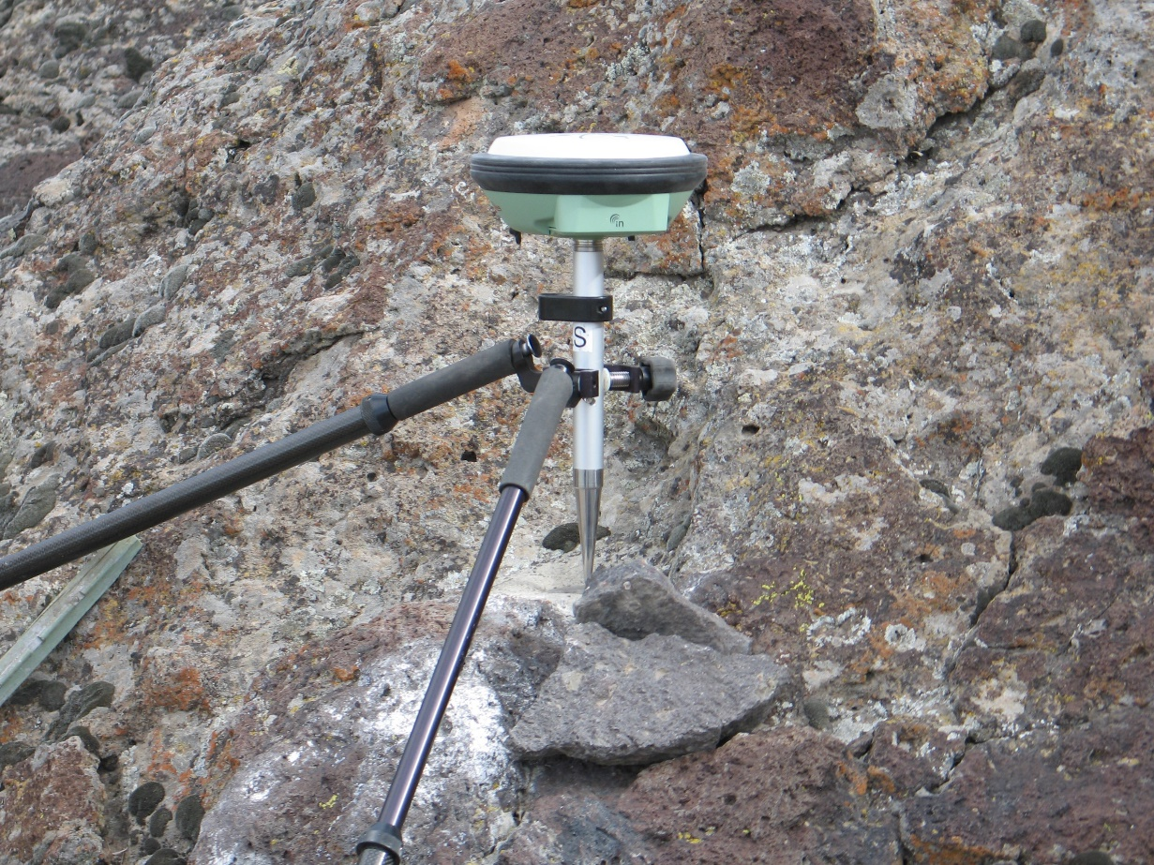
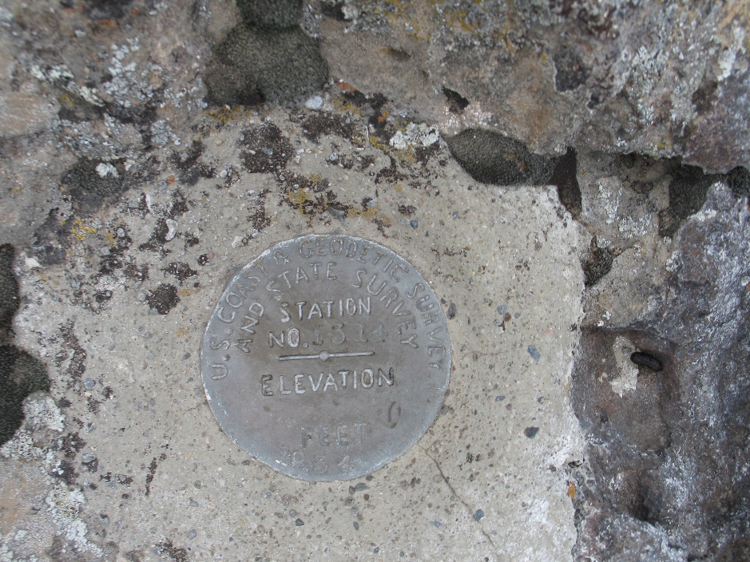
Bench Mark Recovery
First recovery for Y 314, set in 1934.
Set in bedrock ledge requiring a creative setup using a short 0.28 m fixed height rod.

Slide 23
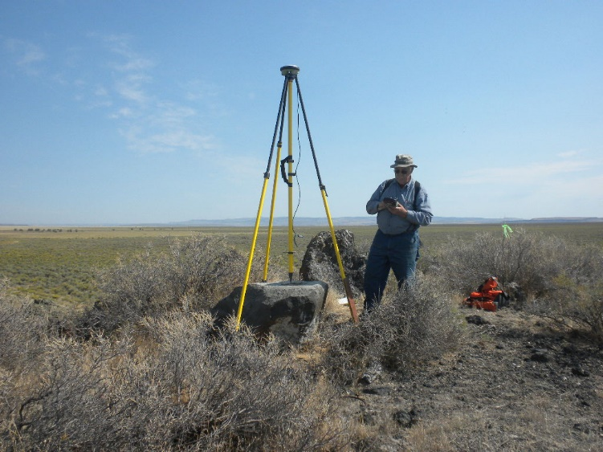
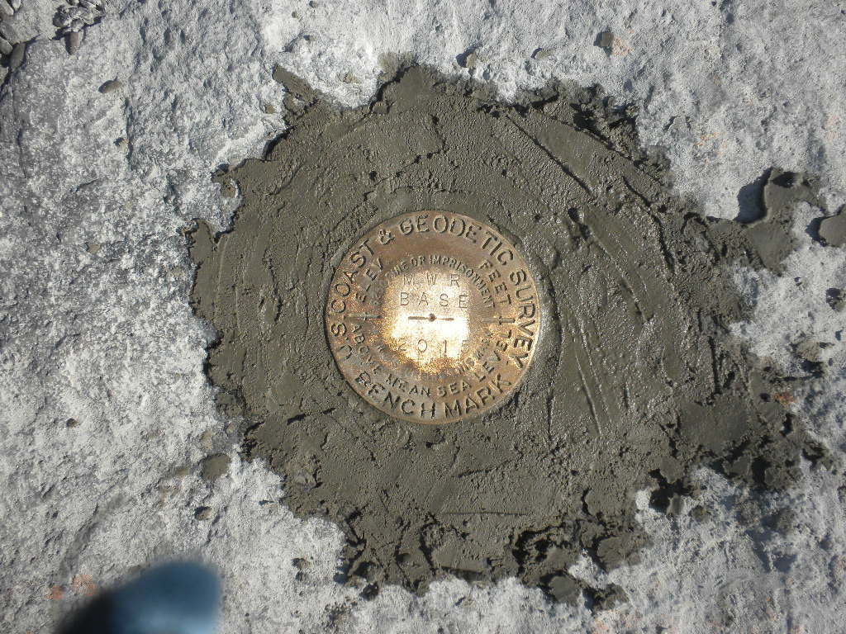
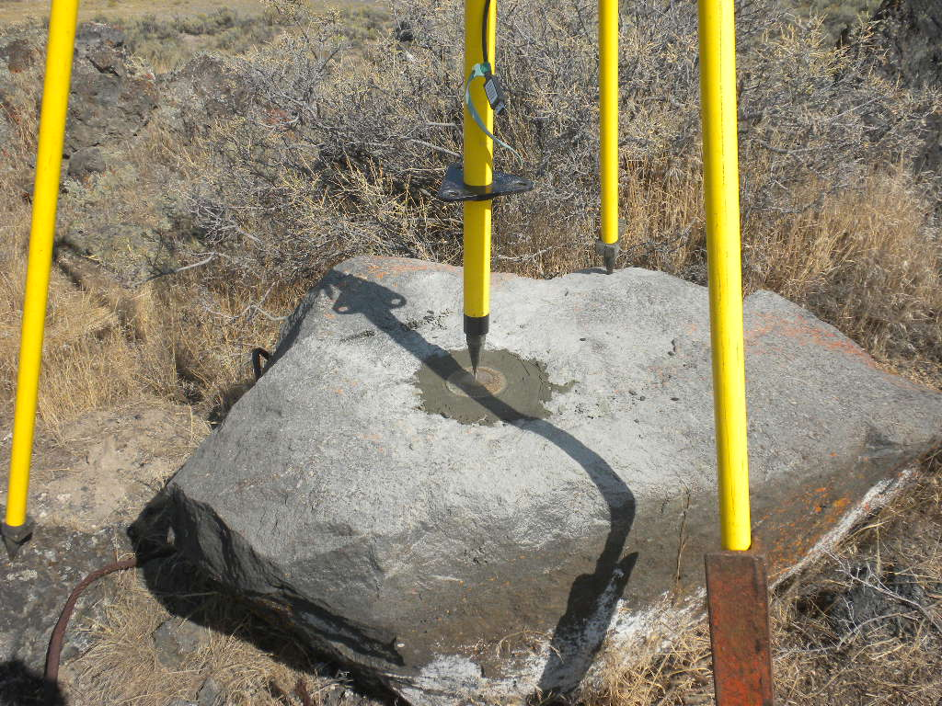
Control set for future RTK
Set mark for future RTK base on bluff overlooking the south side of the refuge.
Mark is recycled C&GS disk. Old stamping was ground off and new stamping applied. Hopefully it will have another 80+ years of service.

Slide 24
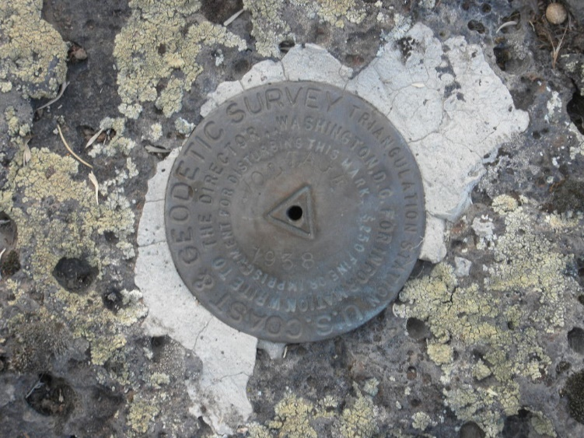
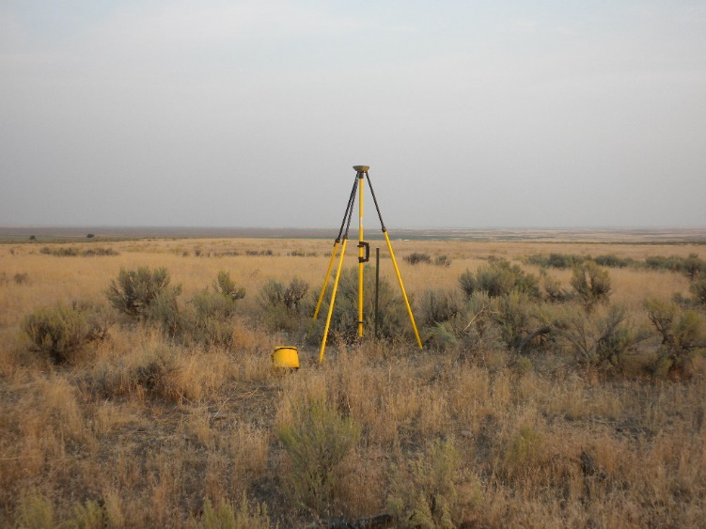
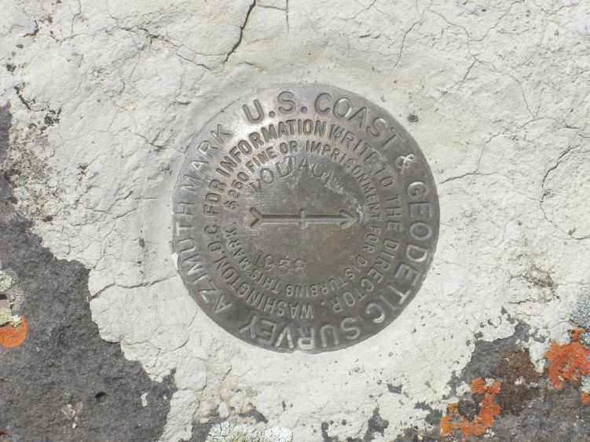
Tri-stations Recovered
Mark “Voltage” recovered, observed and shared with OPUS along with it’s Azimuth Mark. “Voltage” could be used as an RTK base location overlooking the west side of the refuge and Mud Lake and it’s azimuth mark used as a rover check-in.

Slide 25
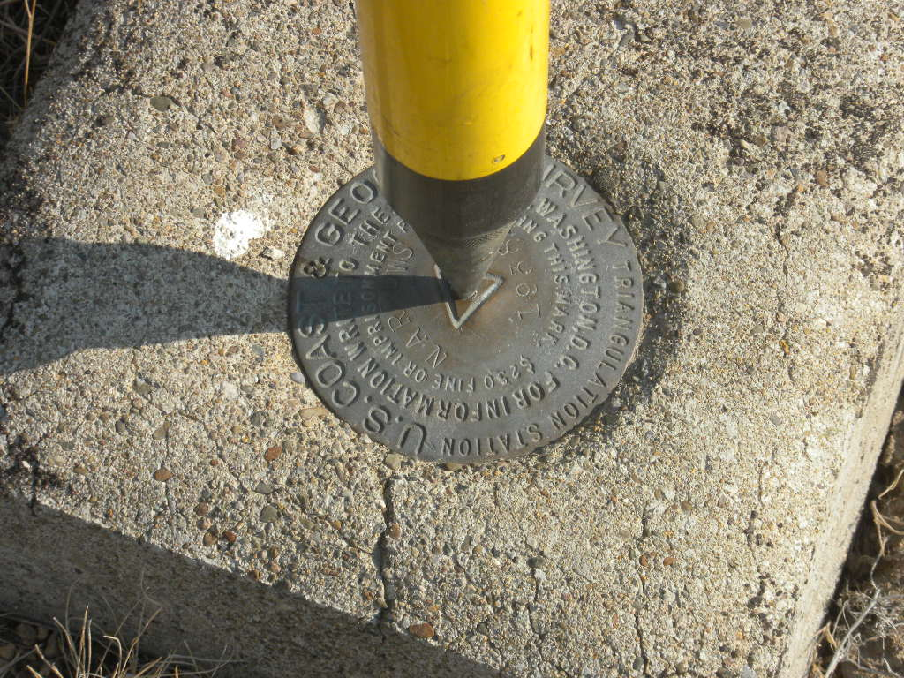
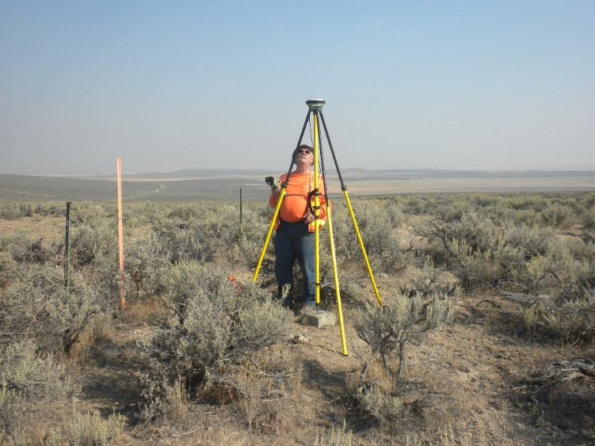
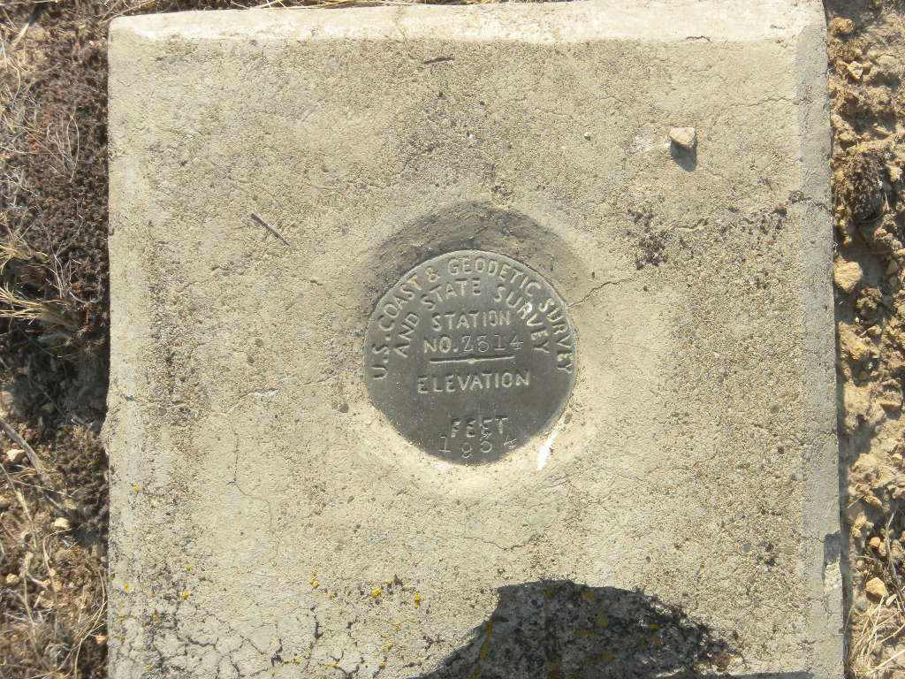
Tri-stations Recovered
Tri-station “Narrows” and its azimuth mark (which is also a bench mark) “Z 314” were recovered, observed and shared with OPUS. Mark “Narrows” could be used as an RTK base location overlooking the north end of Blitzen River section of the refuge and “Z 314” used as a rover check-in point.

Slide 26
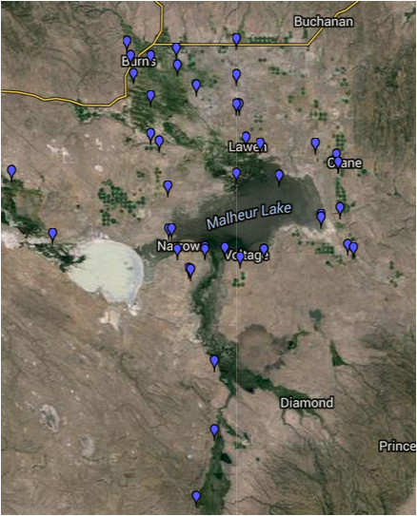
Shared marks in the OPUS database that are around Malheur.
These marks provide NSRS coordinates in NAD 83(2011) 2010.00 LLh as well as State Plane and UTM Grid. In addition the LLh can be converted to Oregon OCRS
zone coordinates.

Slide 27
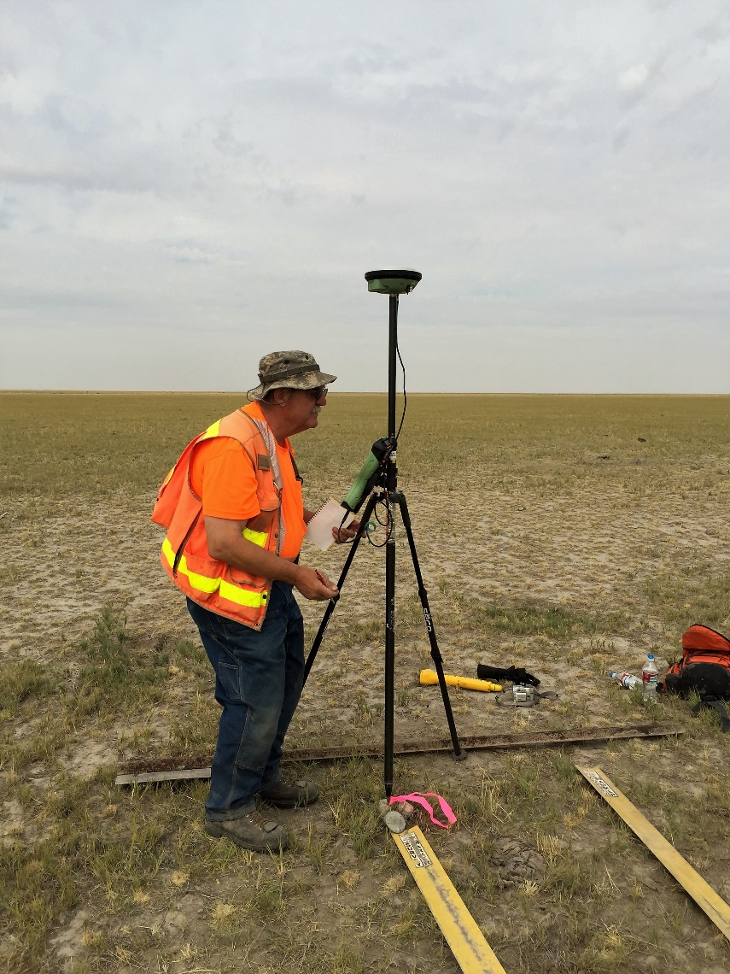
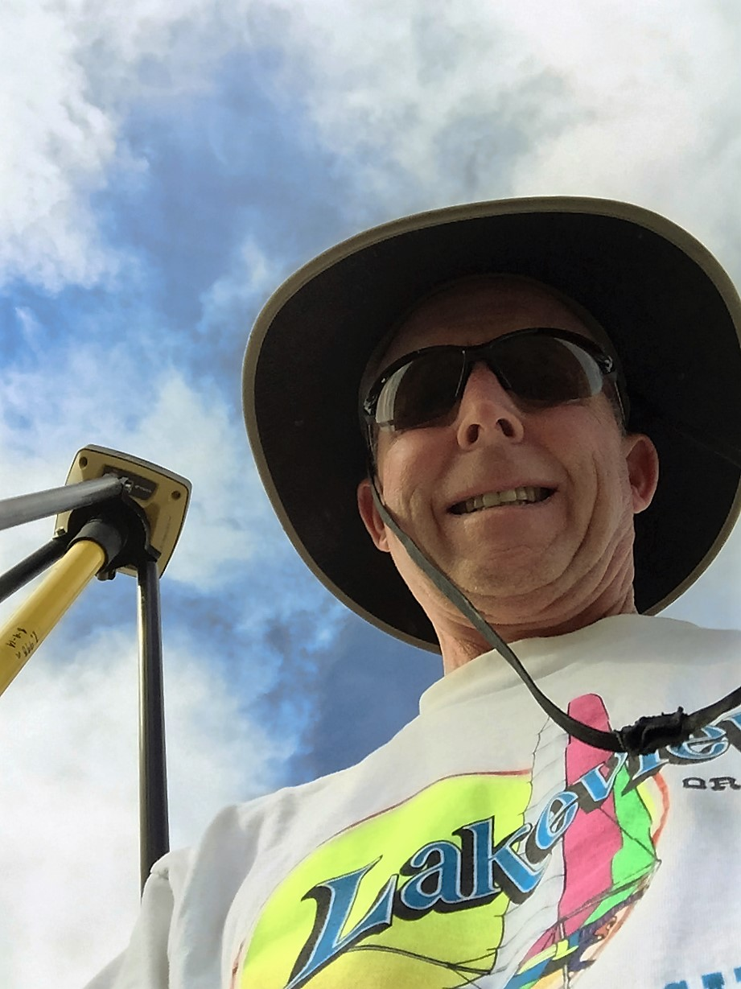
Questions
Stephan (Pat) Barott and Mark L. Armstrong

