Slide 1
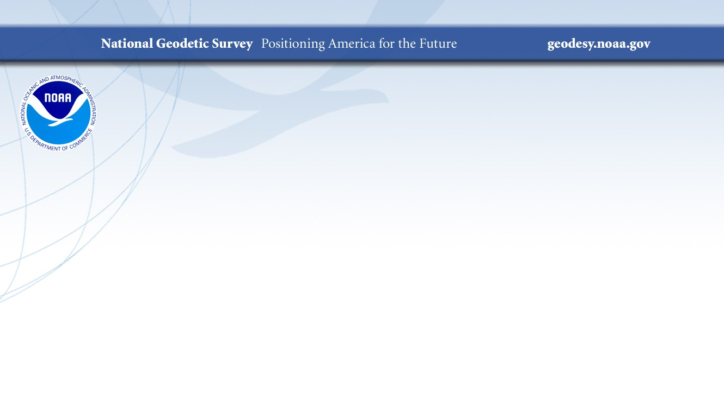

IGLD (2020): Updating the common height reference system for the Great Lakes
Jacob M. Heck, Ph.D.
NOAA’s National Geodetic Survey
Vertical Control - Water Levels Subcommittee of the Coordinating Committee on Great Lakes Basic Hydraulic and Hydrologic Data
Mapping the Great Lakes Webinar Series
June 17, 2021
Notes:
15-20 minutes

Slide 2
What is IGLD?
International Great Lakes Datum (IGLD) is a common height reference system by which water levels can be measured and meaningfully related to each other
Joint effort between the United States and Canada
Maintained by the Coordinating Committee on Great Lakes Basic Hydraulic and Hydrologic Data
Due primarily to Glacial Isostatic Adjustment, IGLD is updated every 25-35 years
The next update will be IGLD (2020)
Notes:
A datum is “Any quantity or set of quantities that may serve as a referent or basis of calculation for other quantities.” – Geodetic Glossary, 1986.

Slide 3
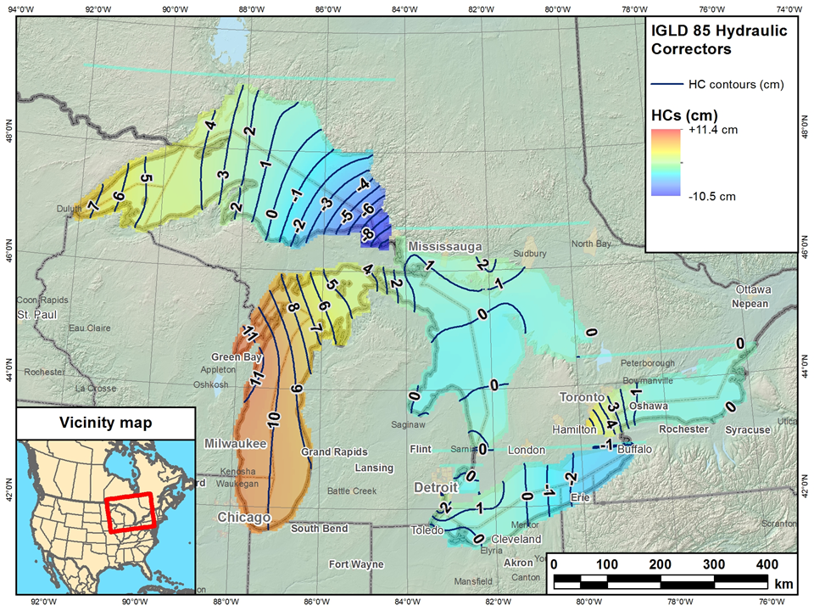
Current IGLD
IGLD (1985) replaced IGLD (1955) in 1992
Same reference zero as NAVD 88 (at Pointe au Père, Québec)
Surface determined by leveling
Dynamic heights
Hydraulic correctors
Notes:
Hydraulic correctors are applied to dynamic heights at locations on or very near the lake, which is assumed to be a flat surface
Hydraulic correctors are not applied on sloping surfaces of rivers and connecting channels
On sloping water surfaces the IGLD 1985 height and NAVD 88 dynamic height are one and the same
Dynamic heights are published by NGS on all bench mark datasheets
IGLD 1985 heights are not displayed on NGS’ datasheets
Hydraulic correctors are determined by CO-OPS
NOS provided software can be used to convert NAVD88 heights to IGLD 1985 heights. This software applies a hydraulic corrector when appropriate

Slide 4

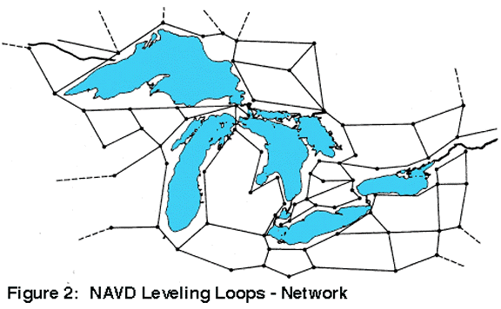
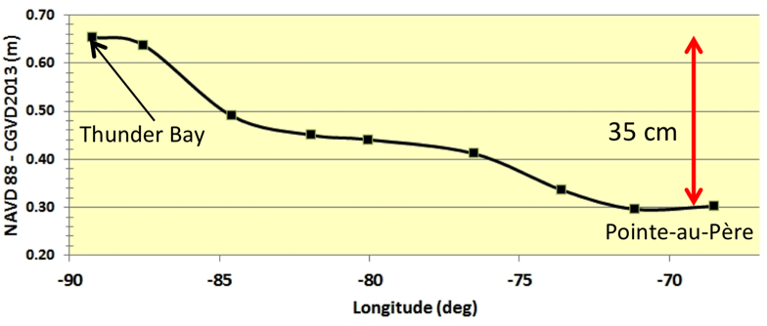
IGLD (1985) Reference Surface
Reference surface is each lake (equipotential surface) to which orthometric or MSL heights are referenced
IGLD 1955 & 1985 used 1000’s miles of geodetic leveling to indirectly define the reference surface
  Very time consuming & cost prohibitive
  Datum accessible only where leveling exists (benchmarks)
  Susceptible to accumulation of systematic errors
Extends the reference zero inland

Slide 5
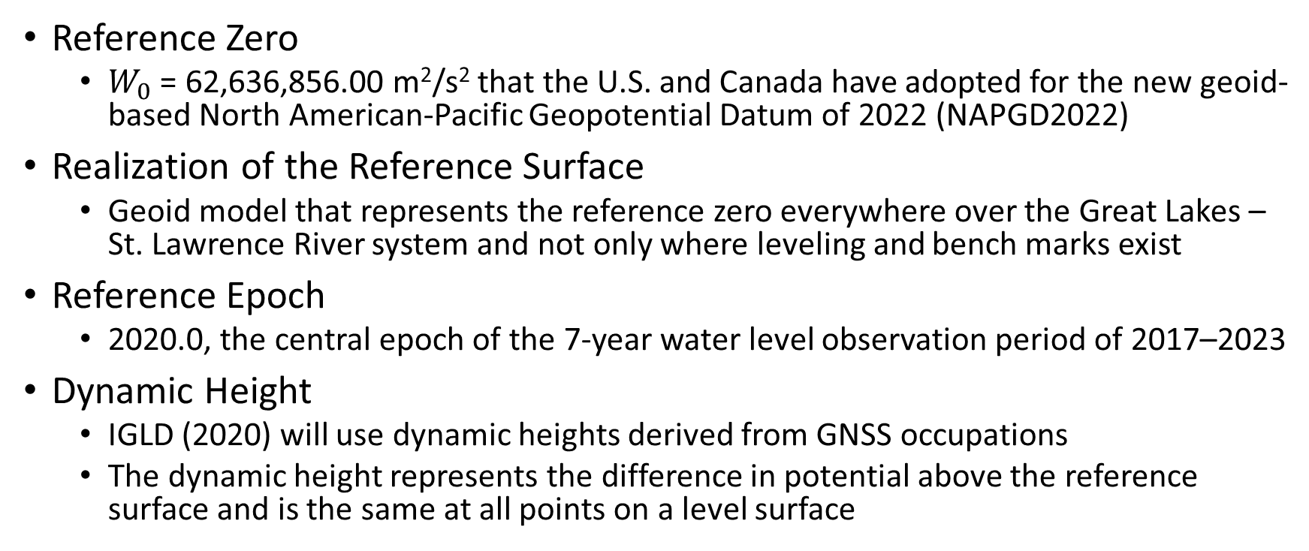
Definition of IGLD (2020)
Reference Zero
  $W_{0}$ = 62,636,856.00 m²/s² that the U.S. and Canada have adopted for the new geoid-based North American-Pacific Geopotential Datum of 2022 (NAPGD2022)
Realization of the Reference Surface
  Geoid model that represents the reference zero everywhere over the Great Lakes – St. Lawrence River system and not only where leveling and bench marks exist
Reference Epoch
  2020.0, the central epoch of the 7-year water level observation period of 2017–2023
Dynamic Height
  IGLD (2020) will use dynamic heights derived from GNSS occupations
  The dynamic height represents the difference in potential above the reference surface and is the same at all points on a level surface

Slide 6
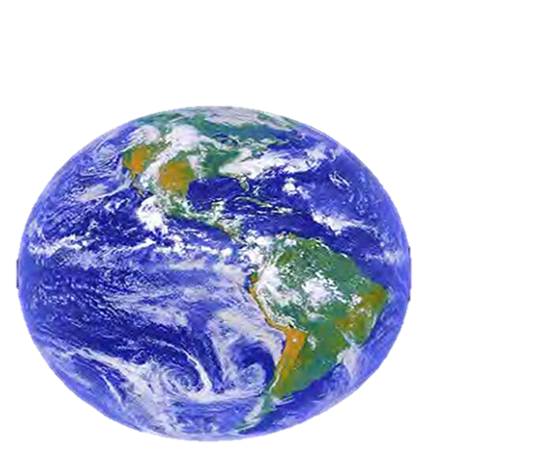
ITRF2020
GRS80 ellipsoid
Notes:
-so there’s a nice little ellipse representing the shape of the GRS80 reference ellipsoid
-what’s GRS80? well, it’s a reference system (being a reference ellipsoid, a gravity model, and more).
-GRS80 in itself is not a datum, although you will see/hear some folks misinterpret that
-now you’ve got a datum (or reference frame)
-in this case, we’re talking about that blue which is symbolizing an ellipsoid with it’s origin locked to the Center Mass of the earth
-which represents the ITRF2020

Slide 7
Earth’s
Surface
h
ITRF2020
origin
GRS80
ellipsoid
Notes:
-so there’s one quarter of the ITRF2020 ellipsoid

Slide 8
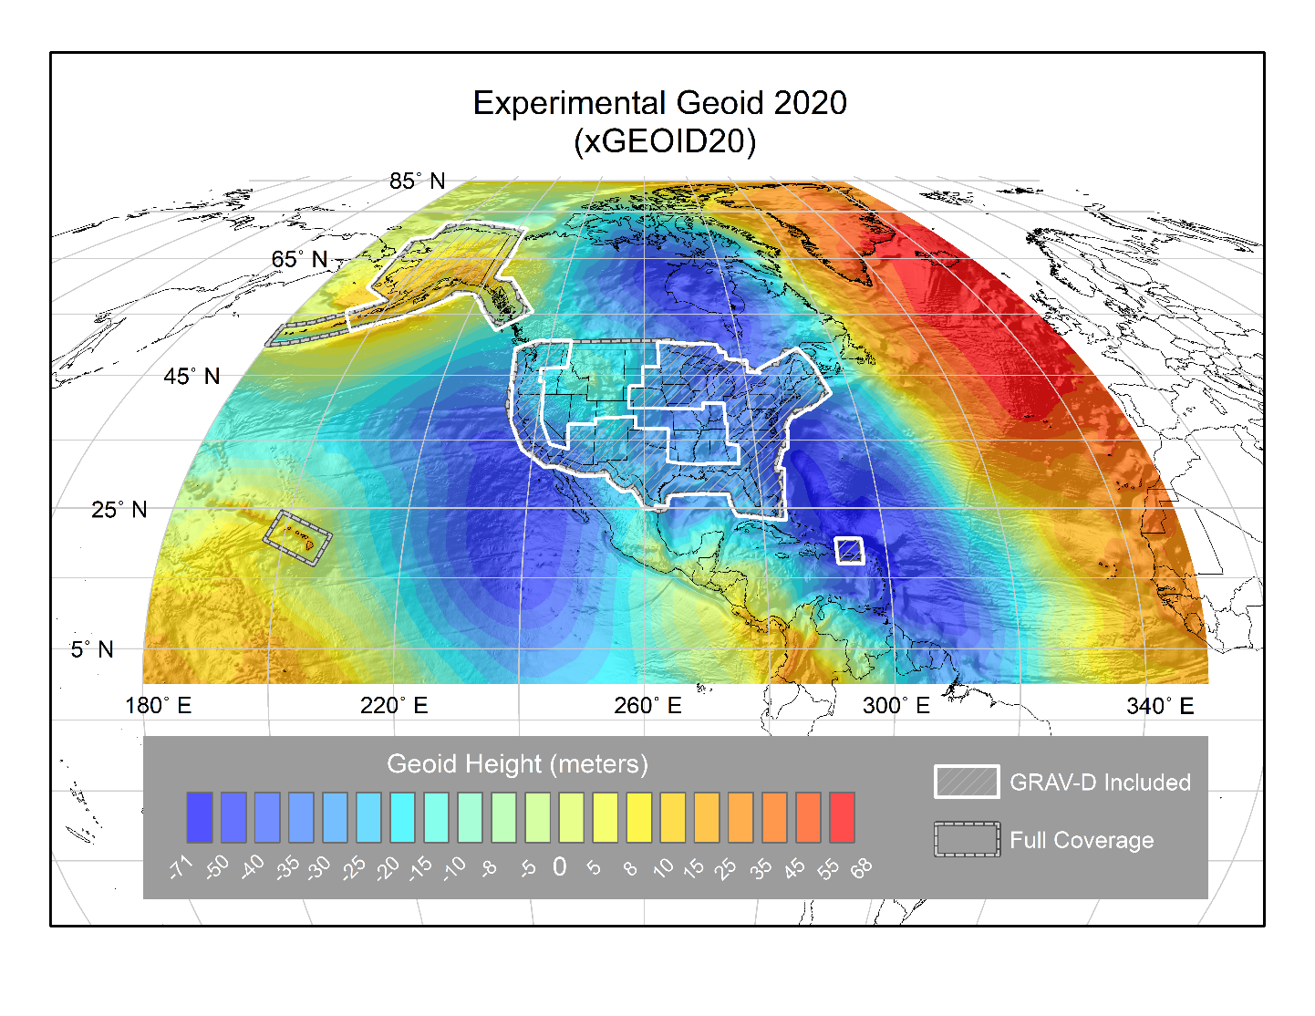

Slide 9
The Geoid, and Heights
h
= H
+ N
h: ellipsoidal height
H: orthometric height
N: geoid undulation
Topography
h
H
The geoid
N
A chosen
ellipsoid
*The relationship between the ellipsoid and the geoid may be swapped in some locations
Notes:
Point of scientific clarity: The geoid is a surface that is always convex. Yes it has undulations, but geoid purists in the audience will point out to you that, measured at the scale of the Earth itself, the geoid always has a POSITIVE radius relative to the center of the Earth. But when we zoom in, just for illustrative purposes, it is nice to show an “undulating” geoid, to distinguish it from both the smooth ellipsoid and the not smooth topography.
Additionally, don’t even bother showing that the plumb line (H) is curved. For purists, fine, but even at America’s largest known curved plumb line (Denali), this curvature is a SUB MILLIMETER effect.

Slide 10
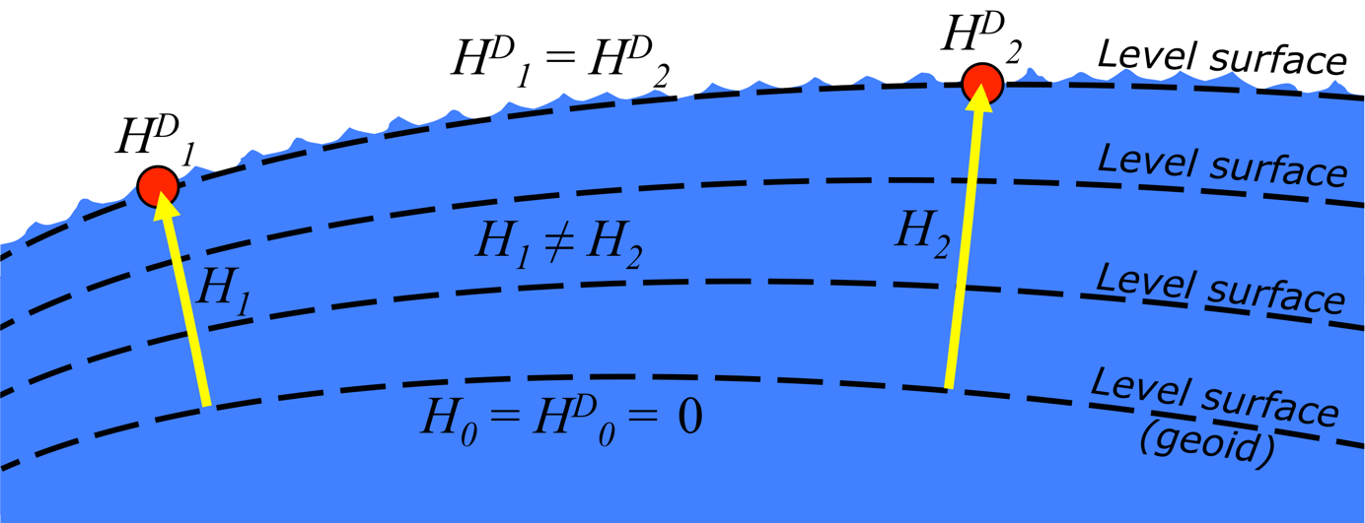
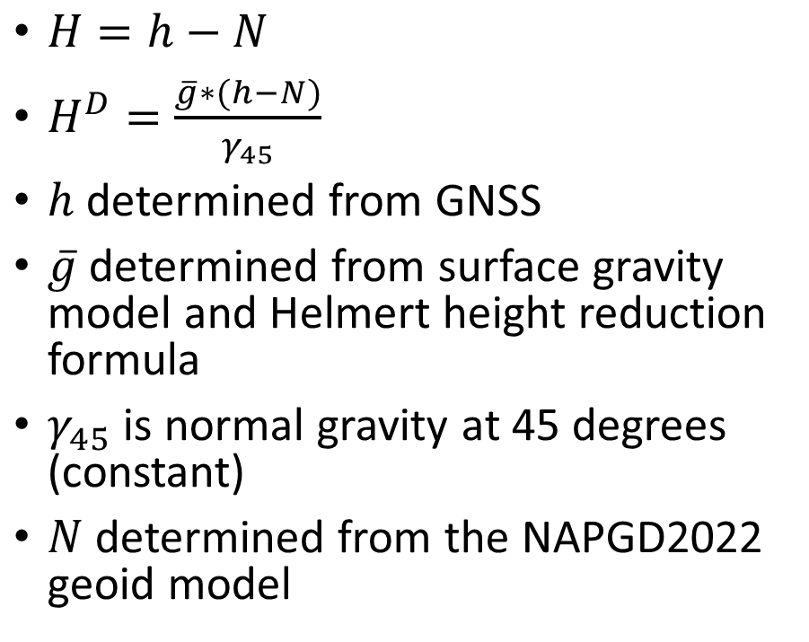
Determining Heights in IGLD (2020)
$H=h−N$
$H^{D}=\frac{\overline{g}∗(h−N)}{γ_{45}}$
$h$ determined from GNSS
$\overline{g}$ determined from surface gravity model and Helmert height reduction formula
$γ_{45}$ is normal gravity at 45 degrees (constant)
$N$ determined from the NAPGD2022 geoid model
Dynamic heights, H^{D}, and orthometric heights, H.
Notes:
* See http://www.ngs.noaa.gov/datums/newdatums/
Physical distance from reference surface to point
Geopotential difference divided by actual gravity (g)
Gravity & H are not constant along an equipotential surface (e.g., lake)

Slide 11
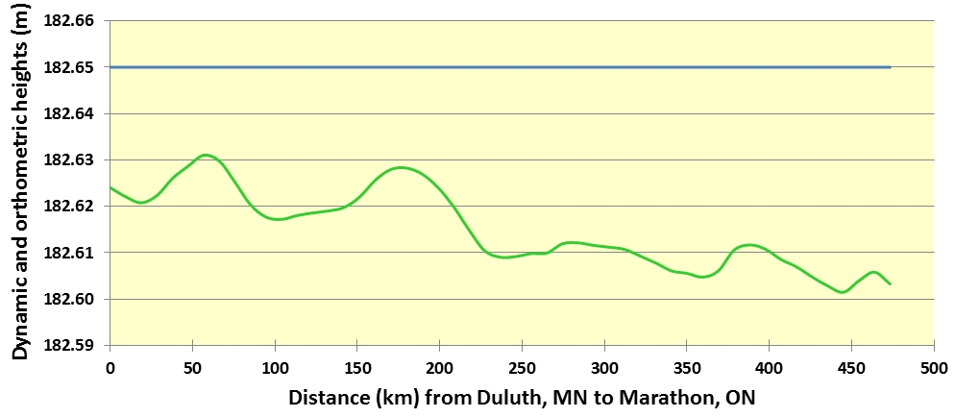
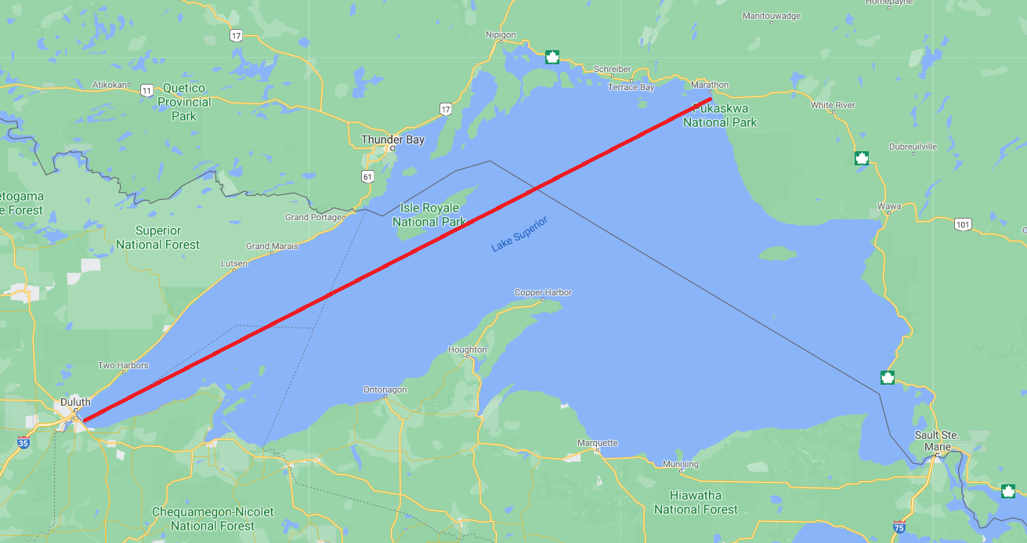
Dynamic vs. Orthometric Heights
South
Dynamic Height
North
  Orthometric Height

Slide 12
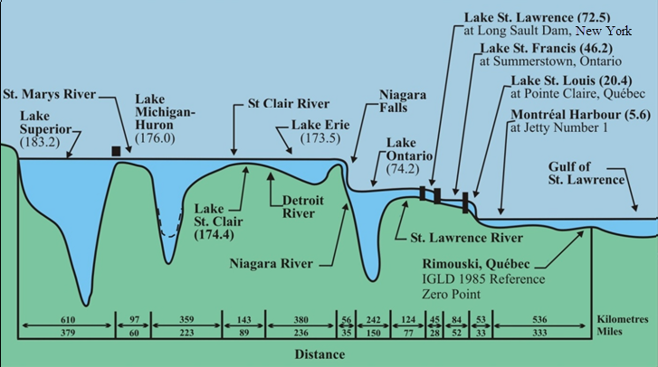
Low Water Datum
LWD or chart datum identifies a surface so low that the water level will seldom fall below it
Different LWD surfaces are used for different lakes & rivers
Depths on navigation charts & for navigation improvements refer to LWD

Slide 13
Low Water Datum
LWD originally determined in 1933 and has not been reviewed since
The same LWD surface has been referenced to the different IGLD datums through a translation of the old LWD surface
Can reference the same LWD to IGLD (2020) but…
Re-evaluation of LWD is recommended due to
  Historically high and low water levels since 1933
  Changes to hydraulic and hydrologic conditions

Slide 14
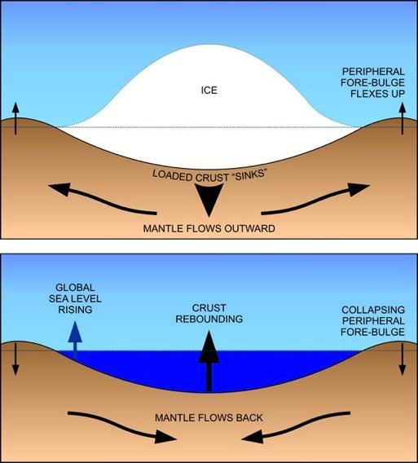
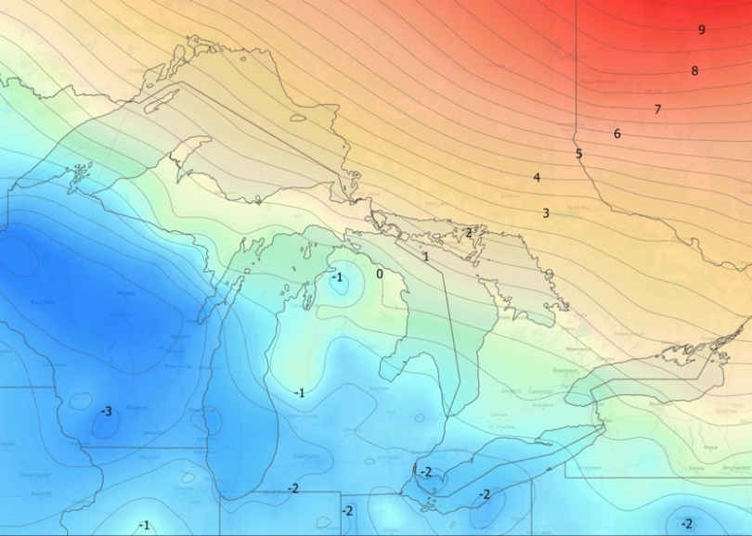
Why a new IGLD?
Glacial Isostatic Adjustment – (GIA)
Uplifting in north
Subsiding in south
Overall tilting ~7 mm/year (21cm or 0.7’ over 30 year)
Need to update IGLD every 25-30 years
Contour map of vertical velocities in mm/yr
Process of glacial isostatic adjustment
Notes:
Updating water levels to a new IGLD will have significant impacts on many operations, products and services in the Great Lakes region; e.g.,
Economic viability and safety of commercial and recreational navigation, including charts, ports/harbors and dredging of navigation channels
Water level regulation and forecasting
Coastal zone management and planning, including flood & erosion prediction and response, and coastal structure design, construction & maintenance
Coastal habitat restoration under the Great Lakes Restoration Initiative (GLRI)

Slide 15
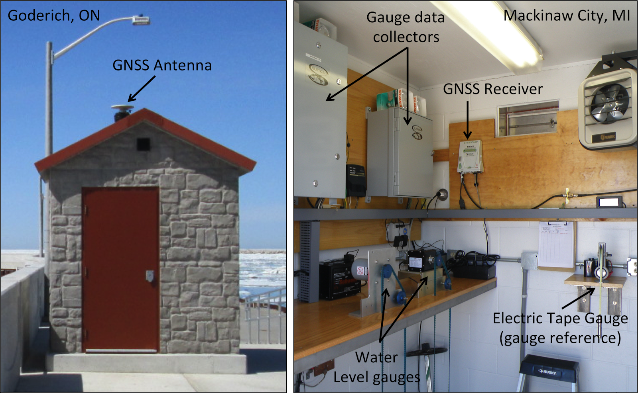
Typical CORS/CACS
Notes:
Permanent GNSS stations (CORS & CACS) installed at many key water level stations
[CORS - Continuously Operating Reference Stations Network]
[CACS – Canadian Active Control System]
Most Connected to same structure as the gauge reference
Enables
Accurate determination of absolute height of gauge reference and water level
No bench mark network needed if GNSS antenna reference point accurately tied to gauge reference – cost savings
Determination of crustal motion at water level stations for velocity model
Accurate velocity model allows datum to be used for longer period of time by accounting for crustal motion
Existing CORS & CACS need to be maintained & further expansion is recommended

Slide 16
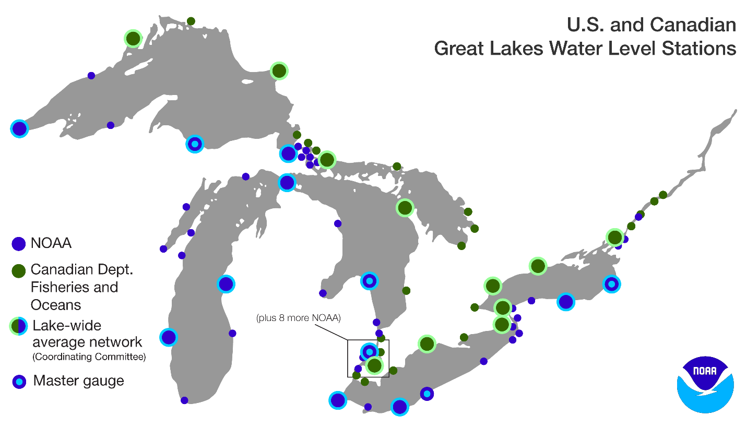

Slide 17
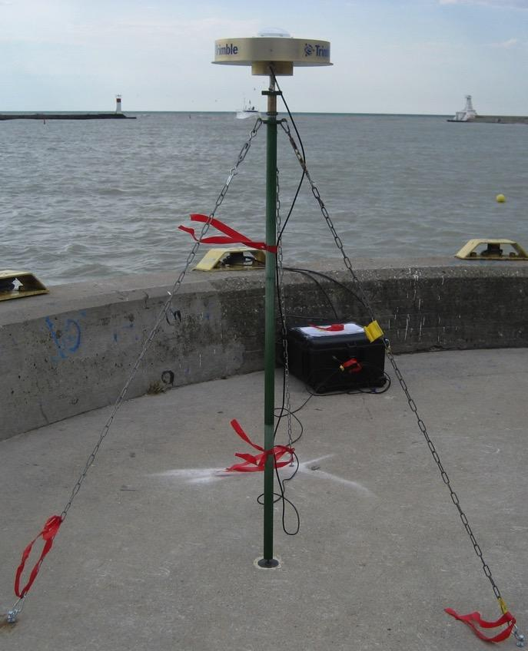
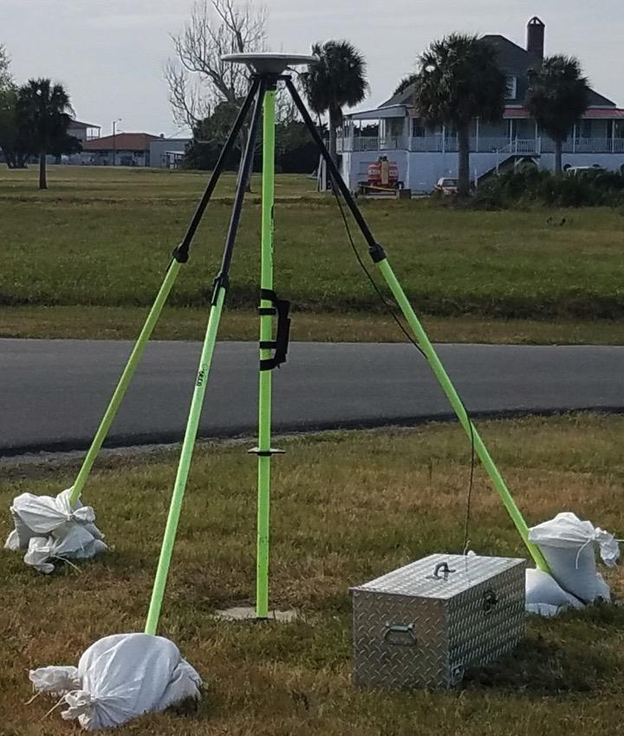
Typical GNSS Setups
Notes:
CORS and CACS stations have been installed at only about a dozen permanent water level gauges in both Canada and the U.S. To determine GIA movements at all of the other permanent water level gauges, specially designed, high-accuracy GPS campaign-style surveys have been performed in 1997, 2005, 2010, and 2015. A new GNSS survey, originally planned for 2020 to coincide with the middle epoch of the new IGLD, has been postponed until 2022 due to COVID-19-related travel restrictions. Comparing repeated, high-accuracy, GNSS-derived ellipsoid heights can provide further estimates of crustal movement (velocities) at the reference bench marks.

Slide 18
Status
GNSS field campaign originally scheduled for 2020 is now postponed until 2022.
Seasonal gauging continues.
Hydraulic corrector working group set up to investigate the need for HCs in IGLD (2020).
IGLD (2020) is planned for release after NAPGD2022 is released.

Slide 19
Thank you
Jacob M. Heck, Ph.D.
jacob.heck@noaa.gov
Great Lakes Regional Geodetic Advisor
National Geodetic Survey
National Oceanic and Atmospheric Administration
http://www.greatlakescc.org

