Slide 1




Journey to the Moving Center of the Earth
The Evolution of the National Spatial Reference System
RISPLS/RIGIS Forum
July 21, 2015
Dan Martin
Northeast Regional Geodetic Advisor
Dan.martin@noaa.gov
240-676-4762

Slide 2
U.S. Department of Commerce
National Oceanic & Atmospheric Administration
National Geodetic Survey
Mission: To define, maintain & provide access to the
National Spatial Reference System (NSRS)
to meet our Nation’s economic, social & environmental needs
National Spatial Reference System
& their time variations
      Latitude
      Longitude
      Height
  Scale
  Gravity
  Orientation
Notes:
- NSRS benefit to the nation = $2.5B/year
est. 300K precision GPS users worldwide (2008); ¼ in US
- Very exciting to us at NGS to see how it has evolved over the years – now cm-accuracy capability / tracking with time

Slide 3






The National Spatial Reference System supports
Nautical charts, among many other geospatial applications
National Oceanic and Atmospheric Administration
Emergency Response Imagery,
Flood zones for the National Flood Insurance Program
Federal Emergency Management Agency
Levee Safety Program to determine levee heights & positions
United States Army Corps of Engineers
Topographic Maps and interior water data for the nation
United States Geological Survey
NSRS gravity data for the geospatial mission of NGA
National Geospatial-Intelligence Agency
Aeronautical Data Quality Assurance
Federal Aviation Administration

Slide 4
GEODETIC DATUMS
  HORIZONTAL
  2 D (Latitude and Longitude) (e.g. NAD 27, NAD 83 (1986))
  VERTICAL
  1 D (Orthometric Height) (e.g. NGVD 29, NAVD 88, Local Tidal)
  GEOMETRIC
  3 D (Latitude, Longitude and Ellipsoid Height)
  Fixed and Stable - Coordinates seldom change
  (e.g. NAD 83 (1996), NAD 83 (2007), NAD 83 (CORS96) NAD 83 (2011))
  also
  4 D (Latitude, Longitude, Ellipsoid Height, Velocities) Coordinates change with time
  (e.g. ITRF00, ITRF08)

Slide 5
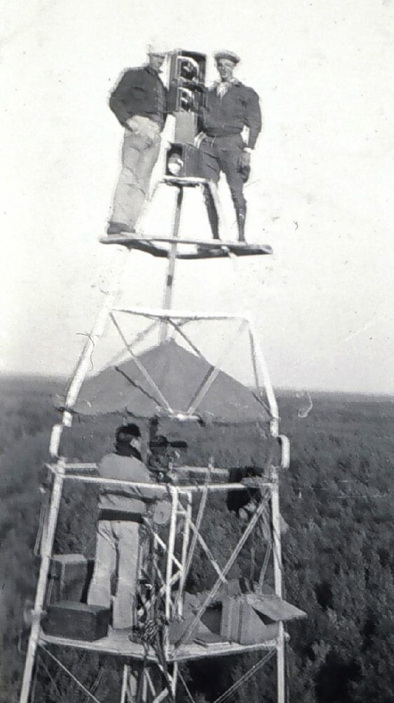
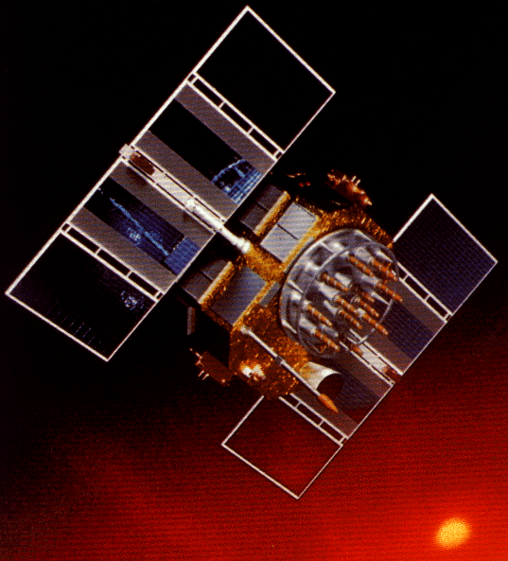
A (very) brief history of NAD 83
Original realization completed in 1986
  Consisted (almost) entirely of classical (optical) observations
“High Precision Geodetic Network” (HPGN) and “High Accuracy Reference Network” (HARN) realizations
  Most done in 1990s, essentially state-by-state
  Based on GNSS but classical stations included in adjustments
National Re-Adjustment of 2007
  NAD 83(CORS96) and (NSRS2007)
  Simultaneous nationwide adjustment (GNSS only)
New realization: NAD 83(2011) epoch 2010.00

Slide 6
What is a Datum?
"A set of constants specifying the coordinate system used for geodetic control, i.e., for calculating the coordinates of points on the Earth."
"The datum, as defined above, together with the coordinate system and the set of all points and lines whose coordinates, lengths, and directions have been determined by measurement or calculation."
NGS has used the first definition for NAD83

Slide 7
Why change datums/Realizations
NAD27 based on old observations and old system
NAD83(86) based on old observations and new system
NAD83(95) based on new and old observations and same system (HARN)
NAD83(NSRS2007) based on new observations and same system. Removed regional distortions and made consistent with CORS
NAD83(2011) based on new observations and same system. Kept consistent with CORS

Slide 8
Horizontal Datums/Coordinates…What do we (you) use in RI?
NAD 83 (Lat-Lon) SPC
  Which one???
    NAD 83 (1986)
    NAD 83 (1992)
    NAD 83 (1996)
    NAD 83 CORS96(2002)
    NAD 83 (NSRS2007)
    NAD 83 (2011)
NAD 27
WGS 84
  Which one???
    WGS 84 (1987)
    WGS 84 (G730)
    WGS 84 (G873)
    WGS 84 (G1150)
    WGS 84 (G1674)
ITRF00 (epoch 97)
IGS08 (epoch 2005)

Slide 9
COORDINATE CHANGES
ADJUSTMENT YEARS LOCAL NETWORK
ACCURACY ACCURACY
NAD 27 1927 – 1986 1:100,000 10 m
NAD 83 (1986) 1986 – 1990 1:100,000 1 m
NAD 83 (1992) (HARN) 1990 – 1997 1:10,000,000 0.1 m
CORS 1994 -------- 0.01/0.02 m 0.02/0.04 m
NAD 83 (1996) (FBN/CBN) 1997 – 2007 0.05/0.05 m 0.05/0.05 m
NAD 83 (NSRS 2007) 2007 - 2012 0.01/0.02 m 0.02/0.04 m
NAD 83 (2011) epoch 2010.0 2012 - ------- 0.009/0.015m

Slide 10
NEW STANDARDS FOR GEODETIC CONTROL (FGDC)
TWO ACCURACY STANDARDS
local accuracy ------------- adjacent points
network accuracy ---------- relative to CORS
Numeric quantities, units in cm (or mm)
Both are relative accuracy measures
Do not use distance dependent expression
Horizontal accuracies are radius of 2-D 95% error circle
Ellipsoidal/Orthometric heights are 1-D (linear) 95% error

Slide 11
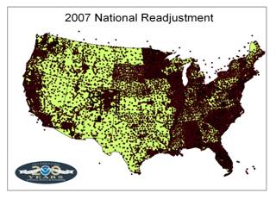

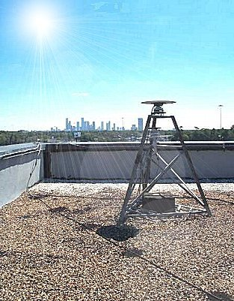
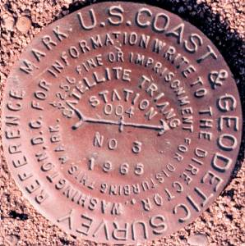
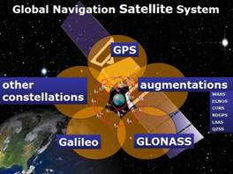
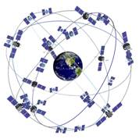
The NSRS has evolved
1 Million Monuments
(Separate Horizontal and Vertical Systems)
70,000
Passive Marks
(3-Dimensional)
→
Passive Marks
(Limited Knowledge of Stability)
≈ 2,000 GPS CORS
(Time Dependent System Possible;
4-Dimensional)
→
GPS CORS → GNSS CORS

Slide 12
ITRF2008, IGS08
And NAD 83(2011)

Slide 13
ITRF2008
For the geodesy, geophysics and surveying communities, the best International Terrestrial Reference Frame is the “gold standard.”
The global community recently adopted an updated expression for the reference frame, the ITRF2008.
13

Slide 14
International Earth Rotation and
Reference System Service
(IERS)
(http://www.iers.org)
The International Terrestrial Reference System (ITRS) constitutes a set of prescriptions and conventions together with the modeling required to define origin, scale, orientation and time evolution
ITRS is realized by the International Terrestrial Reference Frame (ITRF) based upon estimated coordinates and velocities of a set of stations observed by Very Long Baseline Interferometry (VLBI), Satellite Laser Ranging ( SLR), Global Positioning System and GLONASS (GNSS), and Doppler Orbitography and Radio- positioning Integrated by Satellite ( DORIS).
ITRF89, ITRF90, ITRF91, ITRF92, ITRF93, ITRF94, ITRF95, ITRF96, ITRF97, ITRF2000, ITRF2005, ITRF2008

Slide 15
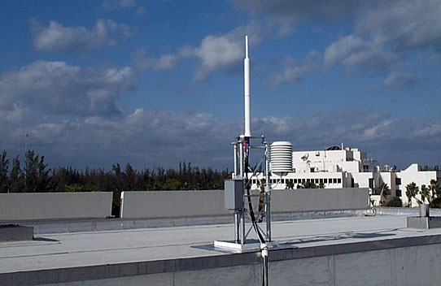
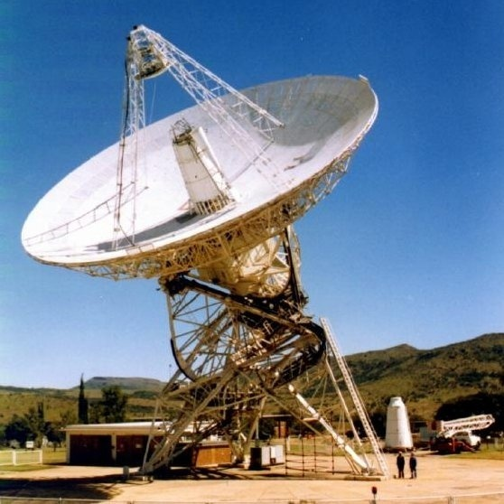
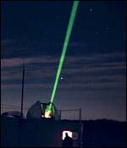
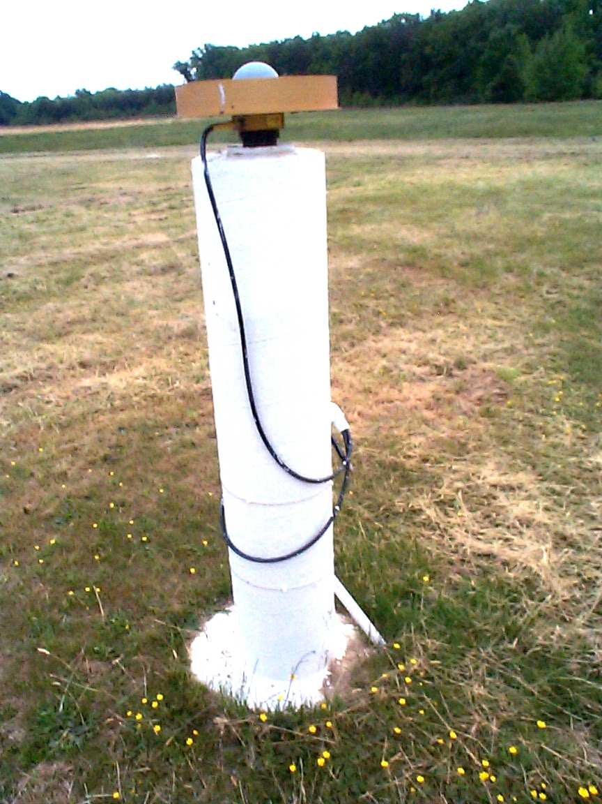
International Terrestrial Reference Frame
4 Global Independent Positioning Technologies
International Global Navigation Satellite Systems Service (IGS)
International Laser Ranging Service (ILRS)
International Very Long Baseline Service (IVS)
International DORIS Service (IDS)

Slide 16
Simplified Concept of NAD 83 vs. ITRF08
h₈₃
h₀₈
Earth’s
Surface
ITRF 08
Origin
2.2 meters
NAD 83
Identically shaped ellipsoids (GRS-80)
a = 6,378,137.000 meters (semi-major axis)
1/f = 298.25722210088 (flattening)
Origin
Notes:
ITRF (International Terrestrial Reference Frame) just has an origin; take NAD83 shaped ellipsoid centered at the ITRF origin to derive ITRF97 ellipsoid heights.
Ellipsoid heights NAD83 vs. ITRF97 - Defined origins are best estimate of the center of mass; NAD83 is not geocentric. Move origin; move ellipsoid surface as illustrated.
Ellipsoid height differences reflect the non-geocentricity of NAD83.

Slide 17
Densification
The ITRF2008 is expressed through the coordinates and velocities of marks on the ground plus ancillary data.
Other organizations can take that information, add additional marks, perform their own adjustment and align their results to the ITRF2008 (A.K.A. densifying).
The variants try to be as consistent with the ITRF2008 as possible, but in the most formal sense, they are unique from the ITRF2008. Therefore, they are given unique names.
17

Slide 18
The IGS08
The IGS has densified reference frame with much larger, global subset of GNSS tracking sites thereby creating a GNSS-only expression of the ITRF2008 called the IGS08. All IGS products have been recreated so as to be consistent with the IGS08 including GNSS ephemerides and antenna models. Information about the IGS08 can be found at the IGS web sites: igscb.jpl.nasa.gov. I would suggest starting with IGSMAIL‐6354, ‐6355 and ‐6356, all dated 2011‐03‐07.
18
Notes:
Many of the sites contributing to the IGS08 also contributed to the ITRF2008, but because other space geodesy techniques contributed to the ITRF2008 and because the IGS08 contains sites not included in the ITRF2008, it should not be called the ITRF2008.
Nonetheless, IGS08 has the same geocenter, orientation and scale as the ITRF2008.

Slide 19
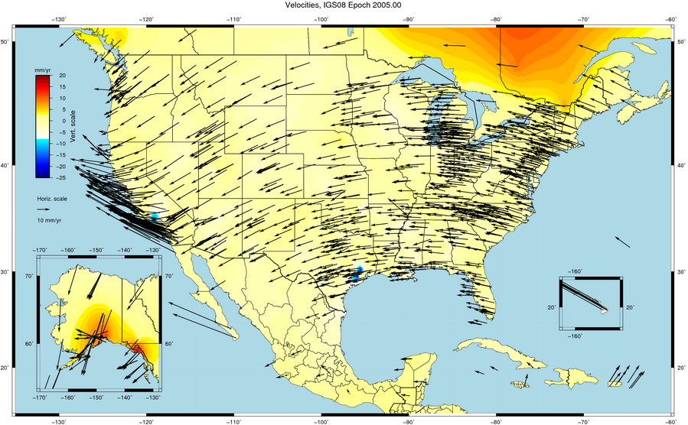

Slide 20
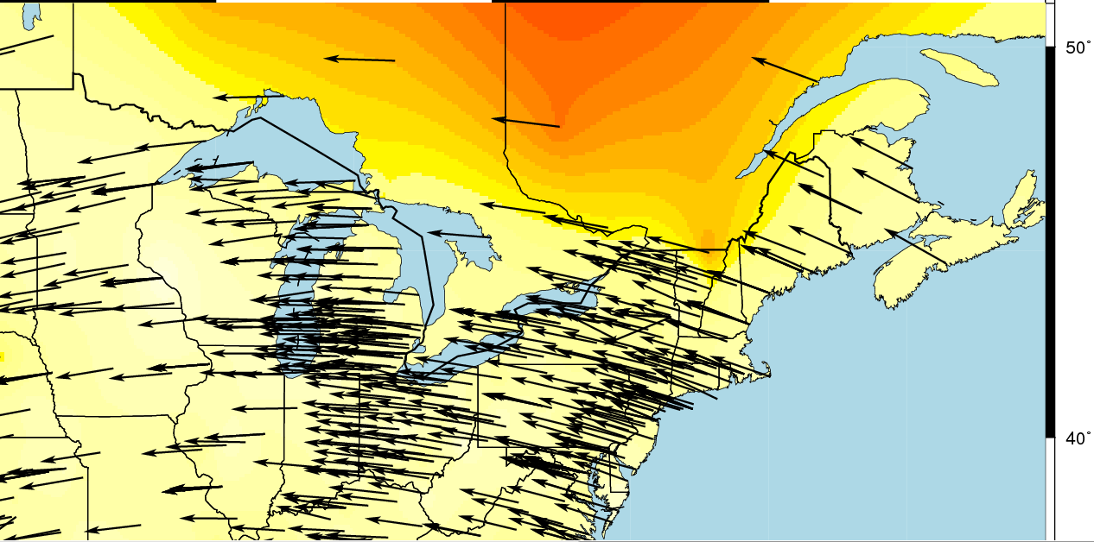
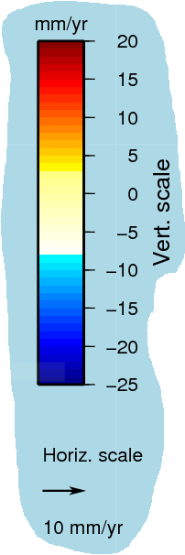

Slide 21
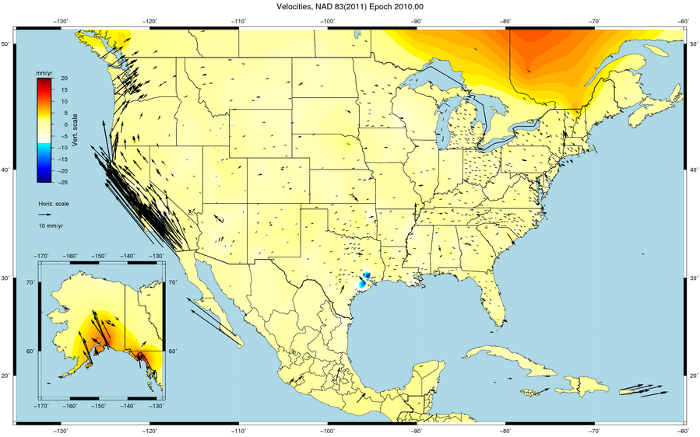

Slide 22
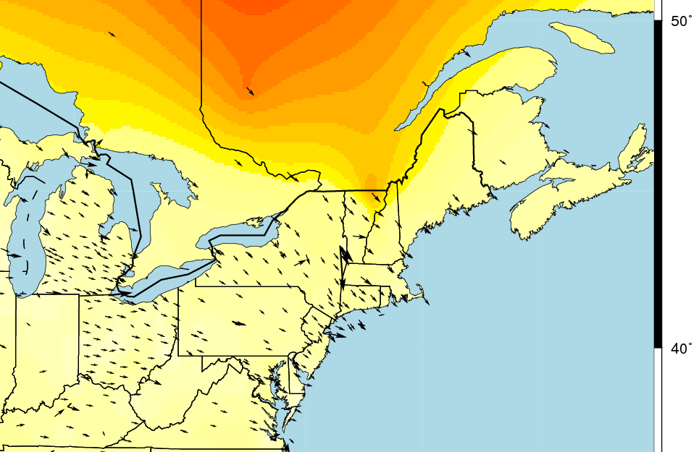
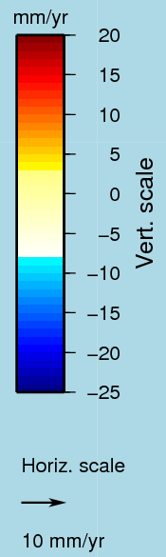

Slide 23
Multi-Year CORS Solution (MYCS)
NGS used its contribution to the IGS08 plus the additional CORS to produce improved IGS08 coordinates and velocities for the CORS network. From this, improved CORS coordinates and velocities in the NAD 83 frame were defined.
To distinguish this from earlier realizations, this reference frame is called the NAD 83 (2011). This is not a new datum: the origin, scale and orientation are the same as in the previous realization.
In September 2011, NGS formally released IGS08 and NAD 83 (2011) coordinates and velocities for the CORS. Information about the IGS08 and NAD 83 (2011) can be found at geodesy.noaa.gov/CORS/coords.shtml.
23

Slide 24
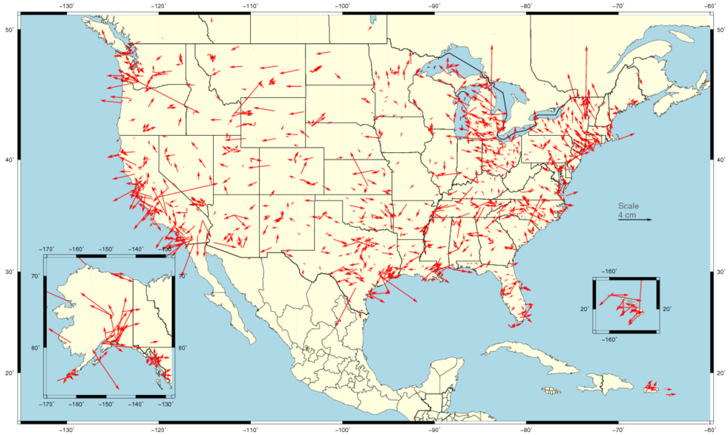
Horizontal Differences In CORS Positions
Horizontal difference in positions of NAD 83(2011) epoch 2002.00 minus NAD 83(CORS96) epoch 2002.00.
24

Slide 25
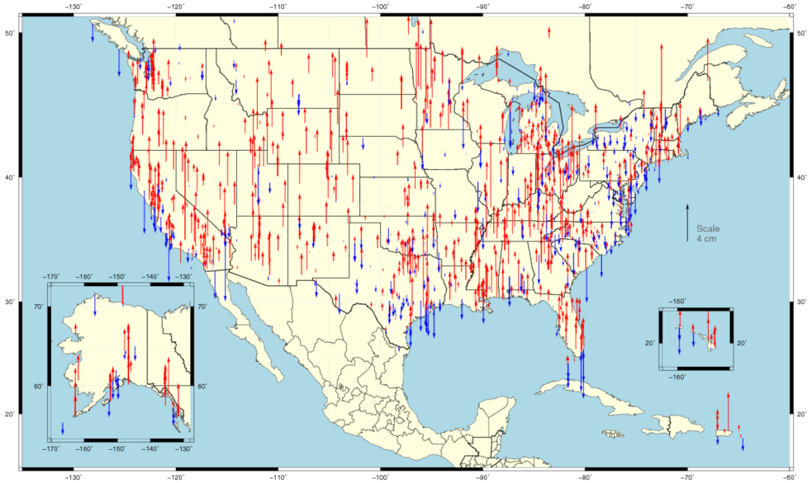
Vertical Differences In CORS Positions
Vertical difference in positions of NAD 83(2011) epoch 2002.00 minus NAD 83(CORS96) epoch 2002.00.
25

Slide 26
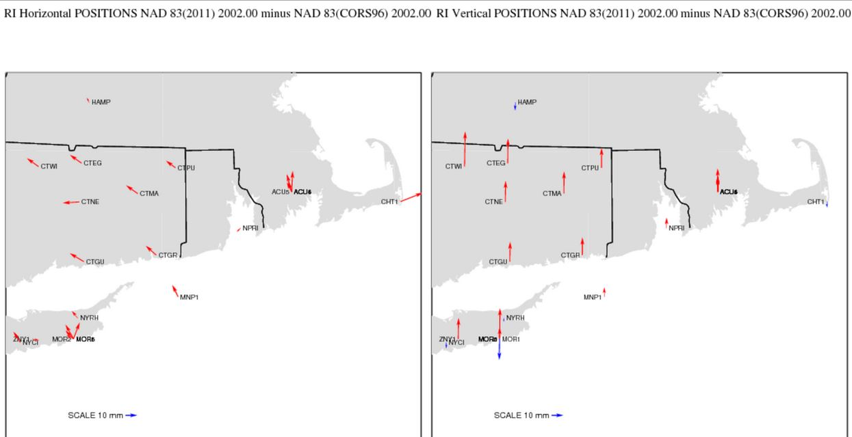

Slide 27
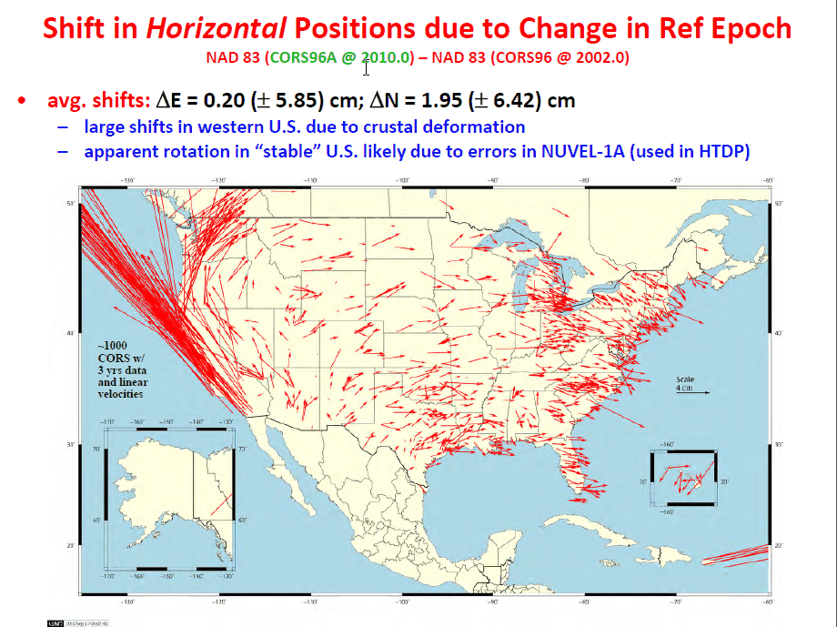
Change in horizontal NAD 83 CORS coordinates
NAD 83(CORS96) epoch 2002.00 → NAD 83(2011) epoch 2010.00
Avg shifts (cm): ΔN = 2.0 (±6.4); ΔE = 0.2 (±5.9); ΔU = -0.9 (±2.0)

Slide 28
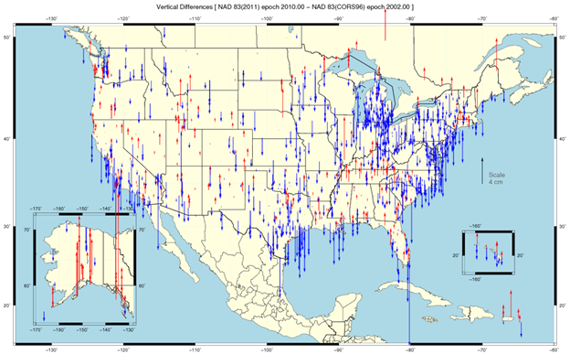

Slide 29
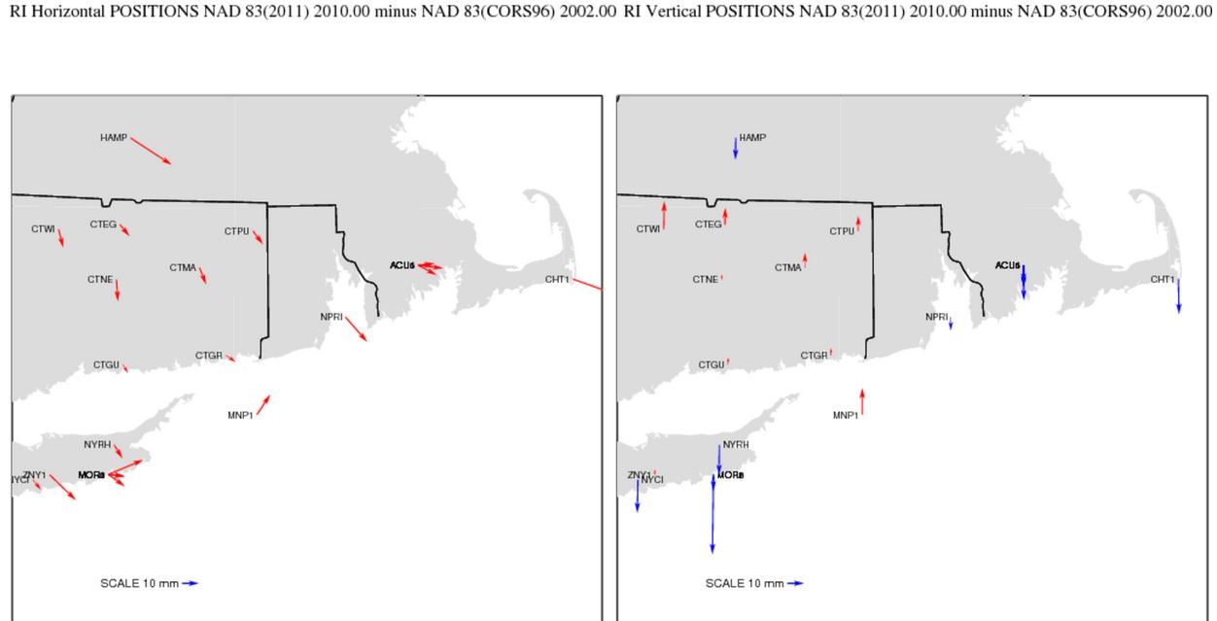

Slide 30
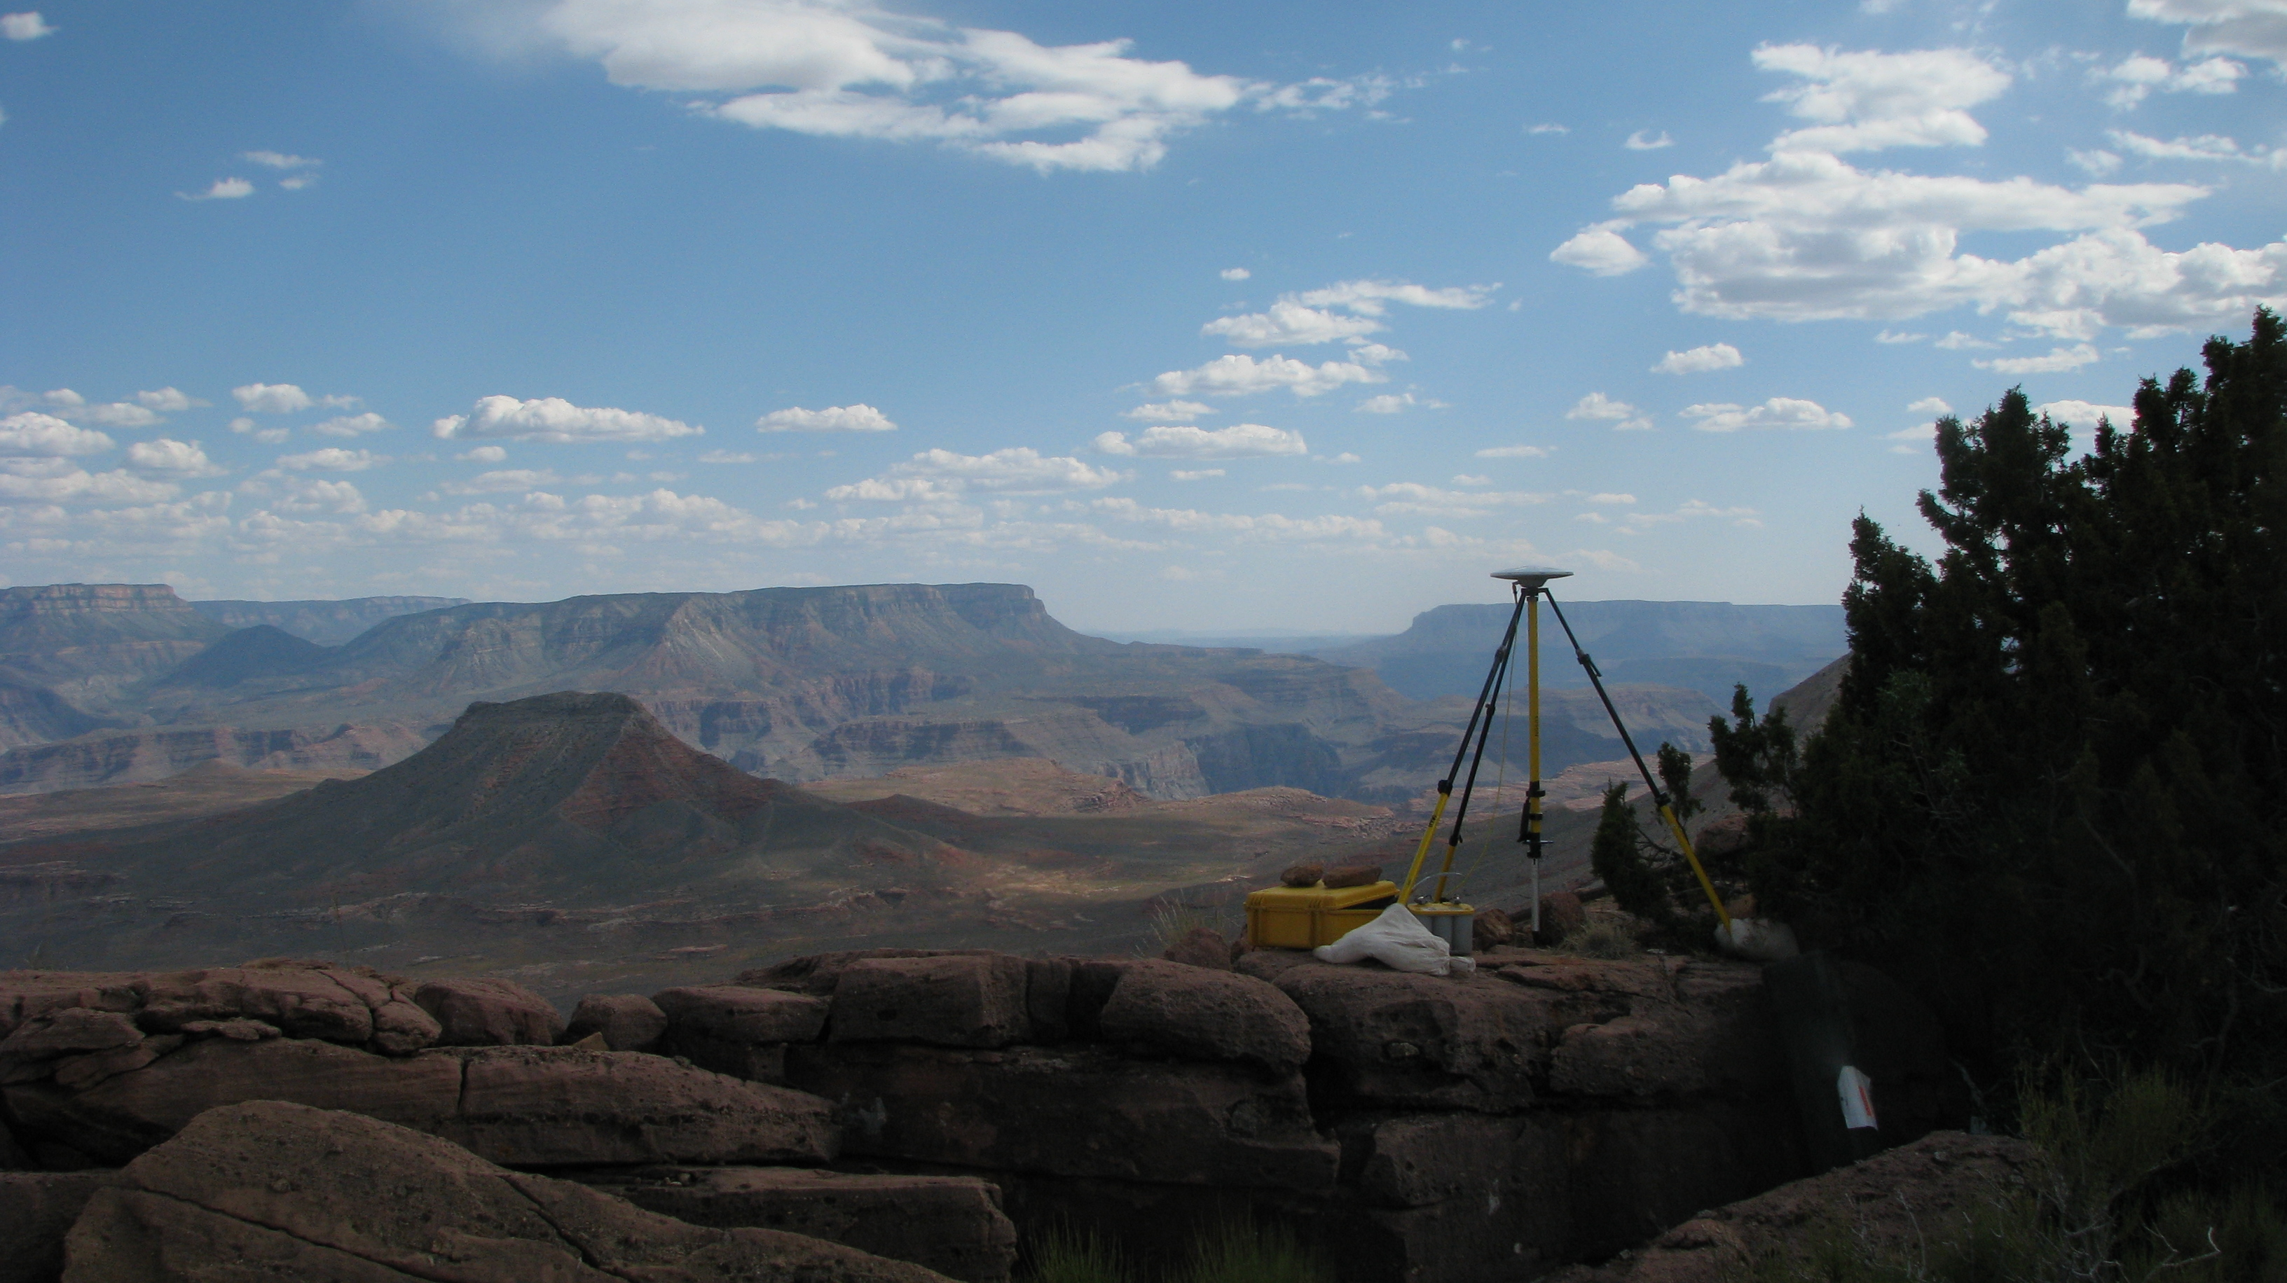
Update and Refinement of the North American Datum of 1983
NAD 83(2011/PA11/MA11) epoch 2010.00
The 2011 national adjustment of passive control and its impact on NGS products and services
National Geodetic Survey
Height Modernization Program monthly meeting
October 11, 2012 ● Silver Spring, MD
Michael Dennis, RLS, PE
michael.dennis@noaa.gov

Slide 31
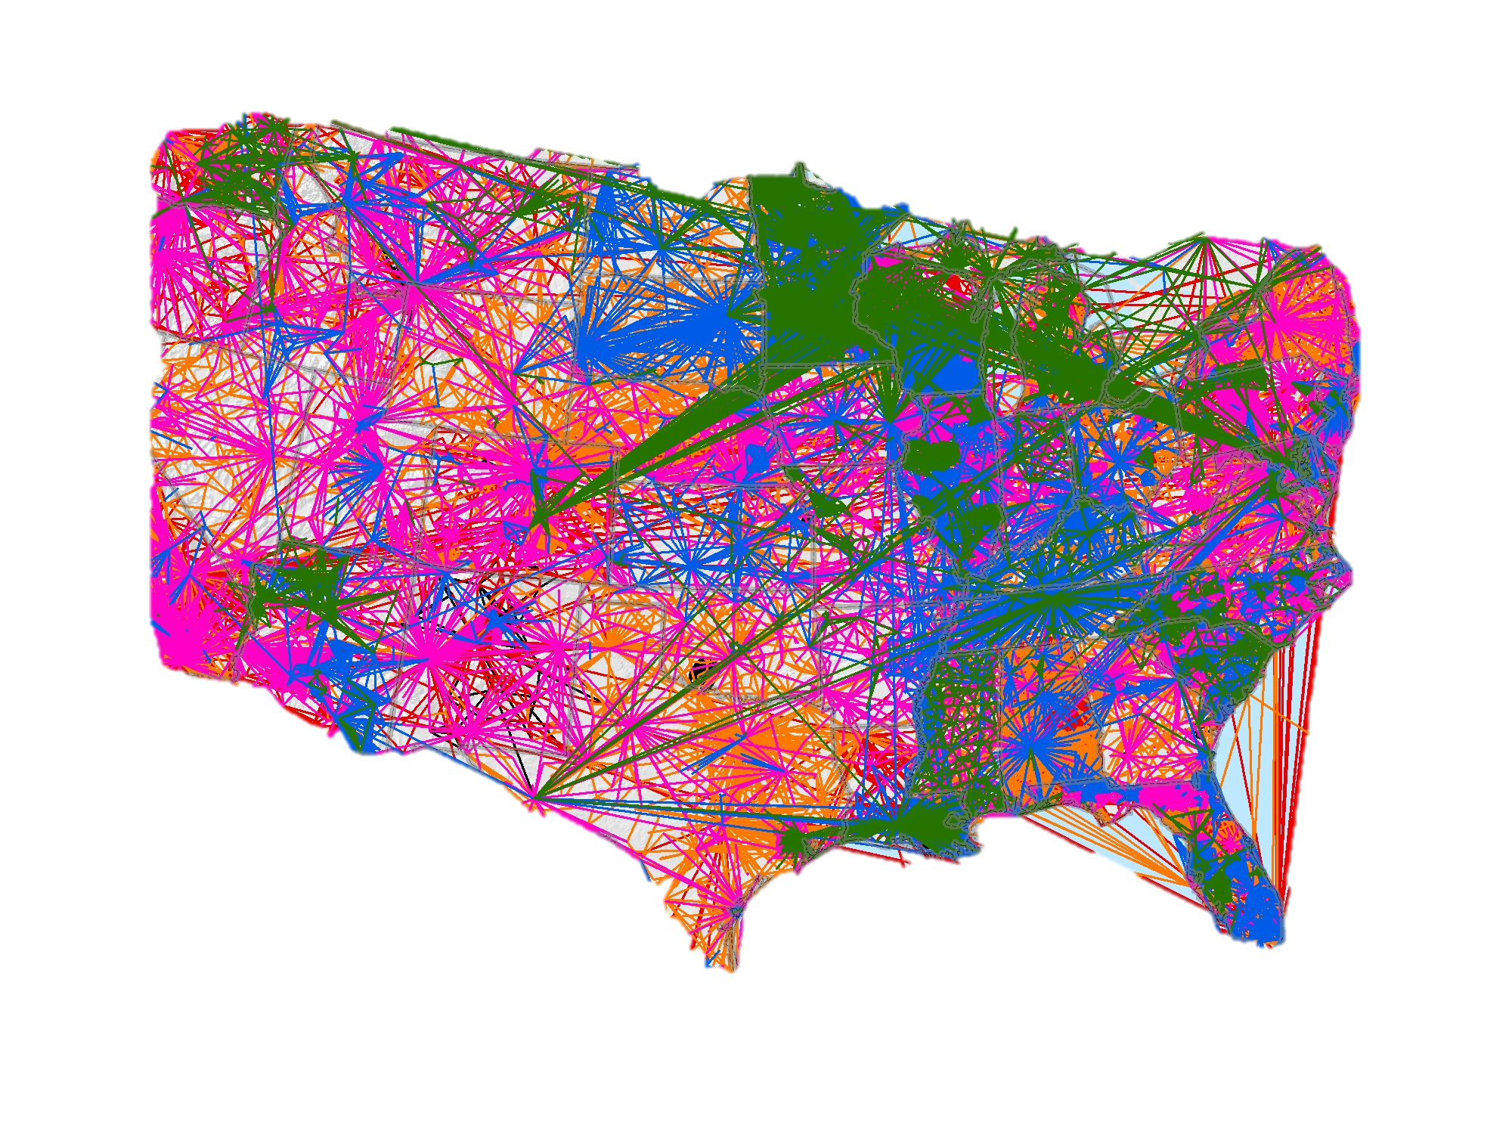
NAD 83 (2011) And
Passive Control Marks
In addition, approximately 80,000 passive control marks were readjusted to provide the best possible consistency with the improved CORS coordinates and velocities.
Known as the National Adjustment of 2011 (NA2011), these results were released in June 2012 and are now available through the datasheets.
For more information, visit
geodesy.noaa.gov/web/news/NA2011_Project.shtml
geodesy.noaa.gov/web/surveys/NA2011/NA2011_FAQ.shtml
Notes:
As mentioned earlier, the NGS used its contribution to the IGS08 plus the CORS to produce improved IGS08 coordinates and velocities for the CORS network. From this, improved CORS coordinates and velocities in the NAD 83 frame were defined at epoch 2010.0. To distinguish this from earlier realizations, it is called the NAD 83 (2011).
This is not a new datum: the origin, scale and orientation are the same as in the previous realization of the NAD 83.
In September 2011, NGS formally released IGS08 and NAD 83 (2011) coordinates and velocities for the CORS. Information about the IGS08 and NAD 83 (2011) can be found at http://geodesy.noaa.gov/CORS/coords.shtml.

Slide 32

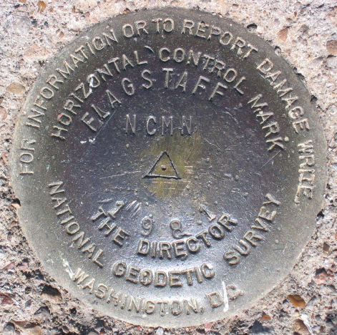
Introducing…
NAD 83(2011) epoch 2010.00
Multi-Year CORS Solution (MYCS)
  Continuously Operating Reference Stations
  Reprocessed all CORS GPS data Jan 1994-Apr 2011
  2264 CORS & global stations
  NAD 83 computed by transformation from IGS08
2011 national adjustment of passive control
  New adjustment of GNSS passive control
  GNSS vectors tied (and constrained) to
  CORS NAD 83(2011) epoch 2010.00
  Over 80,000 stations and
  400,000 GNSS vectors
Realization SAME for CORS
and passive marks
This is NOT a new datum! (still NAD 83)

Slide 33
Why a new NAD 83 realization?
Multi-Year CORS Solution
  Previous NAD 83 CORS realization needed many improvements
  Consistent coordinates and velocities from global solution
  Aligned with most recent realization of global frame (IGS 08)
  Major processing, modeling, and metadata improvements
    Including new absolute phase center antenna calibrations
National adjustment of passive control
  Optimally align passive control with “active” CORS control
    Because CORS provide the geometric foundation of the NSRS
  Incorporate new data, compute accuracies on all stations
  Better results in tectonically active areas
Bottom line
  Must meet needs of users for highly accurate and consistent coordinates (and velocities) using Best Available Methods

Slide 34
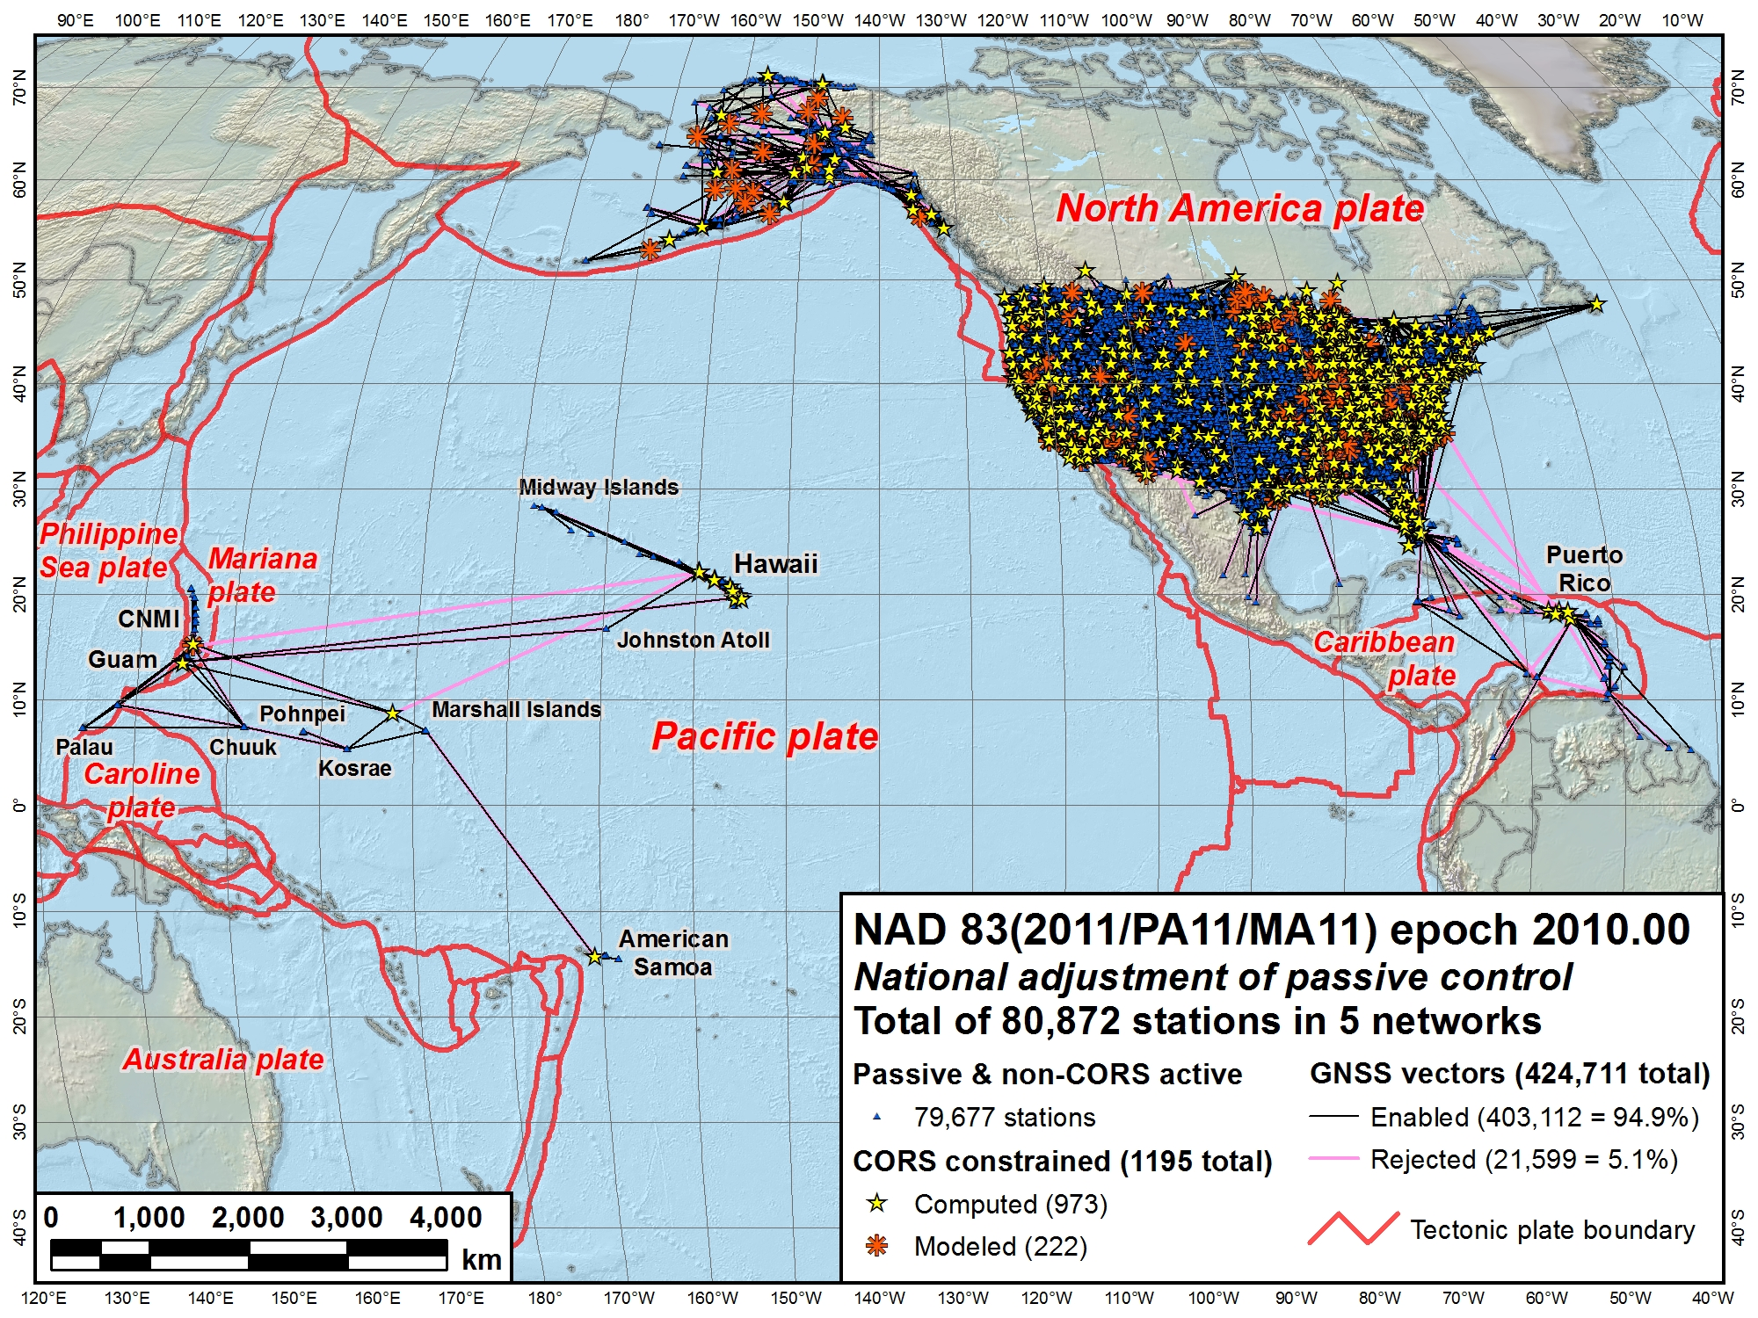
CONUS Secondary
Alaska
Pacific
(MA11)
CONUS Primary
Pacific (PA11)

Slide 35
NAD 83(2011/PA11/MA11) epoch 2010.00
Passive control results summary
Station network accuracies (95% confidence)
  Overall median: 0.9 cm horiz, 1.5 cm height (78,709)
    90% < 2.3 cm horizontal and 4.8 cm ellipsoid height
    Does NOT include 2163 no-check stations
  Median accuracies by network
    CONUS Primary: 0.7 cm horiz, 1.2 cm height (61,049)
    CONUS Secondary: 1.6 cm horiz, 3.4 cm height (16,441)
    Alaska: 3.2 cm horiz, 5.7 cm height (814)
    Pacific (PA11): 2.2 cm horiz, 5.0 cm height (282)
    Pacific (MA11): 1.8 cm horiz, 3.8 cm height (123)

Slide 36
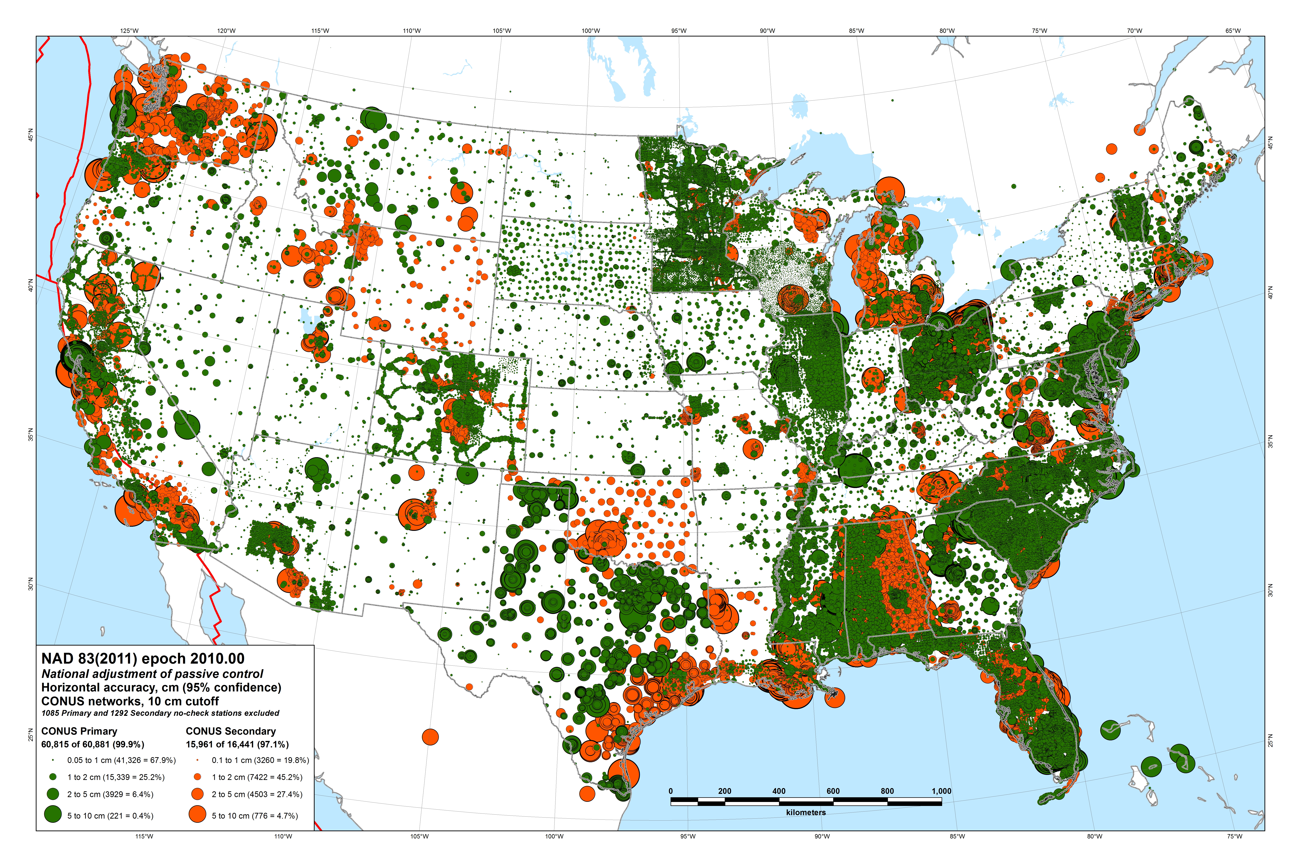

Slide 37
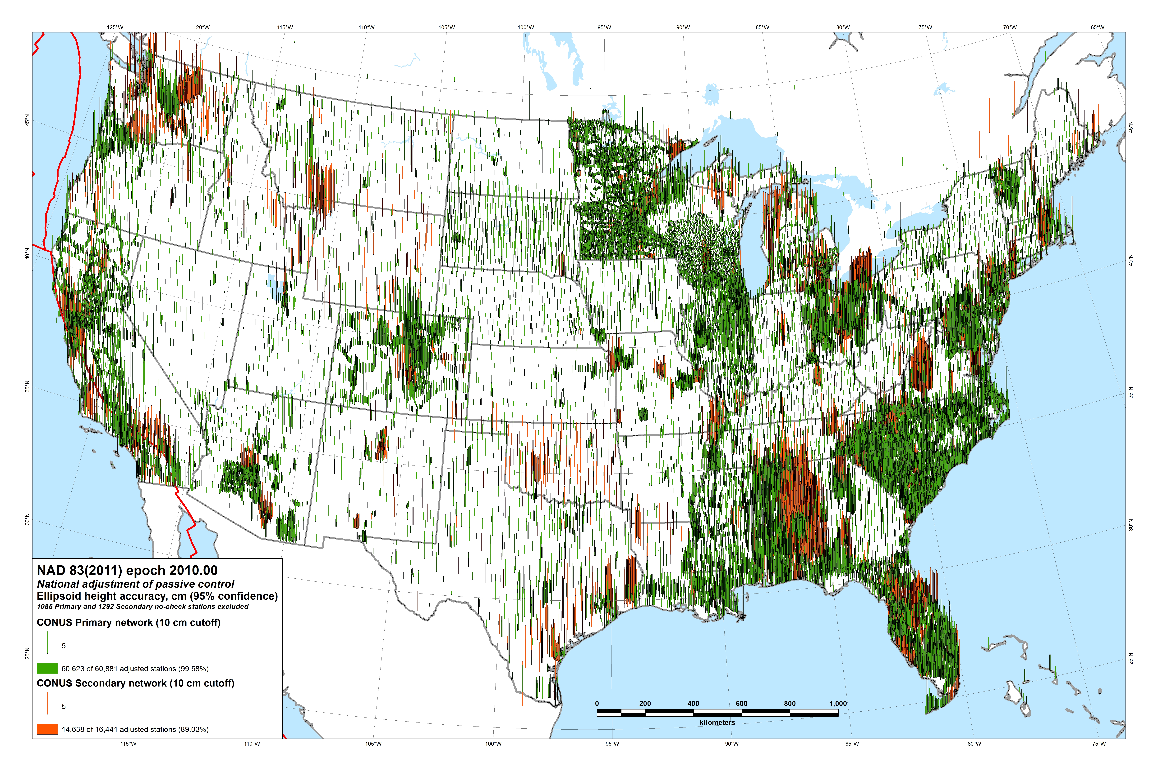

Slide 38
NAD 83(2011/PA11/MA11) epoch 2010.00
Passive control results summary
Station coordinate and height changes
  Overall median: 1.9 cm horiz, 2.1 cm height
    97% changed < 5 cm horizontally and vertically
  Median accuracies by network
    CONUS: 1.9 cm horiz, 2.1 cm height
    Alaska: 6.3 cm horiz, 2.8 cm height
    Pacific (PA11): 2.1 cm horiz, 2.3 cm height
    Pacific (MA11): 2.5 cm horiz, 6.8 cm height

Slide 39
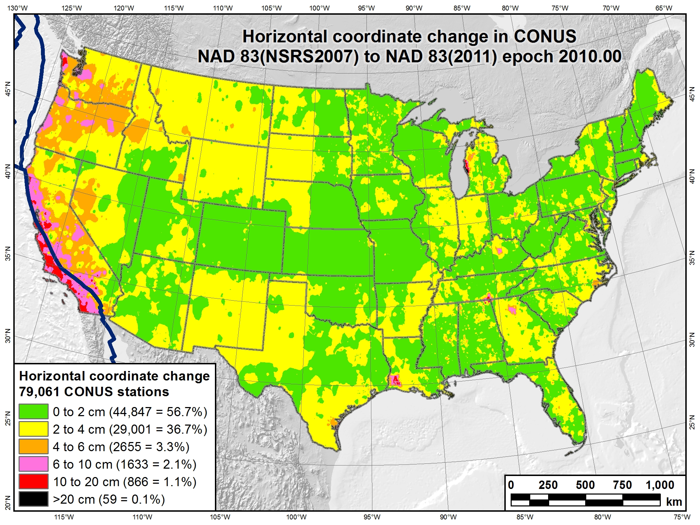

Slide 40
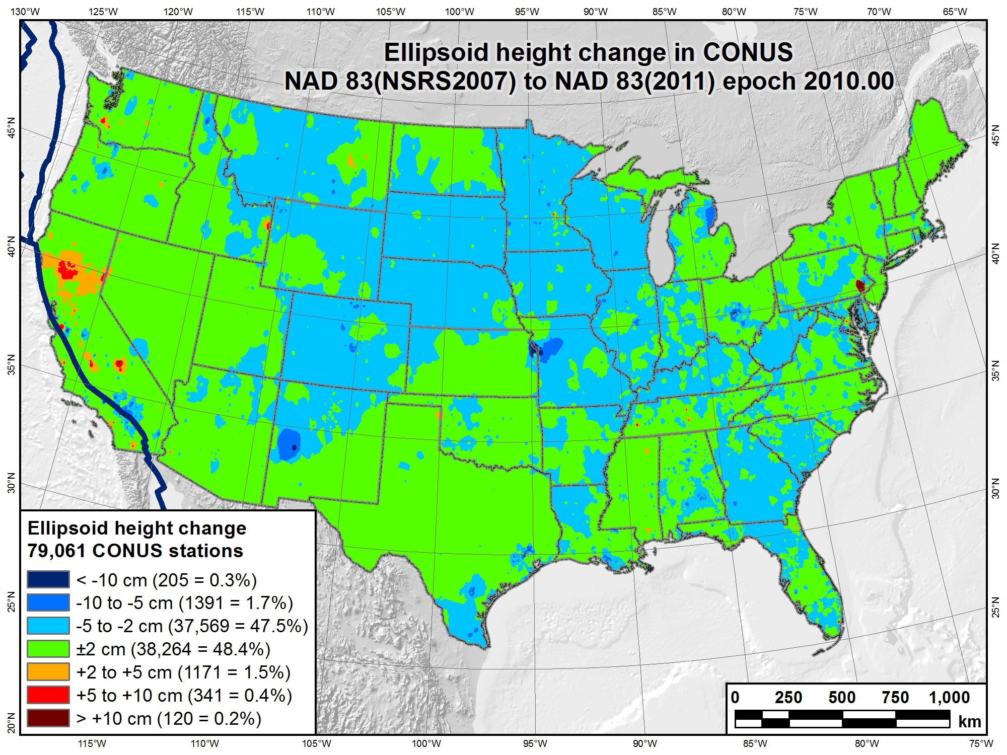

Slide 41
Related Tasks, Products & Deliverables
OPUS (Online Positioning User Service)
  Solutions for NAD 83(2011/PA11/MA11) epoch 2010.00
New hybrid geoid model (GEOID12A)
  NAD 83(2011) ellipsoid heights on leveled NAVD 88 BMs
New process for Bluebooking GPS projects
  Currently under development
  New version of “ADJUST” program
  Includes new GIS tools as part of adjustment process
New NAD 83 coordinate transformation tools
  HARN ←→ NSRS2007 ←→ 2011
  GEOCON GEOCON11
  Both horizontal AND “vertical” (i.e., ellipsoid height)
  Include output that indicates “quality” of transformation
    Quantified using station within grid cell that is worst match with model

Slide 42
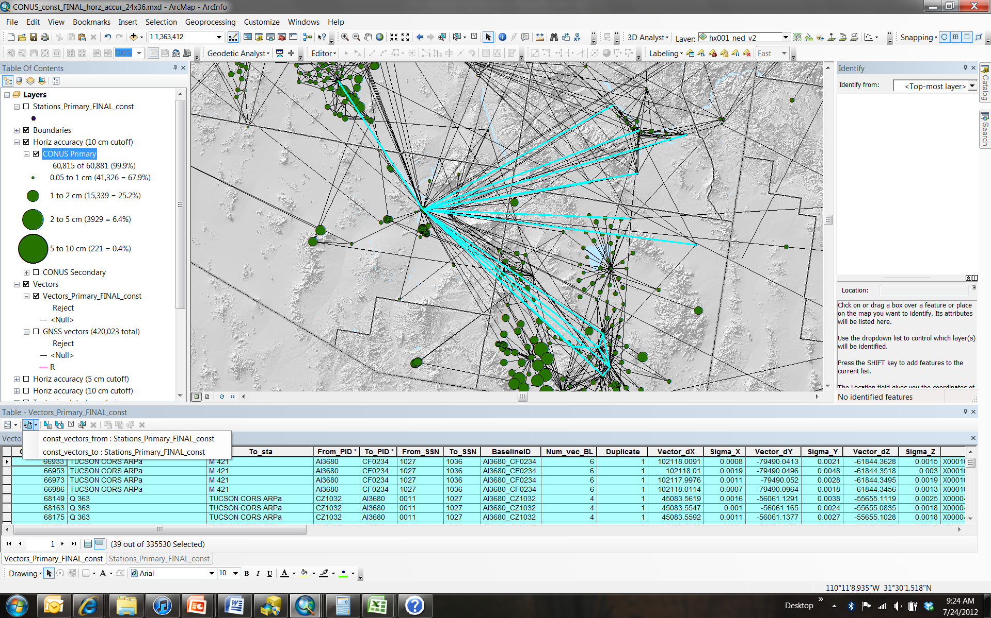
Network adjustment results as GIS features provide powerful analysis capabilities…

Slide 43
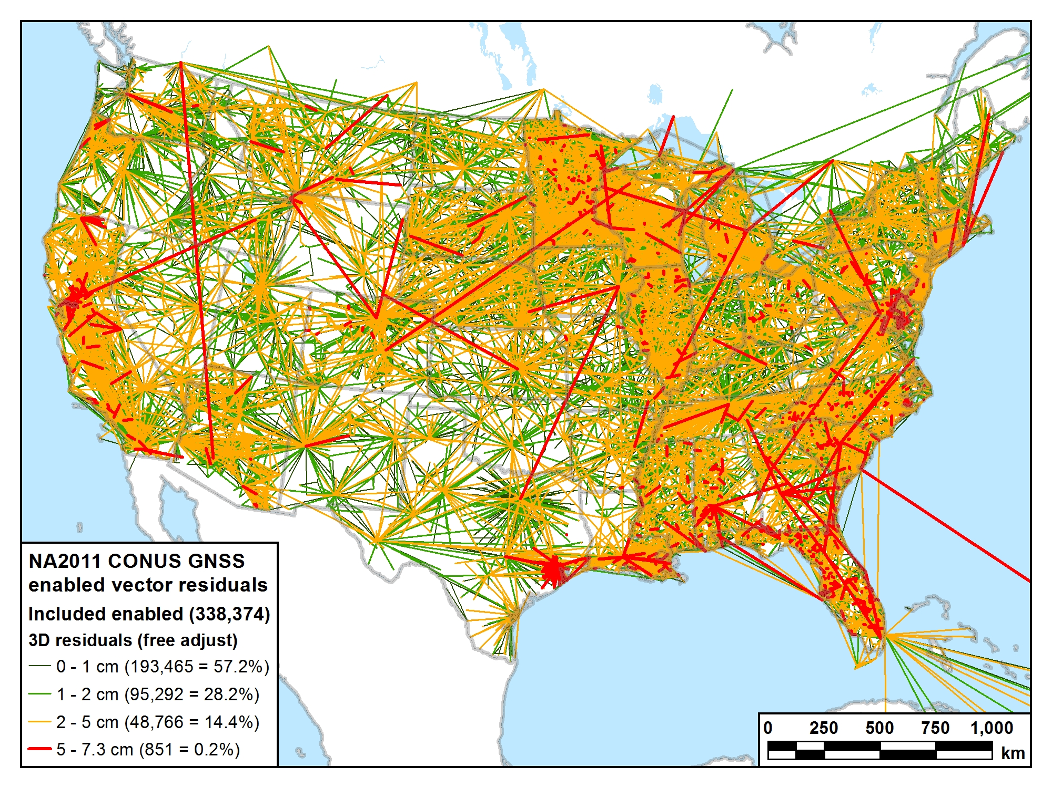
Residuals statistics (cm)
Max = 7.3 Mean = 1.1
Std dev = 0.9 Med = 0.9

Slide 44
Recap: The fundamental questions
When was it done?
  Publication completed on June 30, 2012
    Intent: Simultaneous with release of GEOID12A
How many control stations? 80,872
How much did the coordinates change?
  Median: 1.9 cm horiz, 2.1 cm vertical
How accurate are the results?
  Median: 0.9 cm horiz, 1.5 cm vertical
  (at 95% confidence level)
How do I make use of the results?
  Key is metadata: Know and identify what you have
  Be consistent (i.e., don’t mix realizations)
  Understand your software (e.g., relationship to “WGS 84”)
    Latest WGS 84 is G1674 (week of Feb 5, 2012), epoch 2005.00

Slide 45

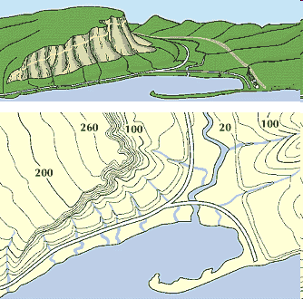
What is a Vertical Datum?
Strictly speaking, a vertical datum is a surface representing zero elevation
Traditionally, a vertical datum is a system for the determination of heights above a zero elevation surface
Vertical datum comprised of:
  Its definition: Parameters and other descriptors
  Its realization: Its physical method of accessibility
"topographic map." Online Art.
Britannica Student Encyclopædia.
17 Dec. 2008
<http://student.britannica.com/ebi/art-53199>

Slide 46
History of vertical datums in the USA
Pre-National Geodetic Vertical Datum of 1929 (NGVD 29)
  The first geodetic leveling project in the United States was surveyed by the Coast Survey from 1856 to 1857.
  Transcontinental leveling commenced from Hagerstown, MD in 1877.
  General Adjustments of leveling data yielded datums in 1900, 1903, 1907, and 1912. (Sometimes referenced as the Sandy Hook Datum)
  NGS does not offer a utility which transforms from these older datums into newer ones (though some users still work in them!)
Notes:
According to Dave Doyle, the USACE still maintains data relative to the 1912 4th General Adjustment!

Slide 47
History of vertical datums in the USA
NGVD 29
  National Geodetic Vertical Datum of 1929
  Original name: “Sea Level Datum of 1929”
  “Zero height” held fixed at 26 tide gauges
    Not all on the same tidal datum epoch (~ 19 yrs)
  Did not account for Local Mean Sea Level variations from the geoid
    Thus, not truly a “geoid based” datum

Slide 48
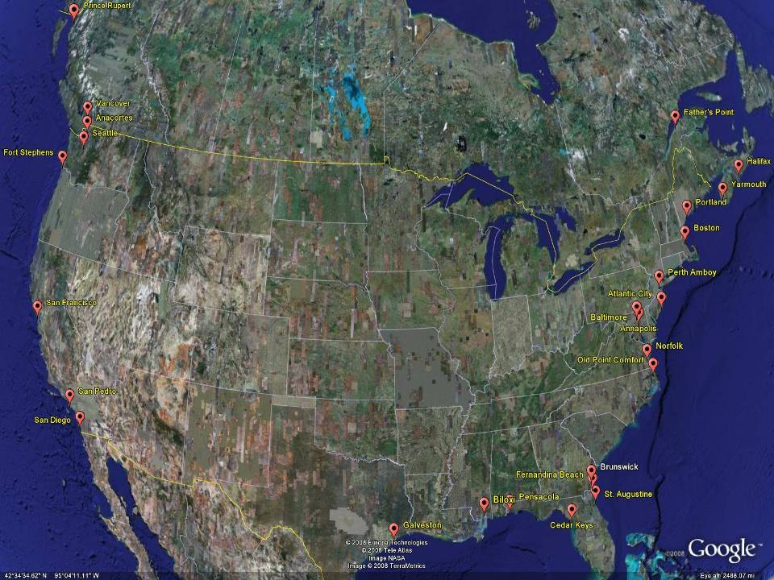
NGVD29
The National Geodetic Vertical Datum of 1929 is referenced to 26 tide gauges in the US and Canada
Notes:
It turns out that MSL is a close approximation to another surface, defined by gravity, called the geoid, which is the true zero surface for measuring elevations. Because we cannot directly see the geoid surface, we cannot actually measure the heights above or below the geoid surface. We must infer where this surface is by making gravity measurements and by modeling it mathematically. For practical purposes, we assume that at the coastline the geoid and the MSL surfaces are essentially the same. Nevertheless, as we move inland we measure heights relative to the zero height at the coast, which in effect means relative to MSL.
Definition: NGVD29 – The National Geodetic Vertical Datum of 1929…
The Sea Level Datum of 1929 was the vertical control datum established for vertical control surveying in the United States of America by the General Adjustment of 1929. The datum was used to measure elevation or altitude above, and depression or depth below, mean sea level (MSL).
Mean sea level was measured at 26 tide gauges: 21 in the United States and 5 in Canada. The datum was defined by the observed heights of mean sea level at the 26 tide gauges and by the set of elevations of all bench marks resulting from the adjustment. The adjustment required a total of 66,315 miles (106,724 km) of leveling with 246 closed circuits and 25 circuits at sea level.
Since the Sea Level Datum of 1929 was a hybrid model, it was not a pure model of mean sea level, the geoid, or any other equipotential surface. Therefore, it was renamed the National Geodetic Vertical Datum of 1929 (NGVD 29) in 1973. The NGVD 29 was subsequently replaced by the North American Vertical Datum of 1988 (NAVD 88) based upon the General Adjustment of the North American Datum of 1988.

Slide 49
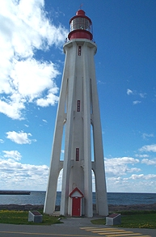
Current Vertical Datum in the USA
NAVD 88: North American Vertical Datum of 1988
Definition: The surface of equal gravity potential to which orthometric heights shall refer in North America*, and which is 6.271 meters (along the plumb line) below the geodetic mark at “Father Point/Rimouski” (NGSIDB PID TY5255).
Realization: Over 500,000 geodetic marks across North America with published Helmert orthometric heights, most of which were originally computed from a minimally constrained adjustment of leveling and gravity data, holding the geopotential value at “Father Point/Rimouski” fixed.
Father Point Lighthouse, Quebec
*Not adopted in Canada
Notes:
By fixing the geopotential value at the origin point, it was possible to ensure that the origins of IGLD 85 and NAVD 88 aligned.
*It should be pointed out that while the datum was defined in such a way as to be usable on the North American continent, it was never actually adopted in Canada. It can be used there, but it’s not their official civilian datum.
Note that the designation of the vertical control point at Father Point is “1250 G=NAVD 88 DATUM POINT” for PID# TY5255 and is not available from the publicly accessible NGSIDB.

Slide 50
History of vertical datums in the USA
NAVD 88
  North American Vertical Datum of 1988
  One height held fixed at “Father Point” (Rimouski, Canada)
  …height chosen was to minimize 1929/1988 differences on USGS topo maps in the eastern U.S.
  Thus, the “zero height surface” of NAVD 88 wasn’t chosen for its closeness to the geoid (but it was close…few decimeters)

Slide 51
History of vertical datums in the USA
NAVD 88 (continued)
  Use of one fixed height removed local sea level variation problem of NGVD 29
  Use of one fixed height did open the possibility of unconstrained cross-continent error build up
  But the H=0 surface of NAVD 88 was supposed to be parallel to the geoid…(close again)

Slide 52
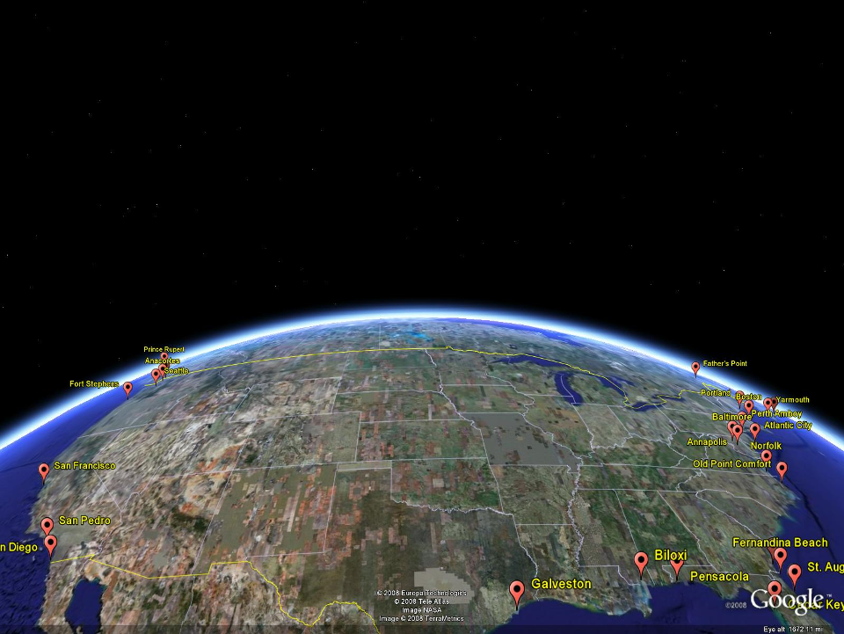
NAVD 88
Referenced to 1 Tide Gage
(Father’s Point)
NGVD 29
Referenced to 26 Tide Gages
-11 cm
125 cm
-23 cm
85 cm
102 cm
NAVD88 minus LMSL(1960-1978)
70 cm
-11 cm
4 cm
-23 cm
Notes:
NGVD29 consisted of the national vertical network referenced to 26 tide stations along the coast of North America
Click
That network was warped or twisted to fit those tide stations. The difference between the geoid (what we run levels on) and LMSL is not the same for every tide station due to prevailing winds, ocean current, etc. It is that difference that warped the network.
Click
NAVD88 utilized additional leveling data along with gravity measurements (to measure the geoid) and was referenced to only one tide station on the St. Lawrence Seaway. As you can see in the graphic, the network was unwarped which changes those reference mark’s elevations (differences between NAVD88 and the local mean sea level shown) This is not the difference between NAVD88 and NGVD29 but it is a representation of what happened.

Slide 53
Types Uses and History of Geoid Height Models
Gravimetric (or Gravity) Geoid Height Models
  Defined by gravity data crossing the geoid
  Refined by terrain models (DEM’s)
  Scientific and engineering applications
Composite (or Hybrid) Geoid Height Models
  Gravimetric geoid defines most regions
  Warped to fit available GPSBM control data
  Defined by legislated ellipsoid (NAD 83) and local vertical datum (NAVD 88, PRVD02, etc.)
  May be statutory for some surveying & mapping applications

Slide 54
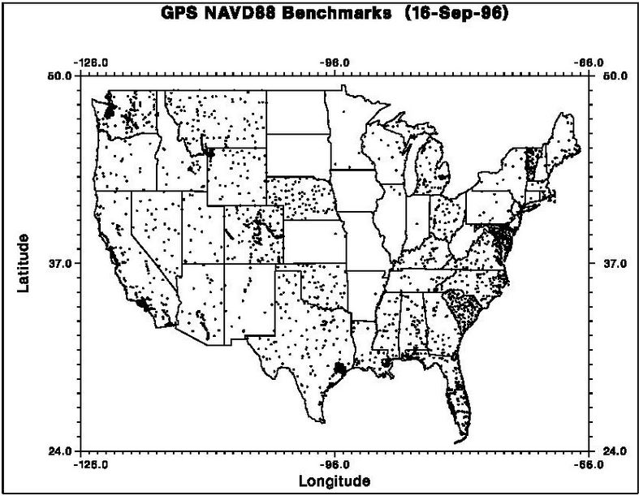
GPSBM1996: 2,951total 0 Canada STDEV ≈ 5 cm (2σ)

Slide 55

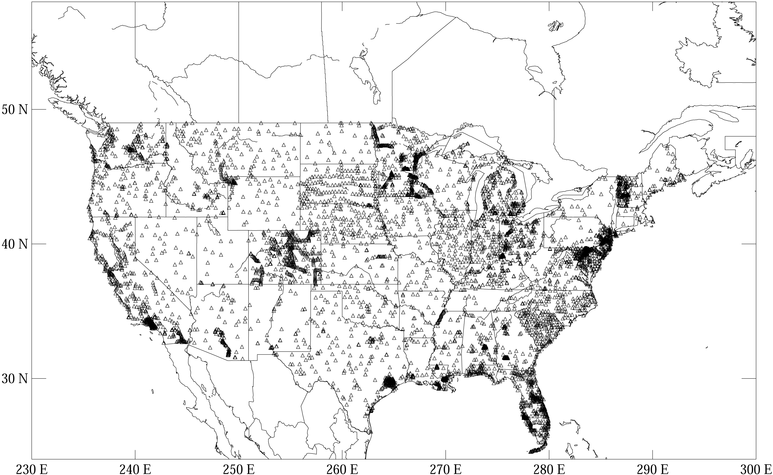
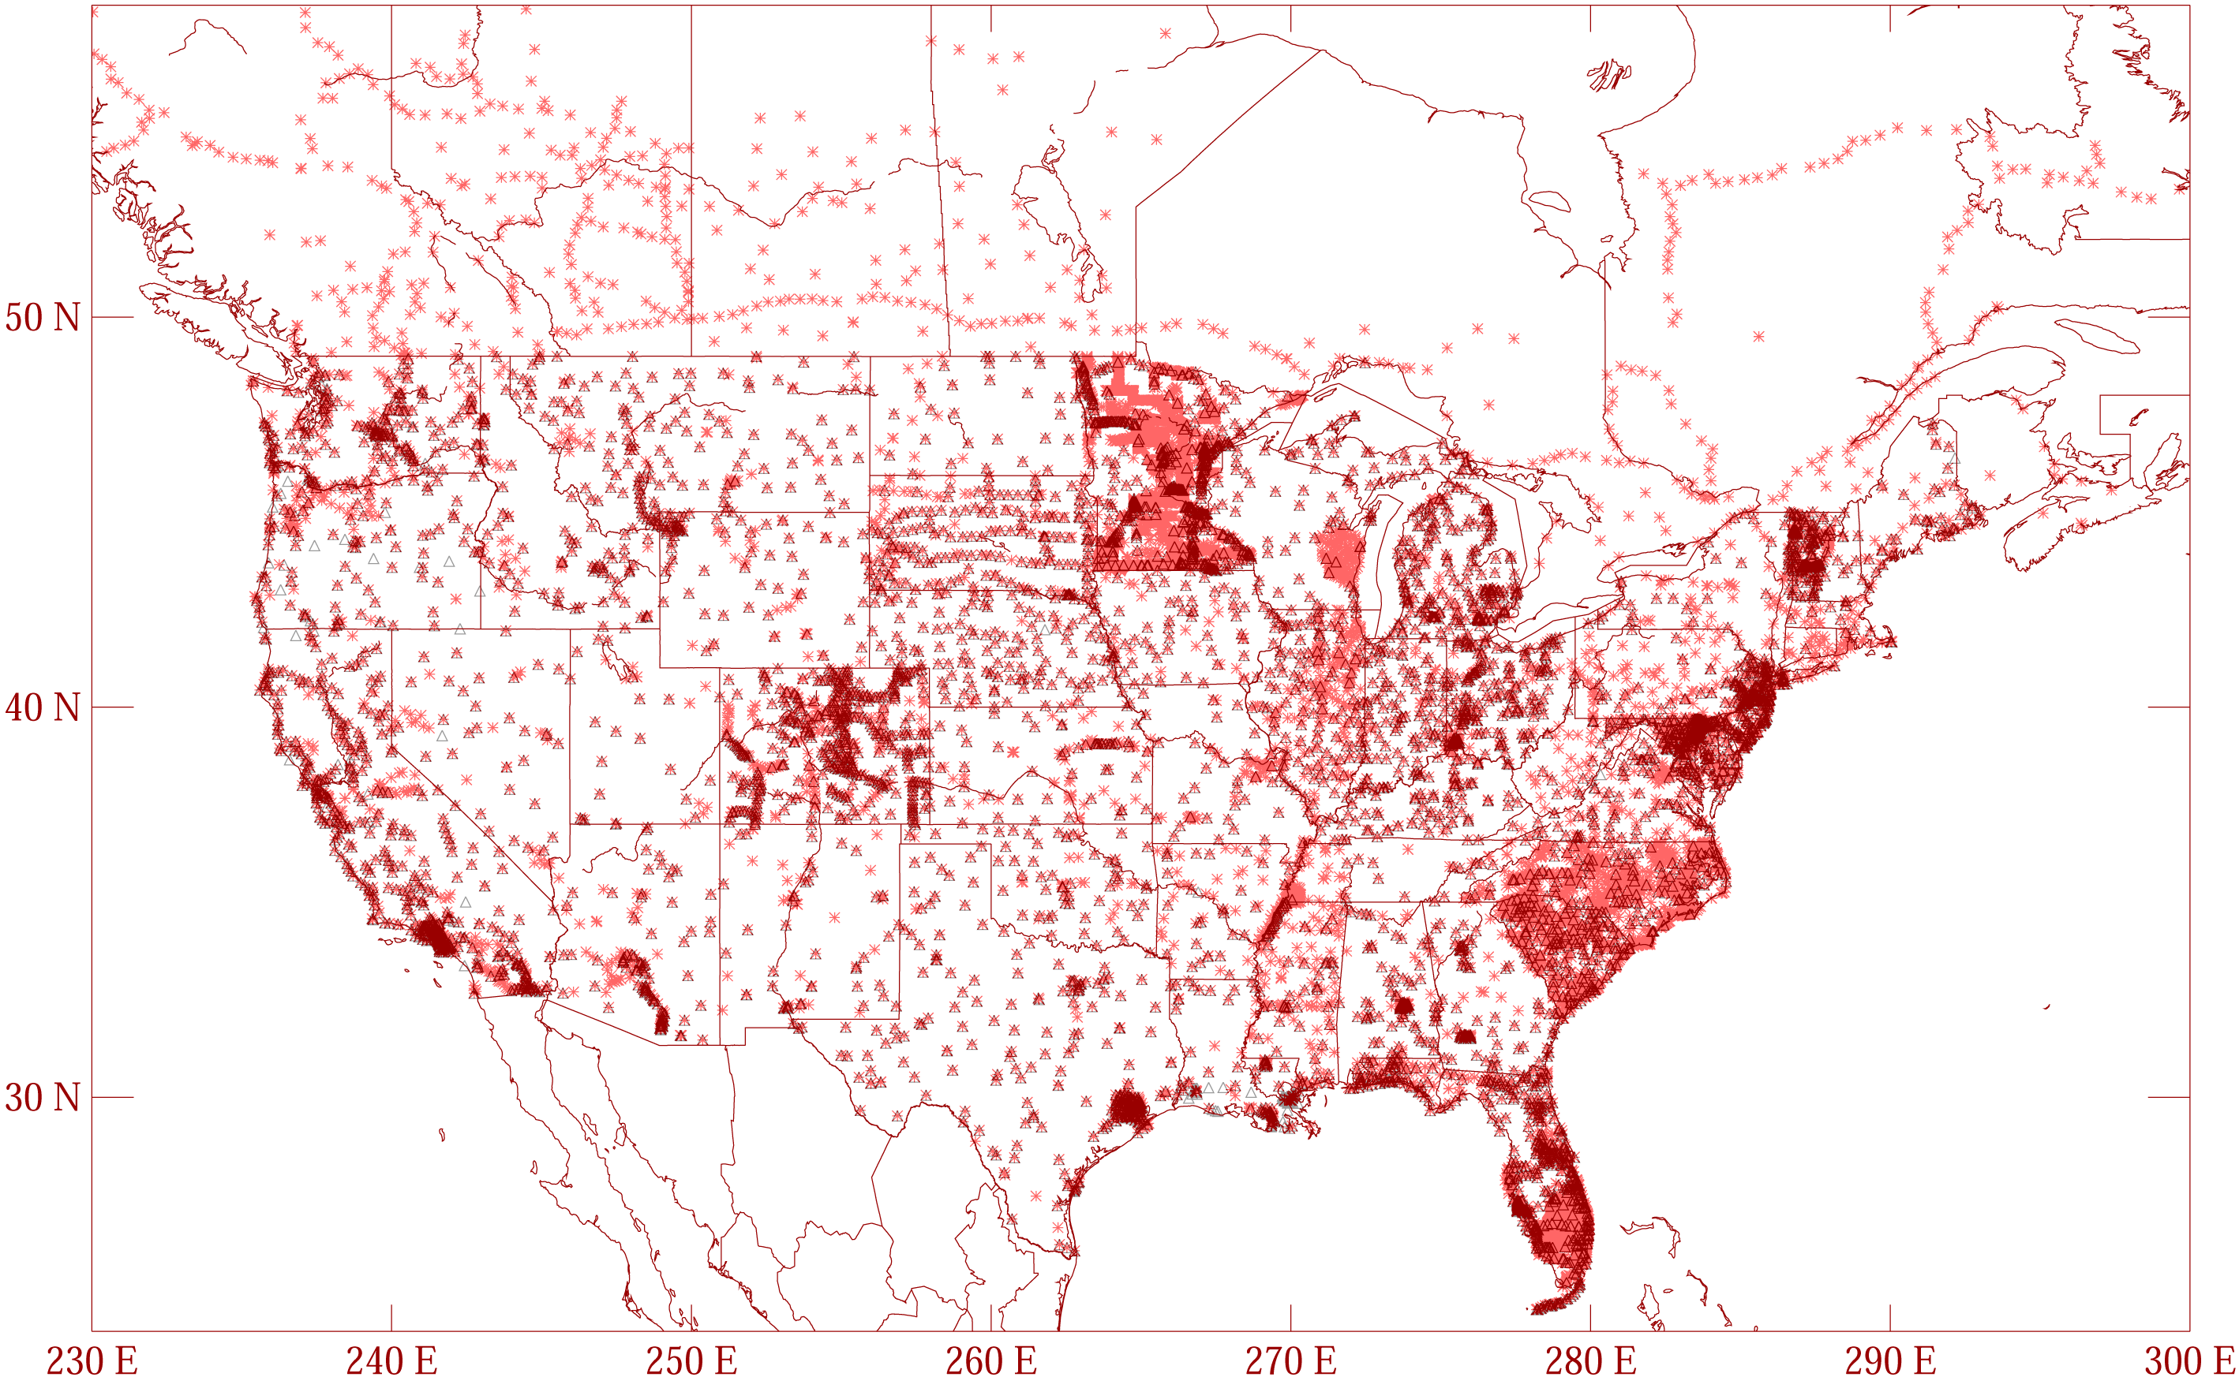
GPSBM1999: 6,169 total 0 Canada STDEV 9.2 cm (2σ)
GPSBM2003: 14,185 total 579 Canada STDEV 4.8 cm (2 σ)
Notes:
These are the control data used to make xGEOID06a, GEOID03 and GEOID99 (GPS on bench marks: GPSBM’s).
Improvements in Distribution are primarily due to obtaining data in Canada.
The bulk of the increase comes in one state: Minnesota (603 => 4161).
Note the inequitable distribution.
You could practically grid the GPSBM’s in South Carolina or Minnesota and get a good result.
Other places are not so fortunate…
Also note that this shows distribution but not quality of the points.
Some regions (e.g., Texas) have systematic quality problems (due to subsidence) that impact the GPSBM’s and the derived hybrid geoids.
Current techniques rely on creating models of the systematic effects at multiple wavelengths. If the spatial density doesn’t support the shorter wavelength models, then the quality of predictions will commensurately be reduced.
Note that a hyper-dense survey isn’t necessary to achieve optimal results. Later discussion on Minnesota will emphasize this.

Slide 56
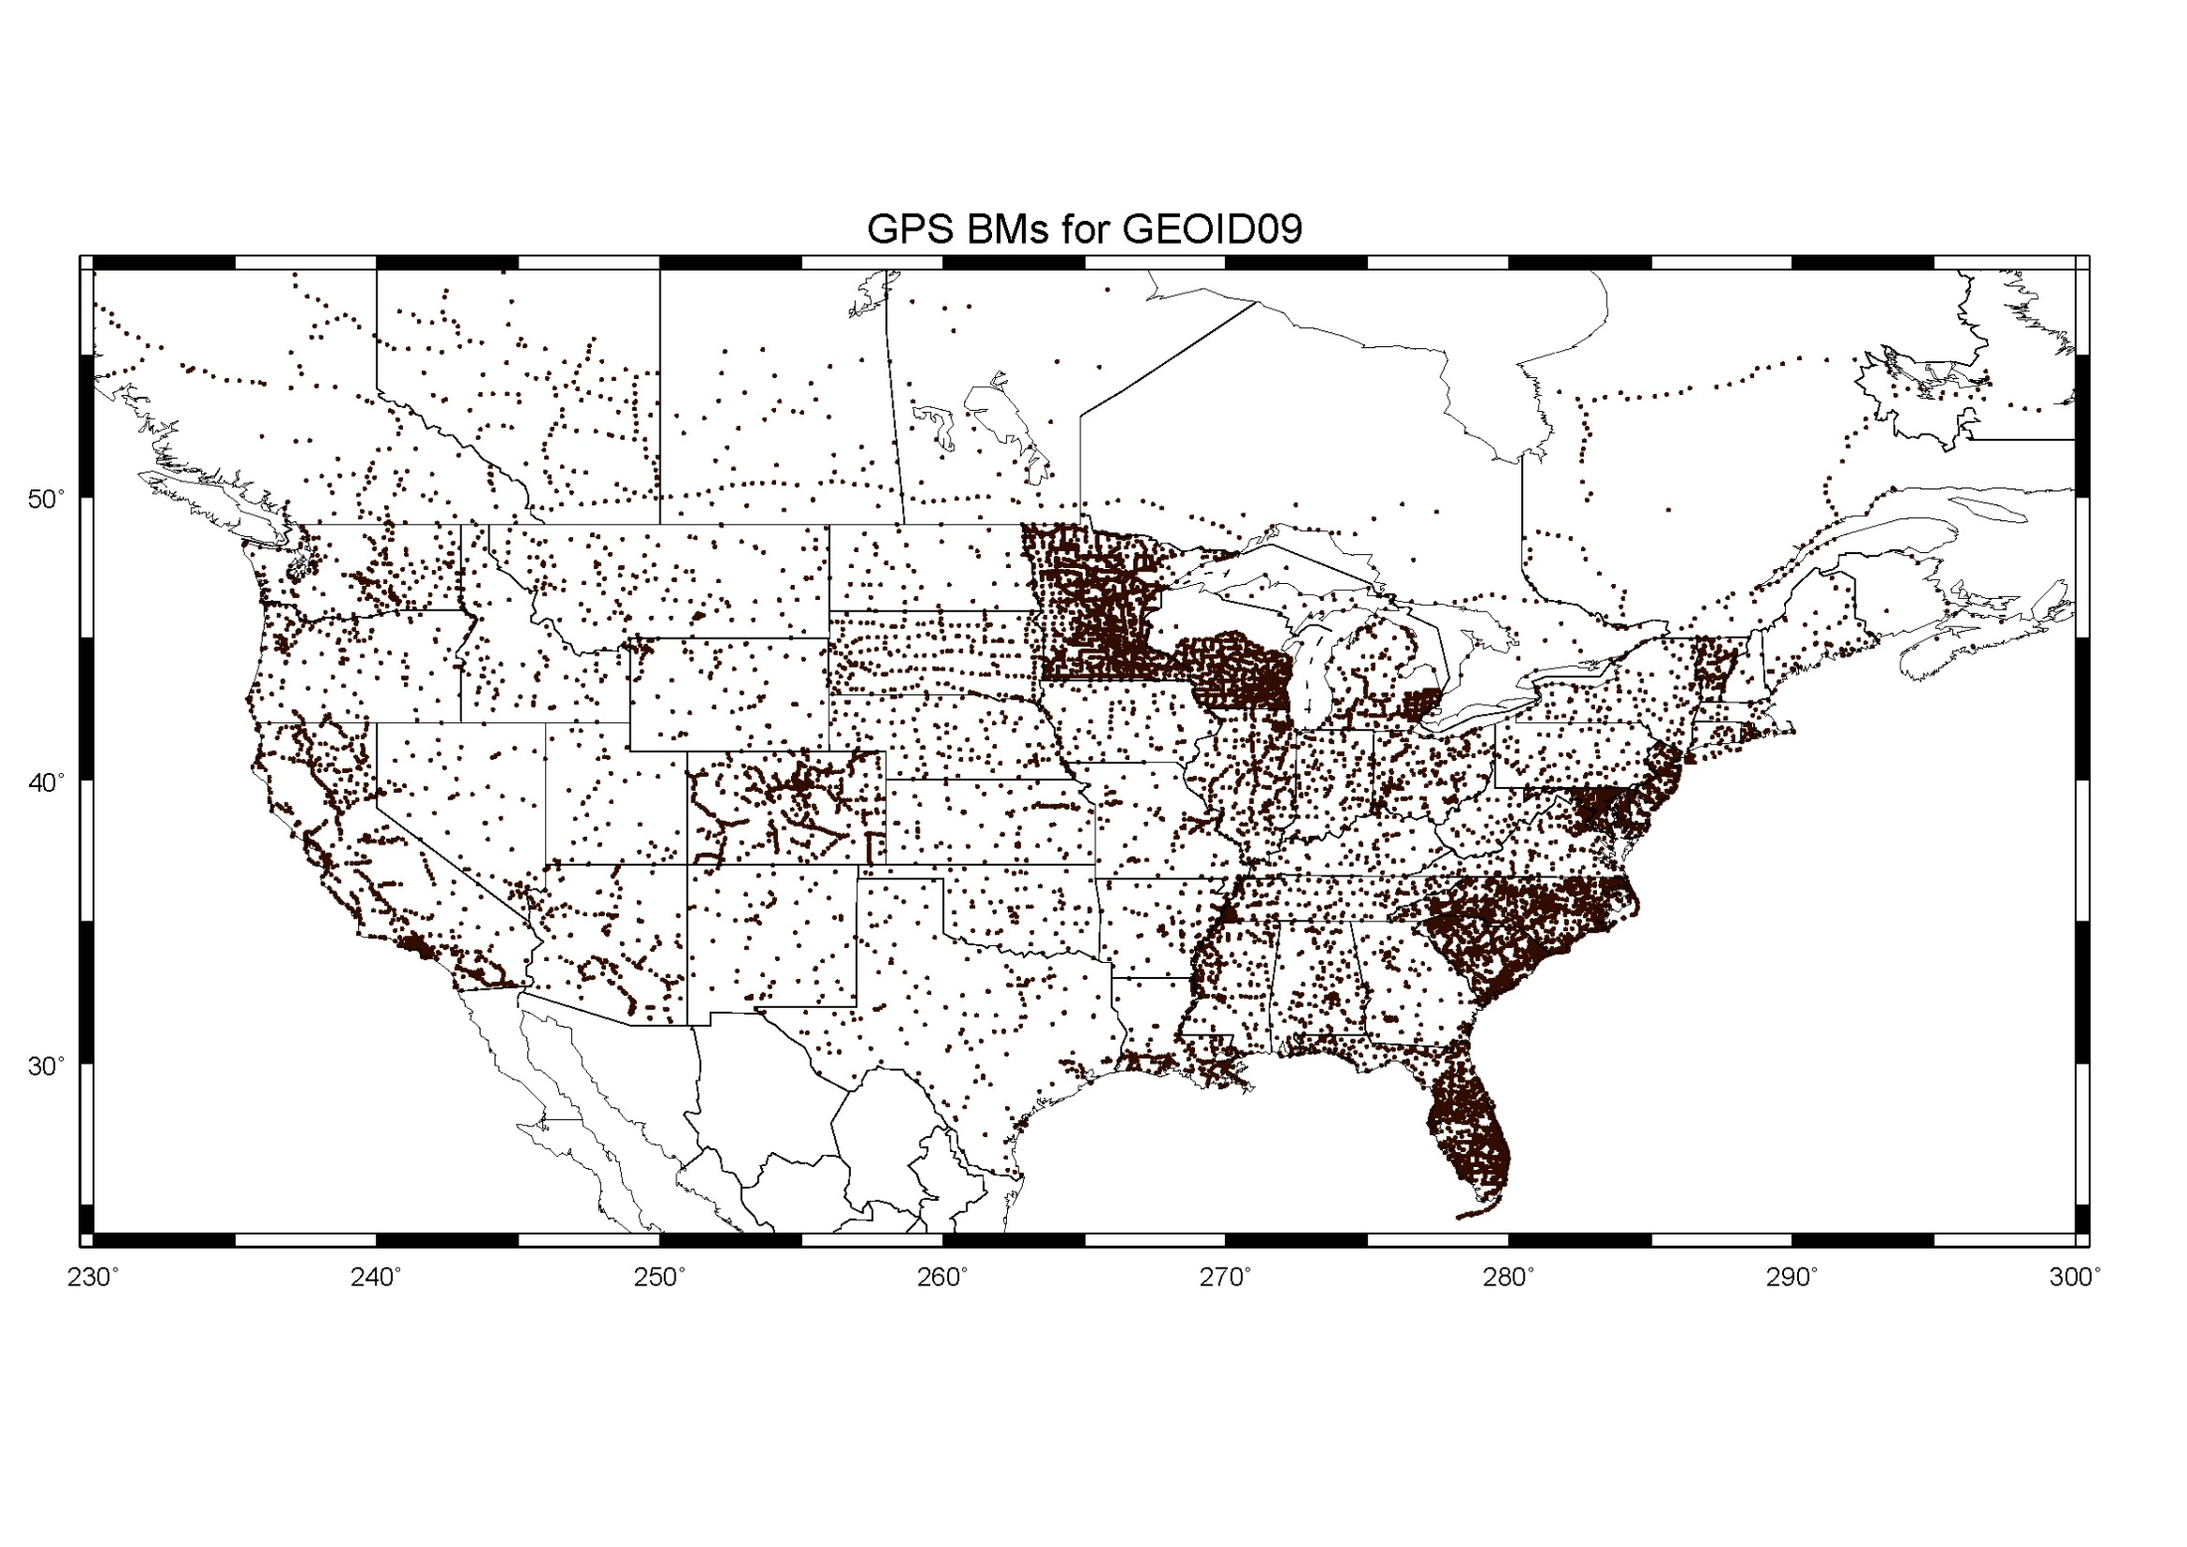
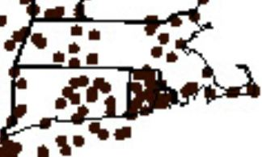
GPSBM2009: 18,398 STDEV 2.8 cm (2σ)

Slide 57
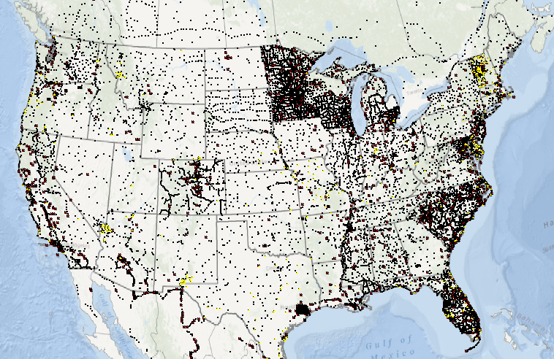
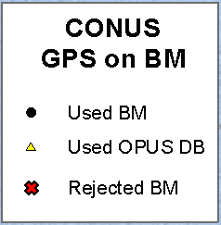
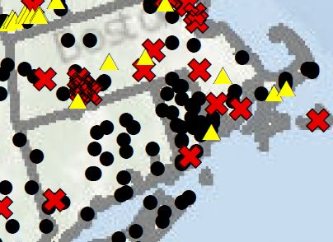
        GGPSBM2012A: 23,961 (CONUS) STDEV 3.4 cm (2σ) 499 (OPUS on BM)
        574 (Canada)
        177 (Mexico)

Slide 58
Which Geoid for Which NAD 83?
NAD 83(2011)
NAD 83(2007)
NAD 83(1996) & CORS96
Geoid12A/12B
Geoid09
Geoid06 (AK only)
Geoid03
Geoid99
Geoid96

Slide 59
Mission and Vision of NGS
To define, maintain and provide access to the National Spatial Reference System to meet our nation’s economic, social, and environmental needs
“Maintain the NSRS” means “NGS must track all of the temporal changes to the defining points of the NSRS in such a way as to always maintain the accuracy in the NSRS definition.”
Vision - Modernize the Geopotential (“Vertical”) and Geometric (“Horizontal”) datums

Slide 60

Party Time, We’re Done!

Slide 61
Problems with NAD 83 and NAVD 88
NAD 83 is not as geocentric as it could be (approx. 2 m)
  Positioning Professionals don’t see this - Yet
NAD 83 is not well defined with positional velocities
NAVD 88 is realized by passive control (bench marks) most of which have not been re-leveled in at least 40 years.
NAVD 88 does not account for local vertical velocities (subsidence and uplift)
  Post glacial isostatic readjustment (uplift)
  Subsurface fluid withdrawal (subsidence)
  Sediment loading (subsidence)
  Sea level rise (0.74 ft – 0.90 ft per 100 years)
    Newport, RI 2.74 mm/yr (0.008 ft/yr) 1930-2014
    Providence, RI 2.25 mm/yr (0.007 ft/yr) 1938-2014

Slide 62

The National Geodetic Survey 10 year plan
Mission, Vision and Strategy
2008 – 2018, 2013-2023
http://www.ngs.noaa.gov/INFO/NGS10yearplan.pdf
Official NGS policy as of Jan 9, 2008
  Modernized agency
  Attention to accuracy
  Attention to time-changes
  Improved products and services
  Integration with other fed missions
2022 Targets:
  NAD 83 and NAVD 88 re-defined
  Cm-accuracy access to all coordinates
  Customer-focused agency
  Global scientific leadership
Notes:
Realization and unification of NAD83 in Canada and the U.S. via the ITRF.
http://www.geod.nrcan.gc.ca > Geodetic Survey Division > Publications > Papers

Slide 63
Terminology
Horizontal Datum
  Geometric Reference Frame
    Geocentric X, Y, Z
    Latitude, Longitude, Ellipsoid Height
Vertical Datum
  Geopotential Reference Frame
    Geoid undulation
    Orthometric height
    Gravity
    Deflection of the Vertical

Slide 64
Future Geometric Reference Frame
CORS-based, via GNSS
coordinates & velocities in ITRF and official US datum
(NAD83 replacement: plate-fixed or “ITRF-like”?) & relationship
replace NAD83 with new geometric reference frame – by 2022
passive control tied to new datum; not a component of new datum
address user needs of datum coordinate constancy vs. accuracy
lat / long / ellipsoid height of defining points accurate to 1 mm, anytime
CORS coordinates computed / published daily; track changes
support development of real-time networks

Slide 65
Future Geopotential Reference Frame
replace NAVD88 with new geopotential reference frame – by 2022
gravimetric geoid-based, in combination with GNSS
monitor time-varying nature of gravity field
develop transformation tools to relate to NAVD88
build most accurate ever continental gravimetric geoid model (GRAV-D)
determine gravity with accuracy of 10 microGals, anytime
support both orthometric and dynamic heights
Height Modernization is fully supported

Slide 66
Why New Reference Frames?
NAD 83
  non-geocentric, i.e. inconsistent with GNSS positioning
  difficult to maintain consistency between CORS & passive network NAD 83 coordinates
  lack of velocities, i.e. NAD 83 does not report station motion for passive marks
NAVD 88
  cross-country build up of errors (“tilt” or “slope”) from geodetic leveling
  passive marks inconveniently located and vulnerable to disturbance and destruction
  0.5 m bias in the NAVD 88 reference surface from the (best) geoid surface approximating global mean sea level
  subsidence, uplift, freeze/thaw, and other crustal motions invalidate heights of passive marks, and can make it difficult to detect such motions
  marks lacking adequate geophysical models - complicate sea level change detection
  changes to Earth’s gravity field cause changes in orthometric heights, but NAVD 88 does not account for those changes (NAVD88 based on a static gravity model)
  gravity model and modeling techniques used to determine NAVD 88 are not consistent with those currently used for geoid modeling

Slide 67
Why isn’t NAVD 88 good
enough anymore
NAVD 88 suffers from use of bench marks that:
  Are almost never re-checked for movement
  Disappear by the thousands every year
  Are not funded for replacement
  Are not necessarily in convenient places
  Don’t exist in most of Alaska
  Weren’t adopted in Canada
  Were determined by leveling from a single point, allowing cross-country error build up
Notes:
Clarification on the word “convenient” – this is used to mean “there isn’t always a bench mark around when you need one – sometimes you have to find one far away and level from it to your site of interest”

Slide 68
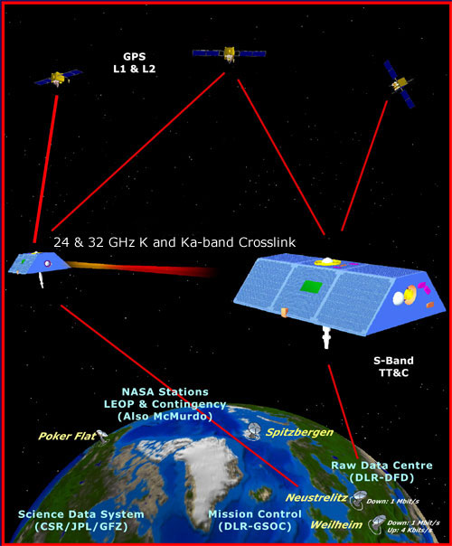
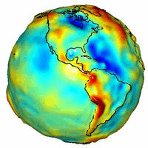
GRACE – Gravity Recovery
and Climate Experiment

Slide 69
Why isn’t NAVD 88 good
enough anymore?
Earth’s
Surface
H (NAVD 88)
H
NAVD 88 reference level
The Geoid
Errors in NAVD 88 : ~50 cm average,
100 cm CONUS tilt,
1-2 meters average in Alaska
Notes:
This slide shows what NGS now knows about the error in NAVD 88 itself. Using a continental geoid computed from the GRACE satellite, a bias and tilt in NAVD 88 has been computed using GPS derived ellipsoid heights on NAVD 88 bench marks. These are now known errors that exist in all NAVD 88 bench marks. This datum realization error, relative to the geoid, is over and above the errors from marks moving.

Slide 70
Why isn’t NAVD 88 good
enough anymore?
NAVD 88 suffers from:
A zero height surface that:
  Has been proven to be ~50 cm biased from the latest, best geoid models (GRACE satellite)
  Has been proven to be ~ 1 meter tilted across CONUS (again, based on the independently computed geoid from the GRACE satellite)

Slide 71
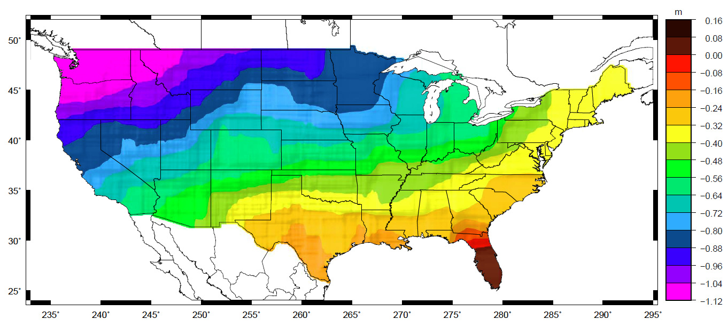
Why isn’t NAVD 88 good
enough anymore?
Approximate level of geoid mismatch known to exist in the NAVD 88 zero surface:
Notes:
This map reflects the sort of height changes that users could expect if NAVD 88 were replaced with a geoid-based vertical datum.
This is only a large scale approximation and should not be used as an absolute guide. Each benchmark might have its own level
Of mismatch, say from uplift or subsidence, not captured by this broad brush.
Also, this is the difference between the zero level of NAVD 88 and the actual geoid. The difference between NAD 83 ellipsoid heights and
ITRF/GRS-80 ellipsoid heights has NO influence on this graph and should not be part of the story.
Updated October 2010

Slide 72
Problems using traditional leveling (to define a National Vertical Datum)
Leveling the country can not be done again
  Too costly in time and money
  Leveling yields cross-country error build-up; problems in the mountains
Leveling requires leaving behind passive marks
  Bulldozers and crustal motion do their worst

Slide 73
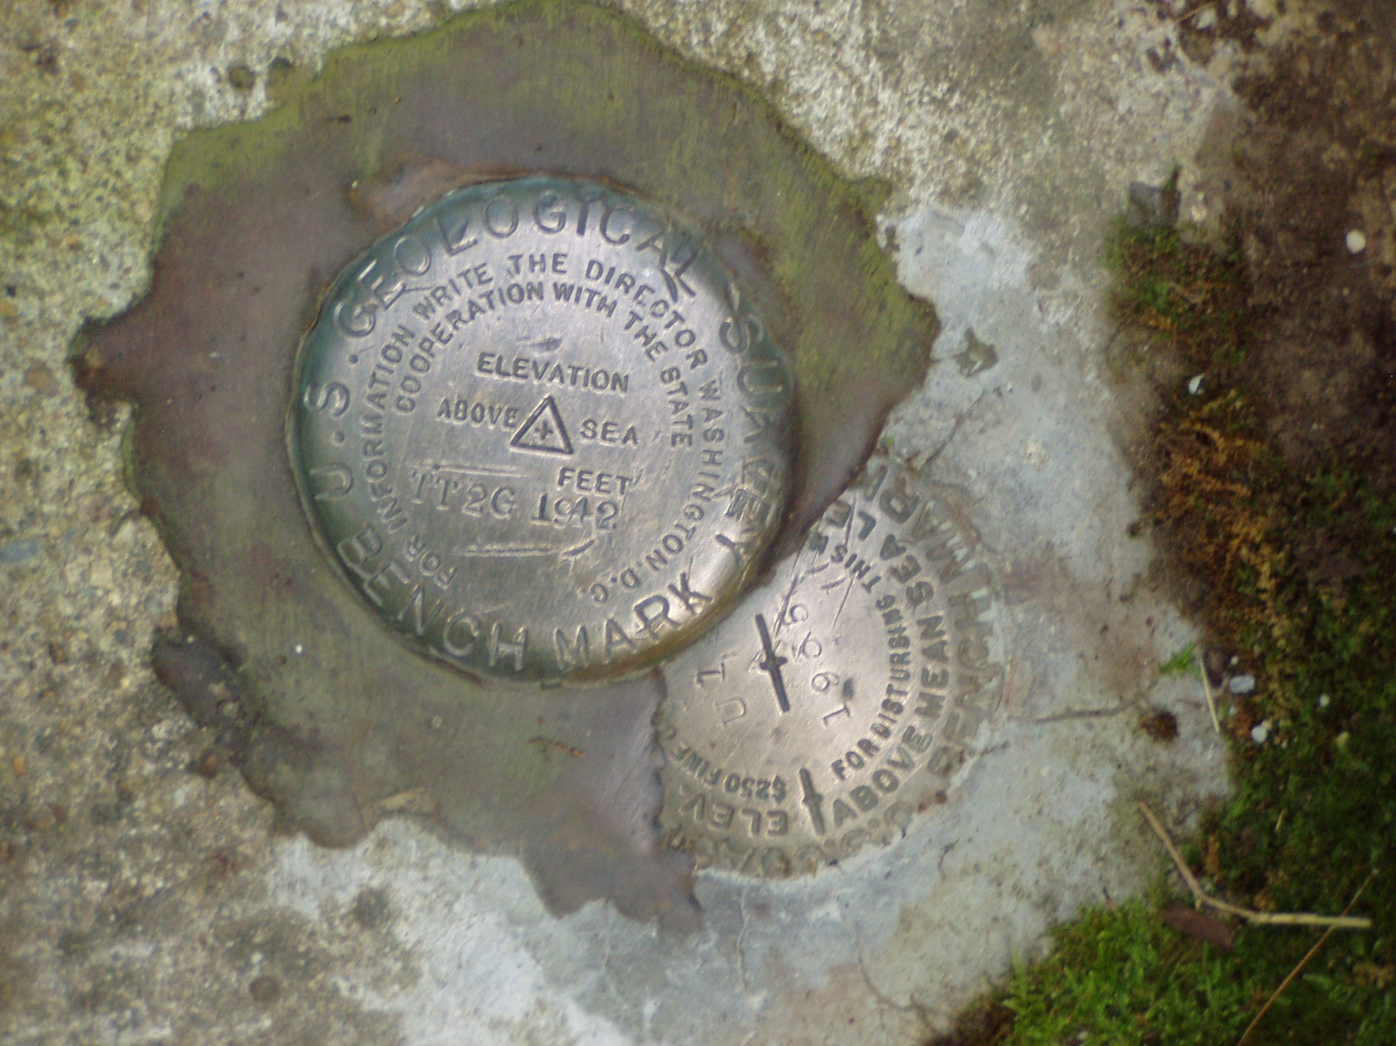
Height-Mod means More Marks?

Slide 74
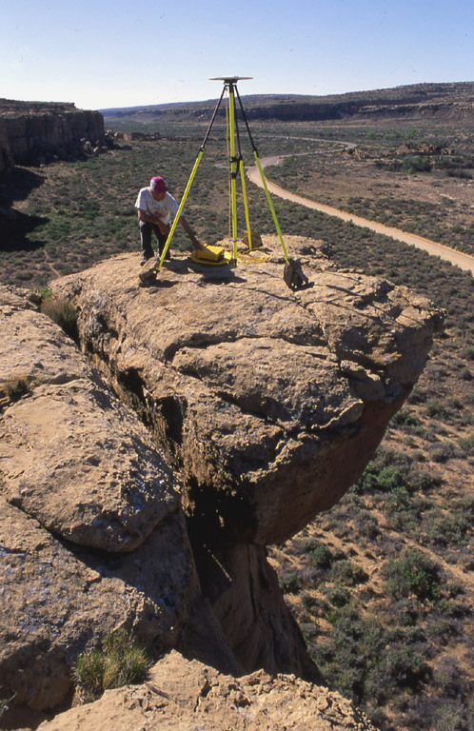

Height Modernization
Height
Modernization
-faster
-cheaper
Differential Leveling
GNSS + …

Slide 75
How accurate is a
GPS-derived Orthometric Height?
Relative (local) accuracy in ellipsoid heights between adjacent points can be better than 2 cm, at 95% confidence level
Network accuracy (relative to NSRS) in ellipsoid heights can be better than 5 cm, at 95% confidence level
Accuracy of orthometric height is dependent on accuracy of the geoid model – Currently NGS is improving the geoid model with more data, i.e. Gravity and GPS observations on leveled bench marks from Height Mod projects
Geoid12a can have an uncertainty in the 2-5 cm range.

Slide 76
How Good Can I Do With OPUS Static?
OPUS Static reliably addresses the more historically conventional requirements for GPS data processing. It typically yields accuracies of:
1 – 2 cm horizontally
2 – 4 cm vertically
However, there is no guarantee that this stated accuracy will result from any given data set. Confirming the quality of the OPUS solution remains your responsibility. That’s the “price” for automated processing.
4-7 mm differential ellipsoid height accuracy in GSVS11
New ellipsoid height accuracy estimates will be included in a planned update to HTMOD guidelines for a number of GNSS techniques.

Slide 77

Positioning Error vs. Duration of the Observing Session
Dual-frequency GPS carrier-phase observations

Slide 78

Vertical Precision Using Dual-Frequency
GPS Carrier Phase Observations 95% Confidence Level

Slide 79


Slide 80





Slide 81
1. Using GNSS is cheaper, easier than leveling
2. To use GNSS we need a good geoid model
Height Modernization Bottom line

Slide 82


Slide 83
Geoid
Geopotential
surfaces
Ellipsoid
surface
Gravity vector
(aka “plumbline”),
pointing “up”
The relationships between the ellipsoid surface (solid red), various geopotential surfaces (dashed blue), and the geoid (solid blue). The geoid exists approximately at mean sea level (MSL). Not shown is the actual surface of the earth, which coincides with MSL but is generally above the geoid.
Notes:
Looking at a side view of the irregular shaped Earth and the relationships between surfaces of equal potential (equipotential or geopotential surfaces), perpendicular to the attraction of gravity at that point. Note these geopotential surfaces are not geometrically parallel due to the variations in the earth’s irregular gravity field. Also, the geopotential surfaces converge (become closer together) at the poles due in large part to Earth’s rotation.
As you run levels across theses surfaces the equipment is plumbed per the attraction of gravity at that point. Our assumption is that our horizontal field of view can be corrected for a nice consistent Earth curvature when in fact a correction for conditions affecting us at a particular point must be accounted for.
Running levels north and south require more correction for the convergence of the geopotential surfaces than when running levels east and west.
The red oval illustrates the reference ellipsoid for our space based coordinate system and, though a close approximation of the size and shape of the Earth, is an entire, unrelated reference surface when determining GPS-derived ellipsoid heights.

Slide 84
The ellipsoid, the geoid, and you
Deflection of the vertical
You are here
Earth surface
Ellipsoid height, h
Orthometric height, H
Alaska
Mean
sea level
Geoid height, N_{G}
Ellipsoid
Geoid
h ≈ H + N_{G}
h = H + N_{G}
Note: Geoid height is negative everywhere in the coterminous US
(but it is positive in most of Alaska)

Slide 85

Gravity measurements help answer two big questions…
How “high above
‘sea level’ ” am I?
(FEMA, USACE,
Surveying and
Mapping)
How large are
hydrodynamic processes?
(Coast Survey, CSC,
CZM)
Earth’s
Surface
Geoid
Coast
Ocean
Surface
Ellipsoid
From
Gravity
From
GPS
From
Satellite Altimetry
Notes:
This slide is an idealized situation demonstrating the usefulness of near-shore gravity, specifically the use of such gravity to accurately compute a gravimetric geoid model. (The geoid is the one unique equipotential surface of the Earth’s gravity field which best fits, in a least-squares sense, global mean sea level).
On land, the use of the Global Positioning System (GPS) for fast, accurate surveying is well documented. However the height determined by GPS refers to a highly idealized, mathematically simple surface known as the ellipsoid. Thus GPS heights are “ellipsoid heights”. Unfortunately, ellipsoid heights are non-intuitive in many ways. First, they can be dozens of meters different from heights above the geoid (known as orthometric heights, or more colloquially, but less correctly as “heights above sea level”). Secondly, ellipsoid heights do not give an accurate portrayal of how water will flow, due to their complete disconnect from the gravity field of the Earth. If one has an accurate model of geoid undulations (the separation between the geoid and ellipsoid), then one can take the GPS-derived ellipsoid heights, remove the geoid undulation, and arrive at your orthometric height (a.k.a. “height above sea level”). This is a significantly faster method of determining orthometric heights compared to traditional surveying methods of spirit leveling.
On the ocean, satellite altimetry is used to monitor sea level. However, because the satellite orbits are known relative to the ellipsoid, and the altimetric measurement is from satellite to sea surface, the resulting information is the height of the sea surface above the ellipsoid, often called the “sea surface height” or SSH. If one is interested, however, in the impact of winds, heating, currents and other phenomena on the ocean surface, then one must remove the gravitational impact on the ocean surface. That is, one must know the separation between the ellipsoid and the geoid over the ocean in order to remove this signal, and arrive at the residual value. This residual, the distance from the geoid up to the sea surface, is known by many names, the most common being “sea surface topography” (SST) or “dynamic ocean topography”.
Coastal areas prone to flooding would benefit both by knowing accurate land elevations (to aid in construction planning, floodplain mapping, etc) as well as knowing accurately how the near shore ocean processes work (to better model responses to hurricanes and other dynamic ocean phenomena). It is an unfortunate fact that the largest areas missing accurate gravity measurements are those areas immediately offshore. This is because ships with gravimeters can not get into these shallows, altimetrically derived gravity models are unreliable due to the inability to accurately compute near-shore tides, and terrestrial gravimeters can not measure in the water. The only practical option to collecting the near-shore ocean gravity data is through airborne based technologies.
Dr. Dru A. Smith
Chief Geodesist
NOAA, National Geodetic Survey
Dru.Smith@noaa.gov
1/11/2006

Slide 86

Gravity for the Redefinition of the American Vertical Datum (GRAV-D)
Replace the Vertical Datum of the USA by 2022 (at today’s funding) with a gravimetric geoid accurate to 1 cm
Orthometric heights accessed via GNSS accurate to 2 cm
Three thrusts of project:
  Airborne gravity survey of entire country and its holdings
  Long-term monitoring of geoid change
  Partnership surveys
Working to launch a collaborative effort with the USGS for simultaneous magnetic measurement
Gravity and Heights are
inseparably connected
Notes:
GRAV-D is the NGS project designed to replace NAVD88 with a vertical datum based upon a gravimetric geoid accurate to 1 cm. Heights above this datum will be accessed via GNSS measurements. Three thrusts of project. Launch USGS collaboration for simultaneous mag measurement.

Slide 87
What is GRAV-D?
GRAV-D will mean:
  As the H=0 surface, the geoid will be tracked over time to keep the datum up to date
  The reliance on passive marks will dwindle to:
    Secondary access to the datum
    Minimal NGS involvement
      Maintenance/checking in the hands of users
    Use at your own risk

Slide 88




Gravity Survey Plan
National Scale Part 1
  Predominantly through airborne gravity
  With Absolute Gravity for ties and checks
  Relative Gravity for expanding local regions where airborne shows significant mismatch with existing terrestrial

Slide 89

GRAV-D Goals
2 cm accuracy orthometric heights -
  from GNSS (1 cm) + geoid model (1 cm)
fast, accurate, consistent orthometric heights -
everywhere in the USA

Slide 90

GRAV-D Expected Coverage
Puerto Rico
US Virgin Is.

Slide 91
Priority- Greatest Datum Need
Alaska
Puerto Rico/US Virgin Islands (PRVI)
Coastal US and Great Lakes
  Great Lakes
  Gulf of Mexico & FL
  Eastern Seaboard
  Western Seaboard
Hawaii and Pacific Islands
Aleutian Islands
Interior CONUS
  Mountainous areas first

Slide 92
GPRA* Performance Metric
For Airborne Surveys
FY09 Baseline | Targets vs Actual
 | FY10 | FY11 | FY12 | FY13 | FY14 | FY15 | FY16 | FY17 | FY18 | FY19 | FY20 | FY21 | FY22
6.14% | 7.5% | 12% | 20% | 28% | 36% | 44% | 52% | 60% | 68% | 76% | 84% | 92% | 100% and Implement
6.14 | 7.8 | 14.7 | 23.9 | 31.0 | 38.1 | 43.2
Oct. 2014 through Jun. 2015
Measure: Percentage of the U.S. and its territories with GRAV-D data available
to support a 1 cm geoid supporting 2 cm orthometric heights.
*GPRA = Government Performance and Results Act of 1993
Notes:
We’ve set up a basic GIS GPRA monitoring in the War Room. We will report the coordinates of our survey monthly and they will calculate our percentages.

Slide 93


Airborne Gravity Current Coverage
Data Block Status
Complete
Processing
Collecting
Planned
As of July 1, 2015
http://www.ngs.noaa.gov/GRAV-D/data_products.shtml

Slide 94




GRAV-D Aircraft
DOI Bureau of Land Management
  Pilatus PC-12
Fugro
  King Air E-90A
Naval Research Lab
  King Air RC-12
NOAA
  Gulfstream Jet Prop
  NOAA P-3 Hurricane Hunter
Pilatus PC-12
King Air E-90A
King Air RC-12
Notes:
GRAV-D surveys have been operating on a number of aircraft. In order to accomplish our objectives within budget, we utilize a “portfolio” of aircraft of both government and contract origin. We’ve used the NOAA Jet Prop and the P-3, although little opportunity exists for further use of these aircraft. We operate about five months/year aboard the BLM Pilatus PC-12 aircraft. This aircraft is used for fire-spotting during warmer weather months in AK and the western US. This year we began working with Fugro to provide us aircraft services. We plan also to work this year with the Naval Research Lab and the VXS-1 Navy Squadron aboard their RC-12 King Air aircraft.

Slide 95


Requirements
Geodetic quality results require accurate aircraft positions, velocities, and accelerations
High-altitude, high-speed, long baseline flights for gravimetry
INS
GPS Antenna
Gravimeter
Absolute Gravity Tie

Slide 96


From Measurement to Product
Airborne Gravity Collection
GPS and Gravity Data Processing
  Kinematic positioning is critical
  NGS-developed software
More info: http://www.ngs.noaa.gov/corbin/class_description/GRAVD_0213.shtml
Gravity Data Release to Public
Inclusion in Yearly Experimental
Gravimetric Geoid Models, e.g.,
xGEOID14B

Slide 97


Problems with Gravity Holdings
Terrestrial gravity
20-100 km gravity gaps along coast
Field is not sampled uniformly
Data range in age and quality, some w/o metadata
Some surveys have systematic errors
Data gaps in littoral areas
Ship gravity
New Orleans

Slide 98

Problems with Gravity Holdings
Decades of gravity surveys are inconsistent with one another
Airborne gravity will provide a baseline for removing these inconsistencies
%
Notes:
This slide shows “crossovers” between any of the 1755 terrestrial gravity surveys which NGS holds in its database. These are
basically mismatches between surveys that overlap one another, plotted at the point of overlap. Note that the color bar
is +/- 2 mGals, and how many surveys disagree with one another at that level. GRAV-D flights should yield about 2 mGal
accuracy surveys, and help reduce the level of disagreement to that range.
The vertical axis of the lower plot is “Percent of points with this level of crossover error” So while it is bell-shaped around -0.26 mGals, the “wings” at the >+2 or <-2 range contain a good 45-50% of all crossovers.
Added October 2010.

Slide 99
Validating Geoid Accuracy
“...the gravimetric geoid used in defining
the future vertical datum of the United States should have an absolute accuracy of 1 centimeter at any place and at any time.”
-- The NGS 10 year plan (2008-2018)
Admirable!...Achievable?
Notes:
The above quote refers to one of many ambitious goals in the NGS 10 year plan. While admirable, its achievability remains an open question. In order to begin addressing the actual achievable accuracy of a gravimetric geoid model, NGS will engage in a variety of testing methods prior to the 2022 date when the gravimetric geoid will serve as the reference surface for a new vertical datum. The first such testing method took place in the summer of 2011 and is known as the Geoid Slope Validation Survey of 2011, or GSVS11. As its name implies, this survey tested the accuracy of differential geoid undulations between points ("geoid slopes") from NGS's gravimetric geoid models. The baseline for comparison will be independently computed geoid slopes from two methods, GPS and leveling as well as Deflections of the Vertical.

Slide 100
Validating Geoid Accuracy
NGS plans up to 3 surveys to validate the accuracy of the gravimetric geoid model
  GSVS11
    2011; Low/Flat/Simple: Texas; Done; Success!
  GSVS14
    2014; High/Flat/Complicated: Iowa; Field work Complete
  GSVS1x
    2016?; High/Rugged/Complicated: Colorado

Slide 101

Geoid Slope Validation Survey
Austin
Observe geoid shape (slope) using multiple independent terrestrial survey methods
  GPS + Leveling
  Deflections of the Vertical
Compare observed slopes (from terrestrial surveys) to modeled slopes (from gravimetry or satellites)
  With / Without new GRAV-D airborne gravity
325 km
218 points
1.5 km apart
Rockport
Notes:
But will this method produce a sufficiently accurate geoid?
This summer, we conducted an experiment to determine the accuracy of our geoid. We selected a line that extended 325 km from downtown Austin, Texas (North end) to Rockport, Texas (South end). There were 218 official survey points along the line, with an average spacing of 1.5 km between them. We compared the slope of the geoid along the line determined with GPS + leveling with deflections of the vertical as measured by the ETH Zurich DIADEM zenith camera. We also compared the observed geoid slope with slopes calculated from various geoid models to evaluate the their quality. As for NGS models, we tested geoids that both included and didn’t include new GRAV-D airborne gravity.

Slide 102


Geoid Slope Validation Survey of 2011
(GSVS11)

Slide 103
Surveys Performed
GPS: 20 identical units, 10/day leapfrog, 40 hrs ea.
Leveling: 1st order, class II, digital barcode leveling
Gravity: FG-5 and A-10 anchors, 4 L/R in 2 teams
DoV: ETH Zurich DIADEM GPS & camera system
LIDAR: Riegl Q680i-D, 2 pt/m² spacing, 0.5 km width
Imagery: Applanix 439 RGB DualCam, 5000’ AGL
Other: RTN, short-session GPS, extra gravity marks around Austin, gravity gradients

Slide 104





GPS
LIDAR/
Imagery
DoV
Gravity
Leveling
Notes:
These are just a small sampling of the field crews in action. Not shown are the RTN, FG-5, short-session GPS, relative gravity and mark setting crews.

Slide 105

Geoid Slope Survey Conclusions
Including airborne gravity data improves geoid slope accuracy at nearly all distances <325 km
The NGS geoid in the TX survey meets the 1 cm accuracy objective only if airborne data are included
  No other model achieved 1 cm accuracy
Gravimetric geoid models and GPS are a viable alternative to long-line leveling
Notes:
The Survey verified that the inclusion of the GRAV-D airborne survey improved the geoid slope accuracies at all distances measured by the survey.

Slide 106

GSVS14 Line
Goal: Same as GSVS11
Region: Moderate terrain
More complex gravity
Data: Same as GSVS11
Timeline: Fiscal year 2014 field season
IA (Cedar Rapids to Denison)

Slide 107
Accessing the New Vertical Datum
Primary access (NGS mission)
  Users with geodetic quality GNSS receivers will continue to use OPUS suite of tools
  Ellipsoid heights computed, and then a gravimetric geoid removed to provide orthometric heights in the new datum
  No passive marks needed
  But, could be used to position a passive mark
Secondary access (Use at own risk)
  Passive marks that have been tied to the new vertical datum
  NGS will provide a “data sharing” service for these points, but their accuracy (due to either the quality of the survey or the age of the data) will not be a responsibility of NGS
Continuously Operating Reference Station
Notes:
Multiple questions come up about using the new vertical datum. Two examples are given in the next few slides. The first is the example of how the new datum will address subsidence, say for floodplain mapping. The second example is about how the datum will be accessible when there aren’t bench marks in the immediate region of interest. Both examples rely on this simple formula:
Get an ellipsoid height (h) from GNSS in the latest geometric datum (the replacement for NAD 83)
Remove Subtract the NGS provided geoid model height (N)
The orthometric height in the new datum (H) is just H=h-N
NGS will eventually stop making the claim that we “know” the heights of bench marks as the method of providing access to the vertical datum. What NGS will do is provide the orthometric height to a user on the day of their survey (and with the disclaimer that this height should not be taken as “known” for very long, due to the dynamic nature of the Earth).

Slide 108
Accessing the New Vertical Datum
NAVD 88 conversion to new datum
  A conversion will be provided between NAVD 88 and the new datum
    Only where recent GNSS ellipsoid heights exist to provide modern heights in the new datum
Notes:
In areas where a brand new (relatively speaking) GNSS based ellipsoid height has been determined at an NAVD 88 bench mark, that data will allow for NGS to convert to the new datum.
The more of these points that can be determined right near the time of the new datum’s release, the better will be the conversion.

Slide 109


Slide 110

REGIONAL CORS NETWORK

Slide 111

IGS08 – NAD 83(2011)
DHoriz = 1.028 m
DEHt = 1.251 m

Slide 112
How will I access the
new vertical datum?
Example 1: Flood insurance survey
1954: Leveling performed
to bench mark
House
1954-1991: Subsidence
House
BM
BM
1991: Original 1954 leveling data is used to compute the NAVD 88 height which is then published for this BM
H₈₈(published)
H₈₈(true)
NAVD 88 zero height surface
Clearly the true height relative to the NAVD 88
zero surface is not the published NAVD 88 height
Last Updated 30 Nov 2009 (DAS)
112

Slide 113
How will I access the
new vertical datum?
Example 1: Flood insurance survey
Using Existing Techniques:
Find bench mark (if you can)
Get published NAVD 88 height
Level off of bench mark
No account for subsidence!
House
BM
House
BM
H₈₈(published)
H₈₈(true)
NAVD 88 zero height surface
Last Updated 30 Nov 2009 (DAS)
113

Slide 114
How will I access the
new vertical datum?
Example 1: Flood insurance survey
Using Future Techniques:
Find bench mark if you wish, or
set a new one of your choosing
Use GNSS/OPUS to get an
orthometric height in the new datum
Level off of bench mark as needed
Subsidence is accounted for by CORS
and a geoid that are monitored
constantly!
House
BM
House
BM
H(2022?) from GNSS/geoid
NAVD 2022(?) zero height surface = geoid
Last Updated 02 Jan 2015 (DJM)
114
114

Slide 115


Additional Information
The NGS 10 year plan (2013-2023)
http://www.geodesy.noaa.gov/INFO/NGS10yearplan.pdf
The GRAV-D Project
http://www.geodesy.noaa.gov/GRAV-D
Socio-Economic Benefits of CORS and GRAV-D
http://www.geodesy.noaa.gov/PUBS_LIB/Socio-EconomicBenefitsofCORSandGRAV-D.pdf
Last Updated 02 Jan 2015 (DJM)
115

Slide 116

Predicted Positional Changes in 2022
Vicinity of Flatwoods, WV
(Computed for station L 278, pid HX1559)
HORIZONTAL = 1.15 m (3.8 ft)
ELLIPSOID HEIGHT = - 1.26 m (- 4.2ft)
Predicted with HTDP
ORTHOMETRIC HEIGHT = - 0.54 m (- 1.8 ft)
Predicted with HTDP and USGG2012
HTDP
“Coping with Tectonic Motion”
R. Snay & C. Pearson
American Surveyor Magazine, December 2010
www.Ameriserv.com
Notes:
ACURRACY BUT NOT CONSISTENCY!!
To summarize: This slide shows how far we’ve come since 1986, really since 1927.
Unfortunately, --- Next slide ----

Slide 117



How will the new datums affect you?
The new geometric datum will change latitude, longitude,
and ellipsoid height in CONUS and AK between 1 and 2 meters.
Notes:
Picture: Map reflects the type of height improvements users could expect if NAVD 88 were replaced with a geoid-based vertical datum. (This is only a large scale approximation and should not be used as an absolute guide. Each benchmark might have its own level of mismatch, for example from uplift or subsidence, not captured by this broad brush. Also, this is the difference between the zero level of NAVD 88 and the actual geoid. The difference between NAD 83 ellipsoid heights and ITRF/GRS-80 ellipsoid heights has NO influence on this graph and should not be part of the story.)
The new datums will be accessed via GNSS technology versus benchmarks
New vertical datum to be released in 2022 will be based upon a gravimetric geoid
Airborne gravity data for the geopotential datum collected by the Gravity for the Redefinition of the American Vertical Datum (GRAV-D) Project will allow for blending of data from satellite, altimetric, and surface sources.
Estimated Differences Between “Old” and “New” Datums:
Geometric Datum
Horizontal: 0.8 to 1.5 m in CONUS
Ellipsoidal heights: -0.2 to -1.6 m CONUS; AK 0 to 1.3 m
Geopotential Datum
Approx. +0.1 m (Florida) to -1.3 m (Washington)
More than 2 meters of change in Alaska

Slide 118

How will the new datums affect you?
The new vertical (geopotential) datum will change heights on average 50 cm with a 1m tilt towards the Pacific Northwest.
Notes:
Picture: Map reflects the type of height improvements users could expect if NAVD 88 were replaced with a geoid-based vertical datum. (This is only a large scale approximation and should not be used as an absolute guide. Each benchmark might have its own level of mismatch, for example from uplift or subsidence, not captured by this broad brush. Also, this is the difference between the zero level of NAVD 88 and the actual geoid. The difference between NAD 83 ellipsoid heights and ITRF/GRS-80 ellipsoid heights has NO influence on this graph and should not be part of the story.)
The new datums will be accessed via GNSS technology versus benchmarks
New vertical datum to be released in 2022 will be based upon a gravimetric geoid
Airborne gravity data for the geopotential datum collected by the Gravity for the Redefinition of the American Vertical Datum (GRAV-D) Project will allow for blending of data from satellite, altimetric, and surface sources.
Estimated Differences Between “Old” and “New” Datums:
Geometric Datum
Horizontal: 0.8 to 1.5 m in CONUS
Ellipsoidal heights: -0.2 to -1.6 m CONUS; AK 0 to 1.3 m
Geopotential Datum
Approx. +0.1 m (Florida) to -1.3 m (Washington)
More than 2 meters of change in Alaska

Slide 119
Predicted Positional Changes in 2022
Vicinity of Corinth, RI.
(Computed for station CORINTH, pid AA9705)
HORIZONTAL = 1.24 m (4.1 ft)
ELLIPSOID HEIGHT = - 1.17 m (- 3.8 ft)
Predicted with HTDP
ORTHOMETRIC HEIGHT = - 0.41 m (- 1.4 ft)
Predicted with HTDP and USGG2009
HTDP
“Coping with Tectonic Motion”
R. Snay & C. Pearson
American Surveyor Magazine, December 2010
www.Ameriserv.com
Notes:
ACURRACY BUT NOT CONSISTENCY!!
To summarize: This slide shows how far we’ve come since 1986, really since 1927.
Unfortunately, --- Next slide ----

Slide 120
Old vs New Datums
Step 1: Do the best scientific positioning work we can in ITRF
  Before any discussion of “plate fixed” or “map projections”
  NGS’s core goal must be the scientific integrity of positions
  New database
  Replacement of static vector-based GNSS processing

Slide 121
Old vs New Datums
Step 2: Consider the question of “plate fixed”:
  Why do users want this?
    Fixed latitude and longitude?
  Nothing is “fixed” though
    Plate is not just rotating; more than 1 plate
  Who wins? Who defines “fixed”? Must all points maintain zero change?
    Model and remove all real motion? (aka “HTDP”)
      If not removing all motion, why remove any motion?
        ITRF minus plate rotation vs just ITRF

Slide 122
State Plane Coordinates
Barring user-requested changes, NGS may use existing SPC projections, boundaries and equations, but with new false northings & eastings (to distinguish from NAD 27 and NAD 83)
User-provided plug-ins (pre-written code) for SPC or other projections may be possible

Slide 123
Old vs New Datums: Access
Old datums used passive control as the primary access
  CORS / OPUS helped, but “datasheets” remain the largest download, far and away more than OPUS is used

Slide 124
Old vs New Datums: Access
New datums
  Primary access: GNSS + geoid model
  Secondary access: Passive control
Fixed:
  CORS + geoid (coords and velocities both)

Slide 125
Old vs New Datums: Passive Control
Roll of passive control in the future:
  Control for projects
    Depending on accuracy needs, new coordinates should be determined, rather than relying on published coordinates based on old surveys
  Monitoring sites for motion
  Calibrating RTNs

Slide 126
metadata to the rescue
your positional metadata should include:
  datum
  epoch
  source
these will facilitate transforming from current to new datum
maintaining your original survey data will provide more accurate results

Slide 127
Measures of Success
FGDC votes to adopt the new datum for U.S. geospatial data.
All NOAA geospatial products are consistent with the new datum.
NOAA geospatial products are understood and accepted by users.
Tools exist which facilitate modernization of legacy data.
New datums replace NAD83/NAVD88 in state and local regulations, documentation
Risks
“Existing datums are good enough”, reduces enthusiasm for adopting the new.
Access to global (ITRF) & local (RTN, LDP) frames reduces the utility of a NAREF frame.
Das Unheimliche; frustration and cognitive dissonance increase with accuracy.
Assumptions
IERS will continue to provide an ITRF common to all GNSS & other navigation systems.
GIS vendors will provide user-friendly solutions to modernize legacy data.

Slide 128


What’s Next for Geodetic Datums?
https://www.youtube.com/playlist?list=PLsyDl_aqUTdFY6eKURmiCBBk-mP4R10Dx
Notes:
https://www.youtube.com/playlist?list=PLsyDl_aqUTdFY6eKURmiCBBk-mP4R10Dx

Slide 129






Find the article(s) in the Archives at:
http://www.amerisurv.com

Slide 130
GOOD COORDINATION BEGINS WITH
GOOD COORDINATES
GEOGRAPHY WITHOUT GEODESY IS A FELONY

