Slide 1
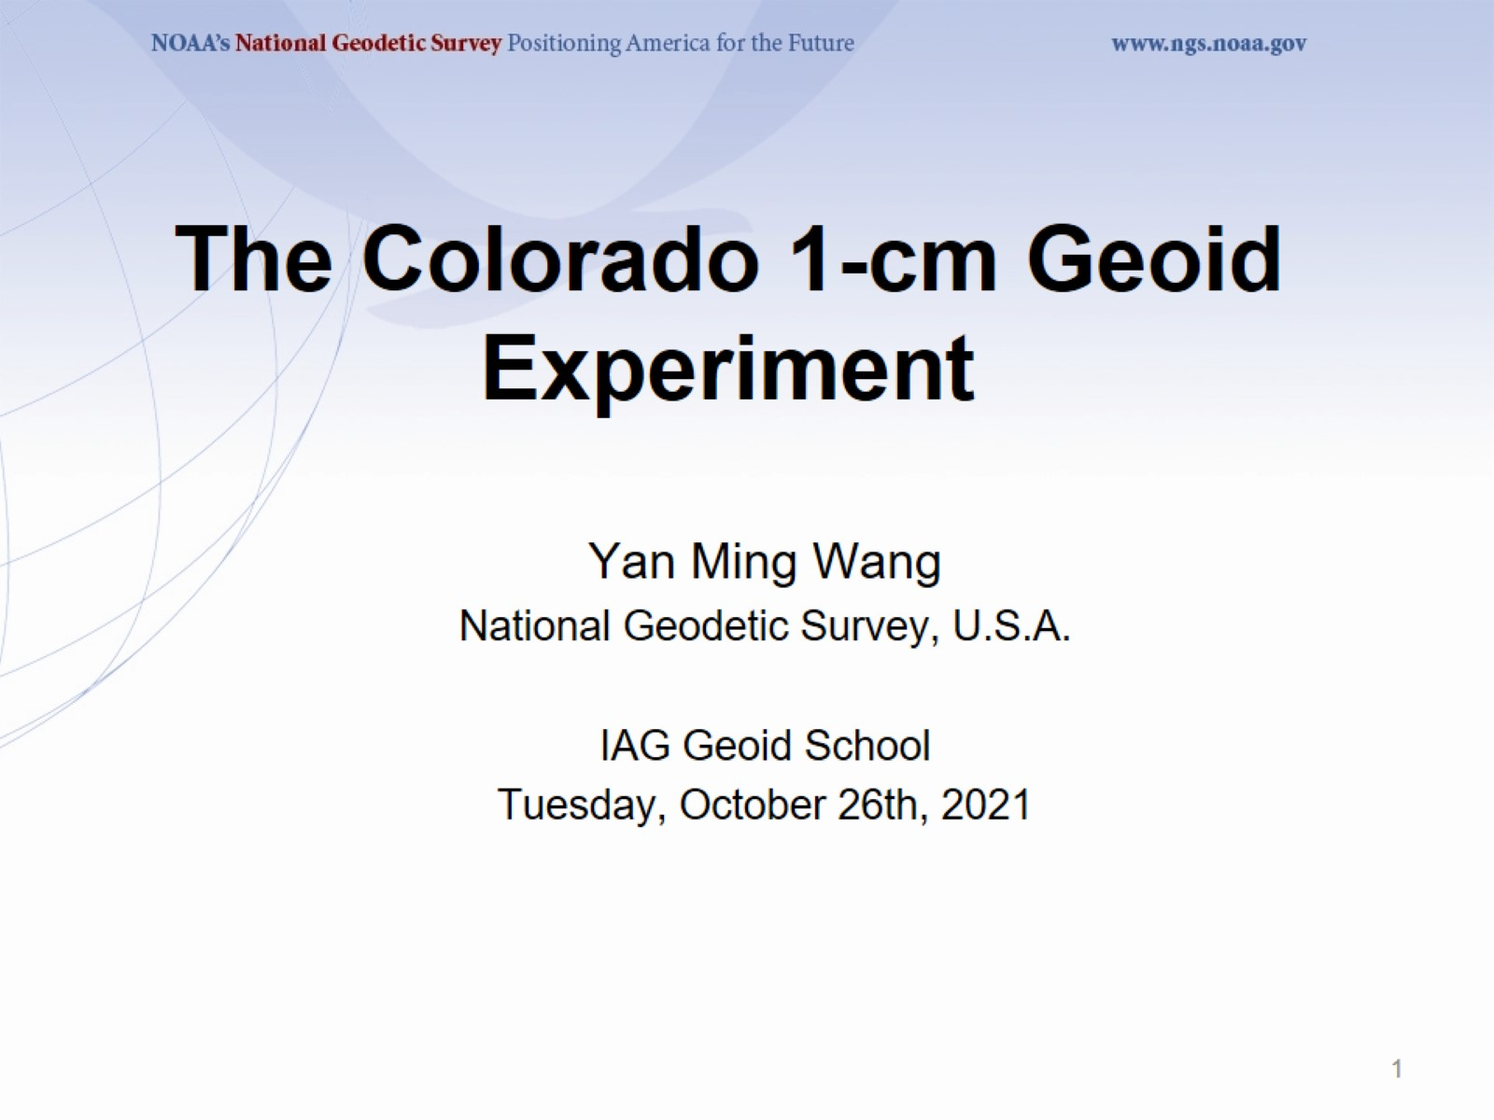
The Colorado 1-cm Geoid Experiment

Slide 2
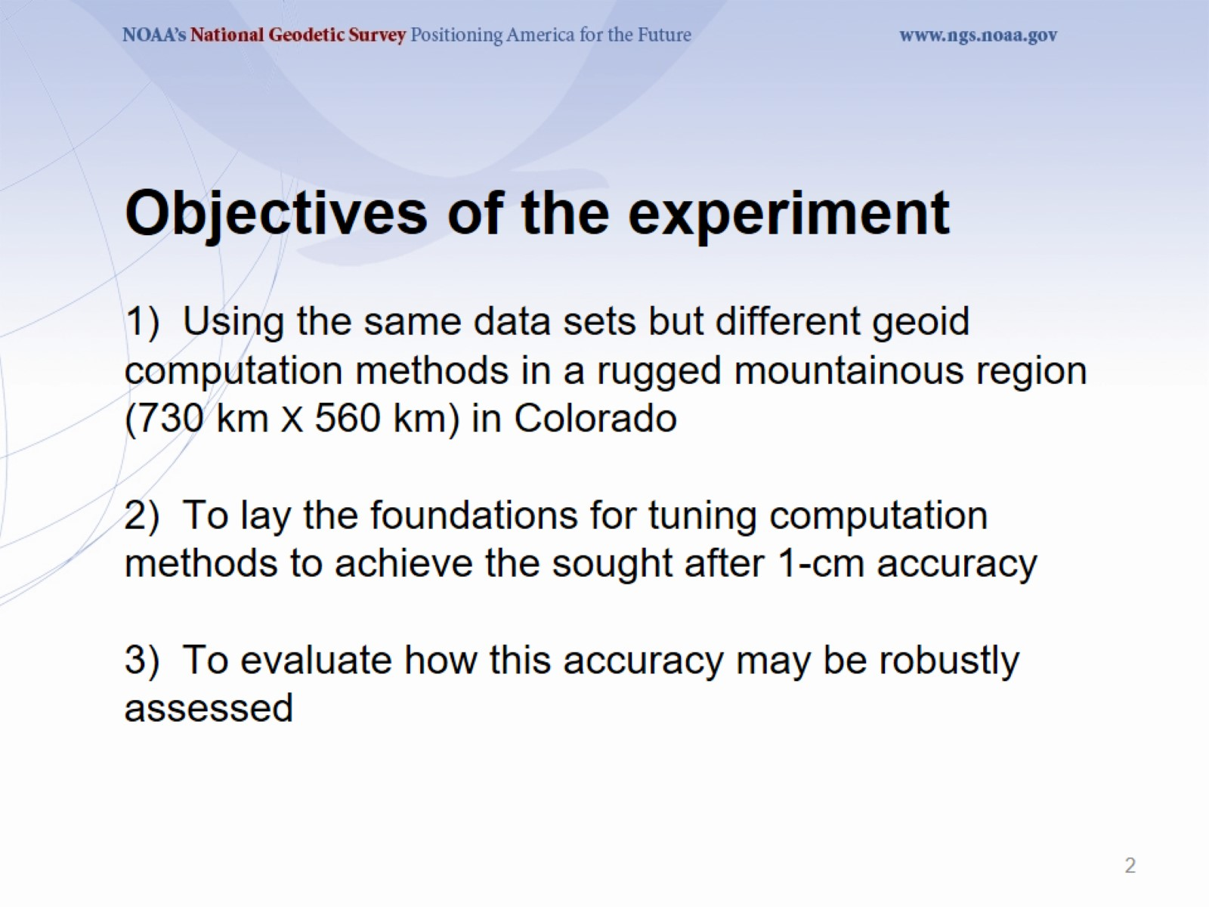
Objectives of the experiment
1) Using the same data sets but different geoid computation methods in a rugged mountainous region (730 km X 560 km) in Colorado
2) To lay the foundations for tuning computation methods to achieve the sought after 1-cm accuracy
3) To evaluate how this accuracy may be robustly assessed

Slide 3
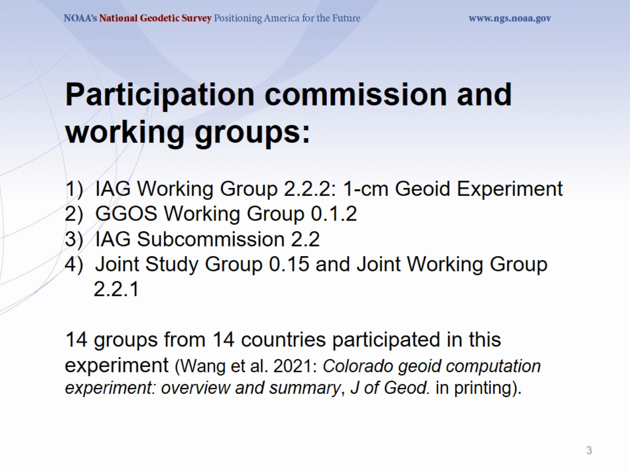
Participation commission and working groups:
1) IAG Working Group 2.2.2: 1-cm Geoid Experiment
2) GGOS Working Group 0.1.2
3) IAG Subcommission 2.2
4) Joint Study Group 0.15 and Joint Working Group
2.2.1
14 groups from 14 countries participated in this experiment (Wang et al. 2021: Colorado geoid computation experiment: overview and summary, J of Geod. in printing).

Slide 4
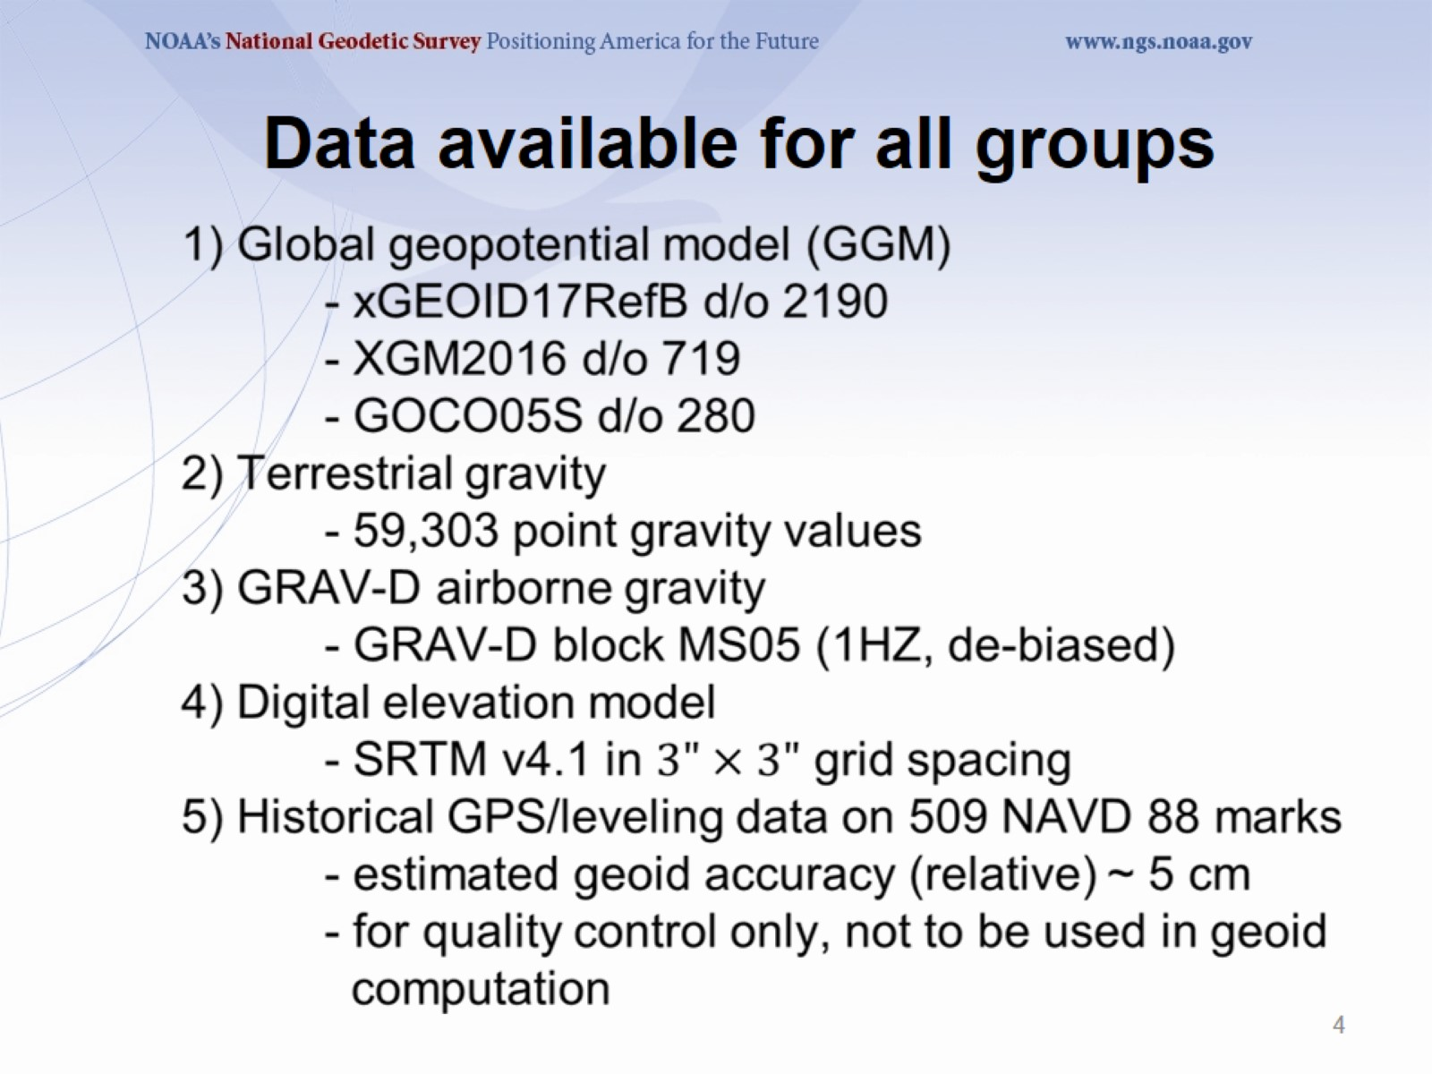

Slide 5
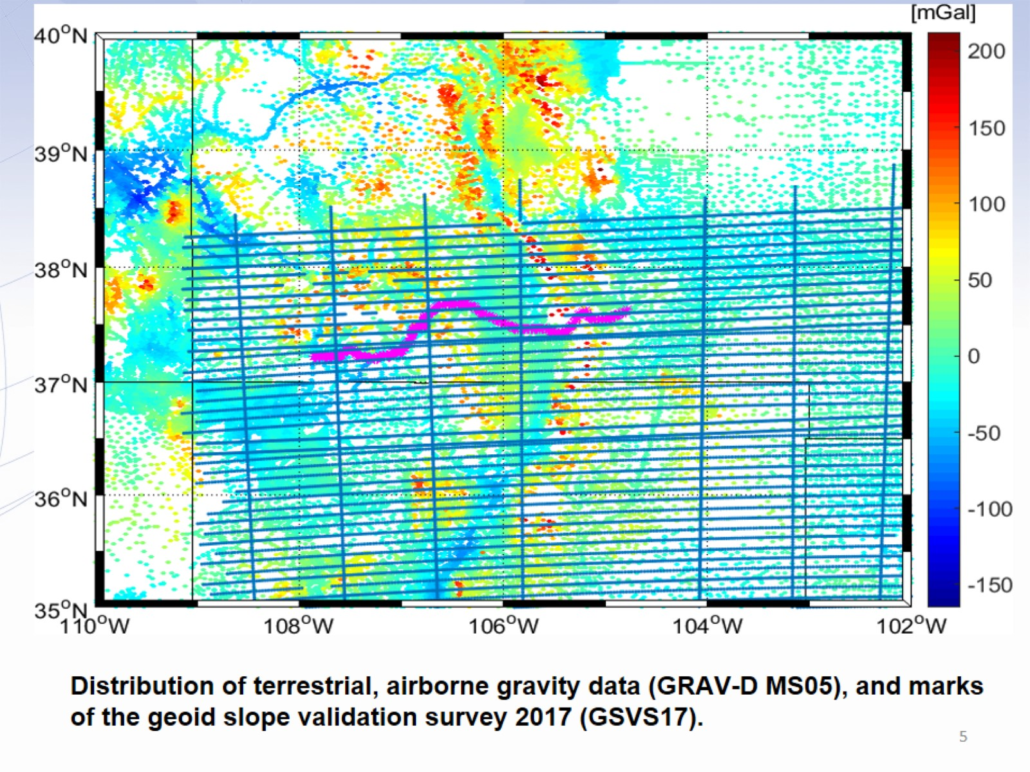
Distribution of terrestrial, airborne gravity data (GRAV-D MS05), and marks of the geoid slope validation survey 2017 (GSVS17).

Slide 6
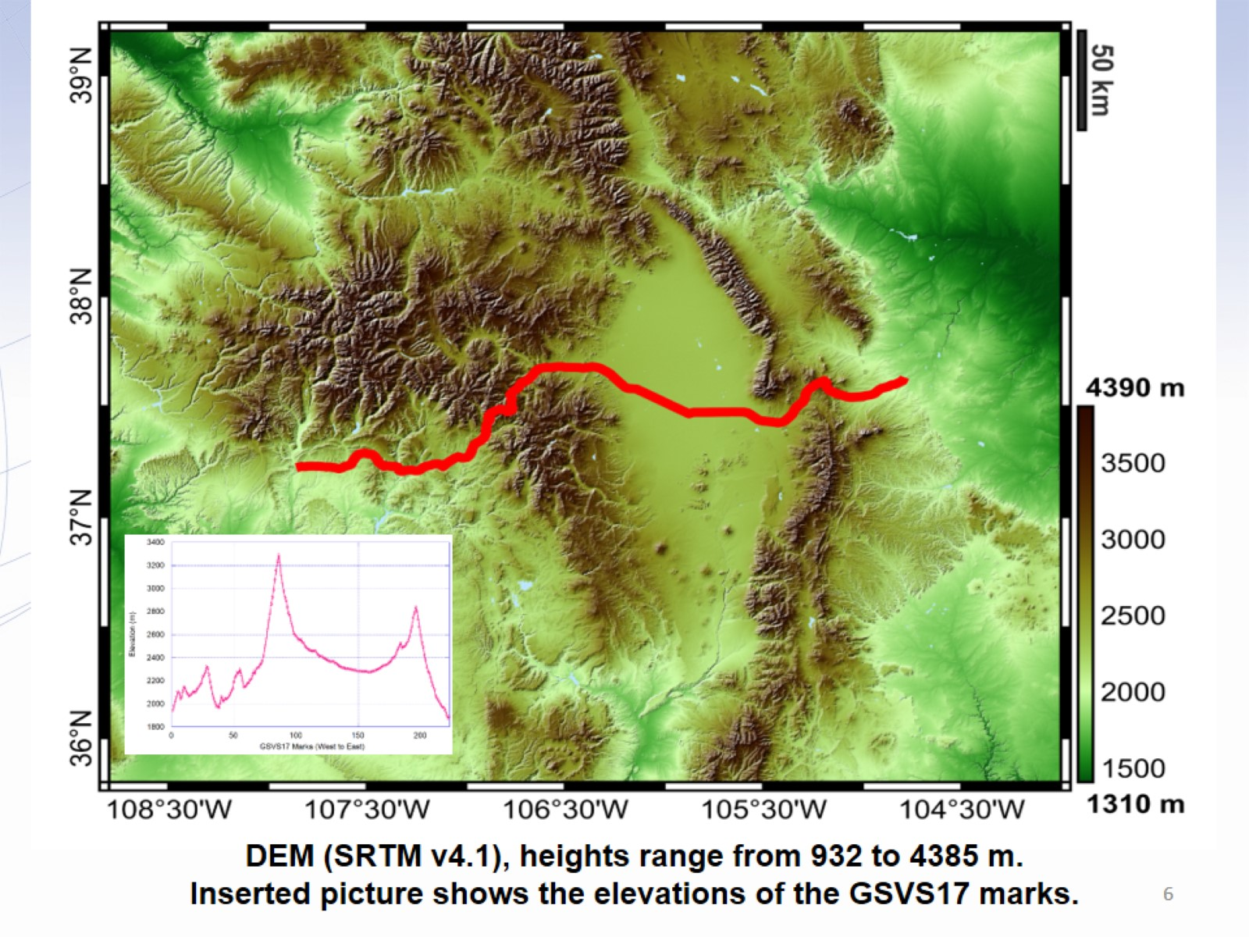
DEM (SRTM v4.1), heights range from 932 to 4385 m.
Inserted picture shows the elevations of the GSVS17 marks.

Slide 7
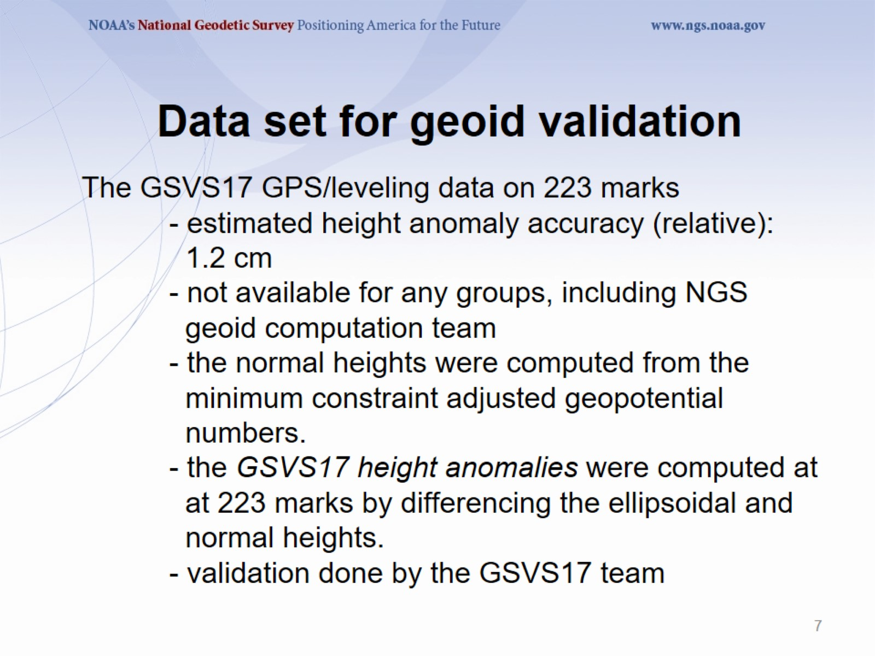
The GSVS17 GPS/leveling data on 223 marks
- estimated height anomaly accuracy (relative): 1.2 cm
- not available for any groups, including NGS geoid computation team
- the normal heights were computed from the minimum constraint adjusted geopotential numbers.
- the GSVS17 height anomalies were computed at at 223 marks by differencing the ellipsoidal and normal heights.
- validation done by the GSVS17 team

Slide 8
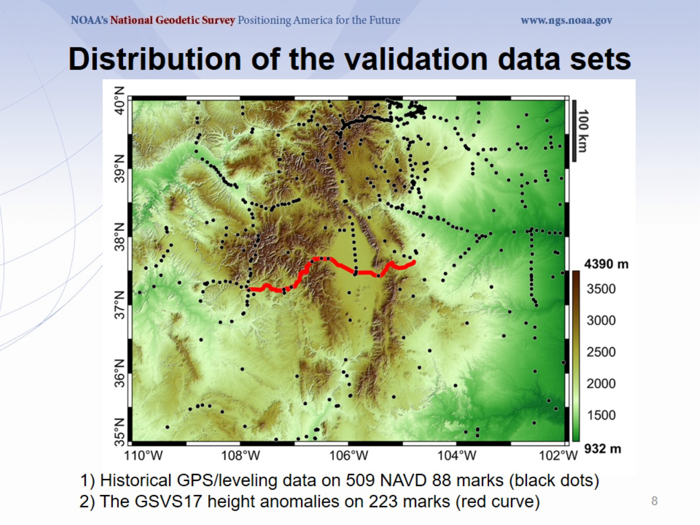

Slide 9
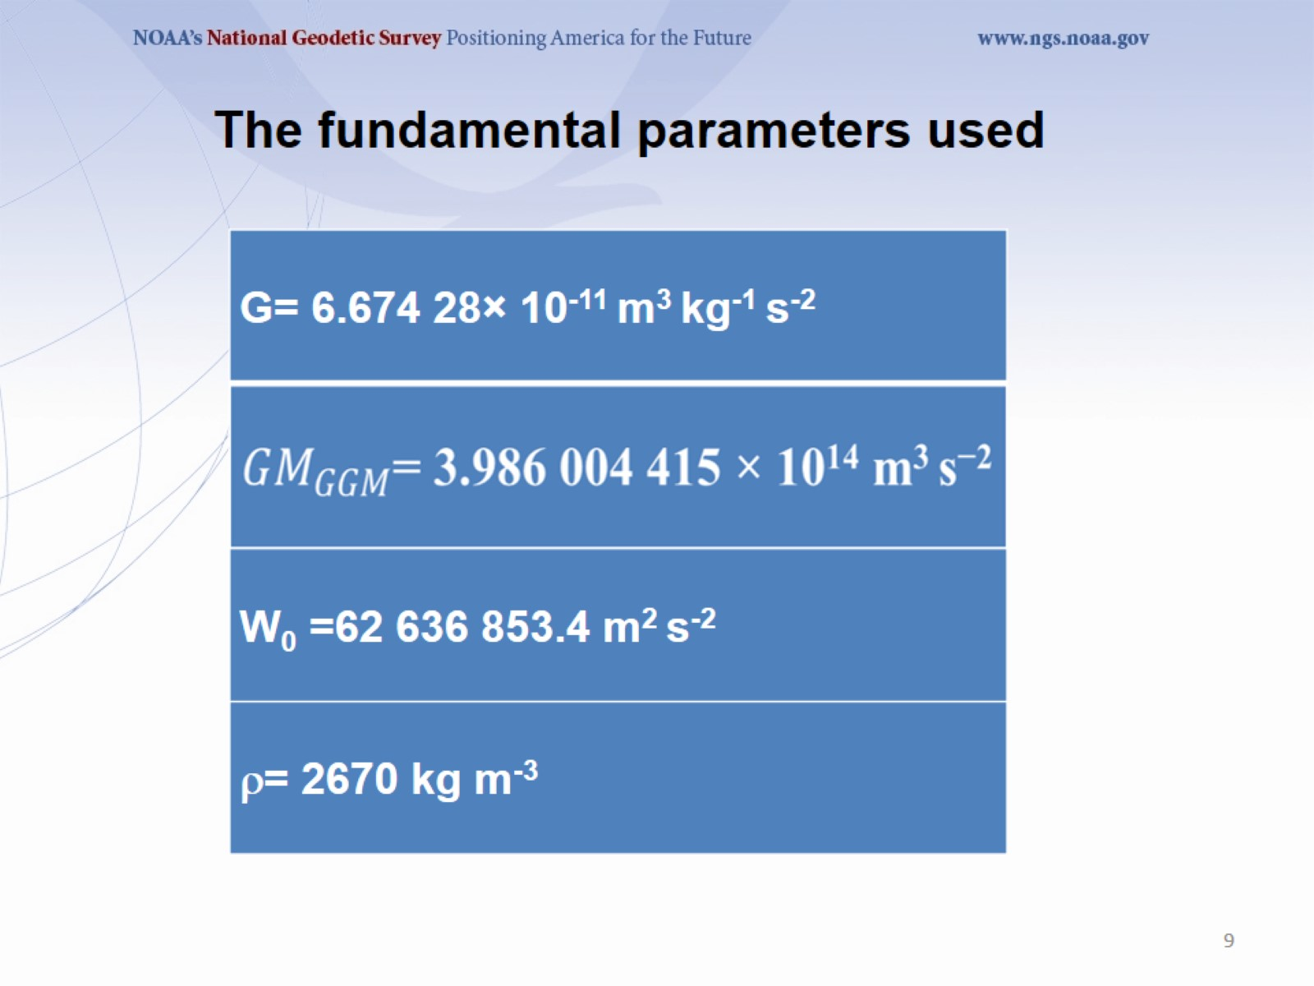
The fundamental parameters used

Slide 10
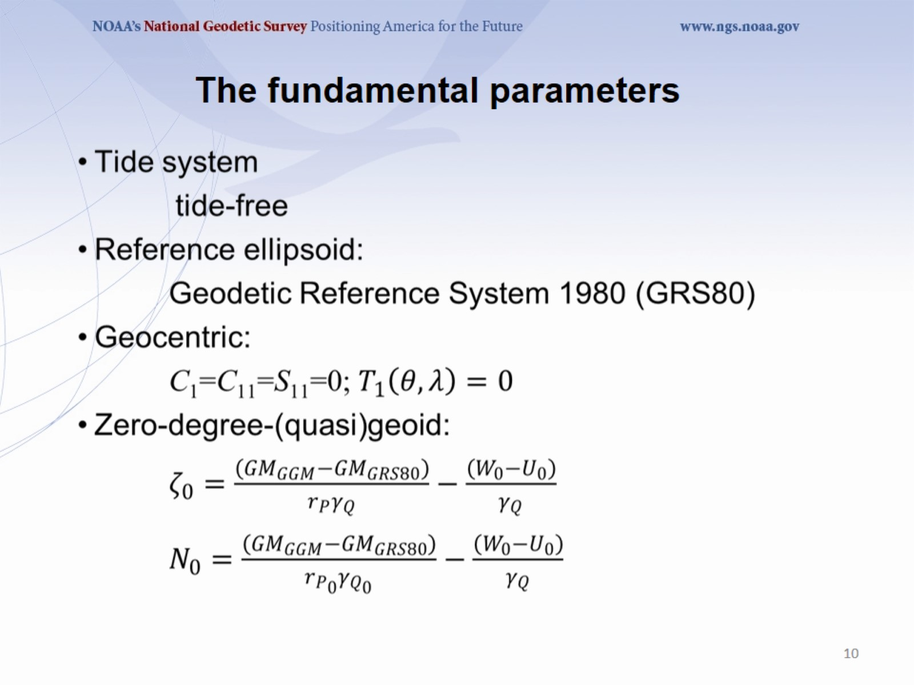
The fundamental parameters

Slide 11
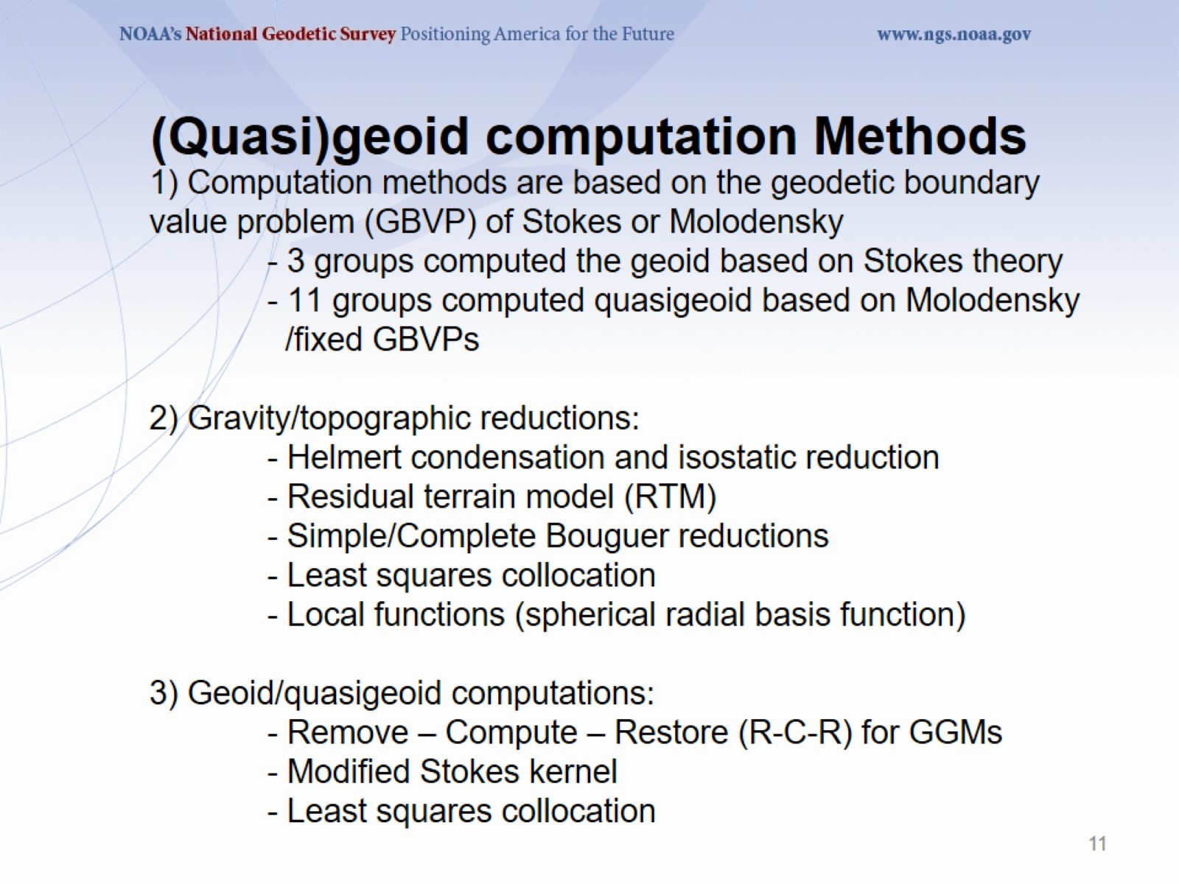
1) Computation methods are based on the geodetic boundary value problem (GBVP) of Stokes or Molodensky
- 3 groups computed the geoid based on Stokes theory
- 11 groups computed quasigeoid based on Molodensky /fixed GBVPs
2) Gravity/topographic reductions:
- Helmert condensation and isostatic reduction
- Residual terrain model (RTM)
- Simple/Complete Bouguer reductions
- Least squares collocation
- Local functions (spherical radial basis function)
3) Geoid/quasigeoid computations:
- Remove – Compute – Restore (R-C-R) for GGMs
- Modified Stokes kernel
- Least squares collocation

Slide 12
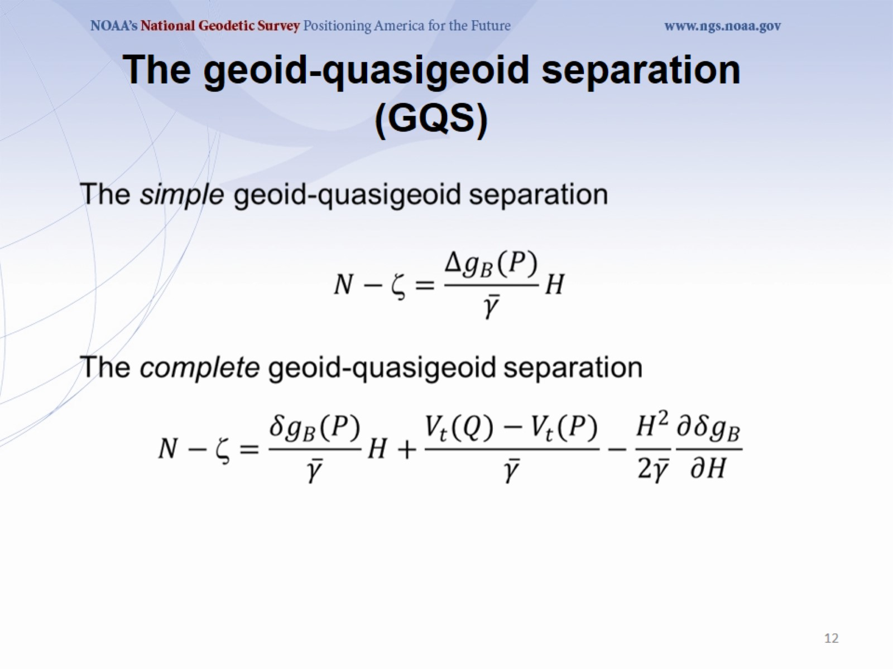
The geoid-quasigeoid separation (GQS)

Slide 13
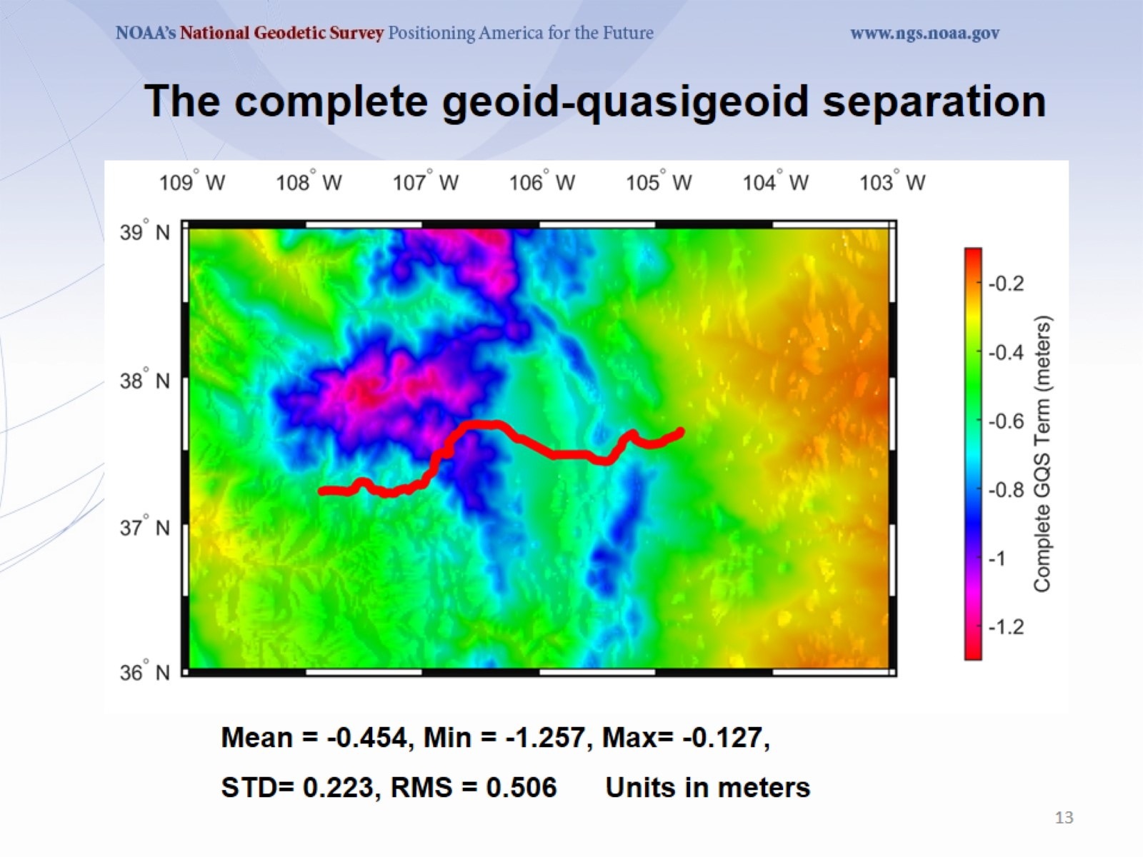
The complete geoid-quasigeoid separation

Slide 14
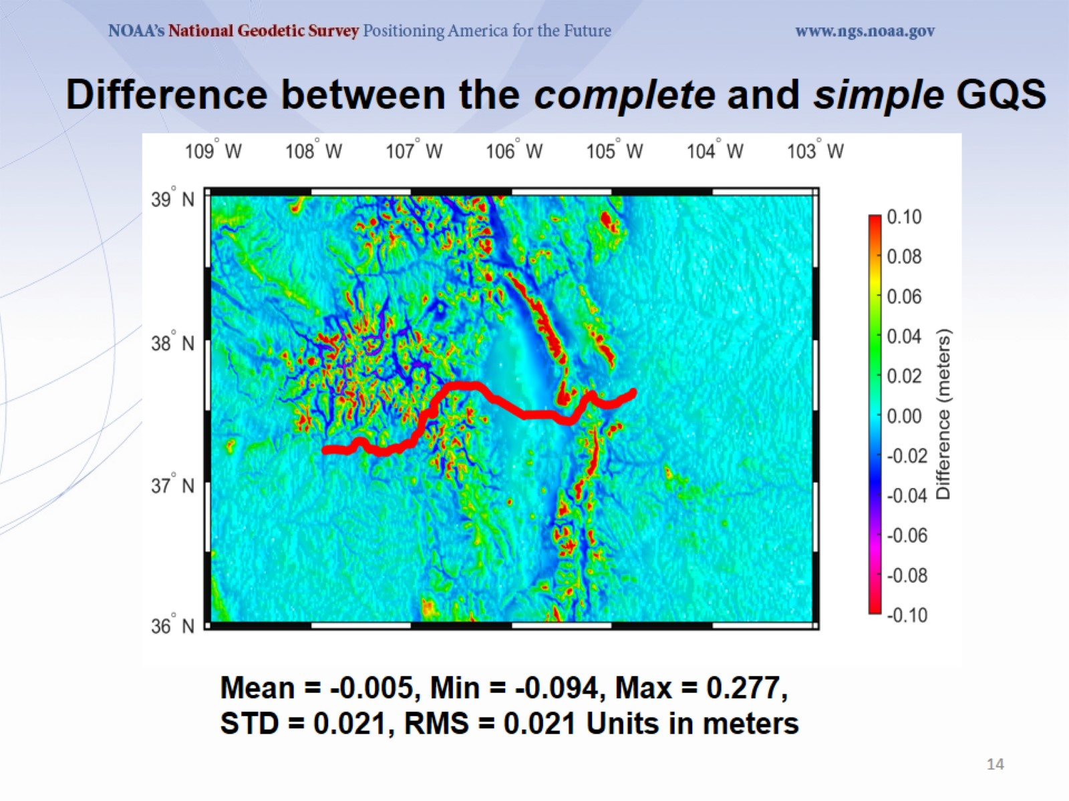
Difference between the complete and simple GQS

Slide 15
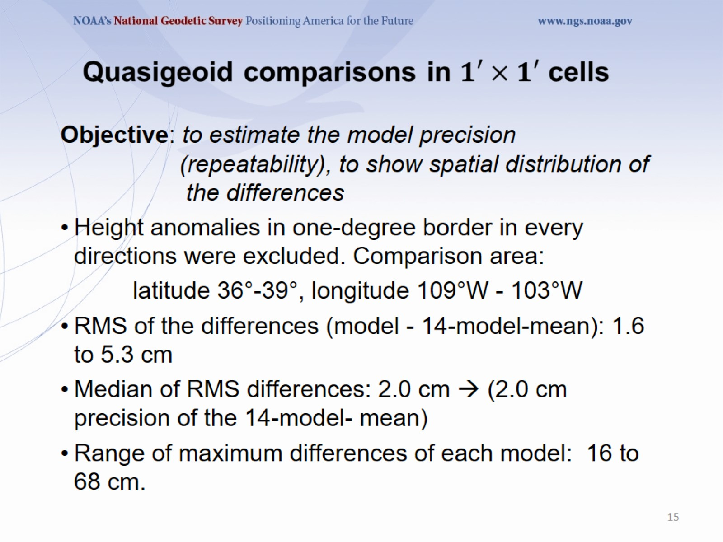

Slide 16
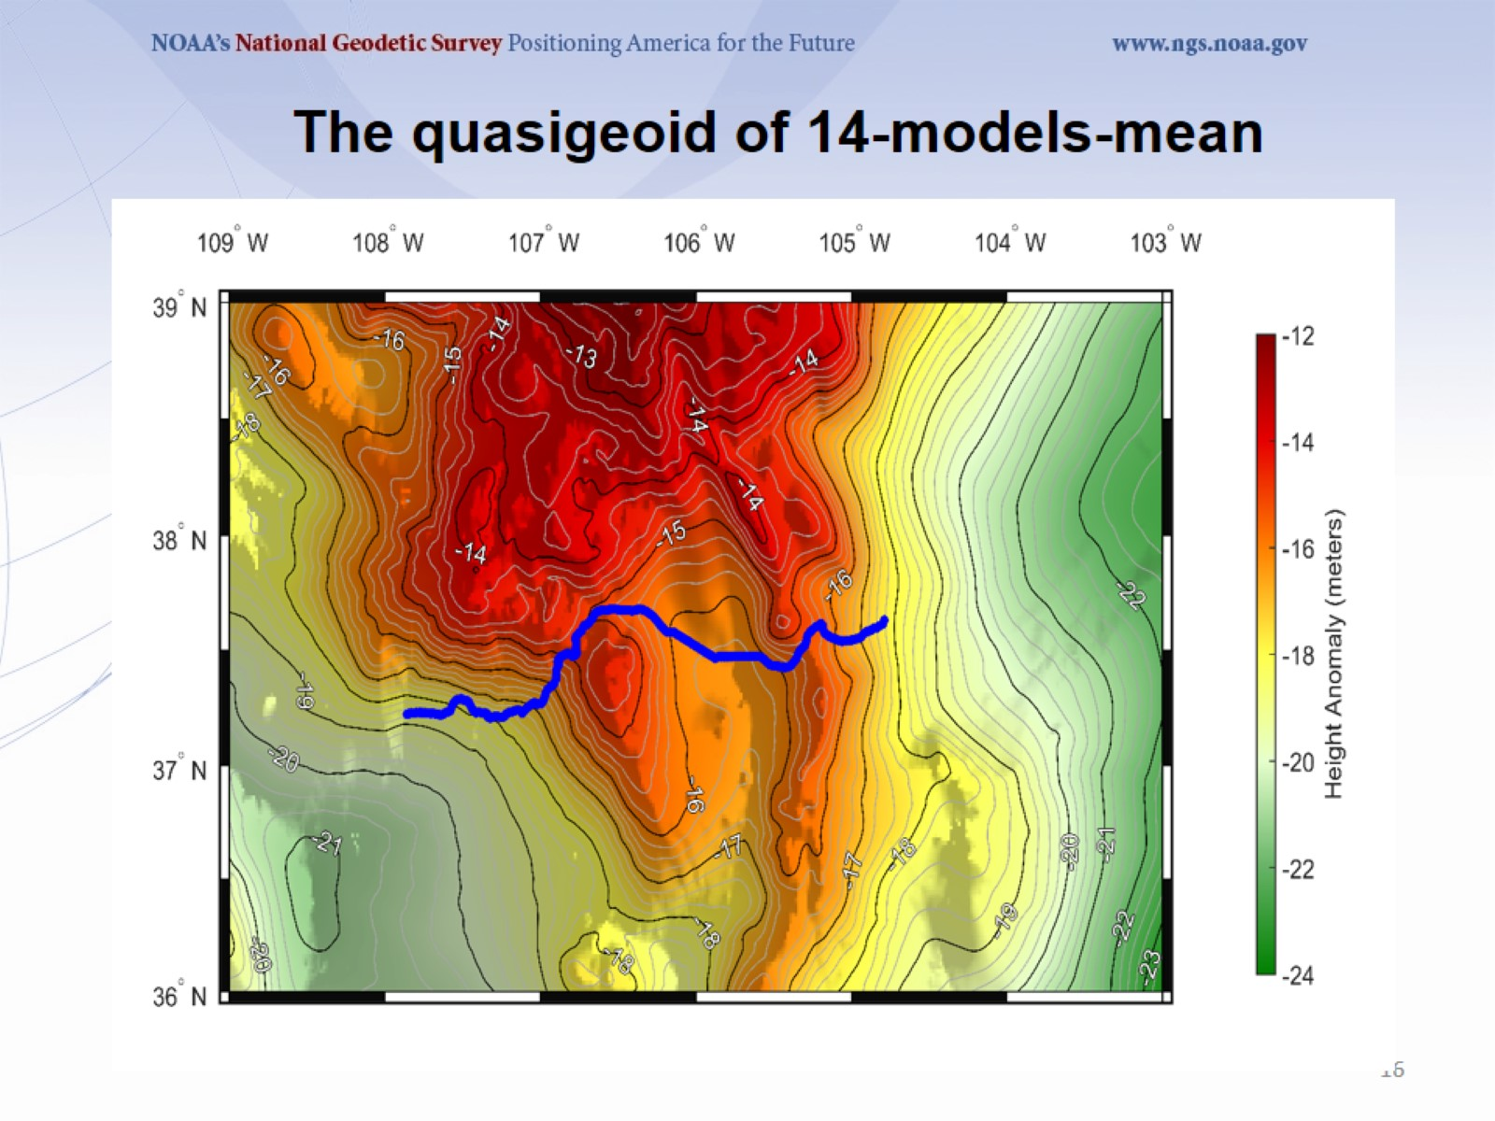
The quasigeoid of 14-models-mean

Slide 17
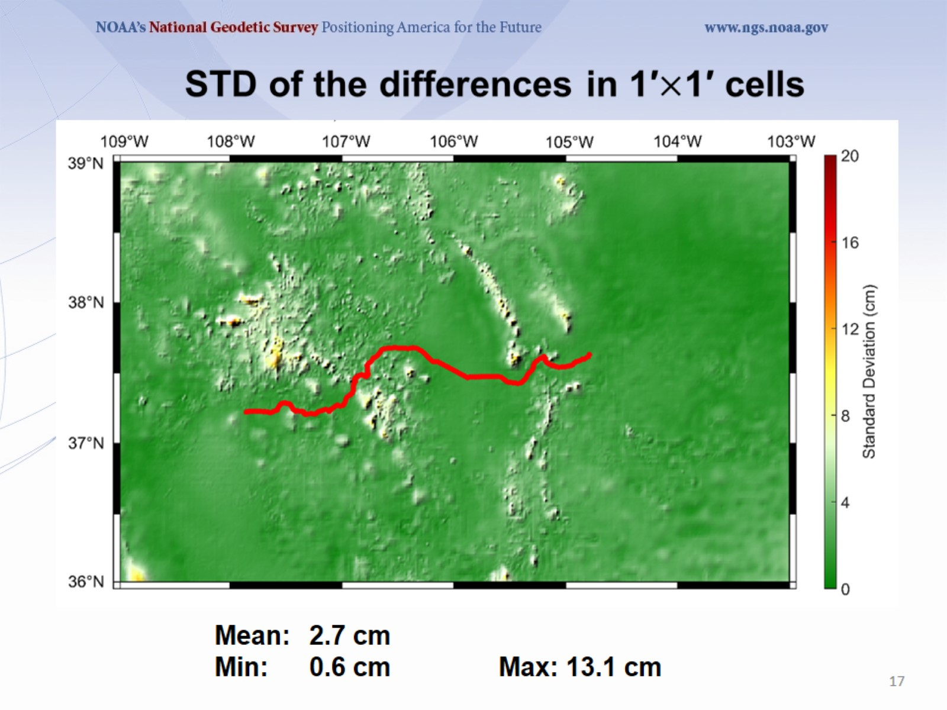

Slide 18
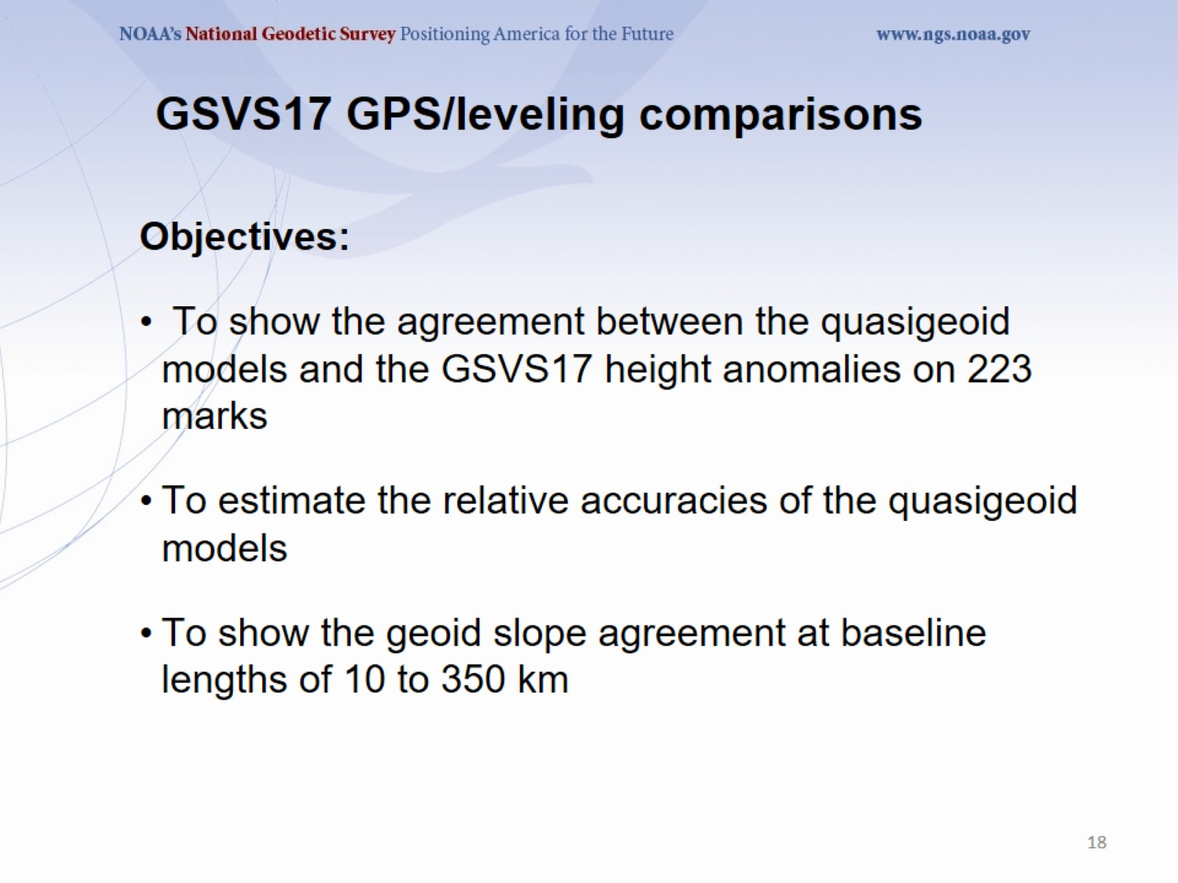
GSVS17 GPS/leveling comparisons

Slide 19
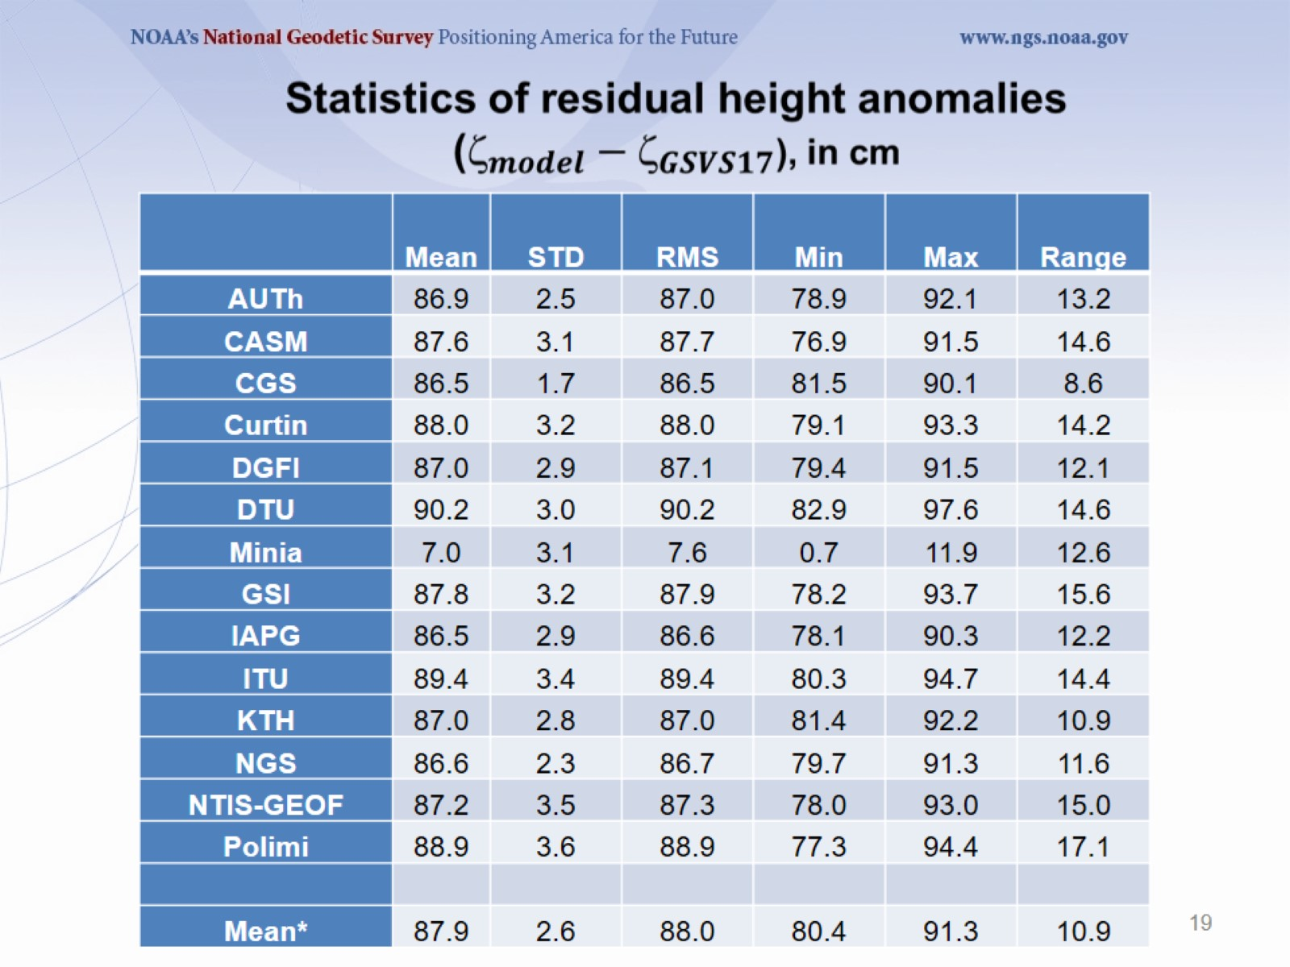

Slide 20
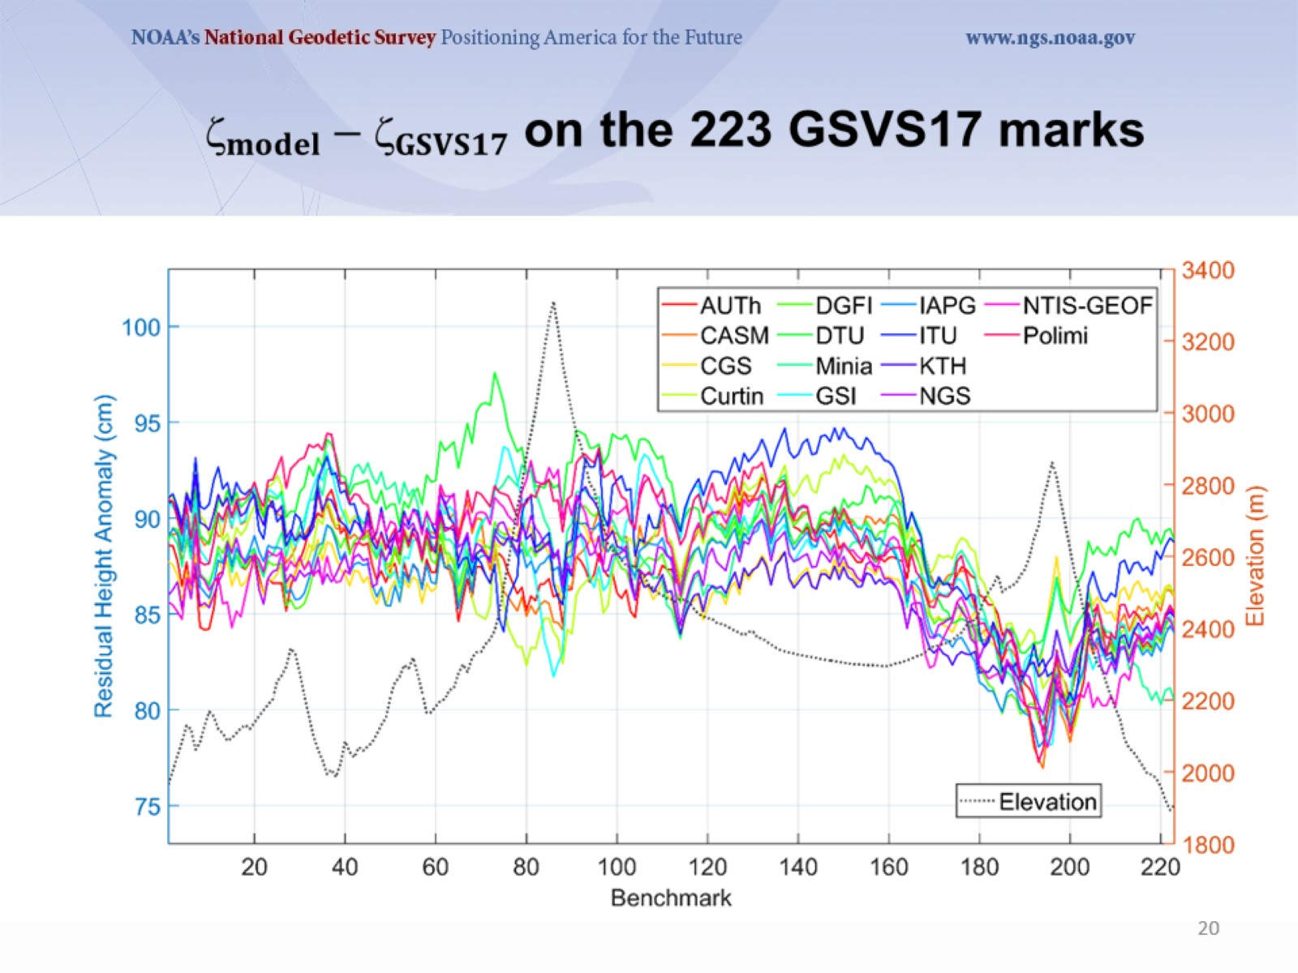

Slide 21
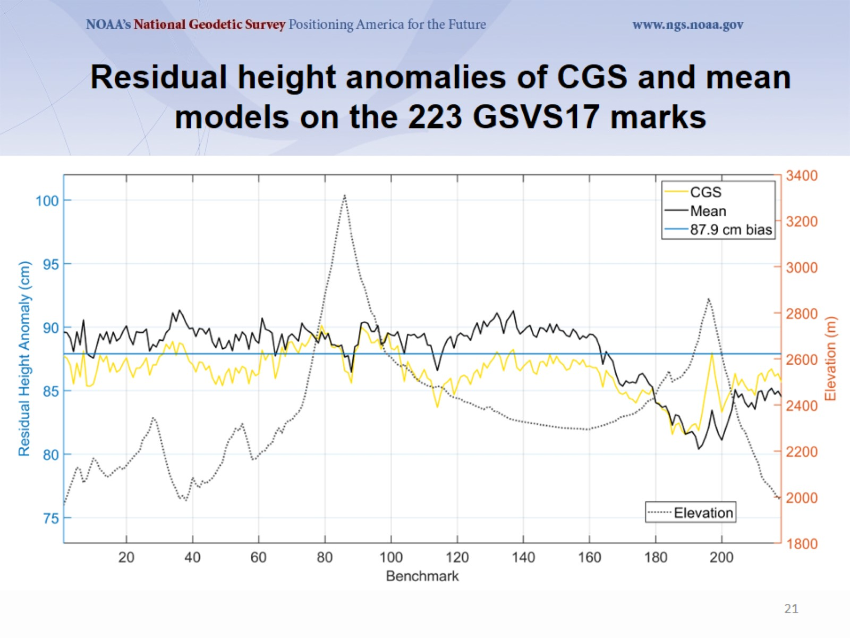
Residual height anomalies of CGS and mean models on the 223 GSVS17 marks

Slide 22
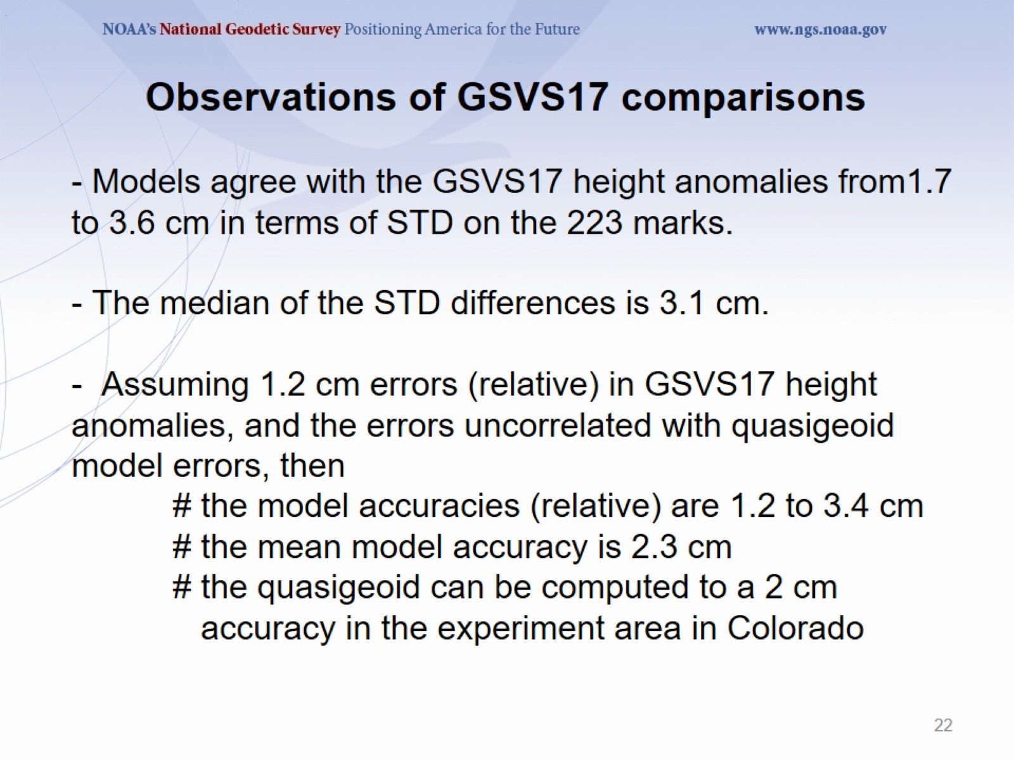
- Models agree with the GSVS17 height anomalies from1.7 to 3.6 cm in terms of STD on the 223 marks.
- The median of the STD differences is 3.1 cm.
- Assuming 1.2 cm errors (relative) in GSVS17 height anomalies, and the errors uncorrelated with quasigeoid model errors, then
# the model accuracies (relative) are 1.2 to 3.4 cm
# the mean model accuracy is 2.3 cm
# the quasigeoid can be computed to a 2 cm accuracy in the experiment area in Colorado

Slide 23
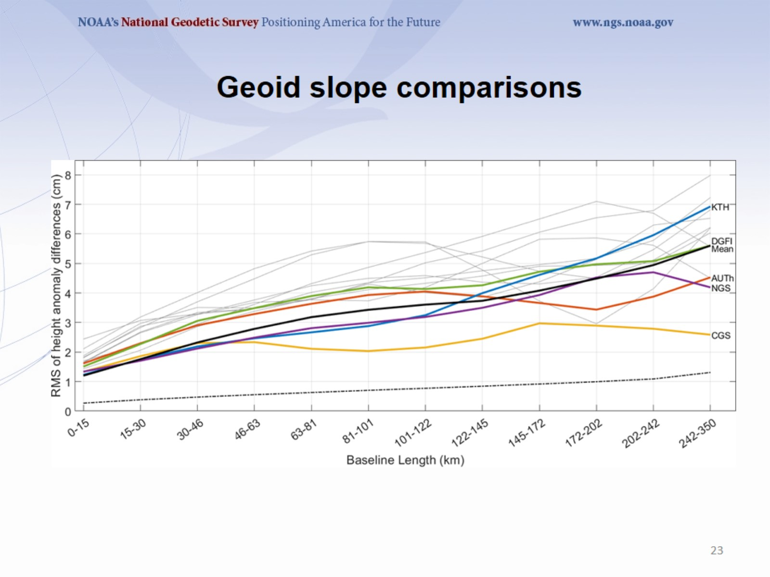
Geoid slope comparisons

Slide 24
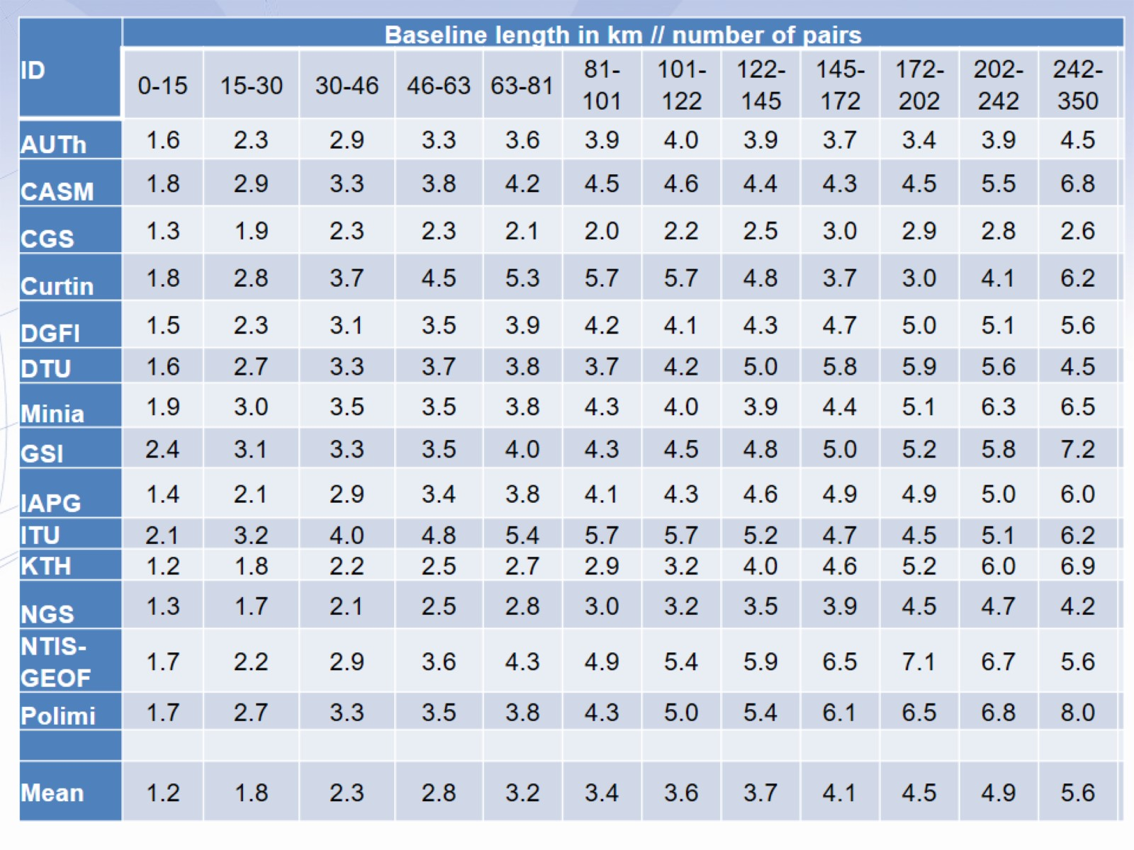
Observations/Conclusions

Slide 25
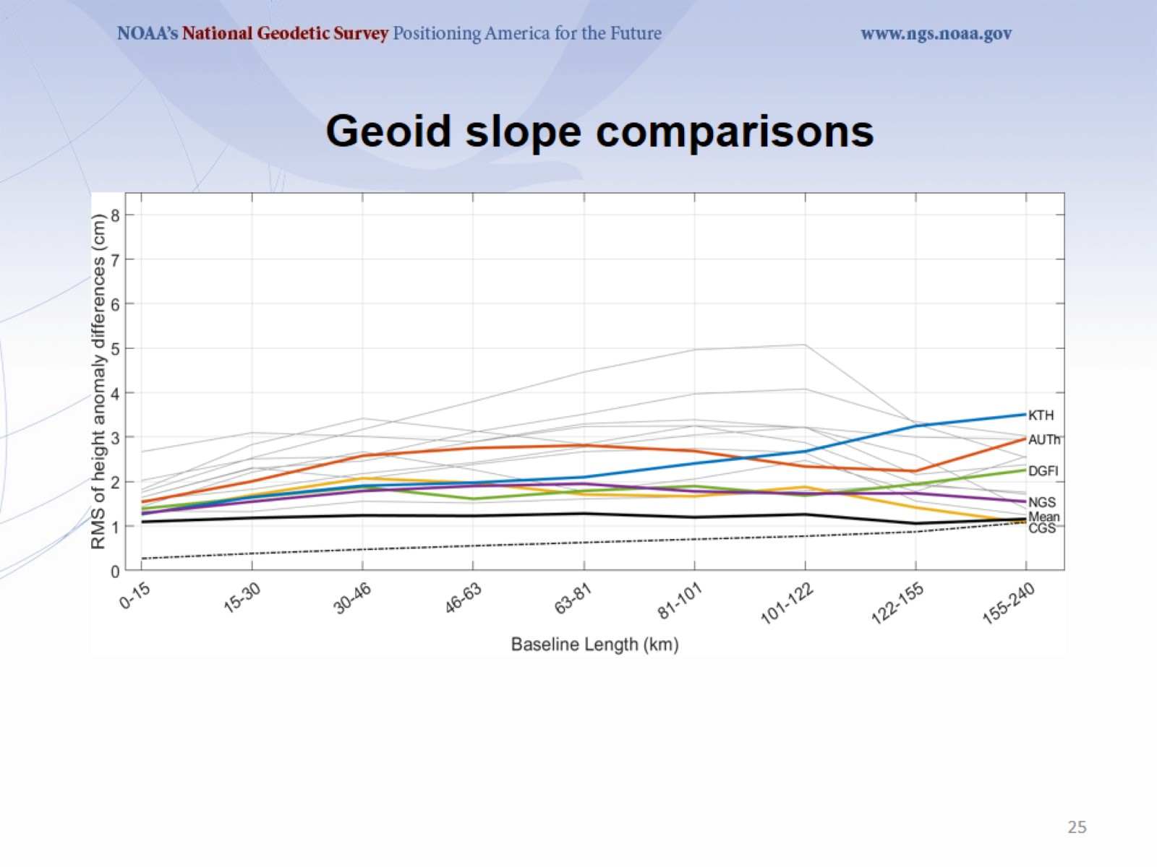
Geoid slope comparisons

Slide 26
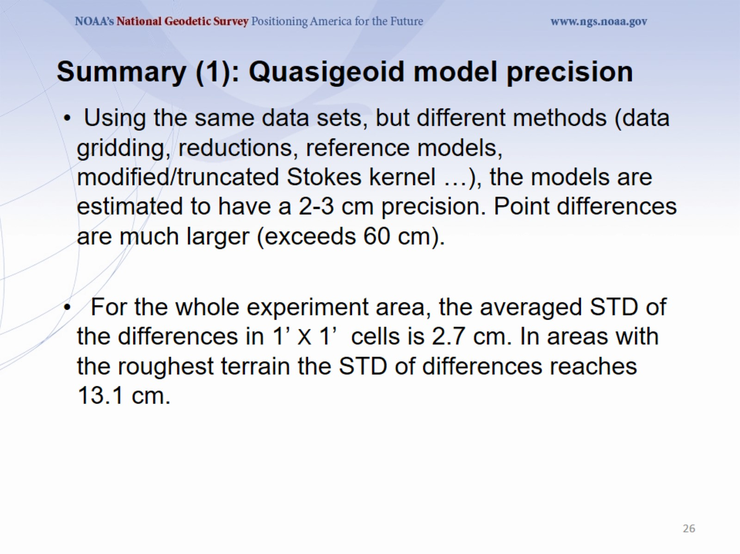
Summary (1): Quasigeoid model precision

Slide 27
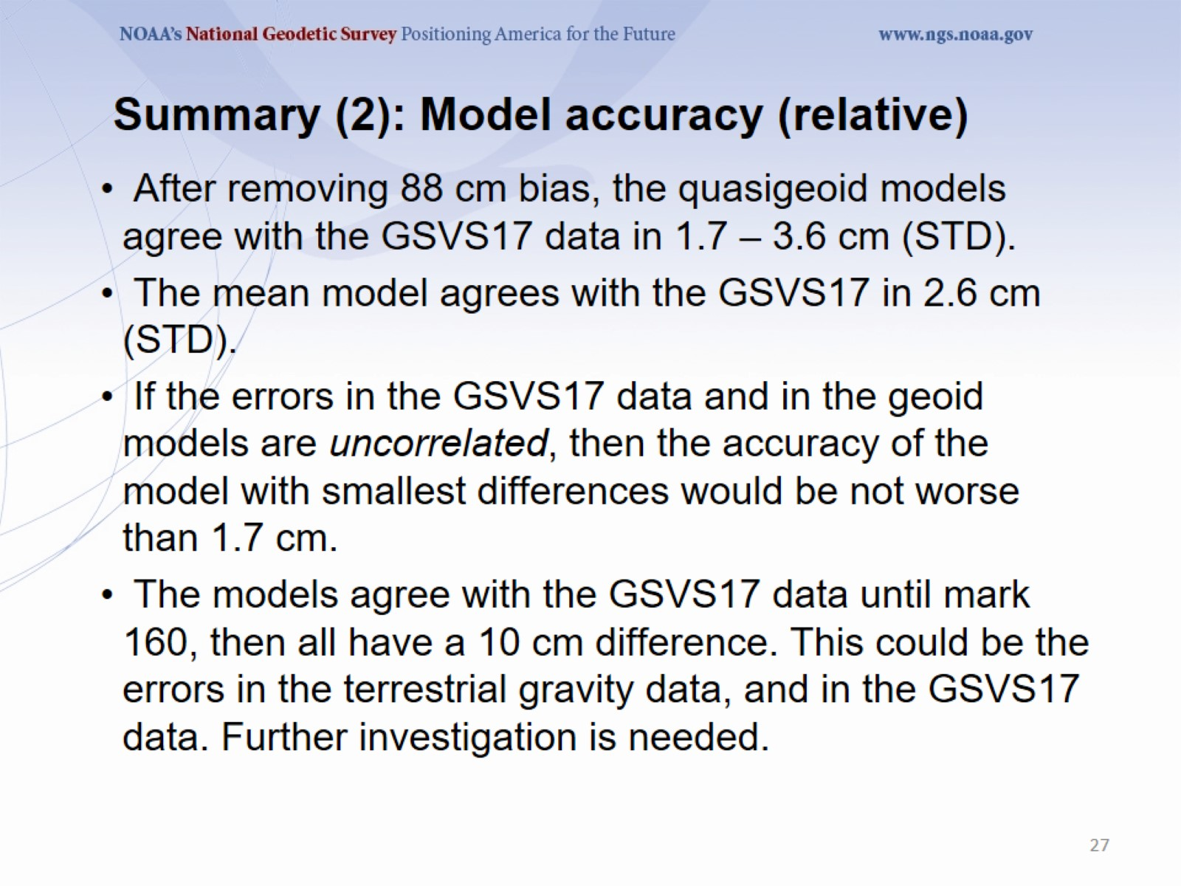
Summary (2): Model accuracy (relative)

Slide 28
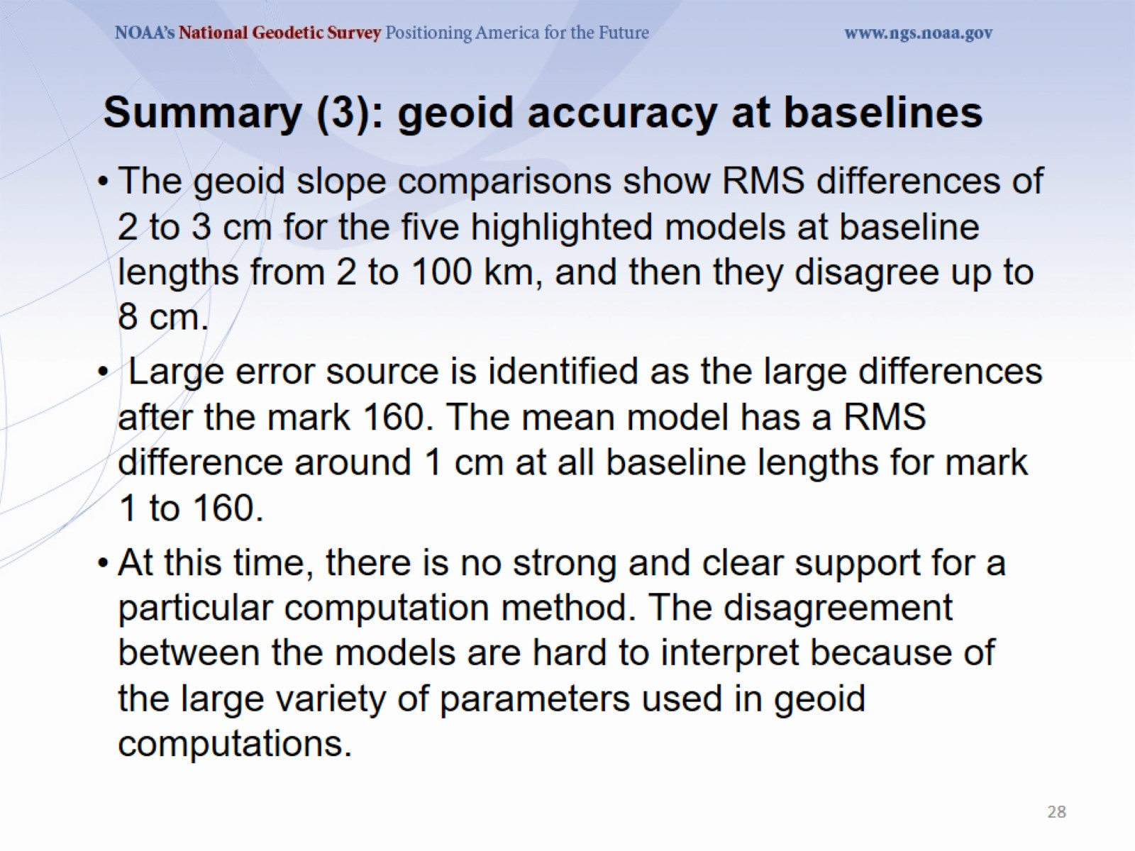
Summary (3): geoid accuracy at baselines

Slide 29
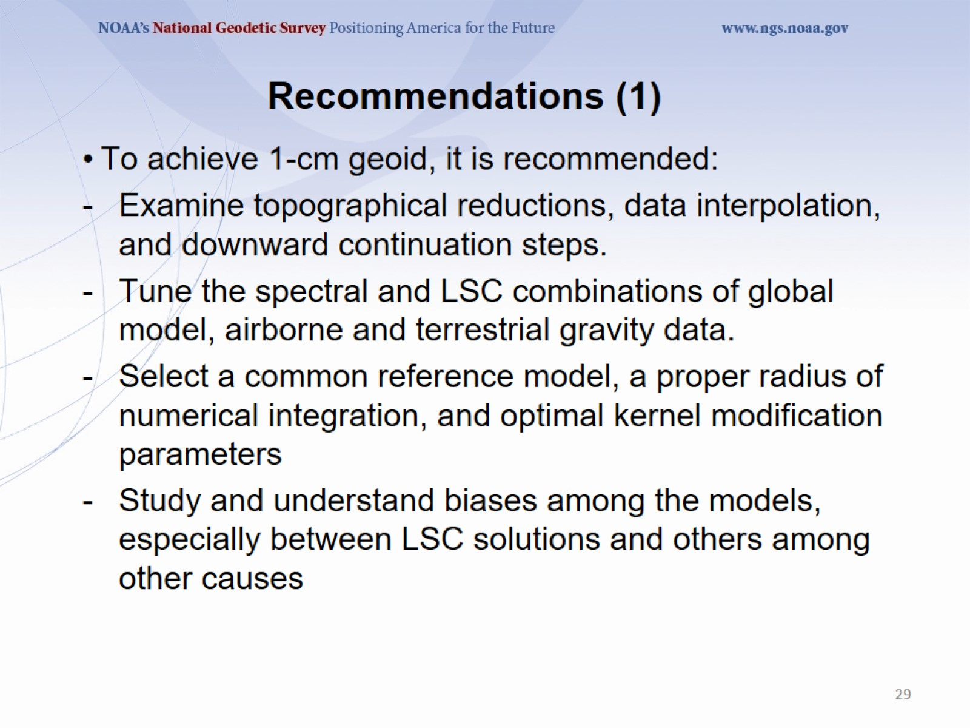
Recommendations (1)

Slide 30
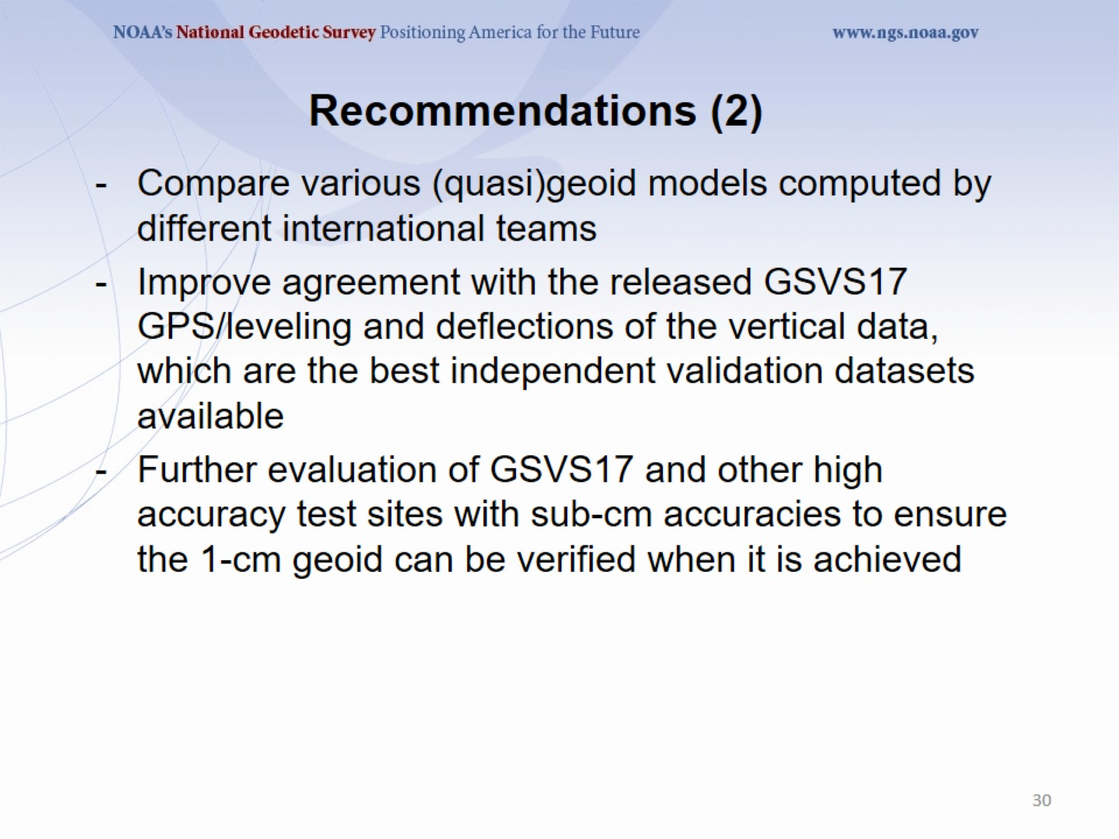
Recommendations (2)

Slide 31
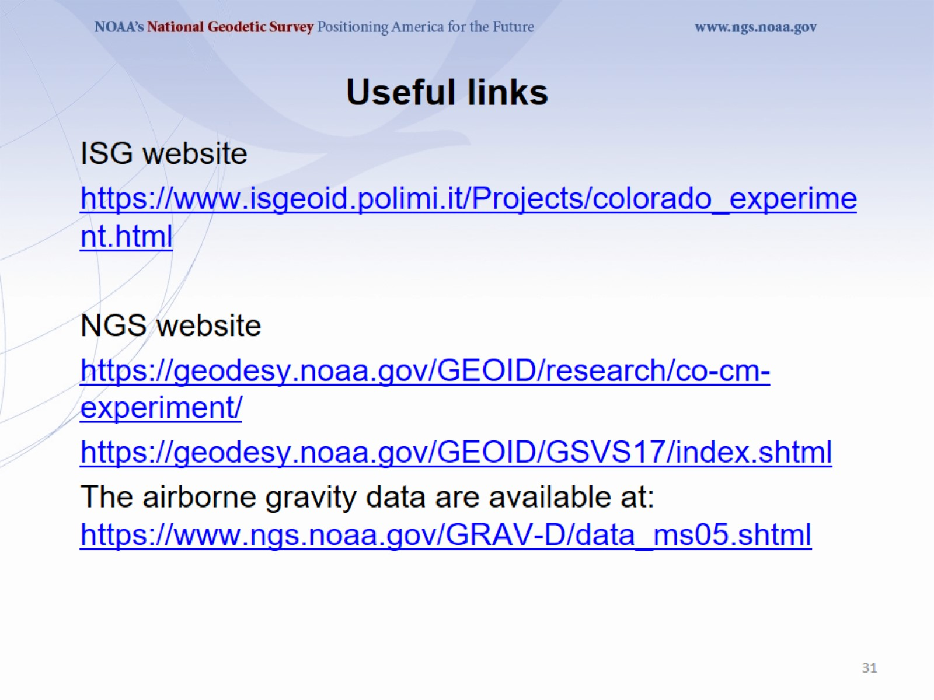
Useful links

Slide 32
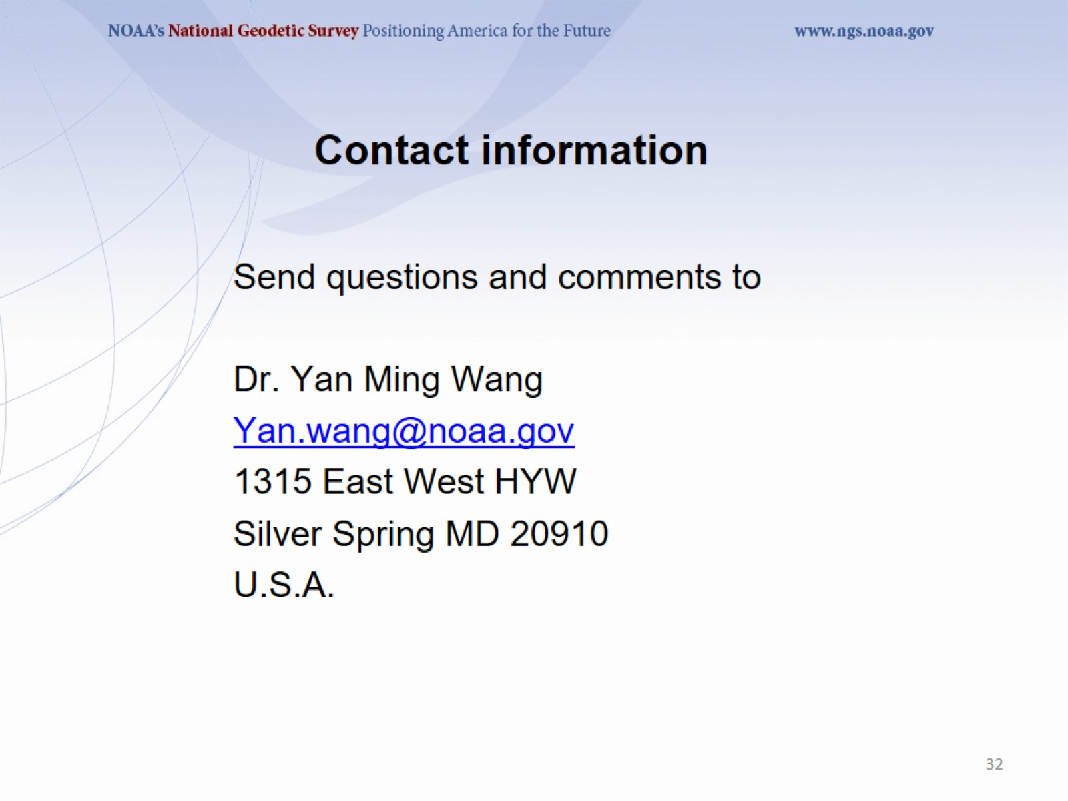
Contact information

