Slide 1

State Plane Coordinate System 2022,
Real Time Networks, and More
Pam Fromhertz
Rocky Mountain Regional Advisor
Pamela.Fromhertz@noaa.gov
240-988-6363
Guest Presenter – Wally Gladstone
Big Sky Geocon
April 3, 2019
geodesy.noaa.gov

Slide 2
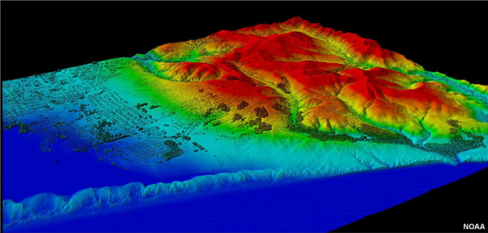

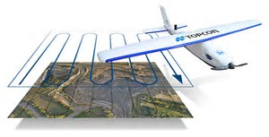
Agenda
Intro
NSRS Modernization
SPCS2022
  Changes are coming – what do you want for your state
  Your input is critical
Real Time Reference Network
GPS on BM
  Phase I - Geoid18
  Phase II – keep collecting
Resources

Slide 3
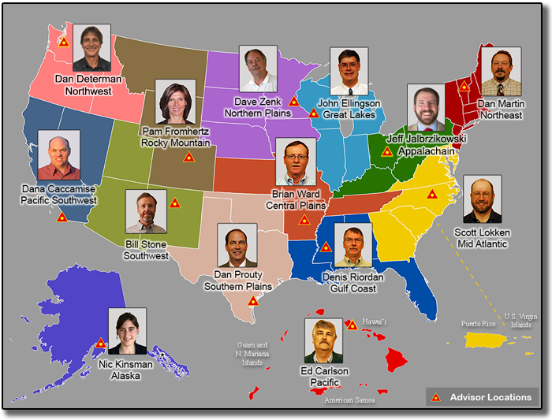
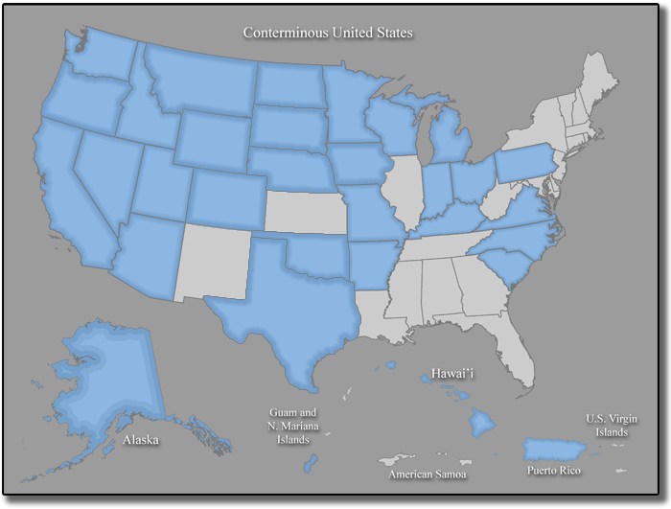
Outreach and Coordination
NGS Advisors
State Coordinators
Notes:
NGS Regional Geodetic Advisors
https://geodesy.noaa.gov/ADVISORS/
State Geodetic Coordinators
https://geodesy.noaa.gov/ADVISORS/state-geodetic-coordinators.shtml

Slide 4
Montana Coordinator Working Group
*Joshua Phillips, MT Association of Registered Land Surveyors (MARLS)
*Tyson Olinger, MT Department of Transportation (MDT)
Erin Fashoway, MT State Library
Wally Gladstone, Tribal
Steve Jay, MAGIP
Stew Willis, MARLS
Pam Fromhertz, NGS
Other interested??
MTCoordinator@marls.com
Marls.com
* Co-Coordinators

Slide 5


Slide 6
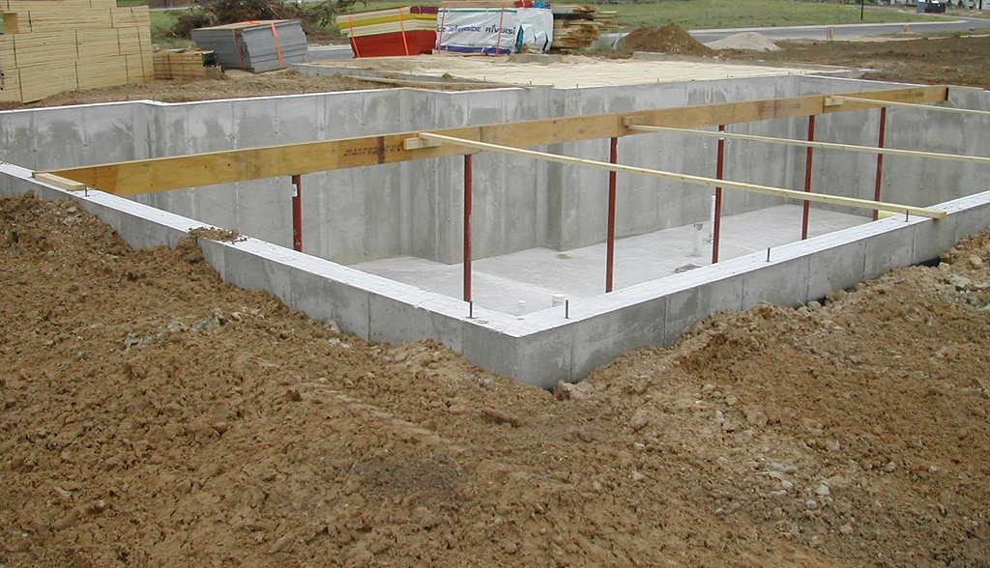
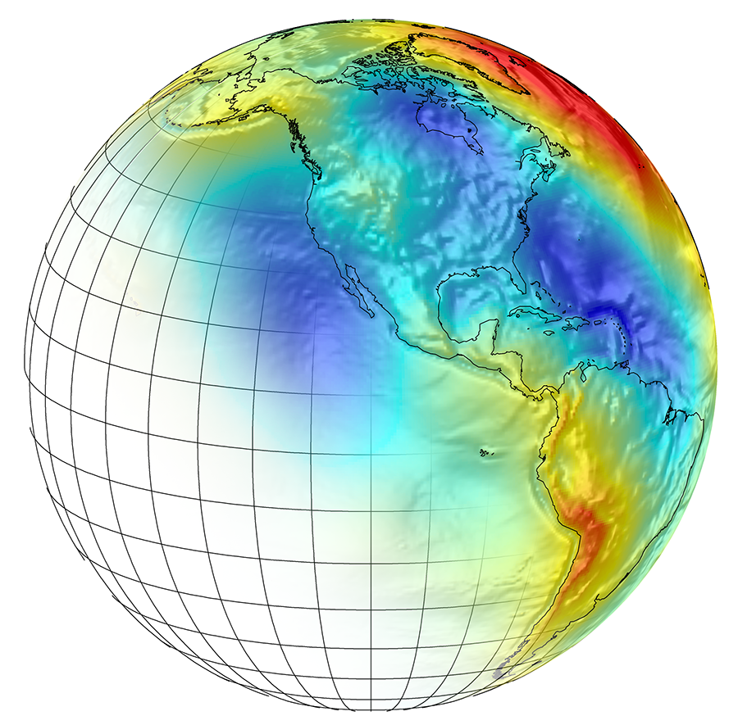
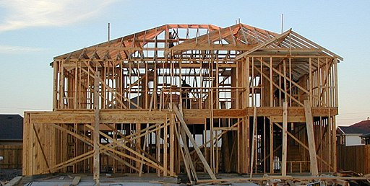
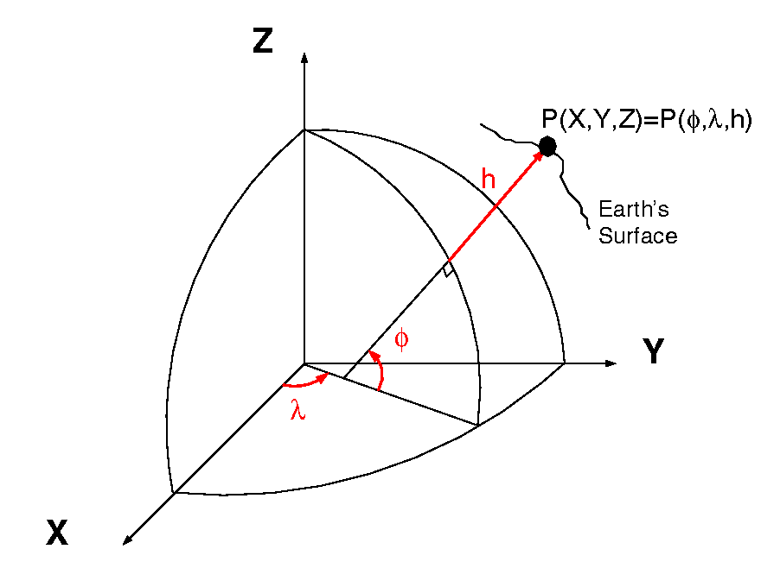
NGS Mission: To define, maintain & provide access to the National Spatial Reference System (NSRS) to meet our Nation’s economic, social & environmental needs
The NSRS:
A common and consistent
Geospatial Infrastructure for positioning
= ht.
aka P(L,L,H)
= lat.
= long.
Lat, Lon, Height, scale, gravity, orientation
Notes:
Foundation image credit Armchairbuilder.com - http://armchairbuilder.com/resources/how-to-build-your-own-home
The National Spatial Reference System is our nations geospatial infrastructure from which all positioning (with the exclusion of military/DOD) is referenced to.
This system provides a consistent framework that allows people to use data in the same reference system to perform analysis and make meaningful comparisons and decisions from that analysis.

Slide 7
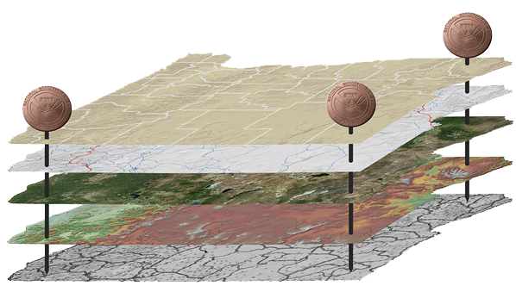
Why do we need Datums?
Provide consistent coordinates
Precise reference system
Align disparate geospatial data
A reference surface or framework to reference your data to

Slide 8
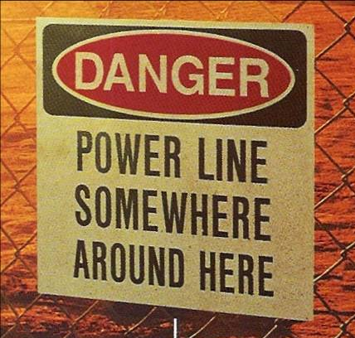
Why does all this stuff matter?
Geospatial data is everywhere
Usefulness diminished if stuff doesn’t line up
If problems easy to fix they already would be fixed
Courtesy of Michael Dennis

Slide 9
NGS and the NSRS – legal context
OMB Circular A-16 (revised 2002)*:
  Requires all federal civilian geospatial agencies to use geodetic control
  Puts DOC/NOAA (=NGS) in charge of that control
  NGS has defined that control as the NSRS
FGCS requirements do not apply to:
  Military/Intelligence federal agencies
  State and local governments
  Private individuals and companies
But these groups often do adopt all or part of the NSRS to be compatible with most federal geospatial data
  Could lead to mixing NSRS and non-NSRS information.
* Some of OMB A-16 was codified into law in the Geospatial Data Act of 2018 –
A full analysis of the implications of that act have not yet been performed

Slide 10
NSRS Horizontal Evolution
Datum | Time Span | Network Accuracy | Method of Reference
NAD27 | 1927 - 1986 | 10 meters | Traverse and Triangulation. Ground marks used for referencing the NSRS
NAD83 (86) | 1986 - 199* | 1 meter
NAD83 (HARN) | 199* - 2007 (varies by state) | 0.1 meter | GPS becomes the means of positioning. Ground marks.
NAD83 (NSRS2007) | 2007 - 2012 | 0.01 meter | GPS – CORS are the means of reference for the NSRS
NAD83 (2011) | 2012 - present | 0.01 meter
Notes:
As technology, scientific discoveries and surveying methodologies and analysis have all improved so has the accuracy of the datums.
Continuous improvements have driven the need for NGS to modernize the NSRS in 2022.

Slide 11
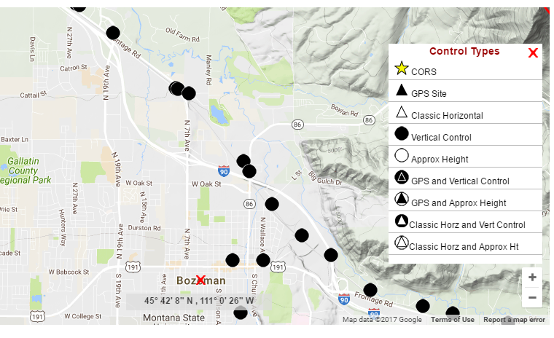
NGS Data Explorer

Slide 12
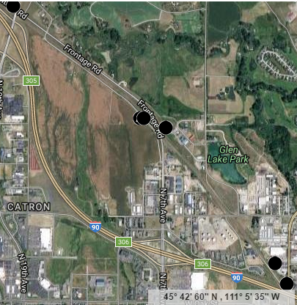
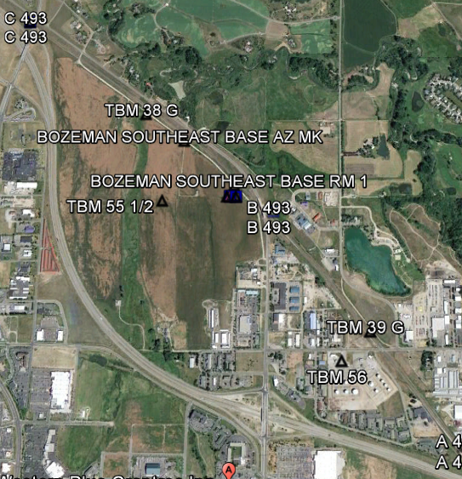
Local Control Displayed
NGS Data Explorer
DS World

Slide 13
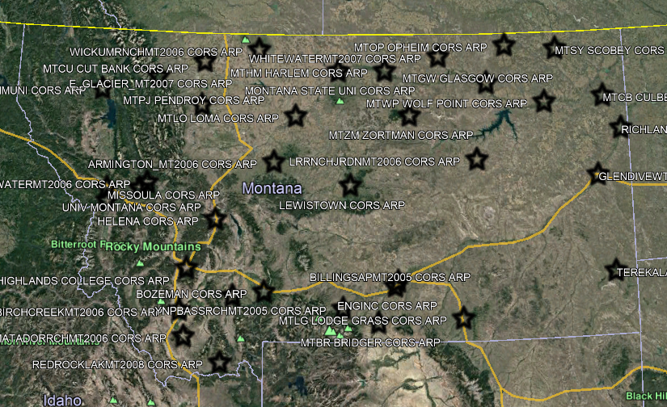
Montana CORS

Slide 14
NSRS Modernization
  All horizontal and vertical datums in the NSRS (NAD 83, NAVD 88, etc.) will be updated with:
    Four (4) new Terrestrial Reference Frames of 2022
    North American-Pacific Geopotential Datum of 2022
  New tools, products, services, and methodologies will be developed jointly to support the transition and access to an improved, modernized NSRS.

Slide 15
Why Modernize the NSRS
Current models built on old technology
  NAD83 not truly Geocentric (~2.2m)
  NAVD88 relies on marks in the ground
  and is not easily maintained
  Today’s technology needs better accuracy
Notes:
NSRS Modernization News
https://geodesy.noaa.gov/datums/newdatums/TrackOurProgress.shtml

Slide 16
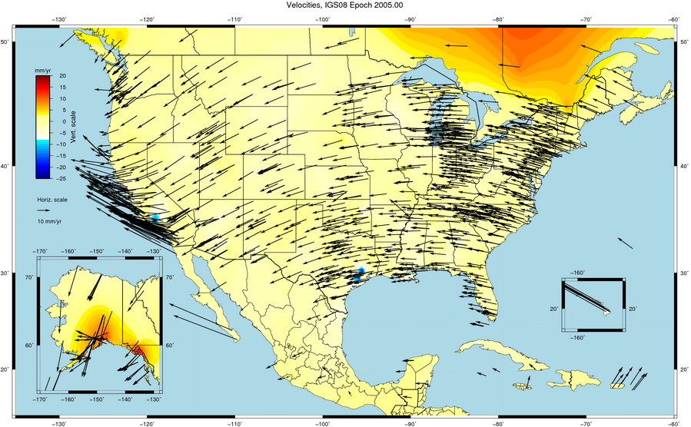
Things Are moving – we can not measure it accurately

Slide 17
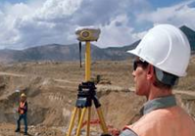
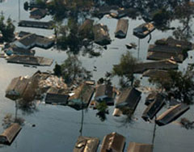
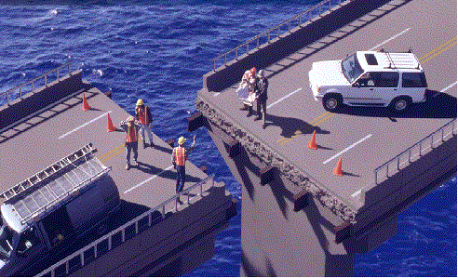

NSRS Modernization
Revolutionize professional surveying
No more need for installing and locating bench marks
Absolute, consistent positioning autonomously, anywhere
Impacts on infrastructure
Any application requiring precise positioning -- bridges, tunnels, railways, agriculture, navigation -- will be easier and more accurate
Vastly improved flood plain mapping
Water flows due to differences in gravity
Critically important in low-lying, flat communities
Fundamental support for new technologies
“Smart Highways” for autonomous vehicles

Slide 18
NSRS Modernization
Four Terrestrial Reference Frames
North American Terrestrial Reference Frame of 2022 (NATRF2022)
Pacific Terrestrial Reference Frame of 2022 (PATRF2022)
Mariana Terrestrial Reference Frame of 2022 (MATRF2022)
Caribbean Terrestrial Reference Frame of 2022 (CATRF2022)
Geopotential Datum for Heights and other Physical Coordinates
North American-Pacific Geopotential Datum of 2022 (NAPGD2022)
Geoid Model (time-dependent, provided in three regions)
GEOID2022
Notes:
Four Terrestrial Reference Frames
Replacing the three existing NAD 83 reference frames will be four plate-fixed terrestrial reference frames. The tectonic plate for each frame may be inferred from their names.
Geopotential datum
A geopotential datum will be created which will contain all of the information necessary to provide mutually consistent orthometric heights, geoid undulations, gravity anomalies, deflections of the vertical and all other geodetic coordinates related to the gravity field.
Geoid model
Within NAPGD2022, a variety of products will exist. The most prominent will be a time dependent model of the geoid, provided in three regions (the first covering the entirety of North and Central America, Hawaii, Alaska, Greenland and the Caribbean, the second covering American Samoa and the third covering Guam and the Commonwealth of the Mariana Islands).

Slide 19
All coordinates and heights
will change!
In Montana by
4 feet horizontally and
-3 feet vertically

Slide 20
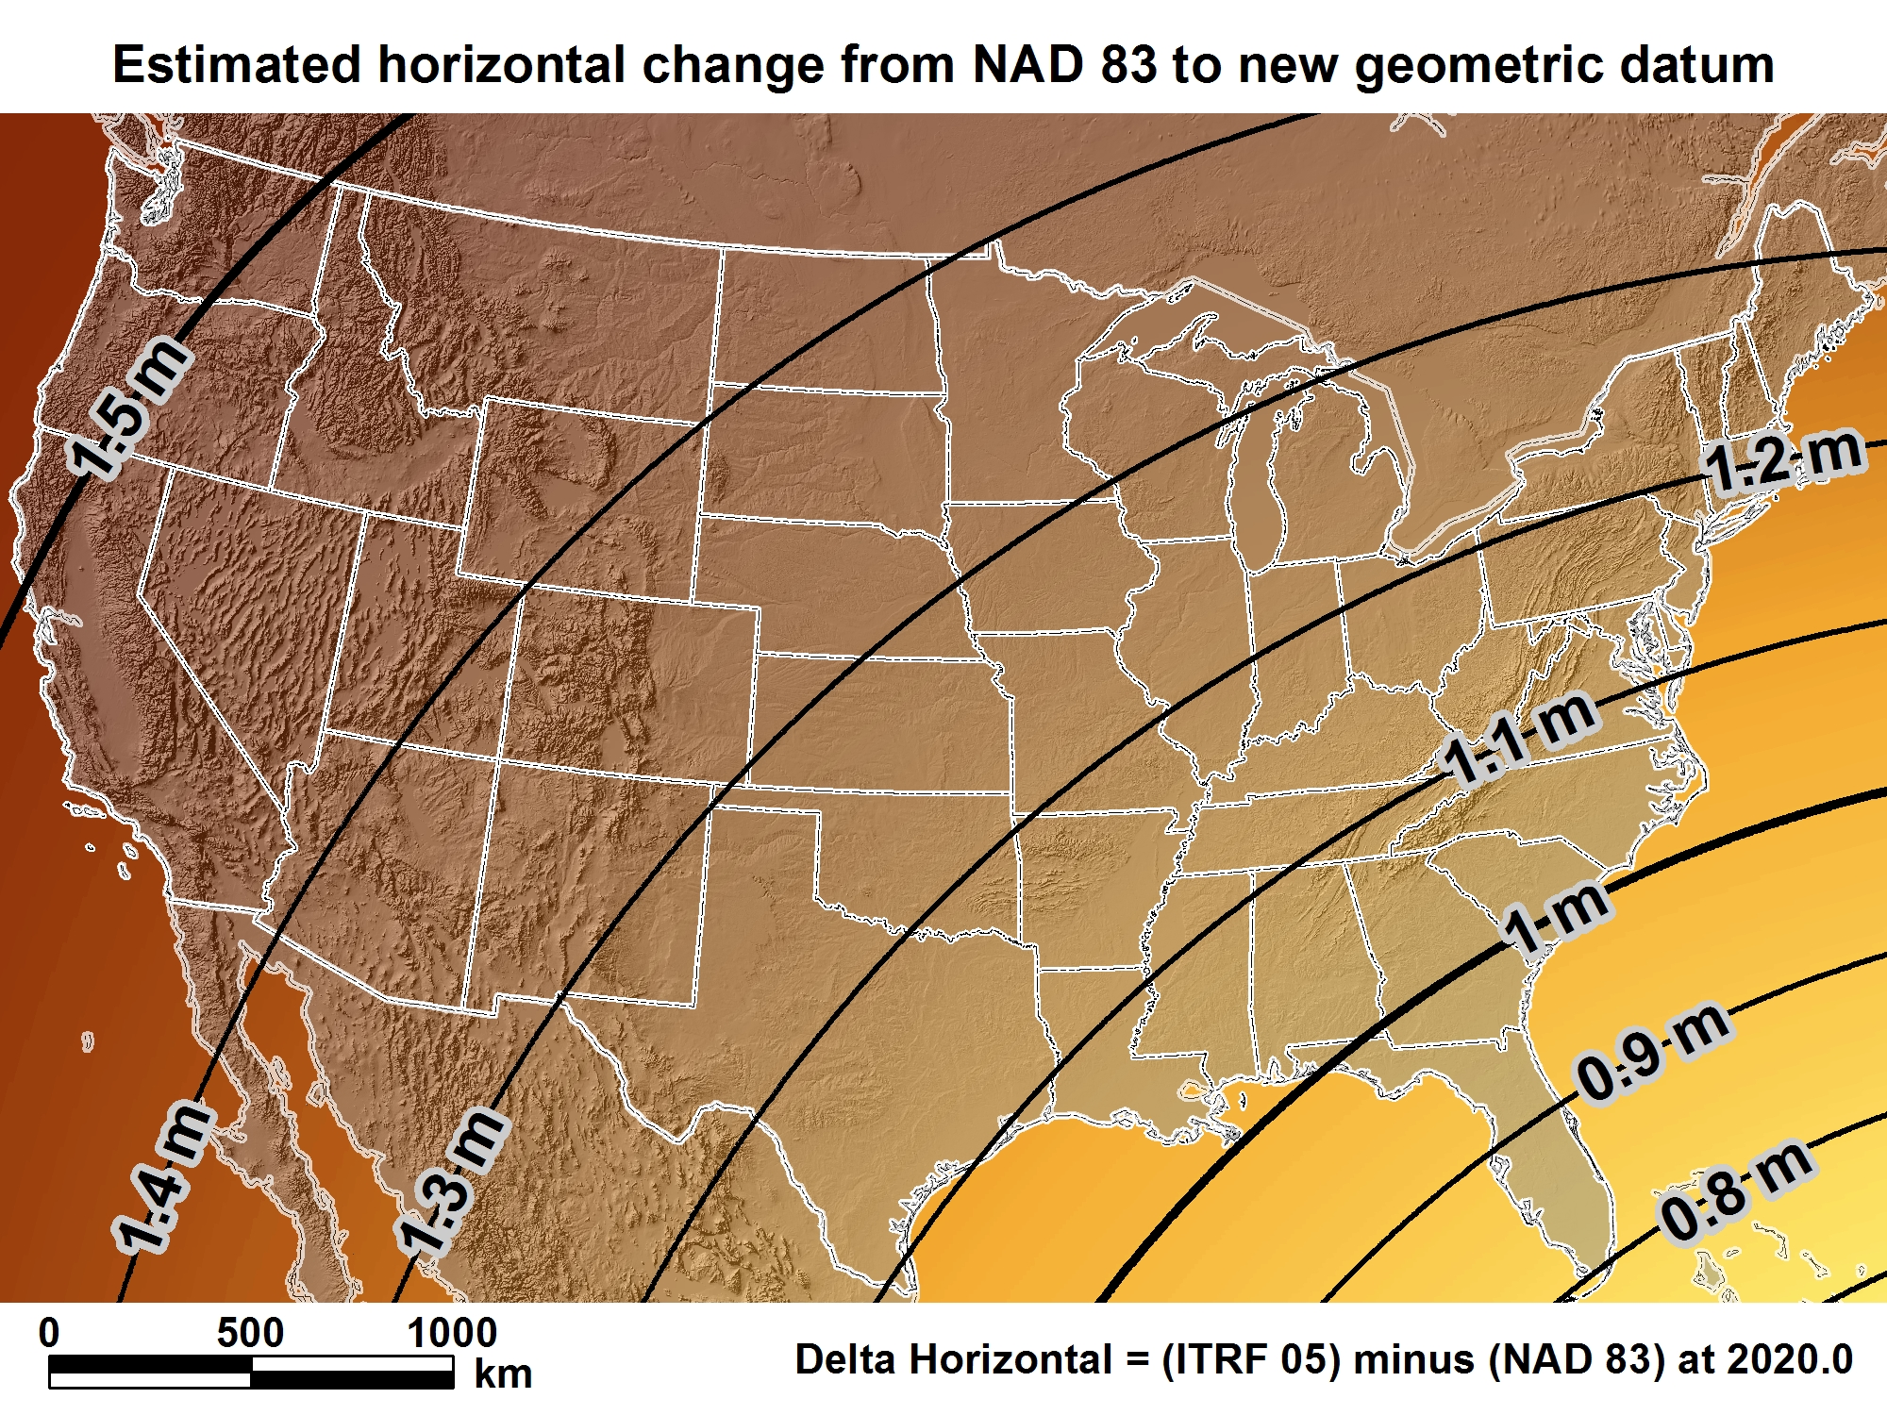
New geometric datum minus NAD 83 (horizontal)

Slide 21
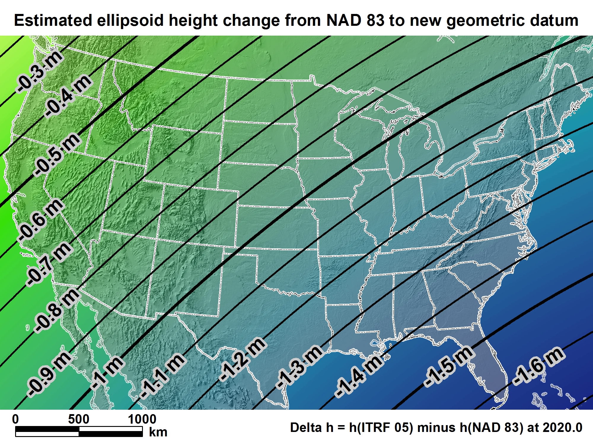
New geometric datum minus NAD 83
(ellipsoid height)

Slide 22
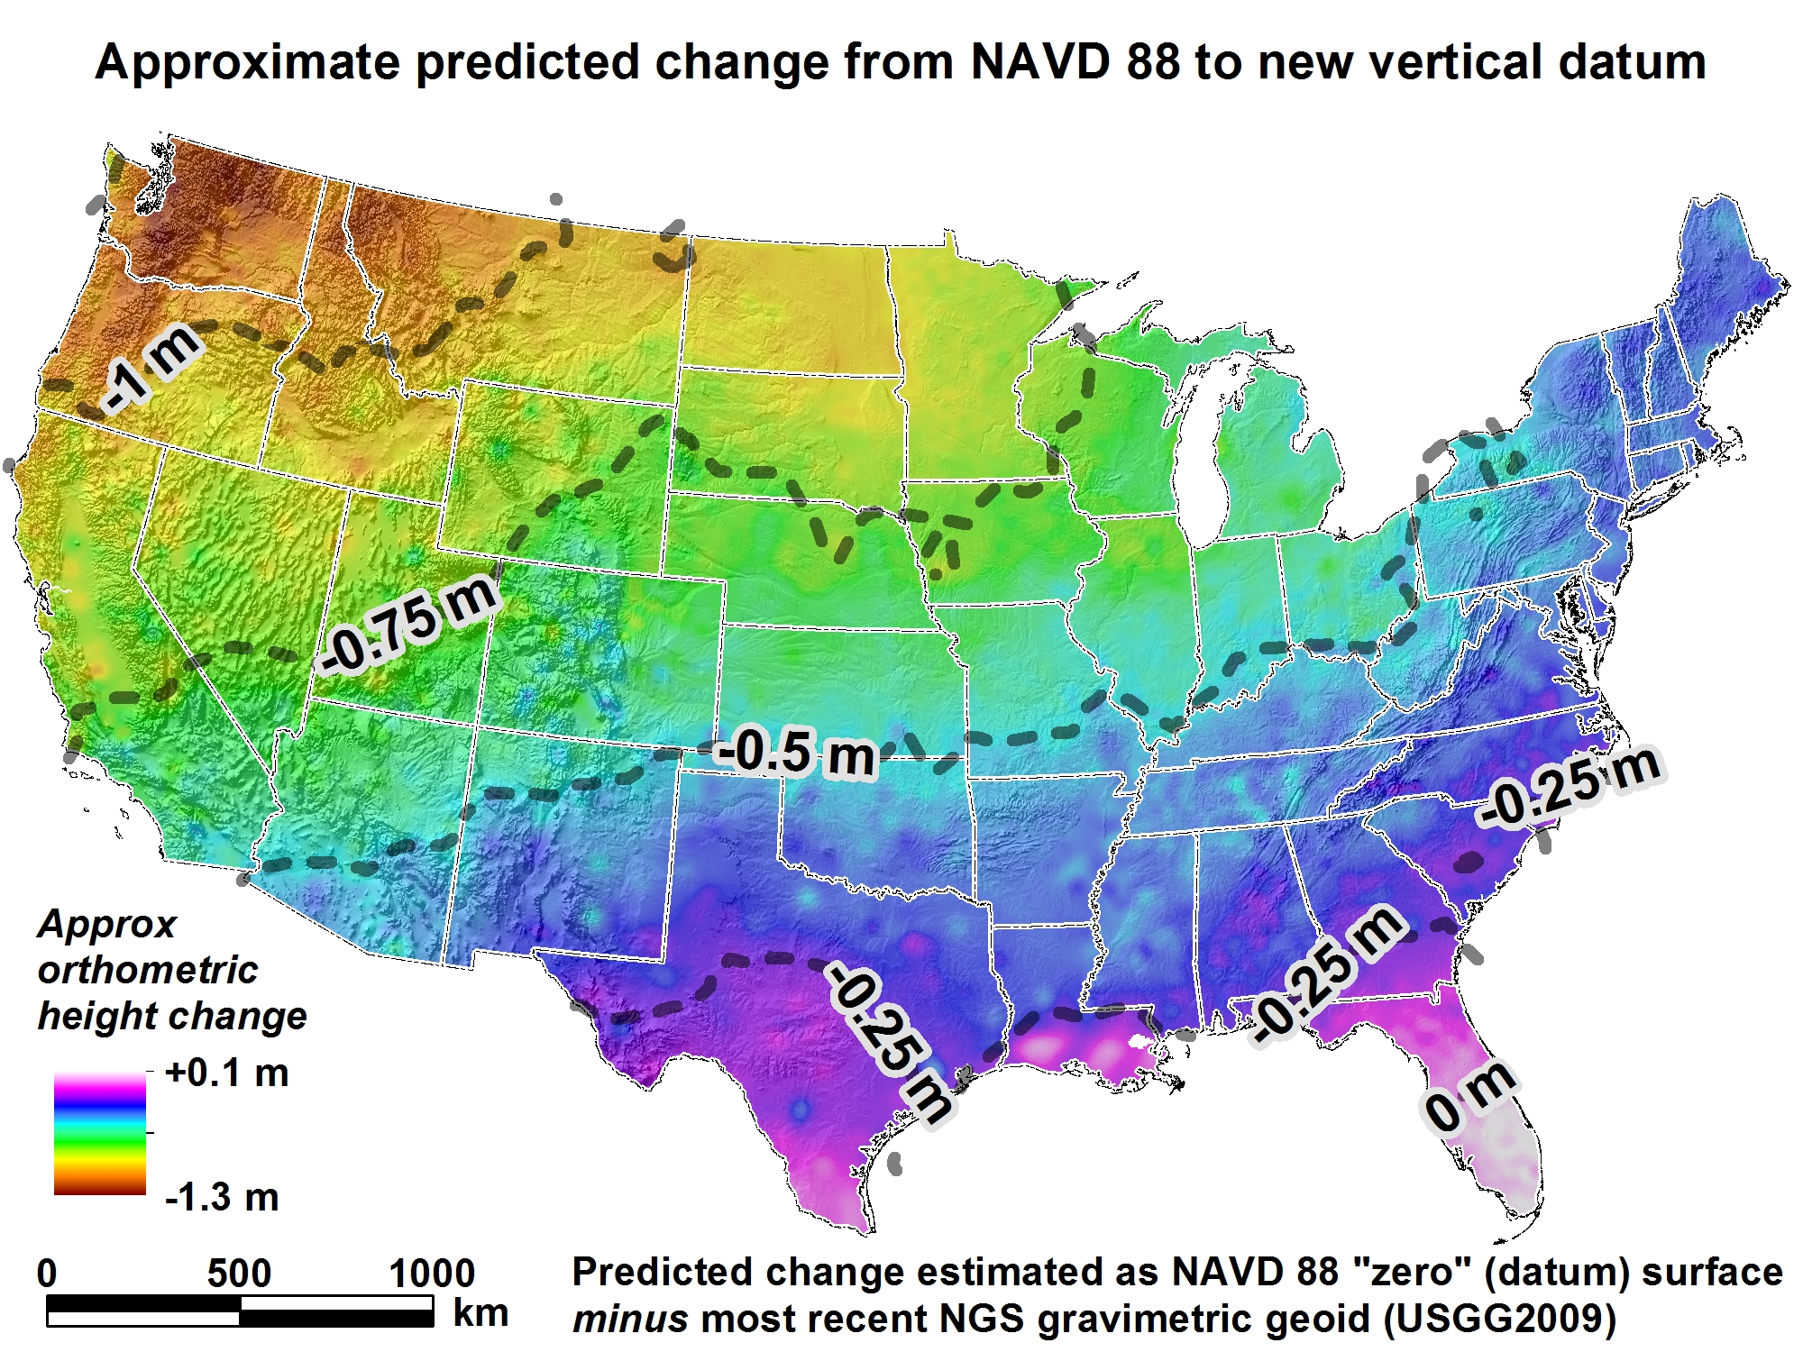
New Vertical Datum
(Outcome)

Slide 23
Ellipsoid, Geoid, and Orthometric Heights
Heights – why so important?
H = Orthometric Height (leveling)
H = h - N
h = Ellipsoidal Height (GPS)
N = Geoid Height (model)
h (NAD83)
TOPOGRAPHIC
SURFACE
(NAVD88) H
N
Geoid Height
(GEOID12B)
Geoid
Ellipsoid

Slide 24

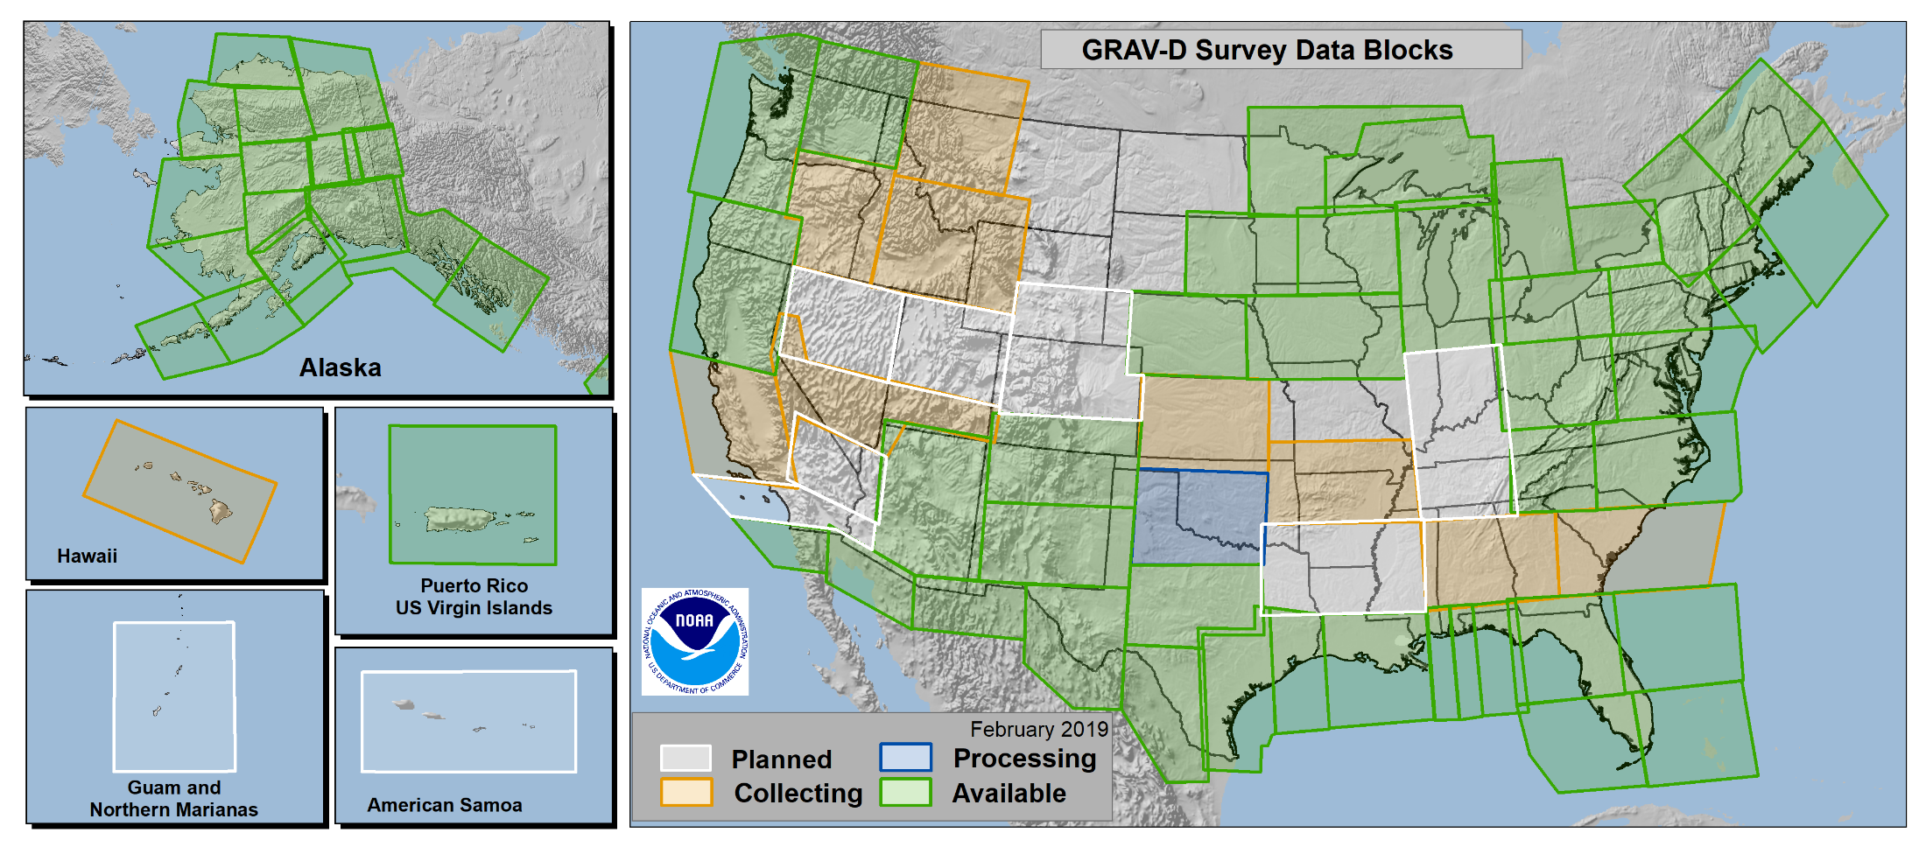
GRAV-D
Gravity for the Redefinition of the
American Vertical Datum
https://www.geodesy.noaa.gov/GRAV-D/
Notes:
More information on GRAV-D
https://geodesy.noaa.gov/GRAV-D/
Data Download for GRAV-D blocks
https://geodesy.noaa.gov/GRAV-D/data_products.shtml

Slide 25
Predicated Positional Changes in 2022
Computed for O 33(PY0374)
near West Yellowstone, MT
Changes:
HORIZONTAL = 1.44m (4.72ft)
ORTHOMETRIC HEIGHT = - 0.855m (-2.80ft)
ELLIPSOID HEIGHT = - 0.63m (2.07ft)
Computed with HTDP, Inverse and xGeoid16B

Slide 26
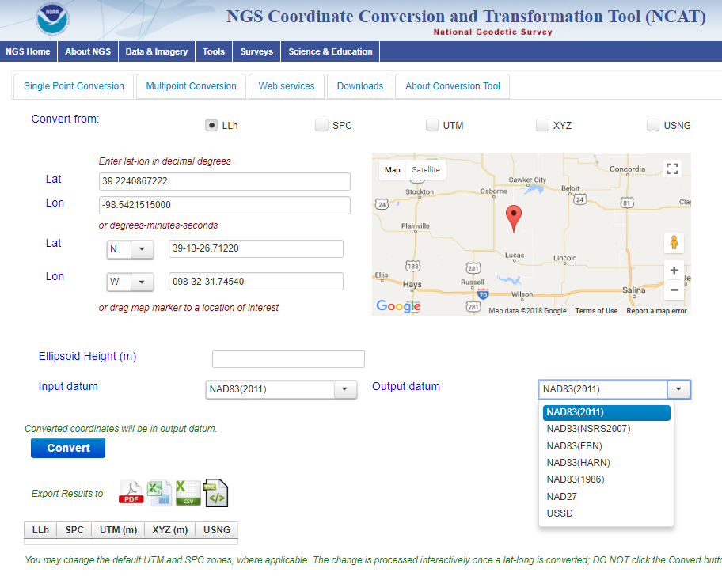
NCAT
NGS Coordinate Conversion and Transformation Tool
Notes:
We also have a new tool available to convert between various coordinate systems using various projects.

Slide 27
Prepare for NSRS Modernization
Transform and collect data in current datums
  NAD83(2011), NAVD88
Capture positional metadata including:
  Datum, epoch, source
Maintain your original survey data
Preserve all original observations

Slide 28
SPCS2022 layers and LDPs
Each state may have max of THREE zone layers:
  One layer will be statewide zone (designed by NGS)
  Other layers have two or more zones (“multi-zone”)
  Only one layer can have discontinuous coverage
Multi-zone layer can consist of LDPs:
  Designed by stakeholders
  Minimum zone width 50 km (if height range < 250m)
  LDP coverage can be discontinuous…
Notes:
Layered zones are allowed for SPCS2022 (for a max of 3 layers)
One state in SPCS 83 has 2 layers, Kentucky (statewide plus a pre-existing 2-zone layer)
States can have 1, 2, or 3 layers
One layer MUST be a statewide zone (so a state with 1 layer has only a statewide zone)
The other 1 or 2 layers will almost always have multiple zones (unless a state has, say, a single LDP in SPCS2022 that covers only part of the state)
Only 1 layer can be “discontinuous”, that is, consist of layers that do not collectively cover the entire state (will show an example of this)
Decision to go with 3 layers based on FRN responses, especially those from mountainous western states
The multi-zone layer(s) can consist of LDPs
Almost always means distortion criterion < ±50 ppm, so must be designed by others (i.e., “contributing partners”), not by NGS

Slide 29
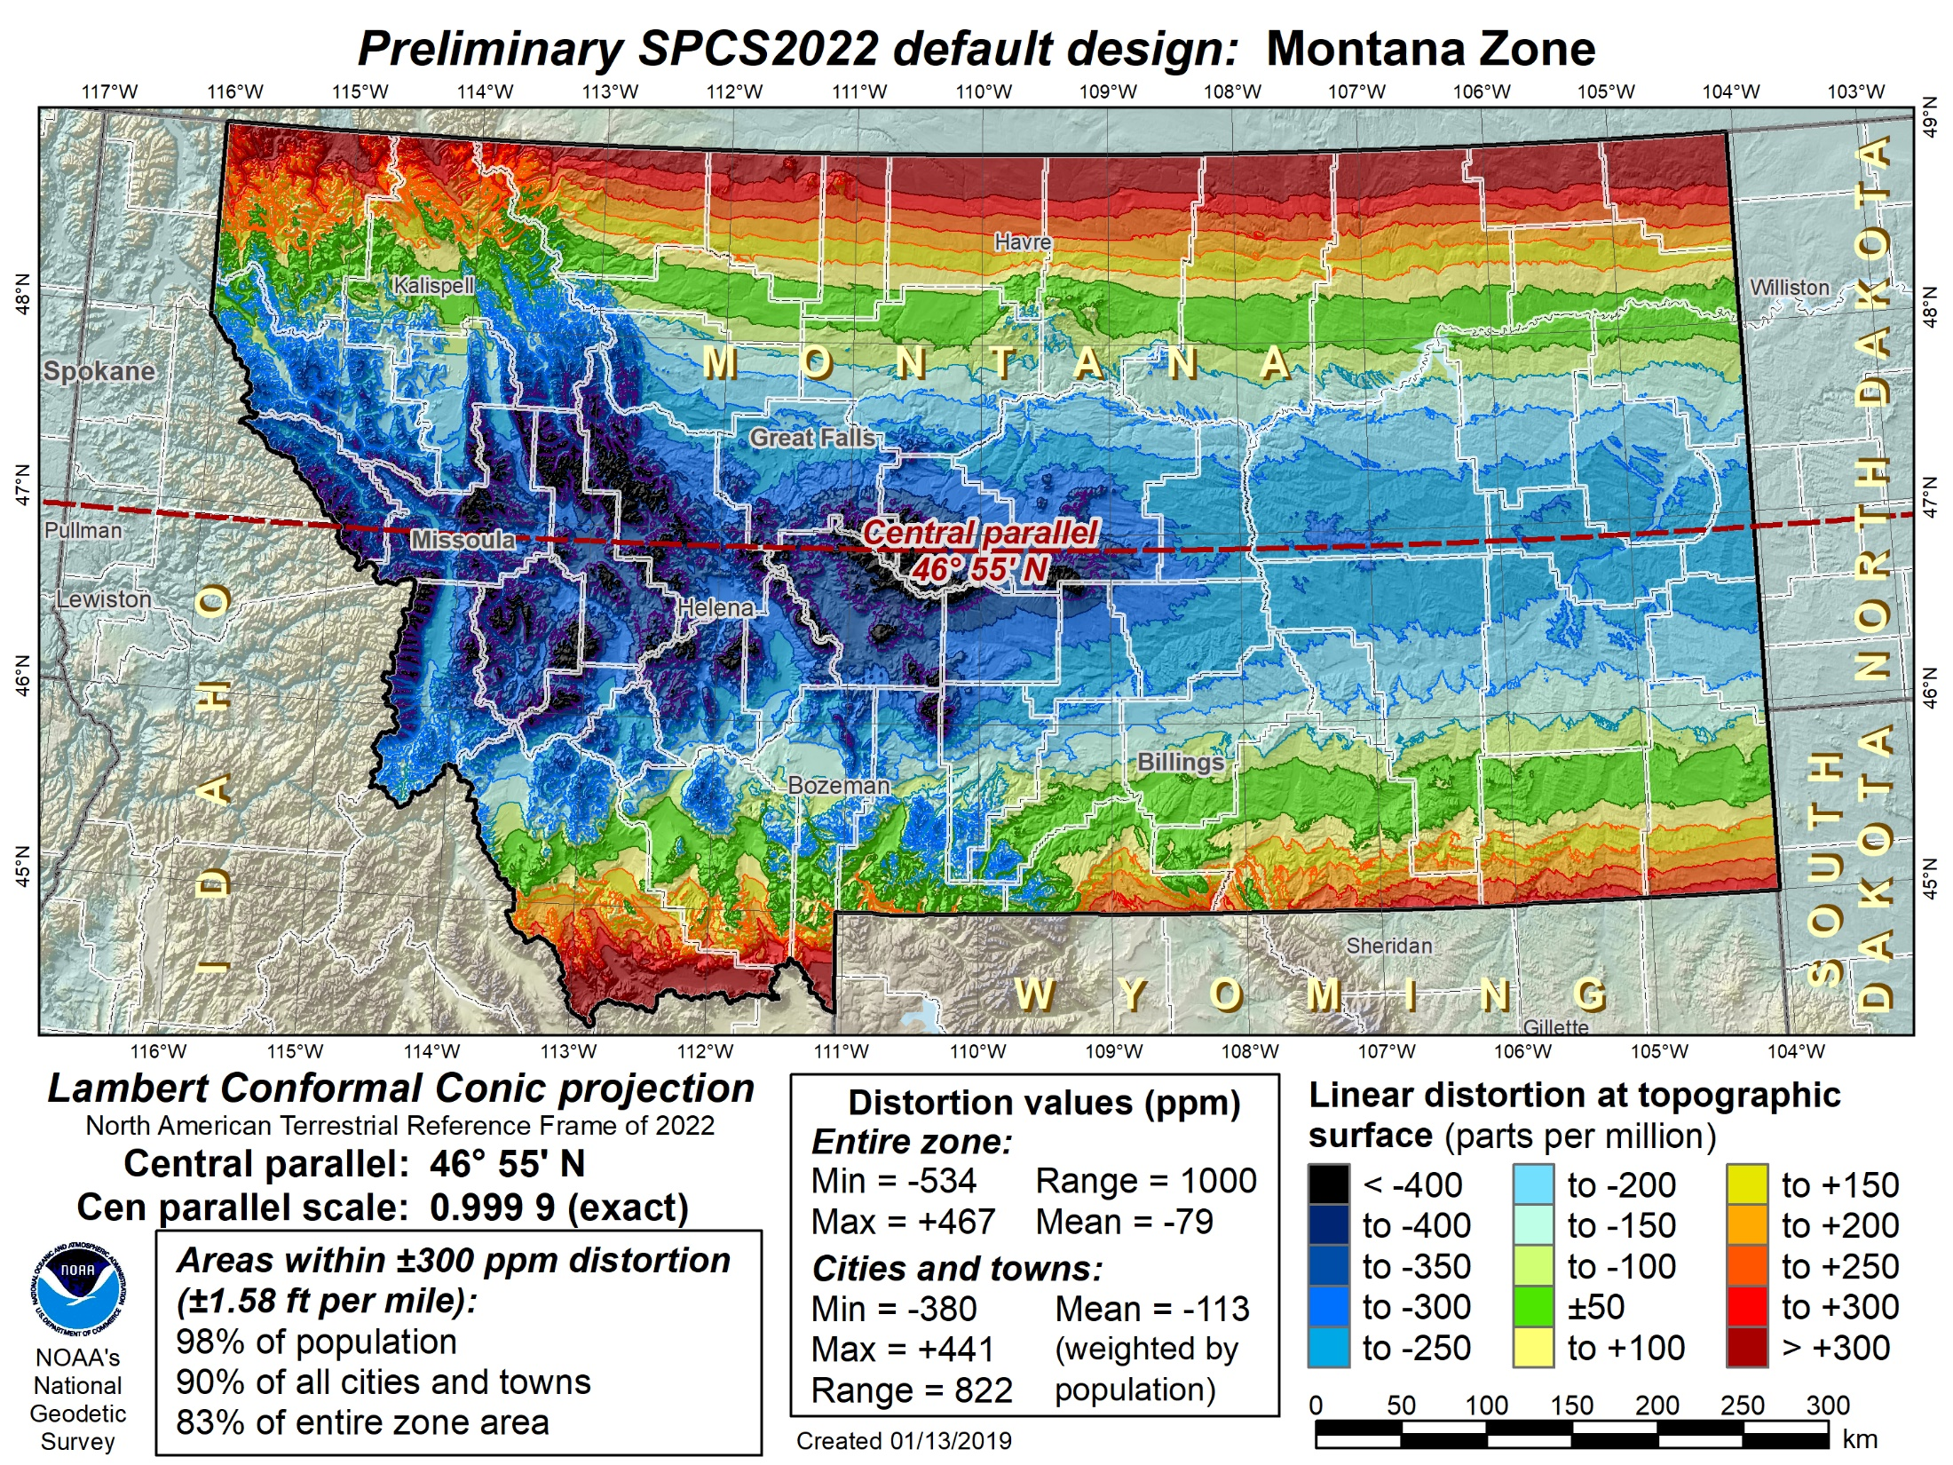
Montana statewide
Preliminary
Notes:
Map of preliminary default SPCS2022 design for Montana, which is also a statewide zone.

Slide 30
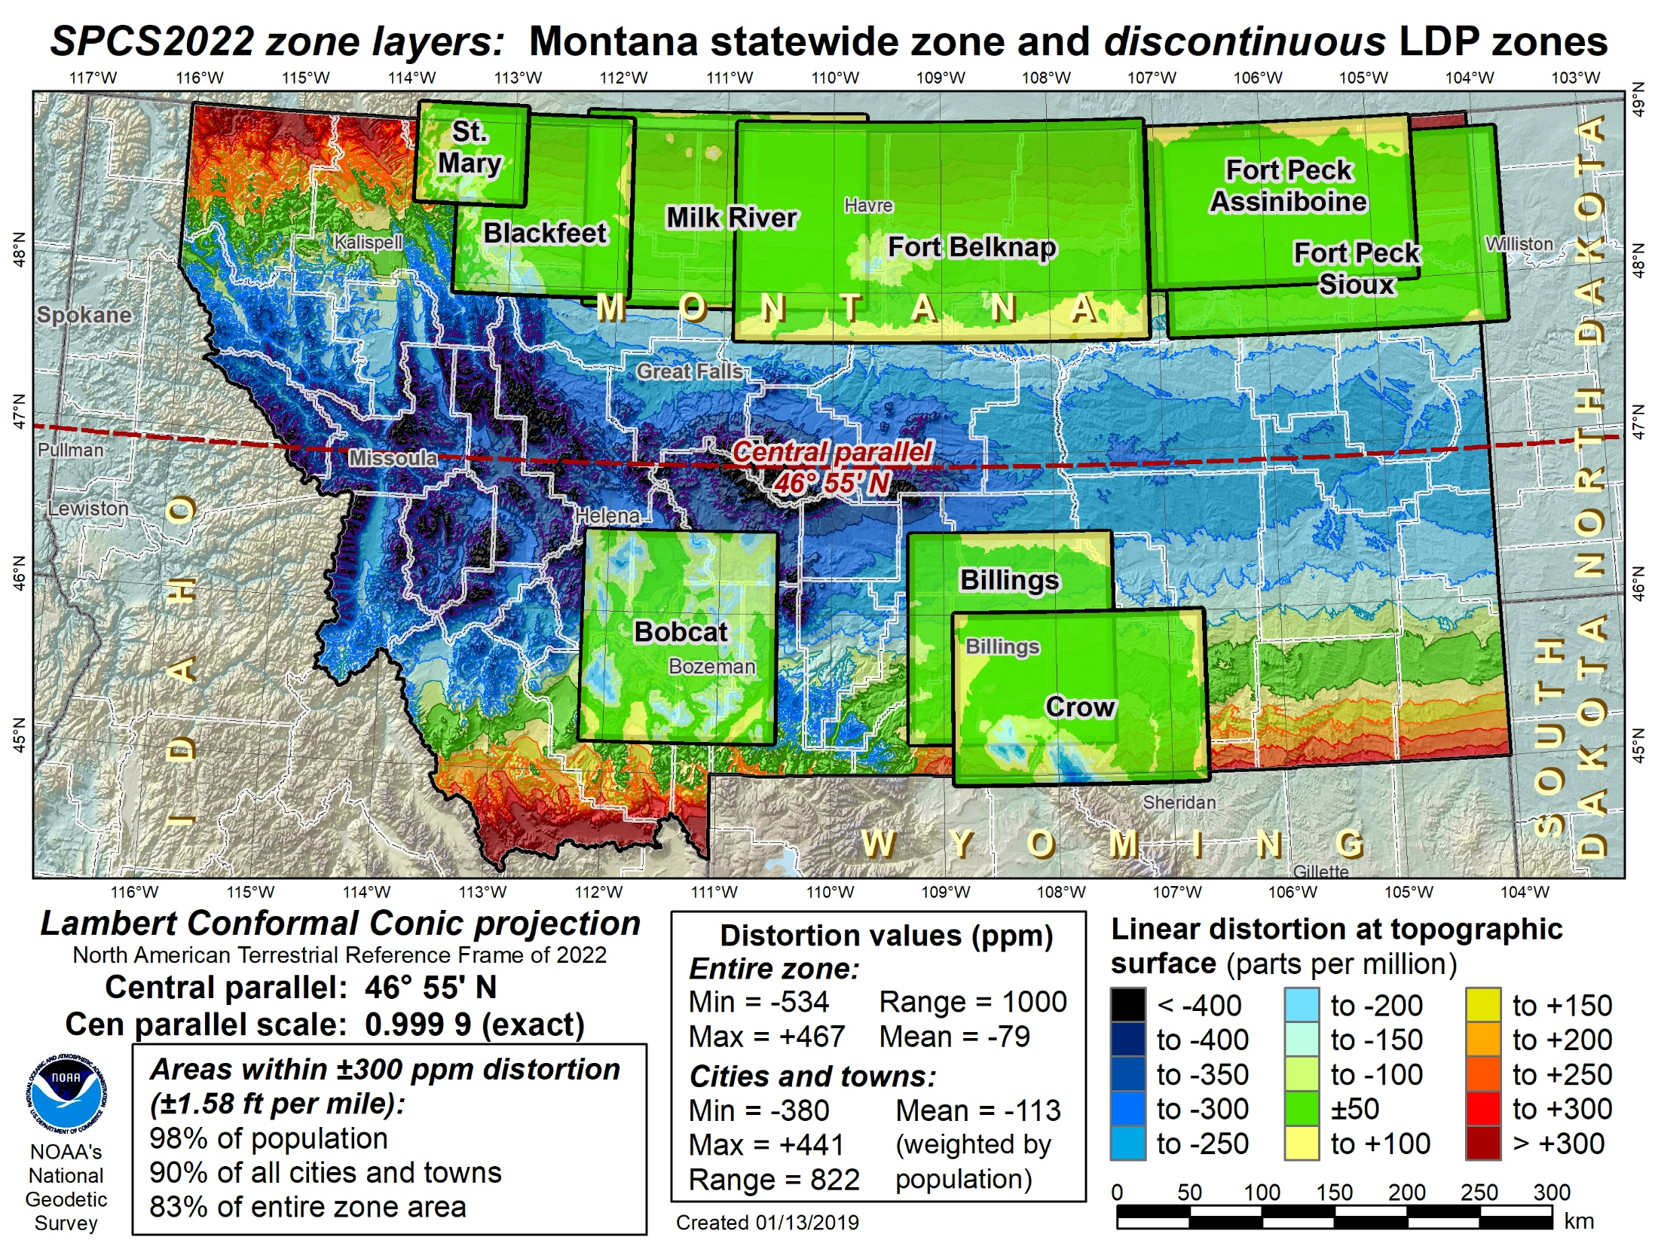
Montana statewide + discontinuous LDPs
Preliminary
Notes:
Map showing preliminary default SPCS2022 design for Montana with layer of discontinuous LDP zones
Both the statewide and LPD zones use the system distortion color ramp (±50 ppm increment)
LDP zones shown are from the existing Rocky Mountain Tribal Coordinate Reference System (RMTCRS)
If decided by Montana stakeholders, a modified (and likely augmented) version of the RMTCRS could coexist with the default statewide zone designed by NGS.

Slide 31
Deadlines for SPCS2022 input
NGS.Feedback@noaa.gov by August 31, 2018
Anyone can comment!
Federal Register Notice (FRN)
Announcement and public comments
  On draft SPCS2022 policy & procedures
  On “special purpose” zones
SPCS2022 Procedures (draft)
Consensus input per SPCS2022 procedures
  Requests for designs done by NGS
  Proposals for designs by contributing partners
Submittal of approved designs
  Proposal must first be approved by NGS
  Designs must be complete for NGS to review
Later requests will be for changes to SPCS2022
NGS.SPCS@noaa.gov
by March 31, 2020 for requests and proposals
by March 31, 2021 for submittal of approved designs
State stakeholders only!

Slide 32

GPS on Bench Marks
Phase I
  Geoid 18
  You helped with the final hybrid Geoid Model
  All About heights
  How important will heights/elevation be in the future?
Phase II
  Transformation Tools
  Help needed with the transformation tools to the new systems over the next couple of years
Thank you

Slide 33
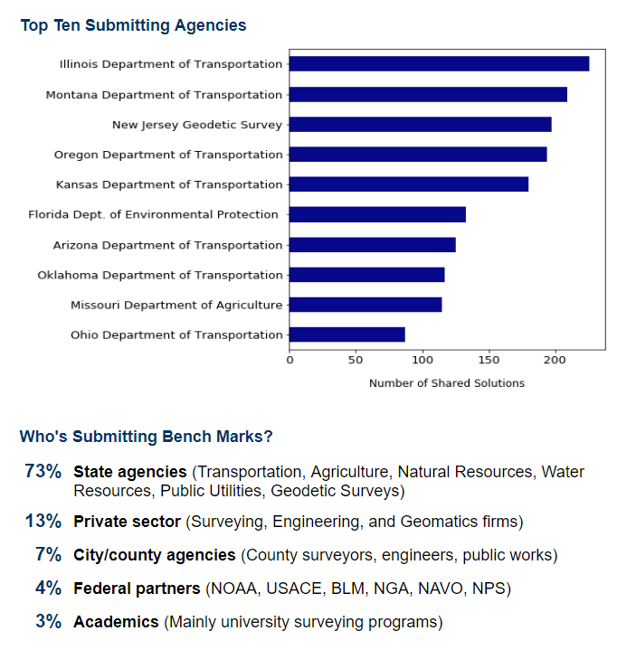
GPS on Bench Marks
2018 Prioritized List
~2500 of 5900 completed
3600 observations
GEOID18
2022 Transformations
Notes:
GPS on Bench Marks Web Map (2018)
https://geodesy.noaa.gov/GPSonBM/webmap/

Slide 34
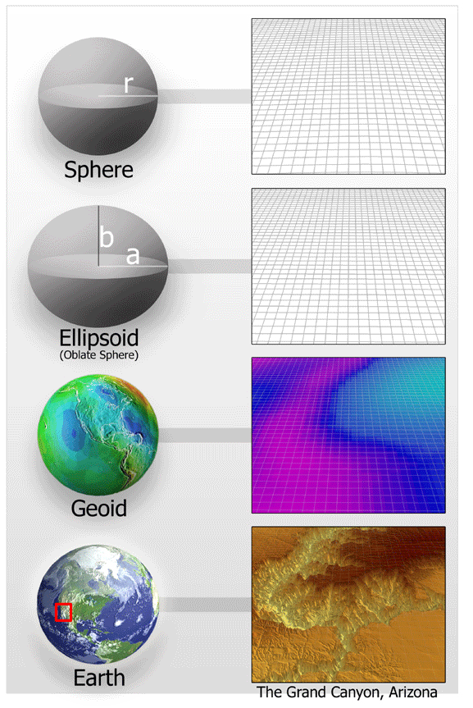
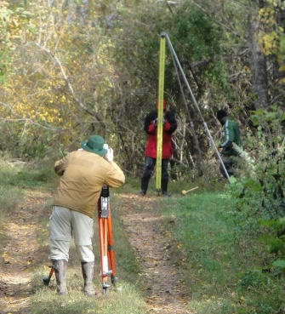
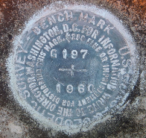
GPS on BM
Prioritization Based on
Residual = h - H - N
-
-
h is ellipsoid height measured using GPS
H is an NAVD 88 Orthometric Height from Leveling
N is from a geoid model
Theoretically, the difference between these three values should be zero. In practice, using actual observations gives a residual, or measure of the misfit between the three. We use the residual to evaluate the observations.

Slide 35
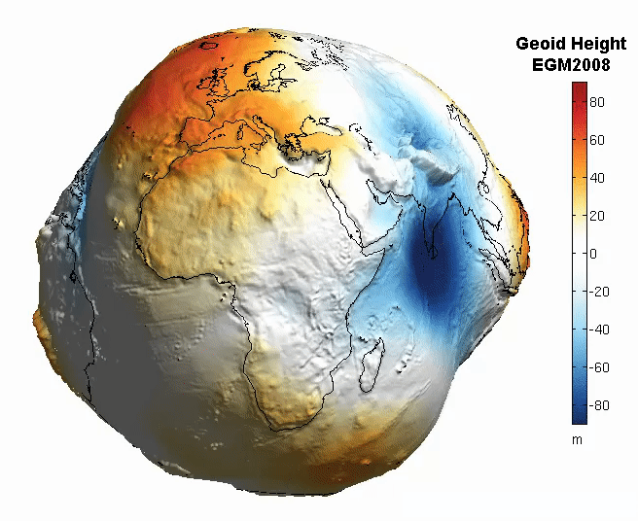
Which geoid to use?
NAD 83 (realization) | Geoid Model
NAD 83 (1986) | N/A
NAD 83 (HARN) | GEOID96/GEOID99
NAD 83 (FBN) | GEOID03
NAD 83 (CORS96) | GEOID03
NAD 83 (NSRS2007) | GEOID09
NAD 83 (2011) | GEOID12B
Make sure you use the proper geoid with the appropriate datum
Notes:
Metadata is pivotal to understanding what system your data is in so you can make appropriate comparisons with other data. There have several realizations of NAD83 and many of them have specific geoid models that should be used with. Using the wrong geoid model with data in a different datum will provide inaccurate heights due to variations in the horizontal and vertical data.

Slide 36
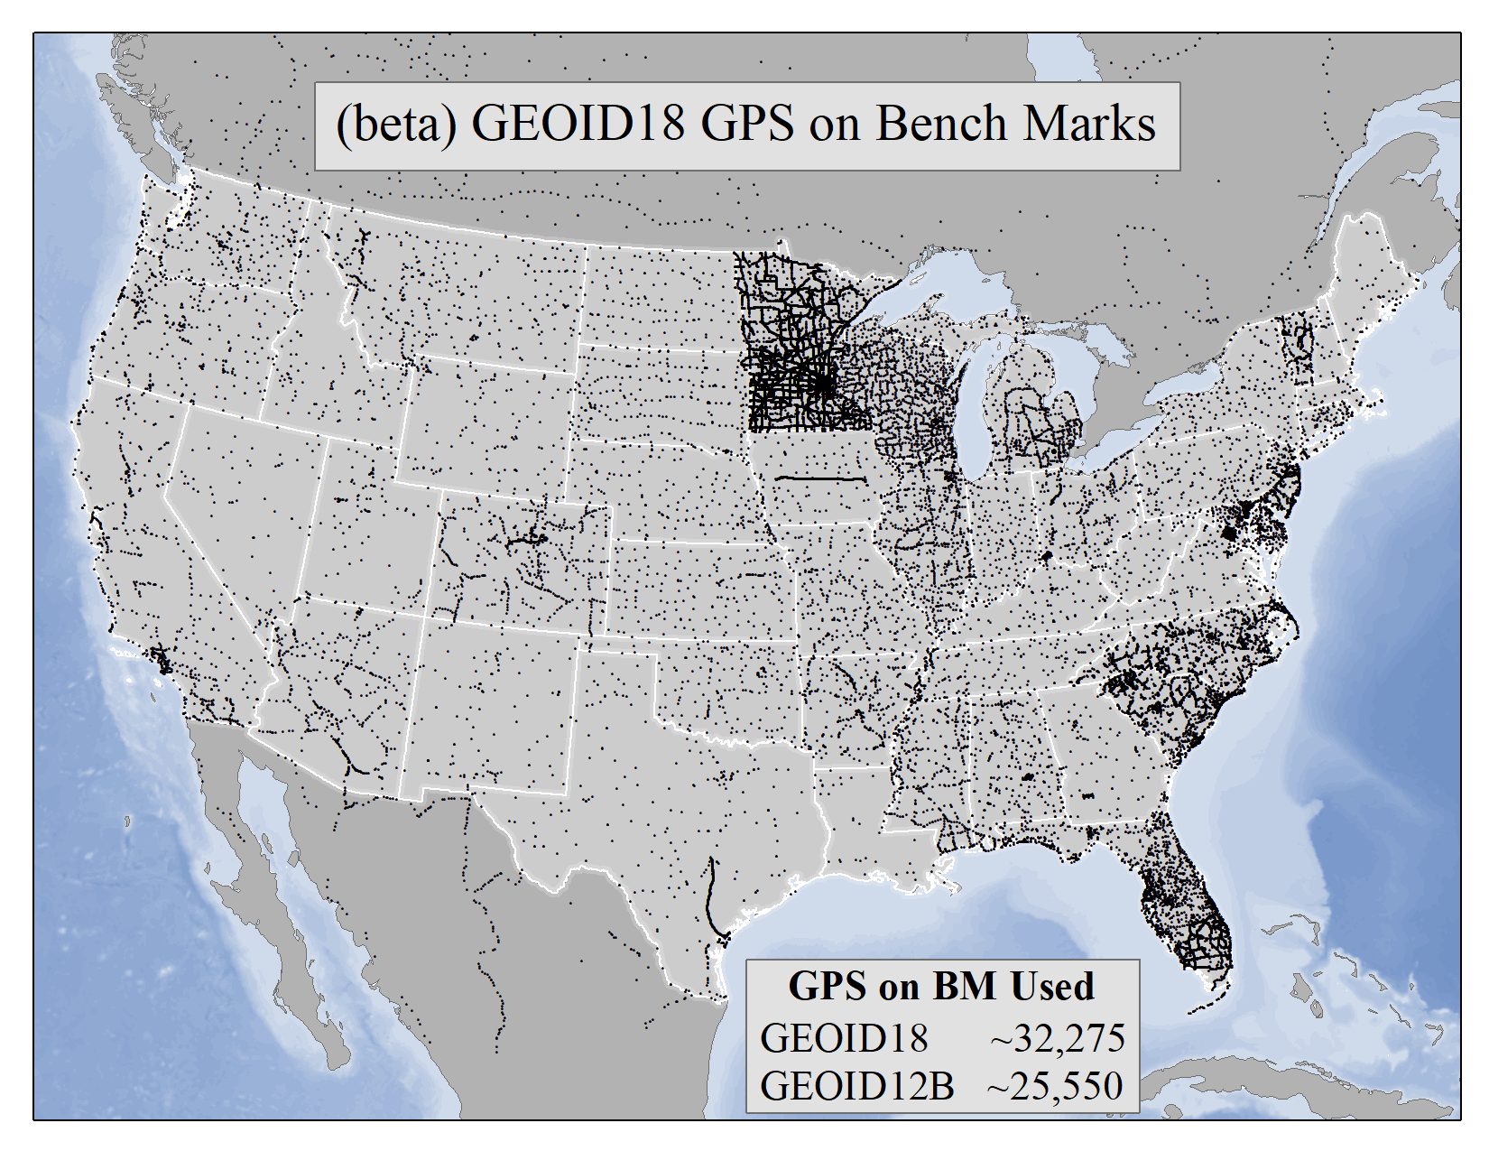
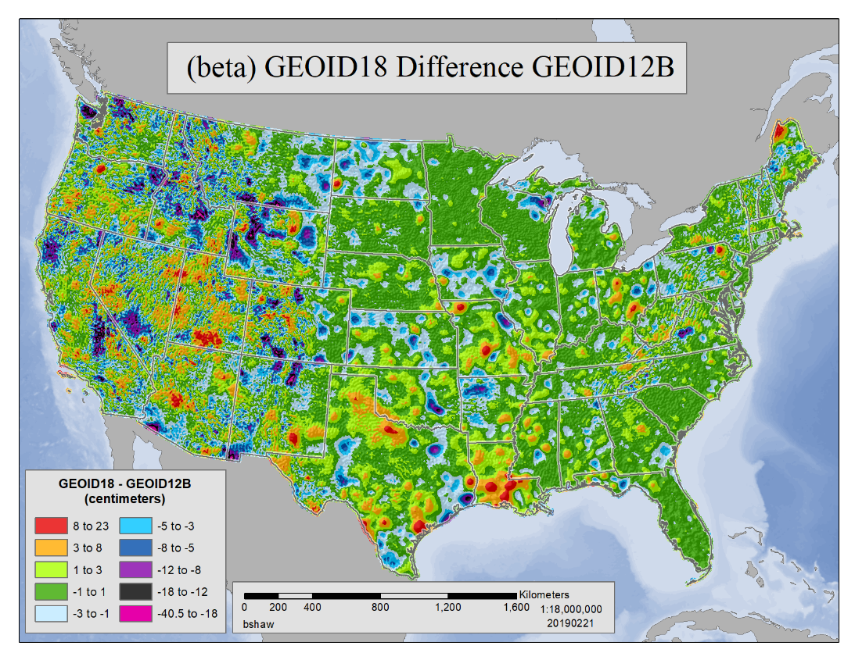
GEOID18
Notes:
As noted in the Blueprint 2 document
https://geodesy.noaa.gov/library/pdfs/NOAA_TR_NOS_NGS_0064.pdf
NAPGD2022 will include all of the following
Geopotential Model of 2022 (GM2022) will include:
Static Geopotential model of 2022 (SGM2022)
Dynamic Geopotential model of 2022 (DGM2022)
GEOID2022 will include:
Static Geoid model of 2022 (SGEOID2022)
Dynamic Geoid model of 2022 (DGEOID2022)
DEFLEC2022 will include:
Static Deflection of the Vertical model of 2022 (SDEFLEC2022)
Dynamic Deflection of the Vertical model of 2022 (DDEFLEC2022)
GRAV2022
Static Gravity model of 2022 (SGRAV2022)

Slide 37
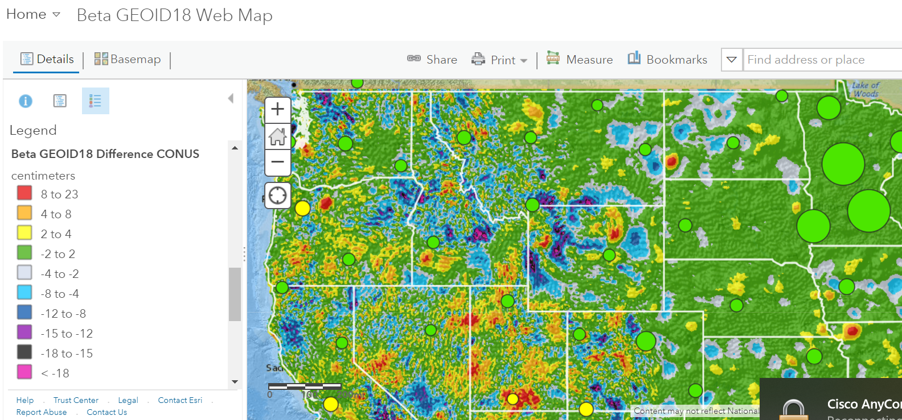
https://arcg.is/1zazKb1

Slide 38
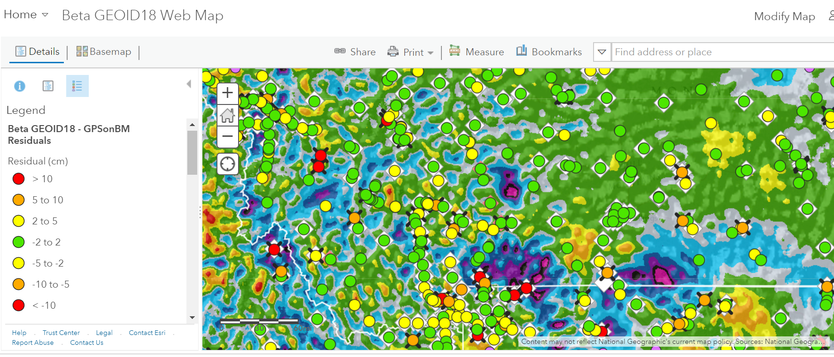

Slide 39
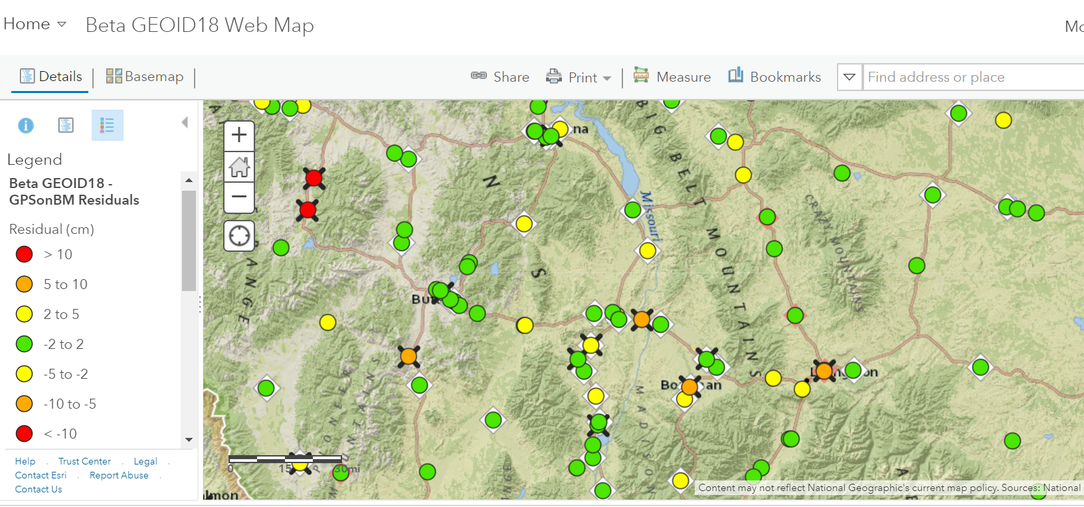

Slide 40
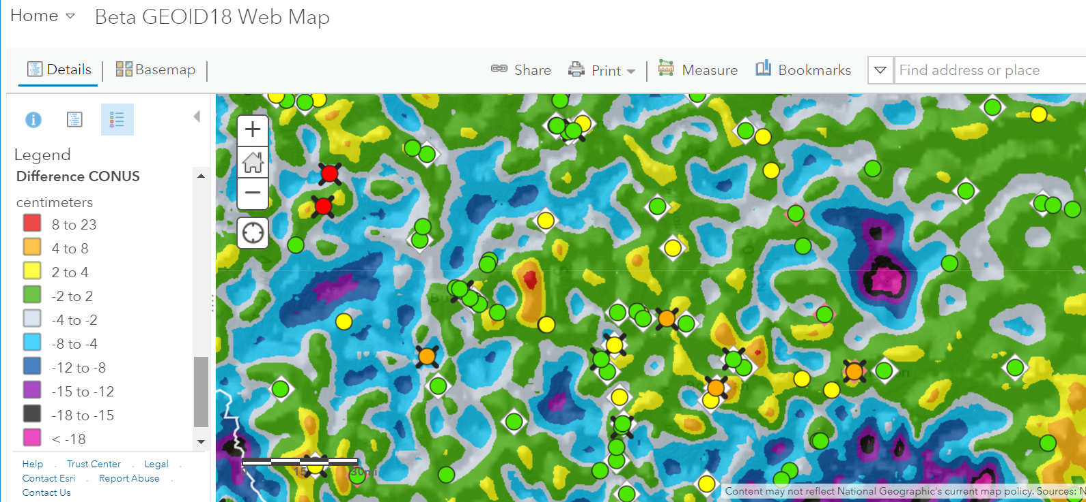

Slide 41
Next Steps
Phase II
New priority stations for Transformation tool
  Many more stations (from 30 km to 10 km spacing)
  Design a more localized approach
  Provide incentive
  Utilize interns (request positions)
  NGS is exploring use of RTK

Slide 42
Crowdsourcing
GPS on Bench Marks
Find Bench Marks (priority and others)
  Use our priority BM/tracking map
  Use NGS Data Explorer
  Use DS-World
Provide a recovery note
  Use DS-World (or new NGS beta app)
  Provide updated descriptions,
  Coordinates, photos (use DS-World)
Collect GPS data
  Share through OPUS
  Create OPUS Data Sheet
GIS Community
can assist here
Requires Survey Grade
GPS data and
min. of 4 hrs of data

Slide 43
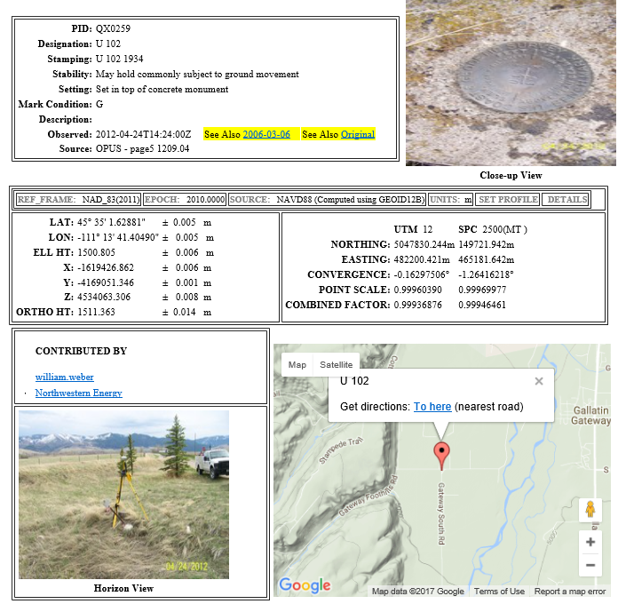
OPUS Share Data Sheet

Slide 44
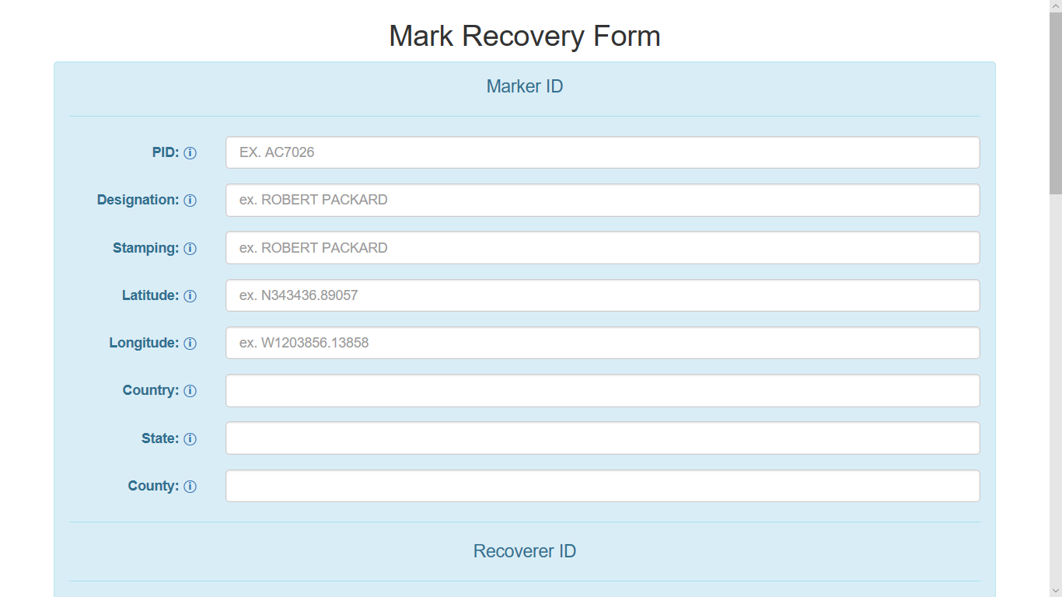
Mark Recovery Form
Partial Sample

Slide 45
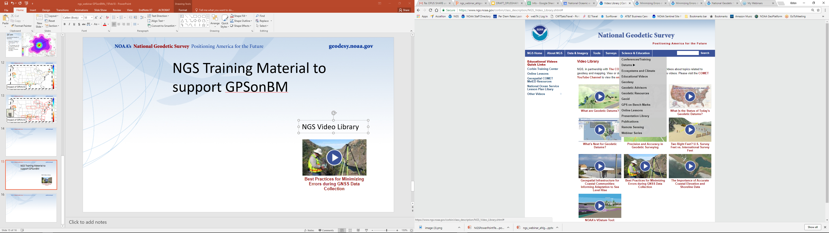
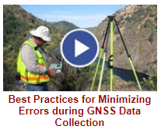

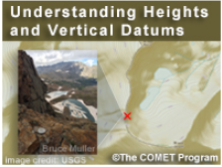
NGS GPS on BM Training Material
GPS on Bench Marks Webpages
NGS Video Library
NGS Online Lessons

Slide 46
Rocky Mountain Region Map and Volunteer Sign up
Signup sheet:
https://survey123.arcgis.com/share/130be382350e4a38a71de3b2e4d92a98 (Must cut and paste)
Status Map:
https://www.arcgis.com/apps/webappviewer/index.html?id=0829616b6ec740b7a0bfbf057188e865
NGS Map:
https://geodesy.noaa.gov/GPSonBM/index.shtml

Slide 47
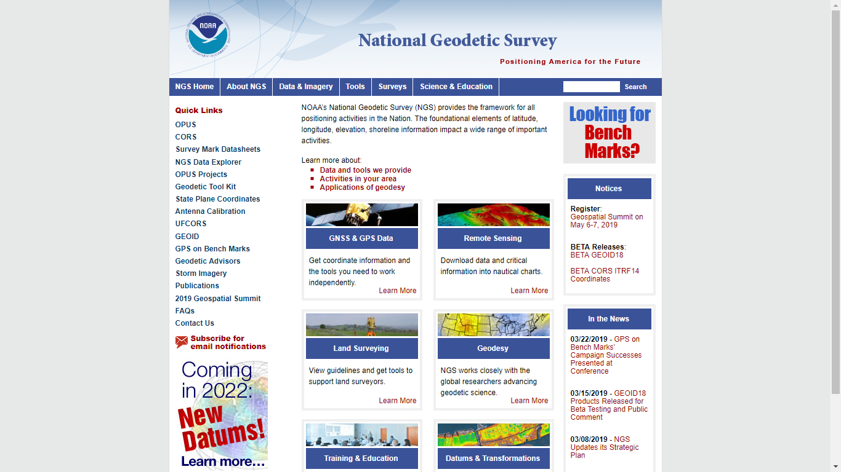
geodesy.noaa.gov

Slide 48
Resources geodesy.noaa.gov
Webinars
  SPCS2022, GPS on BM, …
Subscriptions Services
  NGS news, webinars, training, GPS on BMs
Geospatial Summit
  Register now – in person, webinars, recordings
  May 6-7, outside DC
Training, Presentations (library)

Slide 49
NOAA’s National Geodetic Survey
Thank you
Pam Fromhertz
Rocky Mountain Regional Advisor
Pamela.Fromhertz@noaa.gov
240-988-6363
Geodesy.noaa.gov
Wally Gladstone
NECI
Wallace.Gladstone@neciusa.com
406-839-2217

