Slide 1
California Geodetic Coordinator - Did you know we had one?
A discussion of program history, roles, and looking ahead
Presented by:
Scott P. Martin, PLS
California Geodetic Coordinator
Notes:
1

Slide 2
Scott P. Martin, PLS
40 years in Land Surveying
Licensed for 30.5 years
23.5 years with State (DWR and Caltrans)
16 years in private sector
Past CSRC Executive Committee Vice Chair
Member of CSRC Coordinating Council since 2001
Chair Geodetic Control Work Group
Chair Western Region Height Modernization Consortium

Slide 3
Presentation Topics
1.) Appointment as California Geodetic Coordinator
2.) Role and Interface with NGS/Public
3.) Nature of Inquiries
4.) Role in preparing for new reference frame/datum in 2022
5.) Western Region Height Modernization Consortium
6.) California Geodetic Control Work Group

Slide 4
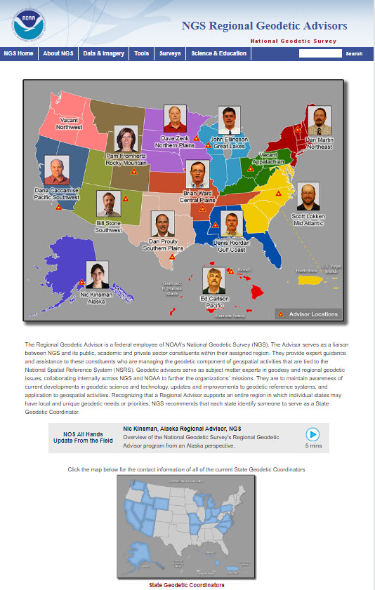
NGS Regional Advisors
Transitioned from State to Regional program in fall 2016
Resulted in Advisors covering larger geographic areas/multiple states
Increased importance of State Geodetic Coordinator program
Notes:
Food Analogy – always safe.

Slide 5
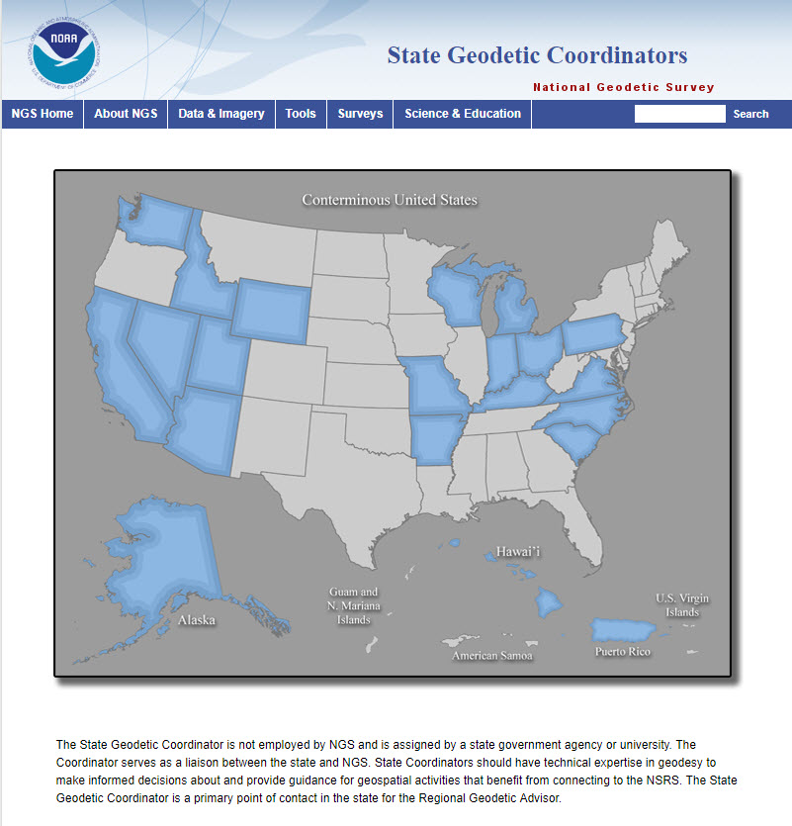
NGS Recognized State Geodetic Coordinators
California was the 9th state to appoint a Geodetic Coordinator
Appointment through the CSRC – Interim initially starting in April 2016
Formalized in December 2016
Bylaws amended – Non-Voting member of the Executive Committee (EC)
Appointment reviewed every two years by the EC
Notes:
Food Analogy – always safe.

Slide 6
Presentation Topics
1.) Appointment as California Geodetic Coordinator
2.) Role and Interface with NGS/Public
3.) Nature of Inquiries
4.) Role in preparing for new reference frame/datum in 2022
5.) Western Region Height Modernization Consortium
6.) California Geodetic Control Work Group

Slide 7
California Geodetic Coordinator roles as envisioned by NGS
Not an NGS employee – appointed by the appropriate State entity. Appointee should have appropriate experience and knowledge to support geodetic initiatives
Provides for enhanced access to NGS staff and resources
Serve as the liaison between the NGS Regional Advisor and local constituents
Provide guidance for inquiries that are more state or local specific rather than NGS policy level issues.

Slide 8
Presentation Topics
1.) Appointment as California Geodetic Coordinator
2.) Role and Interface with NGS/Public
3.) Nature of Inquiries
4.) Role in preparing for new reference frame/datum in 2022
5.) Western Region Height Modernization Consortium
6.) California Geodetic Control Work Group

Slide 9
Examples of Inquiries
More than 50% involve monument preservation or perpetuation. Most are from surveyors, engineers, etc.. but landowners too.
Tag-Team with the NGS Advisor depending on the nature of the inquiry
Can serve a different role than the NGS Advisor, citing the California PLS Act (8771) and the responsibility of licensees and agencies to be in compliance. Just because it is obsolete from a NGS/NSRS perspective does not mean it can be destroyed and not perpetuated.

Slide 10
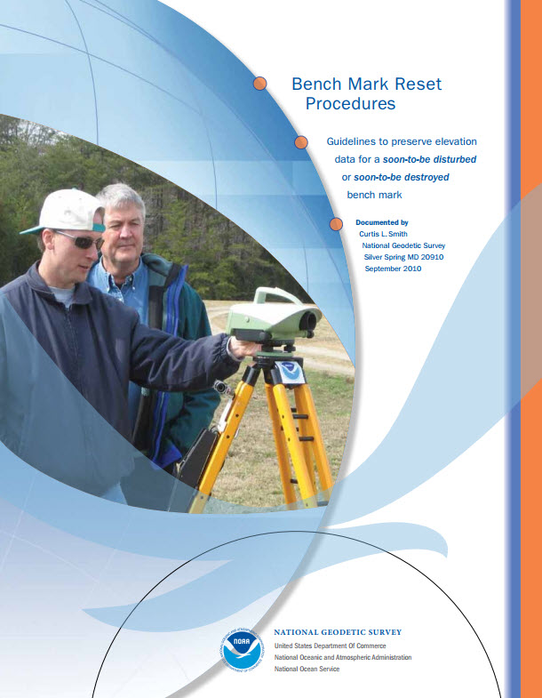
Inquiry Resources
NGS Bench Mark Reset Procedures publication
FGCS Specifications and Procedures to Incorporate Electronic Digital/Bar-Code Leveling Systems
California Public Resources Code
Input from locals, such as County Surveyors
NGS Data Explorer

Slide 11
Presentation Topics
1.) Appointment as California Geodetic Coordinator
2.) Role and Interface with NGS/Public
3.) Nature of Inquiries
4.) Role in preparing for new reference frame/datum in 2022
5.) Western Region Height Modernization Consortium
6.) California Geodetic Control Work Group

Slide 12
Prepping for 2022
Involved with discussions regarding dynamic datum modeling tools for California (think HTDP, but better)
Task Order manager for CSRN epoch update project to be completed in the coming weeks. Epoch 2017.5 or newer
Serving on a committee to finalize PRC updates necessary to accommodate the new geometric reference frame and vertical datum

Slide 13
Presentation Topics
1.) Appointment as California Geodetic Coordinator
2.) Role and Interface with NGS/Public
3.) Nature of Inquiries
4.) Role in preparing for new reference frame/datum in 2022
5.) Western Region Height Modernization Consortium
6.) California Geodetic Control Work Group

Slide 14
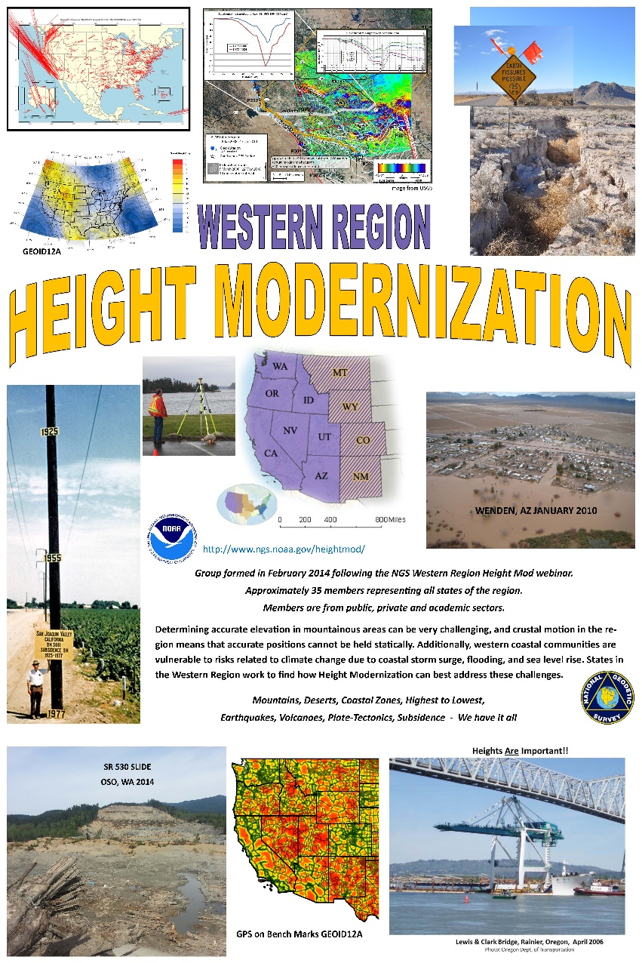
Western Region Height Modernization Consortium
Formed in 2014
Covers 11 western states
Currently has approximately 85 members from public, private, and academic sectors
Hold Quarterly teleconferences or webinars
Great information sharing and networking opportunity
Notes:
Food Analogy – always safe.

Slide 15
Presentation Topics
1.) Appointment as California Geodetic Coordinator
2.) Role and Interface with NGS/Public
3.) Nature of Inquiries
4.) Role in preparing for new reference frame/datum in 2022
5.) Western Region Height Modernization Consortium
6.) California Geodetic Control Work Group

Slide 16
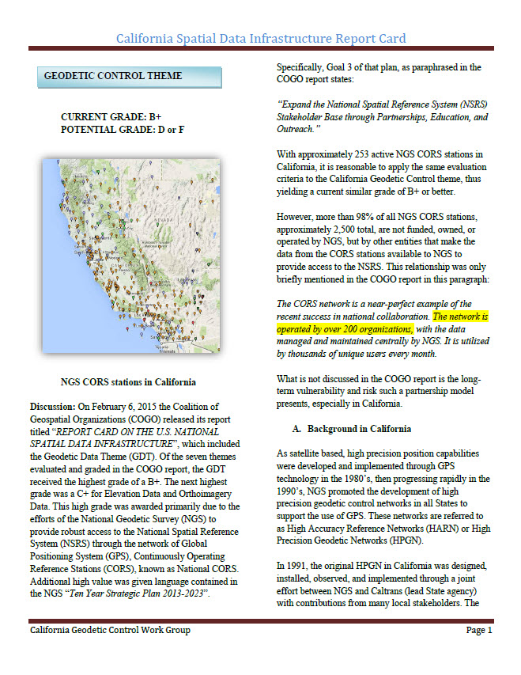
California Geodetic Control Work Group
Chartered by the California GIS Council
Submittal of Recommendations to develop a State supported geodetic infrastructure with Real-Time capability will be submitted to the Council by the end of September 2017
Authored the Report Card (pictured) on the Geodetic Control Theme of the California Spatial Data Infrastructure
Will be involved in Implementation phase, if requested
Notes:
Food Analogy – always safe.

Slide 17
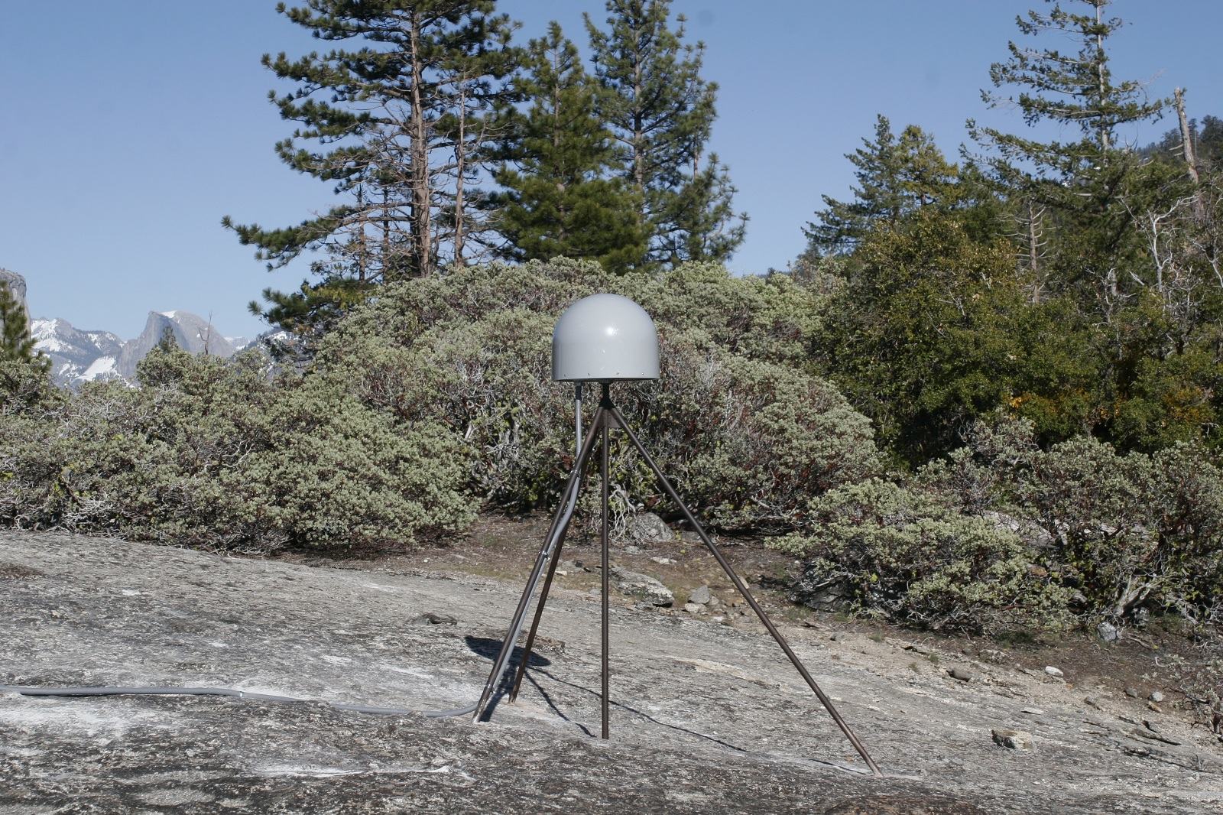
Questions?

