Slide 1


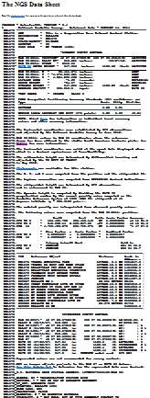
U.S. Department of Commerce National Oceanic & Atmospheric Administration
National Geodetic Survey (NGS)
Understanding The Information Found On NGS Datasheets
John Ellingson – NGS Geodetic Advisor
WISCONSIN - GREAT LAKES REGION
john.ellingson@noaa.gov, 202-306-6904
1

Slide 2
Goal today: To improve understanding of NGS datasheets
Learn alternate ways to obtain datasheets while in the office, or in the field.
Learn about the different sections of datasheets
Learn about important differences in the information that is found in certain sections of the datasheet –avoid using it incorrectly.
2

Slide 3
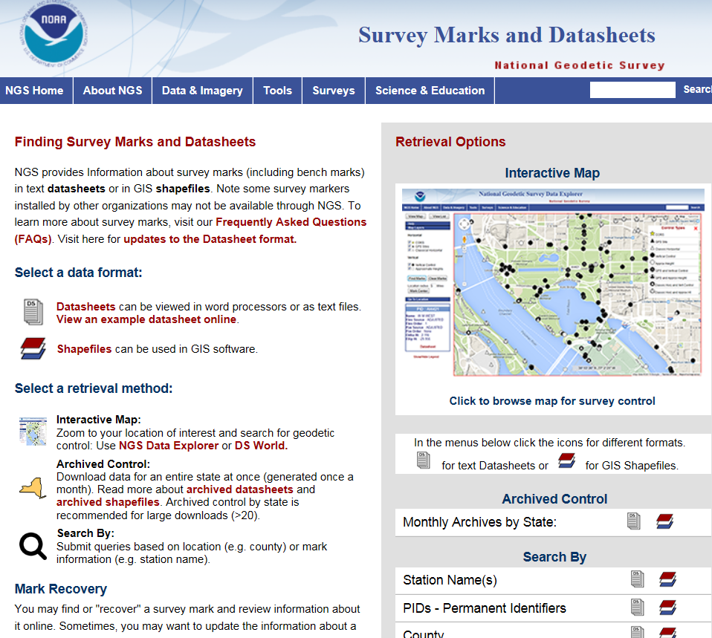
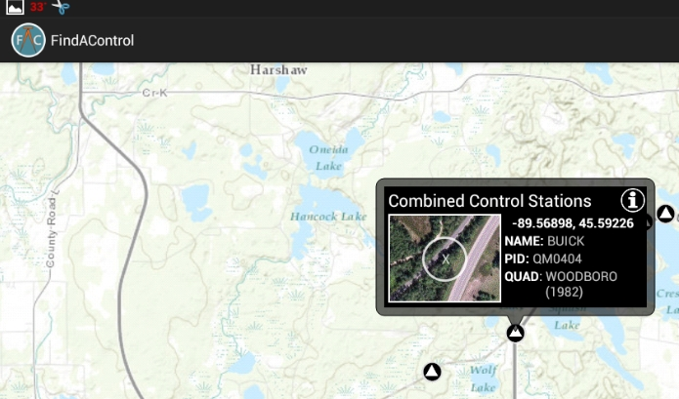
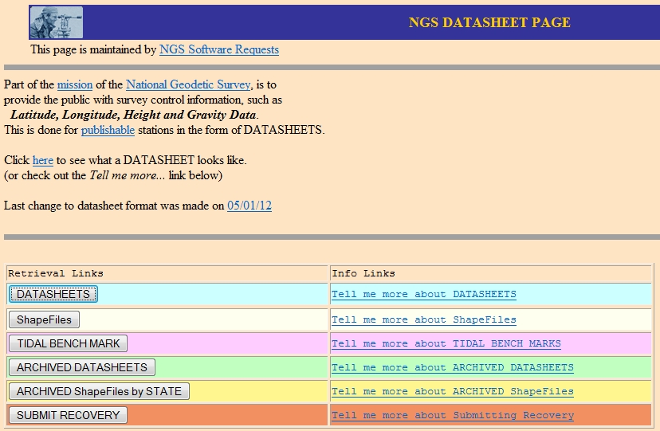
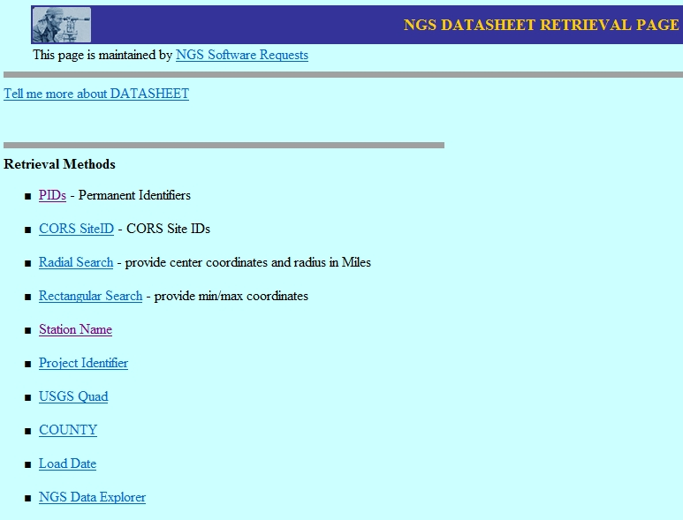
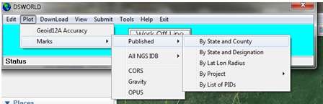
METHODS TO OBTAIN DATASHEETS
“Classical” NGS website retrieval
“DSWorld” software with Google Earth
NGS “Data Explorer” option
Smart Phone App - “FindAControl” *
NGS DATA EXPLORER
FindAControl
*NOT an NGS Product
DSWorld
CLASSICAL METHOD
3

Slide 4
“CLASSICAL” NGS Website retrieval….
http://www.ngs.noaa.gov/cgi-bin/datasheet.prl
Useful information
You can also find a Project ID using a PID
Interactive Map Option
4

Slide 5
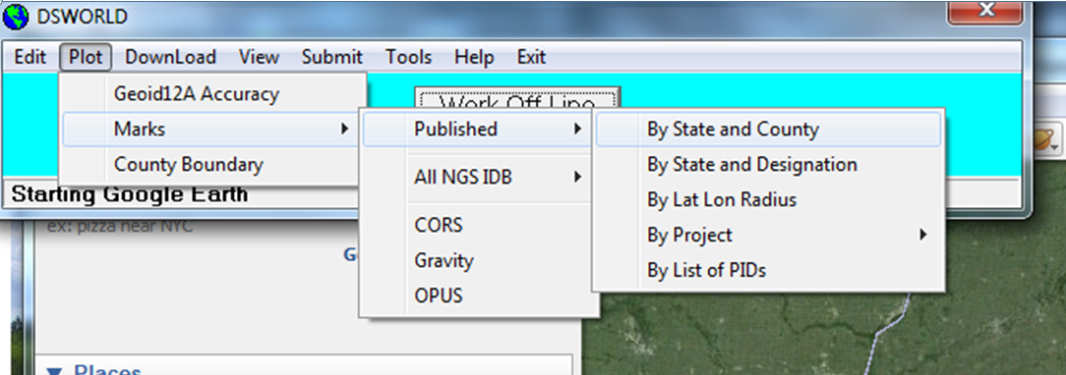
“DSWorld” - software program developed by Malcolm Archer-Shee
Download this free program from the NGS website at – http://www.ngs.noaa.gov/PC_PROD/PARTNERS/index.shtml
5

Slide 6
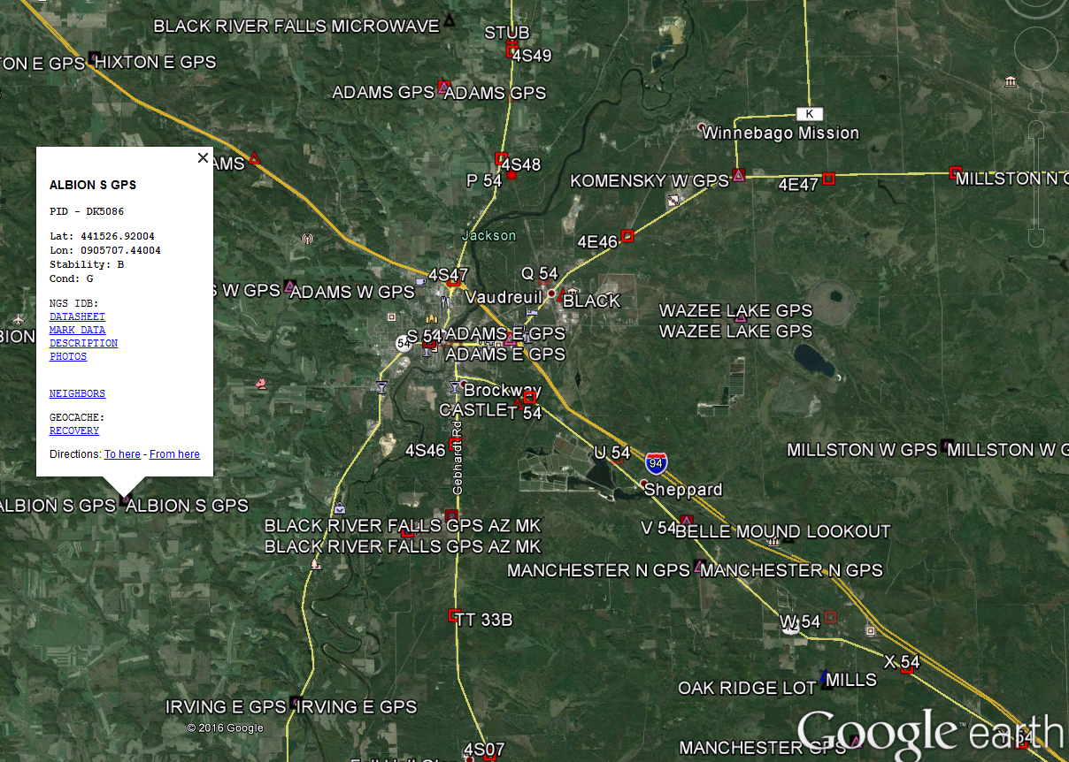
“DSWORLD” Screen Capture
6

Slide 7
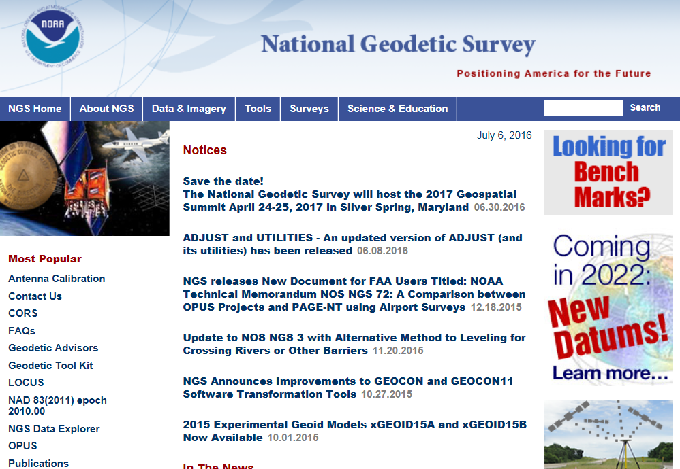
“NGS Data Explorer” found here….
http://www.ngs.noaa.gov/
Click here to reach
“DATA EXPLORER”
7

Slide 8
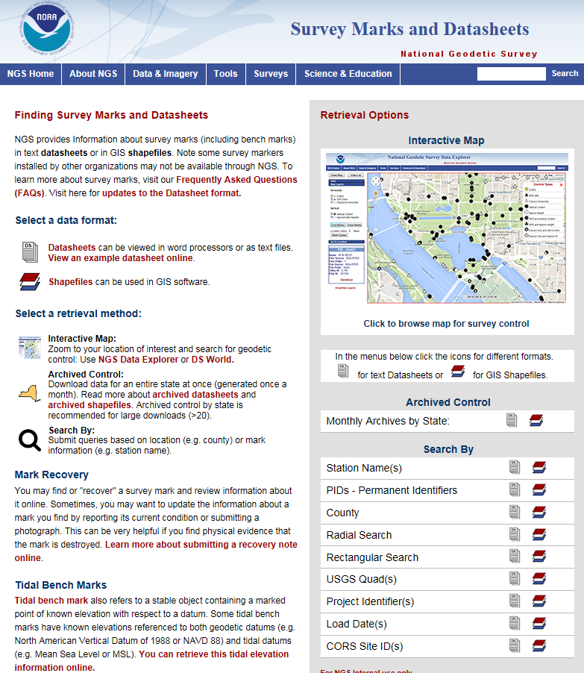
Interactive map method
Statewide datasheet extractions- latest month is available here
Go To “classical method”
“Text format” datasheet retrievals, or…
“Shapefile format” for GIS functionality
8

Slide 9
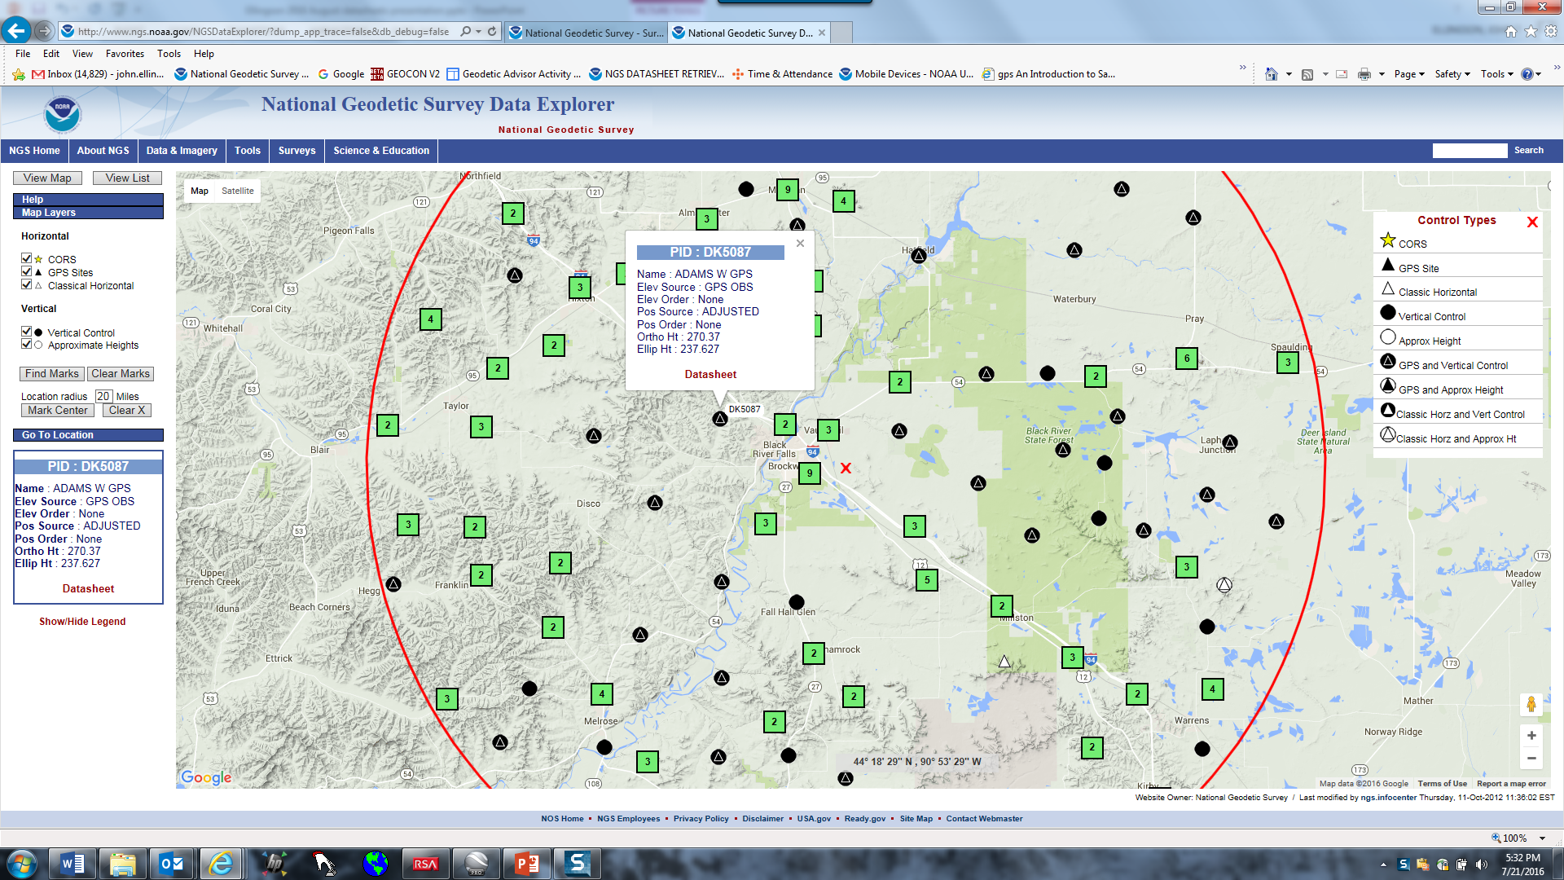
Sample search using NGS “Data Explorer” tool
9

Slide 10
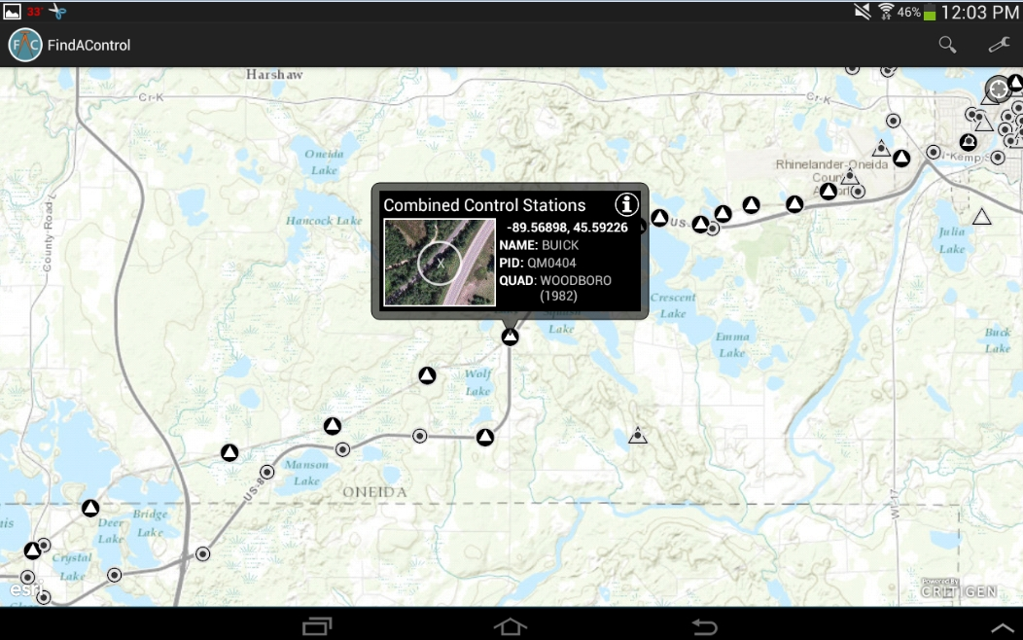
SMART PHONE or TABLET APP --- “FindAControl”
Android and iOS Application - NOT an NGS product
10

Slide 11
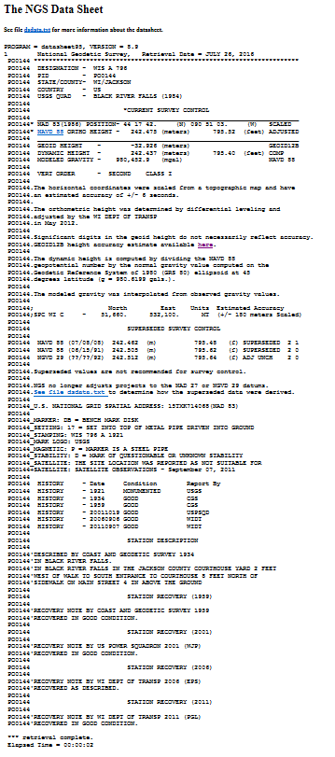
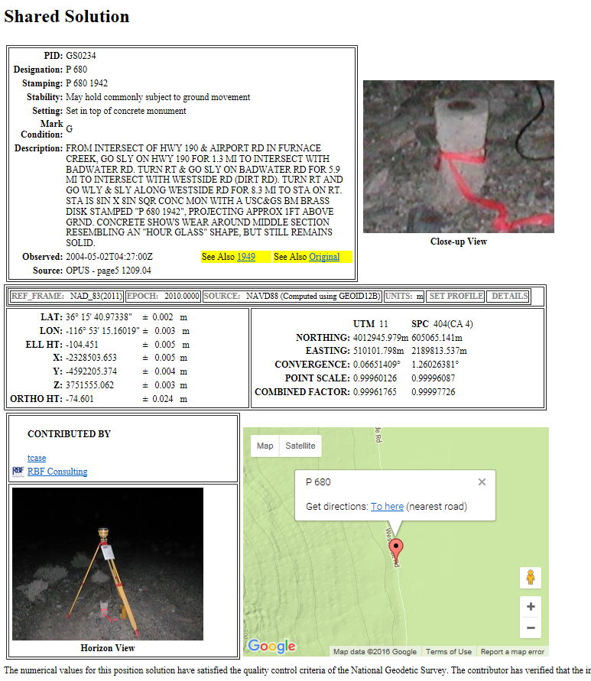
CLASSICAL DATASHEET
OPUS SHARED SOLUTION
11

Slide 12
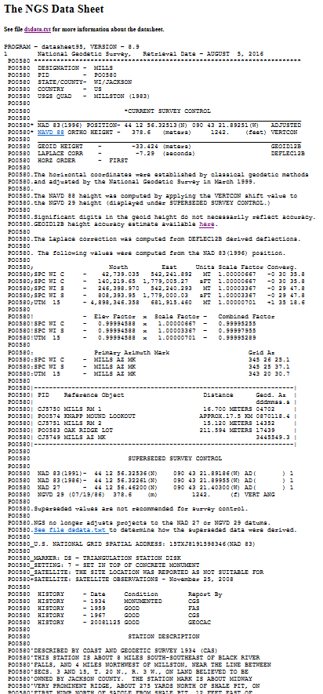
DATASHEET SECTIONS:
Basic Metadata
Current Survey Control
Accuracy
Data Determination Methodology
Projections
Azimuth Marks (old hz marks only)
Superseded Survey Control
Monumentation
National Grid
History
Description and Recoveries
12

Slide 13
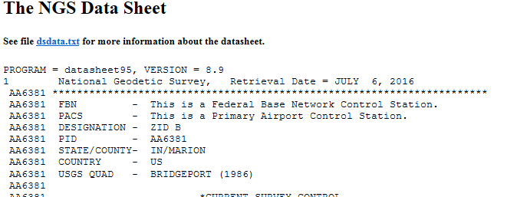
BASIC METADATA SECTION OF EACH DATA SHEET
dsdata.txt is a guide to understanding datasheet info
VERSION # matters to some vendor software programs
THE “PID”….. IT IS IMPORTANT
13

Slide 14
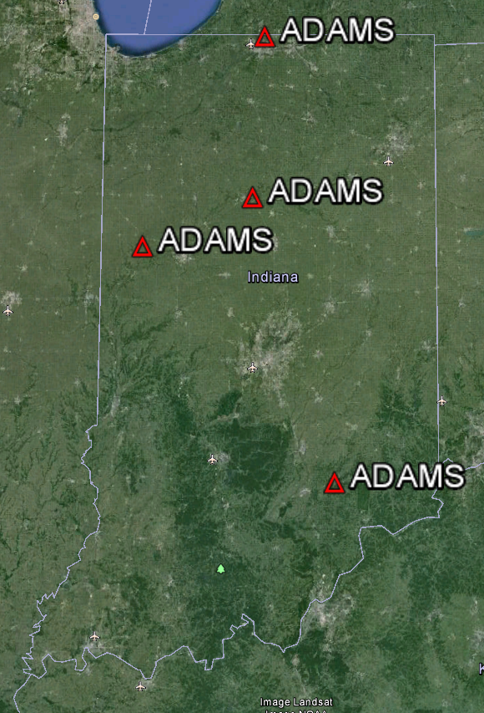
Why is the “PID” important?
The PID is the key to the NGS database which contains more than 1.5 million marks
Four stations are named “ADAMS” in Indiana
Each one has a unique PERMANENT IDENTIFIER (six character PID)
14

Slide 15
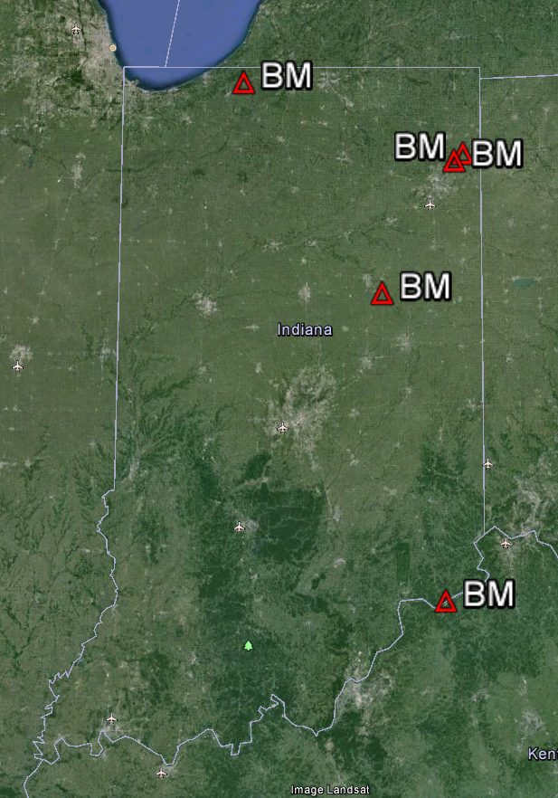
Five Stations have the designation “BM”
Again, each has a unique PID…..
ME0908, MD0784, MD0358, LA1409, HZ1997
15

Slide 16
Three Primary Types of “MODERN” Geodetic Marks:
Leveled only
GPS-Observed only
Leveled and GPS-Observed on same mark
NOTE: there are many old triangulation stations that still exist in the NGS database…. CAUTION: avoid mixing old triangulation data with modern GPS-surveyed marks!
16

Slide 17
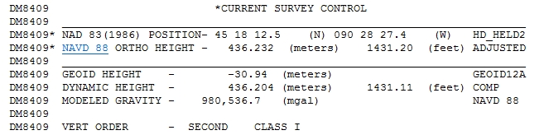

Published “CURRENT SURVEY CONTROL” for a LEVELED-ONLY mark. (NOT GPS observed)
Note Handheld GPS Pos.
Note Position
SCALED from Topo map
Another Vertical Mark Example
17

Slide 18
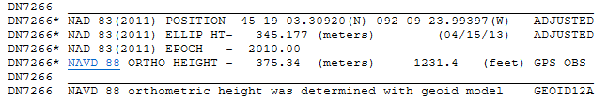
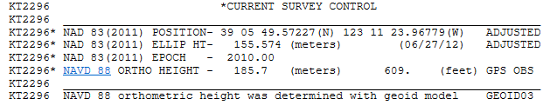
This mark was observed only with GPS (it WAS NOT leveled) -
published height was GPS derived using Geoid model
use the meters value
This mark is also…. GPS-Only
?? use this value??
18

Slide 19
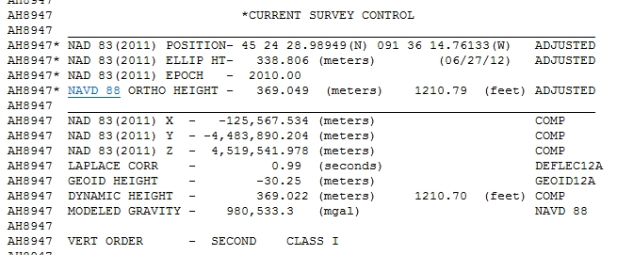
This mark WAS observed with GPS, and it WAS separately leveled
15 vertical
source options
Sources: ADJUSTED, ADJ_UNCH, POSTED, READJUST, N_HEIGHT, RESET, COMPUTED, GPSCONLV, LEVELING, H_LEVEL, GPS_OBS, VERT_ANG, SCALED, U_HEIGHT, VERTCON
Each type is explained in the “dsdata.txt” document
19

Slide 20
“…CONTROL” Section continued
Cartesian
Coordinates
Laplace Correction - combined with astronomic azimuth, yields the geodetic azimuth
Geoid Height -separation between Geoid and the reference ellipsoid (negative in contig. U.S.)
Dynamic Height -geopotential value at the mark (NOT an orthometric height).
Modeled Gravity – interpolated from observed gravity values
Vertical Order Will be 2nd order (or better). NGS does not accept 3rd order, except on “Resets”
20

Slide 21
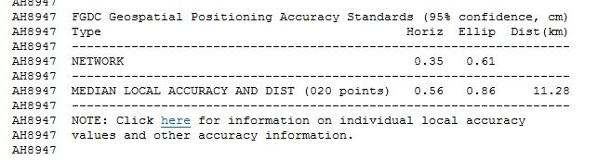
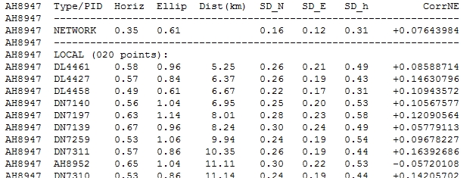
ACCURACY STANDARDS SECTION
replaces Hz Order & Class for marks
Clicking on the “here” link generates the following table
Local Accuracies
21

Slide 22
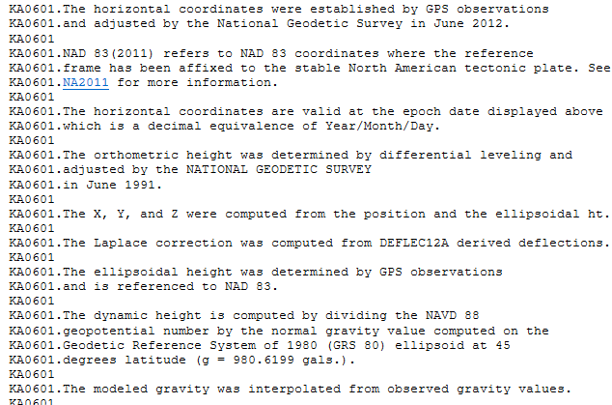
THE NEXT SECTION EXPLAINS HOW THE PUBLISHED VALUES WERE DETERMINED
22

Slide 23
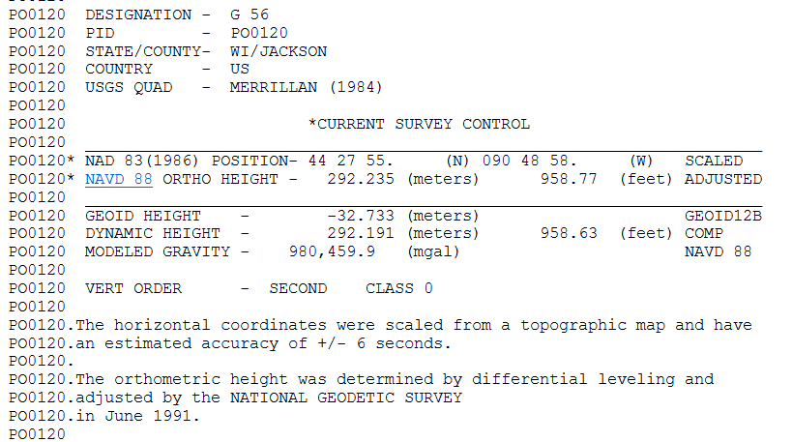
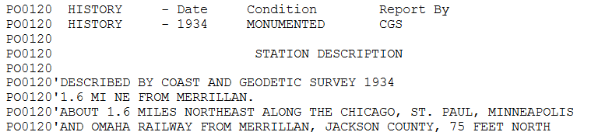
Caution: don’t overlook the age of the observations
Adjusted
in 1991
(re-adjusted)
Leveled
in ~1934
23

Slide 24
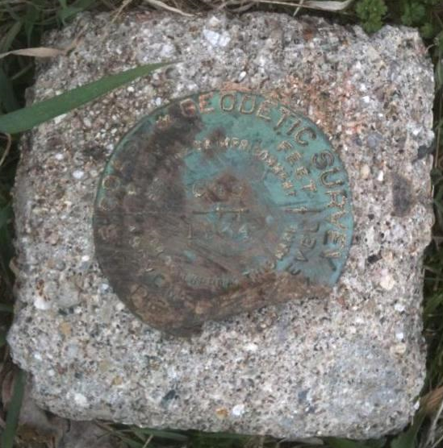

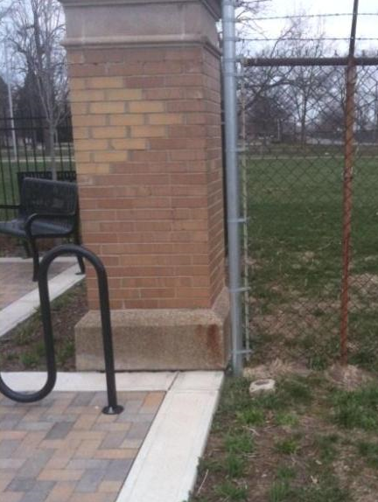
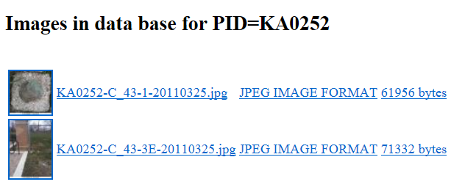
PHOTOGRAPH SECTION
This is station “C 43” - located just northwest of the Indiana State Fairgrounds
24

Slide 25
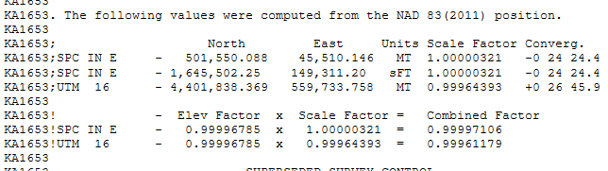
SECTION PROVIDING
STATE PLANE COORDINATES and
UTM COORDINATES
25

Slide 26
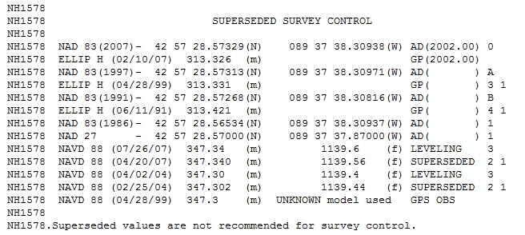
SECTION SHOWING SUPERSEDED VALUES
“KOLLATH”
*
*
*
*
26

Slide 27
SECTION PROVIDING THE MARK’S
NATIONAL GRID ADDRESS
U. S. National Grid (USNG) system is a FGDC standard, developed to improve public safety and commerce.
http://www.fgdc.gov/usng
27

Slide 28
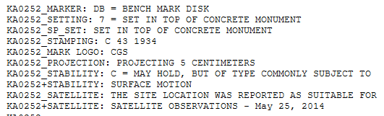
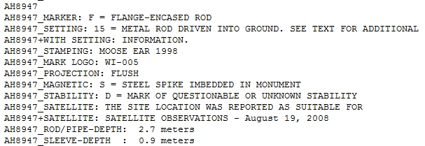
Mark Description Section - Two examples
Station
“C 43”
(Coast and Geodetic Survey disk)
Station
“MOOSE EAR”
(set by Barron Co. WI )
28

Slide 29
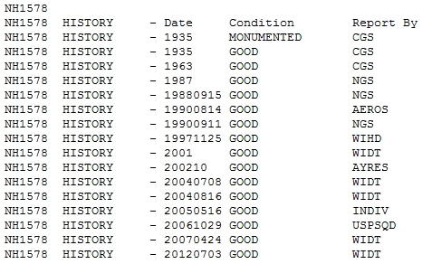
SECTION SHOWING THE MARK’S
“SETTING AND RECOVERY HISTORY”
“Kollath” – 16 recoveries
29

Slide 30
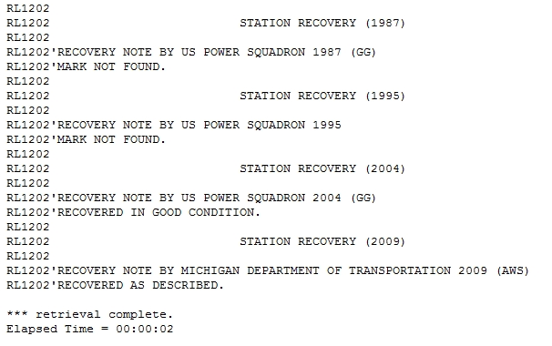
STATION RECOVERY NOTES - BE AWARE THAT RECOVERY NOTES CAN SOMETIMES BE MISLEADING!
Mark originally set by NGS (CGS) in 1948
17 YEARS LATER
30

Slide 31
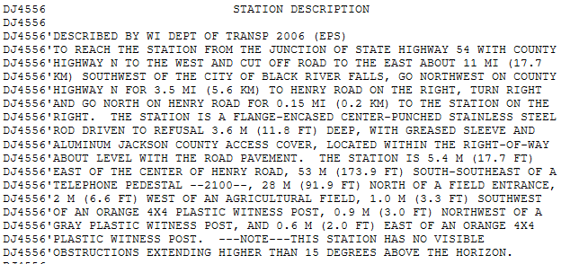
SECTION OF THE DATASHEET SHOWING THE STATION DESCRIPTION … (TO-REACH and TIES)
To-Reach Info
Ties
31

Slide 32

FINALLY,
WATCH FOR NOTIFICATION THAT YOUR DATASHEET(S) EXTRACTION IS COMPLETE
If you do not see this message at the end, you did not get all of the datasheets that you requested.
32

Slide 33
SUMMARY
Different types of marks (Hz- Vert) exist in the field
Datasheets contain much useful info. Info will vary depending on the type of mark.
“dsdata.txt” is a great source for understanding datasheets http://www.ngs.noaa.gov/cgi-bin/ds_lookup.prl?Item=DSDATA.TXT
There are several ways to obtain published NGS data.
Your NGS Advisor is here to assist you with understanding & using the National Spatial Reference System (NSRS)
Thank you for attending this session.
33

Slide 34
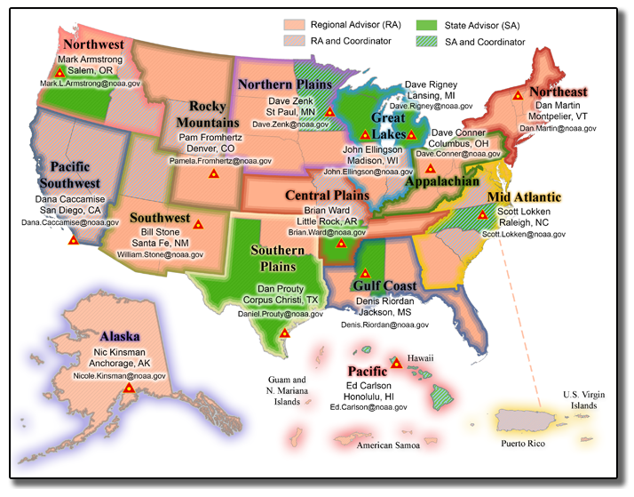
Remember that NGS REGIONAL ADVISORS are here to help you. Find Advisors’ contact info on the NGS website at:
http://www.ngs.noaa.gov/ADVISORS/
QUESTIONS…
34

