Slide 1
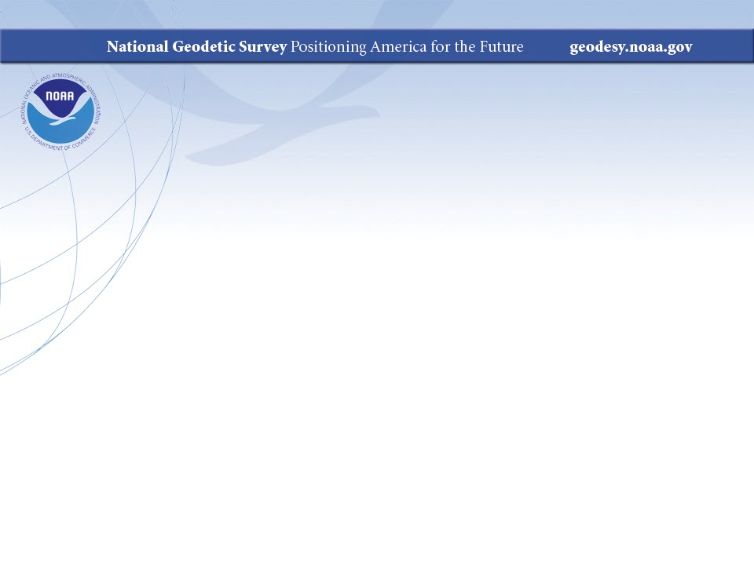
Ecosystems and Climate Operations
NGS Monthly Webinar Series
August 13, 2015
Notes:
NGS’ Ecosystems and Climate Operations has evolved over the past decade into a mature team focused on advancing NGS’ mission to the rest of NOAA and our non-navigational partners. As the new NGS Webinar Series is drawing from a widening pool of geospatial interests, we felt it would be useful for the audience to know a little bit more about who we are and what we do.

Slide 2
Outline
Introducing Ecosystem and Climate Operations (ECO)
  History
  Accomplishments
ECO’s Role
  NGS priorities and geodesy
  NOAA’s priorities
ECO Today and Tomorrow
  Portfolio and Communications
  Near-term projects and future priorities
NGS Ecosystem and Climate Operations (ECO) team http://www.ngs.noaa.gov/web/science_edu/ecosystems_climate/
Notes:
Our presentation will cover the history and accomplishments of ECO, and also how ECO advances NGS’ mission to the rest of NOS and NOAA, how ECO also supports NGS priorities, and we will discuss where ECO is today and some thoughts on our future.

Slide 3
INTRODUCING ECO
NGS Ecosystem and Climate Operations (ECO) team http://www.ngs.noaa.gov/web/science_edu/ecosystems_climate/
Notes:
So, what is ECO, and how did it develop?

Slide 4
Supporting coastal restoration
Problem(s):
Need for high accuracy land elevations and water levels
Lacked understanding of tidal and geodetic datums
Traditional surveying not adapted to coastal habitats
Tidal datums only accurate locally
Solution: teams form at NGS & sister “tides & currents” office
NGS ECO & CO-OPS COASTAL
NGS Ecosystem and Climate Operations (ECO) team http://www.ngs.noaa.gov/web/science_edu/ecosystems_climate/
Notes:
ECO developed to support coastal restoration
Problem:
Coastal scientists and managers need high accuracy land elevations and water levels to successfully restore wetland habitats
There was a lack of guidance and expertise in accessing and using tidal and geodetic datums and their relationships for coastal restoration
Traditional surveying not adapted to coastal habitats
Tidal datums only accurate locally; need local observations
Solution:
In early 2000’s, NGS and CO-OPS demonstrate application of geospatial instrumentation & methodology, data, products, and tools to support wetland restoration and coastal science
CO-OPS COASTAL & NGS ECO
Early activities were based on NOAA habitat restoration pilot projects, some led by the NOAA Restoration Center. Activities were largely ad hoc.

Slide 5
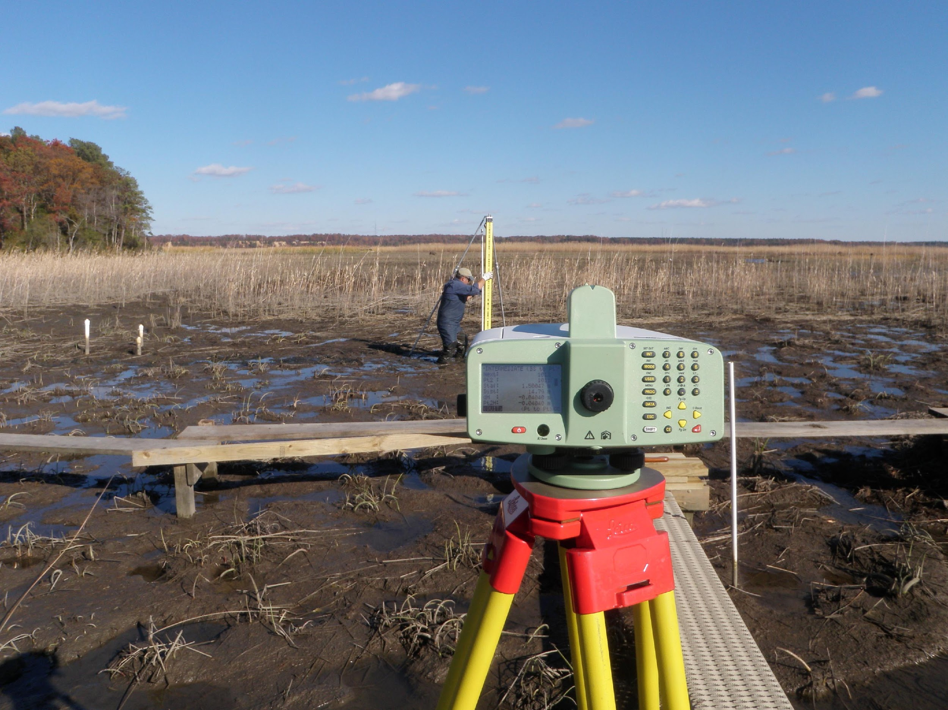
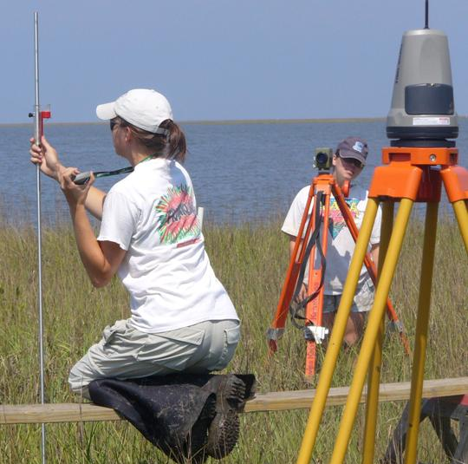
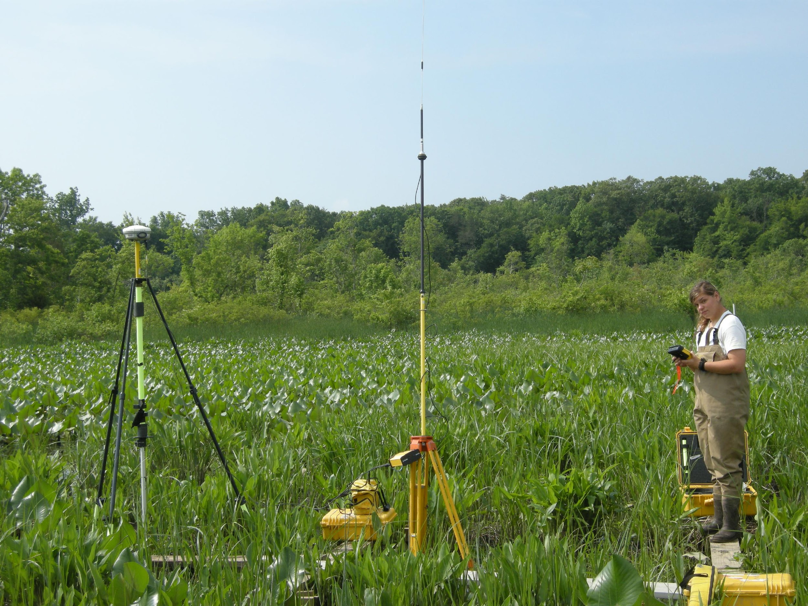
ECO Projects
Including bench mark setting, leveling, Height Mod surveys, terrestrial lidar, static GPS and RTK GPS.
Supporting coastal restoration; coastal science; long-term ecosystem monitoring; studying the impacts of sea level rise; and improving coastal resilience.
NGS Ecosystem and Climate Operations (ECO) team http://www.ngs.noaa.gov/web/science_edu/ecosystems_climate/
Notes:
NGS ECO arose to develop more programmatically our ability to adapt NGS products and services to support our non-navigational coastal stakeholders, through a whole host of different projects:
The range of projects included:
bench mark setting; leveling; Height Mod surveys; terrestrial lidar; static and RTK GPS
PLUS all the work with CO-OPS and water level information
Work was completed by many people across NGS
main ECO team, advisors, Corbin, Norfolk, and others from Silver Spring
RSD has gotten involved adding flight lines during lidar collection
Students!
plus we are always working lock-step with partners and building their capacity
There are a broad range of applications = We don’t do coastal ecosystem research, we make coastal ecosystem research better!
Examples include: coastal restoration; coastal science, long-term ecosystem monitoring, impacts of sea level rise; improving coastal resilience

Slide 6
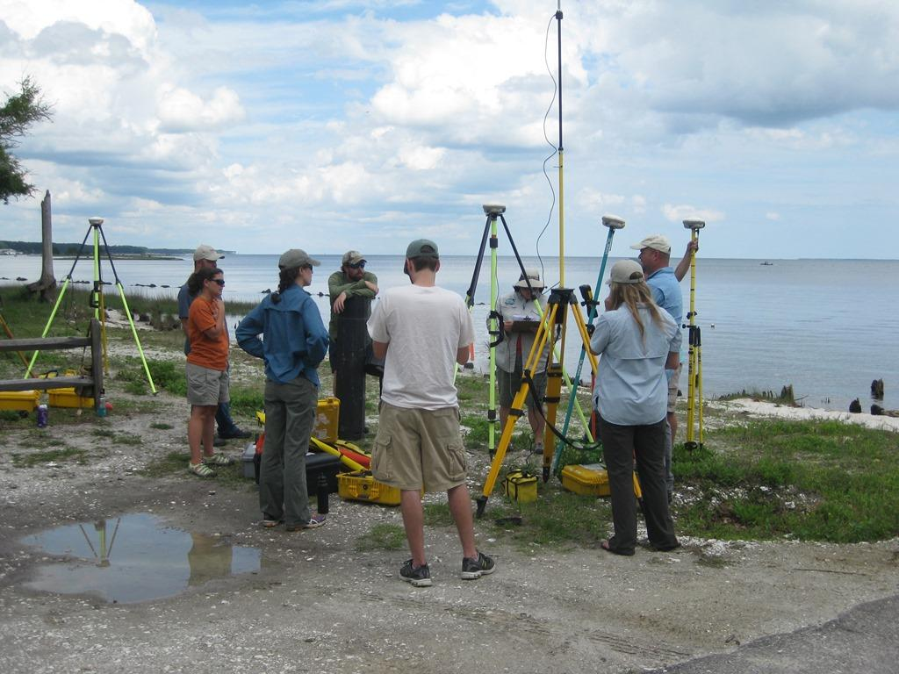
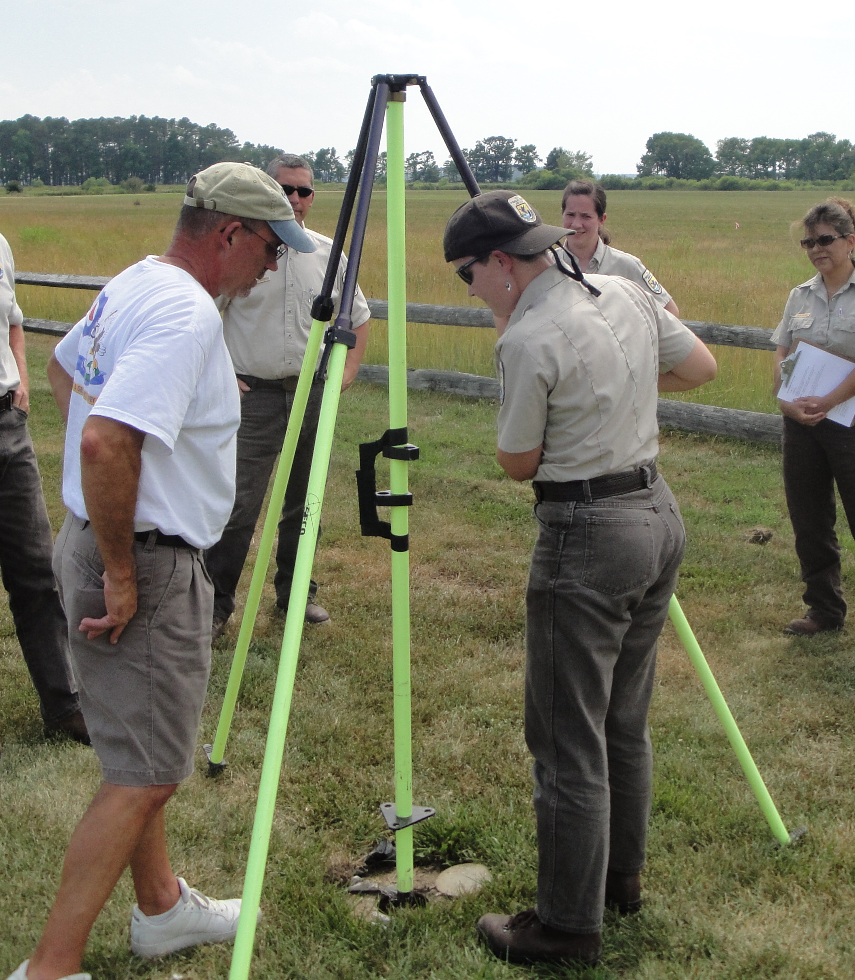
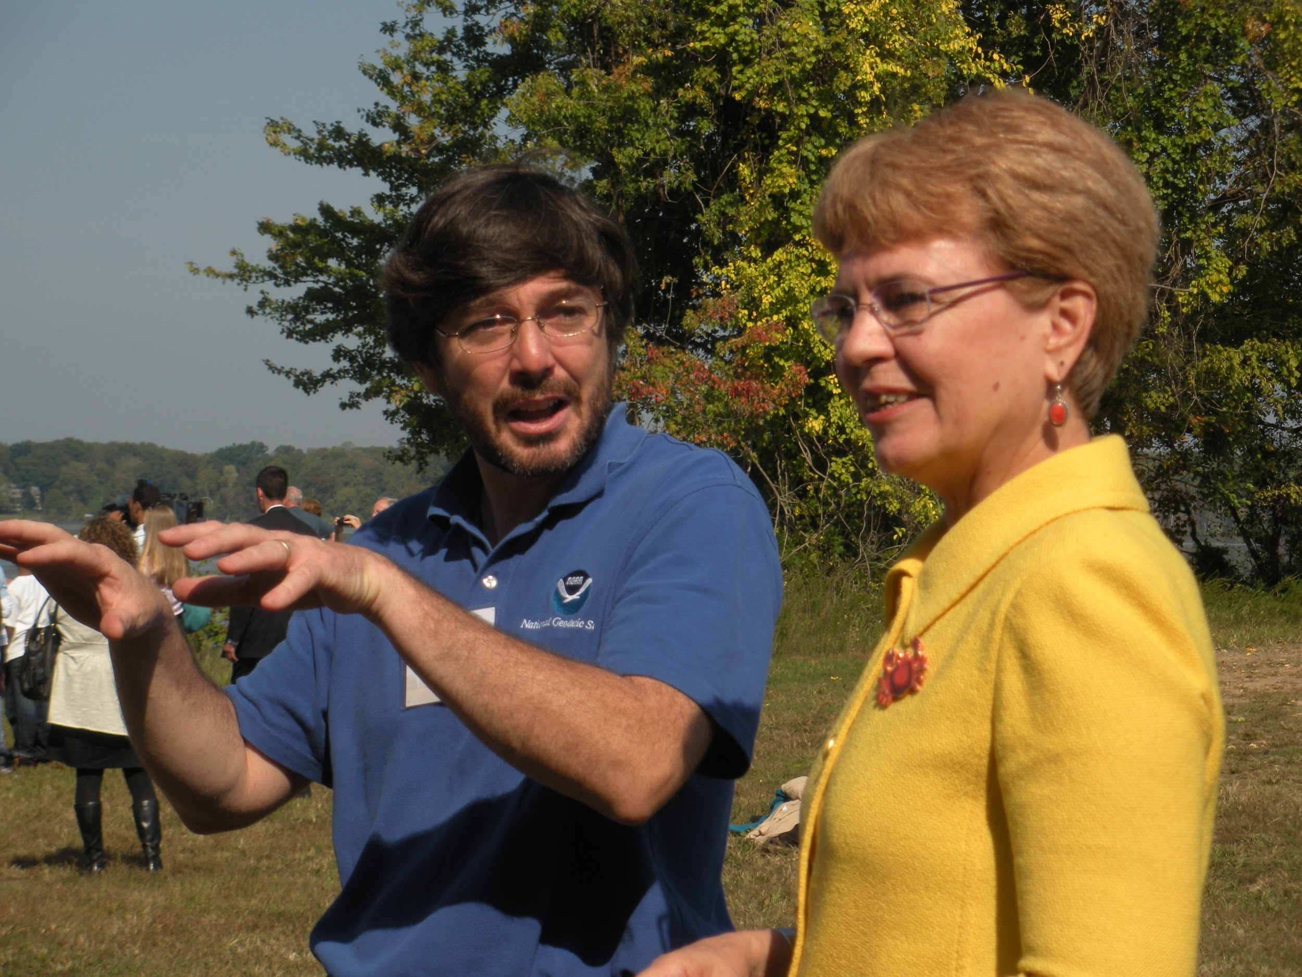
ECO Trainings & Outreach
Working with Corbin Training Center and State Advisors
Representing NGS at numerous workshops
Convening sessions at international conferences and presenting at many others
NGS Ecosystem and Climate Operations (ECO) team http://www.ngs.noaa.gov/web/science_edu/ecosystems_climate/
Notes:
Even though we’ve completed field work ourselves, a large part of the endeavors over the years is to build capacity within this community.
GPS equipment is getting less expensive, and therefore more available to more user communities. It’s a great opportunity to expand a community of practice that understands some of complexities with respect to tidal and geodetic datums.
Some training has been held at Corbin or hosted by geodetic advisors at coastal reserves.
Sometimes we are invited experts, bringing geospatial expertise to workshops.
Another opportunity has been participating in conferences. We’ve convened sessions on geospatial infrastructure and sentinel sites that have been well attended and well received.
Geospatial Infrastructure for Sentinel Sites at CERF 2009
NOAA Sentinel Site Program at CERF in 2013
Chesapeake Bay Sentinel Site Cooperative at RAE in 2014

Slide 7
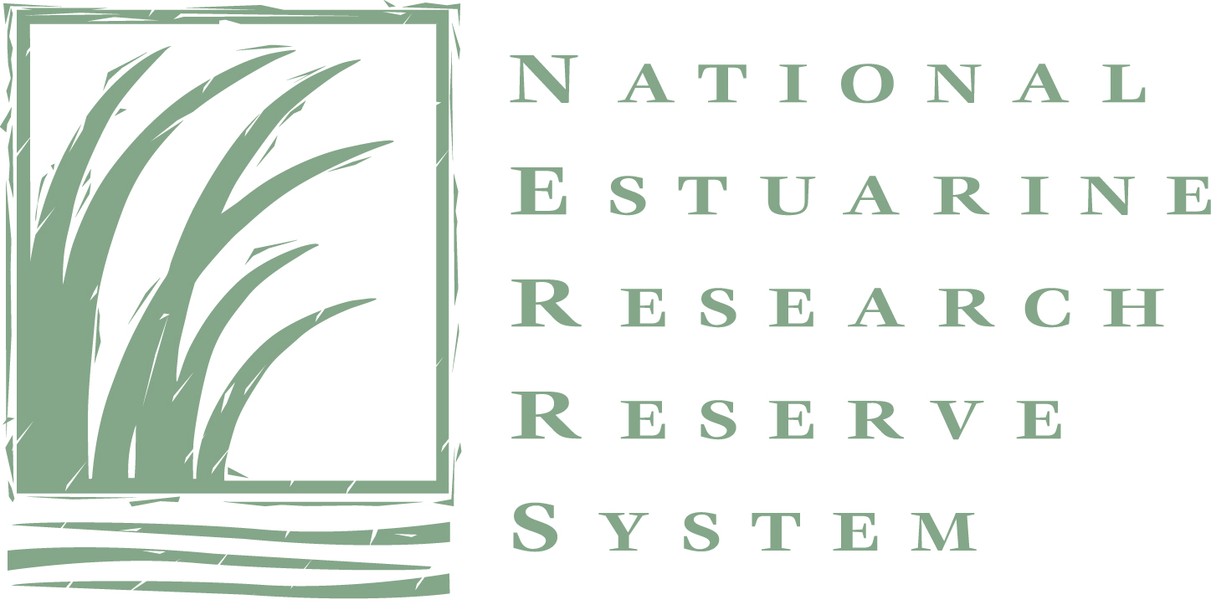

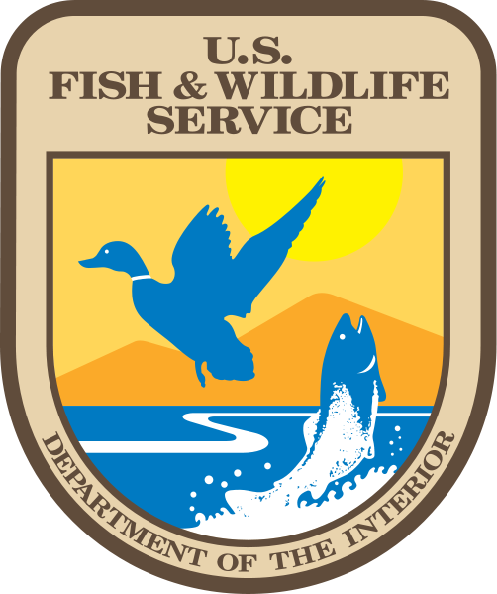

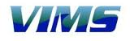
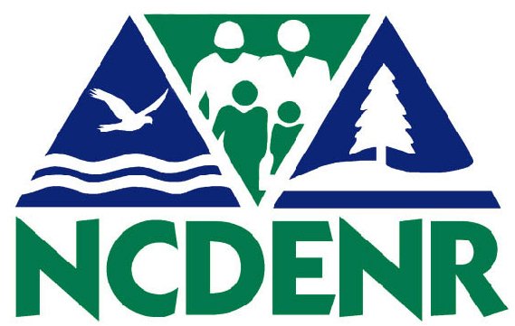

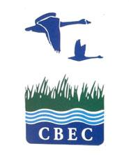

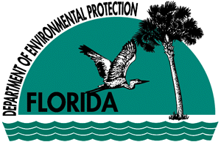

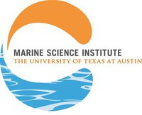
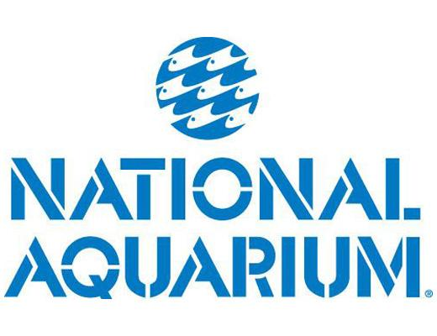

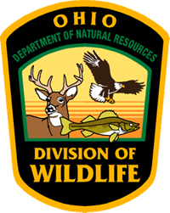

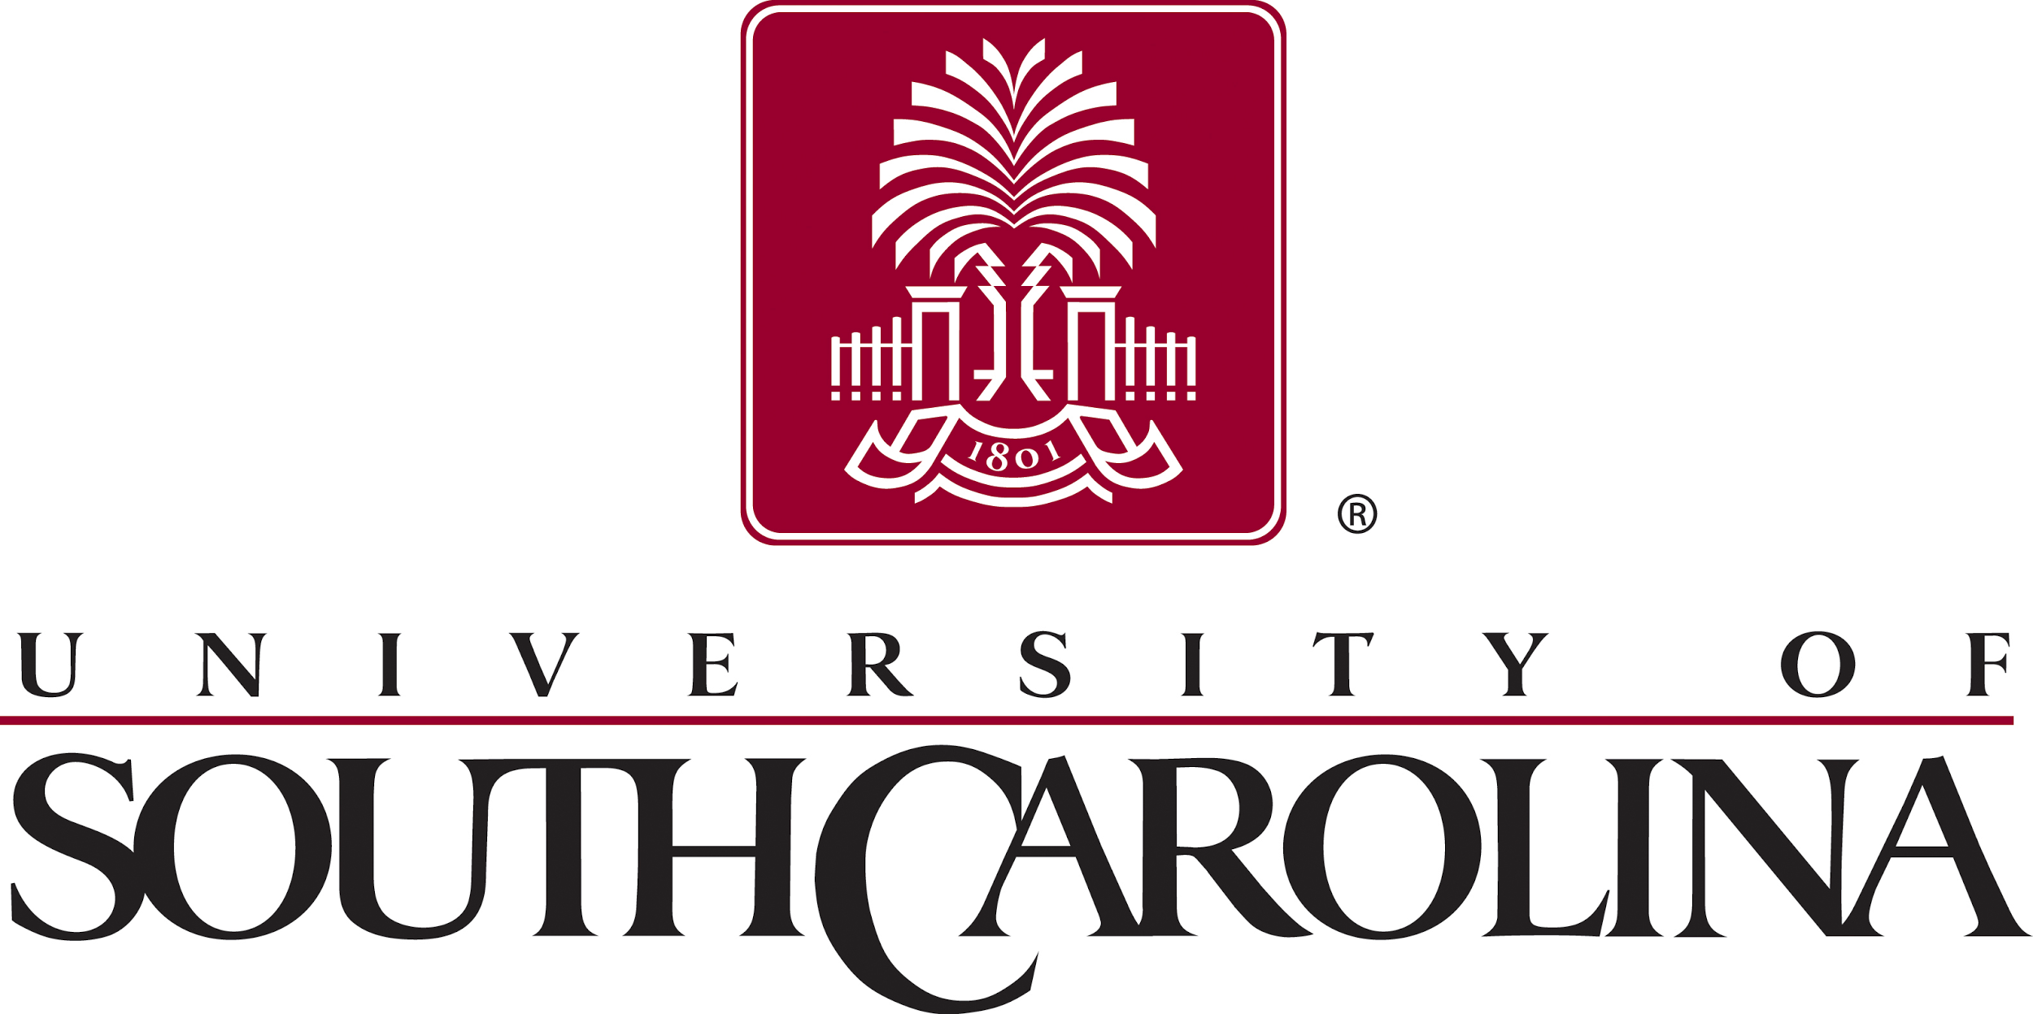
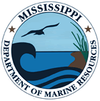

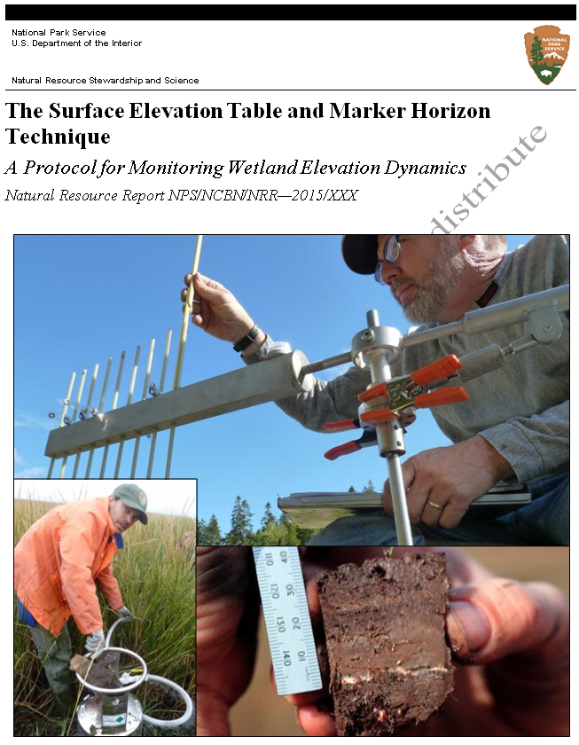
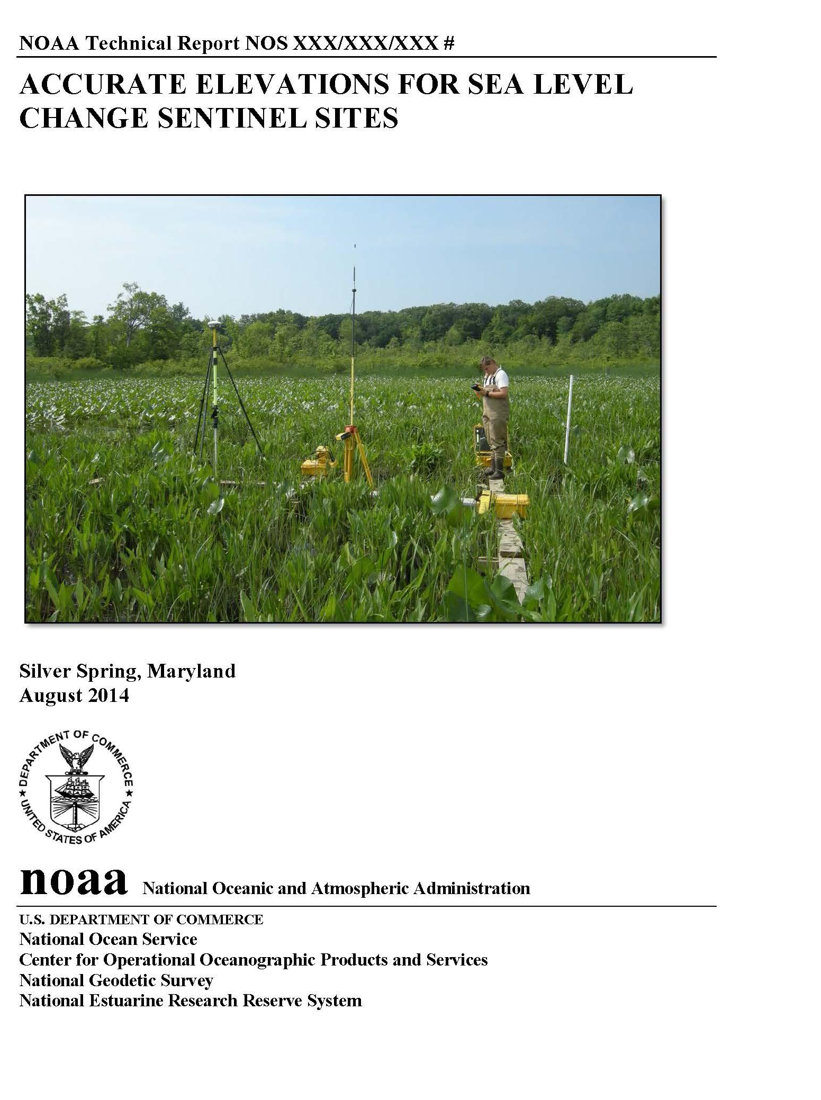
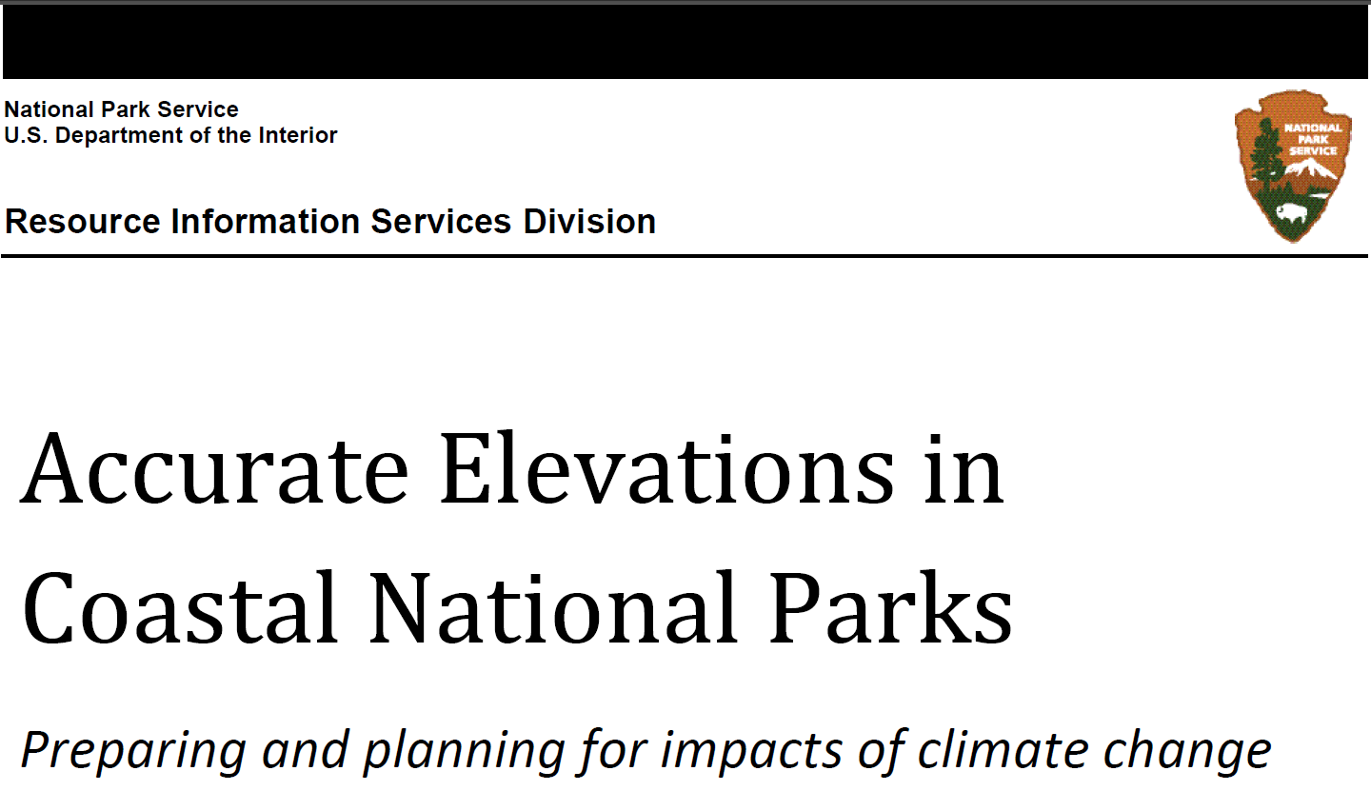
ECO Accomplishments
65+ field projects since 2003
16 Trainings since 2008
50+ Outside presentations
Countless consultations
Three guidelines documents
Strong relationships with many partners, both NOAA and external
Represented NGS on cross-office teams and committees
Notes:
Over the past ten years, ECO has accomplished a great deal.
Over 65 field/demonstration projects since 2003
16 Trainings on such topics as: Leveling, GPS, RTK, and more… (NERRS, NPS, US FWS, USGS, others)
There have been many presentations across NOAA Line offices and program offices
We regularly consult directly with NERR and other coastal managers
We’ve helped create three guidelines documents
GPS Derived Heights on SET
Geospatial Infrastructure for Sentinel Sites
SET Protocols (NPS)
We have a strong relationship with many partners
We’ve represented NGS on many cross-office teams and committees

Slide 8
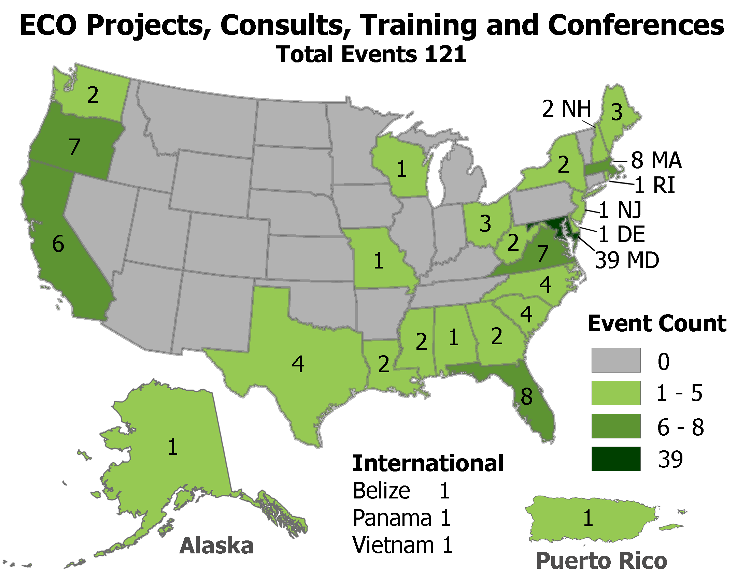
Notes:
As an outcome of these efforts, many coastal parks, reserves, and refuges have the geospatial infrastructure and capacity to complete their work / monitoring based on accurate elevation information.
With a relatively small investment, we’ve worked with an incredibly expansive geography.

Slide 9
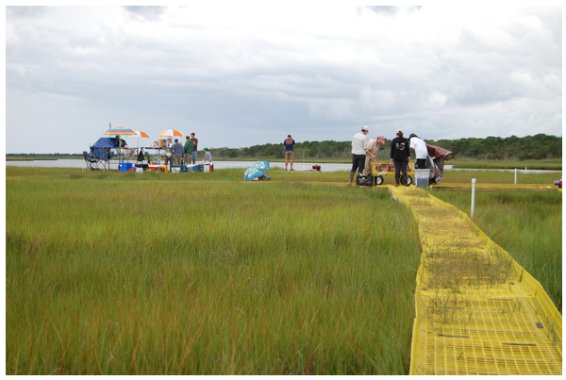
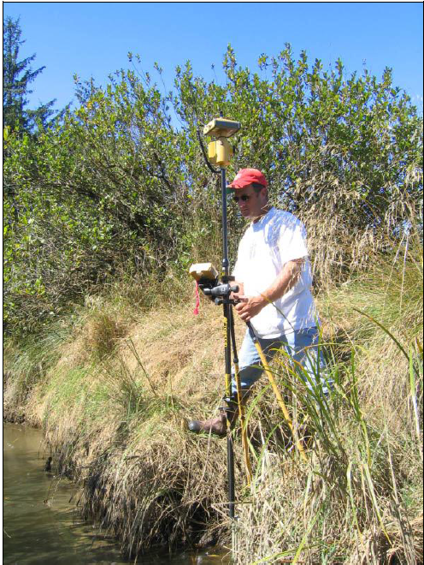
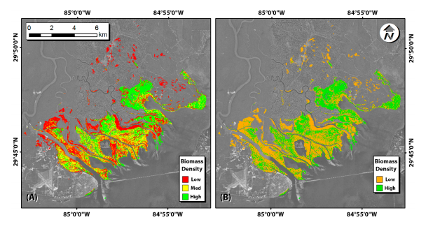
Outcomes - Supporting Science
Waquoit Bay NERR (MA) - Quantifying “Blue Carbon” in marshes for emerging carbon market
Apalachicola NERR (FL) - Improving lidar in marshes by combining remote sensing and vegetation data
South Slough NERR (OR) - Endangered Salmon habitat evaluations and new technology for inundation
Notes:
We don’t do coastal ecosystems science, make make it better… Here are just three examples of how our partners have leveraged the geospatial infrastructure and information they gained from working with us to improve their coastal science.
(on the RIGHT): South Slough, OR: CICEET grant (Cooperative Institute for Coastal and Estuarine Environmental Technology) -given to South Slough NERRS & Dr. Laura Brophy (OSU) to study the use of i-button temperature sensors to measure frequency and duration of inundation, which was then used to characterize endangered salmon habitat across 5 sites along the Oregon coast. NGS provided marsh DEMs (elevation models) and elevation differences between water level loggers and i-button sensors to help calibrate the system, and enabled Laura to model inundation patterns. This ended up informing Oregon’s decisions on habitat preservation and restoration.
Waquoit Bay, MA: Waquoit Bay was awarded a $1.3M NERRS Science Collaborative grant to generate science and management tools that will support coastal wetlands as potential international carbon markets, which aim to incentivize investment in tidal wetland restoration and preservation. This work was funded in large part thanks to the extensive geospatial infrastructure established over the past several years by NGS ECO, which serves as geodetic control for the measurements of wetland vertical accretion.
Apalachicola, FL: using the local control networks established in the Apalachicola NERR by FL state geodetic advisor Dave Newcomer, Dr. Stephen Medeiros (Univ. Central FL) was able to greatly ameliorate the ability to generate accurate DEMs in FL wetlands from lidar and other remotely sensed data. Using the ground-truthed DEMs, Dr. Medeiros was able to reduce the vertical errors by close to 40%, and the vertical bias by close to 50%.
These are examples of how scientists have been able to leverage geospatial infrastructre and high accuracy geospatial data to support their science

Slide 10
ECO’s Role
NGS Ecosystem and Climate Operations (ECO) team http://www.ngs.noaa.gov/web/science_edu/ecosystems_climate/
Notes:
We’ll also talk about ECO’s connections to mainstream geodesy
We’ll talk about ECO’s connections across NOS and NOAA

Slide 11
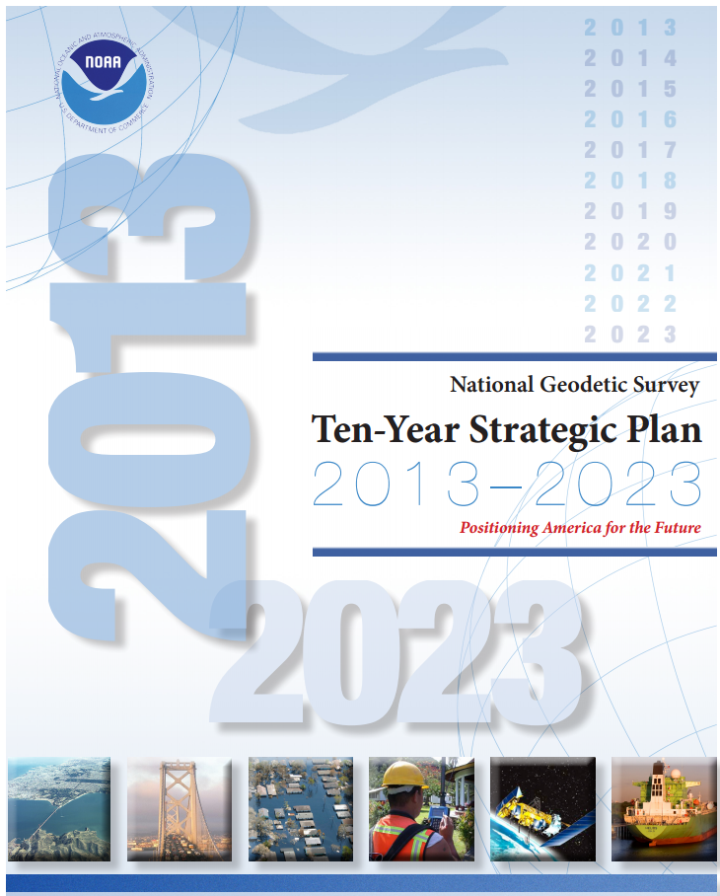
NGS Ten Year Plan
NAD 83 and NAVD 88
will be replaced in ~2022
Transition will involve
all of NGS, including ECO
Notes:
As many of you know, NGS released an updated ten-year plan in 2013. This plan includes the entire breadth of NGS projects and programs, focusing specifically on the planned replacement of NAD 83 and NAVD 88 in approximately 2022.
Over the past decade, ECO has worked very closely with our coastal partners to provide them training, expertise, and field assistance in obtaining access and using high accuracy coordinates with respect to our official horizontal and vertical datums. This has represented a learning curve for many practitioners for whom the whole concept of national datums was relatively new.
Going forward, ECO realizes that it will now have to work even harder to make sure that this new community of users will be able to make as seamless a transition as possible to the new reference frames in the next decade.
What will the new datums mean for our partners who have gotten used to understanding the relationship between local tidal datums and NAVD 88? How will they connect their observing system to the new reference frame? How will they monitor the stability of their sensors? How will they convert all of their legacy data?
To help answer these questions, ECO is engaging in all pieces of the ten year plan - from data collection to education and outreach.

Slide 12
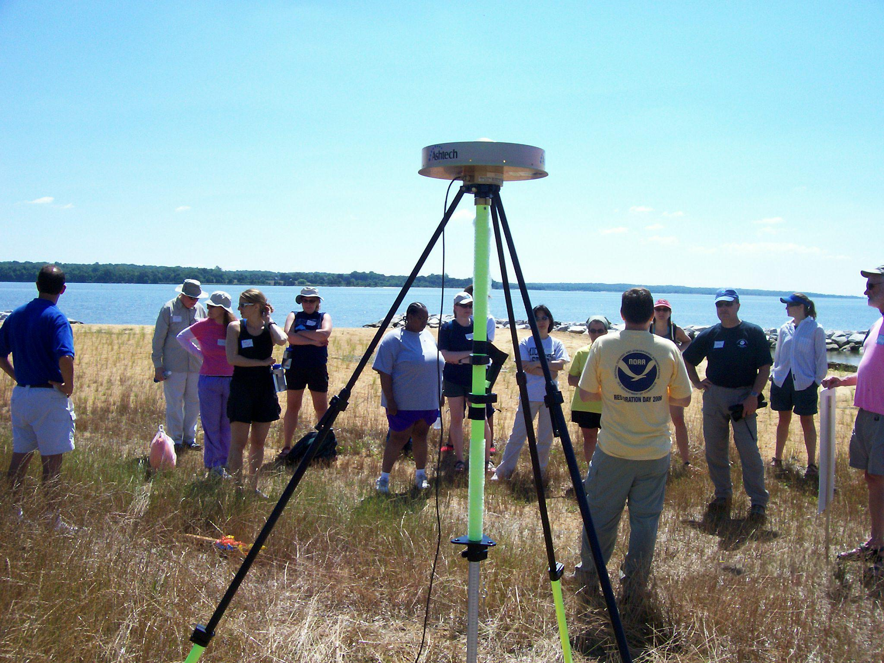
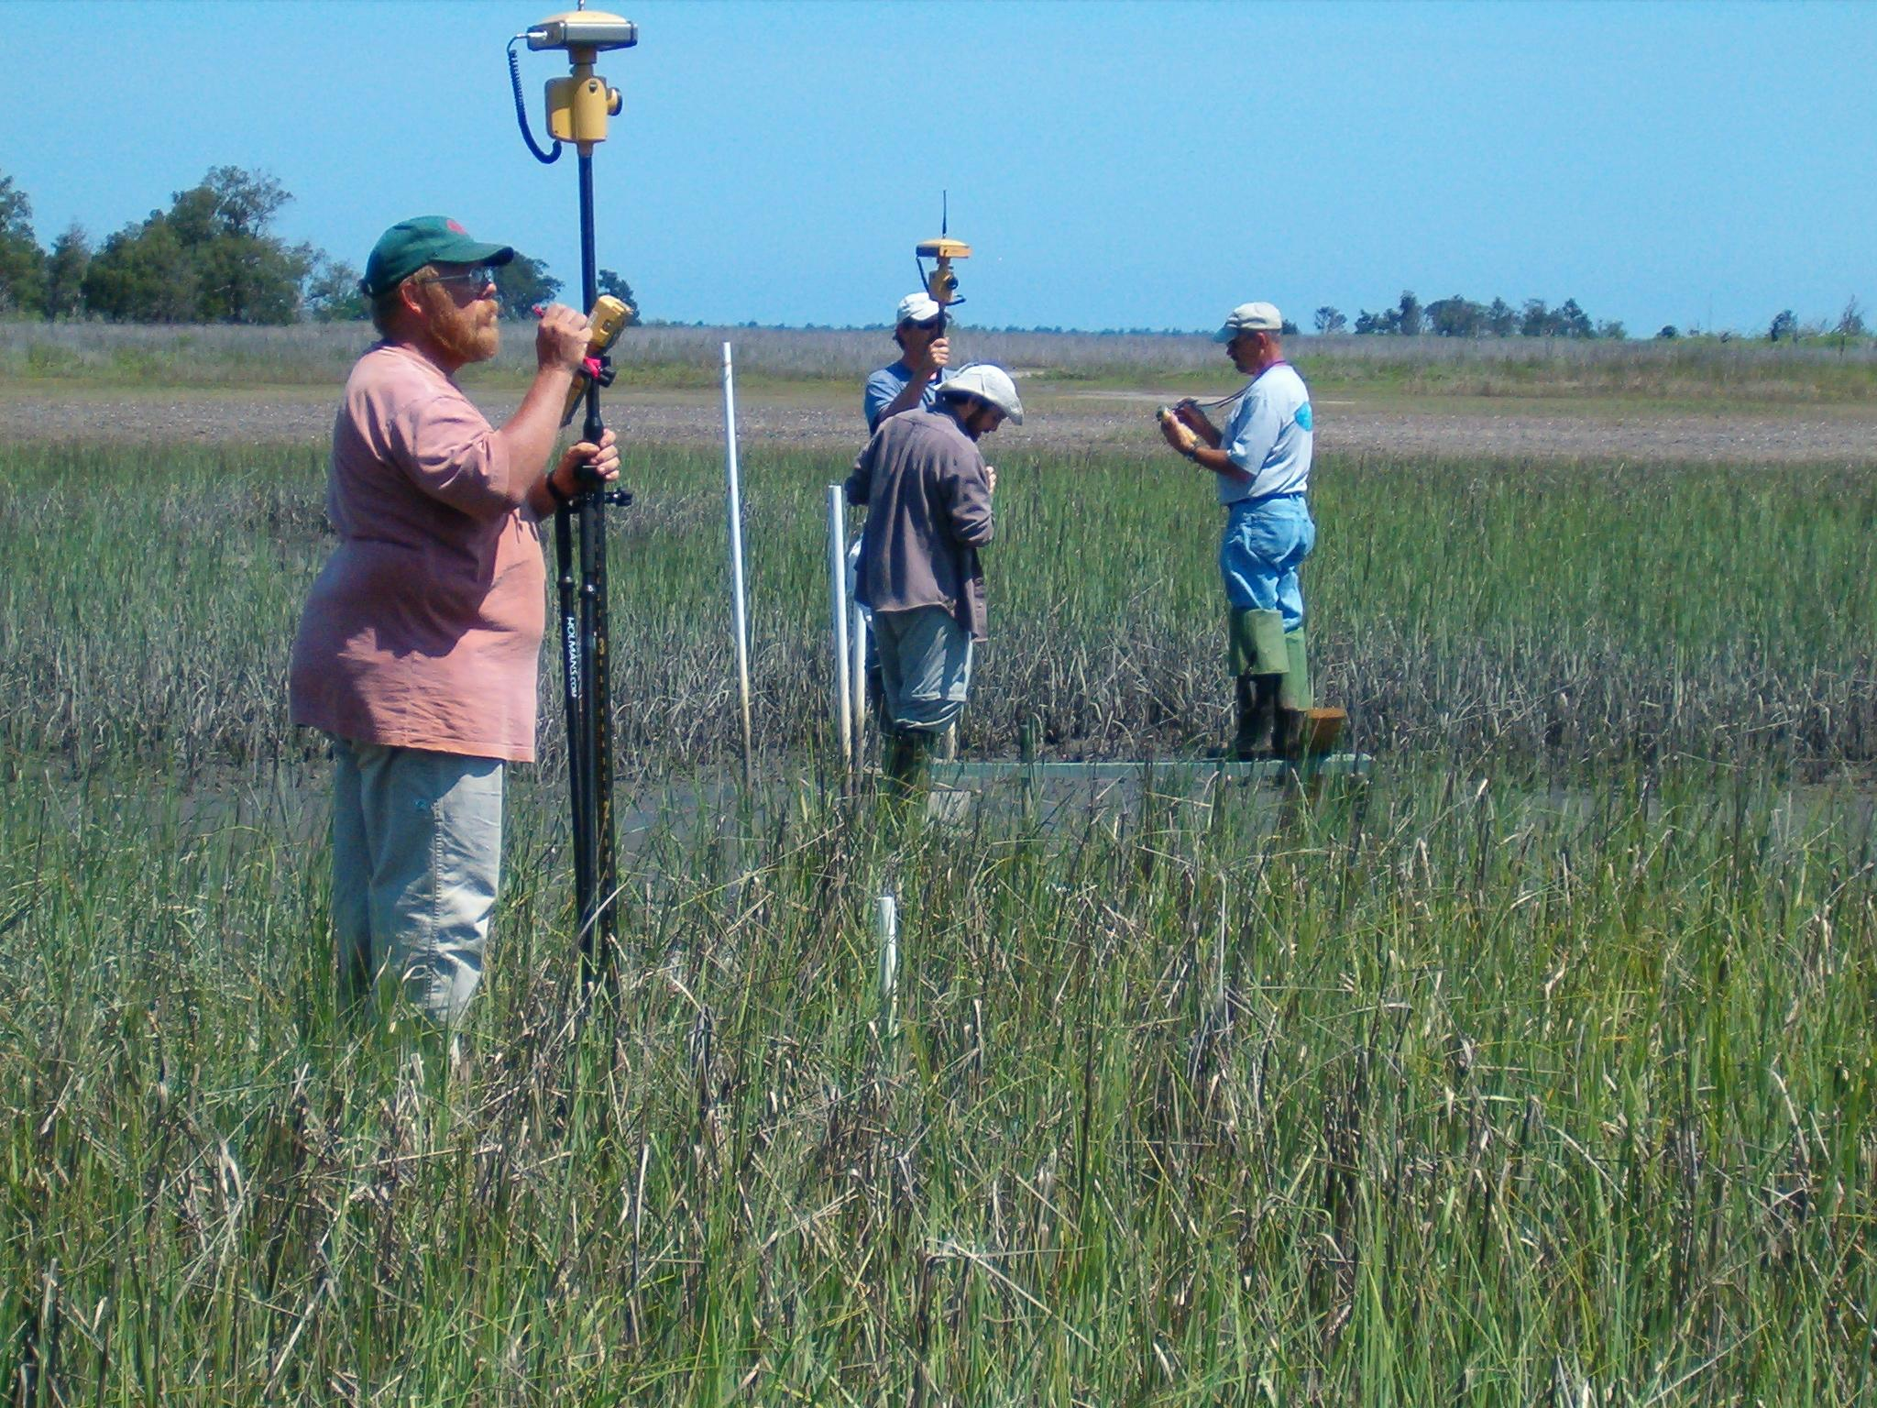
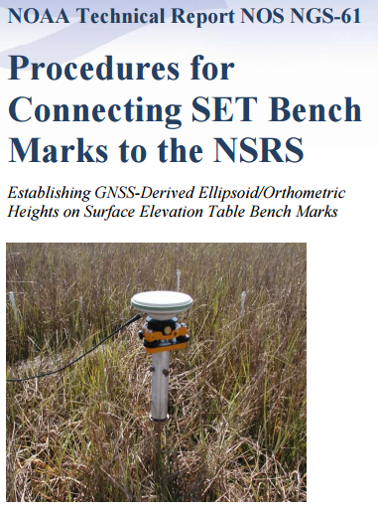
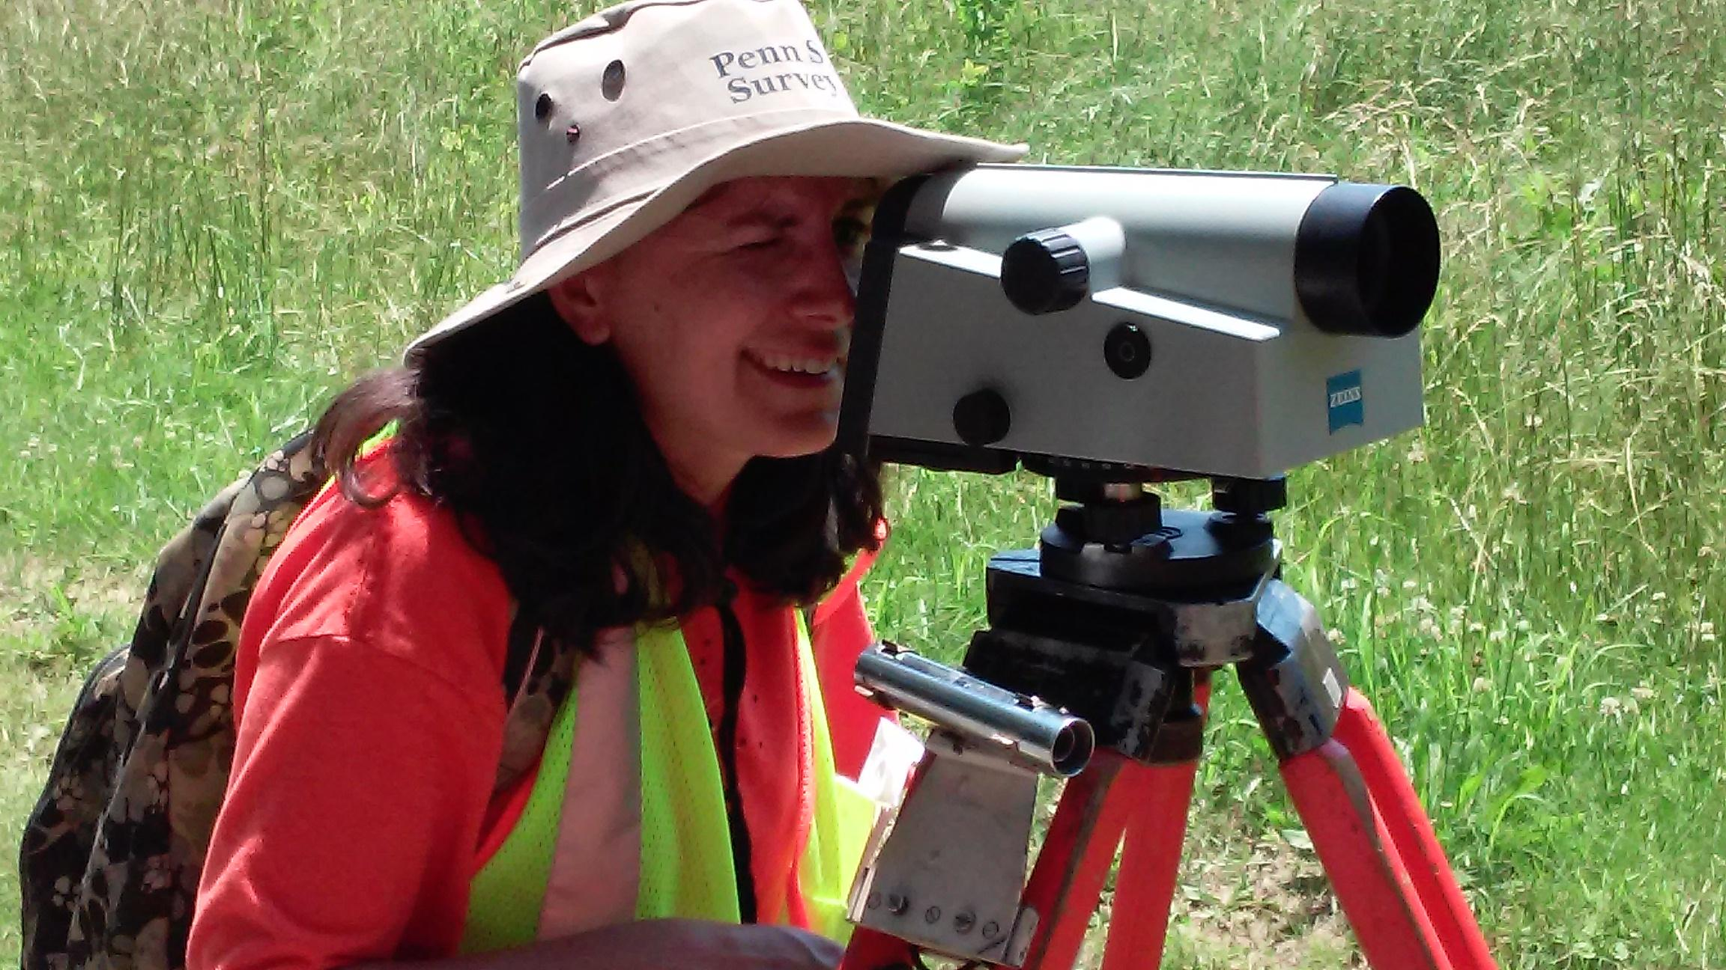
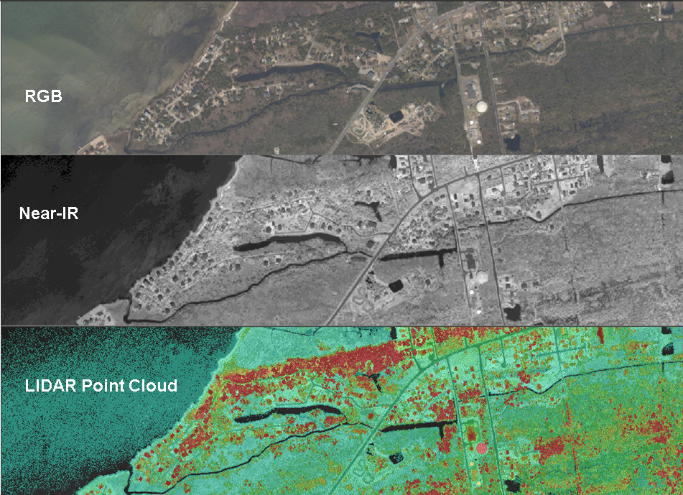
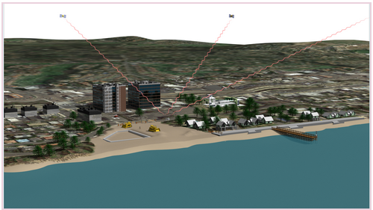
ECO and the Ten-Year Plan
Field Operations
Institutional Knowledge
Better
Surveying
Engage New Stakeholders
University Engagement
Integrated Ocean and Coastal Mapping
Education Portfolio
Notes:
Here are some examples of how ECO is supporting different objectives within the 10 year plan.
Engage new Stakeholders: Participate in regional conferences held by our partners and build capacity through workshops and trainings.
Field Operations and Institutional knowledge: providing field experiences for NGS staff to maintain their skills and to introduce others to survey science.
Better Surveying: field-surveying research and updating surveying manuals to the latest technology (e.g. River crossing/NPS; Guidelines for non-surveyors about leveling / GPS)
University Engagement: hosted multiple students from both Hollings Scholars Program and Educational Partnership Program, as well as Pathways students, volunteers from partner institutions, and collaborating with partners
IOCM - ECO Team as IOCM extension agents
Education Portfolio: Long history of capacity building w training and capacity building

Slide 13
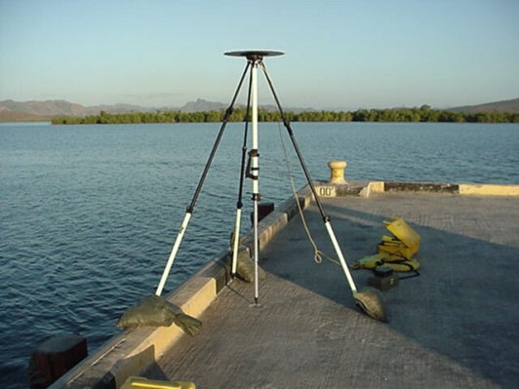
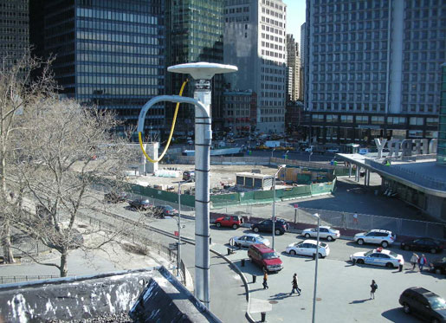
ECO and Geodesy
Strengthening VDatum
NAVD 88 on tidal BM’s
Understanding vertical motion
CORS at NWLON
GPS for long term monitoring
Sea level rise / global reference frames
Strengthening the NSRS
GPS on BM
Notes:
ECO Blends with Mainstream Geodesy: We’ve talked a lot about adapting surveying procedures to the marsh, but we want to point out that many challenging geodetic topics and area of research are of great interest to our coastal stakeholders.
The relationship between NAVD 88 and tidal datums is of great importance, so coastal stakeholders benefit from the strengthening of VDatum.
Coastal stakeholders are looking to best manage their resources into the future, so understanding vertical land motion and global sea level rise will greatly improve their planning.
This includes areas of research / study co-locating CORS at NWLON or possibilities of using GPS for long-term monitoring of land motion.
This also will be improved as our global reference frames continue to be refined to very precise levels.
GPS and other technologies are rapidly becoming more affordable, so there is a large group of stakeholders interested, willing and able to help support and strengthen the NSRS if we educate and partner with them.
Examples of collaborative efforts include GPS on Bench Marks, during National Surveyors week, to share OPUS solutions and recover marks.

Slide 14
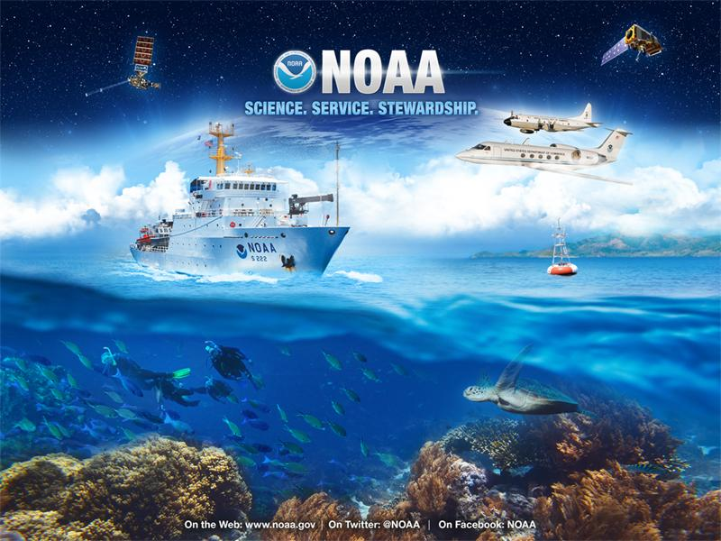
Supporting NOAA’s Priorities
Vision: Resilient Ecosystems, Communities, and Economies.
National Ocean
Service Priorities:
Coastal resilience
Coastal intelligence
Place-based
conservation.
Notes:
1) NGS is dedicated to its mission of providing access to the NSRS, and that job plays an important role in supporting NOAA’s priorities, too.
2) ECO in particular, strengthens the natural synergies between the NGS mission and NOAA priorities.
a) Within the NOAA mission of science, service and stewardship, NGS ECO particularly aims to support resource management along the coast in light of a changing climate.
b) Accurate information along the coasts helps inform decisions that will ultimately improve the resilience of ecosystems, communities and economies.
c) This work all supports the specific goals of the National Ocean Service: coastal resilience, intelligence and place-based conservation.

Slide 15
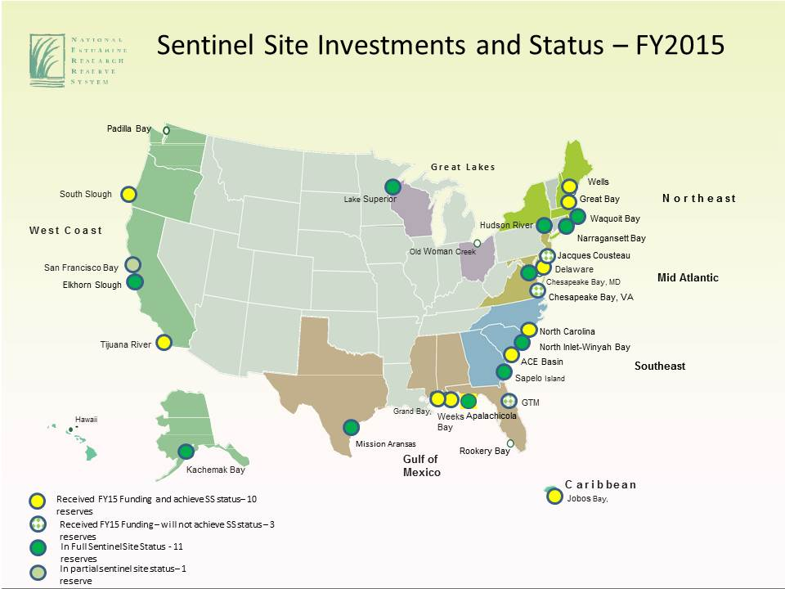
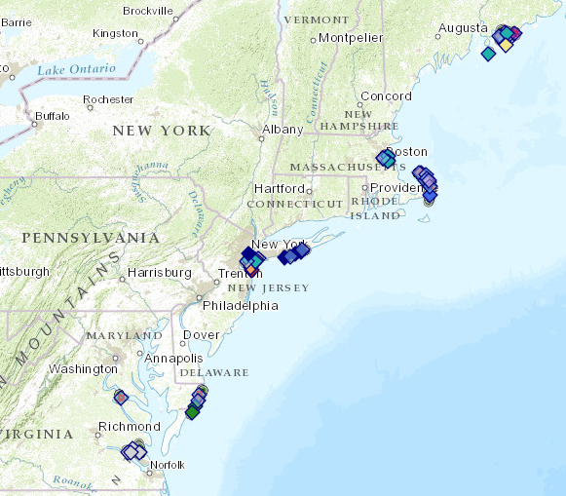
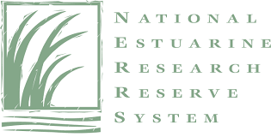


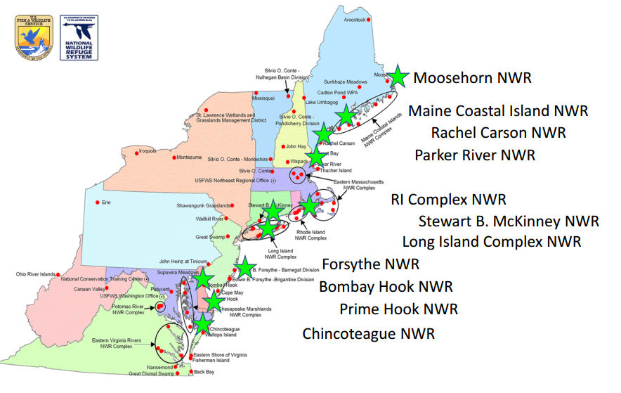
Expanding Geospatial Infrastructure
Notes:
At the core of all partnerships with coastal stakeholders is the idea of using geospatial infrastructure to support long-term monitoring. The most fully implemented realization of this concept is within the National Estuarine Research Reserves System (NERRS). The plan is that every reserve will have an accurate local geodetic network, a connection to the NSRS, and a connection to local water levels to inform their research and management plans.
Other federal agencies (like FWS (mouse click → zoom in) and NPS (mouse click → zoom in)) are also developing compatible Sentinel Site Programs based on the training they received from NGS. In fact, the Sentinel Site concept is a key strategy in the Administration’s Ocean Action Plan.

Slide 16
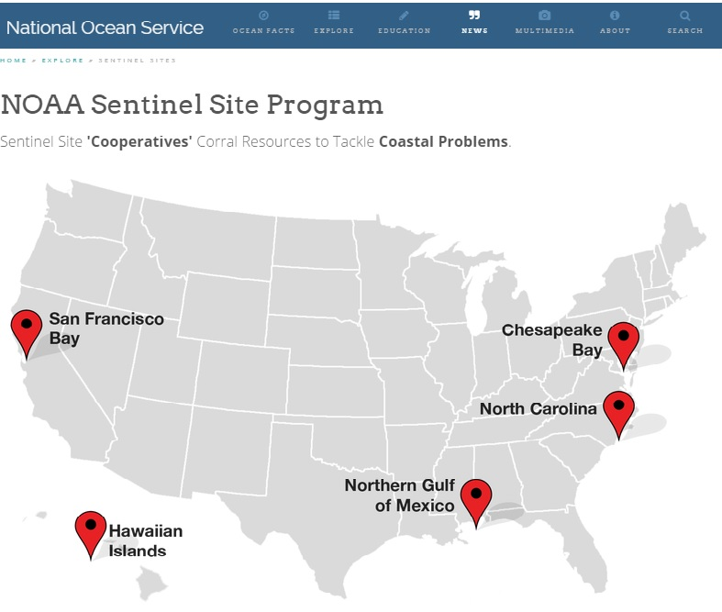
Sentinel Sites: NOAA and Beyond
Leveraging resources:
Across agencies and sectors
Current Focus Area:
Impacts of sea level change and coastal inundation patterns
Notes:
The NOAA Sentinel Site Program - which expanded its scope from coastal habitats to coastal communities - is a direct outcome of ECO’s work with CO-OPS and the NERRS in developing this “sentinel site” concept. Elevation and water level data is now being incorporated into (adaptive) management plans for particular sites, then expanded to broader geographies.
The Sentinel Site Program is interested in many issues, but for its initial efforts, it has focused its resources on examining the impacts of sea level rise to coastal communities and habitats.

Slide 17
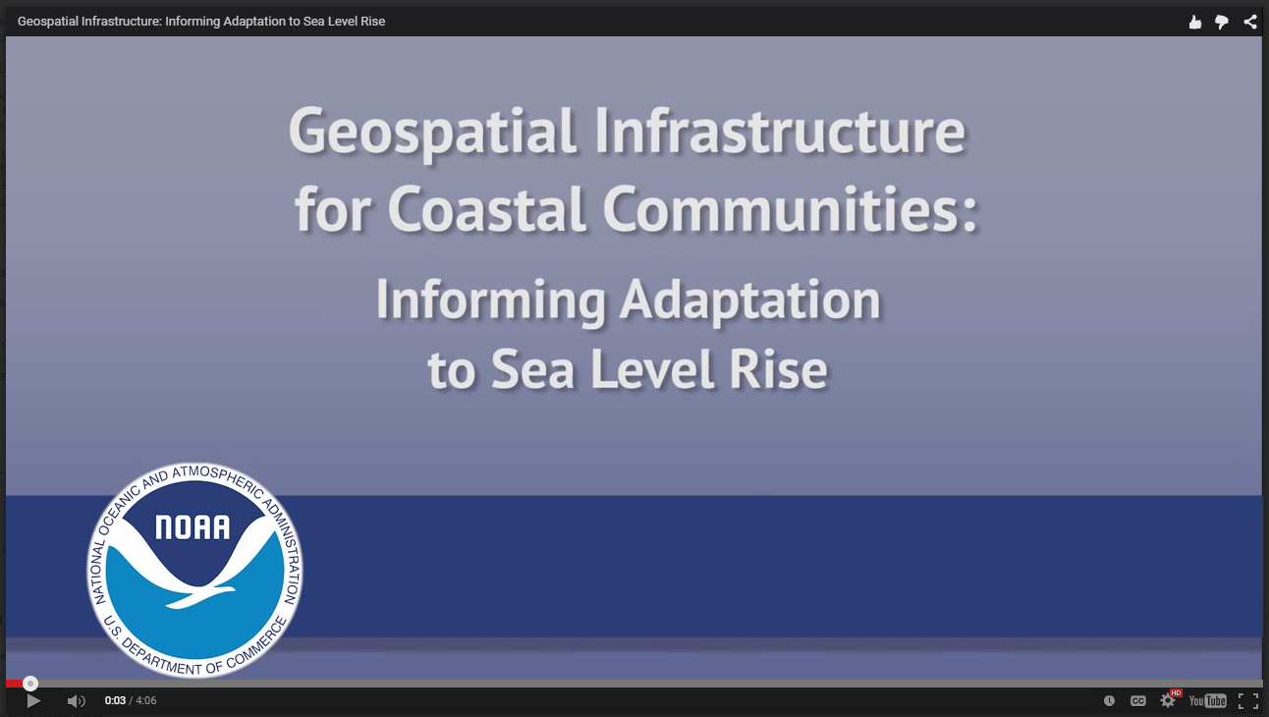
ECO and Communities
ECO’s Role
https://www.youtube.com/watch?v=HsRNiPitTz0
NGS Ecosystem and Climate Operations (ECO) team http://www.ngs.noaa.gov/web/science_edu/ecosystems_climate/
Notes:
With that thought of geospatial infrastructure helping prepare coastal communities for potential sea level rise impacts in mind, we’d like to debut for you, NGS’s newest outreach video. It was developed in parternship with The COMET Program, based in Boulder, CO.
[SHOW VIDEO]

Slide 18
ECO Today and Tomorrow
Notes:
We’ll talk about ECO’s portfolio today, talking about our near-term projects as well as future priorities.

Slide 19
ECO Portfolio
Coordination & Strategy
Research
Guidelines & Publications
Training & Technical support
Outreach and constituent resources
Notes:
Coordination
ECO is a founding member of the Chesapeake Bay Sentinel Site Cooperative, and we remain actively engaged in this effort
Special Projects with Partners (NOAA Restoration Center, NPS, FWS, Smithsonian and more)
Research: Providing management & research community with accurate positioning to support their science
(details on later slide)
Guidelines for surveying in coastal habitats
(details on later slide)
Training
(details on later slide)
Outreach and Constituent resources
(details on later slide)

Slide 20
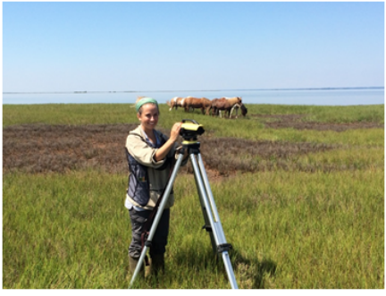
Current Research Activities
Research priorities / publications
Moving beyond the SET
“Time to stability”
SET error
Deep Rod Stability
OPUS Projects and leveling
Notes:
Research priorities / publications
Moving beyond the SET
“Time to stability”
SET error
Deep Rod Stability
OPUS Projects and leveling

Slide 21

Recent / Upcoming Guidelines
Accurate elevations for sea level change sentinel sites (with CO-OPS and NERRS, 2015)
The Surface Elevation Table and Marker Horizon Technique (with NPS and USGS, 2015)
Notes:
Guidelines for surveying in coastal habitats
Back in 2011, ECO partnered with the NGS Instrumentation & Methodology Branch to publish procedures for surveying SET marks with GPS
More recently, we’ve been working on publishing guidelines in support of sentinel sites, we’re entitling: Accurate elevations for sea level change sentinel sites (2015). The document is undergoing final copy editing, and we hope to release it very soon.
Currently, ECO is partnering with the National park Service and USGS in a definitive reference manual for using Surface Elevation Table and marker Horizon technology - everything from how to design a study to how to take readings and analyze the data. The document has already come back from the Department of the Interior’s required external review, and we hope to release it this fall.

Slide 22
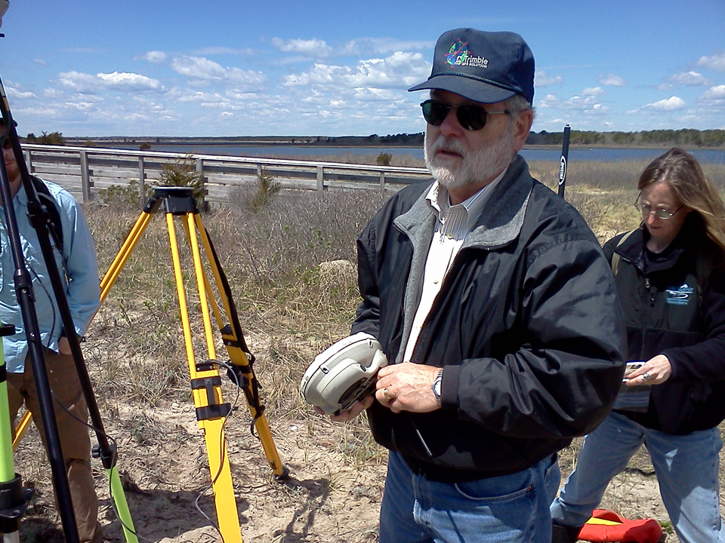
Training / Technical Support
Annual trainings in support of the NERRS
Presentations and conferences
Technical support and field assistance
Notes:
• Annual trainings in support of the NERRS: ECO continues to work closely with our sister Office for Coastal Management to provide annual training in support of the NERRS and other partners.
• Presentations and conferences: ECO has been invited to present at the upcoming 2015 Coastal & Estuarine Research Federation Conference, and we continue to seek out opportunities to reach a broader audience
• Technical support and field assistance - this is largely our bread and butter, as we field questions and provide assistance as our partners begin investing in geospatial infrastructure and data.

Slide 23
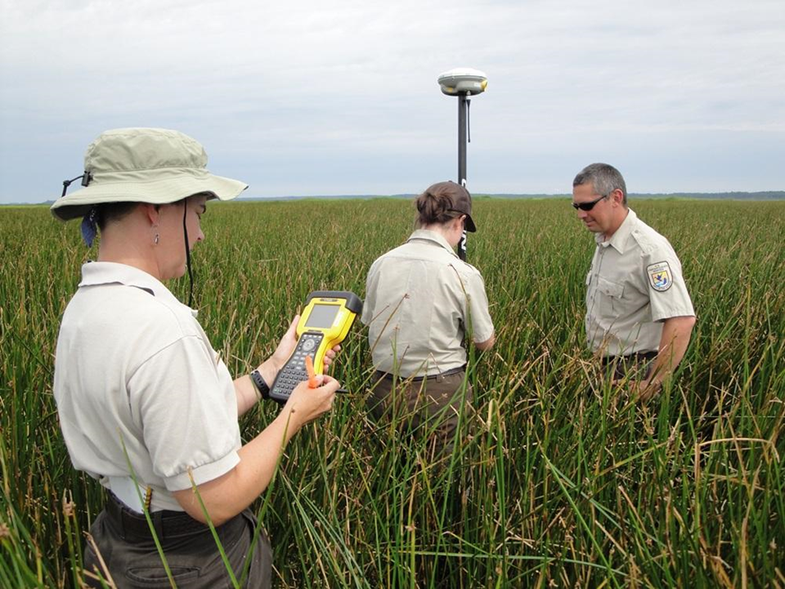
Ongoing Projects: Blackwater NWR
2005 “Height Mod” Survey
2010 - 2013 RTK Surveys
2015 Static GPS Survey
Notes:
We wanted to mention one particular item in our current portfolio which highlights our ongoing mission to assist our coastal partners in their geodetic needs.
Back in 2005, as ECO was just getting its legs, NGS conducted a Height Modernization Survey around the Blackwater National Wildlife Refuge - tens of thousands of hectares containing one third of Maryland’s tidal marshes. The survey included leveled bench marks as well as new deep rod marks and SET deep rod marks in the wetlands.
The region has been suspected of undergoing subsidence, which may have been a compounding factor in the rapid wetland loss that has occurred in the Refuge over the past 50-60 years. So updated heights was important to the Refuge managers to begin addressing management strategies in the face of current and predicted sea level rise. The heights were also used by USGS at SET locations to evaluate “elevation capital” - the height of the wetlands with respect to tidal datums, and the implicit resilience to sea level rise.
In 2009, Blackwater reached out to ECO expressing an interest in adapting surveying techniques to measure and monitor wetland elevation and elevation change within the Refuge. ECO developed a statistical sampling protocol based on RTK techniques, and starting in 2010, Refuge staff began to monitor wetland elevations over the entire refuge. This work is truly unique and has provided significant elevation trends already.
This past spring, the Refuge expressed interest in evaluating the stability of the coordinates used as the base stations for their RTK surveys. ECO worked with them to conduct an intensive 72-hour GPS survey on these bench marks, and we are in the process of analyzing the results and we’ll be comparing them to the re-processed GPS data taken back in 2005. This will hopefully lead to useful insights into relative mark stability as well as any regional vertical land motion.

Slide 24
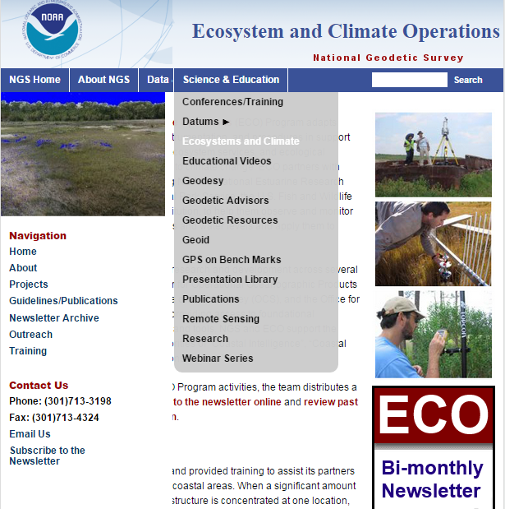
ECO Communications
Coastal stakeholder focused
ECO Website
ECO Bi-Monthly
Newsletter
Notes:
We have an organized way to reach /communicate with our external partners through our web-pages and newsletter
Overview of the web-page: In addition to general information about the program and projects...
We have an outreach page with information about conferences we attend, and that is one place you’ll be able to find our new video.
We have training pages with links to presentations and other materials hosted by the NGS Corbin training site.
We have a Guidelines/Publications page where you can find the documents we’ve helped author.
We write and distribute a bi-monthly newsletter that anyone can sign-up to receive (currently 70+)
You can sign up via our web-site
You can view past newsletters on our web-site
You can email us anytime at NGS.ECO@noaa.gov

Slide 25
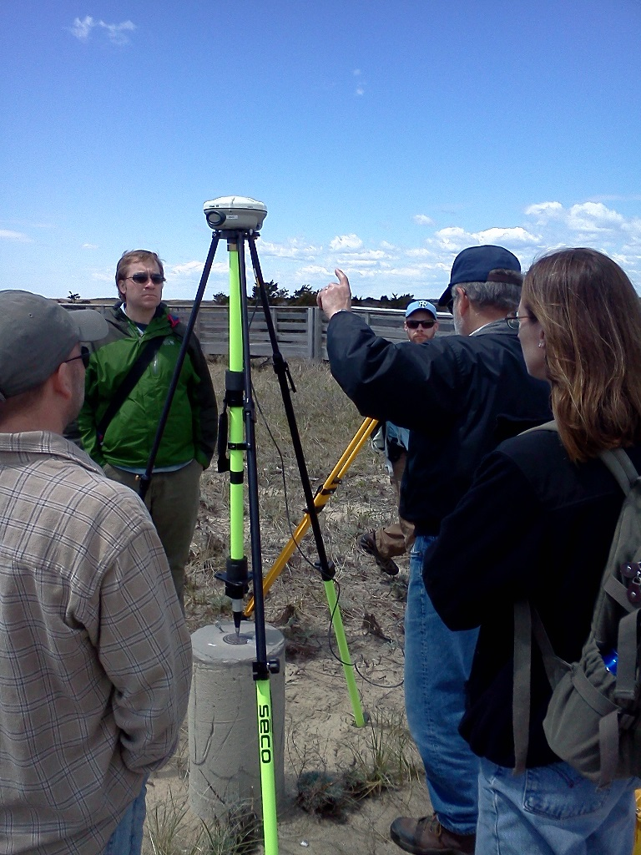
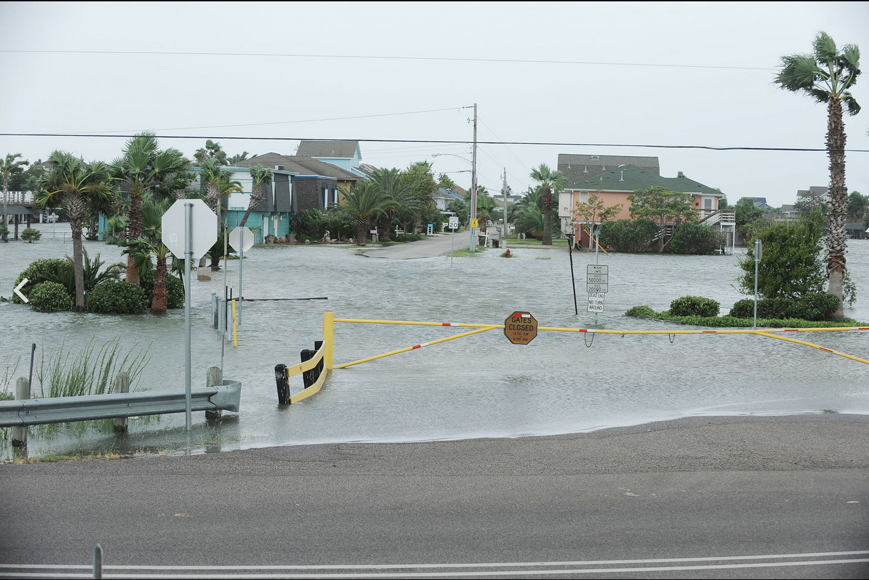
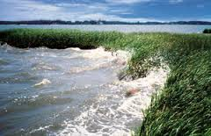
ECO Moving Forward
Transition coastal stakeholders to the new datums
Inform plans adapting to sea level rise impacts
Champion NSRS and geodesy across NOAA and partners
Continue building a community of practice
Notes:
ECO will transition coastal stakeholders and “new surveyors” to new datums. Accurate geospatial tools are now available to much broader user-community, and we must ensure that users can accurately access the National Spatial Reference System
ECO will help NGS lead resilient communities to better decisions and planning. Sea level rise and broader climate change will increase the need for accurate elevation and water level information.
ECO will continue to champion importance of geospatial infrastructure and the NSRS across NOAA program offices and our many partner agencies.
Continue building coastal geodesy community of practice

Slide 26
QUESTIONS?

Slide 27
Back-up Slides

Slide 28
Supporting NOAA’s Priorities
Mission: Science, Service, and Stewardship.
To understand and predict changes in climate, weather, oceans, and coasts,
To share that knowledge and information with others, and
To conserve and manage coastal and marine ecosystems and resources.
Vision: Resilient Ecosystems, Communities, and Economies.
Healthy ecosystems, communities, and economies that are resilient in the face of change.
National Ocean Service Priorities: Coastal resilience; Coastal intelligence; and Place-based conservation.
Notes:
1) NGS is dedicated to its mission of providing access to the NSRS, and that job plays an important role in supporting NOAA’s priorities, too.
2) ECO in particular, strengthens the natural synergies between the NGS mission and NOAA priorities.
a) Within the NOAA mission or science, service and stewardship, NGS ECO particularly aims to support resource management along the coast in light of a changing climate.
b) Accurate information along the coasts helps inform decisions that will ultimately improve the resilience of ecosystems, communities and economies.
c) This work all supports the specific goals of the National Ocean Service: coastal resilience, intelligence and place-based conservation.

