Slide 1
Disability Etiquette, Inclusion, and Hiring
Remarks for the National Geodetic Survey (NGS)
People Committee
by
Mario B. Damiani, J.D.
Policy Advisor
Office of Disability Employment Policy (ODEP)
United States Department of Labor

Slide 2
Contents
What is a Disability?
Department of Labor- ODEP
Federal Employment of Individuals with Disabilities
Respecting Privacy
Many Types of Disabilities
Interacting with Individuals with a Disability

Slide 3
Disclaimer
This PowerPoint presentation is for informational purposes only.
None of the information contained here should be interpreted as instructions for First Aid.
Descriptions of medical conditions and related etiquette are based on common recommendations from different, publicly available sources (including this guide from the United Spinal Association).

Slide 4
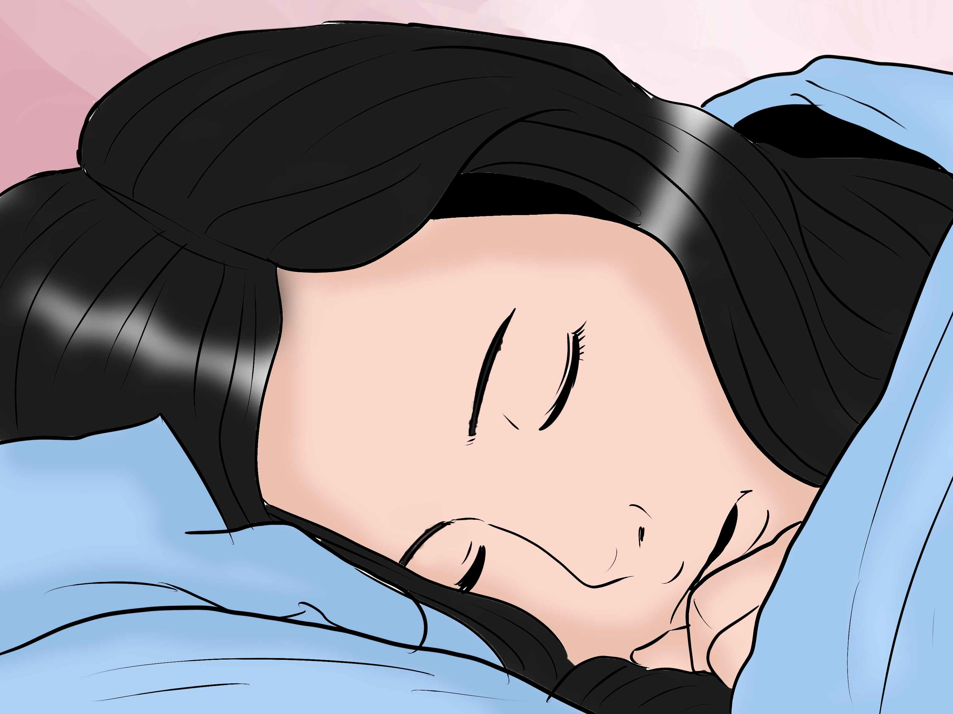
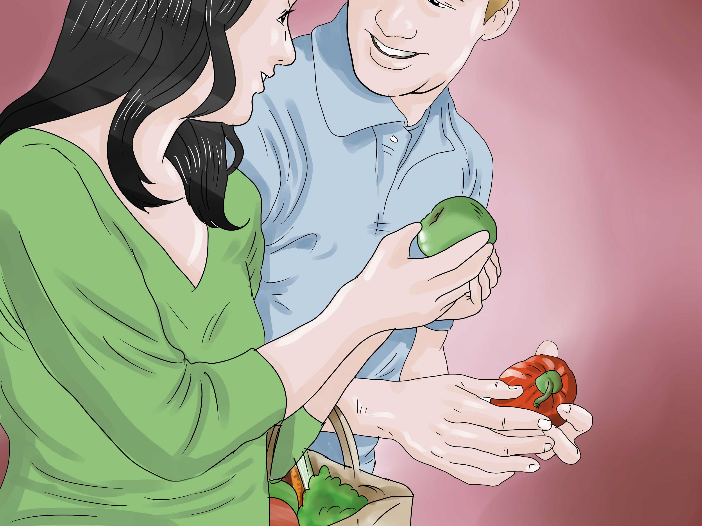

What is a disability?
A physical or mental impairment that substantially limits one or more major life activities….
Examples of major life activities: seeing, hearing, eating, sleeping, walking, breathing, speaking, learning, thinking, working, etc….
Includes major bodily functions, for example functions of the immune system, normal cell growth, or digestive, circulatory, and reproductive functions, etc….
These lists are not exhaustive!

Slide 5
How many people have disabilities?
In the United States, there are an estimated 56.7 million individuals with disabilities (19%) as of 2010.
Worldwide, there are an estimated 1 billion+ individuals with disabilities. Click here for more information on the international situation for people with disabilities.

Slide 6
Disability Rights are Civil Rights
Despite some improvements, individuals with disabilities continually encounter various forms of discrimination:
  Outright intentional exclusion,
  Architectural, transportation, and communication barriers,
  Failure to make modifications to existing facilities and practices,
  Segregation,
  Relegation to lesser services, programs, benefits, jobs.
  Discrimination is due in large part to attitudinal bias.

Slide 7


Office of Disability Employment Policy
U.S. Department of Labor
ODEP works to influence national policy and promote effective workplace practices to ensure that today's workforce is inclusive of people with disabilities.
One area of focus is the recruitment, hiring, retention, and advancement of people with disabilities in the Federal Government

Slide 8

Federal Employment of Individuals with Disabilities (ABA and Resources)
Architectural Barriers Act of 1968 (ABA)
  Requires that buildings and facilities that are designed, constructed, or altered with Federal funds, or leased by a Federal agency, comply with Federal standards for physical accessibility.
  Enforced by the United States Access Board.

Slide 9
Federal Employment of Individuals with Disabilities (Rehab Act & Resources)
Rehabilitation Act of 1973
  Section 501: 1) prohibits disability discrimination in Federal employment and 2) requires Federal agencies to establish affirmative action plans.
  Section 504: prohibits discrimination based on disability in federally funded and federally conducted programs or activities; enforced by each agency. Department of Commerce (DOC): 15 CFR Part 8b & 15 CFR Part 8c.
  Section 508: requires that Federal agencies ensure their electronic and information technology is accessible for people with disabilities - both employees and members of the public. See DOC’s Section 508 Resources.
Resource: http://askjan.org/empl/index.htm#fed

Slide 10
Federal Employment of Individuals with Disabilities (EO and Resources)
Executive Order 13548
Tookit for Agencies
Model Strategies for Recruitment and Hiring
Disability Employment FAQs
Schedule A Hiring Authority
Workforce Recruitment Program
Computer/Electronic Accommodations Program (CAP)

Slide 11

The Americans with Disabilities
Act of 1990 (ADA)
Nation’s primary disability nondiscrimination law.
NOT APPLICABLE to Federal employment or Federal access issues.
Title I: Employment (private sector)
Title 2: State and Local Government Services & Employment
Title 3: Public Accommodations (e.g.,
restaurants, movie theaters, buses, etc.)

Slide 12
Respecting Privacy
You may really care or you may just be curious about a person with a disability who is in crisis, suddenly ill, or misses work for unexplained reasons.
In spite of your concern, please respect the privacy of a person with a disability.
Allow them to discuss their situation if and when they feel comfortable doing so.

Slide 13
Hidden Disabilities
Not all disabilities are apparent. A person may make a request or act in a way that seems strange to you. That request or behavior may be disability-related.
For example, you may give seemingly simple verbal directions to someone, but the person asks you to write the information down.
The person may have a learning disability that makes written communication easier for them.
Or a person may ask to sit, rather than stand, in line. This person may be fatigued from a condition such as cancer, or may be feeling the effects of medication.
Even though these disabilities are hidden, they are real.

Slide 14

General Tips
Don’t tell the person with a disability how inspirational or brave you think they are (or say any other patronizing things).
Don’t stare, point, or laugh at people with disabilities!
Don’t ask the person “Does it hurt?”; “Are you in pain?”; “What happened?”; “Was it an accident?”; “How long have you been like this/in the chair?”; “Are you parents disabled too?”
Don’t talk louder to people with disabilities than you would to anyone else.
Don’t pat people with disabilities on the head, shoulder, or anywhere else.
Don’t ignore the person, avoid eye contact, or speak only to the person that is with them.

Slide 15
General Tips (continued)
Don’t use words like: cripple, handicapped, confined, bound, stricken, retarded, slow, deaf and dumb, invalid, idiot, imbecile, impaired, psycho, crazy, victim; disabled, sightless, blind; slurred; unintelligible, suffer.
Don’t provide assistance without asking first and having the person’s consent.
Don’t assume you know what is best for a person with a disability, even if you know someone with that disability.

Slide 16
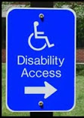
Mobility Disabilities
People who use canes or crutches need their arms to balance themselves, so never grab them.
People who have limited mobility may lean on a door for support as they open it.
Pushing the door open from behind or unexpectedly opening the door may cause them to fall. Even pulling out or pushing in a chair may present a problem.
If your building has different routes through it, be sure that signs direct people to the accessible routes around the facility.
Ensure that security guards and receptionists can answer questions about the most accessible way around the building and grounds, including the location of elevators.
Emergency Info / Evacuation: http://askjan.org/media/emergency.html

Slide 17
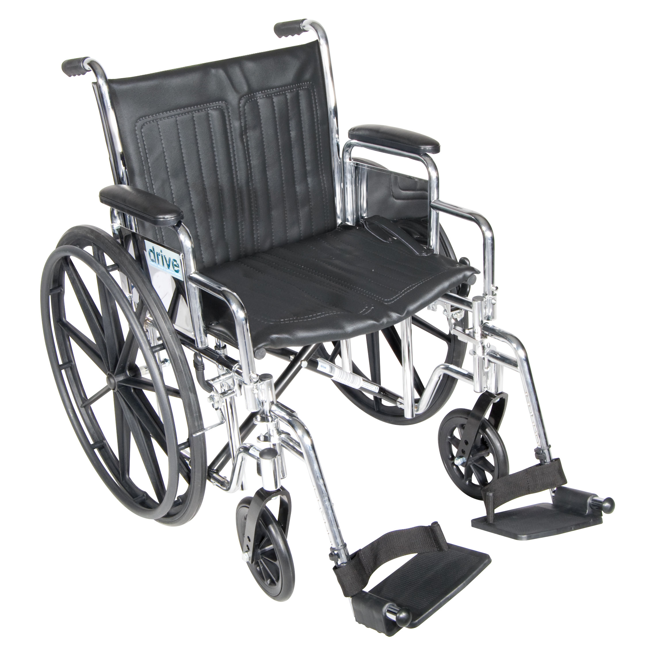
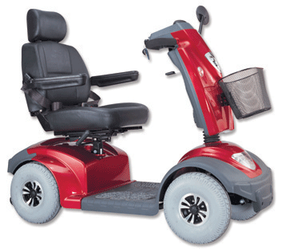
Helpful Tips Regarding
People Who Use Wheelchairs
People who use wheelchairs have different disabilities and varying abilities.
Some can use their arms and hands.
Some can get out of their wheelchairs/scooters and even walk for short distances.
Don’t push or touch a person’s wheelchair; it’s part of their personal space.
Don’t lean over someone who uses a wheelchair to shake another person’s hand or ask a wheelchair user to hold coats.
Don’t ask how fast the wheelchair goes or make other snide remarks.

Slide 18
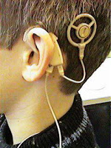
Hearing Disabilities
Deafness vs. hearing loss.
Many deaf individuals use American Sign Language.
When using a sign language interpreter, continue looking directly at the person who is deaf, maintain eye contact, and talk directly to the person.
Lip reading: Speak clearly and avoid chewing gum, smoking, or obscuring your mouth with your hand while speaking.
Rephrase, rather than repeat, sentences the person does not understand.
Before speaking to a person who is deaf or has a loss of hearing, make sure that you get their attention; a subtle wave or tap on the shoulder is often acceptable.

Slide 19

Vision Disabilities
Blind vs. low vision.
Identify yourself before you make physical contact with a person who is blind.
Offer your arm as a guide, do not grab theirs.
If the person has a guide dog, walk on the side opposite the dog.
As you are walking, describe the setting and note any obstacles.
If you need to leave a person who is blind, inform them that you are leaving asked if they need anything before you leave.
Do not touch the persons cane, whether they are holding it or not.
Offer to read written information to a person who is blind.

Slide 20
Communication Disabilities
May be difficult to understand.
Give the person your full attention.
Don’t interrupt or finish the person’s sentences. If you have trouble understanding, don’t nod. Just ask him to repeat.
If you are not sure whether you have understood the person, you can repeat for verification.
If you have tried and still cannot understand the person, ask them to write what they’re saying or to suggest another way of facilitating communication.

Slide 21
Short Stature
Do not treat persons of short stature like they are cute and childlike.
Be sensitive about not using lowered telephones, counters, or urinals if they are in limited supply.
Never pat or kiss a person of short stature on the head.
Adjust yourself so that you can make eye contact without the person straining their neck.

Slide 22
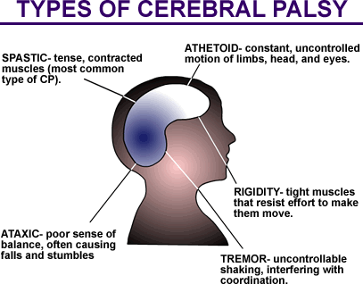
Cerebral Palsy and
Tourette Syndrome
As a result of injury to the central nervous system, people with cerebral palsy have difficulty controlling their muscles.
Both could:
  Have slurred speech and involuntary body movements.
  Appear to be drunk, sick, or have a medical emergency.
  Have vocalizations or gestures that they cannot control.
Get the facts before acting on your first impression.
Patience and normal interaction!

Slide 23
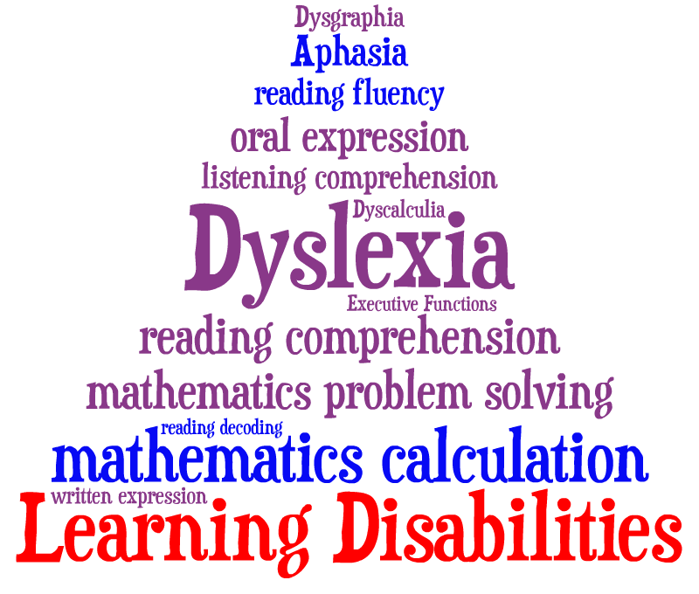
Learning Disabilities
Learning disabilities are lifelong disorders that interfere with a person’s ability to receive, express or process information.
Dyslexia or other reading disabilities: provide verbal explanations and allow extra time for reading.
Auditory processing disorders: might need written information rather than verbal.
Ask the person how you can best relay information.
Be direct in your communication.

Slide 24
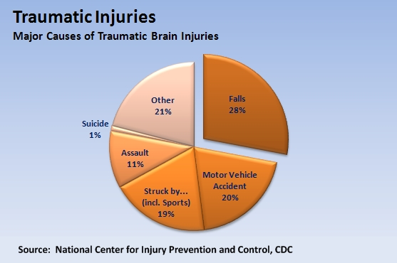
Traumatic Brain Injury
People with traumatic brain injury have had damage to the brain usually as the result of trauma, such as an accident, battlefield injury, or stroke.
May have a loss of muscle control or mobility that is not obvious.
May have poor impulse control or appear pushy.
The person may make inappropriate
comments and may not understand social
cues or “get” indications that they
have offended someone.
Possible poor short-term memory or poor
directional orientation.

Slide 25
Intellectual Disabilities
Used in place of “mental retardation.”
Encompasses various intellectual or cognitive deficits.
E.g. Parkinson’s, Alzheimer’s, acquired brain injury, Down syndrome
People with intellectual disabilities learn slowly.
Speak to the person in clear sentences, using simple words and concrete—rather than abstract—concepts.
Don’t use baby talk or talk down to people who have developmental disabilities…they are adults.
Gauge the pace, complexity, and vocabulary of your speech according to theirs.
Be patient and allow the person to take their time.
Help keep their routines to manage work and daily living.

Slide 26
Autism Spectrum Disorders
Includes Autism and Asperger Syndrome
Are disorders of neural development affecting information processing
Symptoms can include:
  Social Deficits
  Repetitive Behaviors
  Communication Difficulties (Verbal vs. Non-Verbal)
At times you may see someone who is agitated or acting inappropriately. Do not stare, ask if you can help.
Don't speak slowly or be overly nice. They can understand.

Slide 27
HIV or AIDS
People with human immunodeficiency virus (HIV) or Autoimmune Deficiency Syndrome (AIDS) have impaired immune systems.
Common sense:
  Be conscious of not putting someone else – with a potentially compromised immune system – at risk.
  If you have a respiratory infection or any other easily transmittable illness, be considerate of all your employees and stay home, if possible.
Can’t be transmitted through touching/handshake.
This also applies to cancer and many other conditions that can affect the immune system.

Slide 28
Psychiatric Disabilities
People with psychiatric disabilities may at times have difficulty coping with the tasks and interactions of daily life.
Most people with psychiatric disabilities are not violent.
Varying personalities and different ways of coping with their disability.
High vs. low energy; affects social cues, sensitivity; exacerbated by stress. Includes Post-Traumatic Stress Disorder.
Treat each person as an individual and with respect.
In a crisis, stay calm and be supportive as you would with anyone.
Support persons and/or medications can be VERY important.

Slide 29
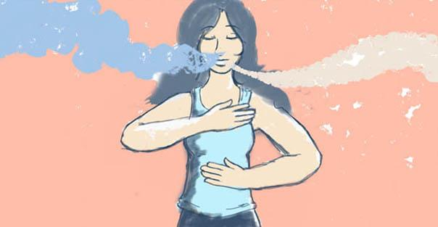
Multiple Chemical Sensitivity (MCS) and Respiratory Disabilities
People with MCS and respiratory disabilities such as asthma or emphysema react to toxins in the air.
Stale air, fumes from cleaning products, perfume, carpeting, air freshener or even the fumes from magic markers.
If you must use a spray product, spray or pour it closely into a cloth, not into the air.
Go easy on fragranced body-care products like cologne, hair spray, hand lotion, and after-shave.
If you aren’t sure if someone near you has MCS or
other respiratory issues, ask before using a
potentially irritating product.

Slide 30

Epilepsy
Epilepsy is a neurological condition characterized by seizures.
The seizures may be convulsive, or the person may appear to be in a trance.
If a person has a seizure, you cannot do anything to stop it.
If a person has fallen, be sure their head is protected and wait for the seizure to end.
Excessive flashing in web content, games, and strobe lights can trigger seizures in some people.

Slide 31
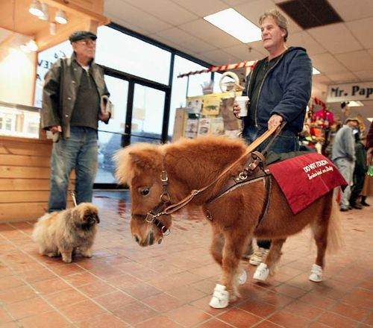
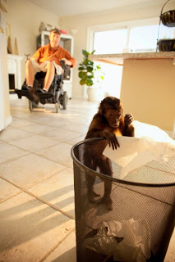
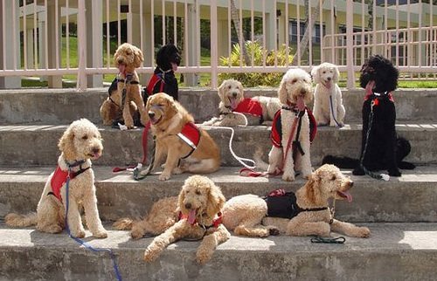
Service Animals
Used by many individuals with different kinds of disabilities.
Service animals are generally highly trained and well behaved.
Do not touch/distract/feed/talk to the service animal without permission.
The animal may be adorable, but it is on the job.
Don’t ask what breed/kind the service dog /animal is or what its role is.

Slide 32
5 Key Take-Aways
Treat others as you wish to be treated.
Always ask before helping.
Be patient: Give people time.
Be respectful: Give people space.
Relax: People with disabilities are just like everyone else.

Slide 33
Questions?

Slide 34
Contact Information
Mario B. Damiani, J.D.
Policy Advisor
Office of Disability Employment Policy
United States Department of Labor
E-mail: damiani.mario@dol.gov

