Slide 1

Debriefing the NGS Geospatial Summit
Various Speakers
Sept. 14, 2017

Slide 2

Overview
2:00-2:05 - Introduction of speakers / icebreaker questions
Christine Gallagher
2:05-2:20 - Overview, online resources, stakeholder feedback, and next steps
Steve Vogel
2:20-2:30 - Progress on Projects since the Summit
Dru Smith
2:30-2:40 - Live polls
Christine Gallagher
2:40-3:00 - Live Question / Answer

Slide 3
Overview, online resources, stakeholder feedback, and next steps
Steve Vogel

Slide 4
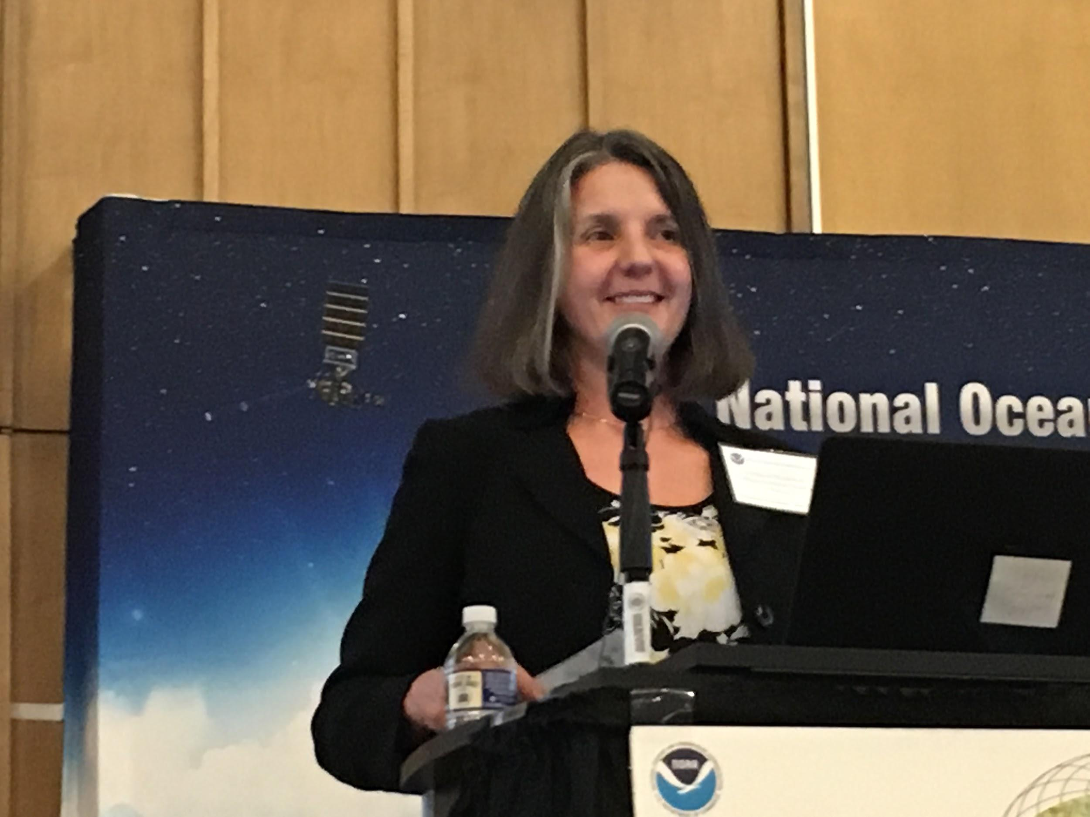
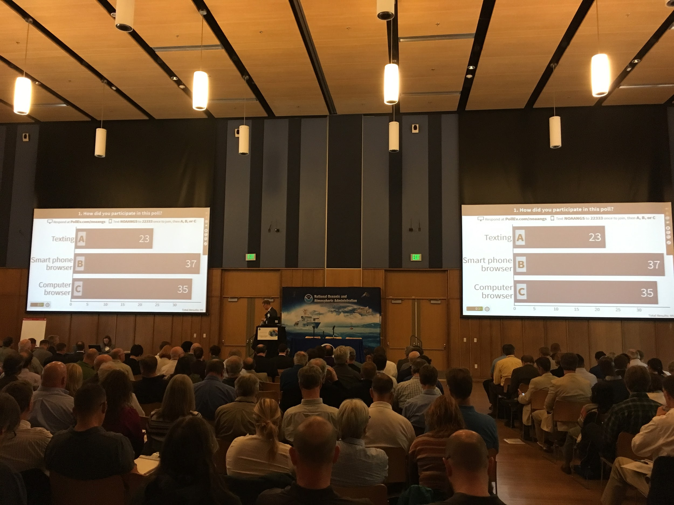
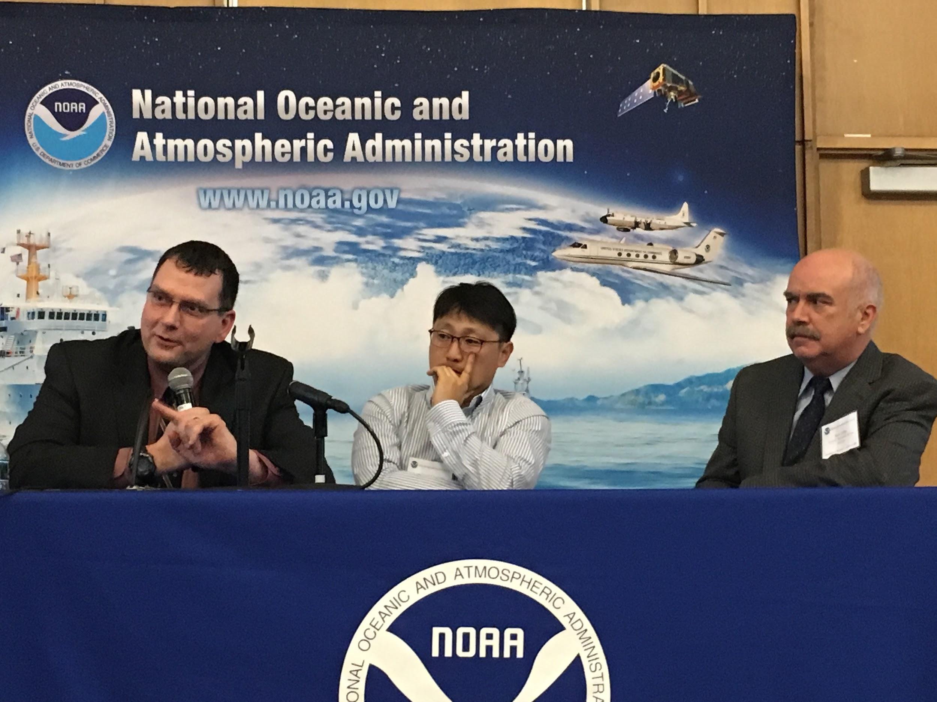
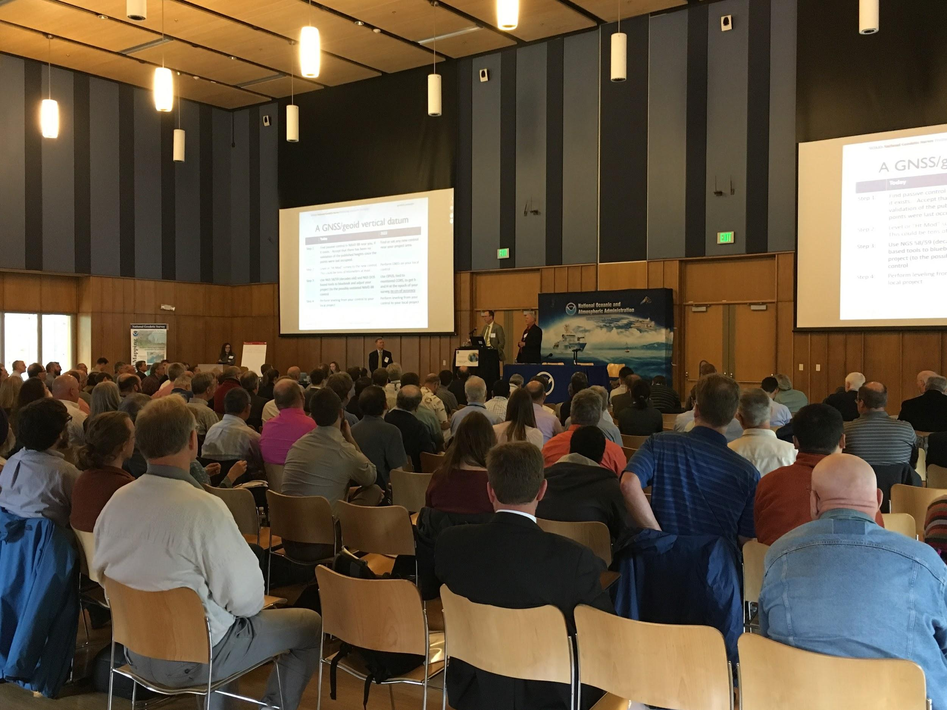
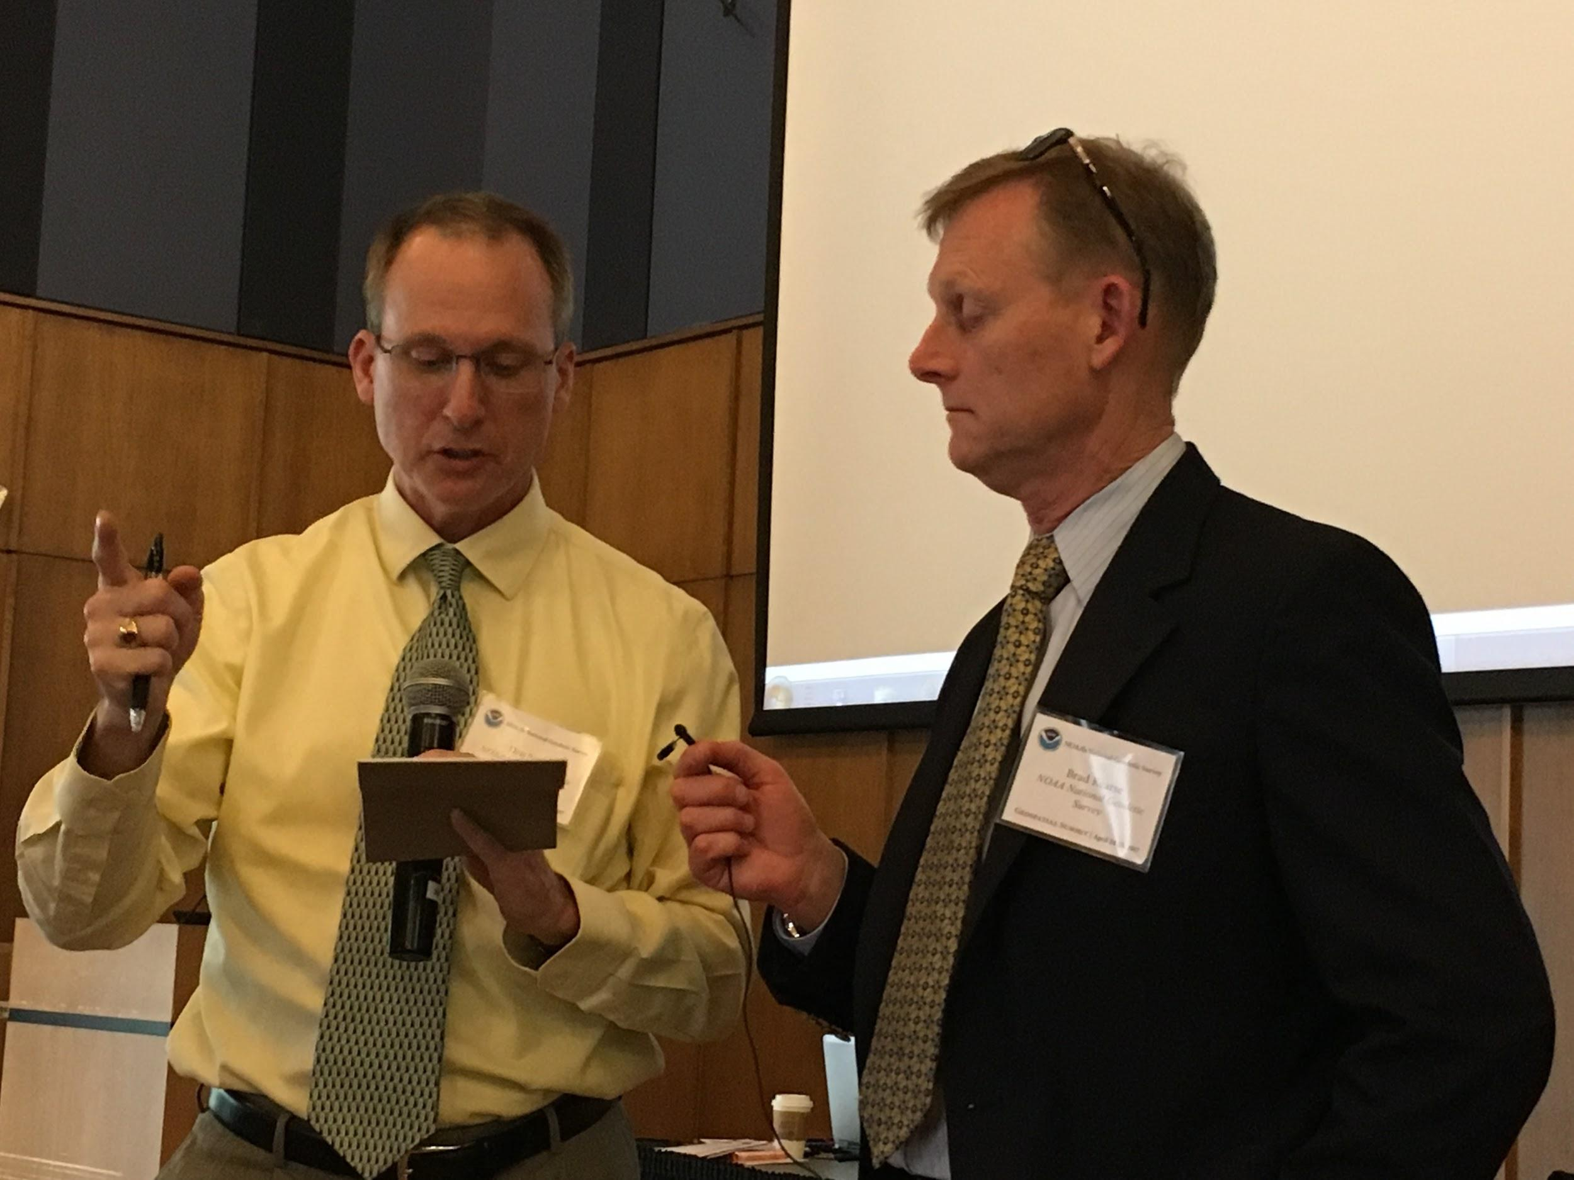
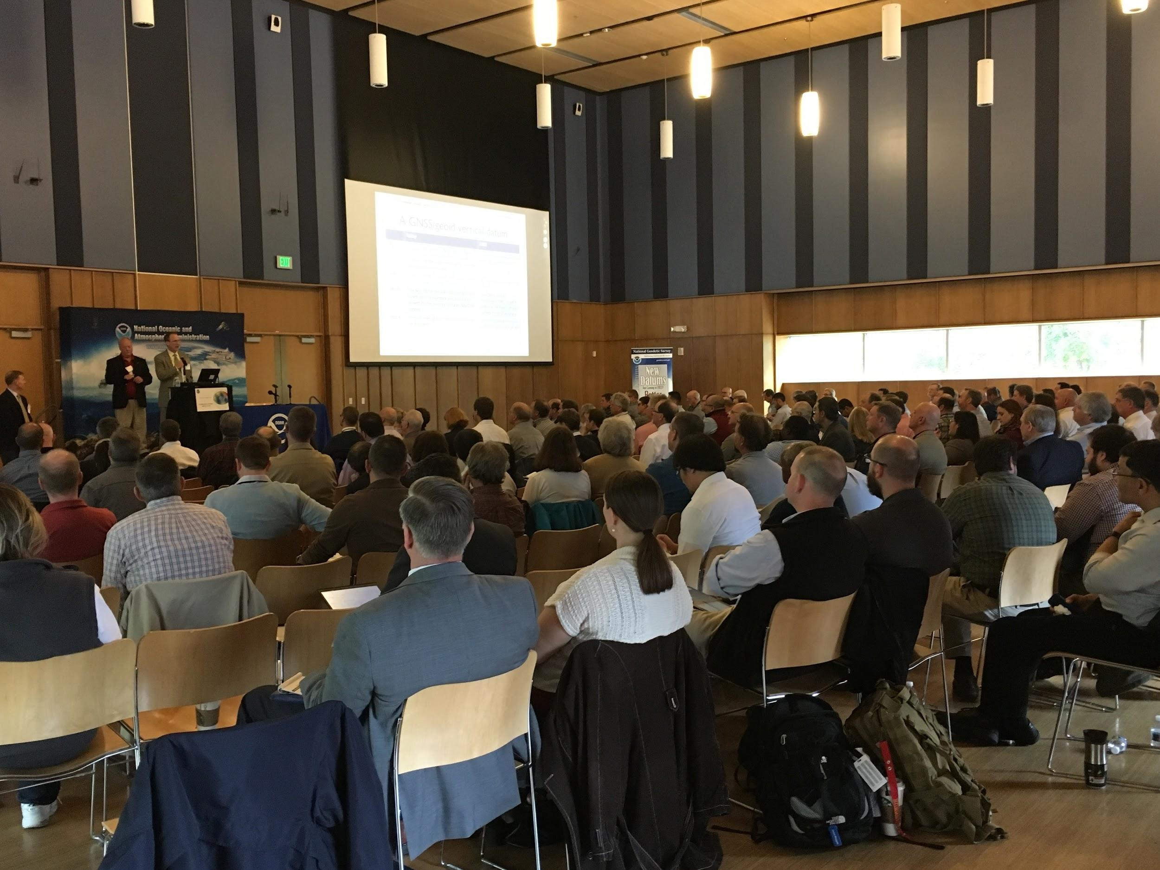
NSRS Modernization: 2017 Geospatial Summit

Slide 5
2017 Geospatial Summit - Background:
2008: NGS plans to modernize NSRS, replace NAD 83, NAVD 88
2010: Fed. Geospatial Summit,
2015: Project updates; address users’ concerns,
2017: Project updates; stakeholder presentations;
Focus: capture/address users’ concerns decision making
Notes:
Put summit into context
2008, NGS Ten-Year Plan intent to modernize NSRS replacing two key elements of the NSRS (ref frames)
•2010: •Host Fed. Geospatial Summit: describe NSRS shortcomings; how to improve, Answer questions about replacing ref. frames.
•capture, address stakeholders’ concerns about the modernization effort
2017: Primary Goal: capture/address stakeholders’ concerns
Live polling: in-room & webinar audiences; post-session feedback
Presentations by stakeholders

Slide 6
Recap 2017 Summit: > 400 attendees: in-person and via webinar
Presentation highlights:
Why NGS is replacing NAD 83, NAVD 88,
Consequences of dynamic Earth on traditional geodetic control
Concerns from NSRS users,
User education; transformation tools
Impacts on partners, stakeholders,
How modernization affects users of geo-referenced data
How users can prepare for new reference frames,
Update legacy data; state-based coordinate legislation
Notes:
with precise positioning must account for plate motion
Need for User education; transformation tools
How users can prepare; leverage communication resources
Heard from stakeholders

Slide 7
Presentations from Partners and Stakeholders:
Federal Emergency Management Agency,
U.S. Geological Survey,
U.S Army Corps of Engineers,
National Geospatial Intelligence Agency
Dewberry, Esri, Trimble,
North Carolina Geodetic Survey,
Fairfax County Government,
Baltimore County Government
Notes:
heard from fed. state local agencies, commercial firms

Slide 8
Stakeholders’ issues, concerns (common format):
We are looking forward to NSRS modernization because:
We are concerned about NSRS modernization because:
The tools, products, or services we need most:
The outreach products or services we need most:
Our preparations for new reference frames include:
Notes:
We asked partner agencies / stakeholders Concerns requested in a common format. NGS partner agencies, were asked to address a specific set of NSRS modernization issues.

Slide 9
Common themes from NSRS users:
Looking forward to NSRS modernization because:
Represent physical world; consistency in georeferenced data products
2. Concerned about NSRS modernization because:
Resource challenges: legacy data; need for user education
3. Most needed tools, products, or services:
Online transformation tools; open-source on modern code base
Notes:
What they told us: will align more closely with global reference systems
reduce confusion provide consistency for numerous georeferenced data products
integrating legacy data
modern code base preferred

Slide 10
Common themes, continued:
4. Most needed outreach products, services:
Summits, webinars, work w/NSPS to update legislation,
Educate professionals: limited geodetic knowledge
5. Preparations to date:
Varies by agency: workshops; policy/guidance documents;
modernization coordinator
Notes:
collaborating with NSPS to update legislation references datums.

Slide 11
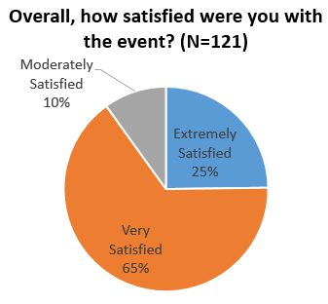
NSRS Modernization: User Feedback (summary)
NSRS users want the benefits,
concerned about resources needed;
Education/training: as important as resulting products: CORS, OPUS;
Strong interest: RTN validation,
online tools: coord. transformation
Attendance: >400 (in-person and webinar).

Slide 12
2017 Geospatial Summit, Summary:
Users shared: current preparations, concerns, challenges,
NGS shared: project updates, policy decisions,
Online resources: help users stay informed, be prepared,
Improving online transformation tools,
User feedback on beta tools: ngs.feedback@noaa.gov
Improving how users submit, process data (replacing bluebooking)
Summarizing scientific aspects, policy decisions in “Blueprint” documents,
Notes:
set of three blueprint documents /NGS technical and policy decisions/ to replace NAD 83.available online

Slide 13
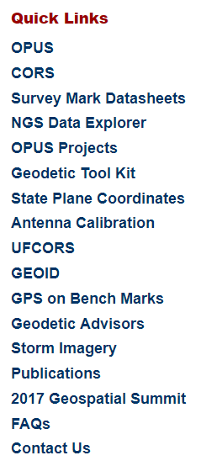
Online Resources: link on home page https://geodesy.noaa.gov/
Summit web page: https://geodesy.noaa.gov/geospatial-summit/index.shtml
Presentations (slides & audio recordings),
Summary reports (also NGS publications library),
NGS 10-yr. plan (details for modernizing NSRS),
Progress updates on modernization project
Notes:
We have complete set resources
Page also contains links to summary reports from 2010, 2015 summits, NGS 10-yr. plan, info on our progress in modernizing NSRS

Slide 14

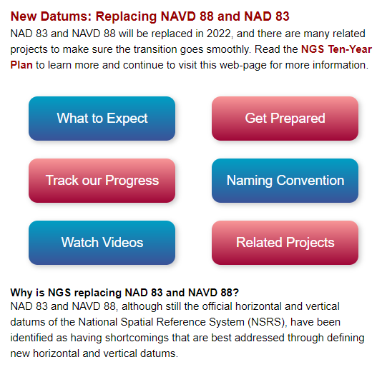
New Datums Web Page:
https://geodesy.noaa.gov/datums/newdatums
What to expect: Coordinate changes, online tools compute
Videos: Learn more about geodetic datums
Track progress: NSRS Modernization News (~ quarterly)
Get prepared: Manage legacy data, SPCS after 2022
Much more...
Notes:
NGS’ centralized information resource for NSRS modernization:

Slide 15



Next Steps (for NGS):
Regular progress reports,
Develop/Improve online tools,
Comprehensive online resources
2018: Commercial firms, equipment vendors
2019: Geospatial summit
Notes:
NGS website features comprehensive resources to prepare for new ref frames

Slide 16

Next Steps (for NSRS users):
Stay in touch: https://geodesy.noaa.gov/
Subscribe:
Contact us: ngs.infocenter@noaa.gov
Share information with colleagues
Engage with professional societies - NSPS, AAGS
Plan to attend: May 2019
End of Summit Overview

Slide 17
Progress on Projects since the Summit
Dru Smith

Slide 18
NSRS Modernization: Recent Policy Decisions
Blueprint for 2022, Part 1: Geometric Coordinates (May 2017)
  Four “terrestrial reference frames”
    Each related to the IGS frame solely through plate rotation
    Primary service: Time-dependent coordinates from OPUS
    All other movements (3-D) will be captured in an Intra-Frame Velocity Model (IFVM) for each frame
Acronyms
  NATRF2022, PATRF2022, CATRF2022, MATRF2022
Blueprint for 2022, Part 2: Geopotential Coordinates (Due out October 2017)

Slide 19
NSRS Modernization: Related Projects
Project | Importance | Status
Define the Mathematical Connection between the IGS frame and the Terrestrial Reference Frames | High | Done
NADCON 5 | High | In Beta
GRAV-D airborne campaign | High | Ahead of schedule
xGEOID annual production | High | Loss of S. Holmes
Euler Pole determination for 4 plates | High | Just begun
Scoping how to compute the Intra-Frame Velocity Models | High | Just begun
Using leveling in a GPS/geoid based geopotential datum | Med/High | Behind Schedule
GEOID Monitoring Service | Med/High | Behind schedule
GPS campaign for Transformations | Med/High | Behind schedule
NSRS Database | Med/High | Repeated setbacks
Notes:
Dru?

Slide 20
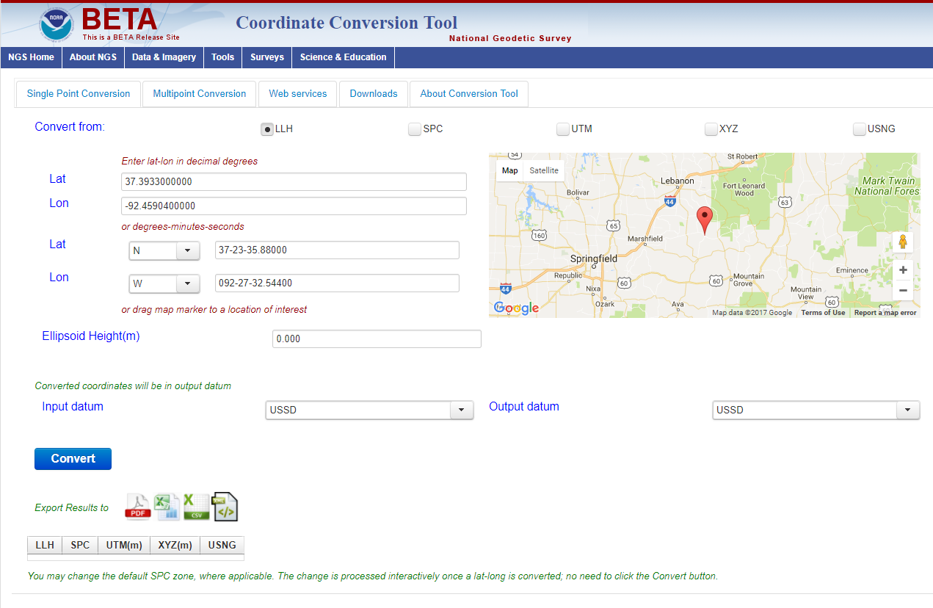
NADCON 5 in Beta
https://beta.ngs.noaa.gov/gtkweb/

Slide 21
Live polls
Christine Gallagher

Slide 22
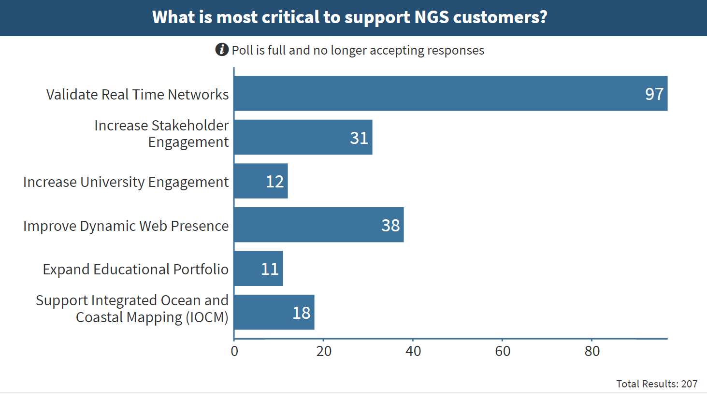
You expressed interest in real time network validation...

Slide 23
Real Time Network (RTN) Validation Efforts
Overview
NGS is building a “validation service.”
It will check if a RTN is consistent with the NSRS.
It will use OPUS-like process for validation.
Feedback
3 live poll questions directed at RTN operators

Slide 24
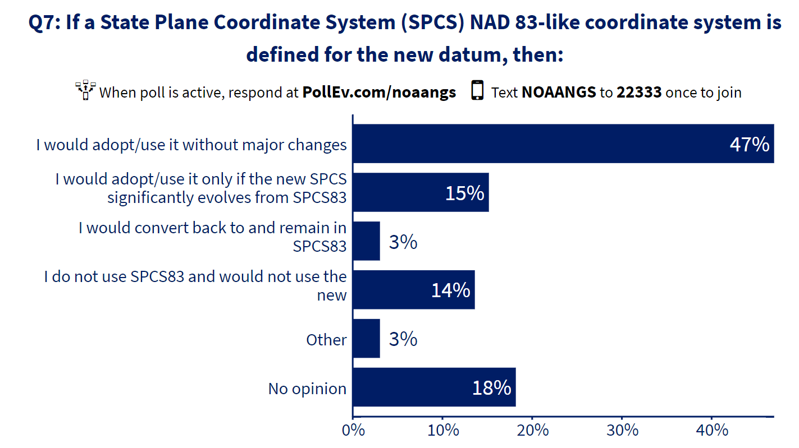
Back in 2015, we asked you about projections...

Slide 25
State Plane Coordinate (SPC) System Related Efforts
Overview
NGS knows that significant numbers of NSRS users continue to rely upon the SPC system, rather than geodetic coordinates.
NGS is investigating how to design the SPC system which could be rolled out in conjunction with the four Terrestrial Reference Frames of 2022.
Feedback
2 live poll questions directed at SPC users

Slide 26
Questions?

Slide 27
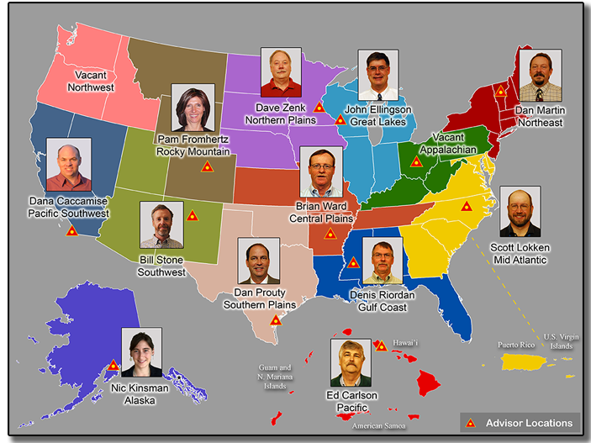
Contact Us
General questions?
NGS.Infocenter@noaa.gov
Feedback on products?
NGS.Feedback@noaa.gov
Technical assistance
Contact your geodetic advisor
https://geodesy.noaa.gov/ADVISORS/index.shtml

