Slide 1



State Plane in 2022
A Spatial Odyssey for Transportation
Geospatial Control Subcommittee of the Geospatial Data Acquisition
Technologies in Design and Construction Committee (AFB80)
Michael L. Dennis, PhD, PE, RLS
NOAA’s National Geodetic Survey
Transportation Research Board
AFB80 Committee Summer Meeting
Daytona Beach, Florida
July 24, 2019

Slide 2
A spatial odyssey of modernization…
National Spatial Reference System
NSRS
Define
Maintain
Access

Slide 3
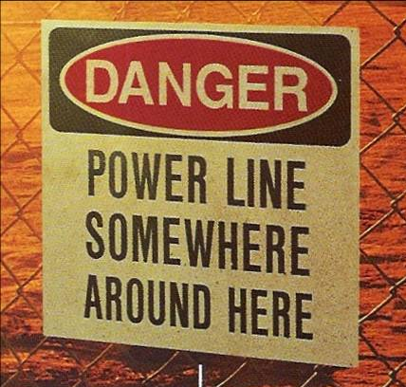
Why should you care about the NSRS?

Slide 4
The plan for today
National Spatial Reference System Modernization
Brief overview of new “datums” for 2022
  Four new Terrestrial Reference Frames of 2022
  North American-Pacific Geopotential Datum of 2022
New State Plane Coordinates
  State Plane Coordinate System of 2022 (SPCS2022)
  Role of SPCS2022 stakeholders
  Characteristics and design approach
  Deadlines for stakeholder input
Fate of the U.S. survey foot after 2022
Notes:
Objective of this presentation is to give an overview of upcoming changes to U.S. National Spatial Reference System (NSRS) in 2022
First part is an overview of new 2022 “datums”, which consists of two main parts:
Geometric: a set of 4 Terrestrial Reference Frames to replace the existing 3 frames of NAD 83
Geopotential: a set gravity models that includes a new vertical datum to replace the 7 vertical datums (including NAVD 88)
The second part of the presentation is on a new State Plane Coordinate System, SPCS2022
Spending more time on this part because projected coordinates are used directly in many transportation applications, and because DOTs are have a voice in how SPCS2022 is developed.
Will cover SPCS2022 policy & procedures, role of stakeholders (including DOTs), general characteristics, customer feedback, and deadlines for stakeholder input
There is not enough time to cover these topics in detail. Much more information is available on the NGS website.

Slide 5
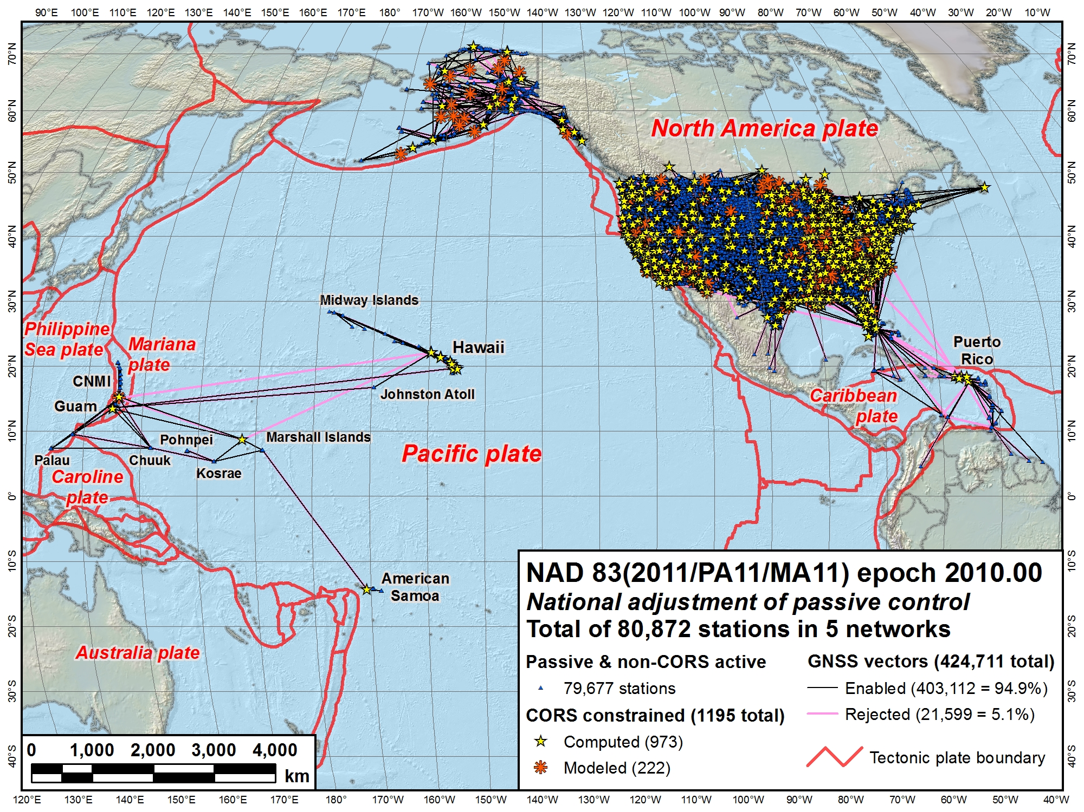
NAD 83 (2011)
NAD 83
(MA11)
NAD 83 (PA11)
North American Datum of 1983
Three frames:
NAD 83 (2011): North America and Caribbean plates
NAD 83 (PA11): Pacific plate
NAD 83 (MA11): Mariana plate
Notes:
This the current situation with geometric reference frames (“horizontal datums”) of the NSRS
There are 3 separate (but related) frames, all called North American Datum of 1983 (NAD 83)
Each is nominally referenced to a different tectonic plate, indicated by the “datum tag” in parentheses:
(2011): North America plate. Includes CONUS, Alaska, and the Caribbean (but not referenced to Caribbean plate)
(PA11): Pacific plate. Includes Hawaii and American Samoa
(MA11): Mariana plate. Includes Guam and the Commonwealth of the Northern Mariana Islands (CNMI)
Each of these frames is semi-dynamic, with the intent that the frame moves with the tectonic plate (to reduce change in coordinates with time)
But the plate motion is not necessarily well modeled
In addition, the frames are not geocentric (offset from Earth center of mass by about 2 meters)

Slide 6
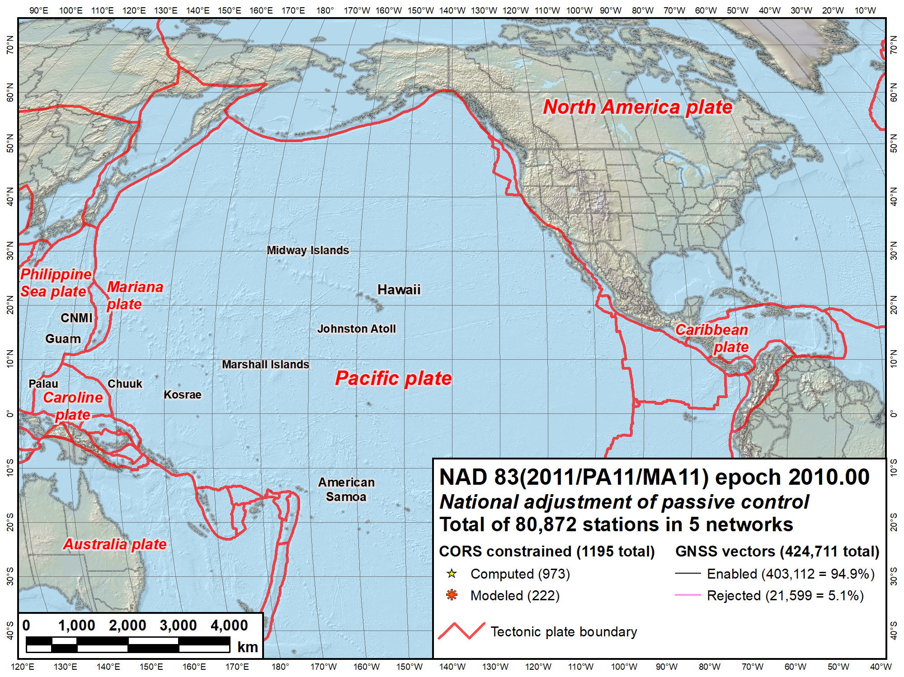
NAVD 88
IGLD 85
NAVD 88
PRVD02
NMVD03
VIVD02
GUVD04
Current vertical datums of the NSRS
ASVD02
NA and Caribbean
NAVD 88
IGLD 85
PRVD02
VIVD09
Pacific
GUVD04
NMVD03
ASVD02
Notes:
This the current situation with vertical datums of the NSRS
There are 7 different vertical datums, all based on differential leveling to give orthometric heights (except for IGLD 85)
North American Vertical Datum of 1988 (NAVD 88): CONUS and Alaska
International Great Lakes Datum of 1985 (IGLD 85): Derived from NAVD 88 for Great Lakes using lake water levels. Uses dynamic (not orthometric) heights for water levels and flow.
Puerto Rico Vertical Datum of 2002
Virgin Islands Vertical Datum of 2009
Guam Vertical Datum of 2004
Northern Mariana Vertical Datum of 2003
American Samoa Vertical Datum of 2002 (in process of being deprecated due to earthquakes)
Have so many because cannot level across substantial expanses of water
Since based on (often old) leveling, susceptible to obsolescence due to height change (e.g., subsidence, earthquakes) and loss of bench marks over time

Slide 7
Geometric: Out with the old, in with the new
The Old:
NAD 83 (2011)
NAD 83 (PA11)
NAD 83 (MA11)
The New:
North American Terrestrial Reference Frame of 2022 (NATRF2022)
Caribbean Terrestrial Reference Frame of 2022 (CATRF2022)
Pacific Terrestrial Reference Frame of 2022 (PATRF2022)
Mariana Terrestrial Reference Frame of 2022 (MATRF2022)
4 plate-fixed frames (rotate with plates)
Derived from International Terrestrial Reference Frame of 2014 (ITRF2014)
Geocentric (consistent with GNSS)
Notes:
Replacing 3 “old” geometric (horizontal) datums with 4 “new” terrestrial reference frames (TRFs)
New TRFs are plate-fixed, so their horizontal coordinates will change only very slowly with time in most places (except tectonically active areas, like western California and southeast Alaska)
The TRFs are derived directly from the International Terrestrial Frame of 2014 (ITRF2014), with plate rotations added
Note ITRF2014 is NOT plate-fixed, so ITRF2014 coordinates have significant velocities everywhere
Since ITRF2014 is geocentric, the 2022 TRFs are also geocentric, making them consistent with GNSS

Slide 8
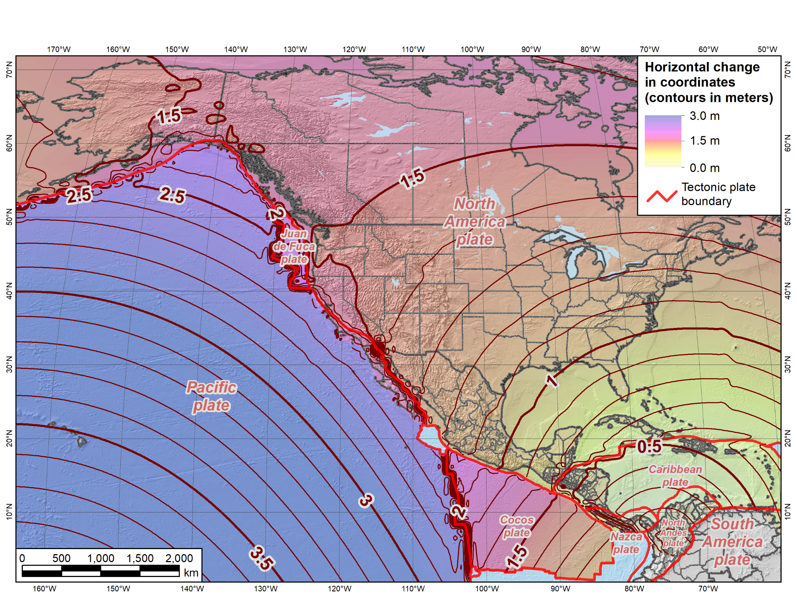
Horizontal change in coordinates: NAD 83 epoch 2010.0 → TRF2022 epoch 2020.0
NATRF2022
PATRF2022
CATRF2022
Notes:
Map showing change in horizontal coordinates from current NAD 83 epoch 2010.0 to the TRFs at epoch 2020.0
Shows NATRF2022, CATRF2022, PATRF2022 (but not MATRF2022)
Note that first reference epoch will be 2020.0 when released in 2022
Magnitude of change varies with tectonic plate (and location on plate):
0.8 to 1.7 m in CONUS and Alaska (but up to ~2 m in California)
0.6 m in Puerto Rico
Much greater on Pacific plate (3.5 m in Hawaii)
TRF2022 coordinates will change very slowly at most locations on their respective plates

Slide 9
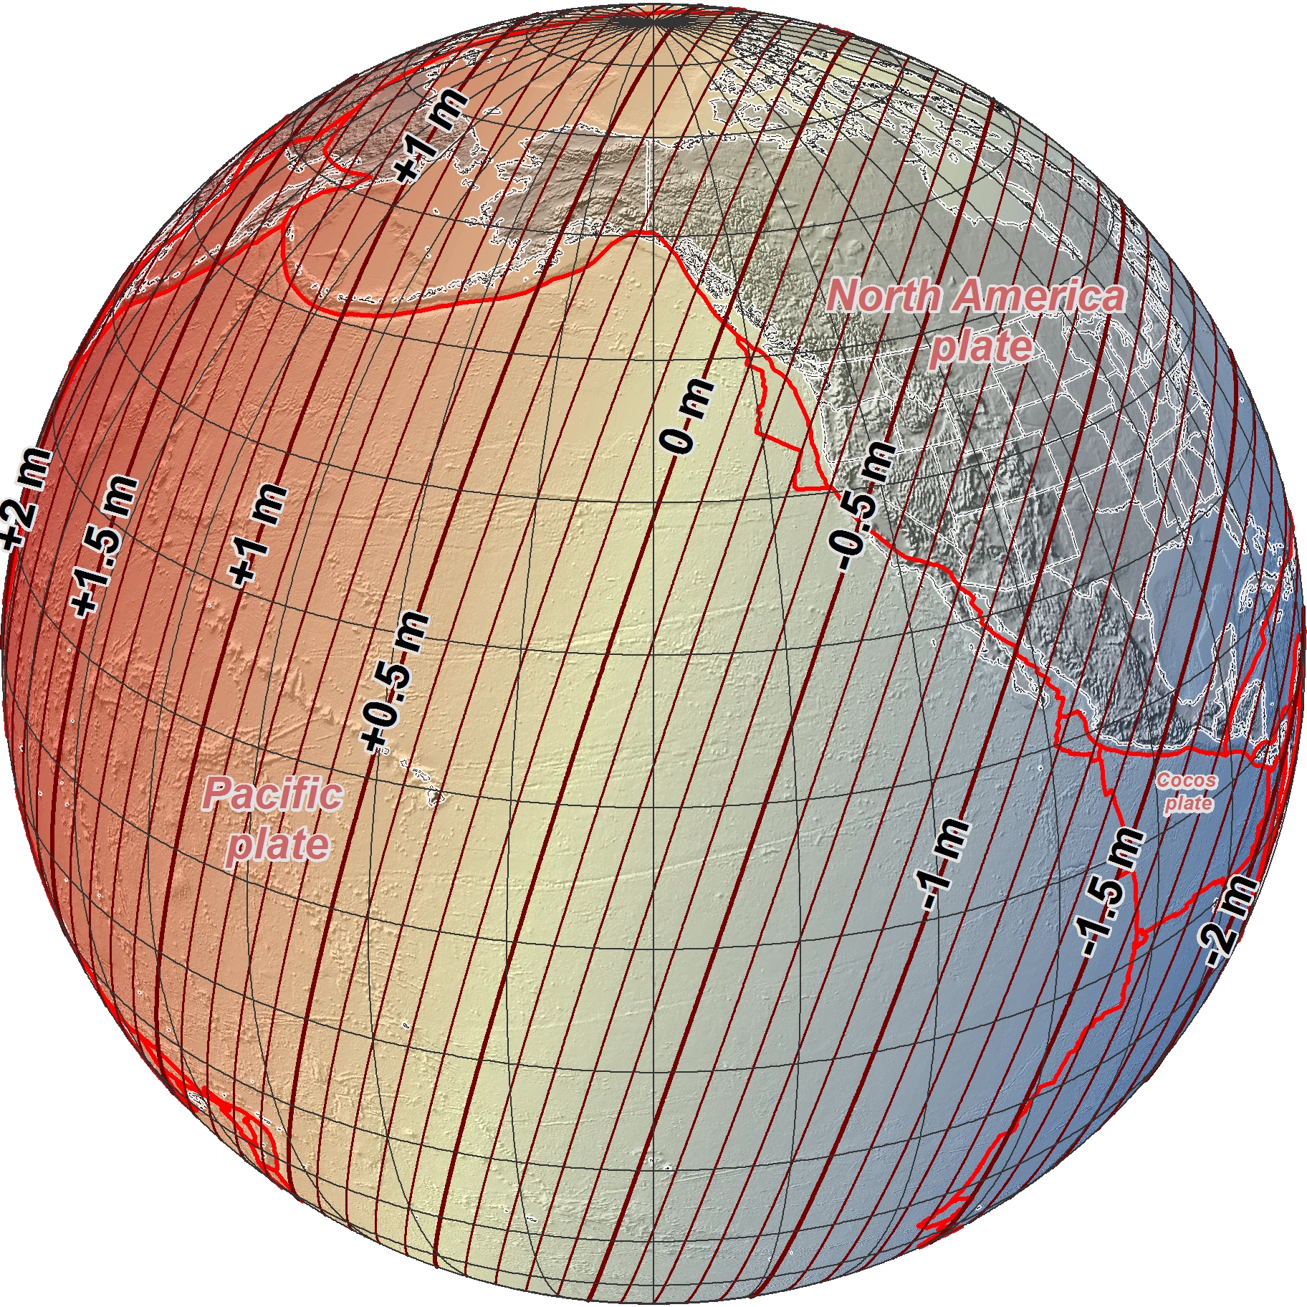
NAD 83 epoch 2010.00 →
2022 Terrestrial
Reference Frames
Change in ellipsoid heights at epoch 2020.00
(contours in meters)
Notes:
Map showing change in ellipsoid heights from current NAD 83 epoch 2010.0 to the TRFs at epoch 2020.0
Change is about ±2 m, which is the amount of non-geocentricity of NAD 83 (essentially shifting entire ellipsoid by ~2 m)
Change depends only on location, independent of tectonic plate rotation (which is modeled as purely horizontal)
2022 TRF ellipsoid heights are identical to ITRF2014 ellipsoid heights
Although given here for epoch 2020.0, overall ellipsoid heights change very slowly with time
But large changes do occur, due to local effects like subsidence and regional effects like post-glacial isostatic adjustment

Slide 10
“Vertical”: Out with the old, in with the new
  The Old:
  NAVD 88
  PRVD 02
  VIVD09
  GUVD04
  NMVD03
  ASVD02
  IGLD 85
  IGSN71
  GEOID12B
  USGG2012
  DEFLEC12B
  The New: One geopotential datum, equator-to-pole
  The North American-Pacific Geopotential Datum of 2022 (NAPGD2022)
  More than just “vertical”
  Heights derived with GNSS
  Includes following models:
    GEOID2022 (geoid heights)
    DEFLEC2022 (deflection of vertical)
    SGRAV2022 (surface gravity)
Helmert orthometric heights
Normal orthometric heights
Dynamic heights
Gravity
Hybrid geoid
Gravimetric geoid
Notes:
Replacing 7 “old” leveling-based vertical datums, a gravity datum, a hybrid geoid model, and a deflection of the vertical model with ONE geopotential datum
North American-Pacific Geopotential Datum of 2022 (NAPGD2022)
Why word “geopotential”? Because it includes much more than just “vertical”
Orthometric heights derived from GNSS ellipsoid heights using GEOID2022 geoid model
Data for creating geoid model used not just for heights, but also deflection of the vertical and surface gravity
Deflection of the vertical and surface gravity needed to reduce terrestrial observations (e.g., leveling, total stations)
Although primary access is with GNSS, will be compatible with terrestrial methods
Derived from global geopotential model
High-resolution parts for quarter of Earth including North America (plus American Samoa and Guam/CNMI in the Pacific)…

Slide 11
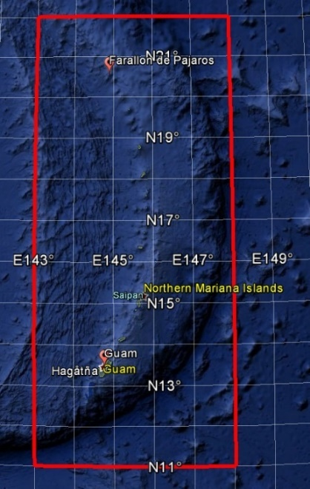
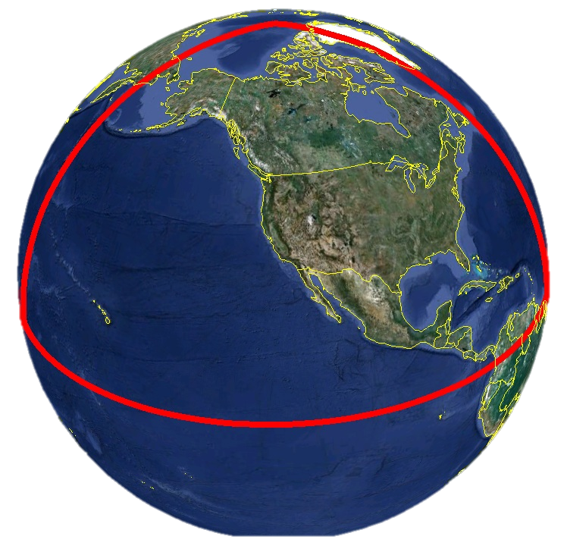
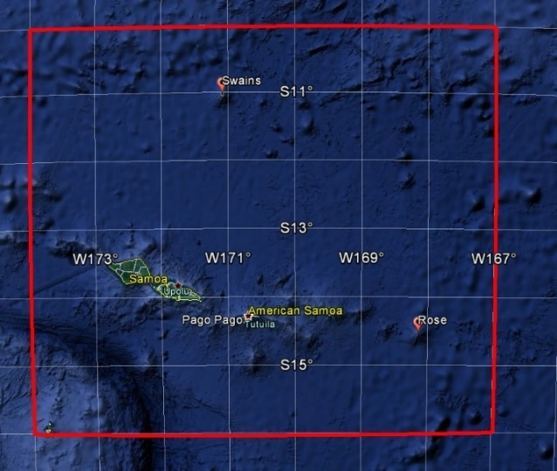
Extent of NAPGD2022 gravimetric geoid model
Guam and Northern Marianas Islands
American Samoa
Notes:
Maps showing extent of high-resolution part of geopotential model (which includes geoid, deflection of the vertical, and surface gravity models)
Most of model is equator-to-pole and includes all of North and Central America and Hawaii
Two smaller grids for Guam/CNMI and American Samoa
All models derived from a single (lower resolution) global geopotential model

Slide 12
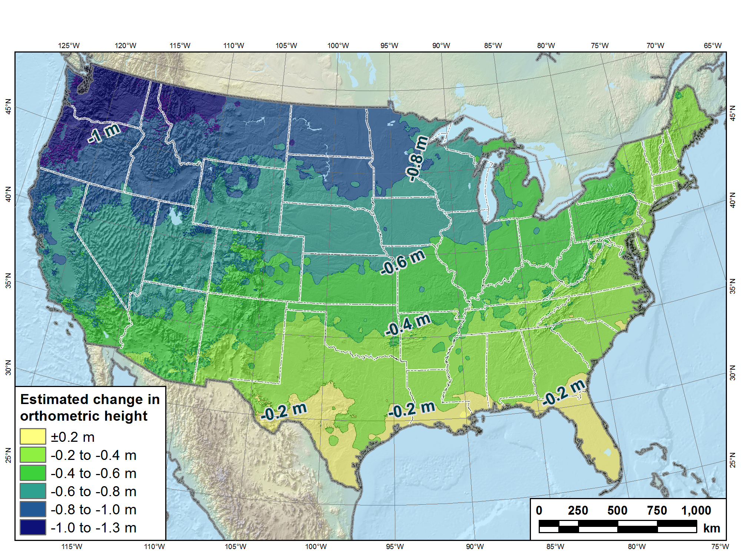
Estimated change in orthometric heights from NAVD 88 to NAPGD2022
NAPGD2022 approximated using xGEOID16B
Notes:
Map showing estimated change in orthometric heights (“elevations”) from NAVD 88 to NAPGD2022 for CONUS
Orthometric heights will decrease in most areas, from about zero in Florida to -1.3 m in Pacific Northwest
Heights in southern Florida will increase by up to +0.2 m
Tilt and bias of NAVD 88 likely due to accumulation of systematic errors in leveling used in its original realization (constrained to single point in St. Lawrence Seaway).

Slide 13
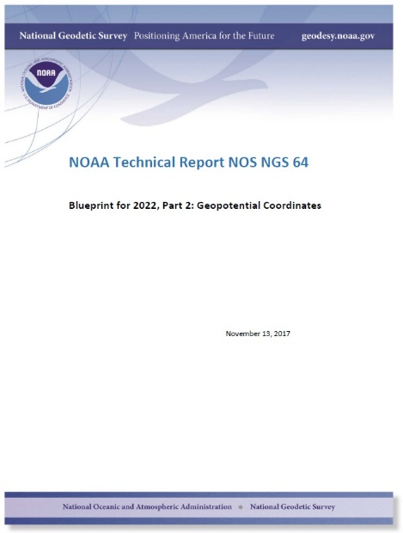
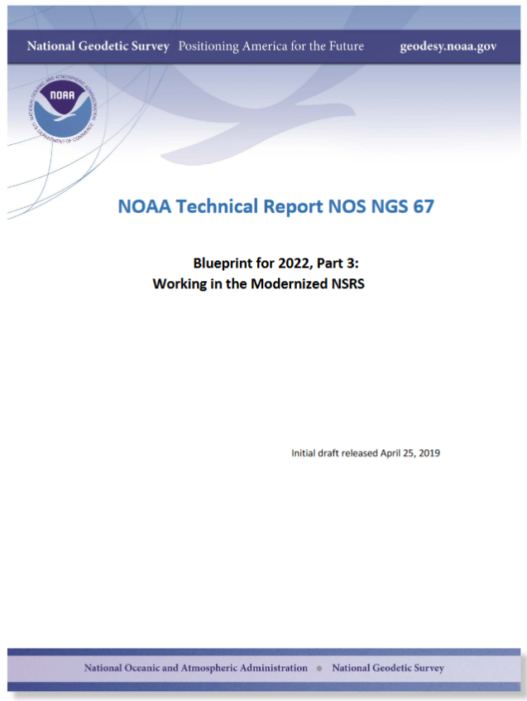
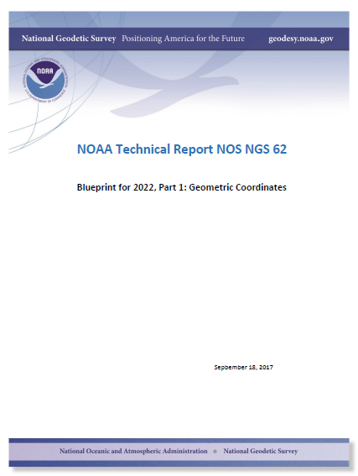
Geopotential
Nov 2017
Working in the
modernized NSRS
April 2019
Geometric
Sep 2017
Webinar on 7/25/2019 at https://geodesy.noaa.gov/web/ science_edu/webinar_series/Webinars.shtml
Notes:
NGS is in process of creating “blueprint” documents for modernization of the NSRS
This is best source of detailed and specific information; living documents that get updated as necessary
Three blueprint documents:
First on geometric coordinates (terrestrial reference frames), latest version Sep 2017
Second on geopotential coordinates (“vertical” datum, gravity, etc.), latest version Nov 2017
Third on working in the modernized NSRS, first version will be published in May 2019. This is the “how to” document for using the new 2022 NSRS. Emphasis is on practical applications. Later versions will include case studies.

Slide 14
New “datums” summary
Modernizing the NSRS
  Accurate and efficient
  Consistent with GNSS (geocentric)
  Compatible with terrestrial methods (e.g., leveling)
4 new terrestrial reference frames
1 new geopotential (“vertical”) datum
Semi-dynamic
  All locations will have velocities (“dynamic” part)
  Can get coordinates for specific dates (“semi” part)
Change of about 1-2 m in most locations
See https://geodesy.noaa.gov/datums/newdatums/
Notes:
To summarize, new “datums” are part of modernizing the NSRS
Will be more accurate and efficient
Consistent with GNSS (in part because geocentric)
GNSS-based (through the NGS CORS), but still compatible with classical terrestrial methods (e.g., leveling, total stations)
Will include of four new TRFs “fixed” to 4 different tectonic plates (based on global ITRF2014)
Will include 1 geopotential datum, allowing for consistent heights (and other gravity-based data) everywhere in the NSRS
Semi-dynamic, meaning it takes into account change with time (velocities) everywhere
Yet it will allow for determining coordinates at any epoch date, and it will include “reference” epochs (the first being 2020.0)
An intra-frame velocity model (IFVM) will be an explicit part of the NSRS to allow movement of coordinates through time
Initial change will be at about 1-2 meters in most location, followed by very slow change over time
In many locations, the changes will be very close to zero
There is much more to this topic than covered here – see the NGS website for more information!

Slide 15
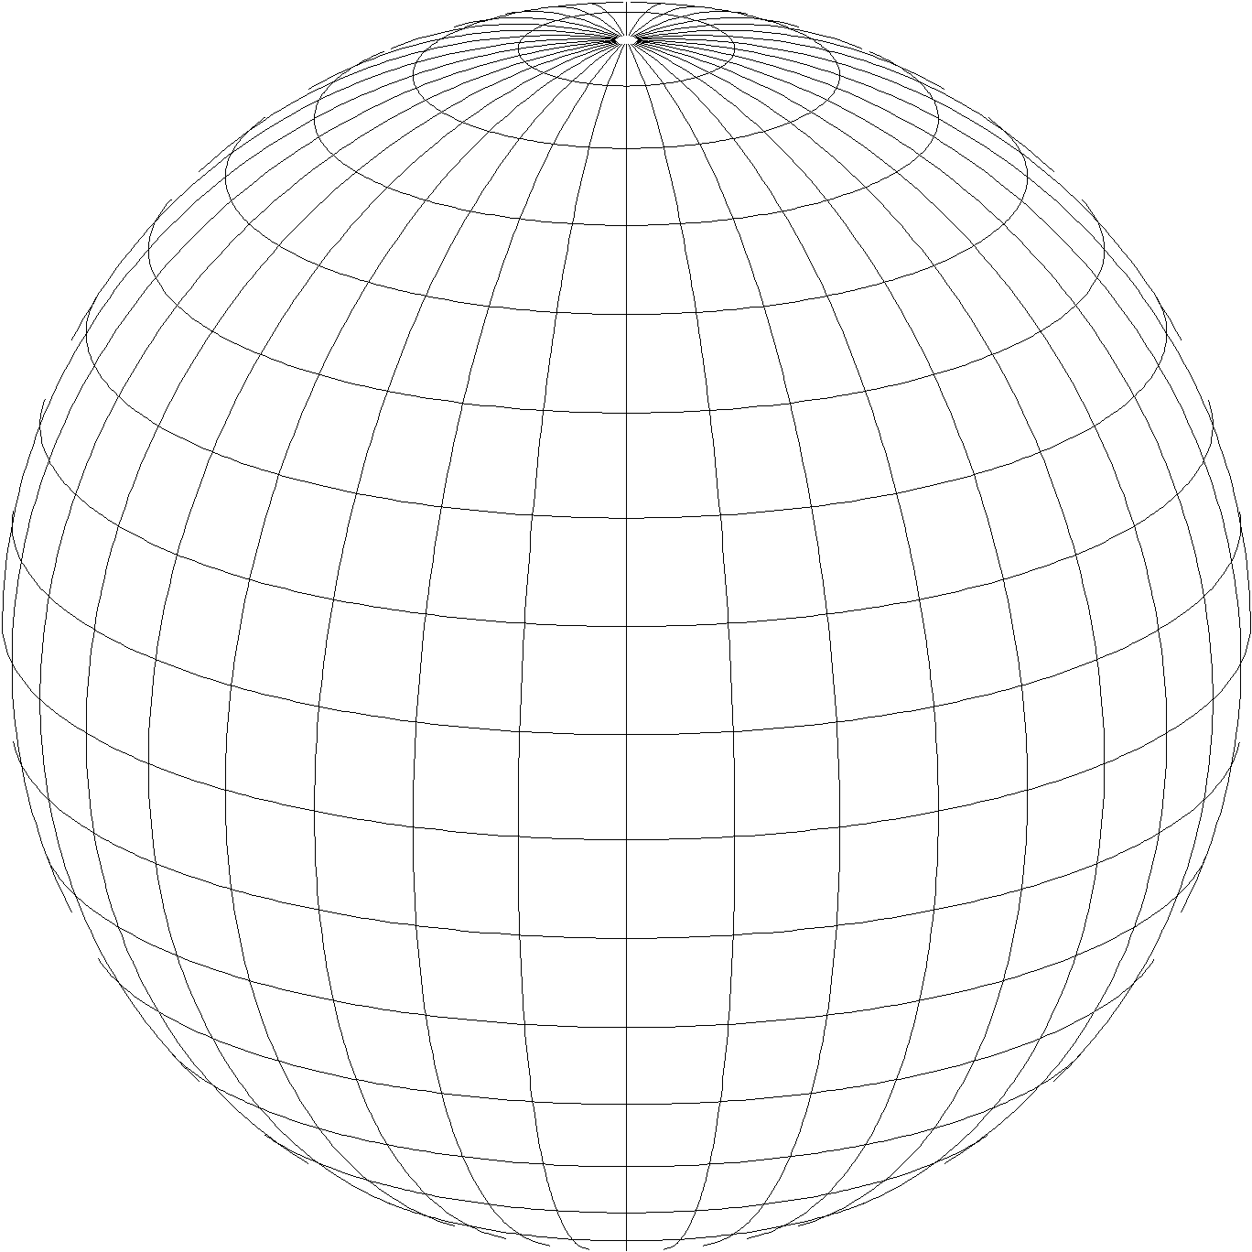
A New State Plane for 2022
State Plane Coordinate System of 2022 (SPCS2022)
  Referenced to 2022 Terrestrial Reference Frames (TRFs)
  Based on same reference ellipsoid as SPCS 83 (GRS 80)
  Same 3 conformal projection types as SPCS 83 and 27:
Lambert Conformal Conic (LCC)
Transverse Mercator (TM)
Oblique Mercator (OM)

Slide 16
General SPCS2022 characteristics
Based on final policy & procedures
Distortion design requirements
  Linear distortion minimized at topographic surface
  (not at ellipsoid surface)
  Purpose: to reduce difference between and projected “grid” and actual “ground” distances
Other characteristics
  Default designs (if no consensus stakeholder input)
  Statewide and “layered” zones
  Low-distortion projections (LDPs)
  “Special use” zones
Notes:
Will go over main general characteristics of SPCS2022 (not enough time to go into detail)
This is based on final SPCS2022 Policy & Procedures (not yet published but most decisions have been made on content)
Final policy & procedures created based in part on public response to the FRN
A key element of SPCS2022 is linear distortion (“scale error”) design requirements
Linear distortion is the difference between a “grid” distance (between the projected coordinates of a pair of points) and the true horizontal “ground” distance (at the topographic surface of the Earth)
SPC2022 zones are designed to minimize linear distortion at the topographic surface, NOT at the ellipsoid surface (as was done for SPCS 83 and 27)
Other relevant characteristics are listed; each will be discussed in this presentation

Slide 17
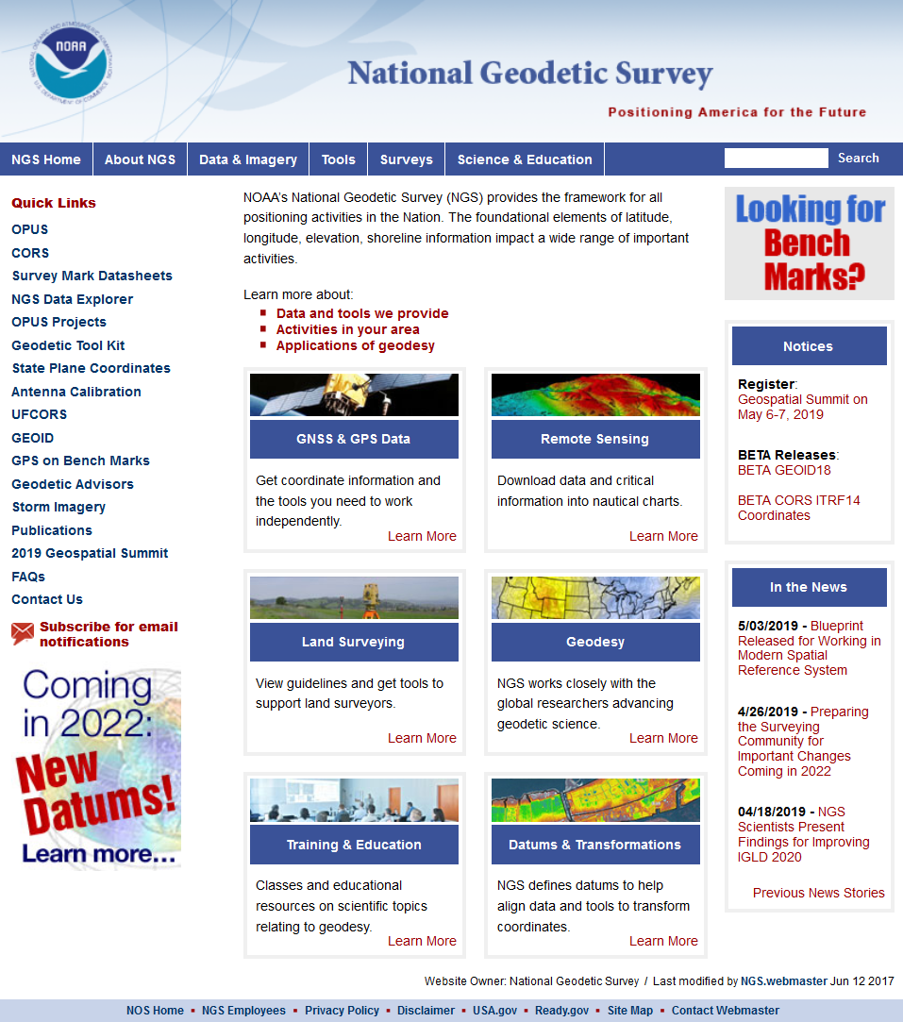
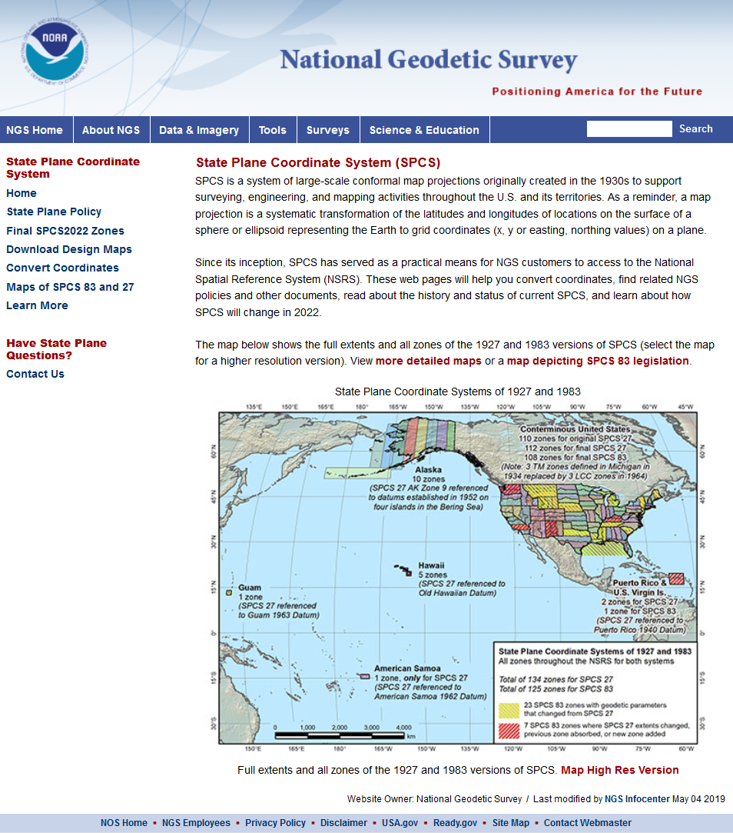
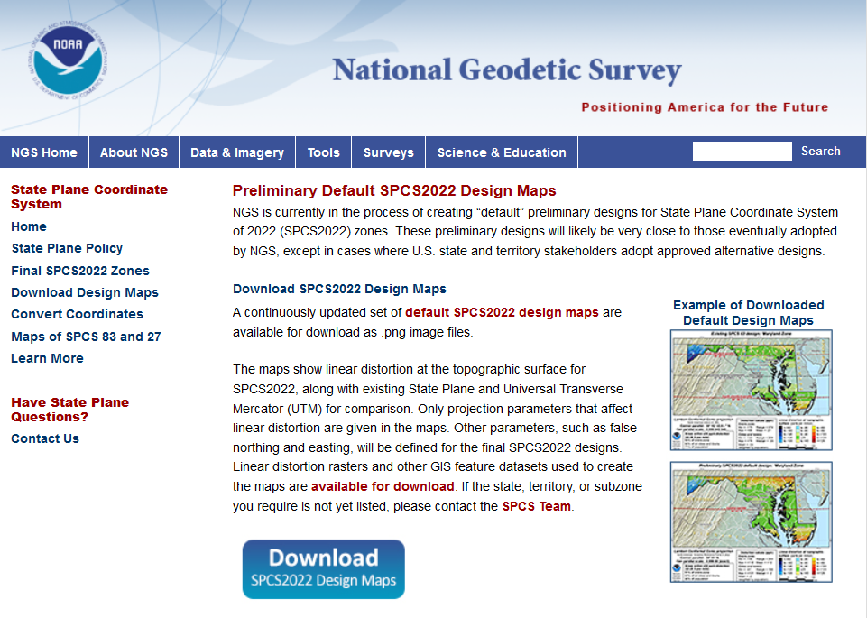

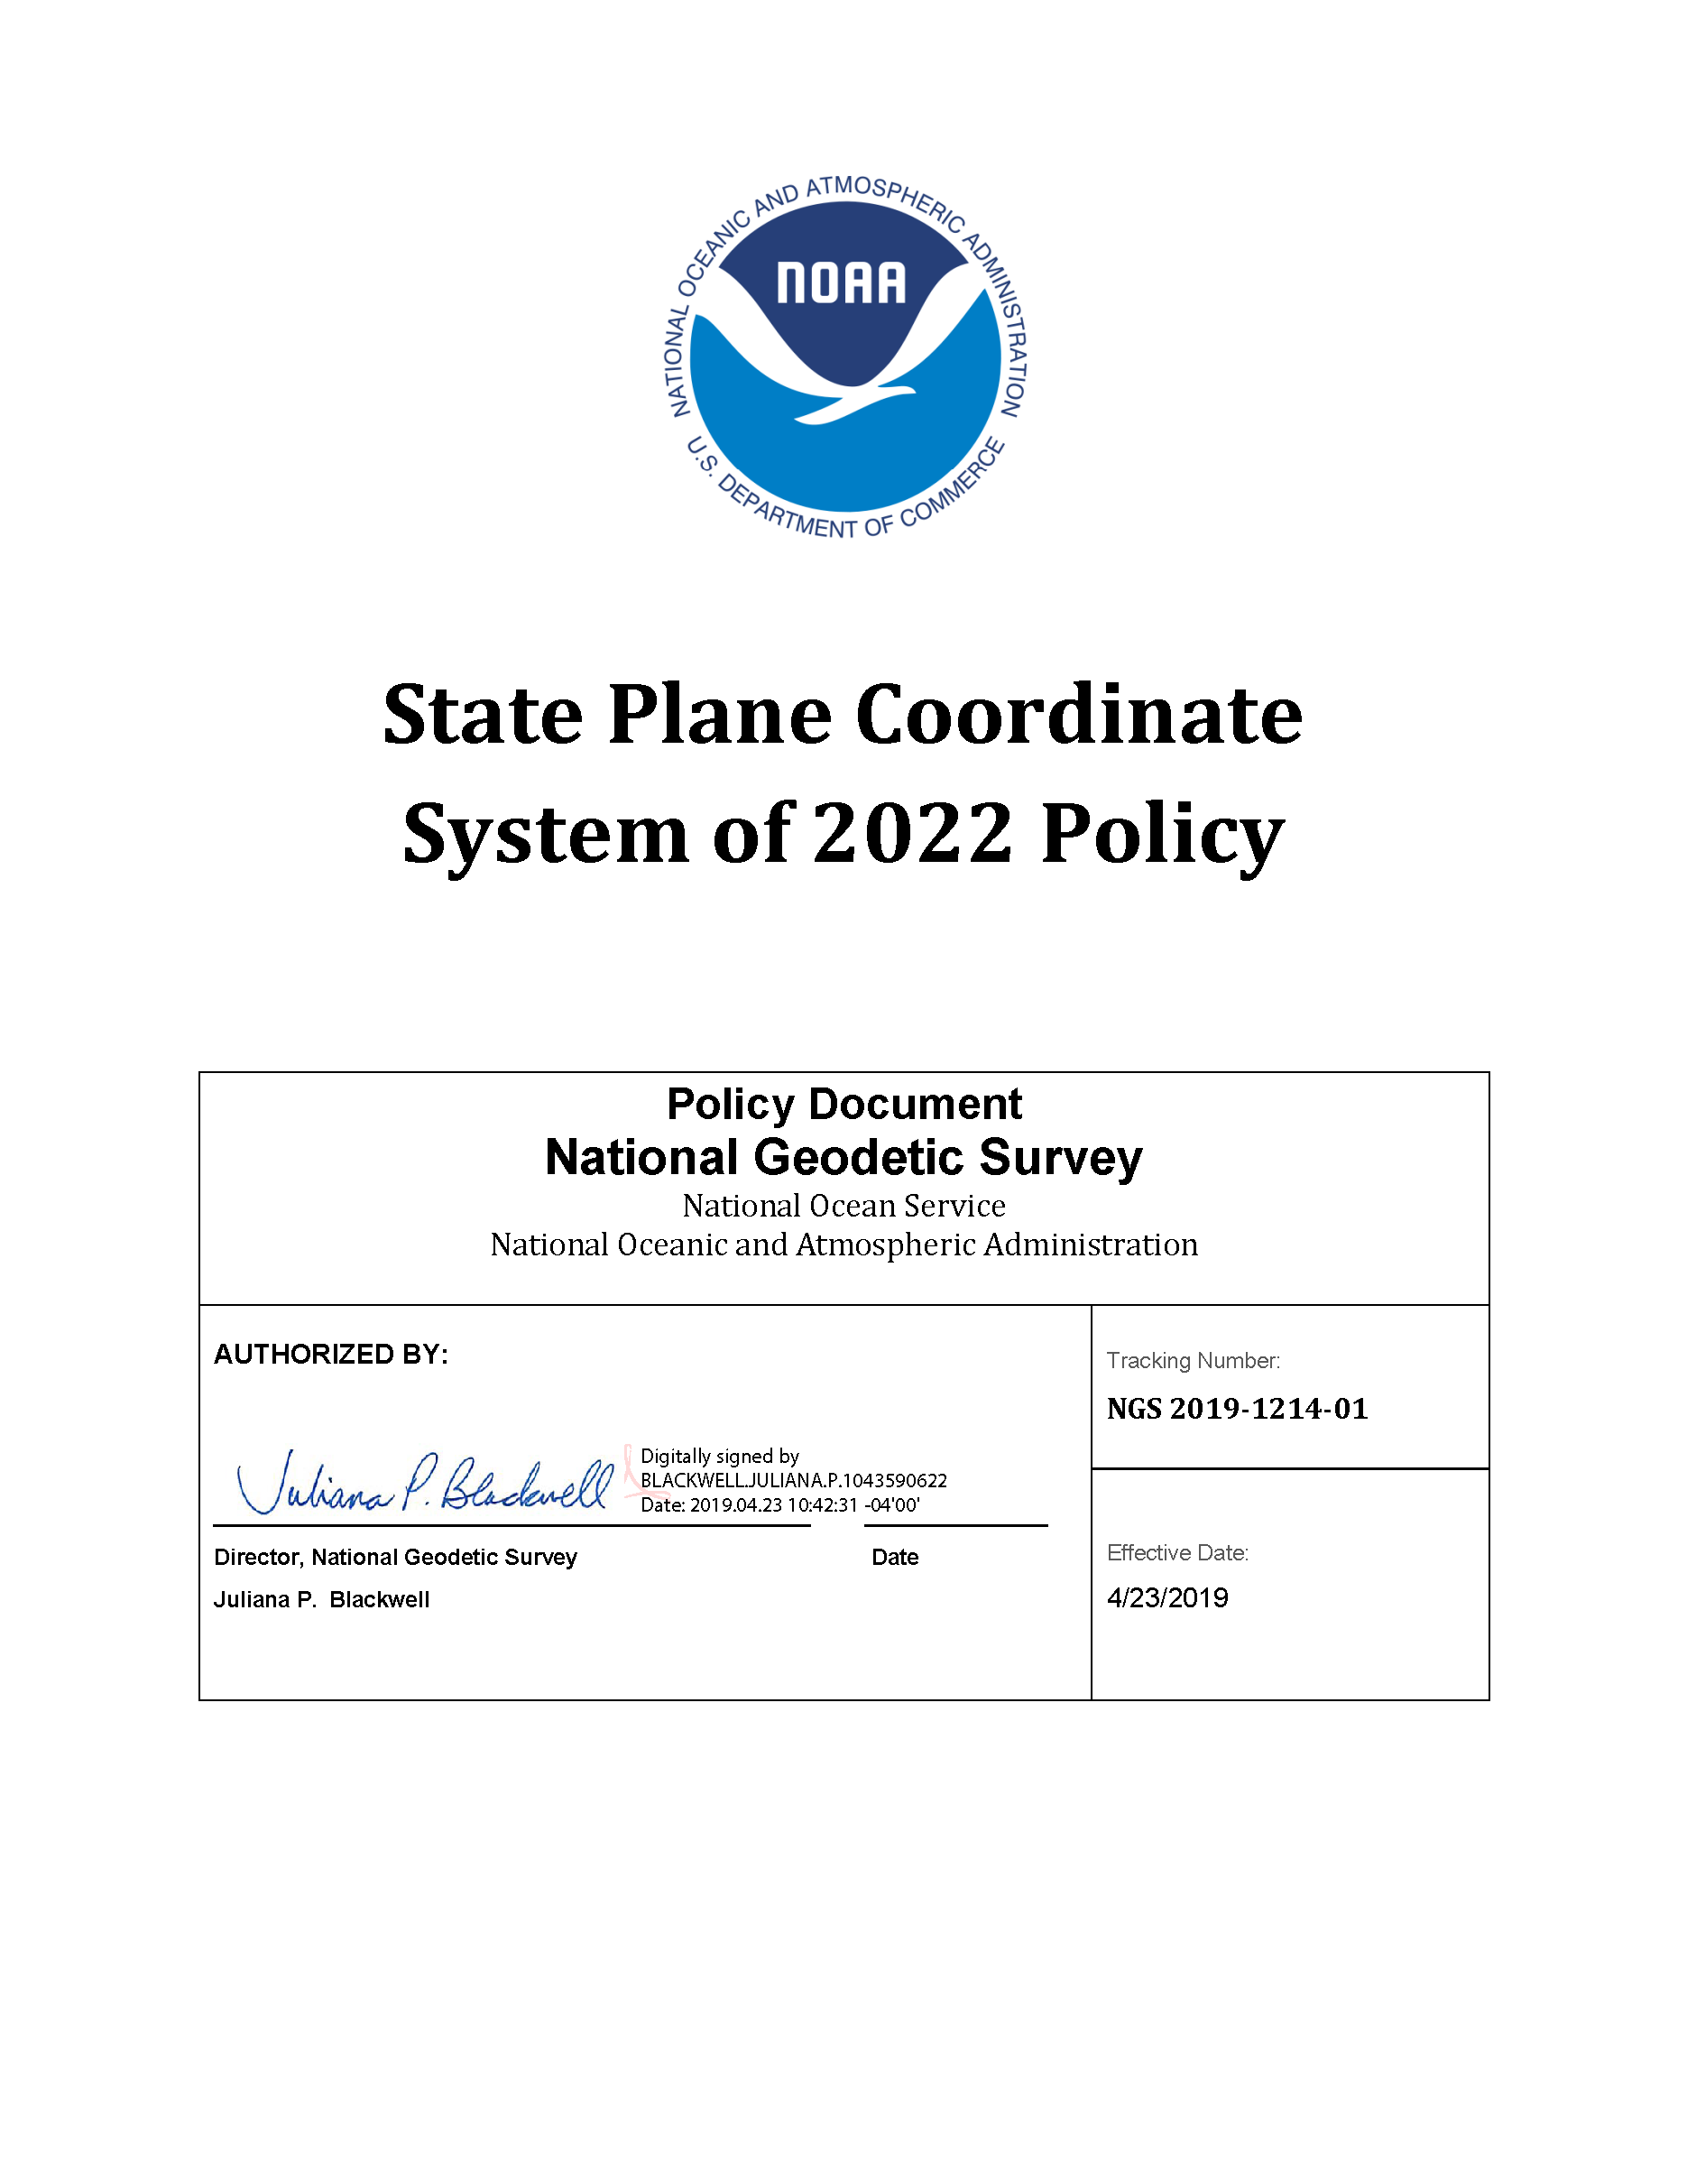
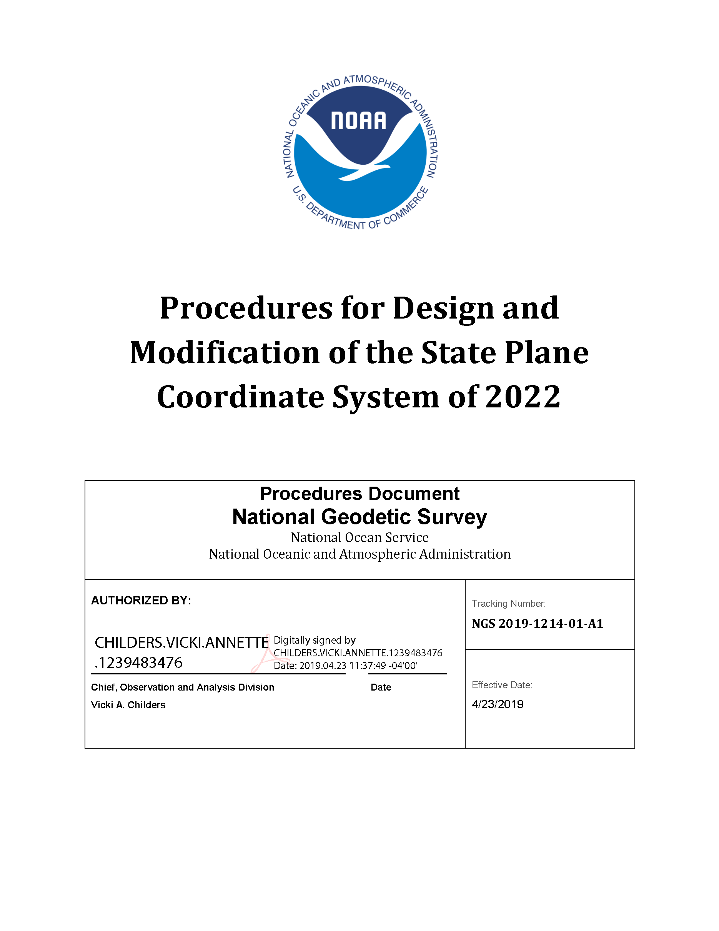
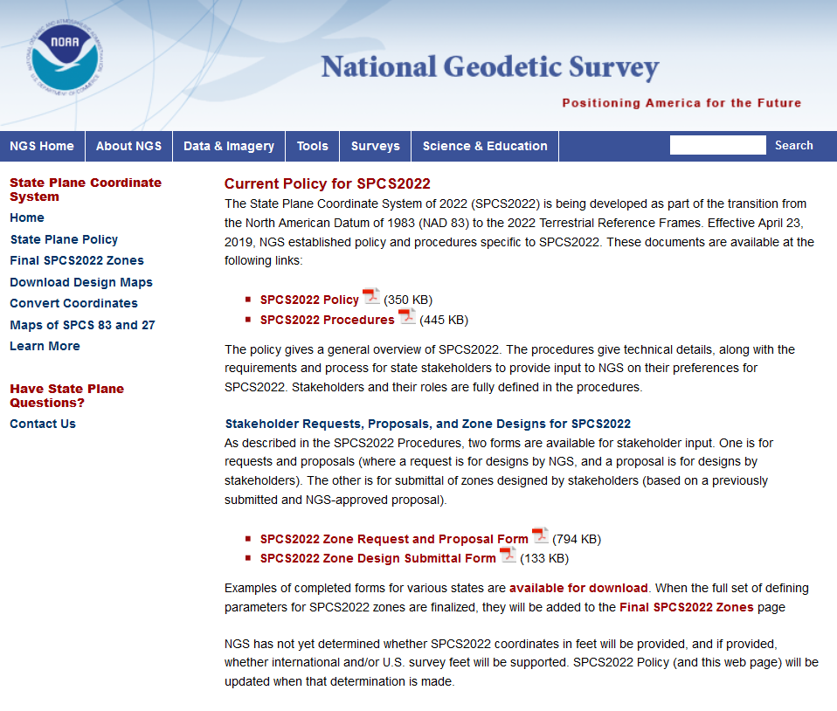
geodesy.noaa.gov
Notes:
A lot of information is available on the NGS website, including:
2022 policy changes
Supporting information (old policy and manuals, new report on SPCS history)
Maps of preliminary SPCS2022 designs available for download
Not all states yet available, but designs are in progress
Includes maps of existing SPCS 83 for comparison

Slide 18
SPCS2022 Stakeholders
State groups that formally interface with NGS
  Departments transportation, Cartographer/GIS office
  Professional surveying, engineering, GIS societies
  Colleges/universities with geospatial curriculum
  Federal agencies can “sign on” with states
Can submit requests and proposals for designs
  Requests are for designs by NGS
  Proposals are designs by stakeholders
Stakeholder input must be unanimous
  Not all must provide input, but all who do must agree

Slide 19
SPCS2022 project activity
2018
Publish State Plane history report: March 6
Webinars on March 8 and April 12
Launch new SPCS web pages: March 19
Publish Federal Register Notice (FRN) and draft SPCS2022 Policy & Procedures: April 18
FRN response deadline: August 31
Provide first preliminary design maps: October 11
2019
Finalized policy & procedures: April 23
First stakeholder request received June 18
Notes:
A list of the things that have occurred in the SPCS2022 Project
Currently in process of finalizing the SPCS2022 Policy & Procedures, with goal of publishing them in Feb 2019

Slide 20
Default SPCS2022 zones
To ensure all states and U.S. territories covered
  For complete system if no consensus stakeholder input
  Nearly same as SPCS 83 but with some changes
  Almost all zone projection types and extents the same
Modify existing zones to meet SPCS2022 policy
  Scale redefined with respect to topographic surface
  Use 1-parallel Lambert and local Oblique Mercator
Will also create a statewide zone for all states
Notes:
Default SPCS2022 zones are zones that will be created by NGS in the absence of consensus stakeholder input.
Most will be same zone extents and same projection type as SPCS 83
A few will use a different projection type and slightly different zone extents
Default designs will modify existing SPCS 83 zones so that they are consistent with new SPCS2022 Policy & Procedures. The most relevant of these modifications are:
Modify the projection axis scale, location, and orientation to minimize linear distortion at topographic surface (rather than at ellipsoid surface)
Use 1-parallel definition for all LCC zones, and use local (“center”) definition of OM projection (rather than “true” or “natural” origin)
NGS will also create a statewide zone for every state (and U.S. territory)
Note that some default zones are already for an entire state. States with more than one zone will also get a statewide zone

Slide 21
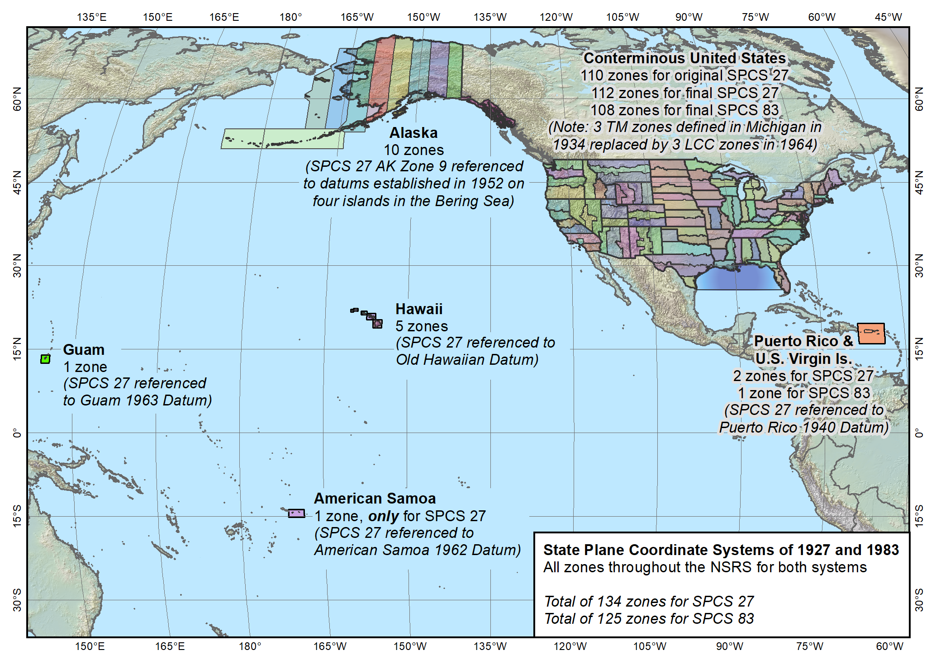
Entire SPCS
State Plane Coordinate Systems of 1927 (134 zones) and 1983 (125 zones)
Notes:
Map of the overall existing and previous versions of SPCS (1983 and 1927)
Shows the full large extent of the system.
Include CONUS, Alaska, and Hawaii
Also includes territories of Puerto Rico, U.S. Virgin Islands, American Samoa, and Guam (American Samoa included in SPCS 27 but not in 83)
Does NOT include Washington DC or islands of CNMI (but those will be included in SPCS2022)

Slide 22
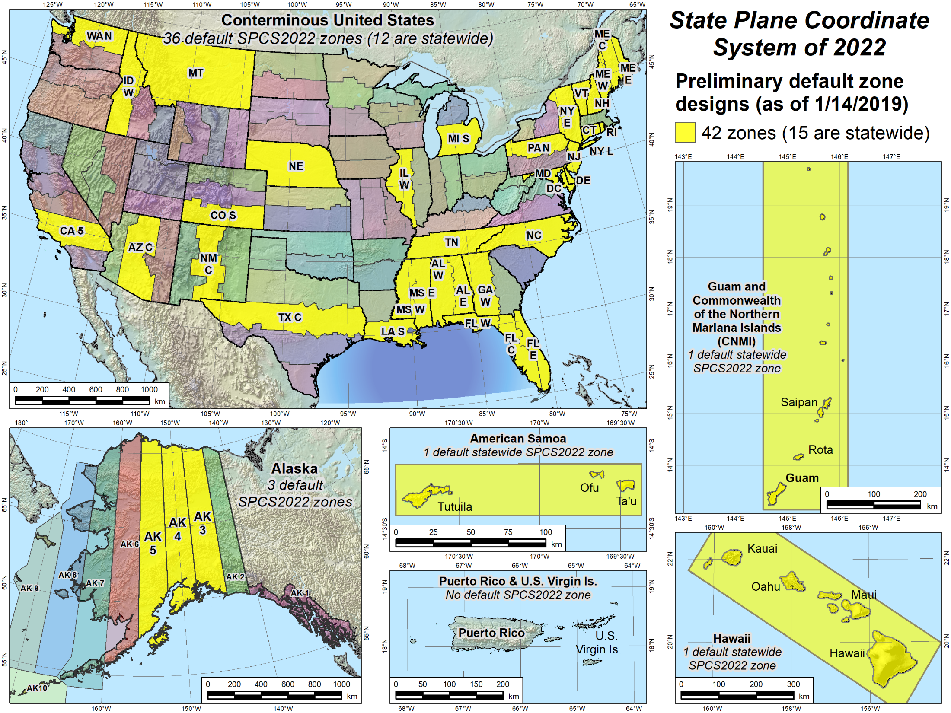
Default zones
Notes:
Larger scale maps of the areas included in the NSRS where SPCS2022 zones will be established
Yellow zones are preliminary designs of SPCS2022 default zones that have been completed.
Some of the default zones are statewide (or territory-wide, as the case may be)
Maps for (most of) these designs are currently available for download, along with maps of the corresponding SPCS 83 zones for comparison (will show examples).

Slide 23
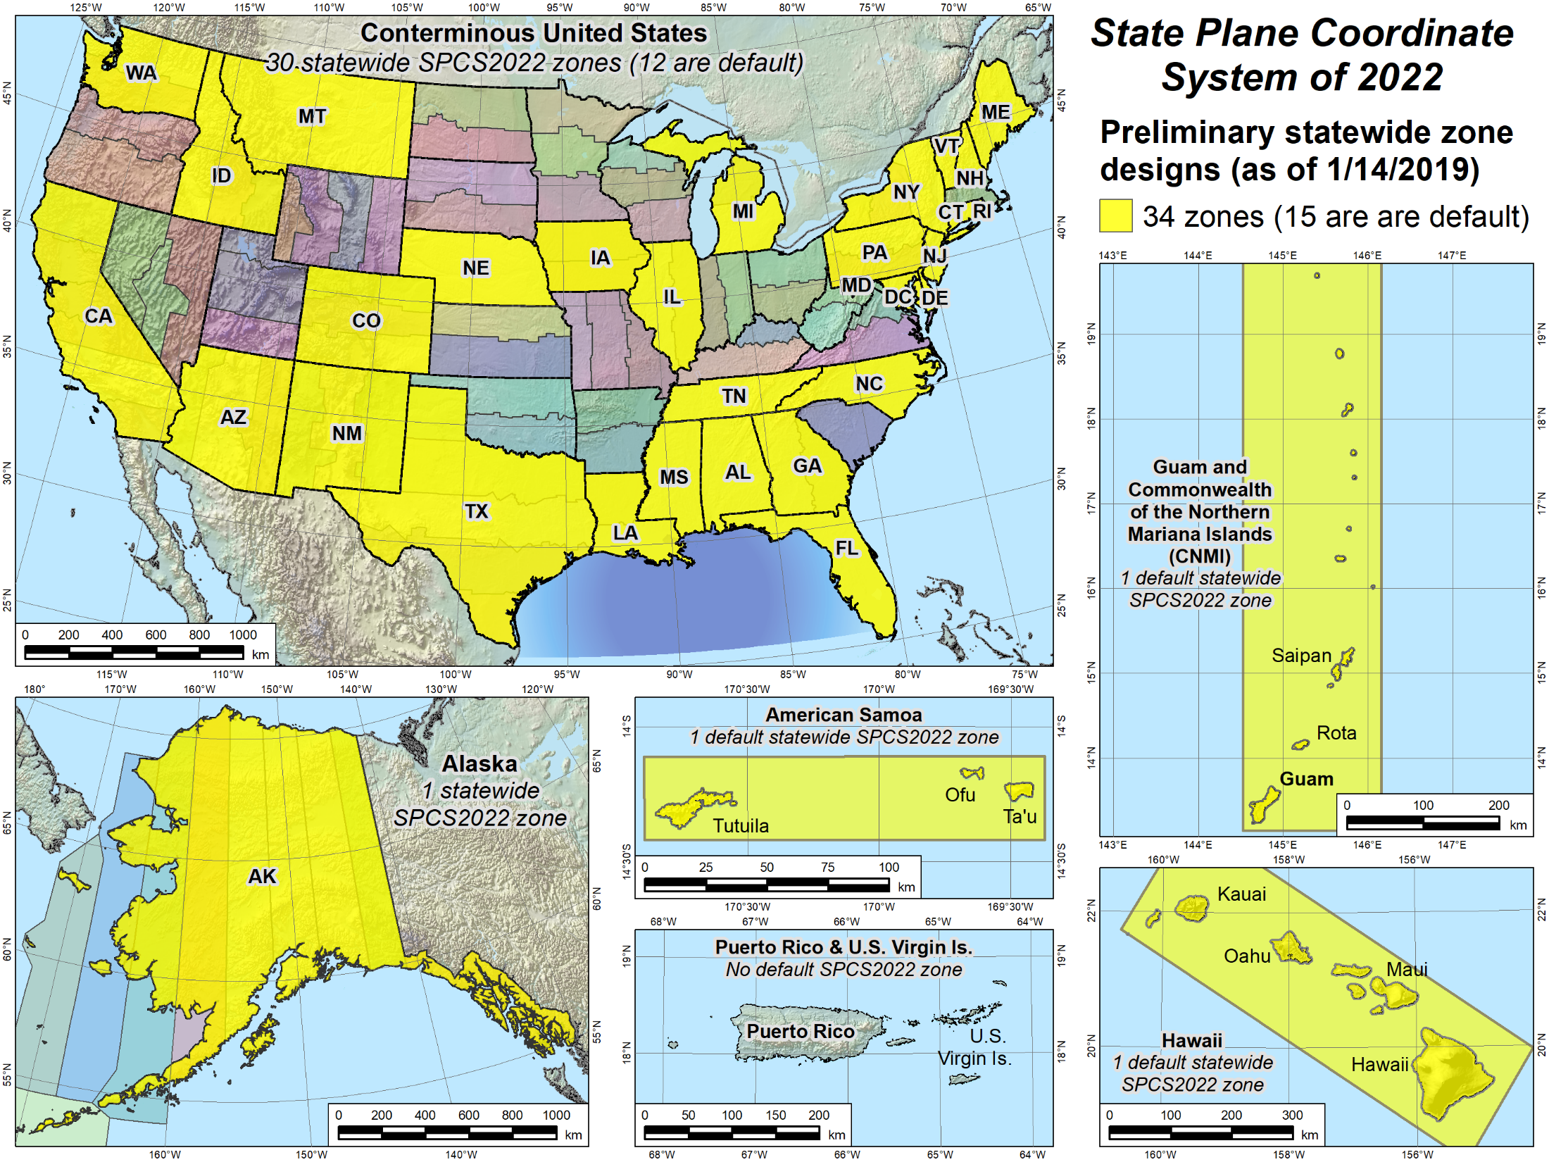
Statewide zones
Notes:
Similar to previous slide, but showing statewide SPCS2022 zones that have preliminary designs and maps available for download.
Note that some of the statewide zones are the same as the default zones in the previous slide
Note also that some states have a preliminary statewide zone design but no default zone design (e.g., Iowa).
States with no default design are ones that will design their own LDP system that provides statewide coverage and will not use the NGS default designs (that correspond to the existing SPCS 83 zones)
Reminder: All sates will get a statewide zone

Slide 24
SPCS2022 zone designs by NGS
Linear distortion design criterion
  Parts per million (ppm), e.g., ±20 , ±50 , ±100 ppm, etc.
Criterion must satisfy all of following:
  90% of population
  75% of all cities and towns (by location only)
  50% of entire zone area
Limitations for designs by NGS
  Minimum design criterion ±50 ppm (1:20,000)
  May be less for default zones if existing zone small
Low distortion projections (LDPs)
  Must be designed by others for distortion < ±50 ppm
Notes:
This is a quick description of the design method used by NGS for SPCS2022 zones
Designs are based on a “linear distortion design criterion”
Criterion can initially be estimated by width of zone perpendicular to the projection axis (central meridian for TM, central parallel for LCC, and skew axis for OM).
The value in parts per million (ppm) for the criterion are ranges of ±5, ±10, ±20, ±30, ±40, ±50, ±75, ±100, ±150, ±200, ±300, or ±400 ppm.
Standard values are used to facilitate design comparison and evaluation
Gives indication of performance at topographic surface, where it is actually used
Design criterion is the smallest standard range (listed above) that satisfies all three of the following minimum percentages:
90% of population (based on actual population distribution)
75% of cities and towns, based only on location, irrespective of population. Done to prevent excessive dominance of very large cities at expense of small communities. Concept here is similar to Congress being represented by the same number of senators for every state, in contrast to population-based matric being analogous to House of Representatives.
50% of entire zone area. This value is set to accommodate mountainous zones; zones with minor topographic relief will usually get much here percent coverage by area.
Zones design by NGS will use a minimum criterion of ±50 ppm (which is half the nominal ±100 ppm used for SPCS 83 and 27, with respect to the ellipsoid).
However, there are many states and existing zones within states that are small enough that a lower criterion will be used by NGS for default designs.
For new zones requested by stakeholders in multi-zone states, NGS will typically not design for less than ±50 ppm.
Low distortion projections (LDPs) must be designed by stakeholder “contributing partners” if the criterion is less than ±50 ppm.

Slide 25
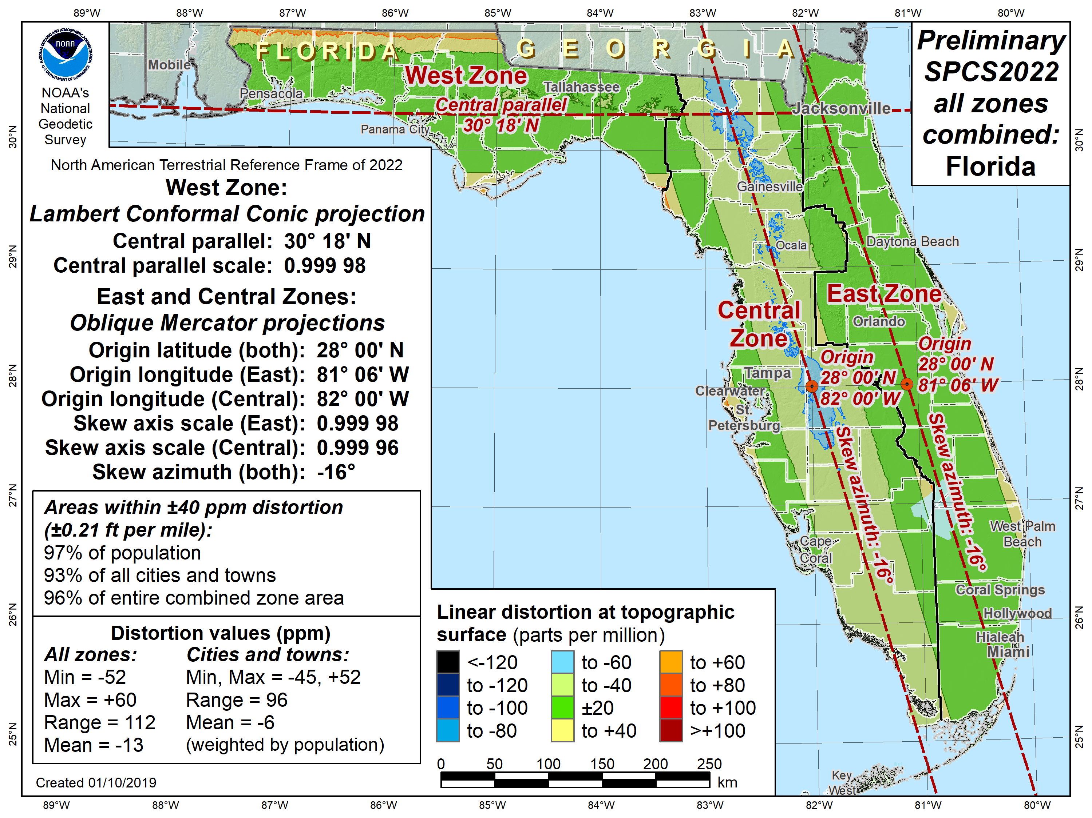
Florida SPCS2022 (preliminary)
±40 ppm distortion design criterion:
97% of population
93% of cities
96% of area
Notes:
Example of 3 preliminary default SPCS2022 zones designed by NGS for Florida
Replaces the existing 3 SPCS 83 zones (shown on the next slide)
Note that following characteristics:
Uses 2 OM projections to replace existing 2 TM projections for the peninsula
Uses 1-parallel LCC to replace existing 2-parallel LCC for panhandle
Uses ±40 ppm design criterion (less than minimum of ±50 ppm) because existing areas are too narrow for a ±50 ppm criterion

Slide 26
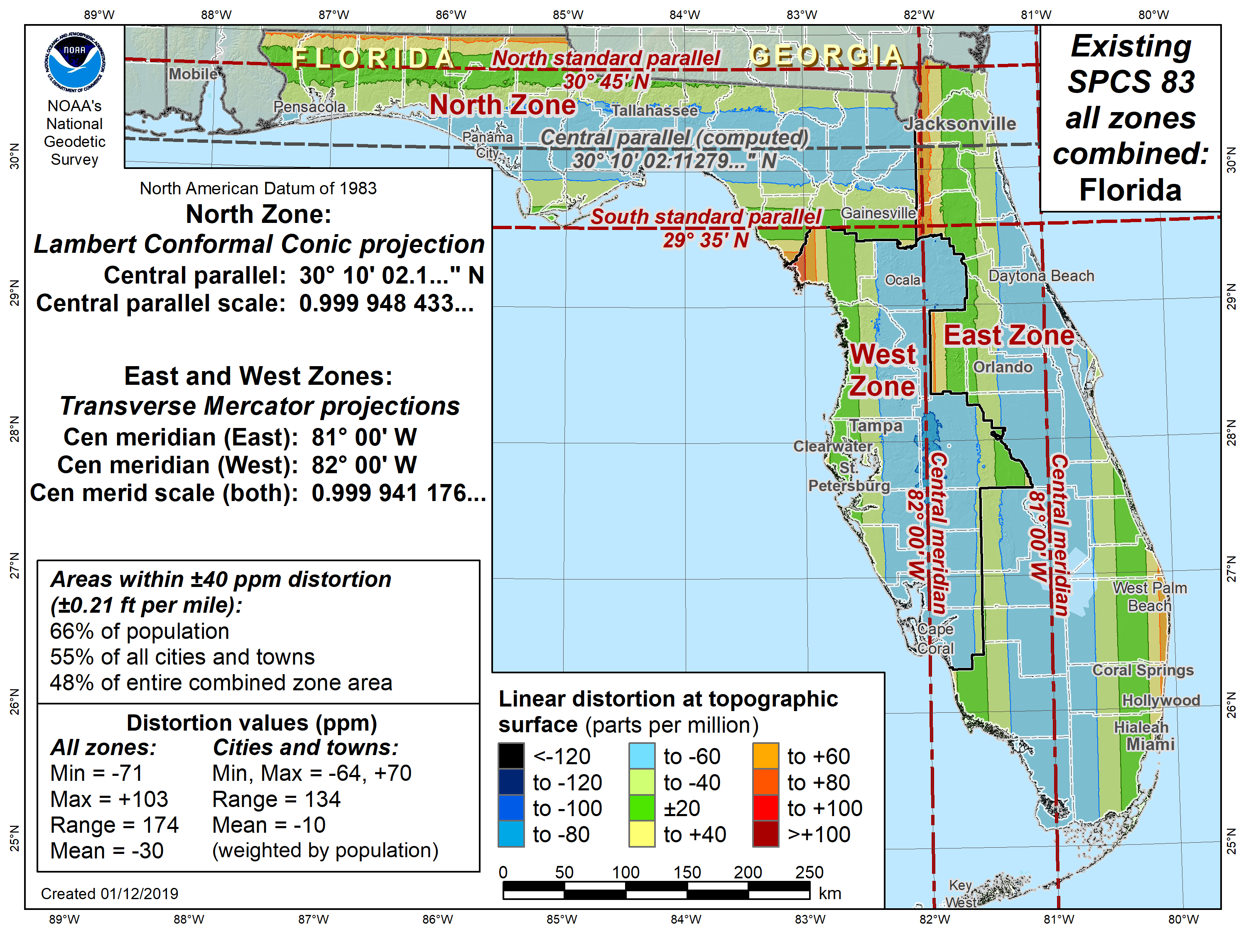
Florida SPCS 83
±40 ppm distortion design criterion:
66% of population
55% of cities
48% of area
Notes:
Distortion map of existing 3 Florida SPCS 83 zones, for comparison with preliminary default SPCS2022 designs
Distortion significantly greater than SPCS2022 design
Performance percentages do not meet design requirements, because this is an “as is” map (not a design), and it uses the same criterion as the design for comparison.

Slide 27
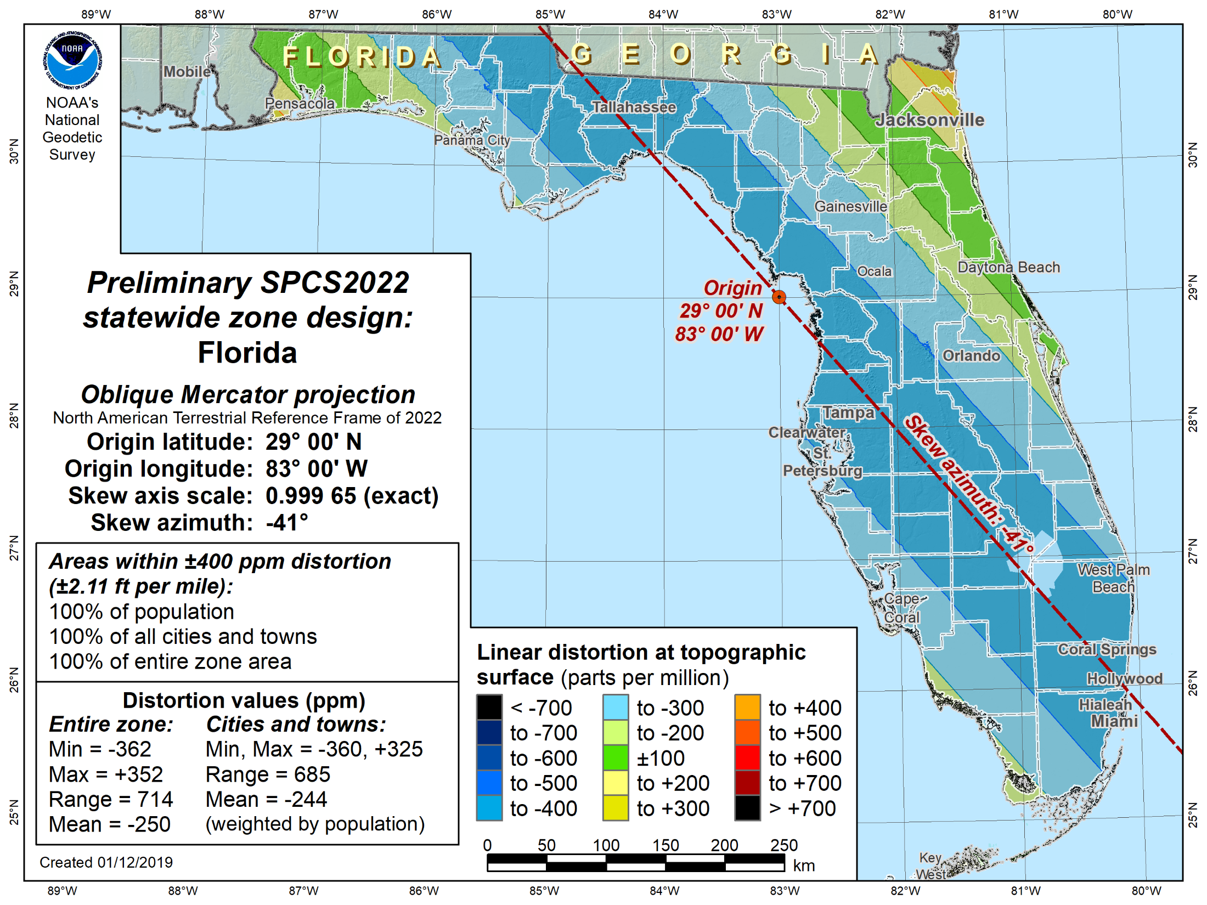
Florida statewide
±400 ppm distortion design criterion:
100% of population
100% of cities
100% of area
Notes:
Preliminary statewide design for Florida, also using an OM projection
Design criterion of ±400 ppm has all percentages of 100%
Next lower criterion of ±300 ppm did not meet all three (90%, 75%, 50%) minimum requirements, so ±400 ppm is smallest available criterion value
±400 ppm corresponds to the distortion limits of a UTM zone (with respect to the ellipsoid)

Slide 28
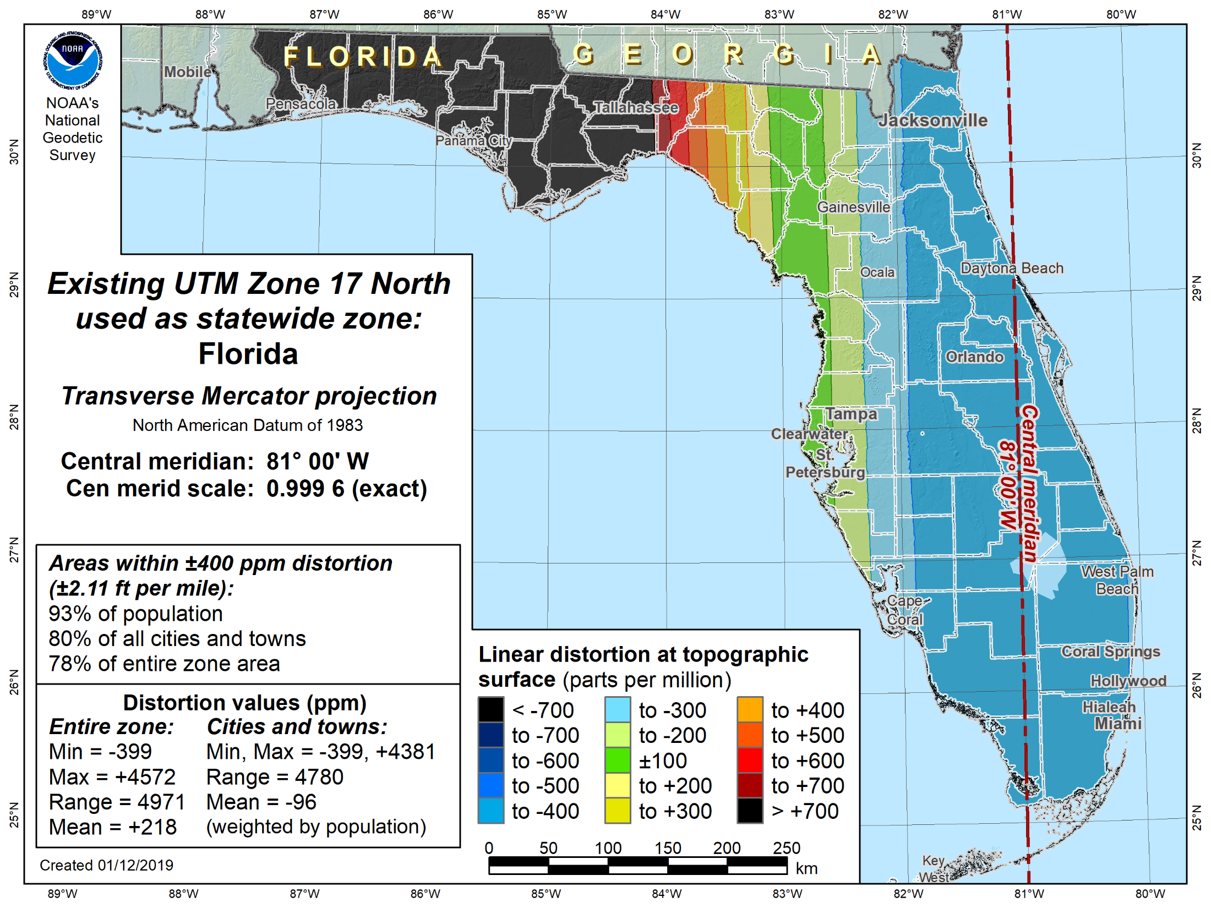
Florida statewide using UTM
±400 ppm distortion design criterion:
93% of population
80% of cities
78% of area
Notes:
Map showing distortion of the nearest UTM zone used as a statewide zone for Florida (this is used by some Florida agencies)
Performance is significantly inferior to preliminary SPCS2022 zone design (greater distortion, highly imbalanced)
UTM does not work well for Florida as a statewide system because:
Central meridian of nearest zone is biased east (at 81°W longitude)
Even for a centered TM zone, Florida is too wide east-west (~7.5°), which is wider than 6° zone width of UTM
UTM generally does NOT work well for statewide zones because:
UTM central meridian usually is not close to the east-west midpoint of a state
Many states are too wide east-west even if the central
UTM is designed to minimize distortion at ellipsoid surface, not topographic surface

Slide 29
State Plane Zone “Layers”
Allow maximum of THREE layers
  One must be statewide layer (designed by NGS)
0, 1, or 2 multiple-zone layers can exist
However:
  Only ONE layer can have complete state coverage
  Only ONE layer can have partial state coverage
Result: ONE multi-zone layer in most states
  Partial coverage layer intended for mountainous states

Slide 30
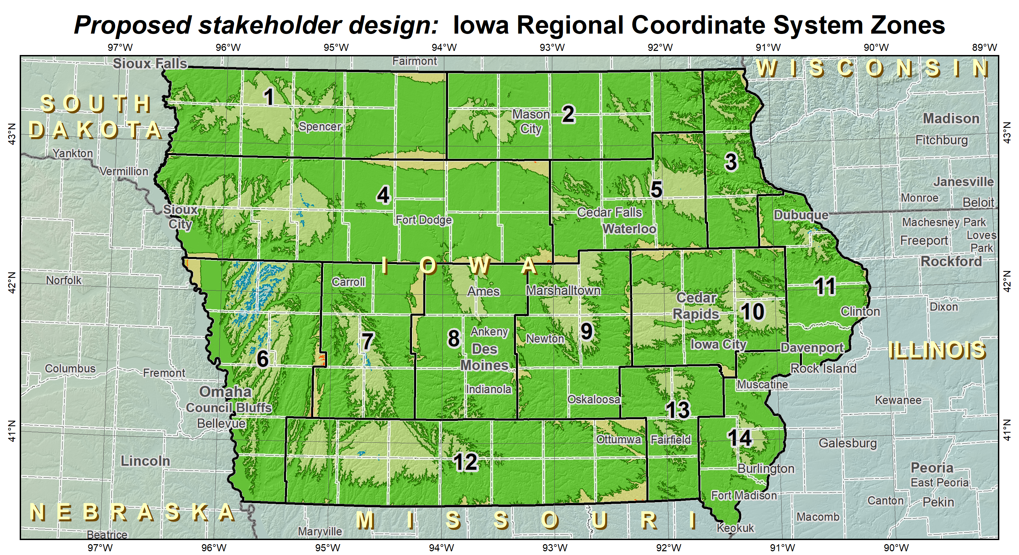
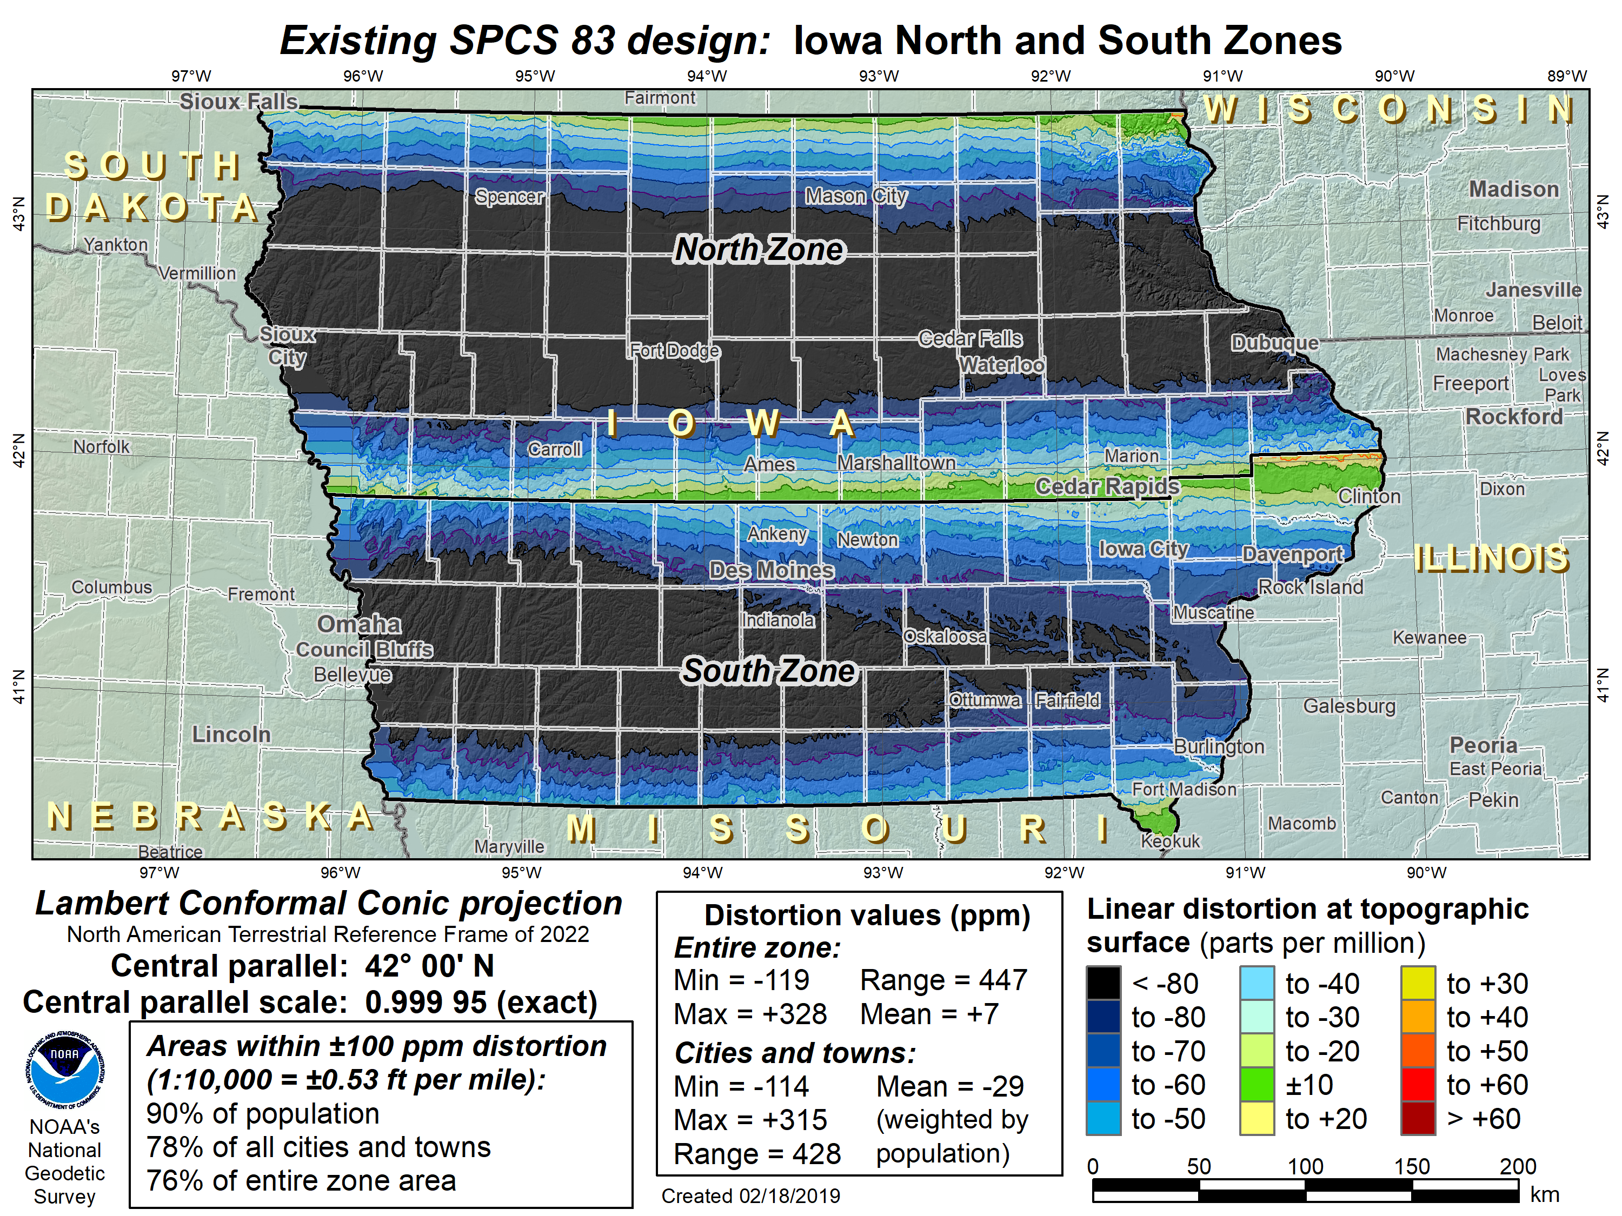
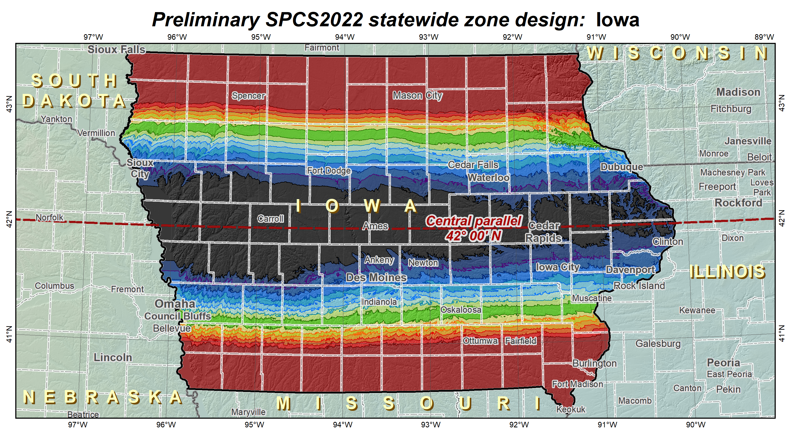
Iowa SPCS2022 layers
Only ONE multi-zone layer with complete state coverage
LDP multiple-zone layer
(COMPLETE state coverage)
OR
SPCS 83-like multiple-zone layer
(COMPLETE state coverage)
Statewide layer for EVERY state

Slide 31
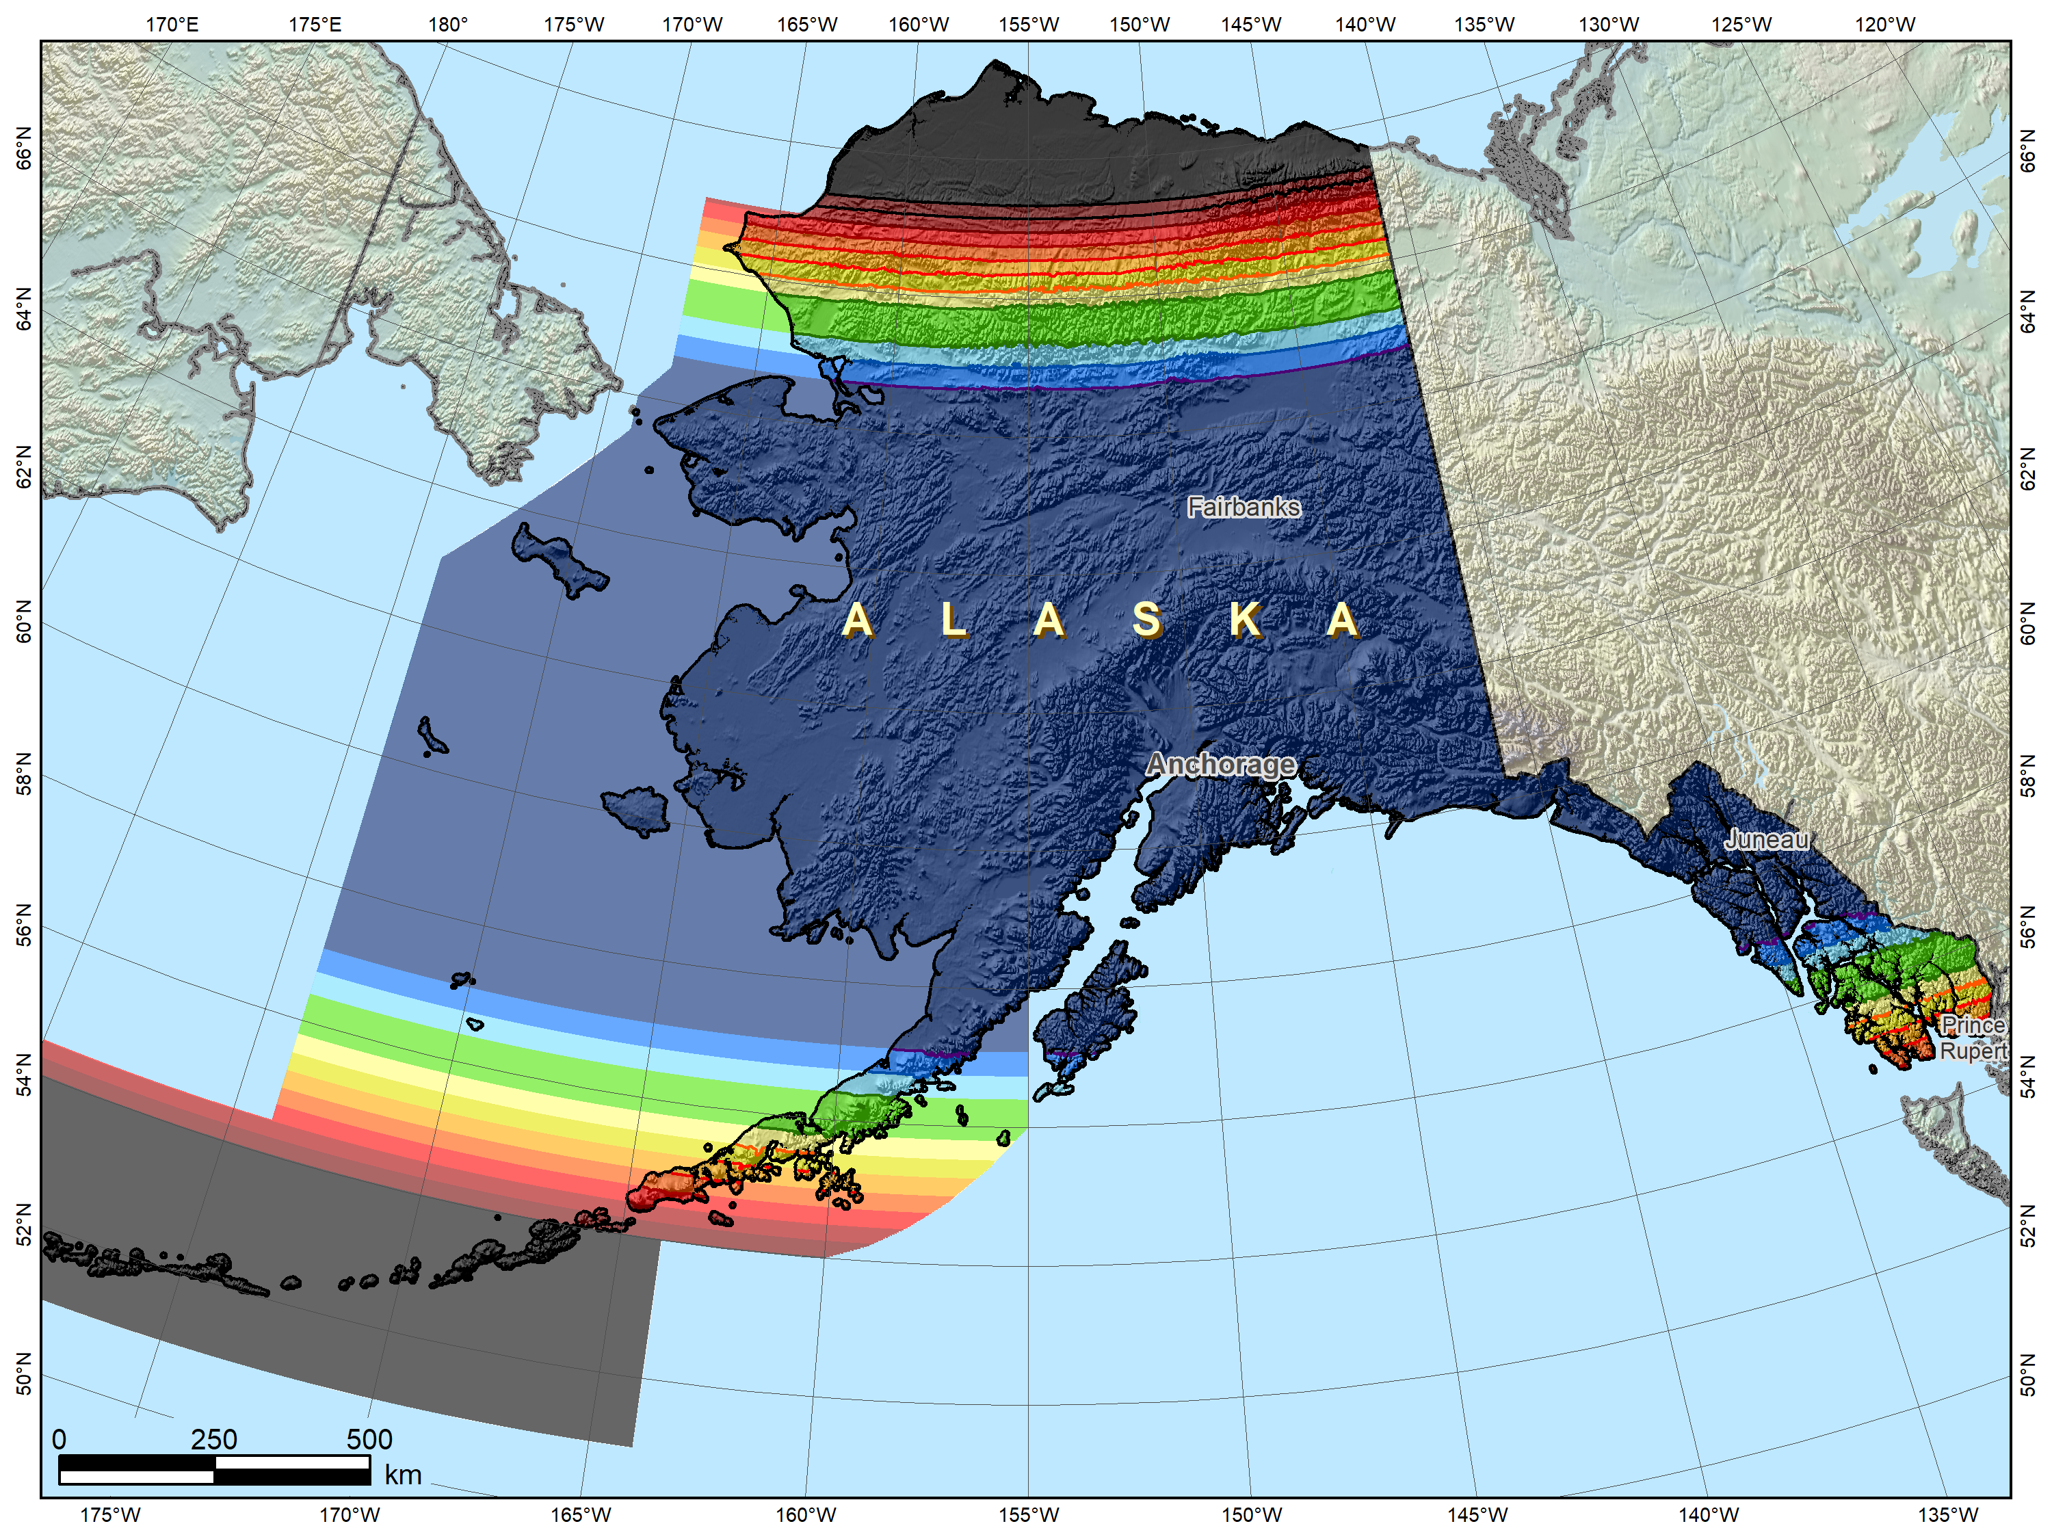
Possible Alaska zone layer configuration
Alaska statewide
layer

Slide 32
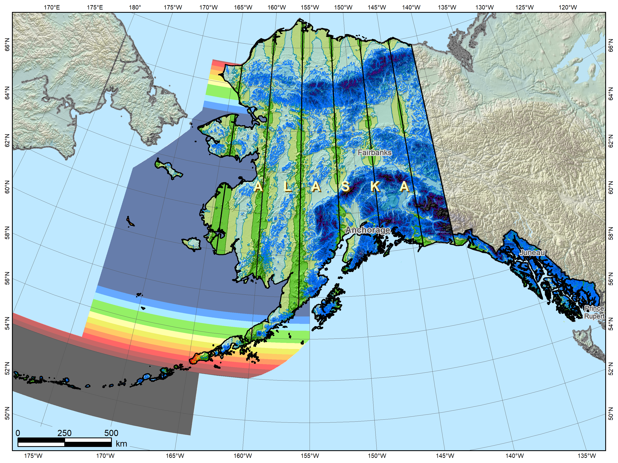
Alaska complete “intermediate” layer
Possible Alaska zone layer configuration
Alaska statewide
layer
+
Multi-zone layer with complete coverage

Slide 33
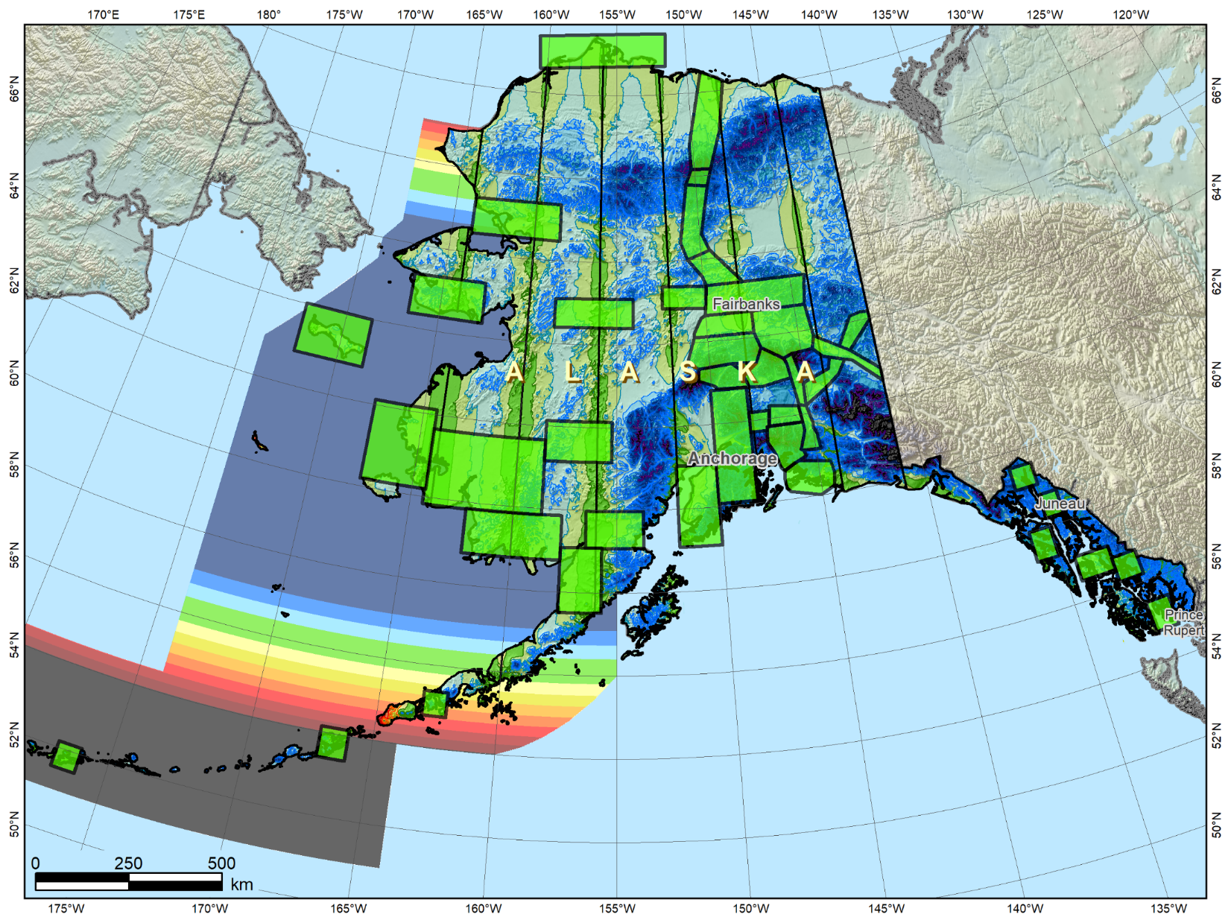
Alaska with THREE SPCS2022 layers
Possible Alaska zone layer configuration
Alaska statewide
layer
+
Multi-zone layer with complete coverage
+
LDP
multi-zone layer with partial coverage
Multi-zone layers:
ONE with complete coverage ONE with partial coverage

Slide 34
Low distortion projections (LDPs)
Multi-zone layer can consist of LDPs
  Designed by stakeholders
  Coverage can be complete or partial (discontinuous)
Minimum zone width
  50 km (31 miles) if height range <= 250 m
  10 km (6 miles) if height range > 250 m
What is zone “width” anyway?
  Width of rectangle that completely encloses zone
  “Minimum bounding rectangle by width”
  Rectangle in same projection as zone, any orientation
Notes:
Layered zones are allowed for SPCS2022 (for a max of 3 layers)
One state in SPCS 83 has 2 layers, Kentucky (statewide plus a pre-existing 2-zone layer)
States can have 1, 2, or 3 layers
One layer MUST be a statewide zone (so a state with 1 layer has only a statewide zone)
The other 1 or 2 layers will almost always have multiple zones (unless a state has, say, a single LDP in SPCS2022 that covers only part of the state)
Only 1 layer can be “discontinuous”, that is, consist of layers that do not collectively cover the entire state (will show an example of this)
Decision to go with 3 layers based on FRN responses, especially those from mountainous western states
The multi-zone layer(s) can consist of LDPs
Almost always means distortion criterion < ±50 ppm, so must be designed by others (i.e., “contributing partners”), not by NGS

Slide 35
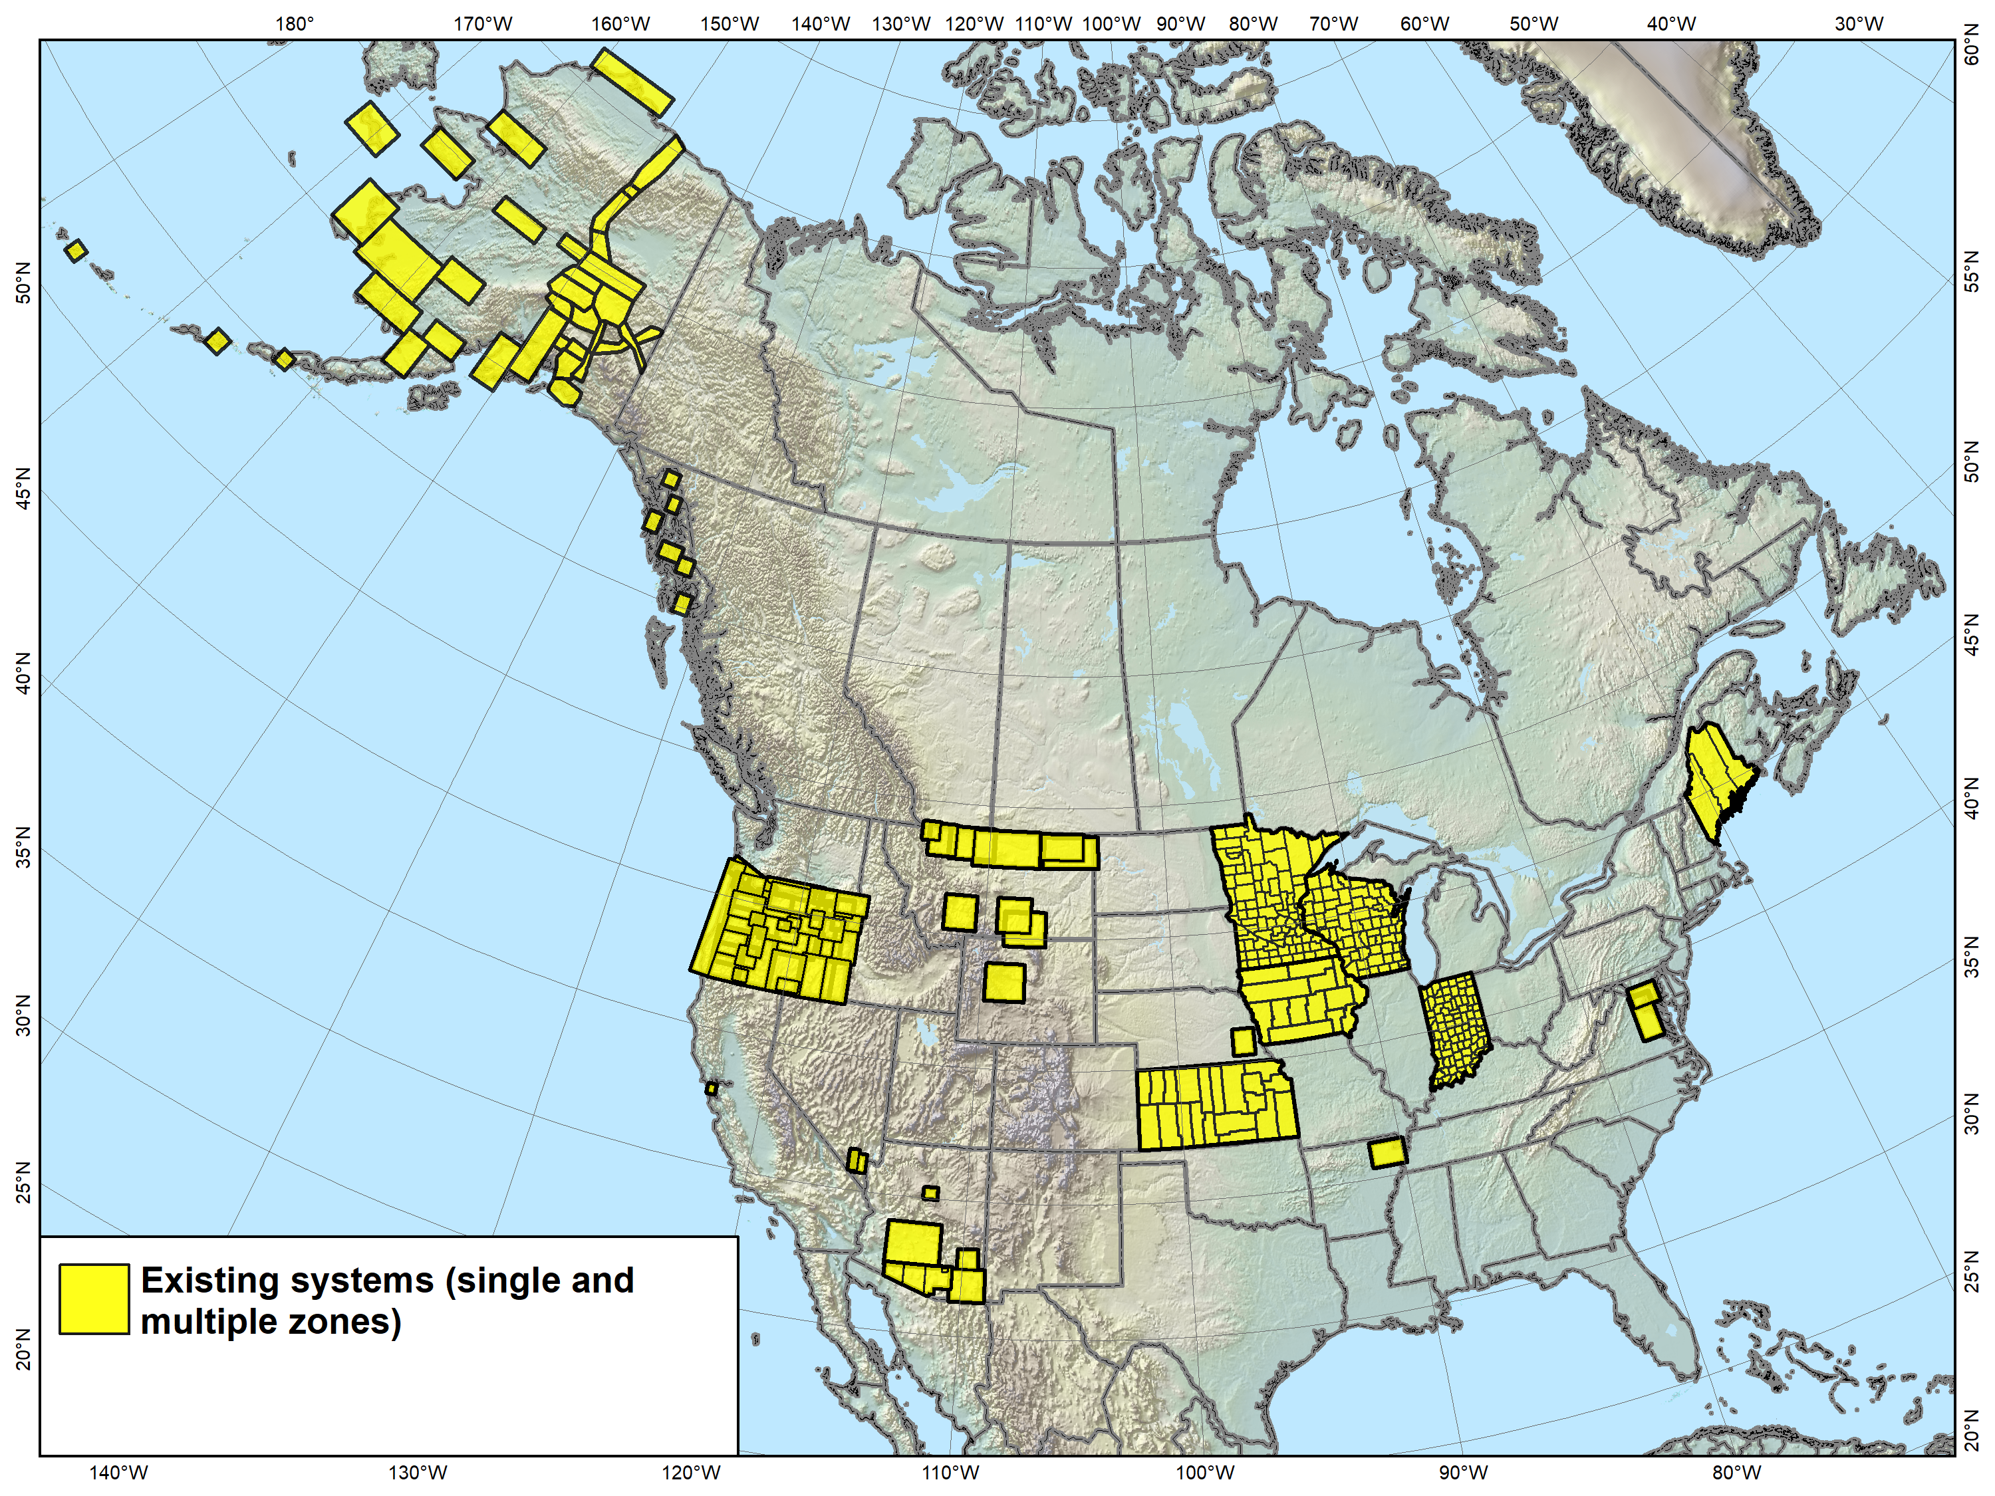
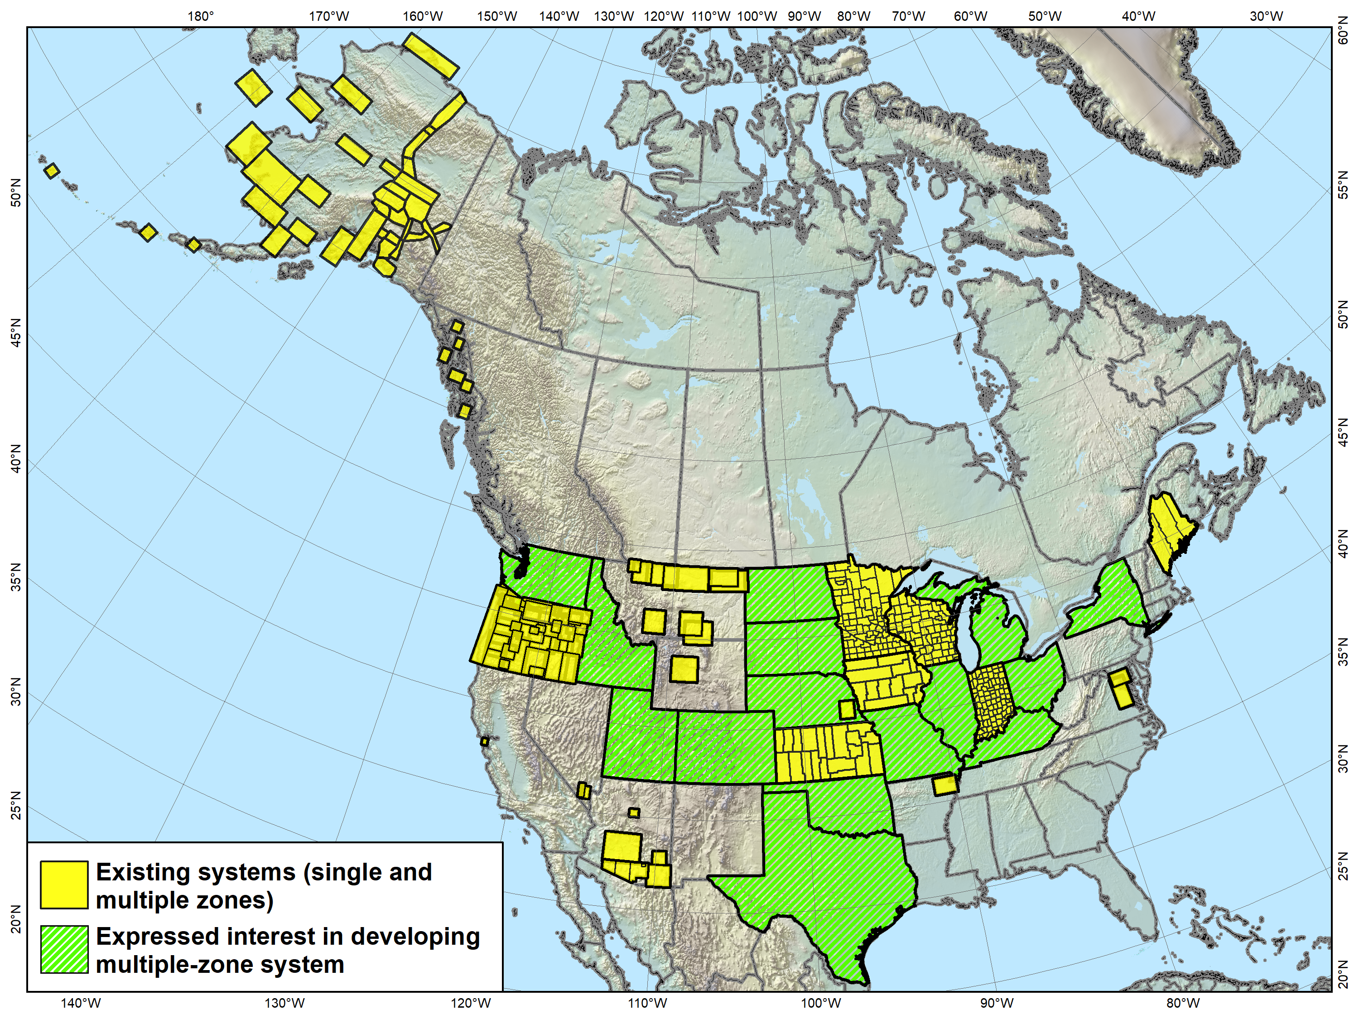
Low Distortion Projections
Versions of most of the LDP systems shown (as well as others) will likely become part of SPCS2022, both with complete and partial state coverage.
Notes:
Map showing LDP systems adopted by government agencies and currently in use throughout the U.S. (there are likely quite a few others).
Note that discontinuous systems like that in Montana exist in other states, most notably Alaska
States with compete LDP zone coverage also exist, and it is expected that all shown will propose an LDP SPCS2022 layer, with no default layer corresponding to their existing SPCS 83 zones (i.e., they will have only 2 layers, statewide and LDP)
One zone shown is for the Navajo Nation
Too large (with too much distortion) to realistically be considered an LDP zone
Falls in 3 states (Arizona, New Mexico, and Utah)
Because it is in more than 1 state, it is a candidate for a “special purpose” zone, which is the topic of the next slide…

Slide 36
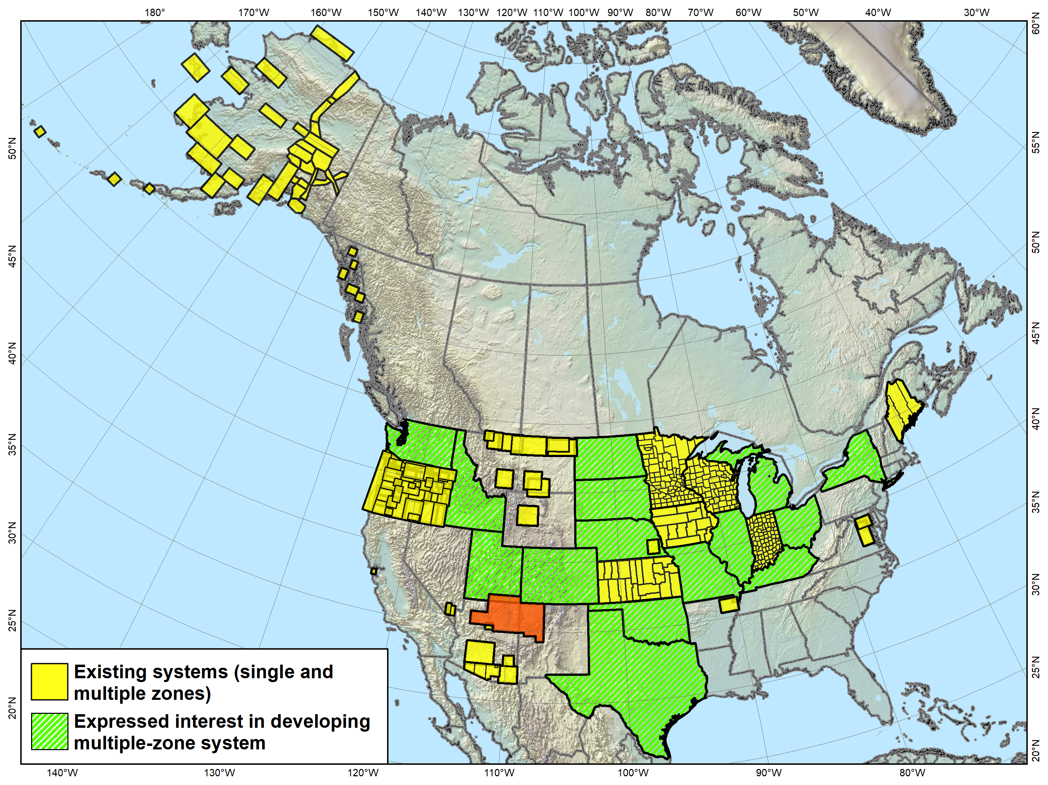
Navajo Nation Coordinate System not actually an LDP, and it falls in 3 states. It is something “special”…
Notes:
Map showing LDP systems adopted by government agencies and currently in use throughout the U.S. (there are likely quite a few others).
Note that discontinuous systems like that in Montana exist in other states, most notably Alaska
States with compete LDP zone coverage also exist, and it is expected that all shown will propose an LDP SPCS2022 layer, with no default layer corresponding to their existing SPCS 83 zones (i.e., they will have only 2 layers, statewide and LDP)
One zone shown is for the Navajo Nation
Too large (with too much distortion) to realistically be considered an LDP zone
Falls in 3 states (Arizona, New Mexico, and Utah)
Because it is in more than 1 state, it is a candidate for a “special purpose” zone, which is the topic of the next slide…

Slide 37
“Special use” SPCS2022 zones
Zones for regions in more than one state
Categories:
  Major urban areas
  (e.g., New York, Chicago, St. Louis)
  Large American Indian reservations
  (e.g., Navajo Nation)
  Large federal jurisdictions or applications
  (e.g., Yellowstone National Park, shoreline mapping of Atlantic Coast)
Requires NGS Director approval
(case-by-case basis)
Notes:
Special use zones were not included in the draft SPCS2022 policy & procedures, but were asked about in the FRN
Most FRN responses indicated this zone type was desirable. Some had no preference, but none were opposed
Specification restricted to areas in more than 1 state (since 3 zone layers allowed in new policy & procedures)
Allowed for large urban areas in more than one zone under initial (1977) SPCS 83 policy (but never used)
Requires approval of NGS Director on case-by-case basis
Mainly because if more than 1 state, difficult to deal with under state stakeholder structure of all other SPCS2022 zones

Slide 38
SPCS2022 deadlines
Consensus input per SPCS2022 procedures
  Requests for designs done by NGS
  Proposals for designs by contributing partners
Submittal of approved designs
  Proposal must first be approved by NGS
  Designs must be complete for NGS to review
Form for making requests and proposals
Form for submitting stakeholder designs
NGS.SPCS@noaa.gov
by March 31, 2020 for requests and proposals
by March 31, 2021 for submittal of approved designs
Later requests will be for changes to SPCS2022
Notes:
Deadlines for requests, proposals, and submittal of approved designs
Designs by “contributing partners” must first be approved as proposals by NGS
Contributing partners can be the stakeholders, or an individuals or organizations designing the zones for the stakeholders
It is expected that most (all?) proposed designs will be for LDP systems (with design criterion < ±50 ppm), since NGS will not design those
Any requests, proposals, or submittals that are not received by the deadlines will not be included in the initial release of SPCS2022 (in 2022)
However, these could still become part of SPCS2022 at a later time
Policy & procedures provide mechanism for changing SPCS2022, so there will still be an opportunity to change/add SPCS2022 layers even after 2022

Slide 39
Fillable PDF stakeholder forms
SPCS2022 Zone Request and Proposal Form
  To request zones designed by NGS
  To propose zones that stakeholders will design
SPCS2022 Zone Design Submittal Form
  For stakeholders to submit designs
  Based in NGS-approved previously submitted proposal
For default designs, no request form needed
  But submitting a request will expedite final design

Slide 40

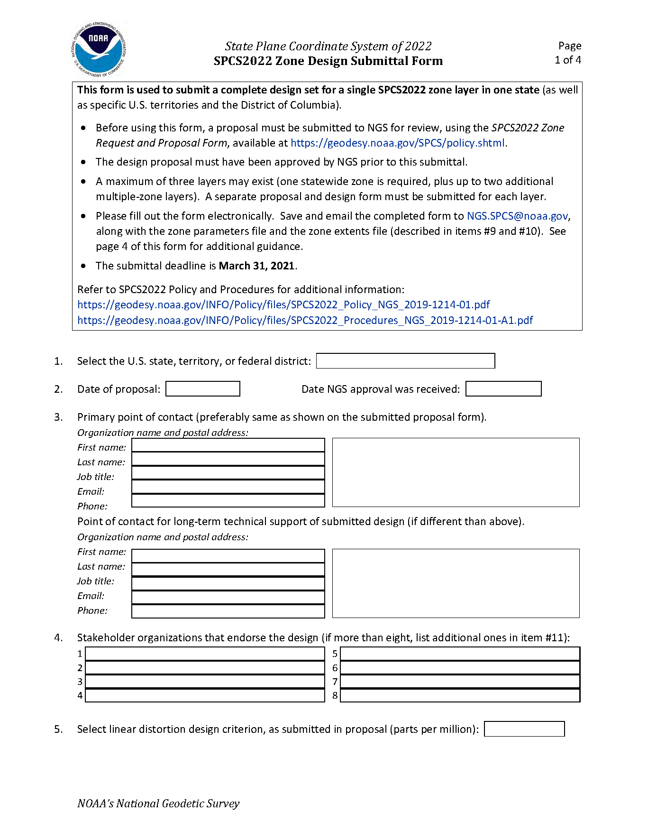
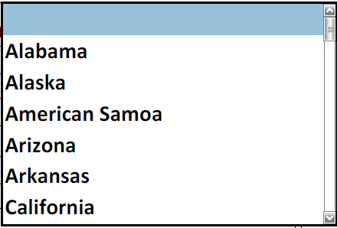
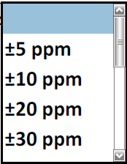
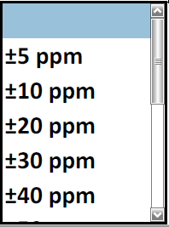
Request/Proposal Form
Design Submittal Form

Slide 41
Positive east longitudes (0° to 360°)
Historically used west longitudes at NGS
  Both negative and positive west longitudes
  Sometimes ±180° at anti-prime meridian (Guam 145°E)
  Sometimes keep increasing west (Guam 215°W)
Advantages of positive east longitudes
  NSRS spans anti-prime but NOT prime meridian
    From +140° → +300° (vs. +140° → −60°)
    No ±180° “switch” at anti-prime meridian
  GEOID2022 grid from +170° → +350° (vs. +10° → − 10°)
  Longitude increases east (just like SPCS eastings)
It just makes sense
  Default positive east (but west longitude still supported)

Slide 42
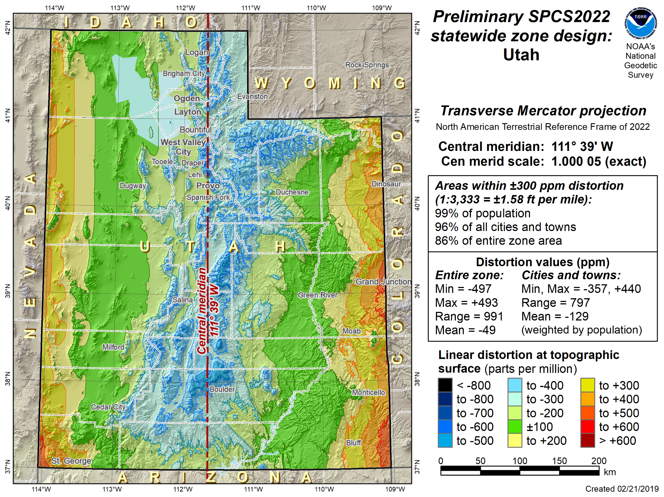
Positive East Longitudes
West Longitudes

Slide 43
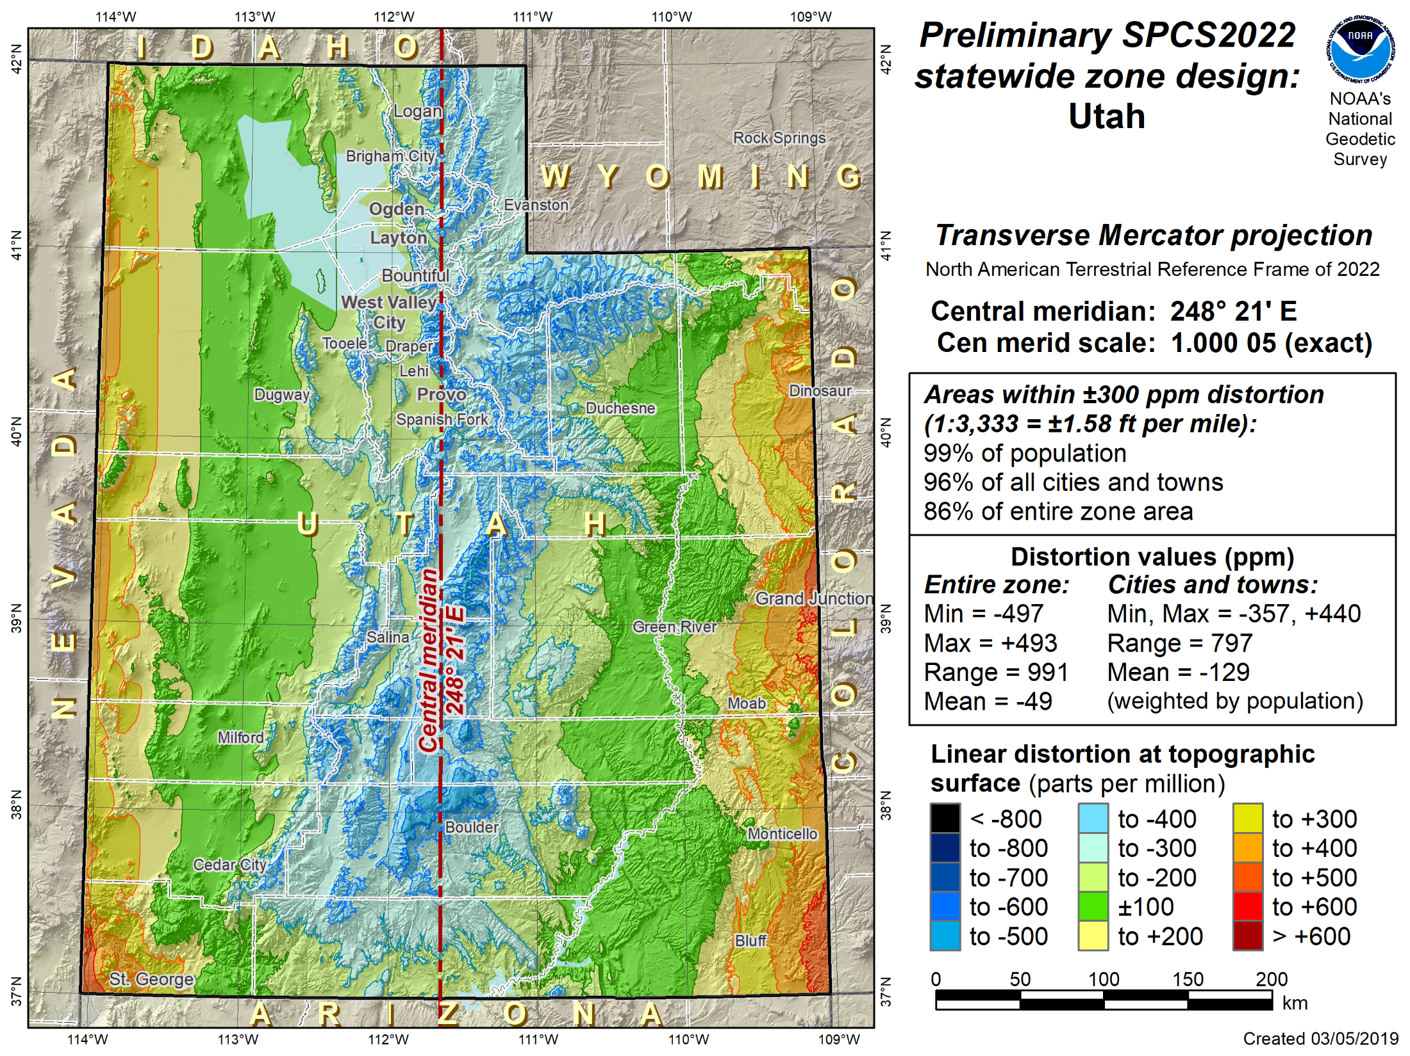
Positive East Longitudes
Positive East Longitudes

Slide 44
SPCS2022 summary
State Plane Coordinate System of 2022 (SPCS2022)
  Part of 2022 new “datum” change to replace SPCS 83
  Same ellipsoid and projections (but differs in other ways)
SPCS2022 characteristics different from SPCS 83:
  Minimize distortion at topo surface, not ellipsoid
  NGS will design statewide and default zones
  Up to 3 zone “layers” allowed (including an LDP layer)
  Allow “special use” zones (in multiple states)
Consensus state stakeholder input required for SPCS2022 zone requests, proposals, and designs
More information at geodesy.noaa.gov/SPCS/
Notes:
SPCS2022 is referenced to 2022 TRFs and thus part of new “datums”, and will replace existing SPCS 83 (referenced to NAD 83)
Similar to SPCS 83 in some ways:
Designed by state, using same reference ellipsoid and same projection types
Differs from SPCS 83 in other ways:
Designs minimize distortion at topographic surface rather than ellipsoid surface (reduces distortion where system is actual used)
NGS will design default zones for every state, and default zones corresponding to existing SPCS 83 zones for states that do not request or propose something different
Can have up to 3 zone layers (where one layer must be a statewide zone). The other layers can be default zones and/or LDP zones (but not designed by NGS). Only one layer can be discontinuous (i.e., zones do not completely cover a state); it is expected that discontinuous layers will always be LDP zones.
“Special use” zones are for major urban areas, American Indian reservations, or federal jurisdictions/applications that fall in more than one state. These must eb approved by the NGS Director on a case-by-case basis.
The stakeholder role is vitally important for states that want something other than default zones. But all requests and proposals from stakeholders must be unanimous to become part of SPCS2022.

Slide 45
And now for something completely different…

Slide 46

A Tale of Two Feet
Two versions of same “foot” in current use
  “New” international foot
  “Old” U.S. survey foot
“New” shorter than “old”
  By 2 ppm (0.01 ft per mile)
  A real problem with real costs
Who is using U.S. survey feet?
  Surveyors exclusively, in most (not all) states
  But it impacts everyone
Notes:
It’s likely everyone watching this webinar knows about the problem: there are two nearly identical versions of the foot in current use in the U.S.;
They differ by 2 parts per million (ppm), or only 0.01 ft per mile, or slightly more than a tenth of an inch in a mile.
Despite (or actually because of) the very small difference, it has become a REAL problem with REAL costs.
What’s in a name? That which we call a “foot” by any other word would smell as… sweet? Maybe that’s not he best analogy for the foot…
“U.S. survey foot” sounds patriotic, is surveyor-centric…
“International foot” sounds like a New World Order, UN sanctioned sort of thing, with perhaps a whiff of socialism…
Is the name really part of the problem? I hope note, but emotion does play a role. We are not entirely rational creatures after all (myself included).
Surveyors are really the only users of the U.S. survey foot (sft). They are also among the very few who even know of its existence. In schools and colleges they only teach students about the official international foot (ift). However, because people use the products created by surveyors, they end up using the sft without even knowing it.
Want to have a conversation about this, get all of us on the same page. So I will present facts to facilitate informed discussion (sprinkled with some opinions…)

Slide 47
What is this all about? The Big Picture
Science + Industry = COMMERCE
  Standards essential
  Without them we are lost
A history of change
  Not for own sake, but to make things better
  Vital component of progress
standards for weights & measures
  Taken for granted because things just “work”
  Many years of effort behind what we have today
  Legally binding and critical to functioning of society
Notes:
Let’s step away from surveying and consider the Big Picture.
This is about much more than surveying. When reading about the U.S. history of weights and measures, the words “science” and “industry” are often used together. And together they mean commerce. Business. Trade. Efficiency. Money. That’s really what this is about. All of those things are facilitated by uniform standards (and compromised without standards).
As stated earlier, change is an integral part of progress. We cannot stand still.
This is also about the law, because there is a powerful legal basis for weights and measures. We did not get here by accident.

Slide 48




Who is responsible for standards?
Today:
National Institute of Standards and Technology
Notes:
Today, the National Institute of Standards and Technology (NIST) is responsible for defining and establishing standards. It is within their authority.
NIST is a bureau of the Department of Commerce (DOC)
The National Oceanic and Atmospheric Administration (NOAA) is also a bureau of DOC.
The National Geodetic Survey (NGS) is a program office in NOAA. It’s actually within the National Ocean Service (NOS) in NOAA.
It may seem odd to show NGS here along with NIST, but there is a reason for it, as you will soon see.

Slide 49



Who is responsible for standards?
Before 1901:
U.S. Coast and Geodetic Survey
Office of Standard Weights and Measures
Superintendent of C&GS also Superintendent
of Office of Standard Weights & Measures
Notes:
Responsibility for standards was different before 1901.
In 1901, the National Bureau of Standards (NBS) was created, which later became in NIST (in 1988)
Department of Commerce was created in 1903, when NBS became part of it (initially in Department of the Treasury).
Before 1901, standards of weights and measures was handled by the U.S. Coast & Geodetic Survey (C&GS), the predecessor of NGS.
Operated under the authority of the Department of the Treasury, in the Office of Standard Weights and Measures.
Superintendent (same as “Director” today) of C&GS was also Superintendent of Weights and Measures – so that is the connection to NGS! But there is a later connection as well, which is also the reason we currently have two foot definitions.

Slide 50
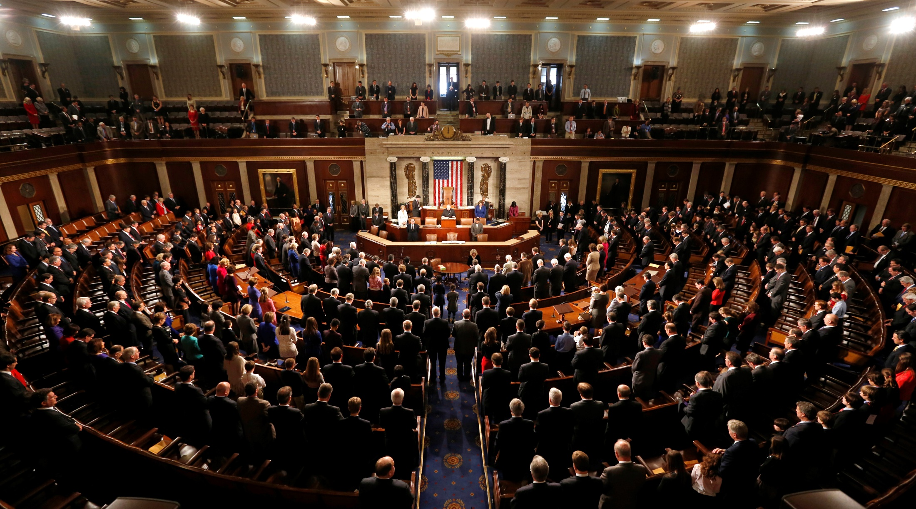
Congress is the Authority
Notes:
The ultimate authority on standards of weights and measures is the U.S. Congress.

Slide 51
Congress is the Authority
Per the U.S. Constitution
(Article I, Section 8, Clause 5)
“The Congress shall have
Power … To coin Money …
and fix the Standard
of Weights and Measures”
Notes:
The authority of Congress is given in the U.S. Constitution, Article I, Section 8, Clause 5.
Congress delegated its power to the Office of Weights and Measures in the Department of the Treasury.
NBS then got this authority as the successor to the Weights and Measures, and NBS became part of DOC.
Why was something like standards of weights and measures so important that it was specifically listed as a congressional power in the Constitution?
Because standards for weights and measures are tightly connected to commerce, including coining of money. We’re going to come back to this near the end of the presentation.
In short, it was to avoid the “toothbrush problem”…

Slide 52
Supreme law of the land
U.S. Constitution, Article I, Section 8, Clause 5
If NIST defines single foot, only it can be used
  State legislating different foot would be unconstitutional
  Same as state coining its own money
  Have two feet now only because 1959 issue not settled
Not a “states rights” issue
  10th Amendment (Bill of Rights): “The powers not delegated to the United States by the Constitution, nor prohibited by it to the States, are reserved to the States respectively, or to the people”
Why? To avoid the “toothbrush problem”
Notes:
Can a state simply choose whatever version of the foot they want? According the Supreme law of the land (the U.S. Constitution), it appears they cannot:
Article I, Section 8, Clause 5 exclusively gives Congress the power to “fix the standard of weights and measures.” Note that this is in the same sentence as the power to coin money
If NIST defines a single foot for the U.S., a state specifying a different foot may be wading into unconstitutional territory. It appears that doing so would be the same as a state coining its own money, and it seems highly unlikely that the federal government would sit idly by if that occurred. I suspect that the only reason it was ever possible for states to choose which foot they wanted is because the 1959 FRN issue was never settled. That is what we are trying to do now.
For those who view this as a “states rights” issue, please refer to the 10th Amendment (the last one in the Bill of Rights). It says that powers reserved to the state (or the people) are only those not delegated to Congress by the Constitution. Since fixing standards of weights and measures are delegated to Congress, they cannot also be reserved to the states.

Slide 53

The trouble with standards…
Without uniformity, standards are useless
Image from beyondplm.com
Notes:
It does not good to have a bunch of conflicting standards. That’s the same as having no standards at all.

Slide 54

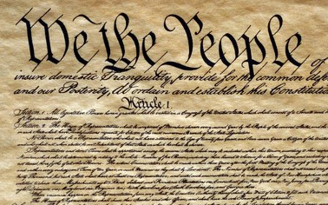



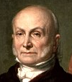
An epic tale and impressive cast
George Washington
Surveyors
Ferdinand Hassler
Thomas Jefferson
Thomas Mendenhall
John Quincy Adams
Notes:
The story of standards in the U.S. is an epic tale with an impressive cast of characters, some of who are very famous. Three are presidents:
George Washington, our first president, who was a surveyor
Thomas Jefferson, our third president, who was also a surveyor, and the founder of NGS (as the Survey of the Coast) in 1807.
John Quincy Adams, our sixth president. He was not a surveyor, but made a major contribution to standards. He was also the only president who had an alligator as a pet, in the White House (sadly, this fun “fact” is probably not true…)
Two other members of the cast are not as famous, at least outside NGS (both are also surveyors):
Ferdinand Hassler, first Superintendent of the C&GS, from 1807-1843 (although not continuously for that whole time, since all work was suspended when C&GS moved to Navy from 1818-1832).
Thomas Mendenhall, Superintendent of C&GS from 1889-1894. Not as well known as Hassler, but his importance in this story will soon become clear.
The last member of the cast is not really a “character”, but is a vital part of the story: the U.S. Constitution.

Slide 55

A long and complex history
U.S. Constitution becomes Supreme Law of the Land
1789
Washington addresses congress; Jefferson recommends decimal system
1790
1815
Hassler brings British Imperial yard to U.S.
1821
Adams report on weights & measures
New British Imperial yard delivered to U.S.
1855
1866
Congress legalizes metric system
1875
U.S. signs “Treaty of the Meter”
1890
Standard meter bars delivered to U.S.

Slide 56

Out of chaos, order
1893
The Mendenhall Order
Thomas Mendenhall
Superintendent C&GS and Office of Weights & Measures (1889-1894)
Embraced meter
Abandoned British Imperial Yard
Declared foot defined by meter:
1 foot = 1200/3937 meter
Provided tables of conversions
e.g., Gunter’s chain = 20.1168 m
66 ift EXACTLY
65.999868 sft
The U.S. officially became metric
Notes:
The Mendenhall Order (1893): When the U.S. officially became metric.
Officially adopted meter as basis of length, where 1 foot = 1200/3937 meter (per 1866 act of Congress), and with meter represented by Meter Bars No. 21 and 27.
Completely abandoned British Imperial Yard as basis for length (as represented by Bronze Bar No. 11).
Declared in Appendix 6 of C&GS Bulletin No. 26, including conversion tables.
Interesting to note that conversion showed 1 Gunter’s chain = 20.1168 m
That is EXACTLY 66 ift (vs. 65.999868 sft)
This is just a coincidence due to rounding, but it shows that for the precision of the chain, the distinction between the ift and sft is immaterial…

Slide 57
Out of order, chaos
1959
“Any data expressed in feet derived from and published as a result of geodetic surveys within the United States will continue to bear the following relationship as defined in 1893:
1 foot = 1200/3937 meter
The foot unit defined by this equation shall be referred to as the U.S. Survey Foot and it shall continue to be used, for the purpose given herein, until such a time as it becomes desirable and expedient to readjust the basic geodetic survey networks in the United States, after which the ratio of a yard, equal to 0.9144 meter, shall apply.”
https://geodesy.noaa.gov/PUBS_LIB/FedRegister/FRdoc59-5442.pdf
Signed by NBS and C&GS directors, approved by Secretary of Commerce, June 25, 1959
Notes:
Federal Register Notice (1959) establishing ift and (temporary) sft
Official adoption of ift (1 ft = 0.3048 m) nationwide.
Temporary exception granted for geodetic surveys (including State Plane coordinates), to accommodate C&GS.
Mandates that ift shall be adopted after readjustment of U.S. geodetic network. This is not a “recommendation” or a “suggestion.” At the time this was published, “shall” was used in legal documents as mandatory (nowadays the usage of “shall” as mandatory is discouraged in legal documents).
Co-issued and signed by NBS and C&GS directors.
This FRN delayed full adoption of the ift, and promoted continued use of the sft for all surveying (not just geodetic surveys), and it is how we got into the situation we are in today.

Slide 58
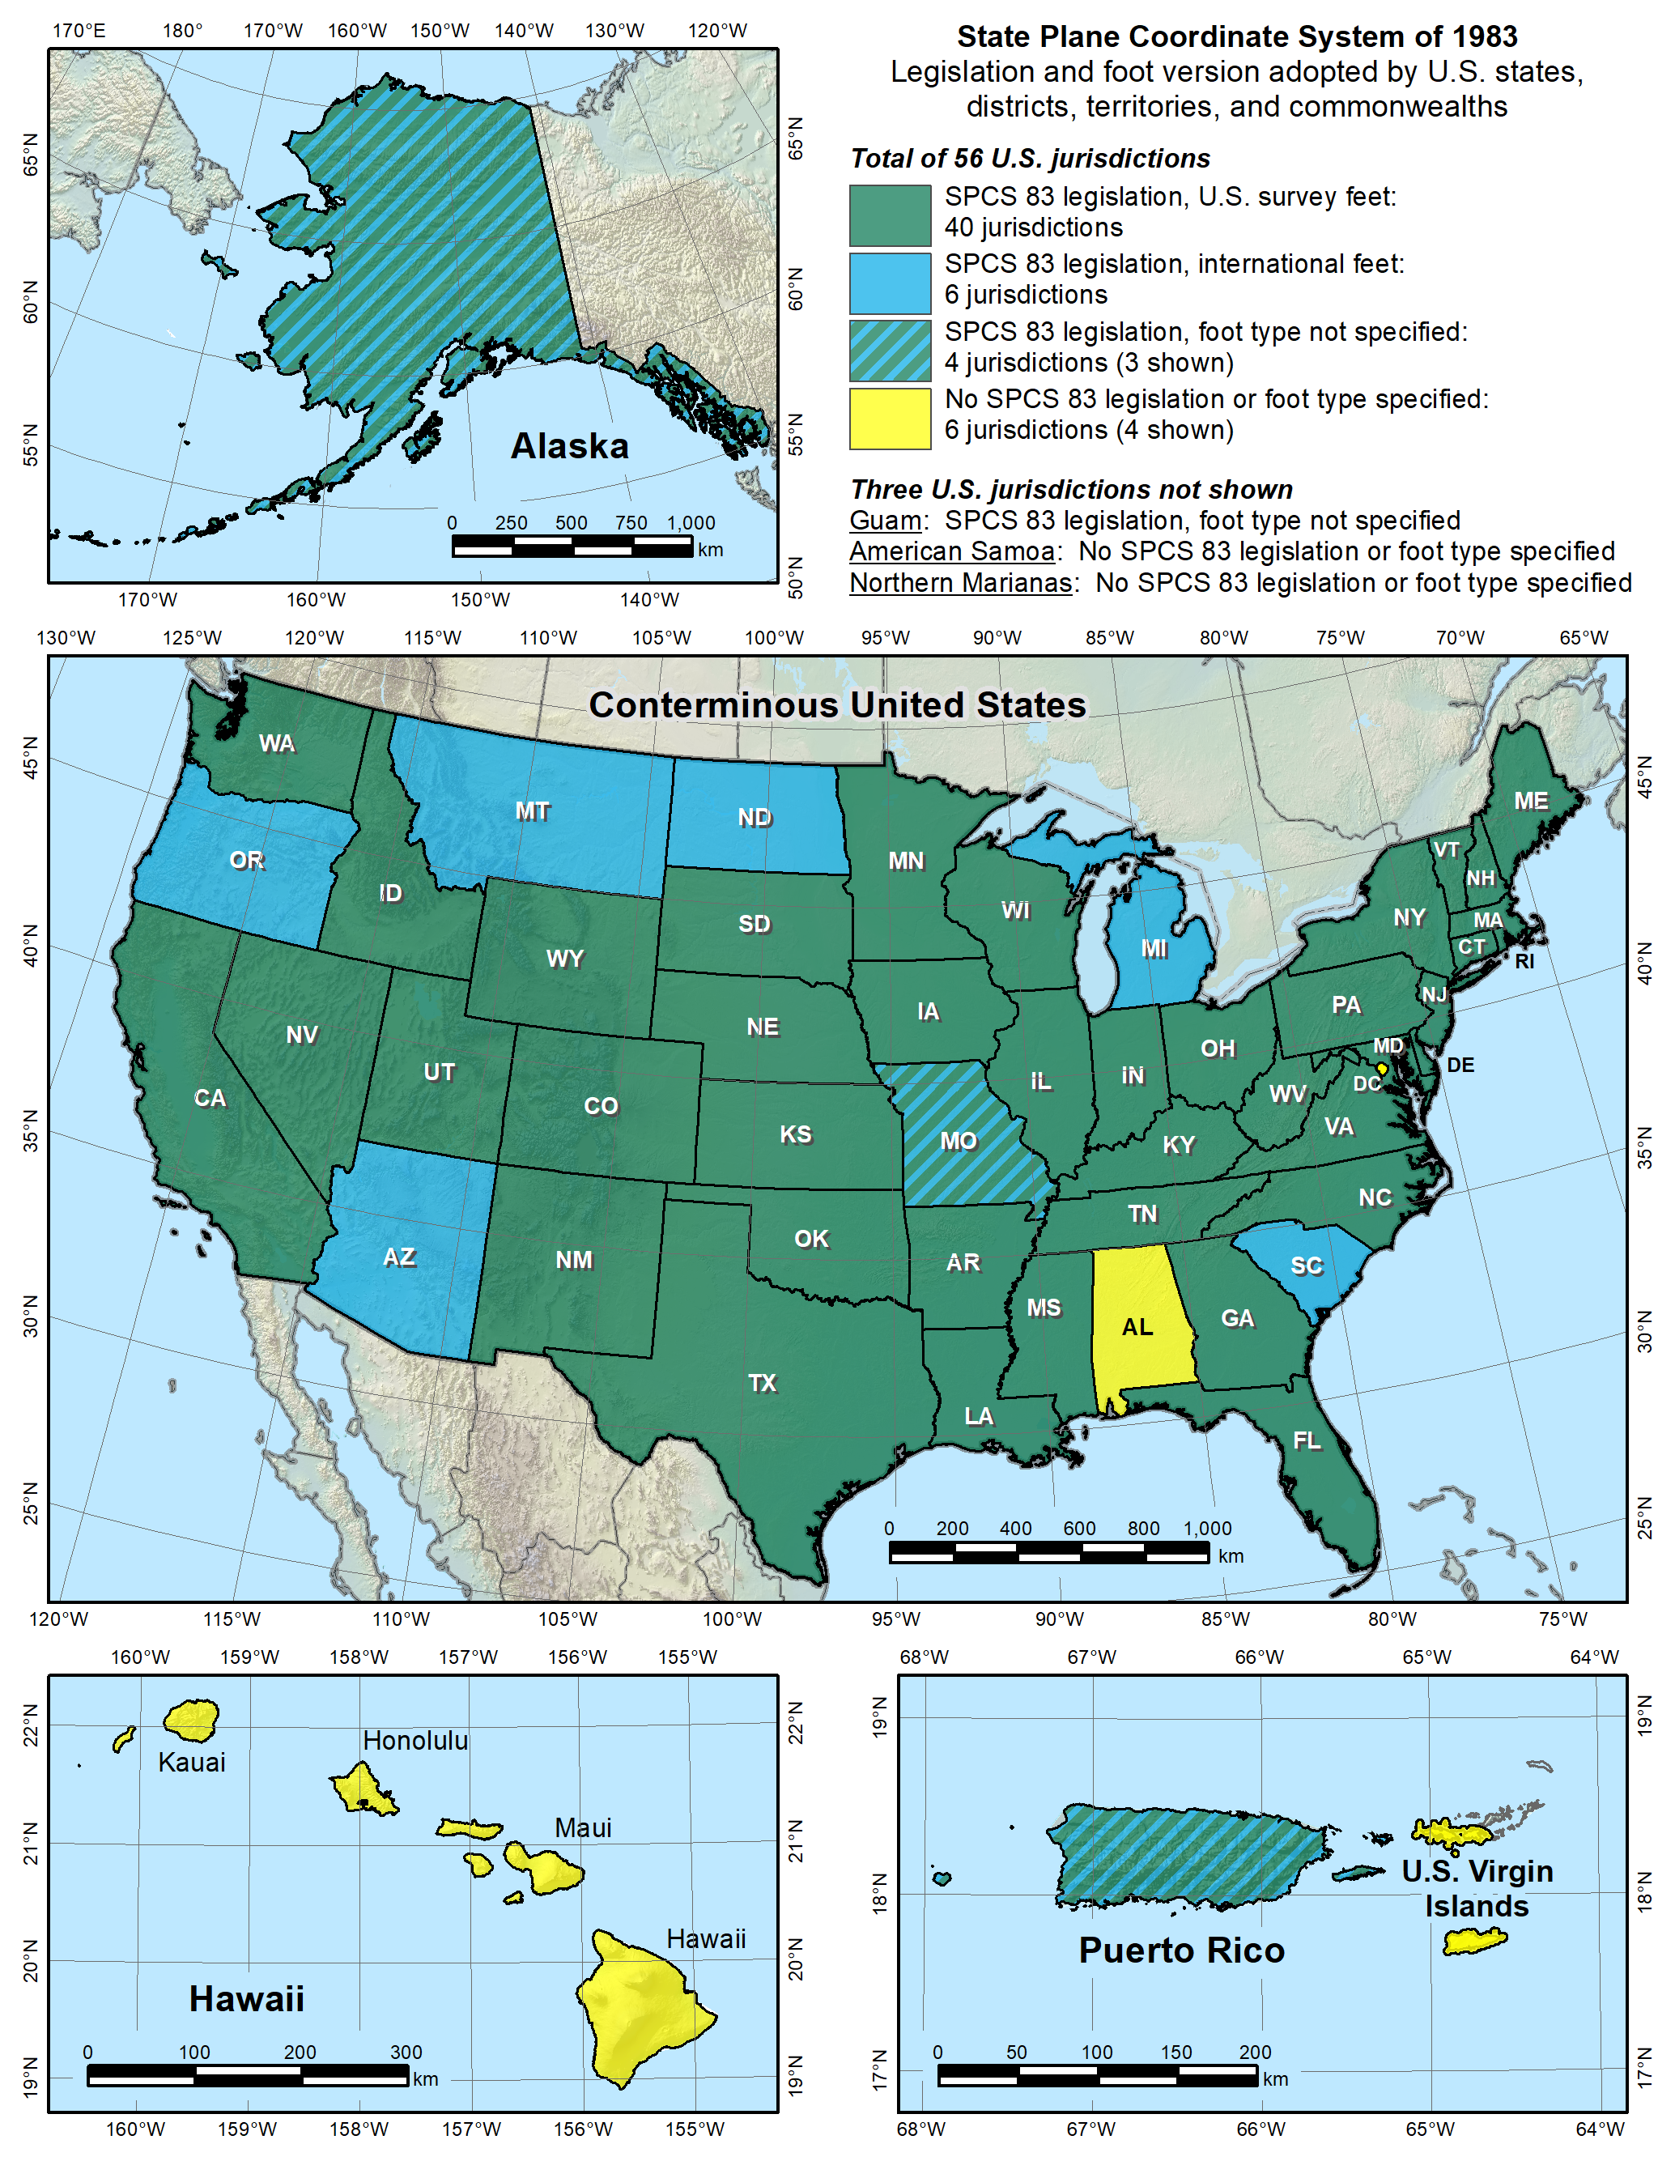


Notes:
Despite the mandate of the 1959 FRN, and the change to a new datum in 1986, NGS allowed states to choose whether they want State Plane coordinates in feet, including which type of foot.
Over time various states have taken actions to select the foot they want to use. Of the 40 states that have selected the sft, 28 have done so in statute, and 12 have done so by working with NGS to issue an FRN (the latest being in 2009, for Utah). So the situation with the 40 “green” states is more complicated than it appears.
Simply put, this is again chaos, just as it was before the Mendenhall Order of 1893. This is exactly the type of situation our five heroes wanted to avoid, having different standards of measure for different parts of the U.S. It is far worse than this map indicates, since jurisdictions within a state use a different foot than on this map. For example, Hawaii shows no foot selection (not even SPCS 83 legislation), yet it uses sft for most areas but ift on military bases. Arizona is shown as an ift state, yet the National Park Service uses sft within Arizona. It is a complete mess. There is no way for me to know for sure, but it is my opinion that our heroes would be spinning in their graves if they saw this.
Addendum: Some surveyors look at the CONUS map and ask why NGS is proposing the ift rather than the sft, since more states have officially selected the sft for SPCS 83 (40 vs. 6). It seems a reasonable question, but it is flawed, for the following reasons:
Minority vs. majority. This is not an issue of a minority overruling a majority. Although most states have adopted the sft (for SPCS 83), it’s important to recognize that surveying and mapping represents only a tiny fraction of overall economic activity in the U.S. Other major parts of the U.S. economy make use of the ift. For example, one of the reasons the ift was adopted in 1959 was for standardizing gauge blocks (the primary means of length standardization used by industry). So surveying is actually a small part of this issue. Because of that, there is essentially no chance that NIST will go back to the sft definition for the entire U.S. If there is going to be one foot, it will certainly be 1 ft = 0.3048 m (exact).
Uniformity. For standards to be useful, they must be uniform. That is why Congress is empowered by the U.S. Constitution to establish standards of weights and measures. Having two concurrent nearly identical definitions of the foot is inconsistent with the very idea of standards. And it is bad for business (i.e., commerce). Keeping the sft for surveying and mapping while using the ift for everything else would perpetuate the inconsistency.
Original intent. In the 1959 FRN that announced nationwide adoption of the ift, the previous foot was named the sft with the intent that it be temporary. It was an accommodation by NBS to C&GS, exclusively for geodetic work. The 1959 FRN mandated that the ift be adopted after readjustment of the U.S. geodetic networks. That occurred in 1986 with the change from NAD 27 to NAD 83. So use of the sft was supposed to end at that time, but it did not. It appears the main reason is that NGS side-stepped the issue by going metric in 1977, perhaps in the hope that the entire nation would go metric. Instead the “temporary” sft became embedded as part of how SPCS 83 is used (but not in how SPCS 83 is defined – the definitions for every zone are metric).
SPCS 83 vs. SPCS2022. In those states where the sft is specified (by state statute or FRN), it is associated with SPCS 83. Such specifications will not apply for SPCS2022. A state could legislate sft for SPCS2022, but if NIST mandates use of the ift, that would likely override state statute, per the U.S. Constitution.
Authority. Only NIST has the authority to deprecate the sft, not NGS. In the end, the fate of the sft will be up to NIST. The reason NGS is involved is that the existence of the sft is due entirely to NIST accommodating NGS in 1959. Because of that, NGS bears responsibility in trying to resolve the issue, as we should have done in 1986, and NGS will work with NIST to that end. If the decision is to deprecate the sft after 2022, it will be announced in an FRN, and NGS will also take other steps to inform our customers. But NGS will continue to support the sft for legacy applications in SPCS 83 and 27 in our products and services.

Slide 59
Epilogue for an erstwhile foot?
The “old” foot defined in 1893 (actually 1866)
Foot officially redefined in 1959
  Old one named “U.S. survey foot” at that time
  Intended as temporary solution
  Supposed to switch to new foot with readjustment of “basic geodetic survey networks”
Kicked can down road in 1959, again in 1986
  Not done for NAD 27 → NAD 83 in 1986
  NGS sidestepped issue by going metric in 1977
What do we do now?
  Another chance with NAD 83 → NSRS2022
Notes:
We’ve come to the end of the epic tale on how the mighty U.S. ended up with two concurrently defined feet. This is a summary of where we are. The question is what do we do now? We missed out in the change from NAD 27 to NAD 83. But we now have another chance, in the switch from NAD 83 to the new 2022 Terrestrial Reference Frames (TRFs), collectively called “NSRS2022” for convenience.

Slide 60
What are the choices?
Do nothing (i.e., NGS stays “metric” only)
  States choose whatever foot they want
  The feet will creep back into NGS products & services
Officially adopt U.S. survey foot for specific things
  U.S. survey foot for surveying and mapping
  International foot for engineering (and everything else)
Use international foot for everything
  Support only foot = 0.3048 meter after 2022, period
Use U.S. survey foot for everything (highly unlikely)
Go entirely metric (good luck with that!)
Notes:
There are five options for moving forward:
Do nothing. This one is interesting, because a number of people have recently proposed a solution where NGS just goes metric, and every state uses whatever foot they want. What they don’t seem to realize is that is exactly what we are doing now! NGS went metric in 1977. But customers wanted to get coordinates in feet, so we provided them. Which meant we had to make sure and give them the type of foot they wanted (even though some locations within sates use a different foot than other parts of states, as mentioned previously). The same thing would most definitely happen again for SPCS2022 if we tried to only give metric coordinates. So the situation would be exactly the same as now.
Officially adopt U.S. survey foot for specific things. This was what was proposed in the 1988 FRN. It would formally perpetuate a dual foot system in the U.S., making it even more entrenched. We would be stuck with a dual foot anti-standard.
Use international foot for everything. This is what NGS proposes. Only one foot after 2022, with same definition as ift. It is the only viable means of using a single foot definition for future work. Legacy work will always use appropriate units (of which there are many types).
Use U.S. survey foot for everything. As discussed previously, this is extremely unlikely, so much so that it’s safe to say it is impossible. The ift is simply too well established in a vast majority of the economy. Surveying is a tiny minority, so it is not reasonable to expect the sft to prevail, even if the sft is used for surveying in most states.
Go entirely metric. This is my personal very strong preference! This is also the preference of most (all?) people at NGS and NIST. But alas it appears much too big a lift for NGS, and even for NIST at this time. Maybe some day in the not-too-distance future (but remember what happened when we tried to go metric in the late 70s). At least SPCS2022 parameters will all be defined in meters! On a positive note, of the people who have provided feedback so far on this topic, more are in favor of going metric than are of keeping the sft (although a large majority opted for the ift).

Slide 61
An NGS proposal
Only one foot after 2022 (1 foot = 0.3048 meter)
  Make official through NIST
  NO option for U.S. survey foot
NGS will help with the transition
  Will fully support backward compatibility
  Use “correct” foot for SPCS 83 and SPCS 27
  Automatically done by NGS products and services
Guiding ideas
  Best opportunity to make the change
  Of all changes in 2022, this is the least significant
  Will make things better
  About the future, not the past
Notes:
NGS proposes that there be only ONE official definition of the foot after 2022, and if done will be accomplished through NIST.
Considering getting rid of word “international”, and just call it the “foot” (that is how it is handled in some software, such Esri’s). People just seem to not like the “international” label. Maybe call if the “American freedom foot.” But seriously, dropping a descriptor solidifies the idea that there is only one foot in the U.S. Keeping the descriptor implies there is more than one foot.
Have NO option for sft after 2022. It will only be used for the past (legacy applications).
NGS will help!
We will try to make the change as simple and painless as possible.
Our products and services will automatically support backward compatibility.
Idea here is that we are trying to make things better by fixing a long-standing problem for the future (not the past). Yes, there will be some difficulties. But at least they will diminish over time. If we do nothing, these problems will never go away.
If you think changing from sft to ift is a big problem, then perhaps you don’t quite understand the other changes that are coming in 2022:
The change from sft to ift is really just a small (2 ppm) scale change. That is smaller than the change in scale for SPCS2022 zones, and that is only PART of the change that will occur for State Plane.
Coordinates in NSRS2022 will change with time. In fact, the entire frame will be time-dependent. Assumptions about control coordinates never changing will have to be abandoned.
The “vertical” datum will be replaced with a geopotential datum based on a gravimetric geoid (rather than leveling). This, too, will have a time-dependent component.
There will be changes in how GNSS, leveling, and total station survey surveys are performed, reduced, processed, and adjusted.
By comparison, the change from sft to ift is so miniscule that it is well within the noise of the other changes.
In short, if you think the change in foot definition is too difficult, then its hard to see how you could deal with these other much larger and vastly more complex changes.

Slide 62
Why make the change?
That was original intent (60 years ago!)
Two “feet” is inefficient and causes confusion
  Leads to errors that cost money
  Absurd to have “same” unit that differs by 2 ppm
  Defeats purpose of having a length standard
Notes:
But why make the change? There are several good reasons:
That was what was originally intended when the sft was named, 60 years ago!
It causes real problems that cost real money, through confusion, errors, and just plain old inefficiencies.

Slide 63
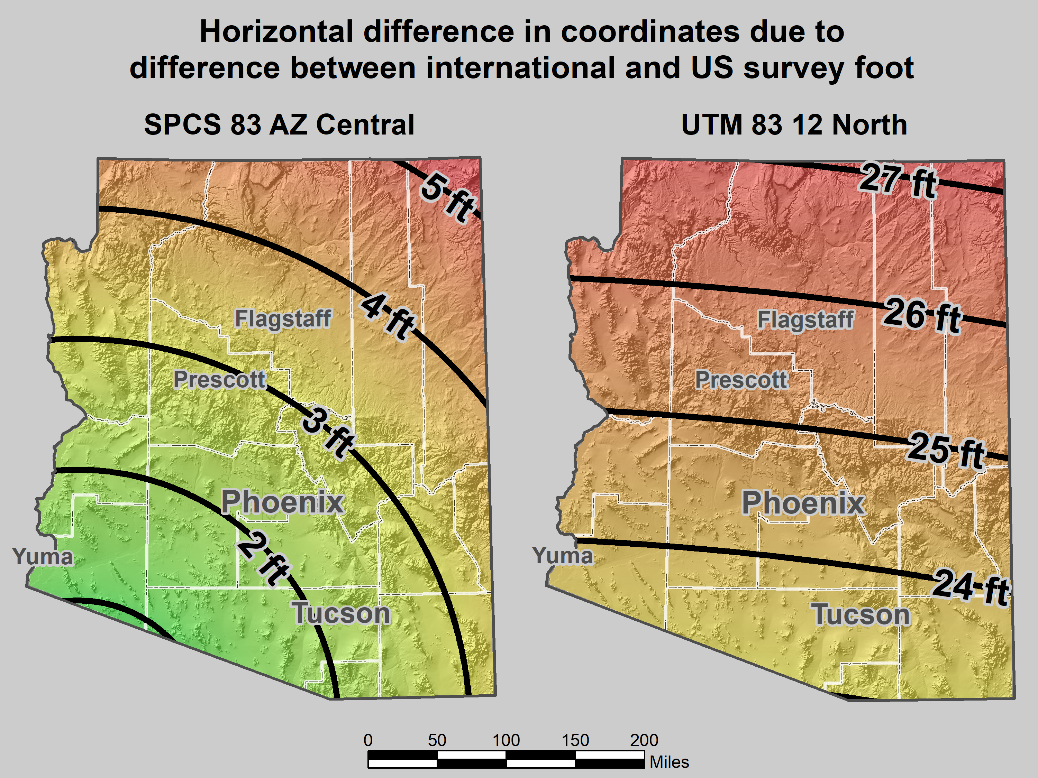
Map of error in mixing feet
Notes:
As an example of some of the problems, consider the state where I am registered, beautiful Arizona. It is an ift state, yet mix-ups with sft occur all the time:
The map on the left shows the horizontal difference in feet when ift and sft are interchanged for SPCS 83 AZ Central Zone.
I worked a lot in Flagstaff. This confusion occurred so often that whenever I saw a 3.5 ft horizontal discrepancy, I suspected it was this issue. And it usually was.
When the City of Flagstaff installed their GIS software, it defaulted to State Plane in sft (even though it’s supposed to be ift). When the City discovered this, they decided to just leave it in sft, which is part of the reason why the 3.5 ft error showed up so often in Flagstaff. But they also occur elsewhere.
I probably shouldn’t complain about ift/sft problems, because I’ve made money off of it. In one weekend I made a couple thousand dollars helping someone with a big survey near Prescott. One of the problems was a 3-ft horizontal discrepancy. Turned out it was due to an ift/sft mix-up, mainly because more than one company worked on the project.
It’s not just State Plane. I don’t know if they still do it, but a statewide electric utility (Arizona Public Service) uses UTM coordinates, in sft. This causes positional errors of 23 to more than 27 feet if ift are used, depending on location.
These problems are real. And they don’t just occur in ift states. They can (and do) occur in any state. I’ve heard more stories about such problems than I can keep track of. This is especially a problem for surveyors licensed in multiple states with different foot types. Or for projects with multiple companies (especially if from different states or countries). Or for anyone who uses software. In short, it has negatively impacted many people, but it can potentially impact anyone. Maybe it has never been a problem for you. But you won’t have to look very far to find someone who has war stories on this topic.

Slide 64
Why make the change?
That was original intent (60 years ago!)
Two “feet” is inefficient and causes confusion
  Leads to errors that cost money
  Absurd to have “same” unit that differs by 2 ppm
  Defeats purpose of having a length standard
Only recognized in part of U.S.
NGS software can support backward-compatibility
Now is the time
  Many changes already being made for 2022
  Change in foot trivial compared to other changes
  U.S. survey foot problems will never go way if not addressed
Notes:
Continuing with why we should make the change:
The sft is not recognized in the entire U.S. Only in parts of the U.S. And even for states where the ift or sft is specified, there are internal exceptions (a few of which I have already mentioned).
NGS can make the transition easier by automatically supporting backward-compatibility in our software. That way you would get sft for all SPCS 27 zones, and also for SPCS 83 in the 40 states that have specified the sft for SPCS 83.
To repeat: Now is the time. Otherwise this problem will never go away (unless the U.S. goes completely metric).

Slide 65
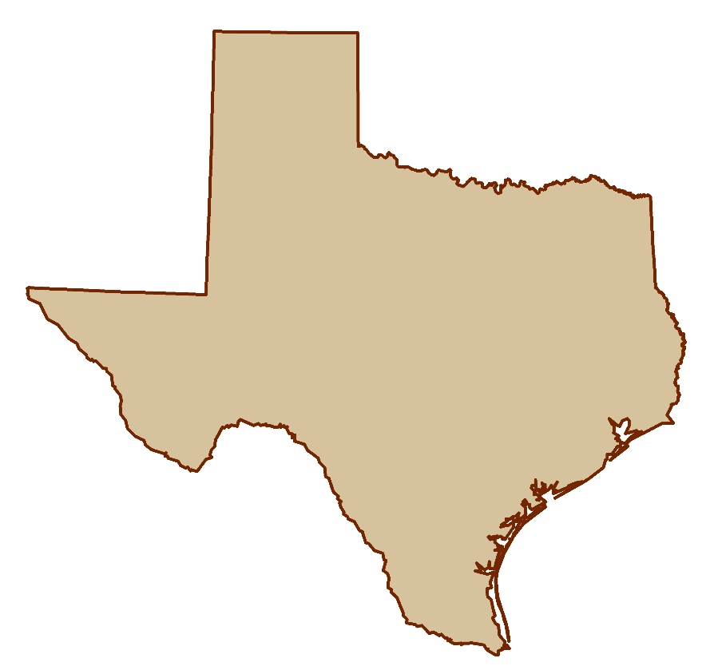
Why make the change?
Texas will be even bigger…
4,092,414 sft
4,092,422 ift
Notes:
Yet another reason for adopting the “new” foot: Texas will get even bigger! It will increase in length by 8 feet – longer than the bed of my pickup truck! And the best part is that they additional 8 feet doesn’t come from its neighbors – all the sft states will get bigger! So I expect Texas to fully support this change…

Slide 66
Arguments for keeping “old” foot
Used for existing records and data
  Circular argument because issue never goes away
  Such logic means old foot will always be retained
  That’s how we got into this mess in the first place
Old foot in state legislation
  But statute is usually (always?) tied to NAD 83
  New statute for 2022 could break that connection
Necessary to convey real property…
  Yet six states have new foot and somehow convey property
The old foot has a better name…
Notes:
Continuing with conveyance if real property:
There are six ift states that somehow manage to convey real property, even though a large number of the deeds and plats in those states are in sft. Any prepared before about 1986 would almost certainly be in sft (and probably quite a few afterward), and all before 1959 would definitely be in sft. I am registered in an ift state, so I have often performed boundary surveys using records that were in sft. Yet this has NEVER caused a problem for me. The reason is simple: the difference is too small. If I can come within 1 foot of a record monument, I’m having a very good day, especially for surveys based on very old records. If you have a boundary survey and your biggest problem is the difference between ift and sft, then congratulations! You’ve got yourself an easy survey.
When surveyors bring up issues like conveyance of real property, I can’t help but wonder if they are (perhaps unwittingly) offering a red herring. The arguments certainly are not convincing. Could this simply be a presented because people don’t like change…?
Returning to the question of state legislation, there’s another problem even for cases where a state decides they are going to specify whatever linear unit they want, regardless of what NGS or NIST decide…

Slide 67


What’s in a name?
U.S. survey vs. international foot
  “U.S. survey” sounds patriotic, surveyor-centric
  “International” Has faint whiff of socialism and New World Order
Idea: Drop word “international”
  Instead call it the:
  American
  Freedom
  Foot

Slide 68
Taking a stand for standards
The foot problem created for convenience
  Intended as temporary, for geodetic work only
  Boundary surveys were not considered
Keeping U.S. survey foot is an “anti-standard”
  U.S. survey foot currently in standards “limbo”
  Single definition efficient, clean, and right thing to do
Issue an “order” to adopt single foot = 0.3048 m?
  That’s what it took to fix mess in 1893
  A long overdue solution
  Within legal authority of federal government…
  …but prefer to persuade rather than coerce
Notes:
NGS wants you to join us in taking a stand for standards, for the reasons listed here that summarize what was discussed in this presentation.
An important point is that although it appears the federal government has the authority to mandate a single foot definition, we believe it is far better to persuade than coerce. Our hope is that you have found this presentation persuasive, and that you are at least considering the merits of a switch from the sft to the ift.

Slide 69
Status on the fate of the foot
NIST and NGS working together
  Single definition of 1 foot = 0.3048 m after 2022
  Will drop “international” from name
Two Federal Register Notices (FRNs)
  First FRN asks for public comment
    Only on how to do it, not whether to do it
    Target comment deadline is Oct 1, 2019
  Second FRN announces official change
    Intend to issue FRN by Dec 31, 2019
    Change effective Jan 1, 2023
First draft completed, in legal review at NIST

Slide 70
In closing…
NGS created problem, will help fix it
  Fully support backward compatibility
  Will make simple and painless as possible
  Foot change minor compared to other 2022 changes
  Contact us at NGS.Feedback@noaa.gov
  Provide comments to FRN
This is about the future
  Remember our heroes and their hard-won victories…
Notes:
In closing, I want to reiterate that NGS essentially created this problem, and now we want to help fix it. Yes, we are coming at this some 30+ years late, but there is no better time to do this than when we are updating the entire NSRS. A change in the foot definition will be a minor part of the overall changes that will occur when we make the transition to a modernized NSRS in 2022. NGS will do everything we can to make a foot change – and all the other 2022 changes – as simple and painless as possible. Remember, the idea here is not change for its own sake, but change to make things better. And these changes will make things better.
I encourage you to provide questions and comments to NGS.Feedback@noaa.gov. If this change for the foot goes forward, there will also be opportunities for comments as part of issuing an FRN.
I remind you, again, that this is about the future, not the past. The past will always exist and will not change. But the future is something we can change, and make better. Please remember our heroes, and the incredible work they put into establishing standards for weights and measures. Their eyes were also on the future, and we are the beneficiaries of their vision.
For those of you who are surveyors (as I am), this is more than about how you practice surveying today, wherever you may work, and whatever type of surveying you do. For those who want to retain the U.S. survey foot, I implore you to please consider the larger picture, and the future. That future will be inherited by the young surveyors, GIS professionals, and all other U.S. citizens. We should strive to do well by them, and for them.

Slide 71
Questions?
Comments?

