Slide 1
Web Services
&
Geodetic toolkit
May 14, 2015

Slide 2
Where we are now…
Most NGS Web applications were built more than 10+ years ago and can be better organized to make them user-friendly.
Multiple page visits are needed for a complete answer.
Results are provided in plain-old html format- No computer-friendly formats supported.
No easy to use API to query and extract data.
Multiple point conversion not supported
Underlying software inhibits integration of state of the art tools.
Notes:
Datasheet, OPUS, Coordinate transformation programs (SPC, XYZ, UTM, Geocon, Nadcon, Vertcon).
-- Datasheet & OPUS provide shapefile downloads.
Feed back via ngs.softwarerequest@noaa.gov
-- Requests to download mark information to be able to build a database and a mobile or GIS friendly application.
Code available for download but code be out of sync with the latest version.
Plug-ins (state of the art tools).

Slide 3
Where we want to be …
Redesign web content around a common theme
Provide one-stop solutions
Promote open data standards and computer-friendly formats (kml, xml, Json, etc.)
Leverage geospatial tools (Oracle Spatial, map-based tools) for data discovery.
Promote web services- traditional (SOAP/RESTful) as well as geospatial (WMS/WFS)
Make pages interactive for better user experience
Re-architect products and services around Service Oriented Architecture (SOA)

Slide 4
Current Progress
A prototype for an integrated toolkit has been developed
http://dev.ngs.noaa.gov/gtkweb
Conversion from/to SPC, UTM, XYZ, and USNG supported
Complete set of coordinates returned for each conversion
Conversion of multiple coordinates supported
Web services supported for ready integration into user software
Tools provided for off-line processing via downloads
Built on a state of the art web framework for better user experience

Slide 5
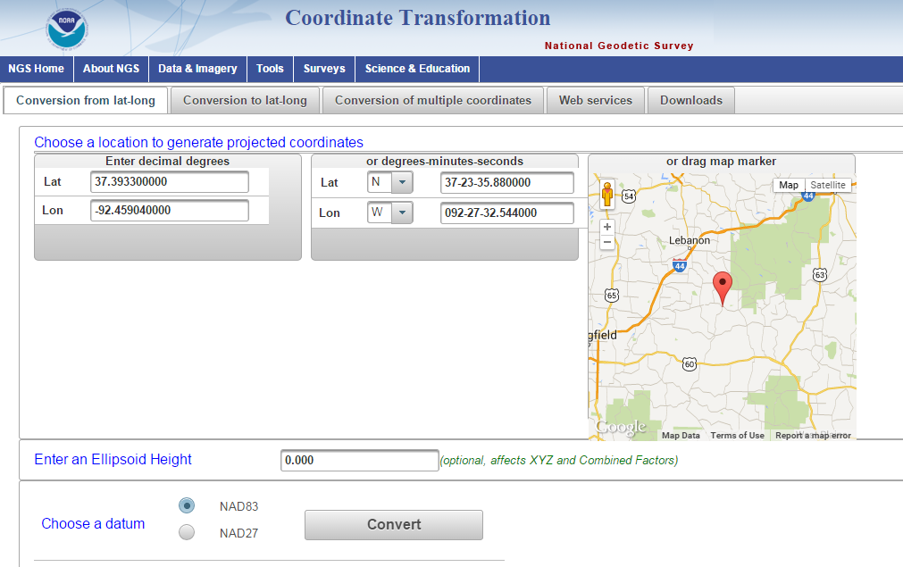
Coordinate Transformation Prototype

Slide 6
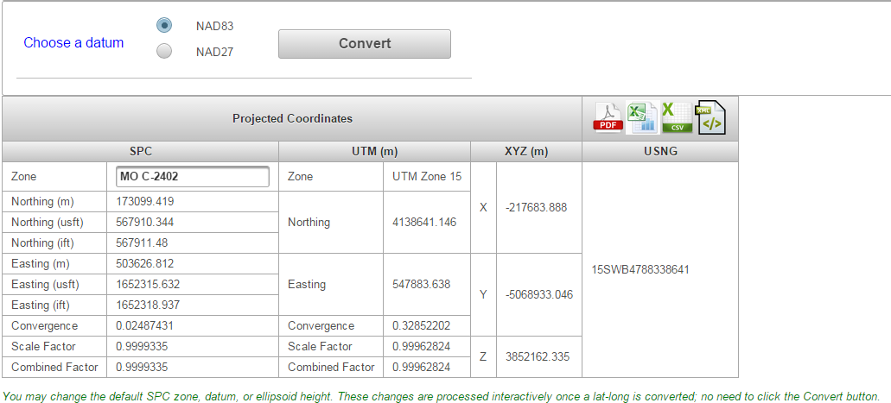
Coordinate Transformation Prototype

Slide 7
What’s Next…
Standardize attribute naming convention (Meta data).
  Latitude, longitude, orthometric_ht, geoid_ht
Integrate other toolkit components into the prototype
-Nadcon, Geocon, Vertcon, VDatum, HTDP, Geoid
Develop a standard API for interpolation

