Slide 1
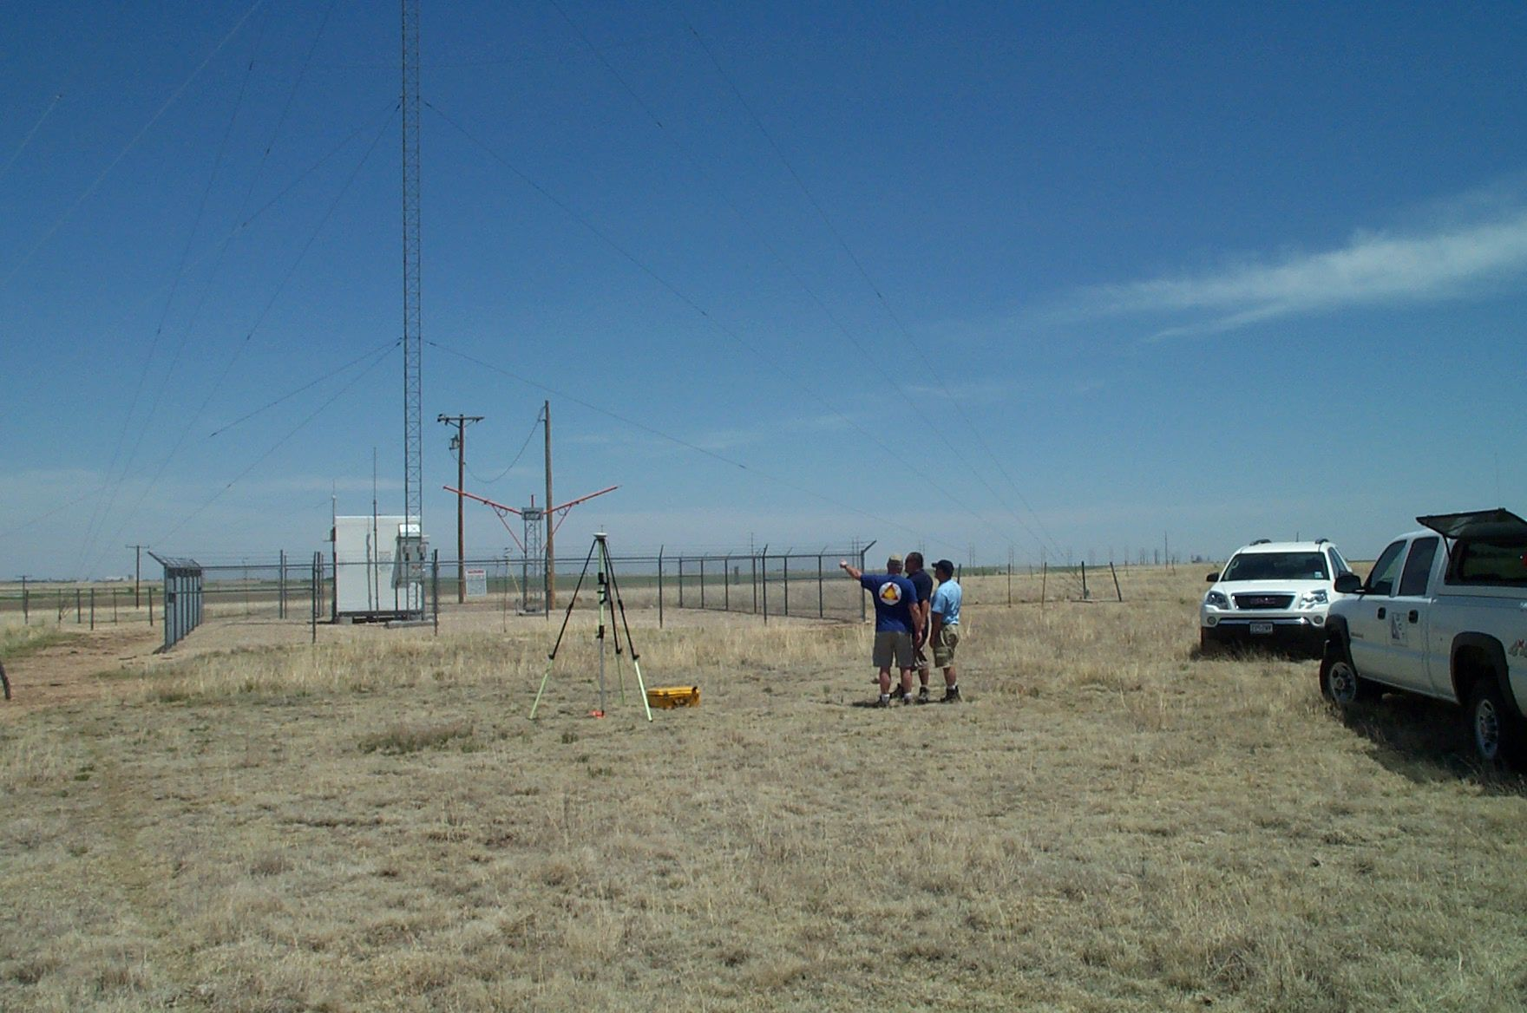
NGS role in supporting to FAA
NOAA / National Geodetic Survey
Aeronautical Survey Program
Quality Review in Support of the FAA Airports Surveying-GIS Program
CDR Chris Kerns and Mark Howard
May 14, 2020
NGS ASP Webinar
Notes:
General Outline
1–7 ASP Overview
8-12 ASP History (Standards and Data Collector)
13–16 FAA AGIS site (work flow)
17-25 AGIS Project SOW
26-32 AC-16 establishing datum tie
33–44 AC-17 georeferenced stereo imagery
44-55 AC-18 survey

Slide 2

Organization
National Oceanic and Atmospheric Administration
National Ocean Service (Line Office)
National Geodetic Survey (Program Office)
Remote Sensing Division
Aeronautical Survey Program
~ 12 Federal Employees and Affiliates
The NGS Aeronautical Survey Program provides products and services to the FAA Aeronautical Information Services (AIS) through a NOAA/FAA Inter-Agency Agreement

Slide 3
FAA Partnership
NOAA’s relationship with FAA goes back 70+ years
NGS has conducted airport surveys since 1947
NGS transitioned from data “provider” to data “validator” when the Airports GIS (AGIS) program was rolled out in 2005
Airport surveys are conducted by private companies using Airport Improvement Funds issued through state grants or directly funded by large airports
NGS Maintains
Surveying expertise
Airport geodetic ties to National Spatial Reference System
Remote sensing capabilities, including a dedicated King Air 350-ER aircraft
Stereo-imagery expertise
In-house software to assess Aeronautical Survey data
Notes:
Nicole Cabana

Slide 4
ASP Overview
Current three-year Inter-Agency Agreement
September 2018 – September 2021
Annual Budget is ~$2.5M
Services
Review aeronautical surveys submitted to AGIS program
  AC-16
  AC-17
  AC-18
Obstacle Verification (FAA Authoritative Obstacle Database)
Special requests from AVN
Airport Facilities Terminal Integration Lab (AFTIL) requests
Notes:
Nicole Cabana
May need to revise…. “Services” Think my slide (next) is a better summary of services

Slide 5
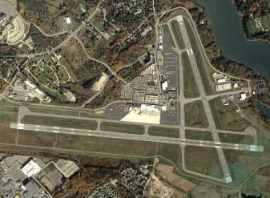
ASP Overview
Provide positional, height, and orientation information to the FAA in support of the National Airspace System (NAS) and safe navigation
Review aeronautical survey deliverables submitted by 3rd party providers to the FAA
Develop survey standards, guidelines, tools, and models designed to assist surveyors conducting aeronautical surveys
Participate in studies of new and emerging technologies (LiDAR, Satellite Imagery, etc.)
Provide technical advice, assistance, training and outreach to data providers conducting aeronautical surveys in accordance with FAA standards. Training consultants helps reduce rejections and increases program efficiency.
http://www.ngs.noaa.gov/AERO/aero.html

Slide 6
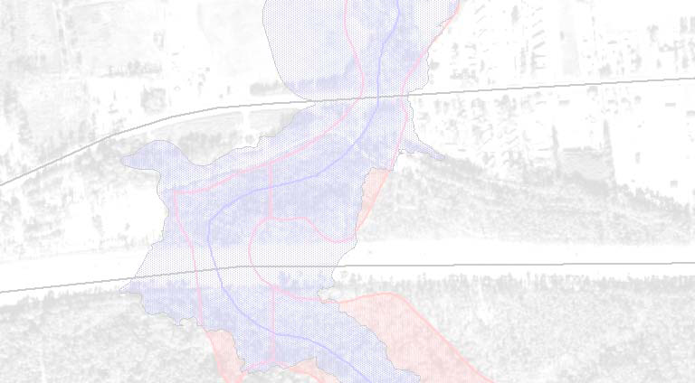
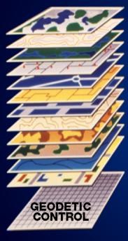

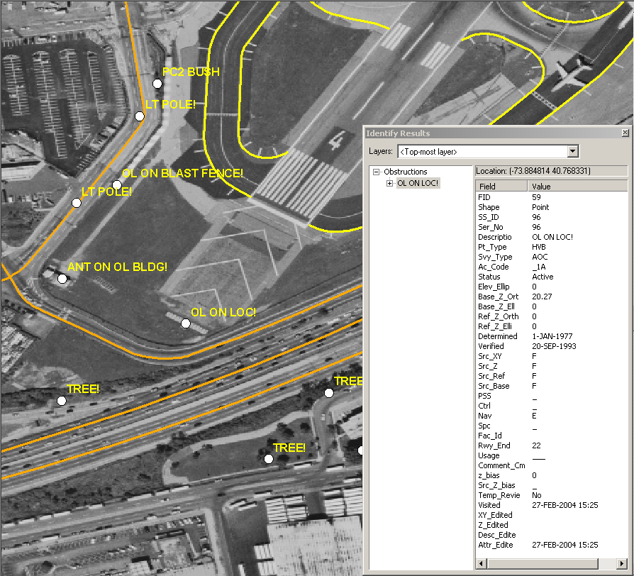
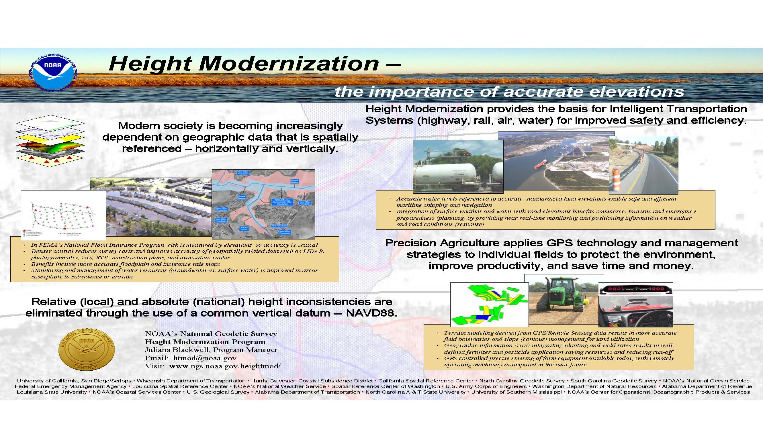
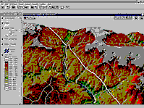
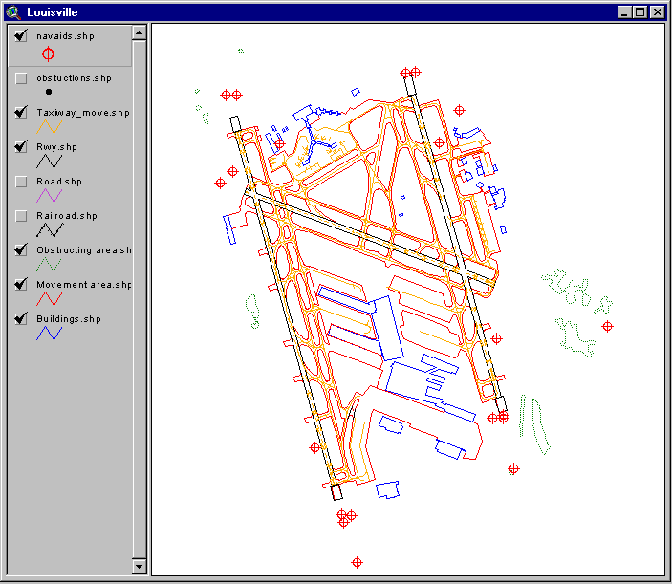
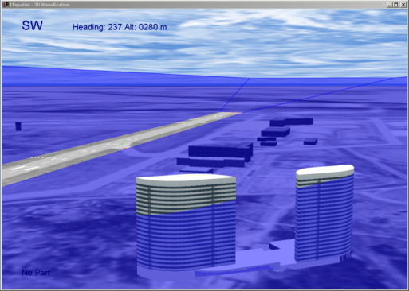
National Spatial Reference System (NSRS)
FAA is becoming increasingly dependent on accurate, standardized aeronautical data that is spatially referenced – horizontally and vertically
Accurate data relative to a consistent national coordinate system provides the basis for intelligent Transportation Systems designed to improve safety and efficiency
Relative (local) and absolute (national) position and height inconsistencies are eliminated through the use of a common reference system (NAD83/NAVD88)
Notes:
Possibly omit
NGS Mission: To define, maintain and provide access to the National Spatial Reference System (NSRS)
to meet our Nation’s economic, social and environmental needs.

Slide 7
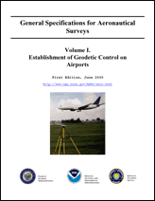
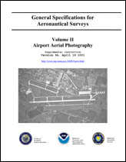

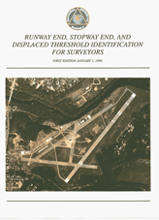
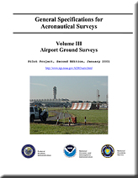
Standards and Guidance Manuals
AC 150/5300-17C
AC 150/5300-16A
Geodetic Control
Airport Imagery
FAA 405
Runway Identification
Ground Survey
AC 150/5300-18B

Slide 8
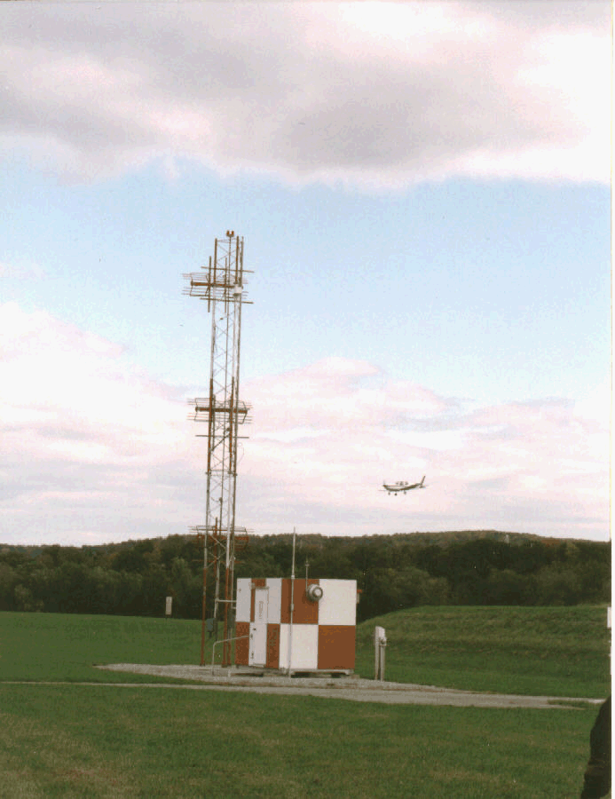
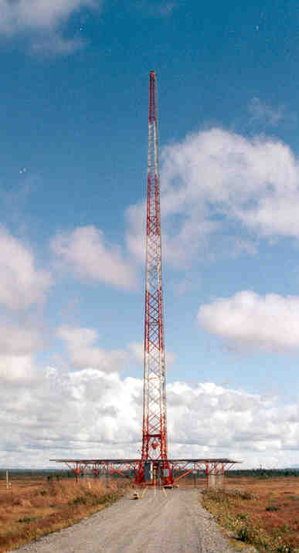
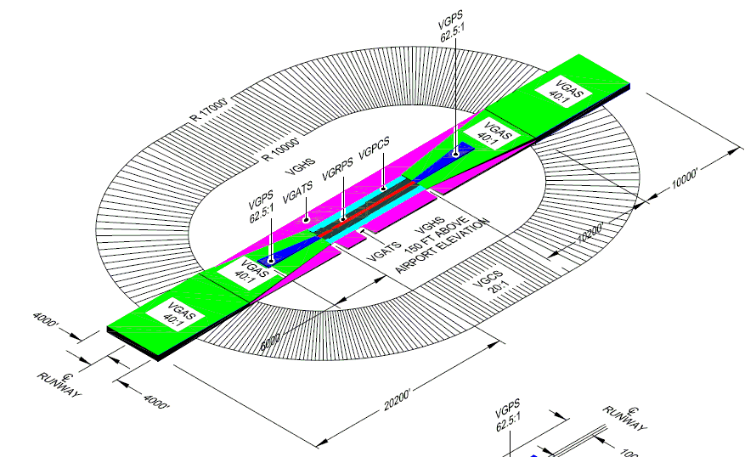
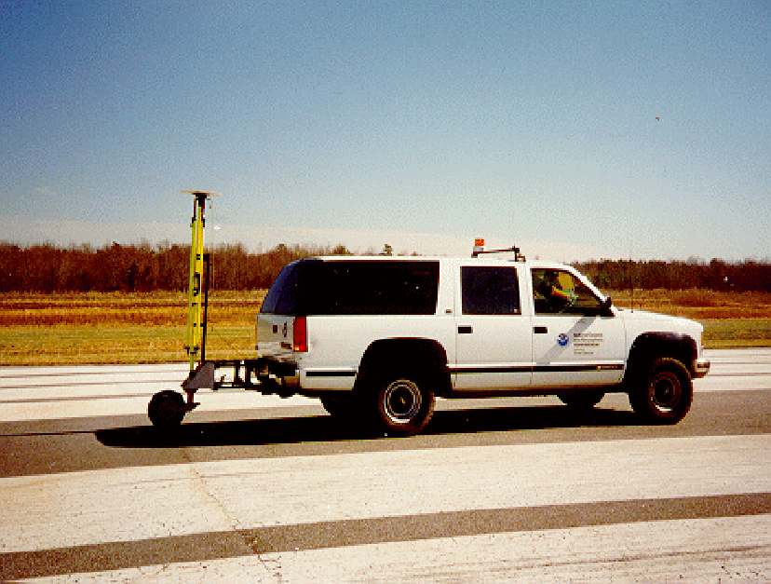
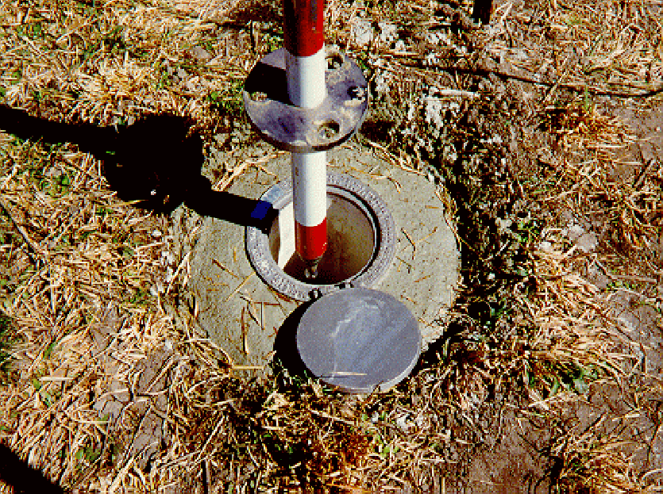
Safety Critical Data for Instrument Procedure Development
  Geodetic Control
  Runway Points
    Runway End, Displaced Threshold, Stopway End, TDZE, Airport Elevation, Runway Intersection, NAVAID Perp Points, ARP, Runway Profile Points
  Runway/Stopway Length and Width
  Displaced Threshold Length
  Runway True Azimuth
  Navigational Aids
  Obstacles
  Obstructing Areas
  Obstruction Identification Surfaces
Notes:
Imagery in support of the aeronautical survey is also critical
Data reviewed by NGS (scope)
Standard OIS are no longer FAR Part 77
Now Airport Airspace

Slide 9

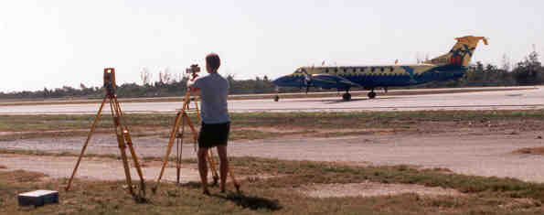
NGS Aeronautical Survey Process
Survey Requirements
Aerial Survey
Geodetic Control Survey
Preliminary Remote Sensing Survey / Data Mining
Field Survey
Final Remote Sensing Survey
Product
FAA

Slide 10
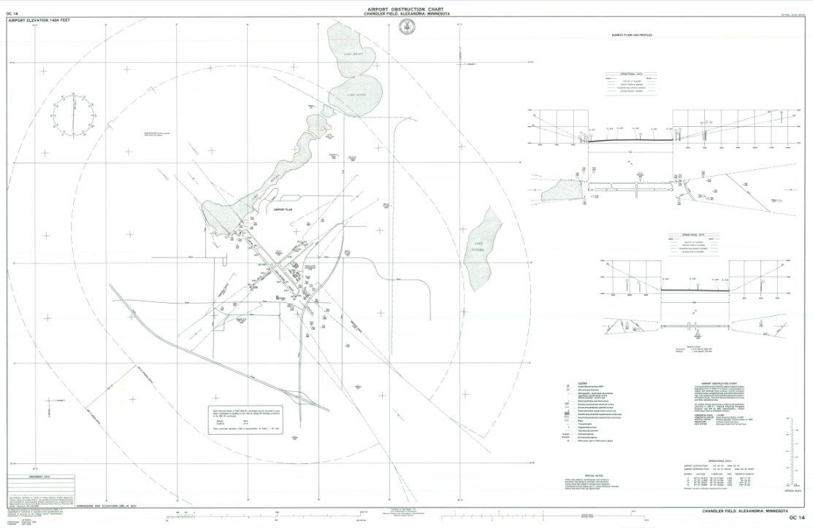
AIRPORT OBSTRUCTION CHART

Slide 11
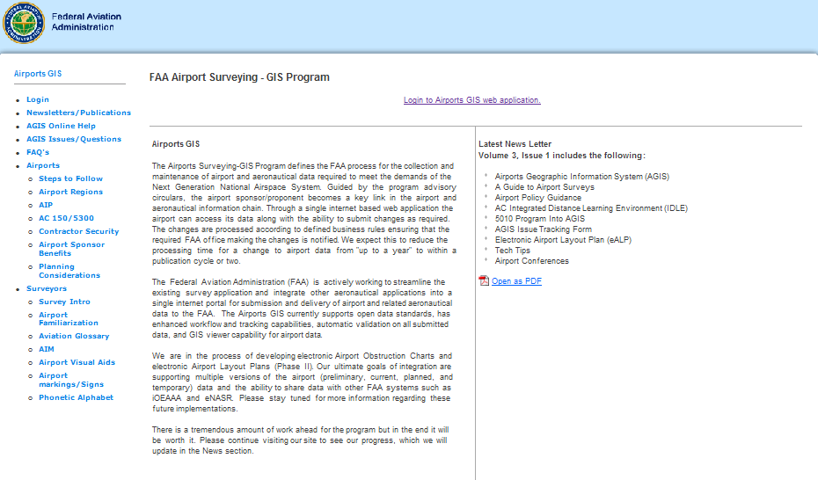
FAA Airport Surveying GIS Program
https://airports-gis.faa.gov/public/index.html
Notes:
Image of web site
(live)
Resources
Submission Process

Slide 12
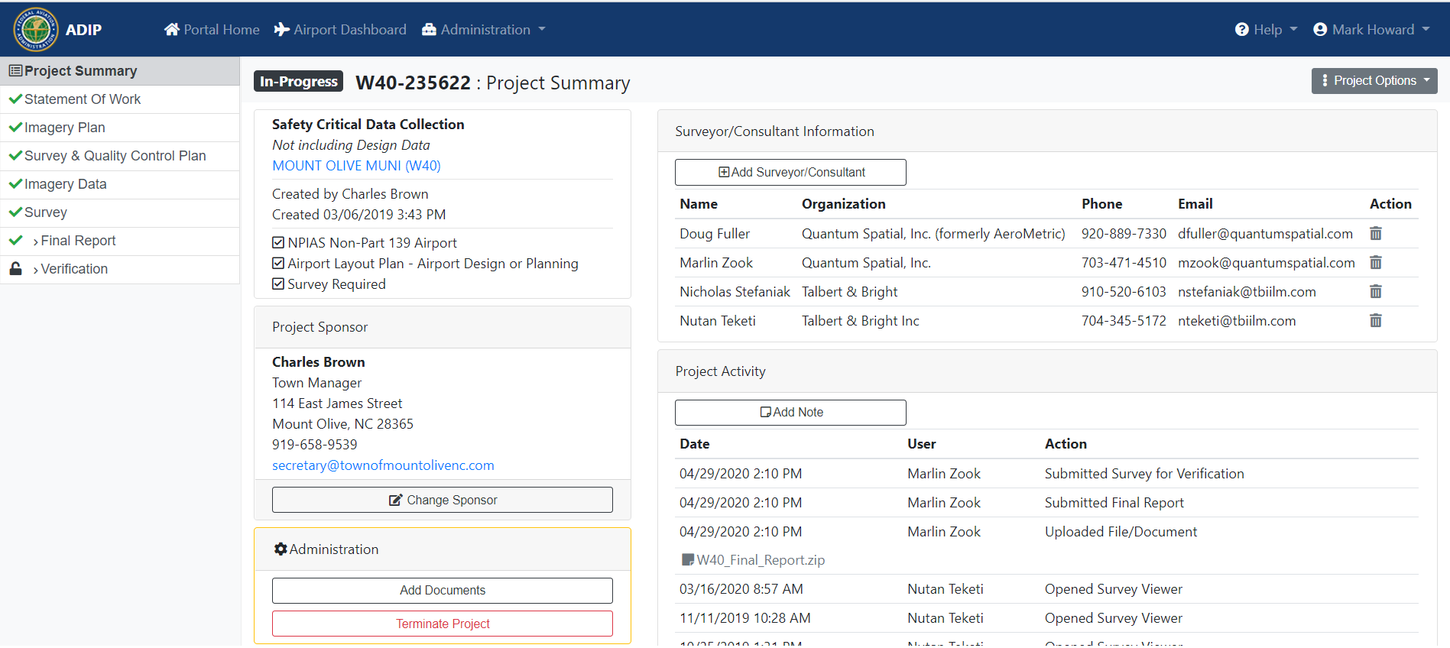
FAA Airport Surveying GIS Program
https://airports-gis.faa.gov/public/index.html
Notes:
Image of web site
(live)
Resources
Submission Process

Slide 13
AGIS Project Workflow
TASK | Sponsor | Consultant | AGIS Staff | NGS
Initialize project on AGIS site | X
Develop SOW | X | X
Submit SOW |  | X
Approve SOW | X
Submit: AC-16 Geodetic Control Plan AC-17 Imagery Plan AC-18 Survey and Quality Control Plan |  | X
Approve AC-16 Geodetic Control Plan |  |  |  | X
Approve: AC-17 Imagery Plan AC-18 Survey and Quality Control Plan |  |  | X
Submit: AC-16 Geodetic Control Data AC-17 Imagery Data |  | X
Approve: AC-16 Geodetic Control Data AC-17 Imagery Data |  |  |  | X
Submit AC-18 Data (Survey and Final Report) |  | X
Approve AC-18 Data |  |  |  | X
Notes:
TOP DOWN work flow

Slide 14
Statement of Work

Slide 15

Statement of Work
Starting On The Same Page
Clearly identify :
Purpose
Obstruction Analysis, Geodetic Control, new taxiway, ALP, etc.
Version and date of the referenced Advisory Circulars
Project Identification Data
Will the deliverables include survey data (as-built), planning data (non-existing), or both?
Notes:
Written Agreement
Technical Document (Supplemental Requirements document)
Clear Picture of Project
Used by NGS to determine the survey requirements for survey. Identifies what is expected to be in submissions

Slide 16
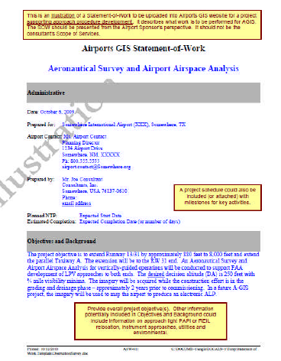
Survey Requirements
Clear description of the
survey requirements
Geodetic Control
Geo-referenced Imagery
Runway Data
Navigational Aid Data
Obstruction Identification Surfaces to be evaluated
Note if the requirements involve the submission of “Design” data
https://airports-gis.faa.gov/public/airportsSteps.html
Notes:
Survey requirements as specified in the FAA AC’s
Identifies work to be performed
Data to be identified, collected and reported (expected to be in submission)
No required format
Templates on AGIS site

Slide 17
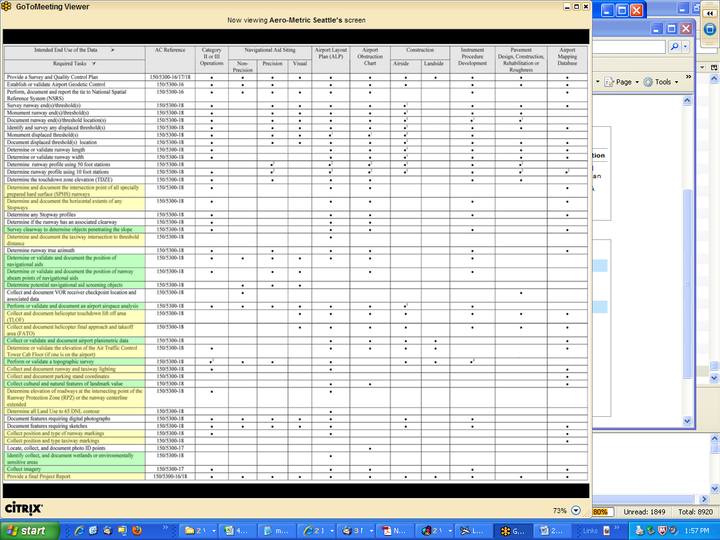
AC-18B Table 2-1 Survey Requirements Matrix
Notes:
Adhoc (non-standard) survey requirements
- Requirements must be clearly stated in SOW

Slide 18
How will the survey be tied to the National Spatial Reference System (NSRS)?
Three options:
Establish Primary and Secondary Airport Control Stations (PACS/SACS)
Verify existing PACS/SACS
Establish Temporary Control Marks
Primary and Secondary Airport Control Stations shall be established as specified in AC-16B (7/8/2019)
Verifying existing Primary and Secondary Airport Control Stations as specified in AC-18B (2/24/2014). If existing Control Stations can not be verified establish Temporary Control Marks in accordance with AC-16B Section 2.2.2 (7/8/2019)….. OR re-establish Primary and Secondary Airport Control Stations as specified in AC-16B (7/8/2019)
Temporary Control Marks shall be established in accordance with AC-16B Section 2.2.2 (7/8/2019)

Slide 19
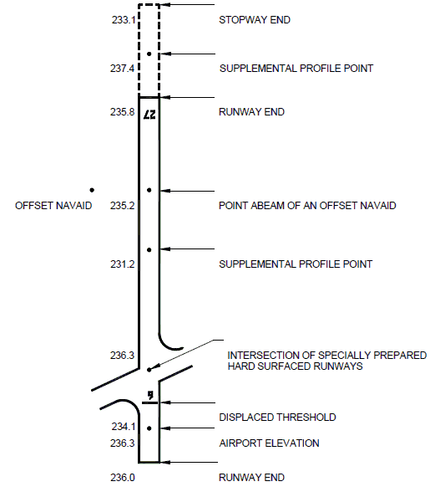
Runway / Stopway Data Requirements
Identify the runway / stopway data to be collected and reported
Is the Airport Part 139 Certified?
Identify, position, and report all runway data as specified in AC 150-5300-18B (Section 2.6.10.3 and 2.6.10.4).
Note any deviations from the standard.

Slide 20
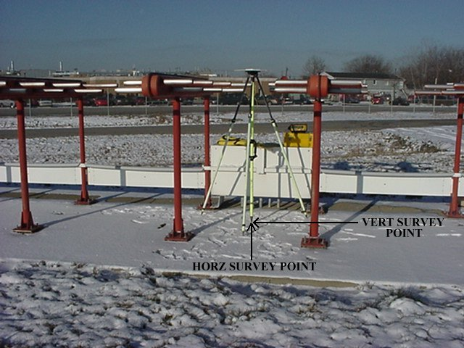
Navigational Aid Requirements
Identify the Navigational Aid data to be collected and reported
Identify, position and report all Navigational Aids as specified in AC 150/5300-18B, Section 2.6.10.6. (Tables 2-2 and 2-3)
Note any deviations from standard.

Slide 21
Obstacle Requirements
Specify the Obstruction Identification Surfaces to be evaluated for obstacles (for each runway)
Runways with Vertically Guided Approaches
Runways with Non-Vertically Guidance
Conduct an Airport Airspace Analysis survey on runway 9/27 in accordance with AC 150/5300-18B, Section 2.7.1.1. Runways with Vertical Guidance.
Acquire aerial imagery for the entire study area and submit the required deliverables as specified in AC 150/5300-17C.
LID | Airport Name | City | State | Approaches
MQB | Macomb Muni | Macomb | IL | 9, 27

Slide 22
Obstacle Requirements for Design Projects
Specify the Obstruction Identification Surfaces to be evaluated for obstacles (for each design runway)
Conduct an Airport Airspace Analysis survey on ultimate (design) runway 9/27 in accordance with AC 150/5300-18B, Section 2.7.1.1. Runways with Vertical Guidance. The surfaces to be analyzed for obstacles will be constructed relative to the design coordinates for runway ends 9 and 27.
Acquire aerial imagery for the entire study area and submit the required deliverables as specified in AC 150/5300-17B.
LID | Airport Name | City | State | Approaches
MQB | Macomb Muni | Macomb | IL | 9, 27

Slide 23
AC 150/5300-16B

Slide 24
AC-16B Geodetic Control
Three options:
  Establish Primary and Secondary Airport Control Stations (PACS/SACS)
  Verify existing PACS/SACS
  Establish Temporary Control Marks
If Project requires verifying existing PACS/SACS or establishing Temporary Survey Marks (TSM) describe how work will be performed in the Survey and Quality Control Plan associated with AC-18B
If Project requires establishing PACS/SACS submit Geodeticl Control Plan after reconnaissance but prior to mark setting

Slide 25
AC-16B Geodetic Control
Geodetic Control Network
CORS
FBN and BM ties must be observed simultaneously with PACS
PACS and SACS monuments are positioned and tied to the National Spatial Reference System through GPS observations.
BM#1
BM#2
PACS
SACS#1
HARN
Airport
SACS#2
AC 150/5300-16A
Simplified Schematic
Notes:
PACS and SACS monuments are positioned and tied to the National Spatial Reference System through GPS observations.
NGS will review plan ensure the survey work will result in a successful, acceptable data submission satisfying the survey requirements specified in the project SOW.

Slide 26
Geodetic Control: Geodetic Control Plan
What is expected in the Plan?
Survey requirements
  Clearly identify how geodetic control requirements will be met
Plan must include the following elements (AC-16B Section 7.3)
  Airport Summary Report
  Station Table
  Airport Control Plot
  Station Location Sketch and Visibility Diagram
  Recovery notes (existing marks)
  GPS Observation Scheme
  Project Vector Diagram
  Listings of equipment and processing software
  Quality control procedures
Sample Geodetic Control Plan http://www.ngs.noaa.gov/AERO/AirportsGIS/AC16/index.shtml

Slide 27
Geodetic Control: Geodetic Control Plan
Reasons plan may not be approved:
Survey requirements inconsistent with Project SOW
Required elements not included in plan
Proposed plan will not satisfy requirements as specified in AC 16B
  Observation scheme, Station Stability, Mark Setting
Proposed plan to use station (existing) that does not meet minimum requirements
Published survey marks incorrectly referenced as PACS/SACS
Proposal plan to establish PACS/SACS using OPUS derived solutions
http://www.ngs.noaa.gov/AERO/AirportsGIS/AC16/index.shtml
Notes:
45-50% of submitted AC-16 Geodetic Control Plans are not approved
Or lead to a increased review time.
observation scheme will not meet minimum requirements
Proposed location of stations will not meet minimum requirements

Slide 28
Geodetic Control: Data Deliverables
What is expected in the Data Deliverables?
Items identified in AC-16B Section 9
  Quality Control Plan
  Survey Plan
  Project Sketch (Vector Diagram)
  Field logs
  Vector processing output
  Final Project Report
    Summary Report, Listings of personnel, survey equipment and software, Final Station listing, Vector Processing scheme, comparison with ITRF coordinates, description of project adjustments
  Adjustment and checking program results
  Original data (Source)
  Station Descriptions
Sample Final Report http://www.ngs.noaa.gov/AERO/AirportsGIS/AC16/index.shtml

Slide 29
Geodetic Control: Data Deliverables
Reasons data submission may not be approved:
Required items not included in submission
Submitted data does not meet minimum requirements
Errors in vector processing
Errors in adjustment
Errors in Blue-book files
Tie accuracy requirements not met
Descriptions not submitted
Sample Geodetic Control Plan http://www.ngs.noaa.gov/AERO/AirportsGIS/AC16/index.shtml
Notes:
Completeness and accuracy assessment to ensure deliverables meet requirements specified in AC 150/5300-16.
45-50% of AC-16 Data submissions are not approved

Slide 30
AC 150/5300-17C

Slide 31

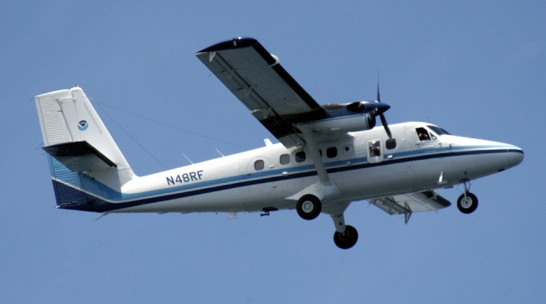
AC-17C Geo-referenced Imagery
High-Resolution photography of the airport collected for the entire study area.
Imagery is used in the photogrammetric process for determining the height and position of obstacles and airport planimetric features.
AC 150/5300-17C

Slide 32
Imagery Acquisition Plan
What is expected in the Plan?
Survey requirements
Clearly identify runway end approaches to be surveyed for obstacles and the Airport Airspace Survey surfaces to be evaluated
Plan must include the elements identified in AC 17C Section 2.1
Briefly descriptions:
  Purpose
  Collection methodology proposed for imagery acquisition
  Methods to geo-reference the imagery
  How imagery will be used to support the data collection required for the survey
Proposed Flight-line diagram (with AAS surfaces)
Imagery (ground) control network diagram
Proposed imagery control stations coordinates (text file)
Listing of equipment proposed to use in the survey (Calibration Report)
Describe proposed quality control procedures
Identifying anticipated imagery acquisition dates

Slide 33
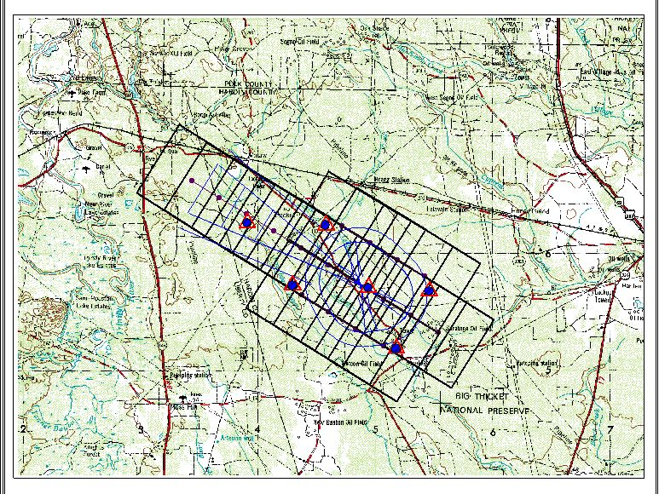
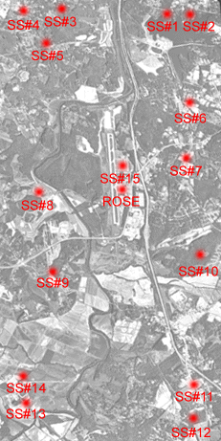
Imagery Acquisition Plan
Reasons a plan may not be approved:
Survey requirements are inconsistent with Project SOW
Required elements not included in plan
Proposed plan will not satisfy requirements
Stereo imagery does not cover entire extents of study area (AAS)

Slide 34
Imagery Data
What is expected in the Imagery Data Deliverable?
Deliverables as specified in AC 17C
Including
  Digital Stereo Imagery
  Flight Layout diagram
  Image Control Points
    Coordinates
    Descriptions (Station Location Sketch and Visibility Diagram)
    Digital ground photographs
  Check Points (5) – OPUS solution results
  Geo-referencing files (Aerial Triangulation)
  Final Report (optional)
    Comments required when work performed differently than stated in imagery plan.
Notes:
NGS is not expecting the ortho-imagery
OIS define the study area
Supplemental information considered useful or explanatory regarding usability of the imagery. Comments are required when the project is completed differently than identified in the imagery plan due to unusual circumstances or problems, equipment malfunctions, changes to proposed methodologies/equipment or any deviations from these specifications.

Slide 35
Image Review Criteria
1. Ground Sample Distance - GSD between 10-30 cm
2. Stereo Coverage - Imagery has sufficient overlap to permit stereo coverage of the entire area to be analyzed (Stereo coverage of all OIS)
3. Geometric Fidelity - Collection and processing of the image data will maintain, within accuracy requirements, the relationship between measurements made in the image model and real world coordinates
4. Geo-Referencing - The imagery has been geo-referenced and the source data used for completing the geo-referencing are provided (See Attachments B,C, and D)
5. Positional Accuracy- Positions of well defined points determined from the stereo imagery shall be within 1 meter relative to the NSRS (NAD 83 NAVD 88) at the 95% confidence level for Easting, Northing, and orthometric height.
6. Resolution - imagery must be sufficiently sharp to allow identification, analysis, and measurement of airport features and obstructions
7. Image Quality - The imagery shall be clear, and evenly exposed across the format.
The imagery shall be free from cloud, cloud shadows, smoke, haze, and any other blemishes which interfere with the intended use of the imagery
8. Acquisition Date - The imagery should be acquired within the 12 month period
  9. Foliage – Acquired at time of full leaf foliage.

Slide 36
Imagery Data Review
Reasons imagery data may not be approved:
Required items not included in submission
Critical
  Imagery control descriptions / coordinates, check points (OPUS solutions), Flight Report, Flight Layout
  Imagery Acceptance Criteria not met
Fatal
  Camera Calibration report, Aerial Triangulation, Imagery
http://www.ngs.noaa.gov/AERO/AirportsGIS/AC16/index.shtml
Notes:
Or lead to a increased review time.
Critical Omission - greatly impacts the time of review and in some cases may terminate the review.
Fatal Omission - terminates the review process. The review cannot be conducted.

Slide 37
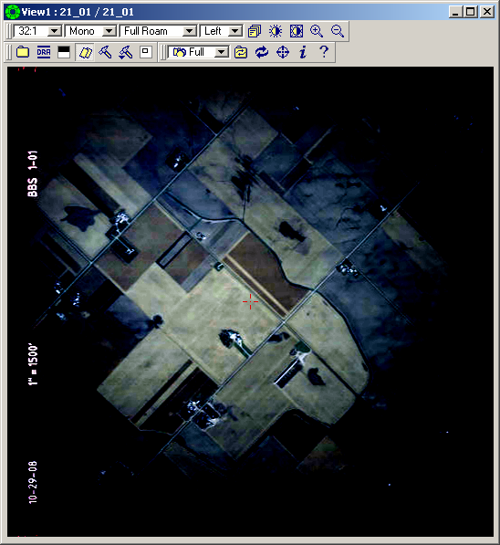
Imagery Quality

Slide 38
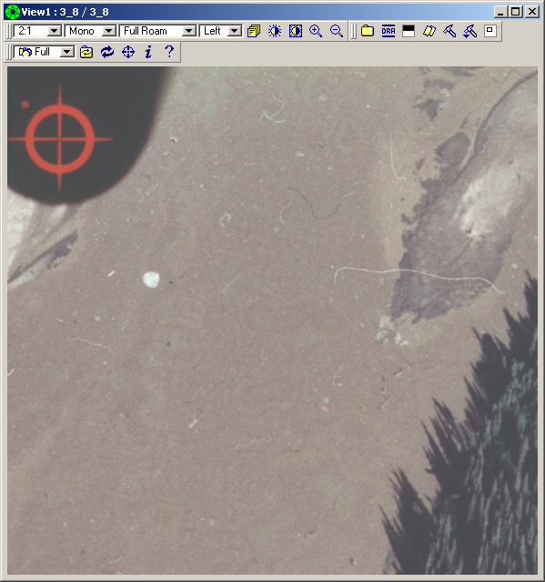
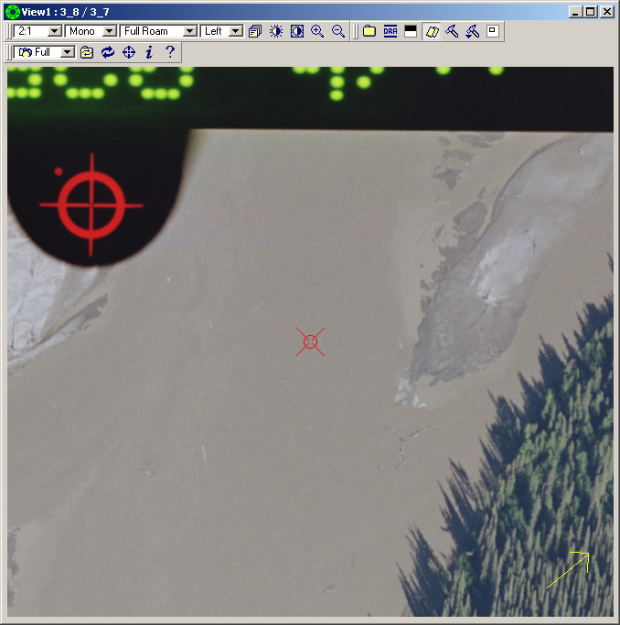
Imagery Quality
Low quality scanner
High quality scanner
Notes:
Imagery is the surveying instrument being used to collect data when perform photogrammetric survey

Slide 39
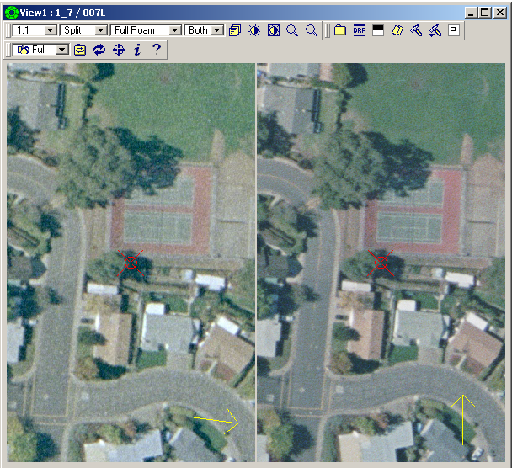

Slide 40
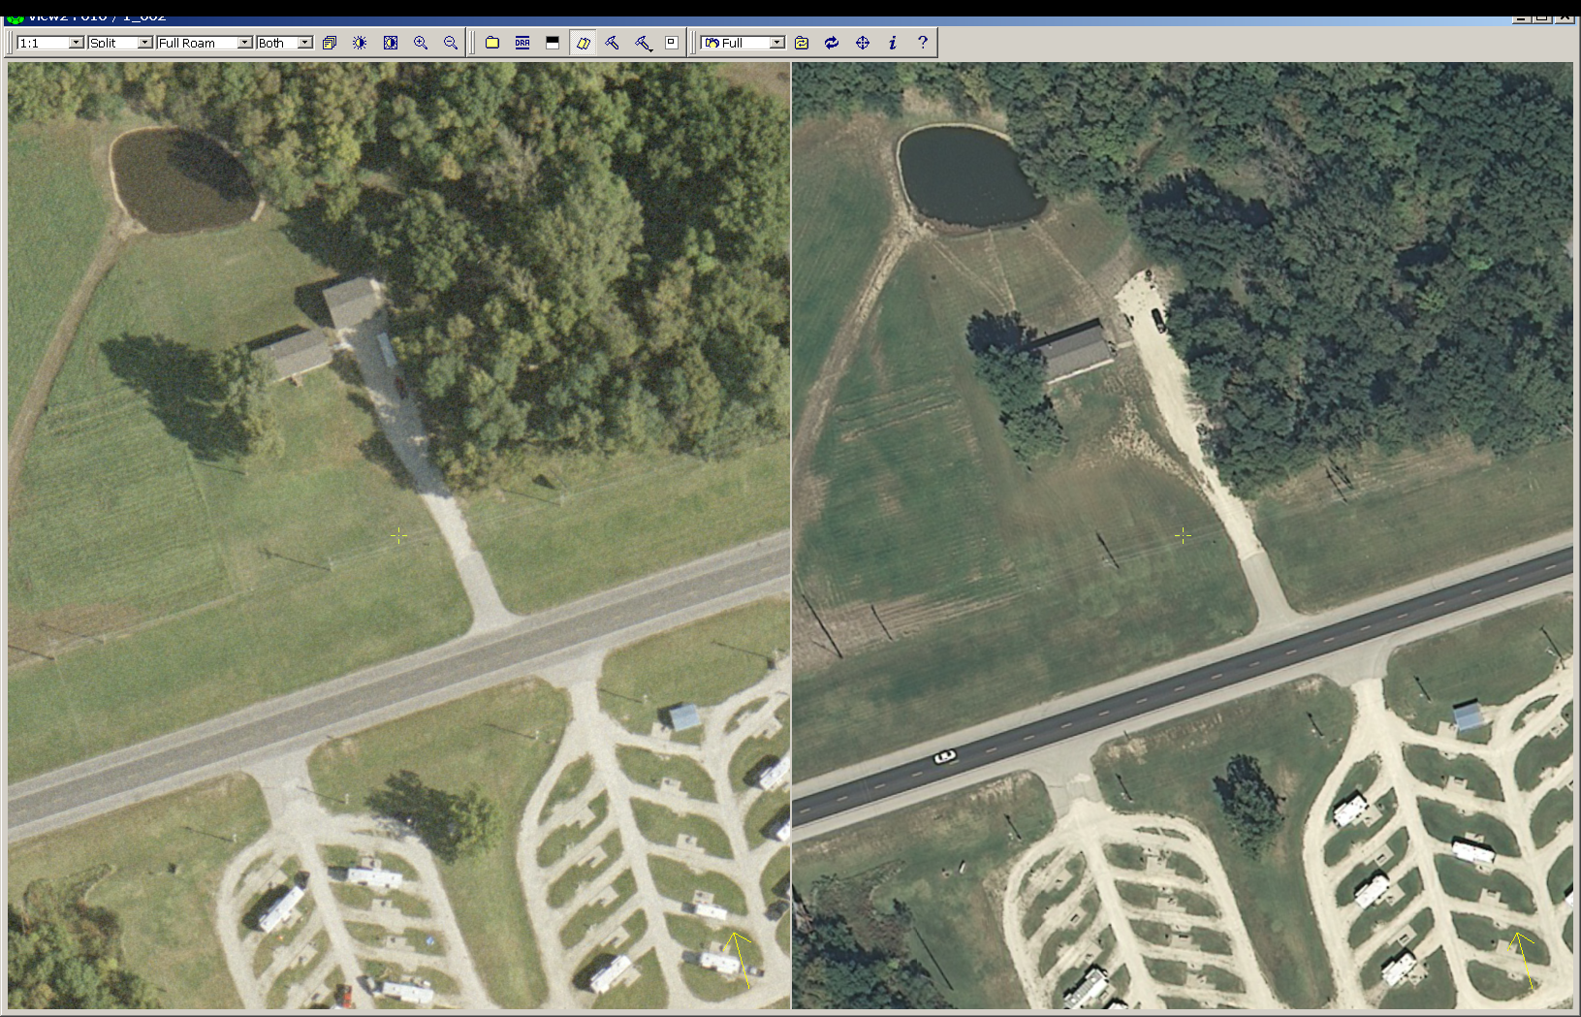

Slide 41
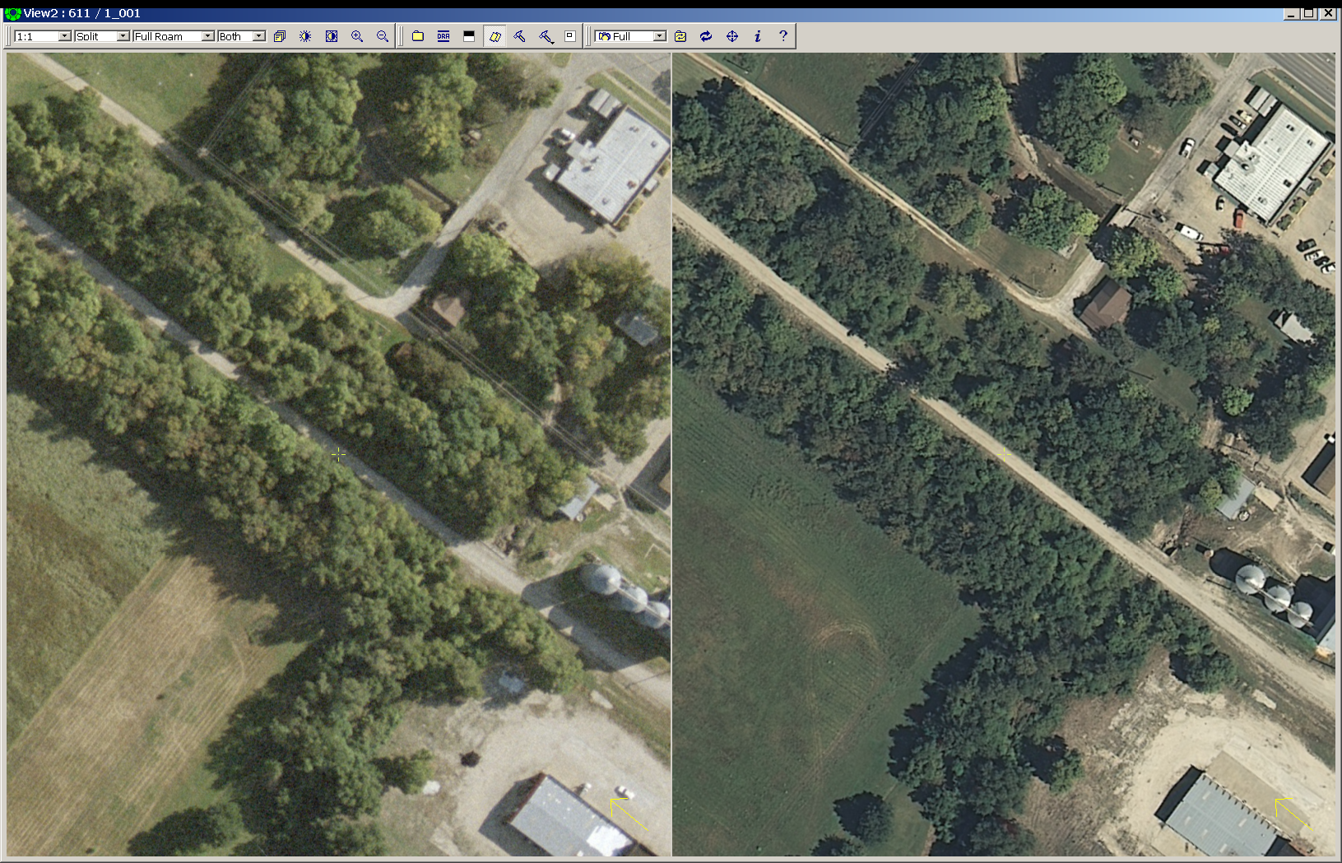
Notes:
10% of AC-17 Imagery data reviews are not approved

Slide 42
AC 150/5300-18B

Slide 43
Survey and Quality Control Plan
Submit Plan any time after SOW is approved.
Purpose is to describe how the work associated with meeting requirements in AC18B will be met
Plan must include elements listed in AC-18B Section 2.6.2
Include brief description of proposed methods that will be used to meet datum tie accuracy requirements when project does not involve establishing PACS/SACS

Slide 44
Survey and Quality Control Plan
What is expected in the Plan?
Survey requirements
  Geodetic control, Runway, Navigational Aid, and Obstacles representation
  Runway end approaches to be surveyed for obstacles and the Airport Airspace Survey surfaces to be evaluated
Plan must include the following elements:
  Detailed description of the field (ground) and remote sensing methods that will be used to identify, locate and collect data. Include a description of analysis methods.
  Describe how obstacles will be evaluate relative surfaces
  If plan is to leverage existing survey data, describe how it will used to meet the requirements for current survey.
  Listings of equipment and processing software
  Quality control procedures

Slide 45
Survey and Quality Control Plan
Reasons plan may not be approved:
Survey requirements inconsistent with Project SOW
Required elements not included in plan
Proposed plan will not satisfy requirements as specified in Project SOW

Slide 46
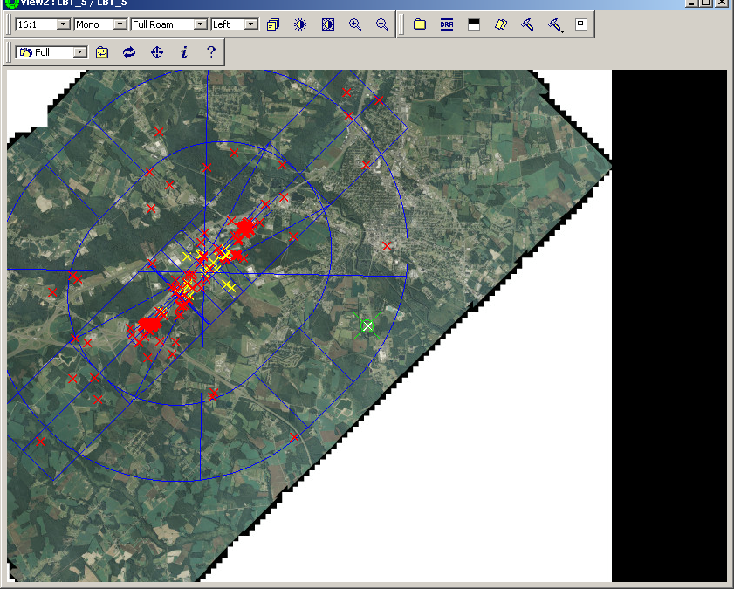
AC-18B Final Survey Data
NGS Review scoped to safety critical data for Instrument Procedure Development
Airport Geodetic Control (2.6.10.1)
Runway Data (2.6.10.2)
Navigational Aids (2.6.10.3)
Obstacle data (2.7)
Evaluate deliverables (data and supporting evidence) to ensure the survey data meets the standards and specifications in AC 18B
NGS leverages the geo-referenced imagery (submitted by the survey consultant) to perform the quality review.
Notes:
AC-18B data must be uploaded to the AGIS site in the correct coordinate system

Slide 47
Geo-spatial Data
AC18B Airport Feature Class
Chapter 5
Aircraft Gate Stand | Runway End | Flora Species Site | Turning Basin
Aircraft Non Movement Area | Runway Label | Forest Stand Area | Navigation Buoy
Air Operations Area | Runway Safety Area Boundary | Hazardous Material Storage Site | Seaplane Ramp Centerline
Airfield Light | Shoulder | Noise Contour | Seaplane Ramp Site
Arresting Gear | Taxiway Intersection | Noise Incident | Docking Area
Frequency Area | Taxiway Element | Noise Monitoring Point | Anchorage Area
Passenger Loading Bridge | Landmark Segment | Sample Collection Point | Security Area
Runway Centerline | Obstacle | Shoreline | Security Identification Display Area
Runway Helipad Design Surface | Obstruction Area | Wetland | Security Perimeter Line
Runway Intesection | Obstruction Identification Surface | Airport Control Point | Sterile Area
Runway LAHSO | Runway Protect Area | Coordinate Grid Area | Bridge
Runway Element | Airport Boundary | Elevation Contour | Driveway Area
Stopway | Airport Parcel | Image Area | Driveway Centerline
Taxiway Holding Position | County | Building | Parking Lot
Airport Sign | Easements And Rights of Ways | Construction Area | Railroad Centerline
Apron | FAA Region Area | Roof | Railroad Yard
Deicing | Land Use | Fence | Road Centerline
Touch Down Lift Off | Lease Zone | Gate | Road Point
Marking Area | Municipality | Tower | Road Segment
Marking Line | Parcel | NAVAID Critical Area | Sidewalk
Movement Area | State | Navaid Equipment | Tunnel
Ruway | Zoning | NAVAID Site | Tank Site
Restricted Access Boundary | Environmental Contamination Area | Water Operating Area | Utility Line
Runway Arresting Area | Fauna Hazard Area | Water Lane End | Utility Point
Runway Blast Pad | Flood Zone | Taxi Channel | Utility Polygon
Notes:
Data Content Standard (Feature Classes)
Data Centric (about the data, how to report)
Does not specify the data to be identified, located and reported for any given survey
- Geodetic control requirements
Runway / Stopway data
- Navigational Aid data
OIS to be evaluated
Obstacle data

Slide 48
Final Data (18B Data Content Standard)
Type | Required Features | Feature Class | Section
Datum Tie | Geodetic Control | AirportControlPoint | 5.8
Runway Points | Runway End | RunwayEnd | 5.4.26
 | Displaced Threshold, Stopway End, TDZE, Airport Elevation, Runway Intersection, NAVAID Perpendicular Point, Profile Point | AirportControlPoint | 5.8
Runway Information | Length/Width | Runway | 5.4.22
 | True Bearing | RunwayEnd | 5.4.26
 | ARP | AirportControlPoint | 5.8
Stopway Information | Length/Width | Stopway | 5.4.13
Navigational Aids | NAVAID Facilities | NavaidEquipment | 5.10
Obstacles | Obstacles | Obstacle | 5.52
 | Obstructing Area | ObstructingArea | 5.53
OIS | Obstruction Identification Surface | ObstructionIdSurface | 5.54
Notes:
Reporting safety critical data
Note: AirportControlPoint is dumping ground
Evidence documenting and supporting the submitted data

Slide 49
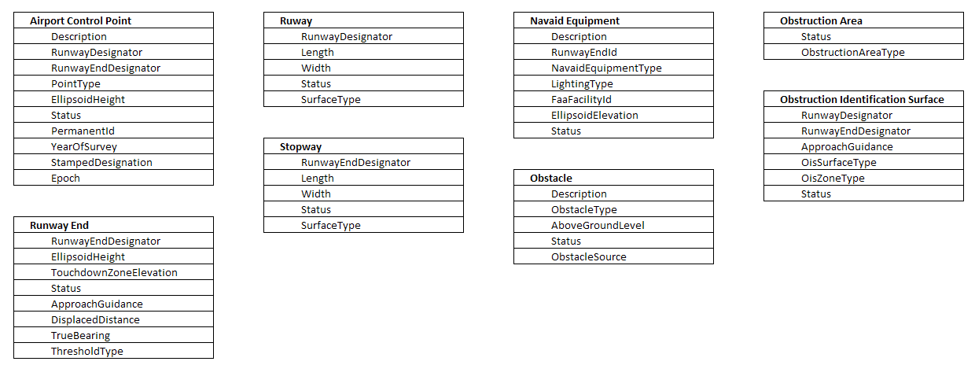
Essential Feature Attribute Information
Notes:
Recommend
- Addition attributes (All - Verification Date, Obstacle - Accuracy)

Slide 50
Final Project Report
What is expected in the Final Project Report:
Project Identification Data
Project Summary
  Scope of survey (survey requirements)
  Brief description how requirements where met
    (Geodetic Control, Runway, Navigational Aid and Obstacle data)
    Condition or problems affecting the survey
    Conclusions
Interview Checklists
Documentation (information and evidence supporting the submitted data)
  Photographs, sketches, diagrams, log sheets
  Comparisons (Published to Surveyed)
  Forms and Checklists
GPS Processing Files
GPS Raw Data
Miscellaneous Digital Files
  Non-GPS Data Collector Files
http://www.ngs.noaa.gov/AERO/AirportsGIS/AC16/index.shtml
Notes:
Project summary :
Conditions:
unusual situation,
discrepancies between published and observed
Non-standard Runway markings
Interview checklist (Airport Manager/Operations, Air Traffic Control, Airway Facilities)
Or lead to a increased review time.
observation scheme will not meet minimum requirements
Proposed location of stations will not meet minimum requirements

Slide 51
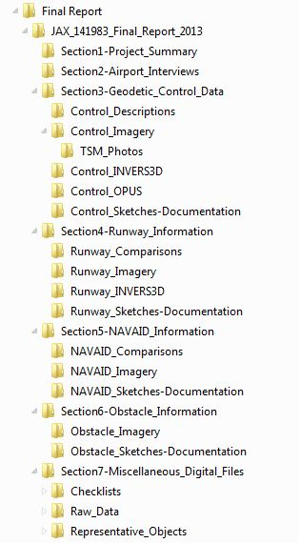
AC18B Final Report File Structure
http://www.ngs.noaa.gov/AERO/AirportsGIS/AC16/FAA_AC_18B_Final_Report_Directory_Structure.shtml

Slide 52
Critical Deficiencies in Final Data
Reasons Data may not be approved:
Survey requirements not met
Data reported incorrectly (mis-identified or in wrong feature class)
Incorrect Feature Attribution
Data reported with z-value of 0 (zero)
More than 9999 features reported in Obstacle Feature Class
Documentation requirements not met
Incomplete submissions delay the review process
http://www.ngs.noaa.gov/AERO/AirportsGIS/AC16/index.shtml
Notes:
Could pull up standard NGS Quality Review Report
38% of AC-18B submitted surveys are not approved

Slide 53
Questions?

Slide 54
Examples of common deficiencies in AC18B submissions

Slide 55
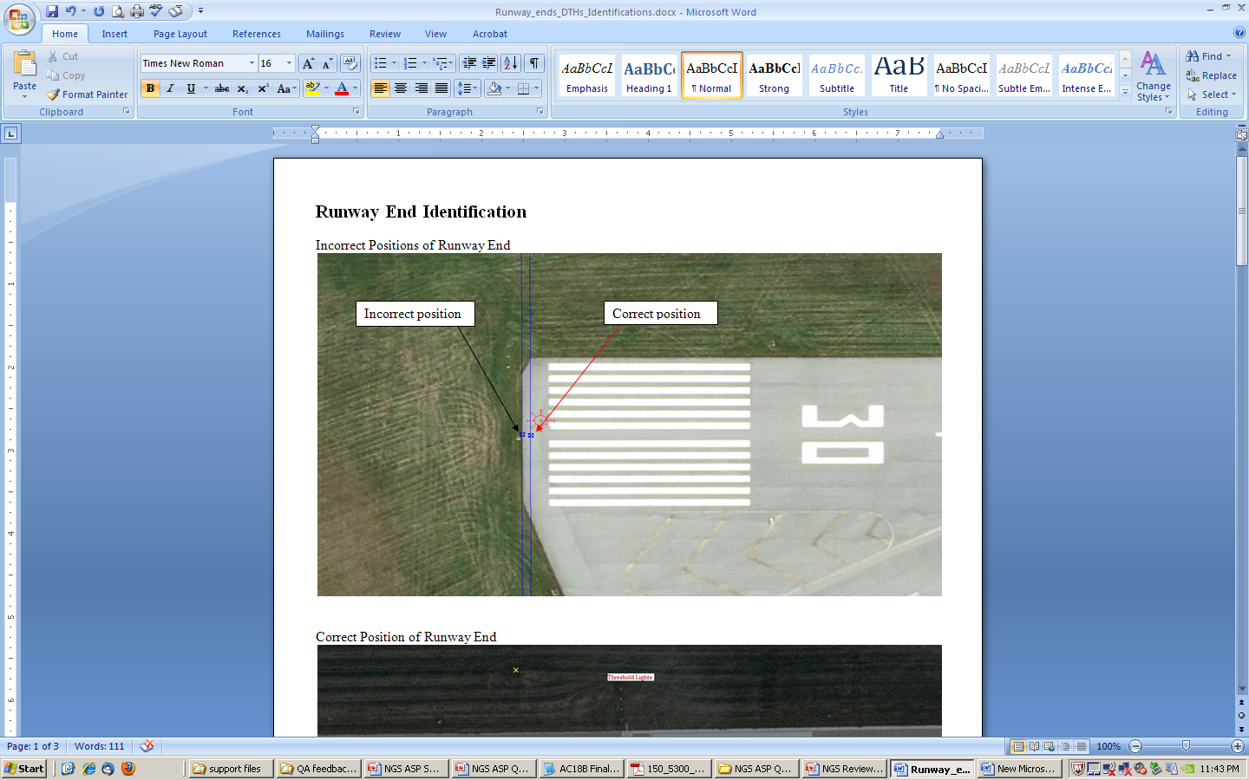

Slide 56
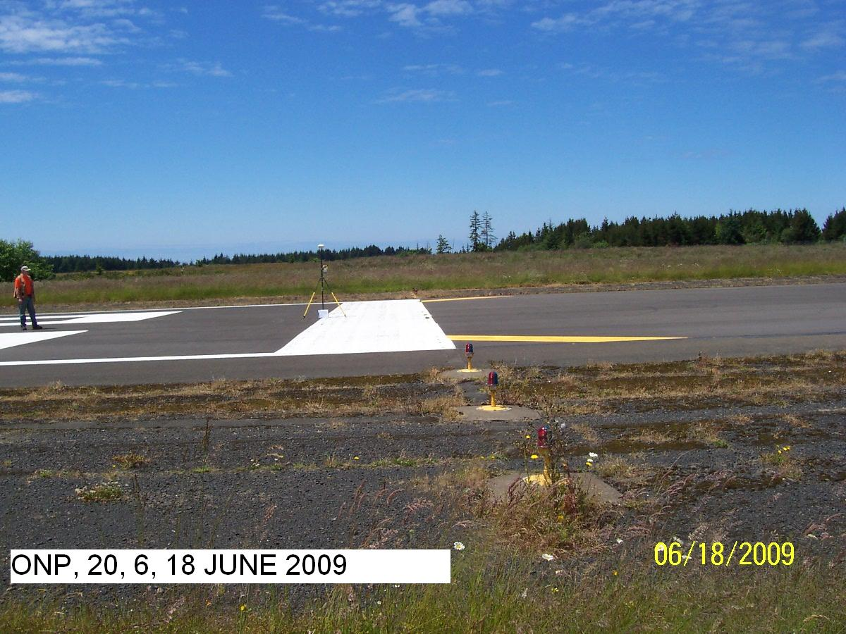
Runway Threshold 20 incorrectly positioned at inboard edge of 10 foot wide white paint bar. Point should be positioned on outboard edge of paint bar. . Refer to C.1.2.8.2

Slide 57
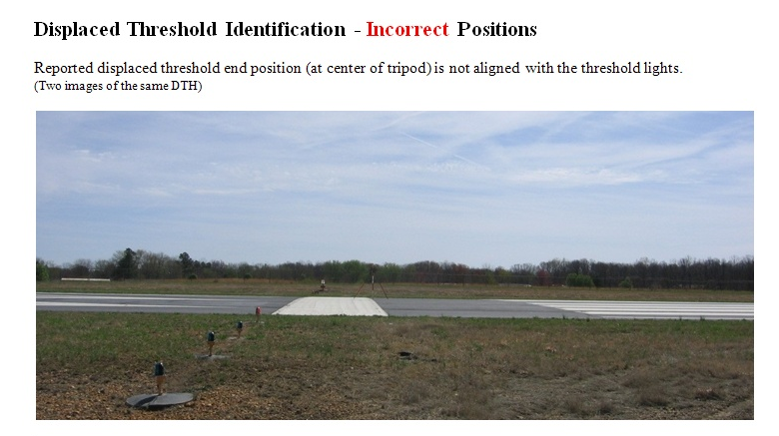

Slide 58
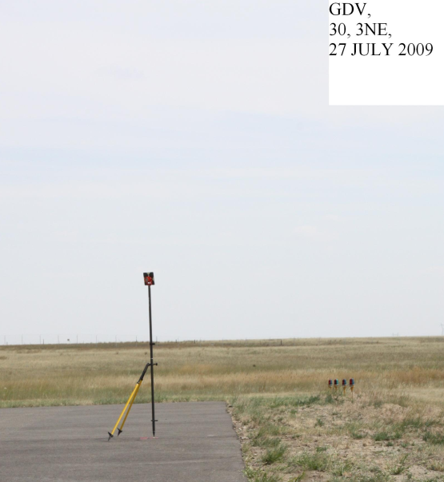
Possible incorrect positioning of runway end 30. Target out of plumb?

Slide 59
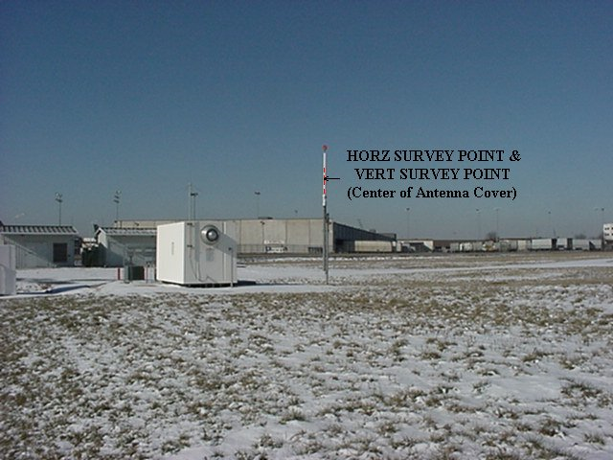
Proper DME Vertical Survey Point (VSP)
Center of antenna canister.

Slide 60
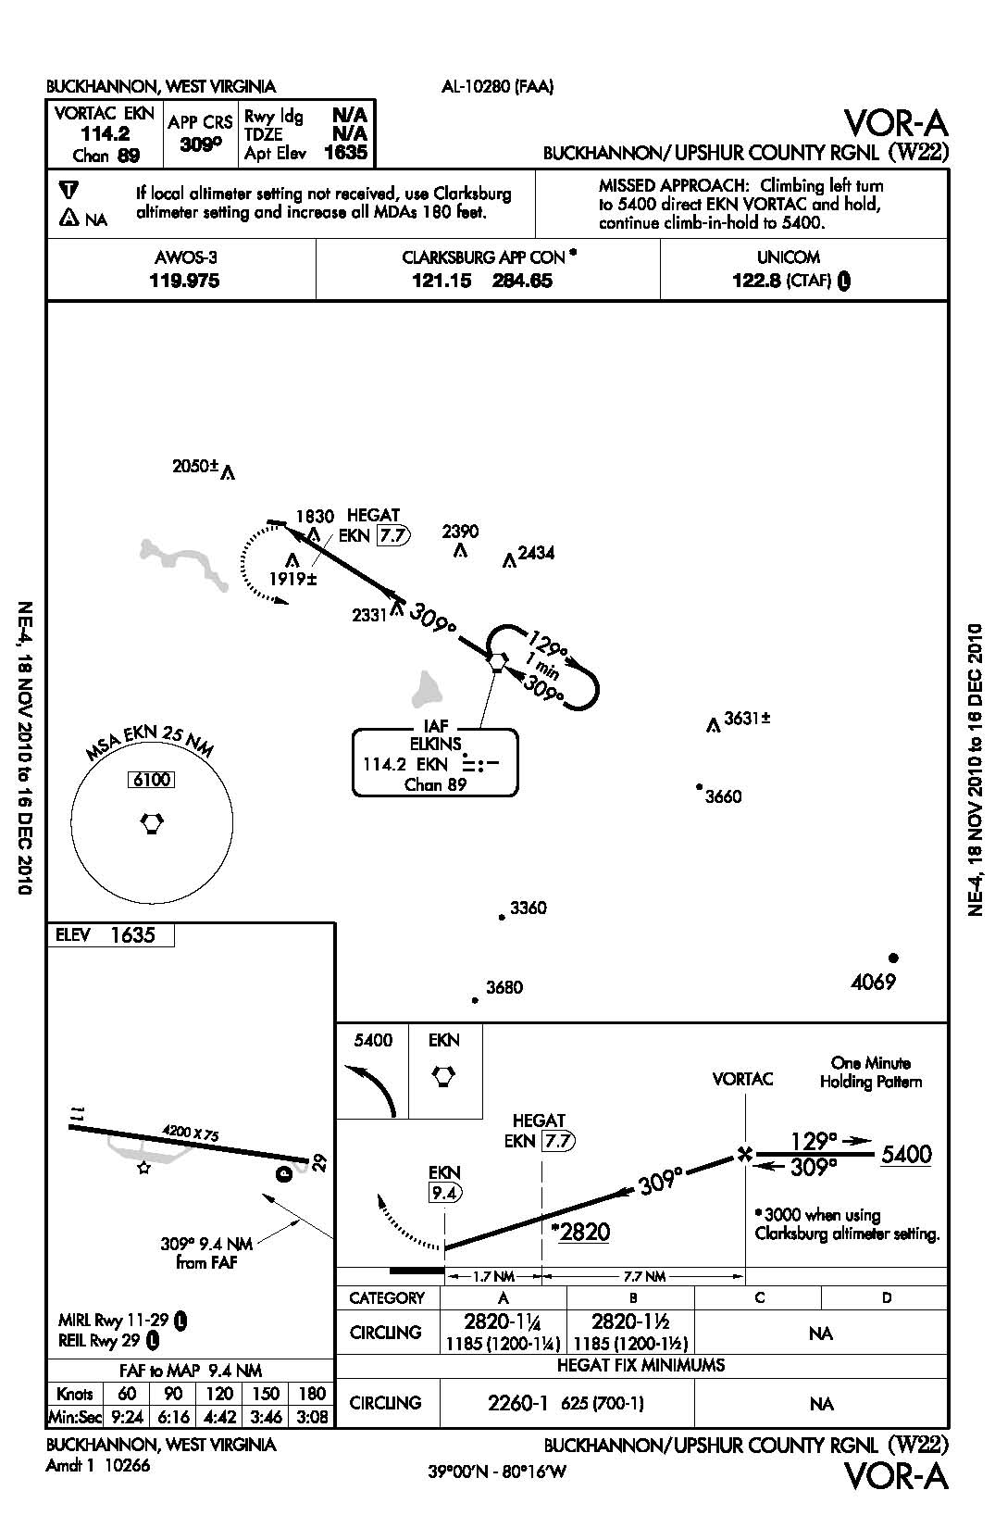
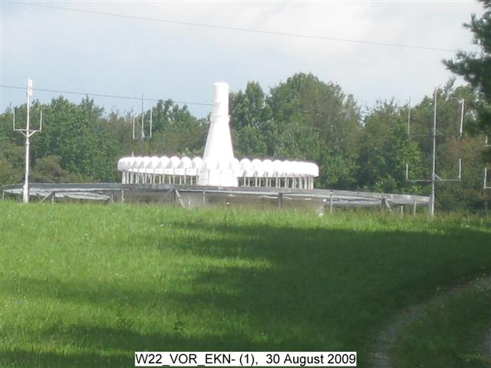
OMMISION - VORTAC
Photograph submitted. Positional Information not reported in submitted geo-spatial files
VORTAC
US Terminal Procedures diagram

Slide 61
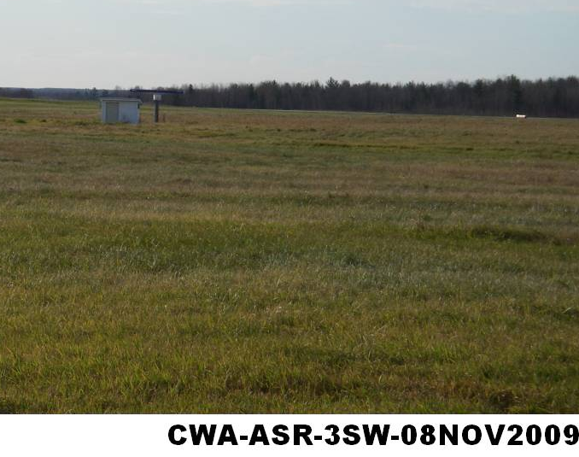
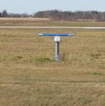
Feature #279 incorrectly described as an ASR. This is actually a piece of equipment called AVIAN RADAR. It is used to track Migratory Birds & Bats.

Slide 62
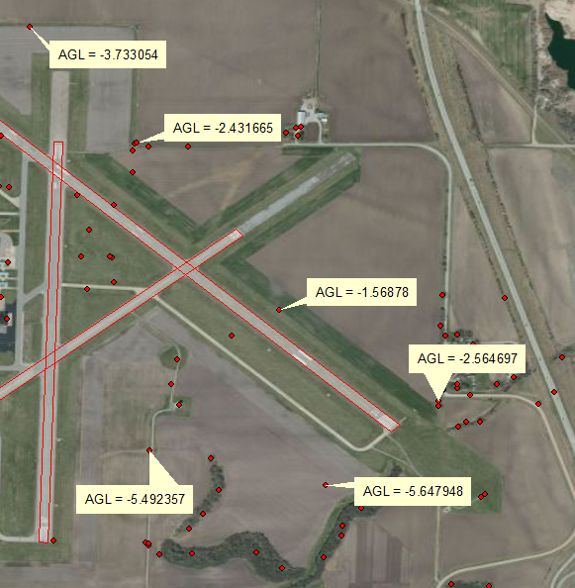
Obstacles Submitted with Negative Above Ground Level Values
The AGL height is determined
as the difference between the
base elevation and top elevation
of a feature; it is a feature’s
height above the ground.
It is not possible for an obstacle
to have a negative AGL.
Notes:
TOP

Slide 63
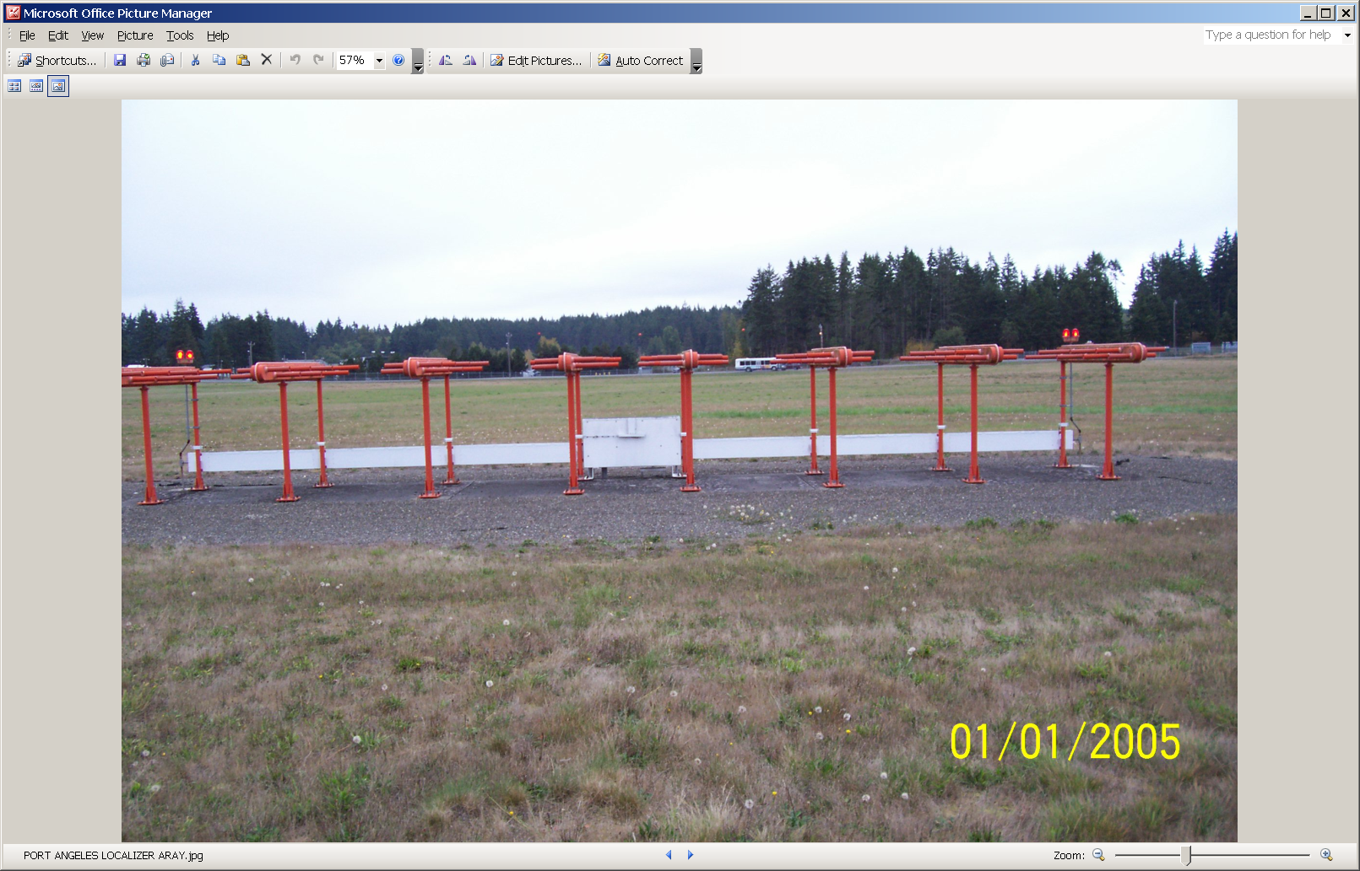
Photograph showing obstacles in approach

Slide 64
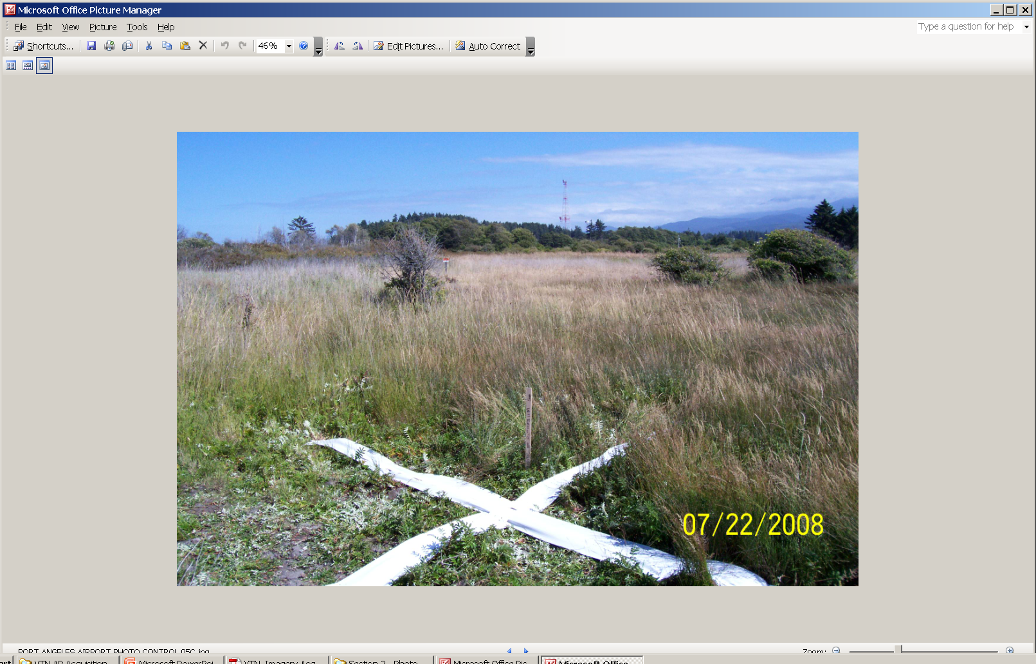
Photograph showing obstacle that was not reported in survey

Slide 65

Obstacle Selection Criteria
Highest feature in Transition to Approach surface

Slide 66
Temporary Survey Marks (TSM)
Temporary Control. If PACS/SACS do not exist or cannot be verified, Temporary Survey Marks (TSM’s) may be established and tied to the NSRS through the use of the NGS Online User Positioning System (OPUS).
The following practices should be observed when using the OPUS to establish temporary airport control:
Establish two independent but inter-visible marks on an airport as a conformity check and perform redundant observations.
Observe each mark in two continuous and independent sessions of at least 4 hours and submit these observations to the NGS OPUS site at http://www.ngs.noaa.gov/OPUS/.
Resubmit observations to obtain improved positions. The priority for orbit selection is:
  IGS precise orbits (typical delay 10-14 days).
  IGS rapid orbits (one day delay).
  IGS ultra-rapid (predicted) orbits (near real-time).
Review and analyze the results of each OPUS solution.
  Good OPUS solutions should typically use 90% or more of the observations.
  OPUS processing should have fixed at least 50% of the ambiguities.
  The overall RMS should seldom exceed 3 cm.
  The peak to peak errors should seldom exceed 5 cm.
Compare the OPUS solutions to ensure datum tie accuracy requirements have been met. Compute coordinate inverses using either the NGS program INVERS3D (available on the NGS website at http://www.ngs.noaa.gov/TOOLS/) or a comparable commercial product.
Provide the OPUS solution reports and associated supporting evidence as part of the observational data in the final report.

