Slide 1
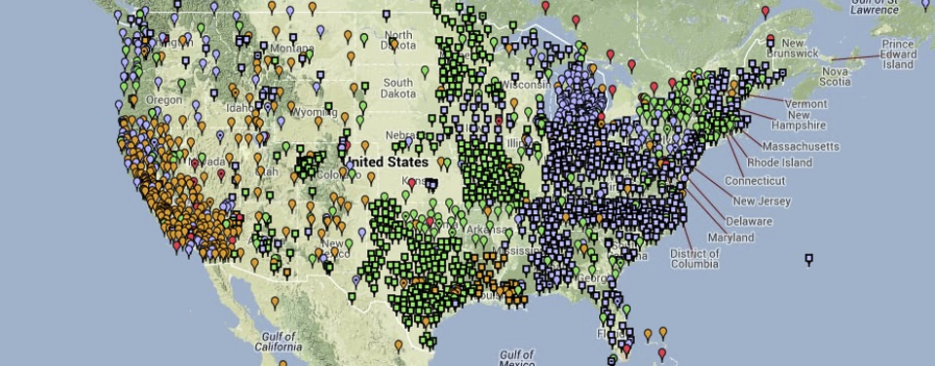

A Guided Tour of the National Spatial Reference System with NOAA’s National Geodetic Survey
NOAA’s National Geodetic Survey (NGS) defines, maintains, and provides access to the National Spatial Reference System (NSRS). Here, we overview NGS products and services, and how they will change as part of NSRS Modernization
AGIC 2021 Education and Training Symposium
October 25, 2021
Lynda Bell and Michael Dennis, National Geodetic Survey
Notes:
Welcome to “Paving the Road to the Future NSRS”

Slide 2


About
I am currently a full time civil servant for the Department of Commerce, serving as the Southwest Regional Geodetic Advisor for NOAA's National Geodetic Survey (NGS). I am serving as a liaison between NGS and its public, academic, and private sector customers within my region (Arizona, New Mexico, and Utah), providing guidance and assistance on geospatial activities that are tied to the National Spatial Reference System. My current duty station is located at the University of Arizona, in the Department of Geosciences, Tucson, AZ.
I have also had the great privilege to serve several other federal agencies in the geospatial community, working as a Geophysicist and Senior Scientist at NASA’s Goddard Space Flight Center in Greenbelt, MD and as a Sea Level Specialist at the National Park Service Headquarters in Fort Collins, CO.
Lynda Bell
NGS SW Regional Advisor
(AZ,NM,UT)
lynda.bell@noaa.gov
240-988-5919
Notes:
I’m Lynda Bell, the National Geodetic Survey Advisor for the Southwest Region.
We will be your narrators for this presentation.

Slide 3
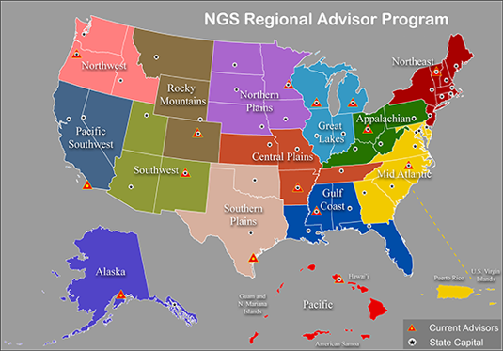
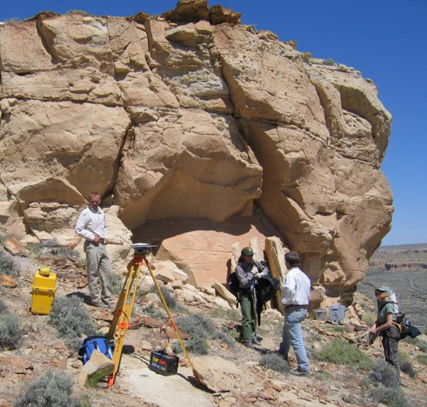
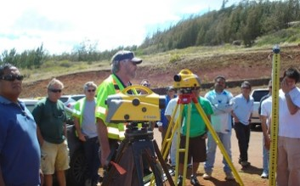
NGS Regional Advisor Program
The Regional Geodetic Advisor is a federal employee of NOAA’s National Geodetic Survey serving as a liaison between NGS and its public, academic, and private sector constituents who are managing the geodetic component of geospatial activities tied to the National Spatial Reference System (NSRS) in their region.
NGS Advisors serve as subject matter experts in geodesy and regional geodetic issues

Slide 4

The Southwest Region (AZ-NM-UT)
NGS Services in the Region
Continuously Operating Reference Stations (CORS)
Online Positioning User Service (OPUS/Projects)
Passive Control
Geoid Models
Transformation Tools
Publishing & Sharing Survey Results
“Good Luck and Have Fun! It’s a fantastic region!” – Bill Stone

Slide 5
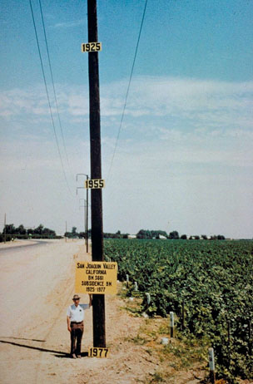
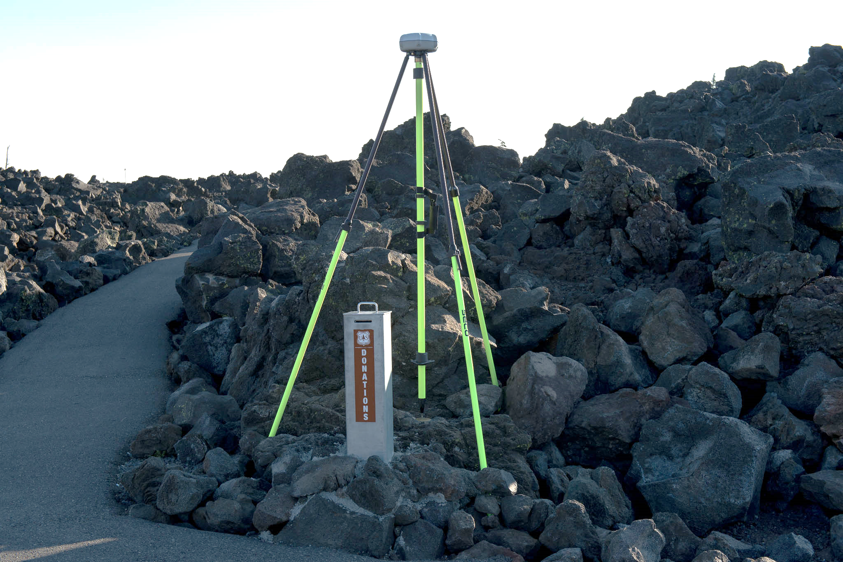
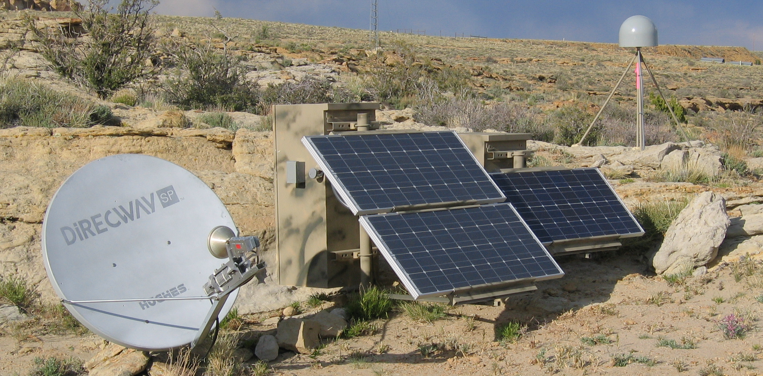
Projects Supporting the NSRS in the SW Region
Partner & Constituent Activities
Installing CORS
Real-time GNSS Networks
Height Modernization
Lidar Survey Control
Subsidence Monitoring
Mark Preservation
GPS on Bench Mark Data Collection
New Datums Preparation
THANK YOU!!!

Slide 6
NGS Mission
Define, maintain, and provide access to the
National Spatial Reference System (NSRS)
to meet our Nation’s economic, social & environmental needs

Slide 7
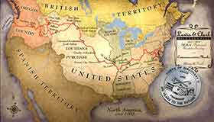

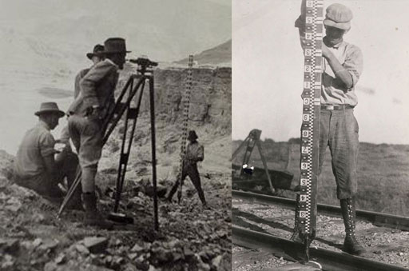
NGS History

Slide 8
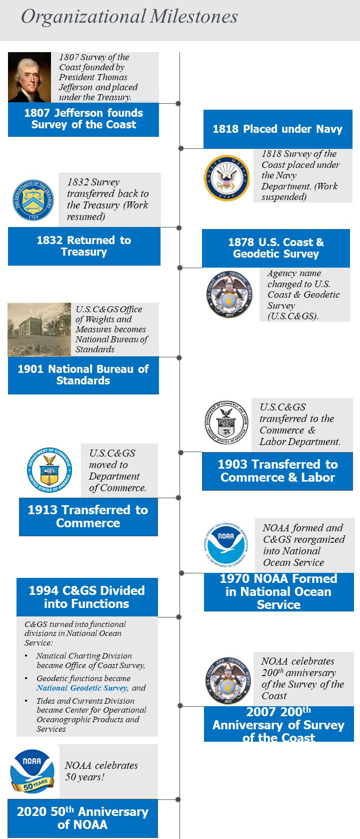
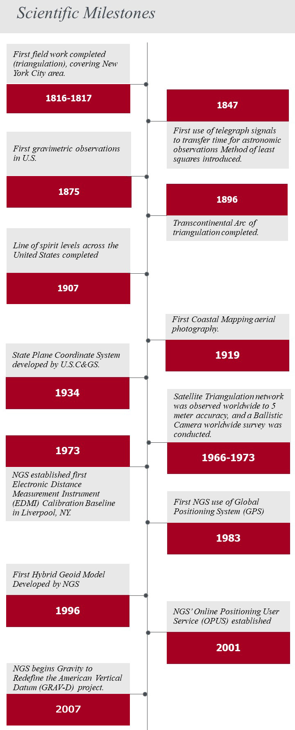
Historic Milestones

Slide 9
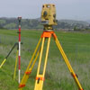

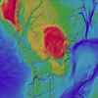
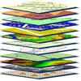

What We Do
The mission of the National Geodetic Survey (NGS) is to define, maintain and provide access to the National Spatial Reference System (NSRS) (PDF, 123 KB). The NSRS provides a consistent coordinate system that defines latitude, longitude, height, scale, gravity, and orientation throughout the United States and its territories.
GNSS and GPS Data
Remote Sensing
Land Surveying
Geodesy
Training and Education
Datums and Transformations

Slide 10

NGS Products and Services
Vertical Datum Transformation Tool
Gravity for the Redefinition of the American Vertical Datum (GRAV-D)
Emergency Response Imagery
Ecosystem and Climate Operations
NSRS
CORS
OPUS
Airport Surveys
Shoreline Mapping
GPS Satellite Orbits

Slide 11
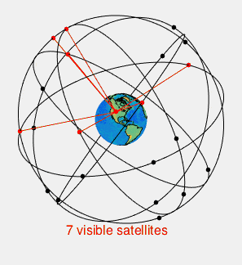
GNSS Data Processing
NGS supports surveyors and others with high-accuracy Global Navigation Satellite System (GNSS) data, ground control marks, models and tools, guidelines and tutorials.
GNSS Tools
Online Positioning User Service (OPUS): Tie your GPS observations to U.S. and international frames.
Antenna Calibration: Look up antenna biases for high-accuracy data processing.
Transformation tools (Geodetic toolkit): Transform data between reference frames and datums.
Geoid Models: Convert GPS heights to orthometric (e.g., NAVD 88).
Orbits: See International GNSS orbit products.
GNSS Survey Methods
NGS is exploring a proposed new file format, GNSS Vector Exchange (GVX) to more consistently use GNSS vectors in survey networks.

Slide 12
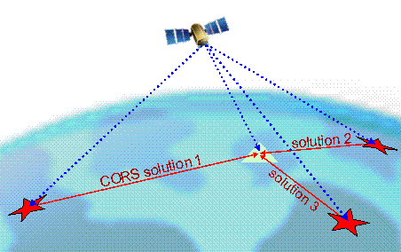
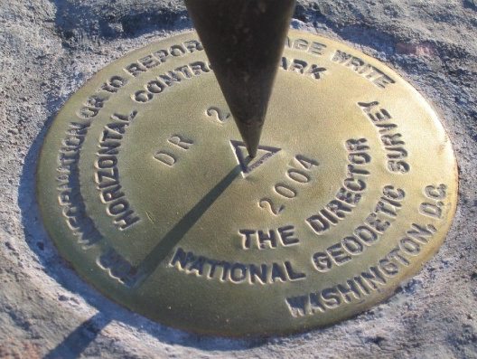
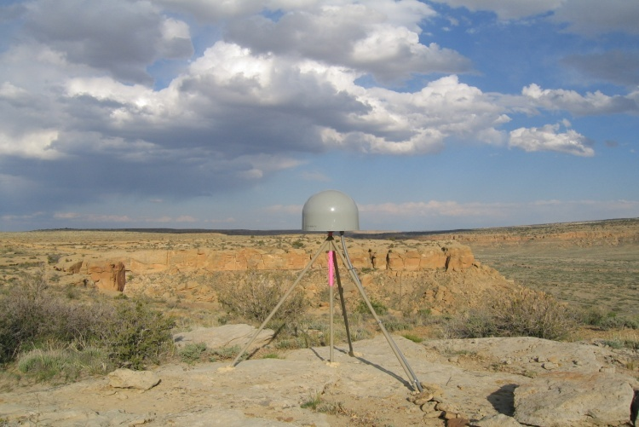
Online Positioning User Service (OPUS)
What is OPUS?
NOAA's Online Positioning User Service (OPUS) provides free access to high-accuracy National Spatial Reference System (NSRS) coordinates. OPUS uses software which computes coordinates using the NOAA CORS Network (NCN).

Slide 13
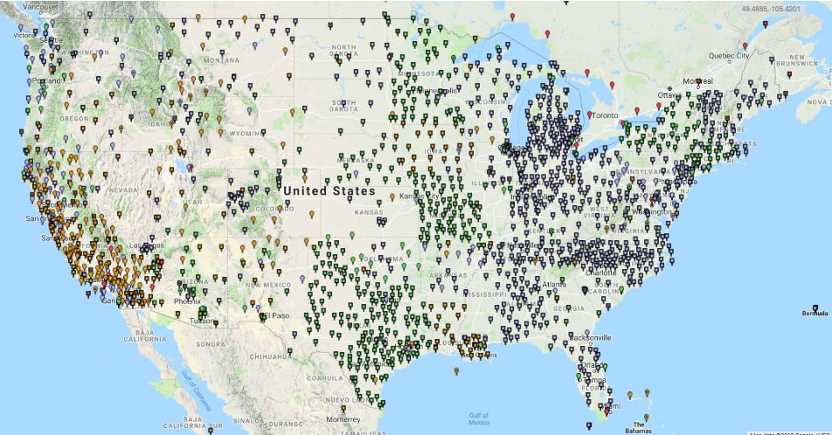
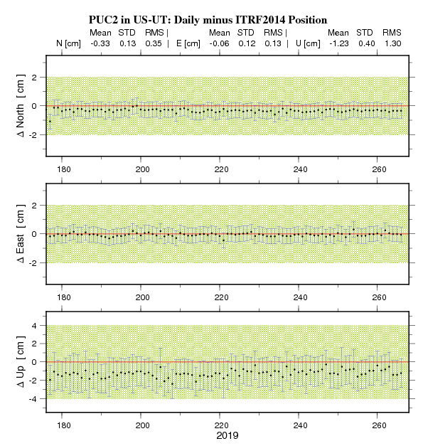
Continuously Operating Reference Stations (CORS)
Continuously Operating Reference Stations (CORS): Get GNSS data files, station coordinates, and velocities from this nationwide array of tracking stations which are used for survey processing and geophysical research

Slide 14
Coordinate Conversions and Transformations
Datums and Transformations
As accuracy and precision of geospatial data increases, it is becoming more important to manage your data carefully and use consistent reference frames. NGS defines datums as the foundation for positioning for the United States and Territories. NGS also provides transformation tools to help align data and to transform coordinates between other datums and projections.
https://geodesy.noaa.gov/INFO/datums-transformations.shtml

Slide 15

NOAA’s NGS Manages the
National Spatial Reference System
The National Spatial Reference System
“A consistent coordinate system that defines latitude, longitude, height, scale, gravity, orientation, and shoreline throughout the United States and is designed to meet our nation’s economic,
social, and environmental needs. “
Components
Geodetic positional coordinates
Geopotential
Acceleration of Gravity
Deflection of the Vertical
Models, tools, and guidelines
The official national shoreline
GNSS Orbits
Orientation, scale, and offset information (NAD 83/ITRF)

Slide 16
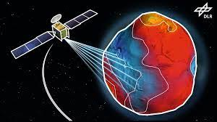

NSRS: Setting a Geodetic Standard
For 200 years, NGS and its predecessor agencies have collaborated with public and private organizations to establish reference stations at precisely determined locations.
More recently, NGS has fostered a network of continuously operating reference stations (CORS) where each CORS includes a highly accurate receiver that continuously collects radio signals broadcast by Global Navigation Satellite System (GNSS) satellites forming a network used to accurately position other points of interest.

Slide 17
NGS Transformation Tools and Data Sets that Support the NSRS
NGS Coordinate Transformation Tools
NGS Coordinate Conversion and Transformation Tool (NCAT): Convert between different coordinate systems and/or transform between different datums.
Vertical Datum Transformation Tool (VDATUM): Converts elevation data from various sources into a common reference system.
Horizontal Time-Dependent Positioning Utility (HTDP): Transforms positions across time and spatial reference frames.
State Plane Coordinates 83 (SPCS83): Provides coordinates on a flat grid for easy computation.
NGS Data Sets
OPUS Share
NGS Data Explorer Geodetic Control
Survey Mark Data Sheets
Antenna Calibration Data
Remote Sensing Data
Storm Imagery
Coastal Imagery
Shoreline Data Explorer
Orthomosaics
Lidar
Aeronautical Data
Gravity Data
Orbit Data

Slide 18
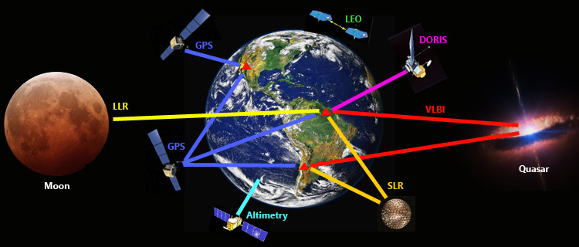

NSRS: Need for Precise Positioning
International Association of Geodesy

Slide 19

NASA Space Geodesy Profiles: Dr. Chopo Ma
Scientists from NASA's Space Geodesy Project discuss the techniques they use to precisely measure the Earth's position in the universe, determine the Earth's center of mass, calibrate satellites, observe sea level rise, and track the movements of the tectonic plates.

Slide 20
NSRS Modernization
Improving the National Spatial Reference System
The National Geodetic Survey has been working over the last ten plus years to remove inaccuracies in the existing datums of the United States
By tracking the dynamic nature of the Earth, and giving users tools to account for it, NGS will provide a new National Spatial Reference System that is semi-dynamic.
“By fully embracing the benefits of GNSS as the positioning tool of today, and of the future, NGS will effectively link the replacements for NAD 83 and NAVD 88 through a geocentric reference frame and gravimetric geoid model”
-Dr. Dru Smith, Chief Geodesist, National Geodetic Survey, 2010

Slide 21
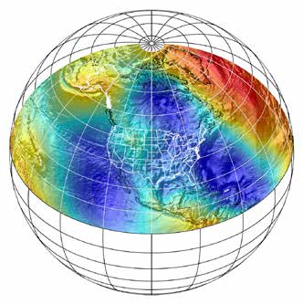
How NSRS Modernization will affect
NGS Products and Services
Whether users choose to work in a fully dynamic or semi-dynamic frame, NGS will provide the tools for transforming between them.
“The terrestrial reference frames replacing NAD83 will be consistent with geocentric global reference frames defining latitude and longitude. The geopotential datum replacing NAVD 88 will be based on a gravimetric geoid model, enhanced by data from NGS’ Gravity for the Redefinition of the American Vertical Datum (GRAV-D) Project.”

Slide 22

The Road Forward
“NGS is seeking to engage the entire geospatial community to make the transition to new datums as seamless as possible”
Supporting the Current Datum
Building the
New Datum
St. Croix River, MN; Concept and photo courtesy Dave Zenk, NGS Northern Plains Regional Advisor
Notes:
No such road would be complete without a bridge between the present and the future.

