Slide 1

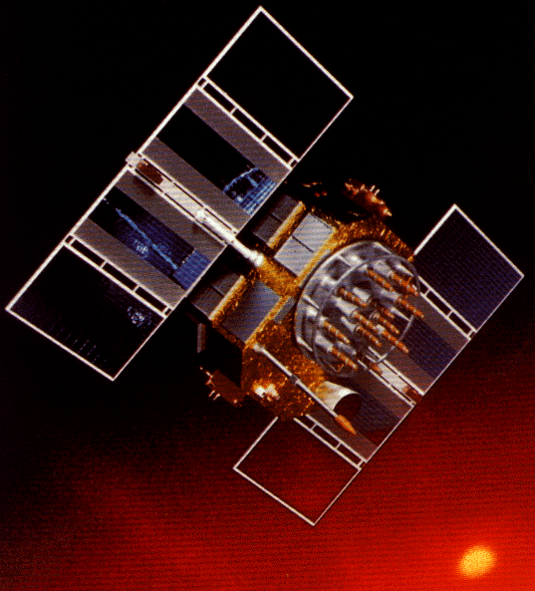
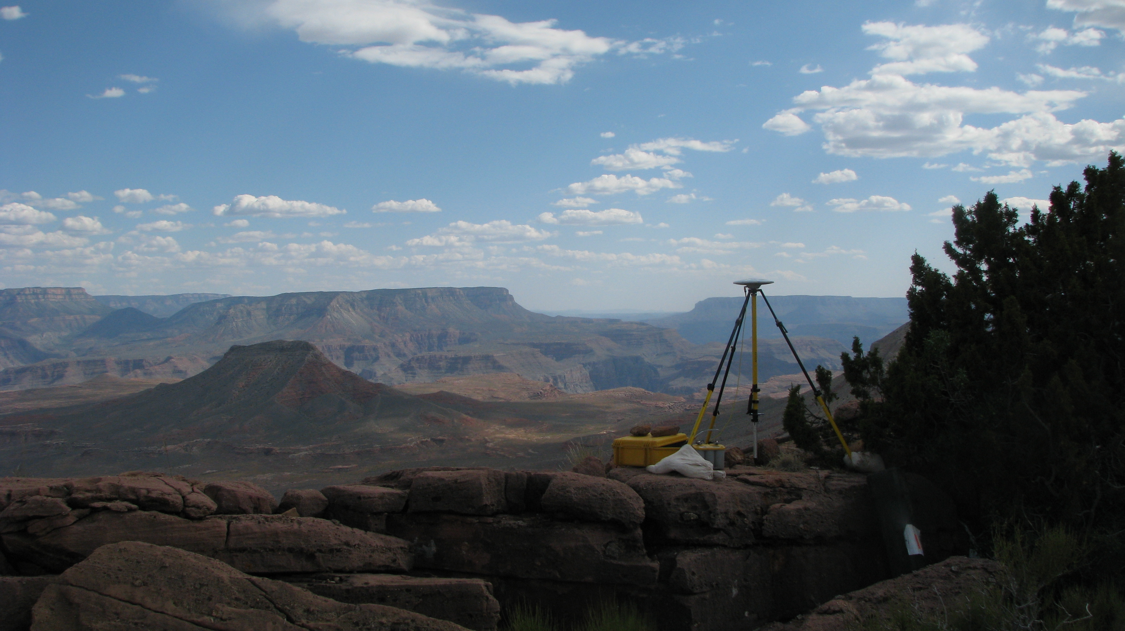
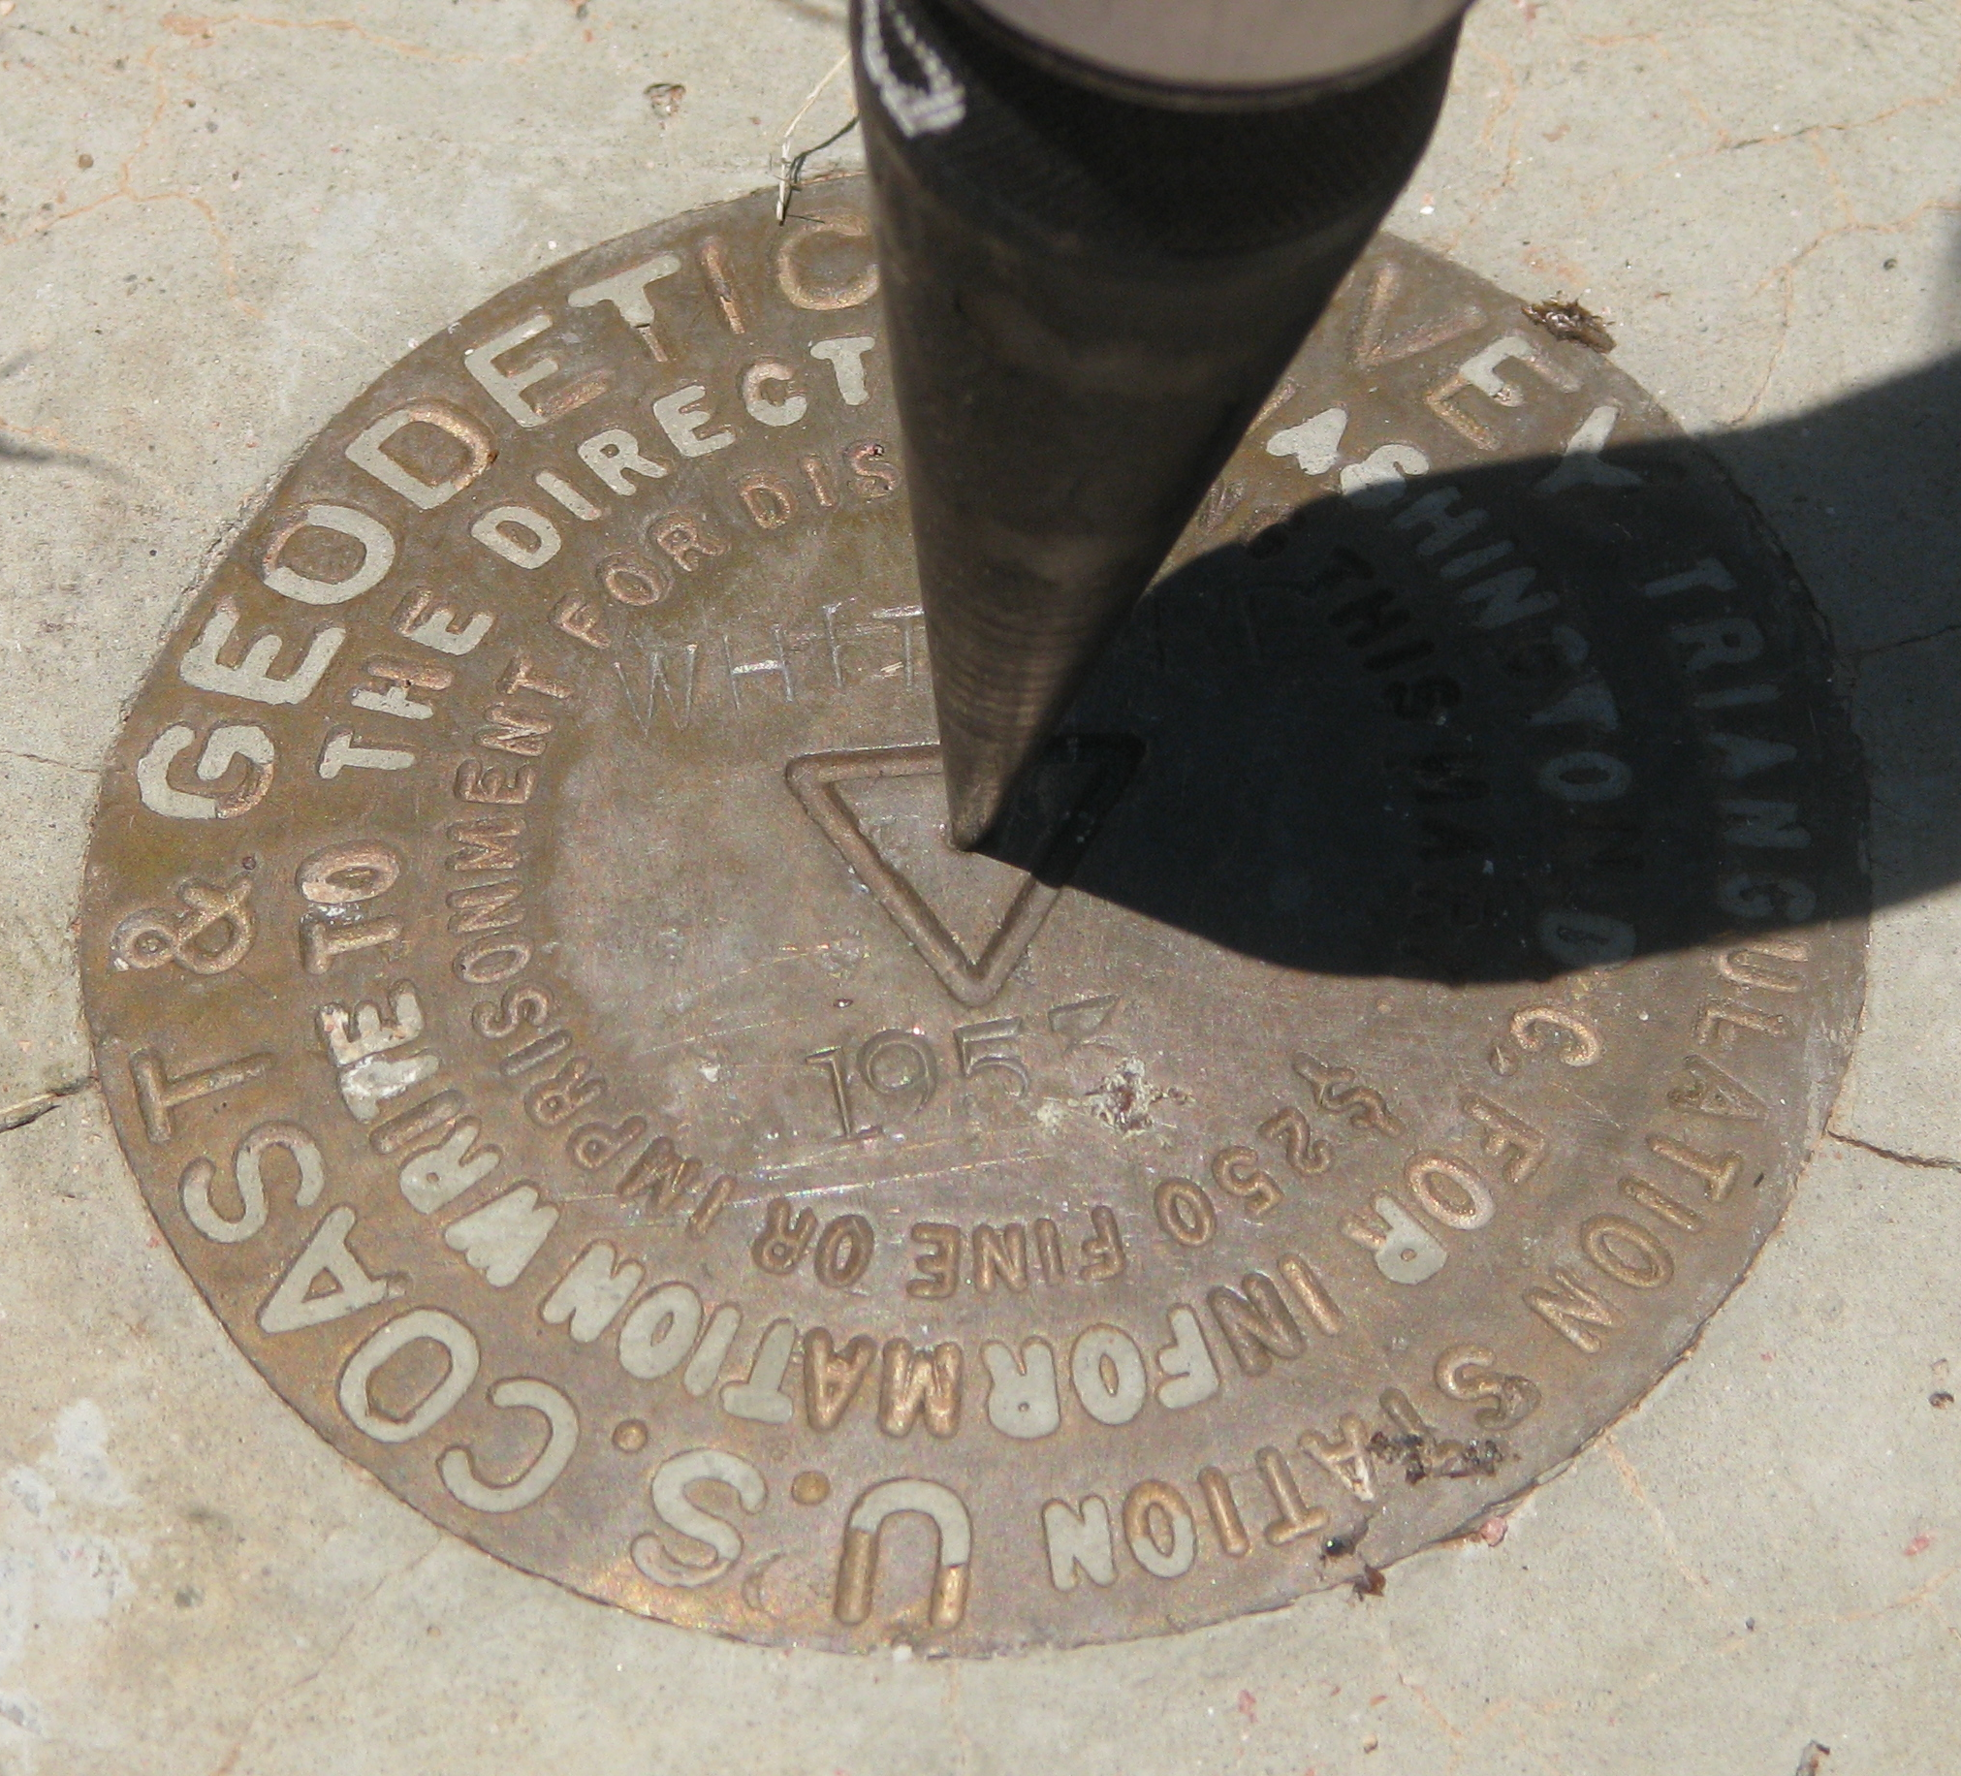
The Many Faces of OPUS and the
Siren Call of Bluebooking: Part 1
Arizona Professional Land Surveyors Association
2014 Annual Conference
April 9-11, 2014 ● Tucson, Arizona
Michael Dennis, RLS, PE
michael.dennis@noaa.gov

Slide 2
The Plan
The Online Positioning User Service (OPUS)
  OPUS Static
  OPUS Rapid Static
  OPUS Net (under development)
  OPUS Projects (released January 2014)
Contributing to the NSRS: “Bluebooking”
  NSRS = National Spatial Reference System
  The NGS mission and NGS policy
  NGS terminology for contributing to the NSRS:
    “Share”, “Submit”, “Publish”, “Datasheet”
A closer look at OPUS-Projects for Bluebooking

Slide 3
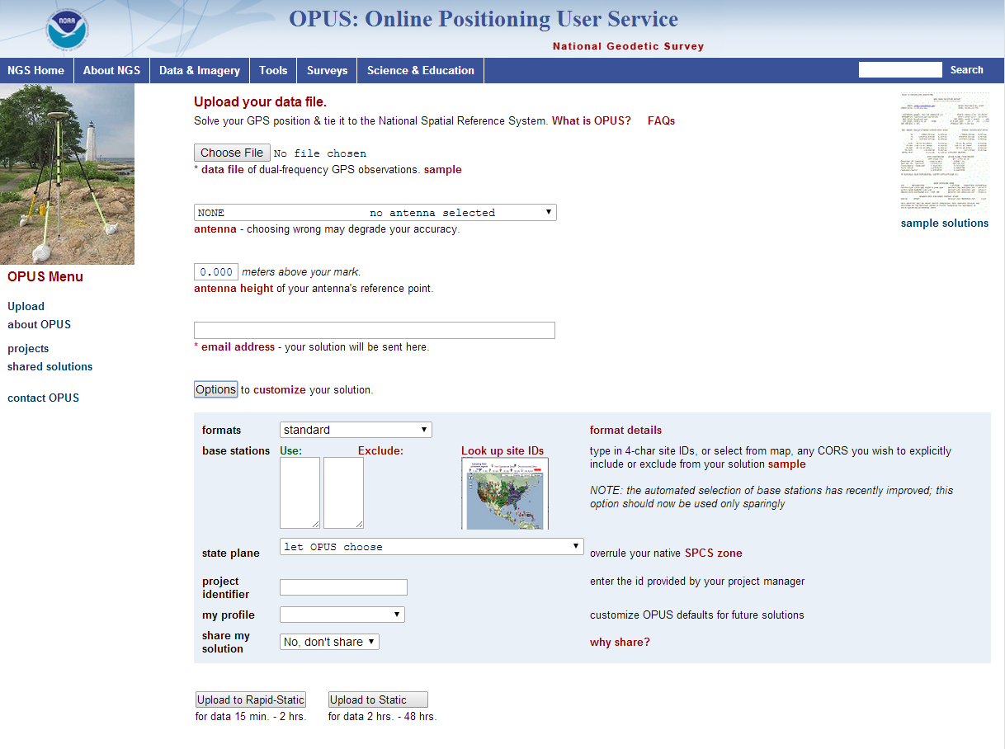

Slide 4
The Many Faces of OPUS
OPUS, the Online Positioning User Service, is a growing set of applications offering web-based access to the tools and resources provided by the NGS. OPUS is composed of:
OPUS Static . . . . . . . static processing
OPUS Rapid-Static . . rapid-static processing
OPUS Sharing . . . . data base and sharing
OPUS Net . . . . . . . improved models and processing strategies
OPUS Projects . . . . multiple marks and occupations

Slide 5
The OPUS Static Interface
Beautiful in its simplicity, the user need only provide:
Their email address.
The antenna type.
The offset to the antenna reference point (ARP).
2- to 48-hours of GPS L1 + L2 data.
In turn, the user receives:
Coordinates accurate to a few centimeters.

Slide 6
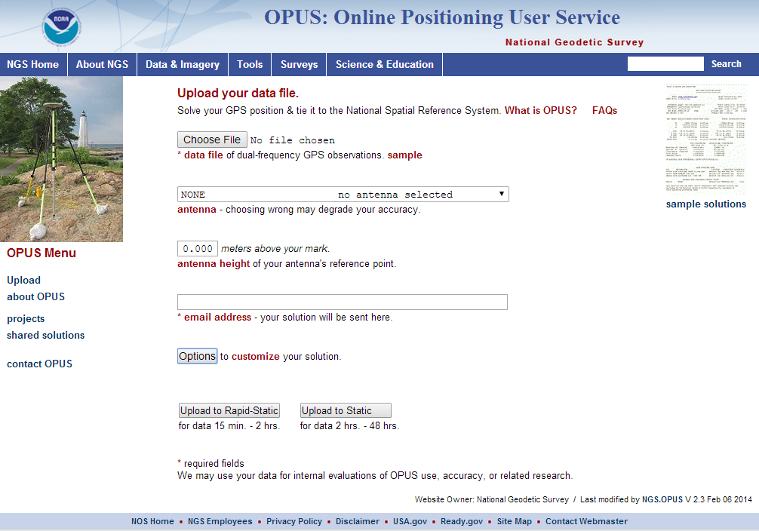
The OPUS Static Interface
This is the OPUS home page used to submit data to the processing queues.
To use OPUS Static, complete the four fields, then click the “Upload to STATIC” button. In a few minutes, an email arrives with the results.
http://geodesy.noaa.gov/OPUS/

Slide 7
How Good Can I Do With OPUS Static?
OPUS Static reliably addresses the more historically conventional requirements for GPS data processing. It typically yields accuracies of:
1 – 2 cm horizontally
2 – 4 cm vertically
However, there is no guarantee that this stated accuracy will result from any given data set. Confirming the quality of the OPUS solution remains your responsibility. That’s the “price” for automated processing.

Slide 8
How Good Can I Do With OPUS Static?
As a quality test, 2-hour data sets from more than 200 CORS were submitted to OPUS Static and the results compared to the accepted coordinates.
Mean: <0.1 cm
N-S RMS: 0.8 cm
E-W RMS: 1.4 cm
Weston, N. “OPUS: Online Positioning User Service”, CGSIC USSLS MEETING, 2008-07-08, NEW ORLEANS, LA.

Slide 9
How Good Can I Do With OPUS Static?
Same data sets, same analysis, but for the vertical. The vertical is always a little more interesting.
Mean: <0.1 cm
U-D RMS: 1.9 cm
Weston, “OPUS: Online Positioning User Service”, CGSIC USSLS MEETING,
2008-07-08, NEW ORLEANS, LA

Slide 10
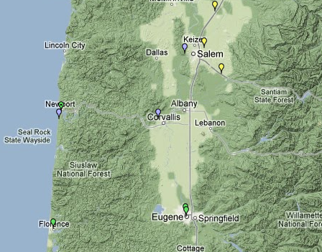
A Quick Example
As an example,
2-hours of
2009-059 data
from CORV, a PBO CORS in Oregon were submitted to OPUS Static.
CORV

Slide 11
The Standard Report
USER: mark.schenewerk@noaa.gov DATE: April 01, 2013
RINEX FILE: corv059f.09o TIME: 15:40:08 UTC
SOFTWARE: page5 1209.04 master63.pl 082112 START: 2009/02/28 05:00:00
EPHEMERIS: igs15206.eph [precise] STOP: 2009/02/28 06:59:30
NAV FILE: brdc0590.09n OBS USED: 5734 / 5906 : 97%
ANT NAME: ASH700936E_C NONE # FIXED AMB: 31 / 31 : 100%
ARP HEIGHT: 1.521 OVERALL RMS: 0.009(m)
REF FRAME: NAD_83(2011)(EPOCH:2010.0000) IGS08 (EPOCH:2009.1596)
X: -2498422.514(m) 0.003(m) -2498423.316(m) 0.003(m)
Y: -3802821.125(m) 0.003(m) -3802819.926(m) 0.003(m)
Z: 4454736.692(m) 0.004(m) 4454736.738(m) 0.004(m)
LAT: 44 35 7.91307 0.004(m) 44 35 7.92691 0.004(m)
E LON: 236 41 43.48298 0.004(m) 236 41 43.42275 0.004(m)
W LON: 123 18 16.51702 0.004(m) 123 18 16.57725 0.004(m)
EL HGT: 105.977(m) 0.002(m) 105.609(m) 0.002(m)
ORTHO HGT: 128.520(m) 0.015(m) [NAVD88 (Computed using GEOID12A)]
UTM COORDINATES STATE PLANE COORDINATES
UTM (Zone 10) SPC (3601 OR N)
Northing (Y) [meters] 4936954.985 105971.634
Easting (X) [meters] 475821.360 2277335.425
Convergence [degrees] -0.21381370 -1.98897464
Point Scale 0.99960719 0.99994603
Combined Factor 0.99959058 0.99992941
US NATIONAL GRID DESIGNATOR: 10TDQ7582136954(NAD 83)
BASE STATIONS USED
PID DESIGNATION LATITUDE LONGITUDE DISTANCE(m)
DI7529 P367 NEWPRTAIR_OR2007 CORS ARP N443506.873 W1240341.596 60113.5
DH4503 P376 EOLARESVR_OR2004 CORS ARP N445628.315 W1230608.099 42648.2
DE6236 LPSB LANE CNTY COOP CORS ARP N440304.409 W1230524.248 61789.3
Here is part of the standard report for this submission.
FYI, these results differ: 0.2 cm horizontally
0.0 cm vertically
from the accepted position (projected to the epoch of the data).

Slide 12
The Extended Report
BASE STATION INFORMATION
STATION NAME: p367 a 3 (NewprtAir_OR2007; Newport, OR USA)
MONUMENT: NO DOMES NUMBER
XYZ -2548424.6112 -3769450.8392 4454655.8317 MON @ 2005.0000 (M)
XYZ -0.0056 0.0017 -0.0024 VEL (M/YR)
NEU -0.0000 0.0000 0.0083 MON TO ARP (M)
NEU 0.0012 0.0008 0.0860 ARP TO L1 PHASE CENTER (M)
NEU 0.0006 -0.0006 0.1183 ARP TO L2 PHASE CENTER (M)
XYZ -0.0234 0.0069 -0.0101 VEL TIMES 4.1596 YRS
XYZ -0.0033 -0.0049 0.0058 MON TO ARP
XYZ -0.0332 -0.0505 0.0612 ARP TO L1 PHASE CENTER
XYZ -2548424.6711 -3769450.8876 4454655.8886 L1 PHS CEN @ 2009.1596
XYZ 0.0000 0.0000 0.0000 + XYZ ADJUSTMENTS
XYZ -2548424.6711 -3769450.8876 4454655.8886 NEW L1 PHS CEN @ 2009.1596
XYZ -2548424.6379 -3769450.8371 4454655.8275 NEW ARP @ 2009.1596
XYZ -2548424.6346 -3769450.8322 4454655.8216 NEW MON @ 2009.1596
LLH 44 35 6.88655 235 56 18.34323 23.0166 NEW L1 PHS CEN @ 2009.1596
LLH 44 35 6.88651 235 56 18.34319 22.9306 NEW ARP @ 2009.1596
LLH 44 35 6.88651 235 56 18.34319 22.9223 NEW MON @ 2009.1596
STATION NAME: p376 a 3 (EOLARESVR_OR2004; Salem, OR United States)
MONUMENT: NO DOMES NUMBER
XYZ -2469806.8858 -3788348.5752 4482853.4285 MON @ 2005.0000 (M)
XYZ -0.0097 0.0019 -0.0037 VEL (M/YR)
NEU -0.0000 0.0000 0.0083 MON TO ARP (M)
NEU 0.0012 0.0008 0.0860 ARP TO L1 PHASE CENTER (M)
NEU 0.0006 -0.0006 0.1183 ARP TO L2 PHASE CENTER (M)
XYZ -0.0405 0.0077 -0.0154 VEL TIMES 4.1596 YRS
XYZ -0.0032 -0.0049 0.0059 MON TO ARP
XYZ -0.0322 -0.0507 0.0616 ARP TO L1 PHASE CENTER
XYZ -2469806.9617 -3788348.6231 4482853.4805 L1 PHS CEN @ 2009.1596
XYZ 0.0000 -0.0000 0.0000 + XYZ ADJUSTMENTS
XYZ -2469806.9617 -3788348.6231 4482853.4805 NEW L1 PHS CEN @ 2009.1596
XYZ -2469806.9295 -3788348.5724 4482853.4190 NEW ARP @ 2009.1596
XYZ -2469806.9263 -3788348.5675 4482853.4131 NEW MON @ 2009.1596
LLH 44 56 28.32998 236 53 51.84005 180.9555 NEW L1 PHS CEN @ 2009.1596
LLH 44 56 28.32994 236 53 51.84002 180.8695 NEW ARP @ 2009.1596
LLH 44 56 28.32994 236 53 51.84002 180.8612 NEW MON @ 2009.1596
If the extended report option was selected, additional information is appended. Scrolling past the standard report you’ll next see the BASE STATION section where the computation of the base stations’ coordinates are shown in detail.
These and the following information are expressed in the International Terrestrial Reference Frame (ITRF) currently in use (now IGS08)

Slide 13
The OPUS Rapid-Static Interface
With OPUS Rapid-Static, the beautiful simplicity remains. In fact the entry form is the same as for OPUS Static. The user provides:
Their email address.
An antenna type.
The vertical offset to the ARP.
15-minutes to 2-hours of GPS L1 + L2 data.
The user receives:
Coordinates accurate to a few centimeters.

Slide 14
The OPUS Rapid-Static Interface
The same interface is used except one clicks the “Upload to RAPID-STATIC” button instead.
http://geodesy.noaa.gov/OPUS/

Slide 15
The Standard Report
USER: mark.schenewerk@noaa.gov DATE: April 01, 2013
RINEX FILE: corv059f.09o TIME: 18:39:20 UTC
SOFTWARE: rsgps 1.37 RS74.prl 1.87 START: 2009/02/28 05:00:00
EPHEMERIS: igs15206.eph [precise] STOP: 2009/02/28 06:59:00
NAV FILE: brdc0590.09n OBS USED: 9090 / 13572 : 67%
ANT NAME: ASH700936E_C NONE QUALITY IND. 35.62/ 90.50
ARP HEIGHT: 1.521 NORMALIZED RMS: 0.289
REF FRAME: NAD_83(2011)(EPOCH:2010.0000) IGS08 (EPOCH:2009.15959)
X: -2498422.514(m) 0.008(m) -2498423.316(m) 0.008(m)
Y: -3802821.127(m) 0.012(m) -3802819.928(m) 0.012(m)
Z: 4454736.691(m) 0.010(m) 4454736.737(m) 0.010(m)
LAT: 44 35 7.91301 0.003(m) 44 35 7.92684 0.003(m)
E LON: 236 41 43.48303 0.003(m) 236 41 43.42280 0.003(m)
W LON: 123 18 16.51697 0.003(m) 123 18 16.57720 0.003(m)
EL HGT: 105.978(m) 0.017(m) 105.610(m) 0.017(m)
ORTHO HGT: 128.521(m) 0.023(m) [NAVD88 (Computed using GEOID12A)]
UTM COORDINATES STATE PLANE COORDINATES
UTM (Zone 10) SPC (3601 OR N)
Northing (Y) [meters] 4936954.983 105971.632
Easting (X) [meters] 475821.361 2277335.426
Convergence [degrees] -0.21381369 -1.98897463
Point Scale 0.99960719 0.99994603
Combined Factor 0.99959058 0.99992941
US NATIONAL GRID DESIGNATOR: 10TDQ7582136954(NAD 83)
BASE STATIONS USED
PID DESIGNATION LATITUDE LONGITUDE DISTANCE(m)
DH4503 P376 EOLARESVR_OR2004 CORS ARP N445628.315 W1230608.099 42648.2
DG5352 STAY STAYTON COOP CORS ARP N444950.532 W1224915.034 47031.0
DE6258 MCSO MARION CNTY COOP CORS ARP N445825.703 W1225720.637 51226.8
DE6433 WDBN WOODBURN COOP CORS ARP N451015.096 W1225212.130 73553.4
DG9893 NWBG ADEPAZ COOP CORS ARP N451800.172 W1225831.850 83544.6
DI0946 LFLO FLORENCE COOP CORS ARP N435900.967 W1240627.690 92644.0
Shown here is part of the OPUS Rapid-Static standard report.
Given the number of significant figures and uncertainties, this result is identical to the OPUS Static result.
Estimated and empirical accuracies from OPUS Rapid-Static within CONUS are comparable to OPUS Static.

Slide 16
The Extended Report
Of necessity, the OPUS Rapid-Static extended report is larger than the corresponding OPUS Static solution. Too large to be conveniently shown here. But while seemingly intimidating, the OPUS Rapid-Static extended report sections are basically the same as those in the OPUS Static extended report.
Some additional sections include:
A covariance matrix for the reference-station-only solution.
A correlation as well as a covariance matrix.
Various Dilutions Of Precision (DOPs).

Slide 17
How Good Can I Do With OPUS Rapid-Static?
Typical estimated and empirical accuracies from OPUS Rapid-Static within the continental U.S. are comparable to OPUS Static.
Although OPUS Rapid-Static can produce quality results from more challenging “short” data sets, it is slightly more restrictive in the data sets allowed. Because of these restrictions, the NGS created the “OPUS Rapid-Static Accuracy and Availability” tool (Choi, NGS).
Always remember, the estimated accuracies suggested by this tool are just that - estimates. Confirming the quality of the OPUS solution remains your responsibility.

Slide 18
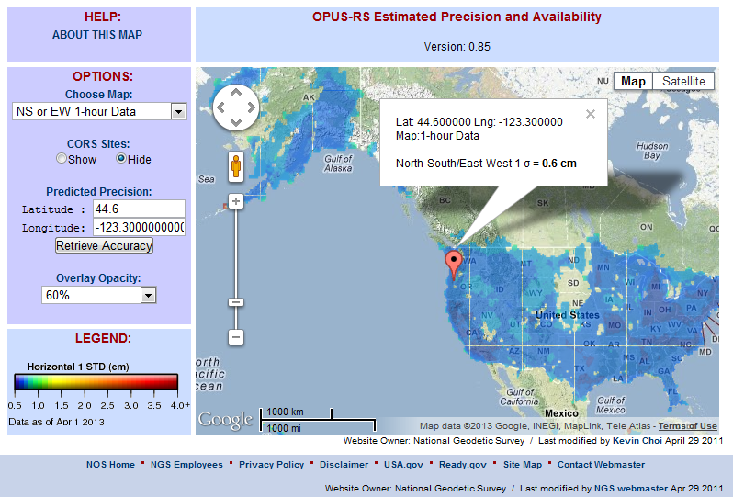
The OPUS Rapid-Static Accuracy and Availability Tool
http://geodesy.noaa.gov/OPUSI/Plots/Gmap/OPUSRS_sigmap.shtml

Slide 19
The OPUS Rapid-Static Accuracy and Availability Tool
1 σ for each 0.2 degree grid.
Horizontal and vertical standard
errors for 15 minutes and
1-hour length data.
Inverse Distance Weighting
method to interpolate the sigmas.
Areas outside the color overlay
are where there are less than
three active CORS sites within
250 km range. OPUS Rapid-Static
will usually fail at these locations.
Automated Weekly updates to account for the availability of CORS.
Global coverage including non-US territories.

Slide 20
How Does OPUS Rapid-Static Work?
OPUS Rapid-Static selects three to nine “best” CORS based upon:
    Having common satellite visibility with the user data.
    Having distances <250 km from the user's mark.
    Orientation relative to the user's mark.
This is shown here graphically.
The star represents the user’s
mark; the triangles are CORS.
No CORS farther than 250 km
from the user's mark will be
included. A minimum of three, and
no more than nine CORS are used.
s
>250km
250km
Choi, 2010, personal communication.

Slide 21
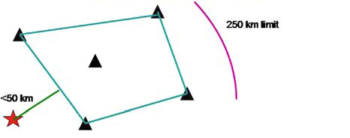
How Does OPUS Rapid-Static Work?
In addition, user's mark must be no more than 50 km from the (convex) polygon created by the selected CORS.
In this example, five CORS and their resulting polygon are shown. If the user’s mark is more than 50 km outside this
polygon, alternate CORS will be considered. If none can be found, the processing will abort.
Schwarz et al., “Accuracy assessment of the National Geodetic Survey's OPUS Rapid-Static utility”, 2009, GPS Solutions, 13(2), 119-132.

Slide 22
OPUS-Net
This processing strategy was implemented in an OPUS-like application, called OPUS-Net during its testing phase. It includes:
Absolute antenna models.
An ocean-tide loading (OTL) model.
A combination of near-by and more-distant CORS.
Implementing these changes results in better precision and consistency with other sources (such as from IGS).

Slide 23
What Is OPUS Projects?
OPUS Projects gives users web-based access to simple visualization, management and processing tools for multiple marks and multiple occupations.
These tools include:
The advantages of data uploading through OPUS.
Data visualization and management aids.
Enhanced data processing using the PAGES suite.
Solution visualization aids.
A simplified means for producing some “Bluebook” files.

Slide 24
What Is OPUS Projects?
OPUS Projects exists in a hierarchical structure
Create . . . . . . . . creates a project.
Upload . . . . . . . . data submission.
Session . . . . . . . session review & processing.
Manage . . . . . . . network adjustments.

Slide 25
What Is OPUS Projects?
Your OPUS Project
OPUS Solution
Data &
Metadata
Session
Solution
OPUS Solution
Processor or Manager
Session
Solution
Manager
Network
Adjustment
Share
Session
Solution
Session
Solution
OPUS Solution
Submit for “Bluebooking” (to publish in NGSIDB)
Copy
To User
Copy
To User
Copy
To User

Slide 26
Why complicate OPUS?
OPUS
Session
Adjustment
CORS3
CORS5
CORS2
CORS1
CORS4
solution HATFIELD
solution MCCOY
Notes:
In OPUS, “rover” data files are processed as if they are independent of each other.
That’s not a bad assumption - and it’s the only assumption possible for OPUS - but, in reality, some files might be related through a deliberate effort to “see” how marks are related to each other. We often call these observing “campaigns”.
If occupied simultaneously, data from marks:
Will “share” some aspects of their environment (similar atmosphere overhead for example) if they are within a few kilometers of each other.
Will “share” a similar satellite geometry if they are within a few tens of kilometers of each other.
And regardless of distances, tmight use the same types of equipment, or the same CORS in processing, etc..
These campaigns are most common kind of GNSS data that NGS collects and its stakeholders share.

Slide 27
Why complicate OPUS?
OPUS
Session
Adjustment
CORS3
CORS5
CORS2
CORS1
CORS4
solution HATFIELD
solution MCCOY
session 001
Notes:
This is a good thing. Combining data from simultaneously occupied marks while processing can improved the results. For example:
Neutral atmosphere (tropo) corrections will improve.
Common CORS and satellites can be de-correlated.
In turn, these help with other things like phase ambiguity resolution (fixing integers).
This simple “trick” will improve the accuracy of the relative positions of the marks in the campaign. This is often the desired end-product.
But include some CORS or occupy some surveyed marks as part of the campaign and NSRS (National Spatial Reference System) coordinates for the marks can be determined.

Slide 28
Why complicate OPUS?
OPUS
Session
Adjustment
CORS3
CORS5
CORS2
CORS1
CORS4
solution HATFIELD
solution MCCOY
session 001
session 002
session N
Notes:
The same will be true for other simultaneous occupations.
If we think about it a bit, we’ll realize that a new, derived data type has been created, the occupation solutions, that has the potential to be better for some purposes.
Now, I’ll introduce in some OPUS Projects jargon. These simultaneous occupations several marks will be called sessions. The processing results will be called session solutions.

Slide 29
Why complicate OPUS?
OPUS
Session
Adjustment
CORS3
CORS5
CORS2
CORS1
CORS4
solution HATFIELD
solution MCCOY
session 001
session 002
session N
network adjustment
Notes:
Taking this one more step, if the session solutions are combined:
The “signal” (what we’re trying to measure - in other words the positions of the marks) will reinforce and be easier to detect.
The “noise” (anything we don’t really care about) will, hopefully, be random and diminish.
Ultimately, combining session solutions into a network adjustment (more OPUS Projects jargon) can improve the results for the entire network.

Slide 30
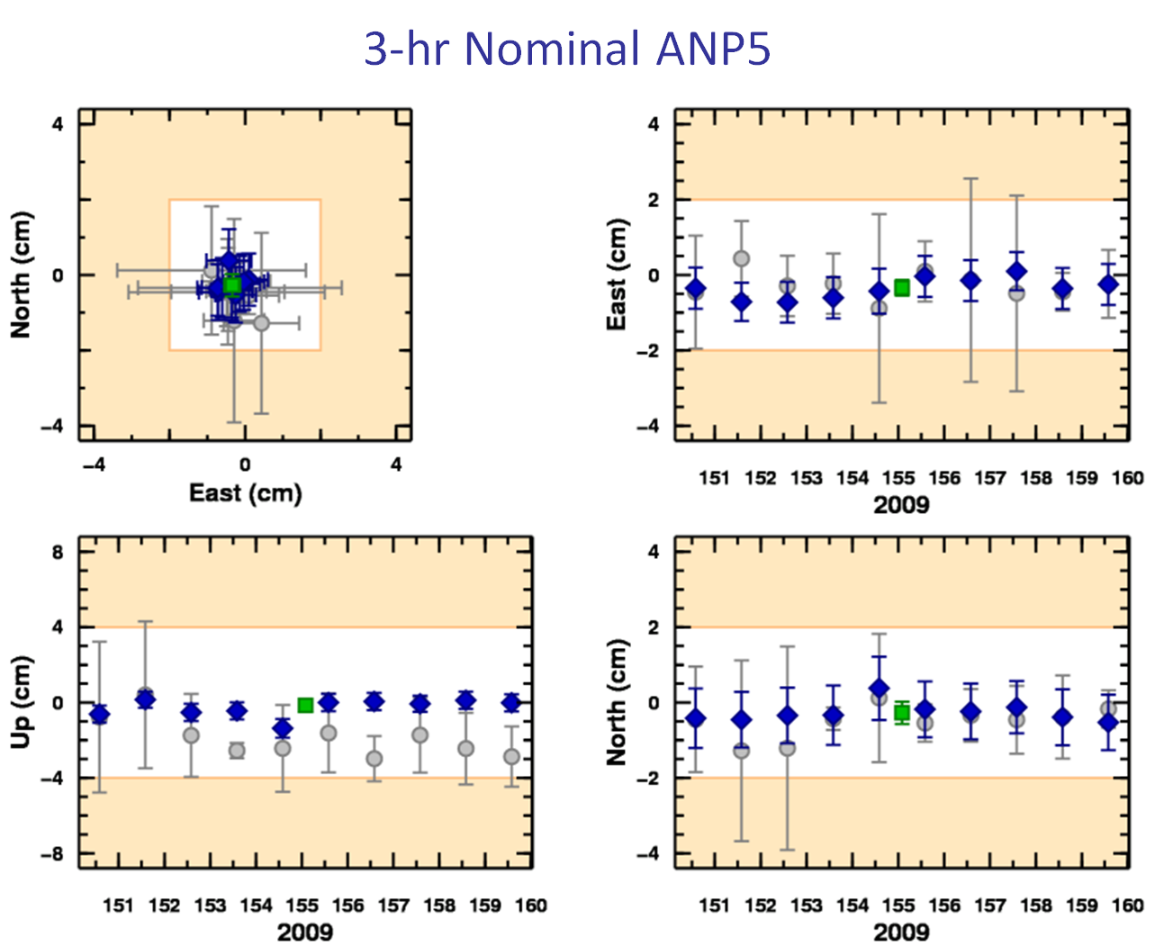
What’s all that really mean for me?
OPUS solutions = pretty good, but each treated as independent and assumes “perfect” CORS.
Sessions = simultaneously-observed marks processed together in sessions increases consistency.
Adjustments = interlinking sessions through network adjustments increases accuracy.
Notes:
The figures are from a “real world” example from the mid-Atlantic region. Your results will vary.
The light (white) shaded areas indicate +/- 2 cm horizontally and +/- 4 cm vertically.
The OPUS results repeat better than these limits.
But (only) slightly more complex processing improves the results.
Not just for this mark, but for all marks in the project.

Slide 31
Are There Any Other Advantages?
Faster, simpler setup
  A project’s data are consolidated in on-line storage.
  Initial data quality assessments provided on upload.
  The data are organized automatically.
Faster, simpler work flow
  Project specific preferences and the on-line GUI simplifies running PAGES.
  Software and models are always up-to-date.
  The quality of the processing results is visually indicated in maps, plots and tables.
  Many useful files are created automatically.
Notes:
Gather data and metadata without having to physically carry it to a location can mean a faster start to processing.
Gathering data by uploading through OPUS gives the “bonus” of an OPUS solution for quick quality control.
Automatically associating data to marks and simultaneously observed data files into sessions can mean less organizational effort is needed.
The ability to set project preferences and GUI (graphical user interface) facilitating this type of processing will permit more folks to use PAGES effectively without having to be a PAGES expert.
The processing occurs on NGS computers so the software and ancillary files are always up-to-date.
Dynamically created maps, plots and table, plus the preferences, help evaluate the results through visual cues.
OPUS Projects builds some useful files saving time.

Slide 32
Any Limitations?
Internet access is required.
OPUS Static upload restrictions apply.
  Dual-frequency pseudorange & phase.
  2 hrs ≤ data span ≤ 48 hrs.
  Observation interval = a factor of 30 (seconds).
Minimum project size.
  1 data file from 1 mark.
Maximum project size.
  About 100 marks in a single session.
  Number of data files < a few hundred.
Notes:
No internet means no access. Users have to be online.
OPUS Static data file limits apply, but we hope to allow Rapid-static files – probably with restrictions – by the end of the year.
1 data file from 1 mark is OPUS so no real gain. Multiple occupations of 1 mark starts to have advantages. But the purpose and, therefore, the strength of OPUS Projects is multiple marks with multiple occupations.
There are practical limits to a project’s size. The number of data files < a few hundred implies:
A few marks occupied many times.
Many marks occupied a few times.

Slide 33

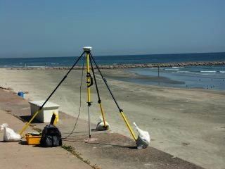

G.I.G.O.
Good coordinates come from good data collected using good practices. We hope OPUS Projects can help make processing and publishing easier, but it can’t spin straw into gold. Folks still need to:
Follow their project’s
specifications.
Use best practices and
careful field procedures.
Select permanent marks
of public interest.
http://gis.larc.nasa.gov/
Notes:
I’m not saying we NGS doesn’t need surveyors or that surveyors don’t need NGS. I am saying a surveyor shouldn’t have to be passable programmer or geodesist, and NGS should be helping surveyors do their job, not teaching them to be passable programmers or geodesists.
GIGO = garbage in, garbage out

Slide 34
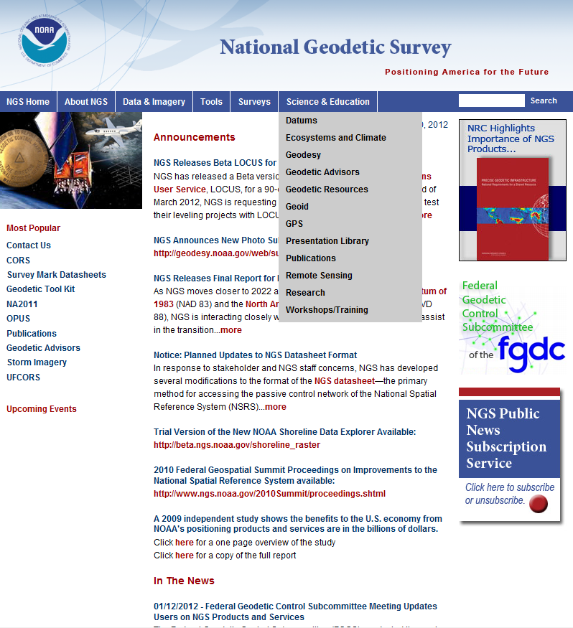
OPUS Projects Training
Because of its increased complexity, training is required to be an OPUS Projects manager.
Workshops are small allowing ample time for one-on-one interaction with the instructor.
The NGS Training Center will schedule workshops run by NGS.
Notes:
NGS requires training to manage a project under the assumption that the manager will provide the necessary training for others participating in the project.
Two types of workshops will be offered:
Projects only: 1.5 days in length.
Bluebooking using Projects: 4 days in length.

Slide 35
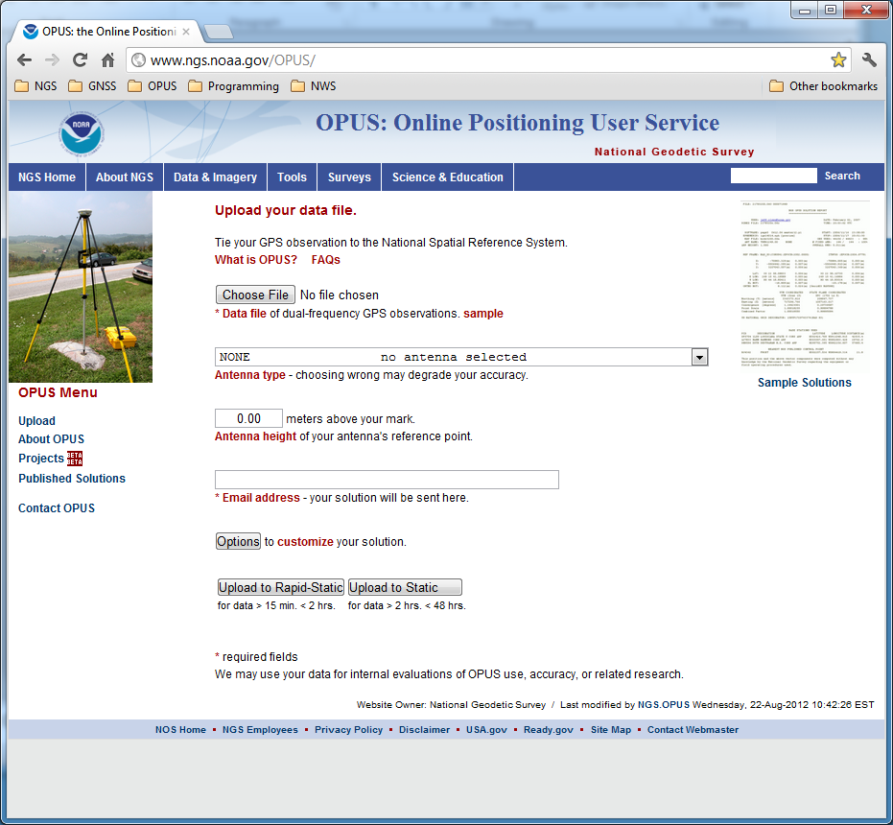
The OPUS upload page is the access point for all things OPUS.
Notes:
The OPUS gateway page is found at http://geodesy.noaa.gov/OPUS/.

Slide 36
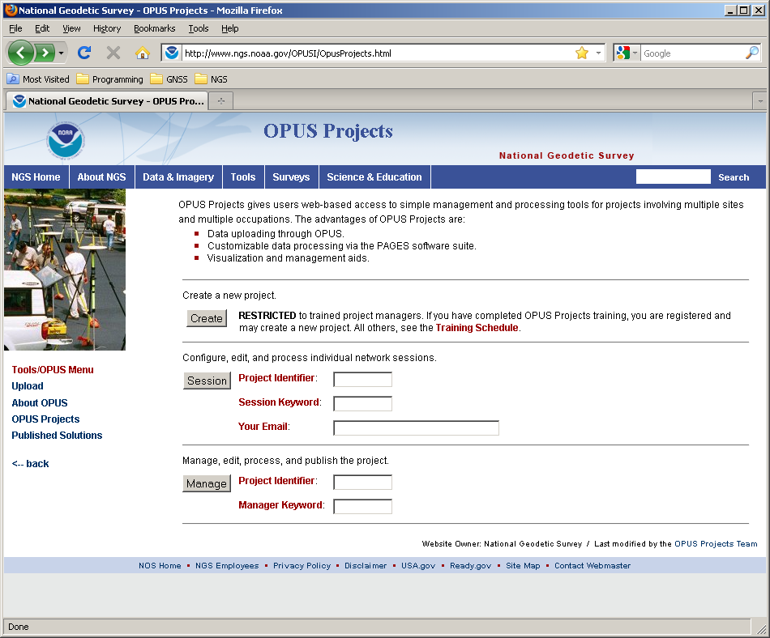
This is the OPUS Projects gateway page.

Slide 37
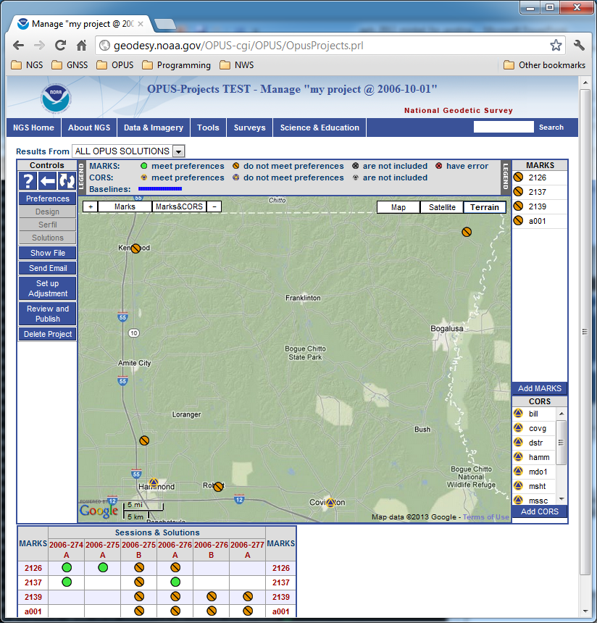
This is the manager’s page.

Slide 38
The map shows the relative location of the project’s marks. If the Session solutions were completed, they would be shown, but the OPUS solution results can always be displayed.

Slide 39
View And Process Sessions
OPUS Projects groups the data into sessions.
Sessions are groups of mark occupations that overlap significantly in time. Note that
a mark may appear in more than one session.
as new data are submitted, the definitions of the sessions may change.
Now that some data has been submitted to the project, processing can begin.

Slide 40
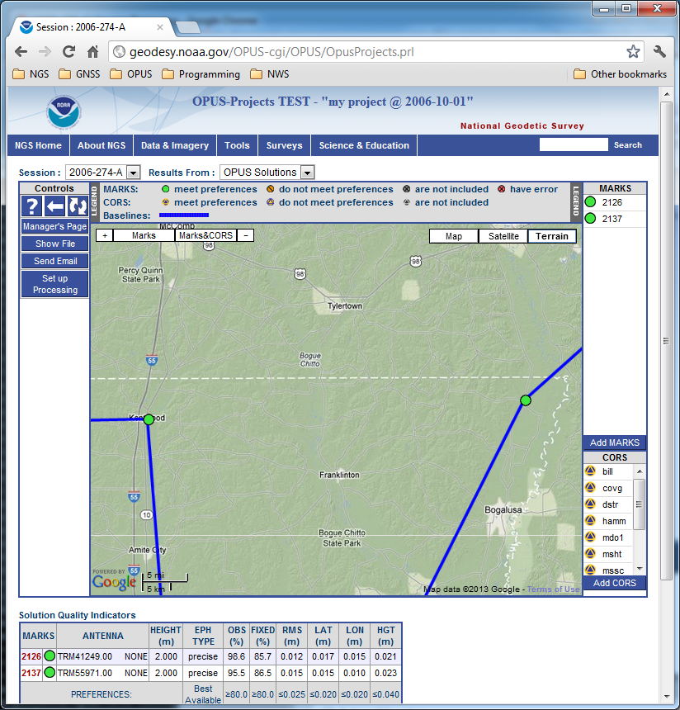
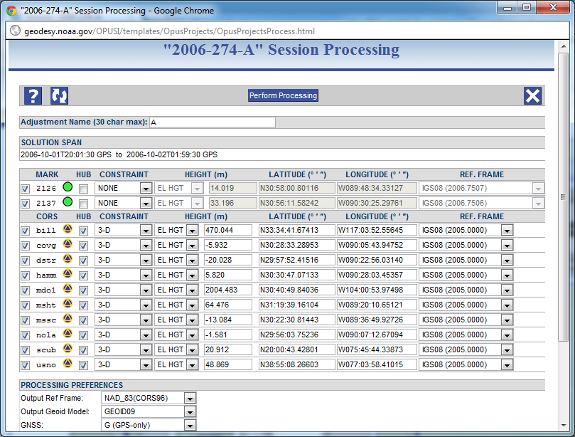
Setup for processing a session’s data.

Slide 41
Once Session processing has been completed, Session and OPUS solutions will be available. Network adjustments will be available too as they are completed.

Slide 42
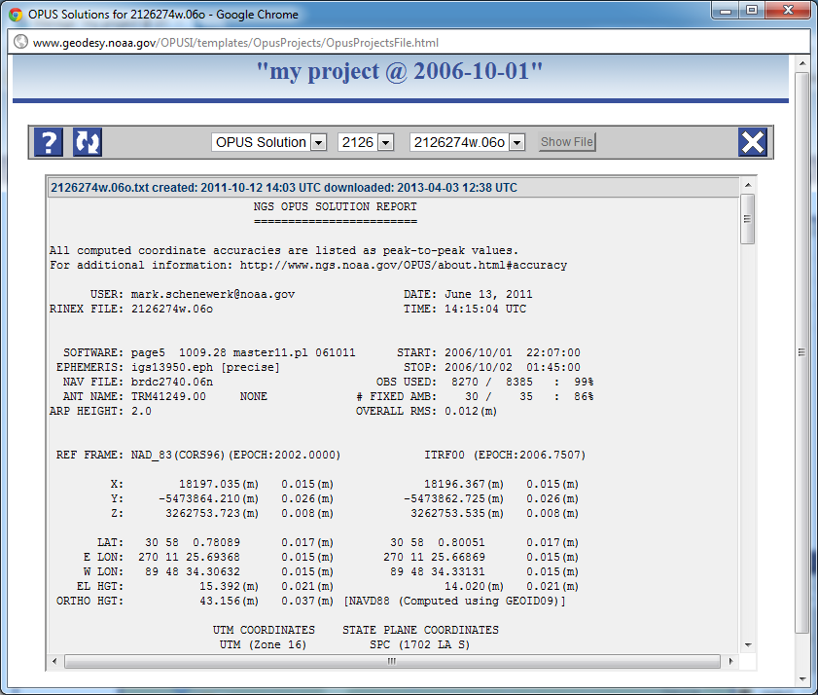
The reports created during OPUS, Session or Network processing are available through the Show File controls. The selected files are display in a separate window for printing or saving locally.

Slide 43
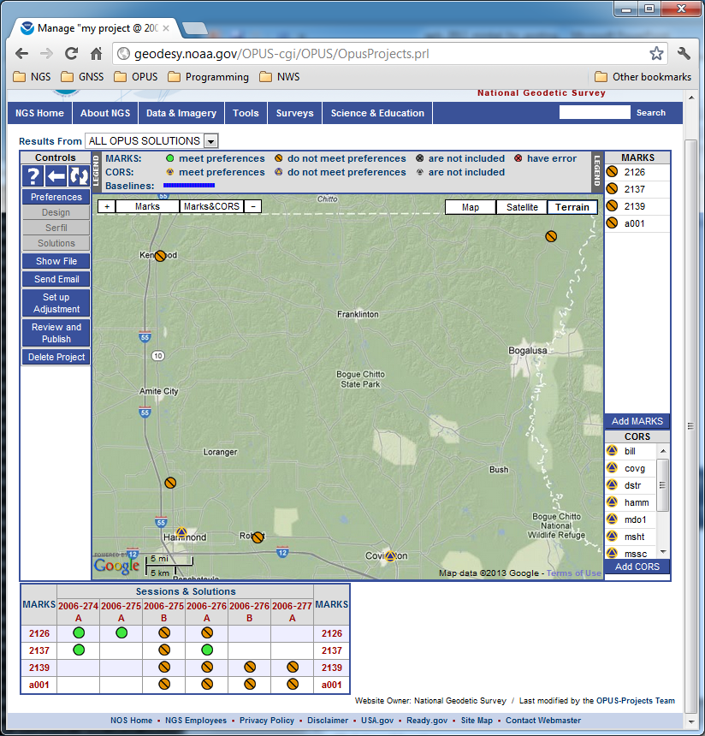
Go to a Mark summary page to see results. To navigate to the 2126 page, click on the Session & Solution table row header for Mark 2126. Similar access is possible from any session page which includes this mark.
Notes:
Going back to the manager’s page, now let’s go to a mark.

Slide 44
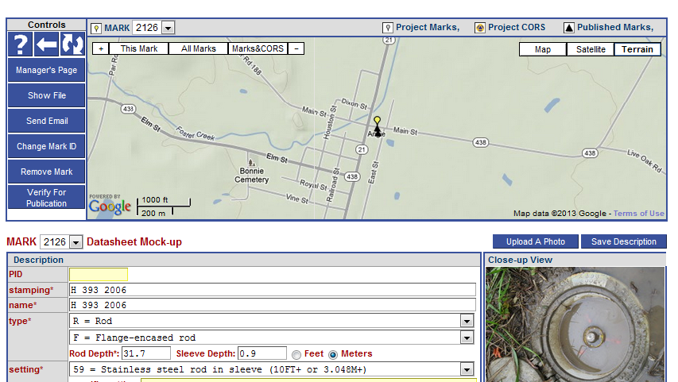
Here’s the page for mark 2126. The individual mark pages are the busiest, so I’ll only describe the contents generally.
Notes:
Mark 2126 page (top).
Note that this is the page the manager sees. Others will see a slightly different presentation.

Slide 45
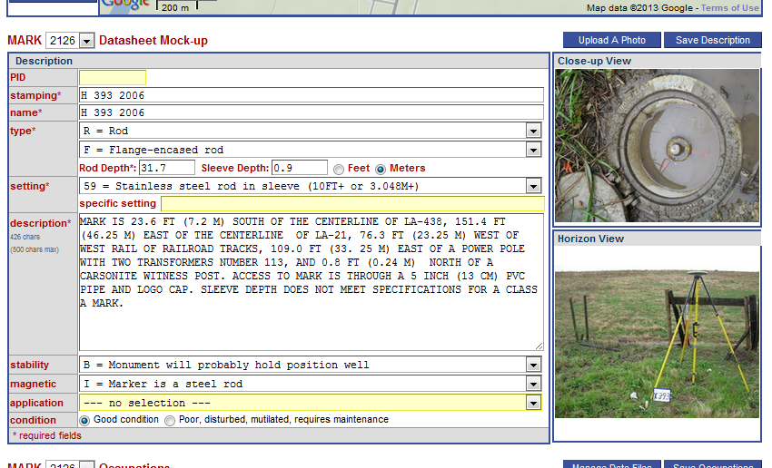
Scrolling down the page, we find a mock-up of the datasheet for this mark. Because we accessed this mark as the project manager, we can modify this information for our own use or in preparation for publishing.

Slide 46
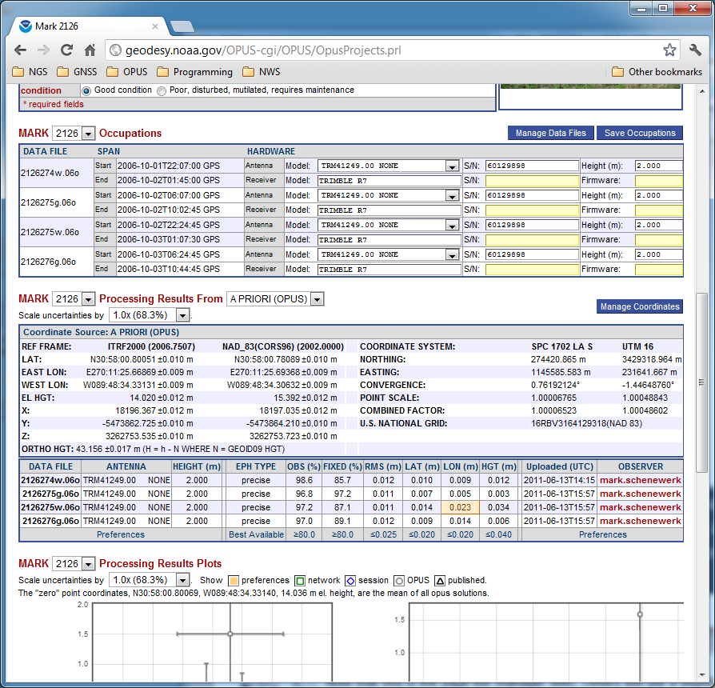
Next on the page is a summary of the occupation information for this mark. Again, because we accessed this mark as the project manager, we can modify this information for our own use or in preparation for publishing.

Slide 47
Next, we can review the processing results for this mark.

Slide 48
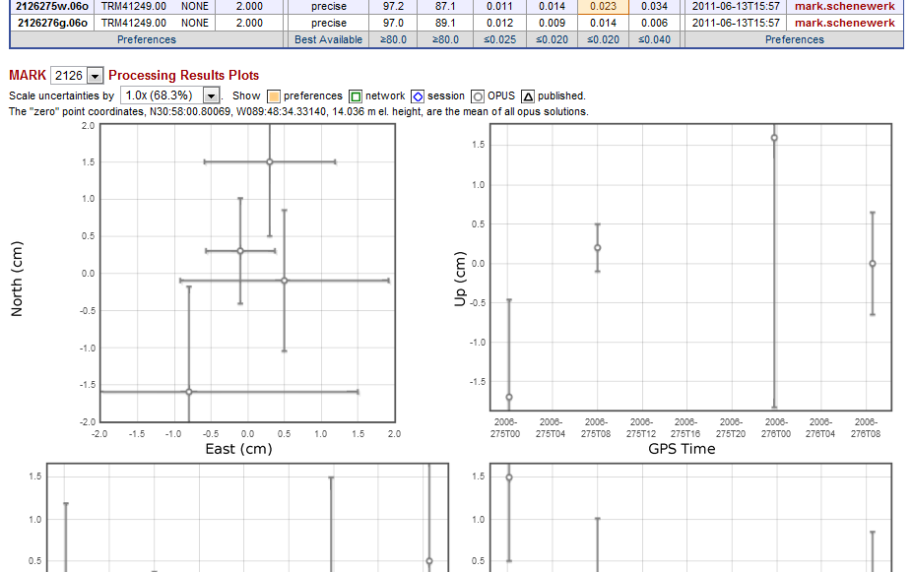
At the bottom are interactive plots and tables summarizing all the processing results for this mark: OPUS results from the uploads, Session Solutions and Network Adjustments. Project preferences are indicated, but, in this case, the results are all within those preferences.

Slide 49
Sharing OPUS results
To share or not to share?
The intent is to make sharing as easy as possible. The requirements are minimal:
4 or more hours of data.
A quality, “GPS-able” mark.
Good field practices.
Good data.
Good description.
http://geodesy.noaa.gov/OPUS/about.jsp#publishing
Only OPUS-Static results can be shared at this time. In the near future will be able to share OPUS-Projects results.
No longer called “Publish” through OPUS interface.

Slide 50
“Share” vs. “Publish”
Share. The act of a user releasing to NGS the observations, metadata, and results of geodetic surveys tied to the NSRS for public dissemination.
Submit. The act of a user releasing to NGS the observations, metadata and results of geodetic surveys tied to the NSRS for the express purpose of NGS evaluating and publishing if appropriate.
Publish. The action of NGS providing to the public, the official NSRS geodetic coordinates set on a mark.
Datasheet. A report containing the published NSRS coordinates on a mark, as well as subsidiary information and metadata such as superseded coordinates, descriptions, and recovery history.

Slide 51
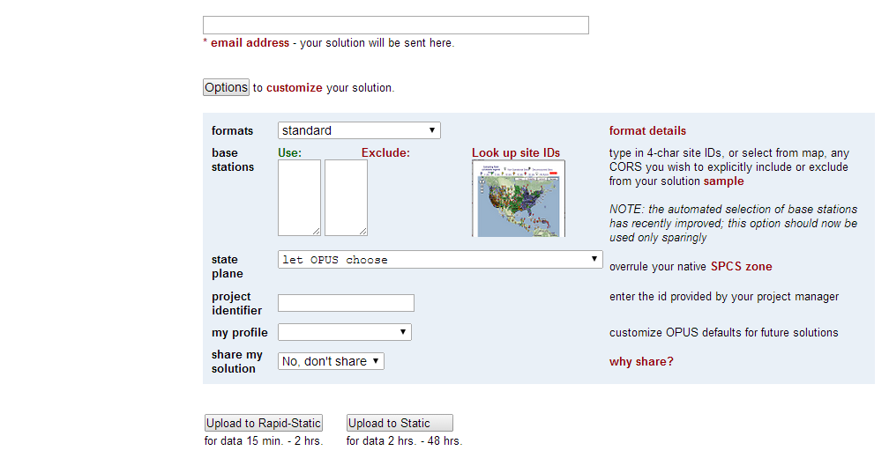
OPUS Sharing Interface
The first step in OPUS Sharing is to upload suitable data to OPUS. At that time, you must explicitly designate that your results should be shared. This is done through the “share my solution” option near the bottom of the Options list.

Slide 52
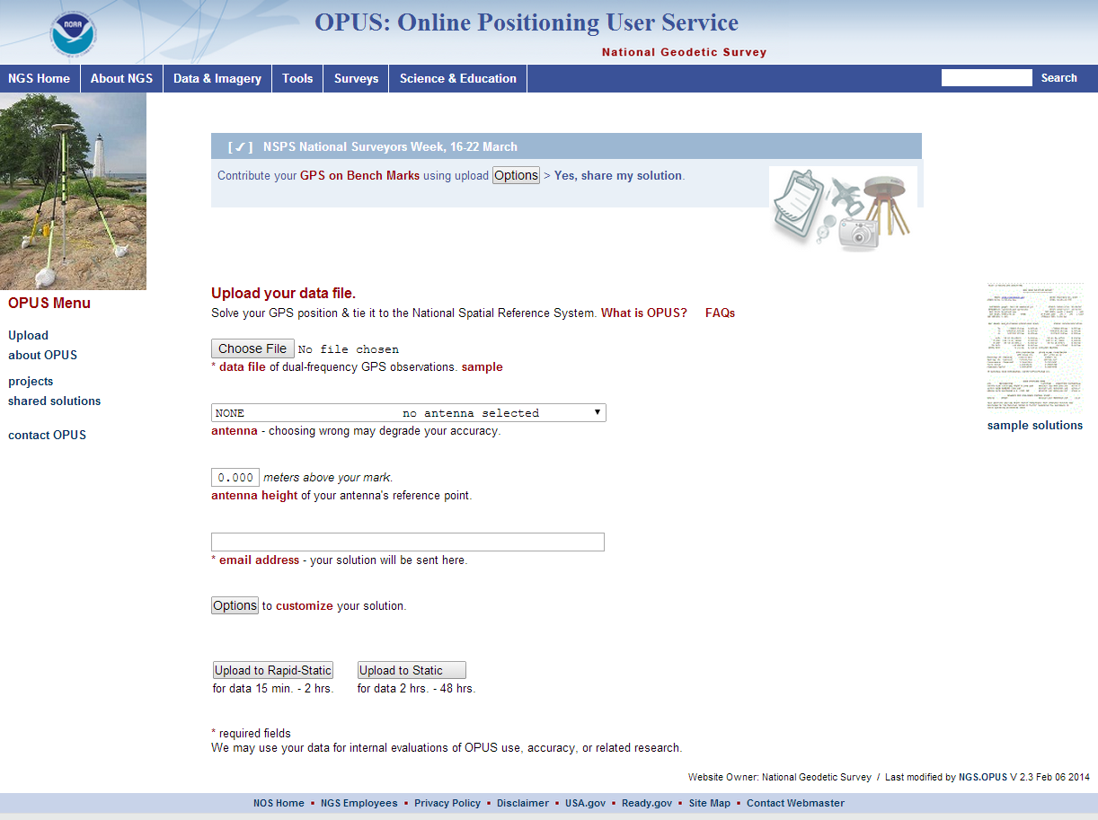
Viewing Shared Solutions
To a view shared solution, use the Shared Solutions link in the menu on the left of the OPUS upload page.

Slide 53
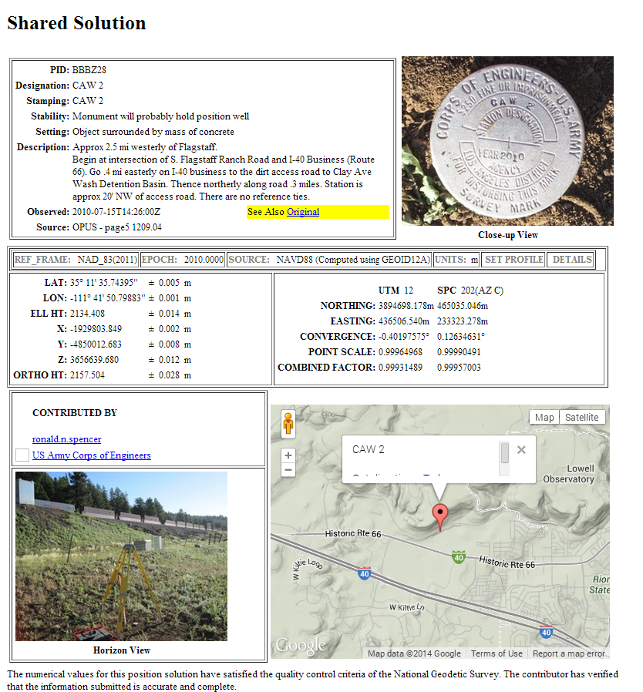
Viewing Shared Solutions
Here’s an example of a shared solution from OPUS-Static.

Slide 54
Publishing survey results
“Publishing” means to an NGS database that can be accessed by the public. Two such databases are nominally available for “geodetic control”:
The NGS Integrated Database (NGSIDB)
  Official repository for “authoritative” NSRS geodetic control
  Specific FGDC/FGCS metadata and QA/QC requirements
  Process for populating referred to as “Bluebooking”
OPUS Database
  Created to allow sharing of OPUS results by public
  Content not vetted or reviewed by NGS (not “control”)
    But OPUS data and results must meet certain requirements

Slide 55
Database Blues
The NGS Integrated Data Base (NGSIDB)
  Every mark has a single set of current coordinates
    Latitude, longitude, ellipsoid height, orthometric height, etc.
  Includes geometric and vertical control
  But Bluebooking to populate NGSIDB is overly onerous
OPUS Database
  Individual marks can have multiple coordinates
  Marks in common with NGSIDB do not have same coords
  Currently only contains geometric positions
    Orthometric heights are directly from a geoid model
  But easy to populate with minimal effort (no Bluebooking!)

Slide 56

Opinions vary about “Bluebooking”
I’d rather be
Bluebooking
Friends …
don’t let friends …
Bluebook

Slide 57
What is “Bluebooking” anyway?
The NGS “Bluebook” is a set of data formats
  For electronic transfer of geodetic data to NGS database
  Defined by NGS and formally part of FGDC
  So “Bluebooking” is just putting data into specified formats
A means for our customers to help build the NSRS
  Users get the control they want, where they want it
  NGS gets data for small fraction of total cost of performing work
  Great example of Fed, local gov’t, and private cooperation
“Bluebooking” now viewed as much more than formats
  Standards & specifications for performing control work
  Strongly associated with high-quality data and results
  But difficult, expensive, inefficient, and (somewhat) error-prone

Slide 58
Matters of Mission and Policy
The NGS Mission
  Define, maintain, and provide access to the NSRS

Slide 59
At NOAA’s NGS, location is our mission
National Spatial Reference System
NSRS
Define
Maintain
Access

Slide 60
Matters of Mission and Policy
The NGS Mission
  Define, maintain, and provide access to the NSRS
  Interpreted as providing authoritative geodetic control
  Non-unique current coordinates at odds with NGS mission
  Different results from different processes are problematic
Governing policies
  Encapsulated within existing FGDC and FGCS documents
    Derived also from executive orders, congressional acts, etc.
    The NGSIDB and “Bluebook” are part of such policy
    Changes must go through FGCS and FGDC
  OPUS-DB in conflict with existing NGS policy
    But its existence implies a de facto policy. What to do?

Slide 61

The way forward
Another fine mess – NGS created this problem, and now NGS will fix it. There are five aspects to this:
WHAT we are (and are not) doing
WHY we are doing it
WHERE we are going
HOW we will get there
WHEN all this is going to happen

Slide 62
WHAT we are (and are not) doing
OP will continue to NOT publish to OPUS-DB
  Publish instead to NGSIDB via traditional “Bluebooking”
OP operational in Jan 2014
“Review and Publish” controls in OP will be inactive
Upgrade OP to facilitate publishing to NGSIDB
Solicit feedback from OP users
  Want “authoritative” access to the NSRS?
  Why in NGS database? To get (implicit) NGS endorsement?
    Or just a digital dumping ground for crowd-sourced coordinates?

Slide 63
WHY we are doing it
Want single authoritative source for geodetic control
Two databases strain already scant resources
  Undermines improvements to NGSIDB and Bluebooking
Existing policy corresponds to NGSIDB and Bluebook
  References to OPUS-DB do not exist in FGDC or FGCS docs
OPUS-DB orthometric heights problematic
  E.g., on islands and in subsidence areas (Gulf Coast)
Multiple current coordinates on individual marks
Consistency between OP and existing processes

Slide 64
WHERE we are going
Consistent with Ten-Year Strategic Plan (2013-2023)
Objective 1-1: “Bluebooking and Datasheets”
  Streamline existing process (especially via OP)
  Reduce errors in loading and in output from NGSIDB
  Merge NGSIDB and OPUS databases…?
Objective 2-3: “Re-invent Bluebooking”
  Learn from Objective 1-1 as guidance on way forward
  Development coordinated with entirely new database
Ultimate goal: Truly modern database and processes

Slide 65
HOW we will get there
Formal project management is only viable way forward
Create project charters and plans
  One for existing processes/database (Objective 1-1)
  One for “re-inventing Bluebooking” (Objective 2-3)
  Also needed for leveling and gravity (not just GNSS)
Multiple requirements, including:
  Detailed plans including comprehensive evaluations, QA/QC
  Realistic evaluations of risks and allocation of resources
  Well-defined objectives and criteria for success
Without this, all is lost

Slide 66
WHEN all this is going to happen
It begins… NOW
OPUS-Projects goes operational (Jan 2014)
  This is an impetus to fix existing problems
  Includes ongoing OPUS-Projects updates
Improve existing Bluebooking process (2014/2015)
  Make it as simple as possible, especially through OP
  Effort will help in subsequent true “re-invention”
Create entirely new Bluebooking process (2018)
  Compatible with new datums
  Coincides with a new NGS database?

Slide 67

Questions?

Slide 68
The Many Faces of OPUS and the
Siren Call of Bluebooking: Part 2
Arizona Professional Land Surveyors Association
2014 Annual Conference
April 9-11, 2014 ● Tucson, Arizona
Michael Dennis, RLS, PE
michael.dennis@noaa.gov

Slide 69
The Plan
The Online Positioning User Service (OPUS)
  OPUS Static
  OPUS Rapid Static
  OPUS Net (under development)
  OPUS Projects (released January 2014)
Contributing to the NSRS: “Bluebooking”
  NSRS = National Spatial Reference System
  The NGS mission and NGS policy
  NGS terminology for contributing to the NSRS:
    “Share”, “Submit”, “Publish”, “Datasheet”
A closer look at OPUS-Projects for Bluebooking

Slide 70
The OPUS-Projects workflow
Step 1 : Create a Project
Step 2 : Upload Data
Step 3 : Session Processing
Step 4 : Network Adjustment
Optional : Use output files for “Bluebooking”

Slide 71
Start at the OPUS Projects gateway page:
http://geodesy.noaa.gov/OPUS-Projects/.

Slide 72

Click the “Create” button to start Creating a Project.

Slide 73
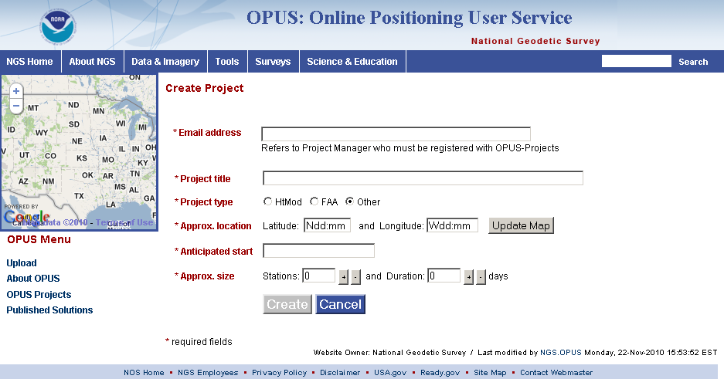
You’ll be taken to the “Create Project” page. Here you’ll enter your email address, a title for and brief summary of your project.

Slide 74
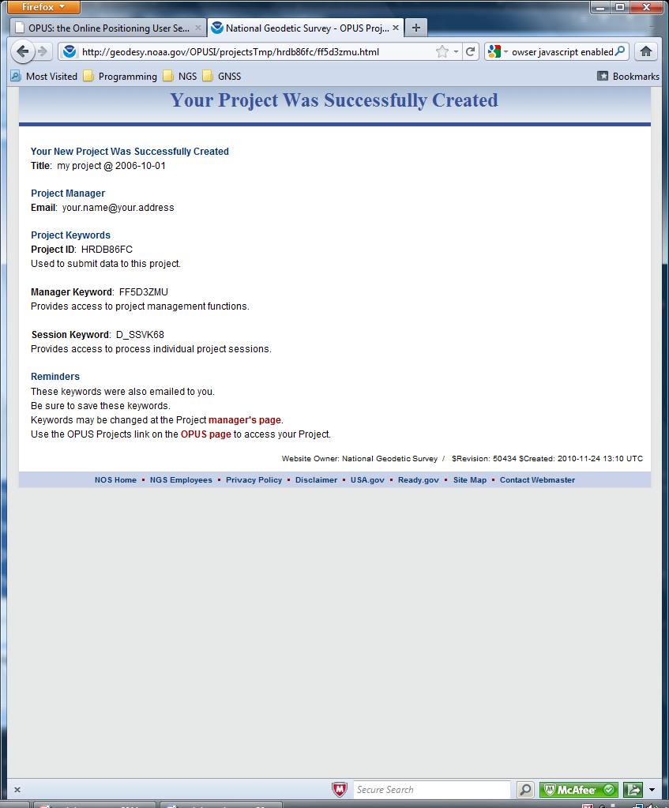
After a moment, an introduction to your newly created project will be shown. It contains information necessary for you to work with your project. You’ll also receive this information in email. Save this email for future reference.

Slide 75
The project identifier, and the manager and session keywords are used to access to your project.

Slide 76
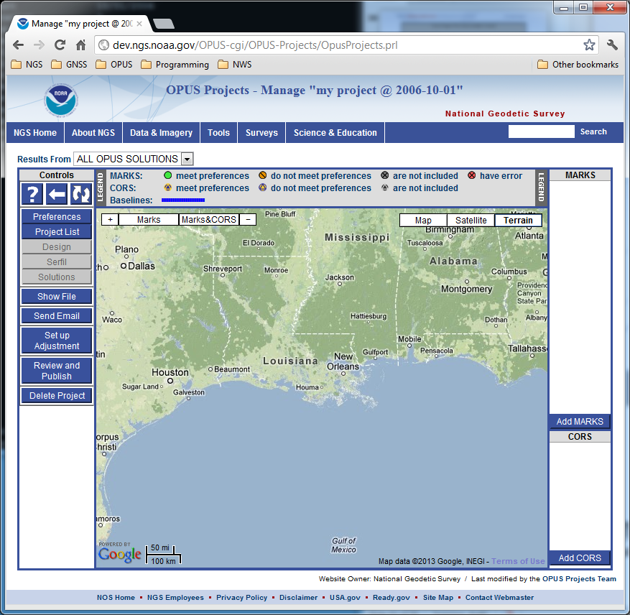
You’ll be taken to the manager’s page for your empty project.

Slide 77
The manager and session pages are built around a Google Map Services™ interactive map to help orient you in the project and region. As data are uploaded, icons representing the project’s marks and included CORS will appear on the map.

Slide 78
Click the “Preferences” button to pop up a window with those controls.

Slide 79
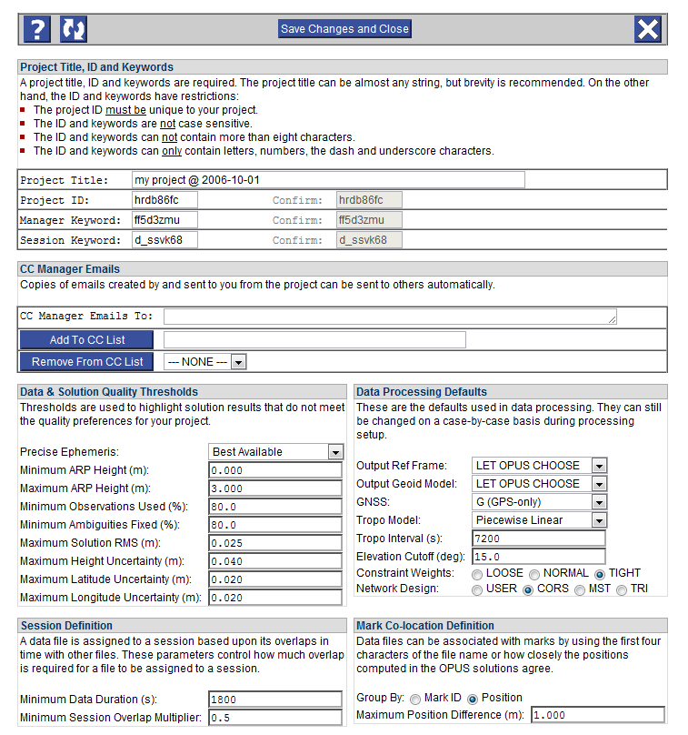
A new window containing the preference controls will appear.

Slide 80
The OPUS-Projects workflow
Step 1 : Create a Project
Step 2 : Upload Data
Step 3 : Session Processing
Step 4 : Network Adjustment
Optional : Use output files for “Bluebooking”

Slide 81
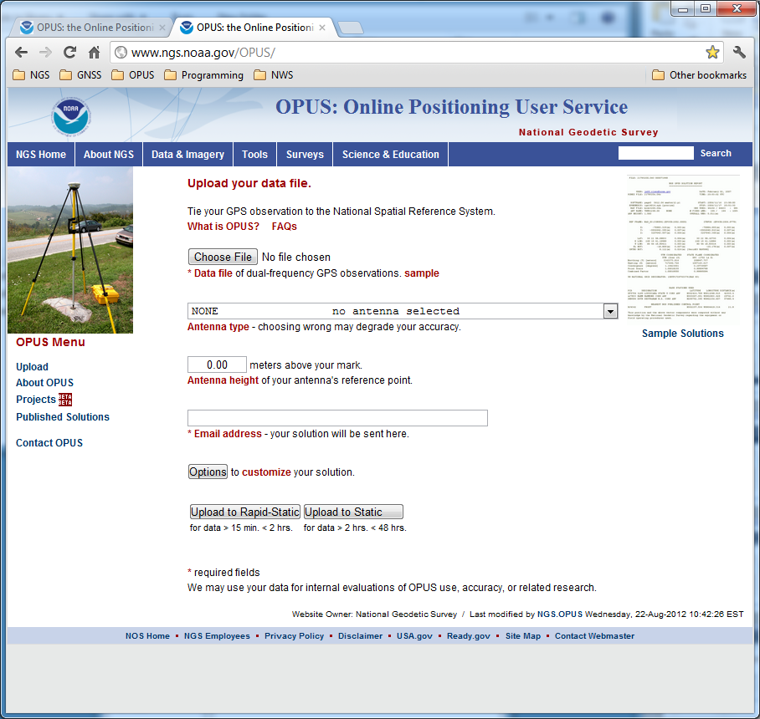
We’ll start at the OPUS upload web page: http://geodesy.noaa.gov/OPUS/

Slide 82
At this time, only OPUS Static is allowed to upload to a project. The conventional OPUS Static rules apply.
Notes:
We anticipate both the Rapid-static and Static will be allowed to upload to projects before the end of 2011.

Slide 83
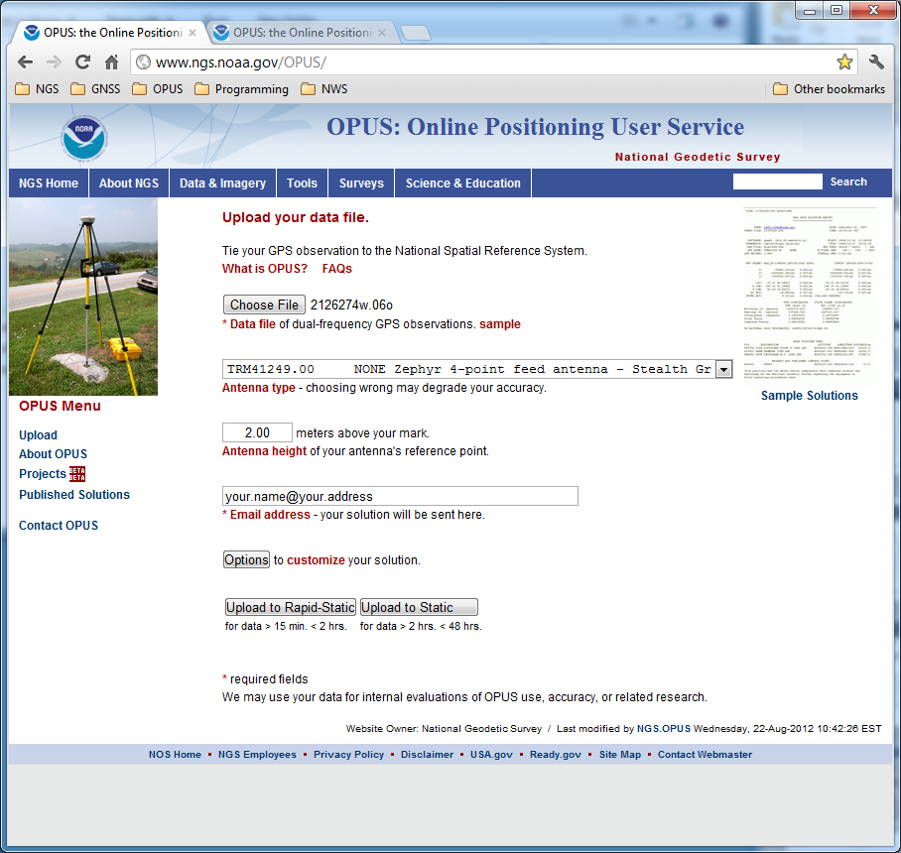
Complete the OPUS upload form normally, but before clicking the “Upload to Static” button, click the “Options” button.

Slide 84
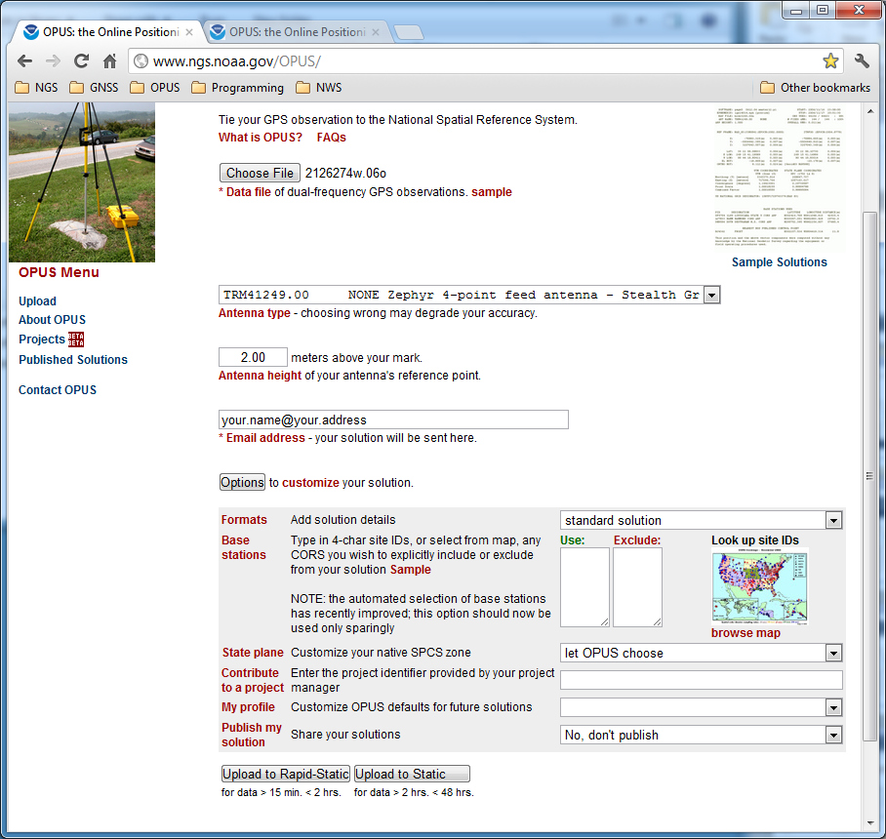
This causes the Options to “accordion” into view.

Slide 85

Enter your project ID into the “Contribute to a project” field. Remember that you can share your project ID so others can upload data to your project.

Slide 86
We’ll leave the other options as they are. Now click the Upload button to have this data file uploaded to your project.

Slide 87
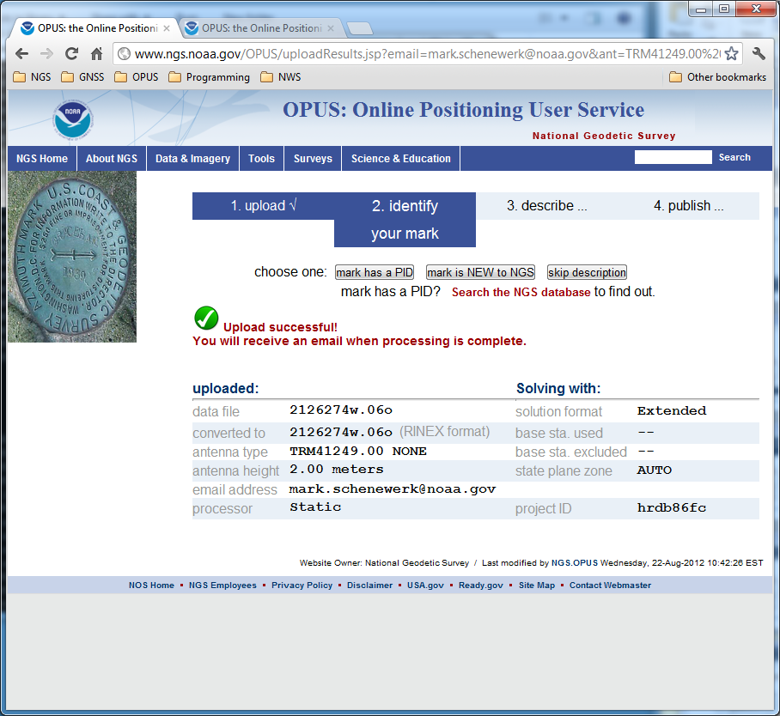
After clicking the upload button, the upload confirmation window will appear, but with some differences from “normal”.
your.name@your.address
Notes:
This essentially appears very similar to using the publish options, but the OPUS results are not published. Publishing a project is done using products created from a network adjustment and then proceeding through the conventional steps for publishing to the NGS Integrated Database.

Slide 88
You project ID will be listed (and should be visually confirmed) …
your.name@your.address

Slide 89
… and you’ll be able to provide a mark description.
your.name@your.address

Slide 90
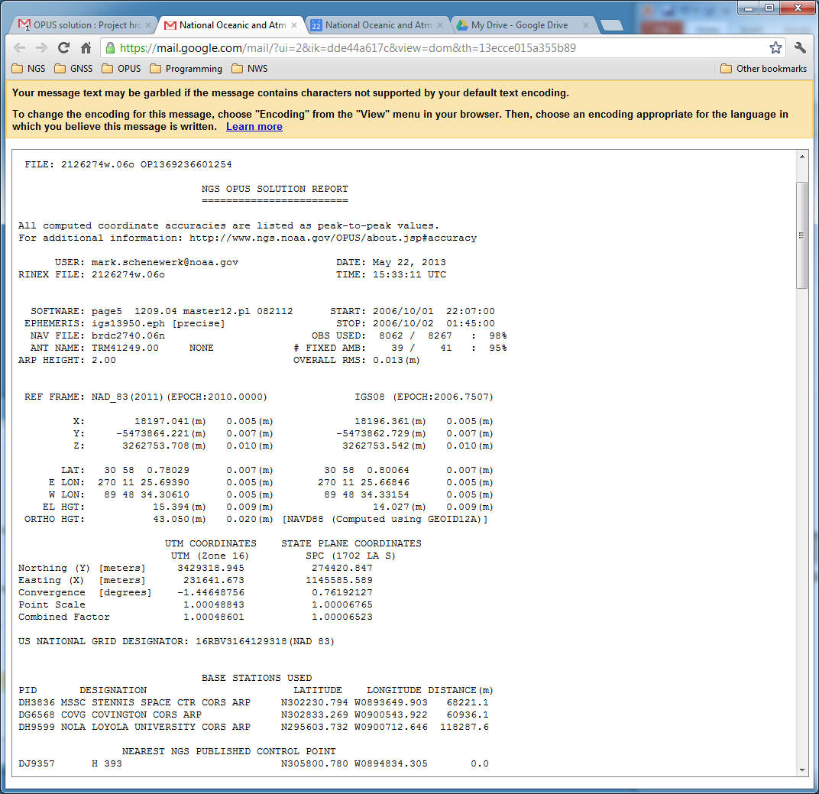
your.name@your.address
The project team member uploading the data files will still get the OPUS solution report. The report will also be available to you, the project manager.

Slide 91
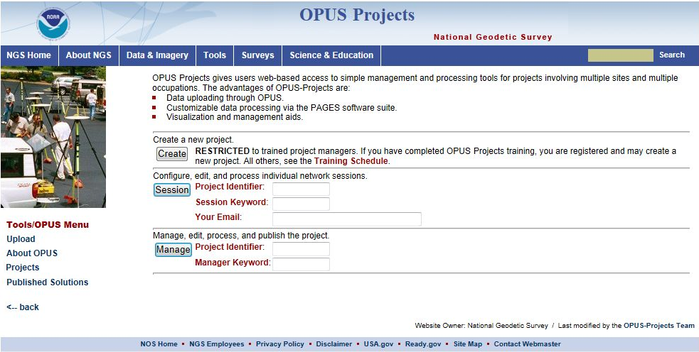
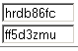
Returning to the OPUS-Project gateway: http://geodesy.noaa.gov/OPUSI/OpusProjects.html
Enter the project ID and manager keyword, the click Manage.

Slide 92
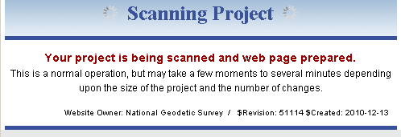
A comfort message will appear while your project prepares itself for display.

Slide 93
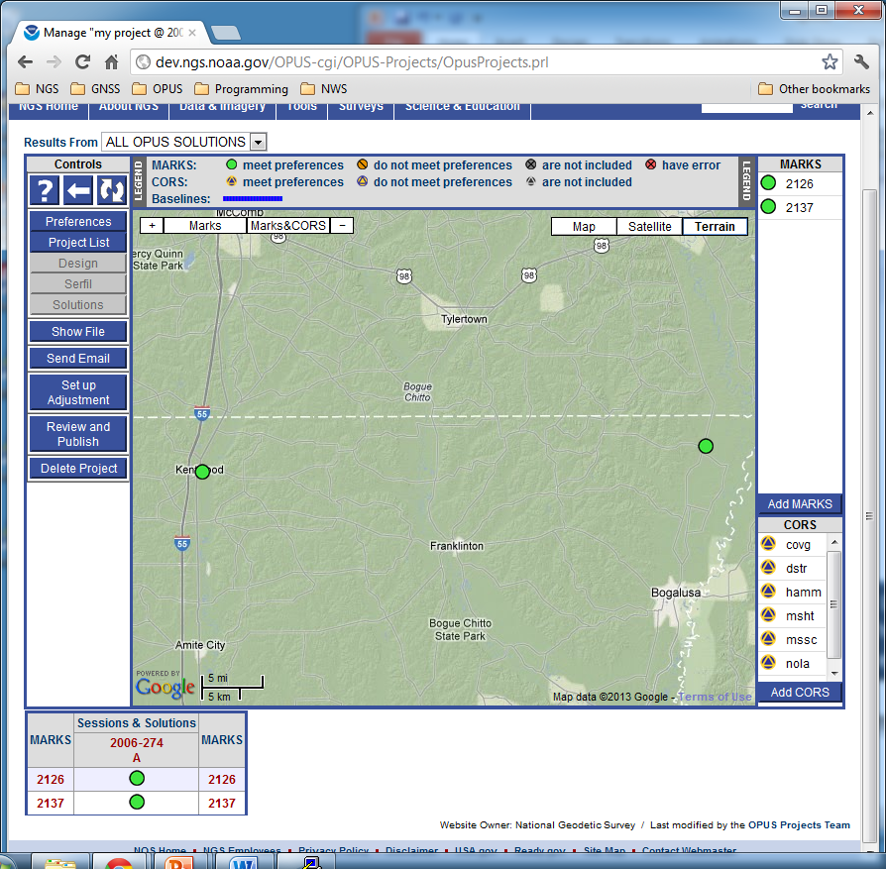
The marks represented by the two data files we’ve upload now appear on the map and in the table to the right. The CORS used in the OPUS solutions are included too.

Slide 94
At the bottom of the page, a new table has appeared. This lists the marks and indicates the sessions to which their data files belong.

Slide 95
Let’s briefly visit the session 2006-274-A session page. Click on the link …

Slide 96
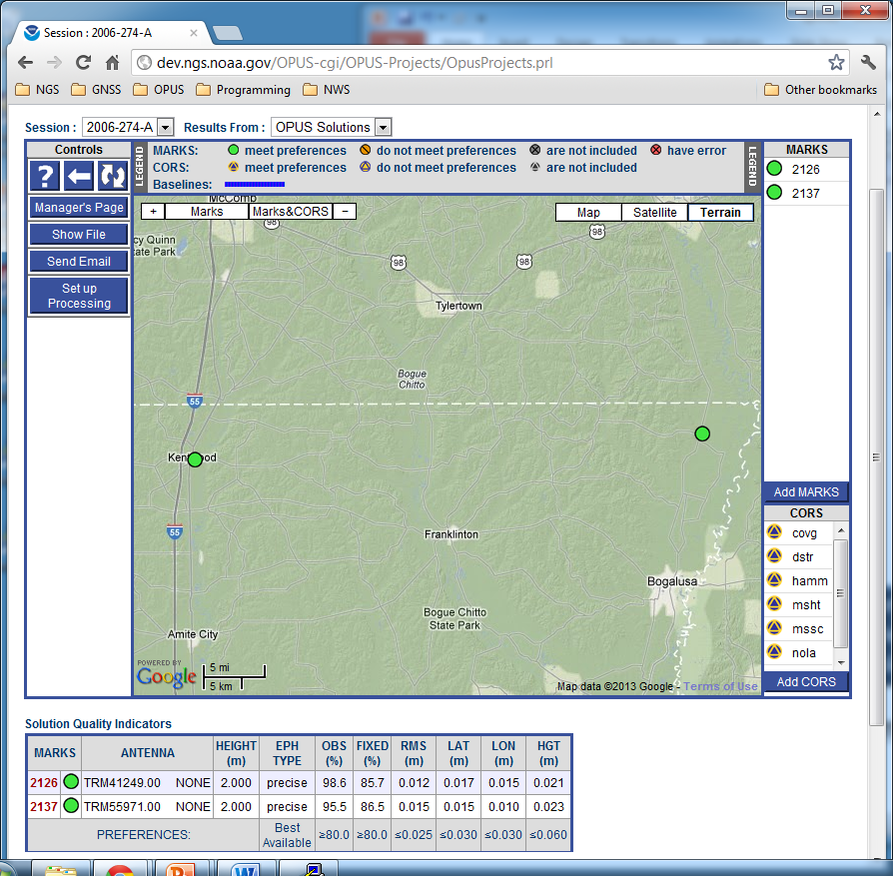
This page contains information and controls specific to this session: 2006-274-A. Here again, we see the marks and CORS on the map and in the tables.

Slide 97
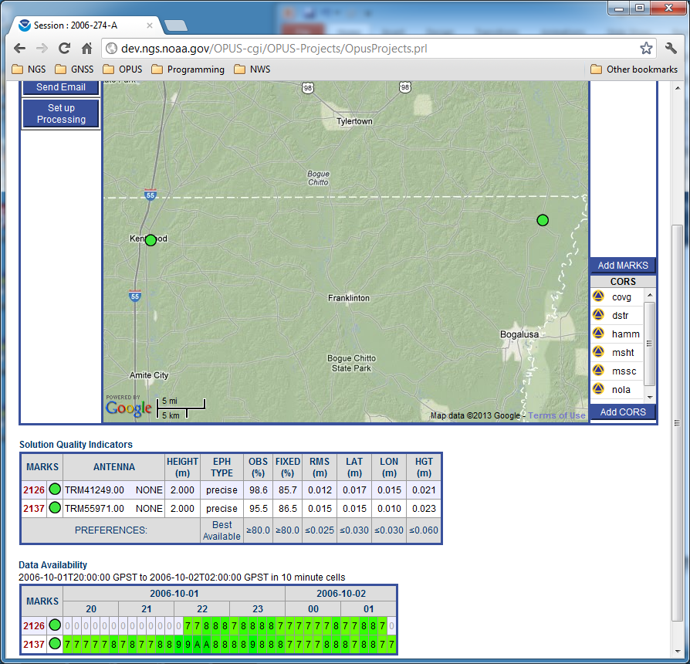
And there are new tables on this page too. The “Solution Quality Indicators” table lists the solution values checked against the quality threshold preferences. The “Data Availability” table gives a representation of the satellite availability in each data file.

Slide 98
The row headers in these tables are convenience links to the individual mark pages, just as on the manager’s page. Let’s visit the page for mark 2126.

Slide 99
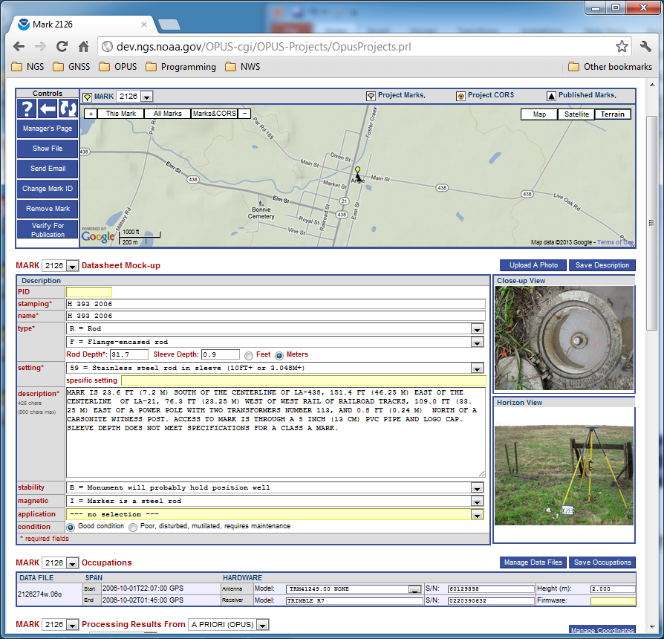
Here, you can review, edit or enter the mark description. Many other tools are available, but we’ll save those for later.

Slide 100
Let’s look a little farther ahead.
Let’s jump to the point where all project data has been uploaded.

Slide 101
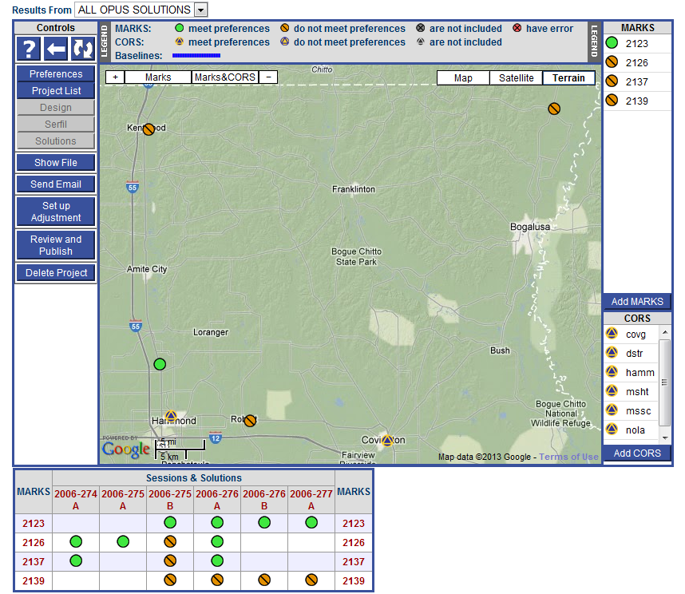
Note that all four marks in our training project are now shown and six sessions have been defined.
Let’s click the Marks&CORS button on the map.

Slide 102
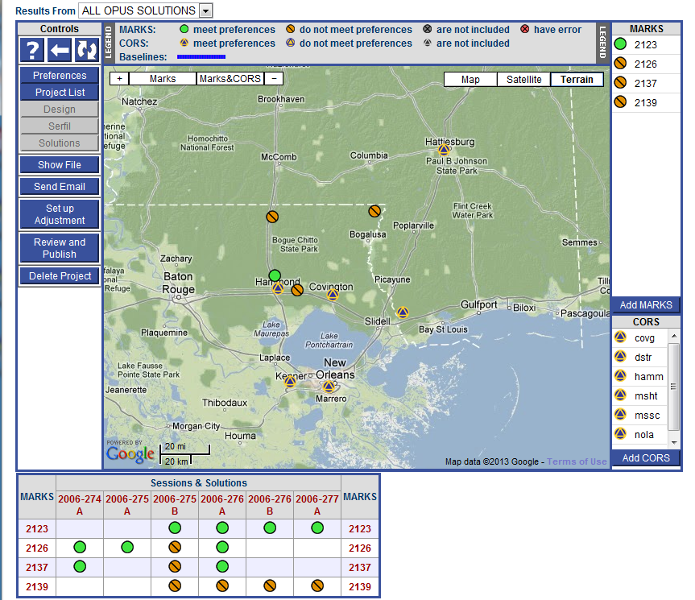
The map’s center and zoom level changes to encompass all project marks and the included CORS.

Slide 103
The OPUS-Projects workflow
Step 1 : Create a Project
Step 2 : Upload Data
Step 3 : Session Processing
Step 4 : Network Adjustment
Optional : Use output files for “Bluebooking”

Slide 104
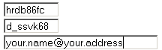
Although you, being the project manager, would usually navigate to a session web page from the manager’s web page, others can access your project’s sessions from the OPUS Projects gateway web page. They would require the project ID and session keyword that you would provide, and a valid email address.
Notes:
Using your project manager keyword rather than the session keyword is also permitted and you’ll be recognized as the project manager.

Slide 105
The project is always scanned for changes when accessed so the information will be up-to-date.

Slide 106
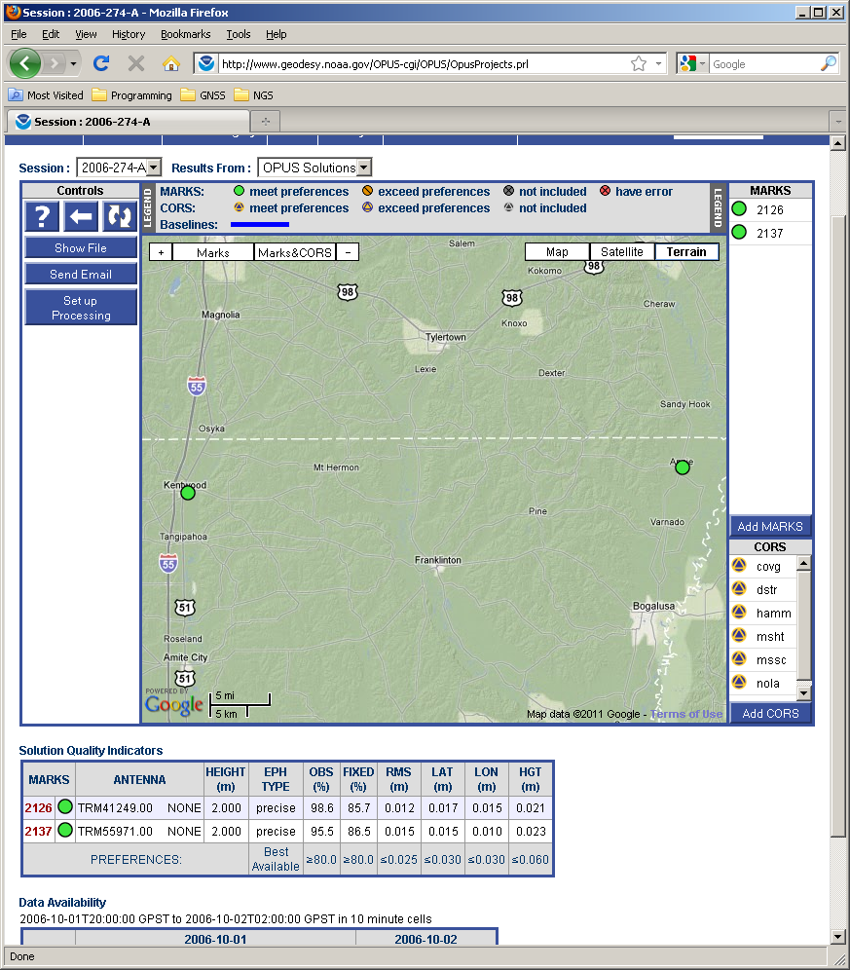
In a few moments, the web page for the earliest session in the project, session 2006-274-A in this case, will appear.

Slide 107

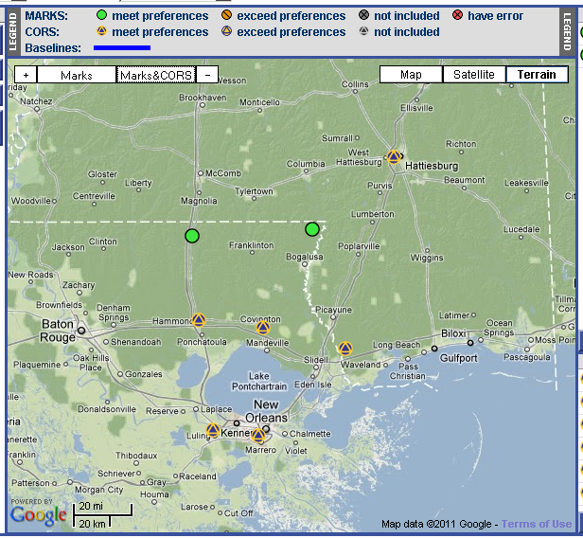
… or center and zoom to show the marks and included CORS.

Slide 108
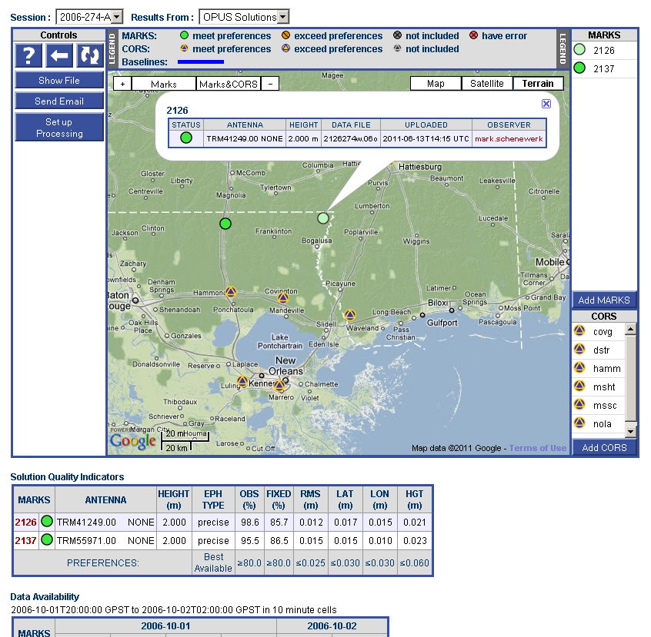
Clicking on a list entry also causes that mark’s information bubble to appear on the map.

Slide 109
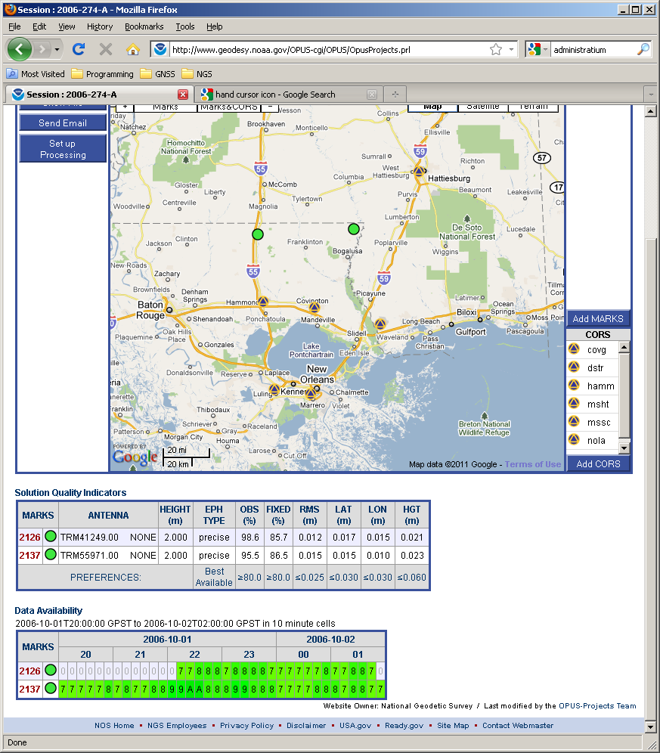
Scrolling to the bottom of the web page, we see a table below the map with the solution values that are checked against the solution quality thresholds. If a value exceeds its threshold, the value is highlighted using an orange color and the mark’s icon is changed to reflect this condition. This table shows that the OPUS solutions for this session meet the project’s preferences.

Slide 110
At the bottom of the web page is a graph indicating the satellite availability in each data file.
Notes:
The time limits and cell size will change from session to session as the table adjusts itself to fit into this area.

Slide 111
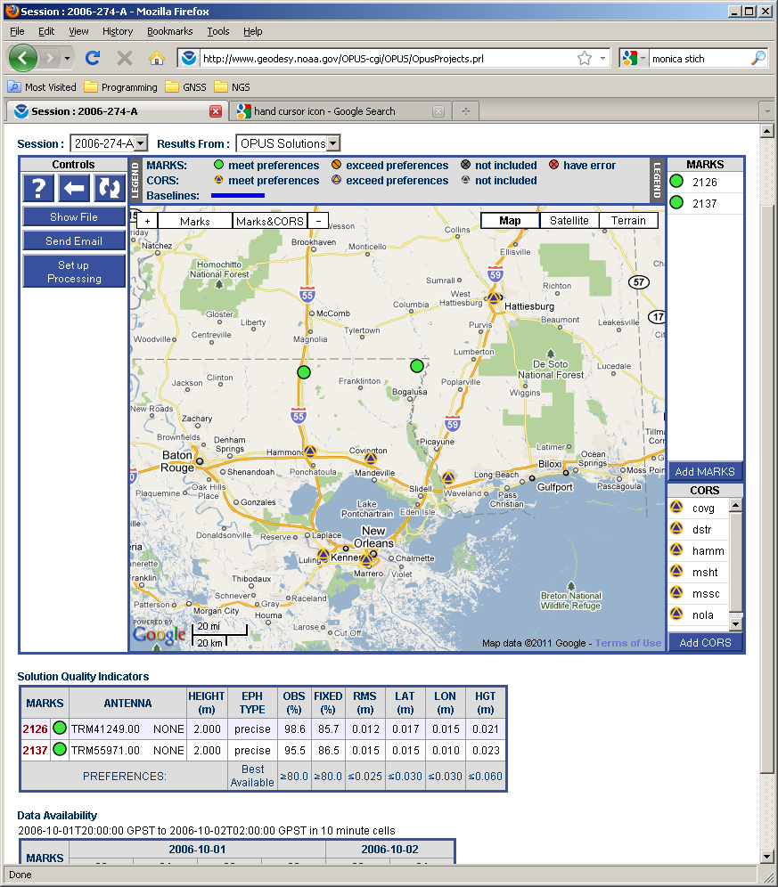
Now let’s scroll back to the top of the web page and describe the processing controls.

Slide 112
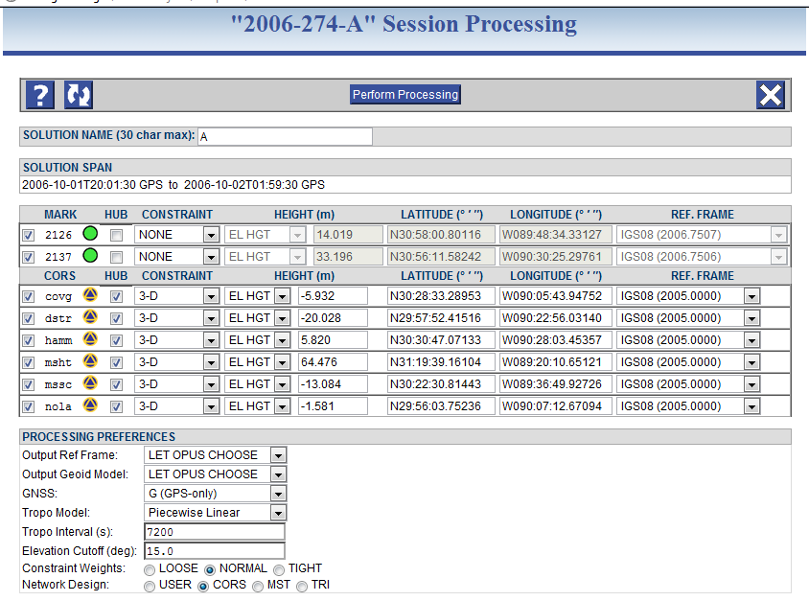
Clicking the “Set up Processing” button causes two things to happen: the processing set up window appears and the baselines implied by the processing selections are shown on the session map.

Slide 113

After shrinking both windows and placing them side by side, we see that the baselines are indeed drawn on the map. Let’s focus on the session processing form, but keep a small copy of the map for the remainder of this discussion.

Slide 114
If no processing has been preformed in this session, the default selections are used as is the case here: all data are included, the CORS are hubs and constrained, …

Slide 115


The Network Design offers some common strategies for connecting marks via baselines in the processing. Picking one of these strategies may change the hub selections, but will never change which marks are included or their coordinates.

Slide 116
Our changes have resulted in a USER strategy meaning we have deviated from one of the predefined strategies. Let’s step through the predefined strategies and note the changes.

Slide 117


As we saw originally, the CORS means that all CORS to be included in the processing are designated hubs.

Slide 118

MST or minimal spanning tree selects the set of shortest possible baselines between mark. All marks are designated hubs. By chance, the resulting baselines are identical to the CORS design.
Notes:
The selection is actually by baseline length and mutual data availability. For well behaved networks smaller than “continental” scales, the mutual data availability usually has little impact.

Slide 119


TRI design creates a set of closed-loops based upon the Delaunay triangulation algorithms.

Slide 120
Let’s return to the default design, CORS, and submit our selections for processing.

Slide 121

your.name@your.address
The selections are checked, inserted in the processing queue and a printable summary is created.

Slide 122

your.name@your.address
NGS OPUS-PROJECTS SESSION SOLUTION REPORT 2006-274-A
FROM PROJECT my project @ 2006-10-01.
SELECTED REPORTS ARE ATTACHED TO THIS EMAIL. ALL REPORTS ARE
AVAILABLE THROUGH THE PROJECT'S WEB PAGE FOR THIS SOLUTION.
ABBREVIATED SUMMARY
SUBMITTED BY: your.name@your.address
SOLUTION FILE NAME: 2006-274-A.sum
SOLUTION SOFTWARE: page5(1301.08)
SOLUTION DATE: 2013-08-07T12:40:26 UTC
STANDARD ERROR OF UNIT WEIGHT: 0.619
TOTAL NUMBER OF OBSERVATIONS: 72609
TOTAL NUMBER OF MARKS: 6
NUMBER OF CONSTRAINED MARKS: 4
OVERALL RMS: 1.2 cm
START TIME: 2006-10-01T00:00:00 GPS
STOP TIME: 2006-10-02T23:59:30 GPS
PROGRAM OPERATION: FULL RUN
FREQUENCY: L1-ONLY TO ION-FREE [BY BASELINE LENGTH]
OBSERVATION INTERVAL: 30 s
ELEVATION CUTOFF: 15 deg
TROPO INTERVAL: 7200 s [PIECE-WISE LINEAR PARAMETERIZATION]
DD CORRELATIONS: ON
In a few minutes (often longer depending upon the number of marks in the session), an email with the results will be sent. It is a summary of the results with full reports attached.

Slide 123

Returning to the session web page and refreshing it if needed, you’ll see the results of our processing are now evident.

Slide 124

The session processing reports are available.

Slide 125


Once satisfied with the quality of these results, you can start an alternate processing set up or another session.

Slide 126
The OPUS-Projects workflow
Step 1 : Create a Project
Step 2 : Upload Data
Step 3 : Session Processing
Step 4 : Network Adjustment
Optional : Use output files for “Bluebooking”

Slide 127

The project ID and manager keyword are required to access the manager’s page from the OPUS Projects gateway page: http://geodesy.noaa.gov/OPUS-Projects/.

Slide 128
The project is always scanned for changes when accessed so the information will be up-to-date.

Slide 129

In a few moments, the manager’s page appears. It looks different now that the data have been uploaded and session processing completed, so lets explore this page.

Slide 130

… or center and zoom to show the marks and included CORS.

Slide 131

The brightly colored lines on the map represent baselines used in the processing. Note that the processing solutions are associated with line colors in the table below the map.

Slide 132

In the case of session solutions, moving the cursor over the label in the table causes only those baselines to be shown.

Slide 133


Slide 134

You can use this menu to display individual session results, the OPUS results and, eventually, individual network adjustments.

Slide 135
“Review and Publish” is deprecated and will be removed in the near future.
Notes:
Target for removal is October, 2013.

Slide 136
The table at the bottom of the page is a terse summary of the project sessions, solutions and marks.

Slide 137

Let’s set up and perform a network adjustment. Start by clicking the “Set up Adjustment” control button.

Slide 138

There are many similarities between the network adjustment and session processing controls. As we did then, let’s focus on these controls but keep a small copy of the map.

Slide 139

First, note that no marks are listed and all the baselines have been removed from the map. They will be replaced as session solutions are included in the adjustment.

Slide 140


The included marks and network design are set in the sessions. They cannot be changed in the adjustment.

Slide 141
… and the constraint weight selected:
LOOSE ≈ 1 m, NORMAL ≈ 1 cm , TIGHT≈ 0.1 mm.

Slide 142
When the selections are complete, click the “Perform Adjustment” button in the control bar at the top of the window.

Slide 143

At that time, the selections are checked, inserted in the processing queue and a printable summary is created. The adjustment rarely takes more than a few minutes once it reaches the top of the queue.

Slide 144
NGS OPUS-PROJECTS NETWORK ADJUSTMENT REPORT
===========================================
All coordinate accuracies reported here are 1 times the formal
uncertainties from the solution. For additional information:
dev.ngs.noaa.gov/OPUS/Using_OPUS-Projects.html#accuracy
These positions were computed without any knowledge by the National
Geodetic Survey regarding the equipment or field operating procedures used.
SUBMITTED BY: mark.schenewerk
SOLUTION FILE NAME: network-final.sum
SOLUTION SOFTWARE: GPSCOM(1210.24)
SOLUTION DATE: 2013-05-21T09:13:11 UTC
STANDARD ERROR OF UNIT WEIGHT: 0.773
TOTAL NUMBER OF OBSERVATIONS: 224036
TOTAL NUMBER OF MARKS: 8
NUMBER OF CONSTRAINED MARKS: 4
START TIME: 2006-10-01T00:00:00 GPS
STOP TIME: 2006-10-04T23:59:30 GPS
FREQUENCY: L1-ONLY TO ION-FREE [BY BASELINE LENGTH]
OBSERVATION INTERVAL: 30 s
ELEVATION CUTOFF: 15 deg
TROPO INTERVAL: 7200 s [PIECE-WISE LINEAR PARAMETERIZATION]
DD CORRELATIONS: ON
INCLUDED SOLUTION RMS SOFTWARE RUN DATE
------------------------------------------------------------------------------
1) 2006-274 A 1.2 cm page5(1301.08) 2013-08-07T12:40 UTC
2) 2006-275 A 1.1 cm page5(1301.08) 2013-08-07T14:51 UTC
3) 2006-275 B 1.5 cm page5(1301.08) 2013-08-07T14:52 UTC
4) 2006-276 A 1.6 cm page5(1301.08) 2013-08-07T14:54 UTC
5) 2006-276 B 1.9 cm page5(1301.08) 2013-08-07T14:56 UTC
6) 2006-277 A 1.7 cm page5(1301.08) 2013-08-07T14:57 UTC
your.name@your.address
When the adjustment is completed, an email is sent. The email contains a summary of the results and has full reports attached.

Slide 145
hamm-2126 80.640 km 1.0 cm 2471 2.3% 100.0% 2
msht-mssc 108.867 km 1.9 cm 15604 5.2% 93.4% 5
+++++++++++++++++++++++++++++++++++++++++++++++++++++++++++++++++++++++++++++
UNCONSTRAINED MARKS
+++++++++++++++++++++++++++++++++++++++++++++++++++++++++++++++++++++++++++++
MARK: 2123 (2123 1)
REF FRAME: NAD_83(2011) (2010.0000) IGS08 (2006.7552)
X: -46694.793 m 0.002 m -46695.473 m 0.002 m
Y: -5495064.269 m 0.002 m -5495062.776 m 0.002 m
Z: 3226832.869 m 0.003 m 3226832.701 m 0.003 m
LAT: 30 35 23.59014 0.003 m 30 35 23.61003 0.003 m
E LON: 269 30 47.28881 0.002 m 269 30 47.26283 0.002 m
W LON: 90 29 12.71119 0.002 m 90 29 12.73717 0.002 m
EL HGT: -7.427 m 0.002 m -8.793 m 0.002 m
ORTHO HGT: 19.630 m 0.012 m (H = h - N WHERE N = GEOID12A HGT)
UTM COORDINATES STATE PLANE COORDINATES
UTM (Zone 15) SPC (1702 LA S)
NORTHING (Y) 3386842.988 m 231955.819 m
EASTING (X) 740977.315 m 1081182.819 m
CONVERGENCE 1.27952553 deg 0.42324530 deg
POINT SCALE 1.00031642 0.99997843
COMBINED FACTOR 1.00031759 0.99997960
US NATIONAL GRID DESIGNATOR: 15RYP4097786842 (NAD 83)
+++++++++++++++++++++++++++++++++++++++++++++++++++++++++++++++++++++++++++++
MARK: 2126 (2126 1)
REF FRAME: NAD_83(2011) (2010.0000) IGS08 (2006.7523)
It includes the individual mark results.
Notes:
The coordinate uncertainties and adjustments for the constrained marks.

Slide 146

Returning to the manager’s page, the network adjustment is now available for review .

Slide 147
The OPUS-Projects workflow
Step 1 : Create a Project
Step 2 : Upload Data
Step 3 : Session Processing
Step 4 : Network Adjustment
Optional : Use output files for “Bluebooking”

Slide 148
Bluebooking using OPUS-Projects
Introductory stuff
  Bluebooking and Height Modernization
  Software (mainly NGS program ADJUST)
Example OP Grand Canyon Project
Steps for Bluebooking
  Setting up a project for ADJUST
  Initial analysis of results from ADJUST
  Final adjustments and analyses
  Finalize project for submitting
Revelry!

Slide 149
What is “Height Modernization”?
Height Modernization is an NGS program
  Improve access to accurate, reliable, consistent “heights”
  Here, focus is obtaining orthometric heights using GNSS
    Done with campaign-style GNSS surveys
    Occupy bench marks with accurate leveled ortho heights
    Perform network adjustment of GNSS vectors to get ortho heights
    Constrained to leveled heights while using hybrid geoid model
Additional information and associated documents
  Height Mod website: www.ngs.noaa.gov/heightmod/
  Guidelines for GNSS-derived ellipsoid and orthometric heights
    NGS-58 (ellipsoid heights)
    NGS-59 (ortho heights)

Slide 150
Software
OPUS-Projects (of course!)
ADJUST program suite
  “adjust_all.zip” at beta.ngs.noaa.gov/PC_PROD/ADJUST/
  ADJUST 6.2.3 plus various utility and checking programs
  Includes documents and a sample project
WinDesc (latest version 4.17.25)
  Create ADJUST constraint files and descriptions
  www.ngs.noaa.gov/PC_PROD/pc_prod.shtml#WinDesc
GIS GPS Toolset: Display and analysis of ADJUST results
  Run using Esri ArcGIS software (ArcMap and ArcToolbox)
Miscellaneous programs
  htdp.exe, preplt2.exe, diflatlon.exe, compVecs.exe, etc.

Slide 151
OPUS-Projects output for Bluebooking
Three ASCII text files
Two files serve as input files for ADJUST
  bfile: Station coordinates, occupation info
  gfile: GPS vectors, uncertainties, correlations
Serfil: Relates station 4-character code to SSN
  SSN is 4-digit “Station Serial Number” in b- and gfiles

Slide 152
Adjustment options files (afiles)
afile is also required by ADJUST
afile is an adjustment options file
  Controls how ADJUST is run
  Gives constrained coordinates for marks
  Gives uncertainties on constrained components
NOT generated by OPUS-Projects (yet)
  Simplest way to create now is using WinDesc

Slide 153
Example OP Project for Bluebooking
Part of an actual Height Mod survey project
  Located at Grand Canyon
  Most occupations in June 2010, some in May 2009
  16 marks total (12 passive plus 4 CORS)
    71 marks total in actual project (61 passive plus 10 CORS)
Tried for realistic, “interesting” characteristics
  Some noisy data, control of variable quality
  Different types of CORS, mix short and long vectors
  Missing sessions, uneven occupations, long time span
  Nice scenery!

Slide 154


Slide 155


Slide 156


Slide 157


Slide 158
OP Grand Canyon Example Project
Marks
  12 passive marks
    4 geometric (“horizontal”) control marks
      2 are also vertical control marks
    6 leveled bench marks (1st order, posted, and offset)
  4 CORS
    2 CORS are referenced to external “monument”
    1 CORS based on “modeled” velocities (no formal accuracies)
Occupations
  6 sessions (3 in May 2009 and 3 in June 2010)
  Highly variable occupation durations (for useable data)

Slide 159
Mark ID | Designation | PID | Geom 3D | Vertical
6866 | 6866 CANYON | GQ0054 |  | Posted
abys | ABYSS | DG5946 | Passive
apex | APEX | DN3518 |  | Offset
b490 | B 490 | FR0789 | Passive | 1st order
b61_ | B 61 | FR0111 |  | Posted
c62_ | C 62 | GP0178 |  | Posted
dsvw | DESERT VIEW
doby | DOBY
espe | ESPEE
ljim | LONG JIM
sign | SIGNAL HILL | GQ0298 | Passive
v488 | V 488 | FR0757 | Passive | 1st order
azpg | CITY OF PAGE CORS ARP | DK8419 | CORS
fern | FERN ECC REF DIMPLE | AI8822 | CORS
fst6 | FLAGSTAFF 6 CORS ARP | DJ8983 | CORS
fred | FRED ECC REF DIMPLE | AI8807 | CORS

Slide 160
OP Grand Canyon Example Project
OPUS-Projects Grand Canyon Example Project
  Used default OPUS-Projects settings
  Used OP essentially as online GPS baseline processor
    Focus is on session processing not network adjustment
    gfiles are created in session processing ONLY
    Network adjustment concatenates session gfiles
Let’s take a look at the OP example project…

Slide 161

OP Grand Canyon Example Project

Slide 162
Adjustment for GNSS Bluebooking
NGS policy (June 2012)
  ADJUST is ONLY software that can be used to submit GNSS projects for publishing in NGS Integrated Data Base
  www.ngs.noaa.gov/INFO/Policy/files/062012_Data_Submission_Policy.pdf
Documentation
  “Constrained Adjustment Guidelines”
  www.ngs.noaa.gov/PC_PROD/ADJUST/adjustment_guidelines.pdf
  Original ADJUST documentation (TM NOS NGS-47)
  www.ngs.noaa.gov/PUBS_LIB/Adjust_TheHorizontalObservationAdjustmentProgram_TM_NOS_NGS_47.pdf
  Supplemental ADJUST documentation
  beta.ngs.noaa.gov/PC_PROD/ADJUST/adjust_supplemental.txt
Entire process needs to be updated

Slide 163
Adjustment sequence overview
Typically 4 adjustments performed for a project
  Minimally constrained (“free”) geometric
    Constrain single mark 3-D
    Internal integrity (mainly vector residuals)
  Geometrically (“horizontally”) constrained
    Constrain multiple mark 3-D, 2-D, or 1-D (ellipsoid height)
    Geoid heights added to final bfile for vertical adjustments
  Minimally constrained (“free”) vertical
    Constrain orthometric height for single mark
  Vertically constrained
    Constrain vertical control 1-D (orthometric height)

Slide 164
Finalize for submittal to NGS
Final output of ADJUST results
  Add ortho heights from vertical adjustment to final bfile
  Manual editing of final bfile (especially vertical metadata)
Create descriptions using WinDesc
Run checking programs
  chkobs.exe, obschk.exe, obsdes.exe
Project report
  See “Constrained Adjustment Guidelines” for requirements
  Plan to provide report template to make this simpler
Submittal to NGS for review and publication
  Mail report and data files (typically on CD or DVD)
  Submittal via Internet is not yet available

Slide 165
Compare OP to ADJUST (free adjust)
Free adjustment OPUS-Projects minus ADJUST results (cm)
Constrained to mark "abys"
OPUS-Projects "normal" constraints weight
 | Delta Horz | Delta EHT | Delta OHT
Min | 0.2 (abys) | -0.6 (abys) | N/A
Max | 0.5 (dsvw) | -0.2 (sign) | N/A
Mean | 0.3 | -0.3 | N/A
Std dev | ±0.1 | ±0.1 | N/A

Slide 166
Compare OP to ADJUST (const adjust)
OPUS-Projects results minus final ADJUST results (cm)
OPUS-Projects "normal" constraints weight
 | Delta Horz | Delta EHT | Delta OHT
Min | 0.2 (b490) | -0.3 (v488) | -3.7 (v488)
Max | 0.8 (dsvw) | 0.6 (b490) | 2.5 (apex)
Mean | 0.6 | 0.3 | -0.1
Std dev |  | ±0.2 | ±1.3
OPUS-Projects "tight" constraints weight
 | Delta Horz | Delta EHT | Delta OHT
Min | 0.1 (abys) | -0.8 (b490) | -0.3 (dsvw)
Max | 0.8 (sign) | 1.2 (fst6) | 0.3 (fred)
Mean | 0.4 | 0.4 | 0.1
Std dev |  | ±0.5 | ±0.2

Slide 167
Compare OP to ADJUST (accuracies)
Accuracy comparison (at 95% confidence)
OPUS-Projects "normal" constraints weight
 | Horizontal (cm) |  | Ellipsoid height (cm) |  | Ratio ADJUST/OP
 | ADJUST | OP | ADJUST | OP | Horiz | Ellipsoid ht
Min | 0.18 (abys) | 0.24 (all) | 0.34 (abys) | 0.20 | 0.7 (abys) | 1.7 (abys)
Max | 1.31 (c62_) | 0.24 (all) | 1.48 (c62_) | 0.39 (c62_) | 5.4 (c62_) | 4.6 (apex)
Mean | 0.56 | 0.24 | 0.70 | 0.21 | 2.3 | 3.3
OPUS-Projects "tight" constraints weight
 | Horizontal (cm) |  | Ellipsoid height (cm) |  | Ratio ADJUST/OP
 | ADJUST | OP | ADJUST | OP | Horiz | Ellipsoid ht
Min | 0.18 (abys) | 0.00 | 0.34 (abys) | 0.00 | ∞ | 3.6 (6866)
Max | 1.31 (c62_) | 0.00 | 1.48 (c62_) | 0.39 (c62_) | ∞ | ∞
Mean | 0.56 | 0.00 | 0.70 | 0.11 | ∞ | 4.2

Slide 168
Why do OP and ADJUST results differ?
OP does not adjust both ellipsoid and ortho heights
  OP always uses relationship h = H + N
OP uses different sigmas on constraints
  Sigmas in XYZ rotated to NEU without covariances
  Passive mark sigmas from OPUS peak-to-peak
ADJUST scales horizontal and vertical errors separately
ADJUST multiplies final sigmas by std dev unit weight
  Not sure if OP does or not…
OP adjusted observables are double differences
  ADJUST adjusted observables are GPS vector components
  But should this cause a difference?

Slide 169
Recap of OP Bluebooking process
Create and process project in OP
  OP emails network adjustment bfile and gfile
Run ADJUST using OP bfile and gfile
  Creat afiles (using WinDesc)
  Perform adjustments and analyses
    Geometric adjustments (free then constrained)
    Vertical adjustments (free then constrained)
  Combine final geometric and vertical adjustments
Create descriptions (using WinDesc)
Run checking programs
Prepare report
Submit report and results to NGS

Slide 170
Additional discussion items
Where is NGS going with all this?
How do you analyze OPUS-Projects results?
  There are no vector residuals to analyze
  There are no vectors to reject
Dependent (“trivial”) vectors
Bluebooking with commercial GNSS baseline processing software

Slide 171
Questions?

