Slide 1



What does NSRS Modernization Look Like?
New Jersey Society of Professional Land Surveyors
February 21, 2025
Dan Martin
Northeast Regional Geodetic Advisor
Dan.martin@noaa.gov
240-676-4762

Slide 2
Today’s Topics
Modernization Progress
  GRAV-D
  GPSonBM
  Laser, SPROCCET
  OPUS Projects 5.2 (Production)
  Beta
    OPUS 5 (GNSS)
  Alpha Page
NSRS Mod Timeline
NOS NGS 92
Modernized Tools
  NCN Station Page
  CORS Time Series Tool
  Modernized OPUS Tools
Modernization Workflows (Audience Participation)

Slide 3
Replacing NAD83
develop four "plate-fixed" reference frames
remove non-geocentricity of NAD83
align to ITRF2020 at epoch 2020.00
remove most of tectonic plate rotation from ITRF2020 via Euler Pole Parameters
(pronounced: “oiler”)
Shift and Drift…
Notes:
We’ll talk about that ‘plate fixed’ later.
Now wait a minute Jeff, what is the IGS? You just explained the ITRF and told us about that!!
IGS Reference Frame is pretty much equivalent to the ITRF, created by the Intl. GNSS Service, of which NGS is a contributing partner.
The Intl. GNSS Service, let’s take a look at their website for a minute.
-pronounced “oiler” poles

Slide 4
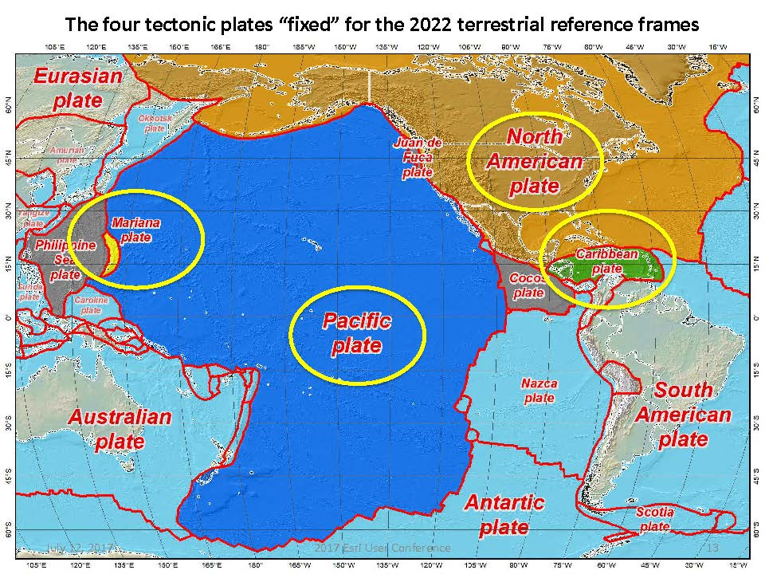
Notes:
-there’s four reference frames because there are four major tectonic plates within the NGS Area of Responsibility.
-As the National Geodetic Survey, we’re part of the DoC so we must cater to all US States and Territories
-thus we’ve got four tectonic plates in our Area of Operations, so four Ref Frames
-But…

Slide 5
Names
The Old:
NAD 83(2011)
NAD 83(PA11)
NAD 83(MA11)
The New:
The North American Terrestrial Reference Frame of 2022
(NATRF2022)
The Caribbean Terrestrial Reference Frame of 2022
(CTRF2022)
The Pacific Terrestrial Reference Frame of 2022
(PTRF2022)
The Mariana Terrestrial Reference Frame of 2022
(MTRF2022)

Slide 6
Names
  The Old:
  NAVD 88
  PRVD 02
  VIVD09
  ASVD02
  NMVD03
  GUVD04
  IGLD 85
  IGSN71
  GEOID18
  DEFLEC18
Orthometric
Heights
  The New:
  The North American-Pacific Geopotential Datum of 2022 (NAPGD2022)
  - Will include GEOID2022
one vertical datum
pole-to-equator
Normal
Orthometric
Heights
Dynamic
Heights
Gravity
Geoid
Undulations
Deflections of
the Vertical

Slide 7
Recent Progress

Slide 8
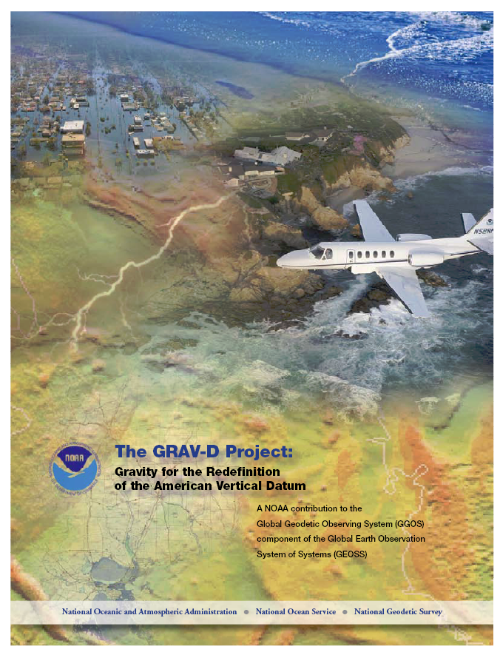
GRAV-D Project Overview
Overall Target: 2 cm accuracy orthometric heights from GNSS and a geoid model
GRAV-D Goal: Create gravimetric geoid accurate to 1 cm where possible using airborne gravity data
GRAV-D: Two thrusts of the project
  Airborne gravity survey of entire country and its holdings
  Long-term monitoring of geoid change
Leveraging partnerships to improve and validate gravity data
Notes:
Target is to be able to achieve 2 cm accuracy orthometric heights (where possible) using a GNSS receiver and a geoid model
Roughly 1 cm uncertainty from GNSS and 1 cm from the geoid model
GRAV-D
Phase 1: snapshot of the entire country to provide a consistent data set
Phase 2: long term monitoring of geoid change – in development
Work with partners to incorporate additional gravity data, particularly surface gravity data, validate existing data, and monitor change

Slide 9
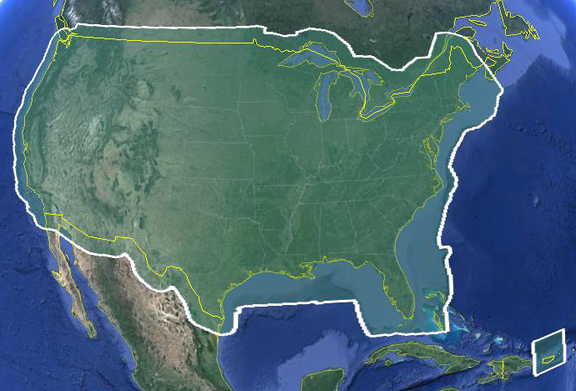
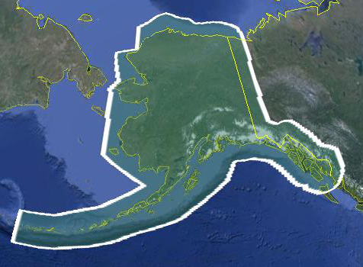
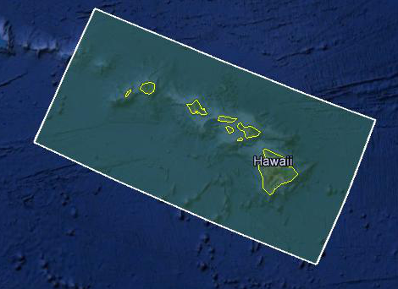
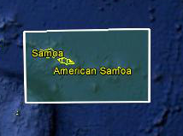
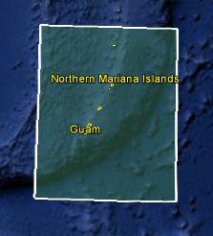
Data Collection Scope
Entire U.S. and territories
  Total Square Kilometers: 15.6 million
  Initial target area for 2022 deadline
  ~200 km buffer around territory or shelf break if possible
Notes:
Project Scope:
Scope of the project: cover roughly 15.6 million square kilometers – contiguous united states, Alaska, Hawaii, Guam, and American Samoa
In order to blend with satellite altimetry data the airborne survey is done to the continental shelf where possible or ~ 200 km beyond the shoreline or border, whichever is further
Deadline of 2022 for datum rollout, which means a target of 2021 to finish the airborne survey
Priority areas were defined as Alaska and coastal areas
Challenges:
Fixed annual budget and time → design of surveys had to fit within an annual budget of $3.5 million and meet the deadline
This was a major factor in setting altitude and line spacing

Slide 10
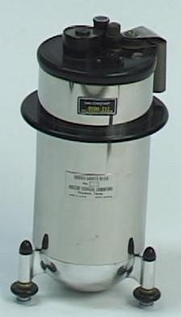
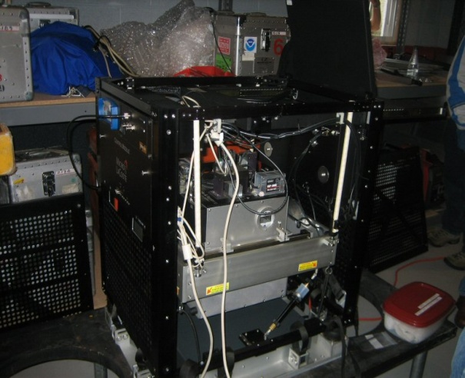
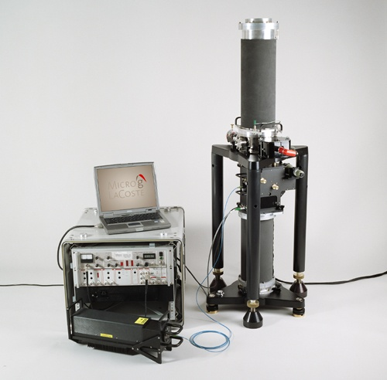
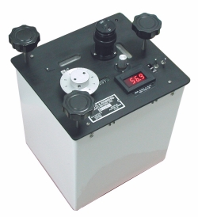
Gravity Survey Plan
National Scale Part 1
  Predominantly through airborne gravity
  With Absolute Gravity for ties and checks
  Relative Gravity for expanding local regions where airborne shows significant mismatch with existing terrestrial

Slide 11
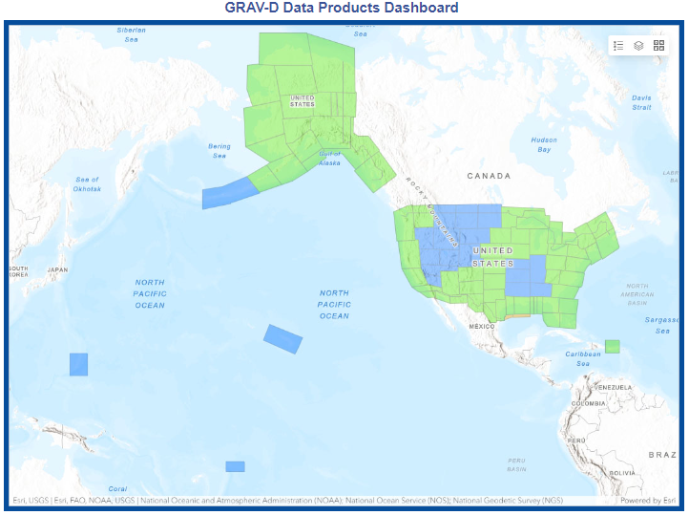

Airborne Gravity Current Coverage
http://www.ngs.noaa.gov/GRAV-D/data_products.shtml

Slide 12
GRAV-D Progress
100% of target area flown!
Re-flew some older, lower quality lines
Flying Canadian Rockies
Beginning to plan some Terrestrial Gravity to densify relative gravity in areas with interesting gravity signals.
Planning absolute gravity 10-15 sites in the NW to support GeMS (Geoid Monitoring Service)

Slide 13
Geoid Monitoring Service
GeMS
Following slides taken from presentations by Kevin Ahlgren, GeMS Project Manager

Slide 14
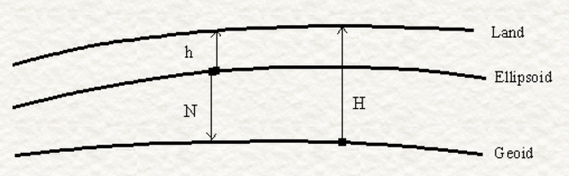
Monitoring Geoid Change: Static vs. Dynamic
From Damiani, 2017 Geospatial Summit
Measured with GPS
Deforms, subsides, uplifts at all length scales
Static, except for model updates
Changes along with large-scale gravity change (caused by mass movement)
Calculated from geoid models
The height that U.S. National Spatial
Reference System Users need
h = ellipsoidal height;
N = geoid height (undulation);
H = orthometric height
In a static world, H ≈ h - N
2022 aim is to achieve 1 cm geoid height accuracy (wherever possible) and 1 cm ellipsoidal height accuracy.
In a changing world, Ḣ ≈ ḣ - Ṅ.
Option 1: Provide a series of static geoids, updated whenever change somewhere in the U.S. reaches 0.5 cm. [Not NGS’ choice]
Option 2: Provide a static geoid (N₀) and geoid change over time (Ṅ) so that orthometric heights remain accurate to 1 cm at all times.
H_{t} = h_{t}-(N₀+ Ṅ*t) [NGS’ choice]

Slide 15
GeMS Project Status
Research and Development
  Scope:
    What can NGS do? What can NGS not do?
    What are the costs, benefits, and risks of doing or not doing a particular element within GeMS?
  Status:
    Nearly completed (95% done).
  Deliverables:
    NOS NGS Technical Report 69: A Preliminary Investigation of the NGS’s Geoid Monitoring Service (GeMS)
    Alpha Products: xDGEOID19 – a dynamic geoid model will be available for testing with xGEOID19.
    Supporting Tools: Software, documentation, and details.
    Recommendations that will drive subsequent GeMS stages.
Operations and Development (TBD)
Refinement and Improvement (TBD)

Slide 16
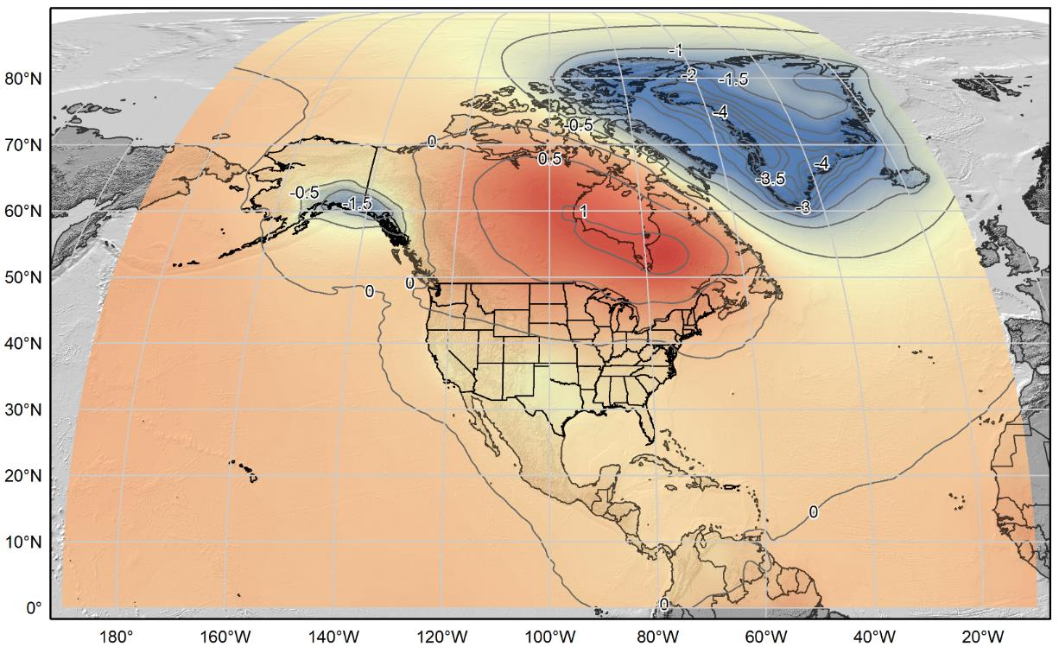
xDGEOID20
Alpha model based on secular trend from GRACE (NASA GSFC mascon v02.4, Luthcke, et al. 2013)).
Units: mm/yr.
Contour Interval: 0.5 mm/yr

Slide 17
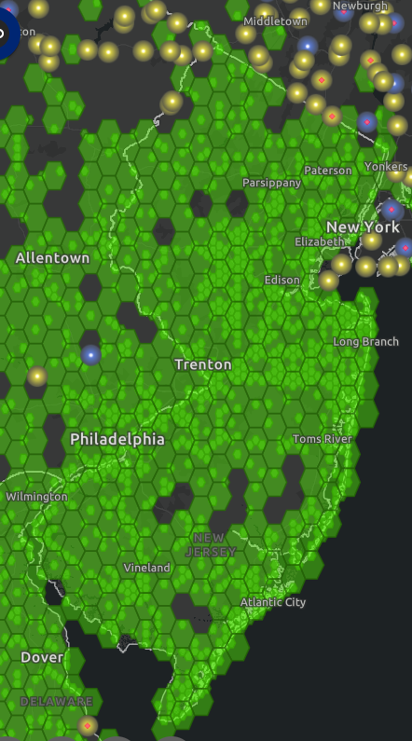
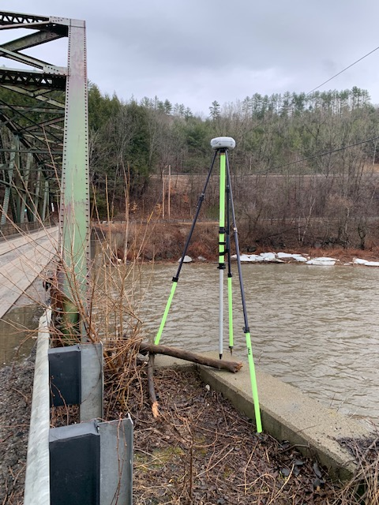
GPSonBM for Transformation Tool
Deadline was extended until Feb. 29, 2024
This was the LAST extension.

Slide 18
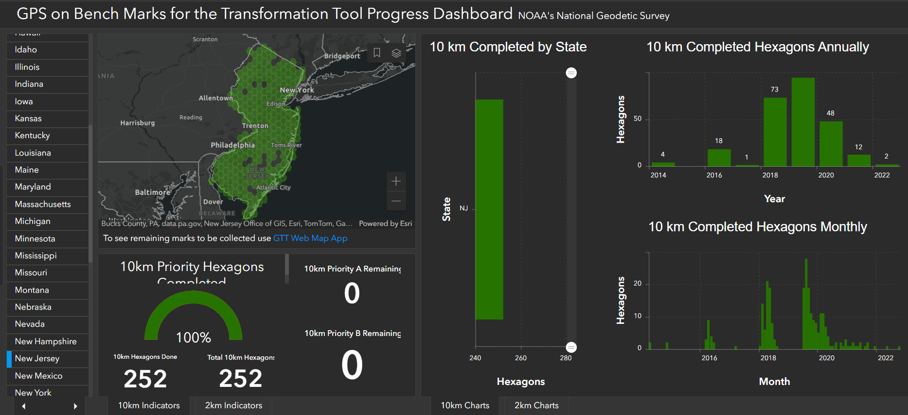
Way to go NJ!!

Slide 19
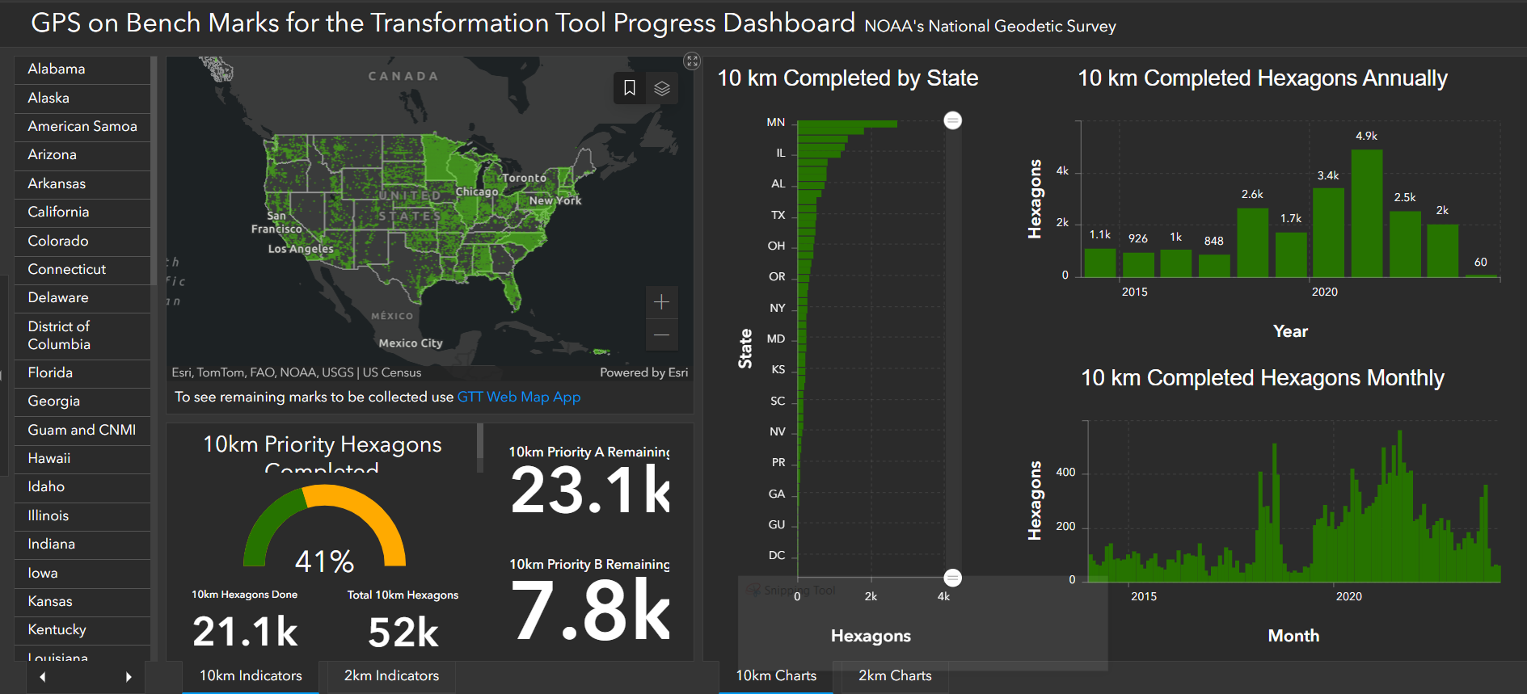
All in all, an amazing effort

Slide 20
LASER
Least squares Adjustments: Statistics, Estimates and Residuals
Contract began in August 2020
Solves many LSA problems
    Has been tested on historic NGS archives
  Uses the pre-existing Eigen library of linear algebra routines

Slide 21
A (probably incomplete) history of LSA software at NGS
INERT1 (1982) …….. Inertial
HOACOS (1979)…… Precursor to Adjust
HAVAGO (1979)……. Precursor to Adjust for 3D adjustments
ADJUST ……………. Horizontal, modified for GPS, used by OP
GPSCOM/LLSOLV...Used to compute CORS network, early OP
ASTA………………...Geodetic leveling
NETSTAT …………...Built for 2007 adjustment, used again in 2011
APOGEE…………….Relative Gravity
CALIBRATE……….. Calibration Baselines
Additionally, LSAs are encompassed within this NGS software tool:
PAGES
Also, there is the following stand-alone set of matrix manipulation subroutines:
Heart Of Gold (1984)

Slide 22
Concerns: General
Inconsistency
  Different languages, different variable names, and different times lead to inconsistency in code
    Some programs might be perfectly compatible, but it’s difficult to know with such a vast number of authors and code over the years.
Lack of generality
  Code written to adjust only one type of geodetic observation has limited usefulness to other applications
Languages: FORTRAN, C++, MATLAB are all in use today
Scalability

Slide 23
Software for PRojecting Observations, Constraints and Cofactor matrices/Errors through Time (SPROCCET)
Replaces HTDP
Support for orthometric data
Use of Geodetic Data eXchange (GDX) format
Use of IFDM2022
Error propagation through time
Distinct modules for 14-parameter Helmert transformations and deformation models

Slide 24
Reprocessing of OPUS Share
Reprocessing began Jan 21. 2025
78,6136 RINEX files to Process
Processing with M-PAGES
  Marks with at least two shared observations, or one Shared and one IDB observations will be added to the initial National Adjustment to create transformation grids for NADCON and VERTCON
  Marks with only one shared observation, and new IDB observations will be added to a later adjustment (to be completed by May, 2025)

Slide 25
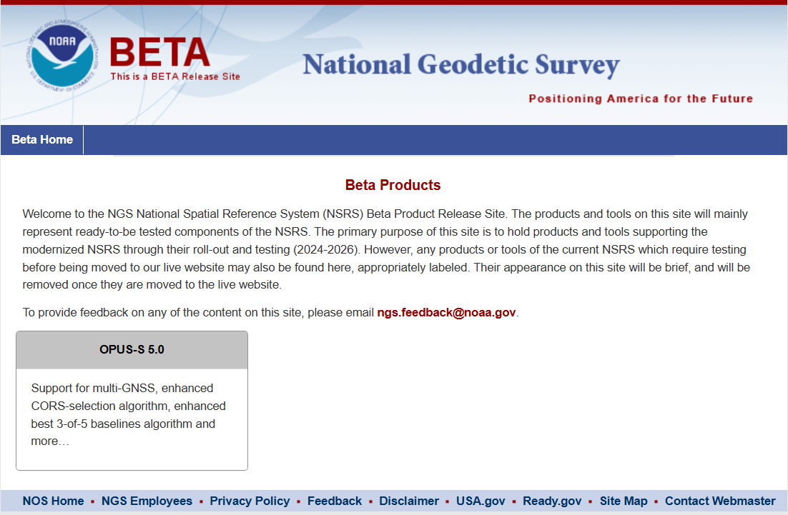

Slide 26
M-PAGES = Multi-GNSS PAGES
Currently in BETA!!
Capable of ingesting all GNSS observables currently supported by the global infrastructure
Capable of using more than two frequencies.
Capable of ingesting RINEX 2 or 3
  Version 2 only supports GPS and GLONASS, Galileo (to a limited extent)
  Submission of proprietary data will result in RINEX 2.11 (limitation of TEQC). NGS will ONLY accept RINEX submission in the near future.
Capable of using pseudorange and phase.
Uses a single-difference processing strategy.
M-PAGES can support NGS strategic objectives.
January 26, 2021
Multi-GNSS OPUS : First Call for Internal Testing

Slide 27
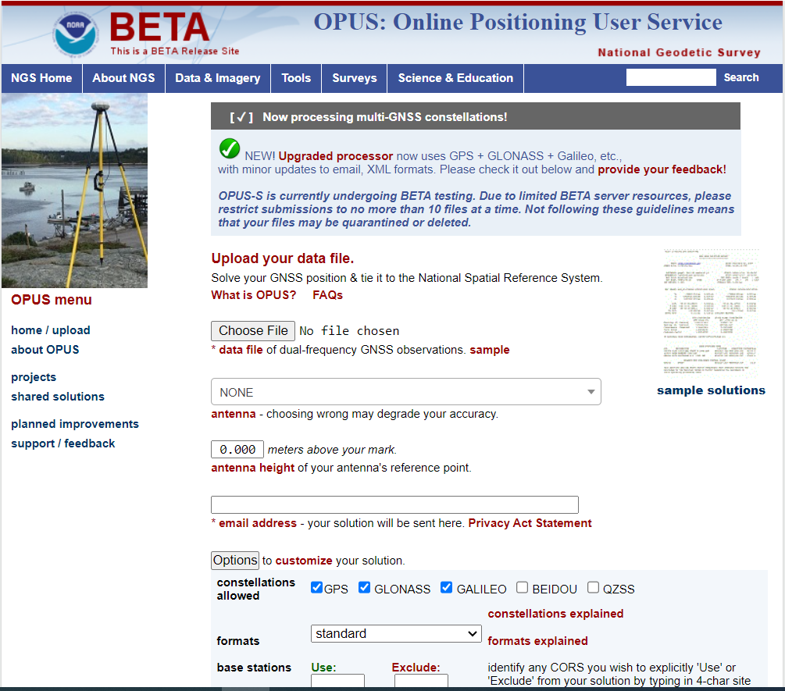

Slide 28
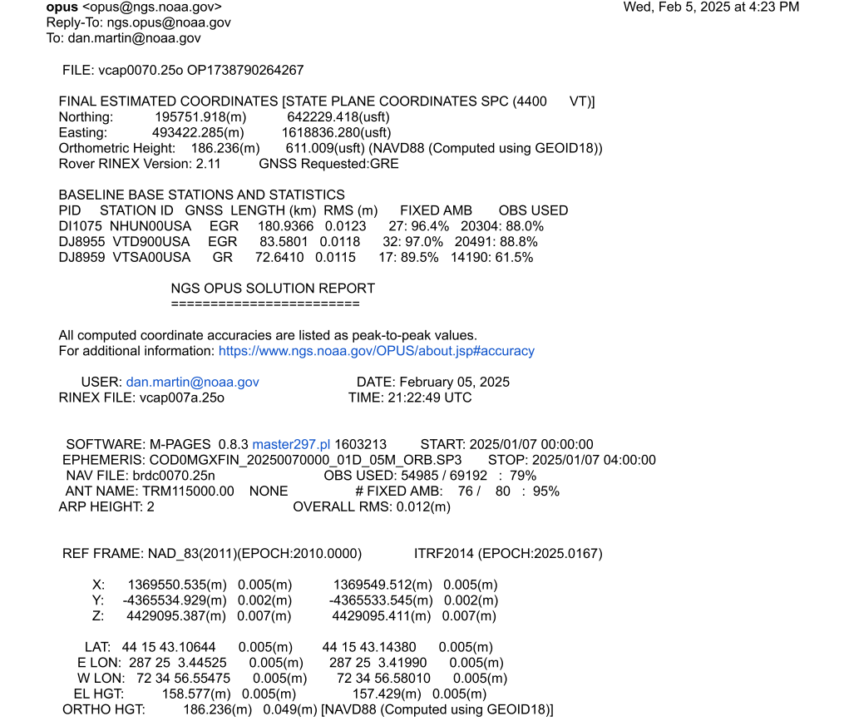

Slide 29
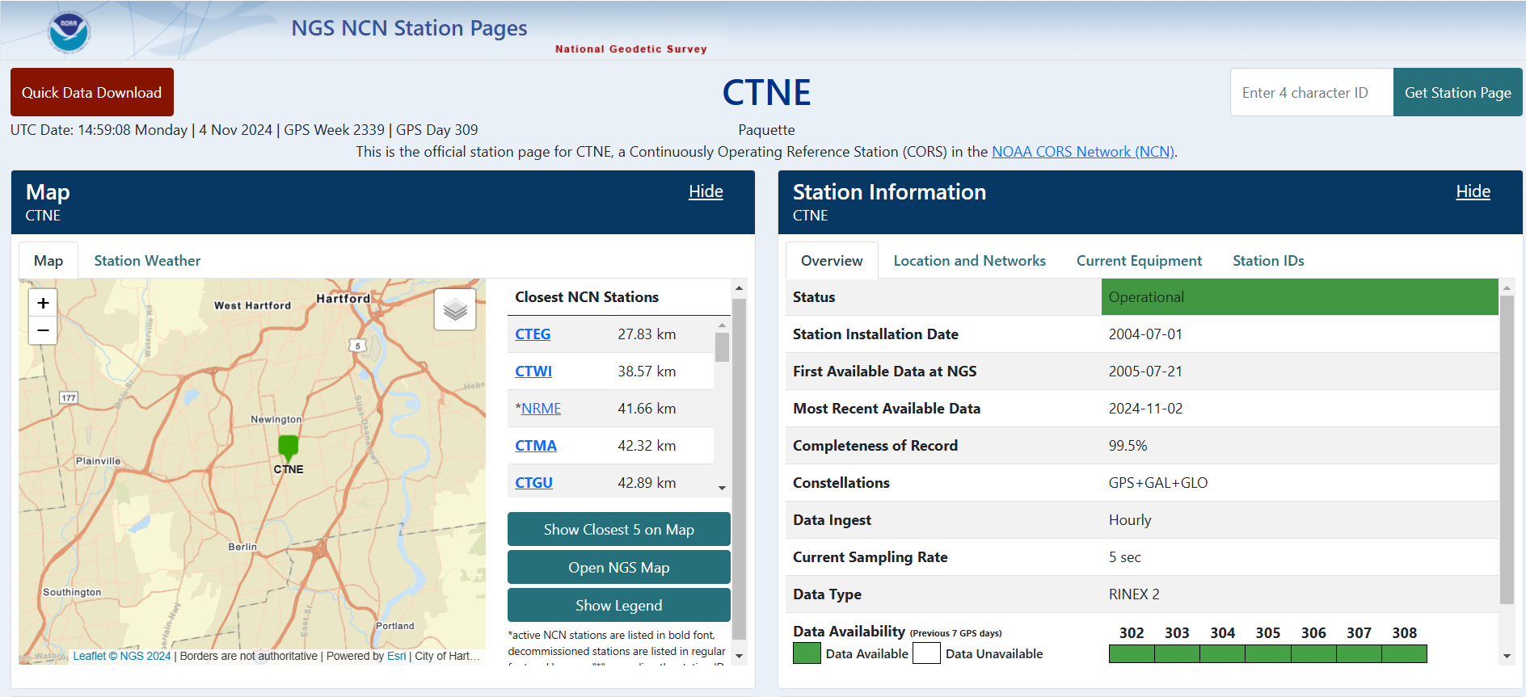
CORS Info (Moved Beta=>Prod)
https://geodesy.noaa.gov/CORS/ncn_station_pages/index.html?stationID=CTNE

Slide 30
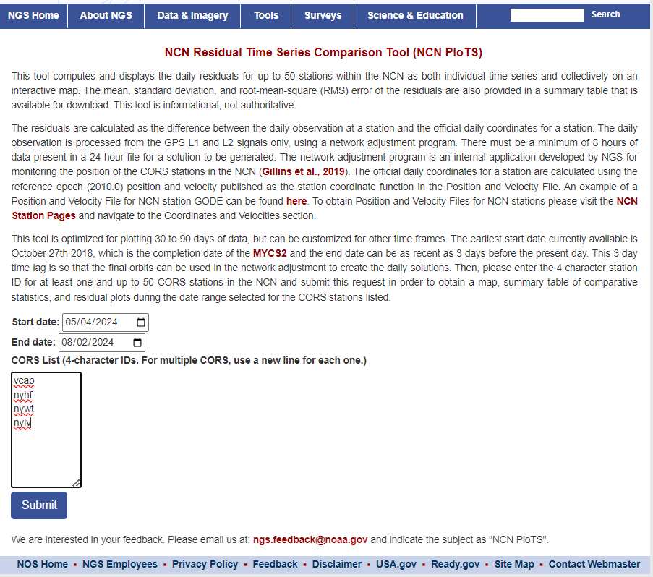
CORS Page short-term series only shows last 90 days

Slide 31
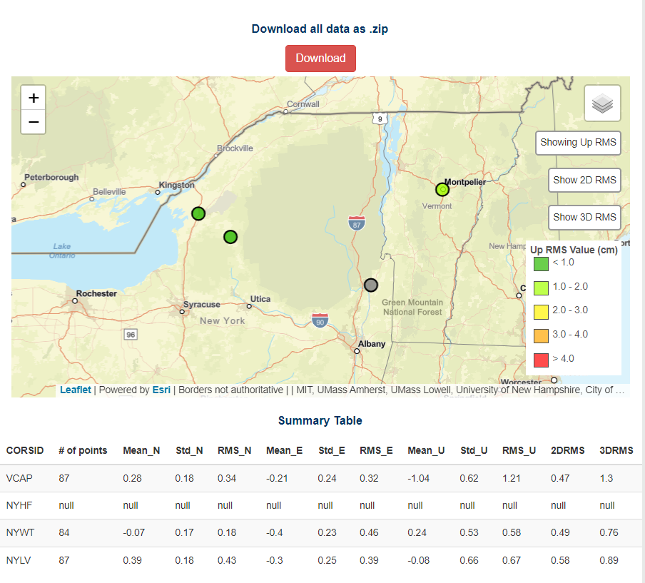

Slide 32
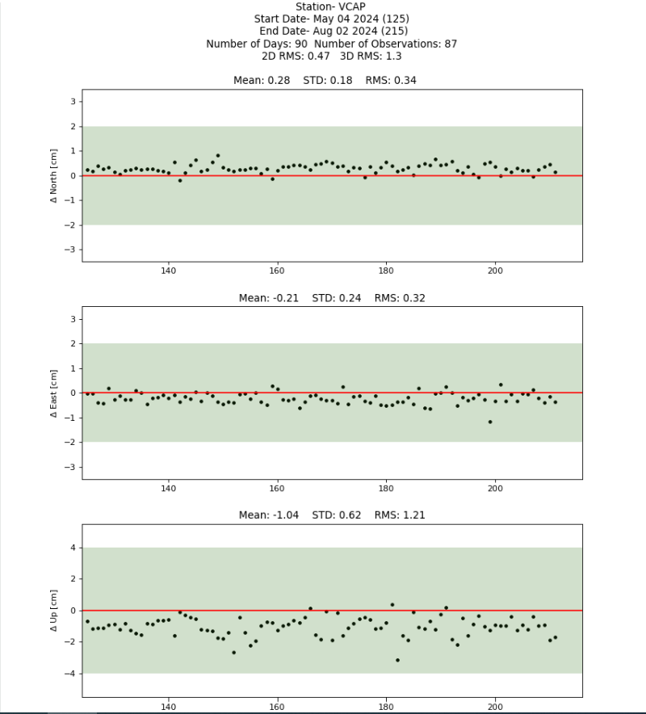

Slide 33
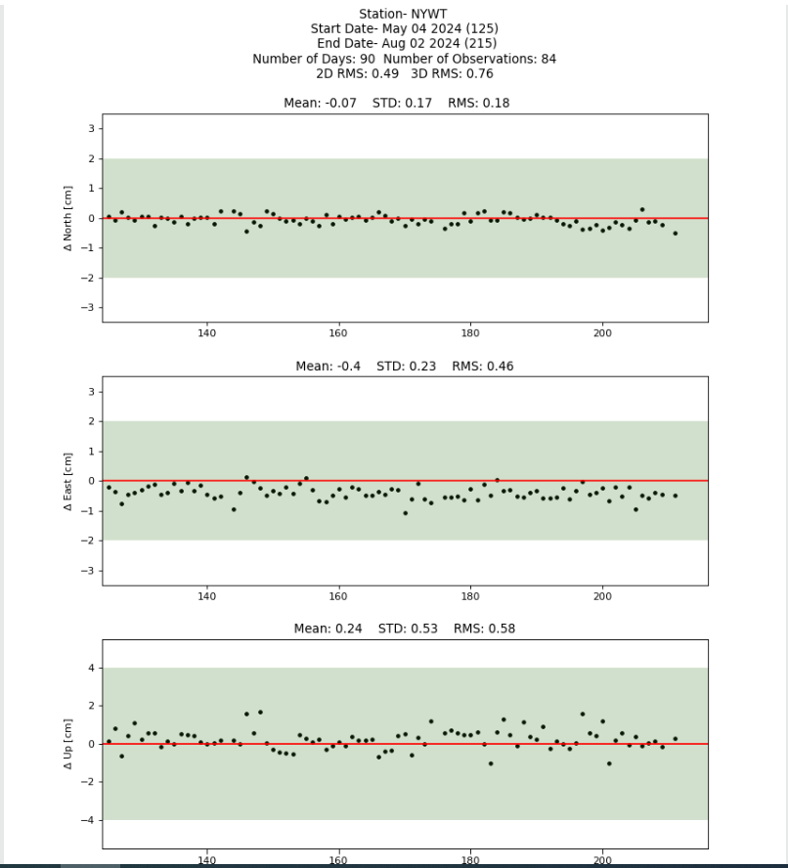
,

Slide 34
NSRS Modernization Alpha Site
Provides examples of the content, format, and structure of select data and products that NGS plans to release as a part of the Modernized NSRS
Products found on this page are for testing purposes only and do not contain any authoritative NGS data or tools

Slide 35
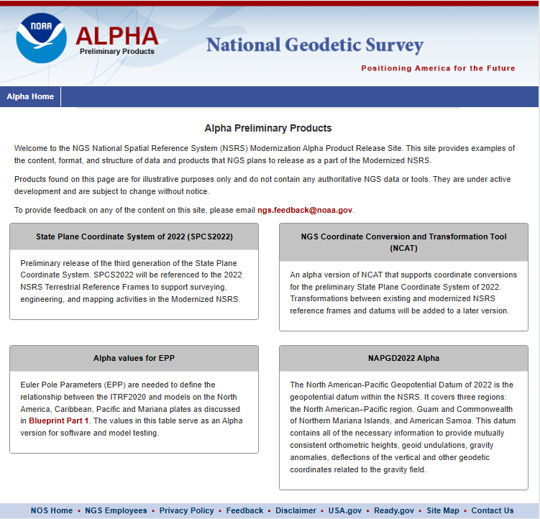

Slide 36
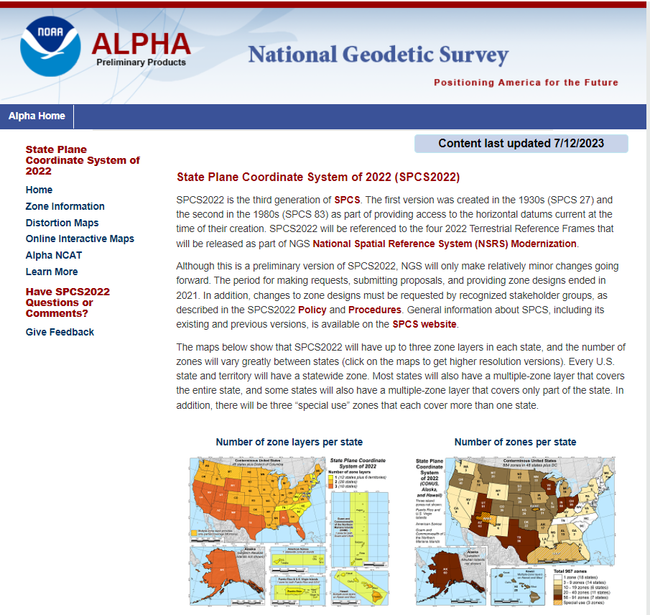

Slide 37
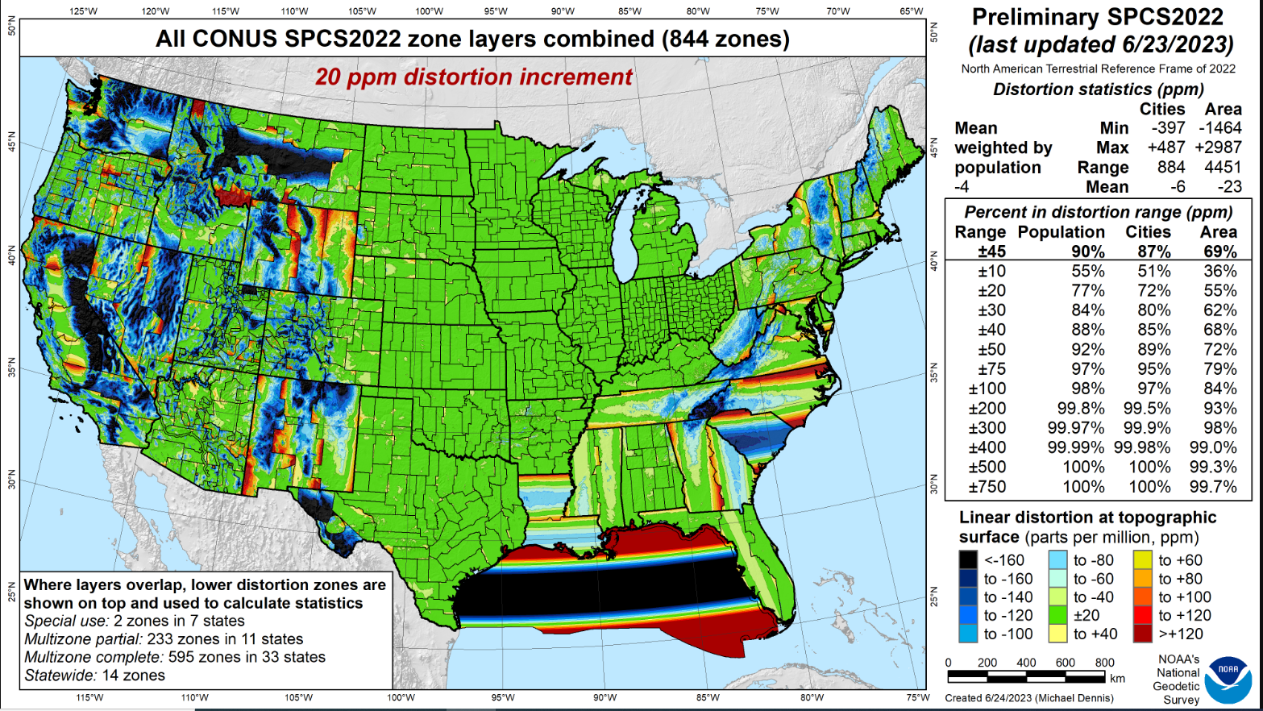
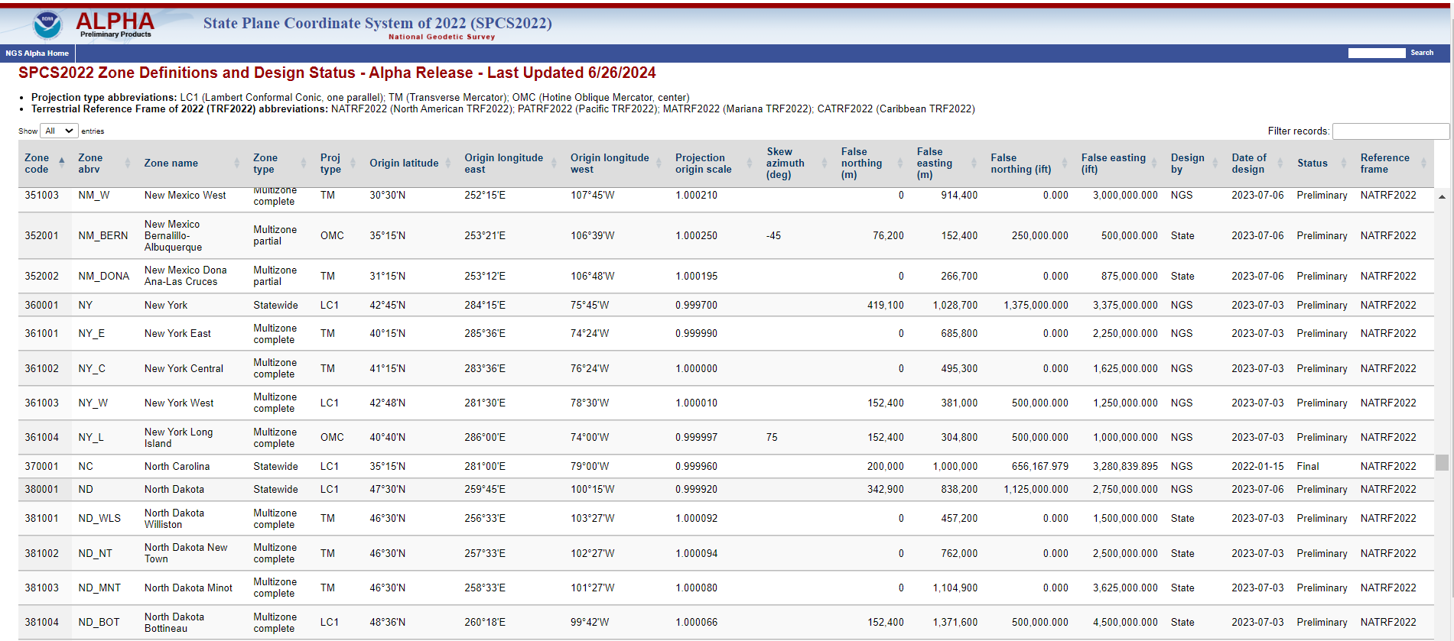

Slide 38
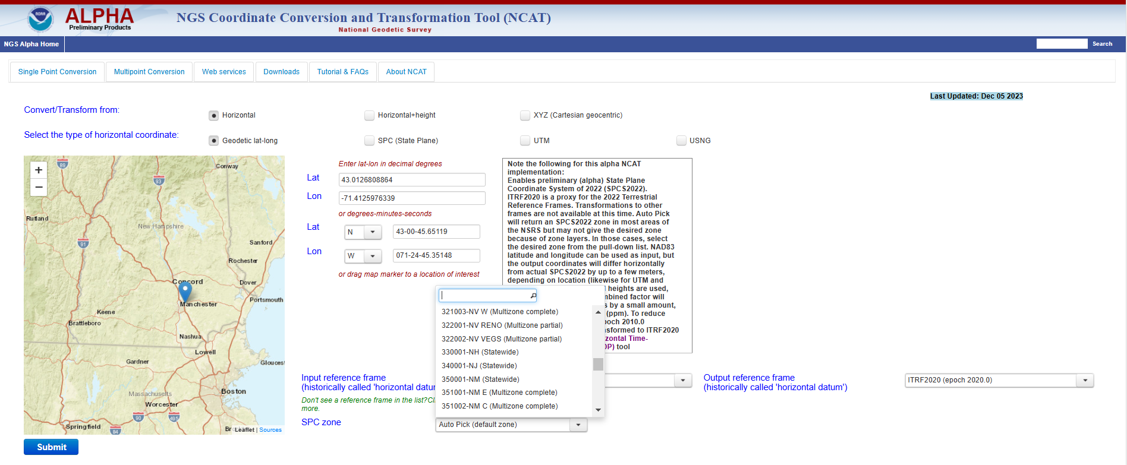
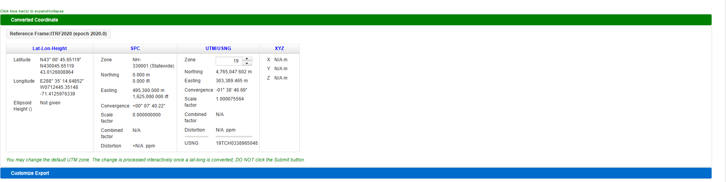

Slide 39
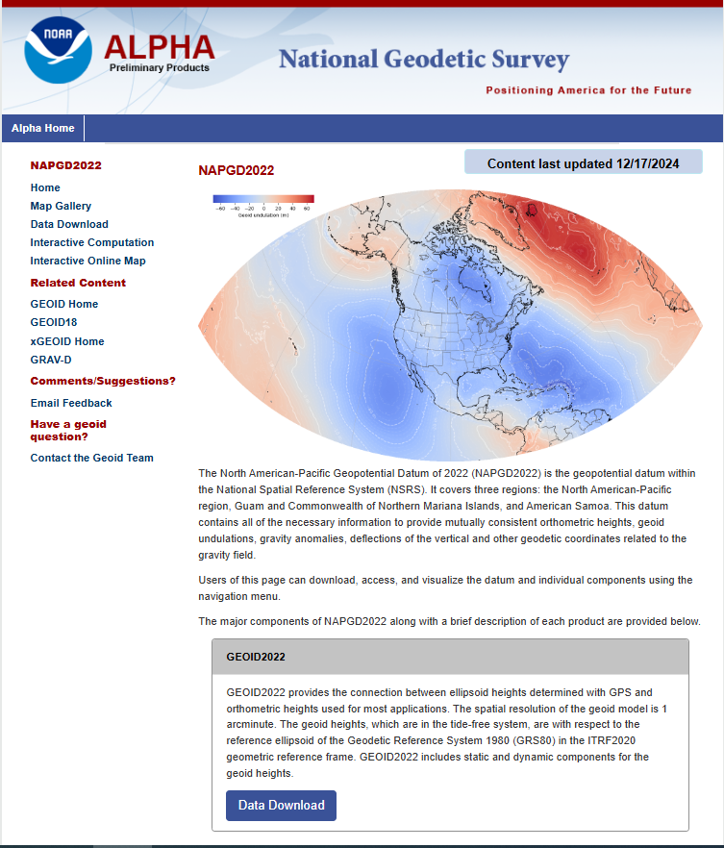
NAPGD2022 ALPHA
https://alpha.ngs.noaa.gov/NAPGD2022/
Jan 14, 2025 Webinar Algren,

Slide 40
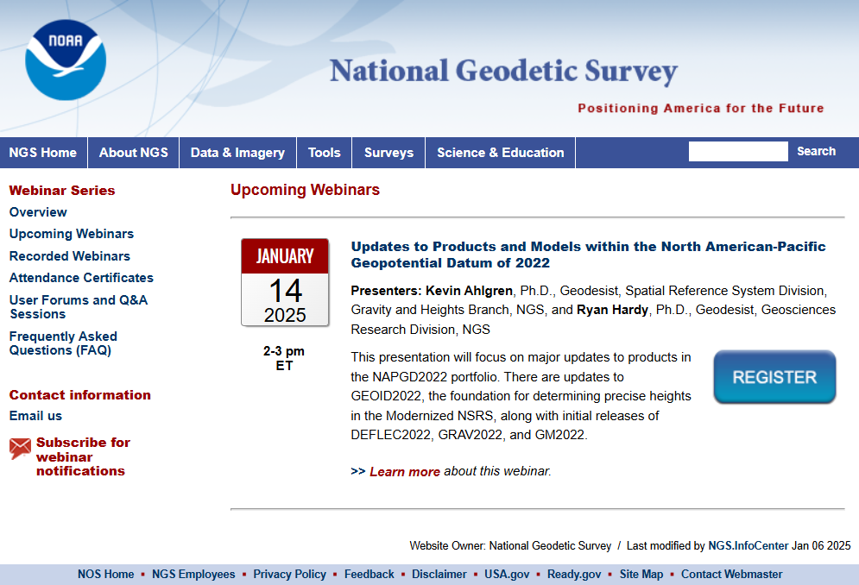

Slide 41
Alpha Pages

Slide 42
What’s New in OPUS World?
OPUS Projects 5.1 moved to Production
  Current version 5.2
  Full support for Bluebooking
  Supports the uploading, QA/QC, adjustment, and submission for publication of real-time kinematic (RTK) vectors in the GVX file format.
  Working to replace mandatory, instructor-led Managers training with self-paced, online videos
  OPUS 5.0 in Beta (includes M-PAGES)
    Multi-constellation

Slide 43
GNSS Vector EXchange Format (GVX)
Website: https://www.ngs.noaa.gov/data/formats/GVX/index.shtml
Detailed documentation
Schema (XSD)
Example vector files
GVX is written in Extensible Markup Language (XML)
Designed to store and carry data in plain text format
Flexible representation of arbitrary data structures
Extensible – new elements can be added later without breaking applications
Both machine-readable and human-readable
Schemas can be used to define “must haves” and “should haves”

Slide 44
GVX Do’s and Don’t’s
Make sure your manufacturer supports GVX
Collect RTK/RTN observations
  Recommend between 3 and 6, 5-min observations, some should be on a different day
  Make sure that you are storing the vector in addition to coordinates
  If RTN, make sure the vector is from a Physical Reference Station, not from a Virtual Reference Station
  If Base is not a NCN station, collect static data on it to be processed in OP

Slide 45
GVX Do’s and Don’t’s Cont…
Load observations to your office software
  some manufactures allow the creation of GVX in the data collector.
  Convert your vector(s) to GVX Format
Upload to an OPUS Project

Slide 46
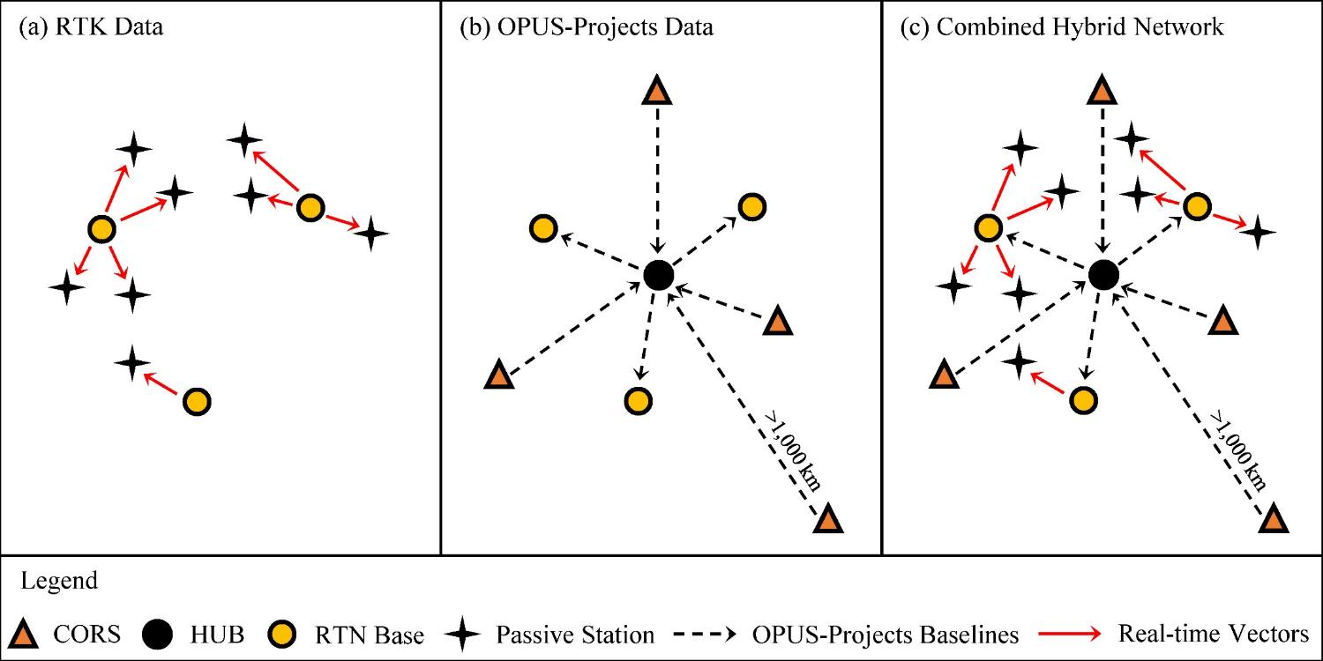
Design for OPUS-Projects and GVX
GVX file (from RTK survey or baseline processing in other software)
OPUS-Projects (from static GNSS session processing)
375-800 km
375-800 km
RTK Base or “From” Mark
RTK Rover or “To” Mark
Vector
Vector in GVX File
[Adapted from Weaver et al. 2018]

Slide 47
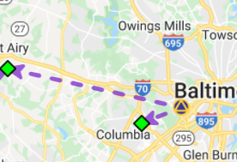
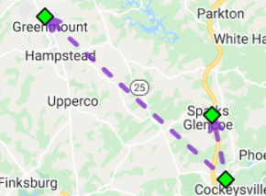
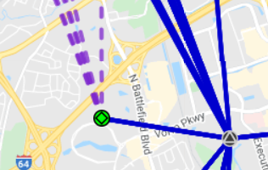
Three Cases for RTK/RTN Bases
RTN Base = CORS
Automatically attaches GVX vectors to official coordinates for CORS
Constrain CORSs
RTK/RTN Base = Not a CORS and new to NGS
Upload static GPS data logged at the base during the days of the RTK survey
Perform session baseline processing to connect to CORSs
Constrain CORSs
3. RTK/RTN Base = Not a CORS but has a datasheet
Could constrain coordinates on datasheet
Or, upload static data at the RTN base, logged during the days of the RTK survey; perform session baseline processing; constrain CORSs

Slide 48
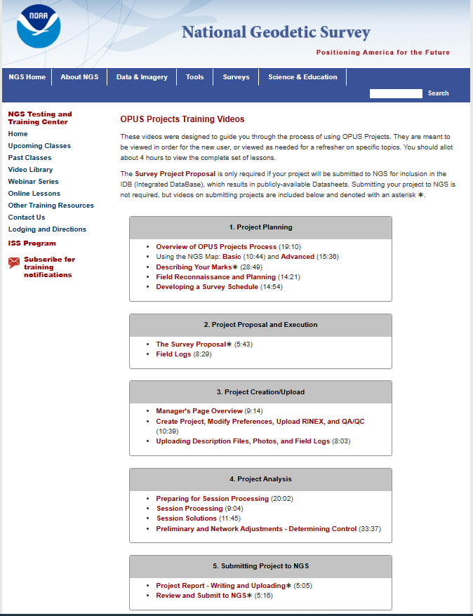
https://geodesy.noaa.gov/web/science_edu/online_lessons/opus-training-videos.shtml

Slide 49

October 09, 2024

Slide 50
Modernization Timeline
In 2022, NGS diverted resources from tool-building to data assurance
  “Limited tools, excellent coordinates”
  Set a goal of roll-out by 2025
NGS is on-track to roll out the modernized NSRS by the middle of 2025.
Work on additional tools will continue in the out-years

Slide 51
Rollout, Testing, Replacement
NGS will roll out components of the modernized NSRS over time (2025-2026)
As each component is rolled out, it can be tested
Once the final component (likely VERTCON) is rolled out (likely late 2025), testing will continue for at least 6 months
Once enough testing is done, and all modernized NSRS components seem stable and correct, the FGCS will vote (likely 2026)
If affirmative, the modernized NSRS will replace the current NSRS

Slide 52
Initial rollout
NGS promised many things in the three Blueprint documents
Not all can be built in a timely manner
So when we say “rollout”, we mean initial rollout, which is at least the minimum viable products needed to replace the current NSRS with the modernized NSRS
Future products and services supporting the modernized NSRS will be rolled-out after the FGCS vote

Slide 53
Rollout: Alpha, Beta, Live
NGS will use three different websites (URLs) as we roll-out the modernized NSRS:
  Live: www.ngs.noaa.gov
    Will hold the current NSRS until the modernized NSRS has been fully tested and the FGCS has voted to replace the current NSRS with the modernized NSRS
  Beta: beta.ngs.noaa.gov
    Re-designed to hold modernized NSRS products only
    Every component of the modernized NSRS will be placed here
    Products assumed to be complete and correct
    For testing
    Subject to change or deletion
  Alpha: alpha.ngs.noaa.gov
    “Incomplete, early, possibly incorrect”
    Not everything will go on alpha

Slide 54
Snapshot of the modernized NSRS at the end of initial rollout
Not everything promised in the Blueprint documents will be built in time for the initial rollout. But the following will be:
  ITRF2020, N/P/C/MATRF2022, NAPGD2022, SPCS2022
  NSRS Database, new datasheets for marks and stations
  RECs
  OPUS-S with multi-GNSS
  OPUS-Projects (GPS only):
    GDX, SPROCCET, LASER, NSRS DB submission
    The ability for NGS to generate RECs from OPUS submissions in a timely manner

Slide 55
Rollout onto Beta
www.ngs.noaa.gov:
ITRF2020 on NCN
SPCS 83
NAVD 88
OPUS-Share
NADCON 5
OPUS-S (GNSS)
NAD 83
GEOID18
OPUS-RS (GPS)
VERTCON 3
OPUS-Projects (GPS)
(Bluebooking, HTDP, ADJUST, NGS IDB, Datasheets)
DEFLEC18
beta.ngs.noaa.gov:
ITRF2020 on NCN
EPP2022
N/P/C/MATRF2022
Geometric RECs
in N/P/C/MATRF2022
NADCON 6?
SPCS2022
IFDM2022
GM2022
Orthometric RECs
in N/P/C/MATRF2022
VERTCON 4?
GEOID2022
NAPGD2022
GRAV2022
DEM2022
DEFLEC2022
OPUS-S (GNSS)
OPUS-Projects (GPS)
(GDX, SPROCCET, LASER, NSRS DB, New Datasheets)
Mid 2024
Late 2024
Early 2025
Late 2025

Slide 56
Testing into replacement
From late 2025 into sometime in 2026, all modernized NSRS components on Beta will go through testing and feedback
After the FGCS vote, a few months of work remain:
  The FGCS will issue an FRN officially announcing the adoption of the modernized NSRS
  The beta website may be wiped of submitted data*
  All modernized NSRS components moved to the Live website
Notes:
Notes: NGS is considering what to do with data submitted during testing. The cleanest solution is to delete it as “test data” and not attempt to move it onto the Live website. If we were to consider moving it to Live, we would need to re-submit the data to ourselves, which is a tremendous amount of work. It is best to assume that NGS will ask submitters to re-submit after the switch.

Slide 57
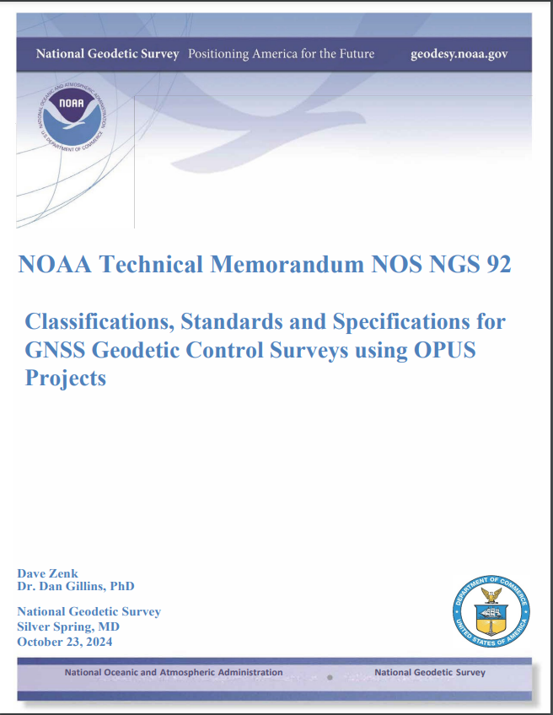
New Standards
Quick Facts
Designed for OPUS Projects, and Bluebooking, but specifications valid on their own
OPUS PP (Post Processed)
GNSS Vector Exchange Format
  Post Processed (vendor software)
  RTN
  RTK
Search our web for “NGS 92” or look in Publication Library

Slide 58
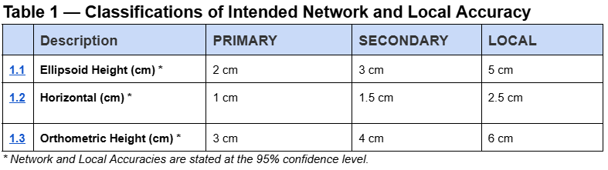
Classifications will not be on datasheet, but are used to describe the intended use/accuracy

Slide 59
Observation Type Definitions
OPUS PP – Static, OPUS Projects
GVX PP - post-processed static or rapid static data using external software
GVX NRTK – Network RTK/RTN (Virtual Reference Station (VRS) method, Master Auxiliary Concept (MAC), etc.
GVX SRTK – Single Base RTK from realtime base station or conventional base/rover

Slide 60
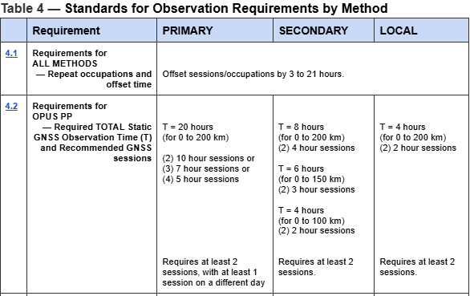
Observation Requirements

Slide 61
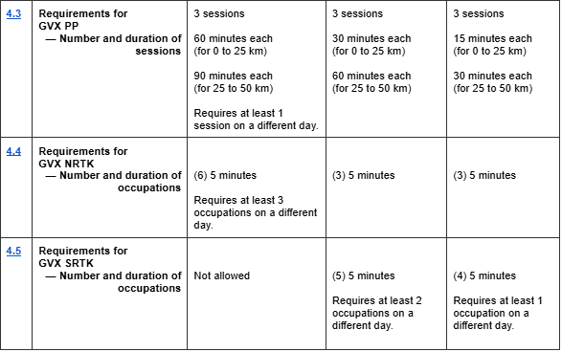
Observation Requirements cont..

Slide 62
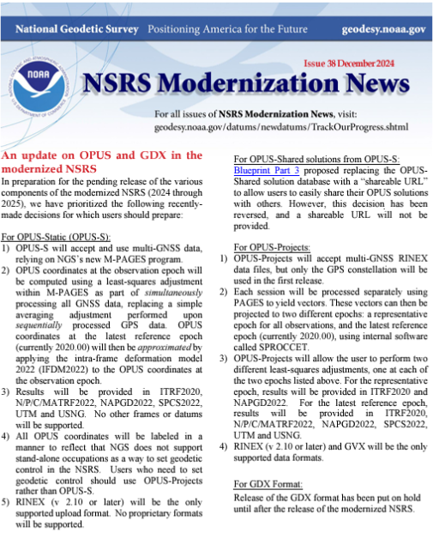

Slide 63
Modernized OPUS-S
Removal of OPUS-Share and OPUS-RS
15 min to 48 hours of data*
RINEX-only upload
Multi-GNSS processing (M-PAGES)
Simultaneous baseline processing
Updated CORS Selector
9-character CORS IDs
New frames: ITRF2020, N/P/M/CATRF2022, SPCS2022
New geoid and vertical frame: GEOID2022, NAPGD2022

Slide 64
OPUS-Projects
Submitting to NGS:
  Removal of project proposal requirement
  Removal of description file requirement
Tracking number for all projects = NGS Survey Project Number
Updated CORS Selector
9-character CORS IDs
Automate adding Distant CORS

Slide 65
OPUS-Projects
GPS-only: Session adjustment via PAGES
Removal of Gpscom and ADJUST
SPROCCET is the LASER pre-processor, replacing HTDP
LASER replaces ADJUST (2 sets of network adjustments)
New datasheets via the DDS
New frames: ITRF2020, N/P/M/CATRF2022, SPCS2022
  Results in specific frame (epoch) will vary by adjustment
New geoid and vertical frame: GEOID2022, NAPGD2022

Slide 66
Audience Participation (Discussion)
Elevation Certificates
Large or Long Duration Project

Slide 67
Elevation Certificate
What information do we need?

Slide 68
Some Things to Consider
Mapping Datum?
Required Accuracy (relative to what)?
Closeness to zone height
Terrain
Geoid uncertainty
Transformation uncertainty
How accurate can you establish height relative to Mapping Datum?

Slide 69
More Things to Consider
Existing “defining” control in area
How was study conducted?
Any Known or suspected motion?

Slide 70
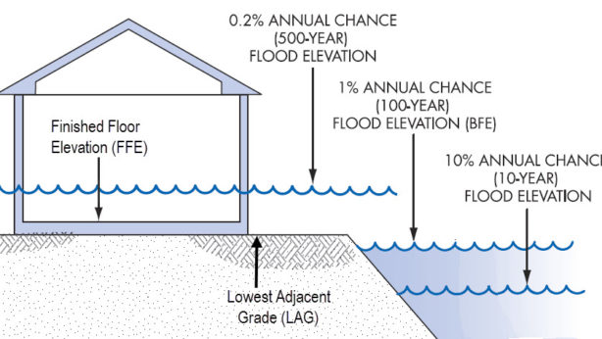

Slide 71
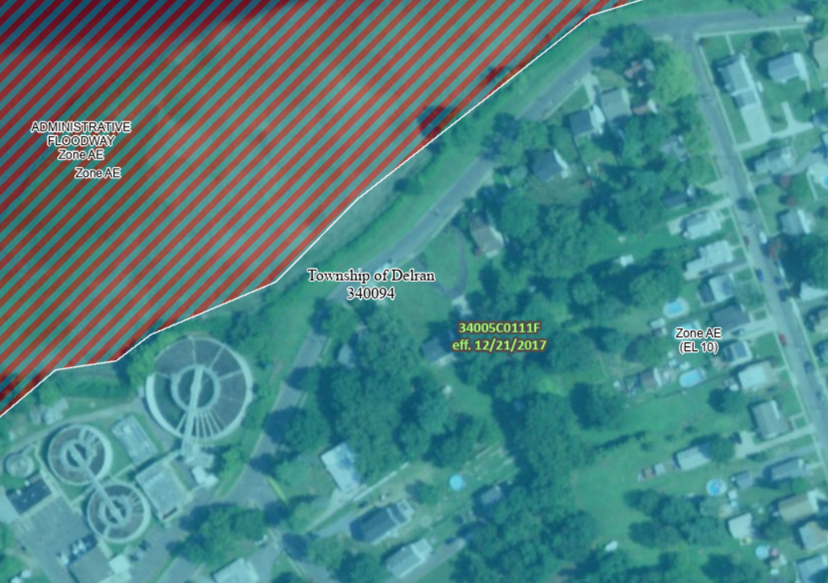

Slide 73
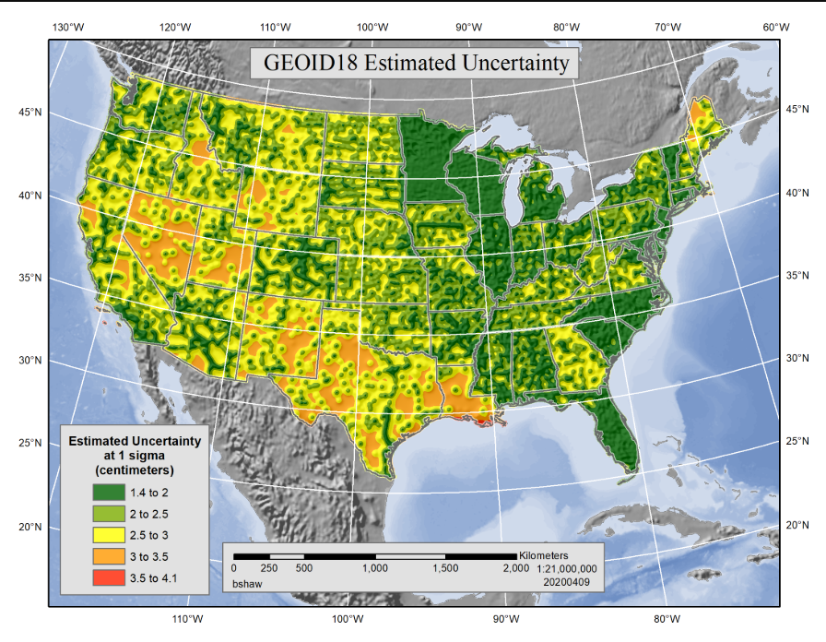
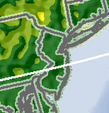

Slide 74
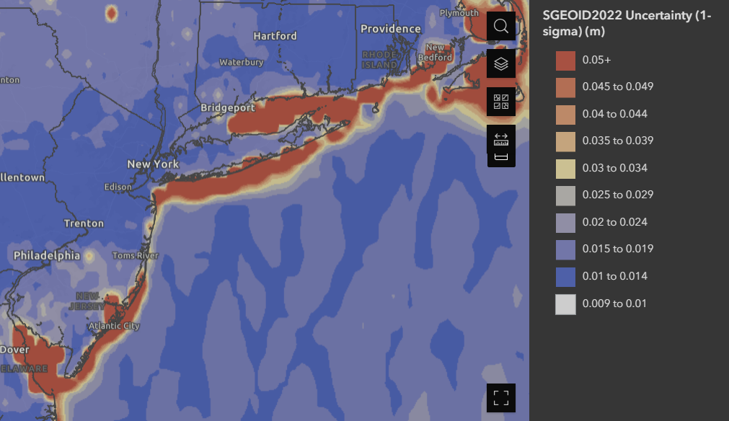
Geoid Uncertainty

Slide 75
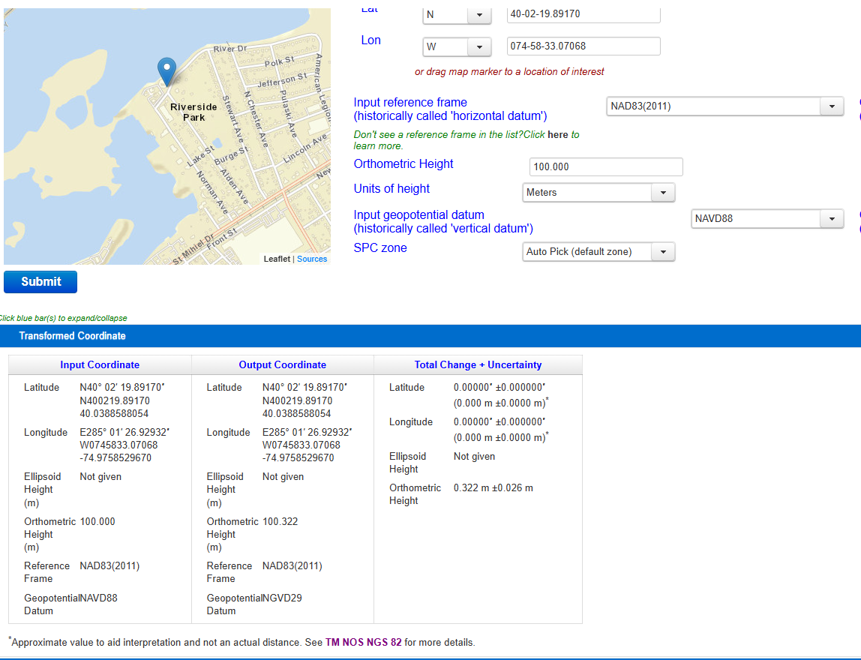

Slide 76

Existing Control
G - 2007
0.5 mi
G - 2007
G - 2007
N - 1990

Slide 77
Height Options
Establish NAPGD 2022
  Use Vertcon to transform to NAVD 88
Establish NATRF2022 h
  Transform to NAD83(2011)
  Apply Geoid18 > NAVD88
Find NAVD88 BM and level, etc…

Slide 78

OPUS Accuracy (Datum)
Approximately 3 cm and 5 cm at 95% for 2 hours and four hours respectively

Slide 79

RTN Accuracy (Datum)
95% Confidence
± 5.0 cm, vertical
± 2.5 cm, horizontal
Or similar to accuracy of a 2-h OPUS-S solution!

Slide 80
Summary on the Accuracy RTK
RTNs in Oregon and South Carolina produced similar results
NRTK is more accurate than SRTK, especially vertically
  HRMSE = 1.0 to 1.8 cm for both NRTK and SRTK
  VRMSE = 3.1 to 4.7 cm for SRTK
  VRMSE = 2.0 to 2.7 cm for NRTK
    VRMSE @ 95% = 3.9 to 5.3 cm
GPS+GLONASS is slightly more accurate than GPS-only
Accuracy hardly improves with session duration, especially after 5 minutes
  T = 3 to 5 minutes appears optimal
Notes:
It seems that in real-time, it is readily possible to measure an ellipsoid height to less than 5 cm at 95% confidence using NRTK. This error could be further reduced by taking multiple repeat NRTK observations on the same mark.

Slide 81

Repeat Occupations
Accuracy improves even more by making repeat occupations on marks
[Gillins et al. 2019]
Notes:
Based on testing of 9 bench marks in Maryland

Slide 82
Large/Long Duration Projects

Slide 83
Large/Long Duration Projects
At what stage is the project?
What are project datums?
Is there, or will there be existing “permanent” project control and how was it established?
How many different teams/subs?
  How are they establishing coordinates?

Slide 84
Thank You!
Questions?
Presentation will be available at:
https://www.ngs.noaa.gov/web/science_edu/presentations_library/
Dan Martin
Northeast Regional Geodetic Advisor
ME, NH, VT, MA, CT, RI, NY, NJ
Dan.martin@noaa.gov
240-676-4762

