Slide 1

Using OPUS and OPUS Projects
PSLS Annual Conference
January 2025
Jeff Jalbrzikowski, P.S., GISP, CFS
Appalachian Regional Geodetic Advisor
jeff.jalbrzikowski@noaa.gov
240-988-5486

Slide 2



Organizational Structure
  -Department of Commerce (DoC)
  (~47,000 employees)
  -National Oceanic and Atmospheric Administration (NOAA)
  -National Ocean Service (NOS)
  -National Geodetic Survey (NGS)
  (~175 employees)
Notes:
-We are the Federal Government’s oldest scientific agency.
-part of the Executive Branch
-I know it can seem kind of strange that NGS is part of the NOS, but the origins of NGS lie with the C&GS.
-we are a “Program Office” of the NOS
Survey of the Coast – 1807
Coast Survey – 1836
Coast and Geodetic Survey – 1878
NGS since 1970

Slide 3


Organizational Structure
We’re not USGS, we’re NGS
  -Department of Commerce (DoC)
  (~47,000 employees)
  -National Oceanic and Atmospheric Administration (NOAA)
  -National Ocean Service (NOS)
  -National Geodetic Survey (NGS)
  (~175 employees)
≠
Notes:
-as you can read my slide, I like to point that out because over my 2 years at NGS I’ve seen and heard this misunderstanding quite a bit
-don’t worry! it doesn’t offend us! and we do work closely with USGS, but we are separate agencies within totally different departments of the federal government

Slide 4
Any references to any commercially available hardware or software do not constitute an endorsement or a disapproval of any manufacturers, developers, dealers, or suppliers.
Thanks.

Slide 5
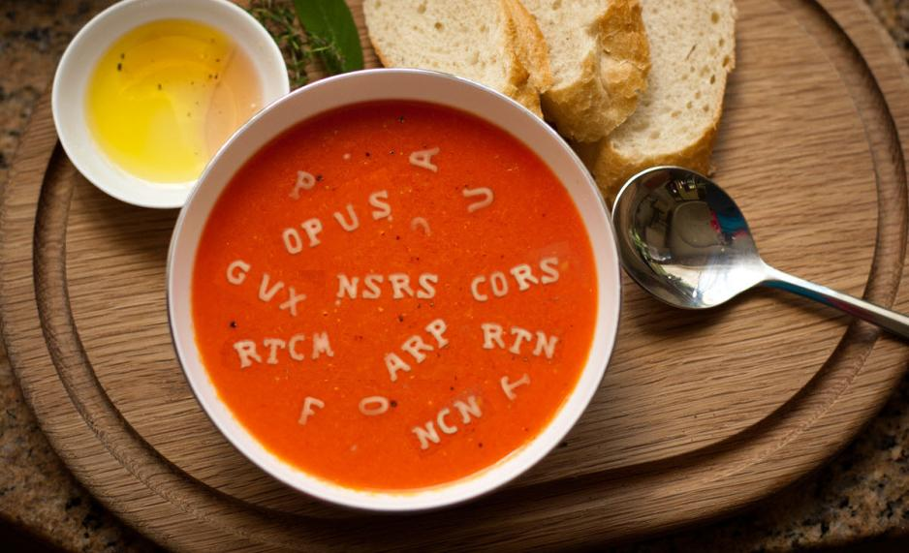
Let’s start with some alphabet soup

Slide 6
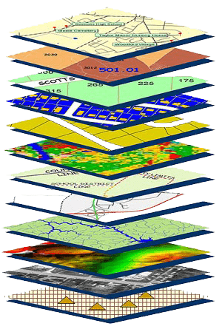
NGS Mission
To define, maintain and provide access to the National Spatial Reference System (NSRS) to meet our Nation’s economic, social, and environmental needs.
NSRS
Notes:
NGS develops and maintains the National Spatial Reference System, a national coordinate system that provides the foundation for transportation, navigation, land record systems, mapping and charting efforts, and a multitude of scientific and engineering applications
CLICK
You’ve all seen this or some similar graphic I’m sure. That bottom layer… that’s our baby, the NSRS.

Slide 7
Yes, we are delayed.
  NSRS Modernization
Notes:
So remember, today’s presentation is not JUST about new datums, it is about modernizing the NSRS as a whole.
You don’t know what the NSRS is? Stay tuned, we’ll get there as we go along.

Slide 8
Delayed Release of the Modernized NSRS
How long will the delay be?
  We plan to roll out components of the modernized NSRS in 2025 or 2026.
Will the names stay the same?
  Yes, terms containing “2022” will remain the same.
When will the rollout be complete?
  Once the FGCS has voted to approve the modernized NSRS (likely in 2026).

Slide 9
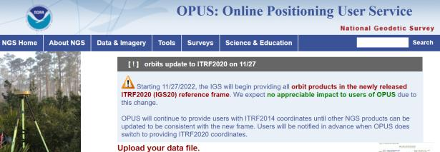
NGS Mission
To define, maintain and provide access to the National Spatial Reference System (NSRS) to meet our Nation’s economic, social, and environmental needs.
access… ? = traditionally → marks/disks/objects
= modern and future → NOAA CORS Network (NCN)
via OPUS
Notes:
Follow up thought
-like it or not, we know that the vast majority of our users are obtaining NSRS coordinates via OPUS
-while that is our plan for the future of primary access, modernized NSRS, as of now the official form of access (specifically to NAVD88) truly is to “touch brass” as they say → meaning occupy a benchmark

Slide 10
Online Positioning User Service
      dual frequency receiver
      static observations (via RINEX → ABCD123x.24o)
      30 seconds epoch/logging rate aka recording interval
  OPUS Rapid Static (OPUS-RS)
      15 minutes to 2 hours of GPS data
  OPUS Static (OPUS-S)
      same requirements as above
      2 to 48 hours of GPS data
  OPUS Projects (OP)
      adds session processing and network adjustment
      training by NGS currently required (~12 hours)
Also Beta OPUS-S
Multi-constellation
More CORS checking
Notes:
https://geodesy.noaa.gov/OPUS-cgi/OPUS-Projects/OpusProjects.prl?action=manage_project&project_keyword=nap025a&manager_keyword=nap025a

Slide 11
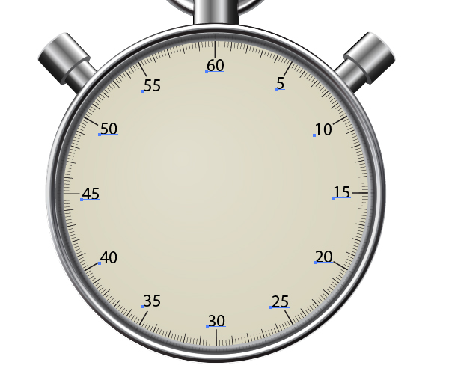
OPUS processes @ 30s intervals
= 30s
= 20s

Slide 12
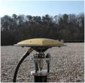
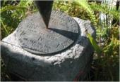
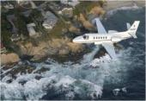
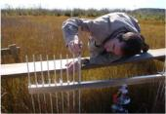


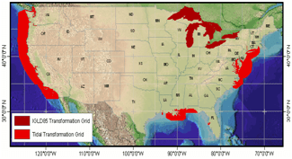




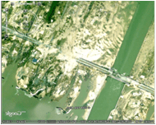





NGS Overview
Modernizing the NSRS
CORS
NHMP
GRAV-D
ECO
NGS Products and Services
ASP
OPUS
VDatum
Orbit Data
National Shoreline
Geodetic Advisors
ERI
Antenna Calibrations
NCAT
CUSP
CBL
Outreach
Notes:
This is not an exhaustive list of NGS programs

Slide 13

GPS Orbit Data aka Ephemerides
NGS orbit analysis and computation is performed together with, and as a component of, the International GNSS Service (IGS)
  IGS coordinates the collection of satellite tracking data
  these orbits are what give us post-processed accuracy
Designated with this responsibility by the Civil GPS Service Interface Committee (CGSIC)
If you’re using OPUS, it’s all behind-the-curtain!
Notes:
The CGSIC is an entity of the US Dept of Transportation.
Ephemeris is a table that lists the coordinates/positions of celestial objects (natural/anthro) during a given time period.
The ephemerides (plural term) are the backbone of GNSS-based positioning; precise ephemerides lead to accurate positions.
*but if you get an OPUS error message about orbit availability, this is your issue that you’ve got satellite data but nothing to process it against.

Slide 14
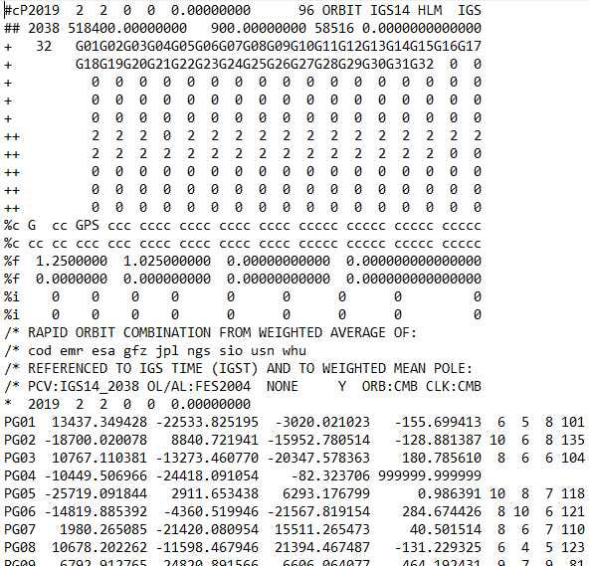
.sp3 file
Sattelite
Orbit Data
Link to NGS GPS Calendar
Notes:
-this is an example .sp3 file
-There’s our GPS Week near the top, number 2038.
-See the SV numbers? Just like a RINEX file you’ll see G## for GPS sats.
-R## for Russian, and whatever else I can’t recall.
-On down you can see this is a Rapid Orbit file, satisfactory for most work.
-Then there’s the date/time stamp followed by the positional records.
-There’s a set of those positions logged every 15 minutes, as opposed to every 15 seconds of land-based receiver logging.

Slide 15
NGS Overview
Modernizing the NSRS
CORS
NHMP
GRAV-D
ECO
NGS Products and Services
ASP
OPUS
VDatum
Orbit Data
National Shoreline
Geodetic Advisors
ERI
Antenna Calibrations
NCAT
CUSP
CBL
Outreach
Notes:
This is not an exhaustive list of NGS programs

Slide 16
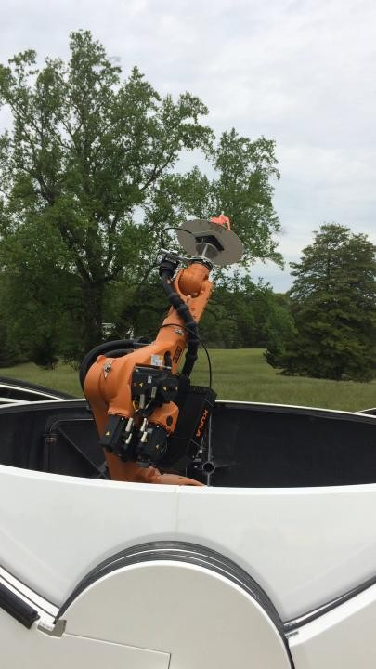
GNSS Antenna Calibration at NGS TTC
For manufacturers or distributors
Sample of 3 to 5 antennas are provided to NGS
  Sales-ready models
  Not prototypes
CAD drawings of antenna
  NGS uses to identify ARP and NRP
Agree that NGS will publish results on the web
  Antenna shows up in OPUS drop-down
Best efforts made, but if the calibrations result in poor statistics → no published model
  Antenna not an option in OPUS
Notes:
-the arm is for absolute GNSS antenna calibrations, the IGS standard
-3D centering of the physical center within 0.2mm
-it’s not yet operational, we’re currently pending IGS approval/acceptance
-what’s being done here? we’re creating a 3D “map” or model of the antenna’s characteristics: where the different signals are received and how that varies, or what’s known as…
-Phase Center Offset
-and Phase Center Variation

Slide 17
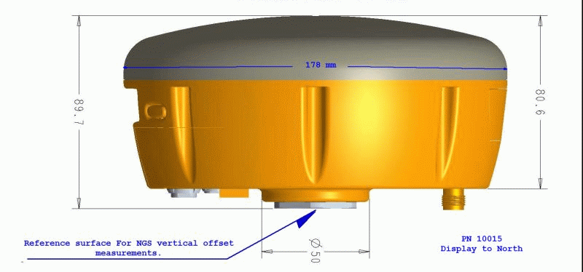
Antenna Calibration – Phase Center Offset
Orange dot = Antenna Phase Center (APC)
Blue dot = Antenna Reference Point (ARP)
Red line = Phase Center Offset (PCO)
Notes:
-so let’s talk about Phase Center Offset
-the ENU values of that red line, which is 3 dimensional, is different per antenna model
-this diagram is an oversimplification of the
Orange dot = mean point of signal reception
Blue dot = Antenna Reference Point (ARP)
Red line = Phase Center Offset (PCO)

Slide 18
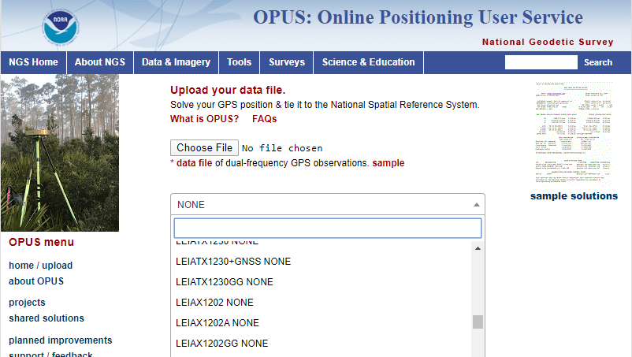
Phase Center Offset
The PCO is one reason it is important to select the correct antenna for OPUS upload → can cause height and XY error
choose
carefully!
if you have questions… drop a line to a Regional Geodetic Advisor
Notes:
-this why it is important to select the correct antenna when using OPUS
-Choosing an incorrect antenna may result in a height error as large as 80 cm and a horizontal error up to 1 cm

Slide 19
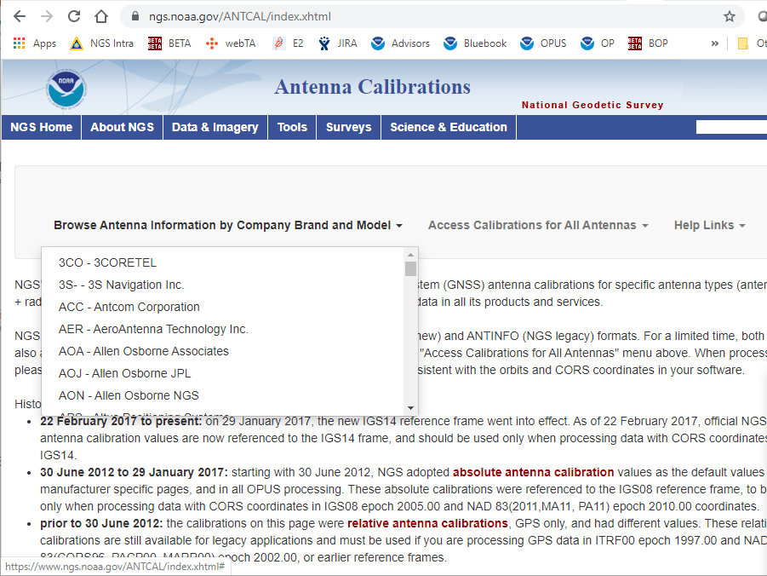
Notes:
-if you want to look up this info in detail, go to our ANTCAL page
-pretty easy to find, the whole list is there, along with ASCII text of the entire dataset of calibrations

Slide 20
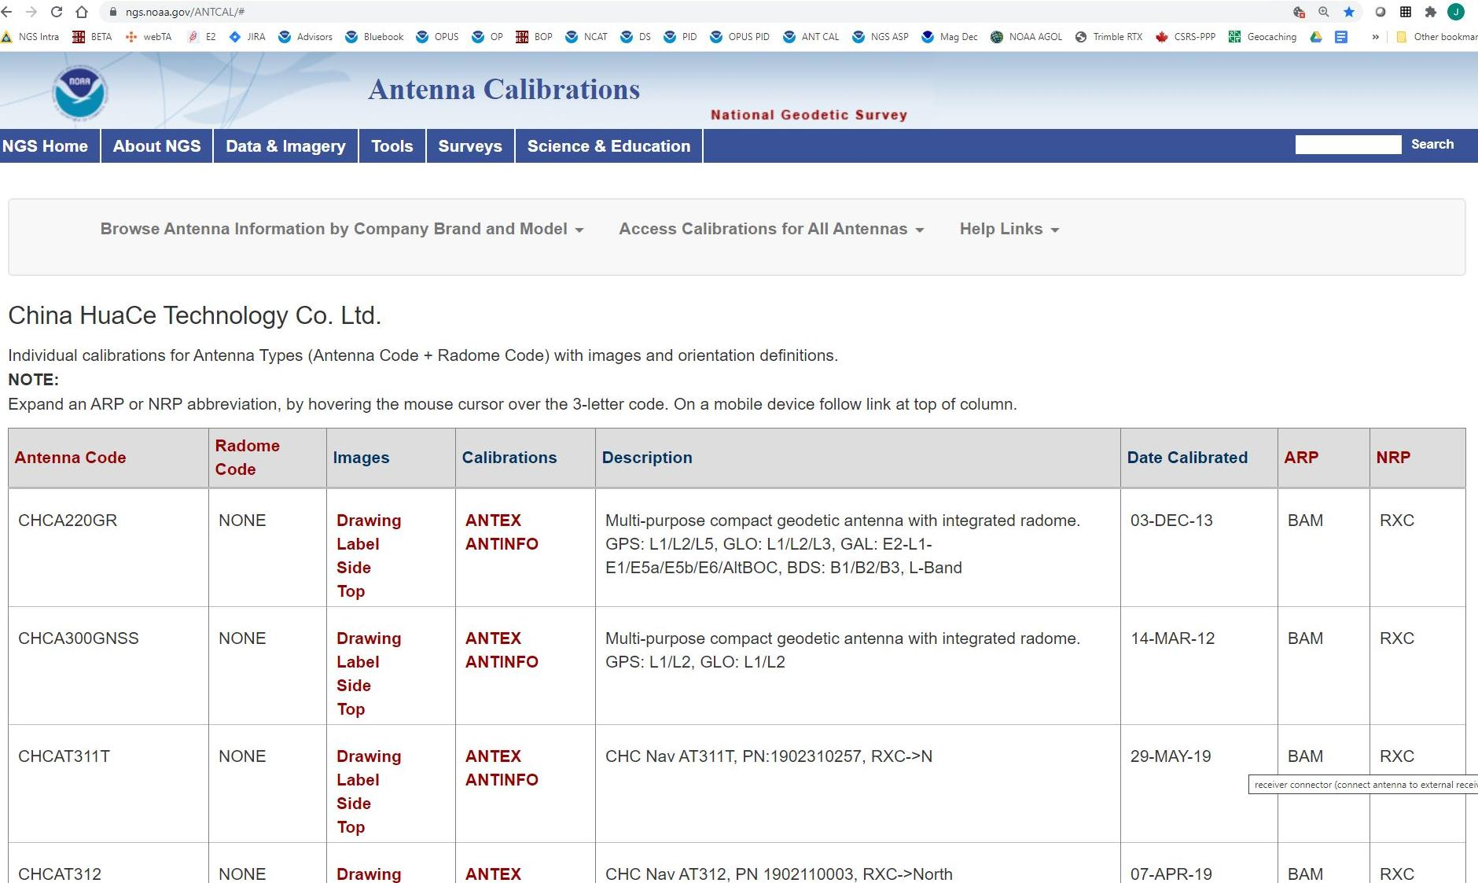
ARP and NRP are found on the right side of table
  hover over for explanation of acronym, or click header link to full list

Slide 21
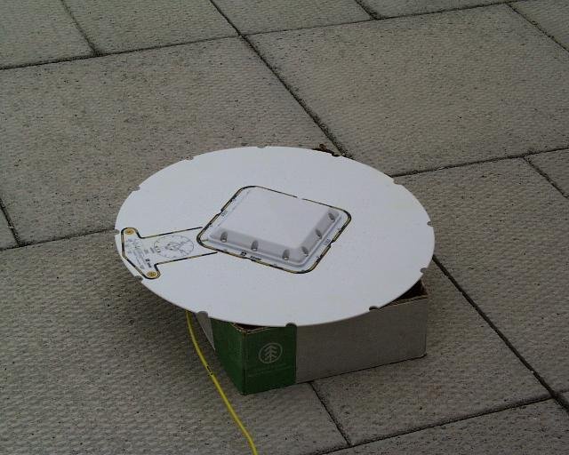
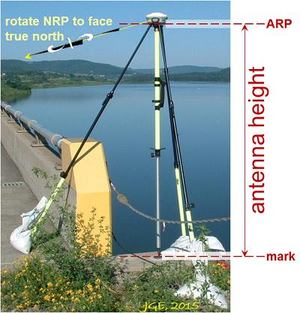
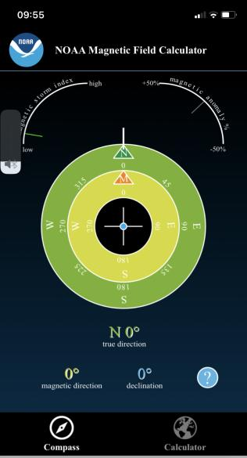
NRP – North Reference Point
Finding North
True = Geodetic = Geographic
NOAA Magnetic Declination
  To work, you have to allow permissions/access to sensors
  Declination based on your GNSS location
  Two North arrows
    N → True North
    M → Magnetic North

Slide 22
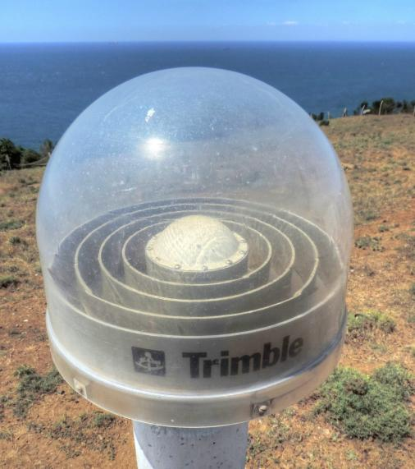
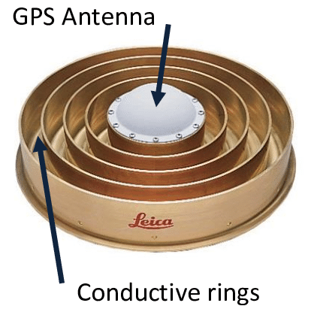
Radome Code in OPUS antenna selection
Radome
NONE
Choke Ring(s)
Notes:
Not always transparent, could be white or grey, etc

Slide 23
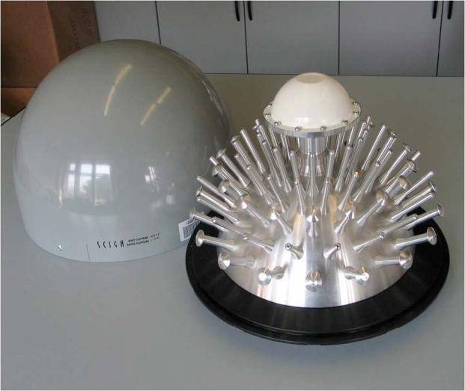

More Examples of Antennas
SCIGN
NONE
3D Choke Ring
vertical dipoles on convex ground plane

Slide 24
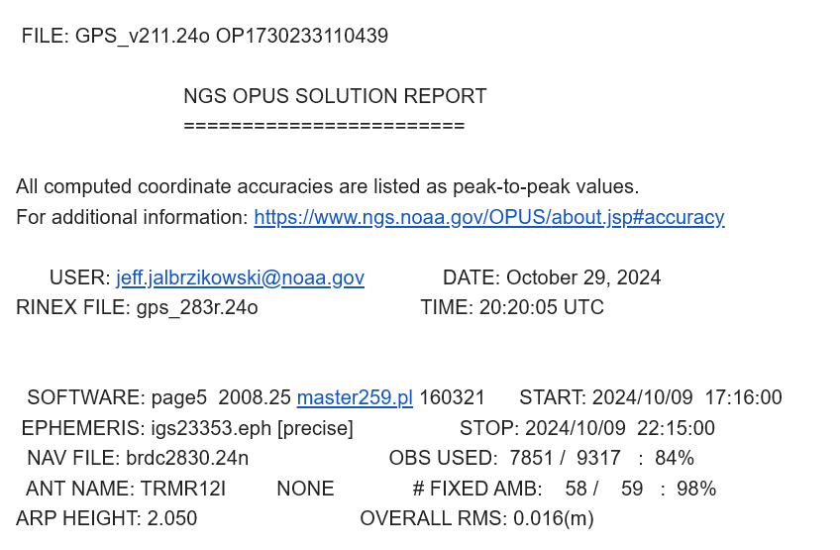
RINEX file naming in OPUS
?
Notes:
Up top on the Solution report is the name of the file as uploaded.
But then you get your OPUS Solution and some of you may have noticed this new but similar file name down below your email address

Slide 25
RINEX Naming … What gives?
OPUS accepts many upload formats
but all of them are converted to RINEX after you upload
  OPUS servers currently use
    UNAVCO’s TEQC and German Research Centre for Geoscience’s GFZRNX
when your file is converted to RINEX, it is given a new file name using the recommended naming convention of the RTCM RINEX v2.11 standard

Slide 26
OPUS RINEX naming convention
AAAADDDB.YYo
  AAAA = your chosen four character “Mark ID”
  DDD = day-of-year of the starting day
  B = letter representing the starting hour of the data
  YY = the two digit year
  o = the RINEX standard for “observation” data
  *All times/days in GPS Time (UTC)
Notes:
-AAAA is ideally the user’s 4 character ID, but that’s something that NOT all hardware writes automatically,
-for example, Trimble equipment writes the last 4 characters of the receiver serial number, has nothing to do with the mark ID
-DDD is the day of year, or Julian day as some say, of the starting day
-B is a letter that represents the starting hour of the data collection, more on that next slide
-YY is the two digit year of the data collection
-the letter “o” is for RINEX Observation file.
-there are also Navigation N files, Meteorological M files, and like 6 others

Slide 27
OPUS RINEX naming convention
Start Time | RINEX Hour
00:00 | a
01:00 | b
02:00 | c
03:00 | d
04:00 | e
05:00 | f
06:00 | g
07:00 | h
08:00 | i
09:00 | j
10:00 | k
11:00 | l
12:00 | m
13:00 | n
14:00 | o
15:00 | p
16:00 | q
17:00 | r
18:00 | s
19:00 | t
20:00 | u
21:00 | v
22:00 | w
23:00 | x
AAAADDDB.YYo
  B is a letter representing the starting hour of the data
  00 = a, 01 = b, 02 = c, ..., 23 = x
  special case is a 24 hr data set, in that case the letter is replaced with a zero (0)
    you may have seen this in NCN data download

Slide 28


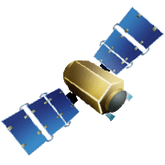
OPUS-RS – 15 min to 2 hours
  -Atmospheric model
  -Delivered 179,000 solutions in 2021
Not integrated with OPUS Projects
Notes:
OPUS-RS or Rapid Static performs two calculations.
1st - creates an atmospheric delay model from surrounding CORS data (white circle)
2nd - Your position is determined via a differential GPS static solution

Slide 29
OPUS-S – 2 to 48 hours
  -Best 3 of 5 baselines
  -Delivered 1,268,000 solutions in 2021
  206,000 solutions in 2011
baseline 5
baseline 4
baseline 1
baseline 3
baseline 2
Notes:
-OPUS Static takes the best 3 of 5 baselines and provides you their peak-to-peak average
-1.2 million solutions delivered in 2021, compared to in 2011 when we first broke the 200,000 solutions milestone
CLICK FOR SECOND NUMBER

Slide 30
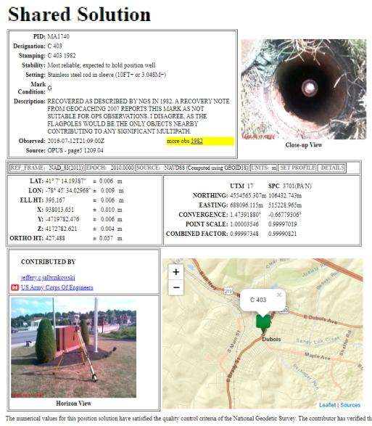
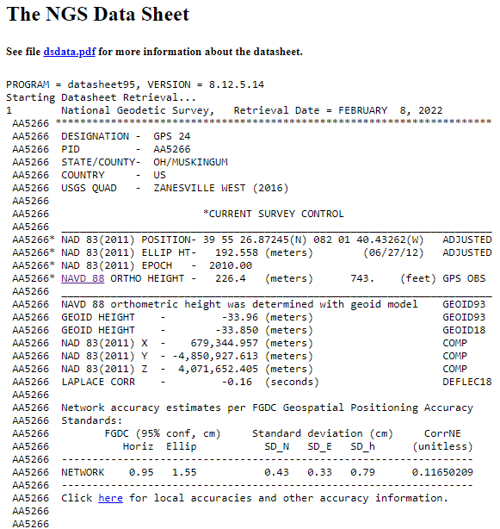
OPUS Share – 4 to 48 hours
  Based on OPUS-S
  2 photos
  Brief description
?
baseline 5
baseline 3
Shared Solution ≠ Datasheet
baseline 1

Slide 31
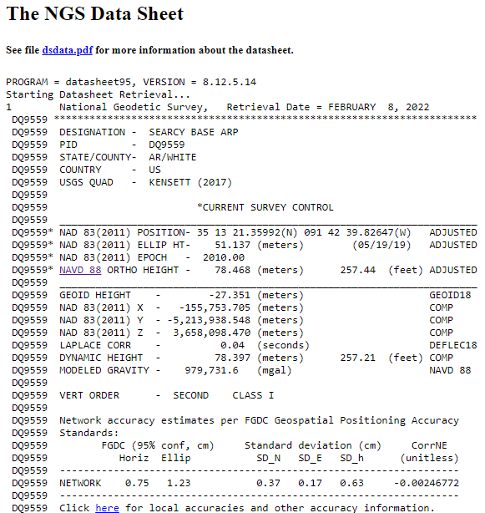
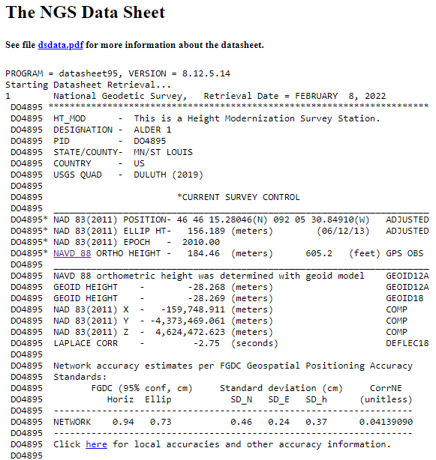
OPUS Projects – 2 to 48 hours
  Based on OPUS-S
  Control network
    Solutions tied together
Notes:
Ties your observations together via multi-baseline processing and least squares adjustment

Slide 32

Notes:
A question many of you may be asking yourself, why OPUS Projects?
-biggest reason up-front is that it is one path to GPSonBM

Slide 33
OPUS Static (OPUS-S)
  2 to 48 hours
  Best 3 of 5 baselines
  Sequentially processed
  Reports your peak-to-peak (P2P) average position
5001
5002
CORS
OPUS Solution
Notes:
-OPUS Static takes the best 3 of 5 baselines, sequentially processed, and provides you their peak-to-peak average
sidenote
-we delivered over 1.2 million solutions in 2021, compared to in 2011 when we first broke the 200,000 solutions milestone

Slide 34

OPUS Static (OPUS-S)
  No correlation between your observed marks
  Low Relative Accuracy
  Even if … collected simultaneously
  … and submitted to OPUS simultaneously
  OPUS-S = independent solutions
5001
5002
CORS
OPUS Solution
Notes:
Point being… there is no correlation, or tie, between marks processed by OPUS Static

Slide 35
OPUS Projects (OP)
  Simultaneous processing of your observed marks
  Improved Relative Accuracy
  Requires more field prep and office processing effort
  OP = true network solutions
  And of course, least squares adjustment
Distant CORS
~375-800 km
5001
5002
5003
5004
CORS
OPUS Solution

Slide 36
OPUS Shared vs. OPUS Projects
 | OPUS Shared | OPUS Projects (RINEX) | OPUS Projects (GVX)
Minimum Occupations | 4 hours At least 1, maybe 2* | 2 hours At least 2 | 5 minutes At least 3
Processing | OPUS-S (sequential) | PAGES (simultaneous) | Real Time (RTN/NRTK)
Adjustment | None | Least Squares Network | Least Squares Network
Metadata | 2 photos Brief Description | 3 photos, WinDesc files, Logs, & Report | 3 photos, WinDesc files, Logs, & Report
*Need 2 or more GPS datasets in our database, existing data holdings count toward that.

Slide 37
OPUS Projects
Web-based, nothing to download
Visualize/map your OPUS Solutions
Process multiple marks and multiple occupations
  Or simply repeat occupations of a single mark
Advantages include:
Data uploading through OPUS
More ability to select CORS used for processing
Process using PAGES… without intricacies of PAGES
Support for submission to NGS

Slide 38
Precision Adjustment of GPS EphemerideS
Example of PAGES output: the b-file
000010*AA*HZTLOBS NGS NATIONAL GEODETIC SURVEY 20130114
000020*10*BOUNDARY MON STRICKLAND NC SC HEIGHT MODERNIZATION 2013 (OP: gps2912f)
000030*12*201301201301MS MARK SCHENEWERK 4NCAA
000040*13*NAD 83(2011) GRS 80 63781370002982572221
000050*25*0001R0143ABLUFMS 004 003
000060*26*BB 0143A -> OP 2013-014-A
000070*27*00011301141641 2000
000080*27*00011301142001 2000
⋮
001900*70*007055 Trimble NavigationDUAL CARRIER PHASE PPSNETR5 4742K10896
001910*70*008055 Trimble NavigationDUAL CARRIER PHASE PPSNETR5 4744K11096
001920*70*009055 Trimble NavigationDUAL CARRIER PHASE PPSNETR5 4829K57356
001930*72*001 AOAD/M_T NONE KW5-0201
001940*72*010 TRM57971.00 NONE 30973141
001950*72*011 TRM57971.00 NONE 30976660
⋮
002040*80*0001BLUFF 34173468578N079034455052W NC
002050*86*0001 20756G N88 -338086 -13052A ANAD_83(2011)
002060*80*0002BOUNDARY MON STRICKLAND NC SC 34173269930N079034661580W NC
002070*86*0002 20728G N88 -338076 -13071A ANAD_83(2011)
002080*80*0004GUY 34164773356N078595524668W NC
⋮
…so yes, OPUS Projects is a big jump into the 21st century!

Slide 39
“What’s the benefit?”
OPUS Projects
OPUS Static
OPUS Projects
Good absolute accuracy
  NSRS/macro-level
Low relative accuracy
  Site/micro-level
Upload 1 file
  Get results
Share with a few clicks
  OPUS Shared Solution
Great absolute accuracy
  NSRS/macro-level
High relative accuracy
  Site/micro-level
Upload files
  QC, least squares adjust
Submit to NGS with a few clicks
  NGSIDB→Datasheets
Notes:
-planned rollout date of Jan 2020.
-I said RTN vectors a lot there, so really important to keep in mind that to do any of this, you will need to be logging your vectors!
-if you’re using the ODOT network, or the KYCORS, and all you’re doing id

Slide 40
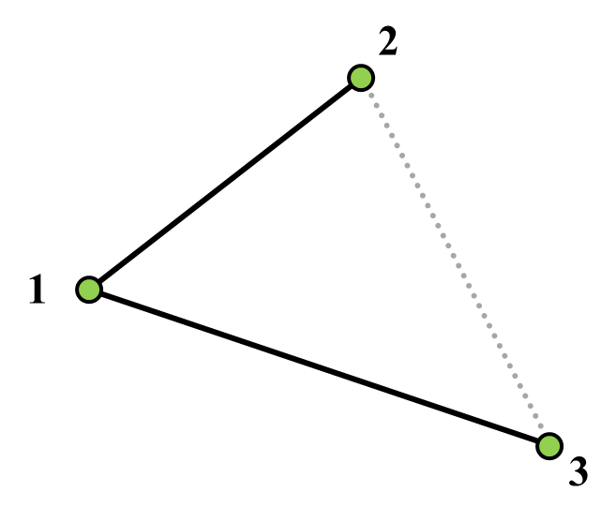
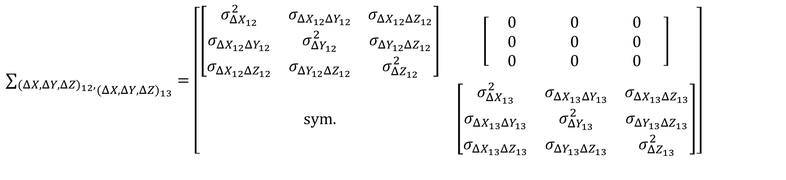
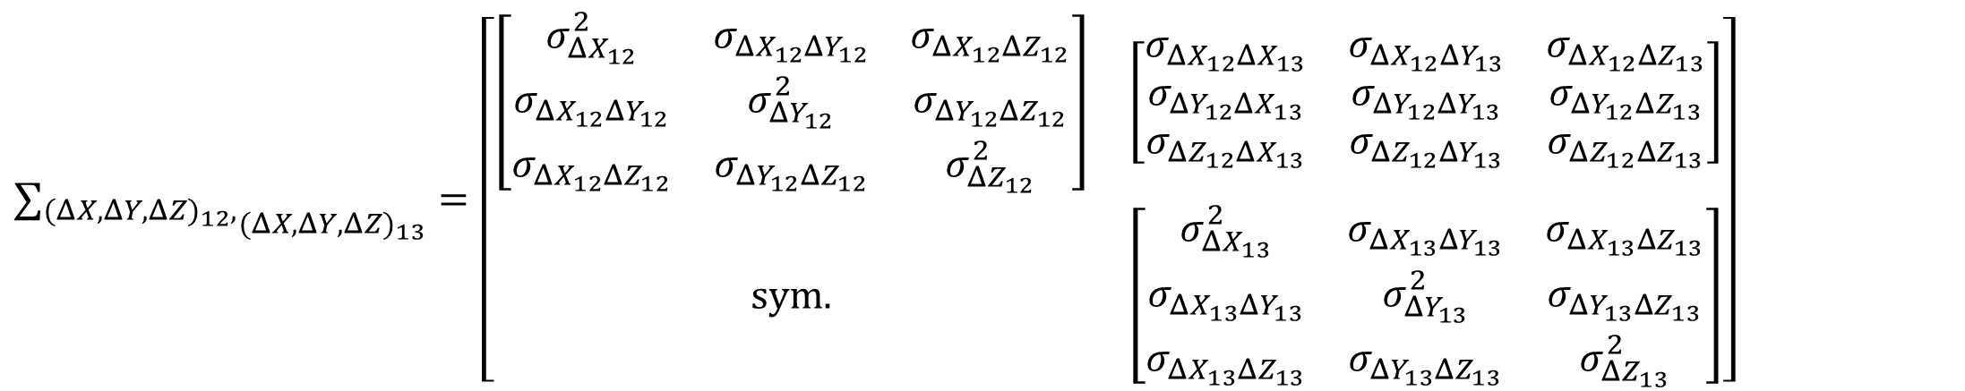
Two Types of GNSS Baseline Processing
Variance-Covariance Matrices
$${∑_{(ΔX,ΔY,ΔZ)_{12},}}_{(ΔX,ΔY,ΔZ)_{13}}=\left[\begin{matrix}\left[\begin{matrix}σ_{ΔX_{12}}^{2} & σ_{ΔX_{12}ΔY_{12}} & σ_{ΔX_{12}ΔZ_{12}} \\ σ_{ΔX_{12}ΔY_{12}} & σ_{ΔY_{12}}^{2} & σ_{ΔY_{12}ΔZ_{12}} \\ σ_{ΔX_{12}ΔZ_{12}} & σ_{ΔY_{12}ΔZ_{12}} & σ_{ΔZ_{12}}^{2}\end{matrix}\right] & \left[\begin{matrix}\text{ 0 } & \text{ 0 } & \text{ 0 } \\ 0 & 0 & \text{0 } \\ 0 & 0 & \text{0 }\end{matrix}\right] \\ \text{sym}\text{.} & \left[\begin{matrix}σ_{ΔX_{13}}^{2} & σ_{ΔX_{13}ΔY_{13}} & σ_{ΔX_{13}ΔZ_{13}} \\ σ_{ΔX_{13}ΔY_{13}} & σ_{ΔY_{13}}^{2} & σ_{ΔY_{13}ΔZ_{13}} \\ σ_{ΔX_{13}ΔZ_{13}} & σ_{ΔY_{13}ΔZ_{13}} & σ_{ΔZ_{13}}^{2}\end{matrix}\right]\end{matrix}\right]$$
Sequential
Commercial Software
$${∑_{(ΔX,ΔY,ΔZ)_{12},}}_{(ΔX,ΔY,ΔZ)_{13}}=\left[\begin{matrix}\left[\begin{matrix}σ_{ΔX_{12}}^{2} & σ_{ΔX_{12}ΔY_{12}} & σ_{ΔX_{12}ΔZ_{12}} \\ σ_{ΔX_{12}ΔY_{12}} & σ_{ΔY_{12}}^{2} & σ_{ΔY_{12}ΔZ_{12}} \\ σ_{ΔX_{12}ΔZ_{12}} & σ_{ΔY_{12}ΔZ_{12}} & σ_{ΔZ_{12}}^{2}\end{matrix}\right] & \left[\begin{matrix}σ_{ΔX_{12}ΔX_{13}} & σ_{ΔX_{12}ΔY_{13}} & σ_{ΔX_{12}ΔZ_{13}} \\ σ_{ΔY_{12}ΔX_{13}} & σ_{ΔY_{12}ΔY_{13}} & σ_{ΔY_{12}ΔZ_{13}} \\ σ_{ΔZ_{12}ΔX_{13}} & σ_{ΔZ_{12}ΔY_{13}} & σ_{ΔZ_{12}ΔZ_{13}}\end{matrix}\right] \\ \text{sym}\text{.} & \left[\begin{matrix}σ_{ΔX_{13}}^{2} & σ_{ΔX_{13}ΔY_{13}} & σ_{ΔX_{13}ΔZ_{13}} \\ σ_{ΔX_{13}ΔY_{13}} & σ_{ΔY_{13}}^{2} & σ_{ΔY_{13}ΔZ_{13}} \\ σ_{ΔX_{13}ΔZ_{13}} & σ_{ΔY_{13}ΔZ_{13}} & σ_{ΔZ_{13}}^{2}\end{matrix}\right]\end{matrix}\right]$$
Simultaneous/Session
PAGES software
Notes:
We also have the matter of single baseline processing and session processing.
Presented here are the variance-covariance matrices for the two baseline observations we looked at earlier. Single baseline processing with commercial software like Trimble Business Center and Leica Geo Office ignore the correlations between the two baseline observations. In principle, survey networks developed with single baseline processing are never entirely correct because they neglect these correlations.
Past studies that have resembled the NGS58 method developed networks with single baseline processing engines.
Alternatively, session processing engines like PAGES in OPUS-Projects maintain the correlations and give results that are more correct, in principle.

Slide 41
SRTK – Single-base RTK
aka RTK
Base sending corrections to Rover
  Radio broadcasting corrections
  Cell modem sending corrections
In context of today’s talk, your must be logging data at your Base (to tie it to NCN)

Slide 42
NRTK – Network RTK
aka RTN - Real Time Network
A group of CORS that collect data and send it to server(s), which then deliver corrections to users
Different principles, but all are NRTK methods:
  VRS - Virtual Reference Station
  MAC - Master-Auxiliary Concept (2 types of corrections possible)
    MAX – Master-Auxiliary Corrections
    i-MAX - Individualized Master-Auxiliary Corrections
  FKP - Flächen Korrektur Parameter

Slide 43
RINEX file format
Receiver INdependent EXchange
We are concerned with the Observation data
  Some day “O-file” (because extension is .YYo)
    mark254q.24o
  Some tools use the extension “.obs”
This is what OPUS processes
  OPUS currently accepts other formats
    Future versions of OPUS will be RINEX only

Slide 44
RINEX file format
“Now Jeff, I upload .tps files all the time…”
Yes, there are other file types you can upload
  Translated to RINEX v2.11 by OPUS servers
    TEQC + GFZRNX + custom coding
For smoothest OPUS experience, use the equipment brand’s RINEX converter
  TPS2RIN; ConvertToRINEX; iGx Download; mdb2rinex

Slide 45
Why design a new file format?
Users have spoken
  You want to be able to submit RT-GNSS data
NGS has researched
  We want to be able to ingest RT-GNSS data
No existing format fit the requirements…

Slide 46
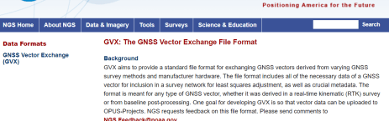
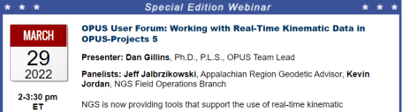
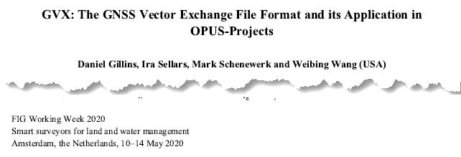
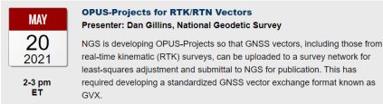
GNSS Vector eXchange (GVX)
Hyperlink to GVX Info Page
Detailed documentation, Schema, and Example File available
Any major search engine: “ngs gvx file format”
Open standard for anyone to use or integrate
GVX is sort of like… RINEX for RTK/RTN data
GVX details?
Check out:

Slide 47
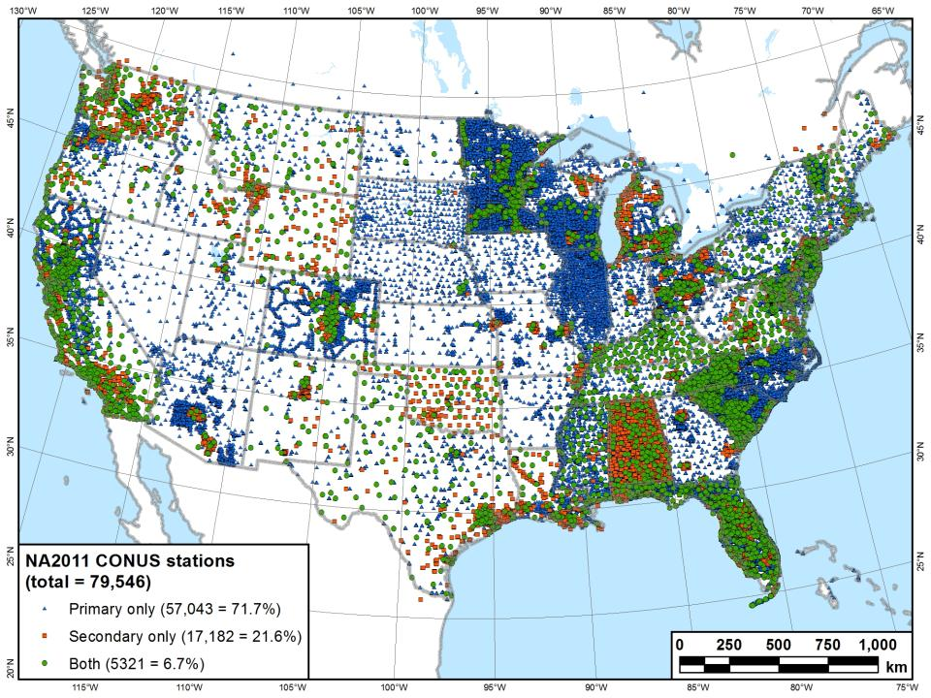
What you see in a map of NSRS control…

Slide 48
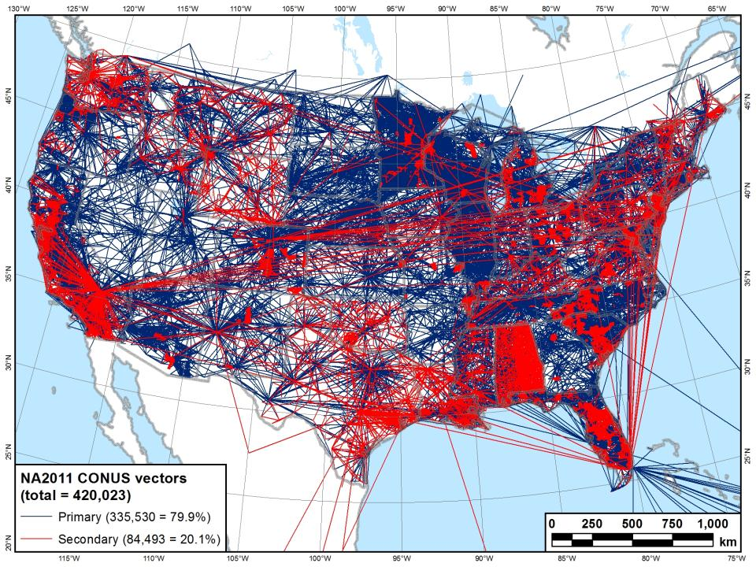
What we see in a map of NSRS control…

Slide 49
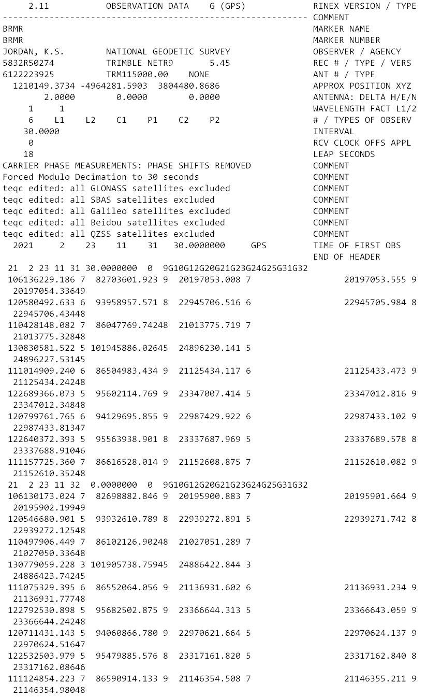
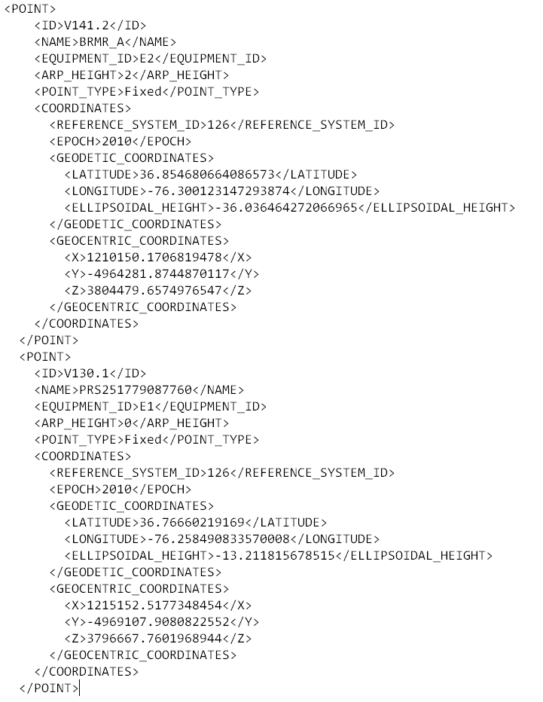
GVX ≈ RINEX for RTK/RTN data
RINEX
GVX

Slide 50
GVX ≈ RINEX for RTK/RTN data
RINEX
GVX
Uncorrected Observations
That’s why we post-process them
Static Observations
One observation per file
Proprietary Format → Open Standard
Export RINEX using your COTS software
Metadata
Antenna, Rx, HI, Point Name, Start Time, SVs at each epoch
Based on ASCII Text File Format
Longtime industry standard
  Way too many to list!
Corrected/Processed Positions
And the Vectors used to create them
RTN, RTK, PP Static, even PPK
Many observations, any mix of above
Proprietary Format → Open Standard
Export GVX using your COTS software
Metadata - same as RINEX, plus…
Project Info, Solution Types, PDOP, Mount Points, Correlation Matrices, QC data
Based on XML File Format
Longtime industry standard
  e.g. LandXML, JXL, MAXML, KML/KMZ

Slide 51







How can I get my data into GVX?
Carlson
Emlid
iGage
JAVAD (J-field)
Leica (Infinity)
Topcon (MAGNET Field & Office)
Trimble (TBC & Access)
These are the companies we are aware of who have implemented GVX or have said that they are working on it.
Please reach out to your tech support POCs if you want GVX.
NGS will work with any company that reaches out with questions.
Notes:
-Please note that this information here can only reflect what we know. If you are a developer working on incorporating GVX into your software… reach out to us! We would be happy to assist you, just as we have assisted some of our other commercial partners named here.
-What would make us happiest is if the list got so long we couldn’t fit in on this slide.
-Oh, and hey, you customers out there… express your desire for GVX to your suppliers/dealers or Support team

Slide 52
GVX Scenarios in OPUS Projects
CORS + RTN
  CORS are not in NCN
  CORS are not in NCN but are in IDB (have PID/Datasheet)
  CORS are in NCN
Static Base + RTK
  Base (positioned via OPUS) sending RTK corrections to rover
Static Post-Processed
  Corrected positions determined with your software
  Results (vectors and points) exported to GVX
Any network method is compatible (e.g. VRS, MAC, FKP)
Notes:
-What makes the difference is that depending on which network station(s) were used in your survey, you will encounter one or more of these scenarios.

Slide 53
GVX Scenarios in OPUS Projects
What’s the difference?
Your workflows in OPUS Projects.
What’s the same?
Your workflows in the field.

Slide 54
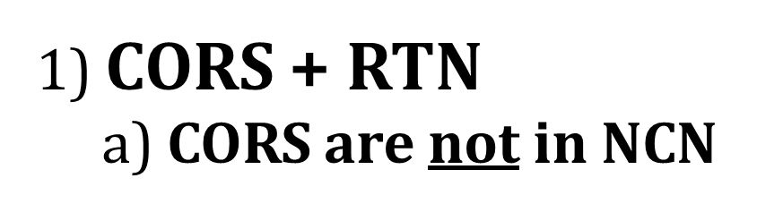

Slide 55
1) CORS + RTN a) CORS are not in NCN
Collect field data with Rover(s)
Download non-NCN CORS data
  From your network provider
Upload WinDesc files
Upload non-NCN CORS data to OPUS Projects
  Using OPUS Static and Project ID
Create GVX in your software and upload it
Session Processing
  Aligns your CORS (RTN Base) to NCN
Network Adjustment
  Constrain to NCN CORS
Notes:
Some of you may be thinking though… what does this even mean that the CORS are not in the NCN?
Let’s look at the example of the WVDOT’s Real Time Network

Slide 56
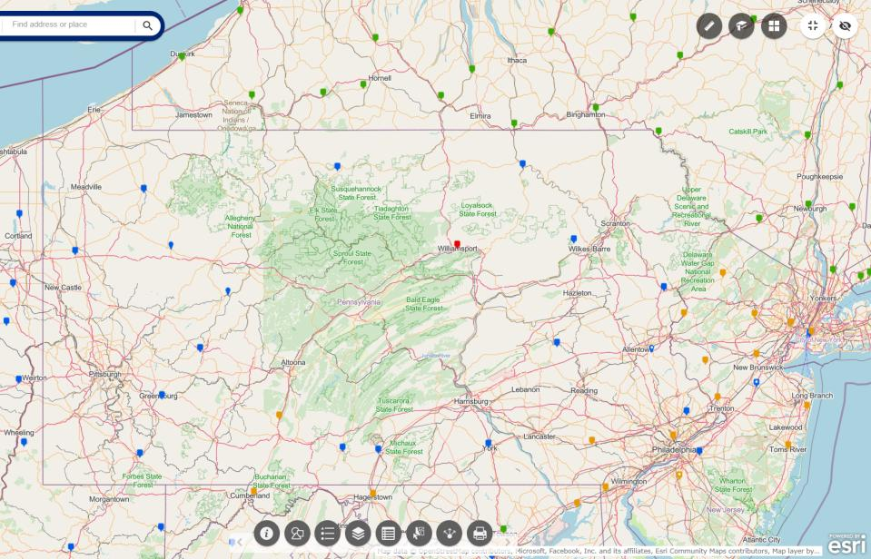
NOAA CORS Network (NCN) in PA
Notes:
where else but the federal government are you going to see two acronyms within one acronym?

Slide 57
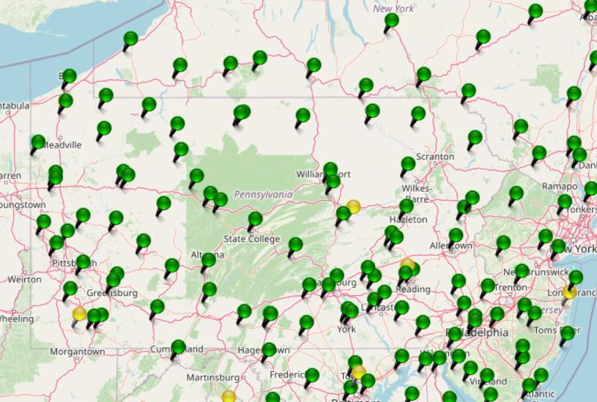
KeyNetGPS CORS Network
Notes:
where else but the federal government are you going to see two acronyms within one acronym?

Slide 58
NOAA CORS Network (NCN) in PA
Notes:
where else but the federal government are you going to see two acronyms within one acronym?

Slide 59
KeyNetGPS CORS Network
non-NCN CORS
Notes:
where else but the federal government are you going to see two acronyms within one acronym?

Slide 60
1) CORS + RTN
a) CORS are not in NCN
Network users typically have access to non-NCN CORS data
  Sometimes called the “Reference Data Shop”
Some network providers do not provide long-term user access
  Anywhere from just 45 days to 365 days
Investigate this during Project Planning
  If non-NCN CORS data is not available…
    NGS cannot help with that
    Contact your network provider for possible access to their archived data
Download non-NCN CORS data
  From your network provider

Slide 61
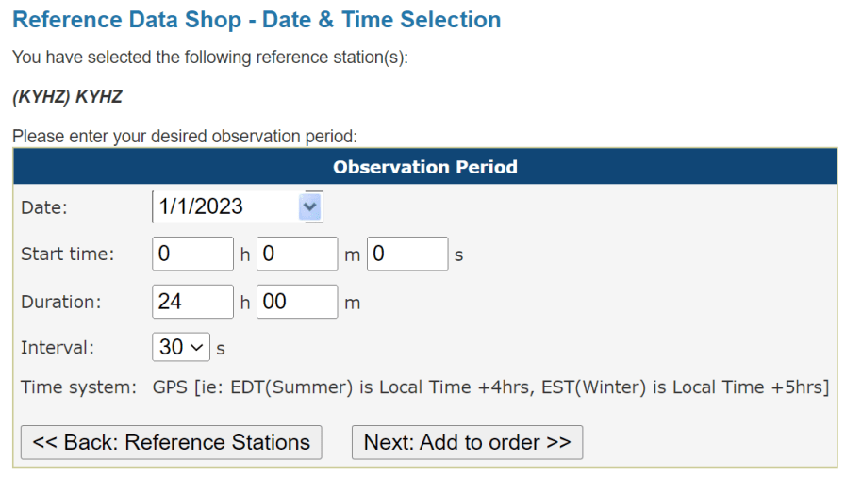
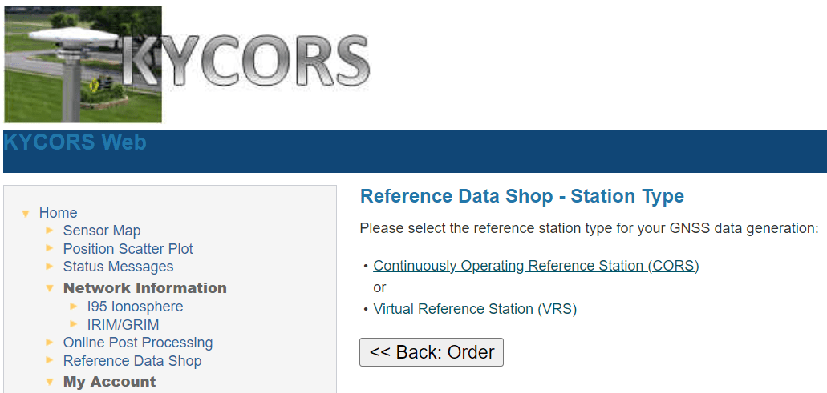
1) CORS + RTN
a) CORS are not in NCN
Notes:
Now we’re looking here not at the WVDOT but the Kentucky Transportation Cabinet network.
This is their web interface, and if I wanted to download some non-NCN CORS data from their network, I’d go into the Reference Data Shop.
For many of the networks, you’ll see both a CORS and a VRS option.
What you want is the CORS data, and the interface will walk thru the rest of the options, you’ll be asked which station(s) you want data from, for date(s), observation interval (HINT… 30 seconds for OPUS!)

Slide 62
1) CORS + RTN
a) CORS are not in NCN
Think of this as…
Your GVX will have the CORS-Rover vectors, but non-NCN CORS.
You are tying to the NCN by way of a CORS-CORS vector via OPUS Static.

Slide 63
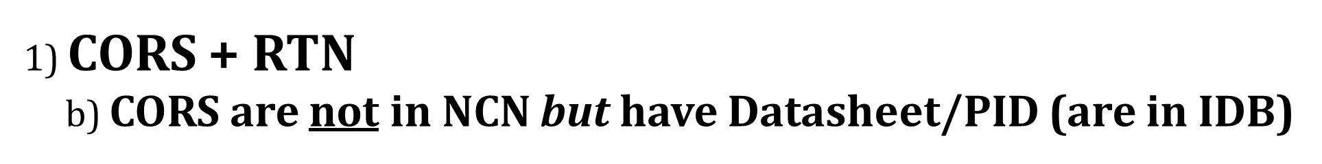

Slide 64
1) CORS + RTN b) CORS are not in NCN but have Datasheet/PID (are in IDB)
Collect field data with Rover(s)
Download non-NCN CORS data
  From your network provider
Upload WinDesc files
Upload non-NCN CORS data to OPUS Projects
  Using OPUS Static and Project ID
Create GVX in your software and upload it
Session Processing
  Aligns your CORS (RTN Base) to NCN
Network Adjustment
  Select Constraints (NCN or non-NCN CORS Datasheet)

Slide 65
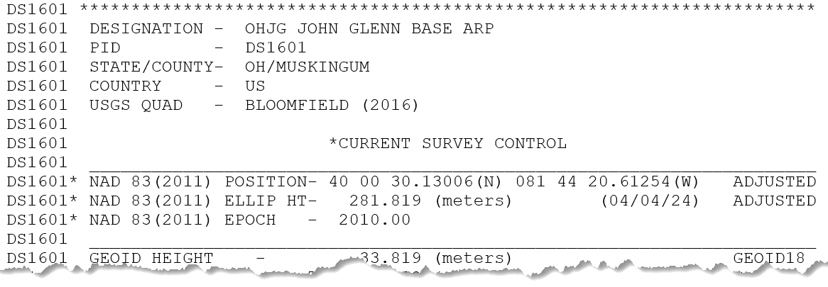
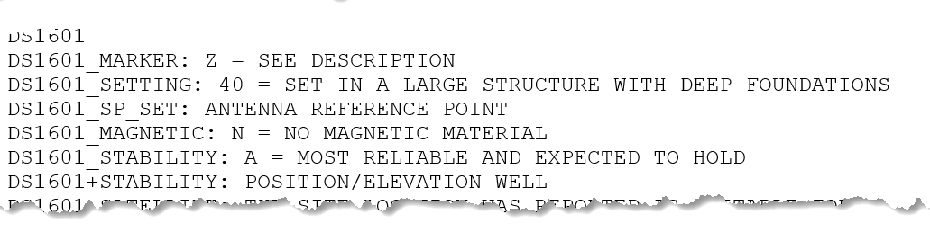
1) CORS + RTN
b) CORS are not in NCN but have Datasheet/PID (are in IDB)
What does that look like?
How do I know?
Consult the NGS Map
and Datasheet
IDB = Intergrated DataBase

Slide 66
1) CORS + RTN b) CORS are not in NCN but have Datasheet/PID (are in IDB)
Think of this as…
Same as previous, but with convenient NSRS constraints available.

Slide 67
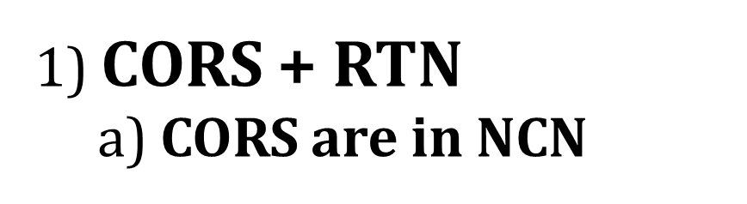

Slide 68
1) CORS + RTN
a) CORS are in NCN
Collect field data with Rover(s)
Create GVX in your software
  Using your field or office software
Upload WinDesc files
Upload GVX to OPUS Projects
  Vectors are automatically linked to NCN CORS
Network Adjustment
    Constrain NCN CORS

Slide 69
1) CORS + RTN
a) CORS are in NCN
Think of this as…
Direct tie to the NSRS via active control.
No need to perform post-processing, only any Network Adjustments.

Slide 70
CORS + RTN
Regardless of CORS used, whether NCN or non-NCN…
If RTN uses Trimble® VRS™ method, you must log vectors
  VRS = Virtual Reference Station
For GVX to work in OP, vectors must be tied to a PRS/PBS
  PRS = Physical Reference Station
  PBS = Physical Base Station
Should not be a concern for MAC or FKP methods
  Vectors will be tied to PRS/PBS by default
No vectors = No GVX = No OPUS Projects

Slide 71
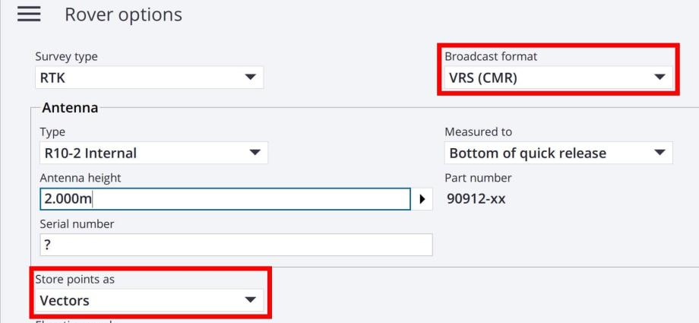
CORS + RTN
Regardless of CORS used, whether NCN or non-NCN…
If RTN uses Trimble® VRS™ method, you must log vectors
GNSS Vector eXchange with VRS means you must:
Store points as Vectors

Slide 72
2) Static Base + RTK
- Base (positioned via OPUS) sending corrections to Rover
Setup Base
  Must log data during all Rover occupations
Collect field data with Rover(s)
Upload WinDesc files
Upload Base data to OPUS Projects
  Using OPUS Static and Project ID
Create GVX in your software and upload it
Session Processing
  Aligns your Base to NCN
Network Adjustment
  Constrain to NCN CORS

Slide 73
Future of OPUS
Removal of OPUS-Share and OPUS-RS
RINEX-only upload
Multi-GNSS processing (M-PAGES)
9-character CORS IDs
Updated CORS Selector

Slide 74
Future of OPUS-Static
15 min to 48 hours of data*
  Any files <1 hour will get a disclaimer on the Solution Report
Simultaneous/Session Baseline Processing
  Yes, in OPUS-S not just in OP
New frames: ITRF2020, NSRS TRFs (NATRF2022), SPCS2022
New vertical datum: NAPGD2022
  Based on GEOID2022

Slide 75
Future of CORS Selector
OPUS CORS Selector “grades” CORS on the following criteria:
  CORS Metrics (Horizontal and Vertical scores)
    Higher score for more “stable” CORS
  Distance from user mark
    Higher score for CORS within 250 km
  Data availability
    Higher score for stations with reliable data
  User requested constellations
    Higher score for more requested constellations
Also based on quadrant
User selected CORS should automatically be included*

Slide 76
Future of OPUS Projects
Submitting to NGS:
  No requirement for Survey Project Proposal
  Removal of WinDesc file requirement
Single tracking number for all projects
  NGS Survey Project Number
Distant/Tropo CORS selection automated
Updated CORS Selector
9-character CORS IDs

Slide 77
Future of OPUS Projects
GPS-only
  Will not use M-PAGES until after NSRS finalized (FGCS vote)
Removal of GPSCOM
HTDP to be replaced by SPROCCET
ADJUST to be replaced by LASER
  Still 2 sets of network adjustments
New datasheets via the DDS
Results in specific frame (epoch) will vary by adjustment

Slide 78
Additional Resources

Slide 79
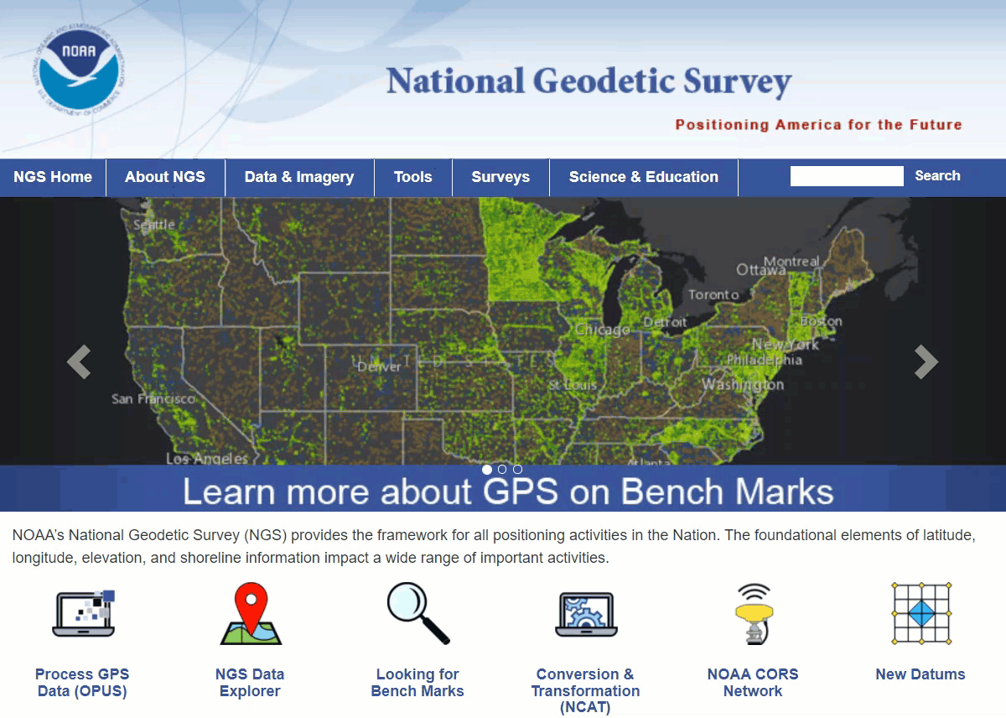
Educational Videos
<5 minutes
Online Lesson
(via MetEd/COMET)
~1 hour
NGS homepage: geodesy.noaa.gov
Notes:
Educational videos and online tutorials –
Our library of lessons and videos are great resources, and will reinforce a lot of information we covered today.
The videos are just 3-5 minutes long.
the lesson is a deeper dive but still only takes an hour.

Slide 80


Email Subscriptions
*Only 1-2 messages per month*
NGS News
  Includes quarterly NSRS Modernization newsletter
Webinar Series
Training
GPS on Benchmarks
Click this icon on homepage

Slide 81




SESSION
EVALUATION
HTTPS://WWW.SURVEYMONKEY.COM/R/2025PSLSEVAL

Slide 82

Jeff Jalbrzikowski, P.S., GISP, CFS
Appalachian Regional Geodetic Advisor
jeff.jalbrzikowski@noaa.gov
240-988-5486
https://www.ngs.noaa.gov/ADVISORS/
or search: “NGS advisors”
Scan the QR code to save my contact info to your phone

