Slide 1
Vertical Datums and Heights
PSLS Annual Conference
January 2025
Jeff Jalbrzikowski, P.S., GISP, CFS
Appalachian Regional Geodetic Advisor
jeff.jalbrzikowski@noaa.gov
240-988-5486

Slide 2
Organizational Structure
-Department of Commerce (DoC)
(~47,000 employees)
-National Oceanic and Atmospheric Administration (NOAA)
-National Ocean Service (NOS)
-National Geodetic Survey (NGS)
(~175 employees)
Notes:
-We are the Federal Government’s oldest scientific agency.
-part of the Executive Branch
-I know it can seem kind of strange that NGS is part of the NOS, but the origins of NGS lie with the C&GS.
-we are a “Program Office” of the NOS
Survey of the Coast – 1807
Coast Survey – 1836
Coast and Geodetic Survey – 1878
NGS since 1970

Slide 3
Organizational Structure
We’re not USGS, we’re NGS
-Department of Commerce (DoC)
(~47,000 employees)
-National Oceanic and Atmospheric Administration (NOAA)
-National Ocean Service (NOS)
-National Geodetic Survey (NGS)
(~175 employees)
≠
Notes:
-as you can read my slide, I like to point that out because over my 2 years at NGS I’ve seen and heard this misunderstanding quite a bit
-don’t worry! it doesn’t offend us! and we do work closely with USGS, but we are separate agencies within totally different departments of the federal government

Slide 4
Any references to any commercially available hardware or software do not constitute an endorsement or a disapproval of any manufacturers, developers, dealers, or suppliers.
Thanks.

Slide 5
Let’s start with some alphabet soup

Slide 6
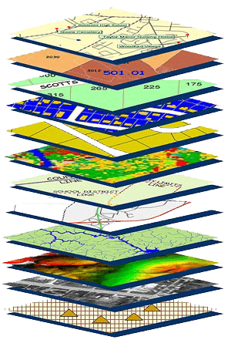
NGS Mission
To define, maintain and provide access to the National Spatial Reference System (NSRS) to meet our Nation’s economic, social, and environmental needs.
NSRS
Notes:
NGS develops and maintains the National Spatial Reference System, a national coordinate system that provides the foundation for transportation, navigation, land record systems, mapping and charting efforts, and a multitude of scientific and engineering applications
CLICK
You’ve all seen this or some similar graphic I’m sure. That bottom layer… that’s our baby, the NSRS.

Slide 7
Yes, we are delayed.
NSRS Modernization
Notes:
So remember, today’s presentation is not JUST about new datums, it is about modernizing the NSRS as a whole.
You don’t know what the NSRS is? Stay tuned, we’ll get there as we go along.

Slide 8
Delayed Release of the Modernized NSRS
How long will the delay be?
NGS plans to roll out components of the modernized NSRS in 2025 or 2026.
Will the names stay the same?
Yes, terms containing “2022” such as “NATRF2022” and “NAPGD2022” will remain the same.

Slide 9
Modernizing the NSRS
Updating all NSRS coordinates
Replace existing datums with new datums
Replacing existing SPCS83 with new SPCS2022
Accounting for coordinates changing with time
Improving NGS products and services
Simplifying customer contributions
Making the NSRS:
More accurate
More accessible
More efficient
begins
Rollout in
2025

Slide 10
6 months in Beta
Migrate to Production all at once

Slide 11
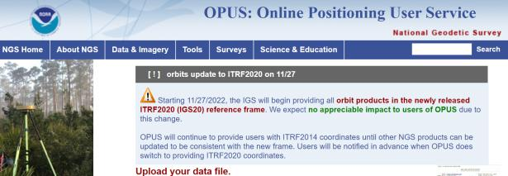
NGS Mission
To define, maintain and provide access to the National Spatial Reference System (NSRS) to meet our Nation’s economic, social, and environmental needs.
access… ? = traditionally → marks/disks/objects
= modern and future → NOAA CORS Network (NCN)
via OPUS
Notes:
Follow up thought
-like it or not, we know that the vast majority of our users are obtaining NSRS coordinates via OPUS
-while that is our plan for the future of primary access, modernized NSRS, as of now the official form of access (specifically to NAVD88) truly is to “touch brass” as they say → meaning occupy a benchmark

Slide 12
Positional Components of
the NSRS
Geometric
aka “Horizontal”
Latitude, Longitude, Ellipsoid Height
Geopotential
aka Orthometric Height
aka “Elevation”
NAD83
NAVD88
Notes:
-geometric component is latitude, longitude, and ellipsoid height
-geopotential component is combined with the geometric components to calculate an ortho height or capital H

Slide 13
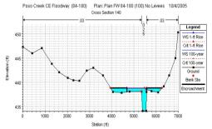
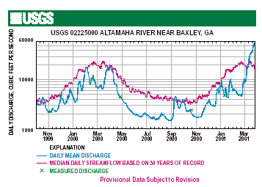
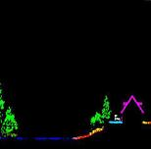
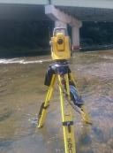
Why does the NSRS matter to me?
Orthometric Datum
Water Level Datum (and Flow Rates)
Ellipsoidal Datum
+
+
Aerial LiDAR/Mapping
Historic Water Levels and Flow Rates
Terrestrial Survey/Cross-Sections
FIRMs require data from disconnected sources.
Datums must be consistently aligned.
Notes:
Example of why we need consistent coordinates (illustrated):
Just in the making of a single FIRM, data collected at different points in time using different methods:
-aerial lidar
-x-section and structure data via survey
-streamflow data/hydrographs
All of these must be reliably aligned and combined with historical data, in both the horizontal and vertical components, to produce a final product in which all of this information is available in one place, to assist professionals like yourselves in appropriate flood mitigation.
→Therefore, Reliable Flood Rate Insurance products rely on the NSRS
In a perfect world…
datums would be parallel and smooth
Surface of Earth would not move

Slide 14
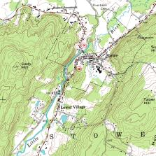
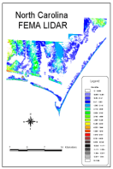
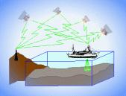
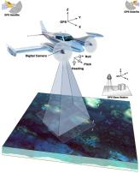
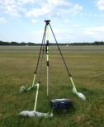
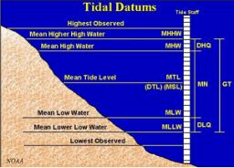
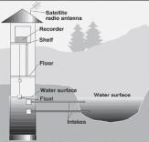
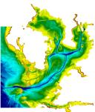
Three types of heights in NSRS
Ellipsoidal
geoid
Orthometric
Raw Hydrographic Surveys
USGS
Topography
NAD83
NAVD88
NGVD29
FEMA NFIP Data & Maps
Engineering and Construction Surveys
Raw GPS Observations
Raw Lidar Data
Water Level or Tidal
NOAA and USACE Hydrography
Shoreline Mapping and Regulatory Boundaries at the Coast
Daily and Extreme Water Levels (Gage)
Notes:
This slide illustrates the 3 categories of vertical datums and examples of where each is directly used They are project and application dependent.
First, we have ellipsoidal datums. Examples include WGS84 and NAD83 (North American Datum of 1983). You will encounter these datums frequently in hydrographic surveys that are vertically referenced with RTK-GPS; any native GPS measurements; and even raw lidar datasets.
Next, we have orthometric datums. These datums are very important because height differences referenced to orthometric datums will allow us to know the direction water will flow, because they have been “gravity-corrected”. The North American Vertical Datum of 1988 (or NAVD 88) is an orthometric datum, which you will see on USGS topographic maps, engineering and development site surveys, and FEMA Flood Insurance Rate Maps.
Finally, we have Tidal Datums, which are derived from water level measurements. They have extremely important applications including daily and extreme water levels; NOAA nautical charts, and shoreline mapping or boundaries along the coast.
*NOAA provides tools (like NCAT and Vdatum) to transform between these different height systems.
The Bridge

Slide 15
Comparing Orthometric Heights
or …“Digging for Datums”

Slide 16
Vertical Datum Visualized
A reference surface that can be used to measure heights in a uniform way.
How much taller is Sally than Jane?
Could measure directly from top of head to top of head.
Or, from floor up to tops of heads and then subtract!
Sally
Jane
X= ?
That’s a relative height, or height difference.
Datum
X = (h Sally) – (h Jane)
That’s a difference in heights above a datum.
Notes:
A vertical reference system is a reference surface that can be used to measure heights in a uniform way.
So, how much taller is Sally?

Slide 17
Datum Difference Visualized
Can still calculate X with a relative height… but it is not accurate, as our reference surface is not the same.
How much taller is Sally than Jane?
Need to know what they’re standing on!
We cannot compare heights that are measured from different reference surfaces.
Sally
Jane
X= ?
NAVD88
Datum 1
NGVD29
Datum 2
X ≠ (h Sally) – (h Jane)
Notes:
-Well, we need to know how tall, or the slope of the hill.
-You cannot compare heights that are measured from different planes of reference.
*If we replace Sally and Jane with an example more related to floodplains:
What if we want to compare a BFE height in 1990 and a BFE height 2010
what if the land has subsided under that base flood elevation over time?
…hold that thought.

Slide 18
Ok Jeff, how do I do that?
…we call that a datum transformation
Notes:
-note that’s the proper technical term, but I’m not going to hound someone who says “conversion”… I slip sometimes too

Slide 19
Terminology - Changing Coordinates
Convert
change the type of coordinate
NAD83(2011) latitude & longitude → NAD83(2011) SPCS
Transform
change the datum of coordinate
NGVD29 height → NAVD88 height
NAD 27 latitude & longitude → NAD 83(2011) latitude & longitude
Propagate
change the epoch of coordinate
NATRF2022 epoch 2020.00 to NATRF2022 epoch 2023.243
Notes:
Historically NGS has been inconsistent with these top two words.
Going forward, we will use them as:
Conversion: Meaning to change the type of coordinate without changing the datum or frame
Transformation: Meaning to change the datum or frame, without changing the type of coordinate

Slide 20
A brief history of (the most prevalent) U.S. vertical datums

Slide 21
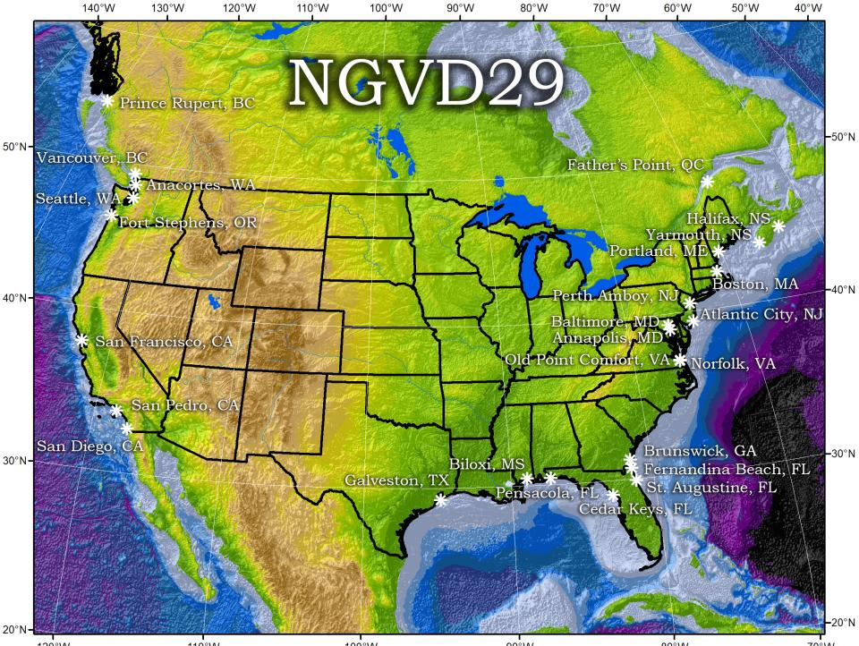
Referenced to 26 tide gauges in the US and Canada
Notes:
It turns out that MSL is a close approximation to another surface, defined by gravity, called the geoid, which is the true zero surface for measuring elevations. Because we cannot directly see the geoid surface, we cannot actually measure the heights above or below the geoid surface. We must infer where this surface is by making gravity measurements and by modeling it mathematically. For practical purposes, we assume that at the coastline the geoid and the MSL surfaces are essentially the same. Nevertheless, as we move inland we measure heights relative to the zero height at the coast, which in effect means relative to MSL.
Definition: NGVD29 – The National Geodetic Vertical Datum of 1929…
The Sea Level Datum of 1929 was the vertical control datum established for vertical control surveying in the United States of America by the General Adjustment of 1929. The datum was used to measure elevation or altitude above, and depression or depth below, mean sea level (MSL).
Mean sea level was measured at 26 tide gauges: 21 in the United States and 5 in Canada. The datum was defined by the observed heights of mean sea level at the 26 tide gauges and by the set of elevations of all bench marks resulting from the adjustment. The adjustment required a total of 66,315 miles (106,724 km) of leveling with 246 closed circuits and 25 circuits at sea level.
Since the Sea Level Datum of 1929 was a hybrid model, it was not a pure model of mean sea level, the geoid, or any other equipotential surface. Therefore, it was renamed the National Geodetic Vertical Datum of 1929 (NGVD 29) in 1973. The NGVD 29 was subsequently replaced by the North American Vertical Datum of 1988 (NAVD 88) based upon the General Adjustment of the North American Datum of 1988.

Slide 22
NGVD29 – based on 26 tide gauges
topographic surface
datum zero
surface
Local Mean Sea Level differs at tide stations due to prevailing winds, ocean current, salinity, seabed topography, etc.
Concept

Slide 23
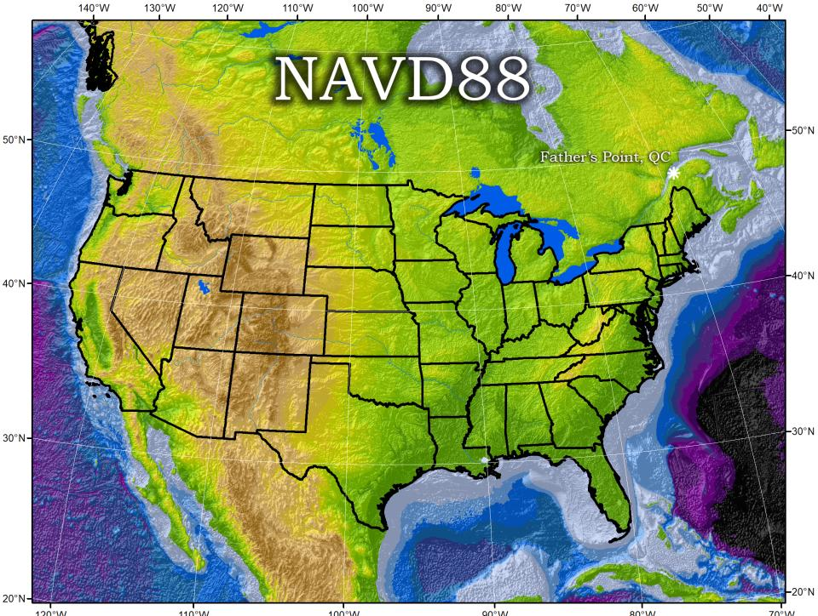
Why one site this time?
removed local sea level variation problem of NGVD29
Referenced to one tidal bench mark in Canada
Notes:
Definition: The surface of equal gravity potential to which orthometric heights shall refer in North America
One height held fixed [at 6.271 meters along the plumb line below the geodetic mark] at “Father Point” (Rimouski, Canada).
By fixing the geopotential value at the origin point, it was possible to ensure that the origins of IGLD 85 and NAVD 88 aligned.
**But perhaps more importantly, the height chosen was to minimize 29→88 differences on USGS topo maps in the eastern U.S. … thus, the “zero height surface” of NAVD 88 was NOT chosen for its closeness to the geoid (but it was close…few decimeters)
Use of one fixed height removed local sea level variation problem of NGVD 29

Slide 24
NAVD88 – based on single benchmark
topographic surface
datum zero
surface
Concept
Notes:
-

Slide 25
Approximate Error in NAVD88 zero surface
Map is the H=0 surface differenced from satellite gravity data
Notes:
Map highlights the tilt/bias to the zero reference surface, that’s another item that was discovered later on with the advent and proliferation of satellite positioning and remote sensing technology.
How was the map created, that is the NAVD88 zero surface (H=0) overlaid onto a satellite based geoid model, then color shaded by vertical difference

Slide 26
NAVD88 – based on single benchmark
topographic surface
datum zero
surface
Most, if not all, of this error in alignment was intentional.
Huh?! It was chosen to minimize the change to contours in USGS quadrangles.
Concept
Notes:
-importantly, the height chosen was to minimize 29→88 differences on USGS topo maps in the eastern U.S. … thus, the “zero height surface” of NAVD 88 was NOT chosen for its closeness to the geoid (but it was close…few decimeters)

Slide 27
Accessing NAVD88
Need to recover and tie in a published benchmark, aka “touch brass”
OPUS provides a geoid-based solution…
Some will argue it is only a pseudo-NAVD88 height

Slide 28
North American Vertical Datum
of 1988
NAVD88
will be replaced by

Slide 29
North American-Pacific Geopotential Datum of 2022
NAPGD2022
(pronounced: nap-jee-dee)

Slide 30
NAPGD2022
North American-Pacific Geopotential Datum of 2022
Based on strength of gravity
at Global Mean Sea Level (GMSL)
OPUS will be your official access to the datum
no ties to benchmarks necessary
because no leveling used to define the datum
gravity data is positioned by GNSS

Slide 31
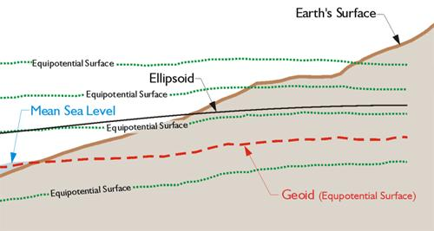
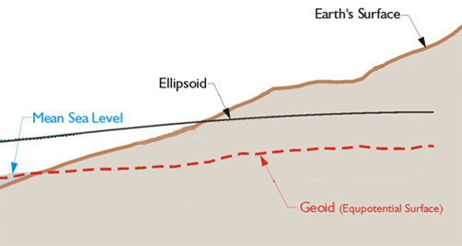
Equipotential Surface
W₀ = 62,636,856.0 m² s⁻²
-GPS for Land Surveyors, by Jan Van Sickle, 4th ed., CRC Press, Taylor & Francis Group, 2015, p. 180. (slightly edited)
Geoids are defined by a specific strength of gravity → W₀
Notes:
Recall our ol’ buddy W sub-naught (W₀)

Slide 32
Why leveling is not part of NAPGD2022
…but will still be important for you.
ground surface
equipotential surfaces
(equal gravity)
Geoid at Site Scale

Slide 33
Why leveling is not part of NAPGD2022
…but will still be important for you.
ground surface
equipotential surfaces
(equal gravity)
Geoid at Continental Scale

Slide 34
Why leveling is not part of NAPGD2022
We are determining height differences across the whole continent
Large Area
Gravity varies due to: geology, water, etc.
You are determining height differences across your area/site
Small Area
Gravity does not change that much locally

Slide 35
Why leveling is not part of NAPGD2022
…but will still be important for you.
You need high accuracy relative height differences
Geoid model is not able to provide that
So don’t abandon your level
What about if submitting data to NGS?
Yes, we will accept leveling, but…
GNSS will also be required

Slide 36
NAVD88 geoids
versus
NAPGD2022 geoids

Slide 37
Which NAD83 goes with which geoid to get to NAVD88?
GEOID18
GEOID12B
NAD83(2011) →
NAD83(2007) →
NAD83(HARN/FBN)
NAD83(CORS96)
GEOID09
GEOID03
GEOID99
GEOID96
Notes:
I’ve gotten this question more than once.
-Does it matter which geoid model I use with which realization of NAD83?
-NGS Answer = yes
-Project-specific answer = maybe note
-I spoke at length with a gentlemen from the Virginia DOT about this, and he did a bunch of comparisons, saw a barely discernable difference… but still the NGS answer is going to be that for a given realization of NAD83, you should use only the corresponding geoid models for your work
-remember NGS is chasing the millimeter… but maybe you aren’t

Slide 38
Two types of geoid models
Gravimetric
Hybrid
Notes:
-believe it or not there’s more than 2 types, but the 2 types you’ll see NGS publish are…

Slide 39
Gravimetric → Hybrid
Gravimetric geoid is created from compiling various types of gravity data
USGG2003, USGG2009, USGG2012, xGEOID19
Hybrid geoid is a gravimetric geoid then best fit some vertical datum … like NAVD88
GEOID03, GEOID09, GEOID12B, GEOID18
Notes:
So… all the geoids you’re using to get elevations from your GNSS data

Slide 40
Gravimetric → Hybrid
USGG2003, USGG2009, USGG2012, xGEOID19
GEOID03, GEOID09, GEOID12B, GEOID18
best fit to NAVD88
best fit to NAVD88
best fit to NAVD88
best fit to NAVD88
Notes:
So… all the geoids you’re using to get elevations from your GNSS data

Slide 41
Gravimetric vs. Hybrid Geoid
topographic surface
gravimetric geoid
hybrid
geoid
datum zero
surface
Concept
Notes:
-importantly, the height chosen was to minimize 29→88 differences on USGS topo maps in the eastern U.S. … thus, the “zero height surface” of NAVD 88 was NOT chosen for its closeness to the geoid (but it was close…few decimeters)

Slide 42
NAVD88 uses a Hybrid Geoid
topographic surface
gravimetric geoid
hybrid
geoid
datum zero
surface
Concept
Notes:
-importantly, the height chosen was to minimize 29→88 differences on USGS topo maps in the eastern U.S. … thus, the “zero height surface” of NAVD 88 was NOT chosen for its closeness to the geoid (but it was close…few decimeters)

Slide 43
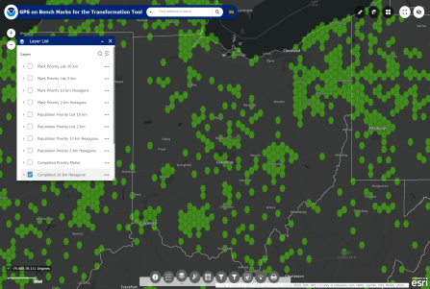
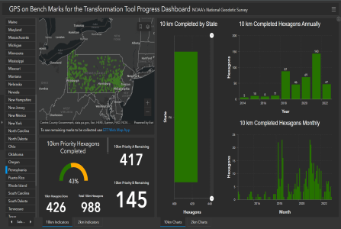
How do we fit the geoid to the datum?
GPS on Bench Marks (GPSonBM)
Web Map Application
Anyone can collect and provide:
2 OPUS-Static solutions
2 photos of each setup
Brief Description w/Ties
Deadline = 29 February 2024
Results increase accuracy of NAVD88 to NAPGD2022 transformation.
Progress Dashboard

Slide 44
NAPGD2022 uses a Gravimetric Geoid
topographic surface
gravimetric geoid
datum zero
surface
Datum zero surface aligned to Global Mean Sea Level (GMSL)
Concept
Notes:
-importantly, the height chosen was to minimize 29→88 differences on USGS topo maps in the eastern U.S. … thus, the “zero height surface” of NAVD 88 was NOT chosen for its closeness to the geoid (but it was close…few decimeters)

Slide 45
Sea Level Change and the Geoid
Threshold Level is published as 20 cm
Process is repeated as GMSL changes
H_{2020.000}
H_{2085.000}
Threshold Level
Threshold Level
Geoid
GMSL
Notes:
The illustrated strategy will be adopted at NGS. An animated characterization of this approach
What this means is that NGS will decouple the geoid from GMSL, until they have diverged by some threshold amount, currently defined as 20cm.
When that threshold is reached a new geoid will be defined and held fixed until reaching next threshold. In this way, the impact of the change of GMSL is accounted for in the heights of the NSRS, while the appearance of stability is maintained for “decades at a time” (BP2 Section 14).
If we calculate how long that might be based on existing rates of sea level rise of 3ish mm/yr then we’re talking ~60 years

Slide 46
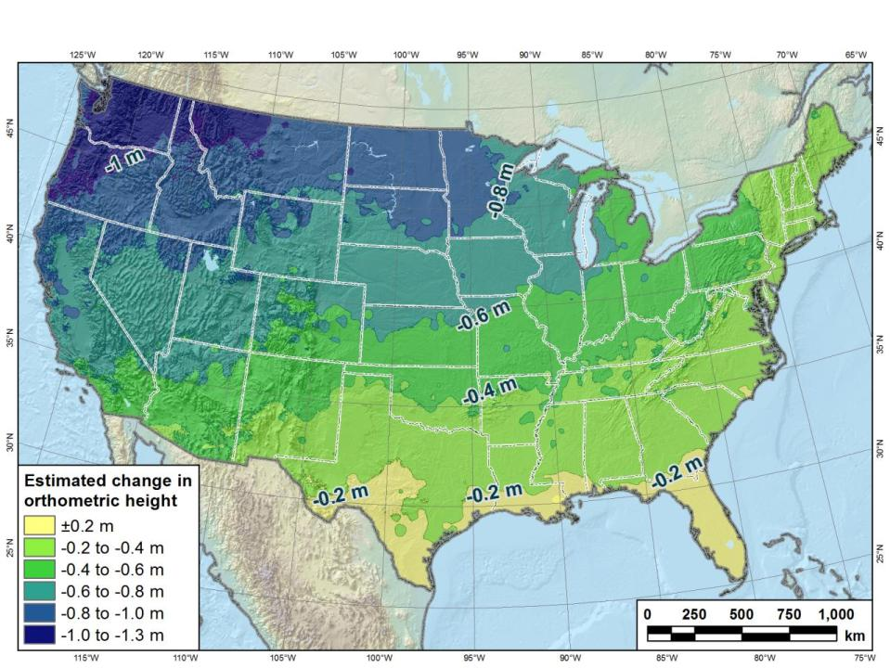
Estimated change in orthometric heights from NAVD88 to NAPGD2022
(NAPGD2022 approximated using xGEOID16B)

Slide 47
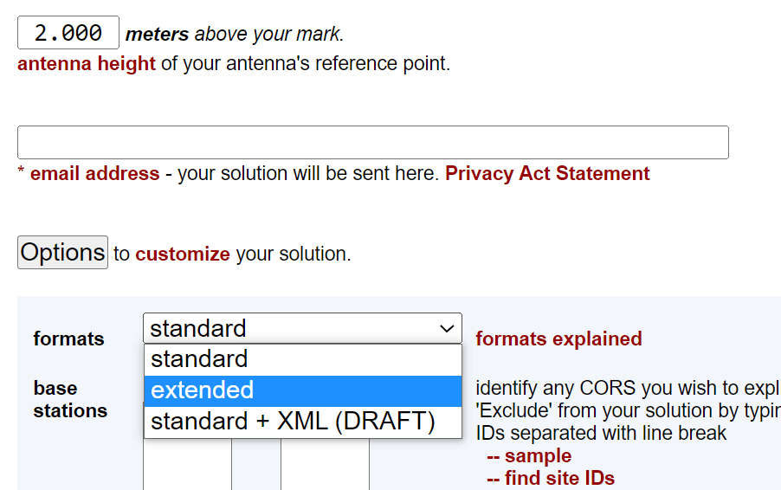
Estimated change in orthometric heights from NAVD88 to NAPGD2022
OPUS Extended Solution Report

Slide 48
Estimated change in orthometric heights from NAVD88 to NAPGD2022
OPUS Extended Solution Report
Scroll all the way to the bottom…

Slide 49
Preparing for NAPGD2022
Inventory heights in your data/datasets
Have you mix & matched geoid models?
Are you tracking levees or other flood control?
Are you managing subsurface utilities?
Access covers, junction boxes, cleanouts, etc.
Maybe geoid differences aren’t even significant.
Know your goals, know your data.

Slide 50
Preparing
Know the epoch of your data/datasets
consider how you will track this
full to-the-second timestamp on every feature?
Modern survey equipment makes this possible
labeling a year for each dataset?
Easy to add to workflows, datasets/databases, folders
something in-between that works for your needs?
2023.1957
2023:27
20230127
Epoch nomenclature is your choice

Slide 51
Preparing
Reprocessing your data
perfect world = everyone reprocesses everything
what does this mean?
consider an ALTA w/topo
start over with the onsite GNSS-based control
reorient all your shots/ties (hopefully linked)
recreate all the drainage features in new datum
unrealistic! … and unnecessary for majority users
Notes:
Reprocessing your data
in a perfect world, everyone would reprocess data
consider a final product like you use everyday - a hydro-enforced DEM
starting fresh with the raw GNSS/IMU processing
generate new ellipsoid height point clouds
recreate all the drainage features in new datum
this is totally unrealistic → both from a financial and programmatic perspective

Slide 52
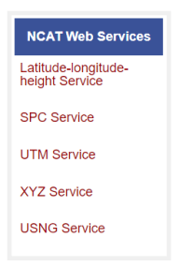
Preparing
Transforming your data
NCAT - NGS Coordinate Conversion and Transformation Tool
ASCII up/download, Web Services, Download, GitHub
ask your software provider(s) about integration
we envision COTS integrations as most popular method of access
Industry Workshops - May 2021 and August 2022
Esri, Trimble, Blue Marble, etc… all the well known names attended
Geospatial Software Developers’ Summit – Nov/Dec
International & Virtual → US NGS and NRCan CGS
Notes:
Transforming your data
NCAT - NGS Coordinate Conversion and Transformation Tool
available now: ASCII upload and Web Services
ask your software providers about integration
we envision this as most popular method of access
Industry Workshop held this year – esri, trimble, bluemarble, all the major well known names were represented
labeling a year for each dataset?
something in-between that works for your needs

Slide 53
Remember…
What’s the goal of NAPGD2022?
Give you the stability in positions that you expect
That’s the point of 20 cm threshold level
Long timeframe before new geoid definition
OPUS will be the official access to the datum
GNSS + geoid
Notes:
What’s the goal of the way NATRF2022 was designed, by including EPP2022 and IFVM2022
Does a database of manholes in PA need cm-level coordinate updates on an annual basis? Probably not.

Slide 54
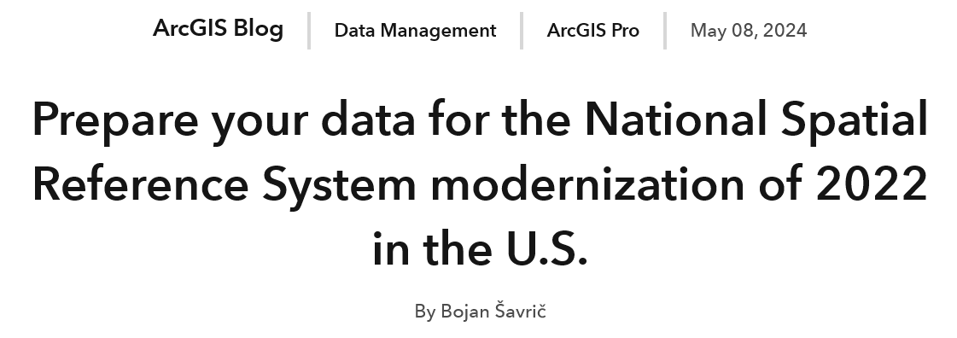
Esri’s Plan
“In the past, we have made preliminary definitions available in our software based on customer requests. Unfortunately, this impacted compatibility between releases due to changes in the final definitions. Note that we will not be adding any preliminary NSRS 2022 definitions in ArcGIS software until the official release in 2026.”
https://www.esri.com/arcgis-blog/products/arcgis-pro/data-management/prepare-your-data-for-the-nsrs-2022/

Slide 55
NAPGD2022
Geopotential
gravity based
no leveling used to define it (none!)
GNSS is your access
collect data & submit it to OPUS
no leveling necessary
Global Mean Sea Level (GMSL) based
geoid change when sea level threshold crossed

Slide 56
NSRS Modernization Rollout
Multiple phases of products:
DEV – internal to NGS
Alpha – open to all; targeted at developers
Beta – open to all; intended for any
Production
This is the end result, the published products

Slide 57
Additional Resources

Slide 58
Educational Videos
<5 minutes
Online Lesson
(via MetEd/COMET)
~1 hour
NGS homepage: geodesy.noaa.gov
Notes:
Educational videos and online tutorials –
Our library of lessons and videos are great resources, and will reinforce a lot of information we covered today.
The videos are just 3-5 minutes long.
the lesson is a deeper dive but still only takes an hour.

Slide 59
Email Subscriptions
*Only 1-2 messages per month*
NGS News
Includes quarterly NSRS Modernization newsletter
Webinar Series
Training
GPS on Benchmarks
Click this icon on homepage

Slide 60
Jeff Jalbrzikowski, P.S., GISP, CFS
Appalachian Regional Geodetic Advisor
jeff.jalbrzikowski@noaa.gov
240-988-5486
https://www.ngs.noaa.gov/ADVISORS/
or search: “NGS advisors”
Scan the QR code to save my contact info to your phone

