Slide 1

Updates on NSRS Modernization
Dru Smith
NSRS Modernization Manager
NOAA’s National Geodetic Survey

Slide 2
Outline
Refresher on NSRS Modernization
Recent progress
Timeline

Slide 3
Refresher on NSRS Modernization

Slide 4
The National Spatial Reference System
The NSRS
Official coordinate system for the USA
Defined by the (USA) National Geodetic Survey
Required to be used by all (USA) Federal Government agencies
Often used by many (USA) state and local government agencies or private surveyors

Slide 5
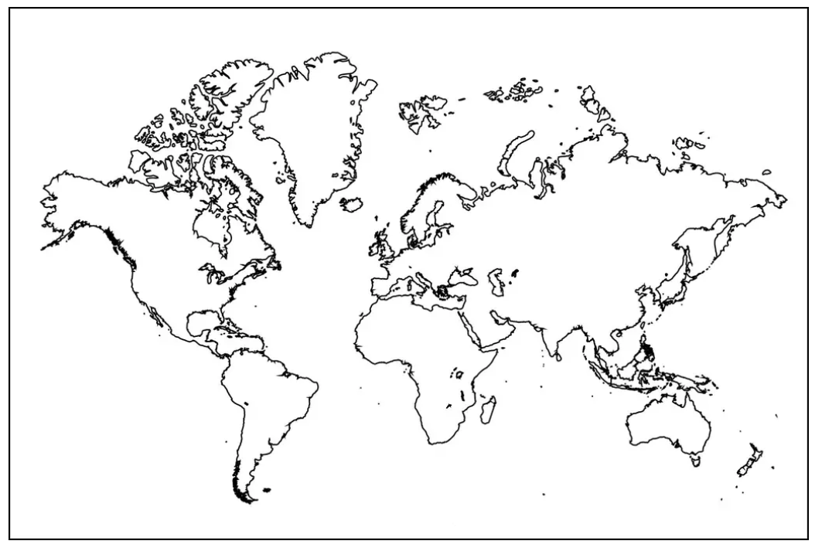
Extent of the current NSRS
Frames: Truly global but used regionally
Geoid/Vertical: Regional
Conterminous US (CONUS; “Lower 48”)
Alaska
Hawaii
Territories: Puerto Rico, U.S. Virgin Islands, American Samoa, Guam, CNMI

Slide 6
NSRS Modernization in (very) brief
NATRF2022
NAD 83(2011)
NAD 83(PA11)
PATRF2022
Hybrid geoids
GEOID2022
NAD 83(MA11)
CATRF2022
MATRF2022
NAVD 88
ASVD 02
PRVD 02
NAPGD2022
Bluebooking
FORTRAN
Disparate tools
Outdated manuals
GDX / OPUS
Modern coding
Integrated tools
Updated manuals
NMVD 03
GUVD 04
VIVD 09

Slide 7
Recent Progress

Slide 8
Recent Accomplishments/Deliverables
Airborne gravity campaign: DONE
After 16 years, the GRAV-D flights are 100% done!!
Final gravity set to the geoid team in February
OPUS-Projects updated
Version 5.1: Bluebooking done for you, loads to the NGS IDB
New Least-squares adjustment software: DONE
LASER version 2.3.0
Support for 3-D geometric (GNSS + classical), orthometric, horizontal gravimetric, vertical gravimetric and CBL

Slide 9
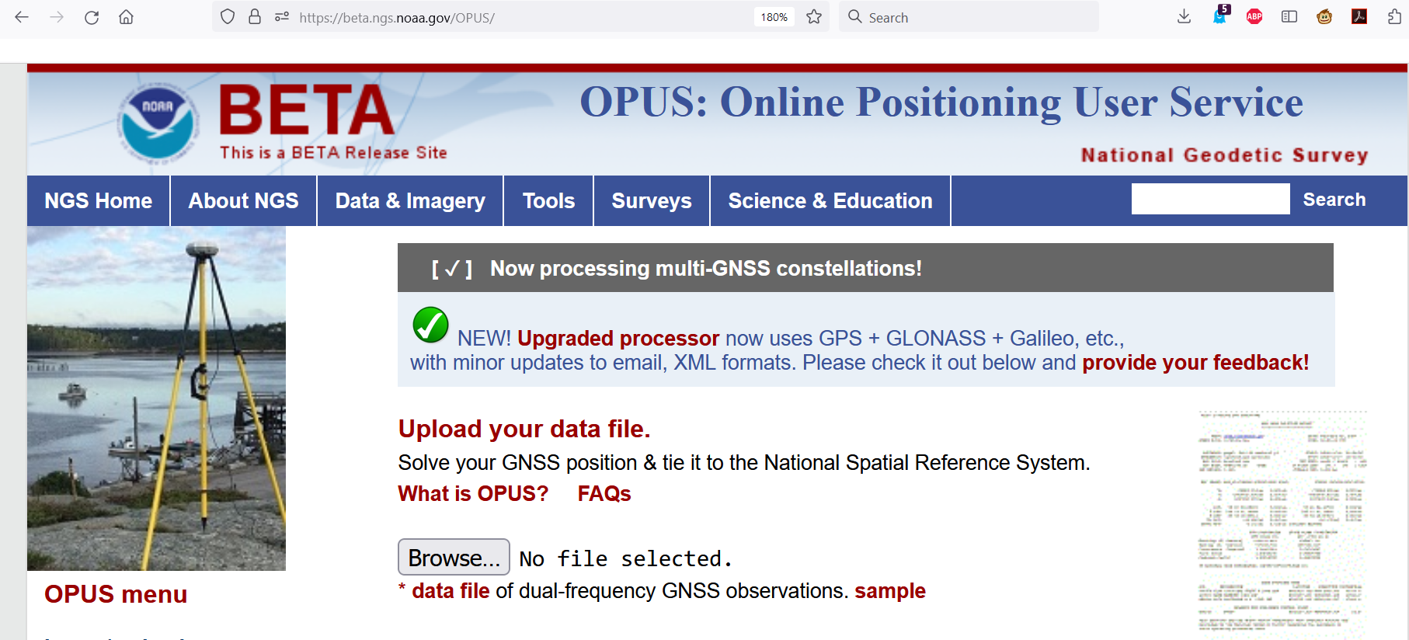
GPS/GLONASS/Galileo/Beidou/ETC
New M-PAGES software exists
Can be accessed through a BETA release of OPUS-S
beta.ngs.noaa.gov/OPUS

Slide 10
LSA Adjustment Methodology Documented
The Multi-Epoch Least-Squares Adjustment Problem: Models Relating Estimable Parameters at a Single Epoch to Geodetic Observations, Stochastic Constraints and Fixed Constraints at Multiple Epochs Volume I: The Projection Method
See NGS Library (https://geodesy.noaa.gov/library/):
NOAA TR NOS NGS 79
NOAA TR NOS NGS 80
NOAA TM NOS NGS 95
NOAA TM NOS NGS 96
Codifies the mathematics of national adjustments (RECs) and OPUS adjustments

Slide 11
Alpha site launched
alpha.ngs.noaa.gov
First product: SPCS2022
More products coming soon
Not everything will go on Alpha
“Incomplete, early, possibly incorrect”

Slide 12
Data Delivery System
New “datasheets” for Marks and Stations have been designed with a common look and feel

Slide 13
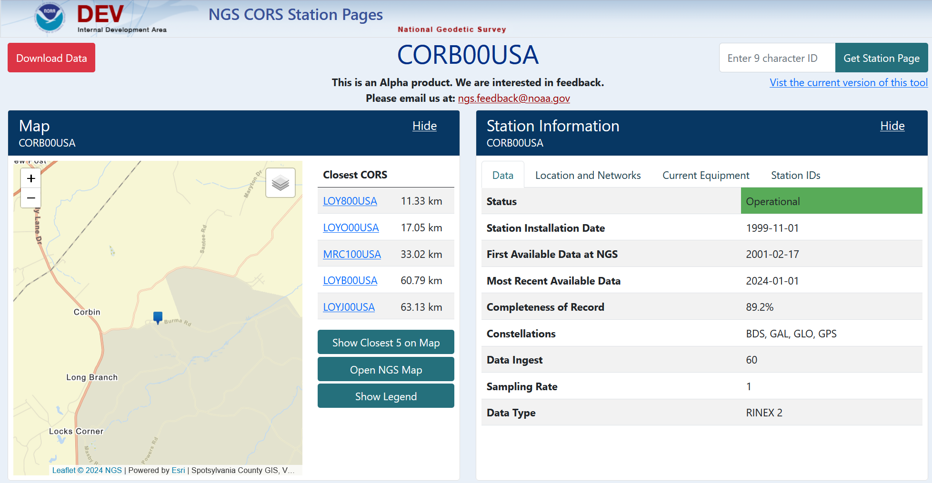
A new CORS “datasheet”

Slide 14
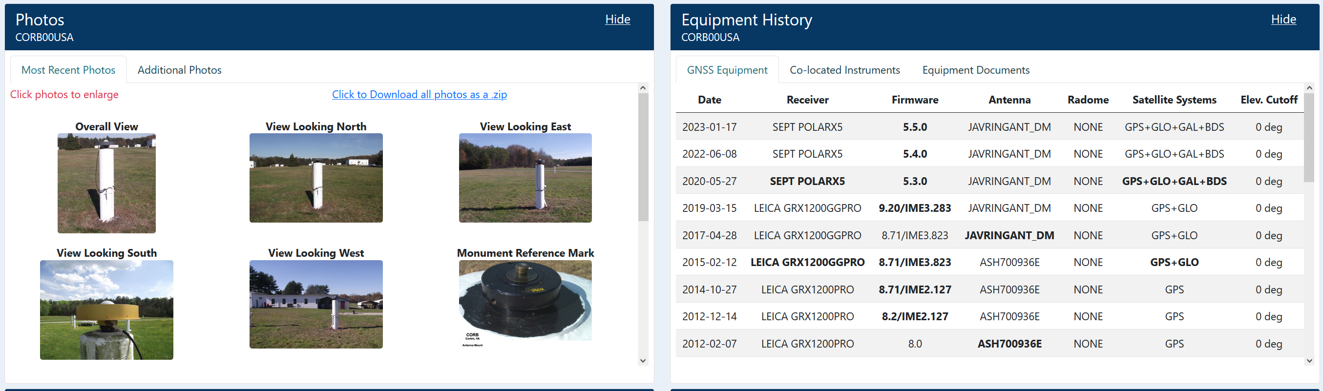
A new CORS “datasheet”

Slide 15
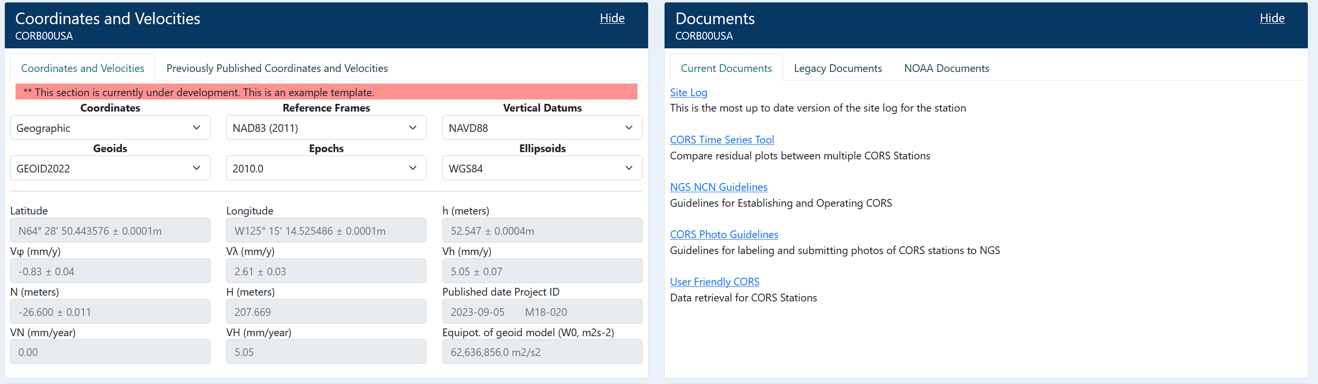
A new CORS “datasheet”

Slide 16
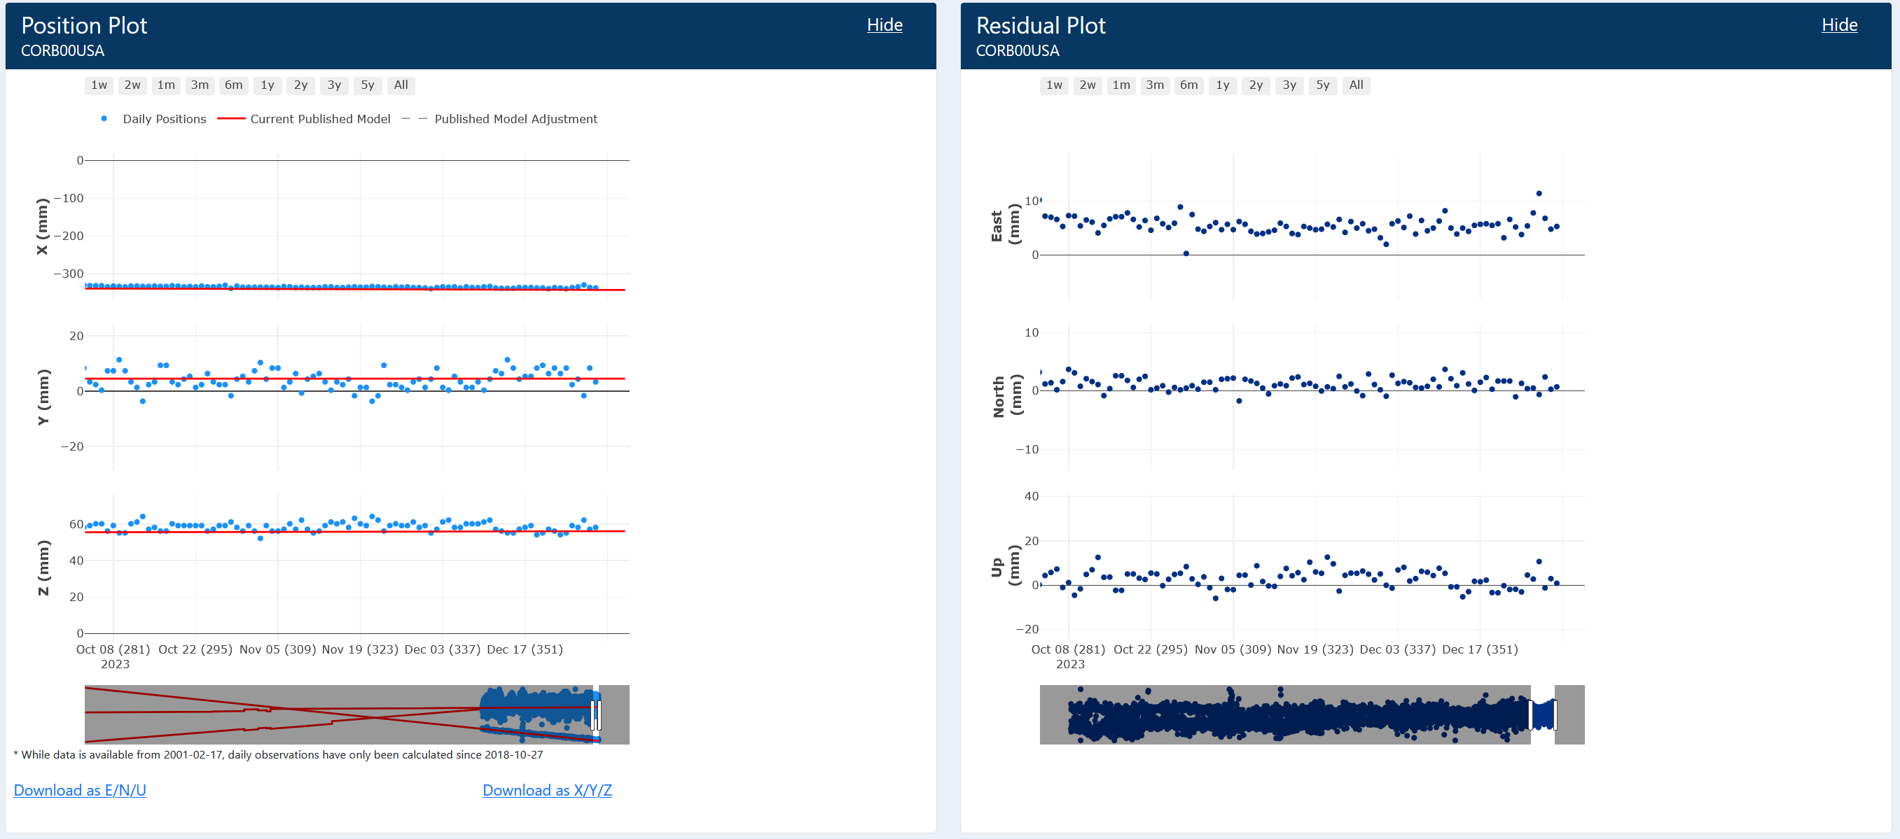
A new CORS “datasheet”

Slide 17
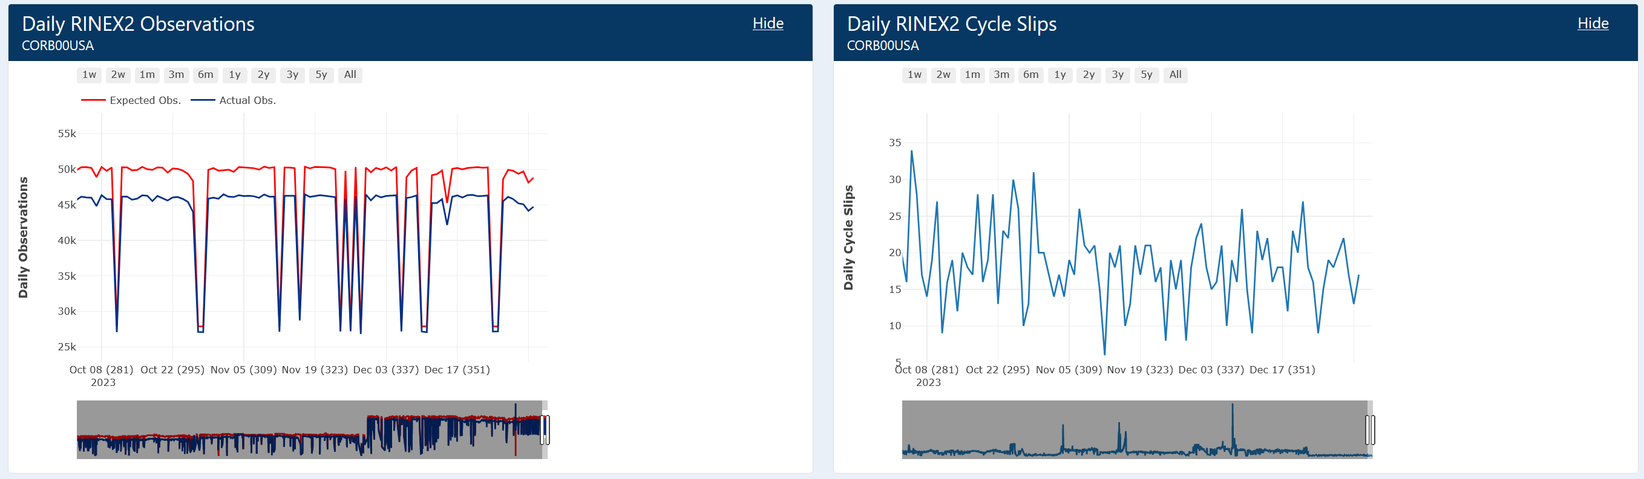
A new CORS “datasheet”

Slide 18
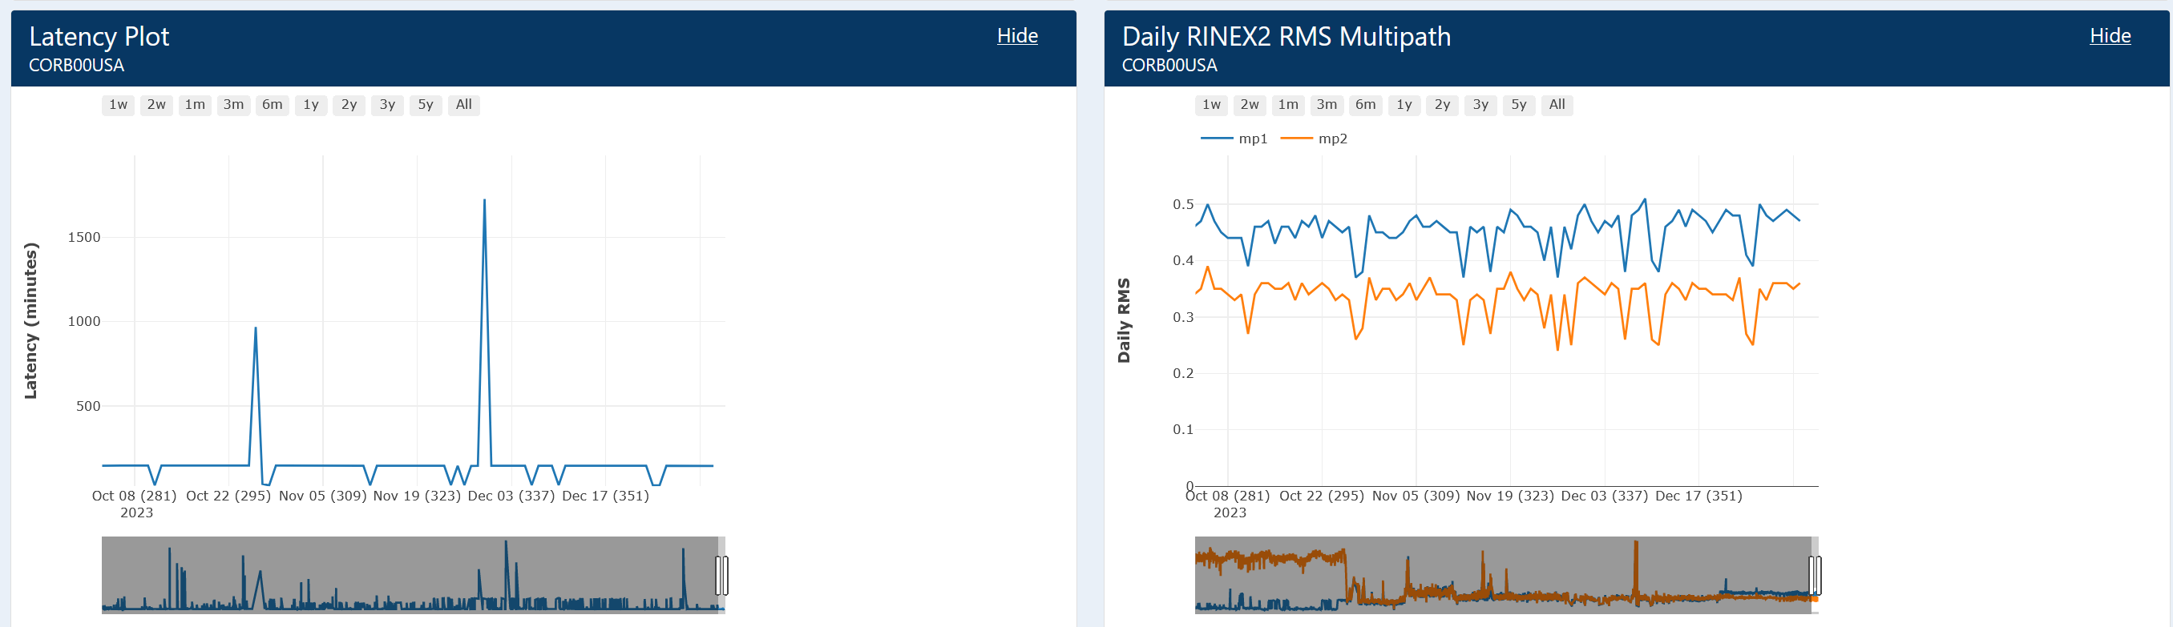
A new CORS “datasheet”

Slide 19
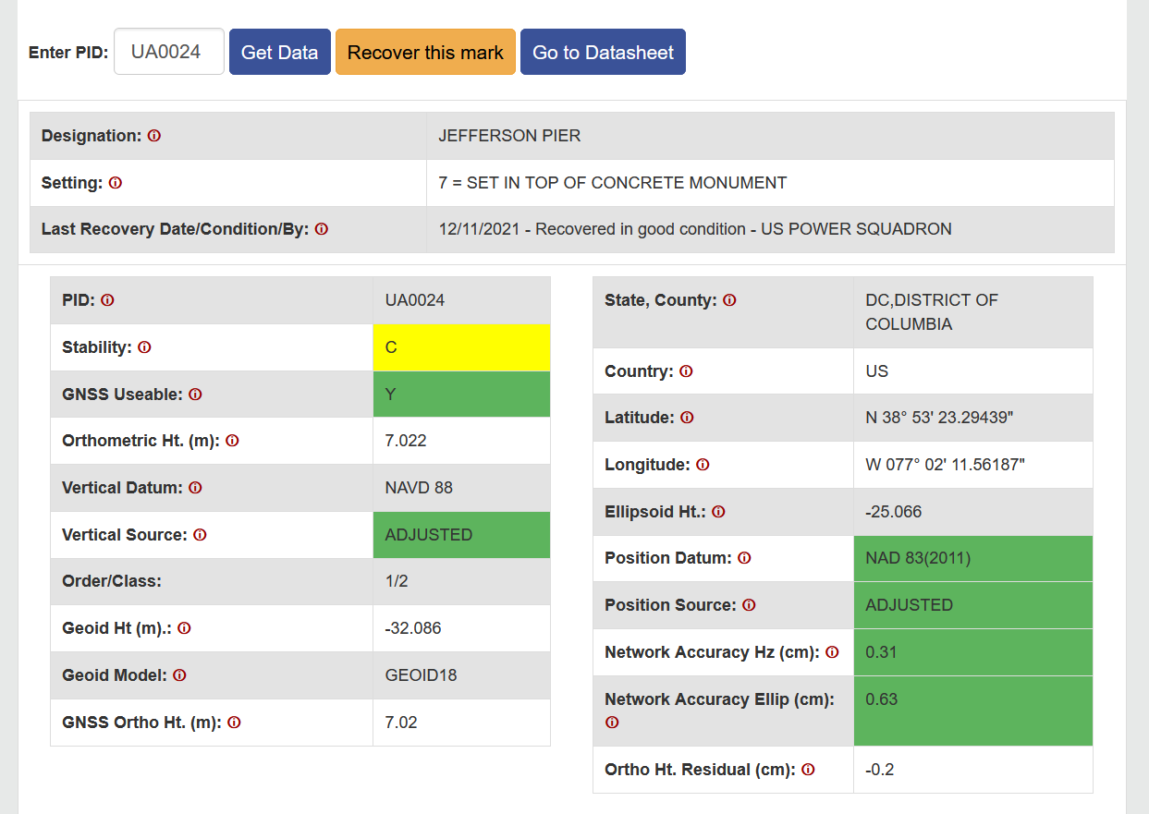
A new passive mark “datasheet”
This is actually our current “passive mark page”, running off of the current database and current NSRS.
The new datasheet will look similar, but have certain modifications which are specific to the new database and modernized NSRS, and which aligns the look and feel with the new CORS datasheet, shown earlier.

Slide 20
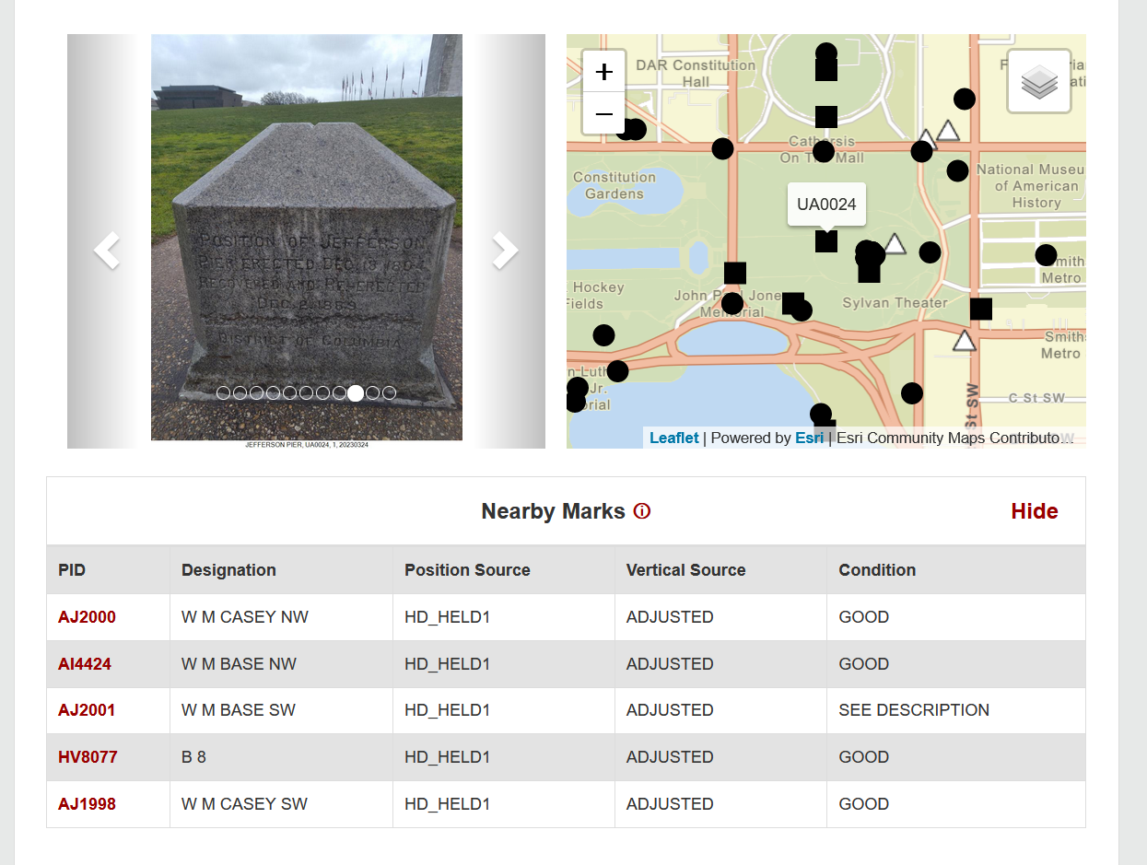
A new passive mark “datasheet”

Slide 21
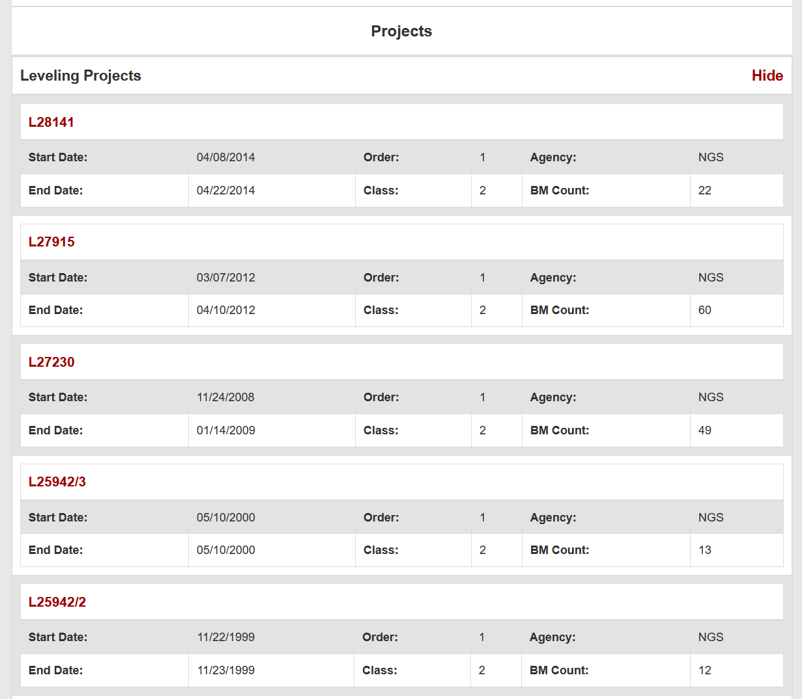
A new passive mark “datasheet”

Slide 22
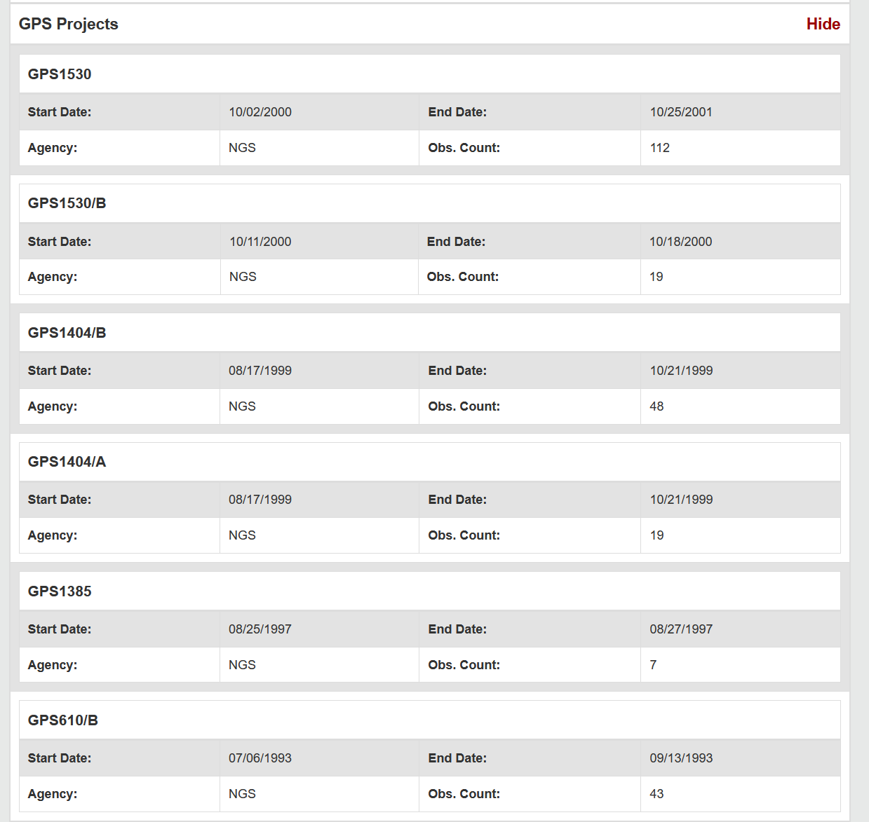
A new passive mark “datasheet”

Slide 23
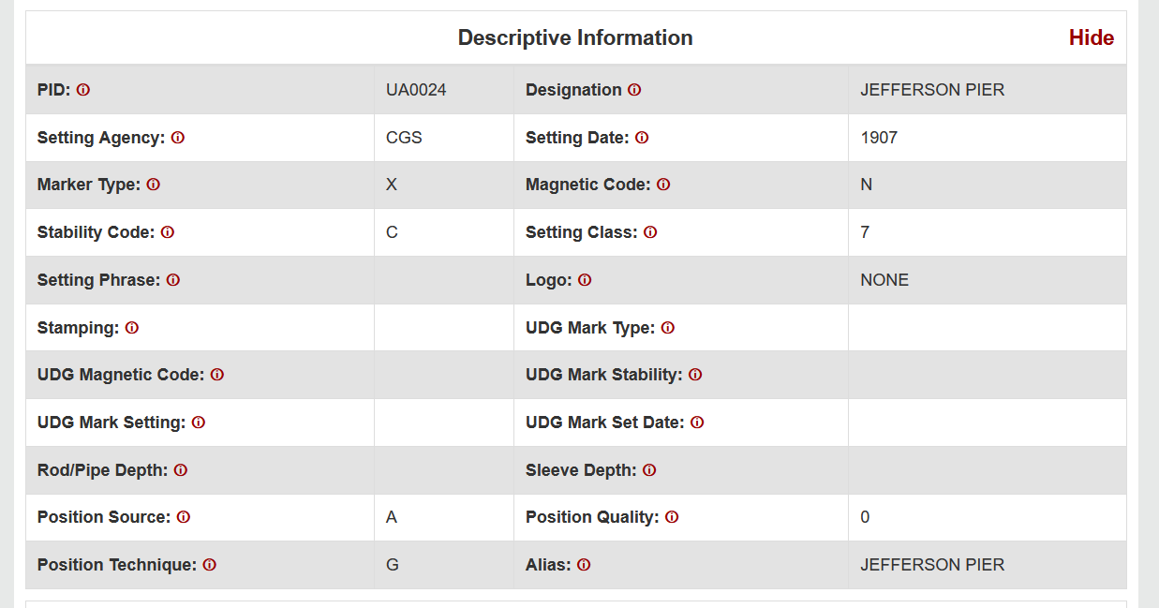
A new passive mark “datasheet”

Slide 24
Reference Epoch Coordinates (RECs)
The Geometric and Orthometric REC projects are underway!
Geometric:
N/P/C/MATRF2022 epoch 2020.00 XYZ coordinates
About 120,000 passive marks
Orthometric
NAPGD2022 epoch 2020.00 orthometric heights
About 950,000 passive marks
Final data pull: April 2024
Expected early results: Late 2024

Slide 25
SPROCCET: Replacing HTDP
Software for PRojecting Observations, Constraints and Cofactor matrices/Errors through Time
Replaces HTDP
Expands functionality:
Geometric and orthometric
Error propagation through time
Modularization
Earthquake error displacement estimates
Bug fixes
Will be built into OPUS and all REC adjustments
Expected completion: Autumn 2024

Slide 26
Timeline

Slide 27
Timeline
In 2022, NGS diverted resources from tool-building to data assurance
“Limited tools, excellent coordinates”
Set a goal of roll-out by 2025
NGS is on-track to roll out the modernized NSRS by the middle of 2025.
Work on additional tools will continue in the out-years

Slide 28
Thank you!

Slide 29
Questions?

Slide 30
Extra Slides

Slide 31
NSRS Modernization in (very) brief – Why?
The current NSRS was:
Defined in the pre-GPS era
Without GPS, the Earth’s center (frame origin) was very hard to detect
Defined without aid of gravity-mission satellites
Leveling, terrestrial gravity, disconnected from the geometric frame
Defined right after punch-cards went away
Tools relied upon 80-character ASCII files and FORTRAN
Defined without a long-term strategy to acknowledge Earth’s dynamics
In short, the current NSRS has failed to keep up with emerging needs
Sea level rise, floodplain mapping, coastal geohazards

Slide 32
The path to full roll-out
The next few slides show key elements, and their roll-out order, though with a purposefully vague timeline to allow some flexibility
To aid in readability, some details are omitted, but can be inferred, such as:
All data will be loaded in the NSRS database
A data delivery system will exist
All tools will be incorporated into NCAT

Slide 33
The path to full roll-out: Frames
NCN
w/ ITRF2020
EPP2022
SPCS2022
2023
2024
2025
IFDM2022

Slide 34
The path to full roll-out: Geopotential
GRAV-D
Complete
(including
re-flights)
DEFLEC2022 Alpha
GM2022
DEFLEC2022
2023
2024
2025
GEOID2022 Alpha
GEOID2022

Slide 35
The path to full roll-out: OPUS
OPUS-Projects
w/ M-PAGES
OPUS-Projects
w/ LASER and
new adjustment
procedures
OPUS-S
w/ M-PAGES
OPUS-S
w/ ITRF2020
OPUS-Projects
w/ ITRF2020
OPUS-S
w/ EPP2022
Initial GDX
release
2023
LASER
completed
2024
2025
OPUS-S
w/ Simultaneous
Processing
OPUS-S
w/ replacement
for HTDP
OPUS-Projects
w/ replacement
for HTDP
OPUS-Projects
w/ IFDM2022
(not HTDP)

Slide 36
The path to full roll-out: Passive control
NCN
w/ ITRF2020
DEFLEC2022 Alpha
EPP2022
DEFLEC2022
Geometric RECs
SPCS2022
NADCON
VERTCON
LASER
completed
Orthometric RECs
2023
2024
2025
IFDM2022
GEOID2022

