Slide 1
2024 Nebraska DOT Survey Coordinators Meeting
October 30, 2024
Dave Zenk
NGS Regional Advisor
MN, ND, SD, NE, IA
Notes:
2024 Nebraska DOT Survey Coordinators Meeting
October 30, 2024
By Dave Zenk
NGS Regional Advisor
MN, ND, SD, NE, IA

Slide 2
Topics Today
What datums will the Modernized NSRS replace?
How will the SPCS2022 affect day-to-day survey practices?
What accuracy & precision should we expect to see in Horizontal and Vertical?
Notes:
Topics Today
What datums will the Modernized NSRS replace?
How will the SPCS2022 will affect day-to-day survey practices?
What accuracy & precision should we expect to see in Horizontal and Vertical?

Slide 3
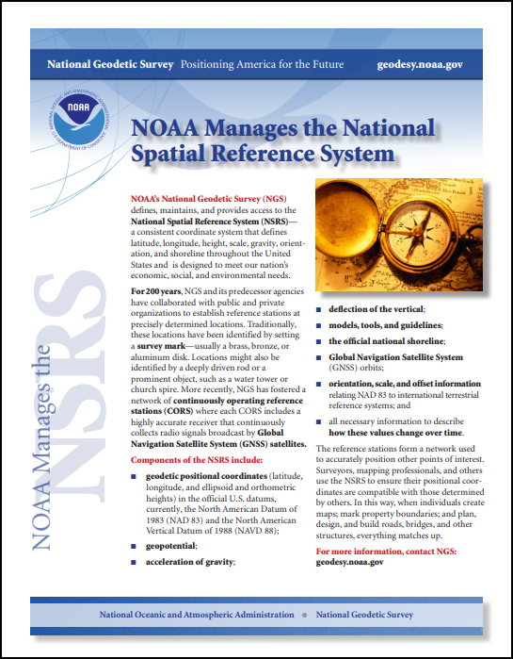
NSRS Background
The National Spatial Reference System (NSRS) consists of the nation’s latitude, longitude, height, scale, gravity, orientation, and how these values change over time.
https://geodesy.noaa.gov/INFO/OnePagers/NSRSOnePager.pdf
Notes:
The National Spatial Reference System (NSRS) consists of the nation’s latitude, longitude, height, scale, gravity, orientation, and how these values change over time.

Slide 4
Needed Research and Development
Major decisions needed to be made regarding how to define and maintain the Modernized NSRS.
These are documented. See the following reports:
  NOAA Technical Report NOS NGS 62
    Blueprint for 2022, Part 1: Geometric Coordinates (61 pages)
  NOAA Technical Report NOS NGS 64
    Blueprint for 2022, Part 2: Geopotential Coordinates (53 pages)
  NOAA Technical Report NOS NGS 67
    Blueprint for 2022, Part 3: Working in the Modernized NSRS (133 pages)
✓
https://geodesy.noaa.gov/library/
Note:
✓ = done
Notes:
Major decisions needed to be made regarding how to define and maintain the Modernized NSRS.
These are documented. See the following reports:
NOAA Technical Report NOS NGS 62
Blueprint for 2022, Part 1: Geometric Coordinates (61 pages)
NOAA Technical Report NOS NGS 64
Blueprint for 2022, Part 2: Geopotential Coordinates (53 pages)
NOAA Technical Report NOS NGS 67
Blueprint for 2022, Part 3: Working in the Modernized NSRS (133 pages)
Note that the checkmark means “done”.

Slide 5

Euler Pole Parameters (EPP)
Continental Plates must rotate around a point because of the curvature of the Earth – called a Euler Pole.
North America appears to rotate around a point off the coast of Peru at a rate of about 2 cm/year.
Note the stationary Lat/Lon grid.
about 2 cm/year
Euler Pole
Notes:
Euler Pole Parameters (EPP)
Continental Plates must rotate around a point because of the curvature of the Earth – called a Euler Pole.
North America appears to rotate around a point off the coast of Peru at a rate of about 2 cm/year.
Note the stationary Lat/Lon grid.

Slide 6
Inconvenient in Practice
Rotation means that the Lat/Lon, when expressed in ITRF, will constantly change.
  That would be inconvenient and confusing in actual day-to-day usage.
NGS has adopted 4 plate-fixed reference frames – one for each plate which has American territories.
  Result: Lat/Lon remains nearly constant except for local movements.
Notes:
Inconvenient in Practice
Rotation means that the Lat/Lon, when expressed in ITRF, will constantly change.
That would be inconvenient and confusing in actual day-to-day usage.
NGS has adopted 4 plate-fixed reference frames – one for each plate which has American territories.
Result: Lat/Lon remains nearly constant except for local movements.

Slide 7
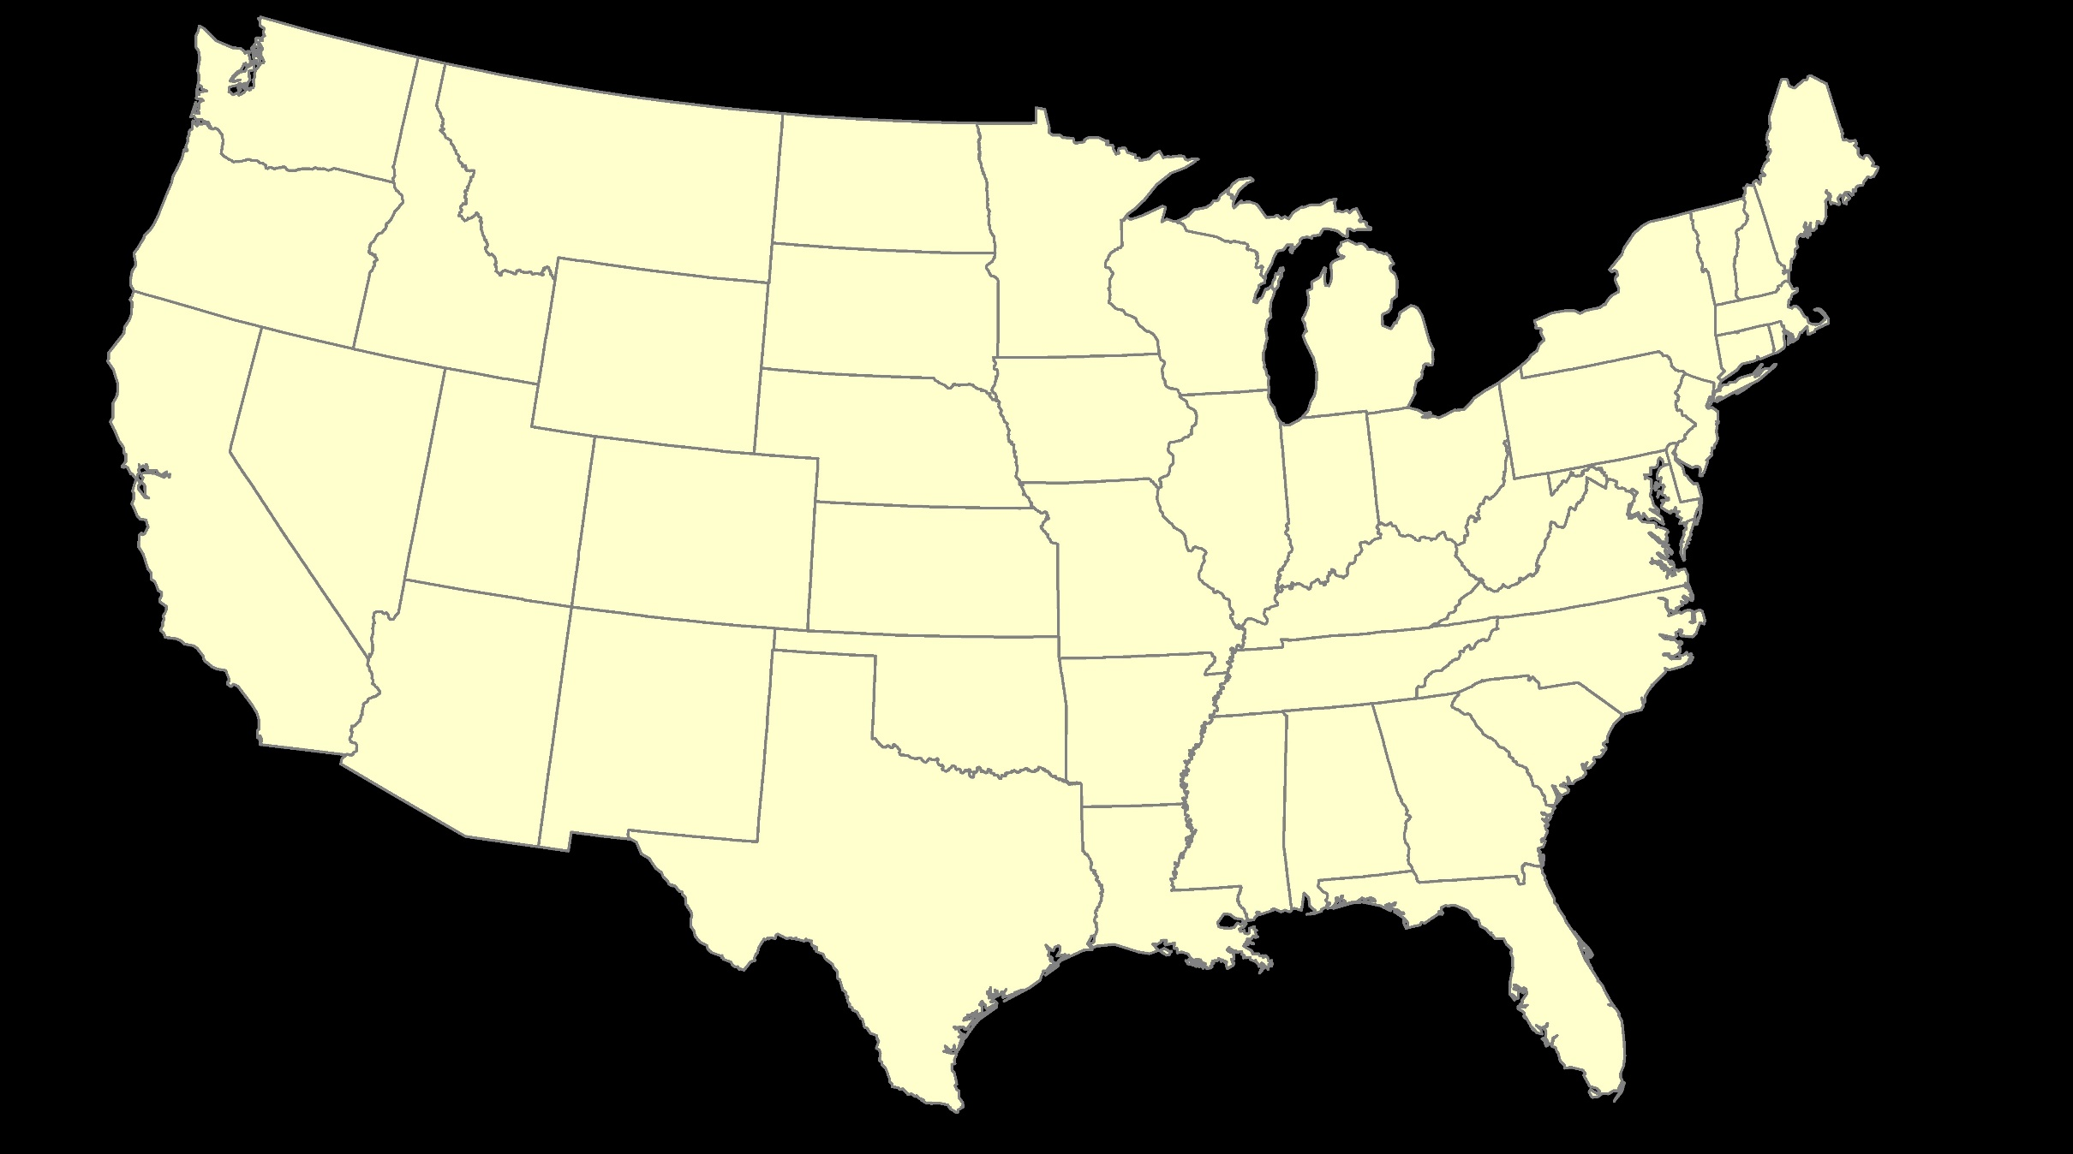
ITRF – constant frame, rotating plate
Notes:
ITRF – constant frame, rotating plate
Note here that the ITRF frame remains fixed, while North America rotates beneath it.
Result is constantly changing coordinates.

Slide 8
NATRF – rotating frame, constant with plate
Notes:
NATRF – rotating frame, constant with plate
Note here that the NATRF frame rotates with North America.
Result is relatively unchanging coordinates, except for small regional/local motions.

Slide 9
ITRF or NATRF – your choice, just use EPP
Notes:
ITRF or NATRF – your choice, just use EPP
NGS has developed a model that will convert ITRF to NATRF based on known rotation velocities and dates.
Enables conversions over time.

Slide 10
Datums to Replace
North American Terrestrial Reference Frame
What are the new datums?
  NATRF2022 – North American Plate (most of USA)
  CATRF2022 – Caribbean Plate
  MATRF2022 – Marianna Plate
  PATRF2022 – Pacific Plate
All are directly related to International Terrestrial Reference Frame (ITRF) by simple angular rotations over a time period.
  Euler Pole Parameters (EPP)
Notes:
Datums to Replace
What are the new datums?
NATRF2022 – North American Plate (most of USA), the North American Terrestrial Reference Frame
CATRF2022 – Caribbean Plate
MATRF2022 – Marianna Plate
PATRF2022 – Pacific Plate
All are directly related to International Terrestrial Reference Frame (ITRF) by simple angular rotations over a time period.
Euler Pole Parameters (EPP)

Slide 11
NSRS Background
Background: Why is NGS replacing NAD 83 and NAVD 88?
NAD 83 and NAVD 88, although still the official horizontal and vertical datums of the National Spatial Reference System (NSRS), have been identified as having shortcomings that are best addressed through defining new horizontal and vertical datums. See the white paper from April 2010:
  Improving the National Spatial Reference System (12 pages)
  https://geodesy.noaa.gov/2010Summit/Improving_the_NSRS.pdf
Specifically:
NAD 83 is non-geocentric by about 2.2 meters.
NAVD 88 is both biased (by about one-half meter) and tilted (by about 1 meter coast to coast) relative to the best global geoid models available today.
These issues derive from the fact that both datums were defined primarily using terrestrial surveying techniques at passive geodetic survey marks.
This network of survey marks deteriorates over time through unchecked physical movement and destruction, and resources are not available to maintain them.
Notes:
The NGS is replacing NAD 83 and NAVD 88
because they have shortcomings that are best addressed through defining new horizontal and vertical datums.
See the white paper from April 2010:
Improving the National Spatial Reference System (12 pages)
https://geodesy.noaa.gov/2010Summit/Improving_the_NSRS.pdf
Specifically:
NAD 83 is non-geocentric by about 2.2 meters.
NAVD 88 is both biased (by about one-half meter) and tilted (by about 1 meter coast to coast) relative to the best global geoid models available today.
These issues derive from the fact that both datums were defined primarily using terrestrial surveying techniques at passive geodetic survey marks.
This network of survey marks deteriorates over time through unchecked physical movement and destruction, and resources are not available to maintain them.

Slide 12
Coordinate Shifts
It is expected that all 3 components of position (Lat/Lon/Ellht) will be different in the NATRF2022 datum.
The Orthometric height will also be different in the NAPGD2022 datum.
The NGS “New Datums” page has some diagrams for the expected differences (next 3 slides).
North American Pacific Geopotential Datum
Notes:
It is expected that all 3 components of position (Lat/Lon/Ellht) will be different in the NATRF2022 datum.
The Orthometric height will also be different in the NAPGD2022 datum, the North American Pacific Geopotential Datum.
The NGS “New Datums” page has some diagrams for the expected differences (next 3 slides).

Slide 13
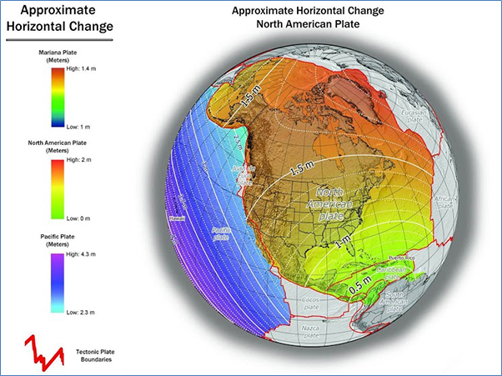
Coordinate Shifts
North American Terrestrial Reference Frame
Ames IA
about 1.25 meters
Notes:
The approximate Horizontal Change varies, in Ames IA it will be about 1.25 meters

Slide 14
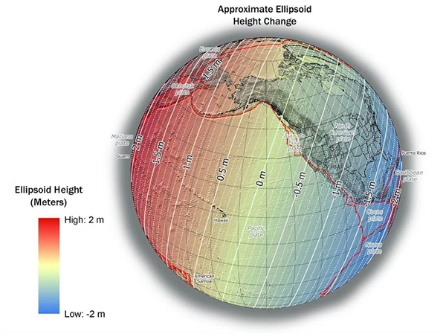
Coordinate Shifts
North American Terrestrial Reference Frame
Ames IA
about -1.0 meters
Notes:
The approximate Ellipsoid Height Change varies, in Ames IA it will be about -1.0 meters

Slide 15
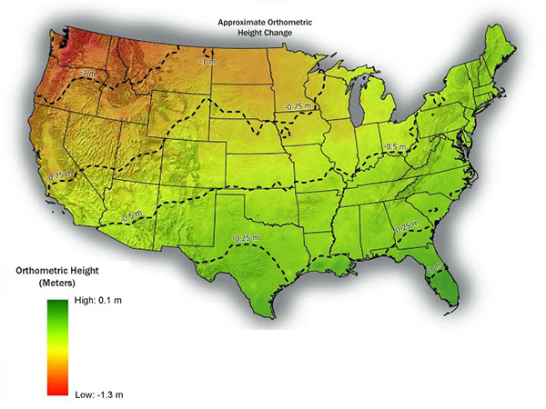
Coordinate Shifts
North American Pacific Geopotential Datum
Ames IA
about -0.75 meters
Notes:
The approximate Orthometric Height change varies, in Ames IA it will be about -0.75 meters

Slide 16
Coordinate Shift
The OPUS Static solution contains a preview of the future coordinates. Example: Ames IA
REF FRAME: NAD_83(2011)(EPOCH:2010.0000) ITRF2014 (EPOCH:2023.7484)
X: -294704.762(m) 0.006(m) -294705.729(m) 0.006(m)
Y: -4737326.292(m) 0.009(m) -4737324.953(m) 0.009(m)
Z: 4246573.802(m) 0.003(m) 4246573.704(m) 0.003(m)
LAT: 42 0 34.52731 0.004(m) 42 0 34.55266 0.004(m)
E LON: 266 26 24.96815 0.006(m) 266 26 24.92261 0.006(m)
W LON: 93 33 35.03185 0.006(m) 93 33 35.07739 0.006(m)
EL HGT: 266.500(m) 0.008(m) 265.486(m) 0.008(m)
ORTHO HGT: 296.411(m) 0.045(m)
[NAVD88 (Computed using GEOID18)]
APPROX ORTHO HGT: 295.660(m) [PROTOTYPE (Computed using xGeoid19B,GRS80,ITRF2014)]
Diff LAT = 0.75 meters northerly
Diff LON = 1.04 meters westerly
Diff Ellht = - 1.014 meters
Diff Ortho = - 0.751 meters
Notes:
The OPUS Static solution contains the NAD83(2011) position and an ITRF2014 position - a preview of the future coordinates.
Example: Ames IA
By submitting a data file to OPUS Static, you can obtain a similar solution for your local area.

Slide 17
NATRF2022 = ITRF @2020.00
SEC = Survey Epoch Coordinates
  SEC will represent the best attempts by NGS to provide coordinates on individual points at the actual epoch of data collection. Their usefulness will be mostly to those who need to know if a mark is moving.
REC = Reference Epoch Coordinates
IFDM = Intra-Frame Deformation Model
NOAA Technical Report NOS NGS 62
Blueprint for the Modernized NSRS, Part 1: Geometric Coordinates and Terrestrial Reference Frames
https://geodesy.noaa.gov/library/pdfs/NOAA_TR_NOS_NGS_0062.pdf
Notes:
NATRF2022 = ITRF @2020.00
SEC = Survey Epoch Coordinates
SEC will represent the best attempts by NGS to provide coordinates on individual points at the actual epoch of data collection. Their usefulness will be mostly to those who need to know if a mark is moving.
REC = Reference Epoch Coordinates
IFDM = Intra-Frame Deformation Model
See
NOAA Technical Report NOS NGS 62
Blueprint for the Modernized NSRS, Part 1: Geometric Coordinates and Terrestrial Reference Frames
https://geodesy.noaa.gov/library/pdfs/NOAA_TR_NOS_NGS_0062.pdf

Slide 18
NATRF2022 = ITRF @2020.00
SEC = Survey Epoch Coordinates
REC = Reference Epoch Coordinates
  REC coordinates are computed by NGS based on submitted geodetic quality observations on marks. They will be associated with a specific reference epoch which will occur either every five or every ten years, starting with 2020.00, independent of what type of observations are being used. The IFDM Model will be used.
IFDM = Intra-Frame Deformation Model
Notes:
NATRF2022 = ITRF@2020.00
REC = Reference Epoch Coordinates
REC coordinates are computed by NGS based on submitted geodetic quality observations on marks. They will be associated with a specific reference epoch which will occur either every five or every ten years, starting with 2020.00, independent of what type of observations are being used. The IFDM Model will be used.
See
NOAA Technical Report NOS NGS 62
Blueprint for the Modernized NSRS, Part 1: Geometric Coordinates and Terrestrial Reference Frames
https://geodesy.noaa.gov/library/pdfs/NOAA_TR_NOS_NGS_0062.pdf

Slide 19
NATRF2022 = ITRF @2020.00
SEC = Survey Epoch Coordinates
REC = Reference Epoch Coordinates
IFDM = Intra-Frame Deformation Model
  IFDM will model the horizontal and vertical deformations within (intra) a frame to capture and remove most of the residual motion not removed by the Euler Pole Rotation.
NOAA Technical Report NOS NGS 62
Blueprint for the Modernized NSRS, Part 1: Geometric Coordinates and Terrestrial Reference Frames
https://geodesy.noaa.gov/library/pdfs/NOAA_TR_NOS_NGS_0062.pdf
Notes:
NATRF2022 = ITRF @2020.00
IFDM = Intra-Frame Deformation Model
IFDM will model the horizontal and vertical deformations within (intra) a frame to capture and remove most of the residual motion not removed by the Euler Pole Rotation.
See
NOAA Technical Report NOS NGS 62
Blueprint for the Modernized NSRS, Part 1: Geometric Coordinates and Terrestrial Reference Frames
https://geodesy.noaa.gov/library/pdfs/NOAA_TR_NOS_NGS_0062.pdf

Slide 20
Example
A mark has been in the NGS Database for several years and has several observations on it predating 2020.00 (not shown).
NGS will compute an initial REC at 2020.00 using the historical data (red symbol).
An initial IFDM will also be computed (red line).
Northing (cm)
IFDM
Time
2020.00
2025.00
2030.00
Notes:
Example
A mark has been in the NGS Database for several years and has several observations on it predating 2020.00 (not shown).
NGS will compute an initial REC at 2020.00 using the historical data (red symbol).
An initial IFDM will also be computed (red line).

Slide 21
Example
A series of new observations are made of the mark at intervals.
NGS will compute an SEC at the epoch of each observation (blue symbols).
Northing (cm)
IFDM
Time
2020.00
2025.00
2030.00
Notes:
Example
A series of new observations are made of the mark at intervals.
NGS will compute an SEC at the epoch of each observation (blue symbols).

Slide 22
Example
A series of new observations are made of the mark at intervals.
NGS will compute an SEC at the epoch of each observation (large blue symbols).
Observations will be projected forward and backward to the epoch of the REC using IFDM (small blue symbols).
2023.00
2028.00
2033.00
Northing (cm)
IFDM
Time
2020.00
2025.00
2030.00
Notes:
Example
Observations will be projected forward and backward to the epoch of the REC using IFDM (small blue symbols).

Slide 23
Example
A new REC will be computed at each 5 year(?) epoch – using data 2 years prior and 3 years after (red symbols).
2023.00
2028.00
2033.00
Northing (cm)
IFDM
Time
2020.00
2025.00
2030.00
Notes:
Example
A new REC will be computed at each 5 year(?) epoch – using data 2 years prior and 3 years after (red symbols).

Slide 24
Example
WHAT HAPPENS IF NO NEW DATA ARE SUBMITTED TO NGS?
The future RECs will follow the initial IFDM, not the actual motion, leading to an uncertain future (white symbols).
Eventually in the absence of observations NGS will stop creating future RECs for that mark.
2023.00
2028.00
2033.00
Northing (cm)
?
?
IFDM
Time
2020.00
2025.00
2030.00
Notes:
Example
WHAT HAPPENS IF NO NEW DATA ARE SUBMITTED TO NGS?
The future RECs will follow the initial IFDM, not the actual motion, leading to an uncertain future (white symbols).
Eventually in the absence of observations NGS will stop creating future RECs for that mark.

Slide 25
Height Determinations
North American Pacific Geopotential Datum of 2022 (NAPGD2022).
Users can and should use the H=h-N approach to create and to verify all control benchmarks in the new orthometric height datum:
  Subsidence and ground motion are automatically taken into account.
  No need to run long lines of leveling.
  Leveling should still be used in local surveys between control benchmarks.
Notes:
Height Determinations
North American Pacific Geopotential Datum of 2022 (NAPGD2022).
Users can and should use the H=h-N approach to create and to verify all control benchmarks in the new orthometric height datum:
Subsidence and ground motion are automatically taken into account.
No need to run long lines of leveling.
Leveling should still be used in local surveys between control benchmarks.

Slide 26
Height Determinations
The Orthometric Heights in the NSRS will be determined by using the equation:
  H = h – N
    H = orthometric height (computed)
    h = ellipsoid height (measured by user, GPS)
    N = Geoid Model (supplied by NGS)
NOAA Technical Report NOS NGS 64
Blueprint for the Modernized NSRS, Part 2: Geopotential Coordinates and Geopotential Datum
https://geodesy.noaa.gov/library/pdfs/NOAA_TR_NOS_NGS_0064.pdf
Notes:
Height Determinations
The Orthometric Heights in the NSRS will be determined by using the equation:
H = h – N
H = orthometric height (computed)
h = ellipsoid height (measured by user, GPS)
N = Geoid Model (supplied by NGS)
See:
NOAA Technical Report NOS NGS 64
Blueprint for the Modernized NSRS, Part 2: Geopotential Coordinates and Geopotential Datum
https://geodesy.noaa.gov/library/pdfs/NOAA_TR_NOS_NGS_0064.pdf

Slide 27
Future Maintenance Is Up to You
If no new observations are submitted to NGS, there will be no new coordinates produced and published on datasheets.
This is because their uncertainty will become so large that users cannot trust old, unverified observations.
The user should therefore make periodic re-observations a routine part of their practices.
But, how?
Notes:
Future Maintenance Is Up to You
If no new observations are submitted to NGS, there will be no new coordinates produced and published on datasheets.
This is because their uncertainty will become so large that users cannot trust old, unverified observations.
The user should therefore make periodic re-observations a routine part of their practices.
But, how?

Slide 28
Future Maintenance Is Up to You
Submit your observations using OPUS tools!
OPUS will
  compute an ITRF position for all new observations using the constantly monitored NCN CORS.
  then apply Euler Pole Parameters (EPP) to yield NATRF2022 positions – the SEC for the observation.
The cumulative SECs (and IFDM) will be used by NGS to compute a REC.
Notes:
Future Maintenance Is Up to You
Submit your observations using OPUS tools!
OPUS will
compute an ITRF position for all new observations using the constantly monitored NCN CORS.
then apply Euler Pole Parameters (EPP) to yield NATRF2022 positions – the SEC for the observation.
The cumulative SECs (and IFDM) will be used by NGS to compute a REC.

Slide 29
Future Maintenance Is Up to You
OPUS Projects will be the model for future submissions.
OPUS Projects exists as a web-delivered service.
Data submission by field crews uses current OPUS Static methods.
Training is available for data analysts.
Notes:
Future Maintenance Is Up to You
OPUS Projects will be the model for future submissions.
OPUS Projects exists as a web-delivered service.
Data submission by field crews uses current OPUS Static methods.
Training is available for data analysts.

Slide 30
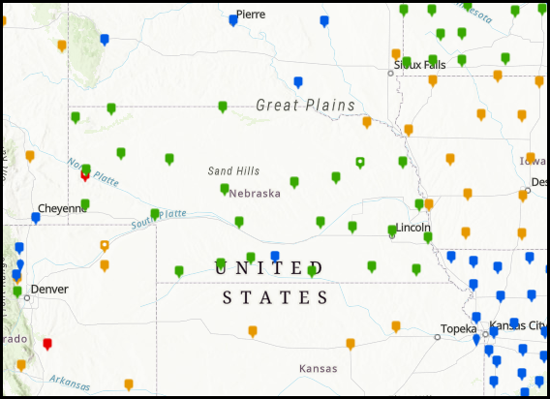
Future Maintenance Is Up to You
Nebraska NCN CORS Map
October 01, 2024
You can see that future SEC and REC coordinates will be tied to the NOAA CORS Network (NCN).
So, it is in the best interest of states to densify their NCN CORS
Notes:
Future Maintenance Is Up to You
You can see that future SEC and REC coordinates will be tied to the NOAA CORS Network (NCN).
So, it is in the best interest of states to densify their NCN CORS

Slide 31
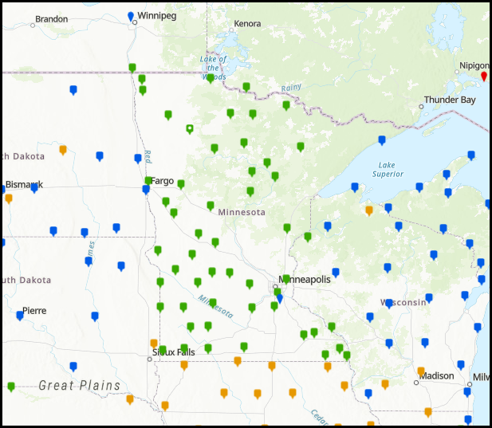
Future Maintenance Is Up to You
Minnesota NCN CORS Map
October 01, 2024
You can see that future SEC and REC coordinates will be tied to the NOAA CORS Network (NCN).
So, it is in the best interest of states to densify their NCN CORS
Notes:
Future Maintenance Is Up to You
You can see that future SEC and REC coordinates will be tied to the NOAA CORS Network (NCN).
So, it is in the best interest of states to densify their NCN CORS

Slide 32
What About Projected Coordinates
The projected cartesian coordinates will be available in several systems.
  State Plane Coordinates
  Low Distortion Projections
  Universal Transverse Mercator
  US National Grid Locator
Notes:
What About Projected Coordinates
The projected cartesian coordinates will be available in several systems.
State Plane Coordinates
Low Distortion Projections
Universal Transverse Mercator
US National Grid Locator

Slide 33
State Plane
SPCS27 and SPCS83 had significant grid-to-ground scale factors.
  A computed distance in SPCS did not closely match the measured distance, unless scale factors were applied correctly.
    Mistakes were common.
    Scale factors were often ignored or mis-applied.
SPCS2022 will reduce scale factors (not eliminate them)
  Careful application of scale factors will still be needed.
Notes:
State Plane
SPCS27 and SPCS83 had significant grid-to-ground scale factors.
A computed distance in SPCS did not closely match the measured distance, unless scale factors were applied correctly.
Mistakes were common.
Scale factors were often ignored or mis-applied.
SPCS2022 will reduce scale factors (not eliminate them)
Careful application of scale factors will still be needed.

Slide 34
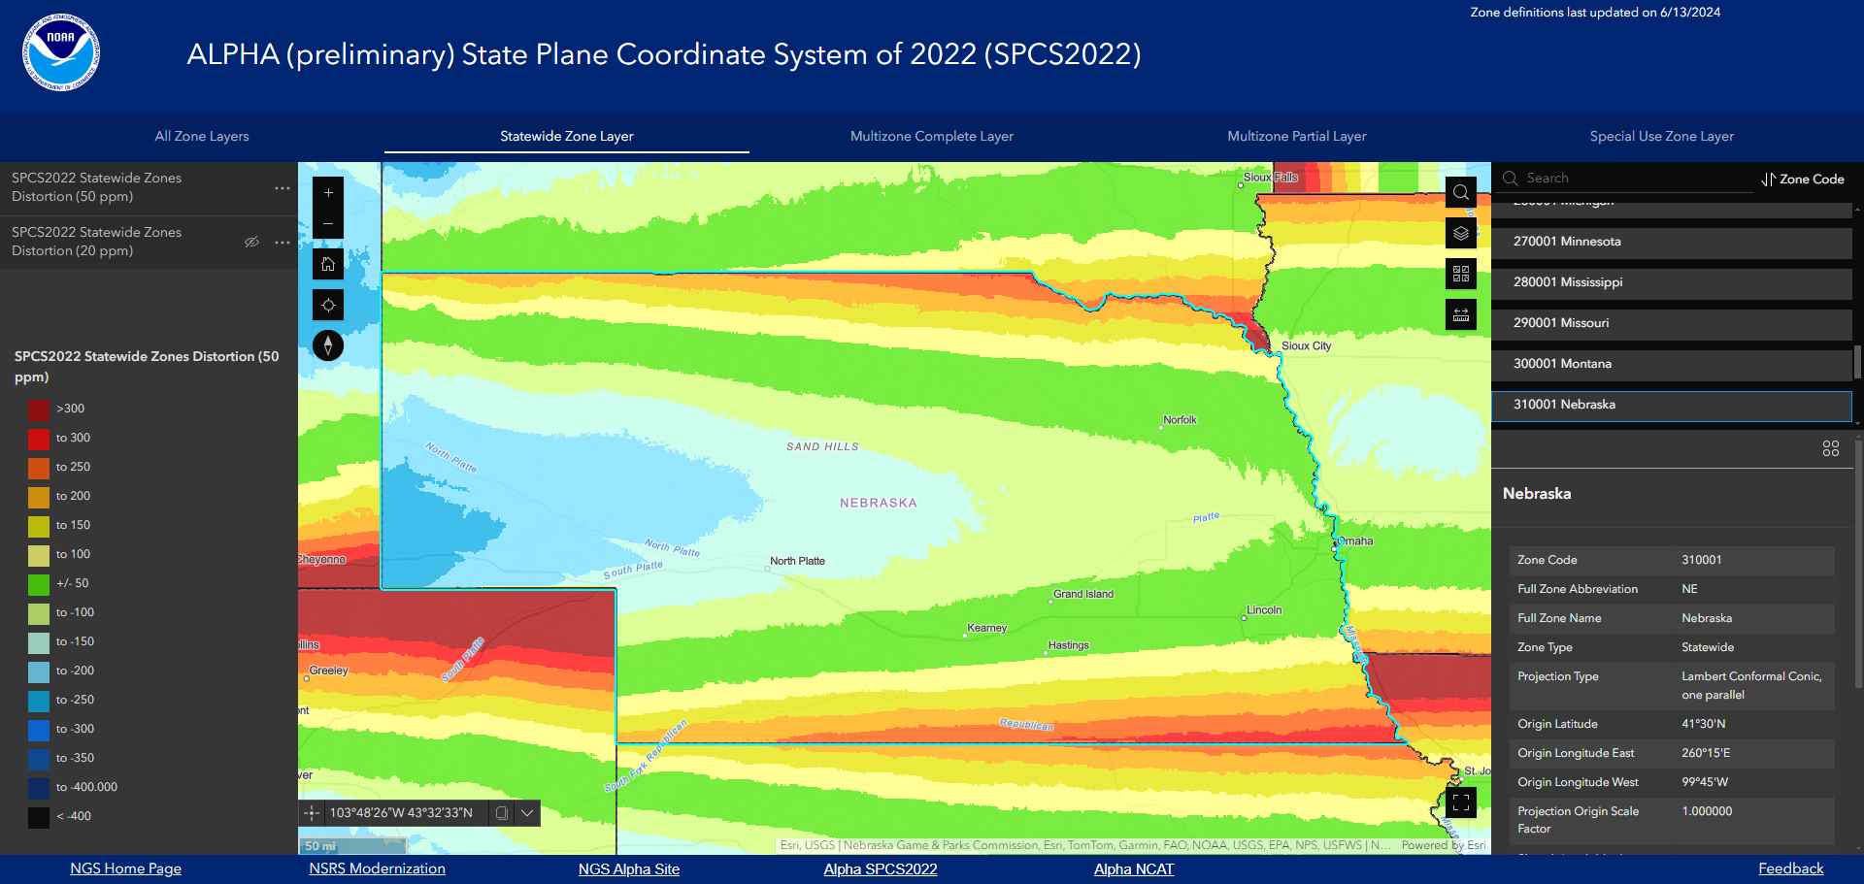
Nebraska State Plane of 2022
Scale factors vary across the state, but less than 50 ppm in highly populated areas
Notes:
Nebraska State Plane of 2022
The Nebraska State Plane Zone of 2022 will be a single Lambert Conformal Projection.
Scale factors in highly populated areas are less than 50 ppm.
Due to height change across the state, the western scale factors are larger.

Slide 35
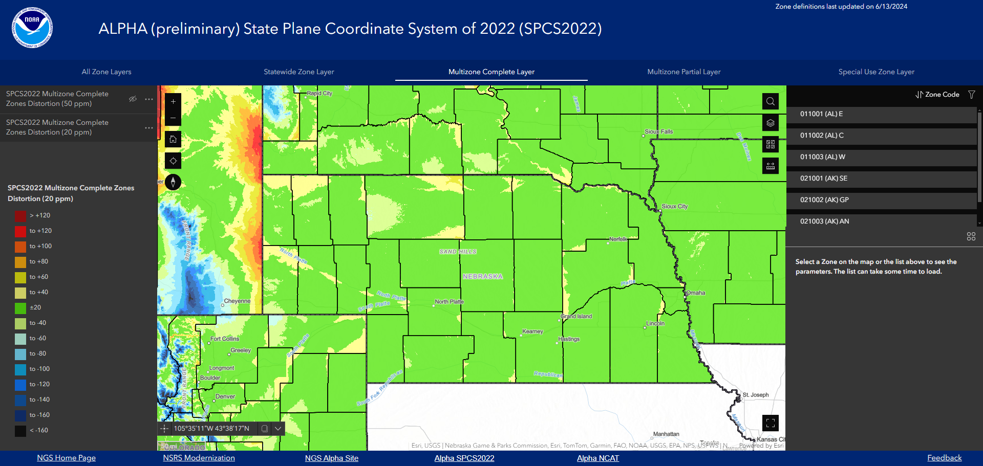
Nebraska Low Distortion Projections
Scale factors are less than 20 ppm almost everywhere
Notes:
Nebraska Low Distortion Projections
Scale factors are less than 20 ppm almost everywhere.

Slide 36
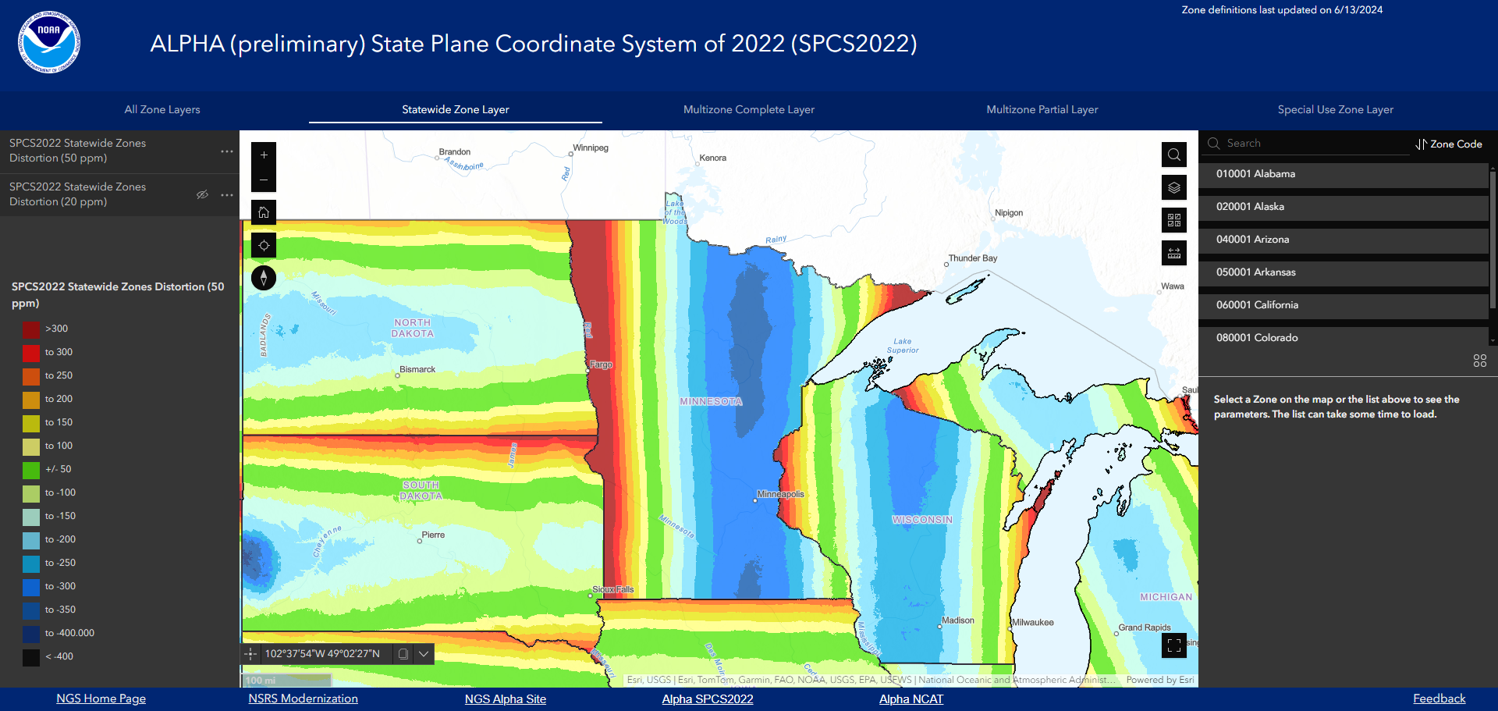
Minnesota State Plane of 2022
Scale factors vary across the state.
Notes:
Minnesota State Plane of 2022
The Minnesota State Plane Zone of 2022 will be a single Transverse Mercator Projection.
Scale factors vary across the state.

Slide 37
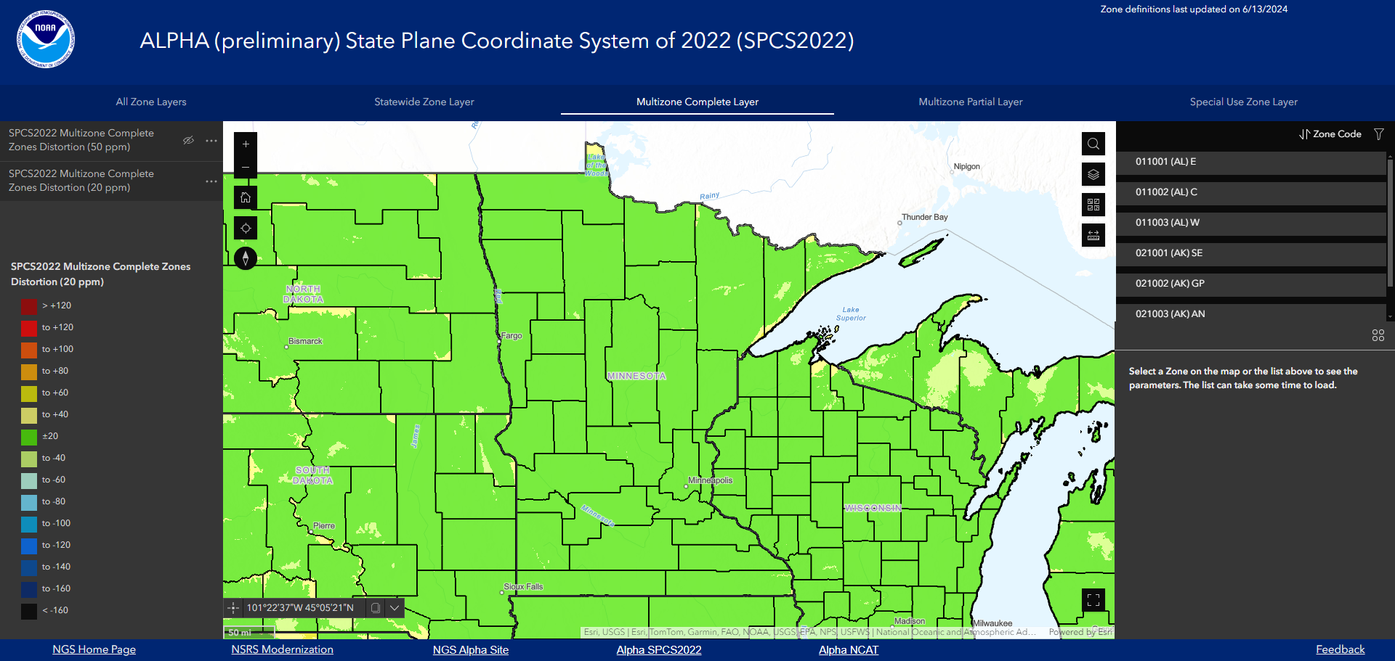
Minnesota Low Distortion Projections
Scale factors are less than 20 ppm almost everywhere
Notes:
Minnesota Low Distortion Projections
Scale factors are less than 20 ppm almost everywhere

Slide 38
Projected Coordinates
Coordinates in one zone can be converted directly to/from other zones.
Coordinates in one zone can be used in neighboring zones for continuity!
Coordinates can be produced in several zones as needed.
But, coordinates may NOT be mixed!
  METADATA
Notes:
Projected Coordinates
Coordinates in one zone can be converted directly to/from other zones.
Coordinates in one zone can be used in neighboring zones for continuity!
Coordinates can be produced in several zones as needed.
But, coordinates may NOT be mixed!
METADATA

Slide 39
Coordinate Conversions
NGS will support all projected coordinates
  NGS Coordinate Conversion and Transformation Tool (NCAT).
  https://www.ngs.noaa.gov/NCAT/
EXAMPLE:
  Open NCAT, select near place of interest
  NAD83(2011) to NAD27
  Orthometric NAVD88 to NGVD29
Notes:
Coordinate Conversions
NGS will support all projected coordinates
NGS Coordinate Conversion and Transformation Tool (NCAT).
https://www.ngs.noaa.gov/NCAT/
EXAMPLE:
Open NCAT, select near place of interest
NAD83(2011) to NAD27
Orthometric NAVD88 to NGVD29

Slide 40
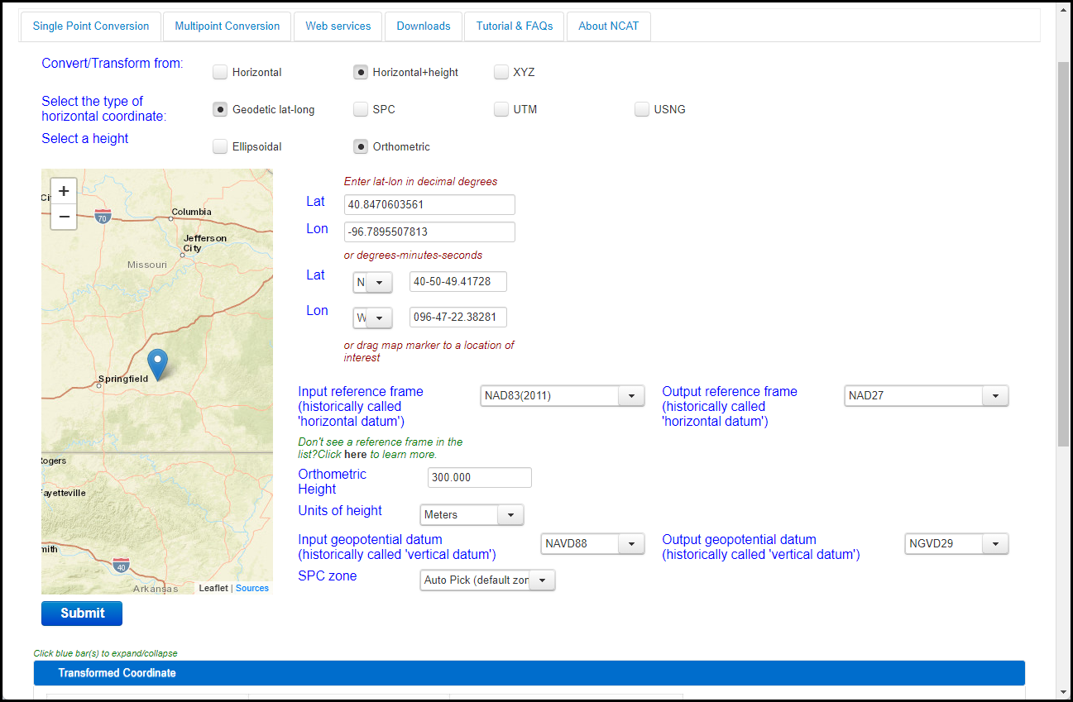
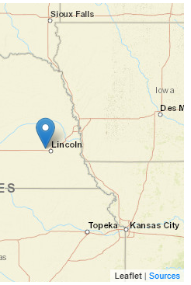
Coordinate Conversions
Input – select the options
Notes:
Coordinate Conversions
Choose the input parameters and select desired outputs.
Click Submit.

Slide 41
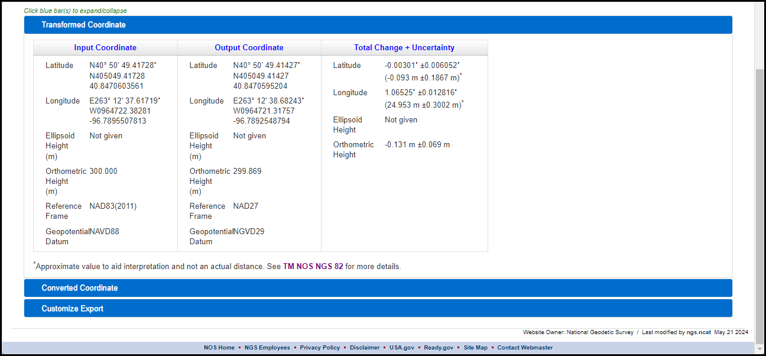
Coordinate Conversions
Output – Transformed to Datum
Notes:
Coordinate Conversions
The transformed coordinate is in the 1st tab.

Slide 42
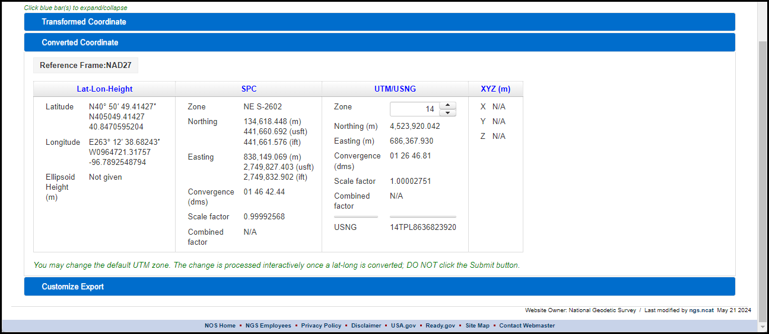
Coordinate Conversions
Output – Converted to Coordinates
Notes:
Coordinate Conversions
The converted coordinate is in the second tab.

Slide 43
Accuracy and Precision
Accuracy – closeness to true value
Precision – repeatability
Accuracy is assured by tying all surveys to the NCN.
  Easy to do in OPUS and in commercial software
Precision is assured by using longer observations and making multiple repeat occupations
  using different observers, equipment, days, times.
Notes:
Accuracy and Precision
Accuracy – closeness to true value
Precision – repeatability
Accuracy is assured by tying all surveys to the NCN.
Easy to do in OPUS and in commercial software
Precision is assured by using longer observations and making multiple repeat occupations
using different observers, equipment, days, times.

Slide 44
Accuracy and Precision
The forthcoming publication NOAA Technical Memorandum NOS NGS 92 gives guidance on how to achieve varying degrees of accuracy and precision, notably Table 1.
Table 1 - Classifications of Intended Network and Local Accuracy
* Network and Local Accuracies are stated at the 95% confidence level.
 | Description | PRIMARY | SECONDARY | LOCAL
1.1 | Ellipsoid Height (cm) * | 2 cm | 3 cm | 5 cm
1.2 | Horizontal (cm) * | 1 cm | 1.5 cm | 2.5 cm
1.3 | Orthometric Height (cm) * | 3 cm | 4 cm | 6 cm
Notes:
Accuracy and Precision
The forthcoming publication NOAA Technical Memorandum NOS NGS 92 gives guidance on how to achieve varying degrees of accuracy and precision, notably
Table 1 - Classifications of Intended Network and Local Accuracy
* Network and Local Accuracies are stated at the 95% confidence level.

Slide 45
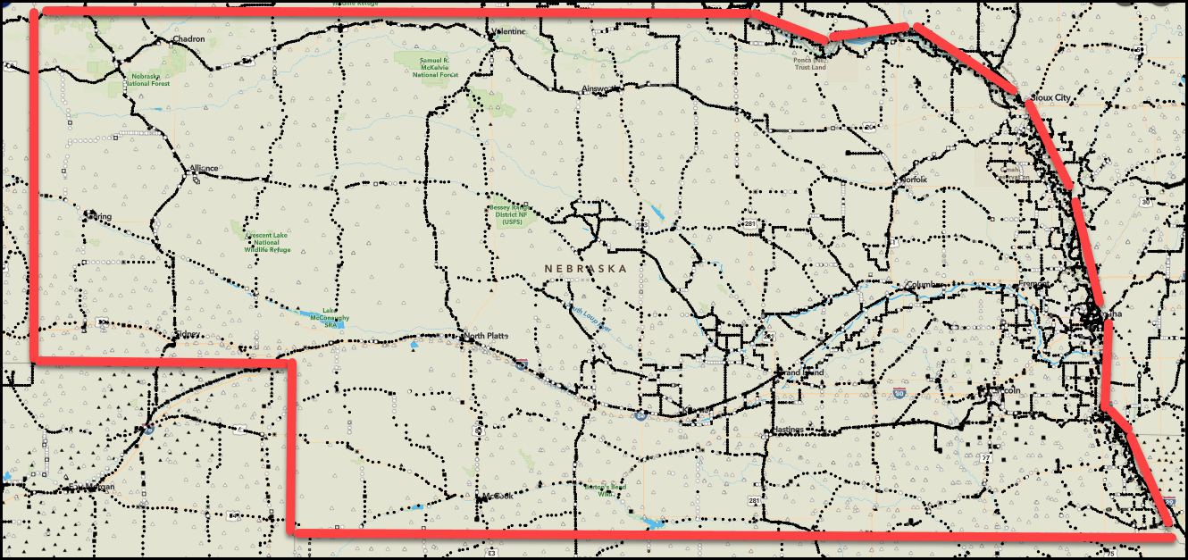
Where is the Need for Control?
NGS Map
https://www.ngs.noaa.gov/datasheets/ngs_map/
Map shows only NGS Control.
State and Local marks not shown.
Notes:
Where is the Need for Control
See:
NGS Map
https://www.ngs.noaa.gov/datasheets/ngs_map/
Note:
Map shows only NGS Control.
State and Local marks not shown

Slide 46
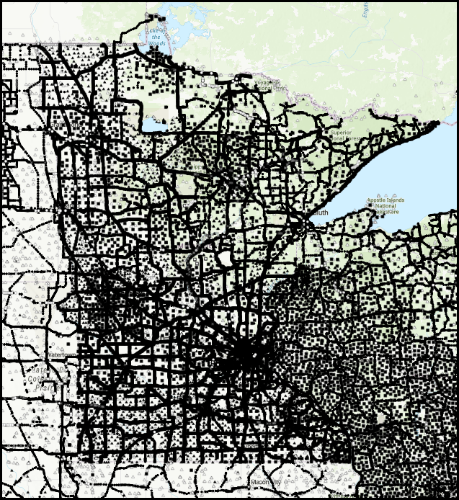
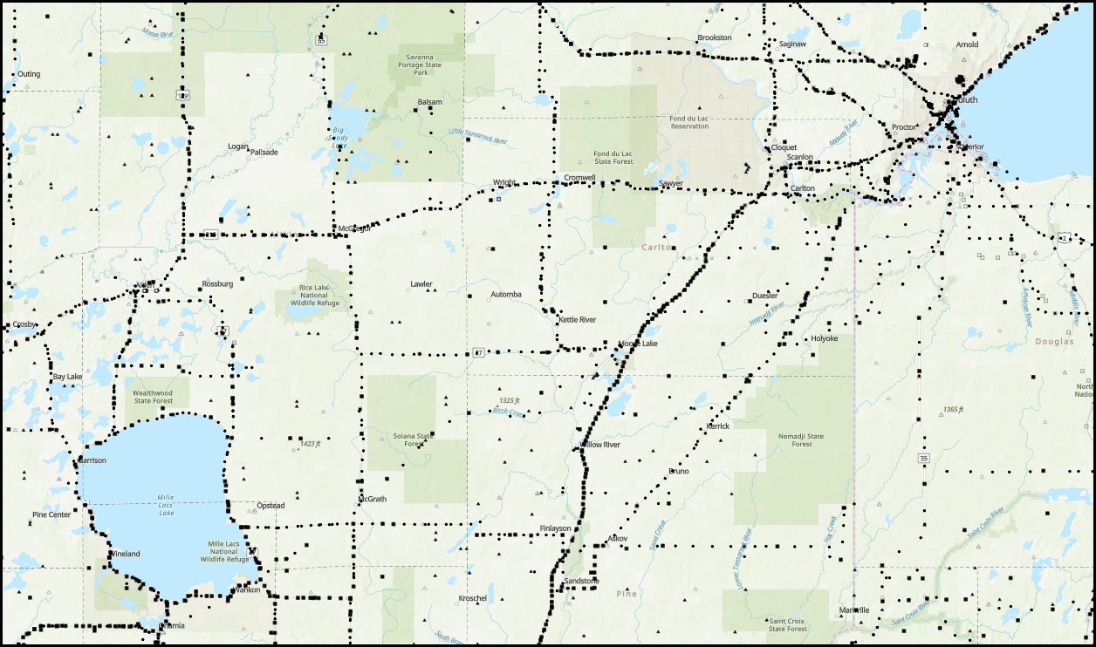
Where is the Need for Control?
NGS Map
https://www.ngs.noaa.gov/datasheets/ngs_map/
Map shows only NGS Control.
State and Local marks not shown.
Notes:
Where is the Need for Control
See:
NGS Map
https://www.ngs.noaa.gov/datasheets/ngs_map/
Note:
Map shows only NGS Control.
State and Local marks not shown

Slide 47
Where is the Need for Control?
Remember:
NGS
  makes the datum accessible.
Local Users
  establish and observe marks,
  in the quantity, proximity, timeliness,
  and the accuracy and precision needed,
  then optionally (recommended), submit the marks to NGS for publication.
Notes:
Where is the Need for Control?
Remember:
NGS makes the datum accessible.
Local Users must establish and observe marks, in the quantity, proximity, timeliness, and the accuracy and precision needed.
And optionally, submit the marks to NGS for publication.

Slide 48
End

