Slide 1

The Modernized NSRS
Kentucky Coordinate Systems
KAMP Annual Conference
October 2024
Jeff Jalbrzikowski, P.S., GISP, CFS
Appalachian Regional Geodetic Advisor
jeff.jalbrzikowski@noaa.gov
240-988-5486

Slide 2



Organizational Structure
  -Department of Commerce (DoC)
  (~47,000 employees)
  -National Oceanic and Atmospheric Administration (NOAA)
  -National Ocean Service (NOS)
  -National Geodetic Survey (NGS)
  (~175 employees)
Notes:
-We are the Federal Government’s oldest scientific agency.
-part of the Executive Branch
-I know it can seem kind of strange that NGS is part of the NOS, but the origins of NGS lie with the C&GS.
-we are a “Program Office” of the NOS
Survey of the Coast – 1807
Coast Survey – 1836
Coast and Geodetic Survey – 1878
NGS since 1970

Slide 3


Organizational Structure
We’re not USGS, we’re NGS
  -Department of Commerce (DoC)
  (~47,000 employees)
  -National Oceanic and Atmospheric Administration (NOAA)
  -National Ocean Service (NOS)
  -National Geodetic Survey (NGS)
  (~175 employees)
≠
Notes:
-as you can read my slide, I like to point that out because over my 2 years at NGS I’ve seen and heard this misunderstanding quite a bit
-don’t worry! it doesn’t offend us! and we do work closely with USGS, but we are separate agencies within totally different departments of the federal government

Slide 4
Any references to any commercially available hardware or software do not constitute an endorsement or a disapproval of any manufacturers, developers, dealers, or suppliers.
Thanks.

Slide 5
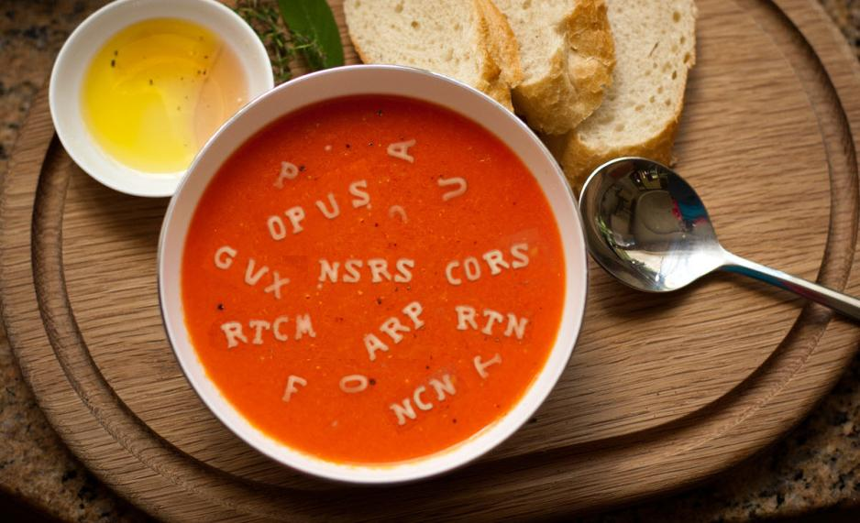
Let’s start with some alphabet soup

Slide 6
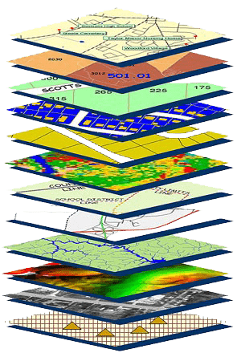
NGS Mission
To define, maintain and provide access to the National Spatial Reference System (NSRS) to meet our Nation’s economic, social, and environmental needs.
NSRS
Notes:
NGS develops and maintains the National Spatial Reference System, a national coordinate system that provides the foundation for transportation, navigation, land record systems, mapping and charting efforts, and a multitude of scientific and engineering applications
CLICK
You’ve all seen this or some similar graphic I’m sure. That bottom layer… that’s our baby, the NSRS.

Slide 7
National Spatial Reference System
A common and consistent geospatial framework to meet the economic, social, and environmental positioning needs of our Nation.
Foundational elements include:
Latitude
Longitude
Height
Gravity
Shoreline Position
…how these change over time
Horizontal Datums | Vertical Datums
Horizontal Datums | Vertical Datums
NAD83 | NAVD88
NAD27 | NGVD29
Elevation
Great Lakes Datums | Geoid Models
Great Lakes Datums | Geoid Models
IGLD85 | GEOID18
IGLD55 | GEOID12B
Notes:
The primary mission of NGS is, “to define, maintain, and provide access to the NSRS to meet our nations economic, social, and environmental needs”.
NSRS is a consistent geospatial framework, common to all Federal agencies and other users
NSRS supports informed decision-making for mapping and charting, navigation, flood risk determination, transportation, land management, and more
Elements of NSRS include (but are not limited to): latitude, longitude, elevation, gravity, shoreline position + their changes over time …other elements include scale, earth orientation parameters and others
The vertical component of the NSRS currently utilizes the North American Vertical Datum of 1988 (NAVD88)

Slide 8
Yes, we are delayed.
  NSRS Modernization
Notes:
So remember, today’s presentation is not JUST about new datums, it is about modernizing the NSRS as a whole.
You don’t know what the NSRS is? Stay tuned, we’ll get there as we go along.

Slide 9
Delayed Release of the Modernized NSRS
How long will the delay be?
  Our website or newsletter is best source of projected timeframe, current estimate is middle of 2025.
Will the names stay the same?
  Yes, terms containing “2022” such as “NATRF2022” and “NAPGD2022” will remain the same.
Will all previously proposed products be released along with the new datums?
  No, they will not. Check out our June 2022 webinar.
hyperlink to the Track Our Progress homepage
June 2022 webinar
hyperlink to the full FAQ

Slide 10
Modernizing the NSRS
Updating all NSRS coordinates
  Replace existing datums with new datums
  Replacing existing SPCS83 with new SPCS2022
  Accounting for coordinates changing with time
Improving NGS products and services
Simplifying customer contributions
Making the NSRS:
  More accurate
  More accessible
  More efficient
begins
Rollout in
2025

Slide 11
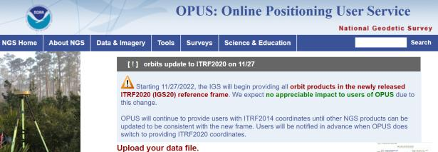
NGS Mission
To define, maintain and provide access to the National Spatial Reference System (NSRS) to meet our Nation’s economic, social, and environmental needs.
access… ? = traditionally → marks/disks/objects
= modern and future → NOAA CORS Network (NCN)
via OPUS
Notes:
Follow up thought
-like it or not, we know that the vast majority of our users are obtaining NSRS coordinates via OPUS
-while that is our plan for the future of primary access, modernized NSRS, as of now the official form of access (specifically to NAVD88) truly is to “touch brass” as they say → meaning occupy a benchmark

Slide 12
Online Positioning User Service
      dual frequency receiver
      static observations (via RINEX → ABCD123x.24o)
      30 seconds epoch/logging rate aka recording interval
  OPUS Rapid Static (OPUS-RS)
      15 minutes to 2 hours of GPS data
  OPUS Static (OPUS-S)
      same requirements as above
      2 to 48 hours of GPS data
  OPUS Projects (OP)
      adds session processing and network adjustment
      training by NGS currently required (~12 hours)
Also Beta OPUS-S
Multi-constellation
More CORS checking
Notes:
https://geodesy.noaa.gov/OPUS-cgi/OPUS-Projects/OpusProjects.prl?action=manage_project&project_keyword=nap025a&manager_keyword=nap025a

Slide 13
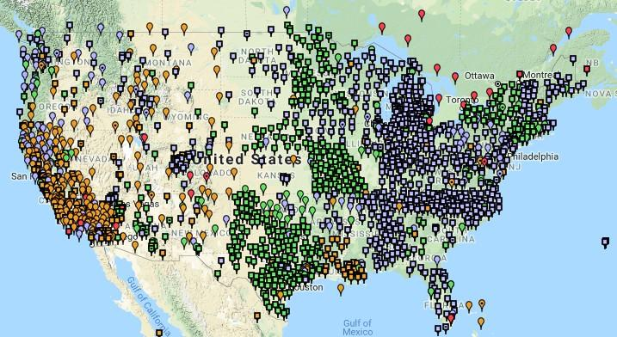
NOAA CORS Network (NCN)
Notes:
-I would like to point out we have a new, official name for the network you see represented on this map,
-The NOAA CORS Network, or NCN
CLICK
-this is neat little graphic with some stats on teh NCN you can find on our website
-below the gaphic youll find a search bar with more information

Slide 14
Positional Components of
the NSRS
Geometric
aka “Horizontal”
Latitude, Longitude, Ellipsoid Height
Geopotential
aka Orthometric Height
aka “Elevation”
NAD83
NAVD88
Notes:
-geometric component is latitude, longitude, and ellipsoid height
-geopotential component is combined with the geometric components to calculate an ortho height or capital H

Slide 15
NATRF2022
North American Terrestrial Reference Frame of 2022
will replace
NAD83
North American Datum of 1983
Technically, not just NATRF2022 but also its 3 sister TRFs…

Slide 16
Four TRFs for Modernized NSRS
North American Terrestrial Reference Frame of 2022
(NATRF2022)
Pacific Terrestrial Reference Frame of 2022
(PATRF2022)
Caribbean Terrestrial Reference Frame of 2022
(CATRF2022)
Mariana Terrestrial Reference Frame of 2022
(MATRF2022)

Slide 17
Terrestrial Reference Frame?
Existing, accepted terminology
  International TRF
  first realization of the ITRF was 1988
  NATRF2022 will be based on ITRF2020
“Horizontal Datum” - misnomer for NAD83
  Really is a Geometric Reference Frame
Notes:
-Where do you see an Epoch right now in NGS data?
CLICK
Datasheets! there you see the epoch of 2010.0
and of course OPUS Solution Reports!
note that in blue over there on the right you’ll see another epoch, in the ITRF, which I will explain later on

Slide 18
International Terrestrial Reference Frame (ITRF)
Is native coordinate system for NCN.
Is what OPUS uses.
Is what most of world uses.
Is what NGA aligns WGS-84 to.
Notes:
So what is that acronym, ITRF?
-it is a global reference frame, the most widely adopted one, or the “gold standard” or the “Cadillac” or what-have-you
-ITRF is the internationally recognized standard
-who realizes the ITRF? well, NGS contributes to the realization but
CLICK
-The IERS is in responsible charge of defining, realizing and promoting the ITRF
-and the ITRF was formally adopted by the…yes, more acronyms
CLICK
IUGG some years ago

Slide 19
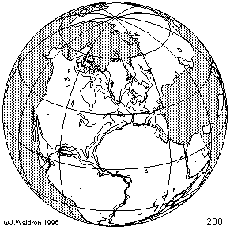
ITRF concept
Watch the grid!
Epoch:
Notes:
Ok, now ITRF mentioned a couple slides ago.
Most simplistic way to explain ITRF is to watch this animation.
This is a very loose representation/visualization of what the ITRF is, a characterization only.

Slide 20
Plate-Fixed NSRS TRFs
ITRF
Frame = constant
NA Plate = rotating
NATRF
Frame = rotating
(relative to ITRF)
NA Plate = constant
(relative to NATRF2022)
Notes:
We say “NATRF2022” is “fixed” to the N.A. Plate, making it a “plate fixed” frame
-the frame is constant to itself, but rotating within ITRF, and moving in a different direction than the other 3 frames

Slide 21
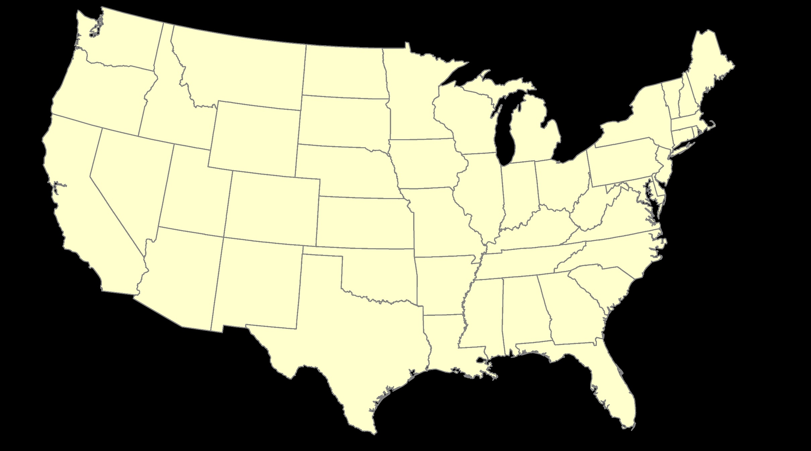
ITRF – constant frame, rotating plate

Slide 22
Plate-Fixed
NATRF – rotating frame, constant with plate

Slide 23
if you know epoch
ITRF or NATRF – your choice if you know epoch

Slide 24
Decades of continuously logged GPS data from the NOAA CORS Network (NCN).
  But how?

Slide 25
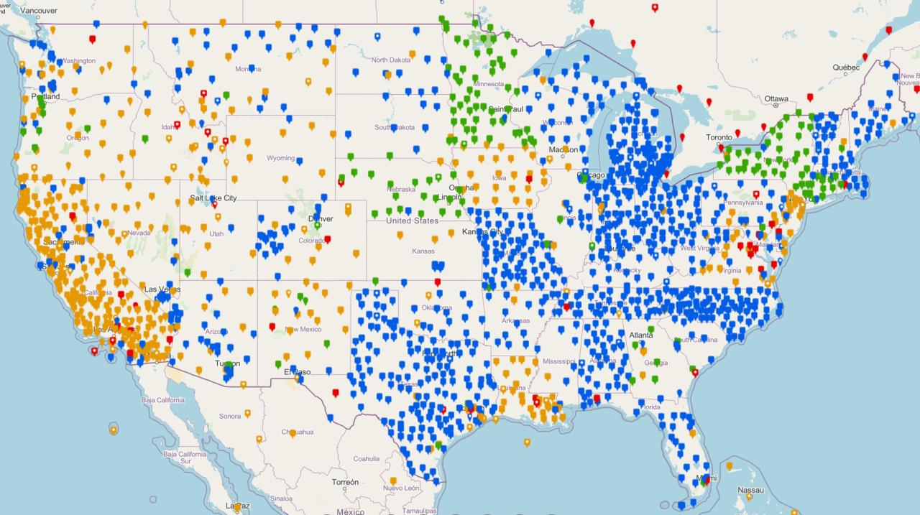
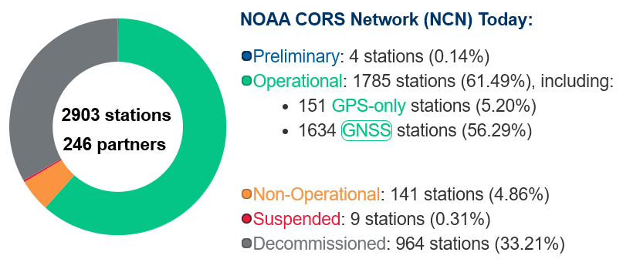
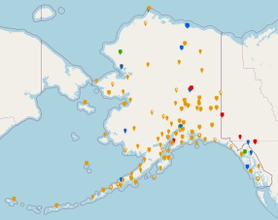
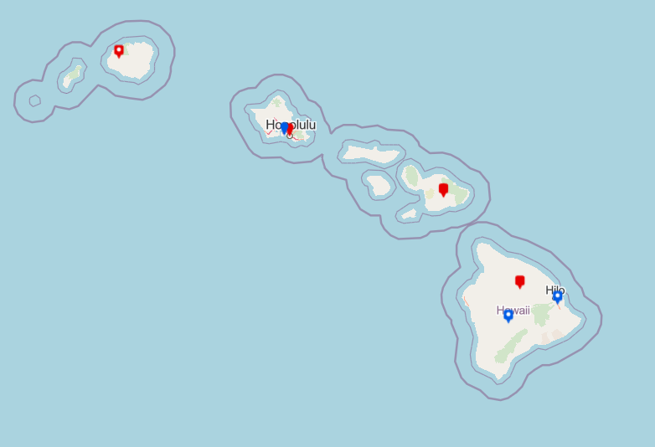
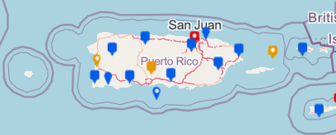
NOAA CORS Network (NCN)
Notes:
The NOAA CORS Network is a multi-purpose, multi-agency cooperative endeavor, combining the efforts of hundreds of government, academic, and private organizations.
The stations are independently owned and operated.
Each agency shares their GNSS observations and station metadata with NGS, which are analyzed and archived.
The data is distributed free of charge with multiple forms of access.

Slide 26
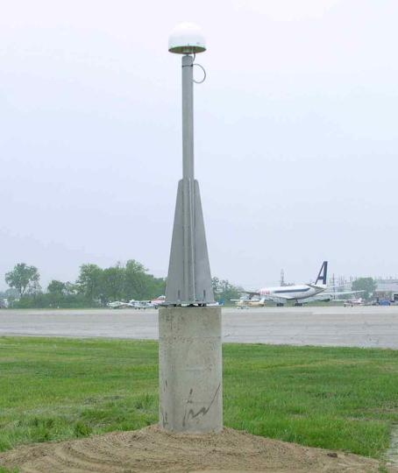
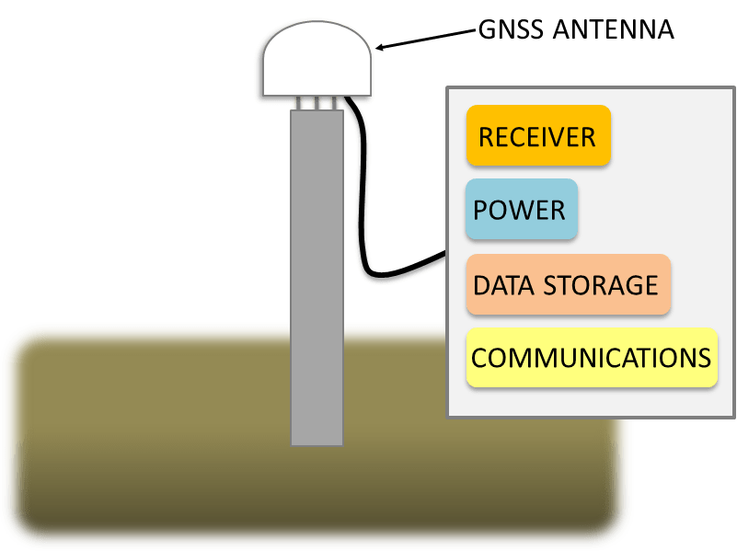
Continuously Operating Reference Station

Slide 27
NOAA CORS Network (NCN)

Slide 28

Plate-Fixed
ITRF or NATRF
= CORS
Notes:
ITRF is independent of any plates, tied to the layer below,
-”plate-agnostic” if we want to sound all silicon valley ish
-the plates go down about 200 km (125 mi) deep below our feet right now, as we’re on a continental plate
--(oceanic plates are roughly half the thickness, like 100 km)
-→ but thickness of the tectonic plates varies greatly, from down to 15 km up over the 200 km I mentioned earlier

Slide 29
Terminology – Time/4D
Epoch
eh-puck? ee-pock? … to-may-to, to-mah-to
an instant of time; a moment in time
astronomy & geodesy use a decimal date
  2021.4762 = 23 June 2021 @ 19:16:00
  using epochs is important, not your format
    start preparing to assign epochs to your data
Notes:
-Where do you see an Epoch right now in NGS data?
CLICK
Datasheets! there you see the epoch of 2010.0
and of course OPUS Solution Reports!
note that in blue over there on the right you’ll see another epoch, in the ITRF, which I will explain later on

Slide 30
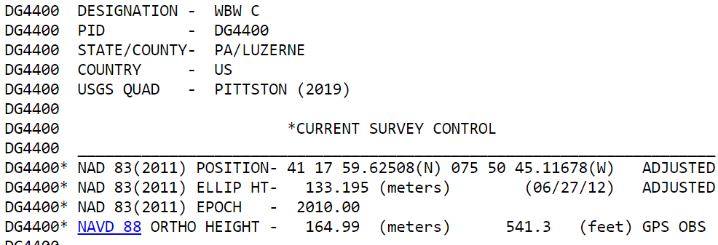
Notes:
-Where do you see an Epoch right now in NGS data?
Datasheets! there you see the epoch of 2010.0
and of course OPUS Solution Reports!
note that in blue over there on the right you’ll see another epoch, in the ITRF, which I will explain later on

Slide 31
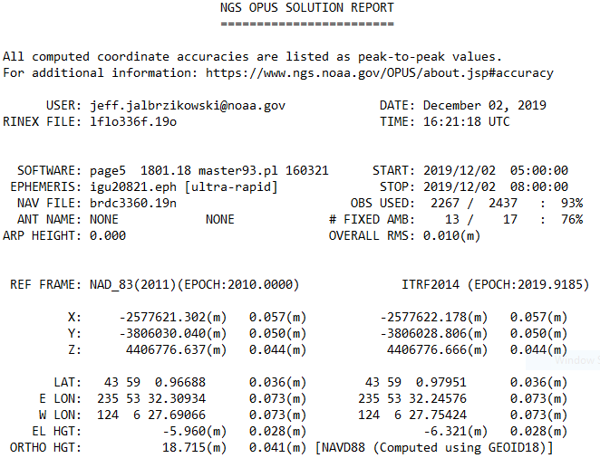
Reference Epoch
Survey Epoch
Notes:
-Where do you see an Epoch right now in NGS data?
and of course OPUS Solution Reports!
note that in blue over there on the right you’ll see another epoch, in the ITRF, which I will explain later on

Slide 32
What is a Reference Epoch?
If you use NAD83 you’re already using one, but probably didn’t know it.
First let’s look at complete nomenclature…

Slide 33
Complete NAD83 Nomenclature
NAD83(2011) epoch 2010.00
Geometric
Datum
Realization
(aka Datum Tag)
Epoch
(in the case of NAD83, a Reference Epoch)
Other NAD83 Reference Epochs
NAD83(1986) epoch 1984.00
NAD83(HARN) epoch 1993.62
NAD83(CORS96) epoch 2002.00
NAD83(2007) epoch 2007.00
NAD83(2011) epoch 2010.00
ITRF2014 epoch 2019.9185
IGS08 epoch 2005.00
NATRF2022 epoch 2020.00
NAD83(1986) epoch 1984.00
NAD83(HARN) epoch 1993.62
NAD83(CORS96) epoch 2002.00
NAD83(2007) epoch 2007.00

Slide 34
Reference Epoch
Survey Epoch
Notes:
-Where do you see an Epoch right now in NGS data?
and of course OPUS Solution Reports!
note that in blue over there on the right you’ll see another epoch, in the ITRF, which I will explain later on

Slide 35
What is a Survey Epoch?
If you use OPUS you’re already using one, but perhaps unaware.

Slide 36
Complete ITRF Nomenclature
ITRF2014 (epoch 2021.0276)
Geometric
Datum
Epoch
(in the above example, a Survey Epoch)
ITRF Reference Epochs
NAD83(1986) epoch 1984.00
NAD83(HARN) epoch 1993.62
NAD83(CORS96) epoch 2002.00
NAD83(2007) epoch 2007.00
NAD83(2011) epoch 2010.00
ITRF2014 epoch 2019.9185
IGS08 epoch 2005.00
NATRF2022 epoch 2020.00
Examples of ITRF Survey Epoch
ITRF92 epoch 1988.0
ITRF2000 epoch 1997.0
ITRF2005 epoch 2000.0
ITRF2008 epoch 2005.0
ITRF2014 epoch 2010.0
ITRF2008 epoch 2012.2011
IGS08 epoch 2006.7572
ITRF2014 epoch 2017.4457
ITRF2014 epoch 2019.9185
ITRF2014 epoch 2021.0276

Slide 37

Coordinate Operations
Conversion
    change the type of coordinate
    NAD83(2011) latitude & longitude → NAD83(2011) SPCS
  Transformation
    change the datum of coordinate
    NAD 27 latitude & longitude → NAD 83(2011) latitude & longitude
Propagation
    change the epoch of coordinate
    NATRF2022 epoch 2023.243 to NATRF2022 epoch 2020.000
Survey Epoch
Reference Epoch
Notes:
Historically NGS has been inconsistent with these top two words.
Going forward, we will use them as:
Conversion: Meaning to change the type of coordinate without changing the datum or frame
Transformation: Meaning to change the datum or frame, without changing the type of coordinate

Slide 38

NCAT
  How will you propagate coordinates back in time from SE to RE?
NGS Coordinate Conversion And Transformation Tool (NCAT)
Epochs/Time/4D
Notes:
-so you’ve probably seen that phrase that I have front and center here, NSRS Modernization
-that’s the blanket term we use to refer to not just the new datums but other updates

Slide 39
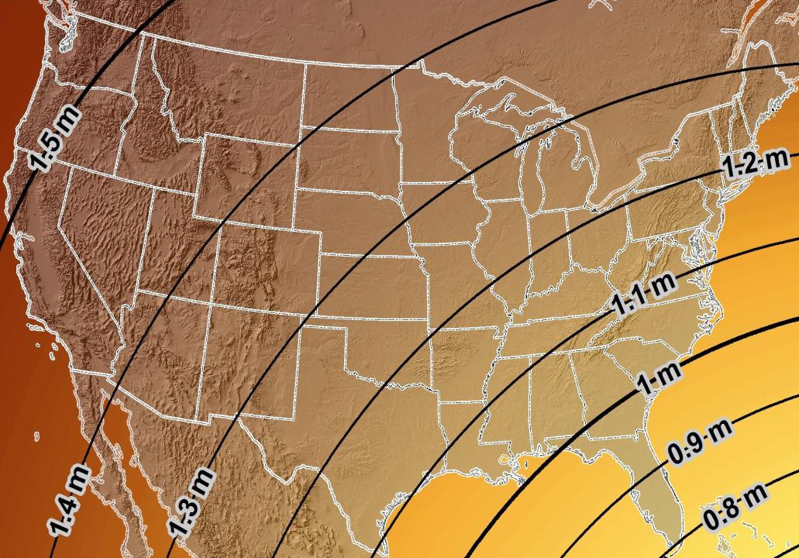
Estimated Geometric Change - Horizontal
NAD83 (2011) → NATRF2022
4.6 ft
Direction of Shift
4.3 ft
3.9 ft
3.6 ft
3.0 ft
Notes:
What’s the magnitude of the horizontal datum shift across Pennsylvania?
Minimum Shift ~3.75 feet
Maximum Shift ~3.97
Remember this is just an estimation, don’t hold me to the numbers please

Slide 40


Slide 41
New Lat/Long = New XY
With a new horizontal datum…
  NAD83 to be replaced by NATRF2022
…comes a new State Plane Coordinate System
  SPCS83 to be replaced by SPCS2022

Slide 42
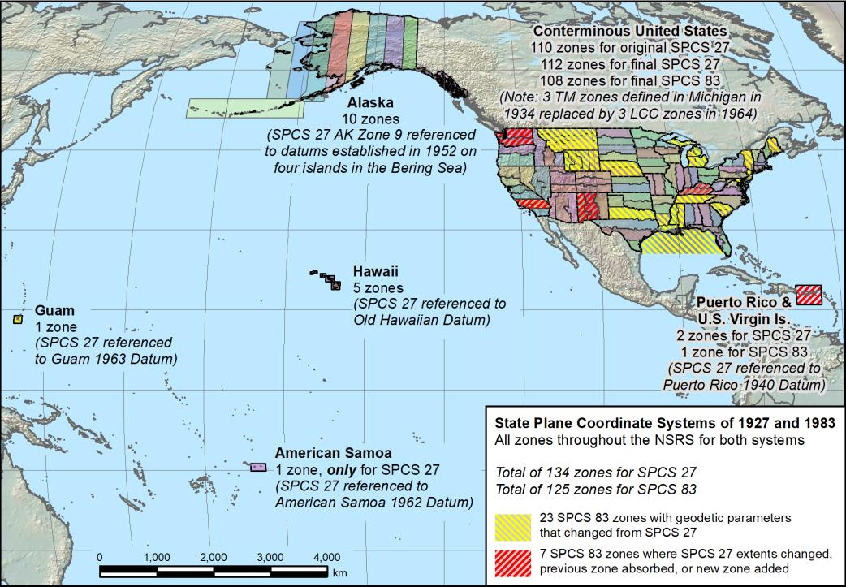
Notes:
This map is all

Slide 43

A “flat” Earth for the future
State Plane Coordinate System of 2022 (SPCS2022)
Similar to existing State Plane…
  Same 3 map projection types
  Same ellipsoid (GRS 80)
But different…
  Based on new datums instead of NAD 83
  Designed to reduce difference between “grid” and “ground”
  Many more “zones”
  Zones “layers” will exist in most states
Lambert Conformal Conic (LCC)
Transverse Mercator (TM)
Oblique Mercator (OM)

Slide 44
Linear distortion with respect to ellipsoid surface
Projection
axis
(k₀ < 1)
Topographic surface
Horizontal ground distance
> ellipsoid distance
and
> grid distance
k₀ = scale on projection axis
LCC: central parallel
TM: central meridian
OM: skew axis
Ellipsoid distance
Grid distance
> ellipsoid distance
< ground distance
(k > 1 and δ < 0)
Projection surface (secant)
Ellipsoid distance
Ellipsoid surface
This design approach
used for SPCS 27 and 83 (minimizes distortion with respect to ellipsoid)
Grid distance
< ellipsoid distance
< ground distance
(k < 1 and δ < 0)
44

Slide 45
Linear distortion with respect to topographic surface
Projection
axis
(k₀ > 1)
Horizontal ground distance
> ellipsoid distance
and
> grid distance
Topographic surface
Projection surface (non-intersecting)
h
Grid distance
> ellipsoid distance
≈ ground distance
(k > 1 and δ ≈ 0)
Ellipsoid distance
Ellipsoid surface
R
45

Slide 46
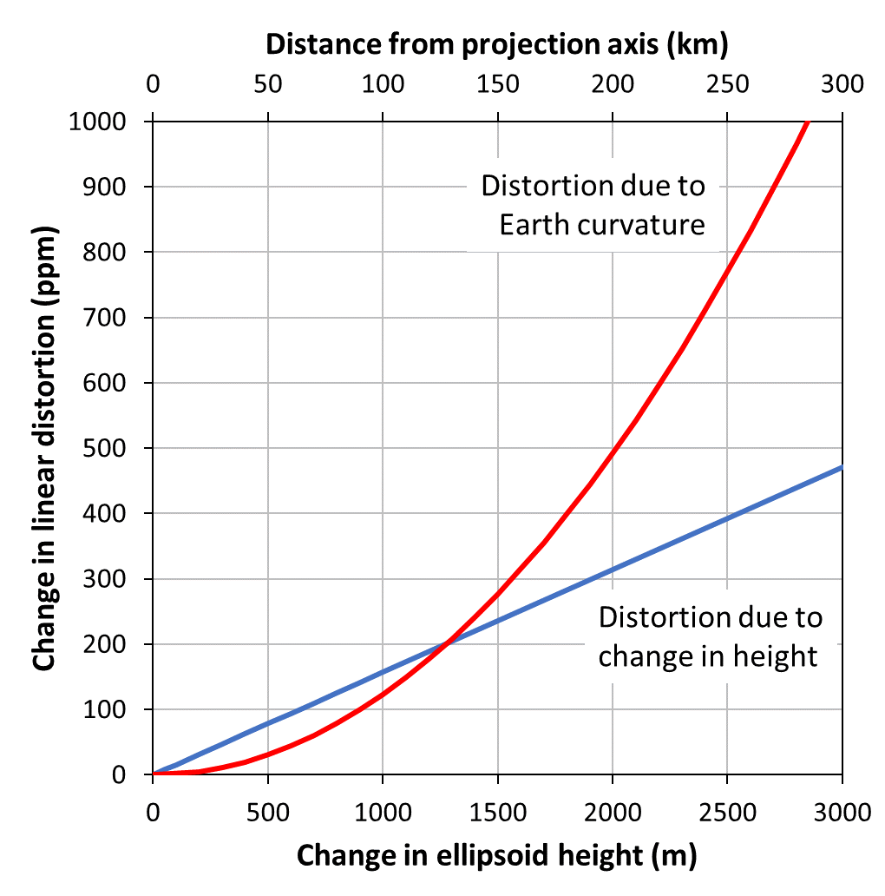
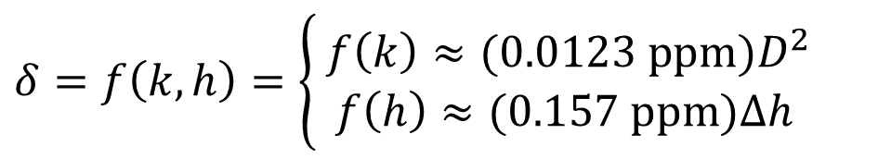
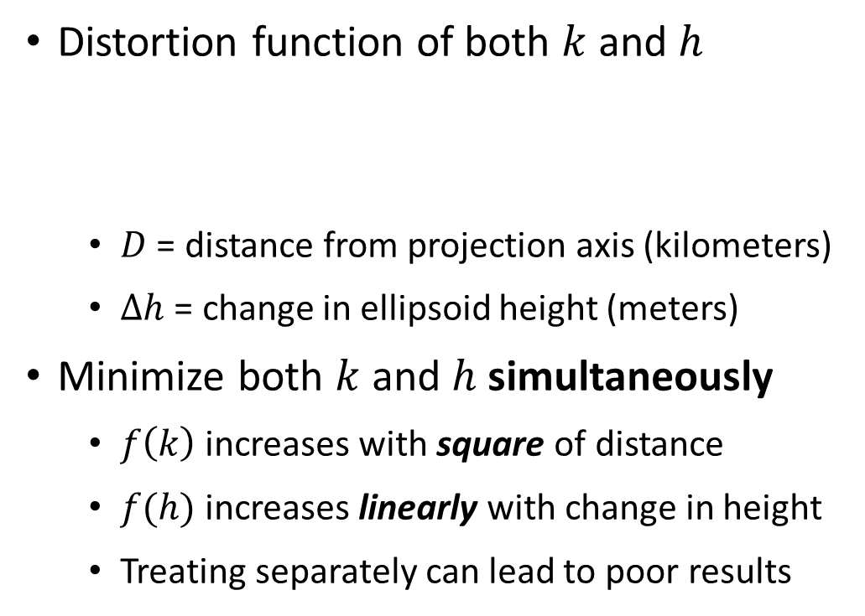
Minimizing linear distortion
Distortion function of both $k$ and $h$
  $D$ = distance from projection axis (kilometers)
  $∆h$ = change in ellipsoid height (meters)
Minimize both $k$ and $h$ simultaneously
  $f\left(k\right)$ increases with square of distance
  $f(h)$ increases linearly with change in height
  Treating separately can lead to poor results
$$δ=f\left(k, h\right)=\left\{\begin{matrix} f\left(k\right)≈(0.0123 ppm)D^{2} \\ f\left(h\right)≈(0.157 ppm)∆h \end{matrix}\right.$$

Slide 47
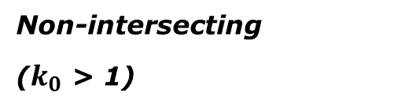
“Non-intersecting” conformal map projection
Topographic surface
Grid distance = ground distance at a point
Projection
axis
Grid distance = ground distance at a point
Non-intersecting
($k_{0}$ > 1)
Grid distance ≈ ground distance over finite distance
Ellipsoid surface
Purpose is to reduce linear distortion at “ground” (topographic surface).
But distortion can vary considerably across area of interest.
47

Slide 48
“Non-intersecting” conformal map projection
Topographic surface
Projection
axis
Non-intersecting
($k_{0}$ > 1)
Ellipsoid surface
48

Slide 49
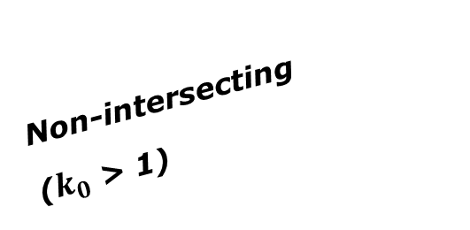
Changing projection axis to reduce distortion variation
Topographic surface
Grid distance = ground distance at many points
Projection
axis
Ellipsoid height of surface not constant:
h₁ ≠ h₂
h₂
Non-intersecting
($k_{0}$ > 1)
h₁
Ellipsoid surface
This design approach
used for SPCS2022 (minimizes distortion with respect to topography)
49

Slide 50
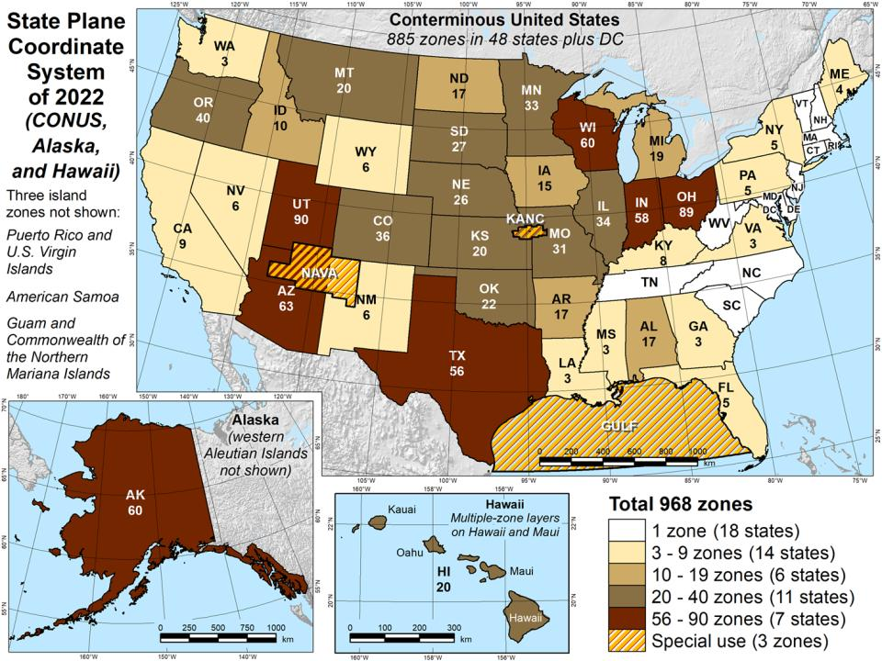

Slide 51
Status of zone layout and designs
Designs by NGS
  159 zones (including 54 statewide)
  Plus 3 “special use zones” (in more than one state)
Designs by state stakeholders
  806 zones in 28 states
  Most are “low-distortion projections” (LDPs)
Total = 968 zones for 56 states and territories
  Number will likely decrease slightly
Compare to 125 zones in existing SPCS83!

Slide 52
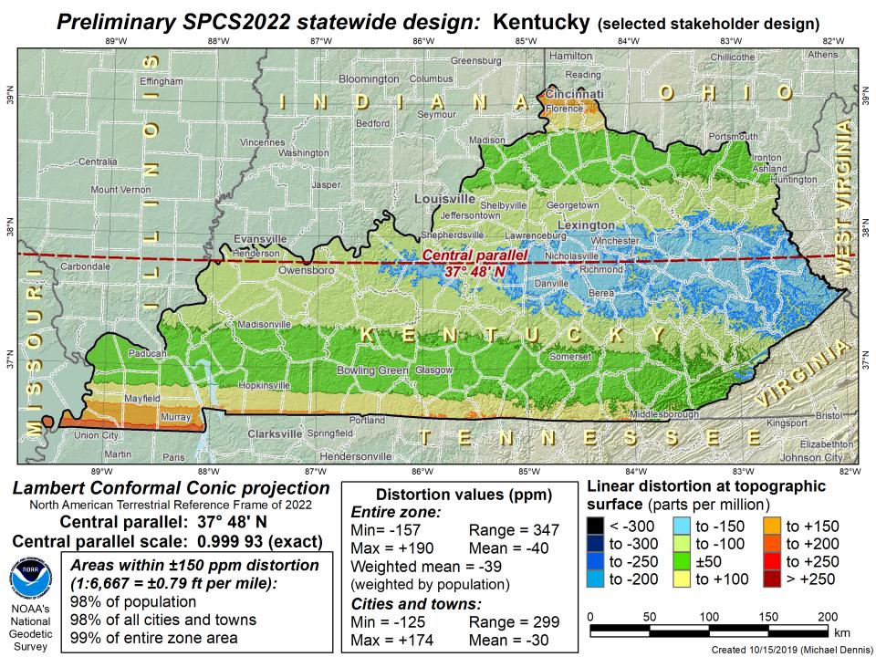

Slide 53
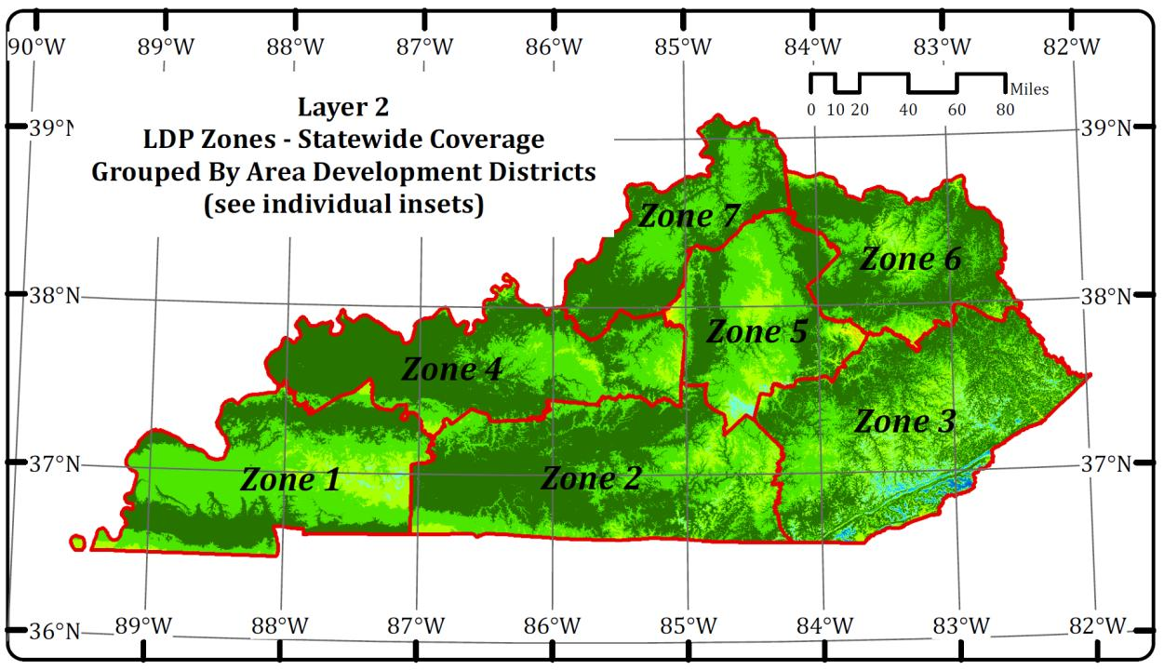

Slide 54
SPCS2022 Zone Layers and LDPs
Each state may have max of 3 zone “layers”
  One layer must be statewide zone
    Kentucky Single Statewide (aka KY1Z-2022)
  Other layers have two or more zones
    Kentucky Multi-Zone → 7 high performance LDPs
  A third layer can exist, but can only be partial coverage
    LDPs for specific areas? No need in Kentucky.
      Maybe a LOJIC zone would be beneficial

Slide 55
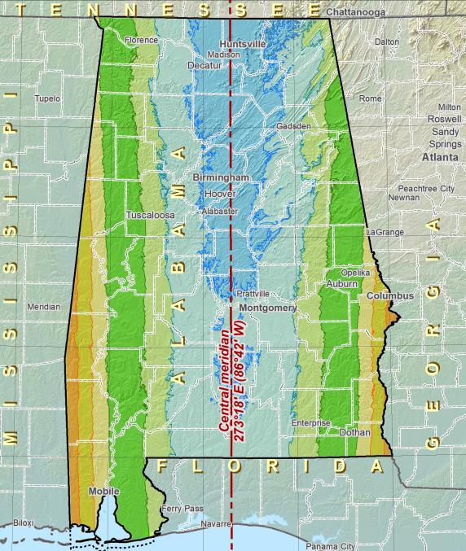
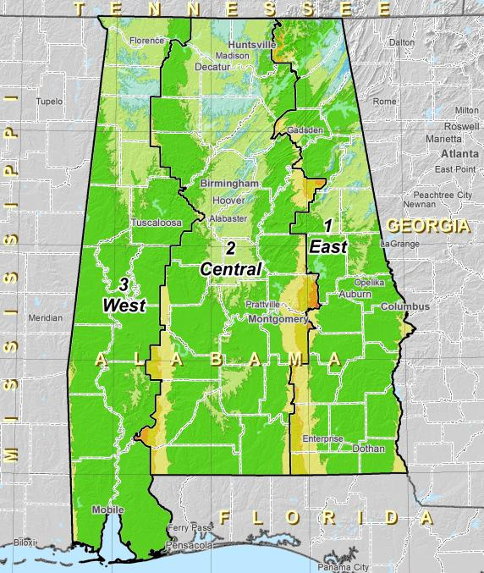
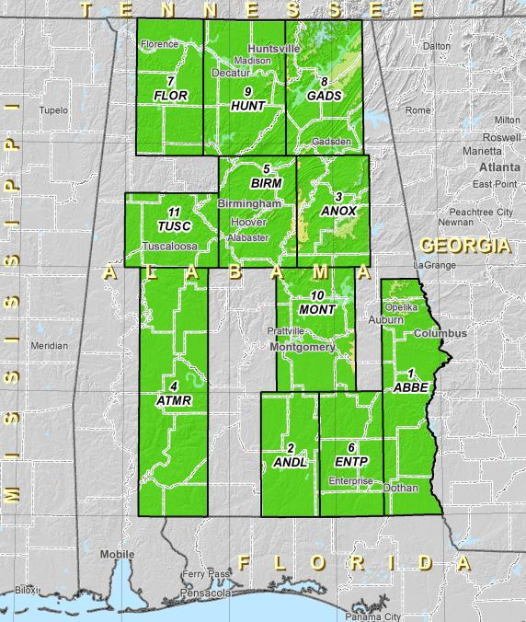
Zone Layers
Single Statewide
Multi-Zone Complete
Multi-Zone Partial

Slide 56
Zone Layers

Slide 57
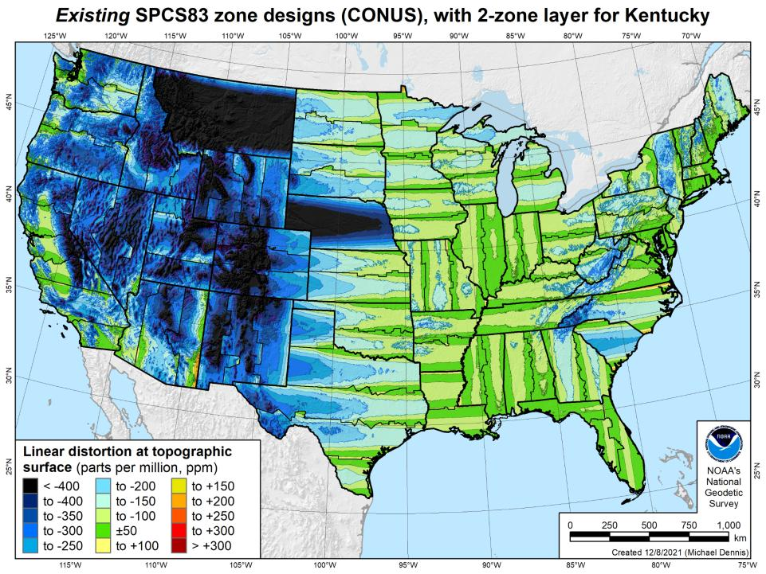
Notes:
What’s the best performing zone layer anywhere?

Slide 58
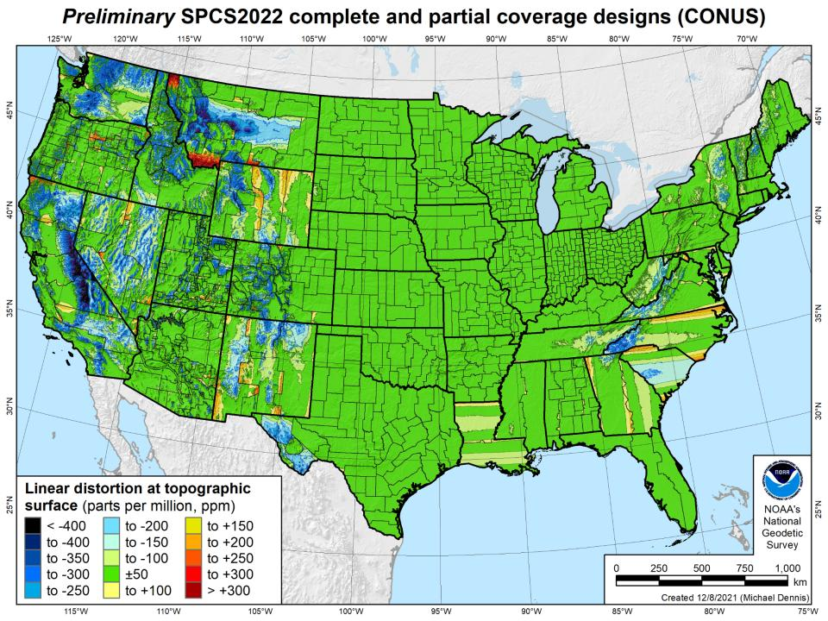

Slide 59
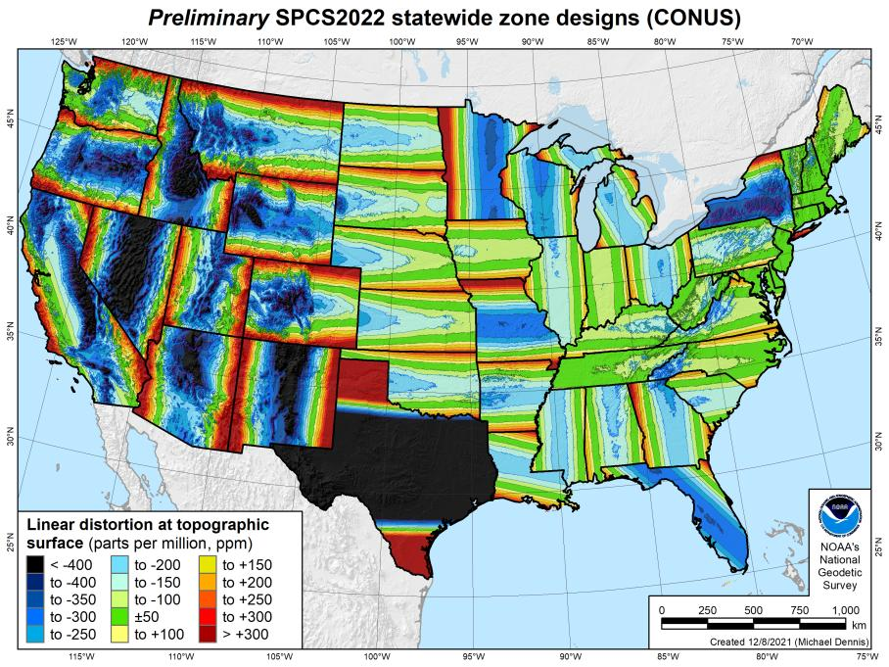
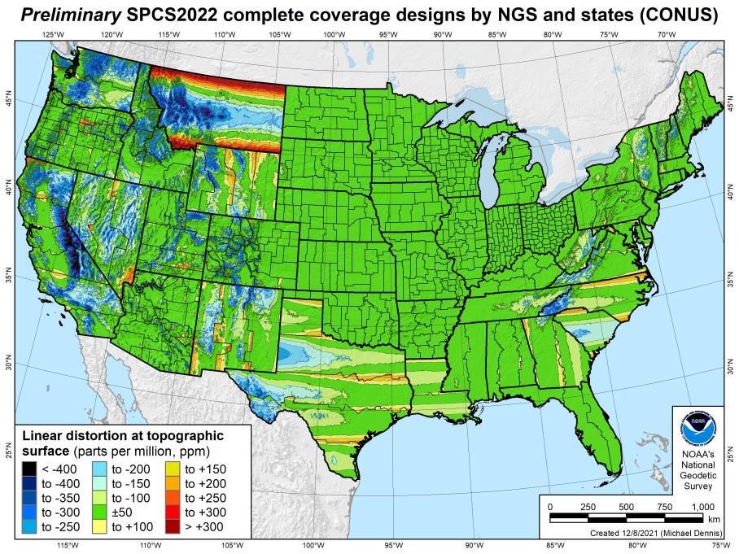
SPCS2022 linear distortion (prelim)
846 zones (CONUS)
Percent within distortion (ppm):
Distor | Pop | Cities | Area
±20 | 76% | 71% | 58%
±50 | 92% | 89% | 76%
±100 | 98% | 97% | 89%
±400 | 100% | 100% | 99.9%
City and area statistics (ppm):
 | Min | -407 | -1438
 | Max | +486 | +2624
 | Range | 893 | 4062
 | Mean | -6 | -23
Mean weighted by pop = -4

Slide 60
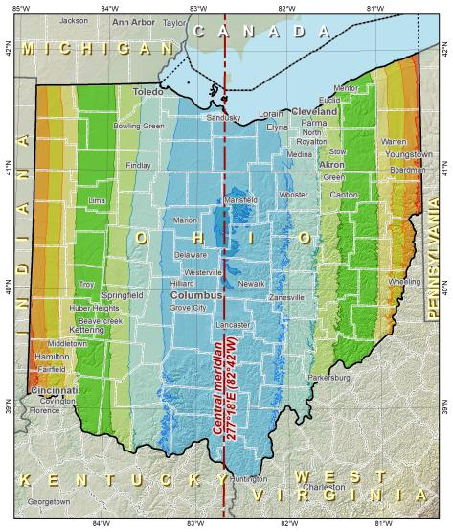
Points to ponder…
What to do with the existing tiling scheme in NATRF2022?
Maintain same footprints, so uneven coordinates at corners?
New footprints, but cleaner coordinates? Both options?

Slide 61
The Survey Foot is dead!
Long live the Survey Foot!
US Survey Foot was deprecated 31 December 2022…
But will always be available in NGS tools for NAD83 and NAD27
Notes:
We start with the SPCS83 zones as a frame of reference
NOTE that the color shading of these zones is matched to that of the Preliminary SPCS2022 Zones that follow

Slide 62
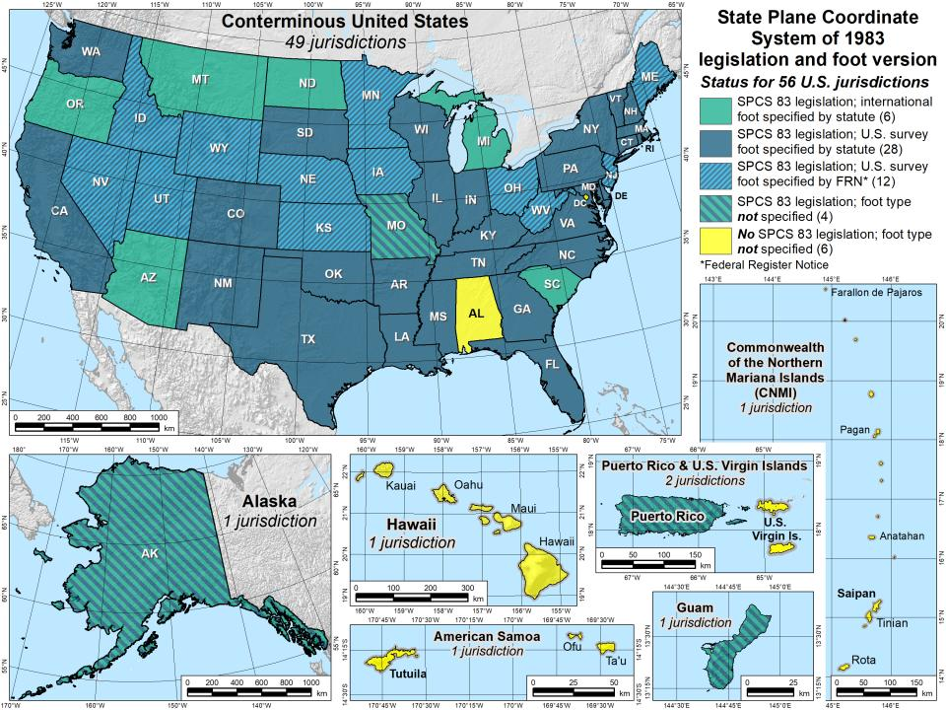

Slide 63
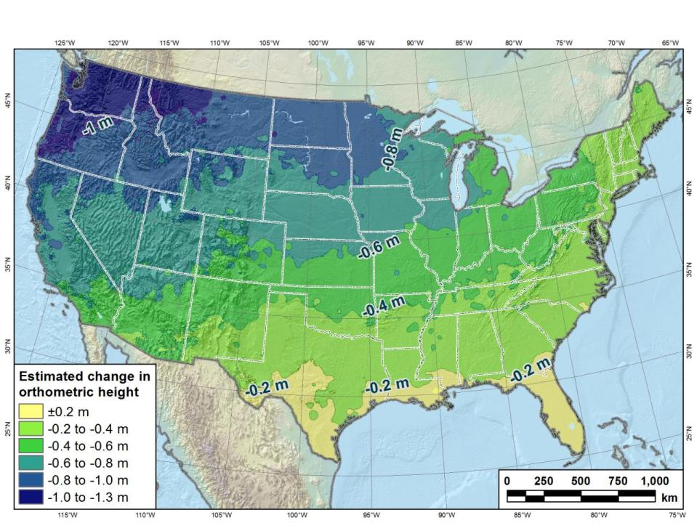
Estimated change in orthometric heights from NAVD88 to NAPGD2022
(NAPGD2022 approximated using xGEOID16B)

Slide 64

Preparing
Know the epoch of your data/datasets
  consider how you will track this
    full to-the-second timestamp on every feature?
      Modern survey equipment makes this possible
    labeling a year for each dataset?
      Easy to add to workflows, datasets/databases, folders
    something in-between that works for your needs?
2023.1957
2023:27
20230127
Epoch nomenclature is your choice

Slide 65
Preparing
Reprocessing your data
  perfect world = everyone reprocesses everything
    what does this mean?
      consider an ALTA w/topo
        start over with the onsite GNSS-based control
        reorient all your shots/ties (hopefully linked)
        recreate all the drainage features in new datum
    unrealistic! … and unnecessary for majority users
Notes:
Reprocessing your data
in a perfect world, everyone would reprocess data
consider a final product like you use everyday - a hydro-enforced DEM
starting fresh with the raw GNSS/IMU processing
generate new ellipsoid height point clouds
recreate all the drainage features in new datum
this is totally unrealistic → both from a financial and programmatic perspective

Slide 66
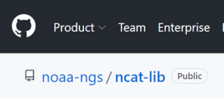
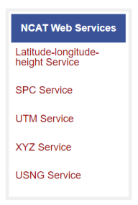
Preparing
  Transforming your data
    NCAT - NGS Coordinate Conversion and Transformation Tool
      ASCII up/download, Web Services, Download, GitHub
      ask your software provider(s) about integration
        we envision COTS integrations as most popular method of access
        Industry Workshops - May 2021 and August 2022
          Esri, Trimble, Blue Marble, etc… all the well known names attended
        Geospatial Software Developers’ Summit – Nov/Dec
          International & Virtual → US NGS and NRCan CGS
Notes:
Transforming your data
NCAT - NGS Coordinate Conversion and Transformation Tool
available now: ASCII upload and Web Services
ask your software providers about integration
we envision this as most popular method of access
Industry Workshop held this year – esri, trimble, bluemarble, all the major well known names were represented
labeling a year for each dataset?
something in-between that works for your needs

Slide 67
Remember…
  What’s the goal of NATRF2022?
    Give you the stability in positions that you expect
  That’s the point of Reference Epochs (REs)
    Akin to the different realizations of NAD83
    REs will be published every 5 or 10 years
      you choose when you update
      in a perfect world, everyone would stay current
aka versions
Notes:
What’s the goal of the way NATRF2022 was designed, by including EPP2022 and IFVM2022
Does a database of manholes in PA need cm-level coordinate updates on an annual basis? Probably not.

Slide 68
Additional Resources

Slide 69
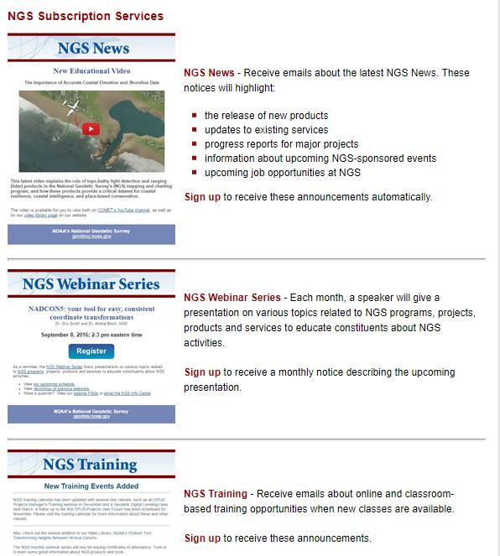

Email Subscriptions
*Only 1-2 messages per month*
NGS News
  Includes quarterly NSRS Modernization newsletter
Webinar Series
Training
GPS on Benchmarks
Click this icon on homepage

Slide 70

Jeff Jalbrzikowski, P.S., GISP, CFS
Appalachian Regional Geodetic Advisor
jeff.jalbrzikowski@noaa.gov
240-988-5486
https://www.ngs.noaa.gov/ADVISORS/
or search: “NGS advisors”
Scan the QR code to save my contact info to your phone

Slide 71
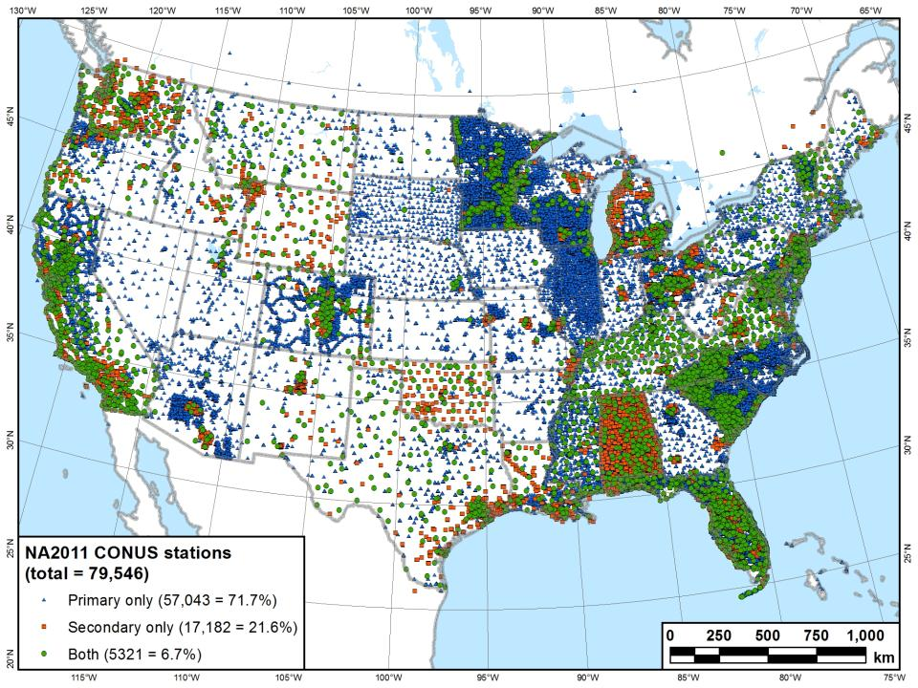
What you see in a map of NSRS control…

Slide 72
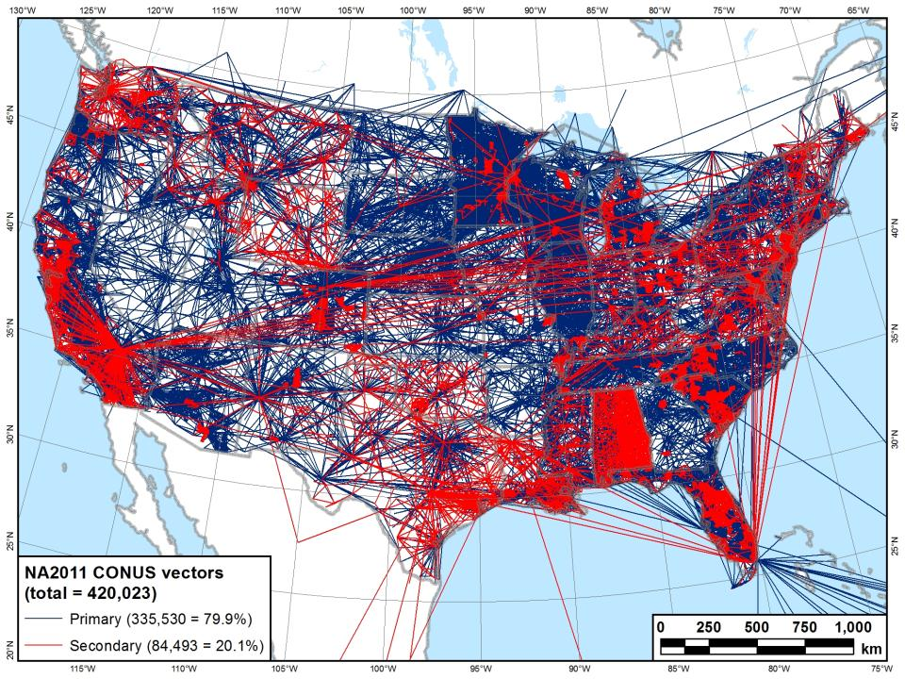
What we see in a map of NSRS control…

