Slide 1
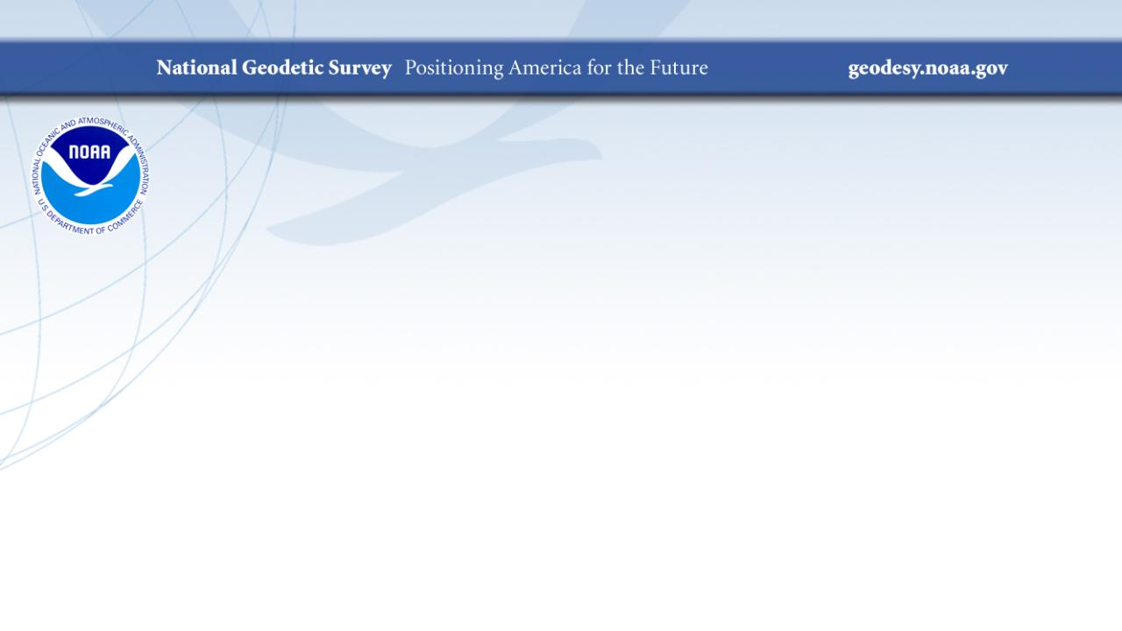
A Deep Dive into
Geodetic Surveying
WVDOH Survey Crew Conference
October 2024
Jeff Jalbrzikowski, P.S., GISP, CFS
Appalachian Regional Geodetic Advisor
jeff.jalbrzikowski@noaa.gov
240-988-5486

Slide 2



Organizational Structure
  -Department of Commerce (DoC)
  (~47,000 employees)
  -National Oceanic and Atmospheric Administration (NOAA)
  -National Ocean Service (NOS)
  -National Geodetic Survey (NGS)
  (~175 employees)
Notes:
-We are the Federal Government’s oldest scientific agency.
-part of the Executive Branch
-I know it can seem kind of strange that NGS is part of the NOS, but the origins of NGS lie with the C&GS.
-we are a “Program Office” of the NOS
Survey of the Coast – 1807
Coast Survey – 1836
Coast and Geodetic Survey – 1878
NGS since 1970

Slide 3


Organizational Structure
We’re not USGS, we’re NGS
  -Department of Commerce (DoC)
  (~47,000 employees)
  -National Oceanic and Atmospheric Administration (NOAA)
  -National Ocean Service (NOS)
  -National Geodetic Survey (NGS)
  (~175 employees)
≠
Notes:
-as you can read my slide, I like to point that out because over my 2 years at NGS I’ve seen and heard this misunderstanding quite a bit
-don’t worry! it doesn’t offend us! and we do work closely with USGS, but we are separate agencies within totally different departments of the federal government

Slide 4
Any references to any commercially available hardware or software do not constitute an endorsement or a disapproval of any manufacturers, developers, dealers, or suppliers.
Thanks.

Slide 5
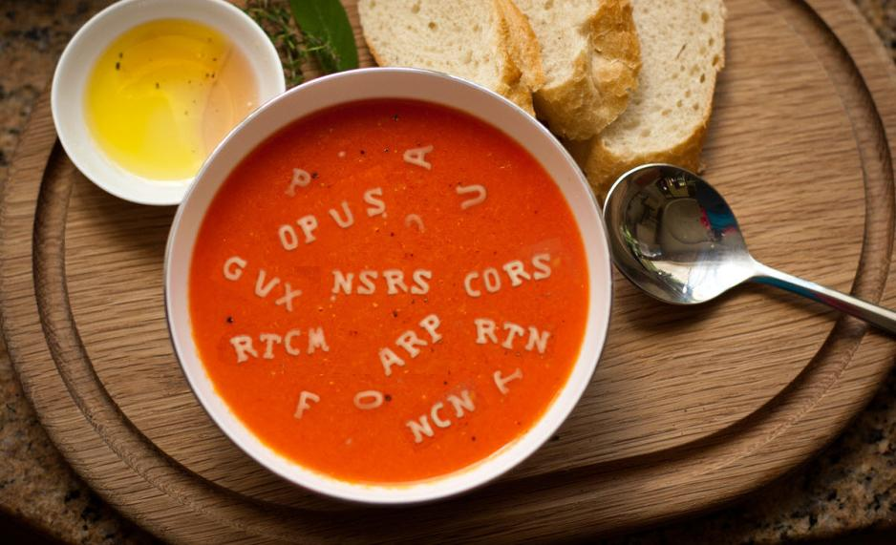
Let’s start with some alphabet soup

Slide 6
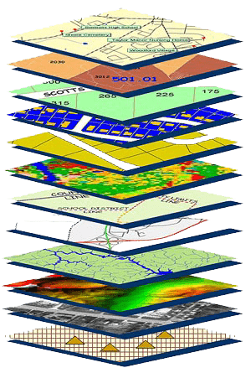
NGS Mission
To define, maintain and provide access to the National Spatial Reference System (NSRS) to meet our Nation’s economic, social, and environmental needs.
NSRS
Notes:
NGS develops and maintains the National Spatial Reference System, a national coordinate system that provides the foundation for transportation, navigation, land record systems, mapping and charting efforts, and a multitude of scientific and engineering applications
CLICK
You’ve all seen this or some similar graphic I’m sure. That bottom layer… that’s our baby, the NSRS.

Slide 7
Yes, we are delayed.
  NSRS Modernization
Notes:
So remember, today’s presentation is not JUST about new datums, it is about modernizing the NSRS as a whole.
You don’t know what the NSRS is? Stay tuned, we’ll get there as we go along.

Slide 8
Delayed Release of the Modernized NSRS
How long will the delay be?
  Our website or newsletter is best source of projected timeframe, current estimate is middle of 2025.
Will the names stay the same?
  Yes, terms containing “2022” such as “NATRF2022” and “NAPGD2022” will remain the same.
Will all previously proposed products be released along with the new datums?
  No, they will not. Check out our June 2022 webinar.
hyperlink to the Track Our Progress homepage
June 2022 webinar
hyperlink to the full FAQ

Slide 9
Modernizing the NSRS
Updating all NSRS coordinates
  Replace existing datums with new datums
  Replacing existing SPCS83 with new SPCS2022
  Accounting for coordinates changing with time
Improving NGS products and services
Simplifying customer contributions
Making the NSRS:
  More accurate
  More accessible
  More efficient
begins
Rollout in
2025

Slide 10
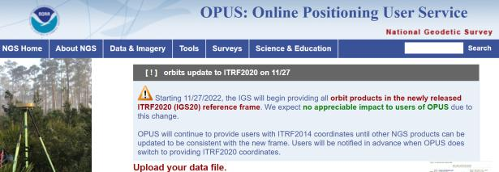
NGS Mission
To define, maintain and provide access to the National Spatial Reference System (NSRS) to meet our Nation’s economic, social, and environmental needs.
access… ? = traditionally → marks/disks/objects
= modern and future → NOAA CORS Network (NCN)
via OPUS
Notes:
Follow up thought
-like it or not, we know that the vast majority of our users are obtaining NSRS coordinates via OPUS
-while that is our plan for the future of primary access, modernized NSRS, as of now the official form of access (specifically to NAVD88) truly is to “touch brass” as they say → meaning occupy a benchmark

Slide 11
Online Positioning User Service
      dual frequency receiver
      static observations (via RINEX → ABCD123x.24o)
      30 seconds epoch/logging rate aka recording interval
  OPUS Rapid Static (OPUS-RS)
      15 minutes to 2 hours of GPS data
  OPUS Static (OPUS-S)
      same requirements as above
      2 to 48 hours of GPS data
  OPUS Projects (OP)
      adds session processing and network adjustment
      training by NGS currently required (~12 hours)
Also Beta OPUS-S
Multi-constellation
More CORS checking
Notes:
https://geodesy.noaa.gov/OPUS-cgi/OPUS-Projects/OpusProjects.prl?action=manage_project&project_keyword=nap025a&manager_keyword=nap025a

Slide 12
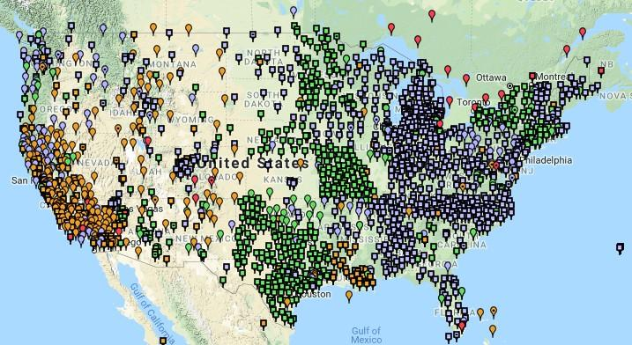
NOAA CORS Network (NCN)
Notes:
-I would like to point out we have a new, official name for the network you see represented on this map,
-The NOAA CORS Network, or NCN
CLICK
-this is neat little graphic with some stats on teh NCN you can find on our website
-below the gaphic youll find a search bar with more information

Slide 13
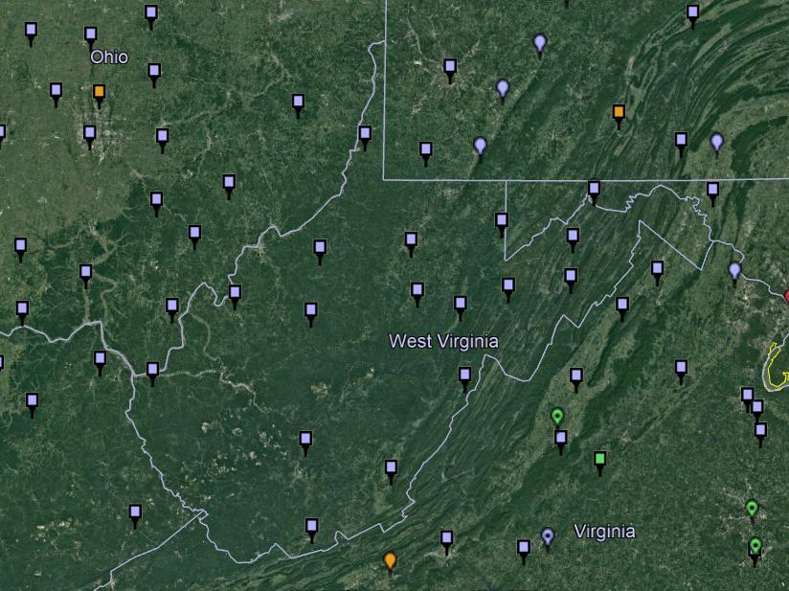
NOAA CORS Network (NCN) in WV

Slide 14
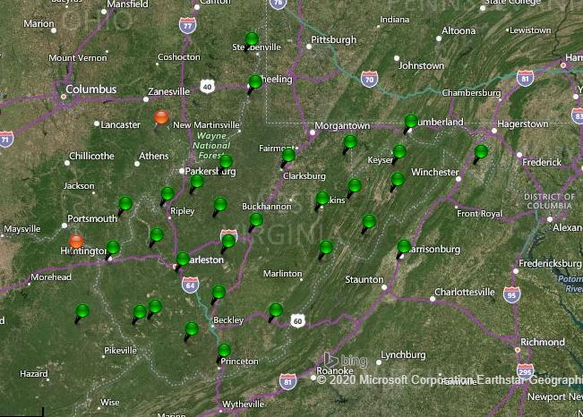
WVDOT CORS Network (and RTN)
Notes:
Just for the sake of discussion, I will point out that the WVDOT’s real time network is based on VRS method

Slide 15
NOAA CORS Network (NCN) in WV

Slide 16
WVDOT CORS Network (and RTN)
non-NCN CORS
Notes:
And now by me flipping back and forth between these, you’ve likely caught on that the stations in red are non-NCN CORS

Slide 17
Positional Components of
the NSRS
Geometric
aka “Horizontal”
Latitude, Longitude, Ellipsoid Height
Geopotential
aka Orthometric Height
aka “Elevation”
NAD83
NAVD88
Notes:
-geometric component is latitude, longitude, and ellipsoid height
-geopotential component is combined with the geometric components to calculate an ortho height or capital H

Slide 18
NATRF2022
North American Terrestrial Reference Frame of 2022
will replace
NAD83
North American Datum of 1983
Technically, not just NATRF2022 but also its 3 sister TRFs…

Slide 19
Four TRFs for Modernized NSRS
North American Terrestrial Reference Frame of 2022
(NATRF2022)
Pacific Terrestrial Reference Frame of 2022
(PATRF2022)
Caribbean Terrestrial Reference Frame of 2022
(CATRF2022)
Mariana Terrestrial Reference Frame of 2022
(MATRF2022)

Slide 20
Terrestrial Reference Frame?
Existing, accepted terminology
  International TRF
  first realization of the ITRF was 1988
  NATRF2022 will be based on ITRF2020
“Horizontal Datum” - misnomer for NAD83
  Really is a Geometric Reference Frame
Notes:
-Where do you see an Epoch right now in NGS data?
CLICK
Datasheets! there you see the epoch of 2010.0
and of course OPUS Solution Reports!
note that in blue over there on the right you’ll see another epoch, in the ITRF, which I will explain later on

Slide 21
International Terrestrial Reference Frame (ITRF)
Is native coordinate system for NCN.
Is what OPUS uses.
Is what most of world uses.
Is what NGA aligns WGS-84 to.
Notes:
So what is that acronym, ITRF?
-it is a global reference frame, the most widely adopted one, or the “gold standard” or the “Cadillac” or what-have-you
-ITRF is the internationally recognized standard
-who realizes the ITRF? well, NGS contributes to the realization but
CLICK
-The IERS is in responsible charge of defining, realizing and promoting the ITRF
-and the ITRF was formally adopted by the…yes, more acronyms
CLICK
IUGG some years ago

Slide 22
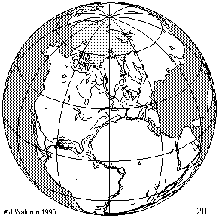
ITRF concept
Watch the grid!
Epoch:
Notes:
Ok, now ITRF mentioned a couple slides ago.
Most simplistic way to explain ITRF is to watch this animation.
This is a very loose representation/visualization of what the ITRF is, a characterization only.

Slide 23
Plate-Fixed NSRS TRFs
ITRF
Frame = constant
NA Plate = rotating
NATRF
Frame = rotating
(relative to ITRF)
NA Plate = constant
(relative to NATRF2022)
Notes:
We say “NATRF2022” is “fixed” to the N.A. Plate, making it a “plate fixed” frame
-the frame is constant to itself, but rotating within ITRF, and moving in a different direction than the other 3 frames

Slide 24
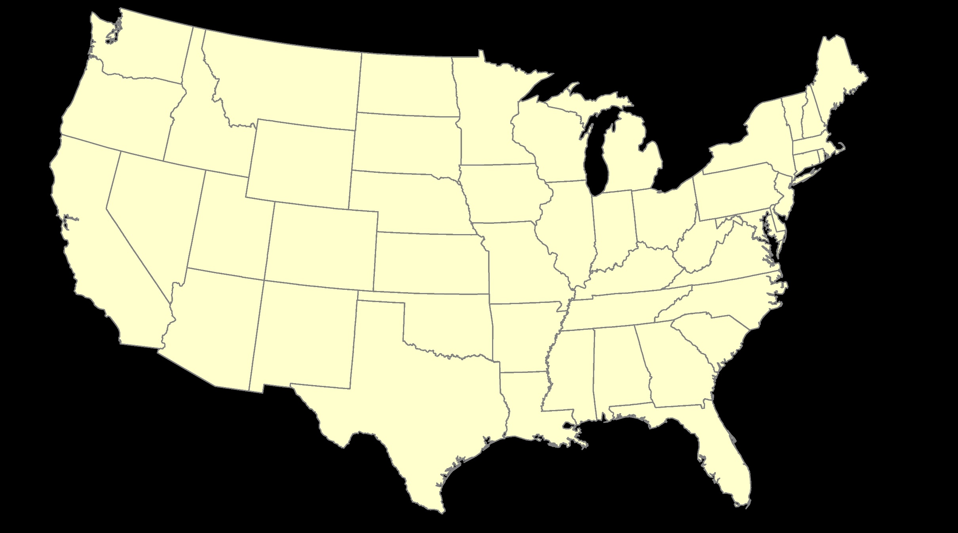
ITRF – constant frame, rotating plate

Slide 25
Plate-Fixed
NATRF – rotating frame, constant with plate

Slide 26
if you know epoch
ITRF or NATRF – your choice if you know epoch

Slide 27
Decades of continuously logged GPS data from the NOAA CORS Network (NCN).
  But how?

Slide 28
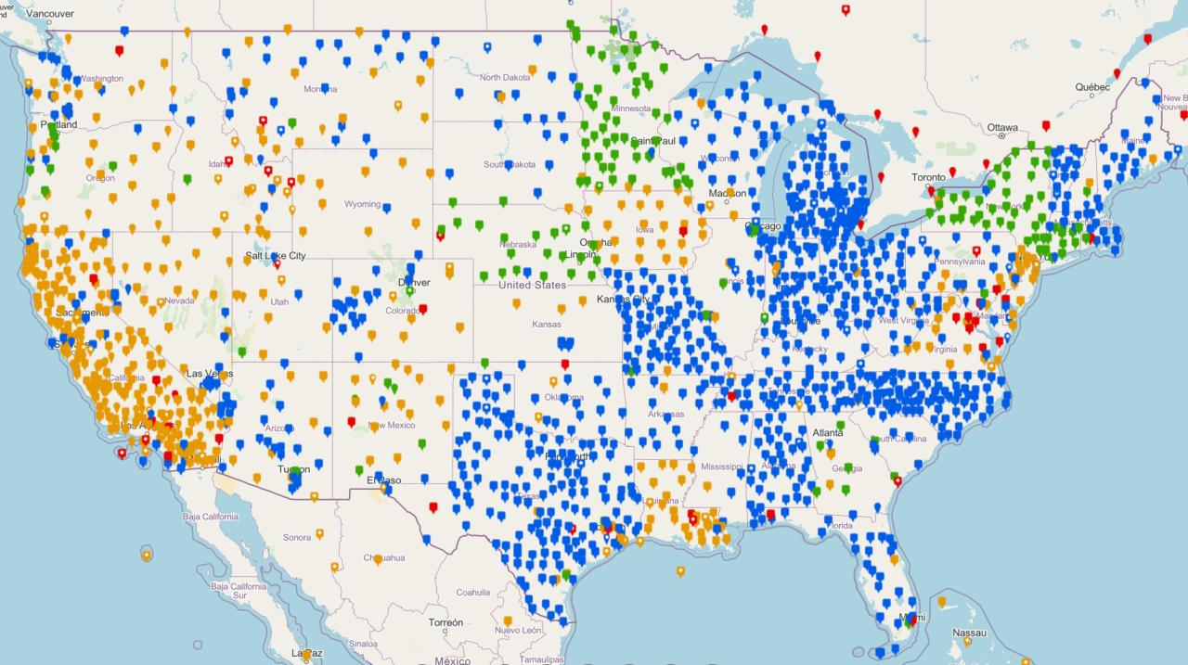
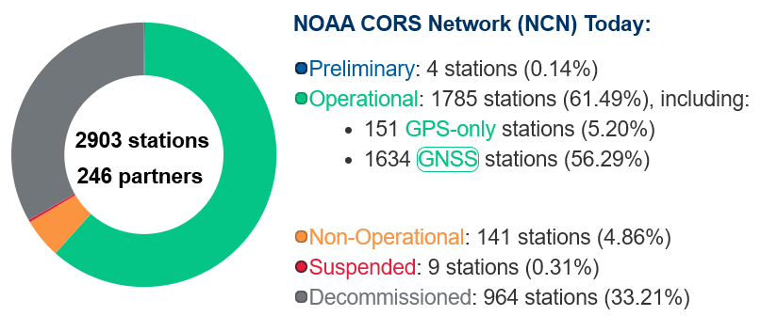
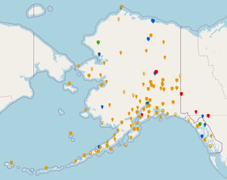
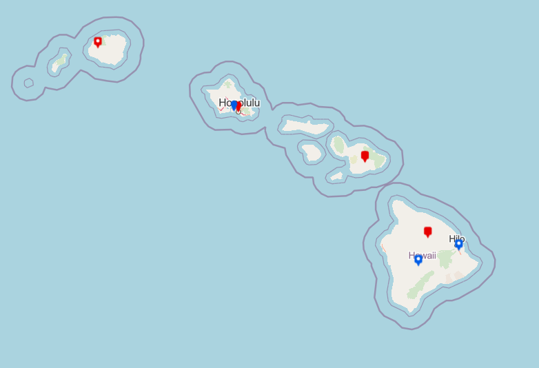
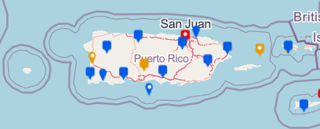
NOAA CORS Network (NCN)
Notes:
The NOAA CORS Network is a multi-purpose, multi-agency cooperative endeavor, combining the efforts of hundreds of government, academic, and private organizations.
The stations are independently owned and operated.
Each agency shares their GNSS observations and station metadata with NGS, which are analyzed and archived.
The data is distributed free of charge with multiple forms of access.

Slide 29
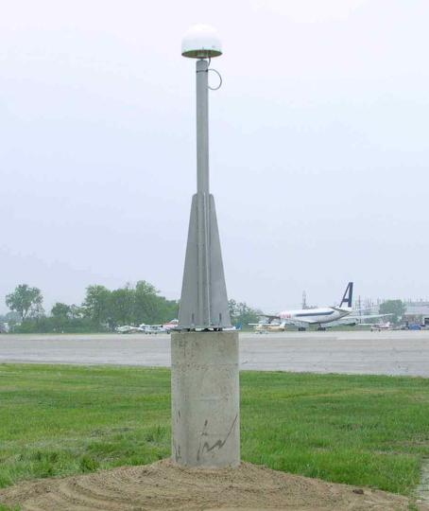
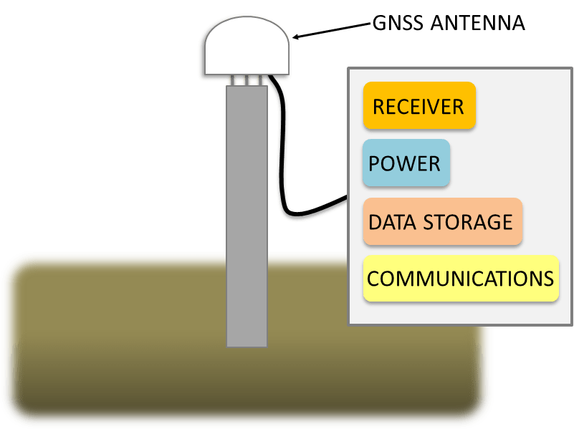
Continuously Operating Reference Station

Slide 30
NOAA CORS Network (NCN)

Slide 31

Plate-Fixed
NATRF – rotating frame, constant with plate
= CORS

Slide 32
Plate-Fixed
ITRF or NATRF
= CORS
Notes:
ITRF is independent of any plates, tied to the layer below,
-”plate-agnostic” if we want to sound all silicon valley ish
-the plates go down about 200 km (125 mi) deep below our feet right now, as we’re on a continental plate
--(oceanic plates are roughly half the thickness, like 100 km)
-→ but thickness of the tectonic plates varies greatly, from down to 15 km up over the 200 km I mentioned earlier

Slide 33
Terminology – Time/4D
Epoch
eh-puck? ee-pock? … to-may-to, to-mah-to
an instant of time; a moment in time
astronomy & geodesy use a decimal date
  2021.4762 = 23 June 2021 @ 19:16:00
  using epochs is important, not your format
    start preparing to assign epochs to your data
Notes:
-Where do you see an Epoch right now in NGS data?
CLICK
Datasheets! there you see the epoch of 2010.0
and of course OPUS Solution Reports!
note that in blue over there on the right you’ll see another epoch, in the ITRF, which I will explain later on

Slide 34
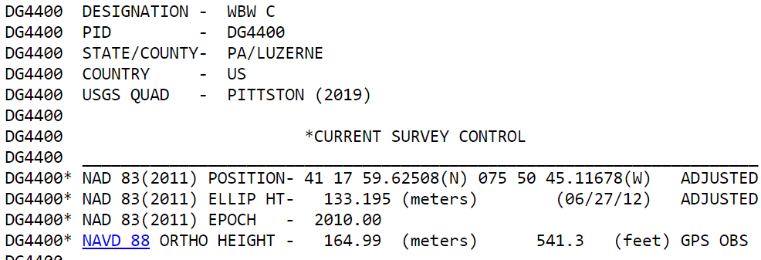
Notes:
-Where do you see an Epoch right now in NGS data?
Datasheets! there you see the epoch of 2010.0
and of course OPUS Solution Reports!
note that in blue over there on the right you’ll see another epoch, in the ITRF, which I will explain later on

Slide 35
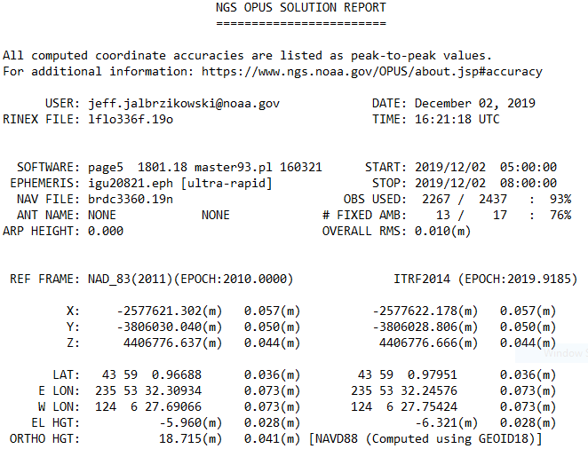
Reference Epoch
Survey Epoch
Notes:
-Where do you see an Epoch right now in NGS data?
and of course OPUS Solution Reports!
note that in blue over there on the right you’ll see another epoch, in the ITRF, which I will explain later on

Slide 36
What is a Reference Epoch?
If you use NAD83 you’re already using one, but probably didn’t know it.
First let’s look at complete nomenclature…

Slide 37
Complete NAD83 Nomenclature
NAD83(2011) epoch 2010.00
Geometric
Datum
Realization
(aka Datum Tag)
Epoch
(in the case of NAD83, a Reference Epoch)
Other NAD83 Reference Epochs
NAD83(1986) epoch 1984.00
NAD83(HARN) epoch 1993.62
NAD83(CORS96) epoch 2002.00
NAD83(2007) epoch 2007.00
NAD83(2011) epoch 2010.00
ITRF2014 epoch 2019.9185
IGS08 epoch 2005.00
NATRF2022 epoch 2020.00
NAD83(1986) epoch 1984.00
NAD83(HARN) epoch 1993.62
NAD83(CORS96) epoch 2002.00
NAD83(2007) epoch 2007.00

Slide 38
Reference Epoch
Survey Epoch
Notes:
-Where do you see an Epoch right now in NGS data?
and of course OPUS Solution Reports!
note that in blue over there on the right you’ll see another epoch, in the ITRF, which I will explain later on

Slide 39
What is a Survey Epoch?
If you use OPUS you’re already using one, but perhaps unaware.

Slide 40
Complete ITRF Nomenclature
ITRF2014 (epoch 2021.0276)
Geometric
Datum
Epoch
(in the above example, a Survey Epoch)
ITRF Reference Epochs
NAD83(1986) epoch 1984.00
NAD83(HARN) epoch 1993.62
NAD83(CORS96) epoch 2002.00
NAD83(2007) epoch 2007.00
NAD83(2011) epoch 2010.00
ITRF2014 epoch 2019.9185
IGS08 epoch 2005.00
NATRF2022 epoch 2020.00
Examples of ITRF Survey Epoch
ITRF92 epoch 1988.0
ITRF2000 epoch 1997.0
ITRF2005 epoch 2000.0
ITRF2008 epoch 2005.0
ITRF2014 epoch 2010.0
ITRF2008 epoch 2012.2011
IGS08 epoch 2006.7572
ITRF2014 epoch 2017.4457
ITRF2014 epoch 2019.9185
ITRF2014 epoch 2021.0276

Slide 41
Coordinate Operations
Conversion
    change the type of coordinate
    NAD83(2011) latitude & longitude → NAD83(2011) SPCS
  Transformation
    change the datum of coordinate
    NGVD29 height → NAVD88 height
    NAD 27 latitude & longitude → NAD 83(2011) latitude & longitude
Propagation
    change the epoch of coordinate
    NATRF2022 epoch 2020.00 to NATRF2022 epoch 2023.243
Notes:
Historically NGS has been inconsistent with these top two words.
Going forward, we will use them as:
Conversion: Meaning to change the type of coordinate without changing the datum or frame
Transformation: Meaning to change the datum or frame, without changing the type of coordinate

Slide 42
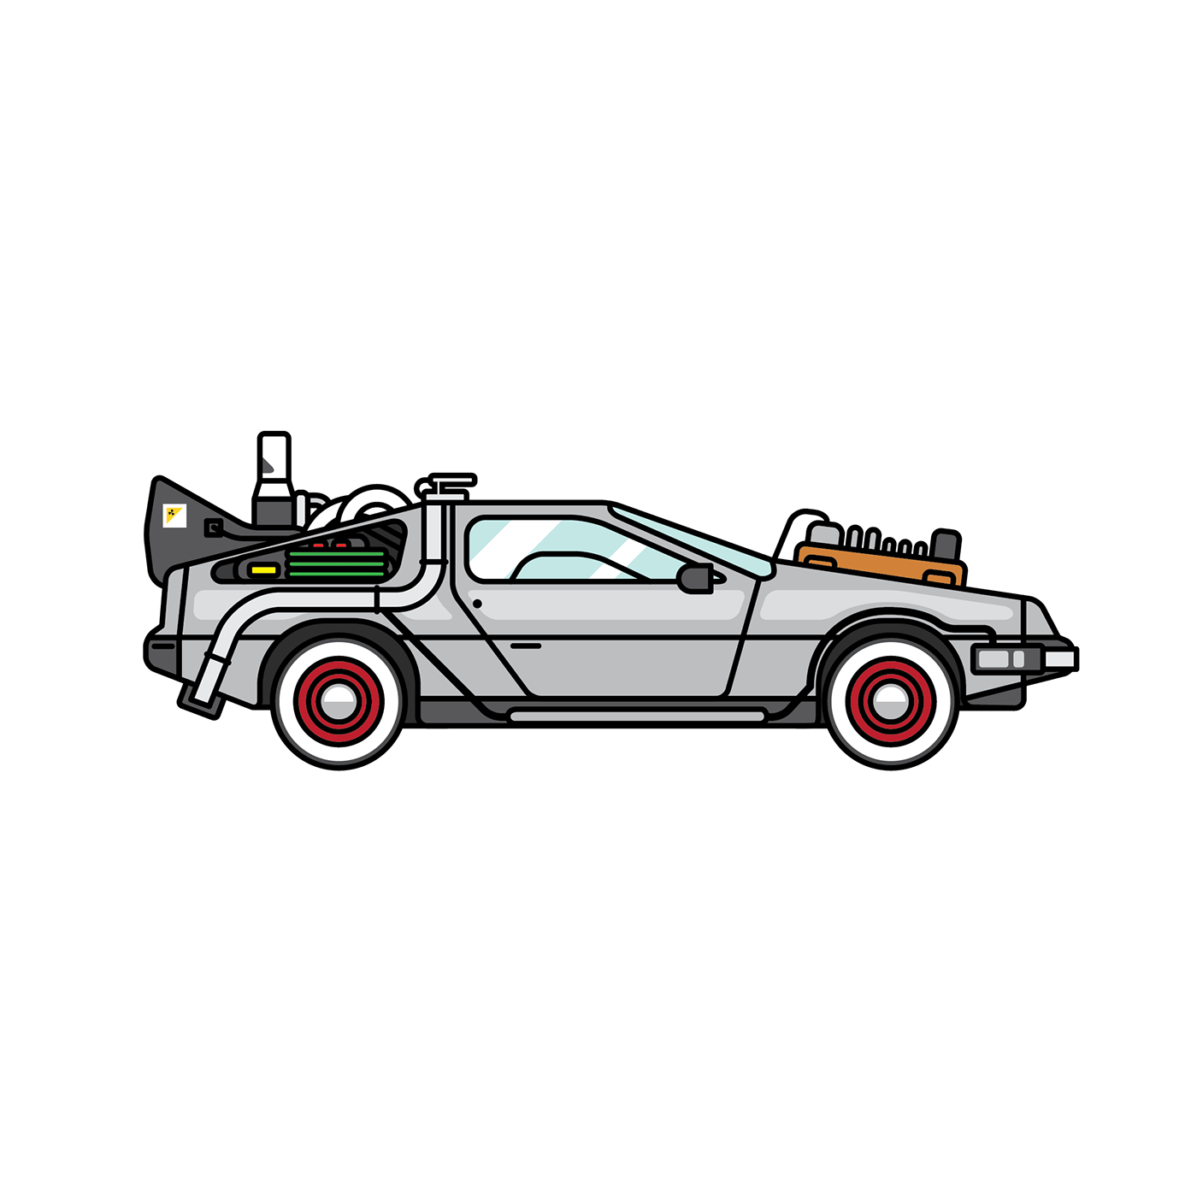
NCAT
  How will you propagate coordinates back in time from SE to RE?
NGS Coordinate Conversion And Transformation Tool (NCAT)
Epochs/Time/4D
Notes:
-so you’ve probably seen that phrase that I have front and center here, NSRS Modernization
-that’s the blanket term we use to refer to not just the new datums but other updates

Slide 43
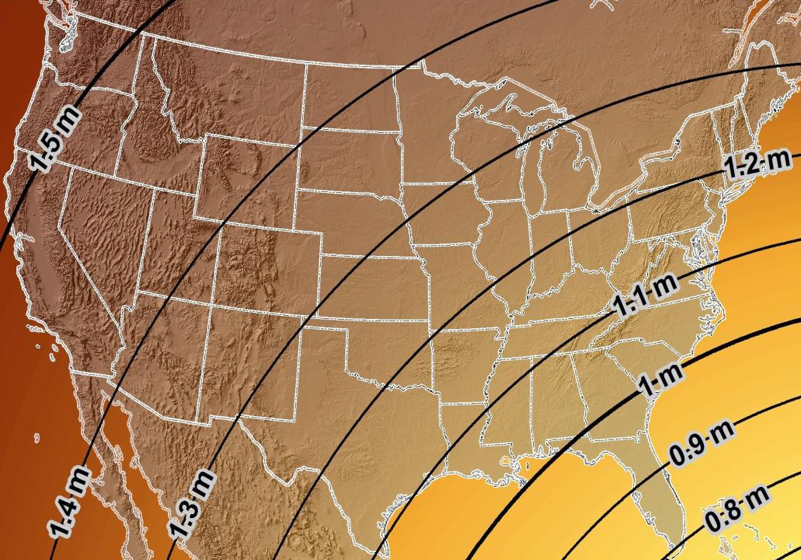
Estimated Geometric Change - Horizontal
NAD83 (2011) → NATRF2022
4.6 ft
Direction of Shift
4.3 ft
3.9 ft
3.6 ft
3.0 ft
Notes:
What’s the magnitude of the horizontal datum shift across Pennsylvania?
Minimum Shift ~3.75 feet
Maximum Shift ~3.97
Remember this is just an estimation, don’t hold me to the numbers please

Slide 44


Slide 45
New Lat/Long = New XY
With a new horizontal datum…
  NAD 83 to be replaced by NATRF2022
There comes a new set of State Plane Coordinate System zones
  SPCS 83 to be replaced by SPCS2022

Slide 46

A “flat” Earth for the future
State Plane Coordinate System of 2022 (SPCS2022)
Similar to existing State Plane…
  Same 3 map projection types
  Same ellipsoid (GRS 80)
But different…
  Based on new datums instead of NAD 83
  Designed to reduce difference between “grid” and “ground”
  Many more “zones”
  Zones “layers” will exist in most states
Lambert Conformal Conic (LCC)
Transverse Mercator (TM)
Oblique Mercator (OM)

Slide 47
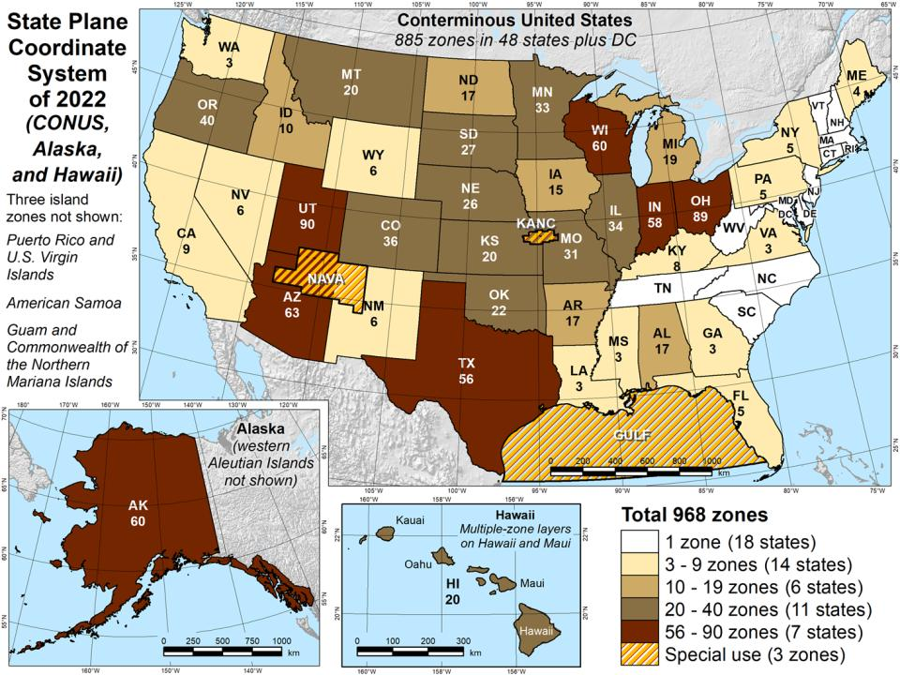

Slide 48
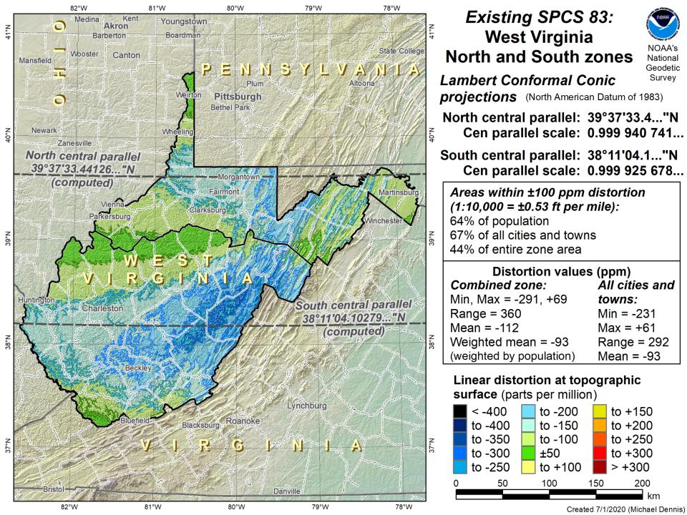

Slide 49
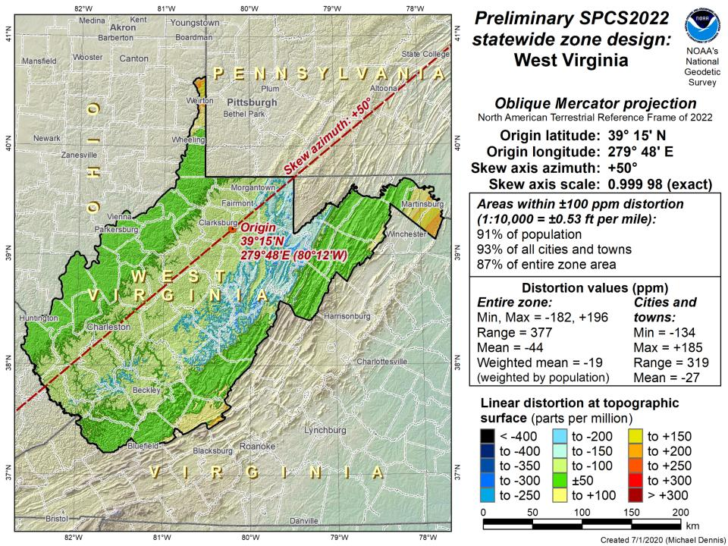
Northings are still North
Eastings are still East

Slide 50
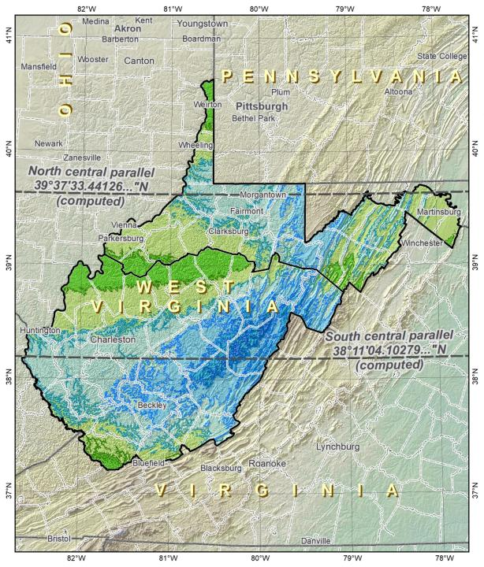
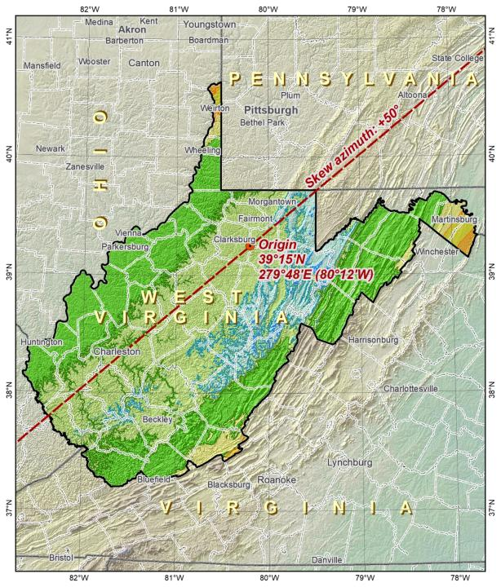
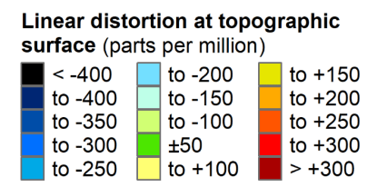
SPCS83
SPCS2022

Slide 51
SPCS2022 Zone Layers and LDPs
Each state may have max of 3 zone “layers”
  One layer must be statewide zone
    West Virginia Single Statewide
  Other layers have two or more zones
    Multi-Zone
  A third layer can exist, but can only be partial coverage
    Low Distortion Projections (LDPs) for specific areas

Slide 52
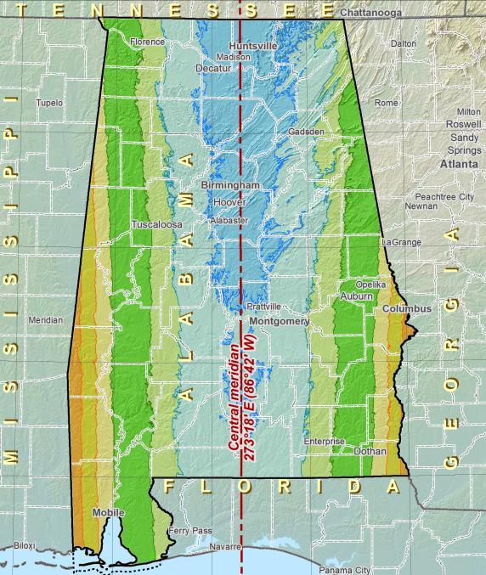
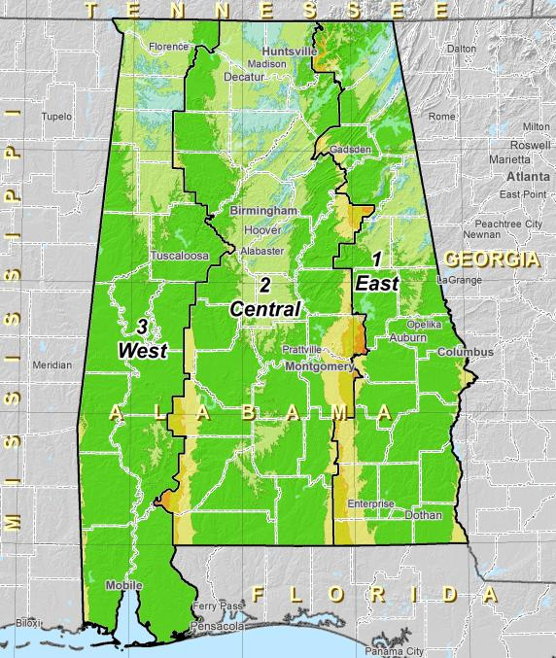
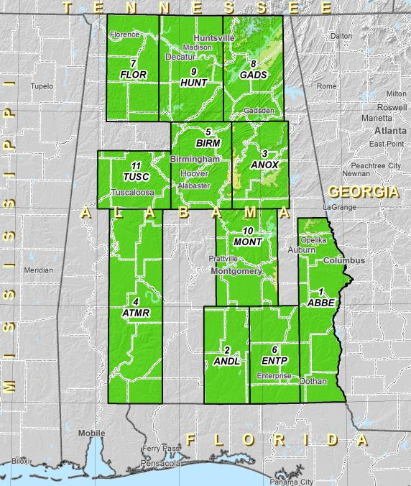
Zone Layers
Single Statewide
Multi-Zone Complete
Multi-Zone Partial

Slide 53
Zone Layers

Slide 54
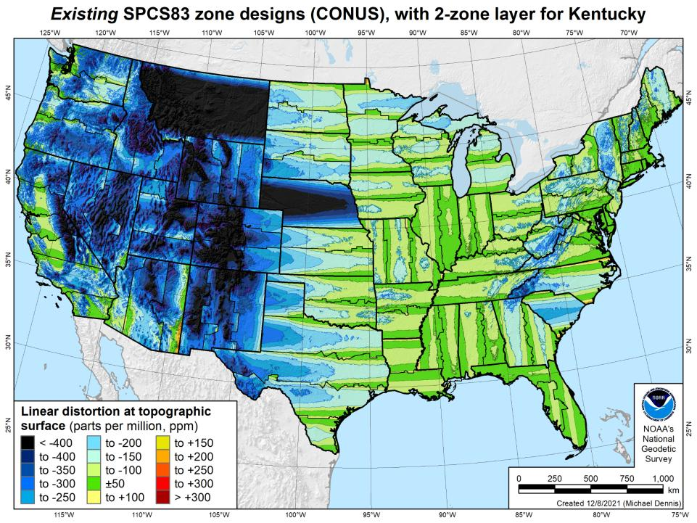
Notes:
What’s the best performing zone layer anywhere?

Slide 55
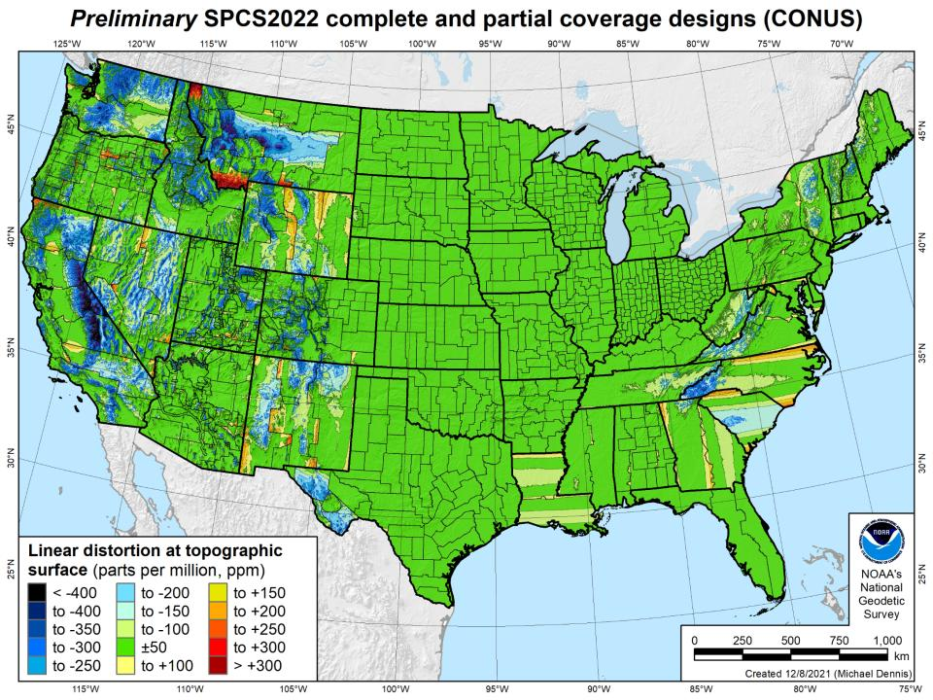

Slide 56
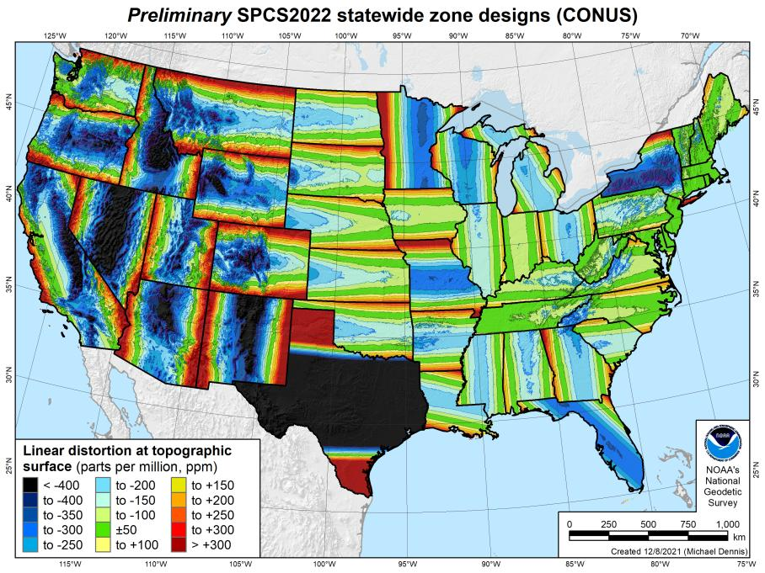
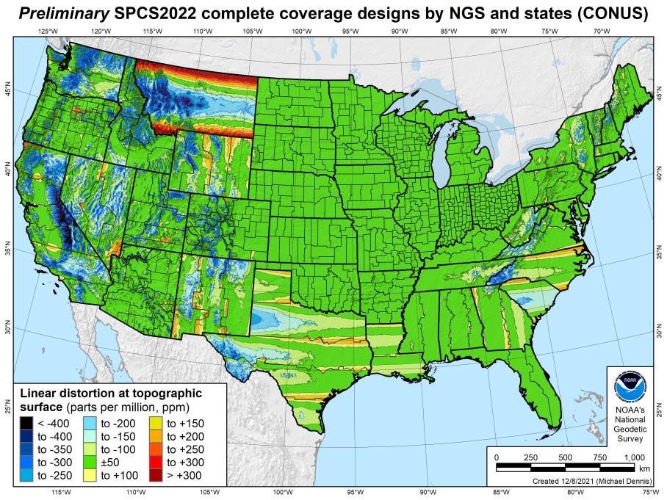
SPCS2022 linear distortion (prelim)
846 zones (CONUS)
Percent within distortion (ppm):
Distor | Pop | Cities | Area
±20 | 76% | 71% | 58%
±50 | 92% | 89% | 76%
±100 | 98% | 97% | 89%
±400 | 100% | 100% | 99.9%
City and area statistics (ppm):
 | Min | -407 | -1438
 | Max | +486 | +2624
 | Range | 893 | 4062
 | Mean | -6 | -23
Mean weighted by pop = -4

Slide 57
The Survey Foot is dead!
Long live the Survey Foot!
US Survey Foot was deprecated 31 December 2022…
But will always be available in NGS tools for NAD83 and NAD27
Notes:
We start with the SPCS83 zones as a frame of reference
NOTE that the color shading of these zones is matched to that of the Preliminary SPCS2022 Zones that follow

Slide 58
Positional Components of
the NSRS
Geometric
aka “Horizontal”
Latitude, Longitude, Ellipsoid Height
Geopotential
aka Orthometric Height
aka “Elevation”
NAD83
NAVD88
Notes:
-geometric component is latitude, longitude, and ellipsoid height
-geopotential component is combined with the geometric components to calculate an ortho height or capital H

Slide 59
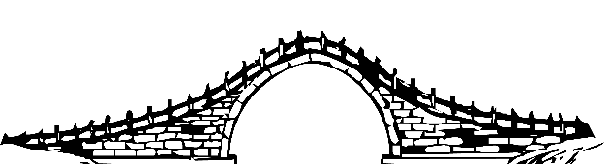
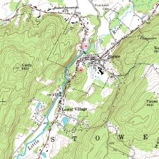
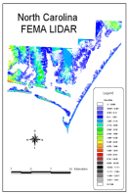
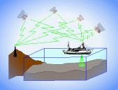
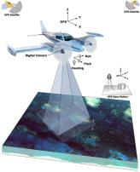

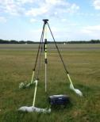
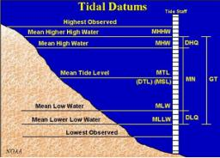
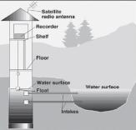
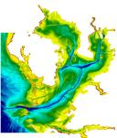
Three types of heights in NSRS
Ellipsoidal
geoid
Orthometric
Raw Hydrographic Surveys
USGS
Topography
NAD83
NAVD88
NGVD29
FEMA NFIP Data & Maps
Engineering and Construction Surveys
Raw GPS Observations
Raw Lidar Data
Water Level or Tidal
NOAA and USACE Hydrography
Shoreline Mapping and Regulatory Boundaries at the Coast
Daily and Extreme Water Levels (Gage)
Notes:
This slide illustrates the 3 categories of vertical datums and examples of where each is directly used They are project and application dependent.
First, we have ellipsoidal datums. Examples include WGS84 and NAD83 (North American Datum of 1983). You will encounter these datums frequently in hydrographic surveys that are vertically referenced with RTK-GPS; any native GPS measurements; and even raw lidar datasets.
Next, we have orthometric datums. These datums are very important because height differences referenced to orthometric datums will allow us to know the direction water will flow, because they have been “gravity-corrected”. The North American Vertical Datum of 1988 (or NAVD 88) is an orthometric datum, which you will see on USGS topographic maps, engineering and development site surveys, and FEMA Flood Insurance Rate Maps.
Finally, we have Tidal Datums, which are derived from water level measurements. They have extremely important applications including daily and extreme water levels; NOAA nautical charts, and shoreline mapping or boundaries along the coast.
*NOAA provides tools (like NCAT and Vdatum) to transform between these different height systems.
The Bridge

Slide 60
North American Vertical Datum
of 1988
NAVD88
will be replaced by

Slide 61
North American-Pacific Geopotential Datum of 2022
NAPGD2022
(pronounced: nap-jee-dee)

Slide 62
NAVD88 geoids
versus
NAPGD2022 geoids

Slide 63
Two types of geoid models
  Gravimetric
  Hybrid
Notes:
-believe it or not there’s more than 2 types, but the 2 types you’ll see NGS publish are…

Slide 64
Gravimetric → Hybrid
  Gravimetric geoid is created from “scratch” with various types of gravity data
      USGG2003, USGG2009, USGG2012, xGEOID19
  Hybrid geoid is simply a gravimetric geoid then best fit some vertical datum… like NAVD88
      GEOID03, GEOID09, GEOID12B, GEOID18
Notes:
So… all the geoids you’re using to get elevations from your GNSS data

Slide 65
Gravimetric → Hybrid
      USGG2003, USGG2009, USGG2012, xGEOID19
      GEOID03, GEOID09, GEOID12B, GEOID18
best fit to NAVD88
best fit to NAVD88
best fit to NAVD88
best fit to NAVD88
Notes:
So… all the geoids you’re using to get elevations from your GNSS data

Slide 66
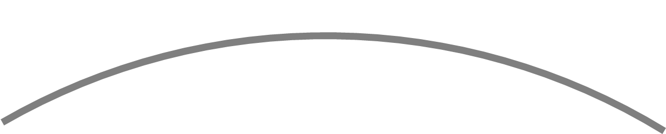
Gravimetric vs. Hybrid Geoid
topographic surface
gravimetric geoid
hybrid
geoid
datum zero
surface
Concept
Notes:
-importantly, the height chosen was to minimize 29→88 differences on USGS topo maps in the eastern U.S. … thus, the “zero height surface” of NAVD 88 was NOT chosen for its closeness to the geoid (but it was close…few decimeters)

Slide 67
NAVD88 uses a Hybrid Geoid
topographic surface
gravimetric geoid
hybrid
geoid
datum zero
surface
Concept
Notes:
-importantly, the height chosen was to minimize 29→88 differences on USGS topo maps in the eastern U.S. … thus, the “zero height surface” of NAVD 88 was NOT chosen for its closeness to the geoid (but it was close…few decimeters)

Slide 68
NAPGD2022 uses a Gravimetric Geoid
topographic surface
gravimetric geoid
datum zero
surface
  Datum zero surface aligned to Global Mean Sea Level (GMSL)
Concept
Notes:
-importantly, the height chosen was to minimize 29→88 differences on USGS topo maps in the eastern U.S. … thus, the “zero height surface” of NAVD 88 was NOT chosen for its closeness to the geoid (but it was close…few decimeters)

Slide 69
Sea Level Change and the Geoid
H_{2020.000}
H_{2085.000}
Threshold Level
-Threshold Level is published as 20 cm
-Process is repeated as GMSL changes
Geoid
GMSL
Notes:
The illustrated strategy will be adopted at NGS. An animated characterization of this approach
What this means is that NGS will decouple the geoid from GMSL, until they have diverged by some threshold amount, currently defined as 20cm.
When that threshold is reached a new geoid will be defined and held fixed until reaching next threshold. In this way, the impact of the change of GMSL is accounted for in the heights of the NSRS, while the appearance of stability is maintained for “decades at a time” (BP2 Section 14).
If we calculate how long that might be based on existing rates of sea level rise of 3ish mm/yr then we’re talking over 50 years

Slide 70

Why leveling is not part of NAPGD2022
…but will still be important for you.
ground surface
equipotential surfaces
(equal gravity)
Geoid at Site Scale

Slide 71
Why leveling is not part of NAPGD2022
…but will still be important for you.
ground surface
equipotential surfaces
(equal gravity)
Geoid at Continental Scale

Slide 72
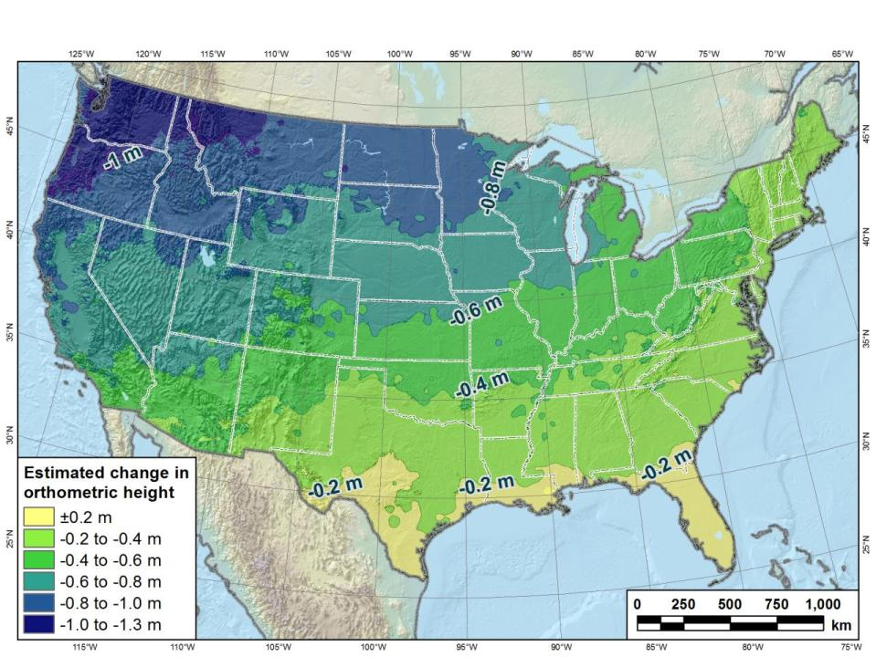
Estimated change in orthometric heights from NAVD88 to NAPGD2022
(NAPGD2022 approximated using xGEOID16B)

Slide 73
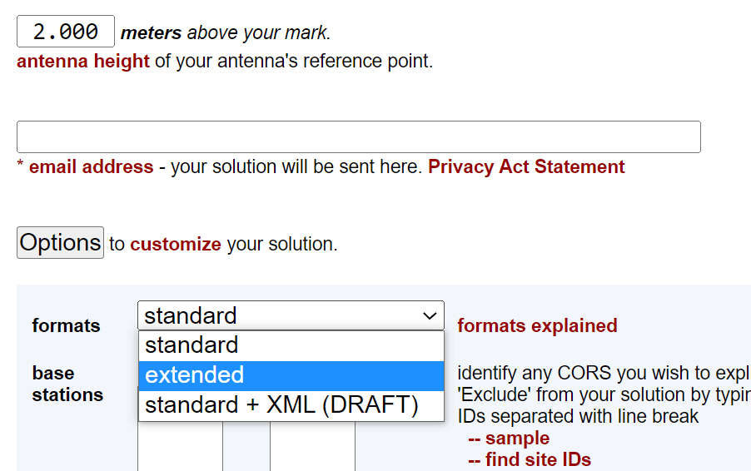
Estimated change in orthometric heights from NAVD88 to NAPGD2022
OPUS Extended Solution Report

Slide 74
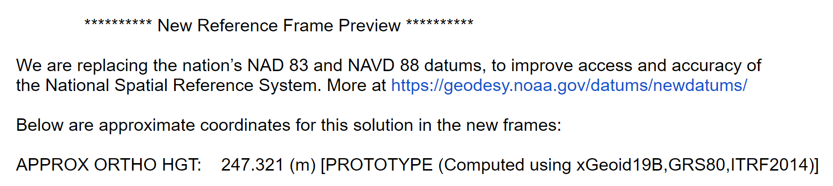
Estimated change in orthometric heights from NAVD88 to NAPGD2022
OPUS Extended Solution Report
  Scroll all the way to the bottom…

Slide 75

Preparing
Know the epoch of your data/datasets
  consider how you will track this
    full to-the-second timestamp on every feature?
      Modern survey equipment makes this possible
    labeling a year for each dataset?
      Easy to add to workflows, datasets/databases, folders
    something in-between that works for your needs?
2023.1957
2023:27
20230127
Epoch nomenclature is your choice

Slide 76
Preparing
Reprocessing your data
  perfect world = everyone reprocesses everything
    what does this mean?
      consider an ALTA w/topo
        start over with the onsite GNSS-based control
        reorient all your shots/ties (hopefully linked)
        recreate all the drainage features in new datum
    unrealistic! … and unnecessary for majority users
Notes:
Reprocessing your data
in a perfect world, everyone would reprocess data
consider a final product like you use everyday - a hydro-enforced DEM
starting fresh with the raw GNSS/IMU processing
generate new ellipsoid height point clouds
recreate all the drainage features in new datum
this is totally unrealistic → both from a financial and programmatic perspective

Slide 77
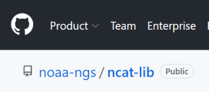
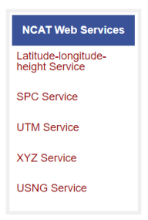
Preparing
  Transforming your data
    NCAT - NGS Coordinate Conversion and Transformation Tool
      ASCII up/download, Web Services, Download, GitHub
      ask your software provider(s) about integration
        we envision COTS integrations as most popular method of access
        Industry Workshops - May 2021 and August 2022
          Esri, Trimble, Blue Marble, etc… all the well known names attended
        Geospatial Software Developers’ Summit – Nov/Dec
          International & Virtual → US NGS and NRCan CGS
Notes:
Transforming your data
NCAT - NGS Coordinate Conversion and Transformation Tool
available now: ASCII upload and Web Services
ask your software providers about integration
we envision this as most popular method of access
Industry Workshop held this year – esri, trimble, bluemarble, all the major well known names were represented
labeling a year for each dataset?
something in-between that works for your needs

Slide 78
Remember…
  What’s the goal of NATRF2022?
    Give you the stability in positions that you expect
  That’s the point of Reference Epochs (REs)
    Akin to the different realizations of NAD83
    REs will be published every 5 or 10 years
      you choose when you update
      in a perfect world, everyone would stay current
aka versions
Notes:
What’s the goal of the way NATRF2022 was designed, by including EPP2022 and IFVM2022
Does a database of manholes in PA need cm-level coordinate updates on an annual basis? Probably not.

Slide 79
Additional Resources

Slide 80
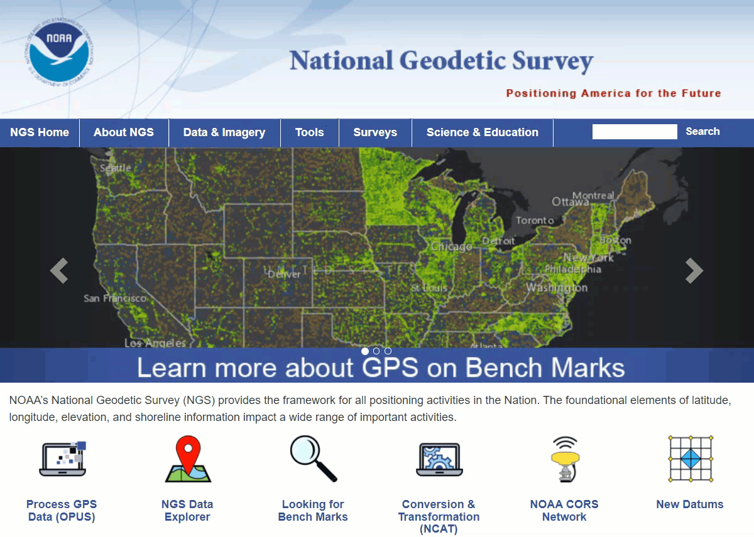
Educational Videos
<5 minutes
Online Lesson
(via MetEd/COMET)
~1 hour
NGS homepage: geodesy.noaa.gov
Notes:
Educational videos and online tutorials –
Our library of lessons and videos are great resources, and will reinforce a lot of information we covered today.
The videos are just 3-5 minutes long.
the lesson is a deeper dive but still only takes an hour.

Slide 81
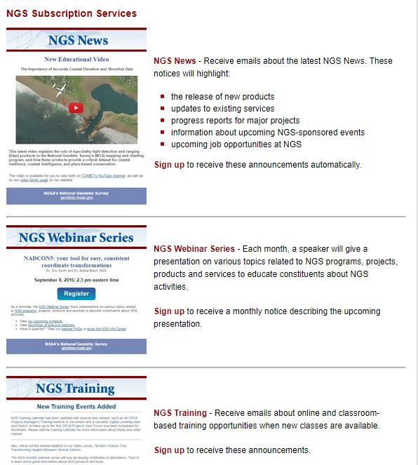

Email Subscriptions
*Only 1-2 messages per month*
NGS News
  Includes quarterly NSRS Modernization newsletter
Webinar Series
Training
GPS on Benchmarks
Click this icon on homepage

Slide 82

Jeff Jalbrzikowski, P.S., GISP, CFS
Appalachian Regional Geodetic Advisor
jeff.jalbrzikowski@noaa.gov
240-988-5486
https://www.ngs.noaa.gov/ADVISORS/
or search: “NGS advisors”
Scan the QR code to save my contact info to your phone

Slide 83

What you see in a map of NSRS control…

Slide 84

What we see in a map of NSRS control…

