Slide 1
Tying your non-NCN CORS to the NSRS
64th CGSIC Meeting
September 2024
Jeff Jalbrzikowski, P.S., GISP, CFS
Appalachian Regional Geodetic Advisor
jeff.jalbrzikowski@noaa.gov
240-988-5486

Slide 2
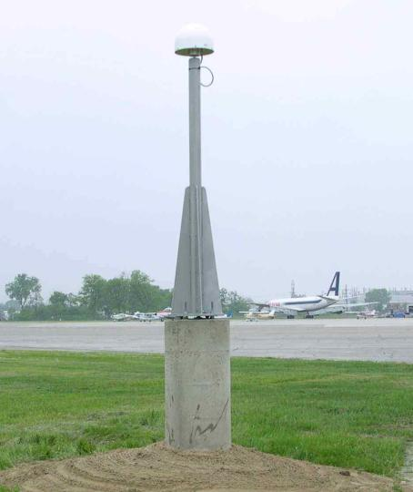
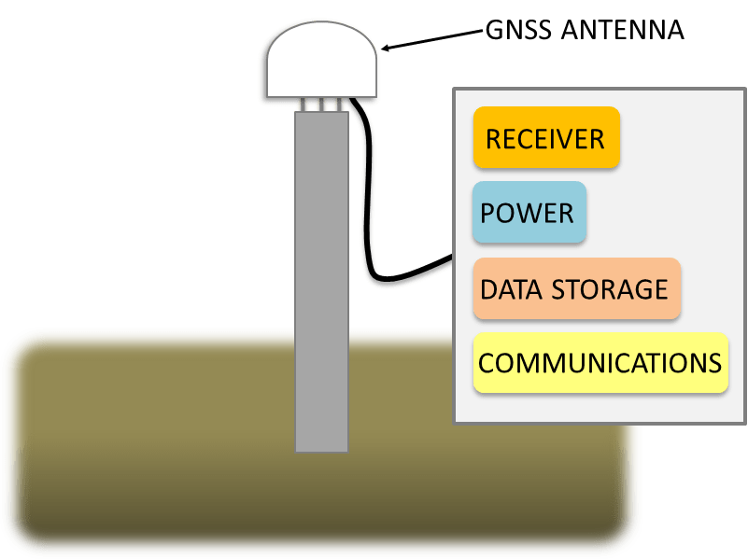
Continuously Operating Reference Station

Slide 3
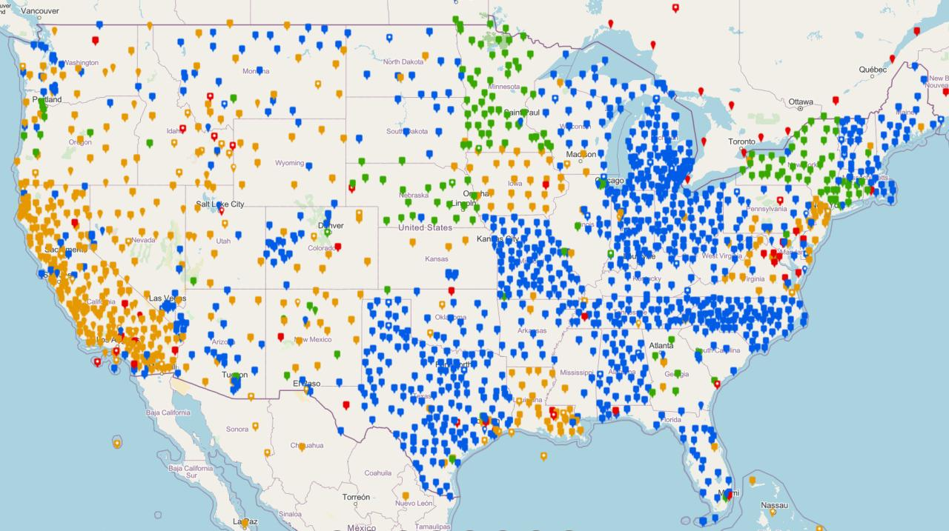
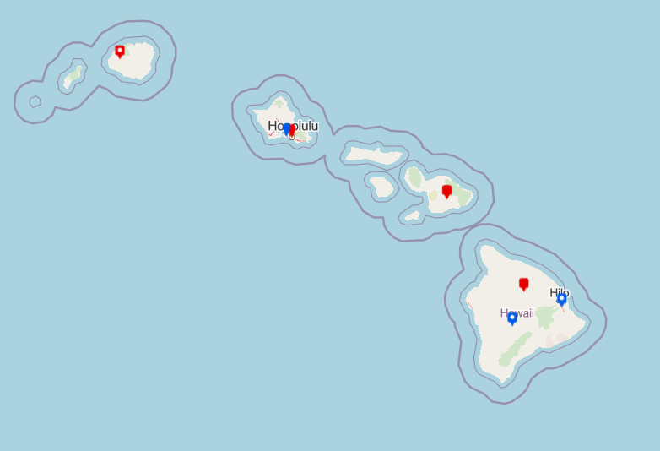
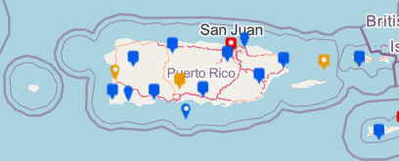
NOAA CORS Network (NCN)
Notes:
The NOAA CORS Network is a multi-purpose, multi-agency cooperative endeavor, combining the efforts of hundreds of government, academic, and private organizations.
The stations are independently owned and operated.
Each agency shares their GNSS observations and station metadata with NGS, which are analyzed and archived.
The data is distributed free of charge with multiple forms of access.

Slide 4
NCN Guidelines (Aug 2020)
Hyperlink →
Notes:
NGS has decided that it can meet and support its mission requirements with a CORS spacing at this distance. A higher density of sites results in excessive redundancy and a significant impact on already limited resources.

Slide 5
How do you do this?

Slide 6
OPUS Projects

Slide 7
What do you need?
1 or more CORS (not already in NCN)
Photos of antenna setup
5 RINEX files of 24 hrs each
Station Descriptions
Must be created using WinDesc software
Project Report

Slide 8
WinDesc
NGS-supplied software
Not only for Station Descriptions
Standardizes project metadata
Necessary to ensure data integrity
Prevents duplicate stations
Facilitates efficient review of projects

Slide 9
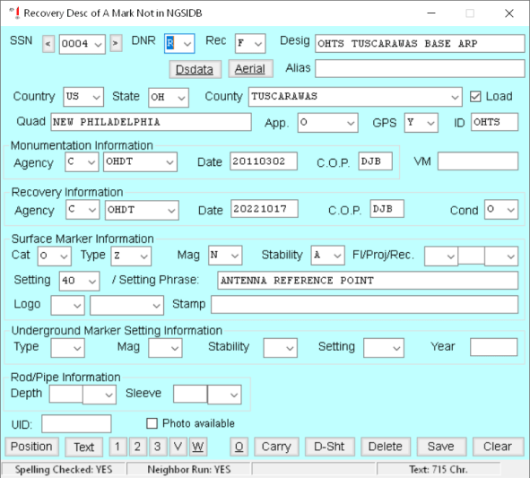
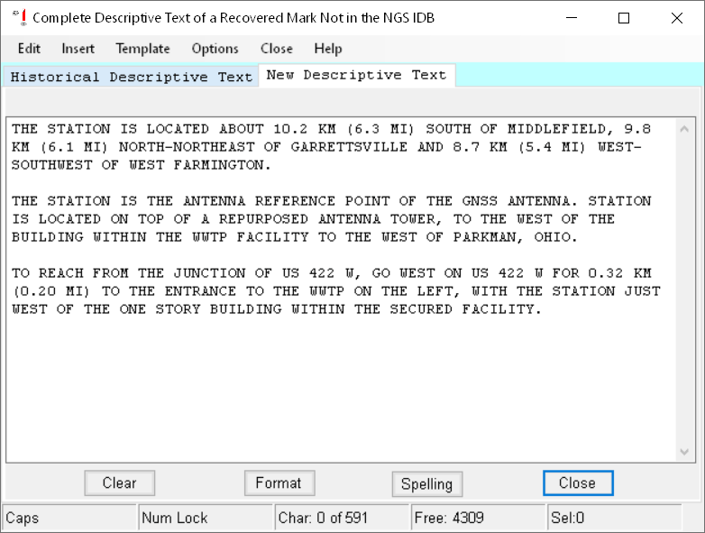
WinDesc

Slide 10
Where to do I start?
Regional Geodetic Advisors
We can assist, clarify questions, discuss goals
NGS Survey Project Proposal
Tell us your plans
We can ensure you follow proper methods

Slide 11
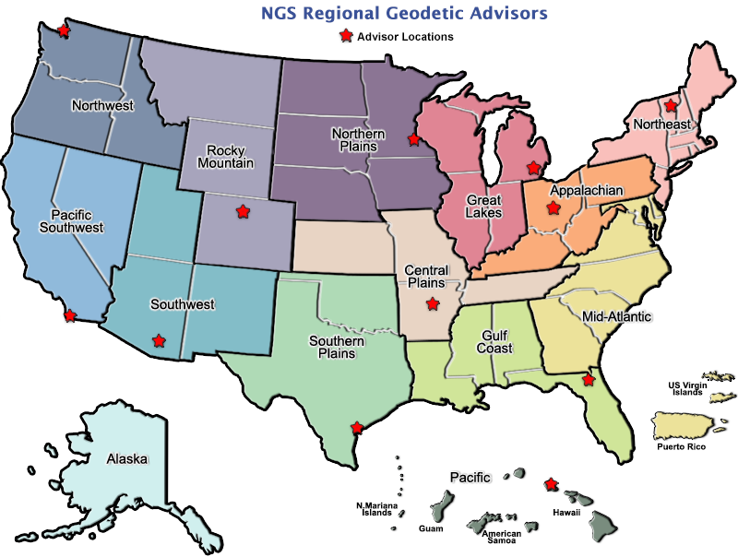
Regional Geodetic Advisor Program
geodesy.noaa.gov/ADVISORS/
14 RGAs across country
We are here to support:
You
Your constituents
Our Federal Partners
Questions about
NSRS Modernization?
Reach out now
Be prepared
Notes:
-14 Regional Advisors, we’ve transitioned from a State-based to a Regional Program
-our advisors homepage up there at the top, also easy to find us by querying any major search engine for “ngs advisors”
-if you know Ross Mackay, he is our Chief Advisor, I report to him…
**ya know, I don’t know why they don’t make him put his photo up here
-we do have one vacant advisor position, that was recently advertised and John up there in Wisconsin is officially retired in oh… 18 days

Slide 13
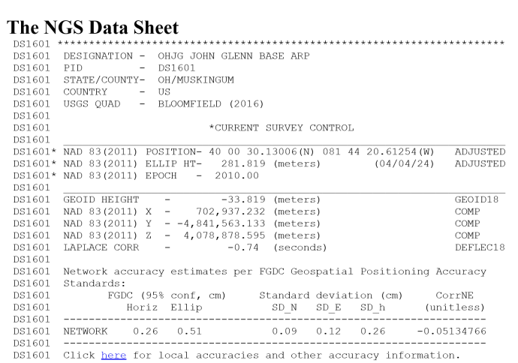
What’s the difference?
NCN
Non-NCN in NGSIDB
PID (Permanent ID)
Datasheet
Observations Archived
24/7/365 daily files
Positions in NSRS
Published Velocities
PID (Permanent ID)
Datasheet
Observations in IDB
5 days of RINEX
Positions in NSRS
Both have their place!
If you can’t be in the NCN, NGSIDB is next best thing.

Slide 14
https://geodesy.noaa.gov/ADVISORS/
-use any major search engine: “NGS advisors”
Jeff Jalbrzikowski, P.S., GISP, CFS
Appalachian Regional Geodetic Advisor
jeff.jalbrzikowski@noaa.gov
240-988-5486

