Slide 1

NSRS Modernization
An Update from NGS
PSLS SW Chapter Meeting
September 2024
Jeff Jalbrzikowski, P.S., GISP, CFS
Appalachian Regional Geodetic Advisor
jeff.jalbrzikowski@noaa.gov
240-988-5486

Slide 2
Any references to any commercially available hardware or software do not constitute an endorsement or a disapproval of any manufacturers, developers, dealers, or suppliers.
Thanks.

Slide 3



Organizational Structure
  -Department of Commerce (DoC)
  (~47,000 employees)
  -National Oceanic and Atmospheric Administration (NOAA)
  -National Ocean Service (NOS)
  -National Geodetic Survey (NGS)
  (~175 employees)
Notes:
-We are the Federal Government’s oldest scientific agency.
-part of the Executive Branch
-I know it can seem kind of strange that NGS is part of the NOS, but the origins of NGS lie with the C&GS.
-we are a “Program Office” of the NOS
Survey of the Coast – 1807
Coast Survey – 1836 → in 1871 the agency was tasked by Congress with responsibility to carry geodetic control inland (>150 years)
Coast and Geodetic Survey – 1878
NGS since 1970

Slide 4


Organizational Structure
We’re not USGS, we’re NGS
  -Department of Commerce (DoC)
  (~47,000 employees)
  -National Oceanic and Atmospheric Administration (NOAA)
  -National Ocean Service (NOS)
  -National Geodetic Survey (NGS)
  (~175 employees)
≠

Slide 5
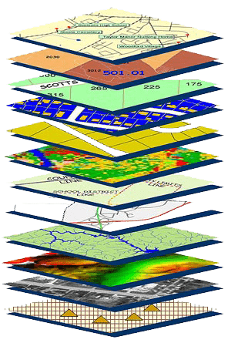
NGS Mission
To define, maintain and provide access to the National Spatial Reference System (NSRS) to meet our Nation’s economic, social, and environmental needs.
NSRS
Notes:
NGS develops and maintains the National Spatial Reference System, a national coordinate system that provides the foundation for transportation, navigation, land record systems, mapping and charting efforts, and a multitude of scientific and engineering applications
CLICK
You’ve all seen this or some similar graphic I’m sure. That bottom layer… that’s our baby, the NSRS.

Slide 6
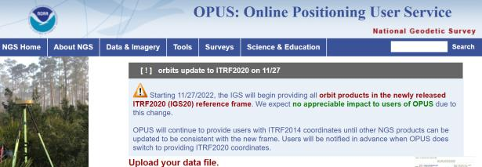
NGS Mission
To define, maintain and provide access to the National Spatial Reference System (NSRS) to meet our Nation’s economic, social, and environmental needs.
access… ? = traditionally → marks/disks/objects
= modern and future → NOAA CORS Network (NCN)
via OPUS
Notes:
Follow up thought
-like it or not, we know that the vast majority of our users are obtaining NSRS coordinates via OPUS
-while that is our plan for the future of primary access, modernized NSRS, as of now the official form of access (specifically to NAVD88) truly is to “touch brass” as they say → meaning occupy a benchmark

Slide 7
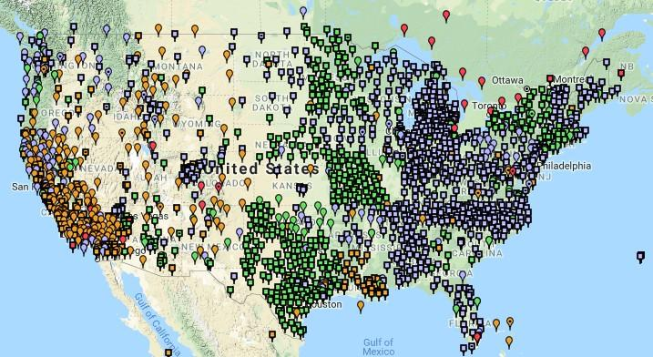
NOAA CORS Network (NCN)
Notes:
-I would like to point out we have a new, official name for the network you see represented on this map,
-The NOAA CORS Network, or NCN
CLICK
-this is neat little graphic with some stats on teh NCN you can find on our website
-below the gaphic youll find a search bar with more information

Slide 8
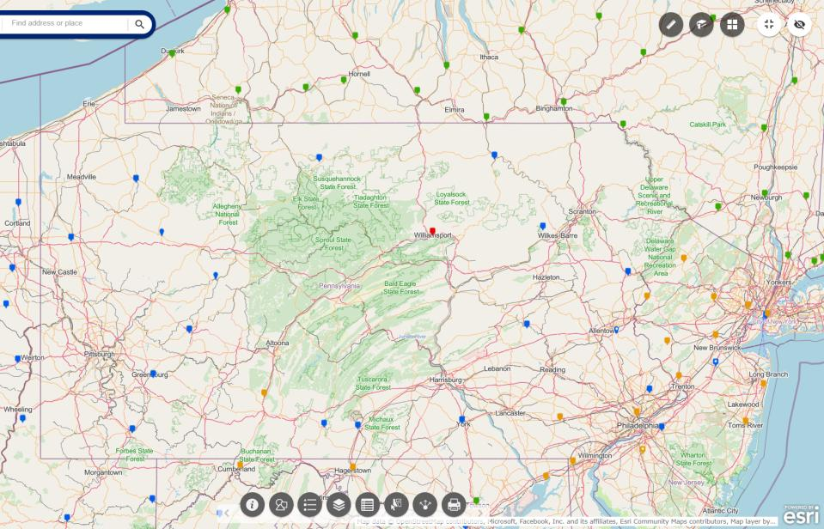
NOAA CORS Network (NCN) in PA
Notes:
where else but the federal government are you going to see two acronyms within one acronym?

Slide 9
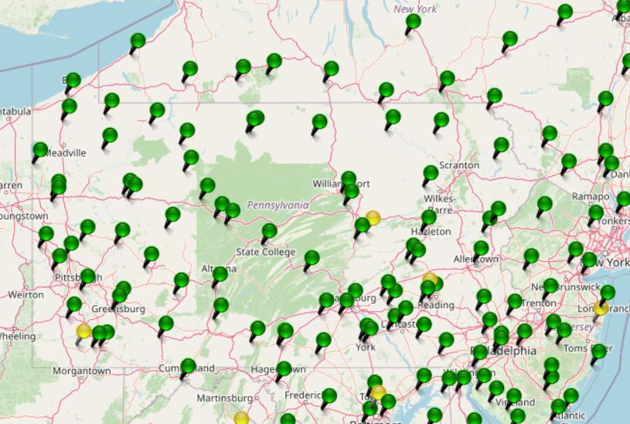
KeyNetGPS CORS Network
Notes:
where else but the federal government are you going to see two acronyms within one acronym?

Slide 10
NOAA CORS Network (NCN) in PA
Notes:
where else but the federal government are you going to see two acronyms within one acronym?

Slide 11
KeyNetGPS CORS Network
non-NCN CORS
Notes:
where else but the federal government are you going to see two acronyms within one acronym?

Slide 12
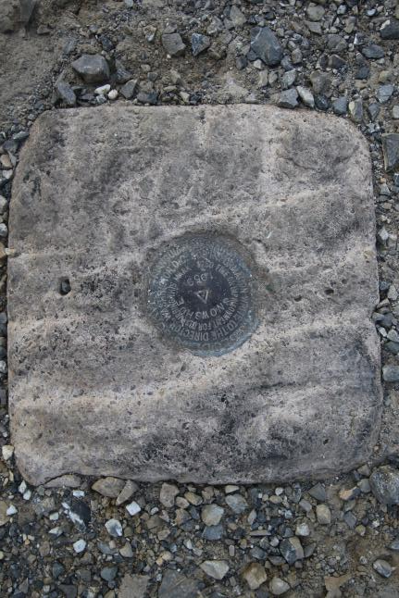
Passive Control
Geodetic Control – Terminology
All marks are passive—they sit there and hold a point
Notes:
All marks are passive!—in that they sit there doing nothing in and of themselves besides holding a point
This includes the fixed antenna mount that is a part of a CORS.
But, some marks have permanently installed equipment that enable nearly continuous observations and these are called “active” stations.

Slide 13
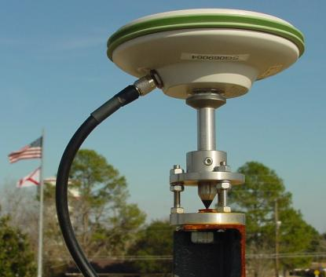
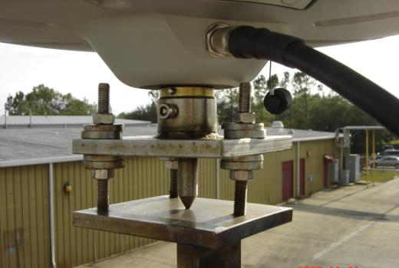
Active Control
Geodetic Control – Terminology
Some marks have permanently installed equipment that enables nearly continuous observations
(they still sit there and hold a point)
Notes:
All marks are passive!—in that they sit there doing nothing in and of themselves besides holding a point
This includes the fixed antenna mount that is a part of a CORS.
But, some marks have permanently installed equipment that enable nearly continuous observations and these are called “active” stations.

Slide 14
Active vs. Passive Control
Geodetic Control – Terminology
Passive – setting up your RTK Base on existing geodetic control (e.g. Datasheet) while collecting with RTK Rover
Active – setting up your RTK Base to log data while collecting with RTK Rover then processing Base data via OPUS; or collecting with RTN/NRTK Rover
My point: surveying is still surveying
Notes:
Often the term active geodetic control has been used to mean some equipment is continuously or at least frequently collecting observations at or near a point
Yet those observations are often used to compute coordinates (often time-dependent) at a point on a mark, which, by its nature is passive

Slide 15
Yes, we are delayed.
  NSRS Modernization
Notes:
So remember, today’s presentation is not JUST about new datums, it is about modernizing the NSRS as a whole.
You don’t know what the NSRS is? Stay tuned, we’ll get there as we go along.

Slide 16
Delayed Release of the Modernized NSRS
How long will the delay be?
  Our website or newsletter is best source of projected timeframe, current estimate is middle of 2025.
Will the names stay the same?
  Yes, terms containing “2022” such as “NATRF2022” and “NAPGD2022” will remain the same.
Will all previously proposed products be released along with the new datums?
  No, they will not. Check out our June 2022 webinar.
hyperlink to the Track Our Progress homepage
June 2022 webinar
hyperlink to the full FAQ

Slide 17
Modernizing the NSRS
Updating all NSRS coordinates
  Replace existing datums with new datums
  Replacing existing SPCS83 with new SPCS2022
  Accounting for coordinates changing with time
Improving NGS products and services
Simplifying customer contributions
Making the NSRS:
  More accurate
  More accessible
  More efficient
begins
Rollout in
2025

Slide 18
Positional Components of
the NSRS
Geometric
aka “Horizontal”
Latitude, Longitude, Ellipsoid Height
Geopotential
aka Orthometric Height
aka “Elevation”
NAD83
NAVD88
Notes:
-geometric component is latitude, longitude, and ellipsoid height
-geopotential component is combined with the geometric components to calculate an ortho height or capital H

Slide 19
NATRF2022
North American Terrestrial Reference Frame of 2022
will replace
NAD83
North American Datum of 1983
Technically, not just NATRF2022 but also its 3 sister TRFs…

Slide 20
Four TRFs for Modernized NSRS
North American Terrestrial Reference Frame of 2022
(NATRF2022)
Pacific Terrestrial Reference Frame of 2022
(PATRF2022)
Caribbean Terrestrial Reference Frame of 2022
(CATRF2022)
Mariana Terrestrial Reference Frame of 2022
(MATRF2022)

Slide 21
Terrestrial Reference Frame?
Existing, accepted terminology
  International TRF
  first realization of the ITRF was 1992
  NATRF2022 will be based on ITRF2020
“Horizontal Datum” - misnomer for NAD83
  Really is a Geometric Reference Frame
Notes:
-Where do you see an Epoch right now in NGS data?
CLICK
Datasheets! there you see the epoch of 2010.0
and of course OPUS Solution Reports!
note that in blue over there on the right you’ll see another epoch, in the ITRF, which I will explain later on

Slide 22
International Terrestrial Reference Frame
(ITRF)
Is native coordinate system for NCN.
Is what OPUS uses.
Is what most of world uses.
Is what NGA aligns WGS-84 to.
Notes:
So what is that acronym, ITRF?
-it is a global reference frame, the most widely adopted one, or the “gold standard” or the “Cadillac” or what-have-you
-ITRF is the internationally recognized standard
-who realizes the ITRF? well, NGS contributes to the realization but
CLICK
-The IERS is in responsible charge of defining, realizing and promoting the ITRF
-and the ITRF was formally adopted by the…yes, more acronyms
CLICK
IUGG some years ago

Slide 23
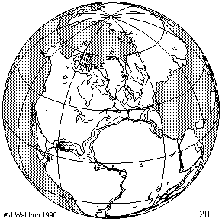
ITRF concept
Watch the grid!
Epoch:
Notes:
Ok, now ITRF mentioned a couple slides ago.
Most simplistic way to explain ITRF is to watch this animation.
This is a very loose representation/visualization of what the ITRF is, a characterization only.

Slide 24
Four TRFs for Modernized NSRS
North American Terrestrial Reference Frame of 2022
(NATRF2022)
Pacific Terrestrial Reference Frame of 2022
(PATRF2022)
Caribbean Terrestrial Reference Frame of 2022
(CATRF2022)
Mariana Terrestrial Reference Frame of 2022
(MATRF2022)

Slide 25
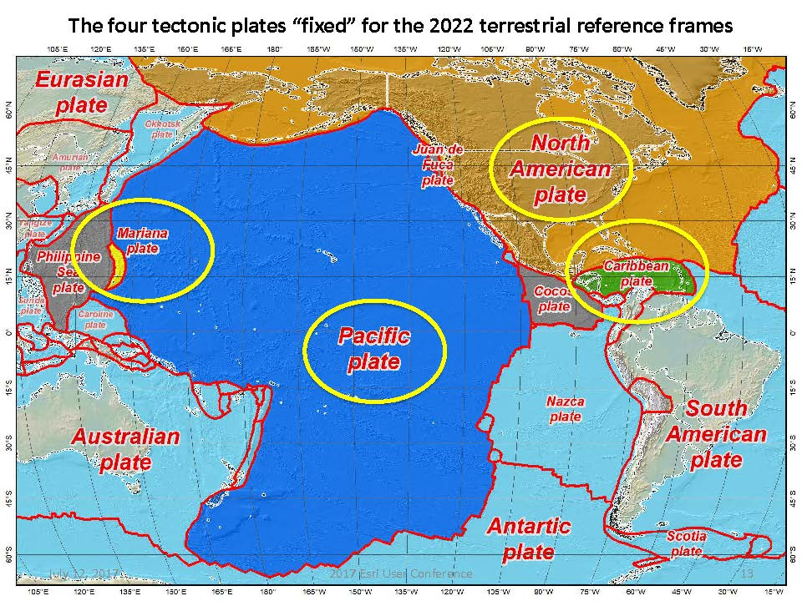
Plate Rotation visualized
Drift…
Notes:
-these are ground-level horizontal velocities
-the arrows illustrate the positions and velocities of CORS plotted in ITRF2014
-our scale is on the left there, with that arrow representing 20mm of motion per year
-so right thru Ohio it’s a little cluttered but we’re seeing arrows about that length so about 2cm/20mm per yr
-what do we notice about the direction of these arrows?
-they look rotational, don’t they?
CLICK HERE
-Note the arrows in California do not conform to the rotation… those are CORS on a different PLATE which is moving in a different direction
CLICK HERE
-so when you look at those arrows you can see the rotation, but the point of rotation is obviously off the map, way down below the screen right?
-that point is what’s known as an Euler Pole

Slide 26
Plate-Fixed NSRS TRFs
ITRF
Frame = constant
NA Plate = rotating
NATRF
Frame = rotating
(relative to ITRF)
NA Plate = constant
(relative to NATRF2022)
Notes:
We say “NATRF2022” is “fixed” to the N.A. Plate, making it a “plate fixed” frame
-the frame is constant to itself, but rotating within ITRF, and moving in a different direction than the other 3 frames

Slide 27
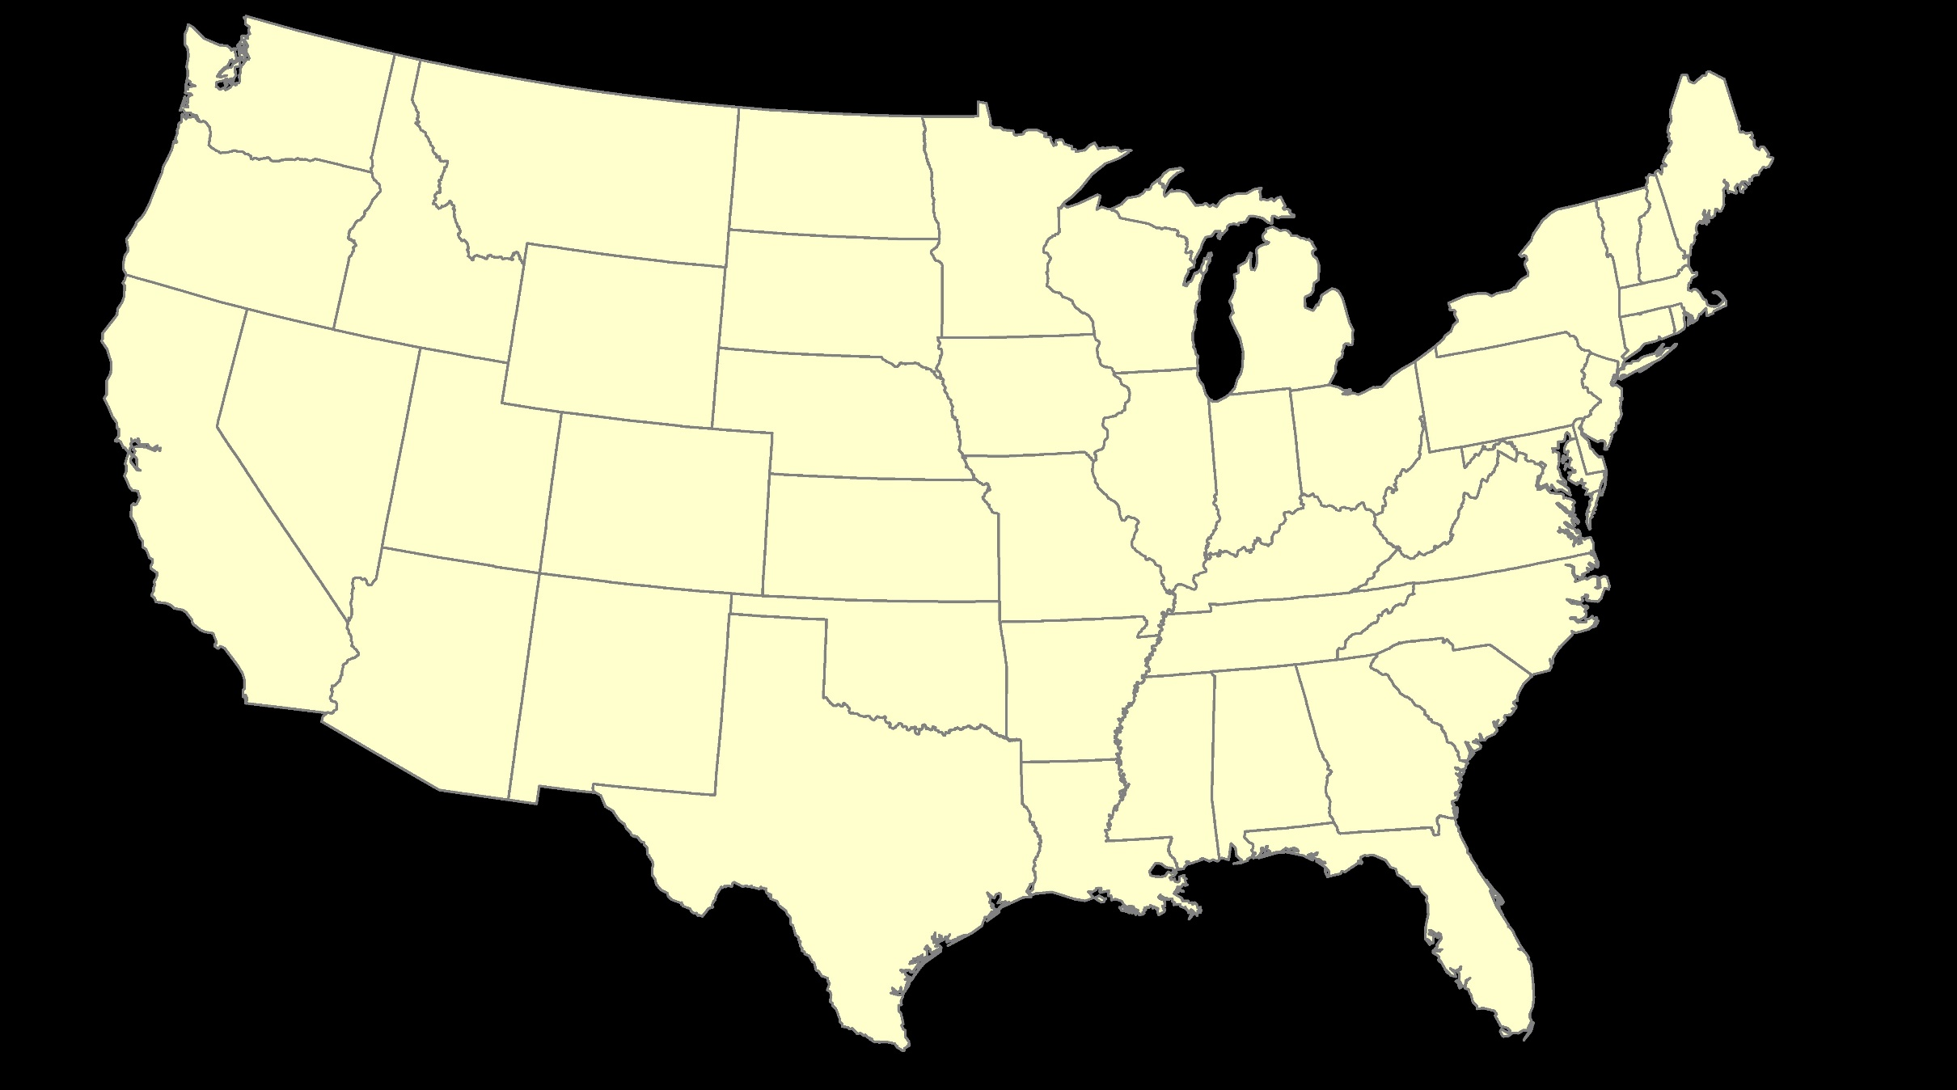
ITRF – constant frame, rotating plate

Slide 28
Plate-Fixed
NATRF – rotating frame, constant with plate

Slide 29
if you know epoch
ITRF or NATRF – your choice if you know epoch

Slide 30
Decades of continuously logged GPS data from the NOAA CORS Network (NCN).
  But how?

Slide 31
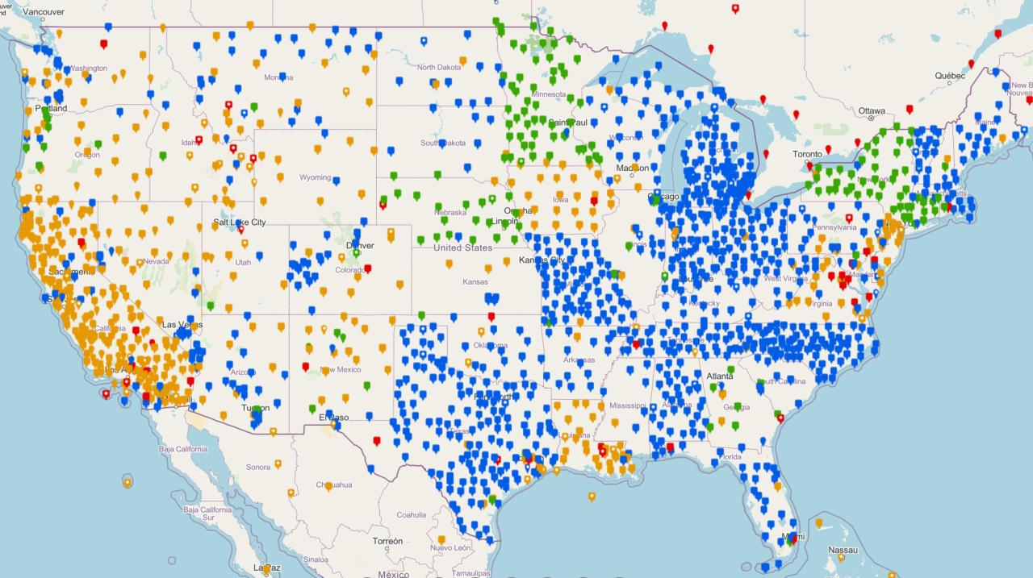
NOAA CORS Network (NCN)

Slide 32

Plate-Fixed
NATRF – rotating frame, constant with plate
= CORS

Slide 33
Plate-Fixed
ITRF or NATRF
= CORS
Notes:
ITRF is independent of any plates, tied to the layer below,
-”plate-agnostic” if we want to sound all silicon valley ish
-the plates go down about 200 km (125 mi) deep below our feet right now, as we’re on a continental plate
--(oceanic plates are roughly half the thickness, like 100 km)
-→ but thickness of the tectonic plates varies greatly, from down to 15 km up over the 200 km I mentioned earlier

Slide 34
Terminology – Time/4D
Epoch
eh-puck? ee-pock? … to-may-to, to-mah-to
an instant of time; a moment in time
astronomy & geodesy use a decimal date
  2021.4762 = 23 June 2021 @ 19:16:00
  using epochs is important, not your format
    start preparing to assign epochs to your data
Notes:
-Where do you see an Epoch right now in NGS data?
CLICK
Datasheets! there you see the epoch of 2010.0
and of course OPUS Solution Reports!
note that in blue over there on the right you’ll see another epoch, in the ITRF, which I will explain later on

Slide 35
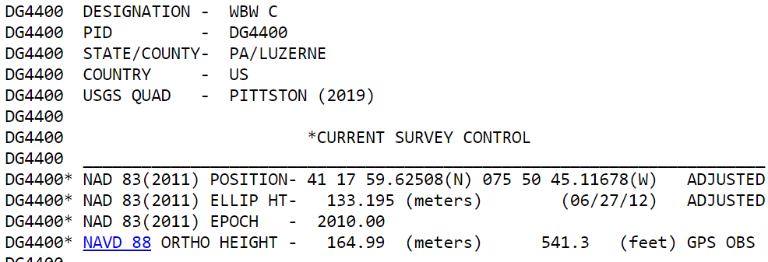
Notes:
-Where do you see an Epoch right now in NGS data?
Datasheets! there you see the epoch of 2010.0
and of course OPUS Solution Reports!
note that in blue over there on the right you’ll see another epoch, in the ITRF, which I will explain later on

Slide 36
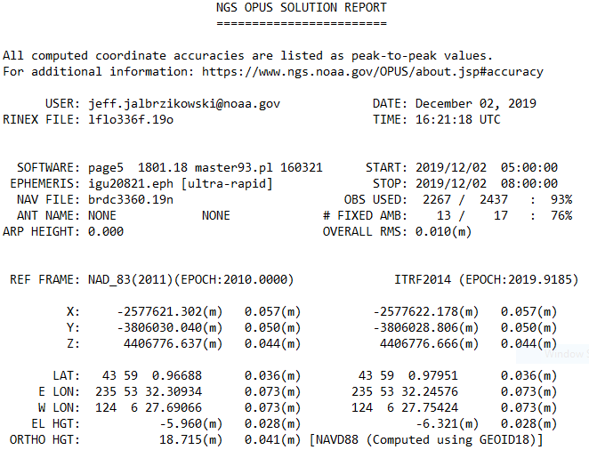
Reference Epoch
Survey Epoch
Notes:
-Where do you see an Epoch right now in NGS data?
and of course OPUS Solution Reports!
note that in blue over there on the right you’ll see another epoch, in the ITRF, which I will explain later on

Slide 37
What is a Reference Epoch?
If you use NAD83 you’re already using one, but perhaps unaware.
First let’s look at complete nomenclature…

Slide 38
Complete NAD83 Nomenclature
NAD83(2011) epoch 2010.00
Geometric
Datum
Realization
(aka Datum Tag)
Epoch
(in the case of NAD83, a Reference Epoch)
Other NAD83 Reference Epochs
NAD83(1986) epoch 1984.00
NAD83(HARN) epoch 1993.62
NAD83(CORS96) epoch 2002.00
NAD83(2007) epoch 2007.00
NAD83(2011) epoch 2010.00
ITRF2014 epoch 2019.9185
IGS08 epoch 2005.00
NATRF2022 epoch 2020.00
NAD83(1986) epoch 1984.00
NAD83(HARN) epoch 1993.62
NAD83(CORS96) epoch 2002.00
NAD83(2007) epoch 2007.00

Slide 39
Reference Epoch
Survey Epoch
Notes:
-Where do you see an Epoch right now in NGS data?
and of course OPUS Solution Reports!
note that in blue over there on the right you’ll see another epoch, in the ITRF, which I will explain later on

Slide 40
What is a Survey Epoch?
If you use OPUS you’re already using one, but perhaps unaware.

Slide 41
Complete ITRF Nomenclature
ITRF2014 (epoch 2021.0276)
Geometric
Datum
Epoch
(in the above example, a Survey Epoch)
ITRF Reference Epochs
NAD83(1986) epoch 1984.00
NAD83(HARN) epoch 1993.62
NAD83(CORS96) epoch 2002.00
NAD83(2007) epoch 2007.00
NAD83(2011) epoch 2010.00
ITRF2014 epoch 2019.9185
IGS08 epoch 2005.00
NATRF2022 epoch 2020.00
Examples of ITRF Survey Epoch
ITRF92 epoch 1988.0
ITRF2000 epoch 1997.0
ITRF2005 epoch 2000.0
ITRF2008 epoch 2005.0
ITRF2014 epoch 2010.0
ITRF2008 epoch 2012.2011
IGS08 epoch 2006.7572
ITRF2014 epoch 2017.4457
ITRF2014 epoch 2019.9185
ITRF2014 epoch 2021.0276

Slide 42
Epochs in Modernized NSRS
Survey Epoch (SE)
Reference Epoch (RE)
Position at the moment of survey data collection
Used in NATRF2022
SEC = SE Coordinate
Ground movement will be illustrated
Position after propagated back in time from SE to RE
Used in NATRF2022
REC = RE Coordinate
Ground movement will be hidden

Slide 43
Terminology - Changing Coordinates
Conversion
    change the type of coordinate
    NAD83(2011) latitude & longitude → NAD83(2011) SPCS
  Transformation
    change the datum of coordinate
    NGVD29 height → NAVD88 height
    NAD 27 latitude & longitude → NAD 83(2011) latitude & longitude
Propagation
    change the epoch of coordinate
    NATRF2022 epoch 2020.00 to NATRF2022 epoch 2023.243
Notes:
Historically NGS has been inconsistent with these top two words.
Going forward, we will use them as:
Conversion: Meaning to change the type of coordinate without changing the datum or frame
Transformation: Meaning to change the datum or frame, without changing the type of coordinate

Slide 44
NCAT
  How will you do that?
NGS Coordinate Conversion And Transformation Tool (NCAT)
Epochs/Time/4D
Notes:
-so you’ve probably seen that phrase that I have front and center here, NSRS Modernization
-that’s the blanket term we use to refer to not just the new datums but other updates

Slide 45
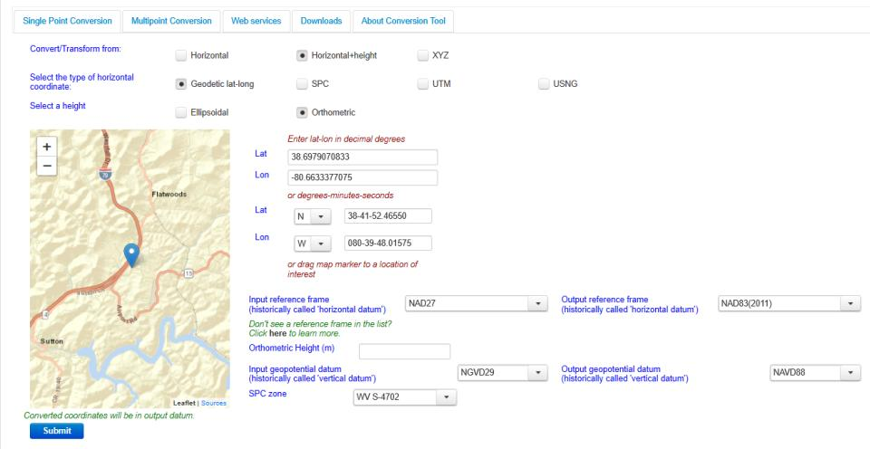
NGS Coordinate Conversion And Transformation Tool (NCAT)
Notes:
NCAT includes the functionality of previous NGS tools:
NADCON 5.0
XYZWIN 2.0
UTMS 2.1
SPC83 2.1
USNG 2.3
Includes error estimate of transformation per point.
Available as the single-point graphic seen here, multi-point upload/download, as a downloadable executable fie to run from the DOS prompt, and as web services for inclusion in your own
It’s a great tool. Anyone using

Slide 46
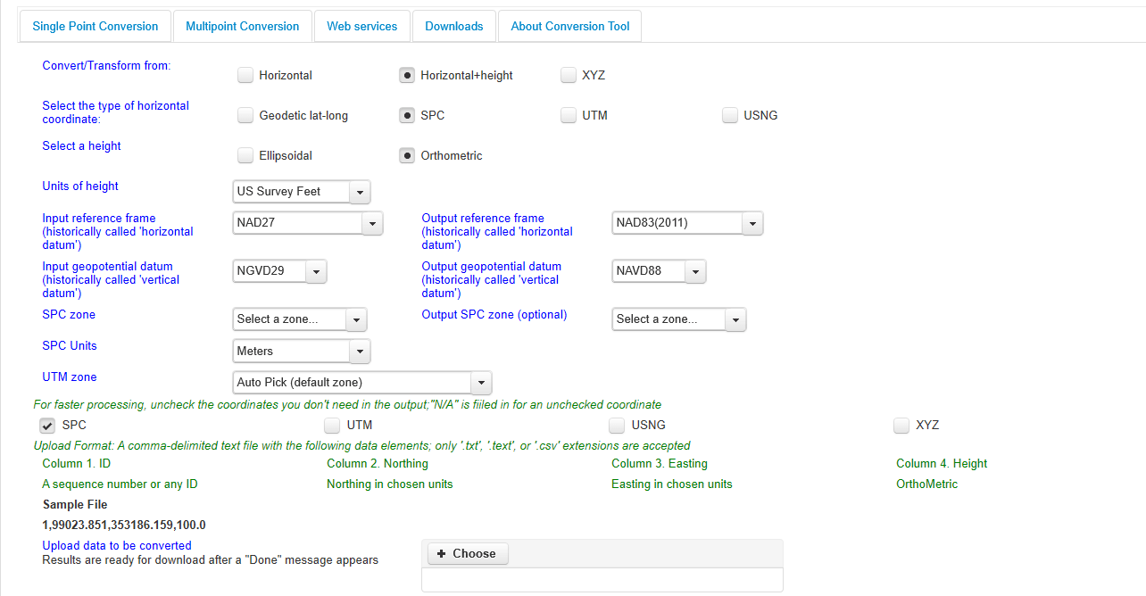
NGS Coordinate Conversion And Transformation Tool (NCAT)
Notes:
NCAT includes the functionality of previous NGS tools:
NADCON 5.0
XYZWIN 2.0
UTMS 2.1
SPC83 2.1
USNG 2.3
Includes error estimate of transformation per point.
Available as the single-point graphic seen here, multi-point upload/download, as a downloadable executable fie to run from the DOS prompt, and as web services for inclusion in your own
It’s a great tool. Anyone using

Slide 47
NGS Coordinate Conversion And Transformation Tool (NCAT)
Notes:
NCAT includes the functionality of previous NGS tools:
NADCON 5.0
XYZWIN 2.0
UTMS 2.1
SPC83 2.1
USNG 2.3
Includes error estimate of transformation per point.
Available as the single-point graphic seen here, multi-point upload/download, as a downloadable executable fie to run from the DOS prompt, and as web services for inclusion in your own
It’s a great tool. Anyone using

Slide 48
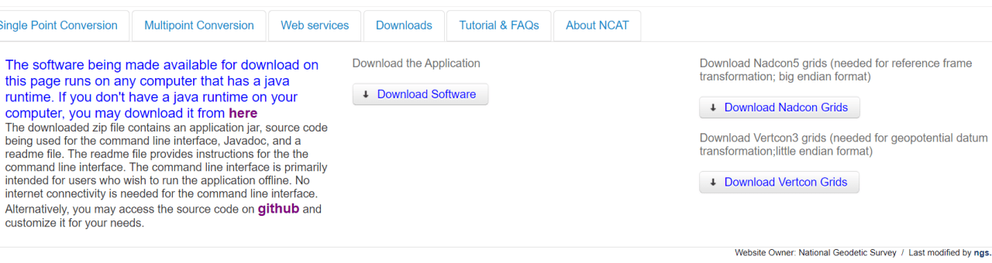
NGS Coordinate Conversion And Transformation Tool (NCAT)
Notes:
NCAT includes the functionality of previous NGS tools:
NADCON 5.0
XYZWIN 2.0
UTMS 2.1
SPC83 2.1
USNG 2.3
Includes error estimate of transformation per point.
Available as the single-point graphic seen here, multi-point upload/download, as a downloadable executable fie to run from the DOS prompt, and as web services for inclusion in your own
It’s a great tool. Anyone using

Slide 49
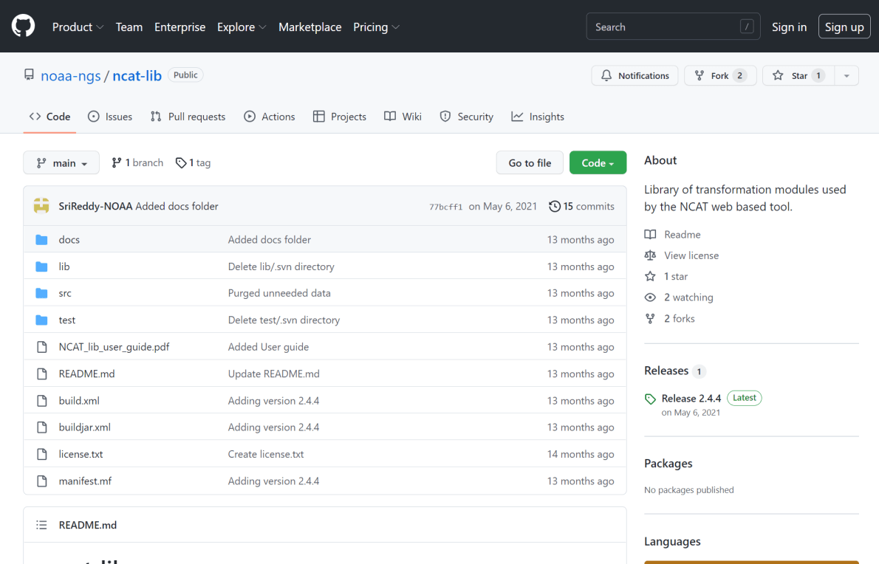
NCAT source code is on GitHub

Slide 50
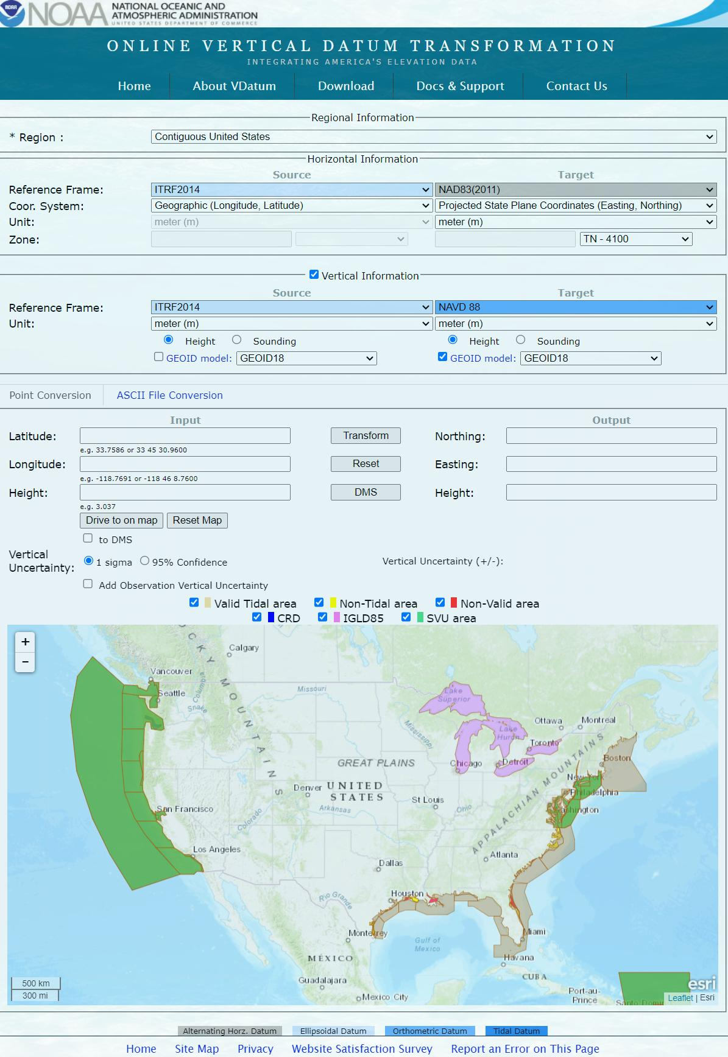

Slide 53
What’s the difference?
NCAT
VDatum
NSRS Datums
  NAD 27
  NAD 83
  NGVD 29
  NAVD 88
  PRVD 02
  ASVD 02
  NMVD 03
  GUVD 04
  VIVD 09
NSRS Datums
Geoid Models
  Add/Subtract from Ellipsoid
Tidal Datums
  MHW, MLLW, MTL
Great Lakes Datum
  IGLD85
ITRF#### ≈ WGS84
Local Tidal (LT)

Slide 54
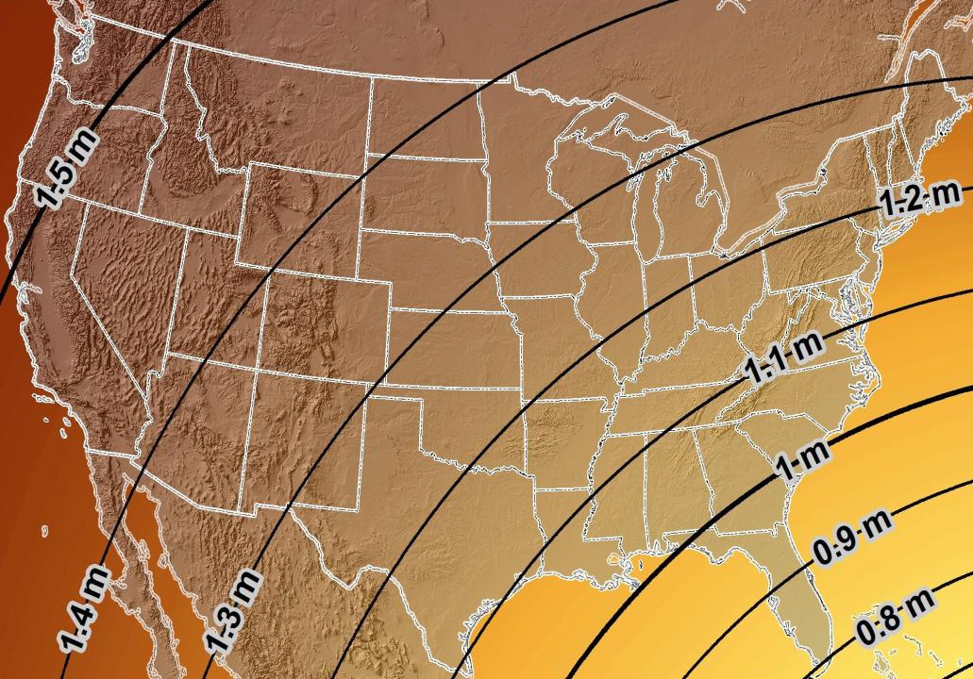
Estimated Geometric Change - Horizontal
NAD83 (2011) → NATRF2022
4.6 ft
Direction of Shift
4.3 ft
3.9 ft
3.6 ft
3.0 ft
Notes:
What’s the magnitude of the horizontal datum shift across Pennsylvania?
Minimum Shift ~3.75 feet
Maximum Shift ~3.97
Remember this is just an estimation, don’t hold me to the numbers please

Slide 55


Slide 56

New Lat/Long = New XY
With a new horizontal datum…
There comes a new set of SPCS zones

Slide 57
State Plane Coordinate System of 1983
SPCS83
North and South Zones as they exist now
Notes:
We start with the SPCS83 zones as a frame of reference
NOTE that the color shading of these zones is matched to that of the Preliminary SPCS2022 Zones that follow

Slide 58
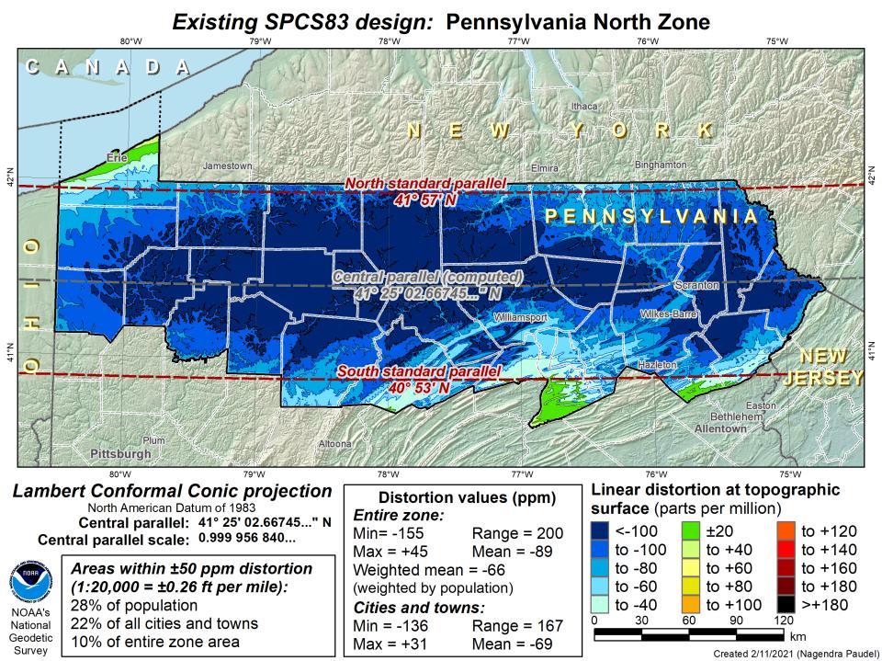
DRAFT

Slide 59
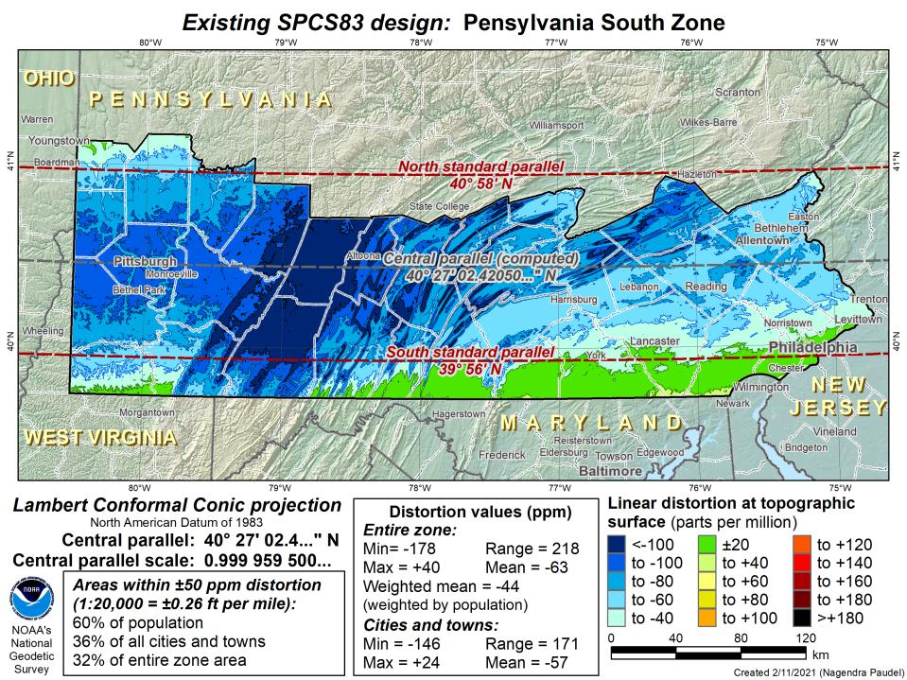
DRAFT

Slide 60
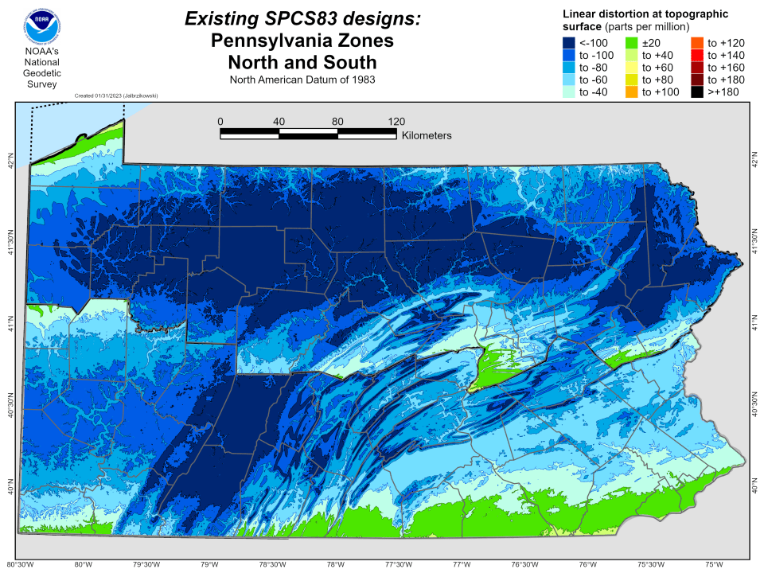

Slide 61
State Plane Coordinate System of 2022
SPCS2022
PA stakeholders requested 4-5 zones, which NGS designed, the following are preliminary maps
Notes:
The following section illustrates the preliminary SPCS2022 zones
There are 4 zones in the NGS design, per request that we design “4-5 zones required to meet the minimum distortion acceptable” set by our design criteria of 50ppm
NOTE the request also included wording: “It is also requested that PennDOT districts be divded into no more than two zones”

Slide 62
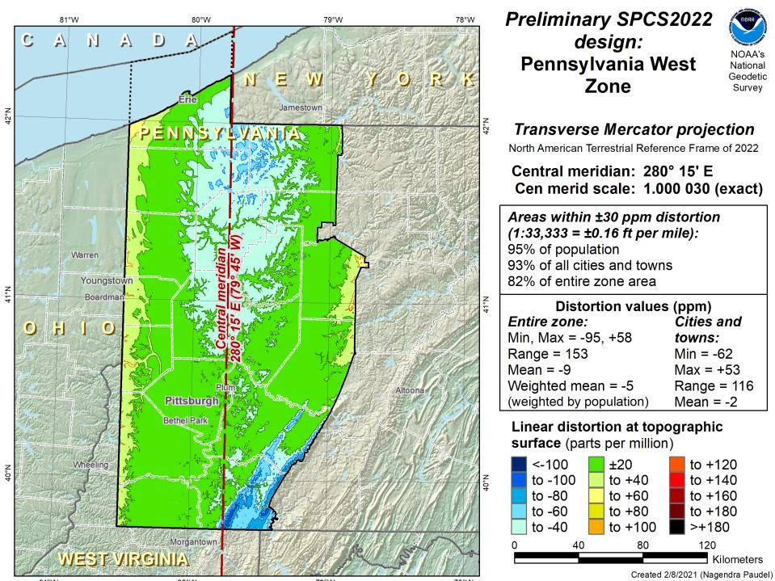
Notes:
NOTE that the West Zone far surpasses the NGS design criteria of 50ppm

Slide 63
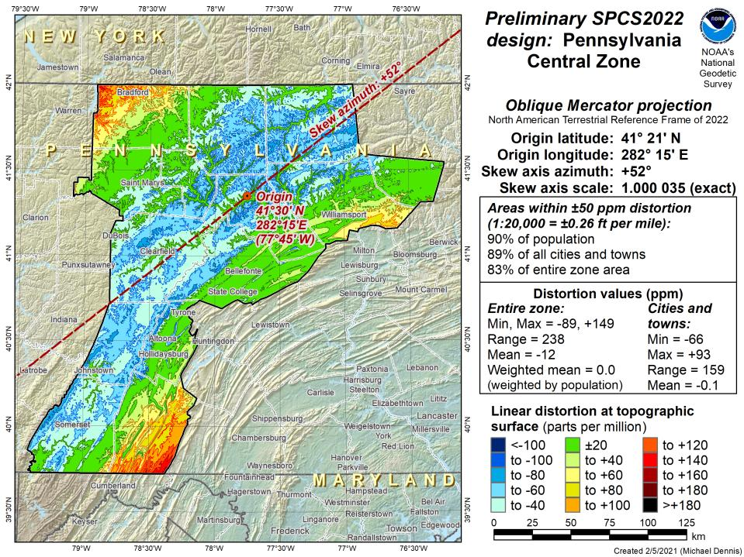
Notes:
This is the first, and likely final, draft of an Oblique Mercator projection for the Preliminary Central Zone
NOTE that even with the

Slide 64
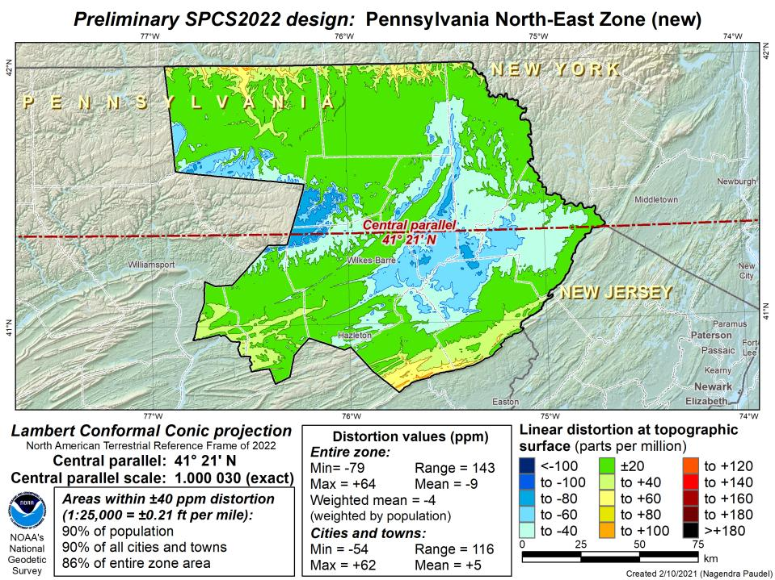
Notes:
This is the second draft of a Preliminary North East Zone
NOTE this includes Columbia and Montour Counties, and the animation highlights the comparison between having these counties in the SE or NE Zone

Slide 65
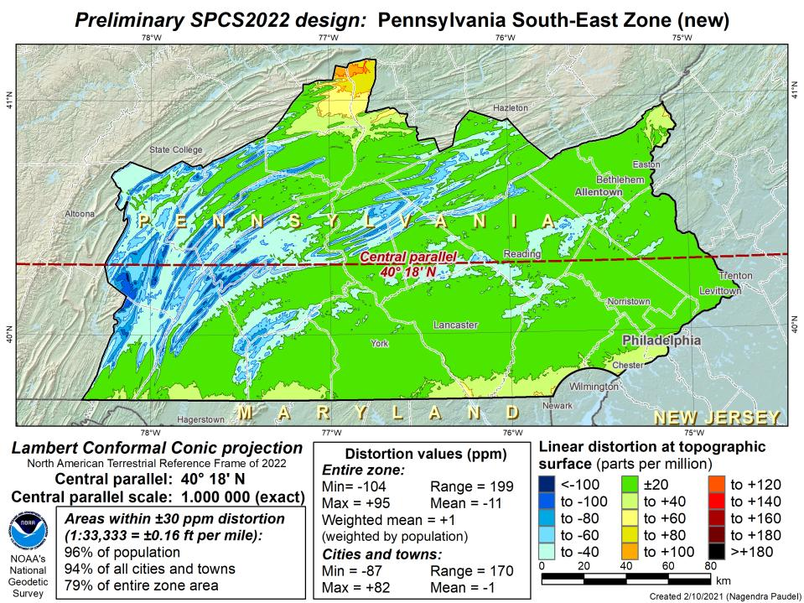
Notes:
This is the second draft of a Preliminary South East Zone
NOTE this excludes Columbia and Montour Counties (they would fall in SE Zone)

Slide 66
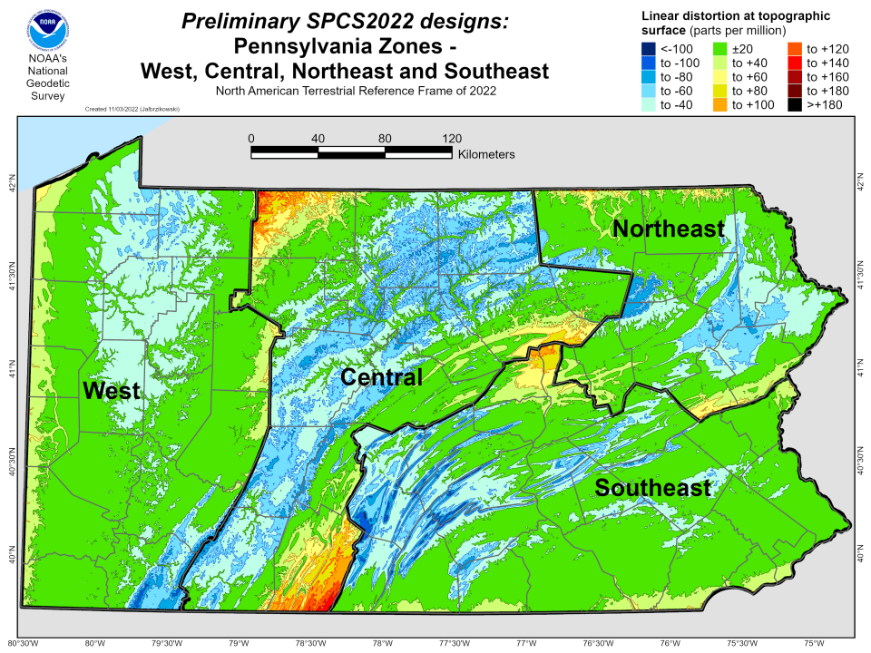

Slide 69
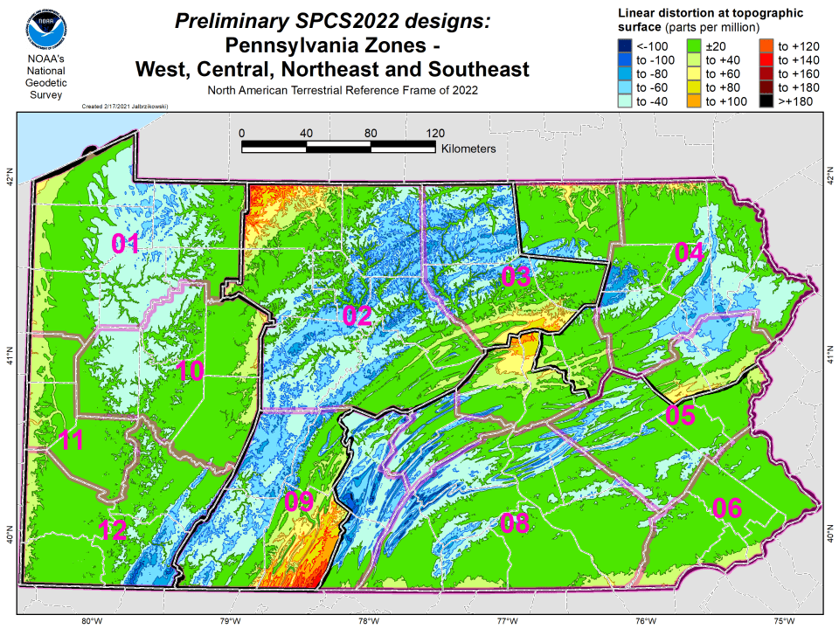

Slide 70
State Plane Coordinate System of 2022
SPCS2022
NGS will create a Single Statewide Zone for every State, the following is a preliminary map

Slide 71
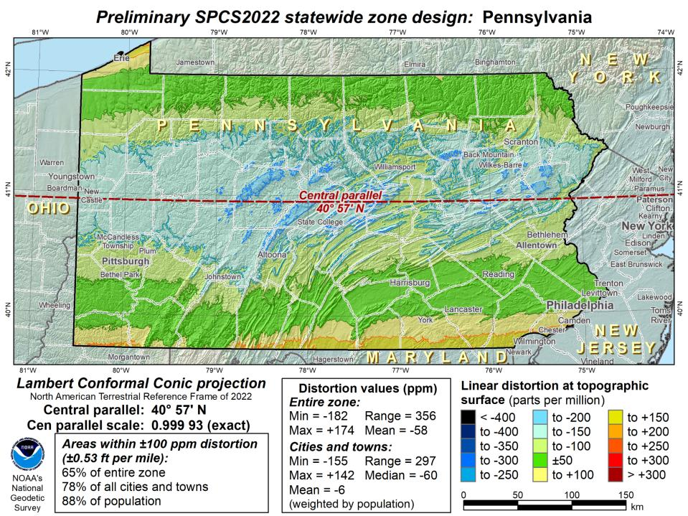
Notes:
This Single Statewide Zone designed by NGS is color shaded to match the following section of slides that show UTM Zones linear distortion values
It is known that some user communities with large areas of responsibility choose to maintain geospatial data and work in UTM
This graphic as compared to the UTM serves to highlight in SPCS2022, users will see better performance (lower linear distortion) if they choose to work in the SPCS2022 Single Statewide Zone rather than one of the UTM Zones that fall within Pennsylvania

Slide 72
Notes:
The NGS designed preliminary single statewide zone is included again here at the end for easier visual comparisons.

Slide 73
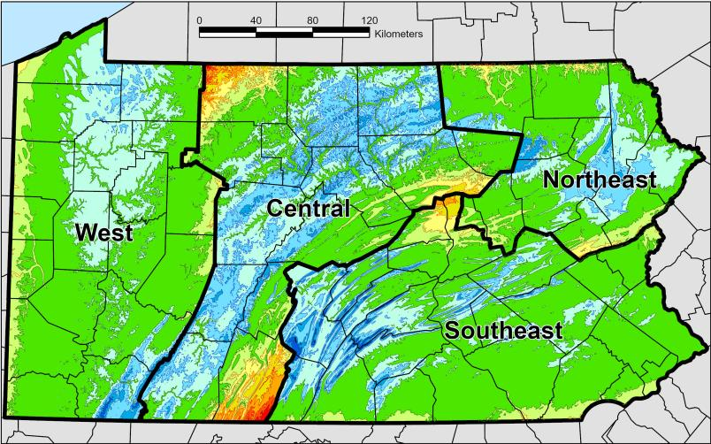
SPCS2022 Zone Layers in PA
Both Single Statewide and Multi-Zone Layers will coexist
Think about your data, your goals, your customers
  Remember that geographic coordinates are your friend!
Smaller zones not “the best” … it all depends on usage & goals

Slide 74
SPCS2022 Zone Layers and LDPs
Each state may have max of 3 zone “layers”
  One layer must be statewide zone
    Pennsylvania Single Statewide
  Other layers have two or more zones
    Pennsylvania Multi-Zone
  A third layer can exist, but must be discontinuous coverage
    Left open for possibilities in Pennsylvania
      Low Distortion Projections (LDPs) for specific areas?

Slide 75
Which is best?
Single Statewide Zone Layer
Multi-Zone Layer
Each has strengths and each has weaknesses.

Slide 76

Do you really need to…?
Notes:
Reminder that you don’t have to cutoff data at any SPCS zone extent → just need to understand that they’re designed with certain extents in mind

Slide 77
Pennsylvania Coordinate System Law
Act of Dec. 16, 1992, P.L. 1224, No. 161
Problems
Designates specific zones
Parameters of projections included
Restricts datum usage to 1983 or 1927
Unit of measure designated as Survey Foot
Anyone familiar with the requirement that SPCS coordinates in recorded land records must be certified by the surveyor?

Slide 78
State Plane Coordinate System of 2022
SPCS2022
Not just Ohio
Notes:
The following section illustrates the preliminary SPCS2022 zones
There are 4 zones in the NGS design, per request that we design “4-5 zones required to meet the minimum distortion acceptable” set by our design criteria of 50ppm
NOTE the request also included wording: “It is also requested that PennDOT districts be divded into no more than two zones”

Slide 79
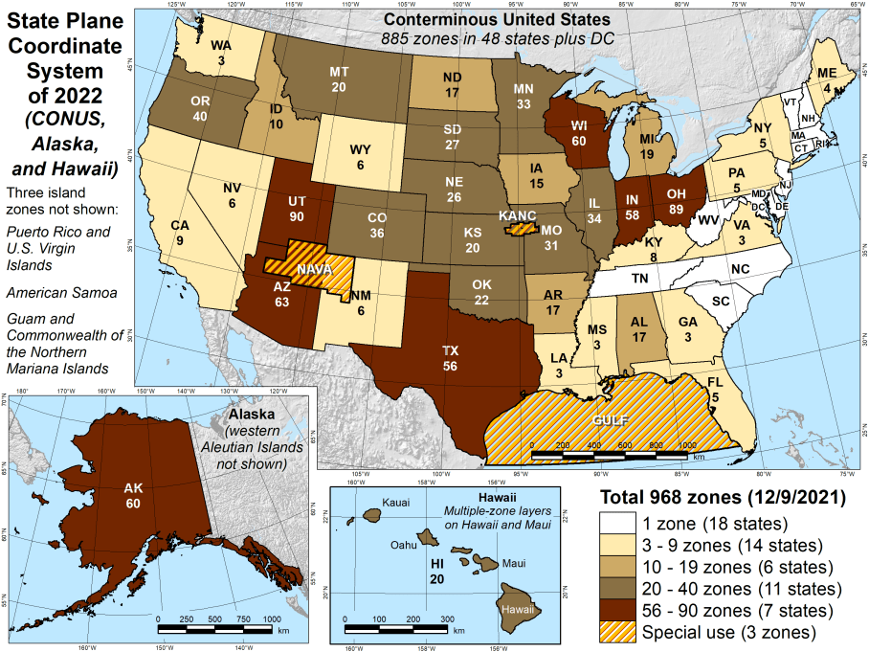
Number of SPCS2022 zones (preliminary)
CONUS, Alaska, and Hawaii
Three island zones not shown:
Puerto Rico and U.S. Virgins Islands
American Samoa
Guam and the Commonwealth of the Northern Mariana Islands

Slide 80
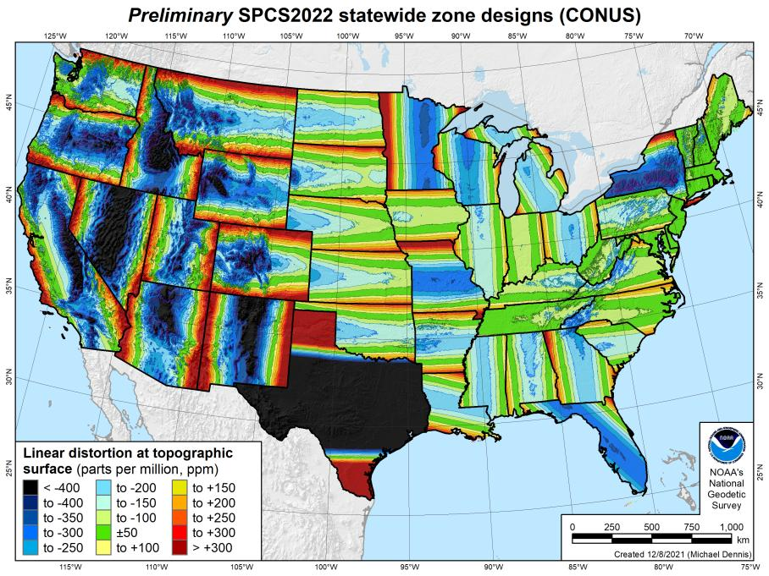
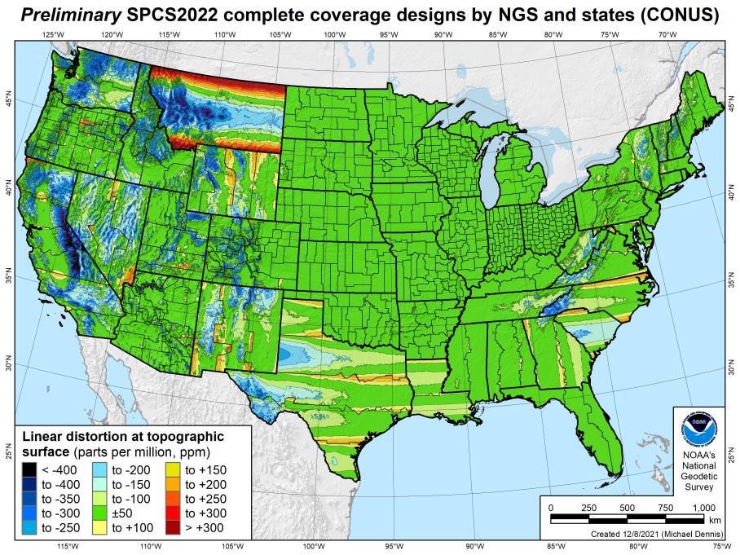
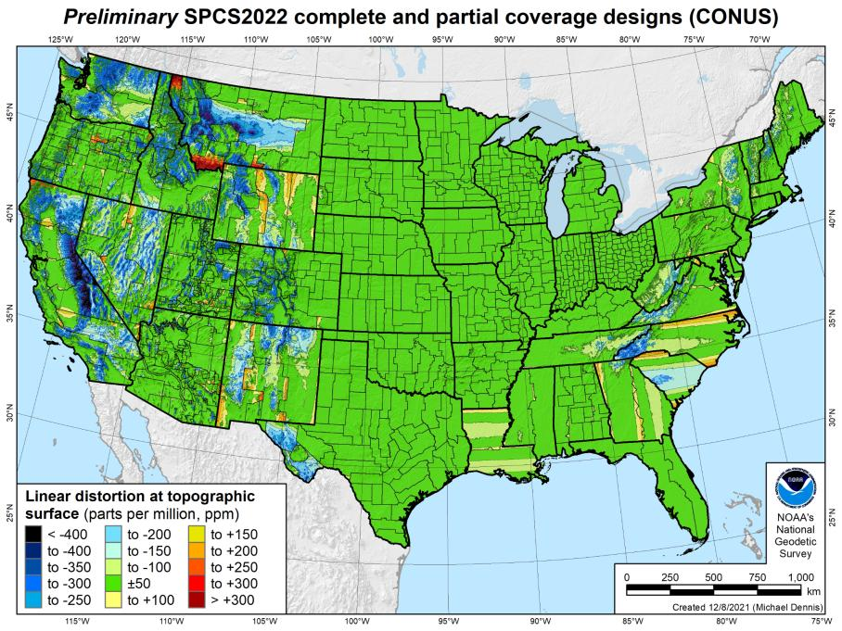
SPCS2022 linear distortion (prelim)
846 zones (CONUS)
Percent within distortion (ppm):
Distor | Pop | Cities | Area
±20 | 76% | 71% | 58%
±50 | 92% | 89% | 76%
±100 | 98% | 97% | 89%
±400 | 100% | 100% | 99.9%
City and area statistics (ppm):
 | Min | -407 | -1438
 | Max | +486 | +2624
 | Range | 893 | 4062
 | Mean | -6 | -23
Mean weighted by pop = -4

Slide 81
The Survey Foot is dead!
Long live the Survey Foot!
US Survey Foot was deprecated 31 December 2022…
But it will always be available in NGS tools for NAD83 and NAD27 coordinates

Slide 82

Preparing
Know the epoch of your data/datasets
  consider how you will track this
    full to-the-second timestamp on every feature?
      Modern survey equipment makes this possible
    labeling a year for each dataset?
      Easy to add to workflows, datasets/databases, folders
    something in-between that works for your needs?
2023.1957
2023:27
20230127
Epoch nomenclature is your choice

Slide 83
Preparing
Reprocessing your data
  perfect world = everyone reprocesses everything
    what does this mean?
      consider an ALTA w/topo
        start over with the onsite GNSS-based control
        reorient all your shots/ties (hopefully linked)
        recreate all the drainage features in new datum
    unrealistic! … and unnecessary for majority users
Notes:
Reprocessing your data
in a perfect world, everyone would reprocess data
consider a final product like you use everyday - a hydro-enforced DEM
starting fresh with the raw GNSS/IMU processing
generate new ellipsoid height point clouds
recreate all the drainage features in new datum
this is totally unrealistic → both from a financial and programmatic perspective

Slide 84
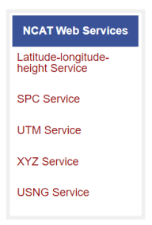
Preparing
  Transforming your data
    NCAT - NGS Coordinate Conversion and Transformation Tool
      ASCII up/download, Web Services, Download, GitHub
      ask your software provider(s) about integration
        we envision COTS integrations as most popular method of access
        Industry Workshops - May 2021 and August 2022
          Esri, Trimble, Blue Marble, etc… all the well known names attended
        Geospatial Software Developers’ Summit – Nov/Dec
          International & Virtual → US NGS and NRCan CGS
Notes:
Transforming your data
NCAT - NGS Coordinate Conversion and Transformation Tool
available now: ASCII upload and Web Services
ask your software providers about integration
we envision this as most popular method of access
Industry Workshop held this year – esri, trimble, bluemarble, all the major well known names were represented
labeling a year for each dataset?
something in-between that works for your needs

Slide 85
Remember…
  What’s the goal of NATRF2022?
    Give you the stability in positions that you expect
  That’s the point of Reference Epochs (REs)
    Akin to the different realizations of NAD83
    REs will be published every 5 or 10 years
      you choose when you update
      in a perfect world, everyone would stay current
aka versions
Notes:
What’s the goal of the way NATRF2022 was designed, by including EPP2022 and IFVM2022
Does a database of manholes in PA need cm-level coordinate updates on an annual basis? Probably not.

Slide 86
Additional Resources

Slide 87
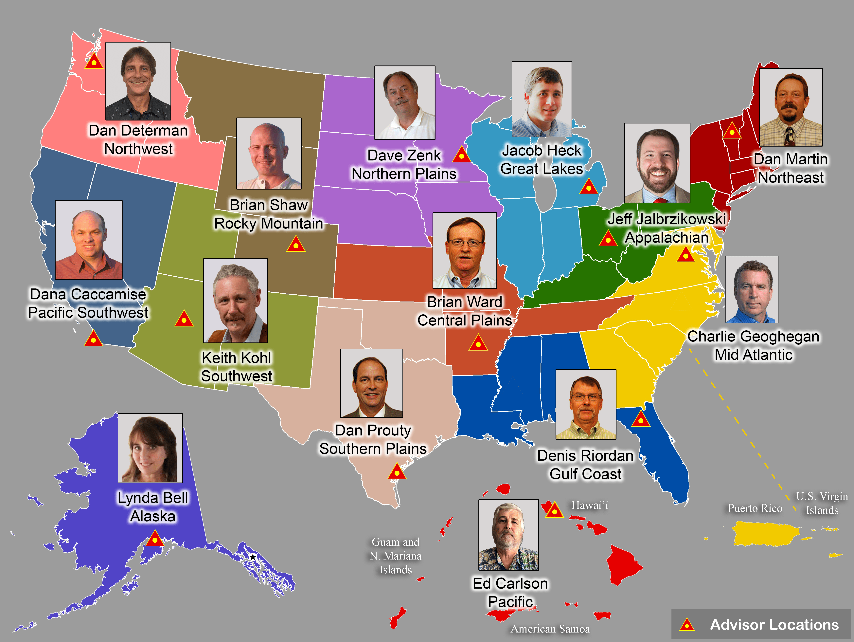
Regional Geodetic Advisor Program
geodesy.noaa.gov/ADVISORS/
14 RGAs across country
We are here to support:
  You
  Your constituents
  Our Federal Partners
Questions about
NSRS Modernization?
  Reach out now
  Be prepared

Slide 88

Educational Videos
<5 minutes
Online Lesson
(via MetEd/COMET)
~1 hour
NGS homepage: geodesy.noaa.gov
Notes:
Educational videos and online tutorials –
Our library of lessons and videos are great resources, and will reinforce a lot of information we covered today.
The videos are just 3-5 minutes long.
the lesson is a deeper dive but still only takes an hour.

Slide 89
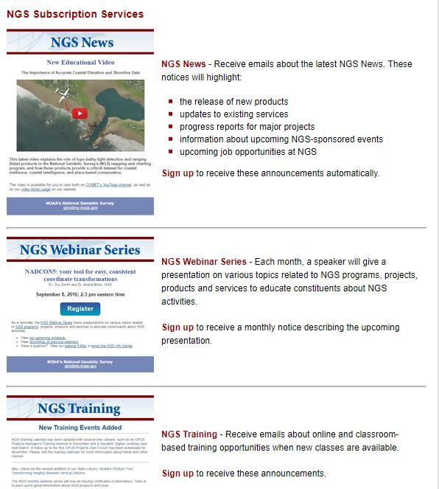

Email Subscriptions
*Only 1-2 messages per month*
NGS News
  Includes quarterly NSRS Modernization newsletter
Webinar Series
Training
GPS on Benchmarks
Click this icon on homepage

Slide 90
https://geodesy.noaa.gov/ADVISORS/
-use any major search engine: “NGS advisors”
Jeff Jalbrzikowski, P.S., GISP, CFS
Appalachian Regional Geodetic Advisor
jeff.jalbrzikowski@noaa.gov
240-988-5486

Slide 91
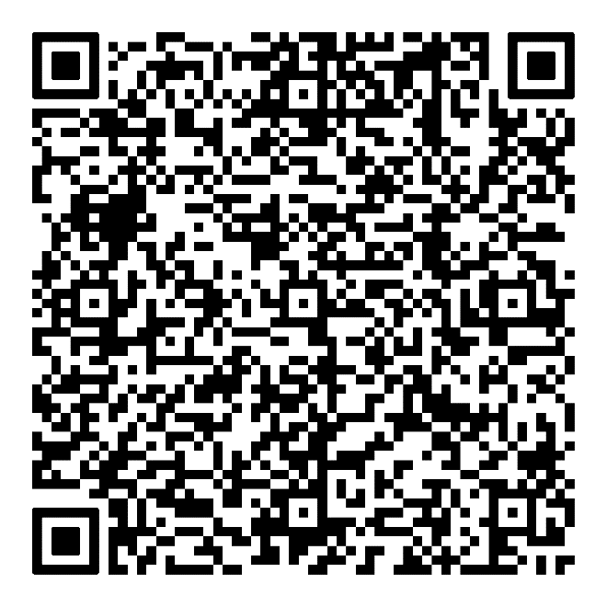
Scan to save my contact info on your phone

