Slide 1
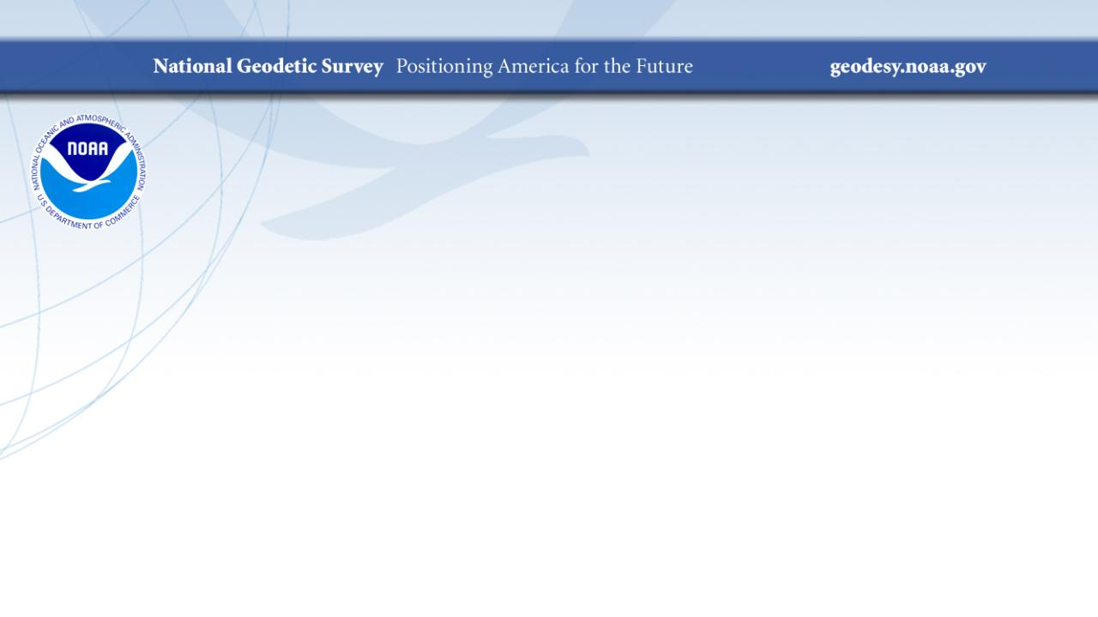
US Survey Foot
A History and Review of its Deprecation
…or Feets Don’t Fail Me Now
PLSO Webinar Series
May 2024
Jeff Jalbrzikowski, P.S., GISP, CFS
Appalachian Regional Geodetic Advisor
jeff.jalbrzikowski@noaa.gov
240-988-5486

Slide 2

Notes:
RIP Paul Barrere!

Slide 3

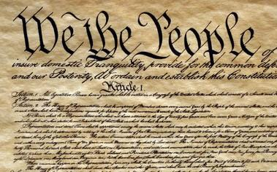




An epic tale and impressive cast
George Washington
Surveyors
Ferdinand Hassler
Thomas Jefferson
Thomas Mendenhall
John Quincy Adams
Notes:
The story of standards in the U.S. is an epic tale with an impressive cast of characters, some of who are very famous. Three are presidents:
George Washington, our first president, who was a surveyor
Thomas Jefferson, our third president, who was also a surveyor, and the founder of NGS (as the Survey of the Coast) in 1807.
John Quincy Adams, our sixth president. He was not a surveyor, but made a major contribution to standards. He was also the only president who had an alligator as a pet, in the White House (sadly, this fun “fact” is probably not true…)
Two other members of the cast are not as famous, at least outside NGS (both are also surveyors):
Ferdinand Hassler, first Superintendent of the C&GS, from 1807-1843 (although not continuously for that whole time, since all work was suspended when C&GS moved to Navy from 1818-1832).
Thomas Mendenhall, Superintendent of C&GS from 1889-1894. Not as well known as Hassler, but his importance in this story will soon become clear.
The last member of the cast is not really a “character”, but is a vital part of the story: the U.S. Constitution.

Slide 4
Weights & Measures: the early years
“Weights and Measures may be ranked among the necessaries of life to every individual of human society.”
Washington:
First messages to Congress
Articles of Confederation
1781
1789
1790
1821
U.S. Constitution
Jefferson: Proposes a decimal system
Adams:
Report on Weights and Measures
Article I, Section 8, Clause 5
Congress to “…fix Standard of Weights and Measures”
Notes:
1781. Articles of Confederation, Article 9, Paragraph 4, granting to Congress the “sole and exclusive right and power of…fixing the standard of weights and measures throughout the united states.”
1789. U.S. Constitution, Article I, Section 8, Clause 5, “The Congress shall have Power…To regulate Commerce…among the several States…To…fix the Standard of Weights and Measures.”
1790. Washington’s first message to Congress, January, 1790: “Uniformity in the currency, weights, and measures of the United States, is an object of great importance, and will, I am persuaded, be duly attended to.” Then again in December 1790, and yet again in 1791.
1790. Thomas Jefferson (then Secretary of State) submitted report on uniformity of weights and measures at request of House of Representatives. Consisted of two plans. The first plan retained the current system, but standardized. The second plan recommended use of a decimal system, which was also recommended by a Senate committee in 1792.
1821. John Quincy Adams (then Secretary of State), as instructed by the Senate, delivered a comprehensive report in standardized weights and measures. This was done in response to president Madison reminding Congress in 1816 that no laws on standardizing weights and measures had been enacted. The report was influential for later developments in standardization.

Slide 5

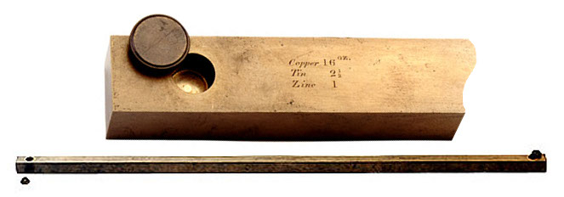
Hassler and the Empire
0.000 073 foot (0.022 mm) shorter than Troughton scale (24 ppm)
Congress Joint Resolution for uniform standards
Brings Troughton scale from England
Submits report
to Congress
1815
1830
1832
1834
1836
1855
“Exact” copy of British Imperial Yard
Directed to resolve weight and measure issues
In England: British Imperial Yard destroyed in a fire!
New Imperial Yard made: U.S. receives
2 copies
Bronze Yard No. 11 becomes official U.S. standard
Notes:
Ferdinand Hassler, first Superintendent of C&GS (1807-1843). All efforts were to make weights and measures consistent with the British Imperial system.
1815. Brings “Troughton Bar” from England (having been detained in Europe due to the War of 1812). That did not solve the problems, though. Still many people on different places in U.S. using different standards
1830. Secretary of the Treasury directs Hassler to resolve issues with weights and measures.
1832. Submits report to Congress. Resulted in adoption of uniform standards.
1836. Congress issues joint resolution for uniform standards, and directed Treasury to furnish state customhouses with a complete set of weights and measures. This is the first direct congressional action to create uniform standards for the U.S.
Now need to go backward in time a bit, by two years:
1834. Tragedy struck: House of Parliament in England burned down, irreparably damaging the official Imperial Yard, the basis for length throughout the Empire!
1855. A new Imperial yard was created and two copies were sent to the U.S.
Bronze Bar No. 11 was one of the copies that become the U.S. standard. It was square cross section was a "line standard"; when the bar was at 62° F the yard was defined by the distance between two fine lines ruled on gold "plugs" which were set into recesses in the ends of the bar to protect them. Protective caps fit in the holes. The reason for recessing the defining lines in holes in the bar is to locate them on the bar's "neutral plane", its axis of symmetry, where length error due to sag of the bar under its own weight is minimum.
Bronze Bar No. 11 was found to be 0.022 mm shorter than the previous standard, the Troughton scale (note that a human hair is on average about 0.1 mm in diameter).

Slide 6

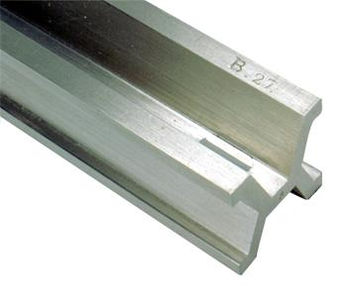
Going metric, in fits and starts
Different length!
Congress legalizes use of metric system
Bronze Yard
No. 11 travels
to England
Standard Meters Nos. 21 and 27 sent from France
1866
1875
1876
1888
1890
U.S. Signs
“Treaty of the Meter”
Bronze Yard No. 11 travels to England, again
Different length - again!
Notes:
The start of the metric era:
1866. Congress legalized use of the metric system for commerce in the U.S. Included 4 conversion tables of metric to existing (nominally British Imperial).
1875. U.S. signs “Treaty of the Meter” or “Metric Convention”, along with 16 other nations, to establish an international bureau of weights and measures (ratified in 1878).
1876 and 1888. Bronze Yard No. 11 transported to England, and in both cases did not agree in length, and by different amounts. Could not be determined with the U.S. or British yards had changed in length. All were considered unstable.
1890. Copies of the international meter were made, with none being the “official” version. Bars no. 21 and 27 were randomly selected and shipped to the U.S.
Chaos: Two separate standards of length existed, one based on the British Imperial yard (as represented by Bronze Bar No. 11), the other as represented by Standard Meters Nos. 21 and 27, 90% platinum, 10% iridium, far superior in construction to the bronze bar (accurate to about 0.0001-0.0002 mm). They disagree at levels that are measurable. What can be done to remedy this problem?
As a related aside, the basis for defining the meter was later refined a few times. The last was in 1983, when it was defined as the distance light travels in a vacuum in 1/299,792,458 of a second. This basis is considered measurable to ab accuracy of 0.1 nm (0.000 0001 mm). That’s 1000-2000 times more accurate than Standard Meters Nos. 21 and 27, and this basis is unlikely to change again anytime soon.

Slide 7

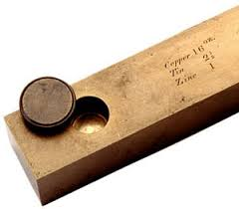

Out of chaos, order
1893
The Mendenhall Order
Thomas Mendenhall
Superintendent C&GS and Office of Weights & Measures (1889-1894)
Embraced meter
Abandoned British Imperial Yard
Declared foot defined by meter:
1 foot = 1200/3937 meter
Provided tables of conversions
e.g., Gunter’s chain = 20.1168 m
66 ift EXACTLY
65.999868 sft
The U.S. officially became metric
Notes:
The Mendenhall Order (1893): When the U.S. officially became metric.
Officially adopted meter as basis of length, where 1 foot = 1200/3937 meter (per 1866 act of Congress), and with meter represented by Meter Bars No. 21 and 27.
Completely abandoned British Imperial Yard as basis for length (as represented by Bronze Bar No. 11).
Declared in Appendix 6 of C&GS Bulletin No. 26, including conversion tables.
Interesting to note that conversion showed 1 Gunter’s chain = 20.1168 m
That is EXACTLY 66 ift (vs. 65.999868 sft)
This is just a coincidence due to rounding, but it shows that for the precision of the chain, the distinction between the ift and sft is immaterial…

Slide 8
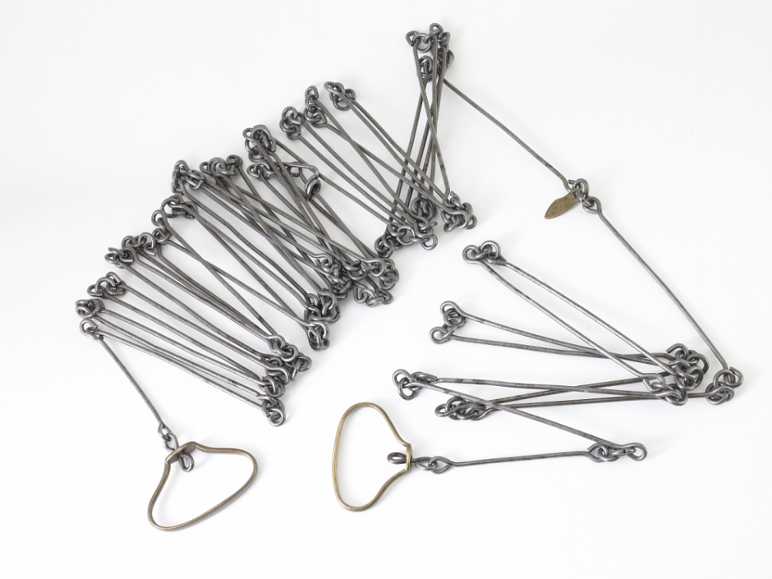
Gunter’s chain and retracement
Invented by Edmund Gunter in 1620
  66 ft long with 100 links… usually
  Distances mostly given in whole links
“Chained” to the U.S. survey foot?
  “Foot” varied in length by much
  more than ±2 ppm before 1893
  Not built to ±2 ppm accuracy
  (±0.000132 ft = 0.0016 inch)
    That’s 0.0002 link per chain
    or 0.016 link per mile
Notes:
Let’s talk about Gunter’s chain and retracement of boundary surveys in the context of sft vs. ift.
Invented in 1620, long before the sft definition was recognized (as 1 ft = 1200/3937 m), and even before the meter was defined (in 1798).
Each link 0.66 ft = 7.92 inches long; most measurements given to nearest whole link.
No meaningful connection between Gunter’s chain and sft, at the 2 ppm level
Foot definition varied by much more than 2 ppm before 1893
Setting 1 chain exactly equal to 66 sft is arbitrary; could just as readily be 66 ift (as shown in Mendenhall Order).
Chains not constructed to 2 ppm accuracy, not even close.
Even if constructed to 2 ppm accuracy, they could not be used in the field to anywhere near that accuracy.
Bottom line: it is not possible to perform a survey to 2 ppm accuracy with a Gunter’s chain. Even with modern technology and the most exacting methods, it would be extremely difficult to achieve that accuracy for a boundary survey.

Slide 9
A new foot for a new century
1 foot = 0.3048 meter exactly (1 yard = 0.9144 m)
New foot definition adopted by NASA predecessor
National Bureau of Standards created
Adopted as “new” foot for entire U.S.
1901
1933
1952
1954
1959
With one little exception…
New foot definition adopted by ANSI predecessor
International nautical mile
1,852 m exact
Notes:
With increasing measurement precision and global trade, it became necessary to adopt a more precise definition of the foot, and one that agreed with international usage.
A motivation for a new definition of the foot was in gage-block standardization for precise machine shop work used by industry. It was a practical solution to a practical problem. Note this has nothing whatsoever to do with surveying.
The new (international) foot definition was 1 ft = 0.3048 m (exact), and is the same to this day (it will not change). The adoption of the ift was a gradual process (as such things often are):
1933. Adopted by American Standards Association, now American National Standards Institute (ANSI).
1952. Adopted by National Advisory Committee for Aeronautics, now National Aeronautics and Space Administration (NASA).
1954. Adopted International Nautical Mile as exactly 1852 m. This is not related specifically to ift, but shows overall move toward adopting “exact” (non-ratio) relationships to the meter.
1959. NSB officially adopts ift for the entire U.S., with one little notable exception…

Slide 10
Kicking the can (Federal Register)
1959
“Any data expressed in feet derived from and published as a result of geodetic surveys within the United States will continue to bear the following relationship as defined in 1893:
1 foot = 1200/3937 meter
The foot unit defined by this equation shall be referred to as the U.S. Survey Foot and it shall continue to be used, for the purpose given herein, until such a time as it becomes desirable and expedient to readjust the basic geodetic survey networks in the United States, after which the ratio of a yard, equal to 0.9144 meter, shall apply.”
https://geodesy.noaa.gov/PUBS_LIB/FedRegister/FRdoc59-5442.pdf
Signed by NBS and C&GS directors, approved by Secretary of Commerce, June 25, 1959
Notes:
Federal Register Notice (1959) establishing ift and (temporary) sft
Official adoption of ift (1 ft = 0.3048 m) nationwide.
Temporary exception granted for geodetic surveys (including State Plane coordinates), to accommodate C&GS.
Mandates that ift shall be adopted after readjustment of U.S. geodetic network. This is not a “recommendation” or a “suggestion.” At the time this was published, “shall” was used in legal documents as mandatory (nowadays the usage of “shall” as mandatory is discouraged in legal documents).
Co-issued and signed by NBS and C&GS directors.
This FRN delayed full adoption of the ift, and promoted continued use of the sft for all surveying (not just geodetic surveys), and it is how we got into the situation we are in today.

Slide 11
More Federal Register Notices
Surveying and mapping only (pending analysis, never resolved)
Proposed permanent use of U.S. Survey Foot
Restatement that metric used for U.S.
International vs. U.S. Survey Foot
1975
1977
1988
1989
1990
NGS goes entirely metric (for NAD 83)
NAD 83 announced
International foot used for “engineering”
U.S. survey foot used for “mapping and land measurement”
Notes:
Other FRNs relevant to the ift vs. sft issue:
1975. Distinguishes between ift and sft, and gives both an exact (1200/3937 m) and approximate (0.304 800 61 m) definition of the sft. It states that the ift is used for “engineering” and the sft is used for “mapping and land measurement”, which by itself creates problems (since engineering and surveying are often done together for projects, so which should be used?). It also provides a clarification that the metric equivalents given in a previous (1968) FRN are approximate for lengths based on the sft. It gives an example of the U.S. survey mile = 1.609 347 km approximately, and the international mile = 1.609 344 km exactly.
1977. NGS policy on publication of plane coordinates based on NAD 83, stating that NGS will officially adopt the metric system. This effectively (but probably inadvertently) allowed NGS to side step the requirement of ending use of the sft, as required in the 1959 FRN.
1988. Proposal by NBS and NOAA/NGS to permanently retain U.S. survey foot for all surveying and mapping, pending analysis of public comment. It appears such a decision was never made.
1989. NGS announces adoption of NAD 83, with reference to publication of plane coordinates in 1977 FRN (and use of the metric system).
1990. A major FRN issued by NIST to reaffirm use and interpretation of the metric system (SI) in the U.S., partly in response to federal legislation on the metric system since the previous NIST FRN on this topic in 1982. Includes tables and descriptions that define the SI in the U.S. Does NOT include conversions between SI and U.S. customary units.
NOTE: In the webinar, I inadvertently mischaracterized the 1975 FR as saying the ift was “exact” and the sft was “approximate.” What that FRN actually says is that conversions in a previous (1968) FRN were only for the ift, and were therefore approximate for sft conversions. The 1975 FRN provides the exact sft conversions as a correction/clarification to the 1968 FRN. My apologies for any confusion this may have caused.

Slide 12
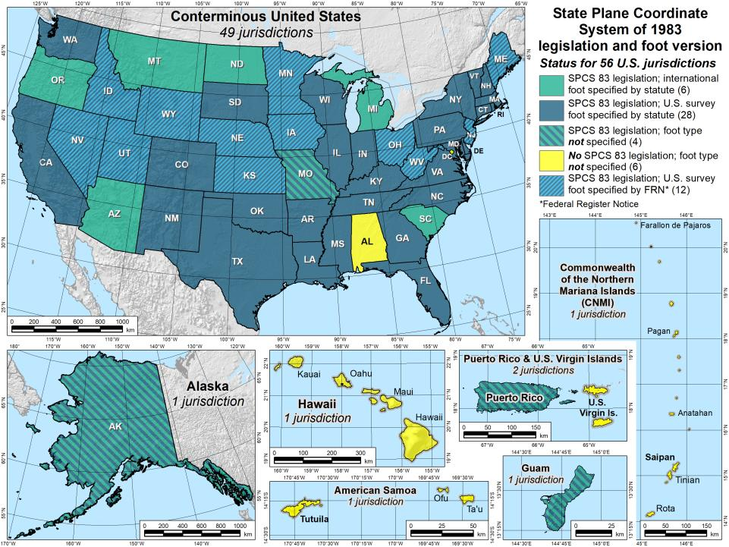


Notes:
Despite the mandate of the 1959 FRN, and the change to a new datum in 1986, NGS allowed states to choose whether they want State Plane coordinates in feet, including which type of foot.
Over time various states have taken actions to select the foot they want to use. Of the 40 states that have selected the sft, 28 have done so in statute, and 12 have done so by working with NGS to issue an FRN (the latest being in 2009, for Utah). So the situation with the 40 “green” states is more complicated than it appears.
Simply put, this is again chaos, just as it was before the Mendenhall Order of 1893. This is exactly the type of situation our five heroes wanted to avoid, having different standards of measure for different parts of the U.S. It is far worse than this map indicates, since jurisdictions within a state use a different foot than on this map. For example, Hawaii shows no foot selection (not even SPCS 83 legislation), yet it uses sft for most areas but ift on military bases. Arizona is shown as an ift state, yet the National Park Service uses sft within Arizona. It is a complete mess. There is no way for me to know for sure, but it is my opinion that our heroes would be spinning in their graves if they saw this.
Addendum: Some surveyors look at the CONUS map and ask why NGS is proposing the ift rather than the sft, since more states have officially selected the sft for SPCS 83 (40 vs. 6). It seems a reasonable question, but it is flawed, for the following reasons:
Minority vs. majority. This is not an issue of a minority overruling a majority. Although most states have adopted the sft (for SPCS 83), it’s important to recognize that surveying and mapping represents only a tiny fraction of overall economic activity in the U.S. Other major parts of the U.S. economy make use of the ift. For example, one of the reasons the ift was adopted in 1959 was for standardizing gauge blocks (the primary means of length standardization used by industry). So surveying is actually a small part of this issue. Because of that, there is essentially no chance that NIST will go back to the sft definition for the entire U.S. If there is going to be one foot, it will certainly be 1 ft = 0.3048 m (exact).
Uniformity. For standards to be useful, they must be uniform. That is why Congress is empowered by the U.S. Constitution to establish standards of weights and measures. Having two concurrent nearly identical definitions of the foot is inconsistent with the very idea of standards. And it is bad for business (i.e., commerce). Keeping the sft for surveying and mapping while using the ift for everything else would perpetuate the inconsistency.
Original intent. In the 1959 FRN that announced nationwide adoption of the ift, the previous foot was named the sft with the intent that it be temporary. It was an accommodation by NBS to C&GS, exclusively for geodetic work. The 1959 FRN mandated that the ift be adopted after readjustment of the U.S. geodetic networks. That occurred in 1986 with the change from NAD 27 to NAD 83. So use of the sft was supposed to end at that time, but it did not. It appears the main reason is that NGS side-stepped the issue by going metric in 1977, perhaps in the hope that the entire nation would go metric. Instead the “temporary” sft became embedded as part of how SPCS 83 is used (but not in how SPCS 83 is defined – the definitions for every zone are metric).
SPCS 83 vs. SPCS2022. In those states where the sft is specified (by state statute or FRN), it is associated with SPCS 83. Such specifications will not apply for SPCS2022. A state could legislate sft for SPCS2022, but if NIST mandates use of the ift, that would likely override state statute, per the U.S. Constitution.
Authority. Only NIST has the authority to deprecate the sft, not NGS. In the end, the fate of the sft will be up to NIST. The reason NGS is involved is that the existence of the sft is due entirely to NIST accommodating NGS in 1959. Because of that, NGS bears responsibility in trying to resolve the issue, as we should have done in 1986, and NGS will work with NIST to that end. If the decision is to deprecate the sft after 2022, it will be announced in an FRN, and NGS will also take other steps to inform our customers. But NGS will continue to support the sft for legacy applications in SPCS 83 and 27 in our products and services.

Slide 13
Federal Register temporary exception
1959
This should have happened in 1989
“Any data expressed in feet derived from and published as a result of geodetic surveys within the United States will continue to bear the following relationship as defined in 1893:
1 foot = 1200/3937 meter
The foot unit defined by this equation shall be referred to as the U.S. Survey Foot and it shall continue to be used, for the purpose given herein, until such a time as it becomes desirable and expedient to readjust the basic geodetic survey networks in the United States, after which the ratio of a yard, equal to 0.9144 meter, shall apply.”
Signed by NBS and C&GS directors, approved by Commerce Secretary, June 25, 1959
https://geodesy.noaa.gov/PUBS_LIB/FedRegister/FRdoc59-5442.pdf
Notes:
Federal Register Notice (1959) establishing ift and (temporary) sft
Official adoption of ift (1 ft = 0.3048 m) nationwide.
Temporary exception granted for geodetic surveys (including State Plane coordinates), to accommodate C&GS.
Mandates that ift shall be adopted after readjustment of U.S. geodetic network. This is not a “recommendation” or a “suggestion.” At the time this was published, “shall” was used in legal documents as mandatory (nowadays the usage of “shall” as mandatory is discouraged in legal documents).
Co-issued and signed by NBS and C&GS directors.
This FRN delayed full adoption of the ift, and promoted continued use of the sft for all surveying (not just geodetic surveys), and it is how we got into the situation we are in today.

Slide 14

Out of order, chaos
A foot still in limbo
2008. NIST “Guide to the Use of the SI”
U.S. survey foot still used
  but never officially permanently adopted
Repeats 1975 FRN ideas about the two feet:
  International ft used for engineering
  U.S. ft used for surveying & mapping
At odds with very idea of “standards”
Notes:
After nearly 100 years of relative order in standards of measure (from the Mendenhall Order of 1893 to release of NAD 83 in 1986), a new chaotic situation was created by perpetuating the sft.
Despite a misguided effort in the 1988 FRN to make the sft “official”, it is still an unofficial nominally “temporary” unit, stuck in standards “limbo”
Latest NIST publication that discusses this (2008) notes that sft is still used, even though it has not been officially and permanently adopted.
Saying that ift is used for engineering and sft for surveying and mapping is absurd. The two are not mutually exclusive. Surveying is almost always a part of civil engineering projects.

Slide 15
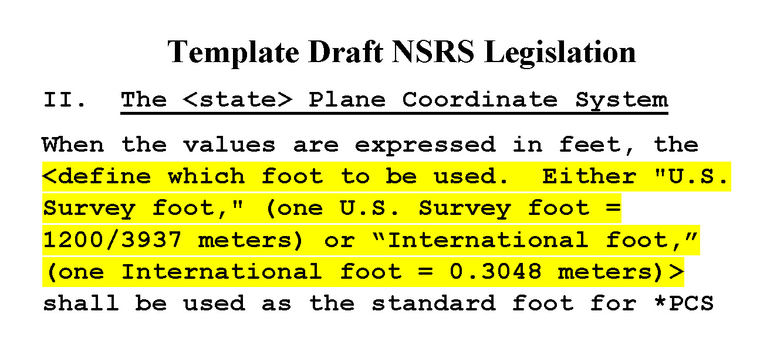
Problem created and perpetuated by NGS
In 1959. Then in 1986. And again in 2016…
We did work with NSPS and AAGS to fix this!
Notes:
NGS must take the bulk of responsibility for this situation.
NBS (NIST) accommodated us in 1959. Yes, NIST allowed it, but it was at the behest of NGS.
NGS perpetuated the problem by avoiding the required remedy in 1986.
We just recently perpetuated it again, in 2016, when we helped write template draft NSRS (National Spatial Reference System) legislation or “model law.”
Done cooperatively with NSPS and AAGS (American Association for Geodetic Surveying)
Explicitly allows selection of ift or sft for those states that want SPCS coordinates in feet.
This was a mistake. NGS went along with this mechanically because we had become inured to the absurd existence of dual feet. The idea of getting rid of the sft did not even occur to us at the time this draft legislation was prepared. Now we want to fix the problem we created.

Slide 16
Why make the change?
That was original intent (60 years ago!)
Two “feet” is inefficient and causes confusion
  Leads to errors that cost money
  Absurd to have “same” unit that differs by 2 ppm
  Defeats purpose of having a length standard
Only recognized in part of U.S.
NGS software can support backward-compatibility
Now is the time
  Many changes already being made for 2022
  Change in foot trivial compared to other changes
  U.S. survey foot problems will never go way if not addressed
Notes:
Continuing with why we should make the change:
The sft is not recognized in the entire U.S. Only in parts of the U.S. And even for states where the ift or sft is specified, there are internal exceptions (a few of which I have already mentioned).
NGS can make the transition easier by automatically supporting backward-compatibility in our software. That way you would get sft for all SPCS 27 zones, and also for SPCS 83 in the 40 states that have specified the sft for SPCS 83.
To repeat: Now is the time. Otherwise this problem will never go away (unless the U.S. goes completely metric).

Slide 17
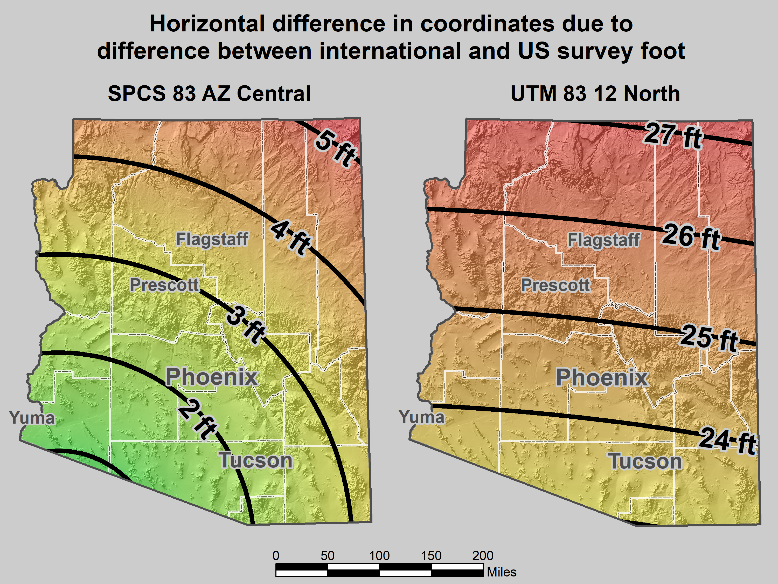
Notes:
As an example of some of the problems, consider the state where I am registered, beautiful Arizona. It is an ift state, yet mix-ups with sft occur all the time:
The map on the left shows the horizontal difference in feet when ift and sft are interchanged for SPCS 83 AZ Central Zone.
I worked a lot in Flagstaff. This confusion occurred so often that whenever I saw a 3.5 ft horizontal discrepancy, I suspected it was this issue. And it usually was.
When the City of Flagstaff installed their GIS software, it defaulted to State Plane in sft (even though it’s supposed to be ift). When the City discovered this, they decided to just leave it in sft, which is part of the reason why the 3.5 ft error showed up so often in Flagstaff. But they also occur elsewhere.
I probably shouldn’t complain about ift/sft problems, because I’ve made money off of it. In one weekend I made a couple thousand dollars helping someone with a big survey near Prescott. One of the problems was a 3-ft horizontal discrepancy. Turned out it was due to an ift/sft mix-up, mainly because more than one company worked on the project.
It’s not just State Plane. I don’t know if they still do it, but a statewide electric utility (Arizona Public Service) uses UTM coordinates, in sft. This causes positional errors of 23 to more than 27 feet if ift are used, depending on location.
These problems are real. And they don’t just occur in ift states. They can (and do) occur in any state. I’ve heard more stories about such problems than I can keep track of. This is especially a problem for surveyors licensed in multiple states with different foot types. Or for projects with multiple companies (especially if from different states or countries). Or for anyone who uses software. In short, it has negatively impacted many people, but it can potentially impact anyone. Maybe it has never been a problem for you. But you won’t have to look very far to find someone who has war stories on this topic.

Slide 18
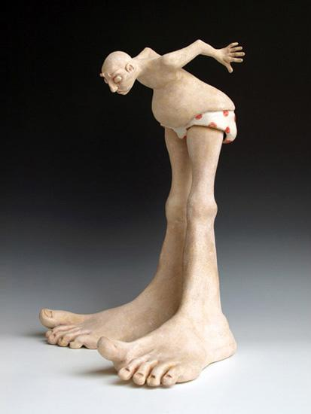
Reasons for adopting “new” foot
Helps prevent “foot confusion” problems
Sharing data
Variety of software
Cost
Notes:
Making the switch to the “new” foot (exactly 0.3048 m) helps prevent various “foot confusion” problems
Sharing data is a potential problem if the type of feet is not specified, or if it is wrongly specified (yes, that happens).
Data sharing is especially a problem for large projects with many players, especially if some come from other states or other countries. Apparently this very problem recently occurred in the high speed rail project in southern California, causing delays (and thus costing money).
Software is written all over the world, by all sorts of people. Some of them may not even know about the two type of feet. Some may know but incorrectly assign the foot type. Others won’t allow you to choose the sft if you’re in an ift state (and vice versa). That is a major problem because of numerous exceptions that occur (a few mentioned previously).
These types of problems cost money. Yes, I made money off such problems. But someone had to pay it, probably the surveyor in charge of the project. Often such costs get passed down to the surveyor.

Slide 19
2 parts per million (ppm)?
1,000,000.00 sft = 999,998.00 ift
10,000,000.00 sft = 9,999,980.00 ift
1,000.00 sft = 999.998 ift (can you measure that?)
International → 1 ft = .3048 m
US → 1 ft = .30480061 m (approx.)
Approx 0.02 ft in about 2 miles
Notes:
It’s likely everyone watching this webinar knows about the problem: there are two nearly identical versions of the foot in current use in the U.S.;
They differ by 2 parts per million (ppm), or only 0.01 ft per mile, or slightly more than a tenth of an inch in a mile.
Despite (or actually because of) the very small difference, it has become a REAL problem with REAL costs.
What’s in a name? That which we call a “foot” by any other word would smell as… sweet? Maybe that’s not he best analogy for the foot…
“U.S. survey foot” sounds patriotic, is surveyor-centric…
“International foot” sounds like a New World Order, UN sanctioned sort of thing, with perhaps a whiff of socialism…
Is the name really part of the problem? I hope not, but emotion does play a role. We are not entirely rational creatures after all (myself included).
Surveyors are really the only users of the U.S. survey foot (sft). They are also among the very few who even know of its existence. In schools and colleges they only teach students about the official international foot (ift). However, because people use the products created by surveyors, they end up using the sft without even knowing it.
Want to have a conversation about this, get all of us on the same page. So I will present facts to facilitate informed discussion (sprinkled with some opinions…)

Slide 20
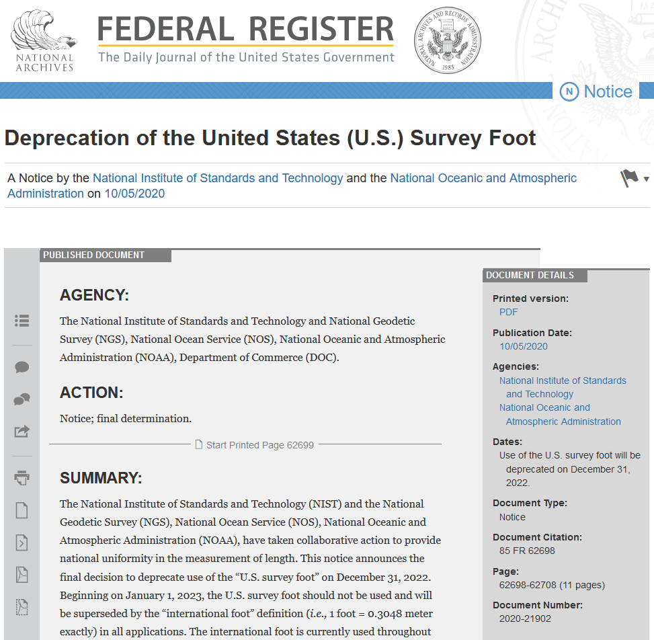
What now?
US Survey Foot officially
deprecated on Dec 31, 2022
  Per final determination Federal Register Notice issued on Oct 5, 2020
  Collaborative action by National Institute of Science and Technology (NIST) and NGS
  Describes public comments received, along with the plan, resources, training, and other information for an orderly transition with minimum disruption
(this image is hyperlinked to the Federal Register page)

Slide 21
The Survey Foot is dead!
Long live the Survey Foot!
US Survey Foot was deprecated 31 December 2022… now what?!?
Notes:
We start with the SPCS83 zones as a frame of reference
NOTE that the color shading of these zones is matched to that of the Preliminary SPCS2022 Zones that follow

Slide 22
What about NSRS Modernization?
Deprecation effective Dec 31, 2022
  NSRS modernization will happen later, circa 2026
For users of existing NSRS:
  Deprecation will have no effect
  U.S. survey foot will still be supported
  Difference in dates will NOT create a problem
Will give more time to make the transition
Notes:
NGS wants you to join us in taking a stand for standards, for the reasons listed here that summarize what was discussed in this presentation.
An important point is that although it appears the federal government has the authority to mandate a single foot definition, we believe it is far better to persuade than coerce. Our hope is that you have found this presentation persuasive, and that you are at least considering the merits of a switch from the sft to the ift.

Slide 23

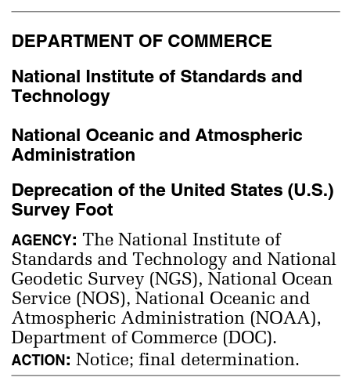
What happened to the US Survey Foot?
Deprecated 31 December 2022
Which begs the question
  What should you be doing now?

Slide 24
What should you be doing now?
Prepare for this along with new datums
Understand the difference between sft and ift
  2 parts per million
Understand this is not enforced
  Neither NIST or NGS are a regulatory agency
  We support education/outreach of course
  But OPUS, NCAT, etc. will not have US Survey Foot options for output in SPCS2022 zones

Slide 25
What should you be doing now?
Ask the right questions
  Does state law specify US Foot for SPCS83?
    40 states do that we know of
    Ohio does not, it actually specifies meters
  Does it specify US Foot for boundary surveys? (Does that matter?)
    We’re not tracking that, it’s not NSRS-related
Prepare for this along with new datums
  Legislation updates?

Slide 26
Recommendations on NSRS legislation
Do not include specific technical information
  No zone parameters, accuracy, or performance specifications
Retain previous versions (SPCS 27 and SPCS 83)
  Provides mechanism for continuing to use U.S. survey foot for SPCS 83
Goal: “future-proof” legislation
  Create statute that will not require later updates
…and to just make life easier
  Much harder to change information in statute
  Less need to explain to legislators
  Some states will have a LOT of zones (e.g., 90 in Utah, 89 in Ohio, 63 in Arizona, etc.)
  Do you really want to put all of these zones into statute?

Slide 27
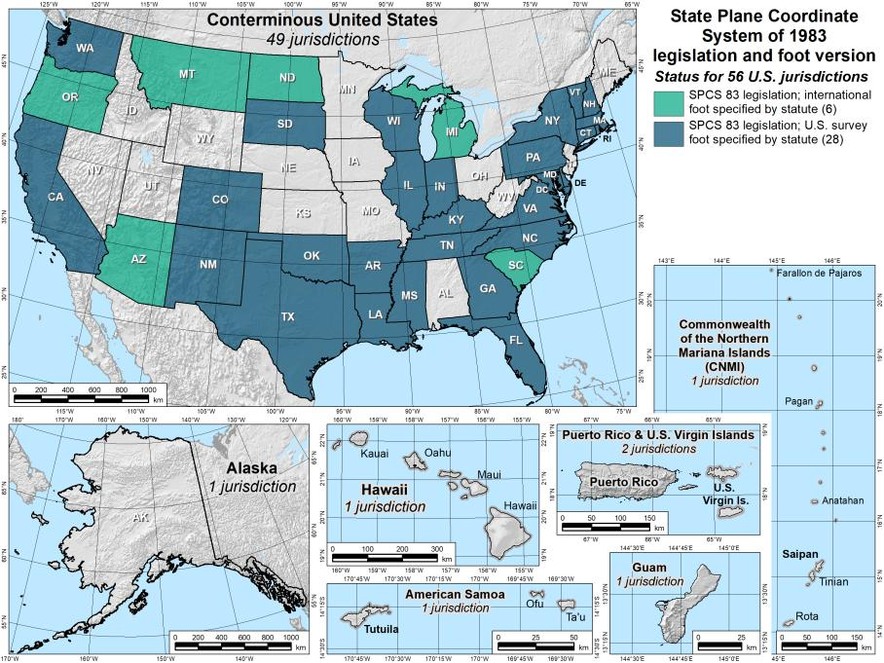
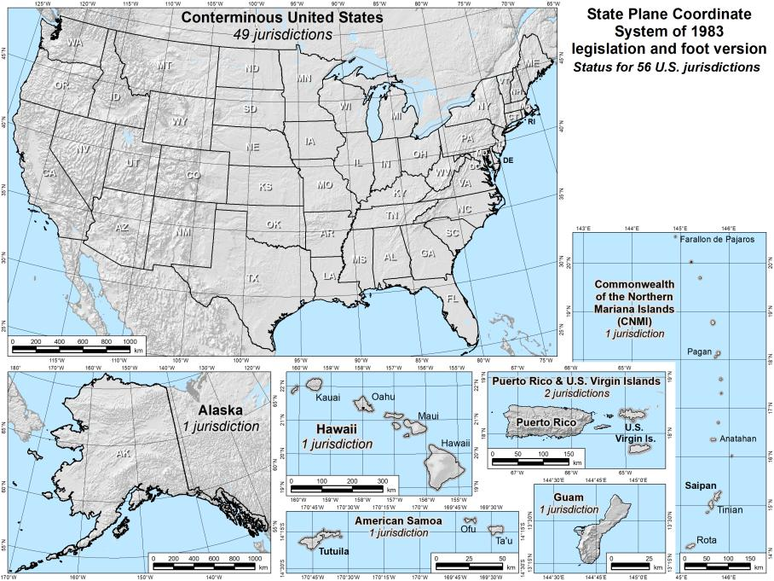
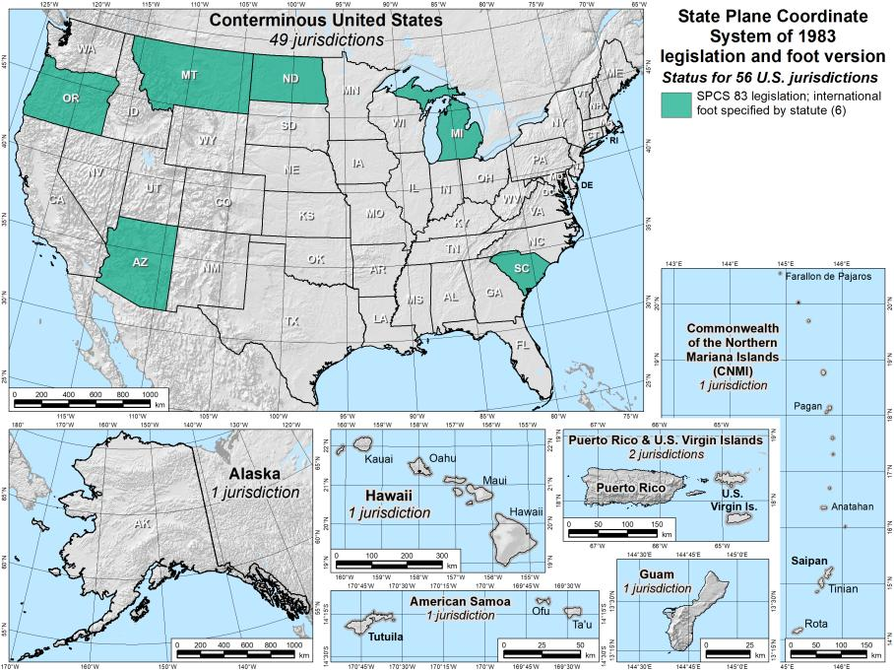
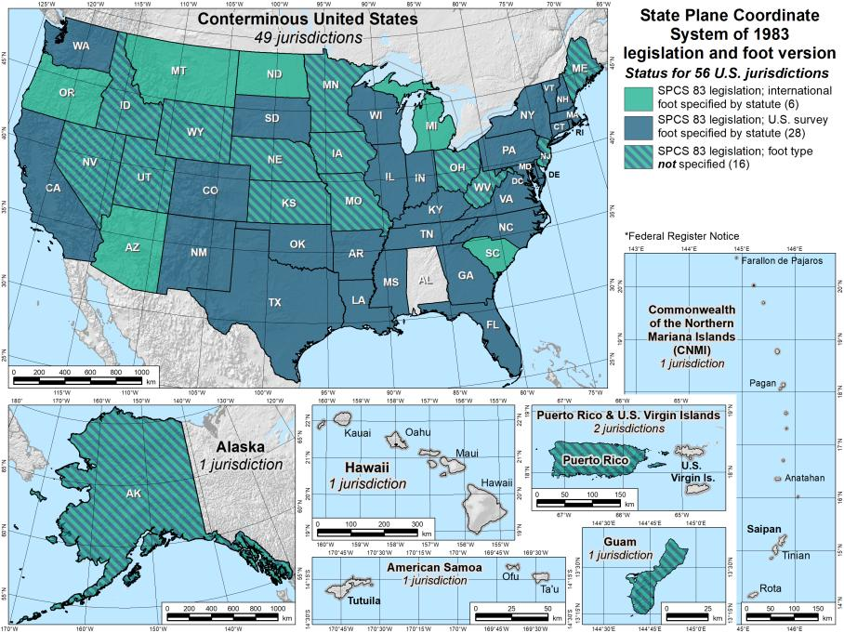
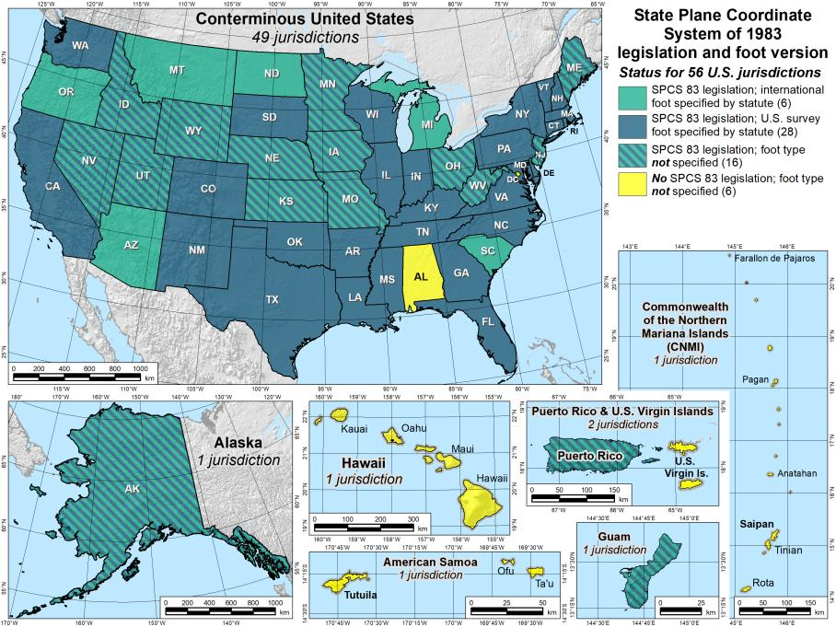
SPCS 83 legislation and foot version
56 U.S. jurisdictions
Legislation
  International foot: 6
  U.S. survey foot: 28
  Neither: 16
  No legislation at all: 6
Fed Register Notice
  U.S. survey foot: 12
  In lieu of legislation
  Done 2006-2009
27
27

Slide 28
The Survey Foot is dead!
Long live the Survey Foot!
US Survey Foot was deprecated 31 December 2022…
But it will always be available in NGS tools for NAD83 and NAD27 coordinates

Slide 29
Additional Resources

Slide 30
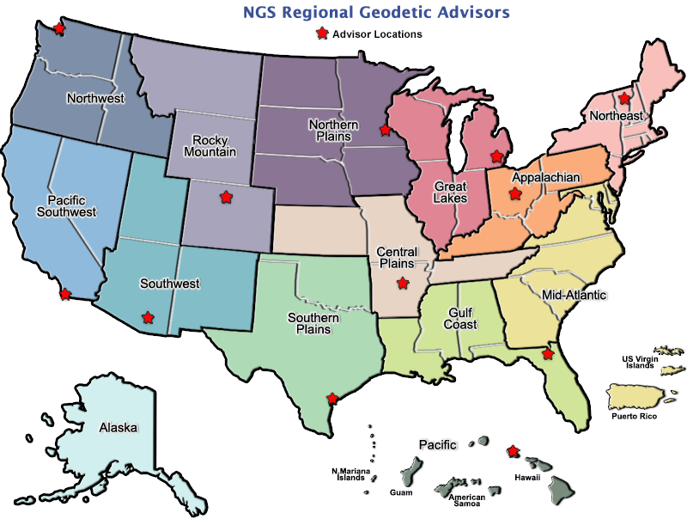
Regional Geodetic Advisor Program
geodesy.noaa.gov/ADVISORS/
14 RGAs across country
We are here to support:
  You
  Your constituents
  Our Federal Partners
Questions about
NSRS Modernization?
  Reach out now
  Be prepared
Notes:
-14 Regional Advisors, we’ve transitioned from a State-based to a Regional Program
-our advisors homepage up there at the top, also easy to find us by querying any major search engine for “ngs advisors”
-if you know Ross Mackay, he is our Chief Advisor, I report to him…
**ya know, I don’t know why they don’t make him put his photo up here
-we do have one vacant advisor position, that was recently advertised and John up there in Wisconsin is officially retired in oh… 18 days

Slide 31


Email Subscriptions
*Only 1-2 messages per month*
NGS News
  Includes quarterly NSRS Modernization newsletter
Webinar Series
Training
GPS on Benchmarks
Click this icon on homepage

Slide 32

Jeff Jalbrzikowski, P.S., GISP, CFS
Appalachian Regional Geodetic Advisor
jeff.jalbrzikowski@noaa.gov
240-988-5486
Scan the QR code to save my contact info to your phone

