Slide 1
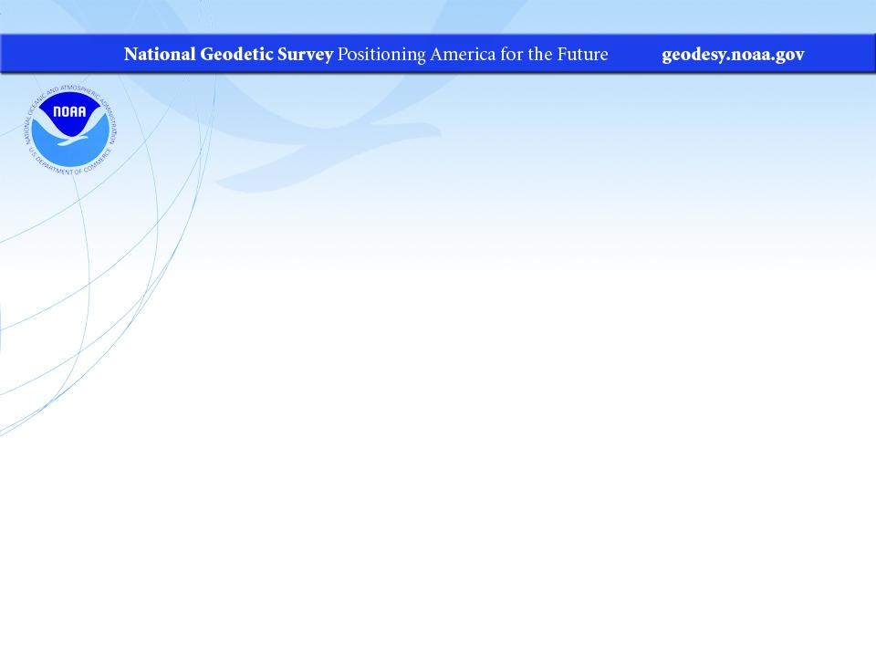
Geodesy for the Geographer
Vertical Datums for the Floodplain Manager
PA GIS Conference
April 2024
Jeff Jalbrzikowski, P.S., GISP, CFS
Appalachian Regional Geodetic Advisor
jeff.jalbrzikowski@noaa.gov
240-988-5486

Slide 2



Organizational Structure
  -Department of Commerce (DoC)
  (~47,000 employees)
  -National Oceanic and Atmospheric Administration (NOAA)
  -National Ocean Service (NOS)
  -National Geodetic Survey (NGS)
  (~175 employees)
Notes:
-We are the Federal Government’s oldest scientific agency.
-part of the Executive Branch
-I know it can seem kind of strange that NGS is part of the NOS, but the origins of NGS lie with the C&GS.
-we are a “Program Office” of the NOS
Survey of the Coast – 1807
Coast Survey – 1836
Coast and Geodetic Survey – 1878
NGS since 1970

Slide 3


Organizational Structure
We’re not USGS, we’re NGS
  -Department of Commerce (DoC)
  (~47,000 employees)
  -National Oceanic and Atmospheric Administration (NOAA)
  -National Ocean Service (NOS)
  -National Geodetic Survey (NGS)
  (~175 employees)
≠
Notes:
-as you can read my slide, I like to point that out because over my 2 years at NGS I’ve seen and heard this misunderstanding quite a bit
-don’t worry! it doesn’t offend us! and we do work closely with USGS, but we are separate agencies within totally different departments of the federal government

Slide 4
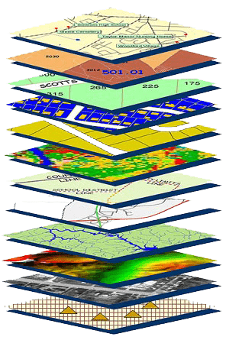
NGS Mission
To define, maintain and provide access to the National Spatial Reference System (NSRS) to meet our Nation’s economic, social, and environmental needs.
NSRS
Notes:
NGS develops and maintains the National Spatial Reference System, a national coordinate system that provides the foundation for transportation, navigation, land record systems, mapping and charting efforts, and a multitude of scientific and engineering applications
CLICK
You’ve all seen this or some similar graphic I’m sure. That bottom layer… that’s our baby, the NSRS.

Slide 5
Modernizing the NSRS
Updating all NSRS coordinates
  Replace existing datums with new datums
  Replacing existing SPCS83 with new SPCS2022
  Accounting for coordinates changing with time
Improving NGS products and services
Simplifying customer contributions
Making the NSRS:
  More accurate
  More accessible
  More efficient
begins
Rollout in
2025

Slide 6
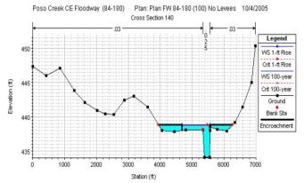
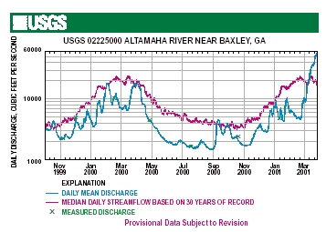

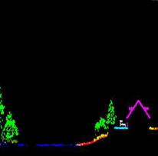
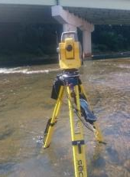
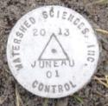
Why does the NSRS matter to me?
Orthometric Datum
Water Level Datum (and Flow Rates)
Ellipsoidal Datum
+
+
Aerial LiDAR/Mapping
Historic Water Levels and Flow Rates
Terrestrial Survey/Cross-Sections
FIRMs require data from disconnected sources.
Dates and datums must be consistently aligned.
Notes:
Example of why we need consistent coordinates (illustrated):
Just in the making of a single FIRM, data collected at different points in time using different methods:
-aerial lidar
-x-section and structure data via survey
-streamflow data/hydrographs
All of these must be reliably aligned and combined with historical data, in both the horizontal and vertical components, to produce a final product in which all of this information is available in one place, to assist professionals like yourselves in appropriate flood mitigation.
→Therefore, Reliable Flood Rate Insurance products rely on the NSRS
In a perfect world…
datums would be parallel and smooth
Surface of Earth would not move

Slide 7

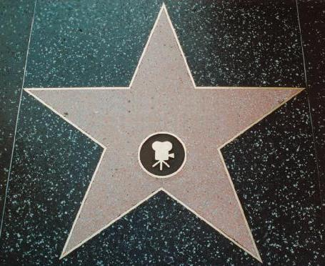
NOAA NGS
and
FEMA NFIP
Hello, we’re NGS.
You may remember us from such documents as …
NATIONAL GEODETIC SURVEY
Section 6.1 of FIS Reports
Your favorite FIRM/DFIRM
CRS Coordinator’s Manual
Notes:
“Hello, we’re NGS. You may remember us from such appearances as section 6.1 of Template: Flood Insurance Study (FIS) Report (Nov 2016)

Slide 8
NOAA NGS
and
FEMA NFIP

Slide 9
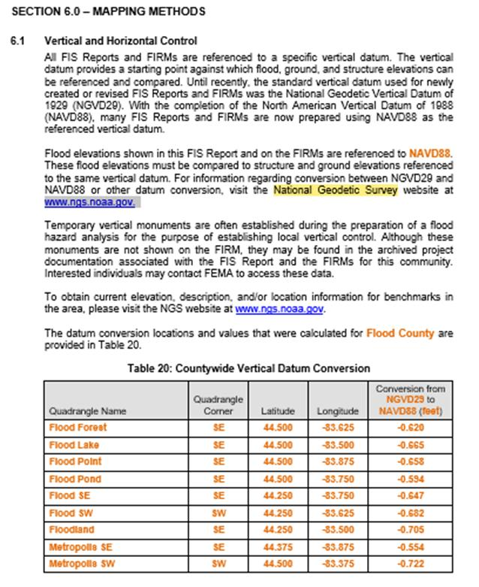
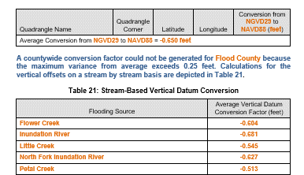
Template FIS Report (Nov 2016)
NOAA NGS
and
FEMA NFIP
Section 6.1 of FIS Report
States the requirement to know the datum for the FIRM and to consult NGS for datum conversion if needed.
Notes:
-Section 6.1 is intended to provide some information on vertical datums
-it should include, if necessary, a table detailing values used to determine either:
a countywide vertical datum “conversion”
or a stream-based vertical datum “conversion”
-NOTE the recommendation to consult NGS for info on transforming between NGVD29 and NAVD88

Slide 10
NOAA NGS
and
FEMA NFIP

Slide 11
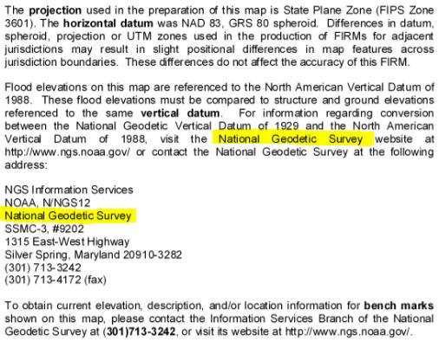
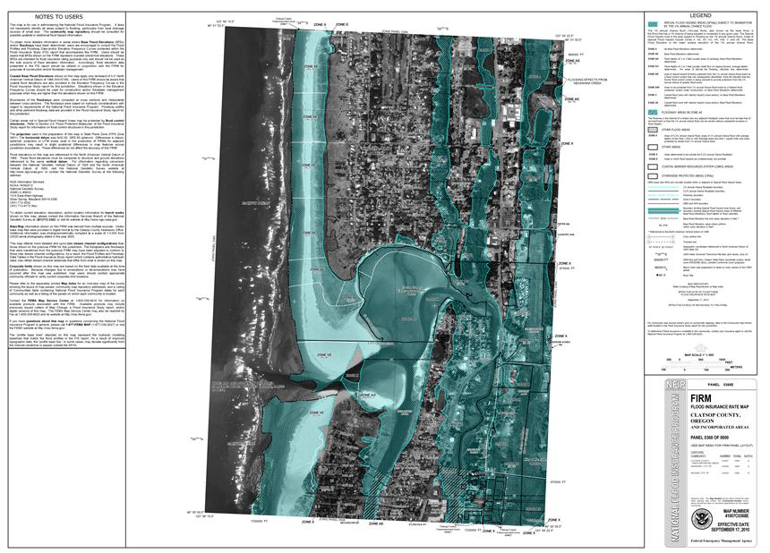
FIRM from Clatsop County, OR
NOAA NGS
and
FEMA NFIP
NOTES TO USERS
Notes:
or the “NOTES TO USERS” section of your favorite FIRM

Slide 12
NOAA NGS
and
FEMA NFIP

Slide 13
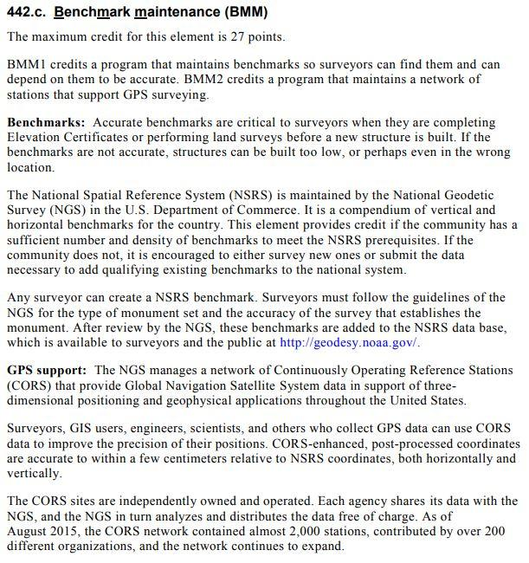
NFIP CRS Coordinator’s Manual
NOAA NGS
and
FEMA NFIP
Why highlight BMM?
Already includes provisions for CORS network to replace conventional disks in the ground.
Notes:
…or even from the FEMA CRS Coordinator’s manual
-specifically Activity 440 (Flood Data Maintenance), Element 442.c (Benchmark Maintenance)
-full discount is 27 points… I don’t know exactly what that means, that’s out of my wheelhouse but if anyone wants to speak from experience, feel free
-why am i brining this up?
- to highlight that the CRS program already includes provisions for CORS network to replace conventional disks in the ground, or what we call passive control because a surveyor sets the mark surveys it in and then … nothing further

Slide 14
NOAA NGS
and
FEMA NFIP

Slide 15
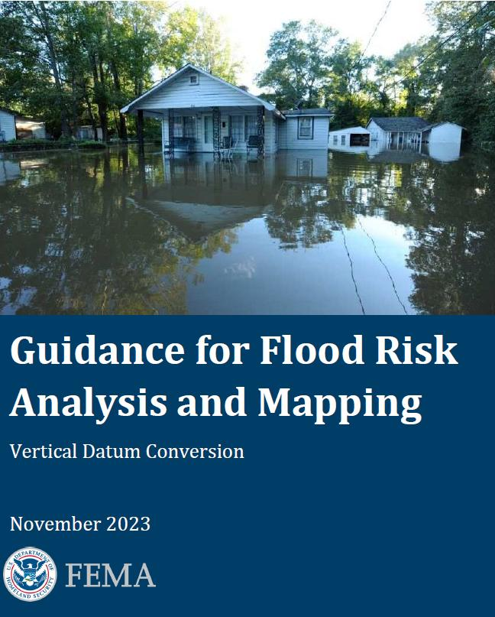
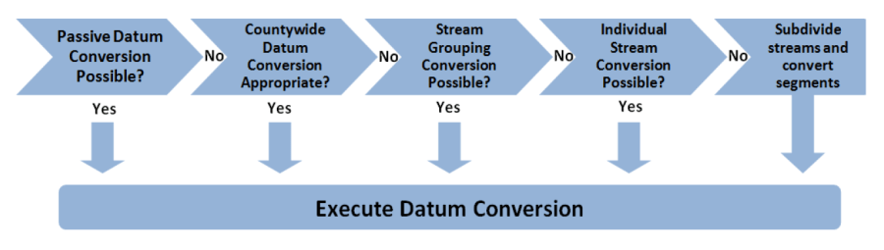
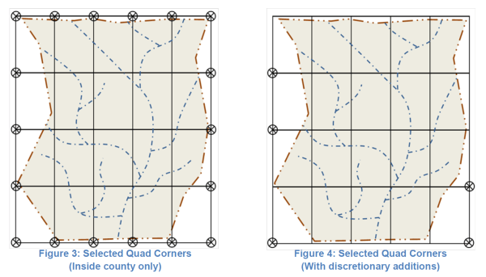
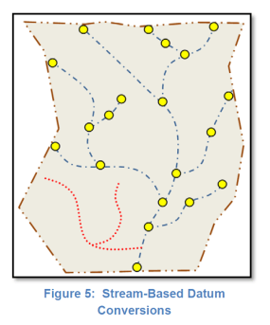
NOAA NGS
and
FEMA NFIP
Notes:
FEMA Vertical Datum Conversion Guidance → find it on their Floods & Maps page
-primary guiding principle in executing vertical datum conversions for unrevised flood elevations is to ensure that no more than a 0.25 foot variance from the average conversion factor exists at any point

Slide 16
Positional Components of
the NSRS
Geometric
aka “Horizontal”
Latitude, Longitude, Ellipsoid Height
Geopotential
aka Orthometric Height
aka “Elevation”
NAD83
NAVD88
Notes:
-geometric component is latitude, longitude, and ellipsoid height
-geopotential component is combined with the geometric components to calculate an ortho height or capital H

Slide 17
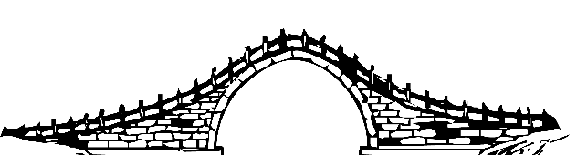
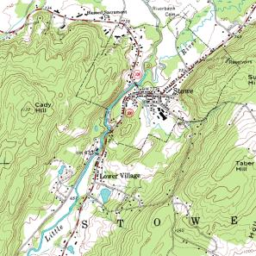
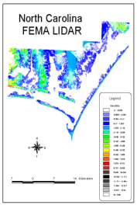
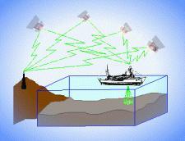
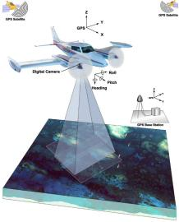
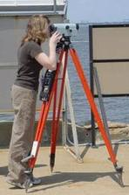
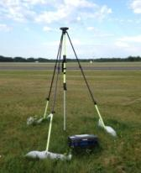
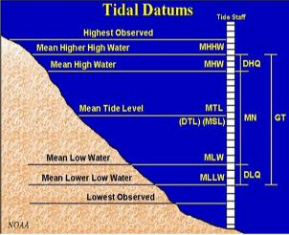
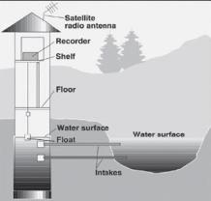
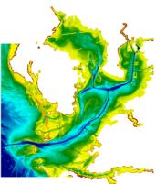
Three types of heights in NSRS
Ellipsoidal
geoid
Orthometric
Raw Hydrographic Surveys
USGS
Topography
NAD83
NAVD88
NGVD29
FEMA NFIP Data & Maps
Engineering and Construction Surveys
Raw GPS Observations
Raw Lidar Data
Water Level or Tidal
NOAA and USACE Hydrography
Shoreline Mapping and Regulatory Boundaries at the Coast
Daily and Extreme Water Levels (Gage)
Notes:
This slide illustrates the 3 categories of vertical datums and examples of where each is directly used They are project and application dependent.
First, we have ellipsoidal datums. Examples include WGS84 and NAD83 (North American Datum of 1983). You will encounter these datums frequently in hydrographic surveys that are vertically referenced with RTK-GPS; any native GPS measurements; and even raw lidar datasets.
Next, we have orthometric datums. These datums are very important because height differences referenced to orthometric datums will allow us to know the direction water will flow, because they have been “gravity-corrected”. The North American Vertical Datum of 1988 (or NAVD 88) is an orthometric datum, which you will see on USGS topographic maps, engineering and development site surveys, and FEMA Flood Insurance Rate Maps.
Finally, we have Tidal Datums, which are derived from water level measurements. They have extremely important applications including daily and extreme water levels; NOAA nautical charts, and shoreline mapping or boundaries along the coast.
*NOAA provides tools (like NCAT and Vdatum) to transform between these different height systems.
The Bridge

Slide 18
Orthometric
Notes:
This slide illustrates the 3 categories of vertical datums and examples of where each is directly used They are project and application dependent.
First, we have ellipsoidal datums. Examples include WGS84 and NAD83 (North American Datum of 1983). You will encounter these datums frequently in hydrographic surveys that are vertically referenced with RTK-GPS; any native GPS measurements; and even raw lidar datasets.
Next, we have orthometric datums. These datums are very important because height differences referenced to orthometric datums will allow us to know the direction water will flow, because they have been “gravity-corrected”. The North American Vertical Datum of 1988 (or NAVD 88) is an orthometric datum, which you will see on USGS topographic maps, engineering and development site surveys, and FEMA Flood Insurance Rate Maps.
Finally, we have Tidal Datums, which are derived from water level measurements. They have extremely important applications including daily and extreme water levels; NOAA nautical charts, and shoreline mapping or boundaries along the coast.
*NOAA provides tools (like NCAT and Vdatum) to transform between these different height systems.

Slide 19
Comparing Orthometric (aka Ortho) Heights
or …“Digging for Datums”

Slide 20

Vertical Datum Visualized
A reference surface that can be used to measure heights in a uniform way.
How much taller is Sally than Jane?
Could measure directly from top of head to top of head.
Or, from floor up to tops of heads and then subtract!
Sally
Jane
X= ?
That’s a relative height, or height difference.
Datum
X = (h Sally) – (h Jane)
That’s a difference in heights above a datum.
Notes:
A vertical reference system is a reference surface that can be used to measure heights in a uniform way.
So, how much taller is Sally?

Slide 21
Datum Difference Visualized
Can still calculate X with a relative height… but it is not accurate, as our reference surface is not the same.
How much taller is Sally than Jane?
Need to know what they’re standing on!
We cannot compare heights that are measured from different reference surfaces.
Sally
Jane
X= ?
NAVD88
Datum 1
NGVD29
Datum 2
X ≠ (h Sally) – (h Jane)
Notes:
-Well, we need to know how tall, or the slope of the hill.
-You cannot compare heights that are measured from different planes of reference.
*If we replace Sally and Jane with an example more related to floodplains:
What if we want to compare a BFE height in 1990 and a BFE height 2010
what if the land has subsided under that base flood elevation over time?
…hold that thought.

Slide 22
Ok Jeff, how do I do that?
…we call that a datum transformation
Notes:
-note that’s the proper technical term, but I’m not going to hound someone who says “conversion”… I slip sometimes too

Slide 23
Terminology - Changing Coordinates
Conversion
    change the type of coordinate
    NAD83(2011) latitude & longitude → NAD83(2011) SPCS
  Transformation
    change the datum of coordinate
    NGVD29 height → NAVD88 height
    NAD 27 latitude & longitude → NAD 83(2011) latitude & longitude
Propagation
    change the epoch of coordinate
    NATRF2022 epoch 2020.00 to NATRF2022 epoch 2023.243
Notes:
Historically NGS has been inconsistent with these top two words.
Going forward, we will use them as:
Conversion: Meaning to change the type of coordinate without changing the datum or frame
Transformation: Meaning to change the datum or frame, without changing the type of coordinate

Slide 24
A very brief history of (the most prevalent) U.S. vertical datums

Slide 25
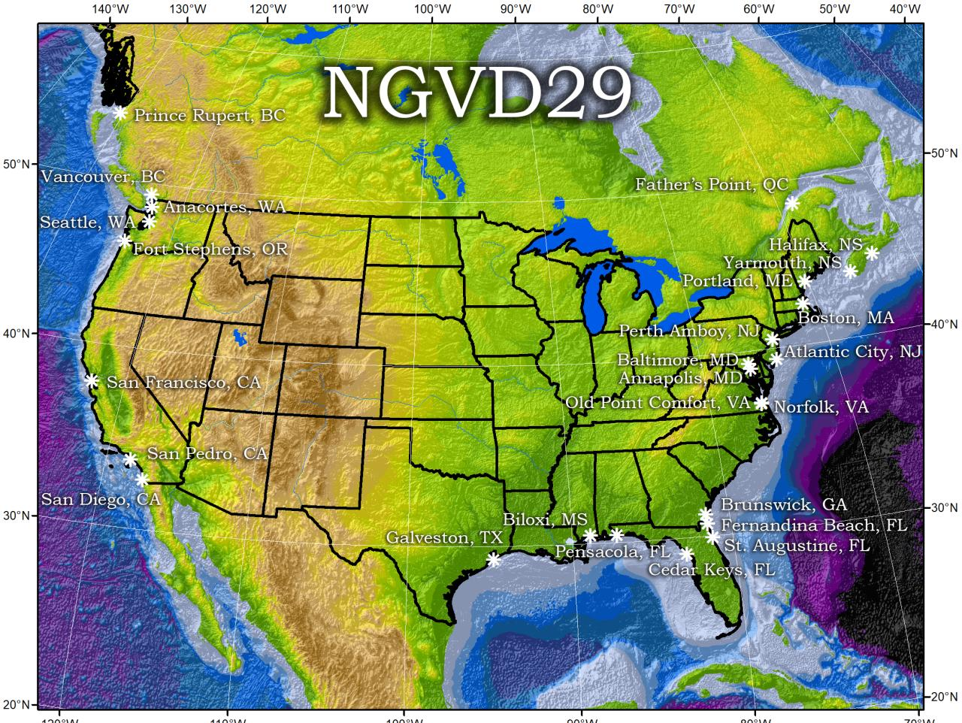
Referenced to 26 tide gauges in the US and Canada
Notes:
It turns out that MSL is a close approximation to another surface, defined by gravity, called the geoid, which is the true zero surface for measuring elevations. Because we cannot directly see the geoid surface, we cannot actually measure the heights above or below the geoid surface. We must infer where this surface is by making gravity measurements and by modeling it mathematically. For practical purposes, we assume that at the coastline the geoid and the MSL surfaces are essentially the same. Nevertheless, as we move inland we measure heights relative to the zero height at the coast, which in effect means relative to MSL.
Definition: NGVD29 – The National Geodetic Vertical Datum of 1929…
The Sea Level Datum of 1929 was the vertical control datum established for vertical control surveying in the United States of America by the General Adjustment of 1929. The datum was used to measure elevation or altitude above, and depression or depth below, mean sea level (MSL).
Mean sea level was measured at 26 tide gauges: 21 in the United States and 5 in Canada. The datum was defined by the observed heights of mean sea level at the 26 tide gauges and by the set of elevations of all bench marks resulting from the adjustment. The adjustment required a total of 66,315 miles (106,724 km) of leveling with 246 closed circuits and 25 circuits at sea level.
Since the Sea Level Datum of 1929 was a hybrid model, it was not a pure model of mean sea level, the geoid, or any other equipotential surface. Therefore, it was renamed the National Geodetic Vertical Datum of 1929 (NGVD 29) in 1973. The NGVD 29 was subsequently replaced by the North American Vertical Datum of 1988 (NAVD 88) based upon the General Adjustment of the North American Datum of 1988.

Slide 26
NGVD29 – based on 26 tide gauges
topographic surface
datum zero
surface
  Local Mean Sea Level differs at tide stations due to prevailing winds, ocean current, salinity, seabed topography, etc.
Concept

Slide 27
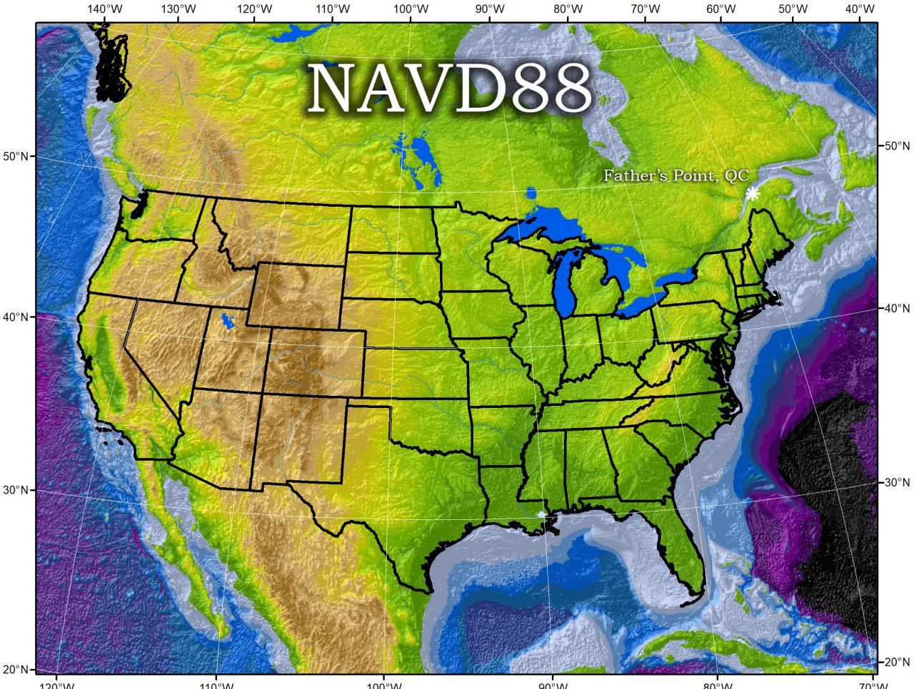
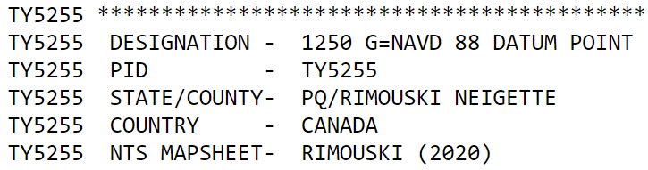
Why one site this time?
removed local sea level variation problem of NGVD29
Referenced to one tidal bench mark in Canada
Notes:
Definition: The surface of equal gravity potential to which orthometric heights shall refer in North America
One height held fixed [at 6.271 meters along the plumb line below the geodetic mark] at “Father Point” (Rimouski, Canada).
By fixing the geopotential value at the origin point, it was possible to ensure that the origins of IGLD 85 and NAVD 88 aligned.
**But perhaps more importantly, the height chosen was to minimize 29→88 differences on USGS topo maps in the eastern U.S. … thus, the “zero height surface” of NAVD 88 was NOT chosen for its closeness to the geoid (but it was close…few decimeters)
Use of one fixed height removed local sea level variation problem of NGVD 29

Slide 28
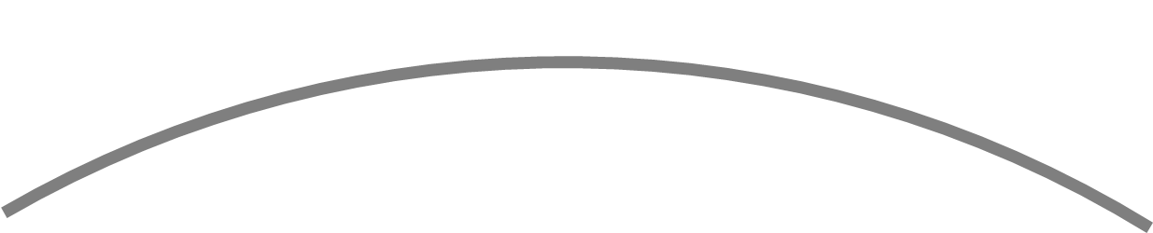
NAVD88 – based on single benchmark
topographic surface
datum zero
surface
Concept
Notes:
-

Slide 29
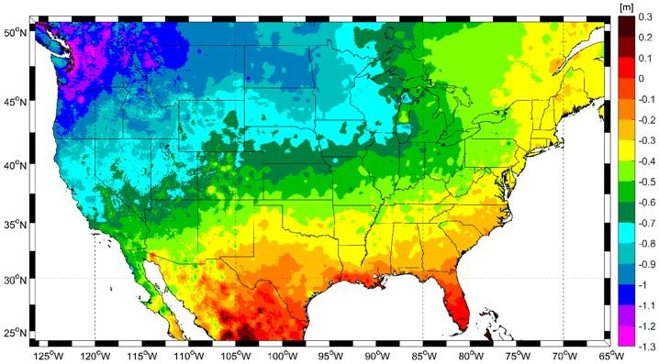
Approximate Error in NAVD88 zero surface
Map is the H=0 surface differenced from satellite gravity data
Notes:
Map highlights the tilt/bias to the zero reference surface, that’s another item that was discovered later on with the advent and proliferation of satellite positioning and remote sensing technology.
How was the map created, that is the NAVD88 zero surface (H=0) overlaid onto a satellite based geoid model, then color shaded by vertical difference

Slide 30
NAVD88 – based on single benchmark
topographic surface
datum zero
surface
  Most, if not all, of this error in alignment was intentional.
  Huh?! It was chosen to minimize the change to contours in USGS quadrangles.
Concept
Notes:
-importantly, the height chosen was to minimize 29→88 differences on USGS topo maps in the eastern U.S. … thus, the “zero height surface” of NAVD 88 was NOT chosen for its closeness to the geoid (but it was close…few decimeters)

Slide 31
Which NAD83 goes with which geoid to get to NAVD88?
GEOID18
GEOID12B
NAD83(2011) →
NAD83(2007) →
NAD83(HARN/FBN)
NAD83(CORS96)
GEOID09
GEOID03
GEOID99
GEOID96
Notes:
I’ve gotten this question more than once.
-Does it matter which geoid model I use with which realization of NAD83?
-NGS Answer = yes
-Project-specific answer = maybe note
-I spoke at length with a gentlemen from the Virginia DOT about this, and he did a bunch of comparisons, saw a barely discernable difference… but still the NGS answer is going to be that for a given realization of NAD83, you should use only the corresponding geoid models for your work
-remember NGS is chasing the millimeter… but maybe you aren’t

Slide 32
North American Vertical Datum
of 1988
NAVD88
will be replaced by

Slide 33
North American-Pacific Geopotential Datum of 2022
NAPGD2022
(pronounced: nap-jee-dee)

Slide 34
NAPGD2022
North American-Pacific Geopotential Datum of 2022
GNSS is your “access point”
  no leveling or ties to benchmarks necessary
Based on strength of gravity
  at Global Mean Sea Level (GMSL)

Slide 35
Gravity → Geoid
You’ve all used a DEM.
(Digital Elevation Model)
Picture a geoid model as a DGM.
(Digital Gravity Model)
-both raster cells of height values
→but represent different things

Slide 36
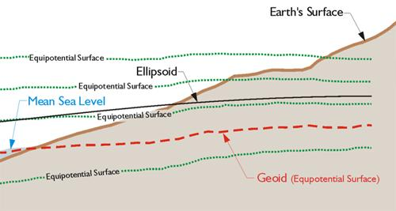
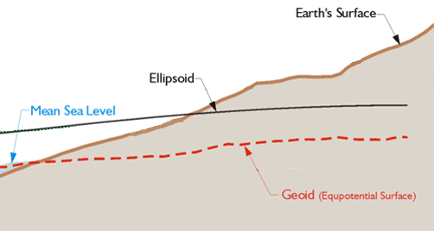
Equipotential Surface
W₀ = 62,636,856.0 m² s⁻²
-GPS for Land Surveyors, by Jan Van Sickle, 4th ed., CRC Press, Taylor & Francis Group, 2015, p. 180. (slightly edited)
Geoids are defined by a specific strength of gravity → W₀
Notes:
Recall our ol’ buddy W sub-naught (W₀)

Slide 37
NAVD88 geoids
versus
NAPGD2022 geoids

Slide 38
Two types of geoid models
  Gravimetric
  Hybrid
Notes:
-believe it or not there’s more than 2 types, but the 2 types you’ll see NGS publish are…

Slide 39
Gravimetric → Hybrid
  Gravimetric geoid is created from “scratch” with various types of gravity data
      USGG2003, USGG2009, USGG2012, xGEOID19
  Hybrid geoid is simply a gravimetric geoid then best fit some vertical datum… like NAVD88
      GEOID03, GEOID09, GEOID12B, GEOID18
Notes:
So… all the geoids you’re using to get elevations from your GNSS data

Slide 40
Gravimetric → Hybrid
      USGG2003, USGG2009, USGG2012, xGEOID19
      GEOID03, GEOID09, GEOID12B, GEOID18
best fit to NAVD88
best fit to NAVD88
best fit to NAVD88
best fit to NAVD88
Notes:
So… all the geoids you’re using to get elevations from your GNSS data

Slide 41
Gravimetric vs. Hybrid Geoid
topographic surface
gravimetric geoid
hybrid
geoid
datum zero
surface
Concept

Slide 42
NAVD88 uses a Hybrid Geoid
topographic surface
gravimetric geoid
hybrid
geoid
datum zero
surface
Concept

Slide 43
NAPGD2022 uses a Gravimetric Geoid
topographic surface
gravimetric geoid
datum zero
surface
  Datum zero surface aligned to Global Mean Sea Level (GMSL)
Concept

Slide 44
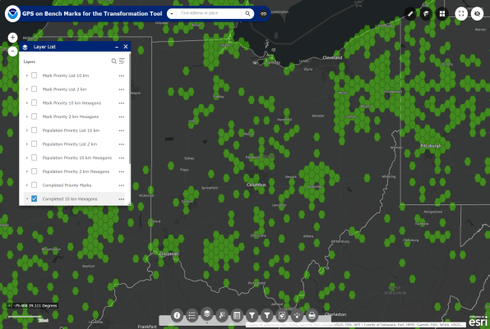
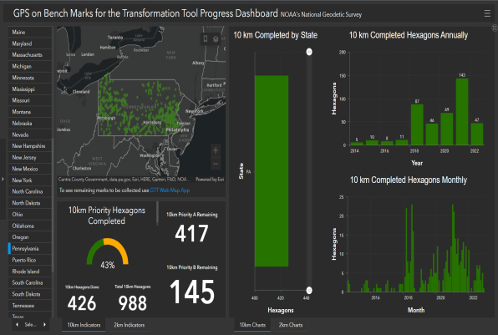
How do we fit the geoid to the datum?
GPS on Bench Marks (GPSonBM)
Anyone can collect and provide:
  2 OPUS-Static solutions
    Dual-freq. Receiver; Antenna Calibration
  2 photos of each setup
  Brief Description w/Ties
  Deadline = 29 February 2024
  Results increase accuracy of NAVD88<->NAPGD2022 transformation.
Web Map Application
Progress Dashboard

Slide 45
Sea Level Change and the Geoid
Threshold Level is published as 20 cm
Process is repeated as GMSL changes
H_{2020.000}
H_{2085.000}
Threshold Level
Geoid
GMSL
Notes:
The illustrated strategy will be adopted at NGS. An animated characterization of this approach
What this means is that NGS will decouple the geoid from GMSL, until they have diverged by some threshold amount, currently defined as 20cm.
When that threshold is reached a new geoid will be defined and held fixed until reaching next threshold. In this way, the impact of the change of GMSL is accounted for in the heights of the NSRS, while the appearance of stability is maintained for “decades at a time” (BP2 Section 14).
If we calculate how long that might be based on existing rates of sea level rise of 3ish mm/yr then we’re talking over 50 years

Slide 46
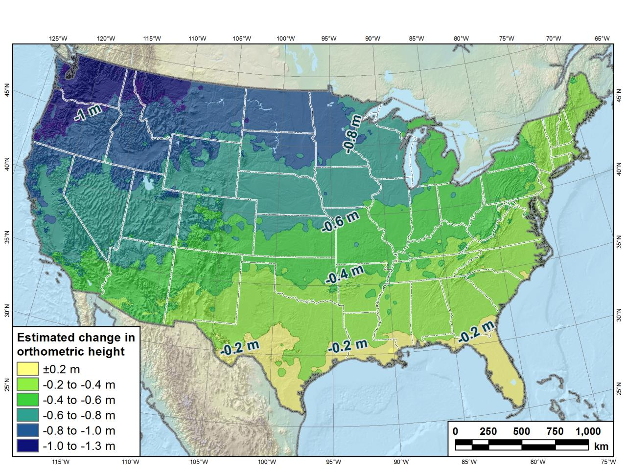
Estimated change in orthometric heights from NAVD88 to NAPGD2022
(NAPGD2022 approximated using xGEOID16B)
Notes:
Change in Pennsylvania:
At least -0.6 feet
At most -2.0 feet
Change here in Columbus
About -1.6 feet

Slide 47
Preparing for NAPGD2022
  Inventory heights in your data/datasets
    Have you mix & matched geoid models?
      Are you tracking levees or other flood control?
      Are you managing subsurface utilities?
        Access covers, junction boxes, cleanouts, etc.
      Maybe geoid differences aren’t even significant.
    Know your goals, know your data.

Slide 48
Preparing for NAPGD2022
  Know the epoch of your data/datasets
    consider how you will track this
      full to-the-second timestamp on every feature?
      labeling a year for each dataset?
      something in-between that works for your needs

Slide 49

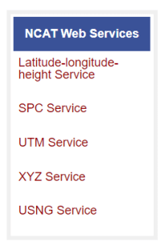
Preparing for NAPGD2022
  Transforming your data
    NCAT - NGS Coordinate Conversion and Transformation Tool
      available now: ASCII upload, Web Services, GitHub
      ask your software provider(s) about integration
        we envision COTS integration most popular method of access
        Industry Workshops held May 2021 and August 2022
          Esri, Trimble, Blue Marble, etc… all the well known names attended
Notes:
Transforming your data
NCAT - NGS Coordinate Conversion and Transformation Tool
available now: ASCII upload and Web Services
ask your software providers about integration
we envision this as most popular method of access
Industry Workshop held last week – esri, trimble, bluemarble, all the major well known names were represented
labeling a year for each dataset?
something in-between that works for your needs

Slide 50
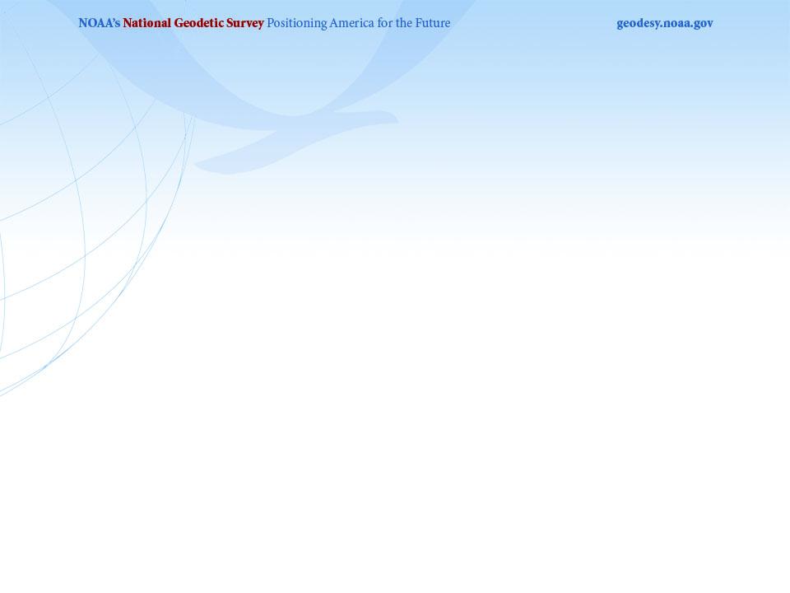
Regional Geodetic Advisor Program
We are here to support:
  You
  Your constituents or customers
  Our Federal Partners/Agencies
Questions about NSRS Modernization?
  Reach out now
  Be prepared
  Questions you can’t (or don’t want to) handle…
    Send them to us!
geodesy.noaa.gov/ADVISORS/

Slide 51
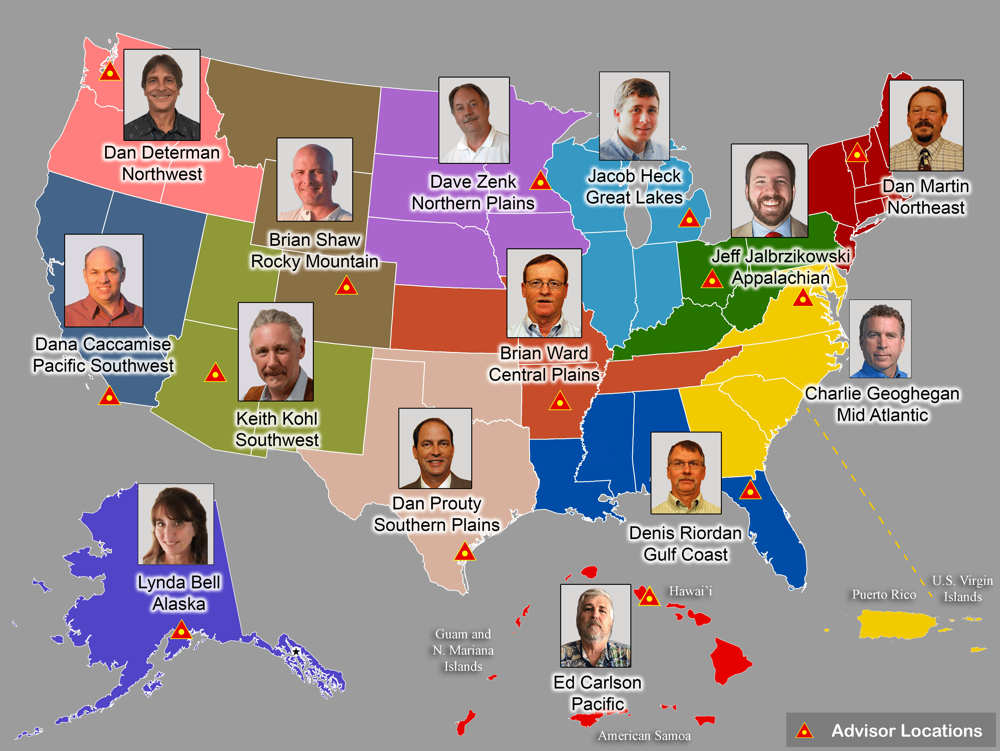
geodesy.noaa.gov/ADVISORS/
Notes:
-14 Regional Advisors, we’ve transitioned from a State-based to a Regional Program
-our advisors homepage up there at the top, also easy to find us by querying any major search engine for “ngs advisors”

Slide 52
The Survey Foot is dead!
Long live the Survey Foot!
US Survey Foot was deprecated 31 December 2022…
But it will always be available in NGS tools for NAD83 and NAD27 coordinates
Don’t stop using it until you move to NATRF2022 and NAPGD2022

Slide 53

Scan to save my contact info

Slide 54
Jeff Jalbrzikowski, P.S., GISP, CFS
Appalachian Regional Geodetic Advisor
jeff.jalbrzikowski@noaa.gov
240-988-5486
https://www.ngs.noaa.gov/ADVISORS/
use any major search engine: “NGS advisors”

