Slide 1
Geodesy for Photogrammetrists NATRF2022 and NAPGD2022
ASPRS PDAD Meeting
March 2024
Jeff Jalbrzikowski, P.S., GISP, CFS
Appalachian Regional Geodetic Advisor
jeff.jalbrzikowski@noaa.gov
240-988-5486

Slide 2
Any references to any commercially available hardware or software do not constitute an endorsement or a disapproval of any manufacturers, developers, dealers, or suppliers.
Thanks.

Slide 3
Organizational Structure
-Department of Commerce (DoC)
(~47,000 employees)
-National Oceanic and Atmospheric Administration (NOAA)
-National Ocean Service (NOS)
-National Geodetic Survey (NGS)
(~175 employees)
Notes:
-We are the Federal Government’s oldest scientific agency.
-part of the Executive Branch
-I know it can seem kind of strange that NGS is part of the NOS, but the origins of NGS lie with the C&GS.
-we are a “Program Office” of the NOS
Survey of the Coast – 1807
Coast Survey – 1836 → in 1871 the agency was tasked by Congress with responsibility to carry geodetic control inland (>150 years)
Coast and Geodetic Survey – 1878
NGS since 1970

Slide 4
Organizational Structure
We’re not USGS, we’re NGS
-Department of Commerce (DoC)
(~47,000 employees)
-National Oceanic and Atmospheric Administration (NOAA)
-National Ocean Service (NOS)
-National Geodetic Survey (NGS)
(~175 employees)
≠
Notes:
-as you can read my slide, I like to point that out because over my 2 years at NGS I’ve seen and heard this misunderstanding quite a bit
-don’t worry! it doesn’t offend us! and we do work closely with USGS, but we are separate agencies within totally different departments of the federal government

Slide 5
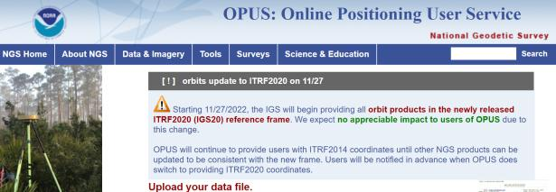
NGS Mission
To define, maintain and provide access to the National Spatial Reference System (NSRS) to meet our Nation’s economic, social, and environmental needs.
access… ? = traditionally → marks/disks/objects
= modern and future → NOAA CORS Network (NCN)
via OPUS
Notes:
Follow up thought
-like it or not, we know that the vast majority of our users are obtaining NSRS coordinates via OPUS
-while that is our plan for the future of primary access, modernized NSRS, as of now the official form of access (specifically to NAVD88) truly is to “touch brass” as they say → meaning occupy a benchmark

Slide 6
NCN - NOAA CORS Network
1695 sites
241 organizations
Notes:
What does that mean?
Please don’t think of this as us here at NGS being some pointy-haired semantics. We need to make distinctions about CORS when talking about all this. If you haven’t already realized this, you’ll start to catch on today.

Slide 7
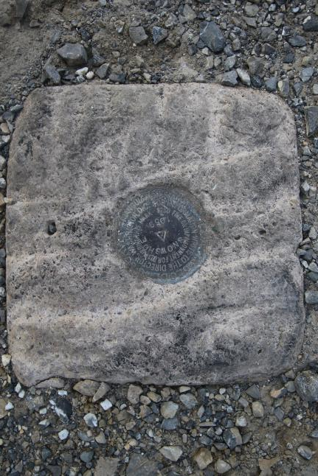
Passive Control
Geodetic Control – Terminology
All marks are passive—they sit there and hold a point
Notes:
All marks are passive!—in that they sit there doing nothing in and of themselves besides holding a point
This includes the fixed antenna mount that is a part of a CORS.
But, some marks have permanently installed equipment that enable nearly continuous observations and these are called “active” stations.

Slide 8
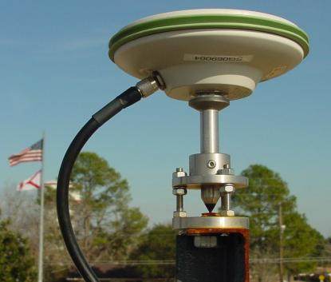
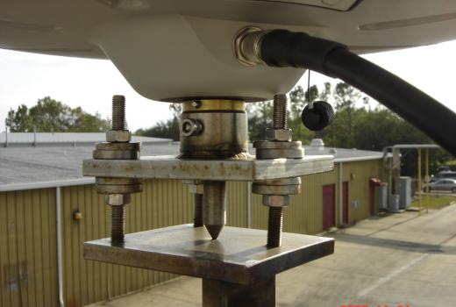
Active Control
Geodetic Control – Terminology
Some marks have permanently installed equipment that enables nearly continuous observations
(they still sit there and hold a point)
Notes:
All marks are passive!—in that they sit there doing nothing in and of themselves besides holding a point
This includes the fixed antenna mount that is a part of a CORS.
But, some marks have permanently installed equipment that enable nearly continuous observations and these are called “active” stations.

Slide 9
Semantics?
Ground Control
“No Control”
Classic method
Photo IDs, etc.
Still control…
Active Control
Via CORS
Hopefully NCN

Slide 10
Yes, we are delayed.
NSRS Modernization
Notes:
So remember, today’s presentation is not JUST about new datums, it is about modernizing the NSRS as a whole.
You don’t know what the NSRS is? Stay tuned, we’ll get there as we go along.

Slide 11
Delayed Release of the Modernized NSRS
How long will the delay be?
Our website or newsletter is best source of projected timeframe, current estimate is middle of 2025.
Will the names stay the same?
Yes, terms containing “2022” such as “NATRF2022” and “NAPGD2022” will remain the same.
hyperlink to the Track Our Progress homepage
June 2022 webinar
hyperlink to the full FAQ

Slide 12
Modernizing the NSRS
Updating all NSRS coordinates
Replace existing datums with new datums
Replacing existing SPCS83 with new SPCS2022
Accounting for coordinates changing with time
Improving NGS products and services
Simplifying customer contributions
Making the NSRS:
More accurate
More accessible
More efficient
begins
Rollout in
2025

Slide 13
Maintaining the NSRS
The NSRS does get updated over the years.
somewhat obvious NAD27→NAD83 … NGVD29→NAVD88
The Federal Register is the official indication of any changes and updates.
Key here is the Federal Register Notice (FRN)
Federal Register - Vol. 58, No. 120, 1993
FRN officially announcing NAVD 88
Affirms “NAVD 88 as the official civilian vertical datum for surveying and mapping activities in the United States performed or financed by the Federal Government.”
“To the extent practicable, legally allowable, and feasible, require that all Federal agencies using or producing vertical height information undertake an orderly transition to NAVD 88.”
http://www.ngs.noaa.gov/PUBS_LIB/FedRegister/FRdoc93-14922.pdf
Notes:
The NSRS does get updated over the years.
somewhat obvious right, I mean we went from NAD27→NAD83 and from NGVD29→NAVD88
The Federal Register is the official indication of any changes and updates.
Key here is within the Register agencies the Federal Register Notice
Release of NAVD 88:
Federal Register (Vol. 58, No. 120, 1993)
Affirms “NAVD 88 as the official civilian vertical datum for surveying and mapping activities in the United States performed or financed by the Federal Government.”
“To the extent practicable, legally allowable, and feasible, require that all Federal agencies using or producing vertical height information undertake an orderly transition to NAVD 88.”

Slide 14
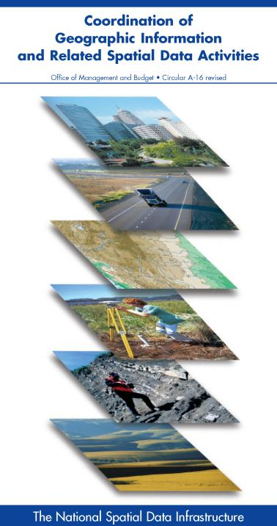
NSRS … do I have to use it?
OMB Circular A-16
requires all Federal civilian agencies to utilize “geodetic control” for their geospatial activities
places NOAA in responsible charge of that control
NGS has defined that control as the NSRS
FGCS has issued requirements, via FRNs, to reference data to the most recent components of the NSRS
1989 FRN designated NAD 83
1993 FRN designated NAVD 88
Hyperlink to NAVD88 FRN
Hyperlink to NAD83 FRN
Notes:
-This is an acronym heavy slide, not much I can do, that’s the government way!
-What’s the OMB Jeff?
-It’s an agency within the Executive Office of the President, they too are part of the Executive Branch of Gov’t just like us at NGS within the Dept of Commerce
-The OMB has published this document, “Circular A-16”
CLICK
-you can see the title there at the top, perhaps you’ve seen this cover before
*-those Federal folks in attendance, I sure hope you have!-*
-the overarching goal of A-16 is preventing the waste of Gov’t funds on duplication of geospatial efforts
CLICK
There’s four really important takeaways from OMB A-16.
1 - it’s Federal policy at one of the highest levels that Federal agencies (civilian agencies not the military/DoD/Intelligence) must utilize geodetic control for all geospatial activities
*Why not DoD, NGA, and the Intelligence agencies? Well, they have their own DoD Directive that requires them to tie everything to WGS84 and EGM08.*
2 – A-16 defines NOAA as being in responsible charge of geodetic control
3 - NOAA dictates NGS as the lead agency and NGS defines that control as “the NSRS” (term adopted in 1994). Why create that term? One phrase to outlive trends & technology, reduce the need to keep spending time and money re-writing policy and documentation every time we create a new datum name.
CLICK
4 – The FGCS…what’s that?, the Federal Geodetic Control Subcommittee, which is a part of the FGDC, the Federal Geographic Data Committee, and the best comparison I can make to the everyday is that it’s the organization for Federal agencies that mirrors what NSPS is to PSLS.
-…anyway, the FGCS has issued requirements via FRNs, or Federal Register Notices
CLICK
-…for agencies to reference all their geospatial data to the most recent components of the NSRS
CLICK

Slide 15
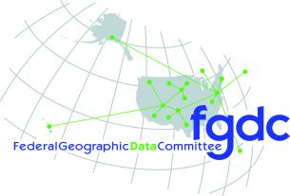
Federal Geospatial Data Committee (FGDC)
FGCS = Federal Geodetic Control Subcommittee
Under the umbrella of the FGDC, NGS leads the FGCS

Slide 16
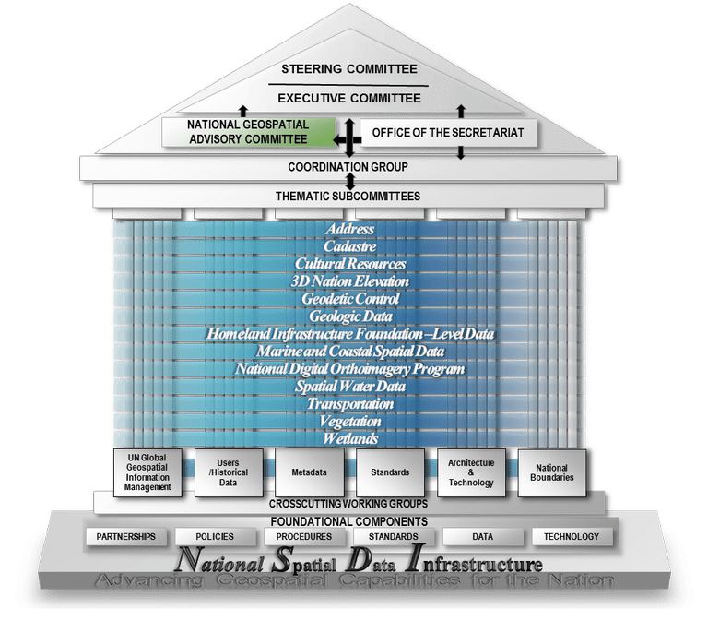

Slide 17
FGCS Member Agencies
DEPARTMENT OF AGRICULTURE
USFS –US Forestry Service
FSA – Farm Service Agency
DEPARTMENT OF COMMERCE
USCB – US Census Bureau
NIST – National Institute of Standards & Technology
NOAA – National Oceanic and Atmospheric Administration
DEPARTMENT OF HOMELAND SECURITY
USCG – US Coast Guard
FEMA – Federal Emergency Management Agency
DEPARTMENT OF DEFENSE
NGA – National Geospatial-Intelligence Agency
USACE – US Army Corps of Engineers
USNO – US Naval Observatory
DEPARTMENT OF THE INTERIOR
BIA – Bureau of Indian Affairs
BOEM – Bureau of Ocean Energy Management
OSMRE – Office of Surface Mining and Reclamation Enforcement
USBR – US Bureau of Reclamation
USGS – US Geological Survey
NPS – National Park Service
BLM – Bureau of Land Management
FWS – Fish and Wildlife Service
DEPARTMENT OF STATE
IBC – International Boundary Commission
IBWC – International Boundary and Water Commission
DEPARTMENT OF TRANSPORTATION
DOT – Department of Transportation
FAA – Federal Aviation Administration
INDEPENDENT AGENCIES
NASA – National Aeronautics and Space Administration
EPA – Environmental Protection Agency
TVA – Tennessee Valley Authority
FCC – Federal Communications Commission
Notes:
Among all these agencies, we serve as the experts on geodetic control and geodesy for the United State government

Slide 18
NGS Products and Services
Not just OPUS
All exist in three environments:
Development (DEV) - internal testing and development
same as when you hear a company talk about an “Alpha” product
Beta - continued internal testing, open for public testing
key features have already been vetted/tested
Production - final product, open to public use
this is what you see first when navigating our website
Notes:
I’ll be talking about OPUS today, but I need to clarify one of our processes for this to all be clear. I will also mention that this is a new-ish workflow for NGS, began in the past 8 or so years.
So all NGS Products & Services go thru this process as they are created, tested internally, open for testing by you our constituents, and then rolled out as final products.
CLICK
There’s three environments that products will exist in, listed here in the order they occur
First, a tool will be created on the “DEV” servers for internal NGS-only development, testing, and otherwise “working the bugs out”
→this is the same phase as when you hear a software company or video game maker talk about their alpha products
CLICK
Next, after some level of confidence in the product is gained, it will be migrated to the Beta servers, thereby open to the public for their own testing
→it’s important to note that when a product is available via our Beta page, when you use it you are indeed now a “beta tester”
key features will have already been tested in the Development environment, but it is still a beta, so as a beta tester please let us know if you have issues/complications/struggles or the like
CLICK
At some point, when all I’s are dotted and T’s crossed, the thing will be moved to the Production environment.
→ by then, the tool is integrated into others, has been vetted with 2 testing phases and functions as expected, but may still continue to receive version updates by repeating this process

Slide 19
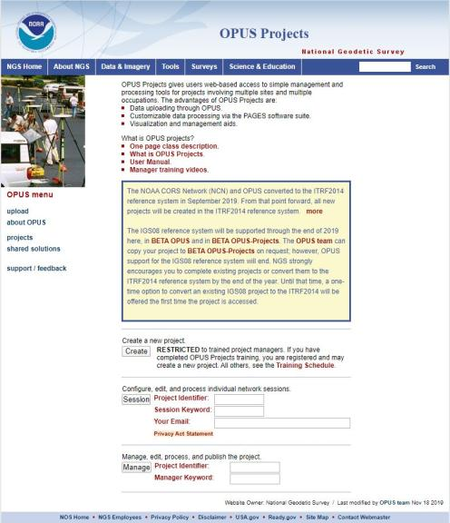
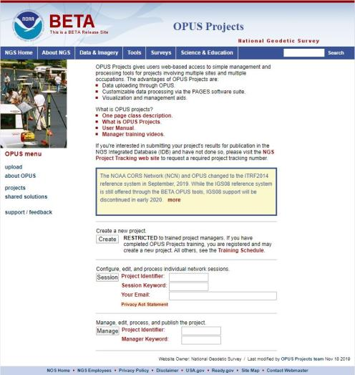
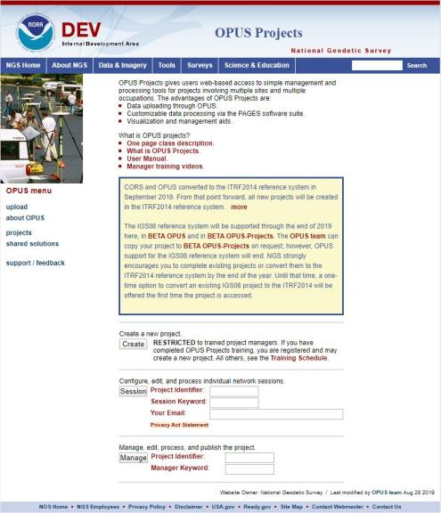
www.ngs.noaa.gov
beta.ngs.noaa.gov
Remember, you won’t see the DEV environment…
Notes:
So here we have 3 screenshots, first here showing the Production OPUS Projects gateway page
CLICK
Second is the Beta page, with the text here showing the URL for our Beta homepage
-How do you find that beta page? substitute “beta” for “www”
-or most tools that have a beta will have a link to that beta platform
CLICK
Last is the Development or DEV example, which again you will not see unless via a demo from NGS personnel

Slide 20
Positional Components of
the NSRS
Geometric
aka “Horizontal”
Latitude, Longitude, Ellipsoid Height
Geopotential
aka Orthometric Height
aka “Elevation”
NAD83
NAVD88
Notes:
-geometric component is latitude, longitude, and ellipsoid height
-geopotential component is combined with the geometric components to calculate an ortho height or capital H

Slide 21
NATRF2022
North American Terrestrial Reference Frame of 2022
will replace
NAD83
North American Datum of 1983
Technically, not just NATRF2022 but also its 3 sister TRFs…

Slide 22
Four TRFs for Modernized NSRS
North American Terrestrial Reference Frame of 2022
(NATRF2022)
Pacific Terrestrial Reference Frame of 2022
(PATRF2022)
Caribbean Terrestrial Reference Frame of 2022
(CATRF2022)
Mariana Terrestrial Reference Frame of 2022
(MATRF2022)

Slide 23
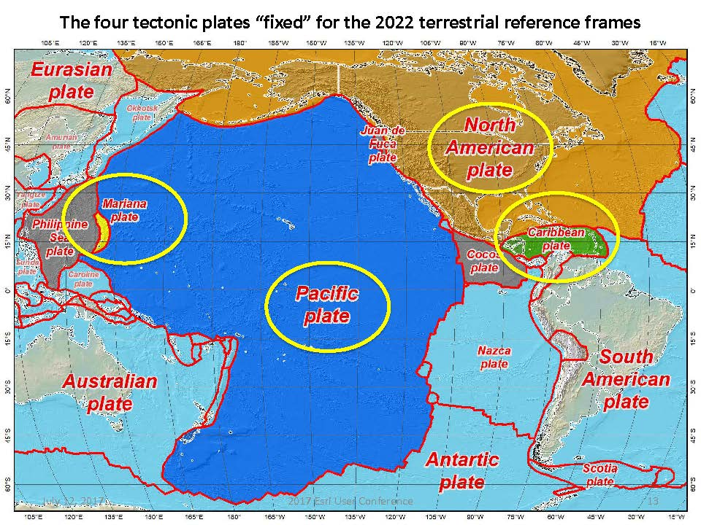
Plate Rotation visualized
Drift…
Notes:
-these are ground-level horizontal velocities
-the arrows illustrate the positions and velocities of CORS plotted in ITRF2014
-our scale is on the left there, with that arrow representing 20mm of motion per year
-so right thru Ohio it’s a little cluttered but we’re seeing arrows about that length so about 2cm/20mm per yr
-what do we notice about the direction of these arrows?
-they look rotational, don’t they?
CLICK HERE
-Note the arrows in California do not conform to the rotation… those are CORS on a different PLATE which is moving in a different direction
CLICK HERE
-so when you look at those arrows you can see the rotation, but the point of rotation is obviously off the map, way down below the screen right?
-that point is what’s known as an Euler Pole

Slide 24
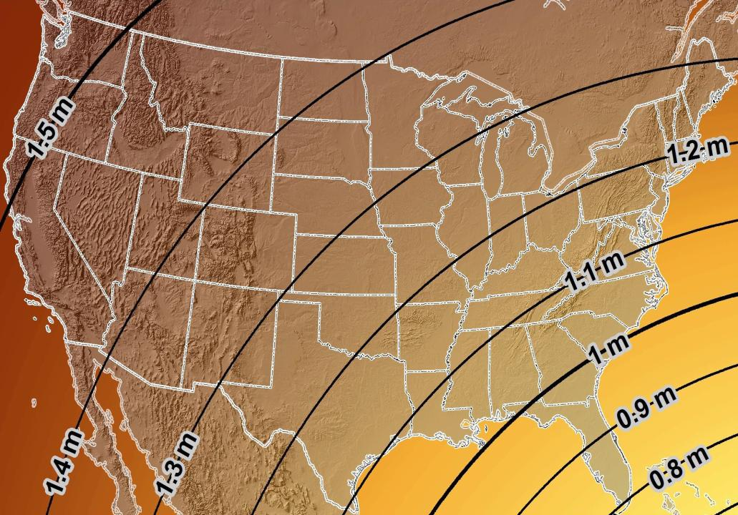
Estimated Geometric Change - Horizontal
NAD83 (2011) → NATRF2022
4.6 ft
Direction of Shift
4.3 ft
3.9 ft
3.6 ft
3.0 ft
Notes:
What’s the magnitude of the horizontal datum shift across Pennsylvania?
Minimum Shift ~3.75 feet
Maximum Shift ~3.97
Remember this is just an estimation, don’t hold me to the numbers please

Slide 25
NCAT
How will you do that?
NGS Coordinate Conversion And Transformation Tool (NCAT)
Epochs/Time/4D
Notes:
-so you’ve probably seen that phrase that I have front and center here, NSRS Modernization
-that’s the blanket term we use to refer to not just the new datums but other updates

Slide 26
NGS Coordinate Conversion And Transformation Tool (NCAT)
Notes:
NCAT includes the functionality of previous NGS tools:
NADCON 5.0
XYZWIN 2.0
UTMS 2.1
SPC83 2.1
USNG 2.3
Includes error estimate of transformation per point.
Available as the single-point graphic seen here, multi-point upload/download, as a downloadable executable fie to run from the DOS prompt, and as web services for inclusion in your own
It’s a great tool. Anyone using

Slide 27
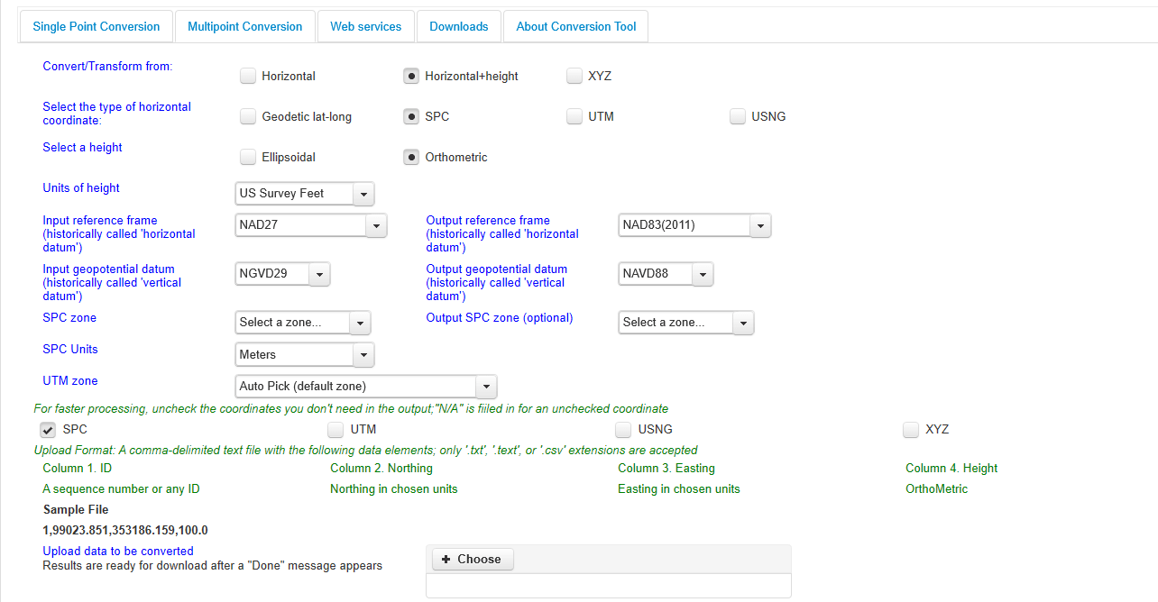
NGS Coordinate Conversion And Transformation Tool (NCAT)
Notes:
NCAT includes the functionality of previous NGS tools:
NADCON 5.0
XYZWIN 2.0
UTMS 2.1
SPC83 2.1
USNG 2.3
Includes error estimate of transformation per point.
Available as the single-point graphic seen here, multi-point upload/download, as a downloadable executable fie to run from the DOS prompt, and as web services for inclusion in your own
It’s a great tool. Anyone using

Slide 28
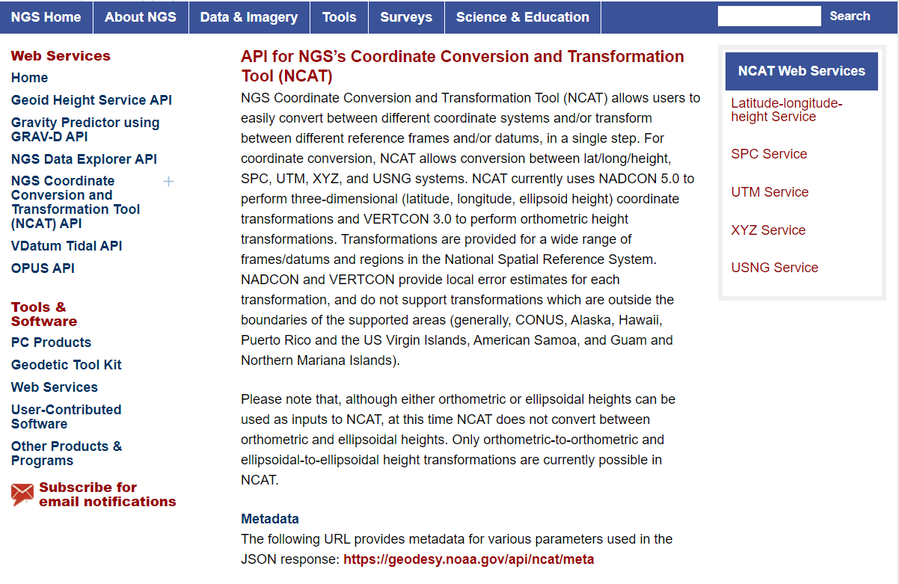
NCAT is available via web services

Slide 29
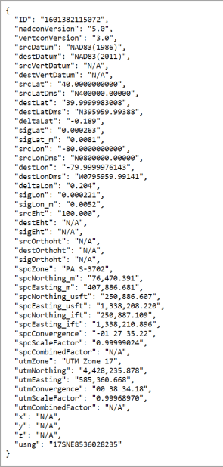
NCAT is available via web services
Note that each operation is a separate service
Struggling?
Contact us.
We can help!

Slide 30
NGS Coordinate Conversion And Transformation Tool (NCAT)
Notes:
NCAT includes the functionality of previous NGS tools:
NADCON 5.0
XYZWIN 2.0
UTMS 2.1
SPC83 2.1
USNG 2.3
Includes error estimate of transformation per point.
Available as the single-point graphic seen here, multi-point upload/download, as a downloadable executable fie to run from the DOS prompt, and as web services for inclusion in your own
It’s a great tool. Anyone using

Slide 31
NGS Coordinate Conversion And Transformation Tool (NCAT)
Notes:
NCAT includes the functionality of previous NGS tools:
NADCON 5.0
XYZWIN 2.0
UTMS 2.1
SPC83 2.1
USNG 2.3
Includes error estimate of transformation per point.
Available as the single-point graphic seen here, multi-point upload/download, as a downloadable executable fie to run from the DOS prompt, and as web services for inclusion in your own
It’s a great tool. Anyone using

Slide 32
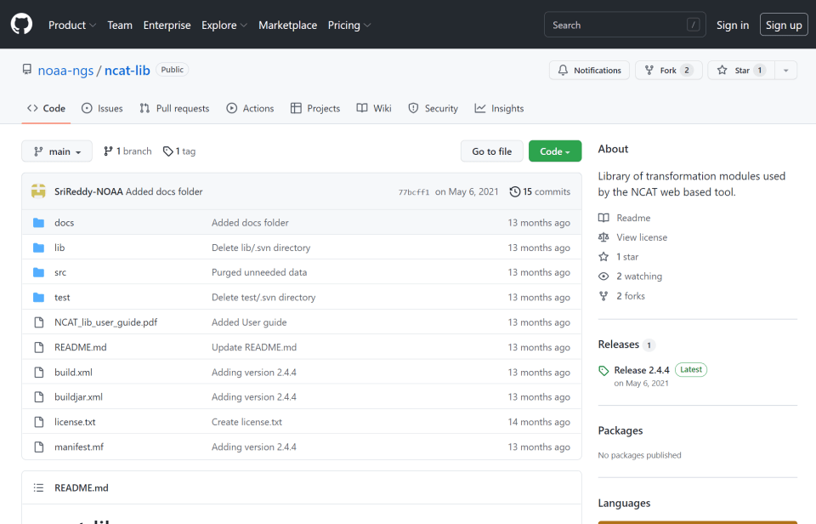
NCAT source code is on GitHub

Slide 36
What’s the difference?
NCAT
VDatum
NSRS Datums
NAD 27
NAD 83
NGVD 29
NAVD 88
PRVD 02
ASVD 02
NMVD 03
GUVD 04
VIVD 09
NSRS Datums
Geoid Models
Add/Subtract from Ellipsoid
Tidal Datums
MHW, MLLW, MTL
Great Lakes Datum
IGLD85
ITRF#### ≈ WGS84
Local Tidal (LT)

Slide 37
State Plane Coordinate System of 2022
SPCS2022
Notes:
The following section illustrates the preliminary SPCS2022 zones
There are 4 zones in the NGS design, per request that we design “4-5 zones required to meet the minimum distortion acceptable” set by our design criteria of 50ppm
NOTE the request also included wording: “It is also requested that PennDOT districts be divded into no more than two zones”

Slide 38
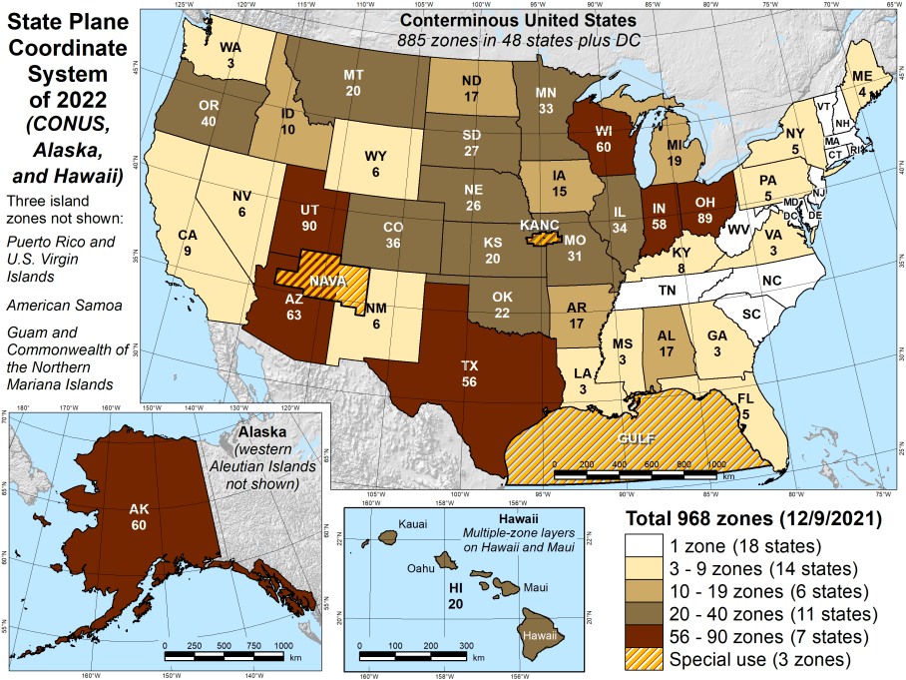
Number of SPCS2022 zones (preliminary)
CONUS, Alaska, and Hawaii
Three island zones not shown:
Puerto Rico and U.S. Virgins Islands
American Samoa
Guam and the Commonwealth of the Northern Mariana Islands

Slide 39
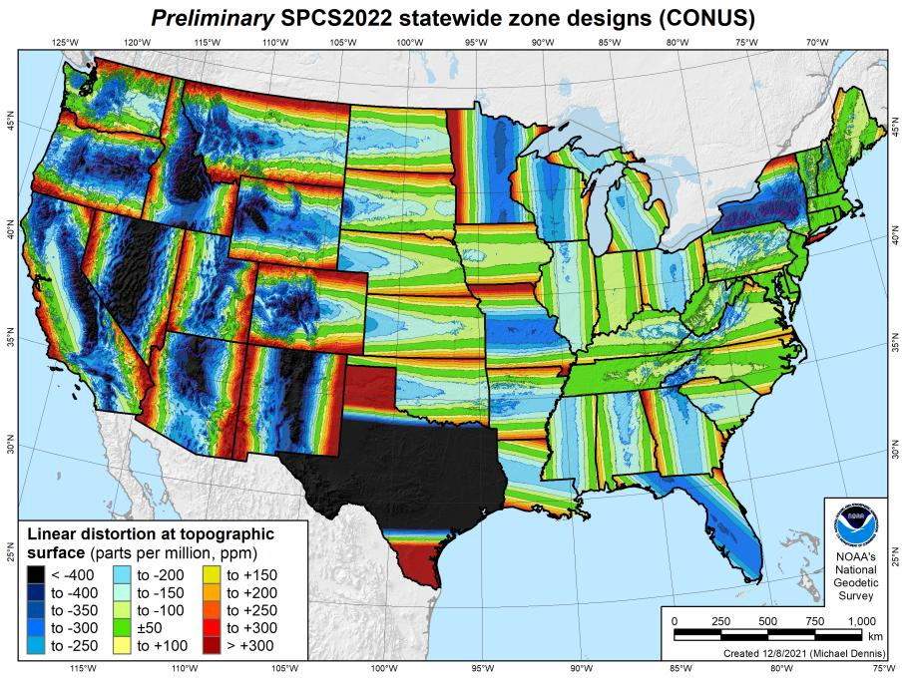
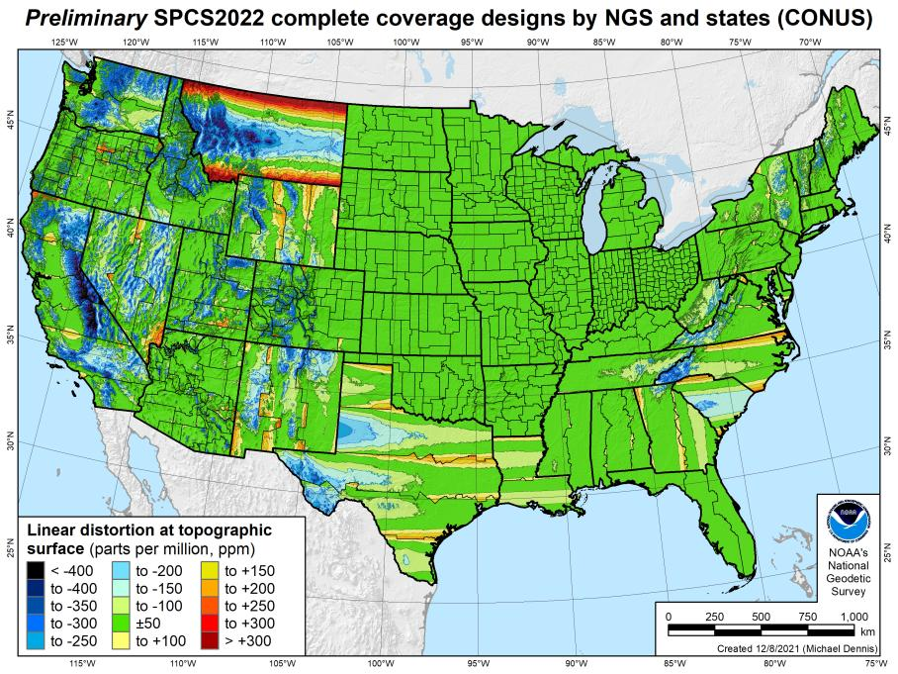
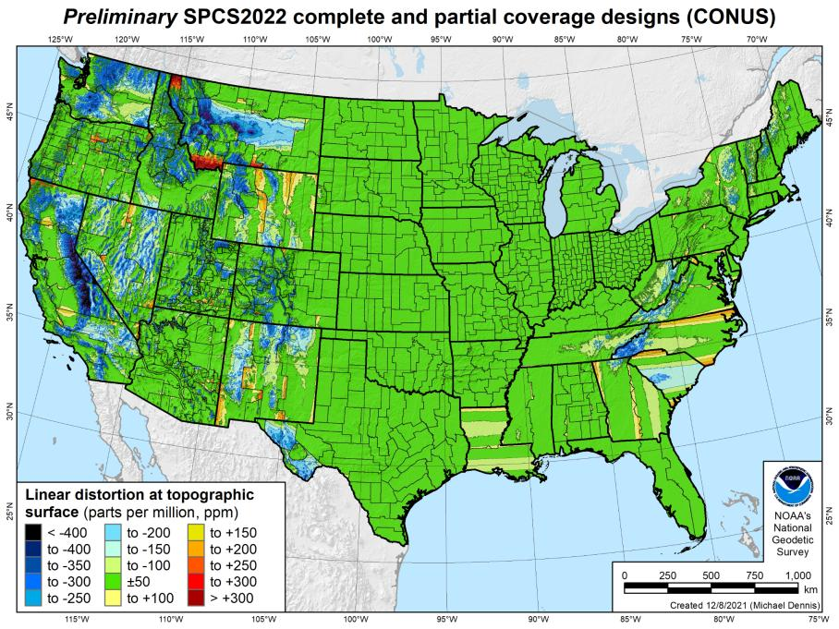
SPCS2022 linear distortion (prelim)
846 zones (CONUS)
Percent within distortion (ppm):
Distor | Pop | Cities | Area
±20 | 76% | 71% | 58%
±50 | 92% | 89% | 76%
±100 | 98% | 97% | 89%
±400 | 100% | 100% | 99.9%
City and area statistics (ppm):
 | Min | -407 | -1438
 | Max | +486 | +2624
 | Range | 893 | 4062
 | Mean | -6 | -23
Mean weighted by pop = -4

Slide 40
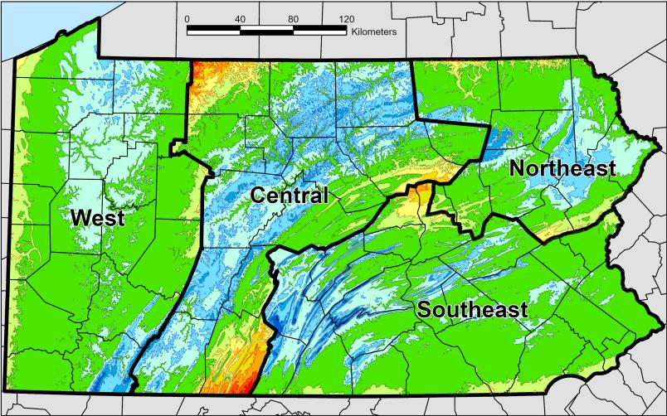
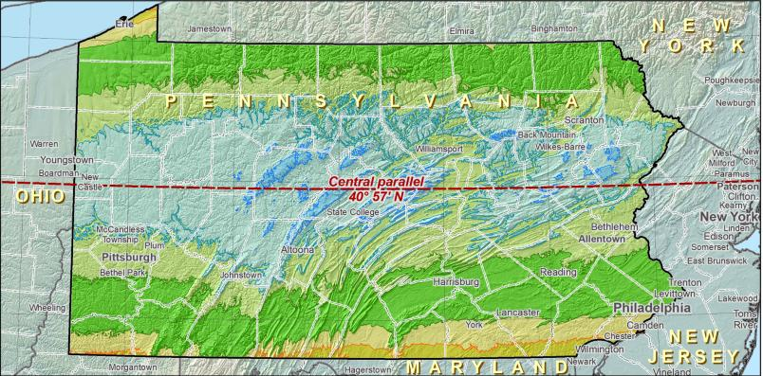
SPCS2022 Zone Layers in PA
Both Single Statewide and Multi-Zone Layers will coexist
Think about your data, your goals, your customers
Remember that geographic coordinates are your friend!
Smaller zones not “the best” … it all depends on usage & goals

Slide 41
Which is best?
Single Statewide Zone Layer
Multi-Zone Layer
Each has strengths and each has weaknesses.

Slide 42
North American Vertical Datum
of 1988
NAVD88
will be replaced by

Slide 43
North American-Pacific Geopotential Datum of 2022
NAPGD2022
(pronounced: nap-jee-dee)

Slide 44
NAPGD2022
Geopotential
gravity based
no leveling used to define it (none!)
GNSS is your access
collect data & submit it to OPUS
no leveling necessary
Global Mean Sea Level (GMSL) based
geoid change when sea level threshold crossed

Slide 45
NAVD88 uses Hybrid Geoid
topographic surface
gravimetric geoid
hybrid
geoid
datum zero
surface
Concept
Notes:
-importantly, the height chosen was to minimize 29→88 differences on USGS topo maps in the eastern U.S. … thus, the “zero height surface” of NAVD 88 was NOT chosen for its closeness to the geoid (but it was close…few decimeters)

Slide 46
NAPGD2022 uses Gravimetric Geoid
topographic surface
gravimetric geoid
datum zero
surface
Datum zero surface aligned to Global Mean Sea Level (GMSL)
Concept
Notes:
-importantly, the height chosen was to minimize 29→88 differences on USGS topo maps in the eastern U.S. … thus, the “zero height surface” of NAVD 88 was NOT chosen for its closeness to the geoid (but it was close…few decimeters)

Slide 47
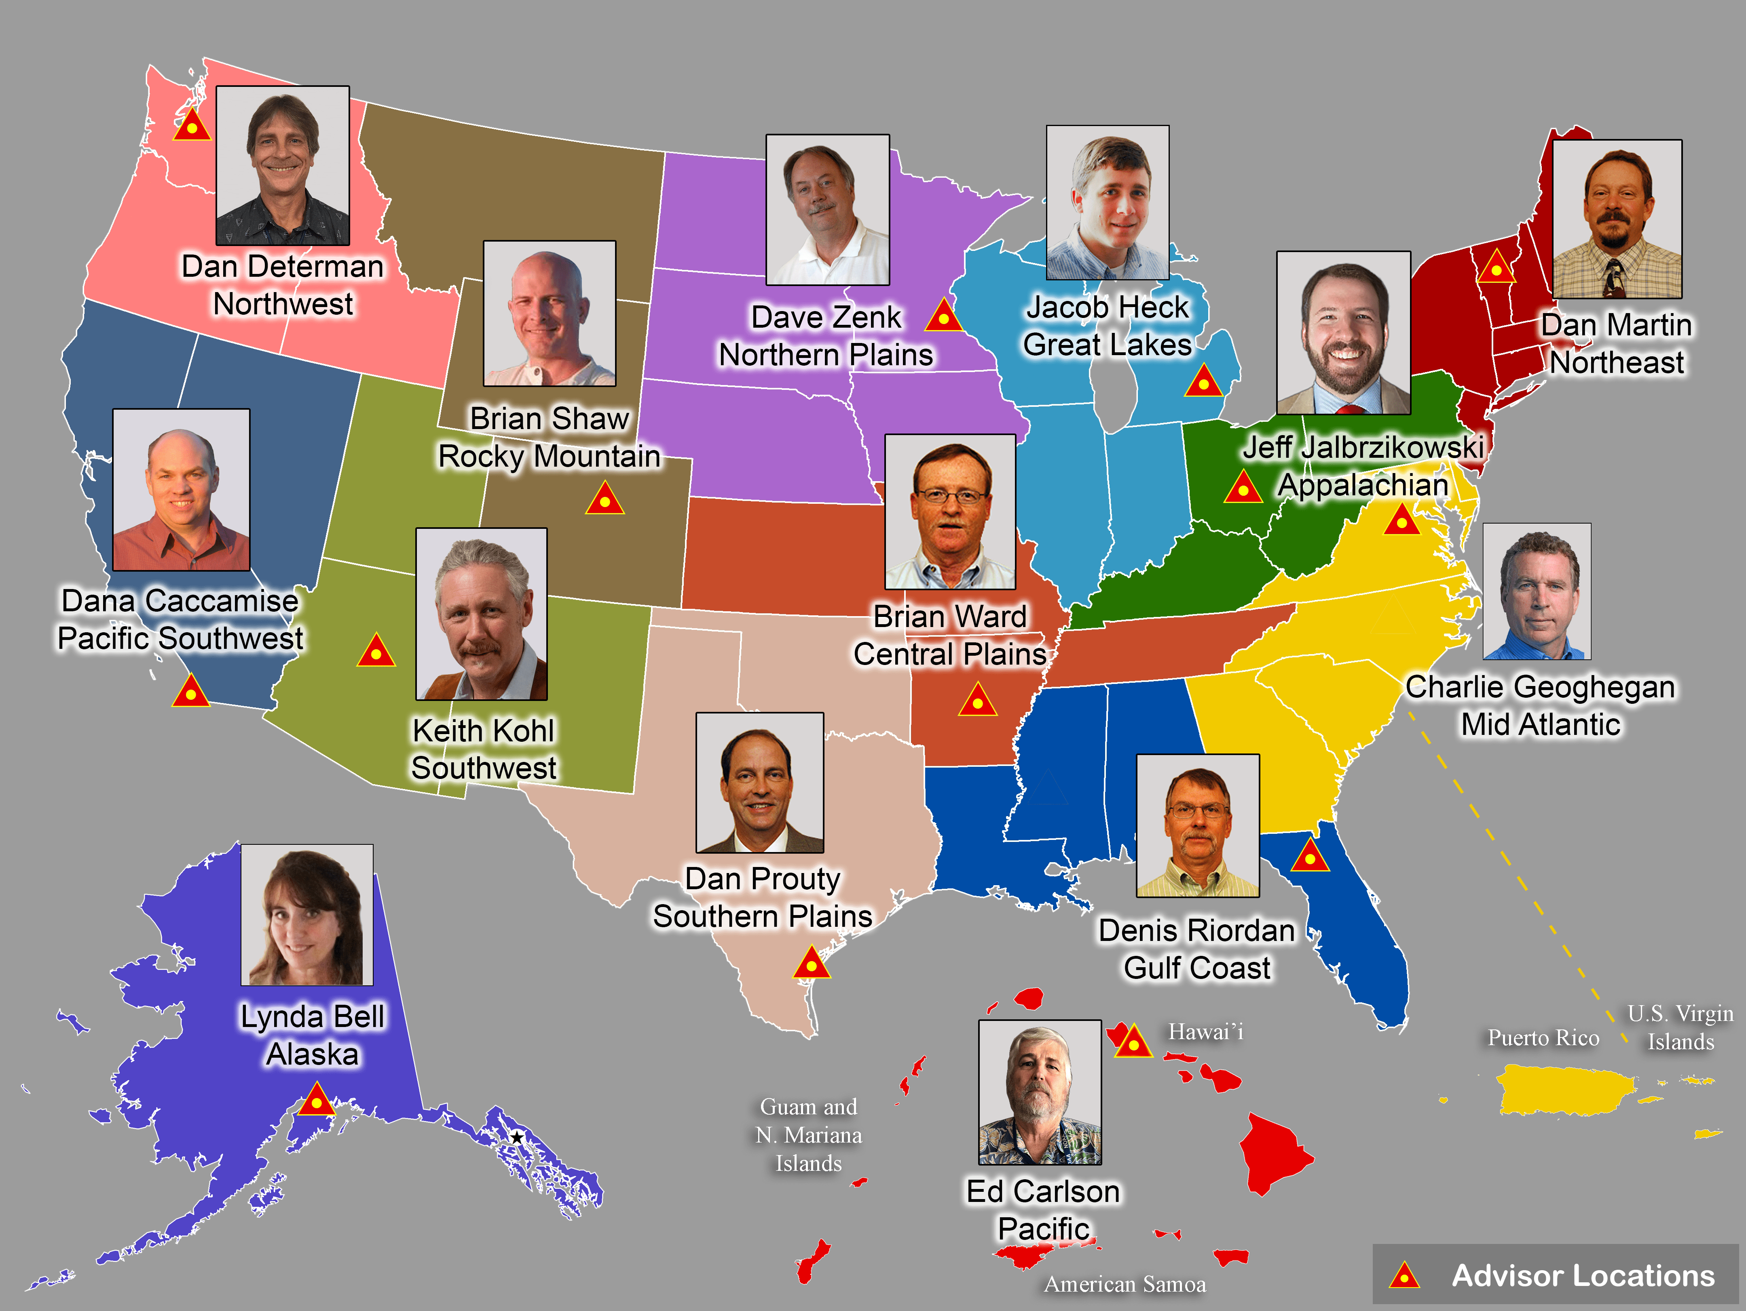
Regional Geodetic Advisor Program
geodesy.noaa.gov/ADVISORS/
14 RGAs across country
We are here to support:
You
Your constituents
Our Federal Partners
Questions about
NSRS Modernization?
Reach out now
Be prepared

Slide 48
Educational Videos
<5 minutes
Online Lesson
(via MetEd/COMET)
~1 hour
NGS homepage: geodesy.noaa.gov
Notes:
Educational videos and online tutorials –
Our library of lessons and videos are great resources, and will reinforce a lot of information we covered today.
The videos are just 3-5 minutes long.
the lesson is a deeper dive but still only takes an hour.

Slide 49
Email Subscriptions
*Only 1-2 messages per month*
NGS News
Includes quarterly NSRS Modernization newsletter
Webinar Series
Training
GPS on Benchmarks
Click this icon on homepage

Slide 50
https://geodesy.noaa.gov/ADVISORS/
-use any major search engine: “NGS advisors”
Jeff Jalbrzikowski, P.S., GISP, CFS
Appalachian Regional Geodetic Advisor
jeff.jalbrzikowski@noaa.gov
240-988-5486

Slide 51
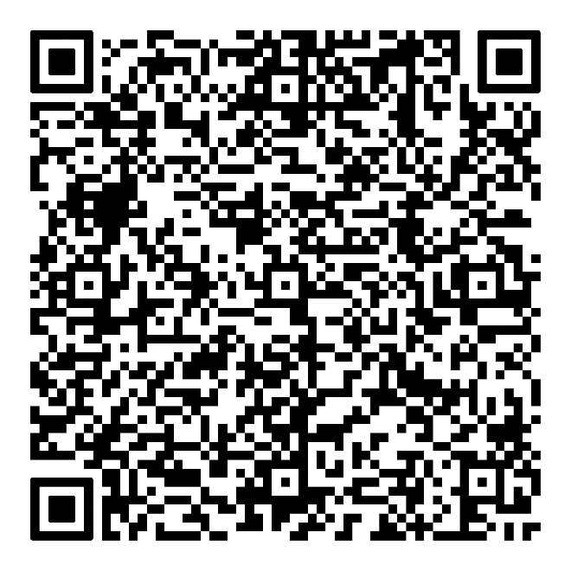
Scan to save my contact info on your phone

