Slide 1

Updates from NGS
NSRS Modernization
USACE Survey CoP Workshop
February 2024
Jeff Jalbrzikowski, P.S., GISP, CFS
Appalachian Regional Geodetic Advisor
jeff.jalbrzikowski@noaa.gov
240-988-5486

Slide 2
Any references to any commercially available hardware or software do not constitute an endorsement or a disapproval of any manufacturers, developers, dealers, or suppliers.
Thanks.

Slide 3



Organizational Structure
  -Department of Commerce (DoC)
  (~47,000 employees)
  -National Oceanic and Atmospheric Administration (NOAA)
  -National Ocean Service (NOS)
  -National Geodetic Survey (NGS)
  (~170 employees)
Notes:
--USACE has ~39,000 employees, some 12,000 professionals in E&C CoP

Slide 4


Organizational Structure
We’re not USGS, we’re NGS
  -Department of Commerce (DoC)
  (~47,000 employees)
  -National Oceanic and Atmospheric Administration (NOAA)
  -National Ocean Service (NOS)
  -National Geodetic Survey (NGS)
  (~175 employees)
≠
Notes:
-as you can read my slide, I like to point that out because over my 2 years at NGS I’ve seen and heard this misunderstanding quite a bit
-don’t worry! it doesn’t offend us! and we do work closely with USGS, but we are separate agencies within totally different departments of the federal government

Slide 5
Yes, we are delayed.
  NSRS Modernization
Notes:
So remember, today’s presentation is not JUST about new datums, it is about modernizing the NSRS as a whole.
You don’t know what the NSRS is? Stay tuned, we’ll get there as we go along.

Slide 6
Delayed Release of the Modernized NSRS
How long will the delay be?
  Our website or newsletter is best source of projected timeframe, current estimate is middle of 2025.
Will the names stay the same?
  Yes, terms containing “2022” such as “NATRF2022” and “NAPGD2022” will remain the same.
Will all previously proposed products be released along with the new datums?
  No, they will not. Check out our June 2022 webinar.
hyperlink to the Track Our Progress homepage
June 2022 webinar
hyperlink to the full FAQ

Slide 7
Modernizing the NSRS
Updating all NSRS coordinates
  Replace existing datums with new datums
  Replacing existing SPCS83 with new SPCS2022
  Accounting for coordinates changing with time
Improving NGS products and services
Simplifying customer contributions
Making the NSRS:
  More accurate
  More accessible
  More efficient
begins
Rollout in
2025

Slide 8
Maintaining the NSRS
The NSRS does get updated over the years.
  somewhat obvious NAD27→NAD83 … NGVD29→NAVD88
The Federal Register is the official indication of any changes and updates.
  Key here is the Federal Register Notice (FRN)
Federal Register - Vol. 58, No. 120, 1993
  FRN officially announcing NAVD 88
  Affirms “NAVD 88 as the official civilian vertical datum for surveying and mapping activities in the United States performed or financed by the Federal Government.”
  “To the extent practicable, legally allowable, and feasible, require that all Federal agencies using or producing vertical height information undertake an orderly transition to NAVD 88.”
http://www.ngs.noaa.gov/PUBS_LIB/FedRegister/FRdoc93-14922.pdf
Notes:
The NSRS does get updated over the years.
somewhat obvious right, I mean we went from NAD27→NAD83 and from NGVD29→NAVD88
The Federal Register is the official indication of any changes and updates.
Key here is within the Register agencies the Federal Register Notice
Release of NAVD 88:
Federal Register (Vol. 58, No. 120, 1993)
Affirms “NAVD 88 as the official civilian vertical datum for surveying and mapping activities in the United States performed or financed by the Federal Government.”
“To the extent practicable, legally allowable, and feasible, require that all Federal agencies using or producing vertical height information undertake an orderly transition to NAVD 88.”

Slide 9
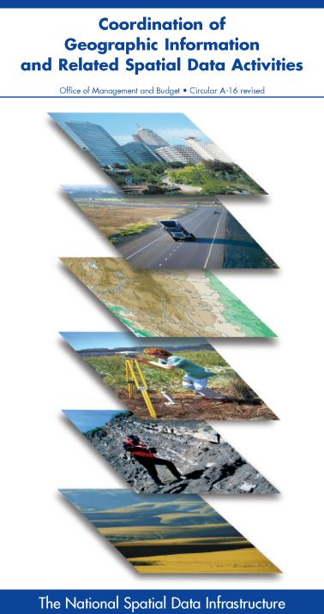


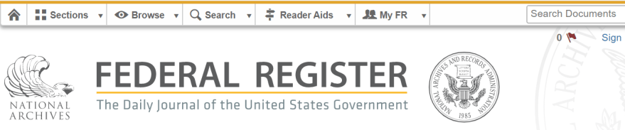
NSRS … do I have to use it?
OMB Circular A-16
  requires all Federal civilian agencies to utilize “geodetic control” for their geospatial activities
  places NOAA in responsible charge of that control
  NGS has defined that control as the NSRS
  FGCS has issued requirements, via FRNs, to reference data to the most recent components of the NSRS
            1989 FRN designated NAD 83
            1993 FRN designated NAVD 88
Hyperlink to NAVD88 FRN
Hyperlink to NAD83 FRN
Notes:
-This is an acronym heavy slide, not much I can do, that’s the government way!
-What’s the OMB Jeff?
-It’s an agency within the Executive Office of the President, they too are part of the Executive Branch of Gov’t just like us at NGS within the Dept of Commerce
-The OMB has published this document, “Circular A-16”
CLICK
-you can see the title there at the top, perhaps you’ve seen this cover before
*-those Federal folks in attendance, I sure hope you have!-*
-the overarching goal of A-16 is preventing the waste of Gov’t funds on duplication of geospatial efforts
CLICK
There’s four really important takeaways from OMB A-16.
1 - it’s Federal policy at one of the highest levels that Federal agencies (civilian agencies not the military/DoD/Intelligence) must utilize geodetic control for all geospatial activities
*Why not DoD, NGA, and the Intelligence agencies? Well, they have their own DoD Directive that requires them to tie everything to WGS84 and EGM08.*
2 – A-16 defines NOAA as being in responsible charge of geodetic control
3 - NOAA dictates NGS as the lead agency and NGS defines that control as “the NSRS” (term adopted in 1994). Why create that term? One phrase to outlive trends & technology, reduce the need to keep spending time and money re-writing policy and documentation every time we create a new datum name.
CLICK
4 – The FGCS…what’s that?, the Federal Geodetic Control Subcommittee, which is a part of the FGDC, the Federal Geographic Data Committee, and the best comparison I can make to the everyday is that it’s the organization for Federal agencies that mirrors what NSPS is to PSLS.
-…anyway, the FGCS has issued requirements via FRNs, or Federal Register Notices
CLICK
-…for agencies to reference all their geospatial data to the most recent components of the NSRS
CLICK

Slide 10

Federal Geospatial
Data Committee (FGDC)
FGCS = Federal Geodetic Control Subcommittee
  Under the umbrella of the FGDC, NGS leads the FGCS

Slide 11
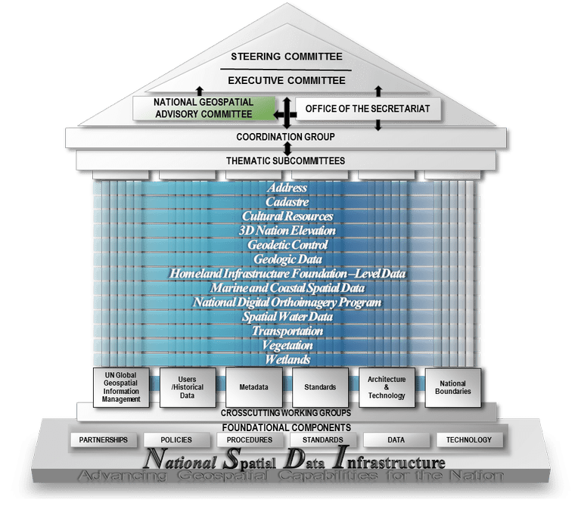

Slide 12
FGCS Member Agencies
DEPARTMENT OF AGRICULTURE
  USFS –US Forestry Service
  FSA – Farm Service Agency
DEPARTMENT OF COMMERCE
  USCB – US Census Bureau
  NIST – National Institute of Standards & Technology
  NOAA – National Oceanic and Atmospheric Administration
DEPARTMENT OF HOMELAND SECURITY
  USCG – US Coast Guard
  FEMA – Federal Emergency Management Agency
DEPARTMENT OF DEFENSE
  NGA – National Geospatial-Intelligence Agency
  USACE – US Army Corps of Engineers
  USNO – US Naval Observatory
DEPARTMENT OF THE INTERIOR
  BIA – Bureau of Indian Affairs
  BOEM – Bureau of Ocean Energy Management
  OSMRE – Office of Surface Mining and Reclamation Enforcement
  USBR – US Bureau of Reclamation
  USGS – US Geological Survey
  NPS – National Park Service
  BLM – Bureau of Land Management
  FWS – Fish and Wildlife Service
DEPARTMENT OF STATE
  IBC – International Boundary Commission
  IBWC – International Boundary and Water Commission
DEPARTMENT OF TRANSPORTATION
  DOT – Department of Transportation
  FAA – Federal Aviation Administration
INDEPENDENT AGENCIES
  NASA – National Aeronautics and Space Administration
  EPA – Environmental Protection Agency
  TVA – Tennessee Valley Authority
  FCC – Federal Communications Commission
Notes:
Among all these agencies, we serve as the experts on geodetic control and geodesy for the United State government

Slide 13
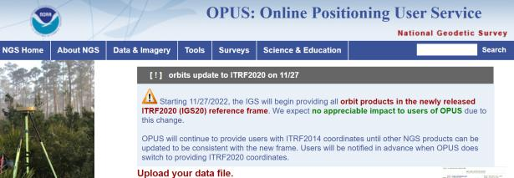
NGS Mission
To define, maintain and provide access to the National Spatial Reference System (NSRS) to meet our Nation’s economic, social, and environmental needs.
access… ? = traditionally → marks/disks/objects
= modern and future → NOAA CORS Network (NCN)
via OPUS
Notes:
Follow up thought
-like it or not, we know that the vast majority of our users are obtaining NSRS coordinates via OPUS
-while that is our plan for the future of primary access, modernized NSRS, as of now the official form of access (specifically to NAVD88) truly is to “touch brass” as they say → meaning occupy a benchmark

Slide 14
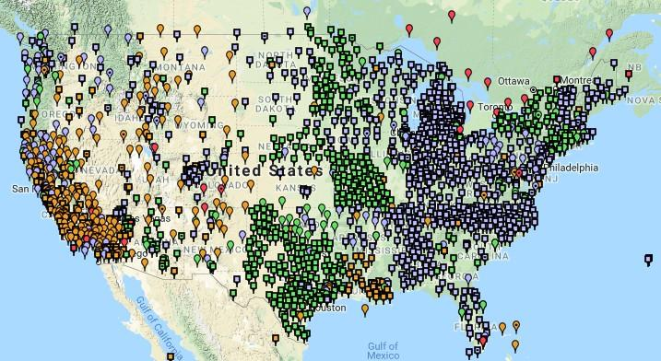
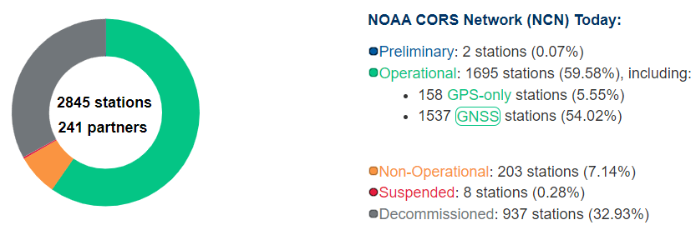
NCN - NOAA CORS Network
1695 sites
241 organizations
Notes:
What does that mean?
Please don’t think of this as us here at NGS being some pointy-haired semantics. We need to make distinctions about CORS when talking about all this. If you haven’t already realized this, you’ll start to catch on today.

Slide 15
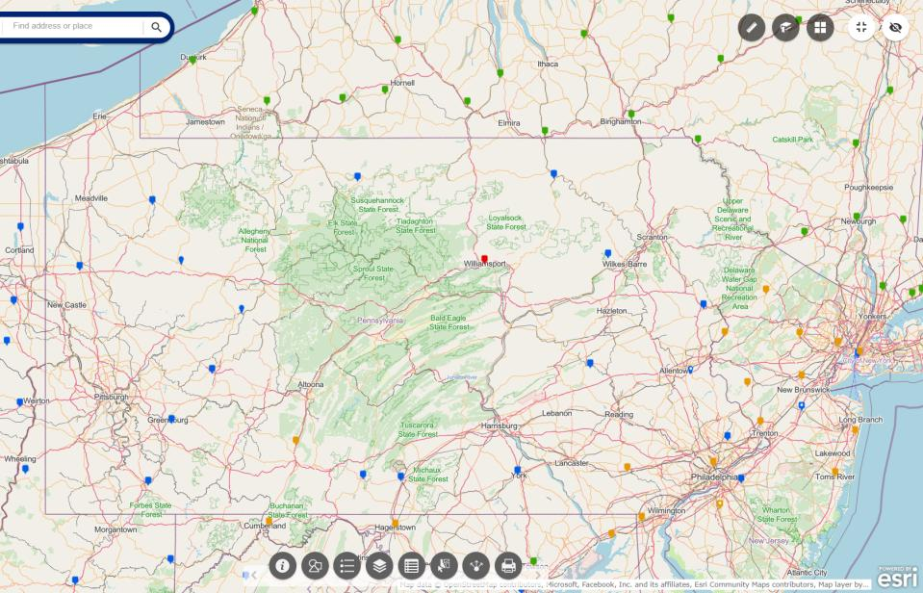
NOAA CORS Network (NCN) in PA
Notes:
where else but the federal government are you going to see two acronyms within one acronym?

Slide 16
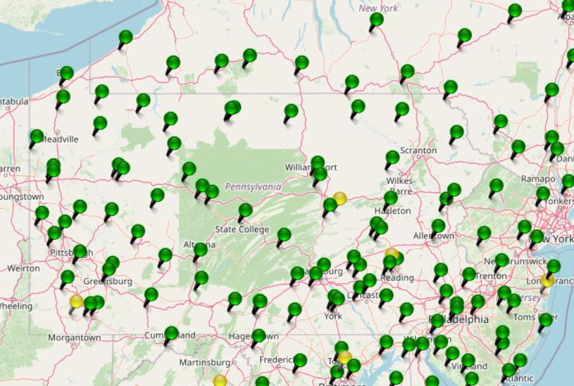
KeyNetGPS CORS Network
Notes:
where else but the federal government are you going to see two acronyms within one acronym?

Slide 17
NOAA CORS Network (NCN) in PA
Notes:
where else but the federal government are you going to see two acronyms within one acronym?

Slide 18
KeyNetGPS CORS Network
non-NCN CORS
Notes:
where else but the federal government are you going to see two acronyms within one acronym?

Slide 19
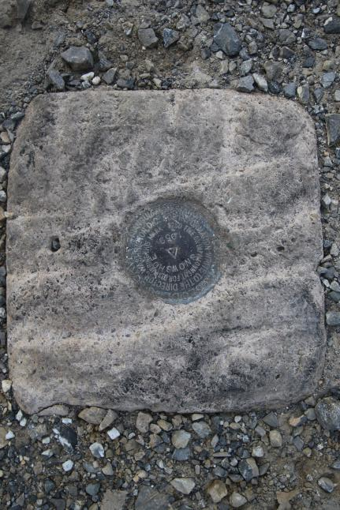
Passive Control
Geodetic Control – Terminology
All marks are passive—they sit there and hold a point
Notes:
All marks are passive!—in that they sit there doing nothing in and of themselves besides holding a point
This includes the fixed antenna mount that is a part of a CORS.
But, some marks have permanently installed equipment that enable nearly continuous observations and these are called “active” stations.

Slide 20
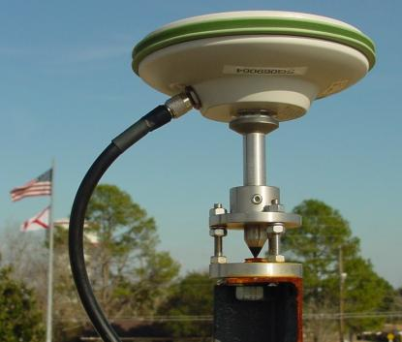
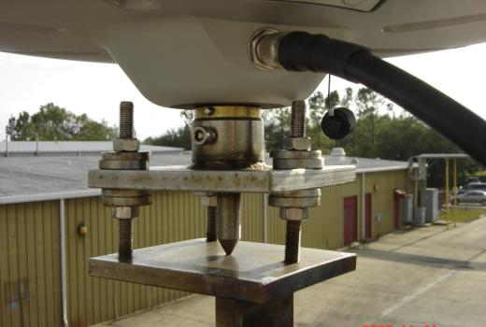
Active Control
Geodetic Control – Terminology
Some marks have permanently installed equipment that enables nearly continuous observations
(they still sit there and hold a point)
Notes:
All marks are passive!—in that they sit there doing nothing in and of themselves besides holding a point
This includes the fixed antenna mount that is a part of a CORS.
But, some marks have permanently installed equipment that enable nearly continuous observations and these are called “active” stations.

Slide 21
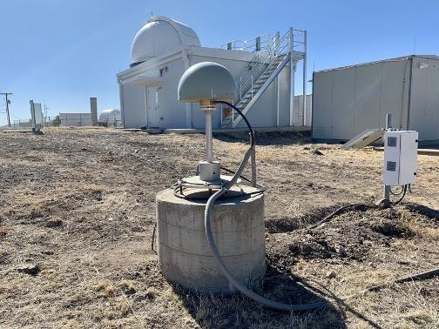
Active Control

Slide 22
Active vs. Passive Control
Passive – RTK Base on existing geodetic control (e.g. Datasheet)
RTK Rover collecting data
Active – RTK Base logging data, processed via OPUS
RTK Rover collecting data
or
NRTK/RTN Rover collecting data
My point: surveying is still surveying
Notes:
Often the term active geodetic control has been used to mean some equipment is continuously or at least frequently collecting observations at or near a point
Yet those observations are often used to compute coordinates (often time-dependent) at a point on a mark, which, by its nature is passive

Slide 23
Positional Components of
the NSRS
Geometric
aka “Horizontal”
Latitude, Longitude, Ellipsoid Height
Geopotential
aka Orthometric Height
aka “Elevation”
NAD83
NAVD88
Notes:
-geometric component is latitude, longitude, and ellipsoid height
-geopotential component is combined with the geometric components to calculate an ortho height or capital H

Slide 24
NATRF2022
North American Terrestrial Reference Frame of 2022
will replace
NAD83
North American Datum of 1983
Technically, not just NATRF2022 but also its 3 sister TRFs…

Slide 25
Four TRFs for Modernized NSRS
North American Terrestrial Reference Frame of 2022
(NATRF2022)
Pacific Terrestrial Reference Frame of 2022
(PATRF2022)
Caribbean Terrestrial Reference Frame of 2022
(CATRF2022)
Mariana Terrestrial Reference Frame of 2022
(MATRF2022)

Slide 26
Terrestrial Reference Frame?
Existing, accepted terminology
  International TRF
  first realization of the ITRF was 1988
  NATRF2022 will be based on ITRF2020
“Horizontal Datum” - misnomer for NAD83
  Really is a Geometric Reference Frame
Notes:
-Where do you see an Epoch right now in NGS data?
CLICK
Datasheets! there you see the epoch of 2010.0
and of course OPUS Solution Reports!
note that in blue over there on the right you’ll see another epoch, in the ITRF, which I will explain later on

Slide 27
International Terrestrial Reference Frame
(ITRF)
Is native coordinate system for NCN.
Is what OPUS uses.
Is what most of world uses.
Is what NGA aligns WGS-84 to.
Notes:
So what is that acronym, ITRF?
-it is a global reference frame, the most widely adopted one, or the “gold standard” or the “Cadillac” or what-have-you
-ITRF is the internationally recognized standard
-who realizes the ITRF? well, NGS contributes to the realization but
CLICK
-The IERS is in responsible charge of defining, realizing and promoting the ITRF
-and the ITRF was formally adopted by the…yes, more acronyms
CLICK
IUGG some years ago

Slide 28
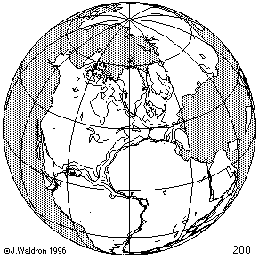
ITRF concept
Watch the grid!
Epoch:
Notes:
Ok, now ITRF mentioned a couple slides ago.
Most simplistic way to explain ITRF is to watch this animation.
This is a very loose representation/visualization of what the ITRF is, a characterization only.

Slide 29
Four TRFs for Modernized NSRS
North American Terrestrial Reference Frame of 2022
(NATRF2022)
Pacific Terrestrial Reference Frame of 2022
(PATRF2022)
Caribbean Terrestrial Reference Frame of 2022
(CATRF2022)
Mariana Terrestrial Reference Frame of 2022
(MATRF2022)

Slide 30
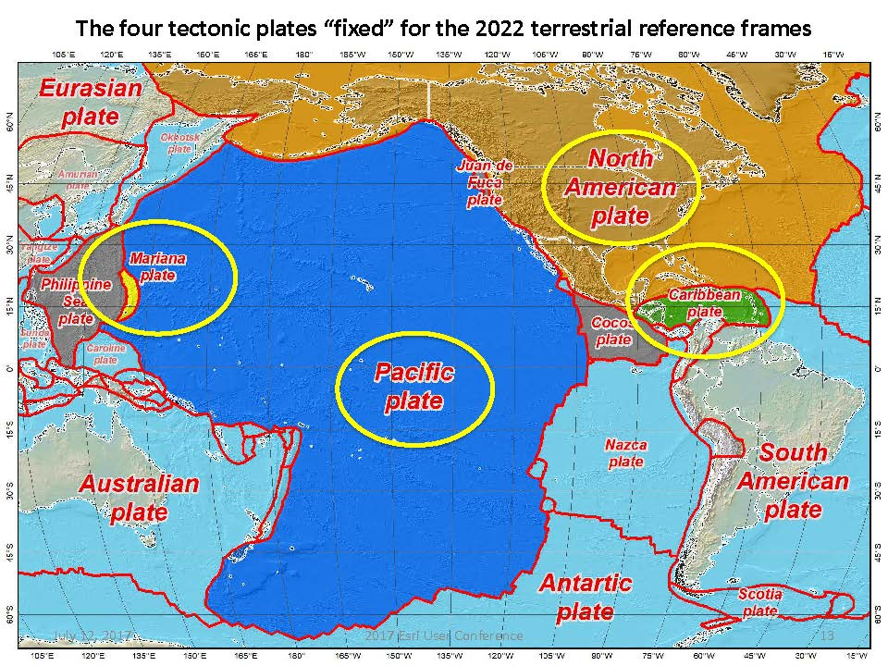
Plate Rotation visualized
Drift…
Notes:
-these are ground-level horizontal velocities
-the arrows illustrate the positions and velocities of CORS plotted in ITRF2014
-our scale is on the left there, with that arrow representing 20mm of motion per year
-so right thru Ohio it’s a little cluttered but we’re seeing arrows about that length so about 2cm/20mm per yr
-what do we notice about the direction of these arrows?
-they look rotational, don’t they?
CLICK HERE
-Note the arrows in California do not conform to the rotation… those are CORS on a different PLATE which is moving in a different direction
CLICK HERE
-so when you look at those arrows you can see the rotation, but the point of rotation is obviously off the map, way down below the screen right?
-that point is what’s known as an Euler Pole

Slide 31
Plate-Fixed NSRS TRFs
ITRF
Frame = constant
NA Plate = rotating
NATRF
Frame = rotating
(relative to ITRF)
NA Plate = constant
(relative to NATRF2022)
Notes:
We say “NATRF2022” is “fixed” to the N.A. Plate, making it a “plate fixed” frame
-the frame is constant to itself, but rotating within ITRF, and moving in a different direction than the other 3 frames

Slide 32
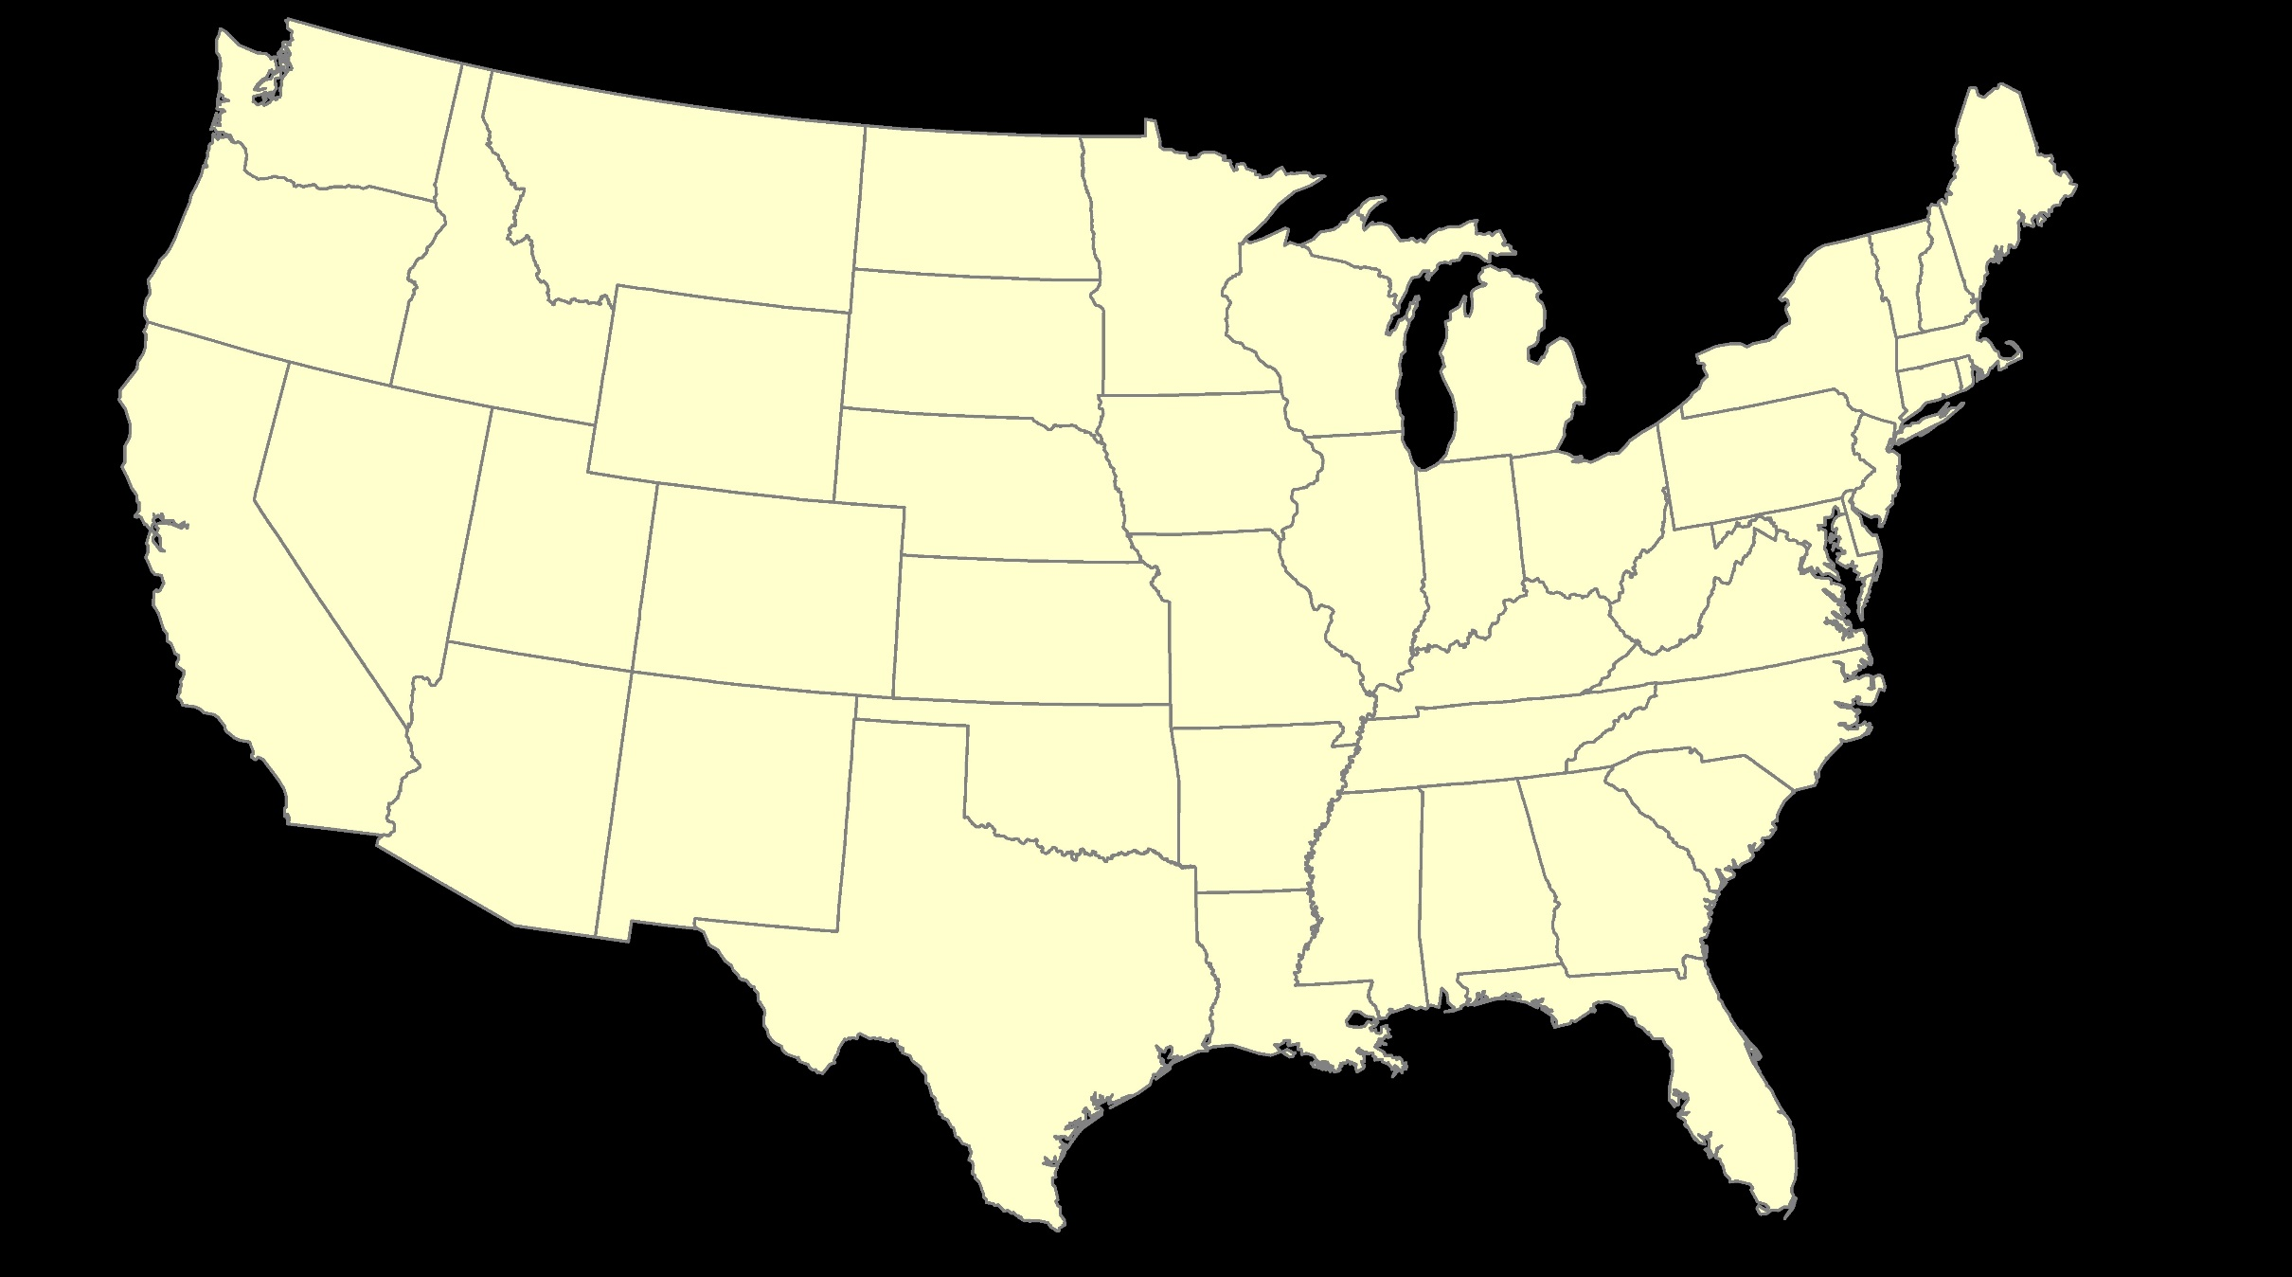
ITRF – constant frame, rotating plate

Slide 33
Plate-Fixed
NATRF – rotating frame, constant with plate

Slide 34
if you know epoch
ITRF or NATRF – your choice if you know epoch

Slide 35
Decades of continuously logged GPS data from the NOAA CORS Network (NCN).
  But how?

Slide 36
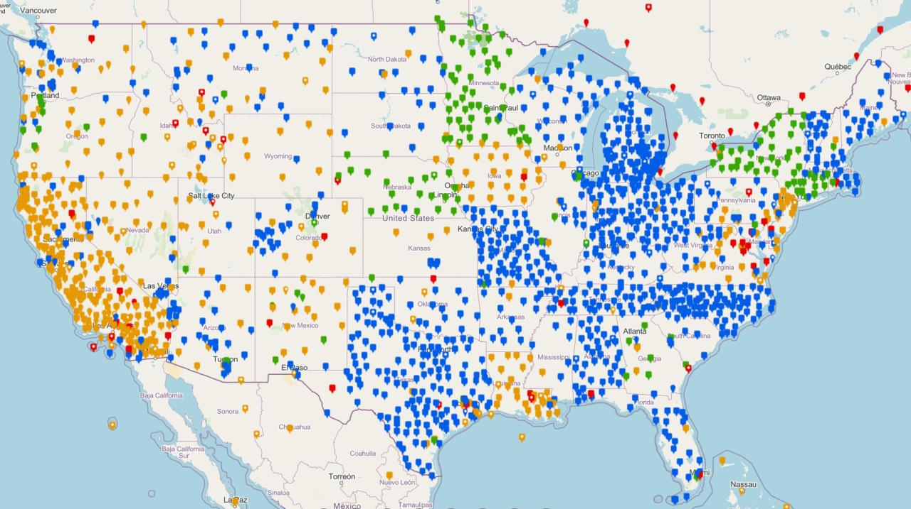
NOAA CORS Network (NCN)

Slide 37

Plate-Fixed
ITRF or NATRF
= CORS
Notes:
ITRF is independent of any plates, tied to the layer below,
-”plate-agnostic” if we want to sound all silicon valley ish
-the plates go down about 200 km (125 mi) deep below our feet right now, as we’re on a continental plate
--(oceanic plates are roughly half the thickness, like 100 km)
-→ but thickness of the tectonic plates varies greatly, from down to 15 km up over the 200 km I mentioned earlier

Slide 38
Terminology – Time/4D
Epoch
eh-puck? ee-pock? … to-may-to, to-mah-to
an instant of time; a moment in time
astronomy & geodesy use a decimal date
  2021.4762 = 23 June 2021 @ 19:16:00
  using epochs is important, not your format
    start preparing to assign epochs to your data
Notes:
-Where do you see an Epoch right now in NGS data?
CLICK
Datasheets! there you see the epoch of 2010.0
and of course OPUS Solution Reports!
note that in blue over there on the right you’ll see another epoch, in the ITRF, which I will explain later on

Slide 39
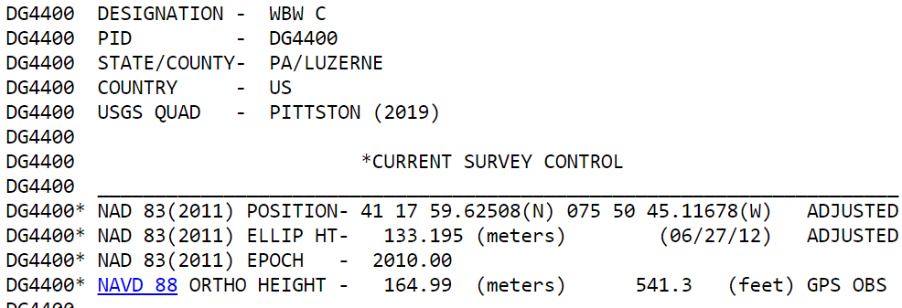
Notes:
-Where do you see an Epoch right now in NGS data?
Datasheets! there you see the epoch of 2010.0
and of course OPUS Solution Reports!
note that in blue over there on the right you’ll see another epoch, in the ITRF, which I will explain later on

Slide 40
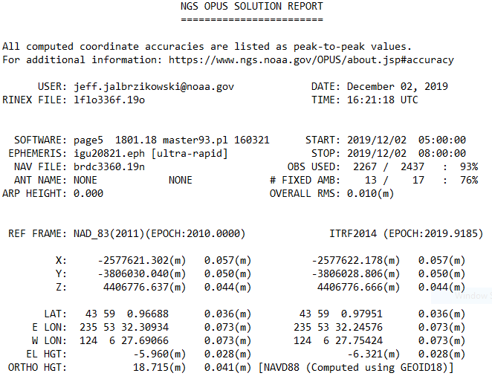
Reference Epoch
Survey Epoch
Notes:
-Where do you see an Epoch right now in NGS data?
and of course OPUS Solution Reports!
note that in blue over there on the right you’ll see another epoch, in the ITRF, which I will explain later on

Slide 41
What is a Reference Epoch?
If you use NAD83 you’re already using one, but perhaps unaware.
First let’s look at complete nomenclature…

Slide 42
Complete NAD83 Nomenclature
NAD83(2011) epoch 2010.00
Geometric
Datum
Realization
(aka Datum Tag)
Epoch
(in the case of NAD83, a Reference Epoch)
Other NAD83 Reference Epochs
NAD83(1986) epoch 1984.00
NAD83(HARN) epoch 1993.62
NAD83(CORS96) epoch 2002.00
NAD83(2007) epoch 2007.00
NAD83(2011) epoch 2010.00
ITRF2014 epoch 2019.9185
IGS08 epoch 2005.00
NATRF2022 epoch 2020.00
NAD83(1986) epoch 1984.00
NAD83(HARN) epoch 1993.62
NAD83(CORS96) epoch 2002.00
NAD83(2007) epoch 2007.00

Slide 43
What is a Survey Epoch?
If you use OPUS you’re already using one, but perhaps unaware.

Slide 44
Complete ITRF Nomenclature
ITRF2014 (epoch 2021.0276)
Geometric
Datum
Epoch
(in the above example, a Survey Epoch)
ITRF Reference Epochs
NAD83(1986) epoch 1984.00
NAD83(HARN) epoch 1993.62
NAD83(CORS96) epoch 2002.00
NAD83(2007) epoch 2007.00
NAD83(2011) epoch 2010.00
ITRF2014 epoch 2019.9185
IGS08 epoch 2005.00
NATRF2022 epoch 2020.00
Examples of ITRF Survey Epoch
ITRF92 epoch 1988.0
ITRF2000 epoch 1997.0
ITRF2005 epoch 2000.0
ITRF2008 epoch 2005.0
ITRF2014 epoch 2010.0
ITRF2008 epoch 2012.2011
IGS08 epoch 2006.7572
ITRF2014 epoch 2017.4457
ITRF2014 epoch 2019.9185
ITRF2014 epoch 2021.0276

Slide 45
Epochs in Current NSRS
Survey Epoch (SE)
Reference Epoch (RE)
Position at the moment of survey data collection
Seen on OPUS Solution
Necessary for ITRF
Ground movement will be illustrated
Position after propagated back in time from SE to RE
Seen on OPUS Solution
Used in NAD 83
Ground movement will be hidden

Slide 46
Epochs in Modernized NSRS
Survey Epoch (SE)
Reference Epoch (RE)
Position at the moment of survey data collection
Used in NATRF2022
SEC = SE Coordinate
Ground movement will be illustrated
Position after propagated back in time from SE to RE
Used in NATRF2022
REC = RE Coordinate
Ground movement will be hidden

Slide 47
4D alignment – Epochs
One epoch in which ITRF2020 will be equal to NATRF2022…
At 00:00 on January 01, 2020 any given coordinates in
ITRF2020 (epoch 2020.0) = NATRF2022 (epoch 2020.0)
Notes:
After that, they diverge and continue to do so, we’ll visualize that soon

Slide 48
Terminology - Changing Coordinates
Conversion
    change the type of coordinate
    NAD83(2011) latitude & longitude → NAD83(2011) SPCS
  Transformation
    change the datum of coordinate
    NGVD29 height → NAVD88 height
    NAD 27 latitude & longitude → NAD 83(2011) latitude & longitude
Propagation
    change the epoch of coordinate
    NATRF2022 epoch 2020.00 to NATRF2022 epoch 2023.243
Notes:
Historically NGS has been inconsistent with these top two words.
Going forward, we will use them as:
Conversion: Meaning to change the type of coordinate without changing the datum or frame
Transformation: Meaning to change the datum or frame, without changing the type of coordinate

Slide 49
NCAT
  How will you do that?
NGS Coordinate Conversion And Transformation Tool (NCAT)
Epochs/Time/4D
Notes:
-so you’ve probably seen that phrase that I have front and center here, NSRS Modernization
-that’s the blanket term we use to refer to not just the new datums but other updates

Slide 50
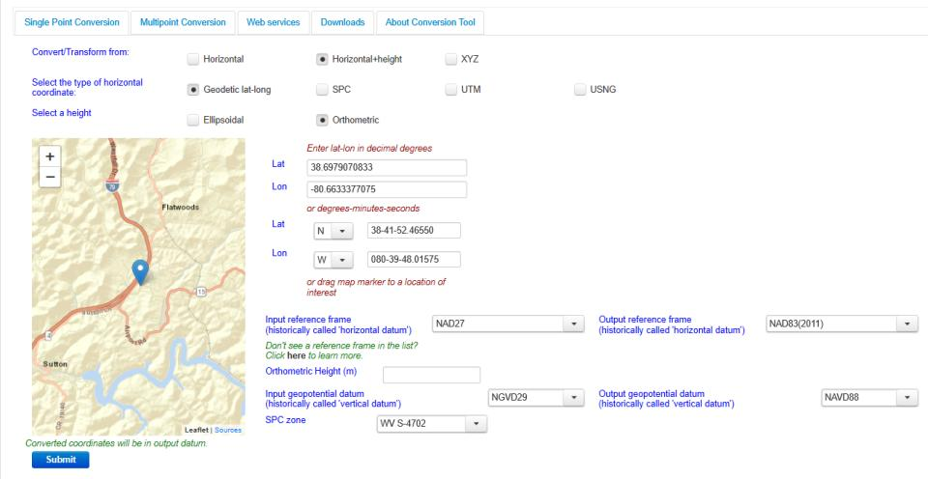
NGS Coordinate Conversion And Transformation Tool (NCAT)
Notes:
NCAT includes the functionality of previous NGS tools:
NADCON 5.0
XYZWIN 2.0
UTMS 2.1
SPC83 2.1
USNG 2.3
Includes error estimate of transformation per point.
Available as the single-point graphic seen here, multi-point upload/download, as a downloadable executable fie to run from the DOS prompt, and as web services for inclusion in your own
It’s a great tool. Anyone using

Slide 51
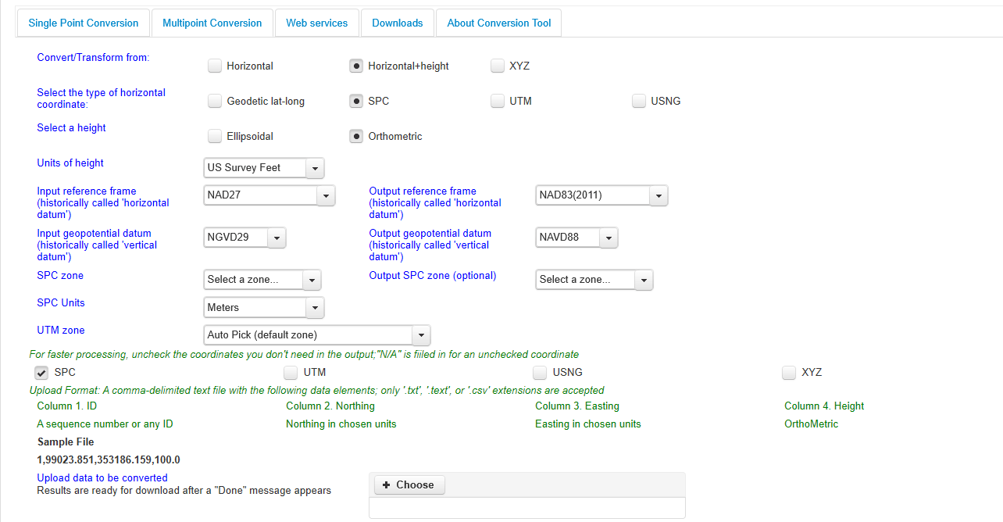
NGS Coordinate Conversion And Transformation Tool (NCAT)
Notes:
NCAT includes the functionality of previous NGS tools:
NADCON 5.0
XYZWIN 2.0
UTMS 2.1
SPC83 2.1
USNG 2.3
Includes error estimate of transformation per point.
Available as the single-point graphic seen here, multi-point upload/download, as a downloadable executable fie to run from the DOS prompt, and as web services for inclusion in your own
It’s a great tool. Anyone using

Slide 52
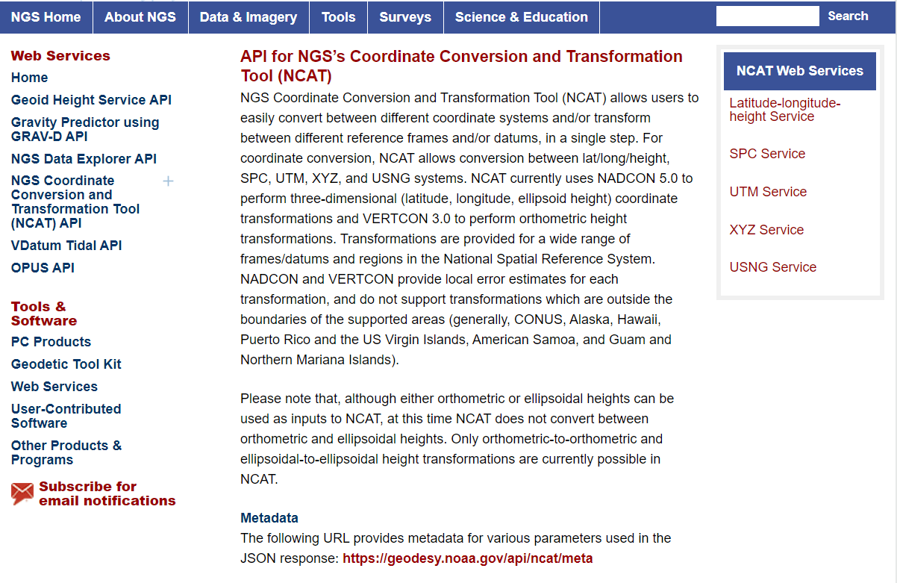
NCAT is available via web services

Slide 53
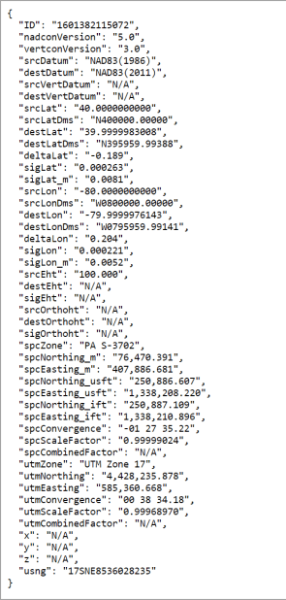
NCAT is available via web services
Note that each operation is a separate service
Struggling?
Contact us.
We can help!

Slide 54
NGS Coordinate Conversion And Transformation Tool (NCAT)
Notes:
NCAT includes the functionality of previous NGS tools:
NADCON 5.0
XYZWIN 2.0
UTMS 2.1
SPC83 2.1
USNG 2.3
Includes error estimate of transformation per point.
Available as the single-point graphic seen here, multi-point upload/download, as a downloadable executable fie to run from the DOS prompt, and as web services for inclusion in your own
It’s a great tool. Anyone using

Slide 55
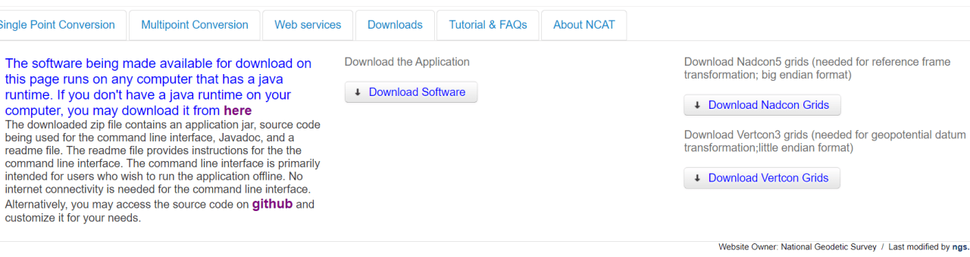
NGS Coordinate Conversion And Transformation Tool (NCAT)
Notes:
NCAT includes the functionality of previous NGS tools:
NADCON 5.0
XYZWIN 2.0
UTMS 2.1
SPC83 2.1
USNG 2.3
Includes error estimate of transformation per point.
Available as the single-point graphic seen here, multi-point upload/download, as a downloadable executable fie to run from the DOS prompt, and as web services for inclusion in your own
It’s a great tool. Anyone using

Slide 56
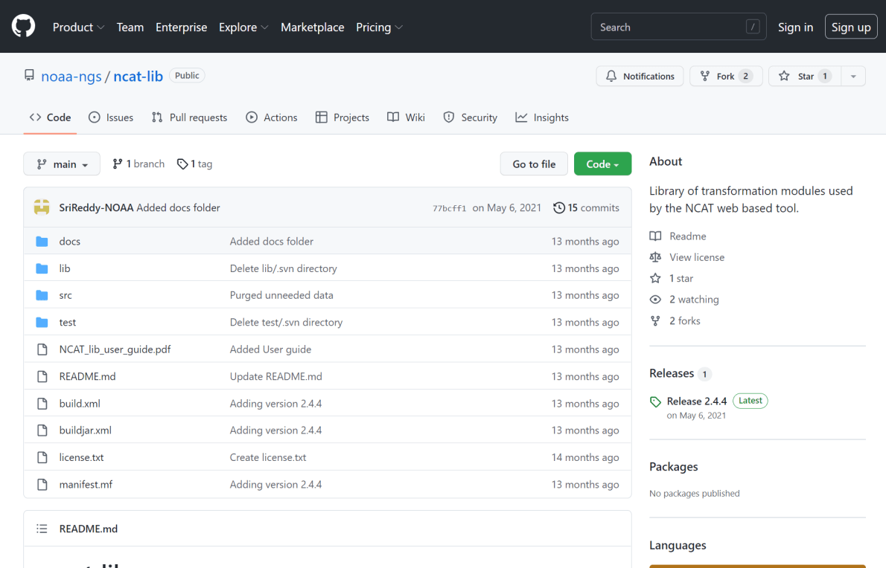
NCAT source code is on GitHub

Slide 57
NOAA VDatum

Slide 58
What’s the difference?
NCAT
VDatum
NSRS Datums
  NAD 27
  NAD 83
  NGVD 29
  NAVD 88
  PRVD 02
  ASVD 02
  NMVD 03
  GUVD 04
  VIVD 09
NSRS Datums
Geoid Models
  Add/Subtract from Ellipsoid
Tidal Datums
  MHW, MLLW, MTL
Great Lakes Datum
  IGLD85
ITRF#### ≈ WGS84
Local Tidal (LT)

Slide 59
New Types of Coordinates for Modernized NSRS

Slide 60
Type | Generally on… | Description
Reported Coordinates | Passive | Mapping accuracy: smartphone, handheld, etc.
OPUS Coordinates | Passive | Computed by you with OPUS using your data. Unchecked by NGS.
Survey Epoch Coordinates (SECs) | Passive | Most accurate. Time-dependent. Computed by NGS every four weeks.
Reference Epoch Coordinates (RECs) | Passive and Active | Modeled from SECs, ACs, IFVM2022 and GeMS. Computed by NGS every five years.
Active Coordinates (ACs) | Active | Continuous time-dependent CORS coordinates. Checked by NGS every day.
Notes:
-is this necessary or does Dr. Dru just like to name things??
-it is necessary to accomplish what the community said they wanted during the early time period of public presentations on the new datums

Slide 61
New Types of Coordinates
Reported Coordinates
  These are from any source where the coordinate is directly reported to NGS without the data necessary for NGS to replicate the coordinate.
    Scaled from a map
    Transformed using NCAT or VDatum
    Smartphone
    Reported directly from an RTK rover without data files
Notes:
Reported Coordinates
“These are from any source where the coordinate is directly reported to NGS without the data necessary for NGS to replicate the coordinate.”
They could be scaled from a map
Or, they might be transformed using NCAT or VDatum
Or, shown on a smartphone’s GPS
Or, perhaps reported directly from an RTK rover without data files.

Slide 62
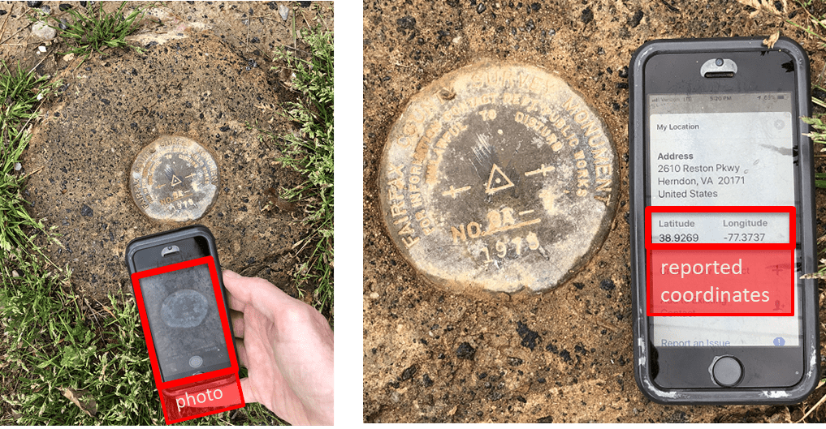
Reported Coordinates
Notes:
Reported Coordinates could be captured with a smartphone, perhaps with a photo, as part of a mark recovery.

Slide 63
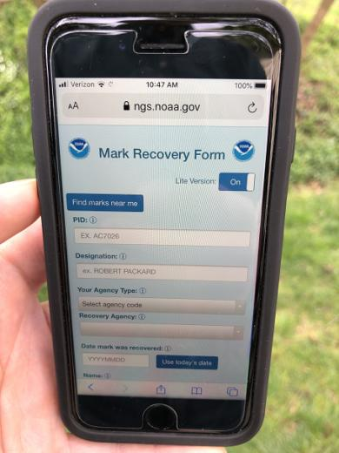
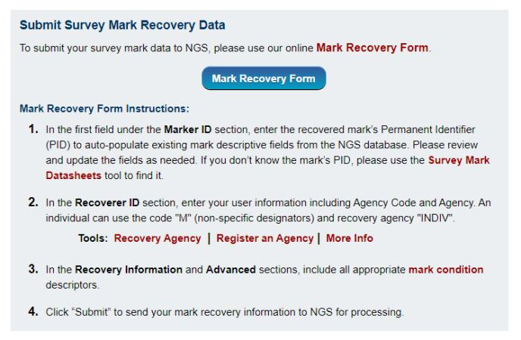
Sidenote: we can sort of do this now…
Our mobile-friendly mark recovery page. Browser based, not an app, nothing to download.
https://www.ngs.noaa.gov/cgi-bin/mark_recovery_form.prl
Notes:
And … NGS has a new mobile-friendly mark recovery webpage.
Please try it out!

Slide 64
Reported Coordinates = Buyer Beware!
Reported coordinates might be very wrong!
  Reported using incorrect datum NAD 27, NAD 83, WGS84
    Systematic Error: 2–100 meters
  Scaled off of a USGS topographic map
    Random Error: ± 600 meters
  Smartphone
    Random Error: ± 10–50 meters
NGS will show you reported coordinates
  But their function is to get you “in the neighborhood” of a mark
  Not for use as control!
Notes:
Reported coordinates might be very wrong!
If they are reported using an incorrect datum NAD 27, NAD 83, WGS84
There could be Systematic Error: 2–100 meters
If they are scaled off of a USGS topographic map
Random Error: ± 600 meters
If they come from a smartphone GPS
Random Error: ± 10–50 meters
NGS data delivery system will show you reported coordinates
But their function is to get you “in the neighborhood” of a mark, not to use as geodetic control!

Slide 65
New Types of Coordinates
OPUS Coordinates
  Computed by the user via OPUS
    Will not be evaluated by anyone at NGS (just like OPUS now)
    These are user-computed values, like you get now from OPUS Static or OPUS Projects
    OPUS Coordinates are the only coordinates you will get directly from OPUS
Notes:
OPUS Coordinates are preliminary coordinates.
“These are coordinates the user wishes to use that have been computed by that user in OPUS.
These coordinates have not been evaluated by anyone at NGS.
These are user-computed values, such as they might get today from either OPUS-Static or OPUS-Projects.
“OPUS Coordinates” are the only coordinates a user will get directly from OPUS.

Slide 66
New Types of Coordinates
OPUS Coordinates may come with the label:
“tied to the NSRS”
But… only if you restrict computations to OPUS-recommended constraints.
Notes:
OPUS Coordinates may also come with the label:
“tied to the NSRS”
But, only if a user restricts their computations to OPUS-recommended constraints.

Slide 67
New Types of Coordinates
OPUS Coordinates may come with the label:
“not tied to the NSRS”
You can deviate from OPUS-recommended constraints and still get OPUS coordinates, but they will be labeled “not tied to the NSRS”.
Notes:
OPUS Coordinates may also come with the label:
“not tied to the NSRS”.
Users who deviate from OPUS-recommended constraints can still perform computations and will get OPUS coordinates, but they will be labeled
“not tied to the NSRS”.

Slide 68
New Types of Coordinates
However, in neither case will OPUS coordinates be considered
“part of the NSRS”
  That title will be estricted to NGS-computed coordinates:
  reference epoch coordinates (RECs)
  survey epoch coordinates (SECs)
  active coordinates (ACs)
Let’s get to the the next few slides for those…
Notes:
However in neither case will OPUS coordinates be considered to be
“part of the NSRS”.
That moniker is restricted to NGS-computed coordinates available from the NSRS database, such as:
survey epoch coordinates (SECs),
reference epoch coordinates (RECs) and
active coordinates (ACs).
Let’s talk about those in the next slides..

Slide 69
New Types of Coordinates
Reference epoch coordinates (RECs)
  Coordinates which have been estimated by NGS, from:
    time-dependent age-limited historic survey data
    CORS coordinate functions
    and an IFDM
  at an official NSRS reference epoch.
    NAD 83(2011) epoch 2010.00 (sort of) would’ve fallen under this category
Notes:
Reference Epoch Coordinates will be Time- and Age-limited:
NGS is considering limiting how far back we reach in order to compute RECs.
While horizontal motions are well known within many crustal motion models (like the IFVM2022 will be), the vertical motions are not.
And since NGS’s intent is to publish RECs only for trusted points, and only for as long as those points ARE trusted (in all 3 dimensions), a time-limit for how far back to reach is definitely one way to keep the coordinates trusted.

Slide 70
New Types of Coordinates
Reference epoch coordinates (RECs)
  These will be computed by NGS every 5 or 10 years
  On a schedule 2–3 years past the reference epoch
  2020.00 coordinates would be computed in calendar year 2022
  RECs are discussed in detail in Blueprint Part 3
Notes:
NGS currently plans for RECs to be computed on a 5 year cycle.
On a schedule 2–3 years past the reference epoch
2020.00 coordinates would be computed in calendar year 2022, etc
The details of this plan are discussed in detail in Blueprint Part 3.

Slide 71
How can you ensure you’ll have RECs on passive control?
Re-observe and submit the data to NGS
  must be submitted by 29 February 2024
Options to submit your GNSS data:
  OPUS Share → 4+ hrs static data; 2 photos; mark ties
    rinse & repeat … as we need redundancy
  OPUS Projects → 2+ hrs data; photos; descriptions
    NGS priority of RTN/RTK integration released in 2020
  traditional “bluebook” submittal
Notes:
-OPUS Share requires 4+ hrs static data; 2 photos; and a brief description of reference ties (not a full IDB “from the post office”)
→ NOTE THAT OPUS SHARE OPTION REQUIRES 2 OBSERVATIONS
→ WHY? WE REQUIRE REDUNDANCY FOR ANY OBS THAT GO INTO OUR DATABASE
-OPUS Projects → 2+ hrs data; photos; full IDB style descriptions via WinDesc (*MUST USE WINDESC*)

Slide 72
New Types of Coordinates
Survey epoch coordinates (SECs)
  Computed by NGS using submitted data and metadata, checked and adjusted to distinct epochs through time.
    Represent the best estimates NGS has of the time-dependent coordinates at any mark
    Adjusting multiple surveys in timespans called “adjustment windows”, to a single epoch within that window.
      Initial plan: 4 weeks for GNSS; 1 year for leveling
Notes:
Survey Epoch Coordinates
“These are coordinates computed by NGS using submitted data and metadata, checked and adjusted and referenced to distinct epochs through time.”
These represent the best estimates NGS has of the time-dependent coordinates at any mark.
SEC’s will be computed by adjusting multiple surveys in timespans called “adjustment windows”, to a single epoch within that window.
NGS’s initial plan: 4 weeks for GNSS; 1 year for leveling

Slide 73
New Types of Coordinates
Active coordinates (ACs)
  Not discrete, but rather a function through time assigned to some point
    For CORS we will use the term coordinate function
      Will be generated by a “fit” to regularly computed coordinates on a TBD basis, perhaps daily, perhaps weekly
      These daily or weekly coordinates will not generally be used as geodetic control by themselves
Notes:
Active Coordinates
These are not discrete, but rather a function through time assigned to some point
At a CORS GRP*, they will be the coordinate function
* Recall that a GRP is the physical point to which coordinates refer at a station like a CORS
The “coordinate function” be generated by a “fit” to regularly computed coordinates on a TBD basis, perhaps daily, perhaps weekly
These daily or weekly coordinates will not generally be used as geodetic control by themselves

Slide 74
Five new types of coordinates for the future NSRS DB
Reported: Good for finding a mark.
  Not to be used as geodetic control
OPUS: Computed by you; as accurate/inaccurate as the choices you make
  Tied to the NSRS if you follow OPUS recommendations
Survey Epoch: Epoch-specific coordinates computed by NGS
  at time of survey
Reference Epoch: Epoch-specific coordinates computed by NGS
  at intervals … 2020, 2025, 2030, etc.
Active: Continuous coordinate functions at a CORS
  CORS only
Notes:
So, in summary there will be five coordinate types:
Reported Coordinates: These are good for finding a point somewhere on Earth.
but not to be used as geodetic control
OPUS Coordinates: which will be computed by you, and will be as accurate or inaccurate as the choices you make
and “Tied to the NSRS” if you follow OPUS recommendations
Reference Epoch Coordinates : Epoch-specific coordinates -
at 2020, 2025, 2030, etc.
Survey Epoch Coordinates: Epoch-specific coordinates -
at time of survey
Active: Coordinates Continuous coordinate functions at a CORS

Slide 75
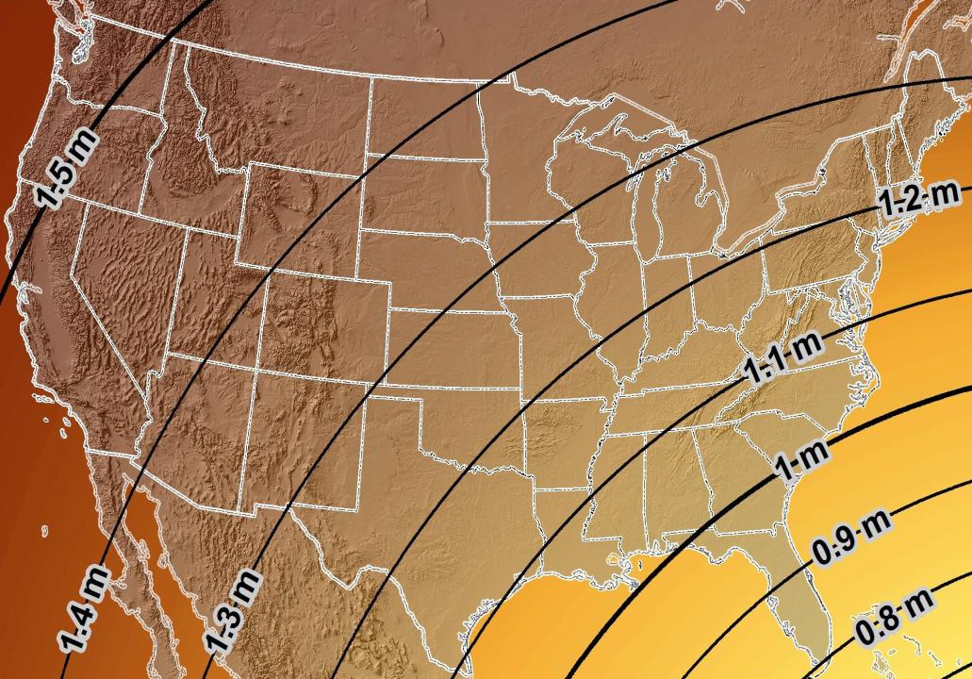
Estimated Geometric Change - Horizontal
NAD83 (2011) → NATRF2022
4.6 ft
Direction of Shift
4.3 ft
3.9 ft
3.6 ft
3.0 ft
Notes:
What’s the magnitude of the horizontal datum shift across Pennsylvania?
Minimum Shift ~3.75 feet
Maximum Shift ~3.97
Remember this is just an estimation, don’t hold me to the numbers please

Slide 76


Slide 77
The Survey Foot is dead!
Long live the Survey Foot!
US Survey Foot was deprecated 31 December 2022… now what?!?
Notes:
We start with the SPCS83 zones as a frame of reference
NOTE that the color shading of these zones is matched to that of the Preliminary SPCS2022 Zones that follow

Slide 78

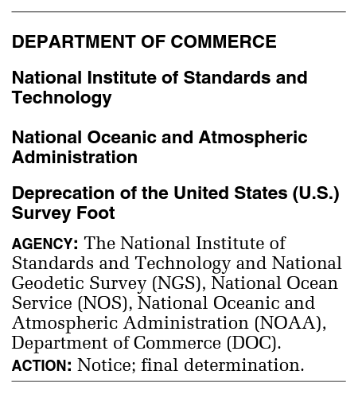
What happened to the US Survey Foot?
Deprecated 31 December 2022
Which begs the question
  What should you be doing now?

Slide 79
What should you be doing now?
Ask the right questions
  Know if subject state law specifies US Foot for SPCS83
Prepare for this along with new datums
Know the difference between sft and ift coordinates
Understand this is not enforced
  Neither NIST or NGS are a regulatory agency
  Remember that OPUS, NCAT, etc. will not have US Survey Foot options for output in SPCS2022 zones
Notes:
Ask the right questions
Know if subject state law specifies US Foot for SPCS83
40 states do that we know of
Prepare for this along with new datums
Understand the difference between sft and ift
2 parts per million
Understand this is not enforced
Neither NIST or NGS are a regulatory agency
But OPUS, NCAT, etc. will not have US Survey Foot options for output in SPCS2022 zones

Slide 80
2 parts per million (ppm)?
1,000,000.00 sft = 999,998.00 ift
10,000,000.00 sft = 9,999,980.00 ift
1,000.00 sft = 999.998 ift (can you measure that?)
International → 1 ft = .3048 m
US → 1 ft = .30480061 m (approx.)

Slide 81
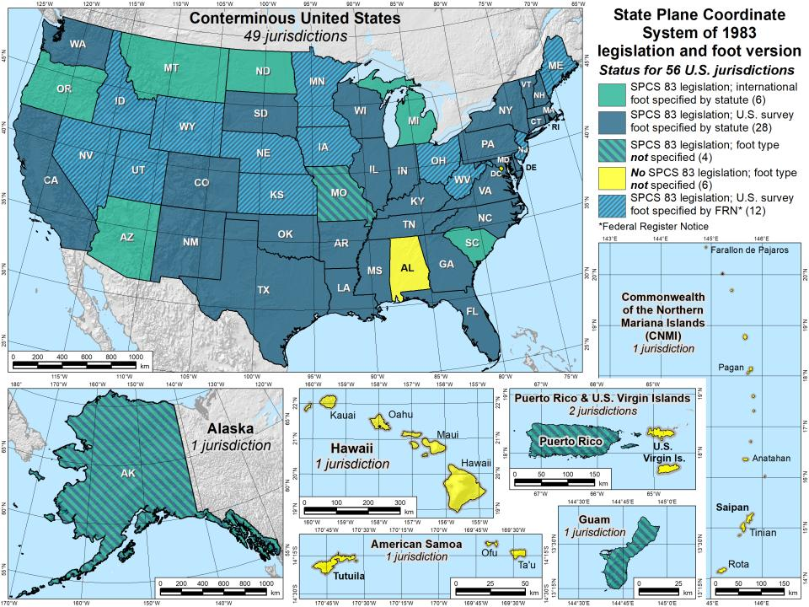

Slide 82
The Survey Foot is dead!
Long live the Survey Foot!
US Survey Foot was deprecated 31 December 2022…
But it will always be available in NGS tools for NAD83 and NAD27 coordinates

Slide 83
Preparing
Inventory heights in your data/datasets
  Have you mix & matched geoid models?
    Are you tracking levees or other flood control?
    Are you managing subsurface utilities?
      Access covers, junction boxes, cleanouts, etc.
    Maybe geoid differences aren’t even significant?
      VADOT story…
  Know your goals, know your data.

Slide 84

Preparing
Know the epoch of your data/datasets
  consider how you will track this
    full to-the-second timestamp on every feature?
      Modern survey equipment makes this possible
    labeling a year for each dataset?
      Easy to add to workflows, datasets/databases, folders
    something in-between that works for your needs?
2023.1957
2023:27
20230127
Epoch nomenclature is your choice

Slide 85
Preparing
Reprocessing your data
  perfect world = everyone reprocesses everything
    what does this mean?
      consider an ALTA w/topo
        start over with the onsite GNSS-based control
        reorient all your shots/ties (hopefully linked)
        recreate all the drainage features in new datum
    unrealistic! … and unnecessary for majority users
Notes:
Reprocessing your data
in a perfect world, everyone would reprocess data
consider a final product like you use everyday - a hydro-enforced DEM
starting fresh with the raw GNSS/IMU processing
generate new ellipsoid height point clouds
recreate all the drainage features in new datum
this is totally unrealistic → both from a financial and programmatic perspective

Slide 86
Preparing
  Transforming your data
    NCAT - NGS Coordinate Conversion and Transformation Tool
      ASCII up/download, Web Services, Download, GitHub
      ask your software provider(s) about integration
        we envision COTS integrations as most popular method of access
        Industry Workshops - May 2021 and August 2022
          Esri, Trimble, Blue Marble, etc… all the well known names attended
        Geospatial Software Developers’ Summit – Nov/Dec
          International & Virtual → US NGS and NRCan CGS
Notes:
Transforming your data
NCAT - NGS Coordinate Conversion and Transformation Tool
available now: ASCII upload and Web Services
ask your software providers about integration
we envision this as most popular method of access
Industry Workshop held this year – esri, trimble, bluemarble, all the major well known names were represented
labeling a year for each dataset?
something in-between that works for your needs

Slide 87
Preparing
What can you do to ensure your control will get coordinates in the new datums on rollout?
Re-observe and submit the data to NGS
  must be submitted by 30 September 2023
Options to submit your data:
  OPUS Share → 4+ hrs static data; 2 photos; mark ties
    rinse & repeat … as we need redundancy
  OPUS Projects → 2+ hrs static GPS data
  → 5+ minutes RTN-GNSS data, 3x per mark
  Also: photos, field logs, descriptions, survey report
Notes:
-OPUS Share requires 4+ hrs static data; 2 photos; and a brief description of reference ties (not a full IDB “from the post office”)
→ NOTE THAT OPUS SHARE OPTION REQUIRES 2 OBSERVATIONS
→ WHY? WE REQUIRE REDUNDANCY FOR ANY OBS THAT GO INTO OUR DATABASE
-OPUS Projects → 2+ hrs data; photos; full IDB style descriptions via WinDesc (*MUST USE WINDESC*)

Slide 88


Slide 89
Remember…
  What’s the goal of NATRF2022?
    Give you the stability in positions that you expect
  That’s the point of Reference Epochs (REs)
    Akin to the different realizations of NAD83
    REs will be published every 5 or 10 years
      you choose when you update
      in a perfect world, everyone would stay current
aka versions
Notes:
What’s the goal of the way NATRF2022 was designed, by including EPP2022 and IFVM2022
Does a database of manholes in PA need cm-level coordinate updates on an annual basis? Probably not.

Slide 90
Any references to any commercially available hardware or software do not constitute an endorsement or a disapproval of any manufacturers, developers, dealers, or suppliers.
Thanks.

Slide 91
NCN - NOAA CORS Network
1695 sites
241 organizations
Notes:
What does that mean?
Please don’t think of this as us here at NGS being some pointy-haired semantics. We need to make distinctions about CORS when talking about all this. If you haven’t already realized this, you’ll start to catch on today.

Slide 92
Online Positioning User Service
      dual frequency receiver
      static observations (via RINEX → ABCD123x.24o)
      30 seconds epoch/logging rate aka recording interval
  OPUS Rapid Static (OPUS-RS)
      15 minutes to 2 hours of GPS data
  OPUS Static (OPUS-S) → also Beta OPUS!
      same requirements as above
      2 to 48 hours of GPS data
  OPUS Projects (OP)
      adds session processing and network adjustment
      training by NGS currently required (~12 hours)
Notes:
Currently 4 types of OPUS.
*OPUS only supports GPS constellation data, last I talked to the OPUS developer the plan for incorporation of other constellations is Jan 2021.
Rapid Static – files uploaded that are 15 minutes to 2 hours in duration are processed using an NGS software called “RSGPS”
Static - files that are 2 to 48 hours in duration are processed using an NGS software called PAGES Your coordinates are the average of three independent, single-baseline solutions,
OP and Beta OP - these are not a different processing software, just a way to tie multiple OPUS-Static solutions together and use least squares methods to adjust them all as a coherent network
**the Beta serves as a testing bed for the developers to roll out new features or improvements and get feedback from users

Slide 93
NGS Products and Services
Not just OPUS
All exist in three environments:
  Development (DEV) - internal testing and development
    same as when you hear a company talk about an “Alpha” product
  Beta - continued internal testing, open for public testing
    key features have already been vetted/tested
  Production - final product, open to public use
    this is what you see first when navigating our website
Notes:
I’ll be talking about OPUS today, but I need to clarify one of our processes for this to all be clear. I will also mention that this is a new-ish workflow for NGS, began in the past 8 or so years.
So all NGS Products & Services go thru this process as they are created, tested internally, open for testing by you our constituents, and then rolled out as final products.
CLICK
There’s three environments that products will exist in, listed here in the order they occur
First, a tool will be created on the “DEV” servers for internal NGS-only development, testing, and otherwise “working the bugs out”
→this is the same phase as when you hear a software company or video game maker talk about their alpha products
CLICK
Next, after some level of confidence in the product is gained, it will be migrated to the Beta servers, thereby open to the public for their own testing
→it’s important to note that when a product is available via our Beta page, when you use it you are indeed now a “beta tester”
key features will have already been tested in the Development environment, but it is still a beta, so as a beta tester please let us know if you have issues/complications/struggles or the like
CLICK
At some point, when all I’s are dotted and T’s crossed, the thing will be moved to the Production environment.
→ by then, the tool is integrated into others, has been vetted with 2 testing phases and functions as expected, but may still continue to receive version updates by repeating this process

Slide 94
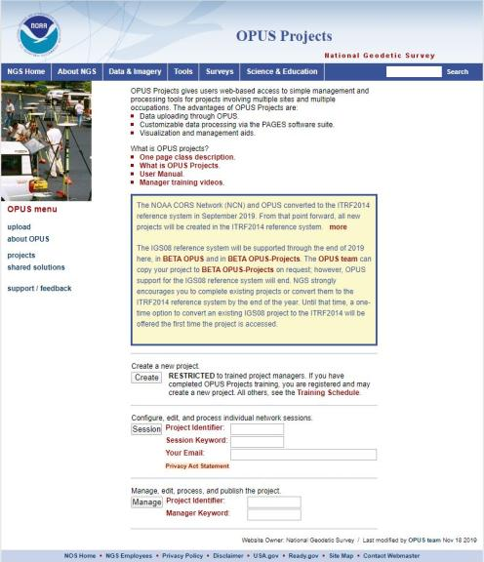
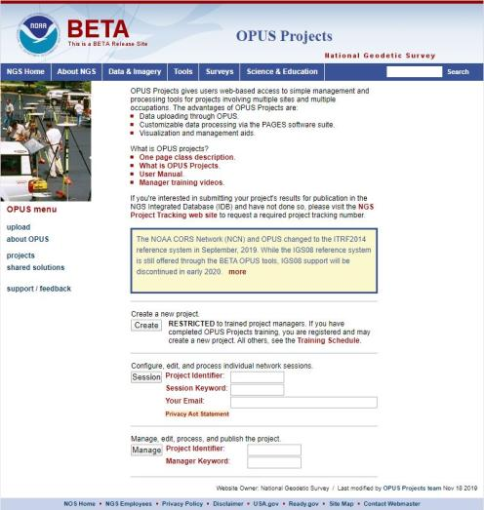
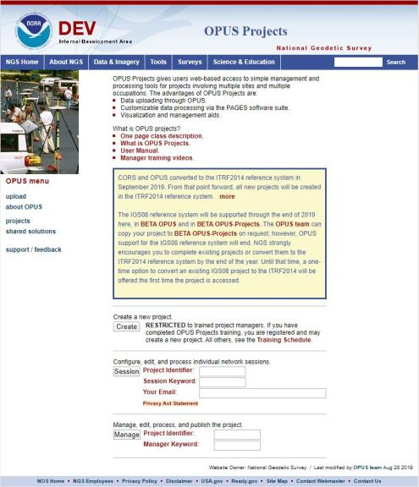
www.ngs.noaa.gov
beta.ngs.noaa.gov
Remember, you won’t see the DEV environment…
Notes:
So here we have 3 screenshots, first here showing the Production OPUS Projects gateway page
CLICK
Second is the Beta page, with the text here showing the URL for our Beta homepage
-How do you find that beta page? substitute “beta” for “www”
-or most tools that have a beta will have a link to that beta platform
CLICK
Last is the Development or DEV example, which again you will not see unless via a demo from NGS personnel

Slide 95
Wait… how do I get to the NGS Beta site?

Slide 96
www.ngs.noaa.gov
beta.ngs.noaa.gov

Slide 97
OPUS only processes every 30s
You can upload 5s interval data
  But OPUS will trim/decimate to 30s interval
  And this may result in error messages
You can even upload 1s interval data
  But only shorter files, or OPUS will abort
For static, 30s yields good results
  If using your commercial software, 15s can be advantageous
Notes:
Even if you’re running RTK…
You can setup your base to only log @ 30s rate
Know your equipment

Slide 98
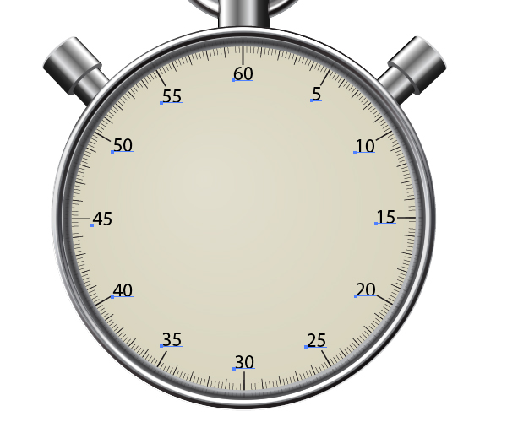
OPUS processes every 30s
20s decimates to 60s

Slide 99
OPUS Rapid Static (OPUS-RS)
  15 min to 2 hours
  Computes atmospheric delay at up to 9 NCN CORS within 250km
  Interpolates that delay to your position
  Reports corrected position with standard deviation stats
5001
CORS
OPUS Solution
Notes:
-OPUS Static takes the best 3 of 5 baselines, sequentially processed, and provides you their peak-to-peak average
sidenote
-we delivered over 1.2 million solutions in 2021, compared to in 2011 when we first broke the 200,000 solutions milestone

Slide 100

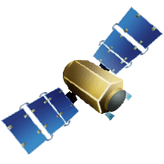

OPUS Rapid Static (OPUS-RS)
15 min to 2 hours
1st creates an atmospheric delay model
2nd position calculated via a DGPS static solution
Notes:
OPUS-RS or Rapid Static performs two calculations.
1st - creates an atmospheric delay model from surrounding CORS data (white circle)
2nd - Your position is determined via a differential GPS static solution

Slide 101
OPUS Static (OPUS-S)
  2 to 48 hours
  Best 3 of 5 baselines
  Sequentially processed
  Reports your peak-to-peak (P2P) average position
5001
5002
CORS
OPUS Solution
Notes:
-OPUS Static takes the best 3 of 5 baselines, sequentially processed, and provides you their peak-to-peak average
-we delivered over 1.2 million solutions in 2021, compared to in 2011 when we first broke the 200,000 solutions milestone
-sidenote that we’ve already broken the 1.5 million mark for 2022

Slide 102

OPUS Static (OPUS-S)
  No correlation between your observed marks
  Low Relative Accuracy
  Even if … collected simultaneously
  … and submitted to OPUS simultaneously
  OPUS-S = independent solutions
5001
5002
CORS
OPUS Solution

Slide 103
OPUS Projects (OP)
  Simultaneous processing of your observed marks
  Improved Relative Accuracy
  Requires more field prep and office processing effort
  OP = true network solutions
  And of course, least squares adjustment
Distant CORS
~400-800 km
5001
5002
5003
5004
CORS
OPUS Solution

Slide 104
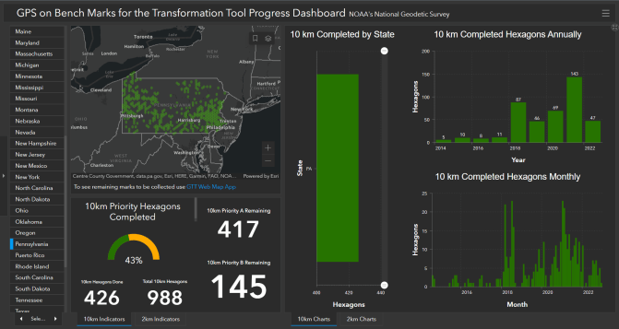
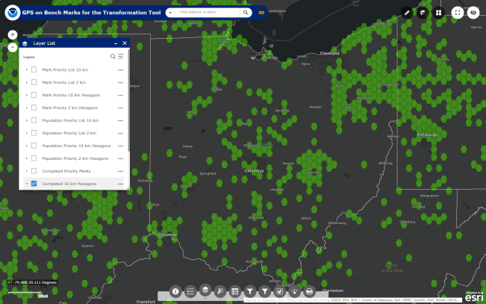

What’s the deal with GPSonBM?
GPS on Bench Marks
Web Map Application
Deadline = 29 February 2024
OPUS Shared Solutions
  2 OPUS-Static, ≥4 hours each
  2 photos of each setup
  Brief Description w/Ties
Progress Dashboard
The struggle is real.
“too much field time”
“we don’t do static”
“poor site, if only we had multi-GNSS”
Notes:
Note here that the Dashboard map is separate from the Web Map Application.
CLICK They are linked, but different tools.
If you got mixed up about this at some point, no worries, you were not the only one.
If we have had this process to submit GPSonBM for years now… why are we now putting out this option for OPUS Projects via GVX?
CLICK

Slide 105


Slide 106
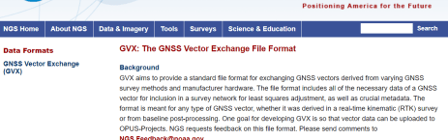
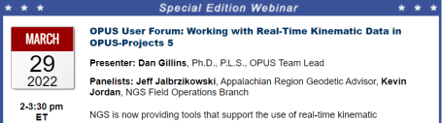
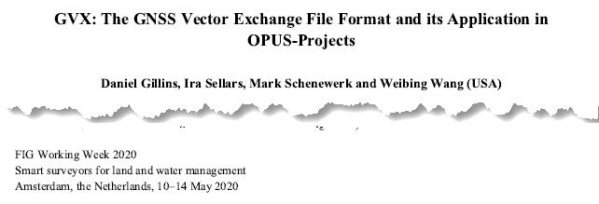
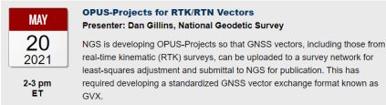
GNSS Vector eXchange (GVX)
Hyperlink to GVX Info Page
Detailed documentation, Schema, and Example File available
Any major search engine: “ngs gvx file format”
Open standard for anyone to use or integrate
GVX is sort of like… RINEX for RTK/RTN data
GVX details?
Check out:

Slide 107
GVX ≈ RINEX for RTK/RTN data
RINEX
GVX
Uncorrected Observations
That’s why we post-process them
Static Observations
One observation per file
Proprietary Format → Open Standard
Export RINEX using your COTS software
Metadata
Antenna, Rx, HI, Point Name, Start Time, SVs at each epoch
Based on ASCII Text File Format
Longtime industry standard
  Way too many to list!
Corrected/Processed Positions
And the Vectors used to create them
RTN, RTK, PP Static, even PPK
Many observations, any mix of above
Proprietary Format → Open Standard
Export GVX using your COTS software
Metadata - same as RINEX, plus…
Project Info, Solution Types, PDOP, Mount Points, Correlation Matrices, QC data
Based on XML File Format
Longtime industry standard
  e.g. LandXML, JXL, MAXML, KML/KMZ

Slide 108







Status of GVX Exporters
…that we know of.
Available Now
Trimble Business Center (TBC) v5.60 - released Nov 2021
Topcon MAGNET Software v7.2 - released Nov 2021
Leica Infinity 4.0.0 - released May 2022
Developers who have expressed interest to us
iGage
Carlson
Emlid
Available, but not fully functional
JAVAD J-field - onboard Triumph-LS device
Notes:
-Please note that this information here can only reflect what we know. If you are a developer working on incorporating GVX into your software… reach out to us! We would be happy to assist you, just as we have assisted some of our other commercial partners named here.
-What would make us happiest is if the list got so long we couldn’t fit in on this slide.
-Oh, and hey, you customers out there… express your desire for GVX to your suppliers/dealers or Support team

Slide 109
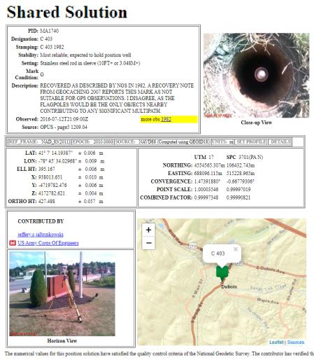
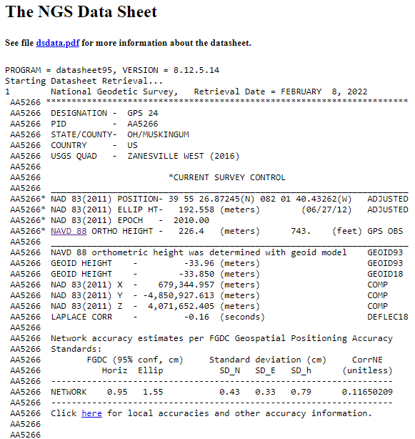
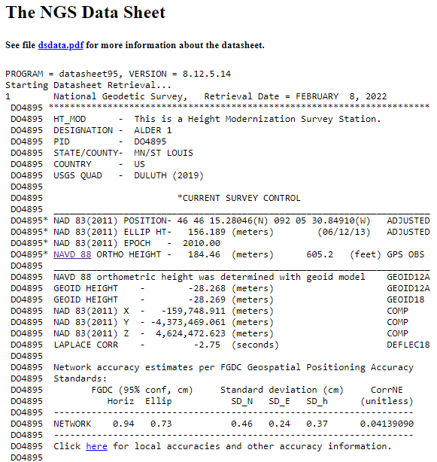
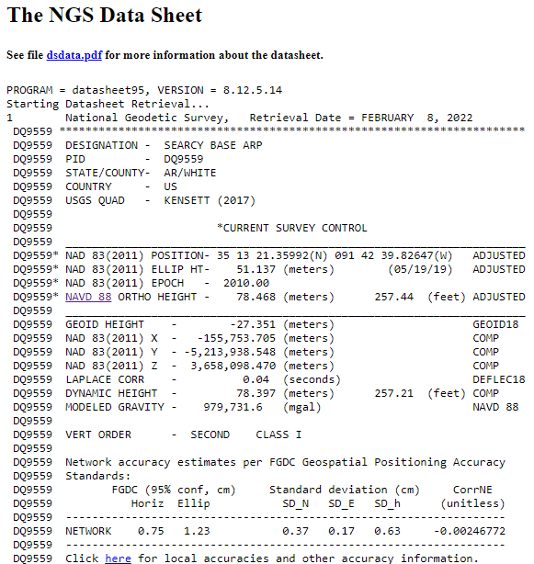
OPUS Shared vs. OPUS Projects
 | OPUS Shared | OPUS Projects (RINEX) | OPUS Projects (GVX)
Minimum Occupations | 4 hours At least 1, maybe 2* | 2 hours At least 2 | 5 minutes At least 3
Processing | OPUS-S (sequential) | PAGES (simultaneous) | Real Time (RTN/NRTK)
Adjustment | None | Least Squares Network | Least Squares Network
Metadata | 2 photos Brief Description | 3 photos, WinDesc files, Logs, & Report | 3 photos, WinDesc files, Logs, & Report
*Need 2 or more GPS datasets in our database, existing data holdings count toward that.

Slide 110
How do I get started with using
RTN data in OPUS Projects for GPSonBM?
RTNonBM?
GVXonBM?
GNSSonBM?

Slide 111
Preparations/Planning
Choose Marks from the Web Map → not every mark is a BM
Reconnaissance and Recovery → is the bridge even still there?
Plan Initial and Repeat/Redundant Occupations
  Repeat start times must differ by >3 hours (even on separate days)
Determine CORS you might end up using in the field
  For the most part you will not get to control that
  Why is this important? → Operational Status, Data Availability, etc.
  Status of CORS (NCN or non-NCN) will affect your workflow
    Let’s look at those different workflows, or GVX scenarios...
Please don’t wing it and hope for the best.
First submit a Survey Project Proposal ☺
Notes:
Please don’t wing it and hope for the best.
Choose Marks from the Web Map (not every mark is a BM)
Plan Initial and Repeat/Redundant Occupations
Repeat start times must differ by >3 hours (even on separate days)
Determine CORS you might end up using in the field
For the most part you will not get to control that

Slide 112
GVX Scenarios in OPUS Projects
CORS + RTN
  CORS are not in NCN
  CORS are not in NCN but are in IDB (have PID/Datasheet)
  CORS are in NCN
Static Base + RTK
  Base (positioned via OPUS) delivering RTK corrections to rover
Static Post-Processed
  Corrected positions determined with your software
  Results (vectors and points) exported to GVX
Any network method is compatible (e.g. VRS, MAC, FKP)
What’s the difference?
Your workflows in OPUS Projects.
What’s the same?
Your workflows in the field.
Notes:
-Sooo… because today’s topic is RTN, we’re going to chop those last 2 items from the slide
CLICK
-Now we’re left with 3 main scenarios of using RTN-GNSS data in OP via GVX
-What makes the difference is that depending on which network station(s) were used in your survey, you will encounter one or more of these scenarios.

Slide 113
1) CORS + RTN a) CORS are not in NCN
Collect field data with Rover(s)
Download non-NCN CORS data
  From your network provider
Upload WinDesc files
Upload non-NCN CORS data to OPUS Projects
  Using OPUS Static and Project ID
Create GVX in your software and upload it
Session Processing
  Aligns your CORS (RTN Base) to NCN
Network Adjustment
  Constrain to NCN CORS
Notes:
Some of you may be thinking though… what does this even mean that the CORS are not in the NCN?
Let’s look at the example of the WVDOT’s Real Time Network

Slide 114
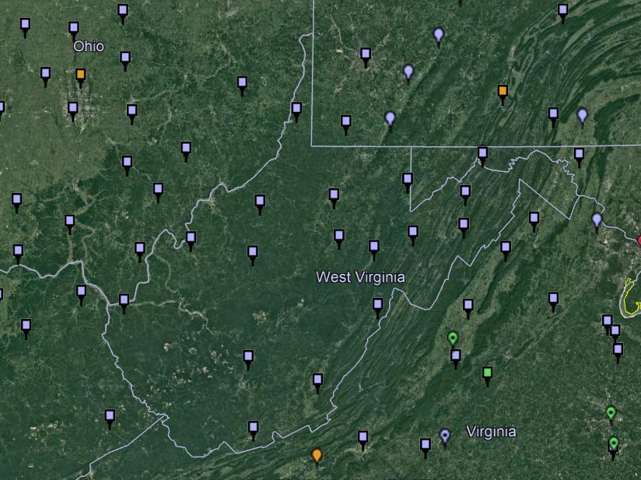
NOAA CORS Network (NCN) in WV

Slide 115
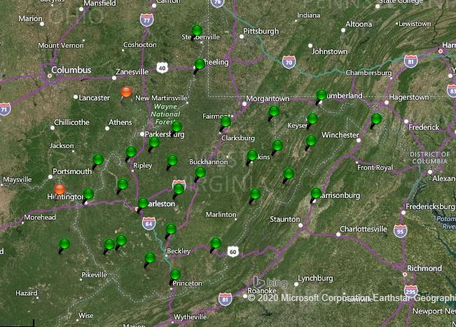
WVDOT CORS Network (and RTN)
Notes:
Just for the sake of discussion, I will point out that the WVDOT’s real time network is based on VRS method

Slide 116
NOAA CORS Network (NCN) in WV

Slide 117
WVDOT CORS Network (and RTN)
non-NCN CORS
Notes:
And now by me flipping back and forth between these, you’ve likely caught on that the stations in red are non-NCN CORS

Slide 118
1) CORS + RTN
a) CORS are not in NCN
Network users typically have access to non-NCN CORS data
  Sometimes called the “Reference Data Shop”
Some network providers do not provide long-term user access
  Anywhere from just 45 days to 365 days
Investigate this during Project Planning
  If non-NCN CORS data is not available…
    NGS cannot help with that
    Contact your network provider for possible access to their archived data
Download non-NCN CORS data
  From your network provider

Slide 119
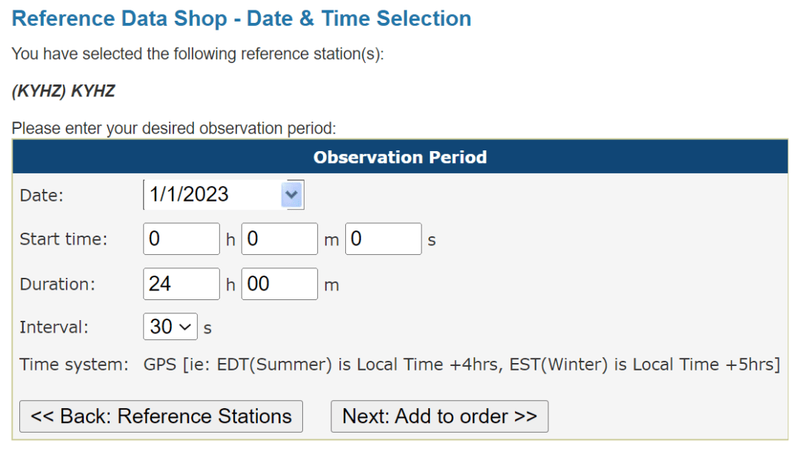
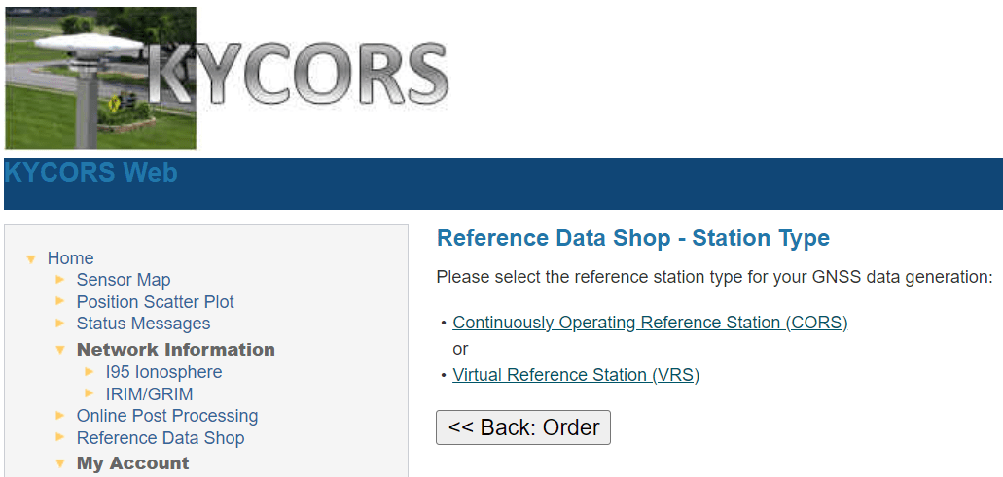
1) CORS + RTN
a) CORS are not in NCN
Notes:
Now we’re looking here not at the WVDOT but the Kentucky Transportation Cabinet network.
This is their web interface, and if I wanted to download some non-NCN CORS data from their network, I’d go into the Reference Data Shop.
For many of the networks, you’ll see both a CORS and a VRS option.
What you want is the CORS data, and the interface will walk thru the rest of the options, you’ll be asked which station(s) you want data from, for date(s), observation interval (HINT… 30 seconds for OPUS!)

Slide 120
1) CORS + RTN b) CORS are not in NCN but have Datasheet/PID (are in IDB)
Collect field data with Rover(s)
Download non-NCN CORS data
  From your network provider
Upload WinDesc files
Upload non-NCN CORS data to OPUS Projects
  Using OPUS Static and Project ID
Create GVX in your software and upload it
Session Processing
  Aligns your CORS (RTN Base) to NCN
Network Adjustment
  Select Constraints (NCN or non-NCN CORS Datasheet)

Slide 121
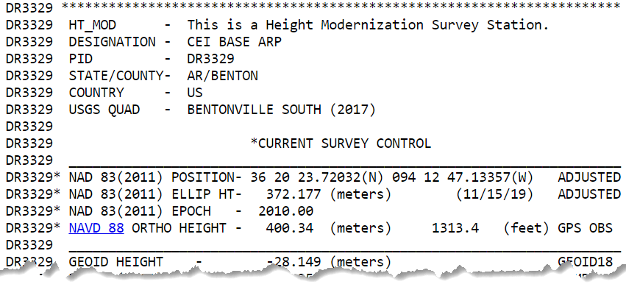

1) CORS + RTN
b) CORS are not in NCN but have Datasheet/PID (are in IDB)
What does that look like?
How do I know?
Consult the NGS Map
or Data Explorer
IDB = Intergrated DataBase

Slide 122
1) CORS + RTN
a) CORS are in NCN
Collect field data with Rover(s)
Create GVX in your software
  Using your field or office software
Upload WinDesc files
Upload GVX to OPUS Projects
  Using OPUS Static and Project ID
  Vectors are automatically linked to NCN CORS
Network Adjustment
    Constrain NCN CORS

Slide 123
CORS + RTN
Regardless of CORS used, whether NCN or non-NCN…
If RTN uses Trimble® VRS™ method, you must log vectors
  VRS = Virtual Reference Station
For GVX to work in OP, vectors must be tied to a PRS/PBS
  PRS = Physical Reference Station
  PBS = Physical Base Station
Should not be a concern for MAC or FKP methods
  Vectors will be tied to PRS/PBS by default
No vectors = No GVX = No OPUS Projects

Slide 124

CORS + RTN
Regardless of CORS used, whether NCN or non-NCN…
If RTN uses Trimble® VRS™ method, you must log vectors
GNSS Vector eXchange with VRS means you must:
Store points as Vectors

Slide 125
Exporting a GVX from TBC
Video Demonstration

Slide 126
CORS + RTN for GPSonBM
Regardless of CORS used, whether NCN or non-NCN…
Minimum of 5 minutes mark occupation time
Total of 3 independent occupations
Must agree by 3 cm Horizontal and 5 cm Ellipsoid Height
Must be separated by at least 3 hours
  Yes, even if occupied on different days
Your marks will be included in the NGS IDB → Datasheets
  So long as you results meet requirements and all metadata is included

Slide 127

Required Metadata for GVXonBM
WinDesc Files → 1 each of .dsc, .des, .err, .dis, .nbr
  Yes, for the foreseeable future you will need to download, install, and learn how to use WinDesc
3 photos per mark → uploaded to Marks Pages
  close-up
  downward from eye-level
  horizon/setup
Project Report (PDF)
Observation Logs (single PDF)

Slide 128


Closing
RTK/RTN is now an option, not a requirement
Redundancy is a surveyor’s best friend
Surveying is still surveying
Notes:
Just because OP opens the door to RTK/RTN, doesn’t mean it is required
Surveying is still surveying

Slide 129
Closing Thoughts
Redundancy is Your Friend
  Even with static GNSS, your “total time on mark” is the key to accuracy (not longer necessarily occupations)
Beta OPUS Projects is the path to GVX Submissions (as of today)
  Where is it? … instead of www.ngs.noaa.gov navigate to beta.ngs.noaa.gov
  Or simply check the NGS Homepage → Beta Release (under News Bulletins)
In the future, GNSS will become a sub-type of GDX file format
  GDX = Geodetic Data eXchange
  Still an XML based file format
  Goal = one file format for observations from: GNSS, Total Station, Digital Level, Gravimeter
  Yes, this is in conjunction with NSRS Modernization efforts

Slide 130
Additional Resources

Slide 131

Regional Geodetic Advisor Program
geodesy.noaa.gov/ADVISORS/
14 RGAs across country
We are here to support:
  You
  Your constituents
  Our Federal Partners
Questions about
NSRS Modernization?
  Reach out now
  Be prepared
Notes:
-14 Regional Advisors, we’ve transitioned from a State-based to a Regional Program
-our advisors homepage up there at the top, also easy to find us by querying any major search engine for “ngs advisors”
-if you know Ross Mackay, he is our Chief Advisor, I report to him…
**ya know, I don’t know why they don’t make him put his photo up here
-we do have one vacant advisor position, that was recently advertised and John up there in Wisconsin is officially retired in oh… 18 days

Slide 132

Educational Videos
<5 minutes
Online Lesson
(via MetEd/COMET)
~1 hour
NGS homepage: geodesy.noaa.gov
Notes:
Educational videos and online tutorials –
Our library of lessons and videos are great resources, and will reinforce a lot of information we covered today.
The videos are just 3-5 minutes long.
the lesson is a deeper dive but still only takes an hour.

Slide 133


Email Subscriptions
*Only 1-2 messages per month*
NGS News
  Includes quarterly NSRS Modernization newsletter
Webinar Series
Training
GPS on Benchmarks
Click this icon on homepage

Slide 134
https://geodesy.noaa.gov/ADVISORS/
-use any major search engine: “NGS advisors”
Jeff Jalbrzikowski, P.S., GISP, CFS
Appalachian Regional Geodetic Advisor
jeff.jalbrzikowski@noaa.gov
240-988-5486

Slide 135

Scan to save my contact info on your phone

