Slide 1
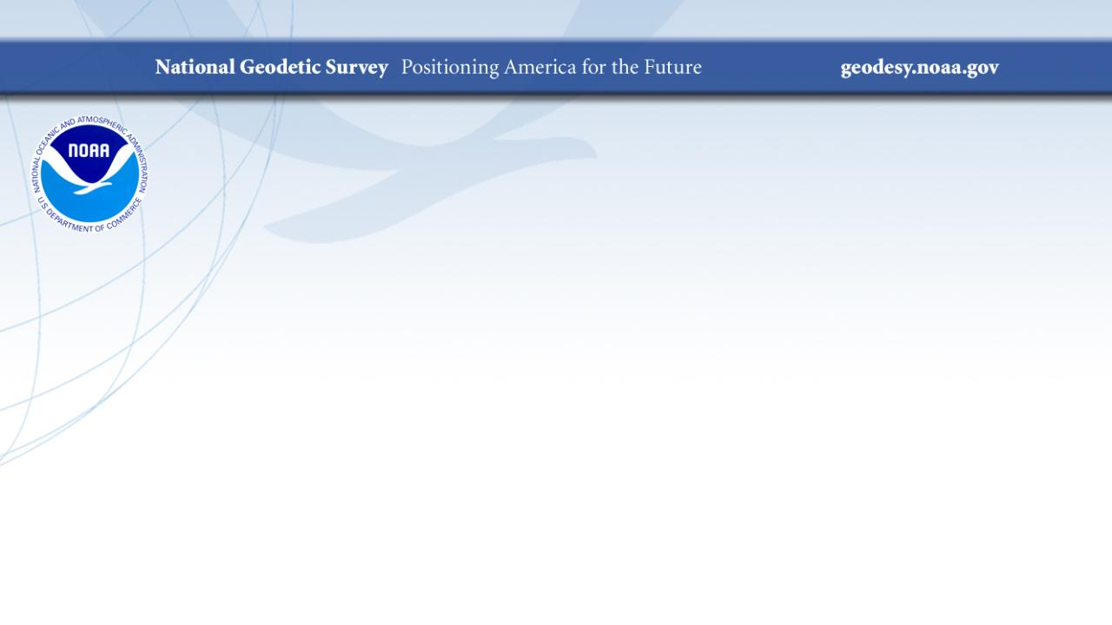
Coordinates in Motion
A Closer Look at NATRF2022
PLSO Annual Conference
February 2024
Jeff Jalbrzikowski, P.S., GISP, CFS
Appalachian Regional Geodetic Advisor
jeff.jalbrzikowski@noaa.gov
240-988-5486

Slide 2
Any references to any commercially available hardware or software do not constitute an endorsement or a disapproval of any manufacturers, developers, dealers, or suppliers.
Thanks.

Slide 3



Organizational Structure
  -Department of Commerce (DoC)
  (~47,000 employees)
  -National Oceanic and Atmospheric Administration (NOAA)
  -National Ocean Service (NOS)
  -National Geodetic Survey (NGS)
  (~175 employees)
Notes:
-We are the Federal Government’s oldest scientific agency.
-part of the Executive Branch
-I know it can seem kind of strange that NGS is part of the NOS, but the origins of NGS lie with the C&GS.
-we are a “Program Office” of the NOS
Survey of the Coast – 1807
Coast Survey – 1836 → in 1871 the agency was tasked by Congress with responsibility to carry geodetic control inland (>150 years)
Coast and Geodetic Survey – 1878
NGS since 1970

Slide 4


Organizational Structure
We’re not USGS, we’re NGS
  -Department of Commerce (DoC)
  (~47,000 employees)
  -National Oceanic and Atmospheric Administration (NOAA)
  -National Ocean Service (NOS)
  -National Geodetic Survey (NGS)
  (~175 employees)
≠
Notes:
-as you can read my slide, I like to point that out because over my 2 years at NGS I’ve seen and heard this misunderstanding quite a bit
-don’t worry! it doesn’t offend us! and we do work closely with USGS, but we are separate agencies within totally different departments of the federal government

Slide 5
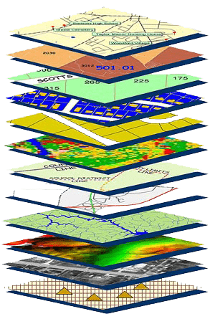
NGS Mission
To define, maintain and provide access to the National Spatial Reference System (NSRS) to meet our Nation’s economic, social, and environmental needs.
NSRS
Notes:
NGS develops and maintains the National Spatial Reference System, a national coordinate system that provides the foundation for transportation, navigation, land record systems, mapping and charting efforts, and a multitude of scientific and engineering applications
CLICK
You’ve all seen this or some similar graphic I’m sure. That bottom layer… that’s our baby, the NSRS.

Slide 6
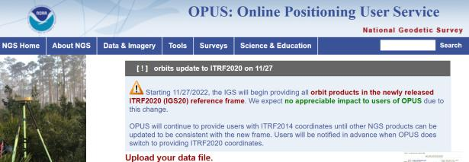
NGS Mission
To define, maintain and provide access to the National Spatial Reference System (NSRS) to meet our Nation’s economic, social, and environmental needs.
access… ? = traditionally → marks/disks/objects
= modern and future → NOAA CORS Network (NCN)
via OPUS
Notes:
Follow up thought
-like it or not, we know that the vast majority of our users are obtaining NSRS coordinates via OPUS
-while that is our plan for the future of primary access, modernized NSRS, as of now the official form of access (specifically to NAVD88) truly is to “touch brass” as they say → meaning occupy a benchmark

Slide 7
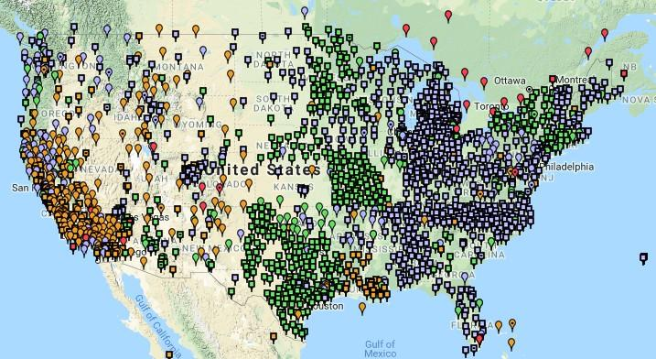
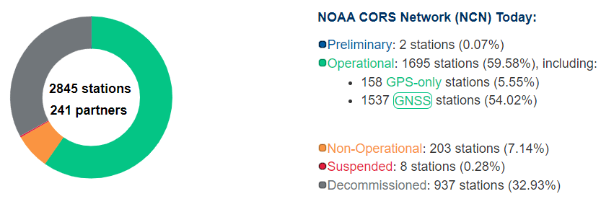
NCN - NOAA CORS Network
1695 sites
241 organizations
Notes:
What does that mean?
Please don’t think of this as us here at NGS being some pointy-haired semantics. We need to make distinctions about CORS when talking about all this. If you haven’t already realized this, you’ll start to catch on today.

Slide 8
CORS Networks
Global: International GNSS Service (IGS) Network
NSRS: NOAA CORS Network (NCN)
Regional: State/Municipal or Private CORS Networks
They’re all semi-coupled, not 100% overlap.
Notes:
Global: International GNSS Service (IGS) Network
The international standard since mid-1990s
Supported by IGS Analysis Centers (ACs) → NGS is one AC of seven total
Overall system sponsored by NASA
NSRS: NOAA CORS Network (NCN)
NGS processes/distributes data, but few are NGS-operated
Subset of NGS-operated CORS comprise the under construction NOAA Foundation CORS Network (NFCN)
Regional/State/Commonwealth/Local Networks
Real-Time Networks (RTN… aka “VRS”)
Currently semi-coupled to the NCN
NGS sees the future as a close coupling of other networks with the NCN so users can seamlessly and confidently work in the NSRS using their favorite regional/local CORS network

Slide 9
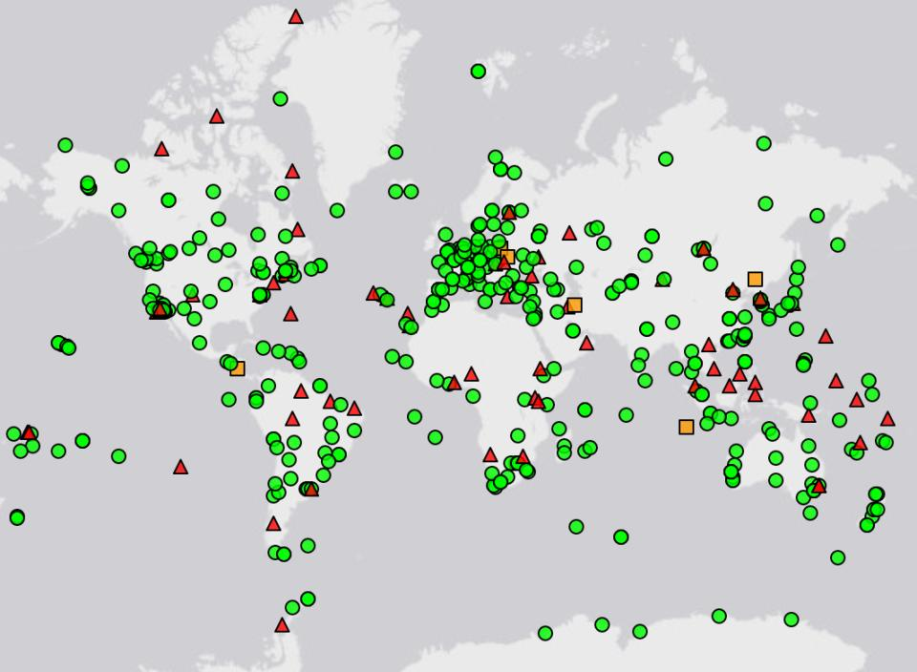
IGS CORS Network
Source: https://www.igs.org/maps/#station-map
Notes:
There are several CORS Networks.
The Global Standard is the IGS Network
IGS = International GNSS Service
The NOAA CORS Network (NCN) which consists of:
The NOAA Foundation CORS Network (NFCN), a sub-network being installed, owned, and operated by NGS
and 2,000+ stations managed, but rarely owned by NGS
Other Regional/Local Networks (RTNs, etc.)
Currently semi-coupled to the NCN
NGS sees the future as a close coupling of these other networks with the NCN so users can seamlessly and confidently work in the NSRS using their favorite regional/local CORS network.

Slide 10
NOAA CORS Network (NCN)
Notes:
-I would like to point out we have a new, official name for the network you see represented on this map,
-The NOAA CORS Network, or NCN
CLICK
-this is neat little graphic with some stats on teh NCN you can find on our website
-below the gaphic youll find a search bar with more information

Slide 11
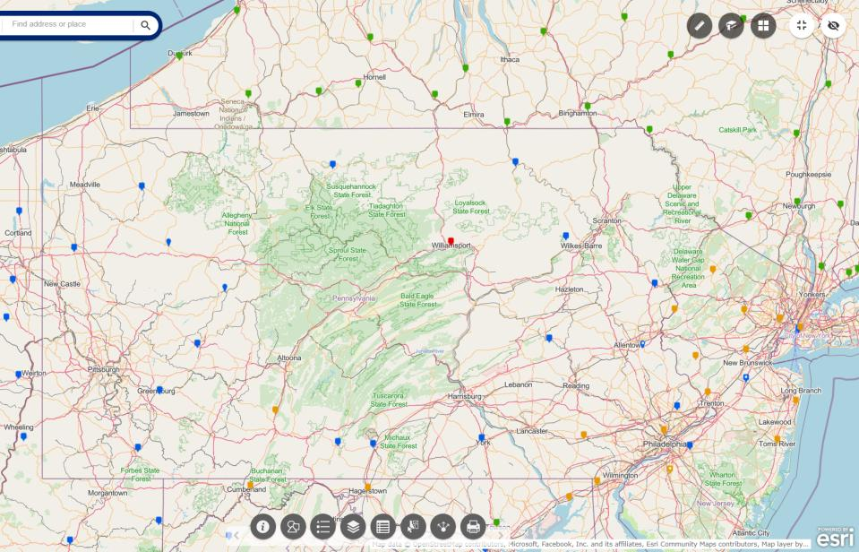
NOAA CORS Network (NCN) in PA
Notes:
where else but the federal government are you going to see two acronyms within one acronym?

Slide 12
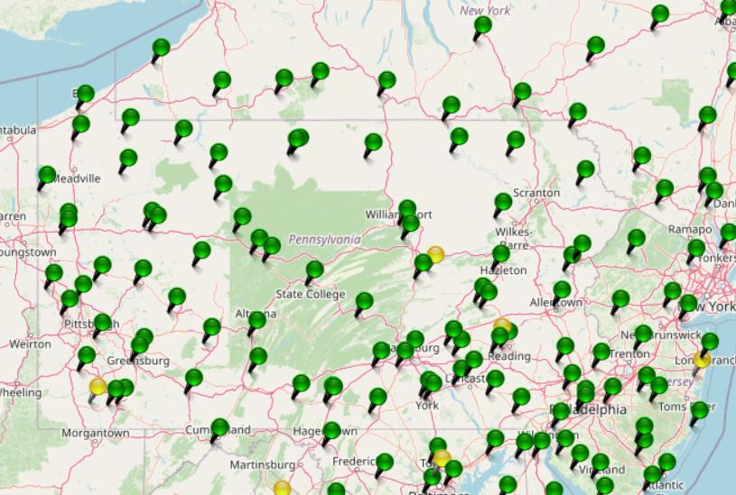
KeyNetGPS CORS Network
Notes:
where else but the federal government are you going to see two acronyms within one acronym?

Slide 13
NOAA CORS Network (NCN) in PA
Notes:
where else but the federal government are you going to see two acronyms within one acronym?

Slide 14
KeyNetGPS CORS Network
non-NCN CORS
Notes:
where else but the federal government are you going to see two acronyms within one acronym?

Slide 15
Online Positioning User Service
      dual frequency receiver
      static observations (via RINEX → ABCD123x.24o)
      30 seconds epoch/logging rate aka recording interval
  OPUS Rapid Static (OPUS-RS)
      15 minutes to 2 hours of GPS data
  OPUS Static (OPUS-S) → also Beta OPUS!
      same requirements as above
      2 to 48 hours of GPS data
  OPUS Projects (OP)
      adds session processing and network adjustment
      training by NGS currently required (~12 hours)
Notes:
Currently 4 types of OPUS.
*OPUS only supports GPS constellation data, last I talked to the OPUS developer the plan for incorporation of other constellations is Jan 2021.
Rapid Static – files uploaded that are 15 minutes to 2 hours in duration are processed using an NGS software called “RSGPS”
Static - files that are 2 to 48 hours in duration are processed using an NGS software called PAGES Your coordinates are the average of three independent, single-baseline solutions,
OP and Beta OP - these are not a different processing software, just a way to tie multiple OPUS-Static solutions together and use least squares methods to adjust them all as a coherent network
**the Beta serves as a testing bed for the developers to roll out new features or improvements and get feedback from users

Slide 16
NGS Products and Services
Not just OPUS
All exist in three environments:
  Development (DEV) - internal testing and development
    same as when you hear a company talk about an “Alpha” product
  Beta - continued internal testing, open for public testing
    key features have already been vetted/tested
  Production - final product, open to public use
    this is what you see first when navigating our website
Notes:
I’ll be talking about OPUS today, but I need to clarify one of our processes for this to all be clear. I will also mention that this is a new-ish workflow for NGS, began in the past 8 or so years.
So all NGS Products & Services go thru this process as they are created, tested internally, open for testing by you our constituents, and then rolled out as final products.
CLICK
There’s three environments that products will exist in, listed here in the order they occur
First, a tool will be created on the “DEV” servers for internal NGS-only development, testing, and otherwise “working the bugs out”
→this is the same phase as when you hear a software company or video game maker talk about their alpha products
CLICK
Next, after some level of confidence in the product is gained, it will be migrated to the Beta servers, thereby open to the public for their own testing
→it’s important to note that when a product is available via our Beta page, when you use it you are indeed now a “beta tester”
key features will have already been tested in the Development environment, but it is still a beta, so as a beta tester please let us know if you have issues/complications/struggles or the like
CLICK
At some point, when all I’s are dotted and T’s crossed, the thing will be moved to the Production environment.
→ by then, the tool is integrated into others, has been vetted with 2 testing phases and functions as expected, but may still continue to receive version updates by repeating this process

Slide 17
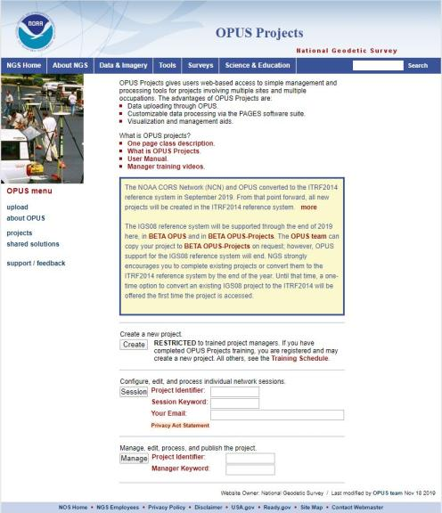
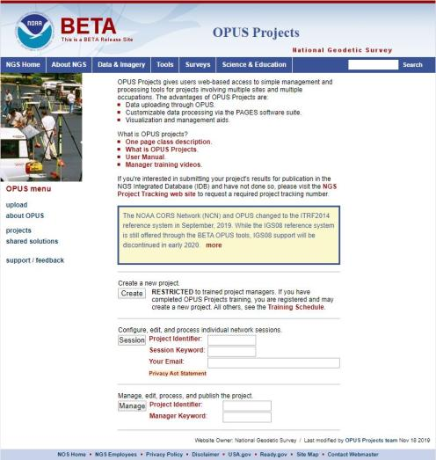
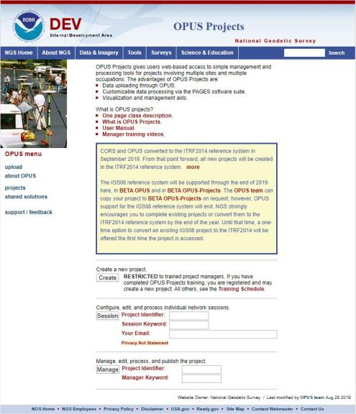
www.ngs.noaa.gov
beta.ngs.noaa.gov
Remember, you won’t see the DEV environment…
Notes:
So here we have 3 screenshots, first here showing the Production OPUS Projects gateway page
CLICK
Second is the Beta page, with the text here showing the URL for our Beta homepage
-How do you find that beta page? substitute “beta” for “www”
-or most tools that have a beta will have a link to that beta platform
CLICK
Last is the Development or DEV example, which again you will not see unless via a demo from NGS personnel

Slide 18
Wait… how do I get to the NGS Beta site?

Slide 19
www.ngs.noaa.gov
beta.ngs.noaa.gov

Slide 20
OPUS only processes every 30s
You can upload 5s interval data
  But OPUS will trim/decimate to 30s interval
  And this may result in error messages
You can even upload 1s interval data
  But only shorter files, or OPUS will abort
For static, 30s yields good results
  If using your commercial software, 15s can be advantageous
Notes:
Even if you’re running RTK…
You can setup your base to only log @ 30s rate
Know your equipment

Slide 21
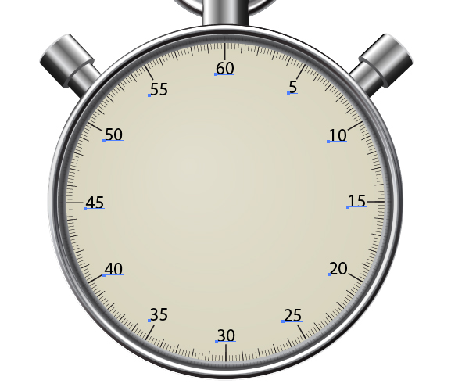
OPUS processes every 30s
20s decimates to 60s

Slide 22
OPUS Rapid Static (OPUS-RS)
  15 min to 2 hours
  Computes atmospheric delay at up to 9 NCN CORS within 250km
  Interpolates that delay to your position
  Reports corrected position with standard deviation stats
5001
CORS
OPUS Solution
Notes:
-OPUS Static takes the best 3 of 5 baselines, sequentially processed, and provides you their peak-to-peak average
sidenote
-we delivered over 1.2 million solutions in 2021, compared to in 2011 when we first broke the 200,000 solutions milestone

Slide 23

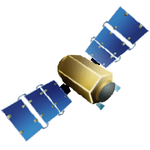

OPUS Rapid Static (OPUS-RS)
15 min to 2 hours
1st creates an atmospheric delay model
2nd position calculated via a DGPS static solution
Notes:
OPUS-RS or Rapid Static performs two calculations.
1st - creates an atmospheric delay model from surrounding CORS data (white circle)
2nd - Your position is determined via a differential GPS static solution

Slide 24
OPUS Static (OPUS-S)
  2 to 48 hours
  Best 3 of 5 baselines
  Sequentially processed
  Reports your peak-to-peak (P2P) average position
5001
5002
CORS
OPUS Solution
Notes:
-OPUS Static takes the best 3 of 5 baselines, sequentially processed, and provides you their peak-to-peak average
-we delivered over 1.2 million solutions in 2021, compared to in 2011 when we first broke the 200,000 solutions milestone
-sidenote that we’ve already broken the 1.5 million mark for 2022

Slide 25

OPUS Static (OPUS-S)
  No correlation between your observed marks
  Low Relative Accuracy
  Even if … collected simultaneously
  … and submitted to OPUS simultaneously
  OPUS-S = independent solutions
5001
5002
CORS
OPUS Solution

Slide 26
OPUS Projects (OP)
  Simultaneous processing of your observed marks
  Improved Relative Accuracy
  Requires more field prep and office processing effort
  OP = true network solutions
  And of course, least squares adjustment
Distant CORS
~400-800 km
5001
5002
5003
5004
CORS
OPUS Solution

Slide 27
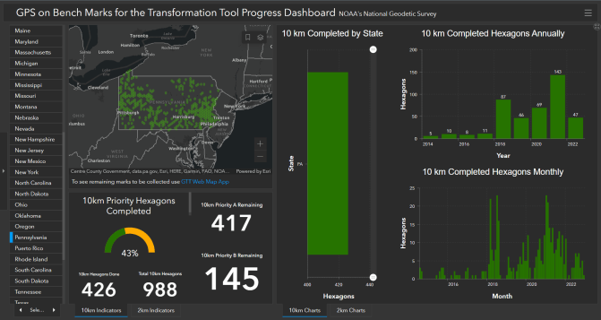
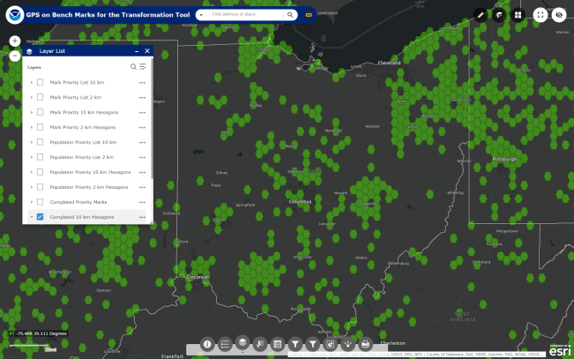

What’s the deal with GPSonBM?
GPS on Bench Marks
Web Map Application
Deadline = 29 February 2024
OPUS Shared Solutions
  2 OPUS-Static, ≥4 hours each
  2 photos of each setup
  Brief Description w/Ties
Progress Dashboard
The struggle is real.
“too much field time”
“we don’t do static”
“poor site, if only we had multi-GNSS”
Notes:
Note here that the Dashboard map is separate from the Web Map Application.
CLICK They are linked, but different tools.
If you got mixed up about this at some point, no worries, you were not the only one.
If we have had this process to submit GPSonBM for years now… why are we now putting out this option for OPUS Projects via GVX?
CLICK

Slide 28


Slide 29
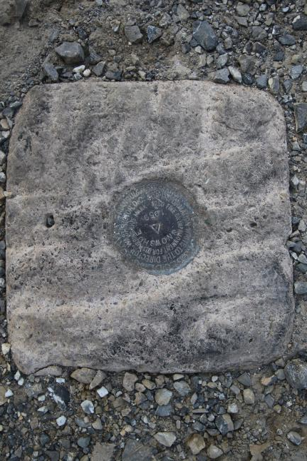
Passive Control
Geodetic Control – Terminology
All marks are passive—they sit there and hold a point
Notes:
All marks are passive!—in that they sit there doing nothing in and of themselves besides holding a point
This includes the fixed antenna mount that is a part of a CORS.
But, some marks have permanently installed equipment that enable nearly continuous observations and these are called “active” stations.

Slide 30
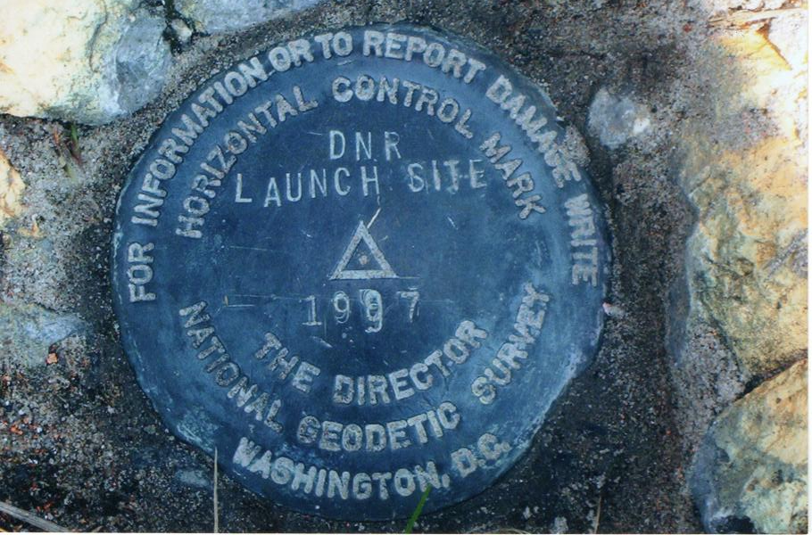
Passive Control

Slide 31
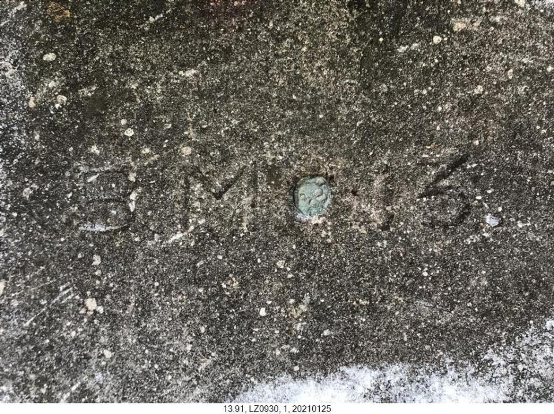
Terminology - Passive Control
Notes:
LZ0930
Lycoming County → PRR copper plug in bridge abutment
--that’s a photo from PennDOT, not sure what District Lycoming County is

Slide 32
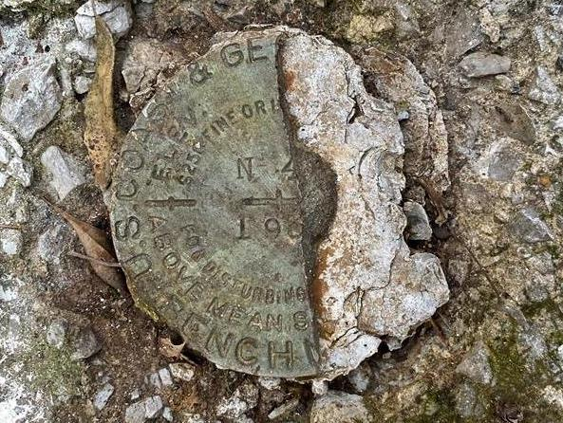
Terminology - Passive Control
Notes:
KW0392 –
https://www.ngs.noaa.gov/cgi-bin/ds_mark.prl?PidBox=KW0392
COLUMBIA COUNTY, PA, NEAR READING COMPANY REAILROAD STATION

Slide 33

Notes:
KR1724 - https://www.ngs.noaa.gov/cgi-bin/ds_mark.prl?PidBox=kr1724
Set 1946 → Washoe County, NV, about 4 miles southwest of Reno
Recovery 1958 → THE STATION MARK WILL BE PRESERVED BY MR. GARCIA, AND WILL BE IN THE CENTER OF HIS LIVING ROOM. - -> BUILT AS A BROKEN WAGON WHEEL WITH THE TRIANGULATION STATION THE HUB THERE-OF.
A STANDARD DISK STAMPED WHEELER 1946, 1958 IS BEING PROVIDED MR. GARCIA, TO PLACE IN THE FLOOR.

Slide 34
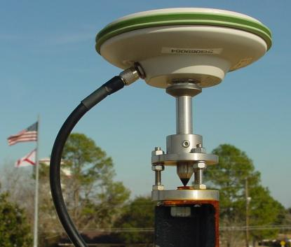
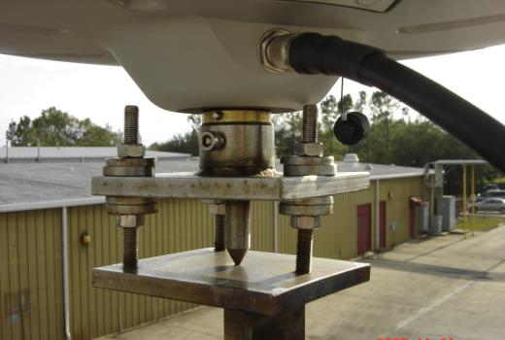
Active Control
Geodetic Control – Terminology
Some marks have permanently installed equipment that enables nearly continuous observations
(they still sit there and hold a point)
Notes:
All marks are passive!—in that they sit there doing nothing in and of themselves besides holding a point
This includes the fixed antenna mount that is a part of a CORS.
But, some marks have permanently installed equipment that enable nearly continuous observations and these are called “active” stations.

Slide 35
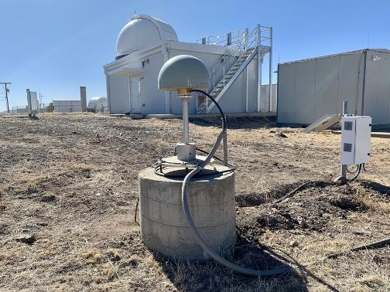
Active Control

Slide 36
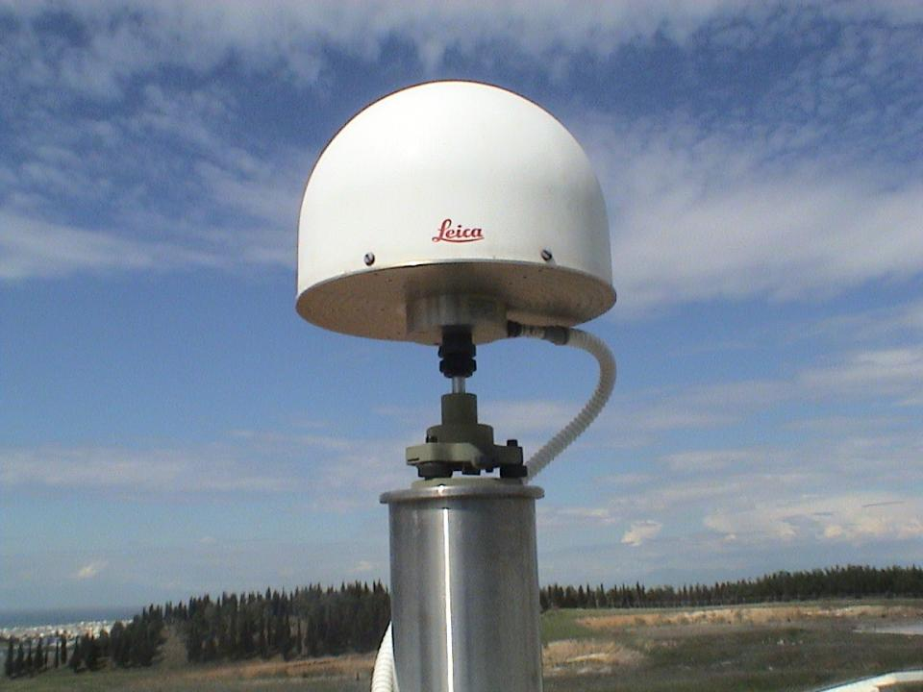
Active Control

Slide 37
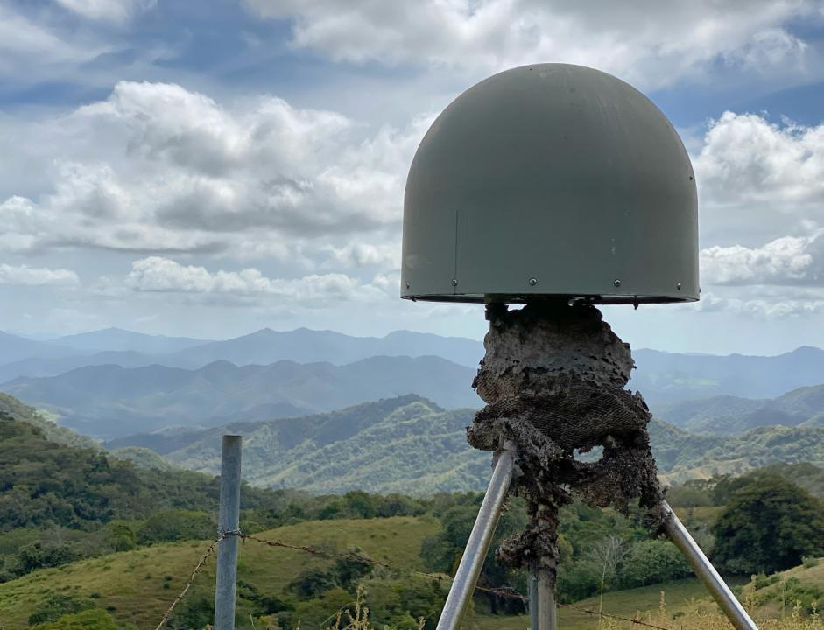
Active Control
Active Control

Slide 38
Active vs. Passive Control
Geodetic Control – Terminology
Passive – setting up your RTK Base on existing geodetic control (e.g. Datasheet) while collecting with RTK Rover
Active – setting up your RTK Base to log data while collecting with RTK Rover then processing Base data via OPUS; or collecting with RTN/NRTK Rover
My point: surveying is still surveying
Notes:
Often the term active geodetic control has been used to mean some equipment is continuously or at least frequently collecting observations at or near a point
Yet those observations are often used to compute coordinates (often time-dependent) at a point on a mark, which, by its nature is passive

Slide 39
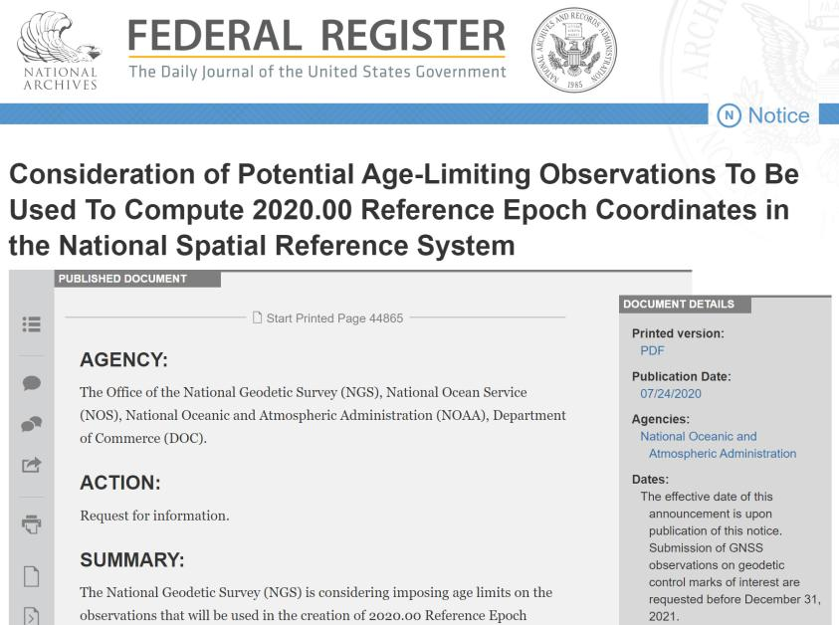
Why OPUS Projects?
Reference Epoch Coordinates (RECs)
  You’ll get coordinates in NATRF2022 and NAPGD2022 on “day one”
  Only “recent” GPS data in the IDB will get RECs
    Federal Register Notice – July 2020
GPS on Benchmarks (GPSonBM)
  3 occupations @ 5 minutes each vs. 2 occupations @ 4 hours each
  Multi-constellation aka “GNSSonBM”

Slide 40
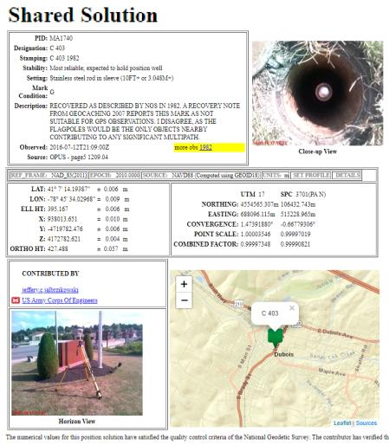
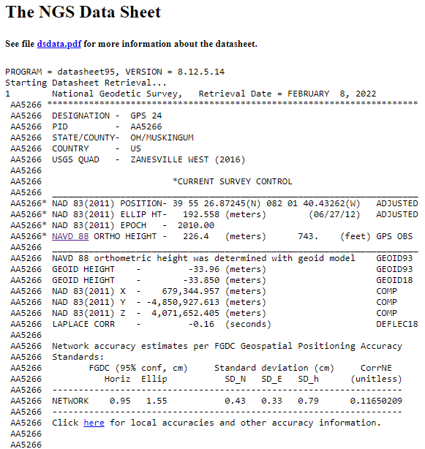
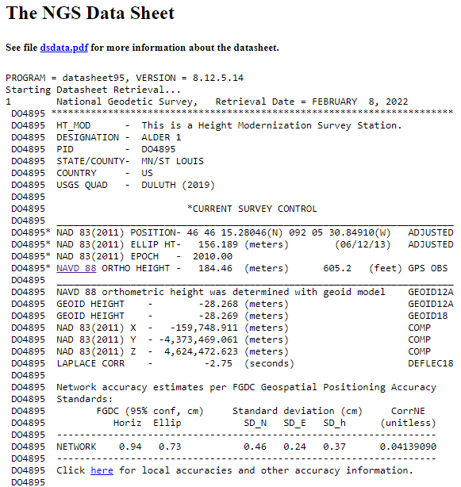
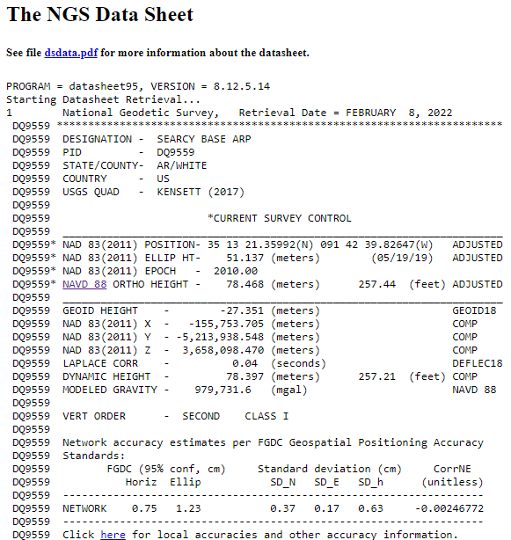
OPUS Shared vs. OPUS Projects
 | OPUS Shared | OPUS Projects (RINEX) | OPUS Projects (GVX)
Minimum Occupations | 4 hours At least 1, maybe 2* | 2 hours At least 2 | 5 minutes At least 3
Processing | OPUS-S (sequential) | PAGES (simultaneous) | Real Time (RTN/NRTK)
Adjustment | None | Least Squares Network | Least Squares Network
Metadata | 2 photos Brief Description | 3 photos, WinDesc files, Logs, & Report | 3 photos, WinDesc files, Logs, & Report
*Need 2 or more GPS datasets in our database, existing data holdings count toward that.

Slide 41
Yes, we are delayed.
  NSRS Modernization
Notes:
So remember, today’s presentation is not JUST about new datums, it is about modernizing the NSRS as a whole.
You don’t know what the NSRS is? Stay tuned, we’ll get there as we go along.

Slide 42
Delayed Release of the Modernized NSRS
How long will the delay be?
  Our website or newsletter is best source of projected timeframe, current estimate is middle of 2025.
Will the names stay the same?
  Yes, terms containing “2022” such as “NATRF2022” and “NAPGD2022” will remain the same.
Will all previously proposed products be released along with the new datums?
  No, they will not. Check out our June 2022 webinar.
hyperlink to the Track Our Progress homepage
June 2022 webinar
hyperlink to the full FAQ

Slide 43
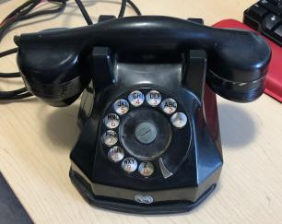
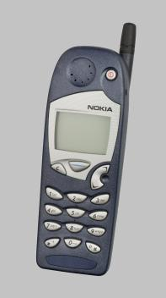
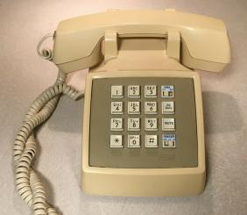
Evolution of the NSRS
NAD27
NAD83 (1986)
NAD83 (2011)
Notes:
NAD27
-like the dial of a rotary phone, you were out there spinning a theodolite around, running resections and solar shots to get a position… am I right?
-and you’d get a position, but it might not be that great, and if you set a mark then everybody wanted your data, like sharing the old party lines
NAD83(1986)
-we brought in a more accurate network, it was easier to access
-you were using an early total station and data collector, just like pushing the buttons on a touchtone phone
NAD83(2007/2011)
-the network was maturing with more CORS just like the cell towers
-just as cell phones were becoming ubiquitous, so too was the use of OPUS

Slide 44
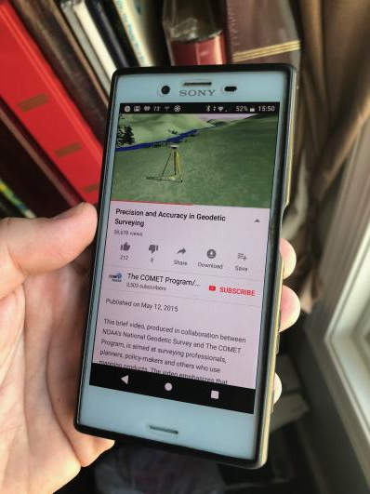
Modernized NSRS is our “smartphone”
You resisted it for a while…
It was a little cumbersome to get used to…
But soon you were hooked!
Notes:
-so if you think about the NSRS that way, then NATRF2022 is our smartphone, in more ways than one, right?
-some folks were excited to get a smartphone, but some (show of hands?) were reluctant to embrace the idea… kind of like this whole NSRS Modernization deal huh?
-some of us are excited for this development and some folks, well some are ready to retire as soon as NGS rolls this out, am I right?

Slide 45
Modernizing the NSRS
Updating all NSRS coordinates
  Replace existing datums with new datums
  Replacing existing SPCS83 with new SPCS2022
  Accounting for coordinates changing with time
Improving NGS products and services
Simplifying customer contributions
Making the NSRS:
  More accurate
  More accessible
  More efficient
begins
Rollout in
2025

Slide 46
Positional Components of
the NSRS
Geometric
aka “Horizontal”
Latitude, Longitude, Ellipsoid Height
Geopotential
aka Orthometric Height
aka “Elevation”
NAD83
NAVD88
Notes:
-geometric component is latitude, longitude, and ellipsoid height
-geopotential component is combined with the geometric components to calculate an ortho height or capital H

Slide 47
NATRF2022
North American Terrestrial Reference Frame of 2022
will replace
NAD83
North American Datum of 1983
Technically, not just NATRF2022 but also its 3 sister TRFs…

Slide 48
Four TRFs for Modernized NSRS
North American Terrestrial Reference Frame of 2022
(NATRF2022)
Pacific Terrestrial Reference Frame of 2022
(PATRF2022)
Caribbean Terrestrial Reference Frame of 2022
(CATRF2022)
Mariana Terrestrial Reference Frame of 2022
(MATRF2022)

Slide 49
Terrestrial Reference Frame?
Existing, accepted terminology
  International TRF
  first realization of the ITRF was 1992
  NATRF2022 will be based on ITRF2020
“Horizontal Datum” - misnomer for NAD83
  Really is a Geometric Reference Frame
Notes:
-Where do you see an Epoch right now in NGS data?
CLICK
Datasheets! there you see the epoch of 2010.0
and of course OPUS Solution Reports!
note that in blue over there on the right you’ll see another epoch, in the ITRF, which I will explain later on

Slide 50
International Terrestrial Reference Frame
(ITRF)
Is native coordinate system for NCN.
Is what OPUS uses.
Is what most of world uses.
Is what NGA aligns WGS-84 to.
Notes:
So what is that acronym, ITRF?
-it is a global reference frame, the most widely adopted one, or the “gold standard” or the “Cadillac” or what-have-you
-ITRF is the internationally recognized standard
-who realizes the ITRF? well, NGS contributes to the realization but
CLICK
-The IERS is in responsible charge of defining, realizing and promoting the ITRF
-and the ITRF was formally adopted by the…yes, more acronyms
CLICK
IUGG some years ago

Slide 51
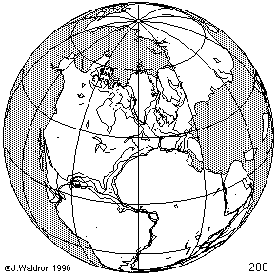
ITRF concept
Watch the grid!
Epoch:
Notes:
Ok, now ITRF mentioned a couple slides ago.
Most simplistic way to explain ITRF is to watch this animation.
This is a very loose representation/visualization of what the ITRF is, a characterization only.

Slide 52
Four TRFs for Modernized NSRS
North American Terrestrial Reference Frame of 2022
(NATRF2022)
Pacific Terrestrial Reference Frame of 2022
(PATRF2022)
Caribbean Terrestrial Reference Frame of 2022
(CATRF2022)
Mariana Terrestrial Reference Frame of 2022
(MATRF2022)

Slide 53
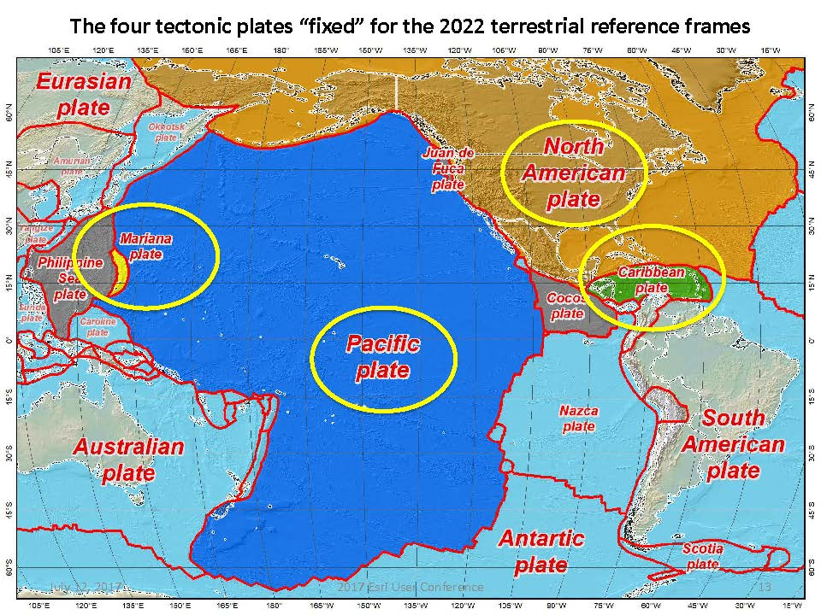
Plate Rotation visualized
Drift…
Notes:
-these are ground-level horizontal velocities
-the arrows illustrate the positions and velocities of CORS plotted in ITRF2014
-our scale is on the left there, with that arrow representing 20mm of motion per year
-so right thru Ohio it’s a little cluttered but we’re seeing arrows about that length so about 2cm/20mm per yr
-what do we notice about the direction of these arrows?
-they look rotational, don’t they?
CLICK HERE
-Note the arrows in California do not conform to the rotation… those are CORS on a different PLATE which is moving in a different direction
CLICK HERE
-so when you look at those arrows you can see the rotation, but the point of rotation is obviously off the map, way down below the screen right?
-that point is what’s known as an Euler Pole

Slide 54
Plate-Fixed NSRS TRFs
ITRF
Frame = constant
NA Plate = rotating
NATRF
Frame = rotating
(relative to ITRF)
NA Plate = constant
(relative to NATRF2022)
Notes:
We say “NATRF2022” is “fixed” to the N.A. Plate, making it a “plate fixed” frame
-the frame is constant to itself, but rotating within ITRF, and moving in a different direction than the other 3 frames

Slide 55
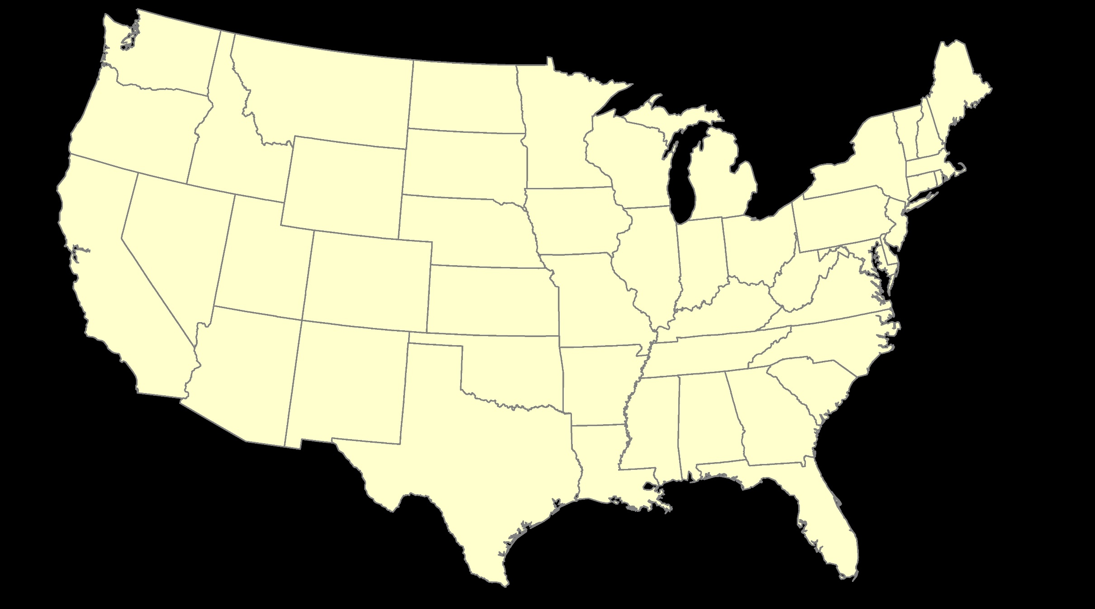
ITRF – constant frame, rotating plate

Slide 56
Plate-Fixed
NATRF – rotating frame, constant with plate

Slide 57
if you know epoch
ITRF or NATRF – your choice if you know epoch

Slide 58
Decades of continuously logged GPS data from the NOAA CORS Network (NCN).
  But how?

Slide 59
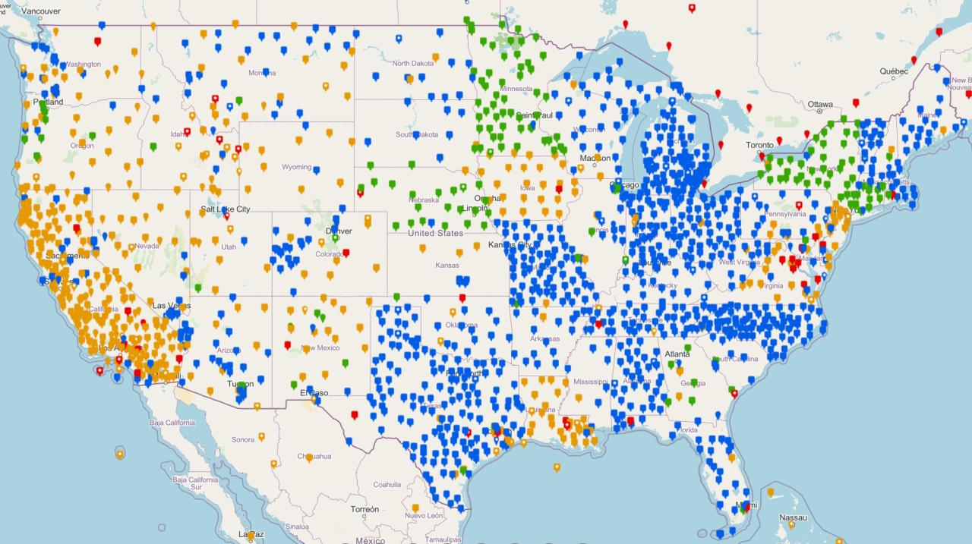
NOAA CORS Network (NCN)

Slide 60

Plate-Fixed
NATRF – rotating frame, constant with plate
= CORS

Slide 61
Plate-Fixed
ITRF or NATRF
= CORS
Notes:
ITRF is independent of any plates, tied to the layer below,
-”plate-agnostic” if we want to sound all silicon valley ish
-the plates go down about 200 km (125 mi) deep below our feet right now, as we’re on a continental plate
--(oceanic plates are roughly half the thickness, like 100 km)
-→ but thickness of the tectonic plates varies greatly, from down to 15 km up over the 200 km I mentioned earlier

Slide 62
Terminology – Time/4D
Epoch
eh-puck? ee-pock? … to-may-to, to-mah-to
an instant of time; a moment in time
astronomy & geodesy use a decimal date
  2021.4762 = 23 June 2021 @ 19:16:00
  using epochs is important, not your format
    start preparing to assign epochs to your data
Notes:
-Where do you see an Epoch right now in NGS data?
CLICK
Datasheets! there you see the epoch of 2010.0
and of course OPUS Solution Reports!
note that in blue over there on the right you’ll see another epoch, in the ITRF, which I will explain later on

Slide 63
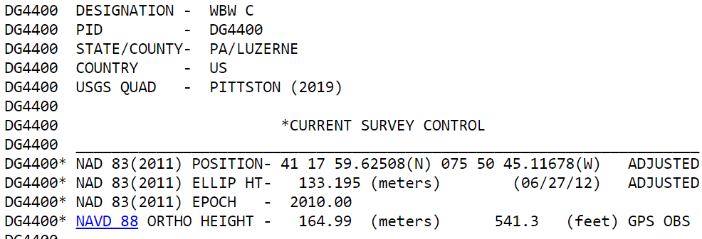
Notes:
-Where do you see an Epoch right now in NGS data?
Datasheets! there you see the epoch of 2010.0
and of course OPUS Solution Reports!
note that in blue over there on the right you’ll see another epoch, in the ITRF, which I will explain later on

Slide 64
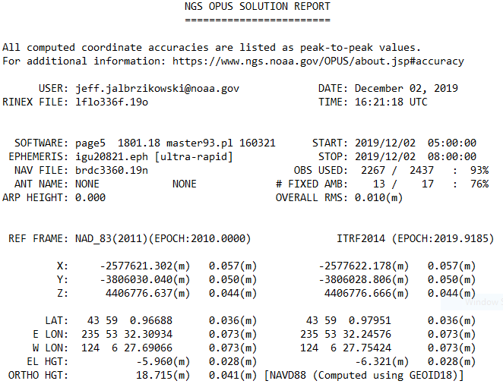
Reference Epoch
Survey Epoch
Notes:
-Where do you see an Epoch right now in NGS data?
and of course OPUS Solution Reports!
note that in blue over there on the right you’ll see another epoch, in the ITRF, which I will explain later on

Slide 65
What is a Reference Epoch?
If you use NAD83 you’re already using one, but perhaps unaware.
First let’s look at complete nomenclature…

Slide 66
Complete NAD83 Nomenclature
NAD83(2011) epoch 2010.00
Geometric
Datum
Realization
(aka Datum Tag)
Epoch
(in the case of NAD83, a Reference Epoch)
Other NAD83 Reference Epochs
NAD83(1986) epoch 1984.00
NAD83(HARN) epoch 1993.62
NAD83(CORS96) epoch 2002.00
NAD83(2007) epoch 2007.00
NAD83(2011) epoch 2010.00
ITRF2014 epoch 2019.9185
IGS08 epoch 2005.00
NATRF2022 epoch 2020.00
NAD83(1986) epoch 1984.00
NAD83(HARN) epoch 1993.62
NAD83(CORS96) epoch 2002.00
NAD83(2007) epoch 2007.00

Slide 67
Epoch
Reference Epoch
Survey Epoch
eh-puck? ee-pock? … to-may-to, to-mah-to
an instant of time, or a date selected as a point of reference
Notes:
-Some communities/countries will refer to the Survey Epoch as the Continuous Epoch or the Dynamic Epoch
*****for 2022, everywhere I use the term ITRF2014 may end up being ITRF2020*****
-we’re aligning to 2020.000 because the goal is to finalize the datum for 2022, and it takes time to process the data and run the calculations, hence aligned to the 2020.000 epoch

Slide 68
What is a Survey Epoch?
If you use OPUS you’re already using one, but perhaps unaware.

Slide 69
Complete ITRF Nomenclature
ITRF2014 (epoch 2021.0276)
Geometric
Datum
Epoch
(in the above example, a Survey Epoch)
ITRF Reference Epochs
NAD83(1986) epoch 1984.00
NAD83(HARN) epoch 1993.62
NAD83(CORS96) epoch 2002.00
NAD83(2007) epoch 2007.00
NAD83(2011) epoch 2010.00
ITRF2014 epoch 2019.9185
IGS08 epoch 2005.00
NATRF2022 epoch 2020.00
Examples of ITRF Survey Epoch
ITRF92 epoch 1988.0
ITRF2000 epoch 1997.0
ITRF2005 epoch 2000.0
ITRF2008 epoch 2005.0
ITRF2014 epoch 2010.0
ITRF2008 epoch 2012.2011
IGS08 epoch 2006.7572
ITRF2014 epoch 2017.4457
ITRF2014 epoch 2019.9185
ITRF2014 epoch 2021.0276

Slide 70
Epochs in Current NSRS
Survey Epoch (SE)
Reference Epoch (RE)
Position at the moment of survey data collection
Seen on OPUS Solution
Necessary for ITRF
Ground movement will be illustrated
Position after propagated back in time from SE to RE
Seen on OPUS Solution
Used in NAD 83
Ground movement will be hidden

Slide 71
Epochs in Modernized NSRS
Survey Epoch (SE)
Reference Epoch (RE)
Position at the moment of survey data collection
Used in NATRF2022
SEC = SE Coordinate
Ground movement will be illustrated
Position after propagated back in time from SE to RE
Used in NATRF2022
REC = RE Coordinate
Ground movement will be hidden

Slide 72
4D alignment – Epochs
One epoch in which ITRF2020 will be equal to NATRF2022…
At 00:00 on January 01, 2020 any given coordinates in
ITRF2020 (epoch 2020.0) = NATRF2022 (epoch 2020.0)
Notes:
After that, they diverge and continue to do so, we’ll visualize that soon

Slide 73
Terminology - Changing Coordinates
Conversion
    change the type of coordinate
    NAD83(2011) latitude & longitude → NAD83(2011) SPCS
  Transformation
    change the datum of coordinate
    NGVD29 height → NAVD88 height
    NAD 27 latitude & longitude → NAD 83(2011) latitude & longitude
Propagation
    change the epoch of coordinate
    NATRF2022 epoch 2020.00 to NATRF2022 epoch 2023.243
Notes:
Historically NGS has been inconsistent with these top two words.
Going forward, we will use them as:
Conversion: Meaning to change the type of coordinate without changing the datum or frame
Transformation: Meaning to change the datum or frame, without changing the type of coordinate

Slide 74
NCAT
  How will you do that?
NGS Coordinate Conversion And Transformation Tool (NCAT)
Epochs/Time/4D
Notes:
-so you’ve probably seen that phrase that I have front and center here, NSRS Modernization
-that’s the blanket term we use to refer to not just the new datums but other updates

Slide 75
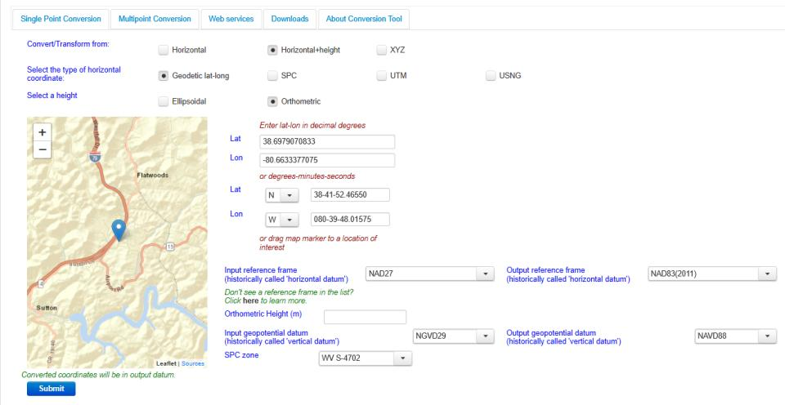
NGS Coordinate Conversion And Transformation Tool (NCAT)
Notes:
NCAT includes the functionality of previous NGS tools:
NADCON 5.0
XYZWIN 2.0
UTMS 2.1
SPC83 2.1
USNG 2.3
Includes error estimate of transformation per point.
Available as the single-point graphic seen here, multi-point upload/download, as a downloadable executable fie to run from the DOS prompt, and as web services for inclusion in your own
It’s a great tool. Anyone using

Slide 76
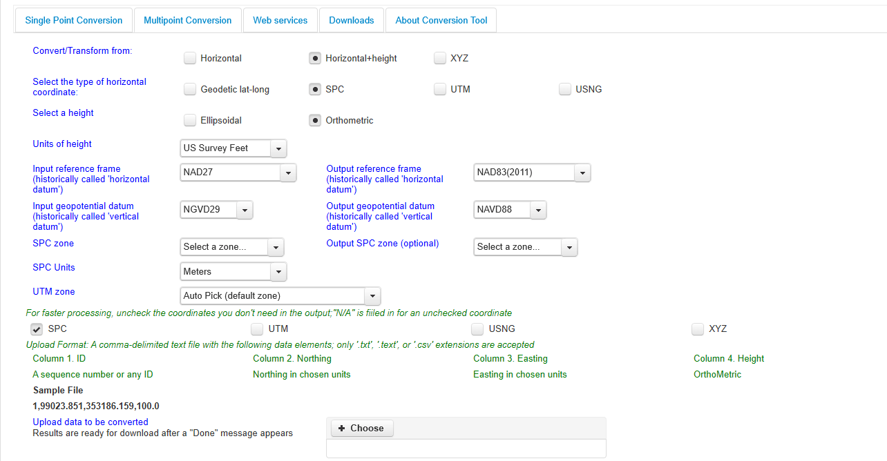
NGS Coordinate Conversion And Transformation Tool (NCAT)
Notes:
NCAT includes the functionality of previous NGS tools:
NADCON 5.0
XYZWIN 2.0
UTMS 2.1
SPC83 2.1
USNG 2.3
Includes error estimate of transformation per point.
Available as the single-point graphic seen here, multi-point upload/download, as a downloadable executable fie to run from the DOS prompt, and as web services for inclusion in your own
It’s a great tool. Anyone using

Slide 77
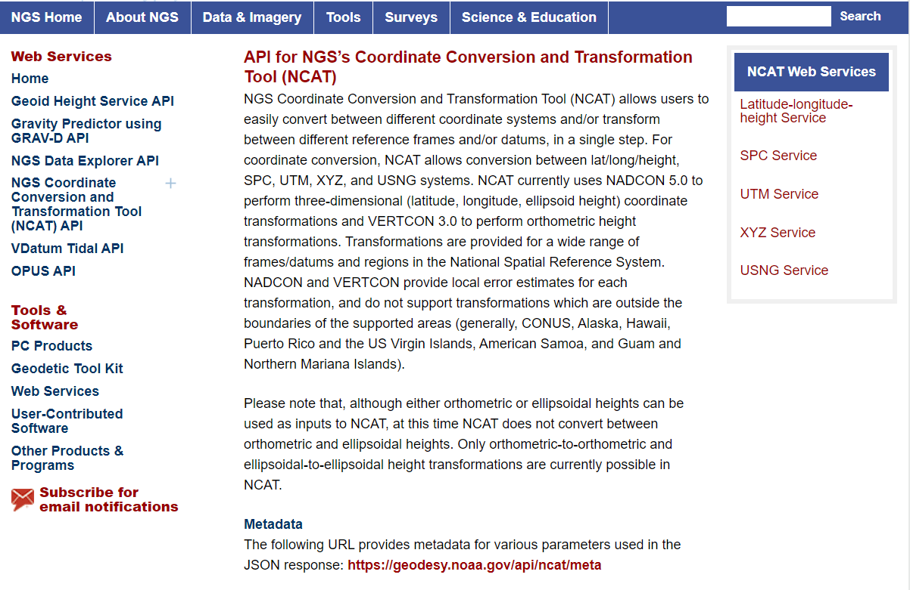
NCAT is available via web services

Slide 78
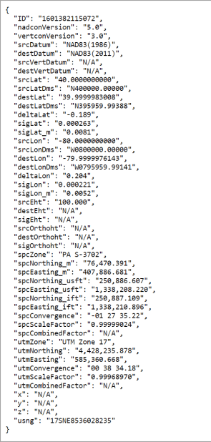
NCAT is available via web services
Note that each operation is a separate service
Struggling?
Contact us.
We can help!

Slide 79
NGS Coordinate Conversion And Transformation Tool (NCAT)
Notes:
NCAT includes the functionality of previous NGS tools:
NADCON 5.0
XYZWIN 2.0
UTMS 2.1
SPC83 2.1
USNG 2.3
Includes error estimate of transformation per point.
Available as the single-point graphic seen here, multi-point upload/download, as a downloadable executable fie to run from the DOS prompt, and as web services for inclusion in your own
It’s a great tool. Anyone using

Slide 80
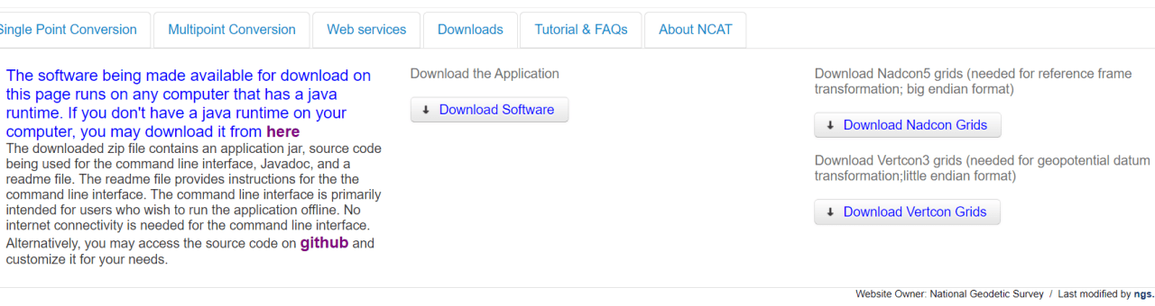
NGS Coordinate Conversion And Transformation Tool (NCAT)
Notes:
NCAT includes the functionality of previous NGS tools:
NADCON 5.0
XYZWIN 2.0
UTMS 2.1
SPC83 2.1
USNG 2.3
Includes error estimate of transformation per point.
Available as the single-point graphic seen here, multi-point upload/download, as a downloadable executable fie to run from the DOS prompt, and as web services for inclusion in your own
It’s a great tool. Anyone using

Slide 81
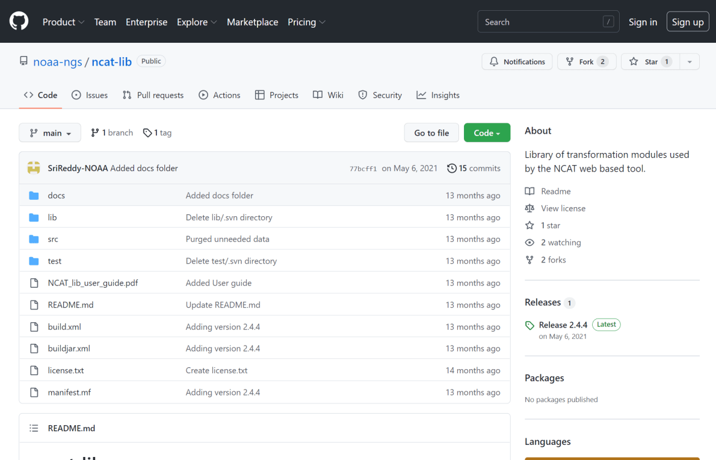
NCAT source code is on GitHub

Slide 82
What’s the difference?
NCAT
VDatum
NSRS Datums
  NAD 27
  NAD 83
  NGVD 29
  NAVD 88
  PRVD 02
  ASVD 02
  NMVD 03
  GUVD 04
  VIVD 09
NSRS Datums
Geoid Models
  Add/Subtract from Ellipsoid
Tidal Datums
  MHW, MLLW, MTL
Great Lakes Datum
  IGLD85
ITRF#### ≈ WGS84
Local Tidal (LT)

Slide 83
New Types of Coordinates for Modernized NSRS

Slide 84
Type | Generally on… | Description
Reported Coordinates | Passive | Mapping accuracy: smartphone, handheld, etc.
OPUS Coordinates | Passive | Computed by you with OPUS using your data. Unchecked by NGS.
Survey Epoch Coordinates (SECs) | Passive | Most accurate. Time-dependent. Computed by NGS every four weeks.
Reference Epoch Coordinates (RECs) | Passive and Active | Modeled from SECs, ACs, IFVM2022 and GeMS. Computed by NGS every five years.
Active Coordinates (ACs) | Active | Continuous time-dependent CORS coordinates. Checked by NGS every day.
Notes:
-is this necessary or does Dr. Dru just like to name things??
-it is necessary to accomplish what the community said they wanted during the early time period of public presentations on the new datums

Slide 85
New Types of Coordinates
Reported Coordinates
  These are from any source where the coordinate is directly reported to NGS without the data necessary for NGS to replicate the coordinate.
    Scaled from a map
    Transformed using NCAT or VDatum
    Smartphone
    Reported directly from an RTK rover without data files
Notes:
Reported Coordinates
“These are from any source where the coordinate is directly reported to NGS without the data necessary for NGS to replicate the coordinate.”
They could be scaled from a map
Or, they might be transformed using NCAT or VDatum
Or, shown on a smartphone’s GPS
Or, perhaps reported directly from an RTK rover without data files.

Slide 86
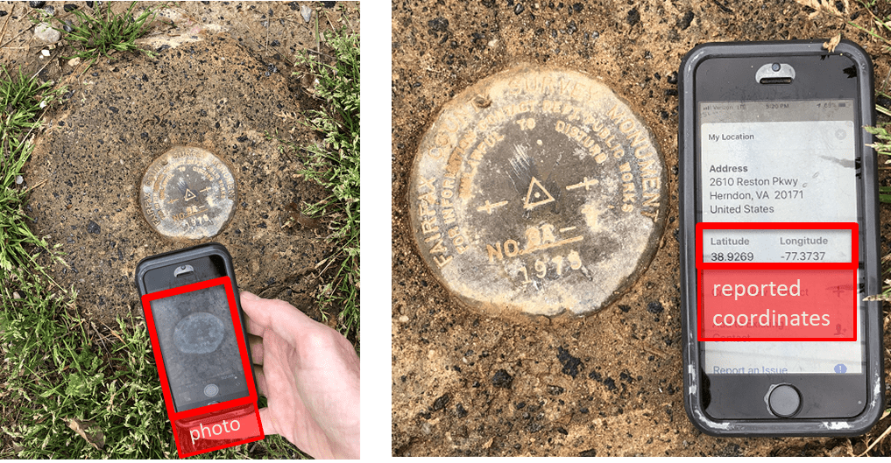
Reported Coordinates
Notes:
Reported Coordinates could be captured with a smartphone, perhaps with a photo, as part of a mark recovery.

Slide 87
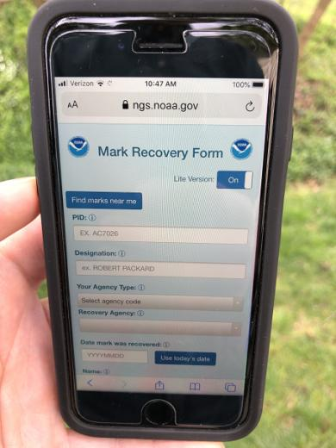
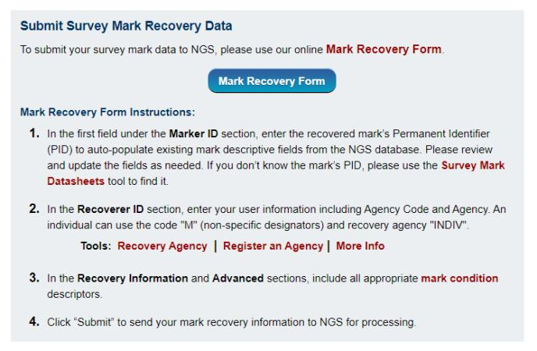
Sidenote: we can sort of do this now…
Our mobile-friendly mark recovery page. Browser based, not an app, nothing to download.
https://www.ngs.noaa.gov/cgi-bin/mark_recovery_form.prl
Notes:
And … NGS has a new mobile-friendly mark recovery webpage.
Please try it out!

Slide 88
Reported Coordinates = Buyer Beware!
Reported coordinates might be very wrong!
  Reported using incorrect datum NAD 27, NAD 83, WGS84
    Systematic Error: 2–100 meters
  Scaled off of a USGS topographic map
    Random Error: ± 600 meters
  Smartphone
    Random Error: ± 10–50 meters
NGS will show you reported coordinates
  But their function is to get you “in the neighborhood” of a mark
  Not for use as control!
Notes:
Reported coordinates might be very wrong!
If they are reported using an incorrect datum NAD 27, NAD 83, WGS84
There could be Systematic Error: 2–100 meters
If they are scaled off of a USGS topographic map
Random Error: ± 600 meters
If they come from a smartphone GPS
Random Error: ± 10–50 meters
NGS data delivery system will show you reported coordinates
But their function is to get you “in the neighborhood” of a mark, not to use as geodetic control!

Slide 89
New Types of Coordinates
OPUS Coordinates
  Computed by the user via OPUS.
    Will not be evaluated by anyone at NGS (just like OPUS now)
    These are user-computed values, such as they might get today from either OPUS Static or OPUS Projects
    OPUS Coordinates are the only coordinates a user will get directly from OPUS
Notes:
OPUS Coordinates are preliminary coordinates.
“These are coordinates the user wishes to use that have been computed by that user in OPUS.
These coordinates have not been evaluated by anyone at NGS.
These are user-computed values, such as they might get today from either OPUS-Static or OPUS-Projects.
“OPUS Coordinates” are the only coordinates a user will get directly from OPUS.

Slide 90
New Types of Coordinates
OPUS Coordinates may come with the label: “tied to the NSRS”
But… only if you restrict computations to OPUS-recommended constraints.
Notes:
OPUS Coordinates may also come with the label:
“tied to the NSRS”
But, only if a user restricts their computations to OPUS-recommended constraints.

Slide 91
New Types of Coordinates
OPUS Coordinates may come with the label: “not tied to the NSRS”
Users who deviate from OPUS-recommended constraints can still perform computations and will get OPUS coordinates, but they will be labeled “not tied to the NSRS”.
Notes:
OPUS Coordinates may also come with the label:
“not tied to the NSRS”.
Users who deviate from OPUS-recommended constraints can still perform computations and will get OPUS coordinates, but they will be labeled
“not tied to the NSRS”.

Slide 92
New Types of Coordinates
However, in neither case will OPUS coordinates be considered “part of the NSRS”
  Restricted to NGS-computed coordinates:
  reference epoch coordinates (RECs)
  survey epoch coordinates (SECs)
  active coordinates (ACs)
Let’s get to the the next few slides for those…
Notes:
However in neither case will OPUS coordinates be considered to be
“part of the NSRS”.
That moniker is restricted to NGS-computed coordinates available from the NSRS database, such as:
survey epoch coordinates (SECs),
reference epoch coordinates (RECs) and
active coordinates (ACs).
Let’s talk about those in the next slides..

Slide 93
New Types of Coordinates
Reference epoch coordinates (RECs)
  Coordinates which have been estimated by NGS, from:
    time-dependent age-limited historic survey data
    CORS coordinate functions
    and an IFVM
  at an official NSRS reference epoch.
    NAD 83(2011) epoch 2010.00 (sort of) would’ve fallen under this category
Notes:
Reference Epoch Coordinates will be Time- and Age-limited:
NGS is considering limiting how far back we reach in order to compute RECs.
While horizontal motions are well known within many crustal motion models (like the IFVM2022 will be), the vertical motions are not.
And since NGS’s intent is to publish RECs only for trusted points, and only for as long as those points ARE trusted (in all 3 dimensions), a time-limit for how far back to reach is definitely one way to keep the coordinates trusted.

Slide 94
New Types of Coordinates
Reference epoch coordinates (RECs)
  These will be computed by NGS every 5 or 10 years
  On a schedule 2–3 years past the reference epoch
  2020.00 coordinates would be computed in calendar year 2022, etc
  RECs are discussed in detail in Blueprint Part 3
Notes:
NGS currently plans for RECs to be computed on a 5 year cycle.
On a schedule 2–3 years past the reference epoch
2020.00 coordinates would be computed in calendar year 2022, etc
The details of this plan are discussed in detail in Blueprint Part 3.

Slide 95
How can you ensure you’ll have RECs on passive control?
Re-observe and submit the data to NGS
  must be submitted by 29 February 2024
Options to submit your GNSS data:
  OPUS Share → 4+ hrs static data; 2 photos; mark ties
    rinse & repeat … as we need redundancy
  OPUS Projects → 2+ hrs data; photos; descriptions
    NGS priority of RTN/RTK integration released in 2020
  traditional “bluebook” submittal
Notes:
-OPUS Share requires 4+ hrs static data; 2 photos; and a brief description of reference ties (not a full IDB “from the post office”)
→ NOTE THAT OPUS SHARE OPTION REQUIRES 2 OBSERVATIONS
→ WHY? WE REQUIRE REDUNDANCY FOR ANY OBS THAT GO INTO OUR DATABASE
-OPUS Projects → 2+ hrs data; photos; full IDB style descriptions via WinDesc (*MUST USE WINDESC*)

Slide 96
New Types of Coordinates
Survey epoch coordinates (SECs)
  Computed by NGS using submitted data and metadata, checked and adjusted to distinct epochs through time.
    Represent the best estimates NGS has of the time-dependent coordinates at any mark
    Adjusting multiple surveys in timespans called “adjustment windows”, to a single epoch within that window.
      Initial plan: 4 weeks for GNSS; 1 year for leveling
Notes:
Survey Epoch Coordinates
“These are coordinates computed by NGS using submitted data and metadata, checked and adjusted and referenced to distinct epochs through time.”
These represent the best estimates NGS has of the time-dependent coordinates at any mark.
SEC’s will be computed by adjusting multiple surveys in timespans called “adjustment windows”, to a single epoch within that window.
NGS’s initial plan: 4 weeks for GNSS; 1 year for leveling

Slide 97
Pros and Cons
 | Reference epoch (RECs) | Survey epoch (SECs)
Pros | Familiarity Large point count | Shows, rather than hides, time dependency at marks Easy to compute in a post-GPS era Very accurate
Cons | Hard to compute Requires an IFVM Perpetuates old way of using geodetic control Hides time dependency of marks Inaccuracies build up based upon the large number of assumptions used | Lack of familiarity by users Will require significant effort to compute pre-GPS era absolute values
Notes:
Comparing reference epoch coordinates and survey epoch coordinates reveals their unique characteristics.
CLICK
PROS for reference epoch
Familiarity
Large point count (because NGS can include legacy observations)
CLICK
PROS for survey epoch
Shows, rather than hides, time dependency at marks
Easy to compute
Very accurate
CLICK
CONS for Reference Epoch
Hard to compute
Requires an IFVM
Perpetuates old way of using geodetic control
Hides time dependency of marks
Inaccuracies build up based upon the large number of assumptions used
CLICK
CONS for survey epoch
Lack of familiarity by users
Will require significant effort to compute pre-GPS era absolute values

Slide 98
More on SECs and RECs
At passive control
SECs: adjusted to a midpoint epoch near the survey
  (4 weeks for GNSS; 1 year for leveling; etc.)
RECs: adjusted to a ref. epoch (2020.00, etc.)
REC adjustments will include:
  Some age-limited span of data → the FRN we discussed
    If that age-limit were 10 years prior and 2 years post R.E.
      Then 2020.00 RECs come from data spanning 2010.00 to 2021.99999
    Exact age-limit won’t be known until we start experimenting in 2022 with the 2020.00 REC adjustments
Notes:
At passive control:
Survey Epoch Coordinates or SECs: are adjusted to a midpoint epoch near the survey
(4 weeks for GNSS; 1 year for leveling; etc)
Reference Epoch Coordinates or RECs: are adjusted to a ref. epoch (2020.00, etc.)
REC adjustments will include:
Some age-limited span of data
If that age-limit were 10 years prior and 2 years post R.E….
Then 2020.00 RECs come from data spanning 2010.00 to 2021.99999
Exact age-limit won’t be known until we start experimenting in 2022 with the 2020.00 REC adjustments

Slide 99
New Types of Coordinates
Active coordinates (ACs)
  Not discrete, but rather a function through time assigned to some point
    For CORS we will use the term coordinate function
      Will be generated by a “fit” to regularly computed coordinates on a TBD basis, perhaps daily, perhaps weekly
      These daily or weekly coordinates will not generally be used as geodetic control by themselves
Notes:
Active Coordinates
These are not discrete, but rather a function through time assigned to some point
At a CORS GRP*, they will be the coordinate function
* Recall that a GRP is the physical point to which coordinates refer at a station like a CORS
The “coordinate function” be generated by a “fit” to regularly computed coordinates on a TBD basis, perhaps daily, perhaps weekly
These daily or weekly coordinates will not generally be used as geodetic control by themselves

Slide 100
Five new types of coordinates for the future NSRS DB
  Reported: Good for finding a mark.
    Not to be used as geodetic control
  OPUS: Computed by you; as accurate or inaccurate as the choices you make
    Tied to the NSRS if you follow OPUS recommendations
  Reference Epoch: Epoch-specific coordinates
    at intervals … 2020, 2025, 2030, etc.
  Survey Epoch: Epoch-specific coordinates
    at time of survey
  Active: Continuous coordinate functions at a CORS
    CORS only, because they collect continuously
Notes:
So, in summary there will be five coordinate types:
Reported Coordinates: These are good for finding a point somewhere on Earth.
but not to be used as geodetic control
OPUS Coordinates: which will be computed by you, and will be as accurate or inaccurate as the choices you make
and “Tied to the NSRS” if you follow OPUS recommendations
Reference Epoch Coordinates : Epoch-specific coordinates -
at 2020, 2025, 2030, etc.
Survey Epoch Coordinates: Epoch-specific coordinates -
at time of survey
Active: Coordinates Continuous coordinate functions at a CORS

Slide 101
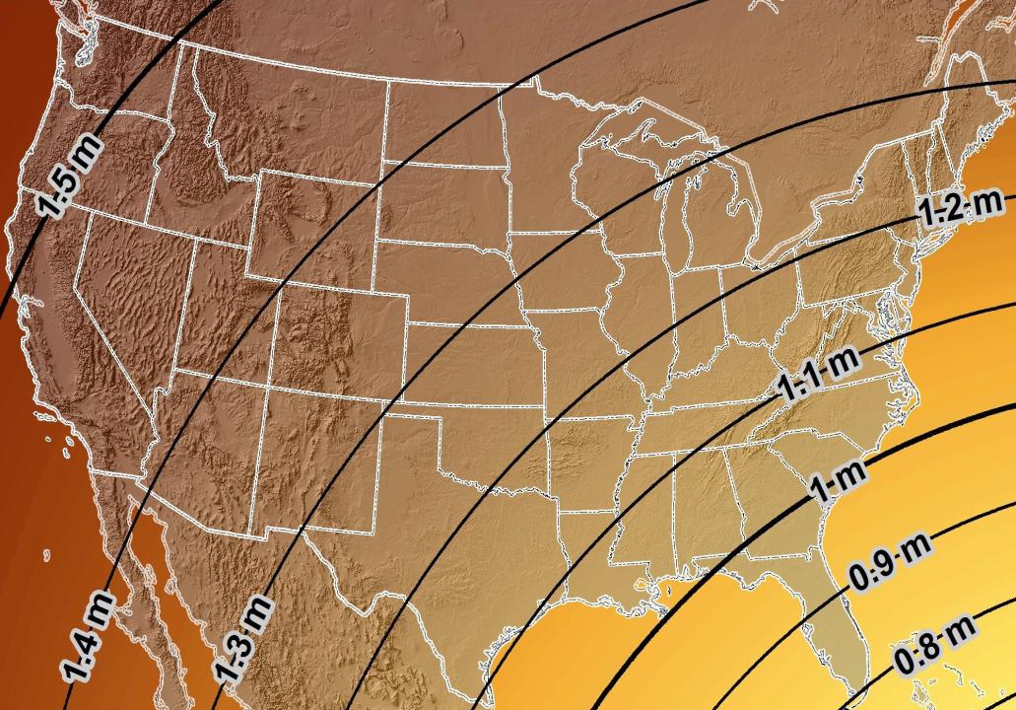
Estimated Geometric Change - Horizontal
NAD83 (2011) → NATRF2022
4.6 ft
Direction of Shift
4.3 ft
3.9 ft
3.6 ft
3.0 ft
Notes:
What’s the magnitude of the horizontal datum shift across Pennsylvania?
Minimum Shift ~3.75 feet
Maximum Shift ~3.97
Remember this is just an estimation, don’t hold me to the numbers please

Slide 102


Slide 103

New Lat/Long = New XY
With a new horizontal datum…
There comes a new set of SPCS zones

Slide 104
State Plane Coordinate System of 1983
SPCS83
North and South Zones as they exist now
Notes:
We start with the SPCS83 zones as a frame of reference
NOTE that the color shading of these zones is matched to that of the Preliminary SPCS2022 Zones that follow

Slide 105
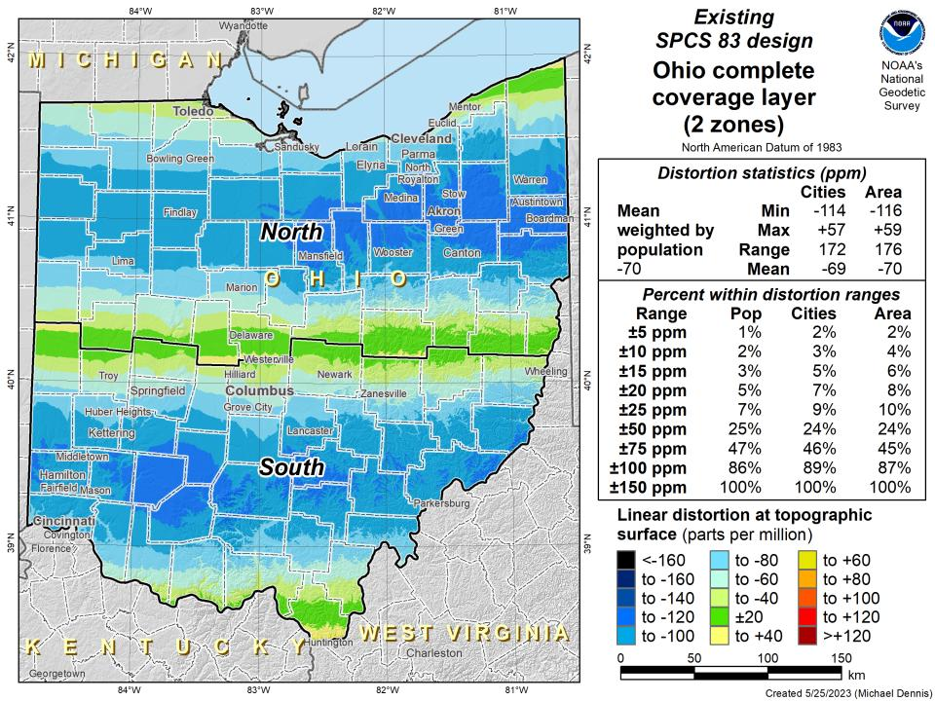

Slide 106
State Plane Coordinate System of 2022
SPCS2022
NGS designed a Single Statewide Zone for every State

Slide 107


Slide 108


Slide 109
State Plane Coordinate System of 2022
SPCS2022
Ohio stakeholders designed 88 zones
Notes:
The following section illustrates the preliminary SPCS2022 zones
There are 4 zones in the NGS design, per request that we design “4-5 zones required to meet the minimum distortion acceptable” set by our design criteria of 50ppm
NOTE the request also included wording: “It is also requested that PennDOT districts be divded into no more than two zones”

Slide 110


Slide 111


Slide 112

SPCS2022 Zone Layers in Ohio
Both Single Statewide and Multi-Zone Layers will coexist
Think about your data, your goals, your customers
  Remember that geographic coordinates are your friend!
Smaller zones not “the best” … it all depends on usage & goals

Slide 113
SPCS2022 Zone Layers and LDPs
Each state may have max of 3 zone “layers”
  One layer must be statewide zone
    Ohio Single Statewide
  Other layers have two or more zones
    Ohio County Coordinate System (designed by ODOT)
  A third layer can exist, but must be discontinuous coverage
    Left open for possibilities
      CRGS2022 anyone?
Notes:
(Cleveland Regional Geodetic Survey)

Slide 114
Which is best?
Each has strengths and each has weaknesses.

Slide 115

Do you really need to…?
Notes:
Reminder that you don’t have to cutoff data at any SPCS zone extent → just need to understand that they’re designed with certain extents in mind

Slide 116
State Plane Coordinate System of 2022
SPCS2022
Not just Ohio
Notes:
The following section illustrates the preliminary SPCS2022 zones
There are 4 zones in the NGS design, per request that we design “4-5 zones required to meet the minimum distortion acceptable” set by our design criteria of 50ppm
NOTE the request also included wording: “It is also requested that PennDOT districts be divded into no more than two zones”

Slide 117

Number of SPCS2022 zones (preliminary)
CONUS, Alaska, and Hawaii
Three island zones not shown:
Puerto Rico and U.S. Virgins Islands
American Samoa
Guam and the Commonwealth of the Northern Mariana Islands

Slide 118



SPCS2022 linear distortion (prelim)
846 zones (CONUS)
Percent within distortion (ppm):
Distor | Pop | Cities | Area
±20 | 76% | 71% | 58%
±50 | 92% | 89% | 76%
±100 | 98% | 97% | 89%
±400 | 100% | 100% | 99.9%
City and area statistics (ppm):
 | Min | -407 | -1438
 | Max | +486 | +2624
 | Range | 893 | 4062
 | Mean | -6 | -23
Mean weighted by pop = -4

Slide 119
The Survey Foot is dead!
Long live the Survey Foot!
US Survey Foot was deprecated 31 December 2022… now what?!?
Notes:
We start with the SPCS83 zones as a frame of reference
NOTE that the color shading of these zones is matched to that of the Preliminary SPCS2022 Zones that follow

Slide 120


What happened to the US Survey Foot?
Deprecated 31 December 2022
Which begs the question
  What should you be doing now?

Slide 121
What should you be doing now?
Ask the right questions
  Does state law specify US Foot for SPCS83?
    40 states do that we know of
  Does it specify US Foot for boundary surveys? (Does that matter?)
    We’re not tracking that, it’s not NSRS-related
Prepare for this along with new datums
  GeoBoard Geodetic Working Group
    Anyone always welcome to any meeting/discussion
    Update Monday evening is that it will likely be un-opposed

Slide 122
What should you be doing now?
Prepare for this along with new datums
Understand the difference between sft and ift
  2 parts per million
Understand this is not enforced
  Neither NIST or NGS are a regulatory agency
  We support education/outreach of course
  But OPUS, NCAT, etc. will not have US Survey Foot options for output in SPCS2022 zones

Slide 123
2 parts per million (ppm)?
1,000,000.00 sft = 999,998.00 ift
10,000,000.00 sft = 9,999,980.00 ift
1,000.00 sft = 999.998 ift (can you measure that?)
International → 1 ft = .3048 m
US → 1 ft = .30480061 m (approx.)

Slide 124


Slide 125
The Survey Foot is dead!
Long live the Survey Foot!
US Survey Foot was deprecated 31 December 2022…
But it will always be available in NGS tools for NAD83 and NAD27 coordinates

Slide 126
Preparing
Inventory heights in your data/datasets
  Have you mix & matched geoid models?
    Are you tracking levees or other flood control?
    Are you managing subsurface utilities?
      Access covers, junction boxes, cleanouts, etc.
    Maybe geoid differences aren’t even significant?
      VADOT story…
  Know your goals, know your data.

Slide 127

Preparing
Know the epoch of your data/datasets
  consider how you will track this
    full to-the-second timestamp on every feature?
      Modern survey equipment makes this possible
    labeling a year for each dataset?
      Easy to add to workflows, datasets/databases, folders
    something in-between that works for your needs?
2023.1957
2023:27
20230127
Epoch nomenclature is your choice

Slide 128
Preparing
Reprocessing your data
  perfect world = everyone reprocesses everything
    what does this mean?
      consider an ALTA w/topo
        start over with the onsite GNSS-based control
        reorient all your shots/ties (hopefully linked)
        recreate all the drainage features in new datum
    unrealistic! … and unnecessary for majority users
Notes:
Reprocessing your data
in a perfect world, everyone would reprocess data
consider a final product like you use everyday - a hydro-enforced DEM
starting fresh with the raw GNSS/IMU processing
generate new ellipsoid height point clouds
recreate all the drainage features in new datum
this is totally unrealistic → both from a financial and programmatic perspective

Slide 129
Preparing
  Transforming your data
    NCAT - NGS Coordinate Conversion and Transformation Tool
      ASCII up/download, Web Services, Download, GitHub
      ask your software provider(s) about integration
        we envision COTS integrations as most popular method of access
        Industry Workshops - May 2021 and August 2022
          Esri, Trimble, Blue Marble, etc… all the well known names attended
        Geospatial Software Developers’ Summit – Nov/Dec
          International & Virtual → US NGS and NRCan CGS
Notes:
Transforming your data
NCAT - NGS Coordinate Conversion and Transformation Tool
available now: ASCII upload and Web Services
ask your software providers about integration
we envision this as most popular method of access
Industry Workshop held this year – esri, trimble, bluemarble, all the major well known names were represented
labeling a year for each dataset?
something in-between that works for your needs

Slide 130
Preparing
What can you do to ensure your control will get coordinates in the new datums on rollout?
Re-observe and submit the data to NGS
  must be submitted by 30 September 2023
Options to submit your data:
  OPUS Share → 4+ hrs static data; 2 photos; mark ties
    rinse & repeat … as we need redundancy
  OPUS Projects → 2+ hrs static GPS data
  → 5+ minutes RTN-GNSS data, 3x per mark
  Also: photos, field logs, descriptions, survey report
Notes:
-OPUS Share requires 4+ hrs static data; 2 photos; and a brief description of reference ties (not a full IDB “from the post office”)
→ NOTE THAT OPUS SHARE OPTION REQUIRES 2 OBSERVATIONS
→ WHY? WE REQUIRE REDUNDANCY FOR ANY OBS THAT GO INTO OUR DATABASE
-OPUS Projects → 2+ hrs data; photos; full IDB style descriptions via WinDesc (*MUST USE WINDESC*)

Slide 131



Slide 132
Remember…
  What’s the goal of NATRF2022?
    Give you the stability in positions that you expect
  That’s the point of Reference Epochs (REs)
    Akin to the different realizations of NAD83
    REs will be published every 5 or 10 years
      you choose when you update
      in a perfect world, everyone would stay current
aka versions
Notes:
What’s the goal of the way NATRF2022 was designed, by including EPP2022 and IFVM2022
Does a database of manholes in PA need cm-level coordinate updates on an annual basis? Probably not.

Slide 133
Additional Resources

Slide 134

Regional Geodetic Advisor Program
geodesy.noaa.gov/ADVISORS/
14 RGAs across country
We are here to support:
  You
  Your constituents
  Our Federal Partners
Questions about
NSRS Modernization?
  Reach out now
  Be prepared
Notes:
-14 Regional Advisors, we’ve transitioned from a State-based to a Regional Program
-our advisors homepage up there at the top, also easy to find us by querying any major search engine for “ngs advisors”
-if you know Ross Mackay, he is our Chief Advisor, I report to him…
**ya know, I don’t know why they don’t make him put his photo up here
-we do have one vacant advisor position, that was recently advertised and John up there in Wisconsin is officially retired in oh… 18 days

Slide 135

Educational Videos
<5 minutes
Online Lesson
(via MetEd/COMET)
~1 hour
NGS homepage: geodesy.noaa.gov
Notes:
Educational videos and online tutorials –
Our library of lessons and videos are great resources, and will reinforce a lot of information we covered today.
The videos are just 3-5 minutes long.
the lesson is a deeper dive but still only takes an hour.

Slide 136


Email Subscriptions
*Only 1-2 messages per month*
NGS News
  Includes quarterly NSRS Modernization newsletter
Webinar Series
Training
GPS on Benchmarks
Click this icon on homepage

Slide 137
https://geodesy.noaa.gov/ADVISORS/
-use any major search engine: “NGS advisors”
Jeff Jalbrzikowski, P.S., GISP, CFS
Appalachian Regional Geodetic Advisor
jeff.jalbrzikowski@noaa.gov
240-988-5486

Slide 138

Scan to save my contact info on your phone

