Slide 1
SPCS2022 Making Earth Flat... One Zone at a Time!
URISA GIS-Pro
October 2023
Jeff Jalbrzikowski, P.S., GISP, CFS
Appalachian Regional Geodetic Advisor
jeff.jalbrzikowski@noaa.gov
240-988-5486

Slide 2
How surveyors and engineers see the Earth…

Slide 3
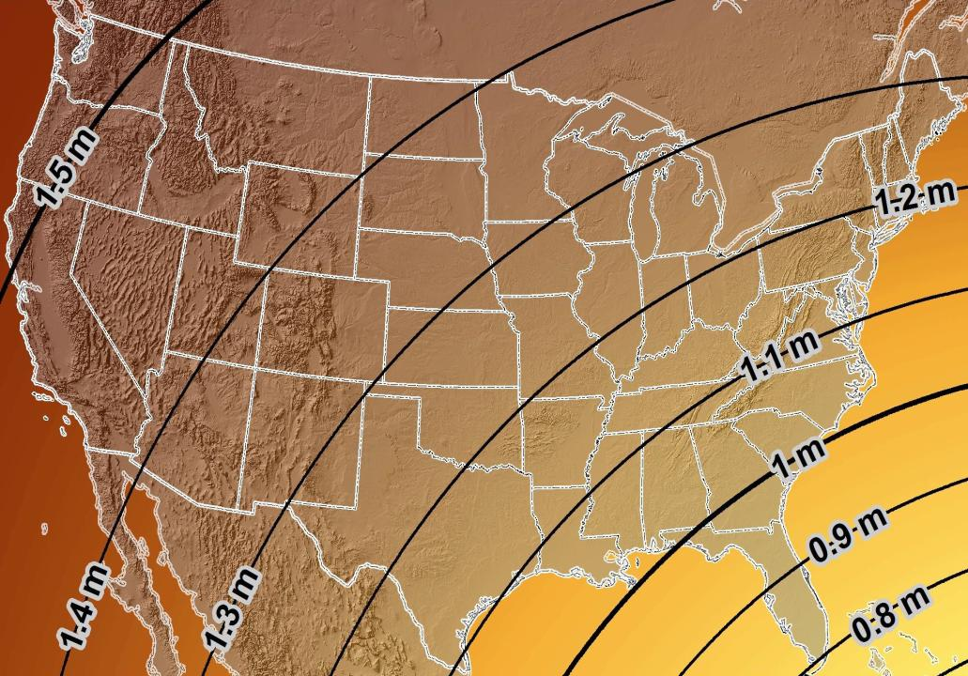
Estimated Geometric Change - Horizontal
NAD83 (2011) → NATRF2022
4.6 ft
Direction of Shift
4.3 ft
3.9 ft
3.6 ft
3.0 ft
Notes:
What’s the magnitude of the horizontal datum shift across Pennsylvania?
Minimum Shift ~3.75 feet
Maximum Shift ~3.97
Remember this is just an estimation, don’t hold me to the numbers please

Slide 4
New Lat/Long = New XY
With a new horizontal datum…
NAD 83 to be replaced by NATRF2022
There comes a new set of State Plane Coordinate System zones
SPCS 83 to be replaced by SPCS2022

Slide 5
I’ll be selling these bumper stickers on LinkedIn…
SPCS2022
MAKING EARTH FLAT AGAIN
…ONE ZONE AT A TIME
Really?
No… not really!

Slide 6
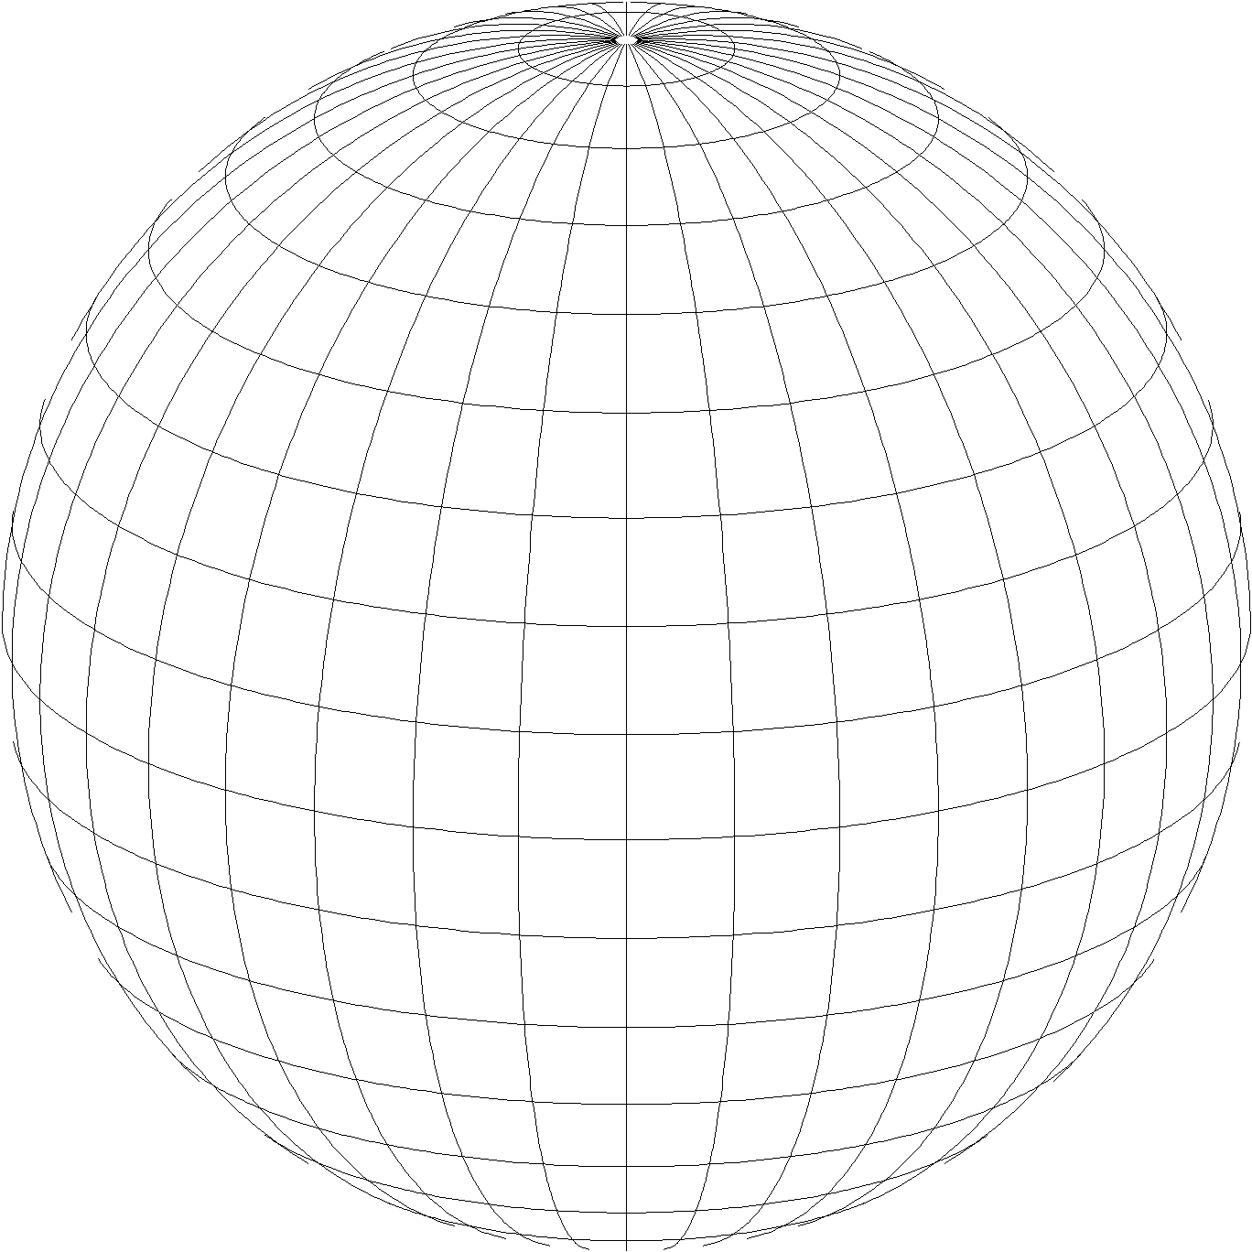
A “flat” Earth for the future
State Plane Coordinate System of 2022 (SPCS2022)
Similar to existing State Plane…
Same 3 map projection types
Same ellipsoid (GRS 80)
But different…
Based on new datums instead of NAD 83
Designed to reduce difference between “grid” and “ground”
Many more “zones”
Zones “layers” will exist in most states
Lambert Conformal Conic (LCC)
Transverse Mercator (TM)
Oblique Mercator (OM)

Slide 7
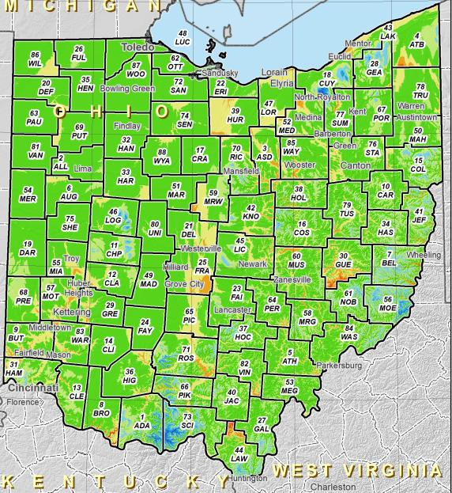
SPCS2022 Zone Layers in Ohio
Both Single Statewide and Multi-Zone Layers will coexist
Think about your data, your goals, your customers
Remember that geographic coordinates are your friend!
Smaller zones not “the best” … it all depends on usage & goals

Slide 8
Linear distortion with respect to ellipsoid surface
Projection axis (k₀ < 1)
Topographic surface
Horizontal ground distance
> ellipsoid distance and > grid distance
k₀ = scale on projection axis
LCC: central parallel
TM: central meridian
OM: skew axis
Ellipsoid distance
Grid distance > ellipsoid distance < ground distance (k > 1 and δ < 0)
Projection surface (secant)
Ellipsoid distance
Ellipsoid surface
This design approach used for SPCS 27 and 83 (minimizes distortion with respect to ellipsoid)
Grid distance < ellipsoid distance < ground distance (k < 1 and δ < 0)
8

Slide 9
Linear distortion with respect to topographic surface
Projection axis (k₀ > 1)
Horizontal ground distance
> ellipsoid distance and > grid distance
Topographic surface
Projection surface (non-intersecting)
h
Grid distance > ellipsoid distance ≈ ground distance (k > 1 and δ ≈ 0)
Ellipsoid distance
Ellipsoid surface
R
9

Slide 10
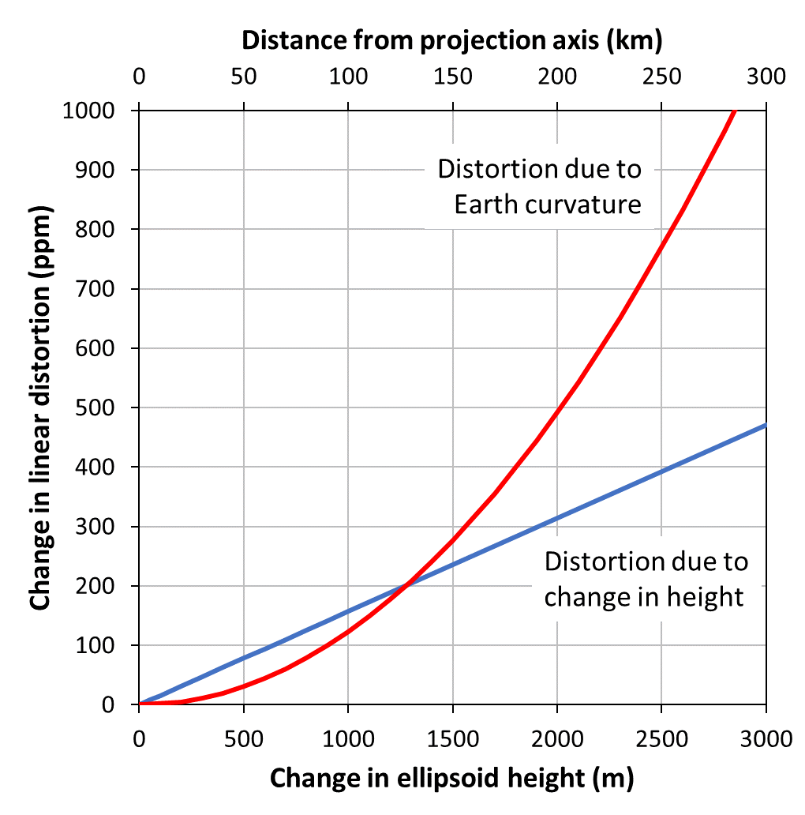
Minimizing linear distortion
Distortion function of both $k$ and $h$
$D$ = distance from projection axis (kilometers)
$∆h$ = change in ellipsoid height (meters)
Minimize both $k$ and $h$ simultaneously
$f\left(k\right)$ increases with square of distance
$f(h)$ increases linearly with change in height
Treating separately can lead to poor results
$$δ=f\left(k, h\right)=\left\{\begin{matrix} f\left(k\right)≈(0.0123 ppm)D^{2} \\ f\left(h\right)≈(0.157 ppm)∆h \end{matrix}\right.$$

Slide 11
“Non-intersecting” conformal map projection
Topographic surface
Grid distance = ground distance at a point
Projection axis
Grid distance = ground distance at a point
Non-intersecting
($k_{0}$ > 1)
Grid distance ≈ ground distance over finite distance
Ellipsoid surface
Purpose is to reduce linear distortion at “ground” (topographic surface).
But distortion can vary considerably across area of interest.
11

Slide 12
“Non-intersecting” conformal map projection
Topographic surface
Projection axis
Non-intersecting
($k_{0}$ > 1)
Ellipsoid surface
12

Slide 13
Changing projection axis to reduce distortion variation
Topographic surface
Grid distance = ground distance at many points
Projection axis
Ellipsoid height of surface not constant:
h₁ ≠ h₂
h₂
Non-intersecting
($k_{0}$ > 1)
h₁
Ellipsoid surface
This design approach used for SPCS2022 (minimizes distortion with respect to topography)
13

Slide 14
State Plane Coordinate System of 1983
SPCS83
North and South Zones as they exist now
Notes:
We start with the SPCS83 zones as a frame of reference
NOTE that the color shading of these zones is matched to that of the Preliminary SPCS2022 Zones that follow

Slide 15
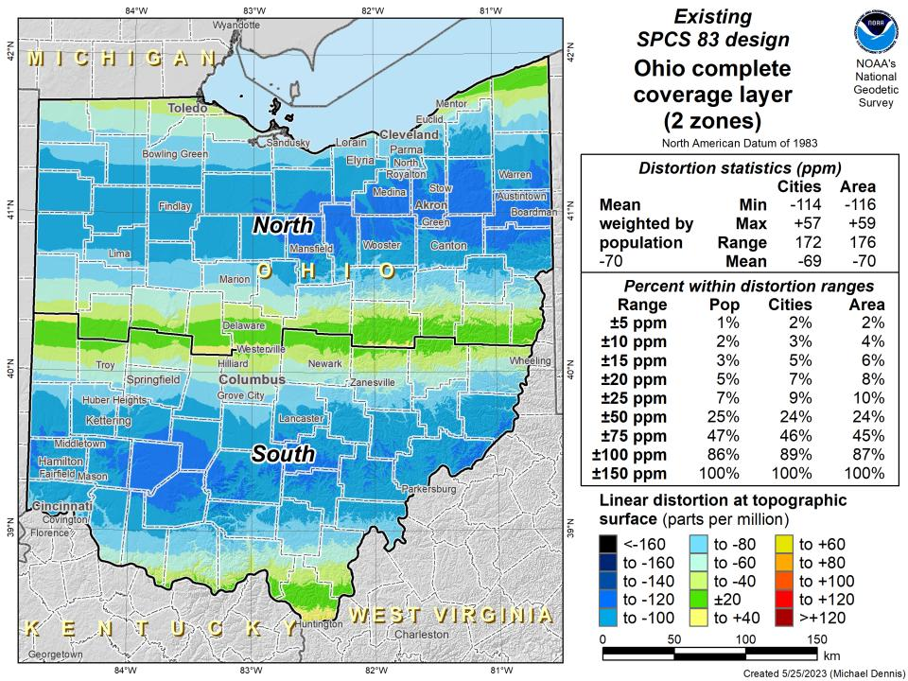

Slide 16
State Plane Coordinate System of 2022
SPCS2022
NGS designed a Single Statewide Zone for every State

Slide 18
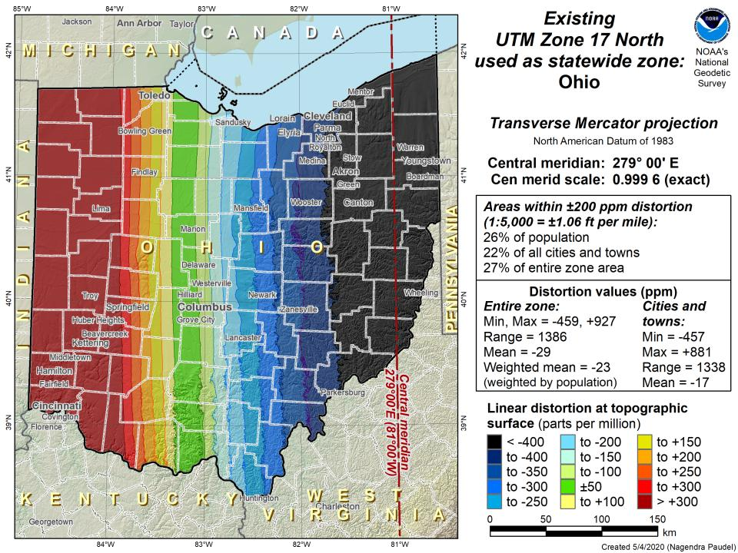

Slide 19
State Plane Coordinate System of 2022
SPCS2022
Ohio stakeholders designed 88 zones
Notes:
The following section illustrates the preliminary SPCS2022 zones
There are 4 zones in the NGS design, per request that we design “4-5 zones required to meet the minimum distortion acceptable” set by our design criteria of 50ppm
NOTE the request also included wording: “It is also requested that PennDOT districts be divded into no more than two zones”

Slide 20
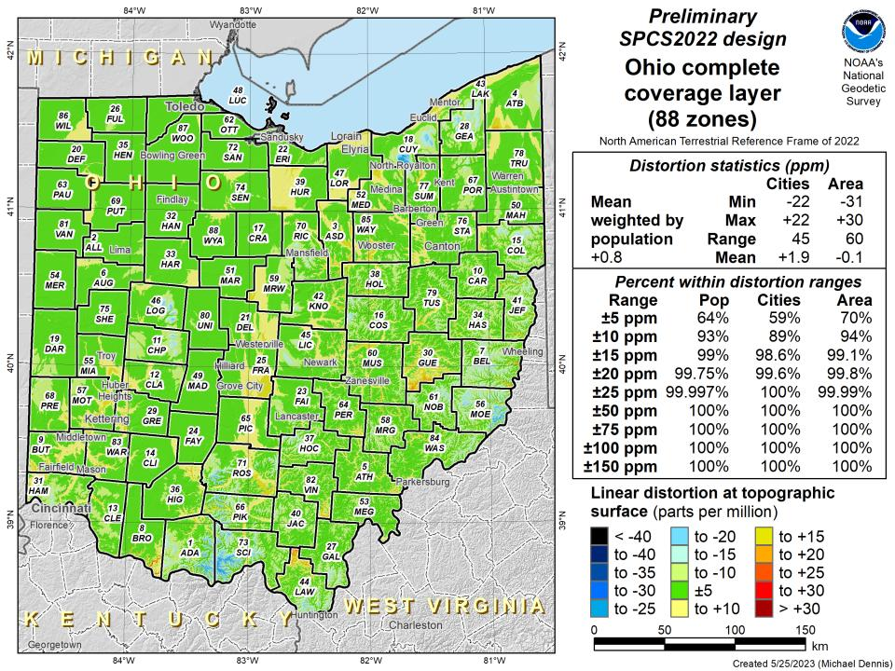

Slide 21
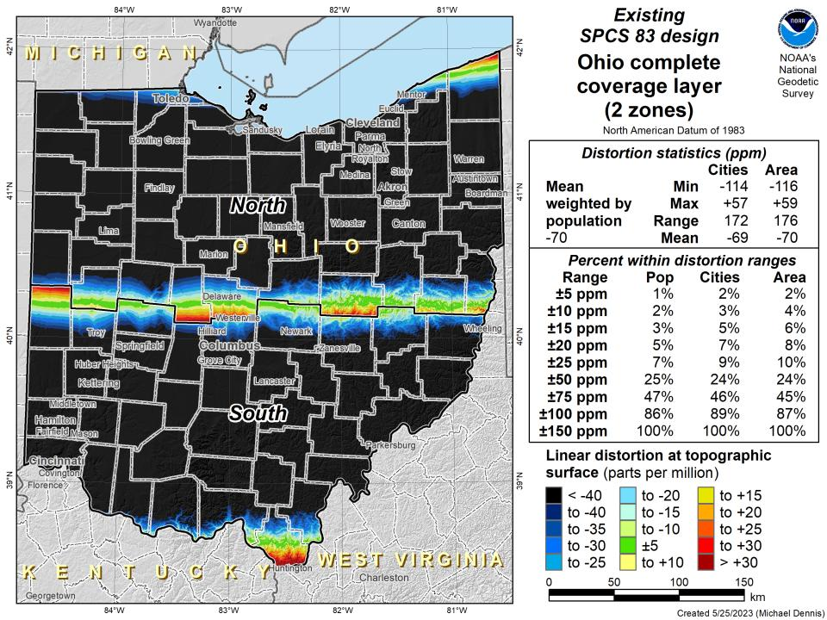

Slide 22
SPCS2022 Zone Layers and LDPs
Each state may have max of 3 zone “layers”
One layer must be statewide zone
Ohio Single Statewide
Other layers have two or more zones
Ohio County Coordinate System (designed by ODOT)
A third layer can exist… but must be discontinuous coverage
A few states with Low Distortion Projection (LDP) zones

Slide 23
Points to ponder…
What to do with the existing tiling scheme in NATRF2022?
Maintain same footprints, so uneven coordinates at corners?
New footprints, but cleaner coordinates? Both options?

Slide 24
State Plane Coordinate System of 2022
SPCS2022
Not just Ohio!
Notes:
The following section illustrates the preliminary SPCS2022 zones
There are 4 zones in the NGS design, per request that we design “4-5 zones required to meet the minimum distortion acceptable” set by our design criteria of 50ppm
NOTE the request also included wording: “It is also requested that PennDOT districts be divded into no more than two zones”

Slide 25
Status of zone layout and designs
Designs by NGS
159 zones (including 54 statewide)
Plus 3 “special use zones” (in more than one state)
Designs by state stakeholders
806 zones in 28 states
Most are “low-distortion projections” (LDPs)
Total = 968 zones for 56 states and territories
Number will likely decrease slightly
Compare to 125 zones in existing SPCS83!

Slide 26
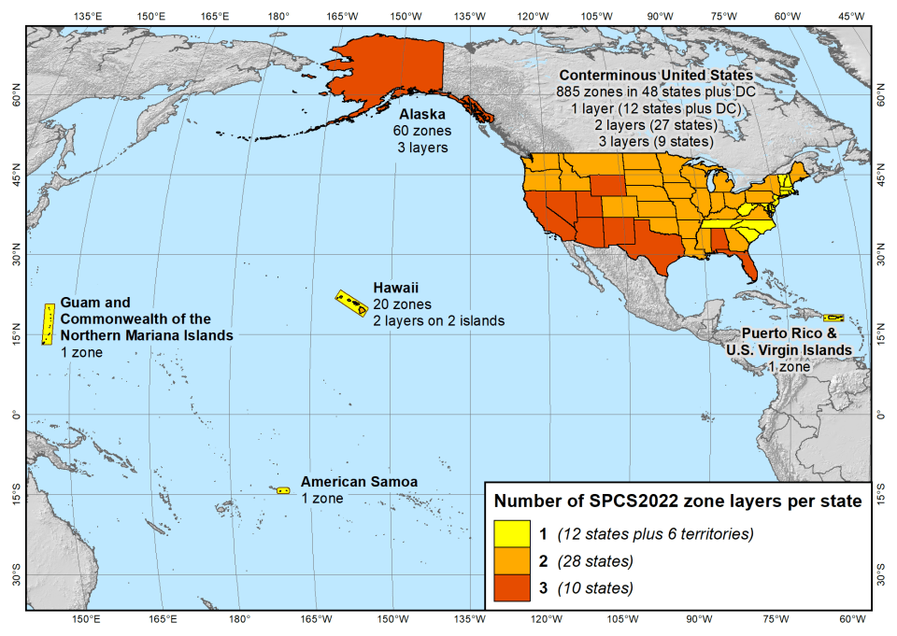
SPCS2022 zone layers
1 layer: 12 states plus 6 territories
2 layers: 28 states
3 layers: 10 states

Slide 27
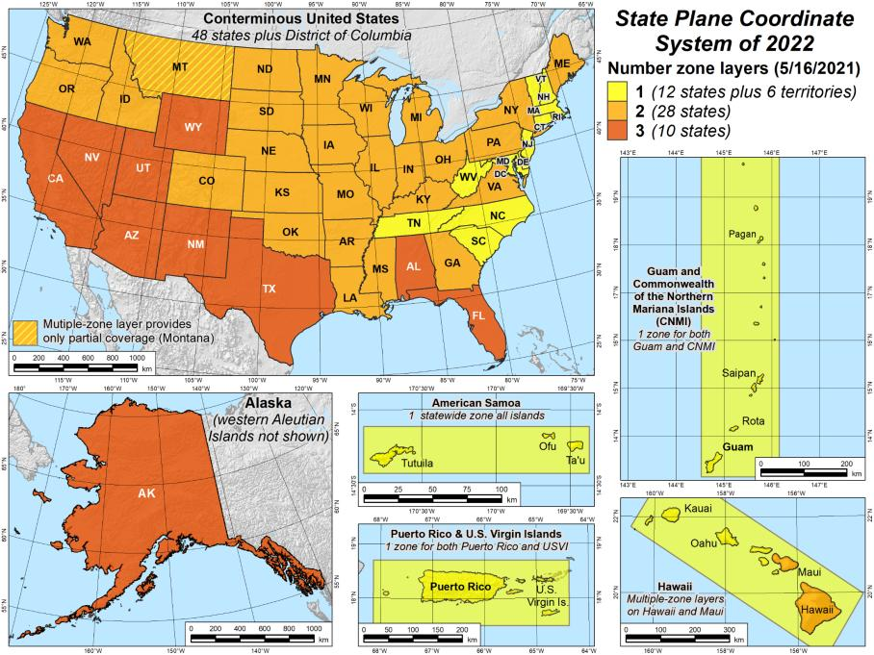
SPCS2022 zone layers
1 layer: 12 states plus 6 territories
2 layers: 28 states
3 layers: 10 states

Slide 28
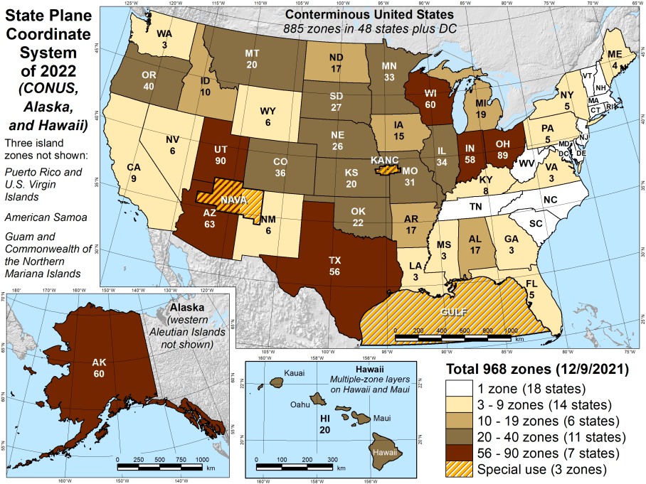
Number of SPCS2022 zones (preliminary)
CONUS, Alaska, and Hawaii
Three island zones not shown:
Puerto Rico and U.S. Virgins Islands
American Samoa
Guam and the Commonwealth of the Northern Mariana Islands

Slide 29
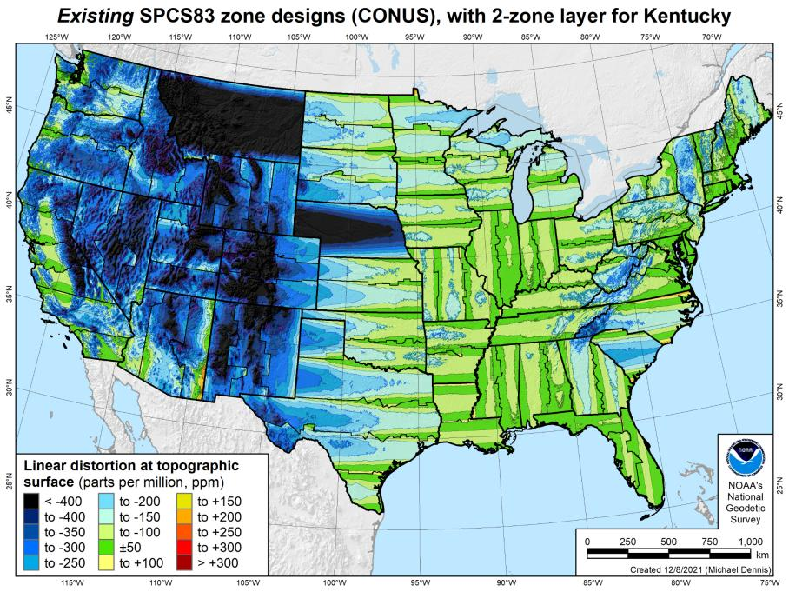
Existing SPCS 83 linear distortion
106 zones (CONUS)
Percent within distortion (ppm):
Distor | Pop | Cities | Area
±20 | 17% | 11% | 6%
±50 | 40% | 30% | 17%
±100 | 74% | 68% | 41%
±400 | 99% | 98% | 91%
City and area statistics (ppm):
 | Min | -913 | -1038
 | Max | +206 | +223
 | Range | 1120 | 1261
 | Mean | -98 | -178
Mean weighted by pop = -75
29

Slide 30
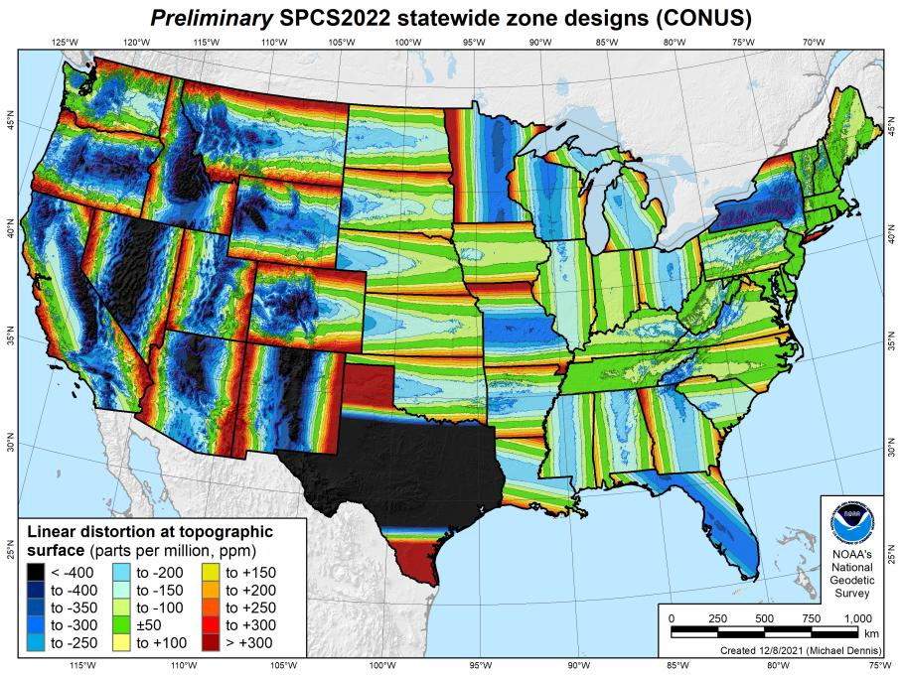
SPCS2022 linear distortion (prelim)
49 zones (CONUS)
Percent within distortion (ppm):
Distor | Pop | Cities | Area
±20 | 14% | 12% | 7%
±50 | 27% | 26% | 18%
±100 | 48% | 48% | 36%
±400 | 91% | 93% | 88%
City and area statistics (ppm):
 | Min | -1512 | -1627
 | Max | +2888 | +2987
 | Range | 4400 | 4614
 | Mean | -86 | -120
Mean weighted by pop = -100
30

Slide 31
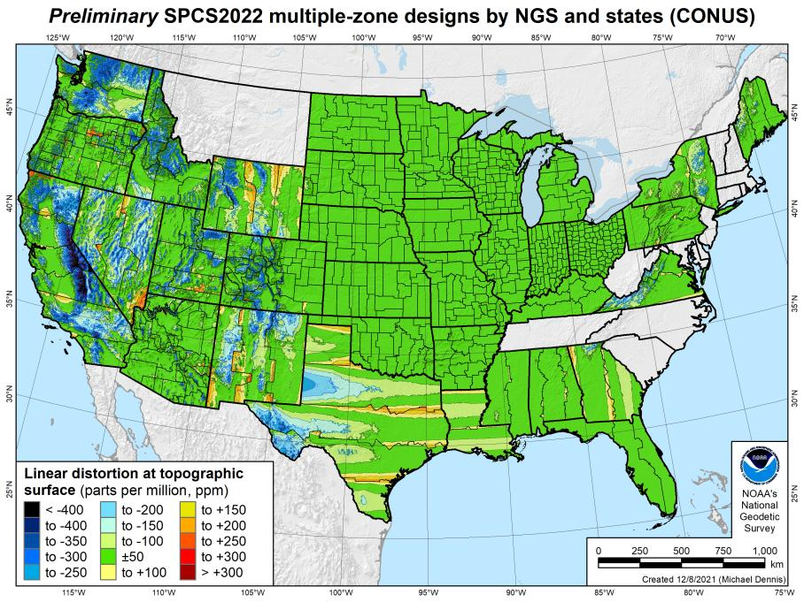
SPCS2022 linear distortion (prelim)
646 zones (35 states)
Percent within distortion (ppm):
Distor | Pop | Cities | Area
±20 | 76% | 70% | 54%
±50 | 92% | 88% | 73%
±100 | 98% | 97% | 89%
±400 | 100% | 100% | 99.9%
City and area statistics (ppm):
 | Min | -400 | -684
 | Max | +245 | +295
 | Range | 644 | 979
 | Mean | -5 | -23
Mean weighted by pop = -4
31

Slide 32
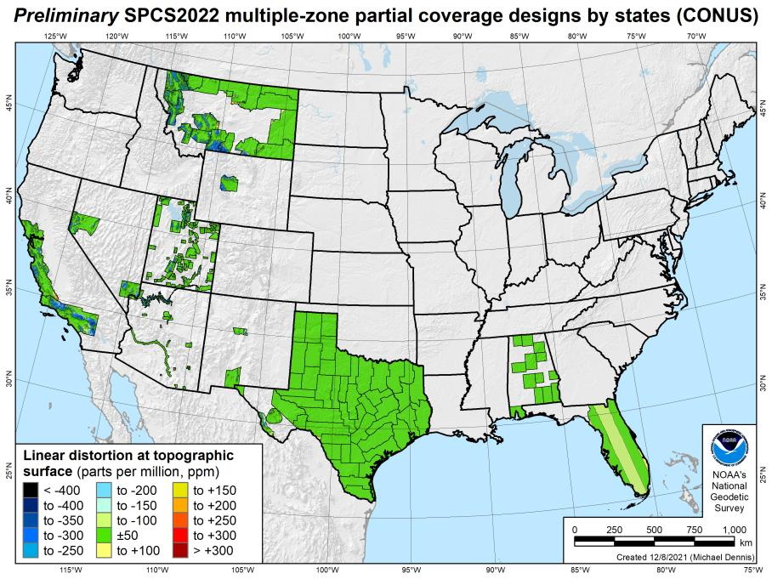
SPCS2022 linear distortion (prelim)
187 zones (10 states)
Percent within distortion (ppm):
Distor | Pop | Cities | Area
±20 | 78% | 78% | 73%
±50 | 91% | 90% | 88%
±100 | 99.8% | 99% | 97%
±400 | 100% | 100% | 100%
City and area statistics (ppm):
 | Min | -261 | -465
 | Max | +120 | +240
 | Range | 381 | 705
 | Mean | -3 | -12
Mean weighted by pop = -1
32

Slide 33
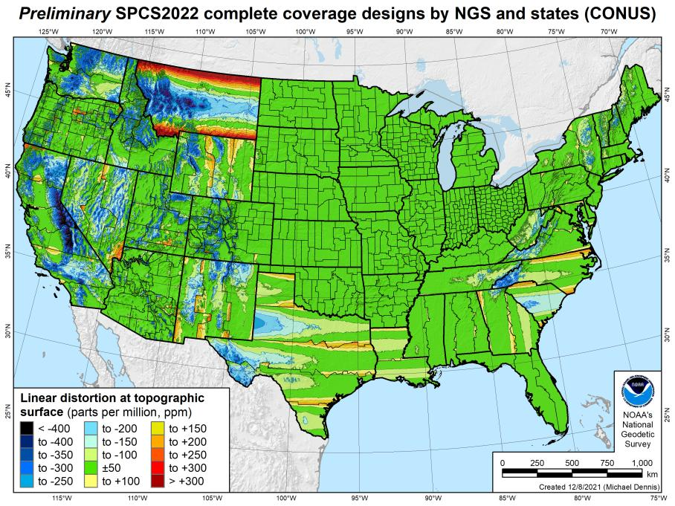
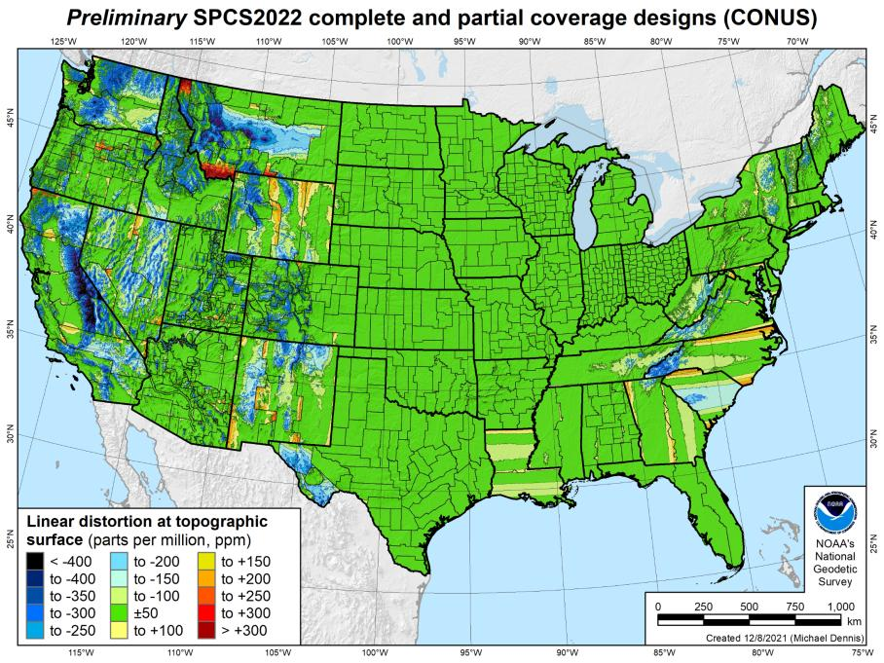
SPCS2022 linear distortion (prelim)
846 zones (CONUS)
Percent within distortion (ppm):
Distor | Pop | Cities | Area
±20 | 76% | 71% | 58%
±50 | 92% | 89% | 76%
±100 | 98% | 97% | 89%
±400 | 100% | 100% | 99.9%
City and area statistics (ppm):
 | Min | -407 | -1438
 | Max | +486 | +2624
 | Range | 893 | 4062
 | Mean | -6 | -23
Mean weighted by pop = -4

Slide 34
Existing SPCS 83 linear distortion
106 zones (CONUS)
Percent within distortion (ppm):
Distor | Pop | Cities | Area
±20 | 17% | 11% | 6%
±50 | 40% | 30% | 17%
±100 | 74% | 68% | 41%
±400 | 99% | 98% | 91%
City and area statistics (ppm):
 | Min | -913 | -1038
 | Max | +206 | +223
 | Range | 1120 | 1261
 | Mean | -98 | -178
Mean weighted by pop = -75
34

Slide 35
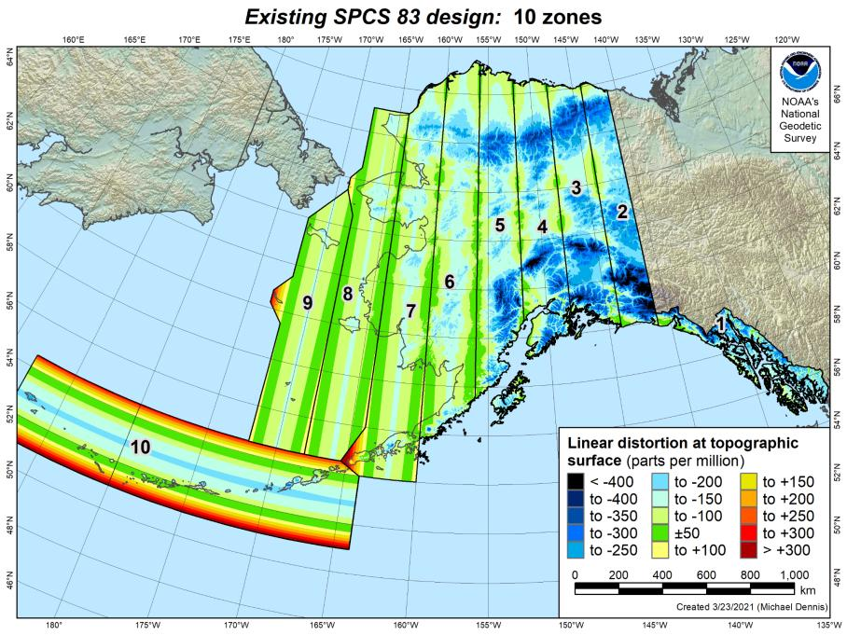
Existing SPCS 83 linear distortion
10 zones (Alaska)
Percent within distortion (ppm):
Distor | Pop | Cities | Area
±20 | 4% | 10% | 4%
±50 | 16% | 23% | 11%
±100 | 40% | 62% | 36%
±400 | 100% | 100% | 99.1%
City and area statistics (ppm):
 | Min | -263 | -967
 | Max | +86 | +342
 | Range | 349 | 1308
 | Mean | -83 | -135
Mean weighted by pop = -92
Statistics are for land areas only
35

Slide 36
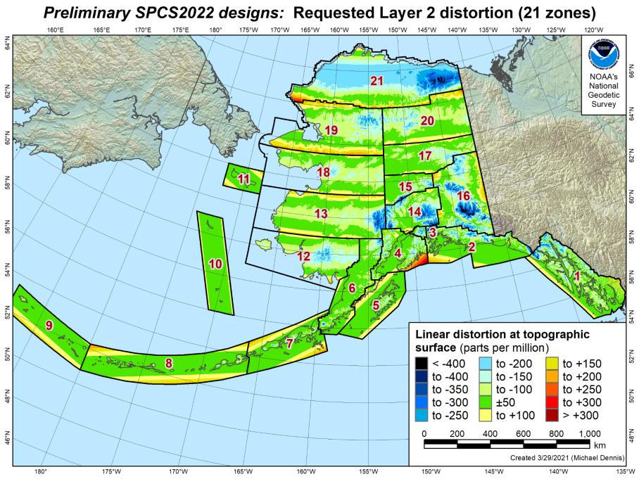
SPCS2022 linear distortion (prelim)
21 zones (Alaska)
Percent within distortion (ppm):
Distor | Pop | Cities | Area
±20 | 77% | 38% | 17%
±50 | 90% | 67% | 38%
±100 | 98% | 93% | 68%
±400 | 100% | 100% | 99.8%
City and area statistics (ppm):
 | Min | -177 | -794
 | Max | +321 | +331
 | Range | 498 | 1125
 | Mean | -7 | -53
Mean weighted by pop = -4
Statistics are for land areas only

Slide 37
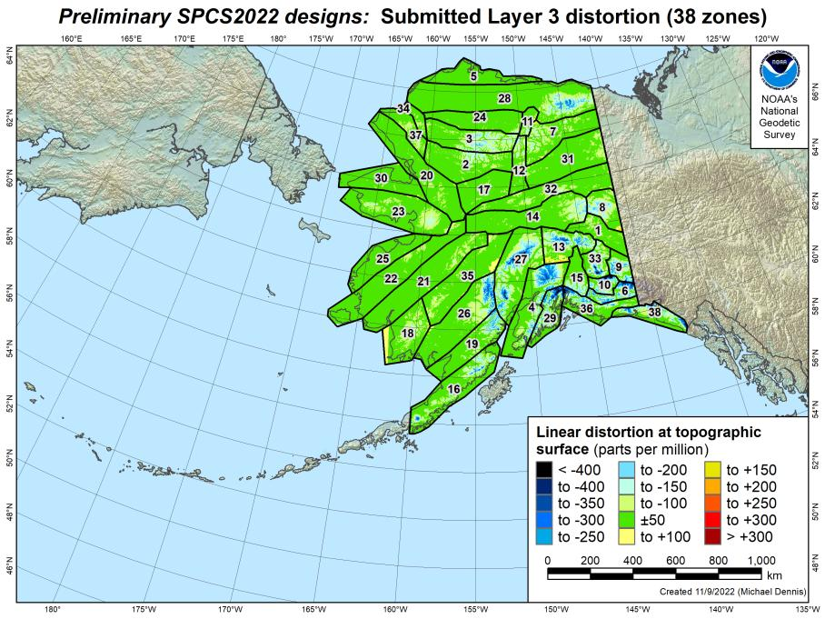
SPCS2022 linear distortion (prelim)
38 zones (Alaska)
Percent within distortion (ppm):
Distor | Pop | Cities | Area
±20 | 89% | 93% | 49%
±50 | 98% | 99.7% | 74%
±100 | 99.7% | 100% | 88%
±400 | 100% | 100% | 99.9%
City and area statistics (ppm):
 | Min | -59 | -937
 | Max | +49 | +190
 | Range | 108 | 1127
 | Mean | +0.4 | -34
Mean weighted by pop = -8
Statistics are for land areas only

Slide 38
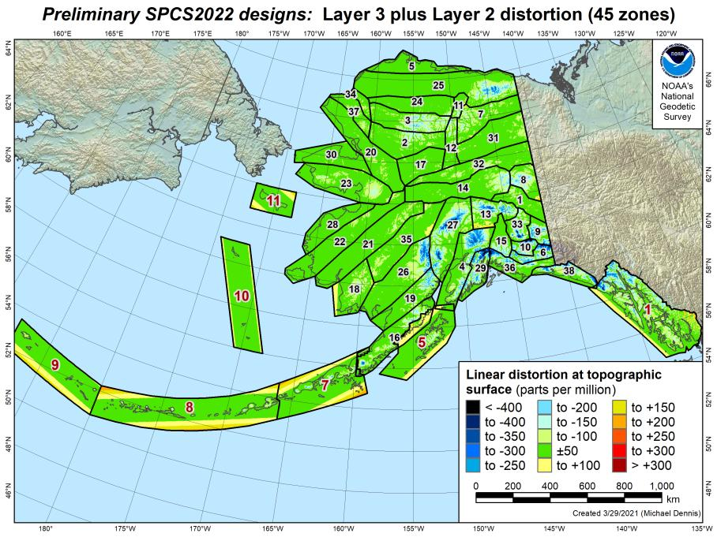
SPCS2022 linear distortion (prelim)
45 zones (Alaska)
Percent within distortion (ppm):
Distor | Pop | Cities | Area
±20 | 86% | 85% | 47%
±50 | 97% | 98% | 73%
±100 | 99.5% | 99.7% | 88%
±400 | 100% | 100% | 99.9%
City and area statistics (ppm):
 | Min | -60 | -937
 | Max | +321 | +335
 | Range | 380 | 1272
 | Mean | -3 | -35
Mean weighted by pop = -10
Statistics are for land areas only

Slide 39
Existing SPCS 83 linear distortion
10 zones (Alaska)
Percent within distortion (ppm):
Distor | Pop | Cities | Area
±20 | 4% | 10% | 4%
±50 | 16% | 23% | 11%
±100 | 40% | 62% | 36%
±400 | 100% | 100% | 99.1%
City and area statistics (ppm):
 | Min | -263 | -967
 | Max | +86 | +342
 | Range | 349 | 1308
 | Mean | -83 | -135
Mean weighted by pop = -92
Statistics are for land areas only
39

Slide 40
About the timing of it all…
Timeline
Complete review of stakeholder submittals
Late 2022-Early 2023: Preliminary designs for stakeholder review
Mid-2023: Finalize all zone designs
Other things in 2023
Provide machine-readable definitions
Modify NGS algorithms (e.g., 1-parallel Lambert)
Document new projection algorithms
Release with rollout of modernized NSRS
Final definitions available by late 2023
Release with new “datums” in 2025
Rollout in
2025

Slide 41
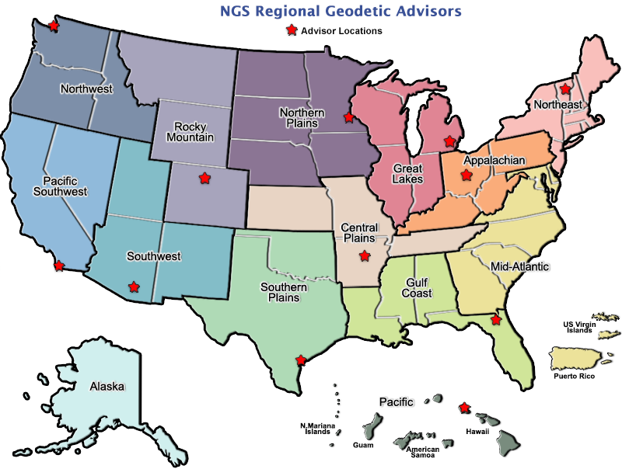
Regional Geodetic Advisor Program
geodesy.noaa.gov/ADVISORS/
14 RGAs across country
We are here to support:
You
Your constituents
Our Federal Partners
Questions about
NSRS Modernization?
Reach out now
Be prepared
Notes:
-14 Regional Advisors, we’ve transitioned from a State-based to a Regional Program
-our advisors homepage up there at the top, also easy to find us by querying any major search engine for “ngs advisors”
-if you know Ross Mackay, he is our Chief Advisor, I report to him…
**ya know, I don’t know why they don’t make him put his photo up here
-we do have one vacant advisor position, that was recently advertised and John up there in Wisconsin is officially retired in oh… 18 days

