Slide 1
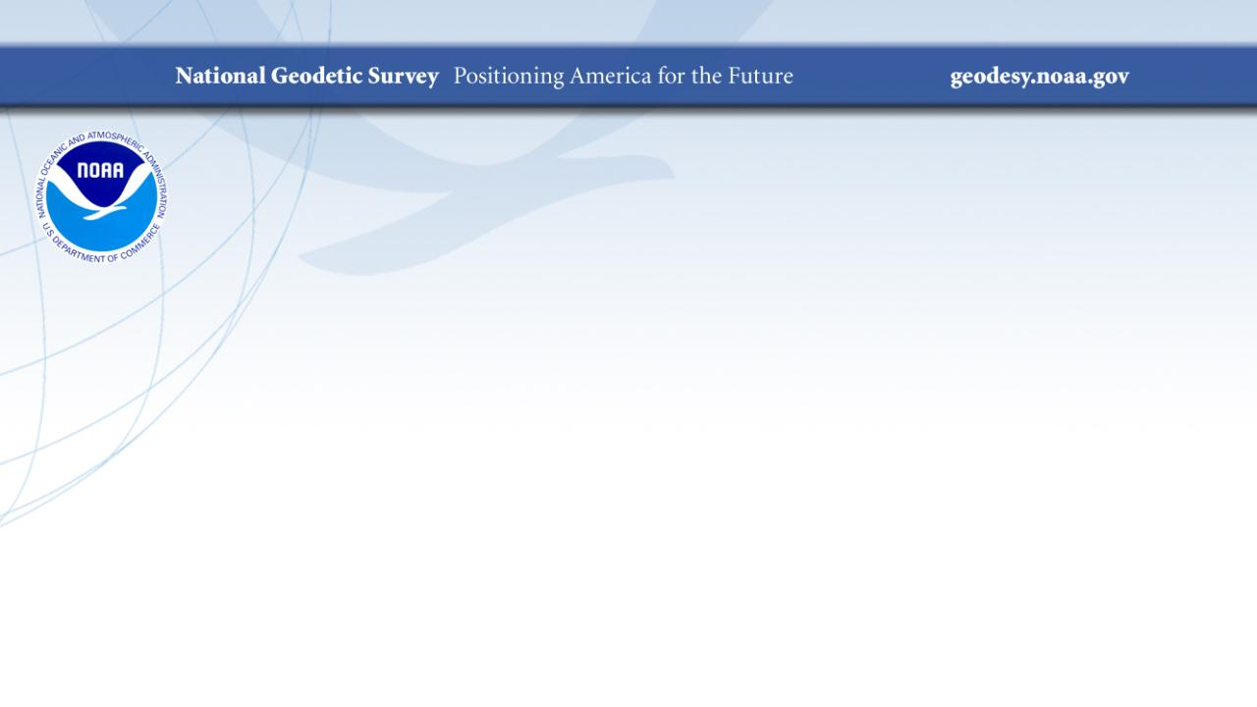
The State Plane Coordinate System for the Student of Geodesy
Ohio State University
March 2023
Jeff Jalbrzikowski, P.S., GISP, CFS
Appalachian Regional Geodetic Advisor
jeff.jalbrzikowski@noaa.gov
240-988-5486

Slide 2
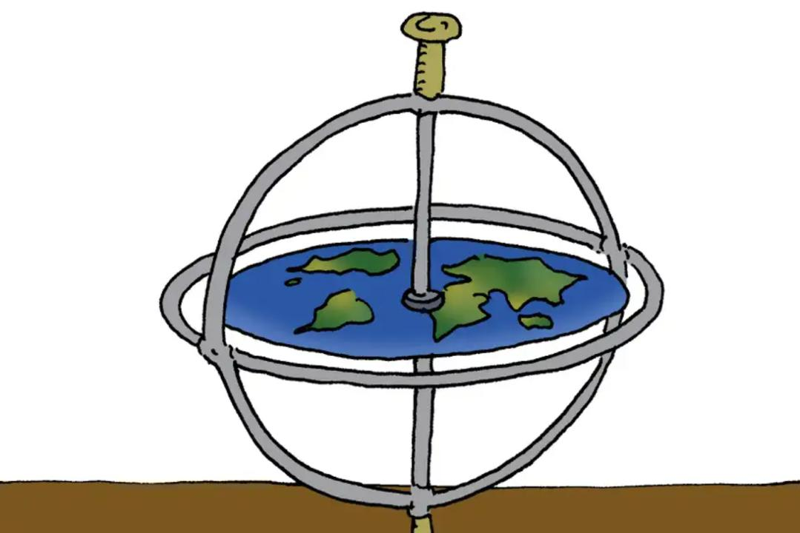
Notes:
A sonnet composed by ChatGPT
Amidst the realm of cartography's art,
Lies a curious matter to impart,
The way our world is displayed on a map,
Takes shape in ways both complex and abstract.
From Mercator to Peters, the choices abound,
Each projection with its own unique sound,
And yet no single one can perfectly portray,
The complexities of our earth in every way.
For as we stretch and flatten and distort,
Our round globe becomes a two-dimensional court,
Where lines must bend and shapes must shrink,
To fit a rectangular canvas without a blink.
Oh, map projections, how you challenge the mind,
In your attempts to represent what we find,
A globe transformed into a map, a fascinating bind.

Slide 3
The State Plane Coordinate System
Also referred to by some as…
State Plane – Ohio State Plane
SPCS – OH SPCS, OSPCS
SPC – Ohio SPC
_PCS – Ohio Planar Coordinate System
_CS – Ohio Coordinate System

Slide 4
Agency History
Survey of the Coast – 1807 to 1836
  Authorized February 10th 1807
  Nation’s Oldest Scientific Agency!
U.S. Coast Survey – 1836 to 1878
  1871 began inland geodetic control mission (over 150 years now)
U.S. Coast and Geodetic Survey – 1878 to 1970
  USC&GS
National Geodetic Survey – 1970 to Present
  Over 50 years as NGS
Notes:
-We are the Federal Government’s oldest scientific agency.
-In keeping with our expanding mission to survey the coasts and harbors of the United States and its interior lands, the agency’s name has evolved over the years too
Survey of the Coast
-Managed by Department of he Navy for about 4 years, but then reassigned to Department of the Treasury
US Coast Survey
-under this title is when, in 1871 the agency was tasked by Congress with responsibility to carry geodetic control inland
US Coast & Geodetic Survey (USC&GS)
-the USC&GS, the name we had for the longest! And this change came along with our current primary mission
National Geodetic Survey
-We celebrated 50 years as NGS in 2020, as did our parent agency NOAA

Slide 5



Organizational Structure
  -Department of Commerce (DoC)
  -National Oceanic and Atmospheric Administration (NOAA)
  -National Ocean Service (NOS)
  -National Geodetic Survey (NGS)
Notes:
-We are part of the Executive Branch
-I know it can seem kind of strange that NGS is part of the NOS, but goes back to origins of the agency being coastal mission

Slide 6


We’re not USGS, we’re NGS
  -Department of Commerce (DoC)
  -National Oceanic and Atmospheric Administration (NOAA)
  -National Ocean Service (NOS)
≠
  -National Geodetic Survey (NGS)
Notes:
-as you can read my slide, I like to point that out because over my 5 years at NGS I’ve seen and heard this misunderstanding quite a bit
-don’t worry! it doesn’t offend us! and we do work closely with USGS, but we are separate agencies within totally different departments of the federal government

Slide 7
NGS Mission
Define, maintain and provide access to the National Spatial Reference System (NSRS) to meet our Nation’s economic, social, and environmental needs.

Slide 8
National Spatial Reference System (NSRS)
A consistent coordinate system that defines…
latitude
longitude
height
scale
orientation
gravity
… and their time variants throughout the United States.
Who among us thinks in lat/long?
Horizontal Datums
NAD83
NAD27
My house is 0.003 arc seconds down that way…
Vertical Datums
NAVD88
NGVD29
Professionals in surveying, engineering, mapping desire this unified spatial reference system… but people don’t design bridges or lay out highways in angular units either (not intuitive).

Slide 9
State Plane Coordinate System (SPCS)
A convenient, efficient way to work in the NSRS
  It’s a Projected Coordinate System (PCS)
    planar coordinates (not angular units)
  Developed by US Government (NGS and predecessors)
    Definitional parameters are publicly available
    State/Commonwealth governments utilize and adopt it
      Also widely adopted by commercial entities/companies
Notes:
A convenient, efficient way to work in the NSRS
It’s a Projected Coordinate System (PCS)
planar coordinates (not angular units)
Developed by US Government (NGS and predecessors)→part of the Nation’s geodetic infrastructure
Definitional parameters are publicly available
State/Commonwealth governments utilize and adopt it
Also widely adopted by commercial entities/companies

Slide 10
History of SPCS
Origins date back to ~1820 (Survey of the Coast)
  Polyconic projection - for maps and charts
    Non-conformal and not equal-area
“Progressive Maps” of US in 1919 (C&GS)
  Based on the Polyconic projections
  Incorporated into World Polyconic Grid (WPG) by AMS
    Not intended for civilian applications (Army)
    But the usefulness of WPG is what led to development of SPCS
    Note that DoD was replaced WPG with UTM in the 1940s
Notes:
Origins date back to ~1820 (Survey of the Coast)
Polyconic projection - for maps and charts
Non-conformal and not equal-area
“Progressive Maps” of US in 1919 (C&GS)
Based on the Polyconic projections
Incorporated into World Polyconic Grid (WPG) by Army Map Service (AMS)
This is what led to development of UTM… and SPCS

Slide 11
History of SPCS
Conformal Map Projections
  Desirable for surveying, engineering, military
    Preserves angles
    Scale error is same in all directions
  Useful for calculations → direction, distance, azimuth
  But… much more difficult to construct, and compute
  Around 1920, for nautical charting, USC&GS adopted:
    Lambert Conformal Conic (LCC)
    Transverse Mercator (TM)

Slide 12
Birth of SPCS
SPCS 27 (based on North American Datum of 27)
  Request from government of NC in 1933
  Quickly led to 110 projection zones across 48 states
    Great Depression→New Deal = Nationwide infrastructure expansion
  Education and outreach by C&GS
    Guidance on how to perform field work & computations
    Manual on using SPCS in Route Surveying for engineers
    Projection Tables, along with trig and log tables (slide rule era!)
    Formulas for electronic coordinate computation publised in 1968
Notes:
SPCS of 1927 (based on NAD 27)
Request from government of NC in 1933
Quickly led to 110 projections across 48 states
Great Depression→New Deal→Civil Works Administration (CWA) led to Nationwide infrastructure expansion… which brought the need/desire for Federal Gov’t to be able to map & track all that
(Funny quote that the system was “…not as a result of a brainstorm of some theoretical mathematician and geodesist.” → still rings somewhat true in that few at NGS use SPCS)
Education and outreach by C&GS
Guidance on how to perform field work & computations
Manual on using SPCS in Route Surveying for engineers
Projection Tables, along with trig and log tables (slide rule era!)
Formulas for electronic coordinate computation publised in 1968

Slide 13
Advancement of SPCS
SPCS 27 … moving into the 1970s
  By now with 50 states, plus other updates, 131 zones
  Procedures for scaling coordinates to the topographic surface
    Moving the “grid” to “ground” aka Modified State Plane
      Why? Surveyors collect field data on the ground
  SPCS was now mature… but was the NSRS?
    Nope! Late 70s brought progress towards NAD 83
  With a whole new datum, system of zones needs redeveloped

Slide 14
Redesign of SPCS
SPCS 83 (based on North American Datum of 1983)
  NGS studied & considered a different approach for NAD 83
    Computer-based computations made everything easier
    Now SPCS had been around for 40+ years → familiarity
    SPCS 27 had already been codified into law in 38 states
  Changed false eastings and northings
  Same two projections: LCC or TM
  Zone design based on linear distortion w.r.t. ellipsoid surface
    Note this was same approach as SPCS 27

Slide 15

Future of SPCS
SPCS2022 (based on NATRF2022)
  Again NGS considered a different approach for the NSRS TRFs
    GIS makes everything easier
  Changed false eastings and northings (but why?)
  Same two projections: LCC or TM
  Zone design based on linear distortion w.r.t. topographic surface
    Not previously possible at nationwide scale
    Plethora of elevation data makes this possible (USGS 3DEP, etc.)

Slide 16
SPCS2022 – What makes it different?
Overall distortion design philosophy
  Linear distortion minimized (or “optimized”) at topographic surface
  (not at ellipsoid surface)
  Purpose: reduce difference between projected “grid” and actual “ground” distances
What is linear distortion?
  Defined at a point (infinitesimal distances)
  Unique (i.e., same in every direction) only for conformal projections
  Given here in parts per million (ppm) = mm per km
Linear distortion | = | δ | = | Projected minus actual distance
 |  |  |  | Actual distance

Slide 17
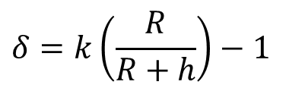
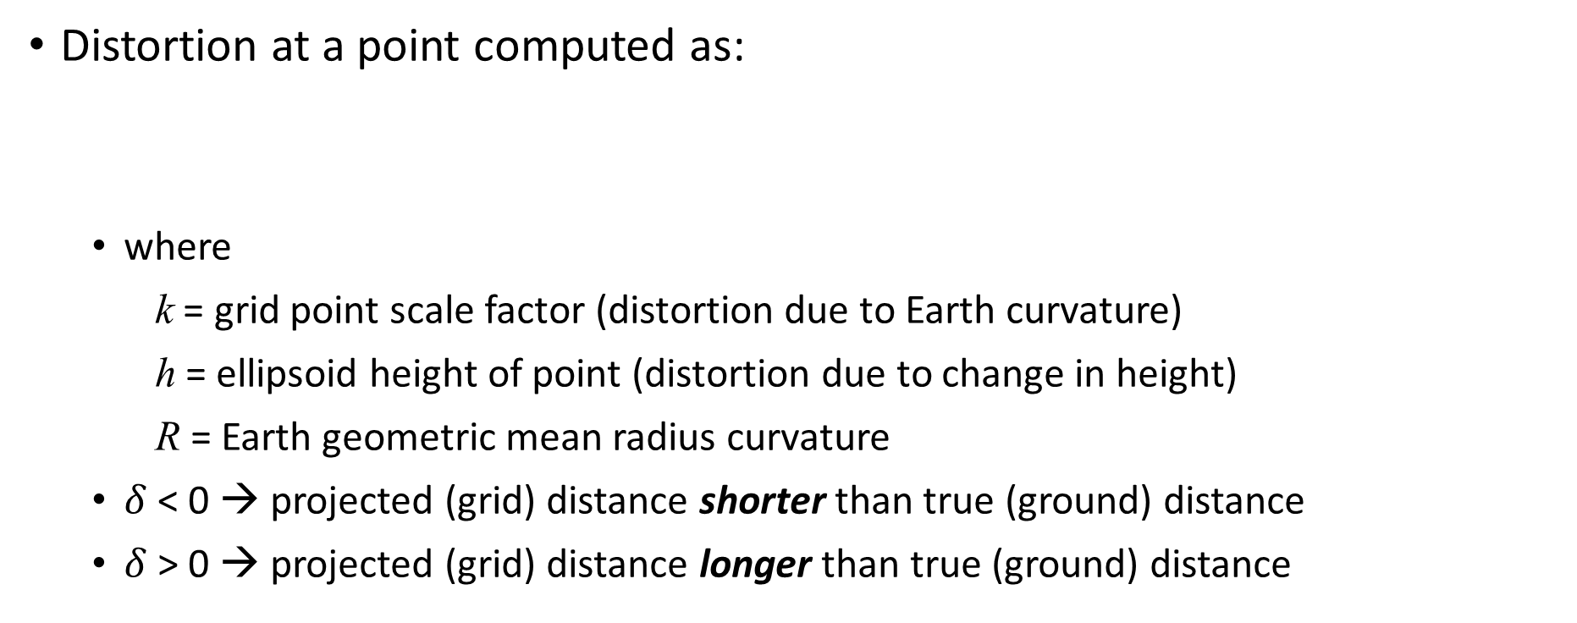
Map projection linear distortion
Distortion at a point computed as:
  where
    k = grid point scale factor (distortion due to Earth curvature)
    h = ellipsoid height of point (distortion due to change in height)
    R = Earth geometric mean radius curvature
  $δ$ < 0 → projected (grid) distance shorter than true (ground) distance
  $δ$ > 0 → projected (grid) distance longer than true (ground) distance
Combined factor
Grid point scale factor
$$δ=k\left(\frac{R}{R+h}\right)−1$$
Height (“elevation”) factor
Notes:
How does NGS calculate linear distortion?
Let’s walk thru it
--k is our grid point scale factor, distortion due to earth curvature
--Ratio highlighted in green is the elevation factor
Together, these two are referred to as the combined factor
Items that make it up are …
Distortion = Combined Factor minus one

Slide 18

Linear distortion with respect to ellipsoid surface
Projection
axis
(k₀ < 1)
Topographic surface
Horizontal ground distance
> ellipsoid distance
and
> grid distance
k₀ = scale on projection axis
LCC: central parallel
TM: central meridian
OM: skew axis
Grid distance
> ellipsoid distance
< ground distance
(k > 1 and δ < 0)
Ellipsoid distance
Projection surface (secant)
Ellipsoid distance
Ellipsoid surface
This design approach
used for SPCS 27 and 83 (minimizes distortion with respect to ellipsoid)
Grid distance
< ellipsoid distance
< ground distance
(k < 1 and δ < 0)
$$δ=k −1$$
18
Notes:
For SPCS 27 and 83, topography was ignored
Distortion was only a function of the Grid Point Scale Factor, nothing about radius of Earth, height, etc.

Slide 19
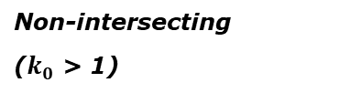
“Non-intersecting” conformal map projection
Topographic surface
Grid distance = ground distance at a point
Projection
axis
Grid distance = ground distance at a point
Non-intersecting
($k_{0}$ > 1)
Grid distance ≈ ground distance over finite distance
Purpose is to reduce linear distortion at “ground” (topographic surface).
But distortion can vary considerably across area of interest.
Ellipsoid surface
This design approach
used for SPCS 27 and 83 (minimizes distortion with respect to ellipsoid)
19

Slide 20
“Non-intersecting” conformal map projection
Topographic surface
Projection
axis
Non-intersecting
($k_{0}$ > 1)
Ellipsoid surface
20

Slide 21
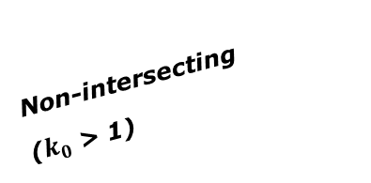
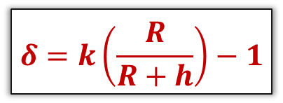
Changing projection axis to reduce distortion variation
This design approach
used for SPCS2022 (minimizes distortion with respect to topography)
Topographic surface
Grid distance = ground distance at many points
Projection
axis
Ellipsoid height of surface not constant:
h₁ ≠ h₂
h₂
Non-intersecting
($k_{0}$ > 1)
h₁
ONLY way to reduce variation in distortion is to change projection axis location (or change projection).
Ellipsoid surface
Projection axis scale can be less than 1 for steeply sloping areas even if heights are large.
IMPORANT: For large areas, there is no single defining ellipsoid height for scaling the projection.
$$δ=k\left(\frac{R}{R+h}\right)−1$$
R₂
R₁
21

Slide 22
Linear distortion magnitudes
Parts per million | Centimeters per kilometer | Feet per mile | Dimensionless ratio
20 ppm | 2 cm/km | 0.1 ft/mile | 1:50,000
50 ppm | 5 cm/km | 0.3 ft/mile | 1:20,000
100 ppm | 10 cm/km | 0.5 ft/mile | 1:10,000
400 ppm | 40 cm/km | 2.1 ft/mile | 1:2,500

Slide 23
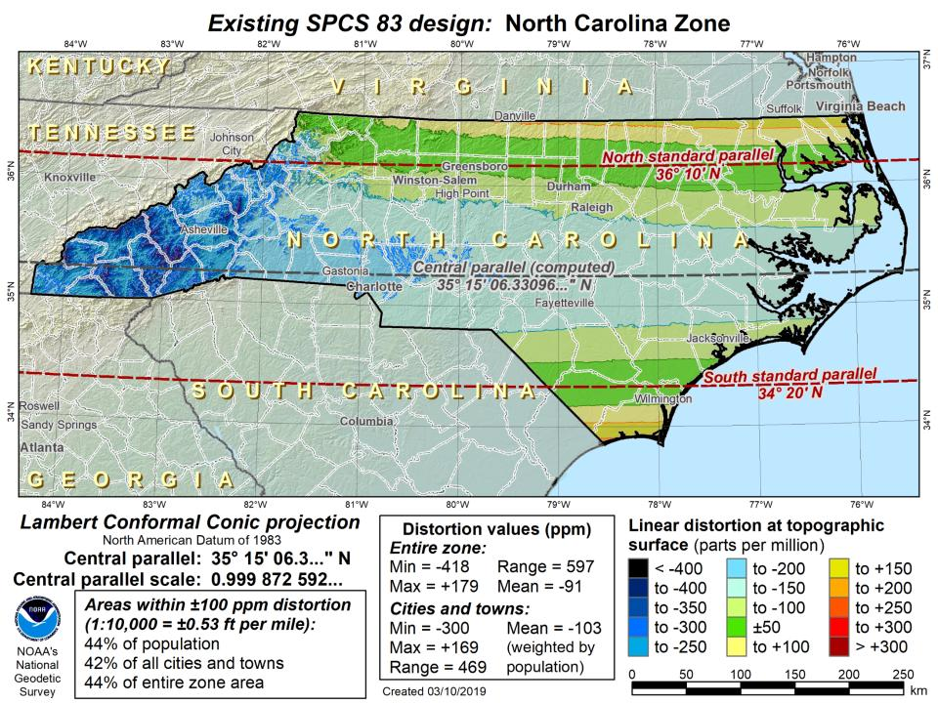

Slide 24
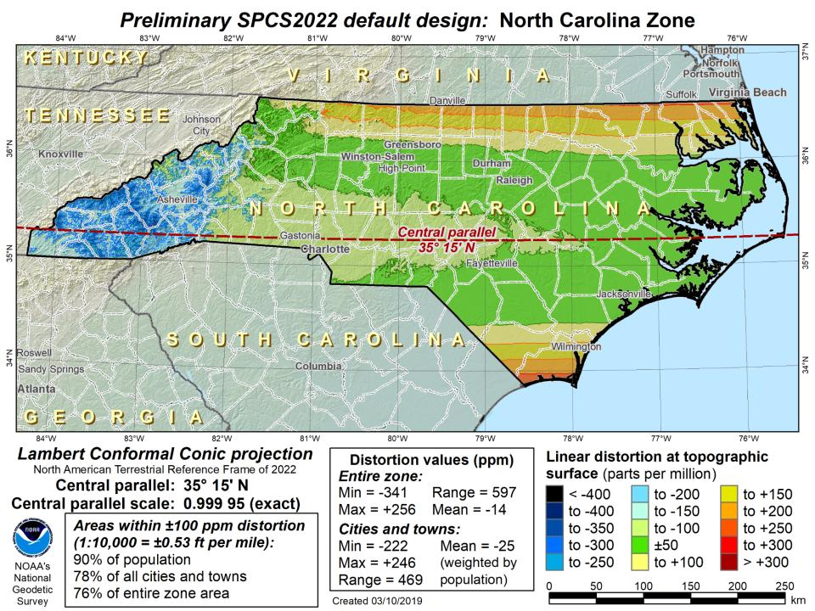

Slide 25
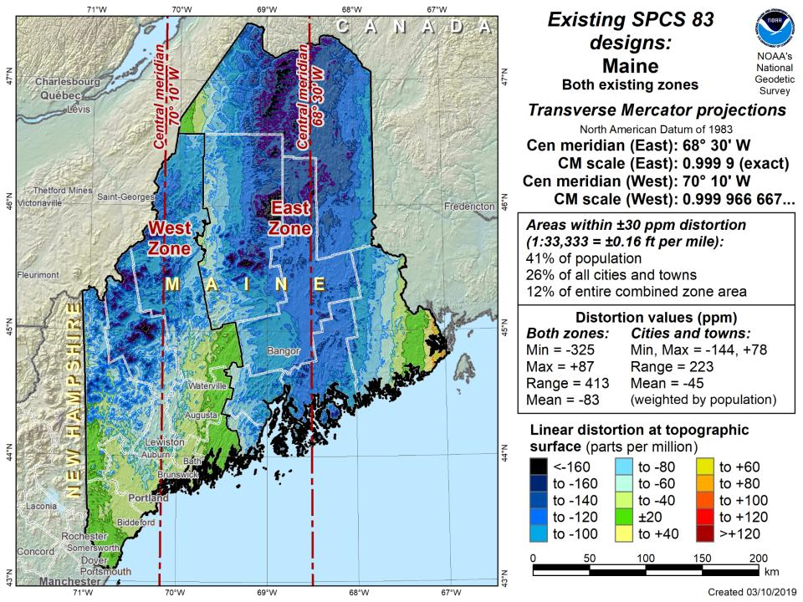

Slide 26
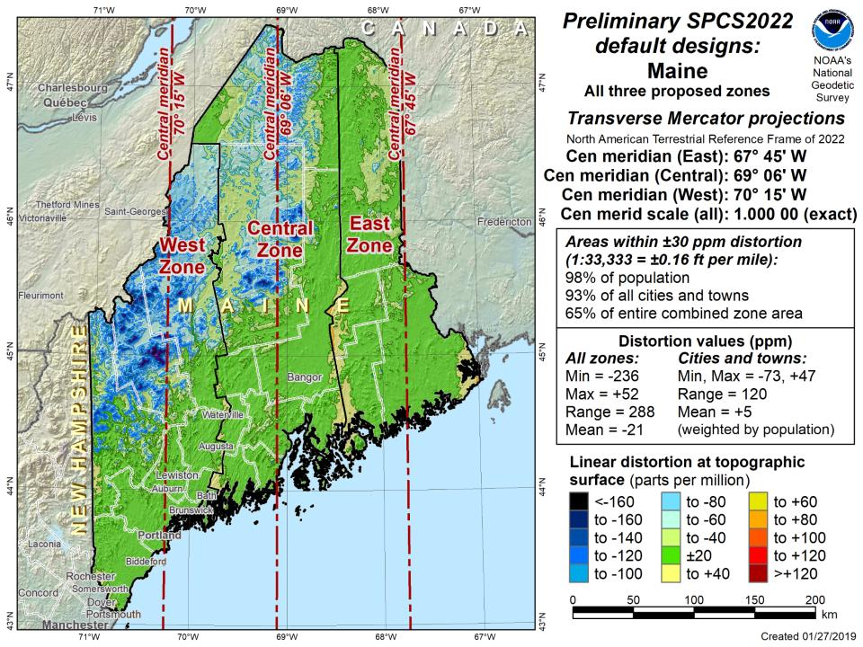

Slide 27
SPCS2022 statistics
Total of 968 zones
  Yep… 159 zones designed by NGS
  But also 806 zones designed by the states
Nowhere else (that we know of) can citizens and stakeholders directly contribute to national geodetic infrastructure

Slide 28
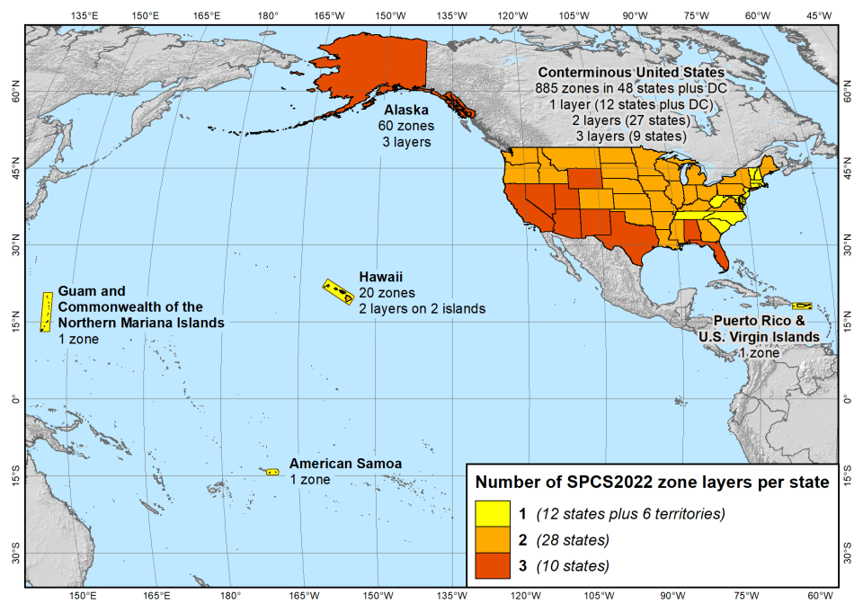
SPCS2022 zone layers
1 layer: 12 states plus 6 territories
2 layers: 28 states
3 layers: 10 states

Slide 29
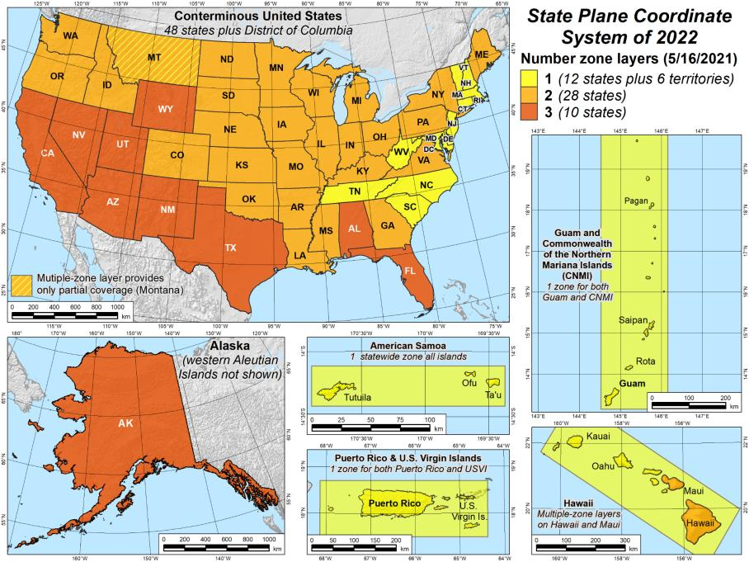
SPCS2022 zone layers
1 layer: 12 states plus 6 territories
2 layers: 28 states
3 layers: 10 states

Slide 30
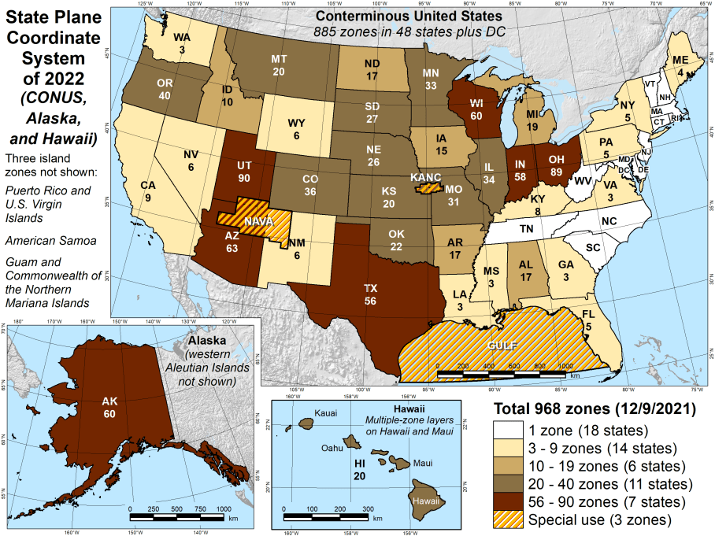
Number of SPCS2022 zones (preliminary)
CONUS, Alaska, and Hawaii
Three island zones not shown:
Puerto Rico and U.S. Virgins Islands
American Samoa
Guam and the Commonwealth of the Northern Mariana Islands

Slide 31
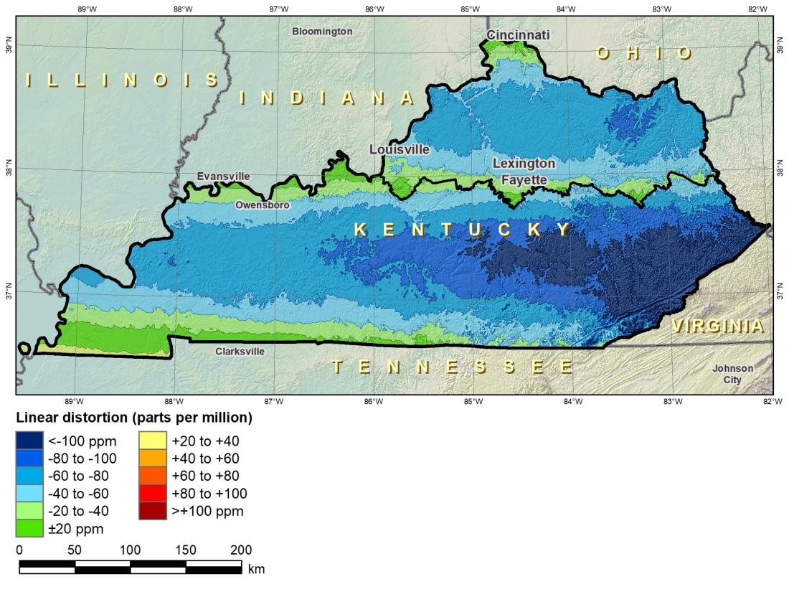
“Layered” zones
SPCS 83 Kentucky N and S zones (Lambert Conformal Conic)
 |  | North | South
N parallel |  | 38°58’N | 37°56’N
S parallel |  | 37°58’N | 36°44’N
 |  | Distortion (ppm)
Min |  | -93 | -211
Max |  | +17 | +42
Mean |  | -56 | -67

Slide 32
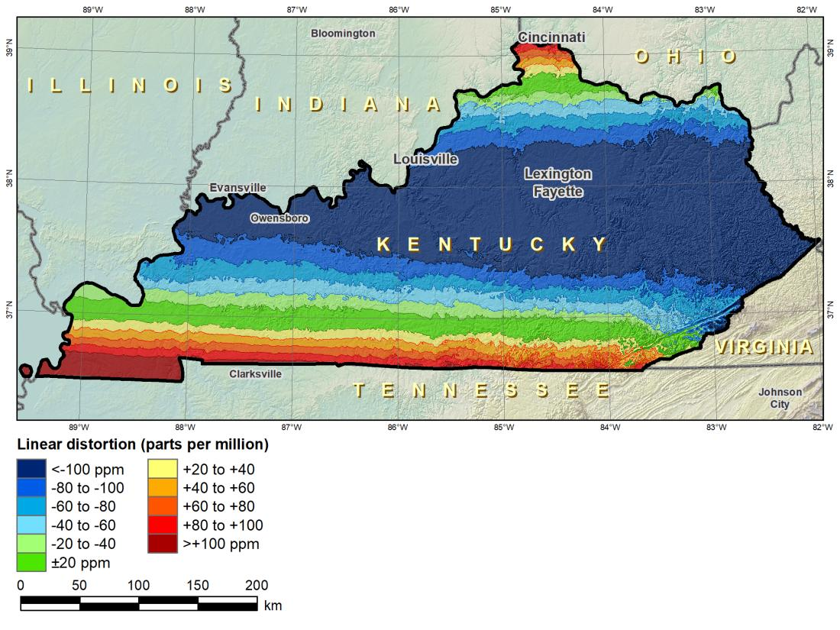
“Layered” zones
SPCS 83 Kentucky statewide zone (Lambert Conformal Conic)
 |  | North | South | Statewide
N parallel |  | 38°58’N | 37°56’N | 38°40’N
S parallel |  | 37°58’N | 36°44’N | 37°05’N
 |  | Distortion (ppm)
Min |  | -93 | -211 | -166
Max |  | +17 | +42 | +181
Mean |  | -56 | -67 | -58

Slide 33
Co-existing layers within Kentucky SPCS 83
North and South Zones (KY-N, KY-S)
Statewide Zone (KY1Z)

Slide 34
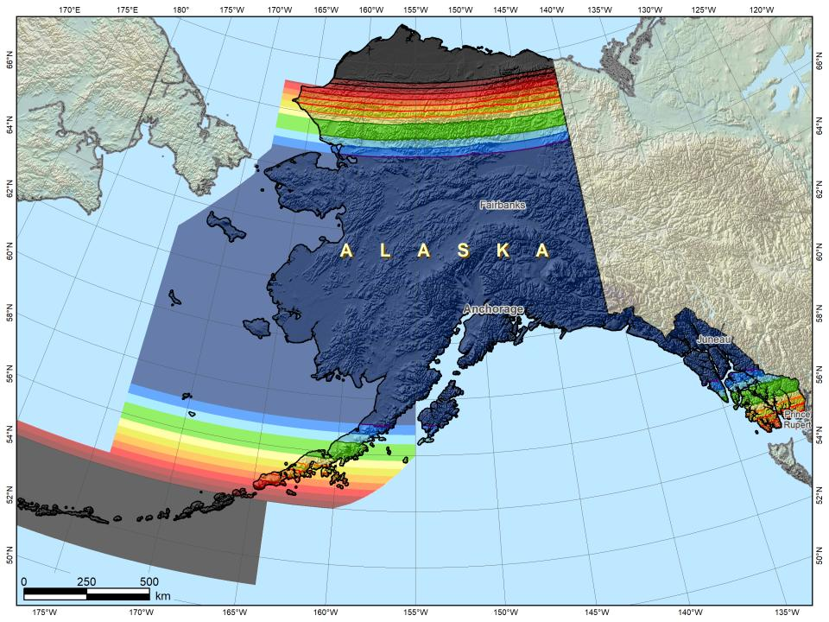
Three zone layers concept
1. Statewide layer

Slide 35
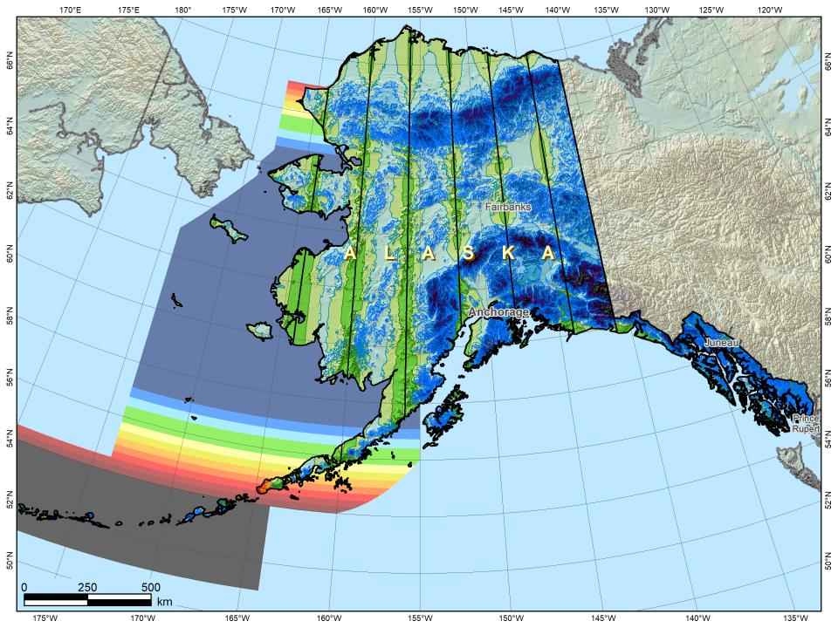
Alaska complete “intermediate” layer
Three zone layers concept
1. Statewide layer
2. “Intermediate” layer (complete state coverage)
35

Slide 36
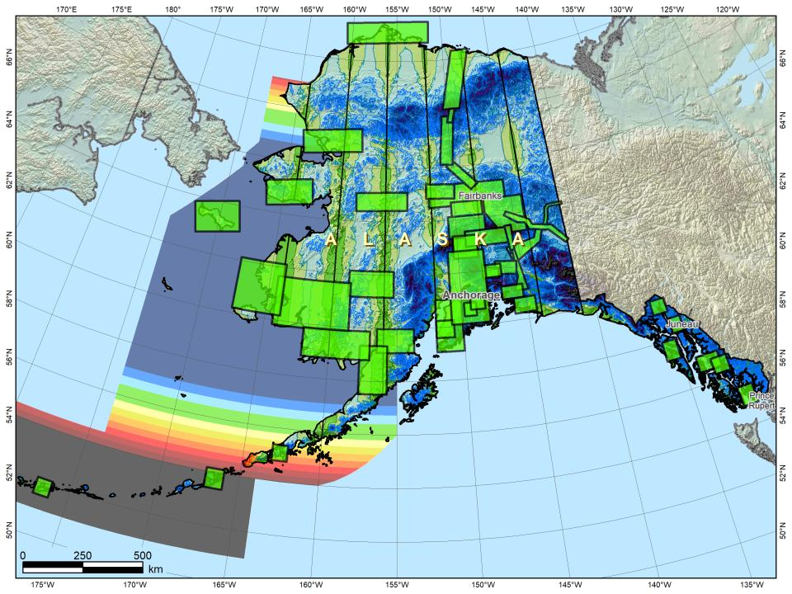

Three zone layers concept
1. Statewide layer
2. “Intermediate” layer (complete state coverage)
3. LDP layer (partial state coverage)
36

Slide 37
State Plane Coordinate System of 1983
SPCS83
North and South Zones as they exist now
Notes:
We start with the SPCS83 zones as a frame of reference
NOTE that the color shading of these zones is matched to that of the Preliminary SPCS2022 Zones that follow

Slide 38
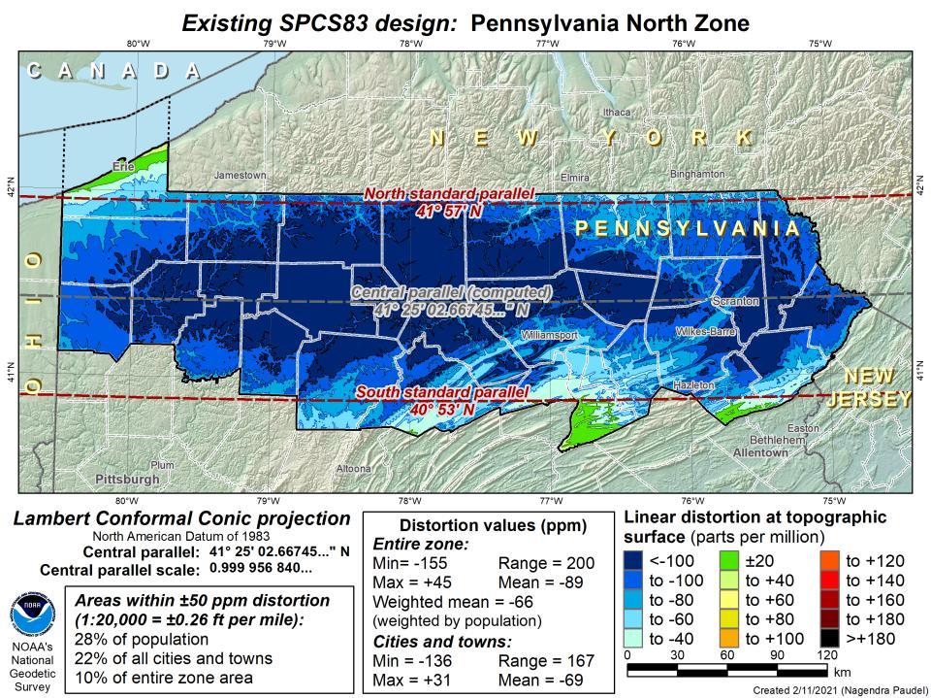
DRAFT

Slide 39
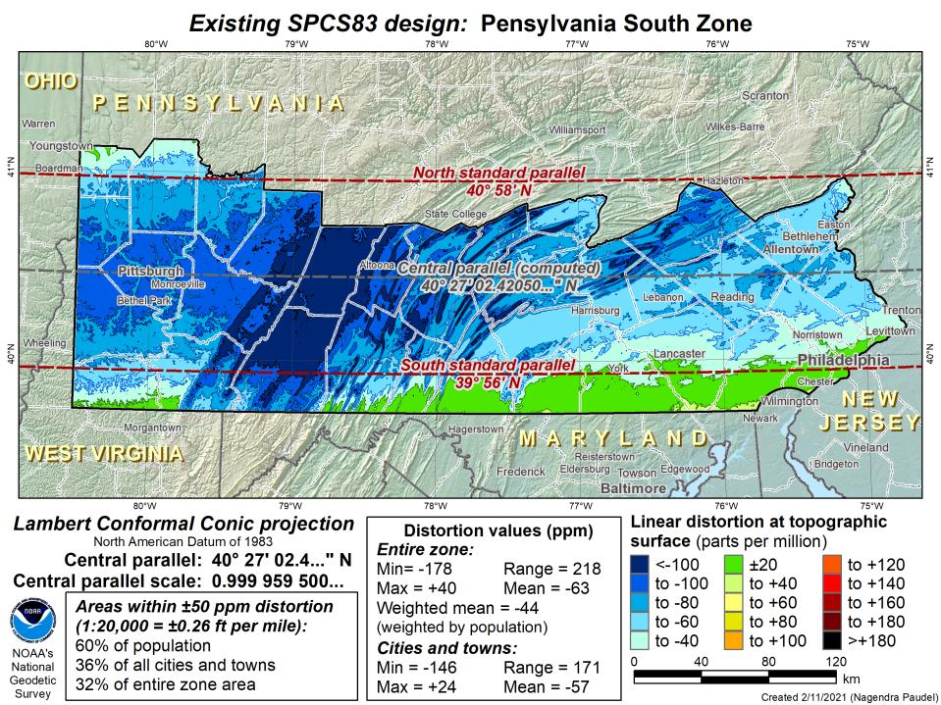
DRAFT

Slide 40
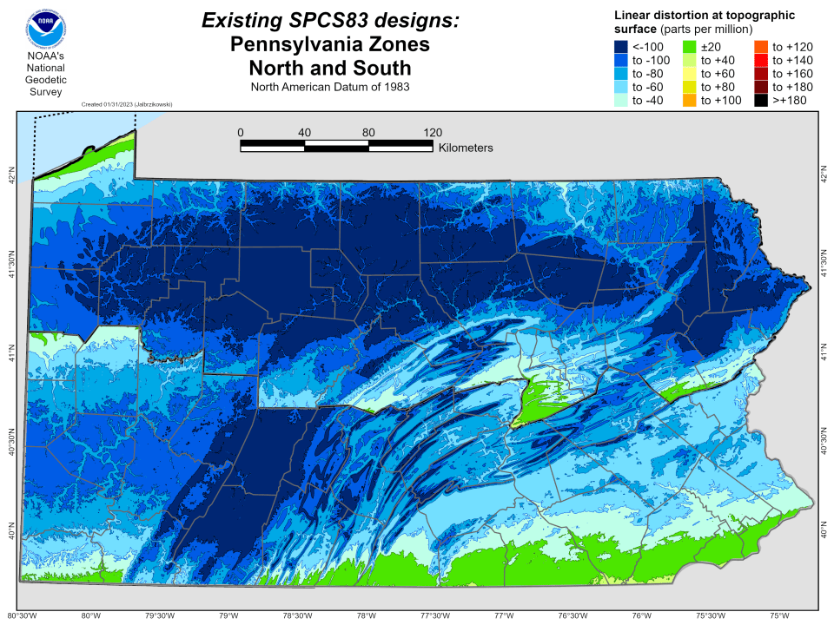

Slide 41
State Plane Coordinate System of 2022
SPCS2022
PA stakeholders requested 4-5 zones, which NGS designed, the following are Preliminary maps
Notes:
The following section illustrates the preliminary SPCS2022 zones
There are 4 zones in the NGS design, per request that we design “4-5 zones required to meet the minimum distortion acceptable” set by our design criteria of 50ppm
NOTE the request also included wording: “It is also requested that PennDOT districts be divded into no more than two zones”

Slide 42
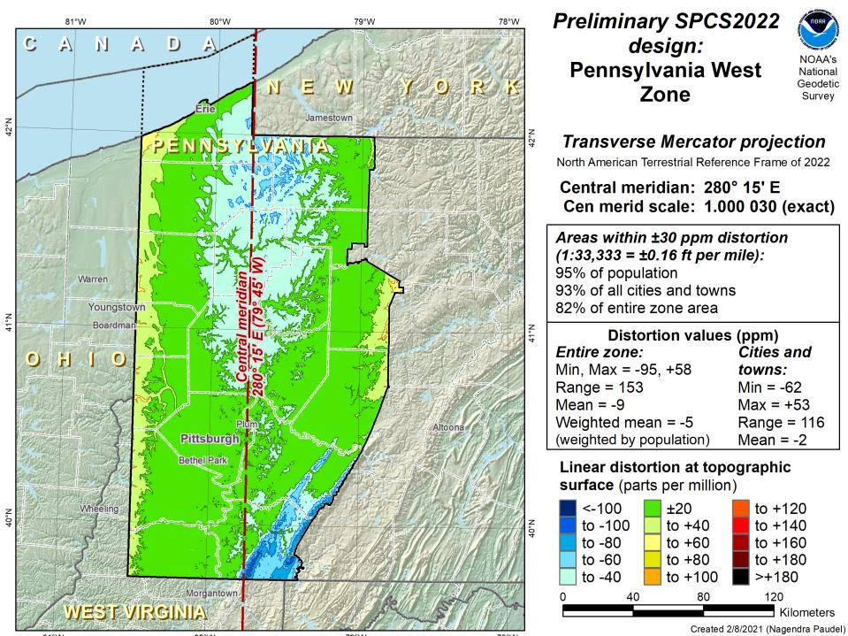
Notes:
NOTE that the West Zone far surpasses the NGS design criteria of 50ppm

Slide 43
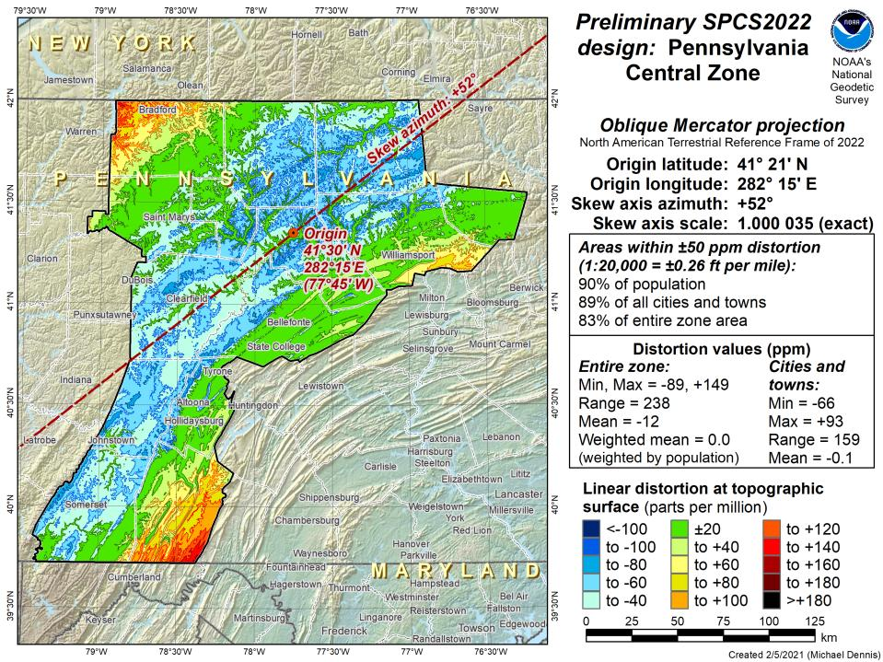
Notes:
This is the first, and likely final, draft of an Oblique Mercator projection for the Preliminary Central Zone
NOTE that even with the

Slide 44
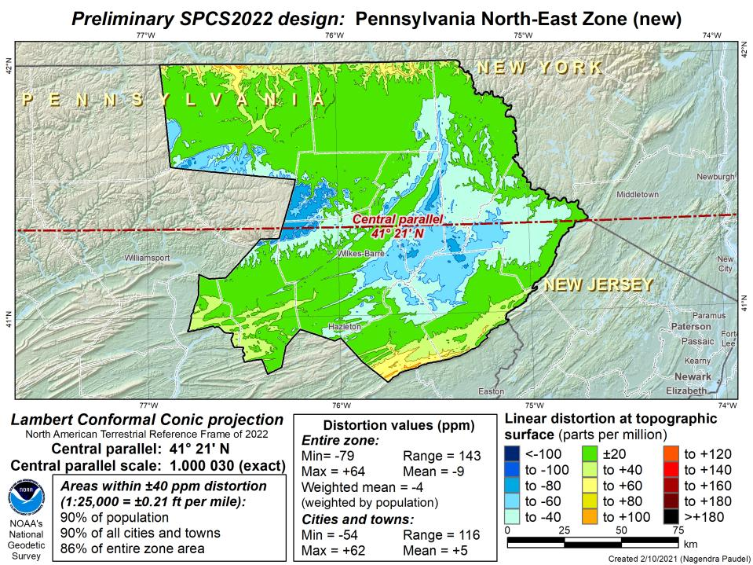
Notes:
This is the second draft of a Preliminary North East Zone
NOTE this includes Columbia and Montour Counties, and the animation highlights the comparison between having these counties in the SE or NE Zone

Slide 45
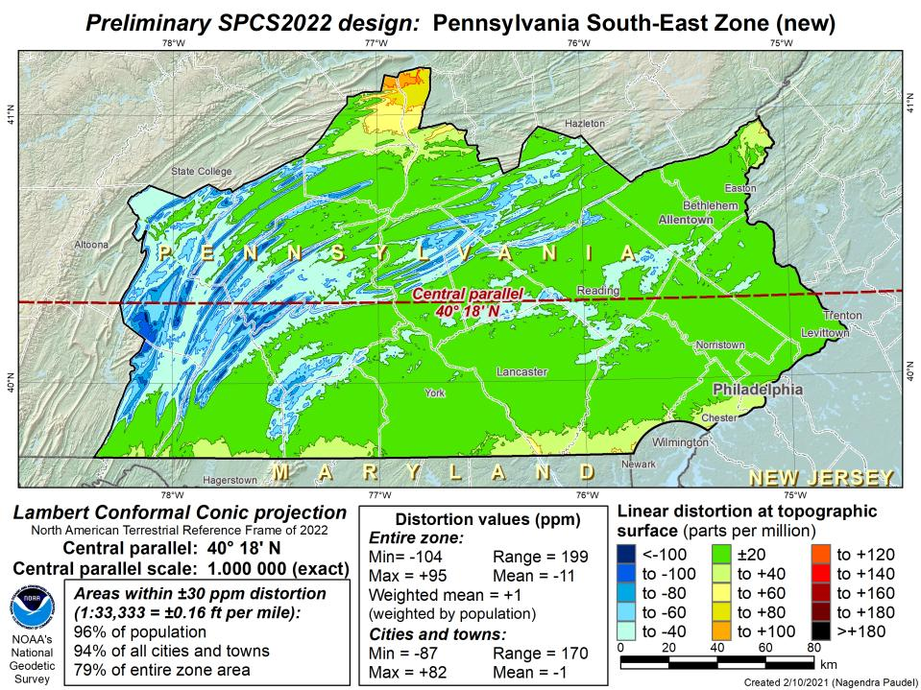
Notes:
This is the second draft of a Preliminary South East Zone
NOTE this excludes Columbia and Montour Counties (they would fall in SE Zone)

Slide 46
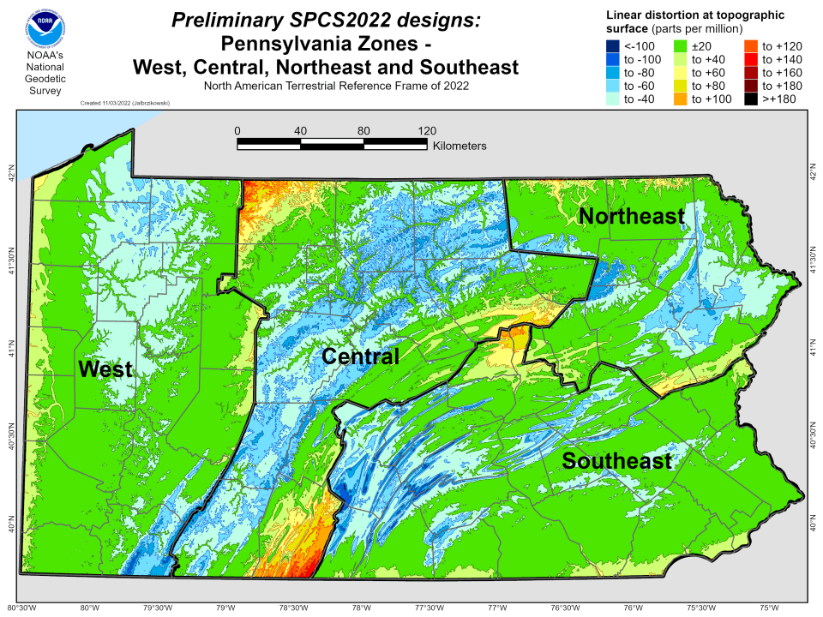

Slide 49
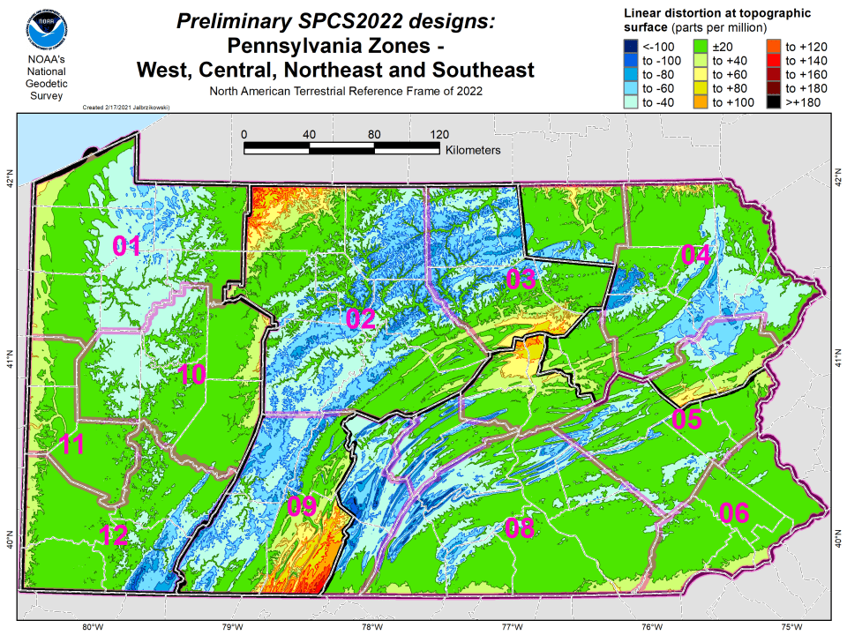

Slide 50
State Plane Coordinate System of 2022
SPCS2022
NGS will create a Single Statewide Zone for every State, the following is a Preliminary map

Slide 51
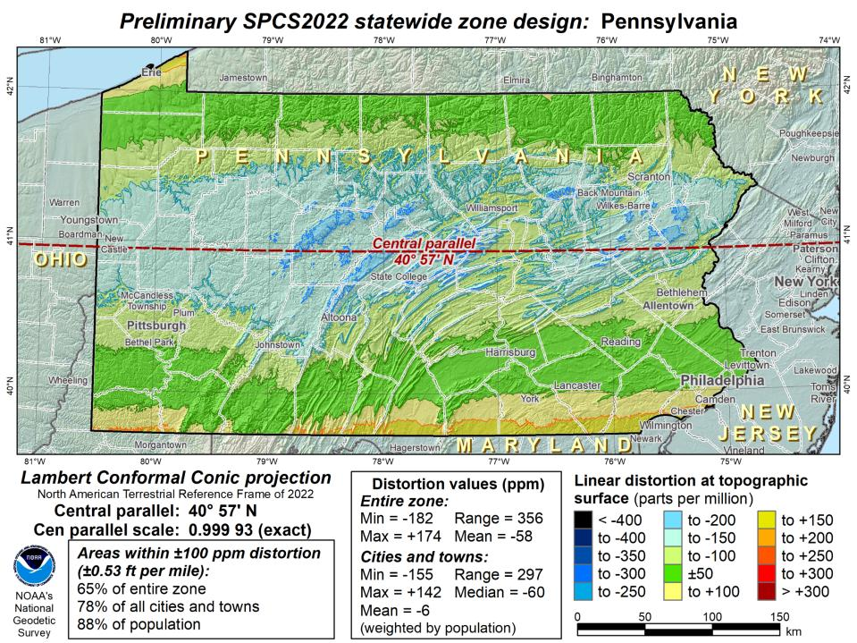
Notes:
This Single Statewide Zone designed by NGS is color shaded to match the following section of slides that show UTM Zones linear distortion values
It is known that some user communities with large areas of responsibility choose to maintain geospatial data and work in UTM
This graphic as compared to the UTM serves to highlight in SPCS2022, users will see better performance (lower linear distortion) if they choose to work in the SPCS2022 Single Statewide Zone rather than one of the UTM Zones that fall within Pennsylvania

Slide 52
UTM (NAD83) Zones as
UTM
The following are maps using existing UTM zones as a Single Statewide Zone
(included to highlight the lower performance as compared to Preliminary NGS Zone)

Slide 53
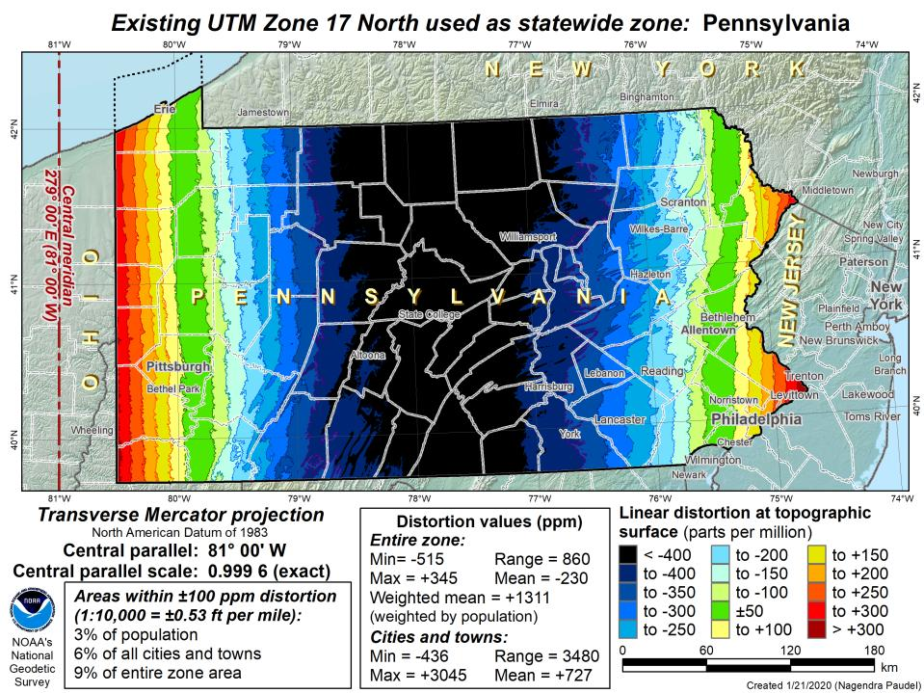

Slide 54
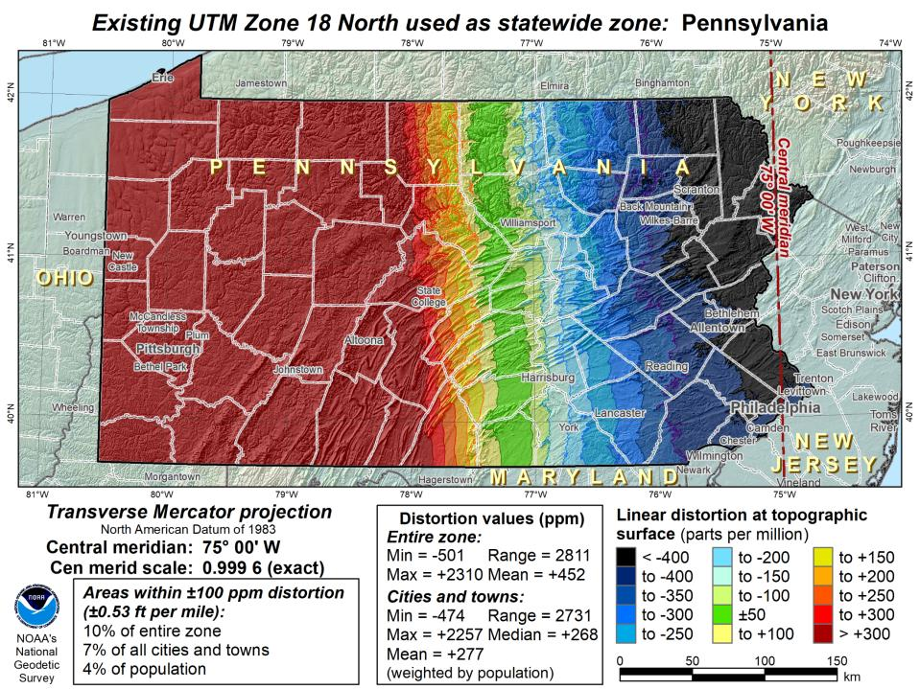

Slide 55
Notes:
The NGS designed preliminary single statewide zone is included again here at the end for easier visual comparisons.

Slide 56
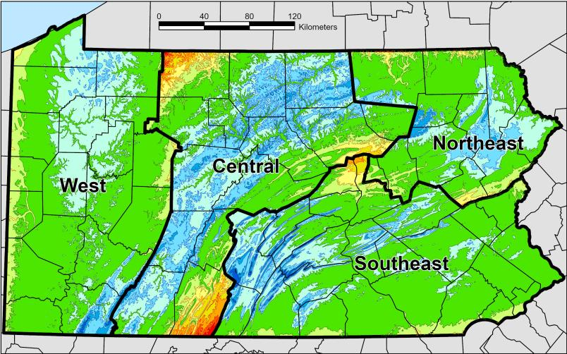
SPCS2022 Zone Layers in PA
Both Single Statewide and Multi-Zone Layers will coexist
Think about your data, your goals, your customers
  Remember that geographic coordinates are your friend!
Smaller zones not “the best” … it all depends on usage & goals

Slide 57
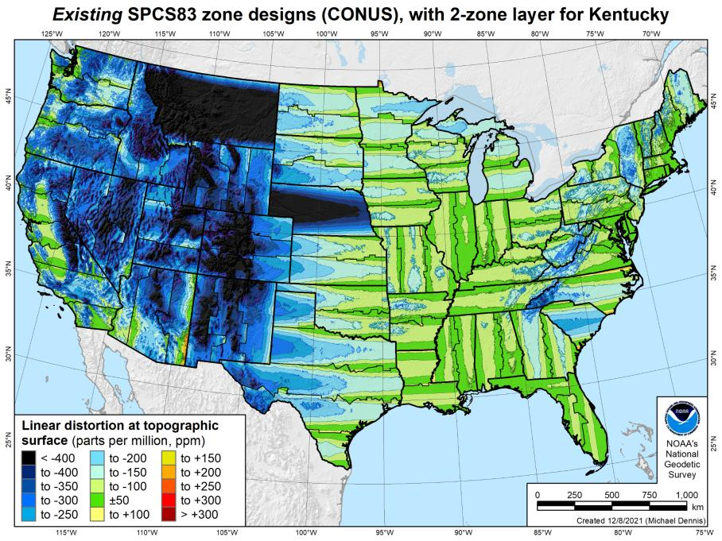
Existing SPCS 83 linear distortion
106 zones (CONUS)
Percent within distortion (ppm):
Distor | Pop | Cities | Area
±20 | 17% | 11% | 6%
±50 | 40% | 30% | 17%
±100 | 74% | 68% | 41%
±400 | 99% | 98% | 91%
City and area statistics (ppm):
 | Min | -913 | -1038
 | Max | +206 | +223
 | Range | 1120 | 1261
 | Mean | -98 | -178
Mean weighted by pop = -75
57

Slide 58
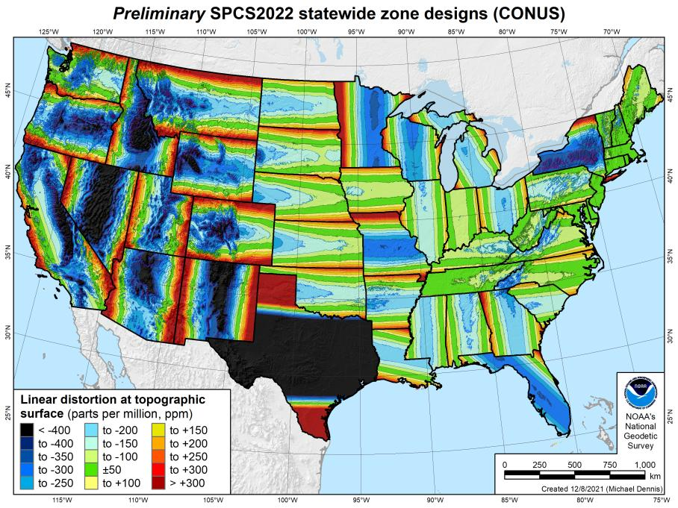
SPCS2022 linear distortion (prelim)
49 zones (CONUS)
Percent within distortion (ppm):
Distor | Pop | Cities | Area
±20 | 14% | 12% | 7%
±50 | 27% | 26% | 18%
±100 | 48% | 48% | 36%
±400 | 91% | 93% | 88%
City and area statistics (ppm):
 | Min | -1512 | -1627
 | Max | +2888 | +2987
 | Range | 4400 | 4614
 | Mean | -86 | -120
Mean weighted by pop = -100
58

Slide 59
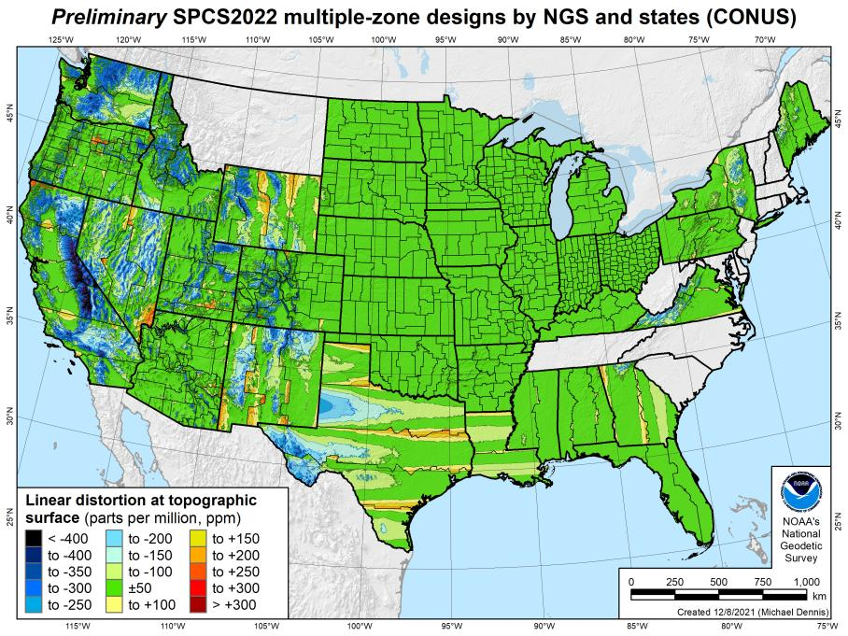
SPCS2022 linear distortion (prelim)
646 zones (35 states)
Percent within distortion (ppm):
Distor | Pop | Cities | Area
±20 | 76% | 70% | 54%
±50 | 92% | 88% | 73%
±100 | 98% | 97% | 89%
±400 | 100% | 100% | 99.9%
City and area statistics (ppm):
 | Min | -400 | -684
 | Max | +245 | +295
 | Range | 644 | 979
 | Mean | -5 | -23
Mean weighted by pop = -4
59

Slide 60
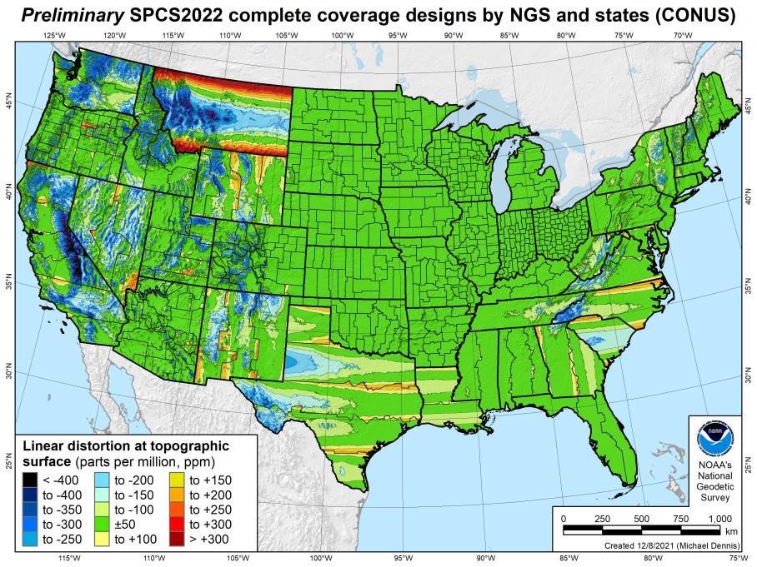
SPCS2022 linear distortion (prelim)
846 zones (CONUS)
Percent within distortion (ppm):
Distor | Pop | Cities | Area
±20 | 76% | 71% | 58%
±50 | 92% | 89% | 76%
±100 | 98% | 97% | 89%
±400 | 100% | 100% | 99.9%
City and area statistics (ppm):
 | Min | -407 | -1438
 | Max | +486 | +2624
 | Range | 893 | 4062
 | Mean | -6 | -23
Mean weighted by pop = -4

Slide 61
Existing SPCS 83 linear distortion
106 zones (CONUS)
Percent within distortion (ppm):
Distor | Pop | Cities | Area
±20 | 17% | 11% | 6%
±50 | 40% | 30% | 17%
±100 | 74% | 68% | 41%
±400 | 99% | 98% | 91%
City and area statistics (ppm):
 | Min | -913 | -1038
 | Max | +206 | +223
 | Range | 1120 | 1261
 | Mean | -98 | -178
Mean weighted by pop = -75
61

Slide 62
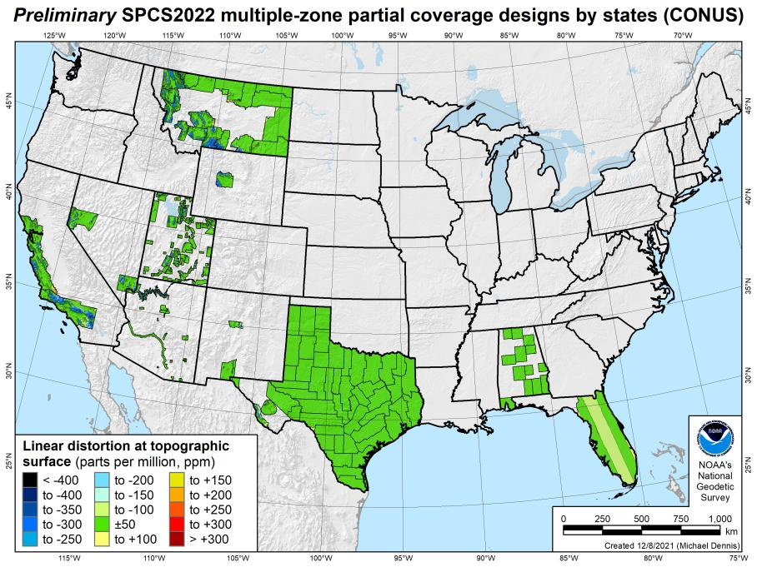
SPCS2022 linear distortion (prelim)
187 zones (10 states)
Percent within distortion (ppm):
Distor | Pop | Cities | Area
±20 | 78% | 78% | 73%
±50 | 91% | 90% | 88%
±100 | 99.8% | 99% | 97%
±400 | 100% | 100% | 100%
City and area statistics (ppm):
 | Min | -261 | -465
 | Max | +120 | +240
 | Range | 381 | 705
 | Mean | -3 | -12
Mean weighted by pop = -1
62

Slide 63
About the timing of it all…
Timeline
  Review of stakeholder submittals is complete
  Late 2022-Early 2023: Preliminary designs for stakeholder review
  Mid-2023: Finalize all zone designs
Other things in 2023
  Provide machine-readable definitions (e.g. WKT)
  Modify NGS algorithms (e.g., 1-parallel Lambert)
  Document new projection algorithms
Release with rollout of modernized NSRS
  Final definitions available by late 2023
  Release with new “datums” in 2025
Rollout in
2025

Slide 64
NSRS Modernization
Geometric (LLh)
Orthometric (H)
NAD 83
will be replaced by
North American Terrestrial Reference Frame of 2022
NATRF2022
NAVD 88
will be replaced by
North American Pacific Geopotential Datum of 2022
NAPGD2022

Slide 65
Who uses SPCS?
Surveyors
  Used extensively, with all sorts of data/projects
GIS Professionals
  Very popular PCS, along with UTM
Engineers
  Many are unfamiliar with anything other PCS
Notes:
Surveyors
Used extensively, with all sorts of data/projects
GIS Professionals
Very popular PCS, along with UTM
Engineers
Many are unfamiliar with anything other PCS

Slide 66
Why use SPCS?
Zone parameters built-in to COTS software
States sometimes require it for surveyors
Surveying↔Engineering common ground
  Coordinates - field data matched to design data
More efficient than assumed/local system

Slide 67
How to use SPCS?
Click a few buttons in your favorite software
  Right? Not always that easy!
NGS Coordinate Conversion and Transformation Tool (NCAT)
  ASCII up/download, Web Services, or Download
  Library of modules used are on GitHub → github.com/noaa-ngs
Definitional parameters published by NGS
  Go to the source… please!
    Questions, ambiguities? Contact NGS → Regional Advisor, etc.

Slide 68
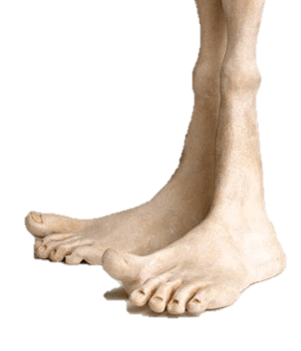
Units in SPCS
Two versions of “foot” in current use:
“Old” U.S. survey foot
“New” international foot
‭1 ft = 1200/3937 m = 0.3048006096…‬ m
1 ft = 0.3048 m exactly
Differ by
2 parts per million (ppm) or ~0.01 ft (~1/8 inch) per mile
  A real problem with real costs

Slide 69
A tale of two feet
Who uses U.S. survey feet?
  Surveyors in most (not all) states
  But it impacts everyone
  It is a major issue for the
  National Spatial Reference System (NSRS),
  especially State Plane coordinates
  (and other projected coordinate systems)

Slide 70
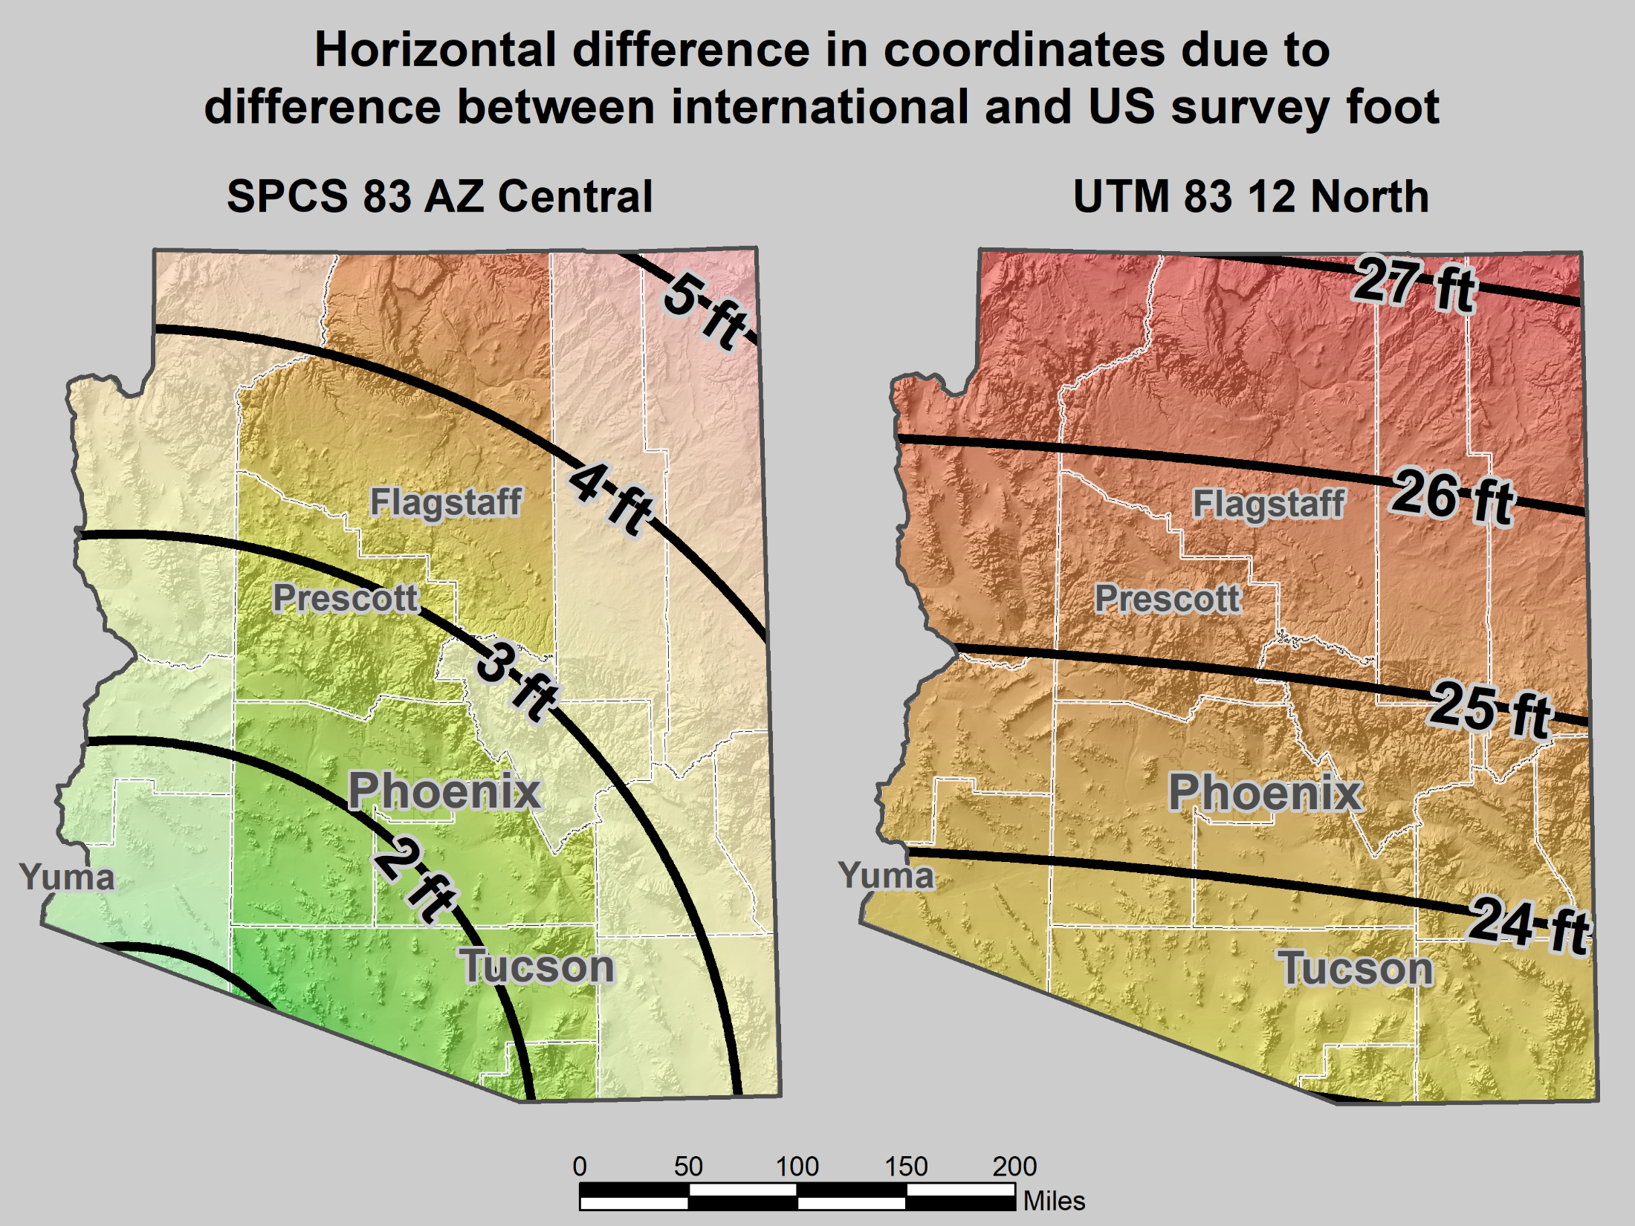
Horizontal error when mixing up feet
SPCS 83 AZ Central Zone
UTM 83 12 North Zone

Slide 71
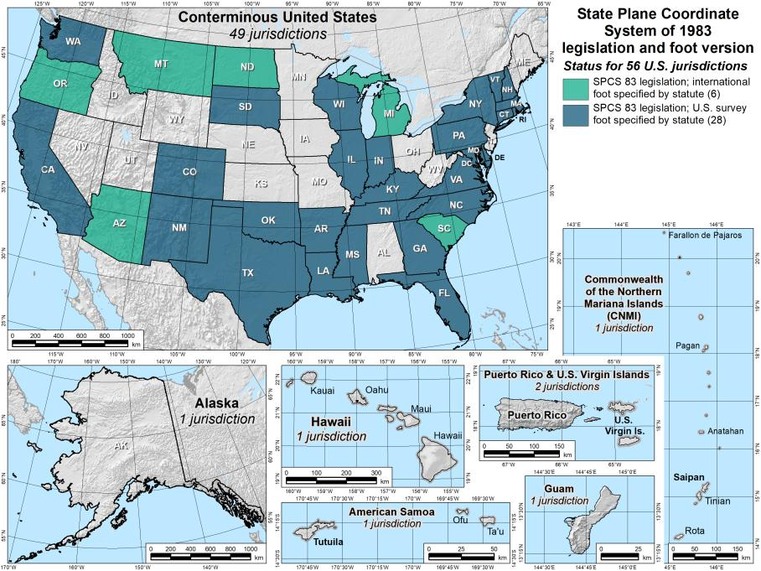
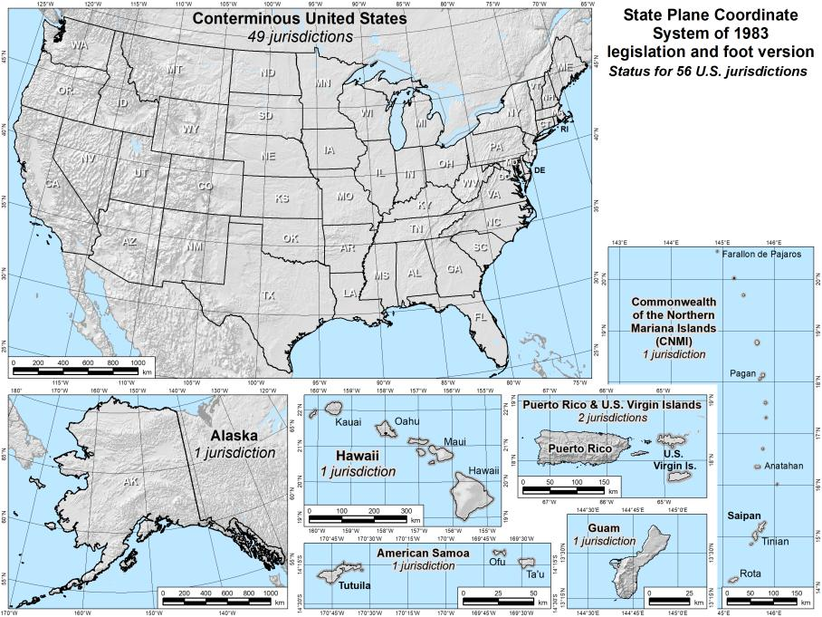
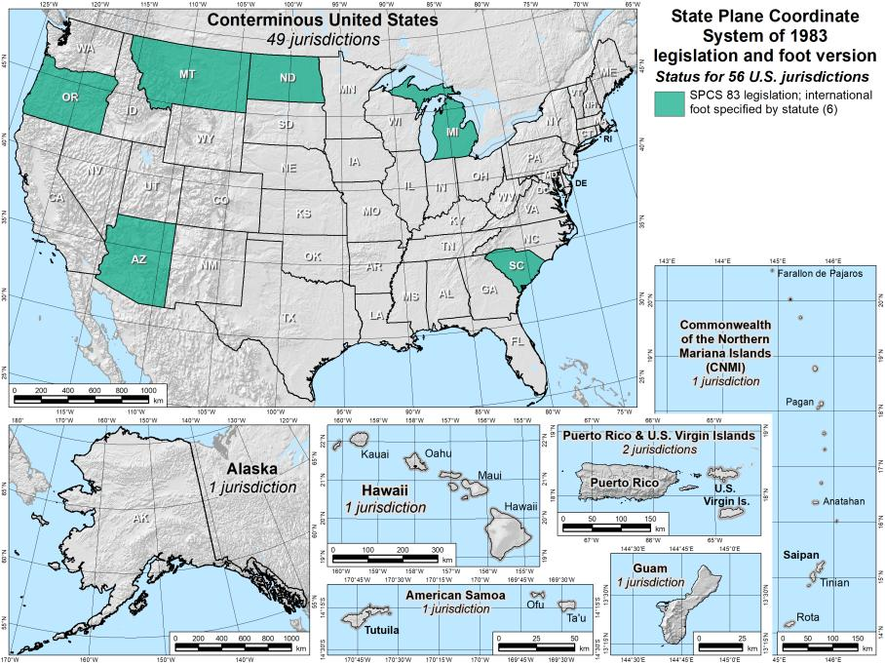
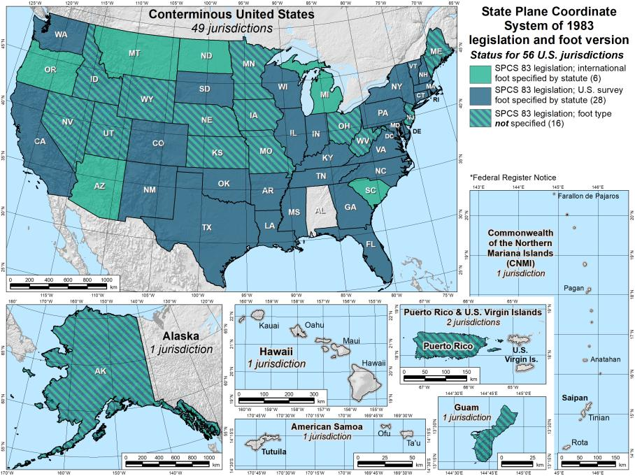
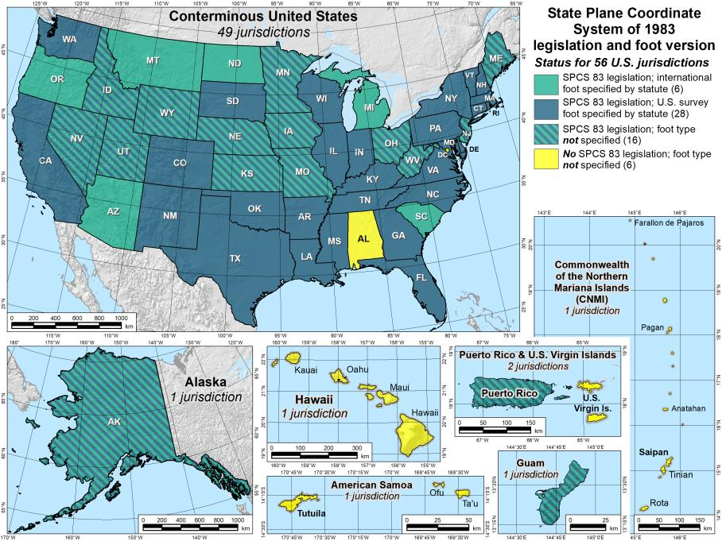
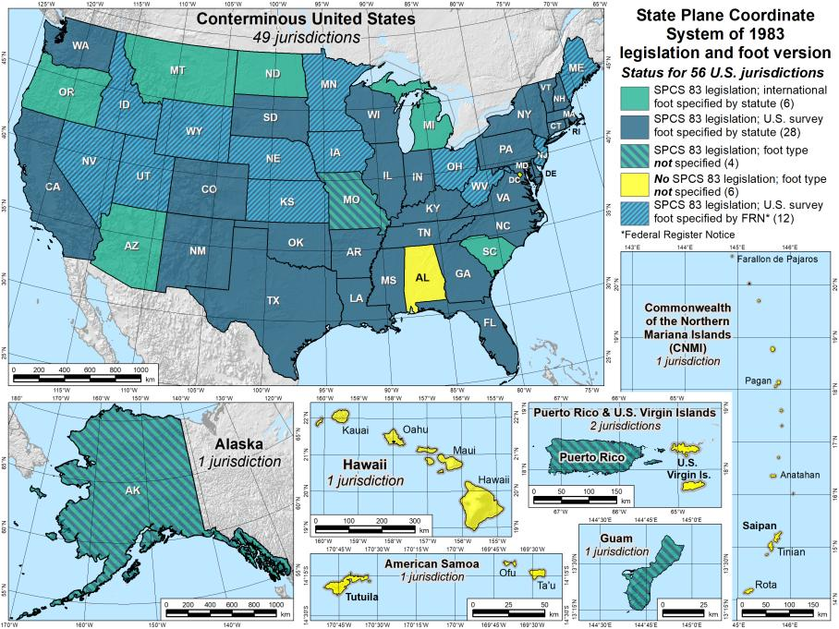
SPCS 83 legislation and foot version
56 U.S. jurisdictions
Legislation
  International foot: 6
  U.S. survey foot: 28
  Neither: 16
  No legislation at all: 6
71
71

Slide 72
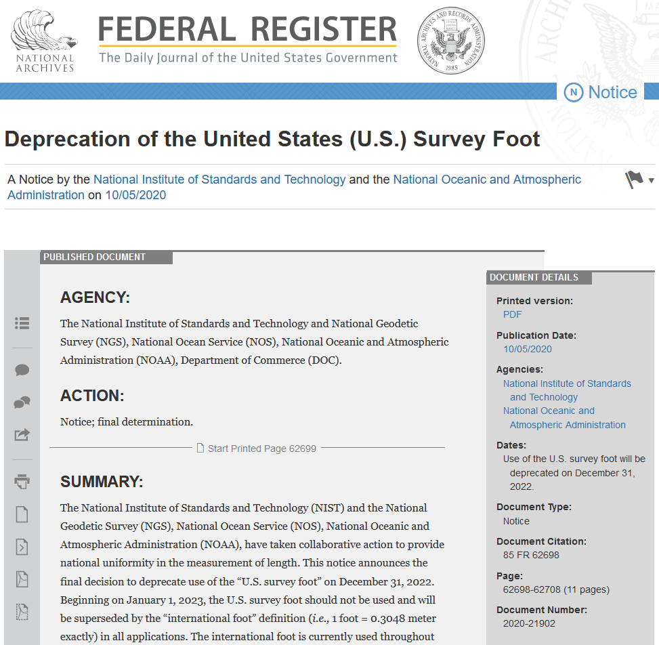
What the deal with this whole U.S. survey foot thing?
Deprecated on Dec 31, 2022
  Per final determination Federal Register Notice issued on Oct 5, 2020
  Collaborative action by National Institute of Science and Technology (NIST) and NGS
  Describes public comments received, along with the plan, resources, training, and other information for an orderly transition with minimum disruption
(this image is hyperlinked to the Federal Register page)

Slide 73
What happens now with SPCS units?
Nothing really! But why?!?! → “orderly fashion with minimum disruption”
Continue to follow state directives for SPCS 83 (and SPCS 27)
  The 40 states that “officially” use U.S. foot for SPCS 83
  All SPCS 27 zones
  NGS will support such “legacy” use forever
  But NOT supported for ANY zones in SPCS2022
Please remember…
NGS will always support
U.S. survey foot for SPCS 83 and 27

Slide 74
Reference Material
https://geodesy.noaa.gov/SPCS/
  click Learn More on left side
  Includes below, recorded webinars, and more
NOAA Special Publication NOS NGS 13
  The State Plane Coordinate System: History, Policy, & Future Directions, Michael L. Dennis, 2018
NOAA Manual NOS NGS 5
  State Plane Coordinate System of 1983, James E. Stern, 1990

Slide 75
https://geodesy.noaa.gov/ADVISORS/
-use any major search engine: “NGS advisors”
Jeff Jalbrzikowski, P.S., GISP, CFS
Appalachian Regional Geodetic Advisor
jeff.jalbrzikowski@noaa.gov
240-988-5486

