Slide 1

Geodesy for the Geographer
Preparing for NSRS Modernization
Pennsylvania GIS Conference
April 2023
Jeff Jalbrzikowski, P.S., GISP, CFS
Appalachian Regional Geodetic Advisor
jeff.jalbrzikowski@noaa.gov
240-988-5486

Slide 2



Organizational Structure
  -Department of Commerce (DoC)
  (~47,000 employees)
  -National Oceanic and Atmospheric Administration (NOAA)
  -National Ocean Service (NOS)
  -National Geodetic Survey (NGS)
  (~175 employees)
Notes:
-We are the Federal Government’s oldest scientific agency.
-part of the Executive Branch
-I know it can seem kind of strange that NGS is part of the NOS, but the origins of NGS lie with the C&GS.
-we are a “Program Office” of the NOS
Survey of the Coast – 1807
Coast Survey – 1836
Coast and Geodetic Survey – 1878
NGS since 1970

Slide 3


Organizational Structure
We’re not USGS, we’re NGS
  -Department of Commerce (DoC)
  (~47,000 employees)
  -National Oceanic and Atmospheric Administration (NOAA)
  -National Ocean Service (NOS)
  -National Geodetic Survey (NGS)
  (~175 employees)
≠
Notes:
-as you can read my slide, I like to point that out because over my 2 years at NGS I’ve seen and heard this misunderstanding quite a bit
-don’t worry! it doesn’t offend us! and we do work closely with USGS, but we are separate agencies within totally different departments of the federal government

Slide 4
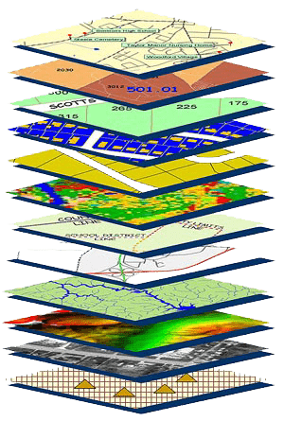
NGS Mission
To define, maintain and provide access to the National Spatial Reference System (NSRS) to meet our Nation’s economic, social, and environmental needs.
NSRS
Notes:
NGS develops and maintains the National Spatial Reference System, a national coordinate system that provides the foundation for transportation, navigation, land record systems, mapping and charting efforts, and a multitude of scientific and engineering applications
CLICK
You’ve all seen this or some similar graphic I’m sure. That bottom layer… that’s our baby, the NSRS.

Slide 5
Modernizing the NSRS
Updating all NSRS coordinates
  Replace existing datums with new datums
  Replacing existing SPCS83 with new SPCS2022
  Accounting for coordinates changing with time
Improving NGS products and services
Simplifying customer contributions
Making the NSRS:
  More accurate
  More accessible
  More efficient
Rollout in
2025

Slide 6
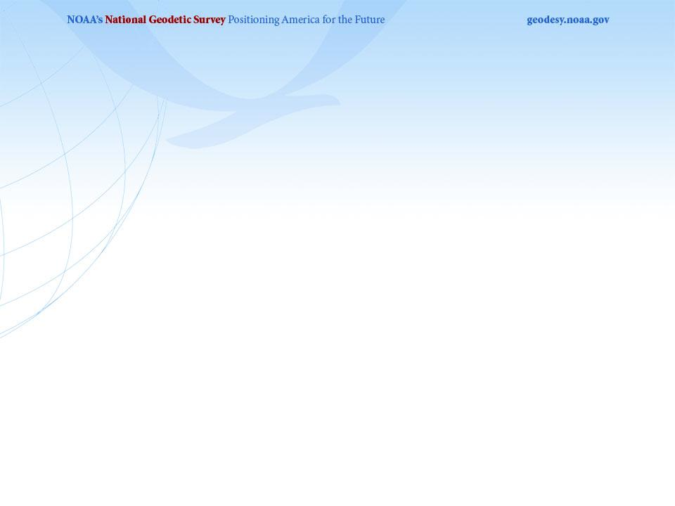
Regional Geodetic Advisor Program
14 RGAs across the country
  2 positions currently filled by temporary details
    Alaska; Mid-Atlantic (being DE, MD, VA, NC, SC, GA, PR, VI)
Plus our Chief of Regional Advisor Branch
  Christine Gallagher
    Recently transitioned from other NGS role
We’re the eyes and ears of the agency
  Support NGS HQ in Silver Spring, MD
  Pester NGS HQ in Silver Spring, MD ☺

Slide 7
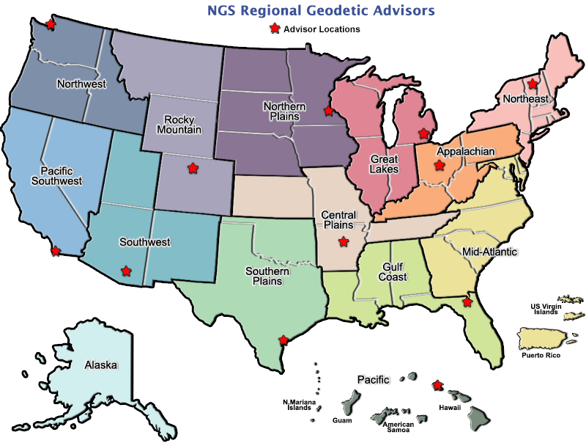
geodesy.noaa.gov/ADVISORS/
Notes:
-14 Regional Advisors, we’ve transitioned from a State-based to a Regional Program
-our advisors homepage up there at the top, also easy to find us by querying any major search engine for “ngs advisors”
-if you know Ross Mackay, he is our Chief Advisor, I report to him…
**ya know, I don’t know why they don’t make him put his photo up here
-we do have one vacant advisor position, that was recently advertised and John up there in Wisconsin is officially retired in oh… 18 days

Slide 8
Regional Geodetic Advisor Program
We are here to support:
  You
  Your constituents or customers
  Our Federal Partners/Agencies
Questions about NSRS Modernization?
  Reach out now
  Be prepared

Slide 9
Terminology - Changing Coordinates
Conversion
    change the type of coordinate
    NAD83(2011) latitude & longitude → NAD83(2011) SPCS
  Transformation
    change the datum of coordinate
    NGVD29 height → NAVD88 height
    NAD 27 latitude & longitude → NAD 83(2011) latitude & longitude
Propagation
    change the epoch of coordinate
    NATRF2022 epoch 2020.00 to NATRF2022 epoch 2023.243
Notes:
Historically NGS has been inconsistent with these top two words.
Going forward, we will use them as:
Conversion: Meaning to change the type of coordinate without changing the datum or frame
Transformation: Meaning to change the datum or frame, without changing the type of coordinate

Slide 10
NATRF2022
North American Terrestrial Reference Frame of 2022
will replace
NAD83
North American Datum of 1983
Technically, not just NATRF2022 but also its sister TRFs…

Slide 11
Four TRFs for Modernized NSRS
North American Terrestrial Reference Frame of 2022
(NATRF2022)
Pacific Terrestrial Reference Frame of 2022
(PATRF2022)
Caribbean Terrestrial Reference Frame of 2022
(CATRF2022)
Mariana Terrestrial Reference Frame of 2022
(MATRF2022)

Slide 12
Plate-Fixed NSRS TRFs
ITRF
Frame = constant
NA Plate = rotating
NATRF
Frame = rotating
(relative to ITRF)
NA Plate = constant
(relative to NATRF2022)
Notes:
We say “NATRF2022” is “fixed” to the N.A. Plate, making it a “plate fixed” frame
-the frame is constant to itself, but rotating within ITRF, and moving in a different direction than the other 3 frames

Slide 13
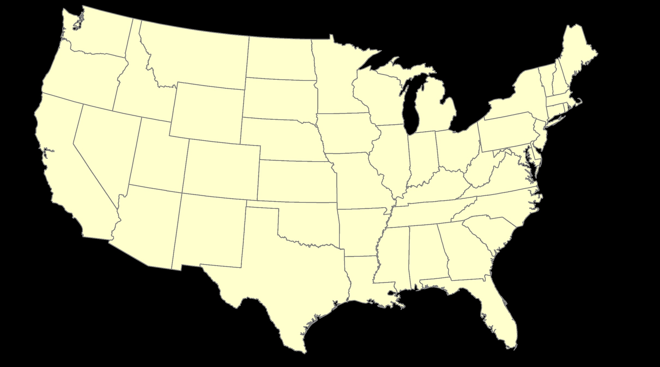
ITRF – constant frame, rotating plate

Slide 14
Plate-Fixed
NATRF – rotating frame, constant with plate

Slide 15
if you know epoch
ITRF or NATRF – your choice if you know epoch

Slide 16
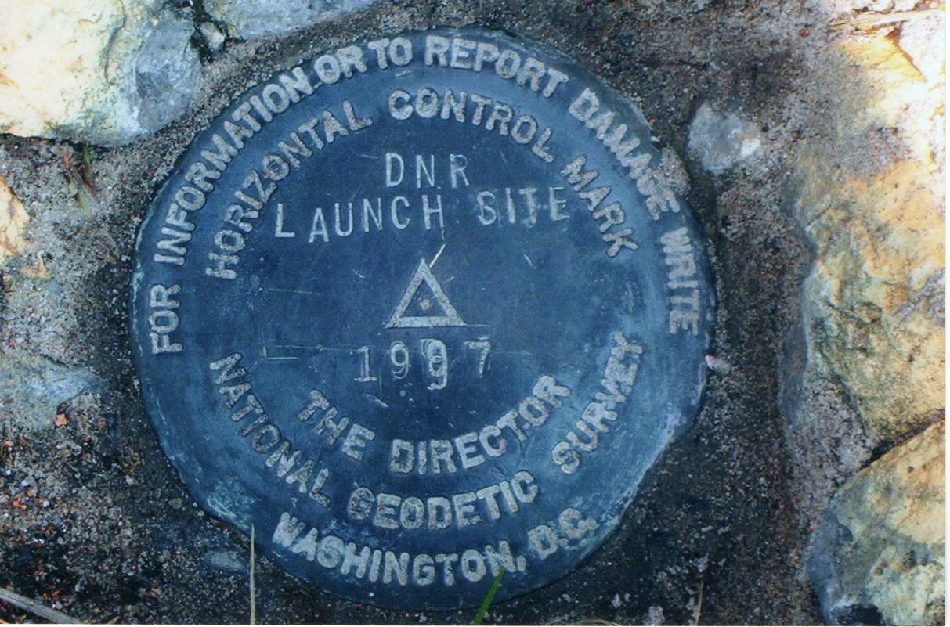
Passive Control

Slide 17
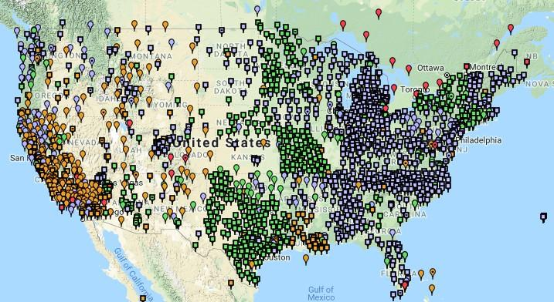
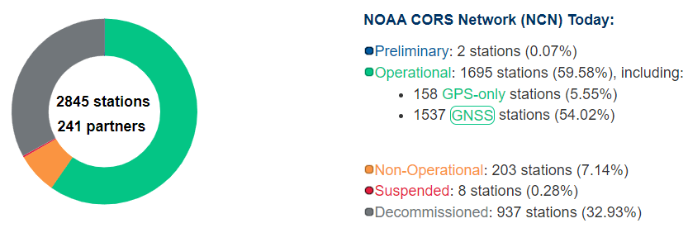
NOAA CORS Network (NCN)
Active Control
1695 sites
241 organizations

Slide 18
Remember…
  What’s the goal of NATRF2022?
    Give you the stability in positions that you expect
  That’s the point of Reference Epochs (REs)
    Akin to the different realizations of NAD83
    REs will be published every 5 or 10 years
      you choose when you update
      we expect many users will adopt our first Reference Epoch Coordinates , then stay on it long term
aka versions
Notes:
REs will be published every 5 or 10 years
-you choose when you update
-in a perfect world, everyone would stay current, but we expect many users will adopt first RE and stay ther

Slide 19
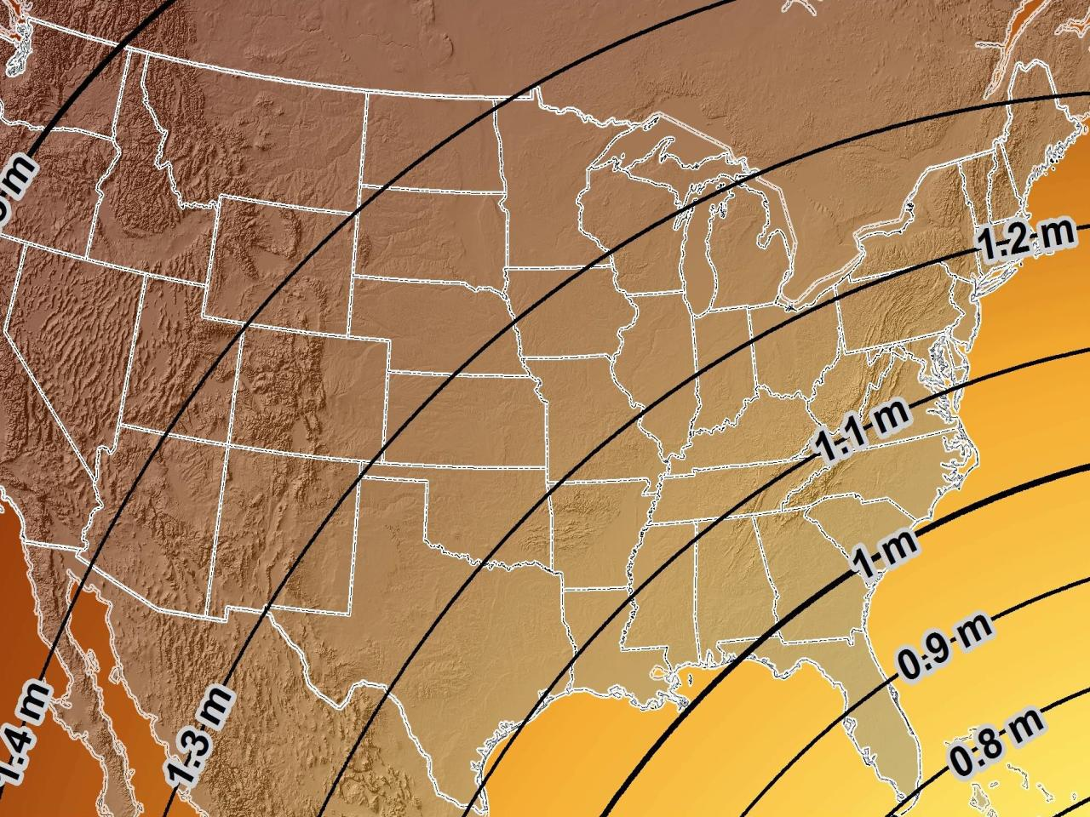
Estimated Geometric Change - Horizontal
NAD83 (2011) → NATRF2022
4.6 ft
Direction of Shift
4.3 ft
3.9 ft
3.6 ft
3.0 ft
Notes:
What’s the magnitude of the horizontal datum shift across Pennsylvania?
Minimum Shift ~3.75 feet
Maximum Shift ~3.97
Remember this is just an estimation, don’t hold me to the numbers please

Slide 20
Preparing for New Datums
  Two factors will dictate your frequency of coordinate updates
    Your accuracy needs
    The region you work in → tectonic motion
      Do manholes need cm-level updates annually?
      We accommodate that… you choose
      Just because we’re chasing the millimeter… it doesn’t mean you need to.
Notes:
What’s the goal of the way NATRF2022 was designed, by including EPP2022 and IFVM2022
For a database of features in PA
Does a database of manholes in PA need cm-level coordinate updates on an annual basis? Probably not.

Slide 21
Preparing for New Datums
  Know the epoch of your data/datasets
    consider how you will track this
      full to-the-second timestamp on every feature?
      labeling a year for each dataset?
      something in-between that works for your needs?

Slide 22
Preparing for New Datums
  Reprocessing your data
    in a perfect world, everyone would reprocess
      What does this really mean?
        consider a hydro-enforced DEM
          start over with the raw flight data (GNSS/IMU)
          generate new point clouds
          recreate all the drainage features in new datum
      unrealistic!
Notes:
this is totally unrealistic → both from a financial and programmatic perspective

Slide 23
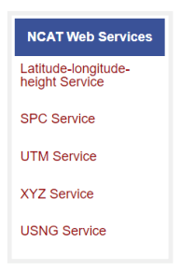
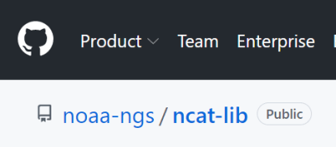
Preparing for New Datums
  Transforming your data
    NGS Coordinate Conversion and Transformation Tool
      ASCII up/download, Web Services, or Download
      Source code on GitHub → github.com/noaa-ngs
      ask your software provider(s) about integration
        we envision COTS integrations as most popular method of access
Notes:
Transforming your data
NCAT - NGS Coordinate Conversion and Transformation Tool
available now: ASCII upload and Web Services
ask your software providers about integration
we envision this as most popular method of access
Industry Workshops - May 2021 and August 2022
-Esri, Trimble, Blue Marble, etc… all the well known names attended
Geospatial Software Developers’ Summit – Nov/Dec
- International & Virtual → US NGS and NRCan CGS

Slide 24
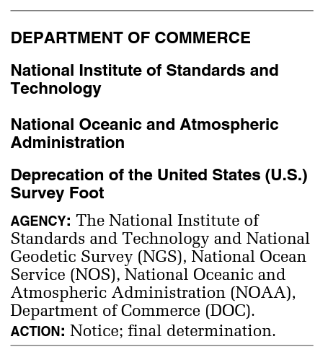
What happened to the US Survey Foot?
Deprecated 31 December 2022
Which begs the question
  What should you
  be doing now?

Slide 25
2 parts per million (ppm)?
1,000,000.00 sft = 999,998.00 ift
10,000,000.00 sft = 9,999,980.00 ift
1,000.00 sft = 999.998 ift (can you measure that?)
International → 1 ft = .3048 m
US → 1 ft = .30480061 m (approx.)

Slide 26
What should you be doing now?
Ask the right questions
  Does state law specify US Foot for SPCS83?
    40 states do that we know of
  Does it specify US Foot for boundary surveys? (Does that matter?)
    We’re not tracking that, it’s not NSRS-related
Understand that we do not enforce this
  Neither NIST or NGS are a regulatory agency
  We support education/outreach of course
Prepare for this along with new datums

Slide 27
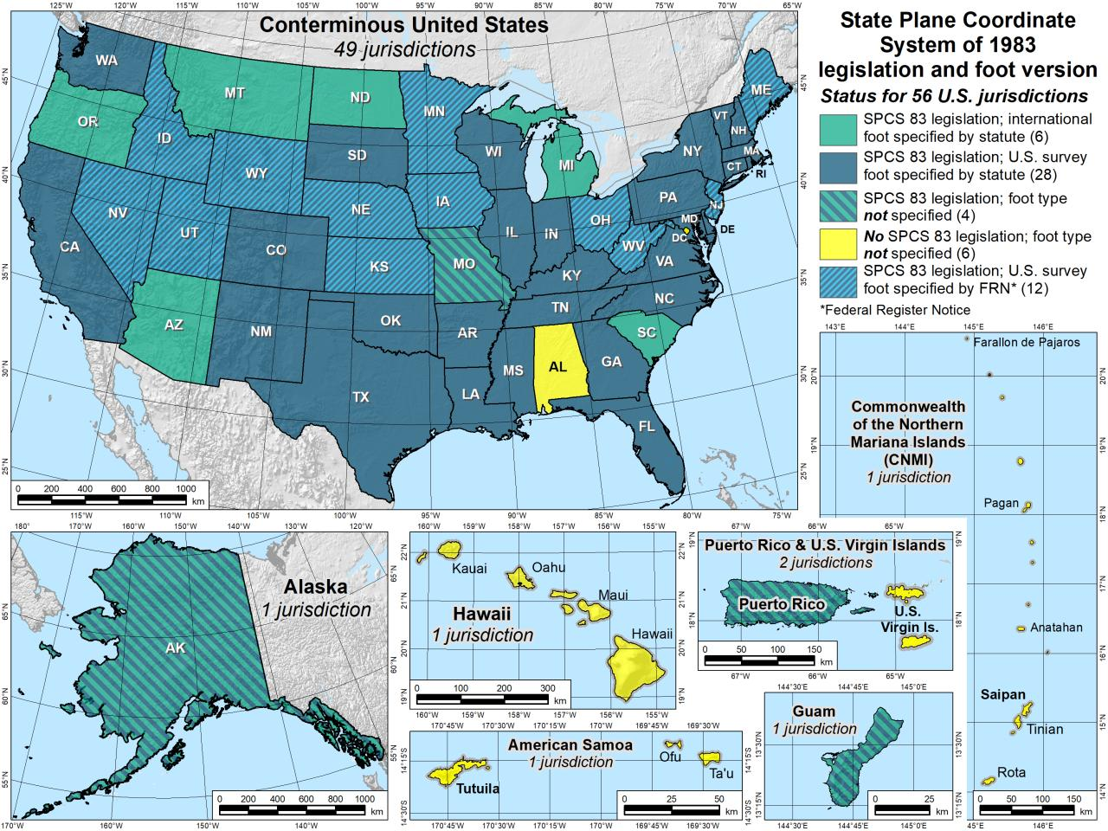

Slide 28
The Survey Foot is dead!
Long live the Survey Foot!
US Survey Foot was deprecated 31 December 2022…
But will always be available in NGS tools for NAD83 and NAD27

Slide 29

I’ll be selling these bumper stickers on LinkedIn…
SPCS2022
MAKING EARTH FLAT AGAIN
…ONE ZONE AT A TIME
Really?
No… not really!

Slide 30
State Plane Coordinate System of 1983
SPCS83
North and South Zones as they exist now
Notes:
We start with the SPCS83 zones as a frame of reference
NOTE that the color shading of these zones is matched to that of the Preliminary SPCS2022 Zones that follow

Slide 31
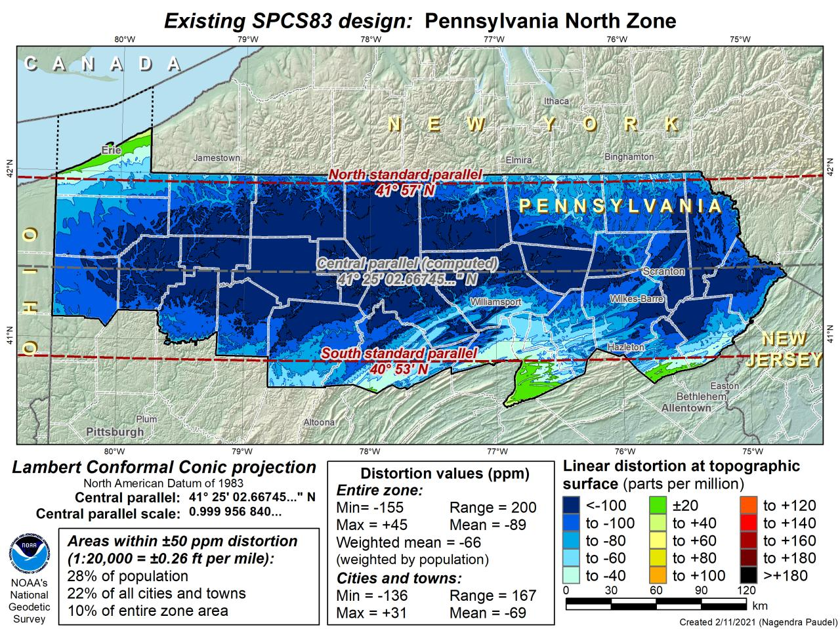
DRAFT

Slide 32
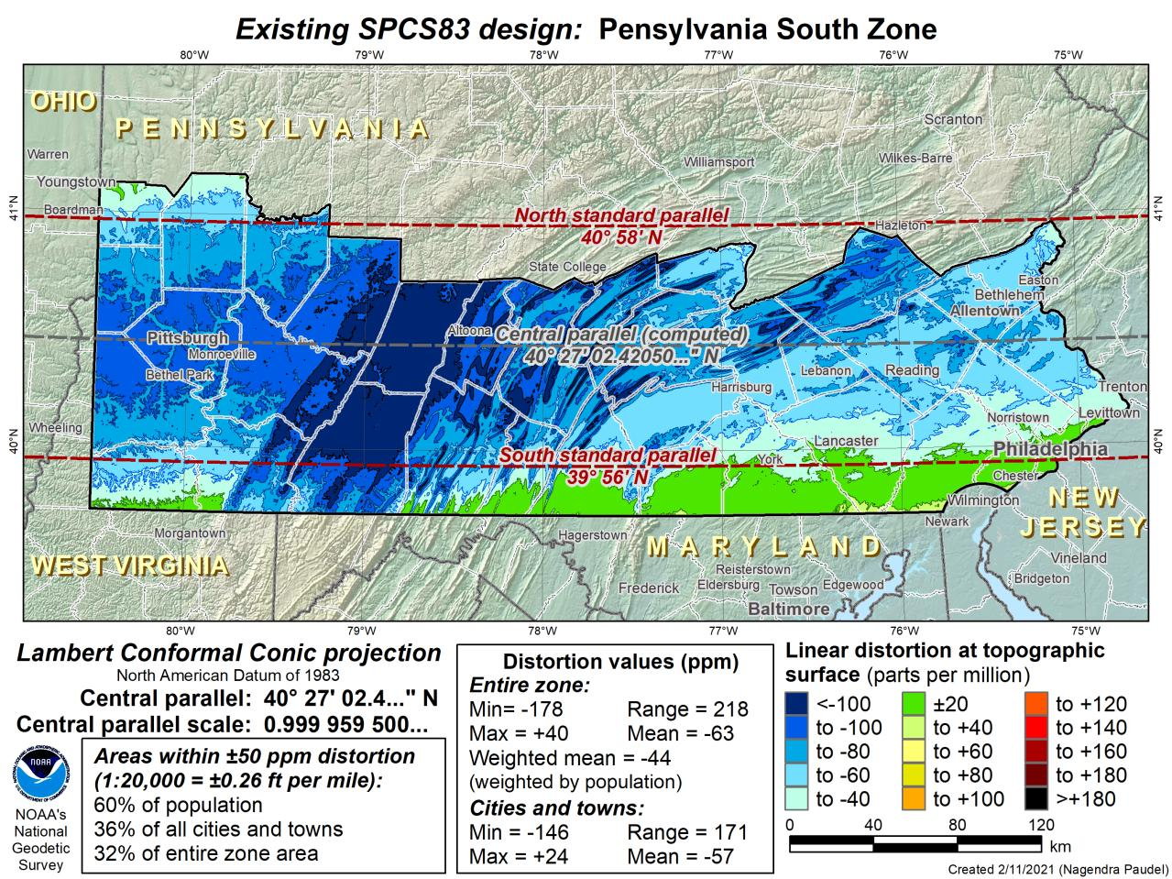
DRAFT

Slide 33
State Plane Coordinate System of 2022
SPCS2022
PA stakeholders requested 4-5 zones, which NGS designed, the following are Preliminary maps
Notes:
The following section illustrates the preliminary SPCS2022 zones
There are 4 zones in the NGS design, per request that we design “4-5 zones required to meet the minimum distortion acceptable” set by our design criteria of 50ppm
NOTE the request also included wording: “It is also requested that PennDOT districts be divded into no more than two zones”

Slide 34
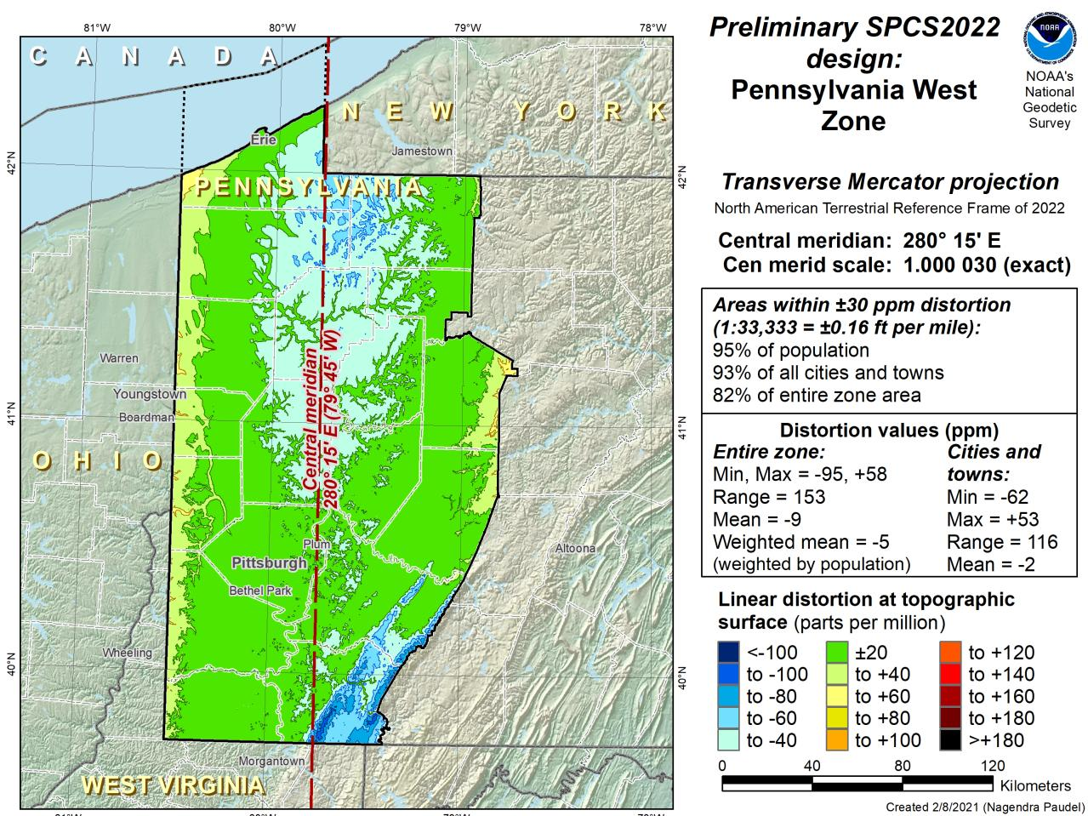
Notes:
NOTE that the West Zone far surpasses the NGS design criteria of 50ppm

Slide 35
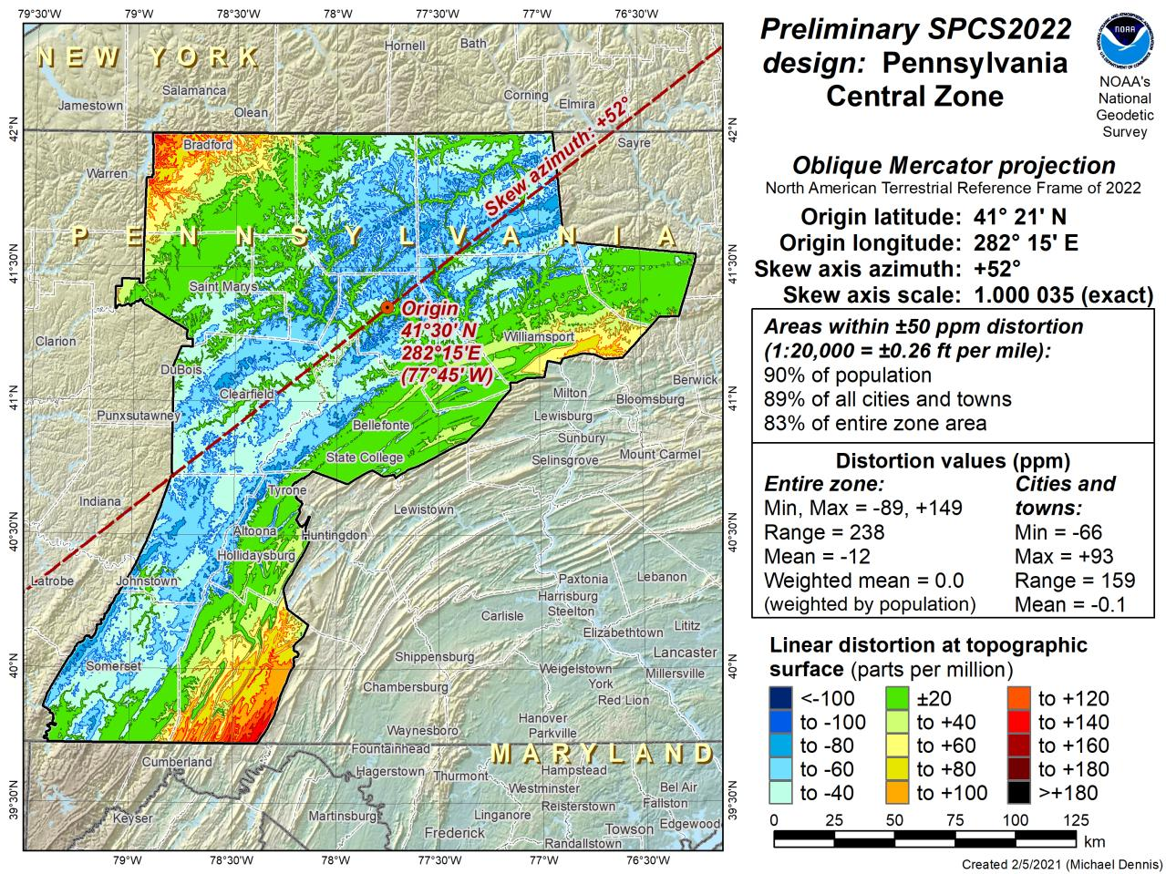
Notes:
This is the first, and likely final, draft of an Oblique Mercator projection for the Preliminary Central Zone
NOTE that even with the

Slide 36
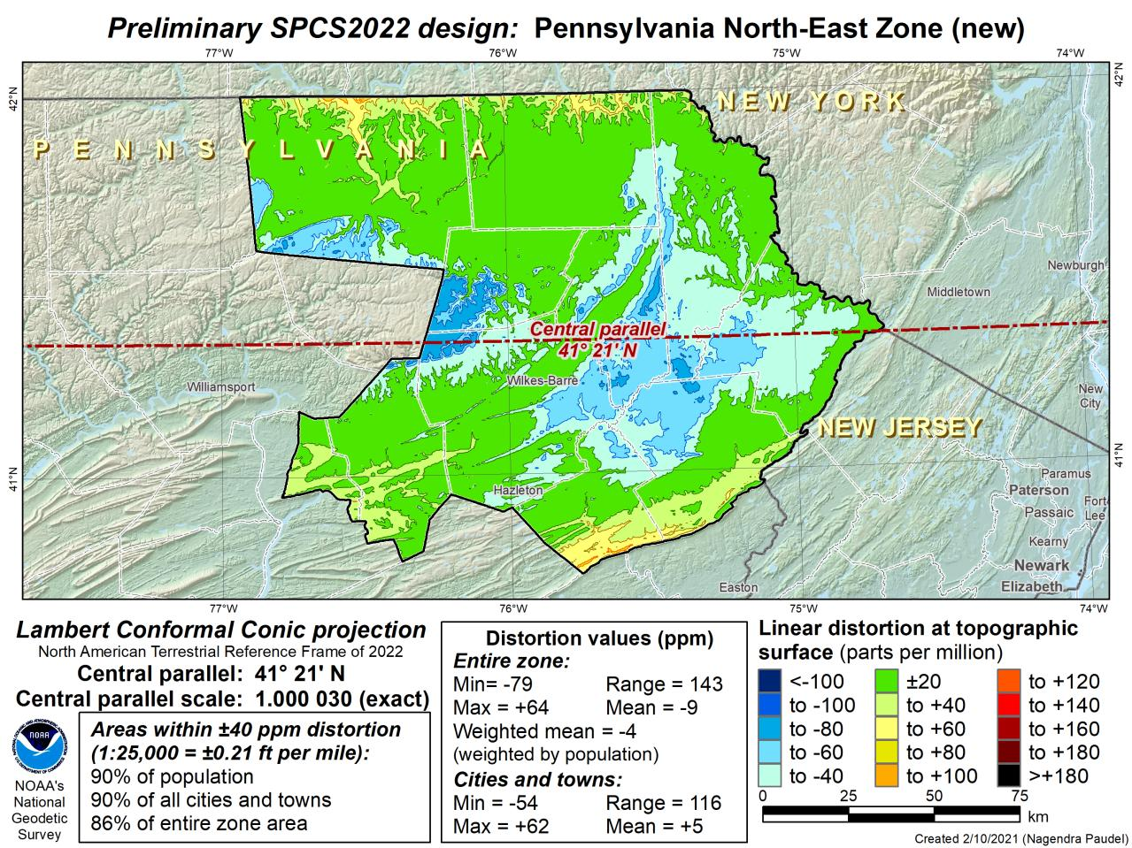
Notes:
This is the second draft of a Preliminary North East Zone
NOTE this includes Columbia and Montour Counties, and the animation highlights the comparison between having these counties in the SE or NE Zone

Slide 37
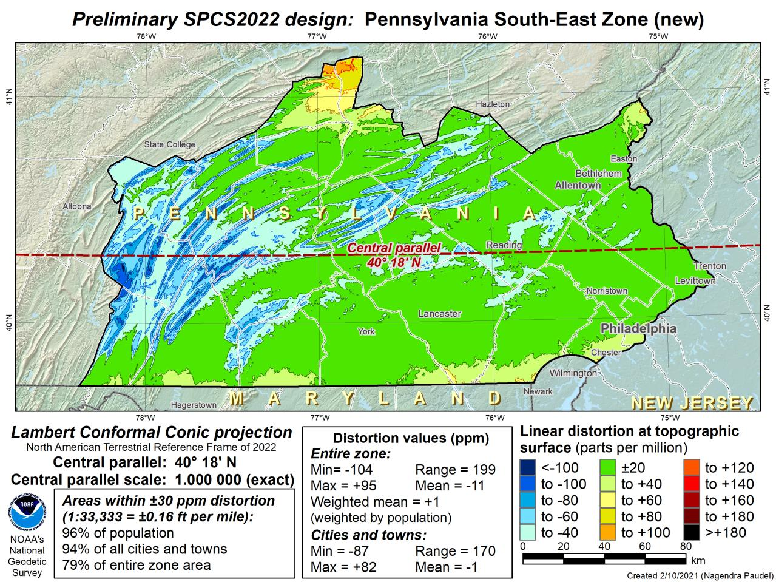
Notes:
This is the second draft of a Preliminary South East Zone
NOTE this excludes Columbia and Montour Counties (they would fall in SE Zone)

Slide 38
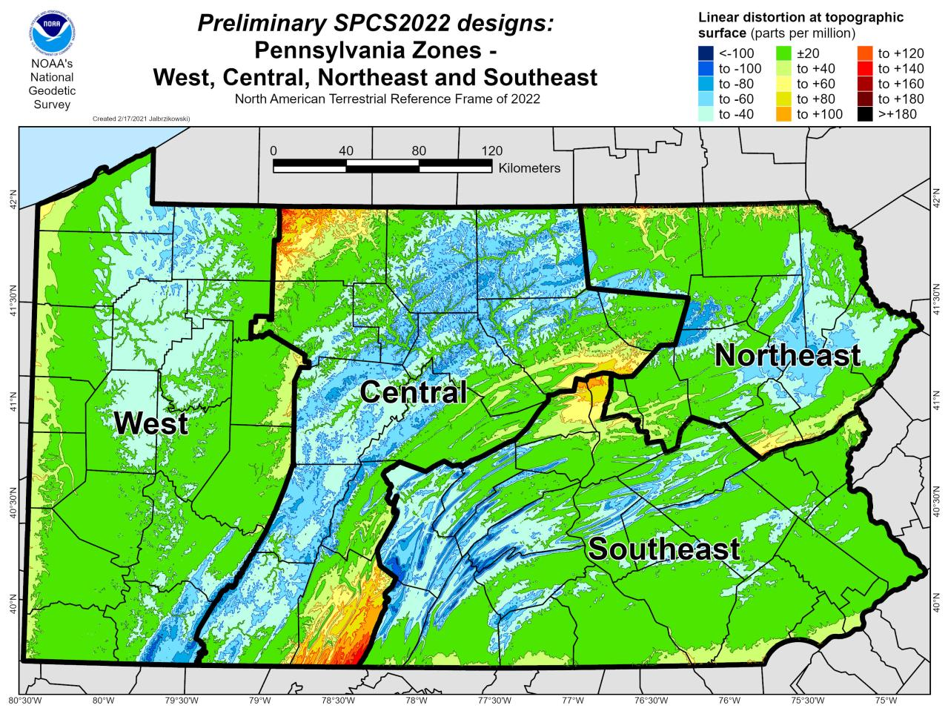

Slide 39
State Plane Coordinate System of 2022
SPCS2022
NGS will create a Single Statewide Zone for every State, the following is a Preliminary map

Slide 40
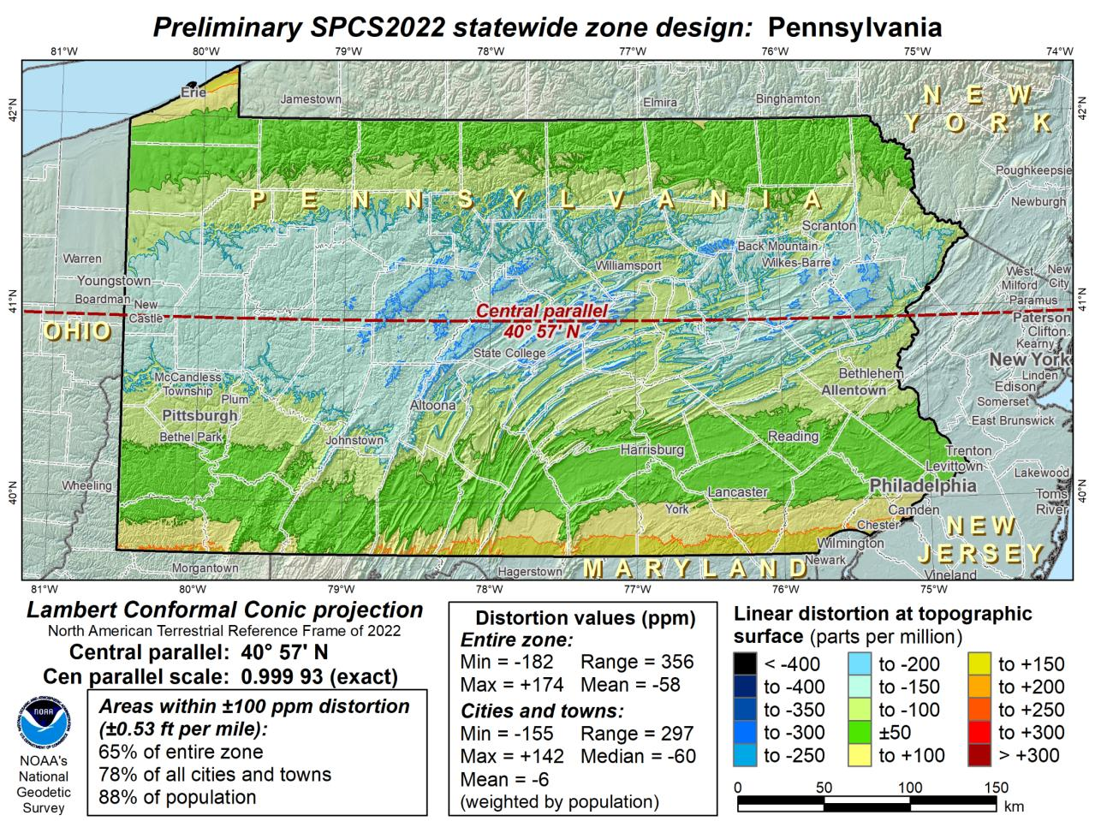
Notes:
This Single Statewide Zone designed by NGS is color shaded to match the following section of slides that show UTM Zones linear distortion values
It is known that some user communities with large areas of responsibility choose to maintain geospatial data and work in UTM
This graphic as compared to the UTM serves to highlight in SPCS2022, users will see better performance (lower linear distortion) if they choose to work in the SPCS2022 Single Statewide Zone rather than one of the UTM Zones that fall within Pennsylvania

Slide 41
UTM (NAD83) Zones as
UTM
The following are maps using existing UTM zones as a Single Statewide Zone
(included to highlight the lower performance as compared to Preliminary NGS Zone)

Slide 42
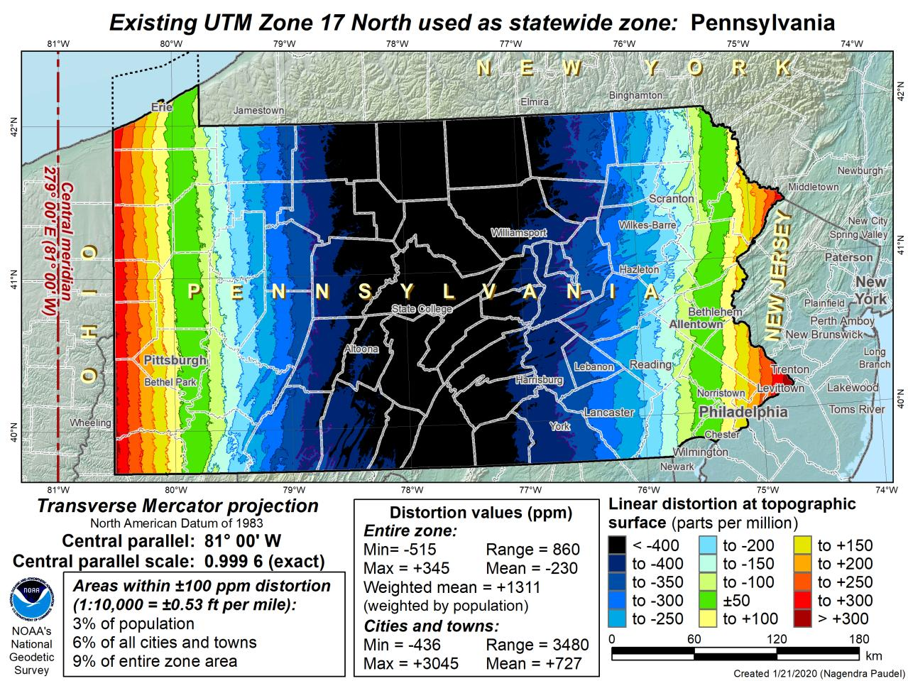

Slide 43
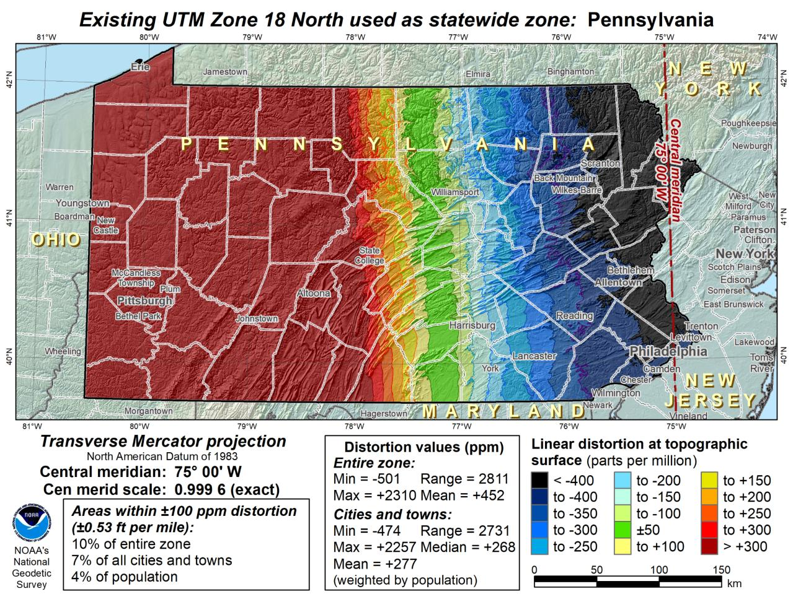

Slide 44
Notes:
The NGS designed preliminary single statewide zone is included again here at the end for easier visual comparisons.

Slide 45
SPCS2022 Zone Layers in PA
Both Single Statewide and Multi-Zone Layers will coexist
Think about your data, your goals, your customers
  Remember that geographic coordinates are your friend!
Smaller zones not “the best” … it all depends on usage & goals

Slide 46
SPCS2022 Zone Layers and LDPs
Each state may have max of 3 zone “layers”
  One layer must be statewide zone
    PA Single Statewide
  Other layers have two or more zones
    PA Multi-Zone (West, Central, Northeast, Southeast)
  Only one layer can have discontinuous coverage
    Left open for possibilities
Multi-zone layer can consist of LDPs
  Designed by stakeholder “contributing partners”
    NGS will not do this for stakeholders
  LDP coverage can be discontinuous

Slide 47
What to do with the existing tiling scheme in NATRF2022?
Maintain same footprints, so uneven coordinates at corners?
New footprints, but cleaner coordinates? Both options?

Slide 48
North American Vertical Datum
of 1988
NAVD88
will be replaced by

Slide 49
North American-Pacific Geopotential Datum of 2022
NAPGD2022
(pronounced: nap-jee-dee)

Slide 50
NAVD88 geoids
versus
NAPGD2022 geoids

Slide 51
Two types of geoid models
  Gravimetric
  Hybrid
Notes:
-believe it or not there’s more than 2 types, but the 2 types you’ll see NGS publish are…

Slide 52
Gravimetric → Hybrid
  Gravimetric geoid is created from “scratch” with various types of gravity data
      USGG2003, USGG2009, USGG2012, xGEOID19
  Hybrid geoid is simply a gravimetric geoid then best fit some vertical datum… like NAVD88
      GEOID03, GEOID09, GEOID12B, GEOID18
Notes:
So… all the geoids you’re using to get elevations from your GNSS data

Slide 53
Gravimetric → Hybrid
      USGG2003, USGG2009, USGG2012, xGEOID19
      GEOID03, GEOID09, GEOID12B, GEOID18
best fit to NAVD88
best fit to NAVD88
best fit to NAVD88
best fit to NAVD88
Notes:
So… all the geoids you’re using to get elevations from your GNSS data

Slide 54
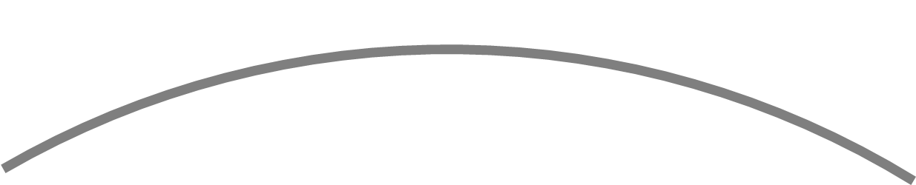
Gravimetric vs. Hybrid Geoid
topographic surface
gravimetric geoid
hybrid
geoid
datum zero
surface
Concept

Slide 55
NAVD88 uses a Hybrid Geoid
topographic surface
gravimetric geoid
hybrid
geoid
datum zero
surface
Concept

Slide 56
NAPGD2022 uses a Gravimetric Geoid
topographic surface
gravimetric geoid
datum zero
surface
  Datum zero surface aligned to Global Mean Sea Level (GMSL)
Concept

Slide 57
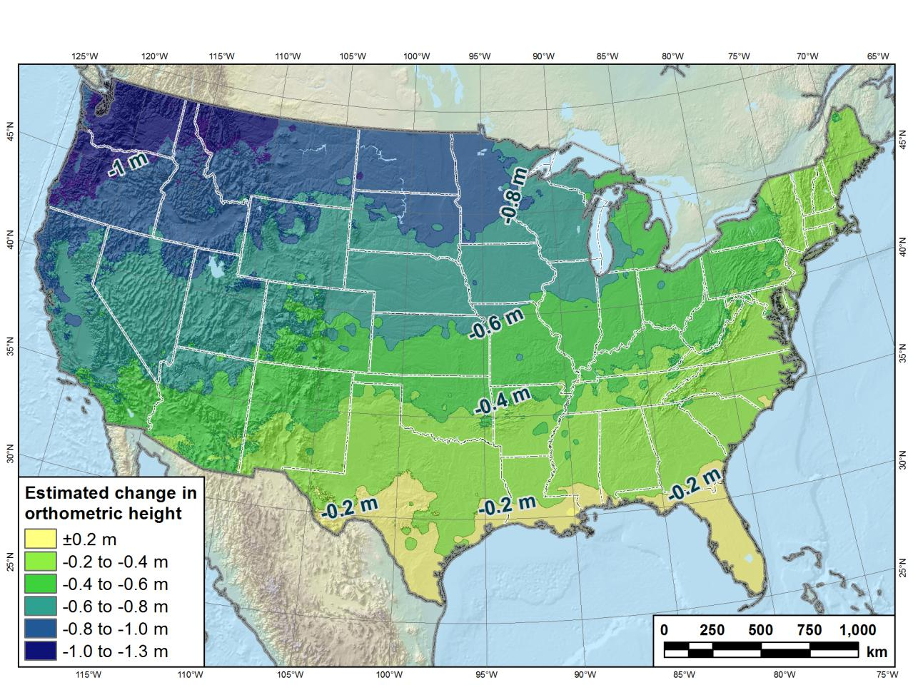
Estimated change in orthometric heights from NAVD88 to NAPGD2022
Change in Pennsylvania:
At least -0.6 feet
At most -2.0 feet
(NAPGD2022 approximated using xGEOID16B)

Slide 58
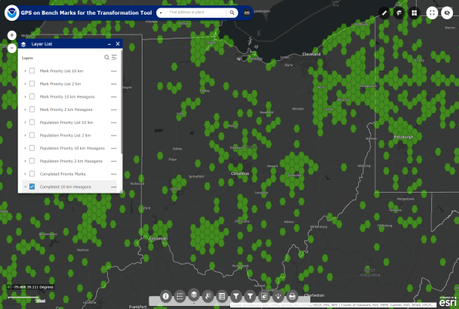
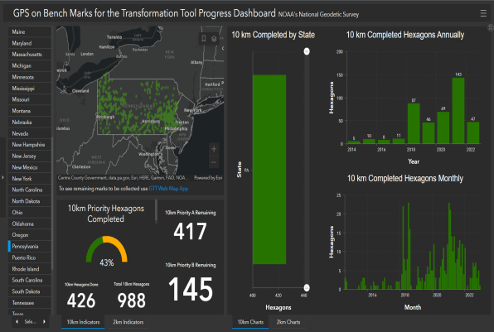

Quality of vertical datum transformation?
GPS on Bench Marks (GPSonBM)
Anyone can collect and provide:
  2 OPUS-Static solutions
    ≥4 hours each
  2 photos of each setup
  Brief Description w/Ties
  Deadline = 30 September 2023
  Results increase accuracy of NAVD88<->NAPGD2022 transformation.
Web Map Application
Progress Dashboard

Slide 59
The Survey Foot is dead!
Long live the Survey Foot!
US Survey Foot was deprecated 31 December 2022… now what?!?
Notes:
We start with the SPCS83 zones as a frame of reference
NOTE that the color shading of these zones is matched to that of the Preliminary SPCS2022 Zones that follow

Slide 60
What happened to the US Survey Foot?
Deprecated 31 December 2022
Which begs the question
  What should you
  be doing now?

Slide 61
What should you be doing now?
Prepare for this along with new datums
Understand this is not enforced
  Neither NIST or NGS are a regulatory agency
  We support education/outreach of course
  But OPUS, NCAT, etc. will not have US Survey Foot options/output in SPCS2022 zones

Slide 62
2 parts per million (ppm)?
1,000,000.00 sft = 999,998.00 ift
10,000,000.00 sft = 9,999,980.00 ift
1,000.00 sft = 999.998 ift (can you measure that?)
International → 1 ft = .3048 m
US → 1 ft = .30480061 m (approx.)

Slide 63
The Survey Foot is dead!
Long live the Survey Foot!
US Survey Foot was deprecated 31 December 2022…
But will always be available in NGS tools for NAD83 and NAD27

Slide 64
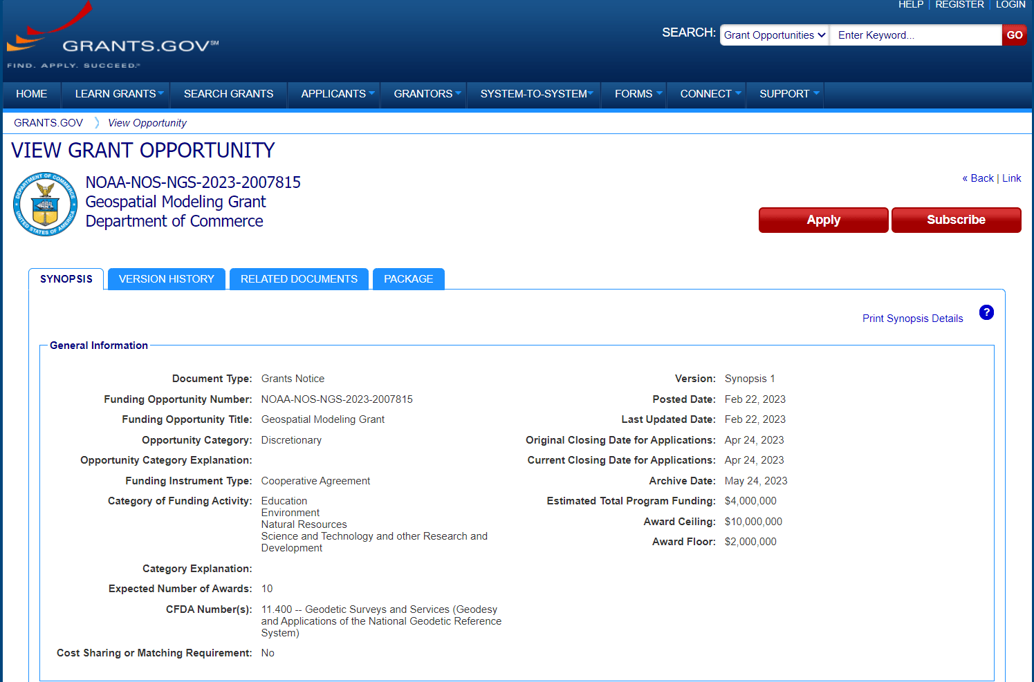
Notes:
Eligible funding applicants for this competition are institutions of higher education, state, local and Indian tribal governments.
The purpose of this notice is for us to solicit grant proposals to implement activities that modernize and improve the National Spatial Reference System (NSRS) and advance the science of geodesy in the United States.
NOAA encourages proposals submitted in response to this announcement to include student collaboration and education.

Slide 65
Jeff Jalbrzikowski, P.S., GISP, CFS
Appalachian Regional Geodetic Advisor
jeff.jalbrzikowski@noaa.gov
240-988-5486
https://www.ngs.noaa.gov/ADVISORS/
use any major search engine: “NGS advisors”

