Slide 1
Geodesy for the Geographer Preparing for NSRS Modernization
NSGIC Midyear Meeting
February 2023
Jeff Jalbrzikowski, P.S., GISP, CFS
Appalachian Regional Geodetic Advisor
jeff.jalbrzikowski@noaa.gov
240-988-5486

Slide 2
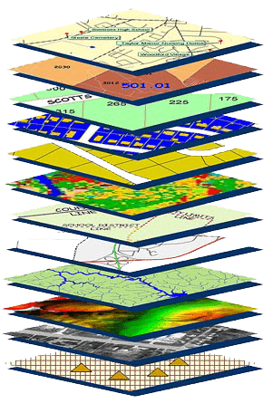
NGS Mission
To define, maintain and provide access to the National Spatial Reference System (NSRS) to meet our Nation’s economic, social, and environmental needs.
NSRS
Notes:
NGS develops and maintains the National Spatial Reference System, a national coordinate system that provides the foundation for transportation, navigation, land record systems, mapping and charting efforts, and a multitude of scientific and engineering applications
CLICK
You’ve all seen this or some similar graphic I’m sure. That bottom layer… that’s our baby, the NSRS.

Slide 3
Modernizing the NSRS
Updating all NSRS coordinates
Replace existing datums with new datums
Replacing existing SPCS83 with new SPCS2022
Accounting for coordinates changing with time
Improving NGS products and services
Simplifying customer contributions
Making the NSRS:
More accurate
More accessible
More efficient
Rollout in
2025

Slide 4
Regional Geodetic Advisor Program
14 RGAs across the country
2 positions currently filled by temporary details
Alaska; Mid-Atlantic (being DE, MD, VA, NC, SC, GA, PR, VI)
Plus our Chief of Regional Advisor Branch
Christine Gallagher
Recently transitioned from other NGS role
We’re the eyes and ears of the agency
Support NGS HQ in Silver Spring, MD
Pester NGS HQ in Silver Spring, MD ☺

Slide 5
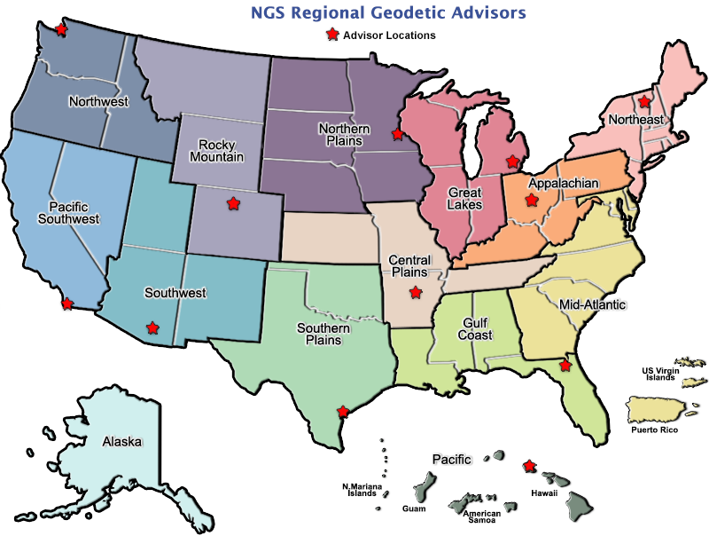
geodesy.noaa.gov/ADVISORS/
Notes:
-14 Regional Advisors, we’ve transitioned from a State-based to a Regional Program
-our advisors homepage up there at the top, also easy to find us by querying any major search engine for “ngs advisors”
-if you know Ross Mackay, he is our Chief Advisor, I report to him…
**ya know, I don’t know why they don’t make him put his photo up here
-we do have one vacant advisor position, that was recently advertised and John up there in Wisconsin is officially retired in oh… 18 days

Slide 6
State Geodetic Coordinators
Not an NGS employee, rather:
State/Commonwealth government
DOT survey lead
Geospatial Information Officer
CORS or RTN (GPS/GNSS network) manager
Academia
Professor or Program Director
Professional society representative
Serves as a liaison between that geospatial community and the NGS RGA→HQ
Notes:
-The State Geodetic Coordinator is not employed by NGS and is typically assigned by a state government agency or university.
-This is not a role we require or request in any way, the goal for the SGC is to allow a self-appointment from any state/commonwealth that is interested
-There are a handful of states also that have designated more than one SGC, thar

Slide 7
State Geodetic Coordinators

Slide 8
Regional Geodetic Advisor Program
We are here to support:
You
Your constituents or customers
Our Federal Partners/Agencies
Questions about NSRS Modernization?
Feel free to send your people to us!

Slide 9
Terminology - Changing Coordinates
Conversion
change the type of coordinate
NAD83(2011) latitude & longitude → NAD83(2011) SPCS
Transformation
change the datum of coordinate
NGVD29 height → NAVD88 height
NAD 27 latitude & longitude → NAD 83(2011) latitude & longitude
Propagation
change the epoch of coordinate
NATRF2022 epoch 2020.00 to NATRF2022 epoch 2023.243
Notes:
Historically NGS has been inconsistent with these top two words.
Going forward, we will use them as:
Conversion: Meaning to change the type of coordinate without changing the datum or frame
Transformation: Meaning to change the datum or frame, without changing the type of coordinate

Slide 10
NATRF2022
North American Terrestrial Reference Frame of 2022
will replace
NAD83
North American Datum of 1983
Technically, not just NATRF2022 but also its sister TRFs…

Slide 11
Four TRFs for Modernized NSRS
North American Terrestrial Reference Frame of 2022
(NATRF2022)
Pacific Terrestrial Reference Frame of 2022
(PATRF2022)
Caribbean Terrestrial Reference Frame of 2022
(CATRF2022)
Mariana Terrestrial Reference Frame of 2022
(MATRF2022)

Slide 12
Plate-Fixed NSRS TRFs
ITRF
Frame = constant
NA Plate = rotating
NATRF
Frame = rotating
(relative to ITRF)
NA Plate = constant
(relative to NATRF2022)
Notes:
We say “NATRF2022” is “fixed” to the N.A. Plate, making it a “plate fixed” frame
-the frame is constant to itself, but rotating within ITRF, and moving in a different direction than the other 3 frames

Slide 13
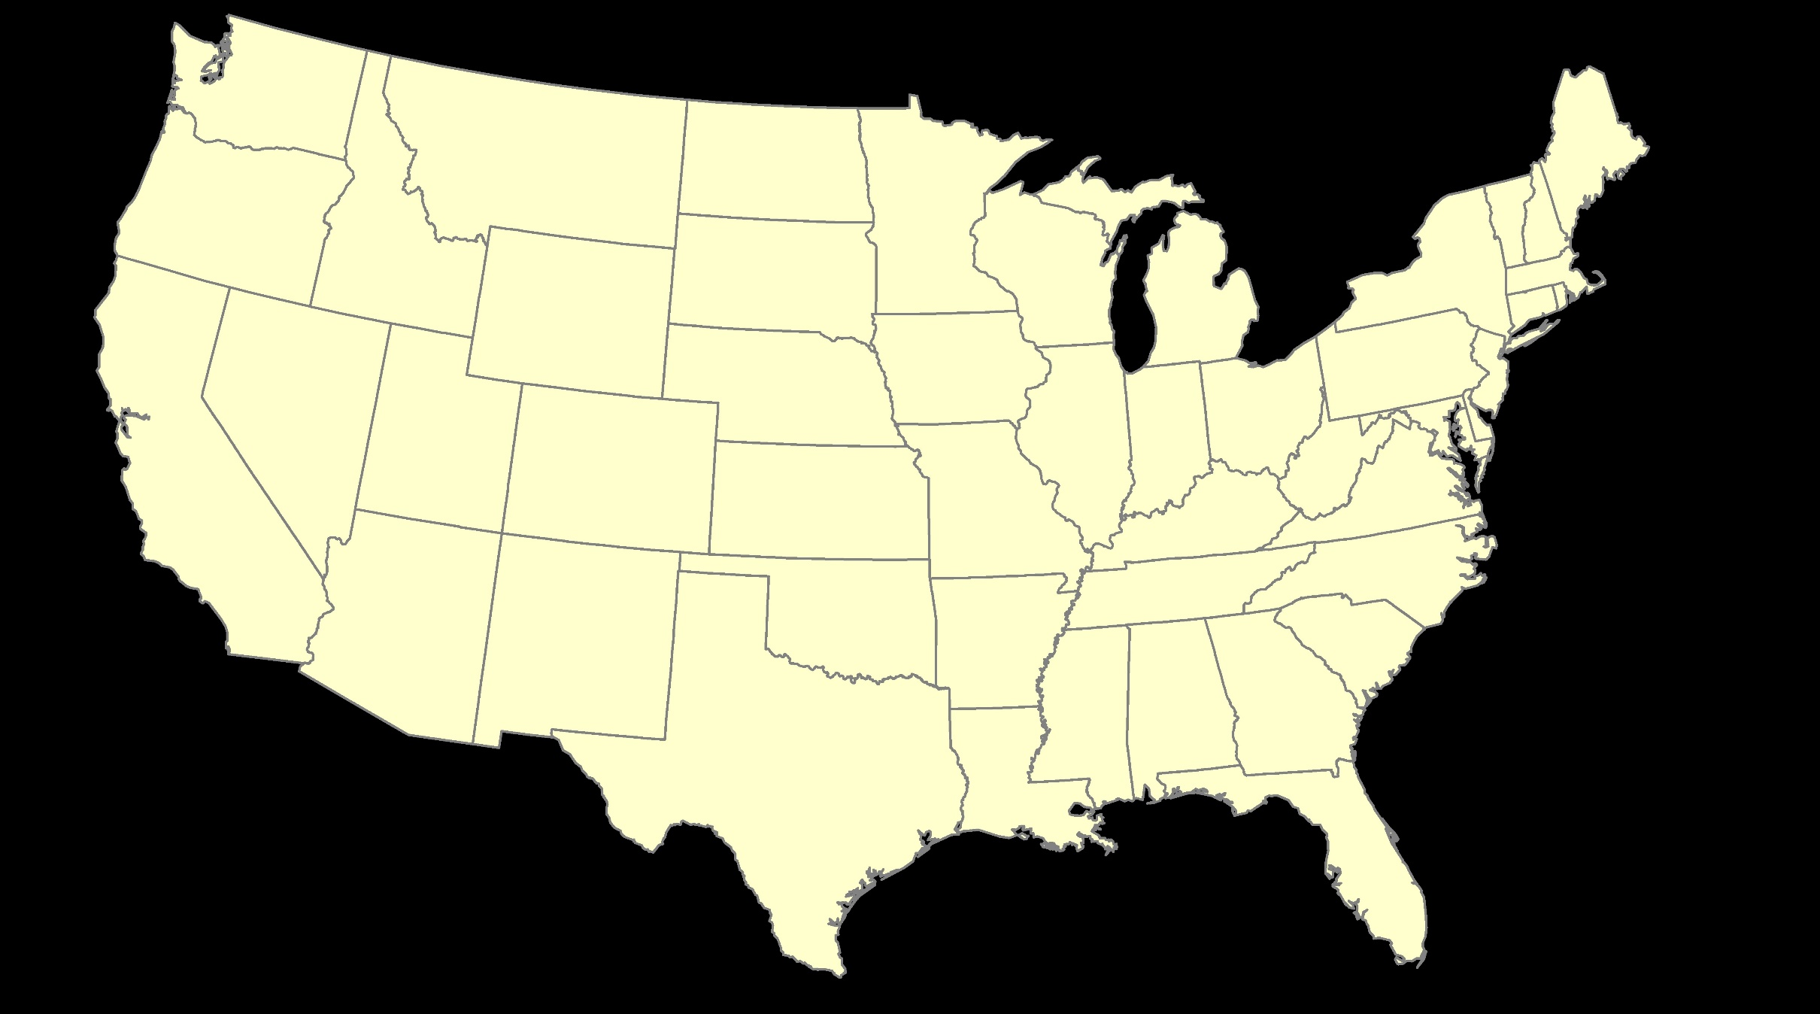
ITRF – constant frame, rotating plate

Slide 14
Plate-Fixed
NATRF – rotating frame, constant with plate

Slide 15
if you know epoch
ITRF or NATRF – your choice if you know epoch

Slide 16
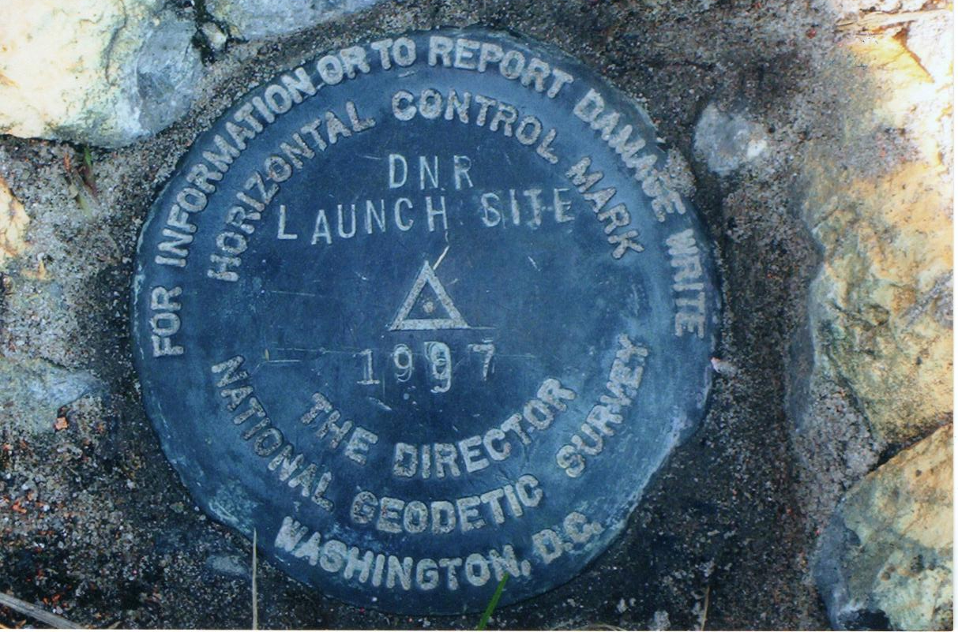
Passive Control

Slide 17
NOAA CORS Network (NCN)
Active Control
1695 sites
241 organizations

Slide 18
Remember…
What’s the goal of NATRF2022?
Give you the stability in positions that you expect
That’s the point of Reference Epochs (REs)
Akin to the different realizations of NAD83
REs will be published every 5 or 10 years
you choose when you update
we expect many users will adopt our first Reference Epoch Coordinates , then stay on it long term
aka versions
Notes:
REs will be published every 5 or 10 years
-you choose when you update
-in a perfect world, everyone would stay current, but we expect many users will adopt first RE and stay ther

Slide 19
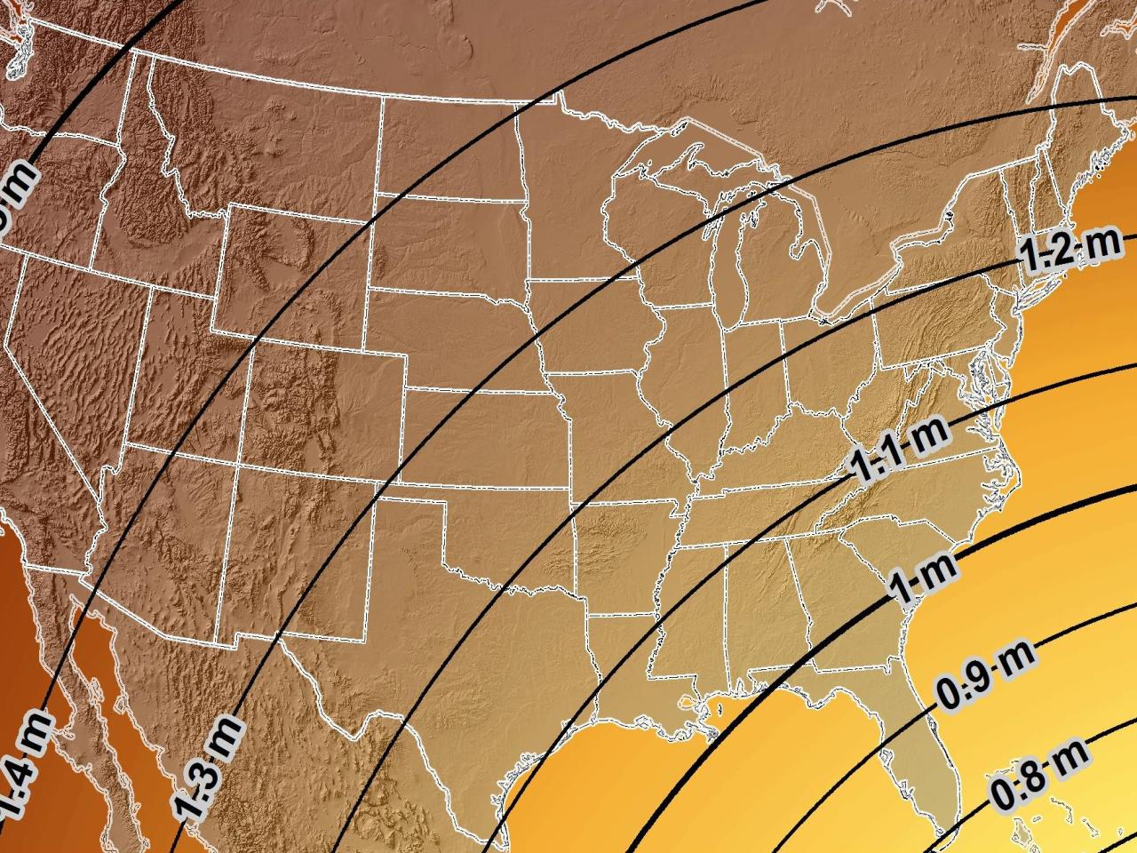
Estimated Geometric Change - Horizontal
NAD83 (2011) → NATRF2022
4.6 ft
Direction of Shift
4.3 ft
3.9 ft
3.6 ft
3.0 ft
Notes:
What’s the magnitude of the horizontal datum shift across Pennsylvania?
Minimum Shift ~3.75 feet
Maximum Shift ~3.97
Remember this is just an estimation, don’t hold me to the numbers please

Slide 20
Preparing for New Datums
Two factors will dictate your frequency of coordinate updates
Your accuracy needs
The region you work in → tectonic motion
Do manholes need cm-level updates annually?
We accommodate that… you choose
Just because we’re chasing the millimeter… it doesn’t mean you need to.
Notes:
What’s the goal of the way NATRF2022 was designed, by including EPP2022 and IFVM2022
For a database of features in PA
Does a database of manholes in PA need cm-level coordinate updates on an annual basis? Probably not.

Slide 21
Preparing for New Datums
Know the epoch of your data/datasets
consider how you will track this
full to-the-second timestamp on every feature?
labeling a year for each dataset?
something in-between that works for your needs?

Slide 22
Preparing for New Datums
Reprocessing your data
in a perfect world, everyone would reprocess
What does this really mean?
consider a hydro-enforced DEM
start over with the raw flight data (GNSS/IMU)
generate new point clouds
recreate all the drainage features in new datum
unrealistic!
Notes:
this is totally unrealistic → both from a financial and programmatic perspective

Slide 23
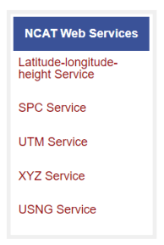
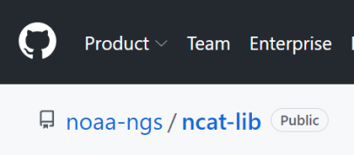
Preparing for New Datums
Transforming your data
NGS Coordinate Conversion and Transformation Tool
ASCII up/download, Web Services, or Download
Source code on GitHub → github.com/noaa-ngs
ask your software provider(s) about integration
we envision COTS integrations as most popular method of access
Notes:
Transforming your data
NCAT - NGS Coordinate Conversion and Transformation Tool
available now: ASCII upload and Web Services
ask your software providers about integration
we envision this as most popular method of access
Industry Workshops - May 2021 and August 2022
-Esri, Trimble, Blue Marble, etc… all the well known names attended
Geospatial Software Developers’ Summit – Nov/Dec
- International & Virtual → US NGS and NRCan CGS

Slide 24
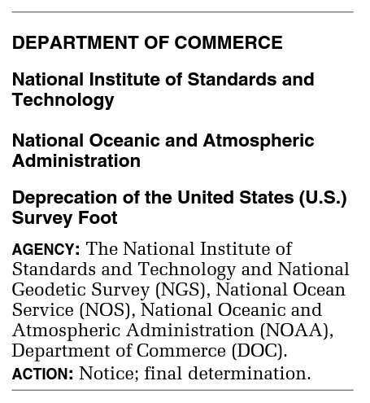
What happened to the US Survey Foot?
Deprecated 31 December 2022
Which begs the question
What should you
be doing now?

Slide 25
2 parts per million (ppm)?
1,000,000.00 sft = 999,998.00 ift
10,000,000.00 sft = 9,999,980.00 ift
1,000.00 sft = 999.998 ift (can you measure that?)
International → 1 ft = .3048 m
US → 1 ft = .30480061 m (approx.)

Slide 26
What should you be doing now?
Ask the right questions
Does state law specify US Foot for SPCS83?
40 states do that we know of
Does it specify US Foot for boundary surveys? (Does that matter?)
We’re not tracking that, it’s not NSRS-related
Understand that we do not enforce this
Neither NIST or NGS are a regulatory agency
We support education/outreach of course
Prepare for this along with new datums

Slide 27
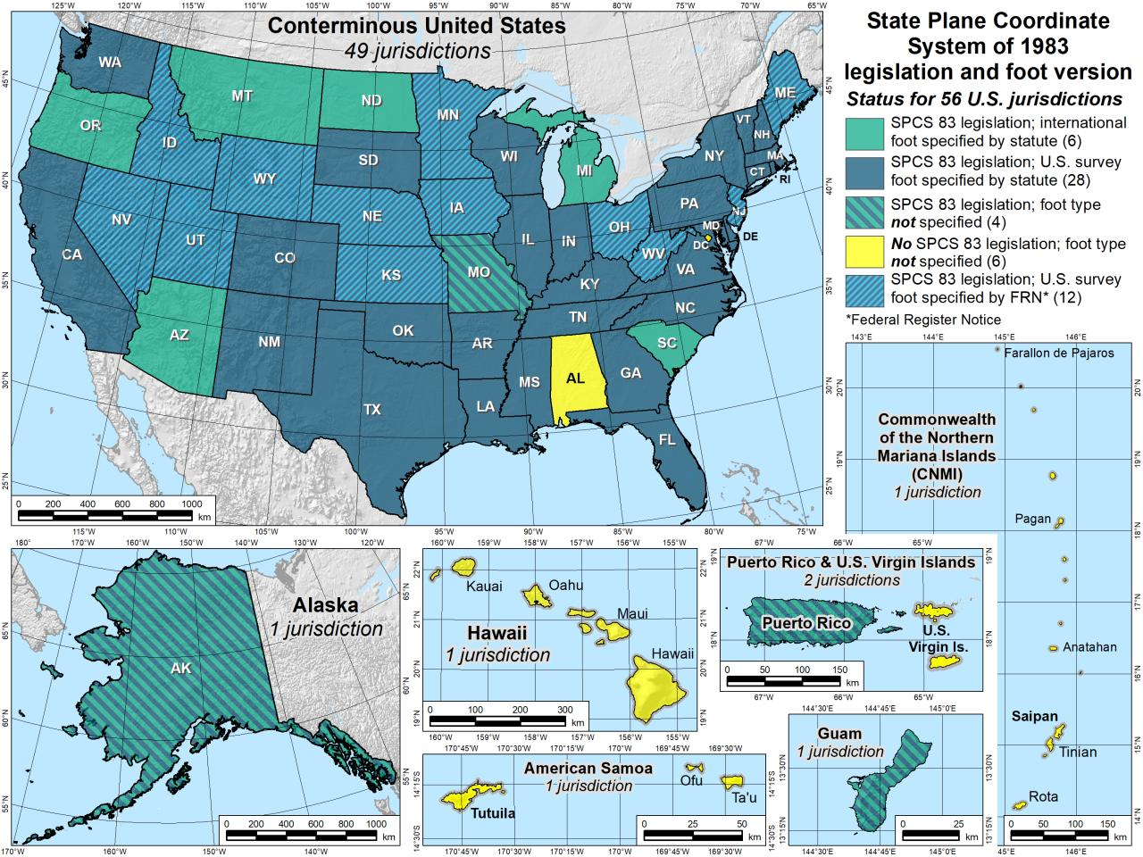

Slide 28
The Survey Foot is dead!
Long live the Survey Foot!
US Survey Foot was deprecated 31 December 2022…
But will always be available in NGS tools for NAD83 and NAD27

Slide 29
I’ll be selling these bumper stickers in hospitality suite tonight…
SPCS2022
MAKING EARTH FLAT AGAIN
…ONE ZONE AT A TIME
Really?
No… not really!

Slide 30
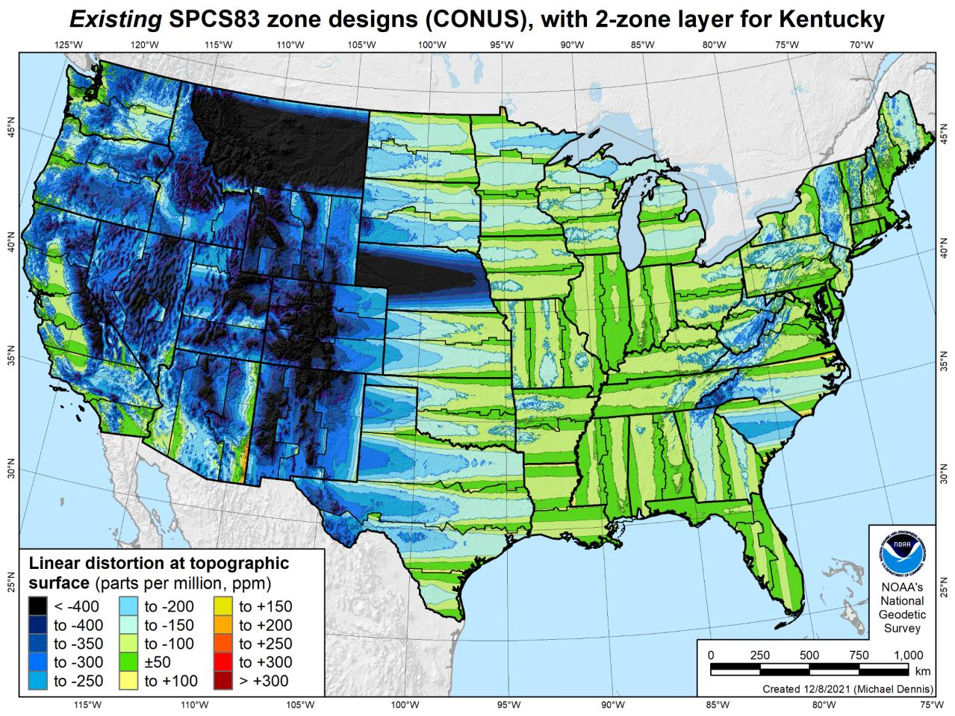
Notes:
106 zones (CONUS)

Slide 31
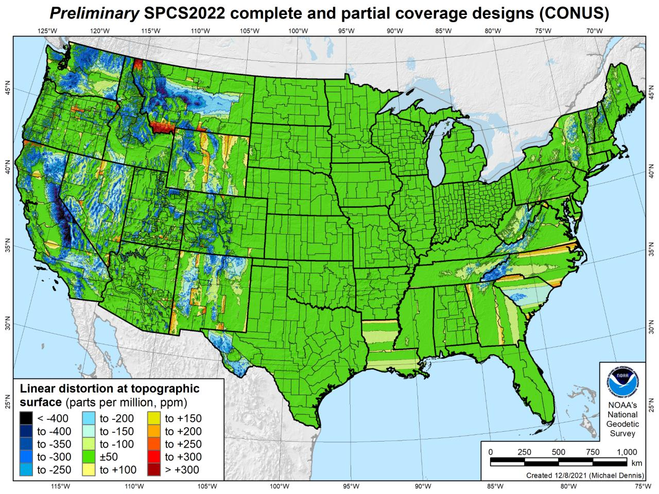
Notes:
846 zones (CONUS)

Slide 32
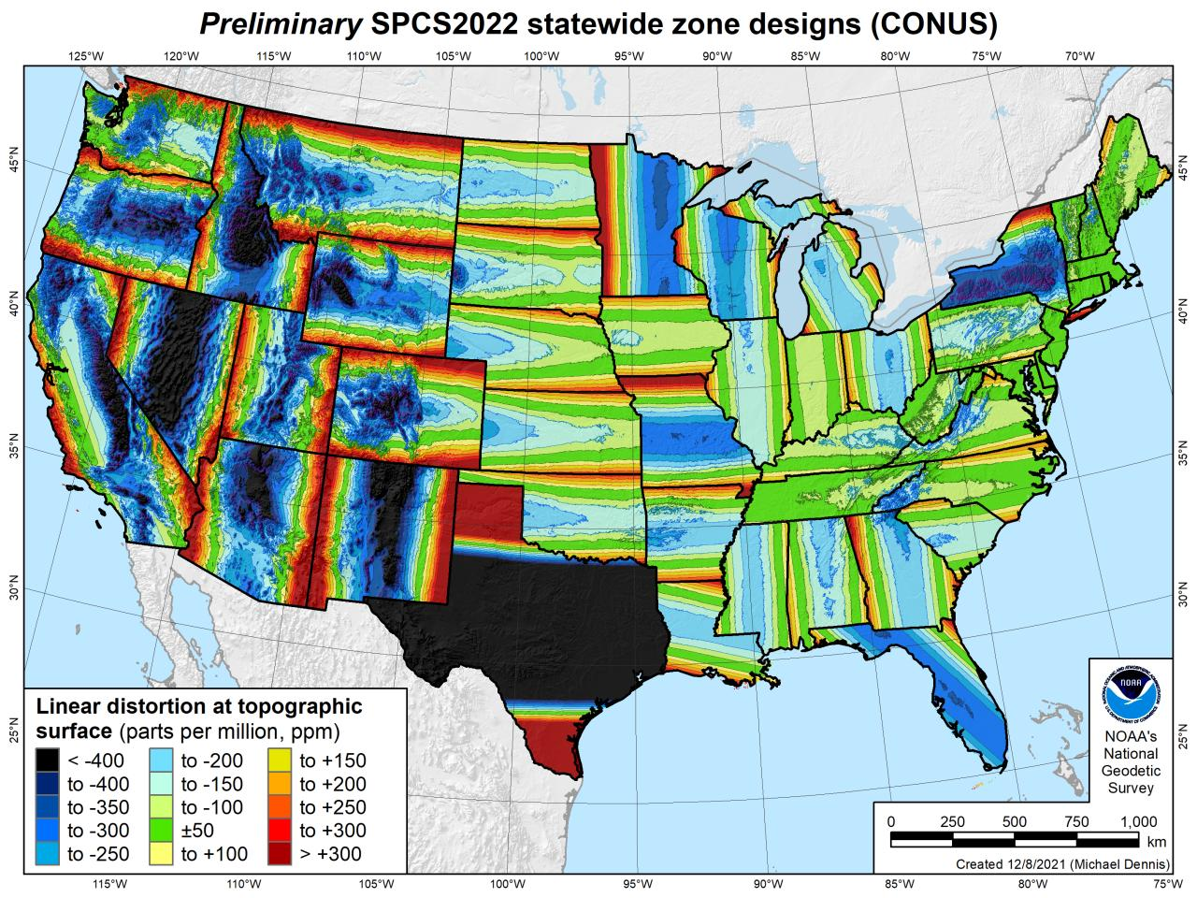
Notes:
49 zones (CONUS)

Slide 33
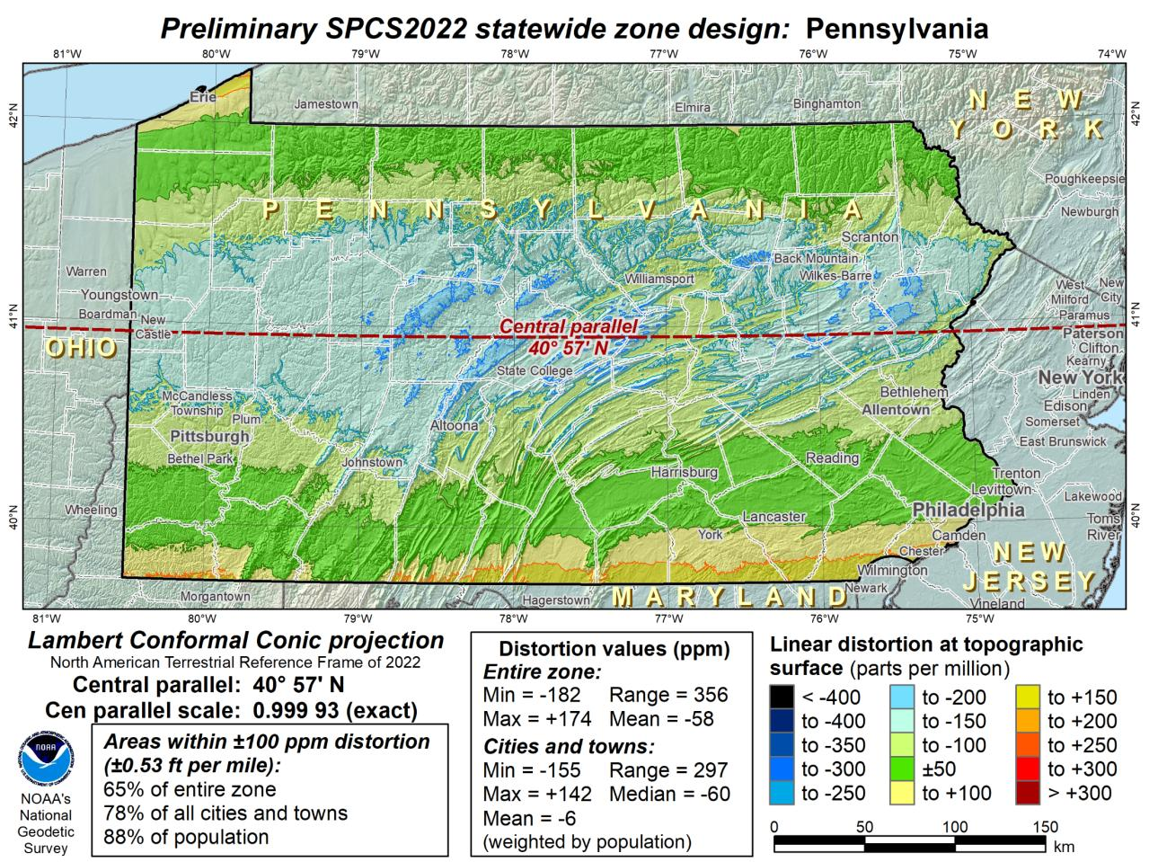
What to do with the existing tiling scheme in NATRF2022?
Maintain same footprints, so uneven coordinates at corners?
New footprints, but cleaner coordinates? Both options?

Slide 34
North American Vertical Datum
of 1988
NAVD88
will be replaced by

Slide 35
North American-Pacific Geopotential Datum of 2022
NAPGD2022
(pronounced: nap-jee-dee)

Slide 36
NAVD88 geoids
versus
NAPGD2022 geoids

Slide 37
Two types of geoid models
Gravimetric
Hybrid
Notes:
-believe it or not there’s more than 2 types, but the 2 types you’ll see NGS publish are…

Slide 38
Gravimetric → Hybrid
Gravimetric geoid is created from “scratch” with various types of gravity data
USGG2003, USGG2009, USGG2012, xGEOID19
Hybrid geoid is simply a gravimetric geoid then best fit some vertical datum… like NAVD88
GEOID03, GEOID09, GEOID12B, GEOID18
Notes:
So… all the geoids you’re using to get elevations from your GNSS data

Slide 39
Gravimetric → Hybrid
USGG2003, USGG2009, USGG2012, xGEOID19
GEOID03, GEOID09, GEOID12B, GEOID18
best fit to NAVD88
best fit to NAVD88
best fit to NAVD88
best fit to NAVD88
Notes:
So… all the geoids you’re using to get elevations from your GNSS data

Slide 40
Gravimetric vs. Hybrid Geoid
topographic surface
gravimetric geoid
hybrid
geoid
datum zero
surface
Concept

Slide 41
NAVD88 uses a Hybrid Geoid
topographic surface
gravimetric geoid
hybrid
geoid
datum zero
surface
Concept

Slide 42
NAPGD2022 uses a Gravimetric Geoid
topographic surface
gravimetric geoid
datum zero
surface
Datum zero surface aligned to Global Mean Sea Level (GMSL)
Concept

Slide 43
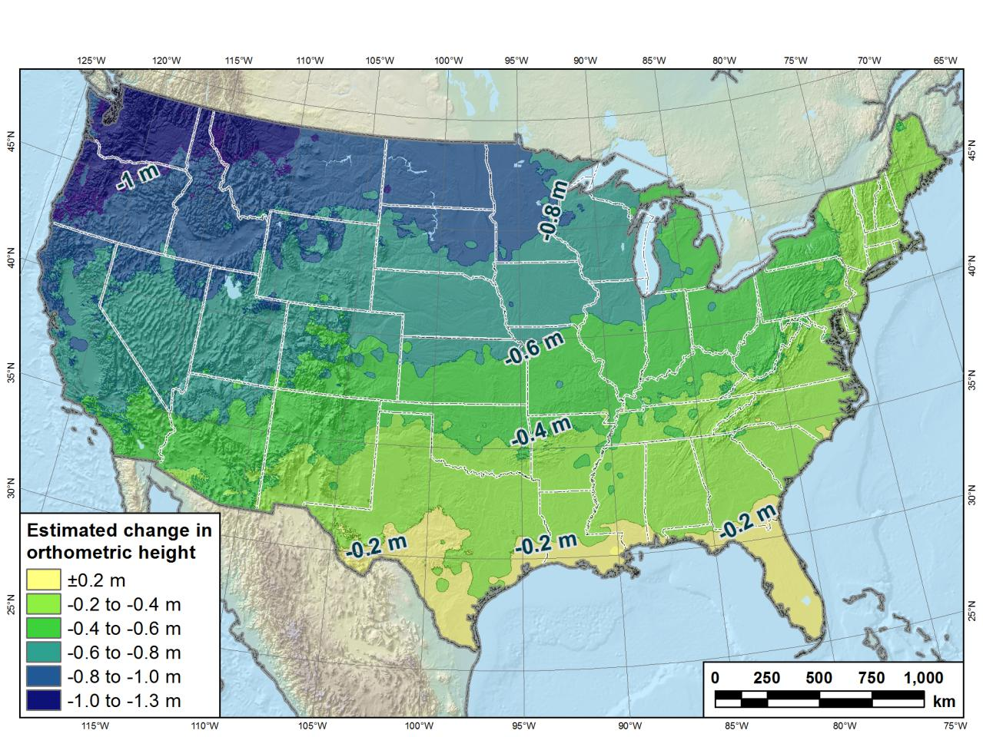
Estimated change in orthometric heights from NAVD88 to NAPGD2022
(NAPGD2022 approximated using xGEOID16B)

Slide 44
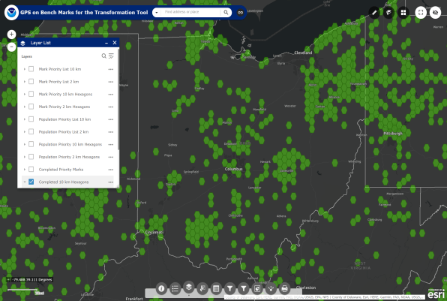
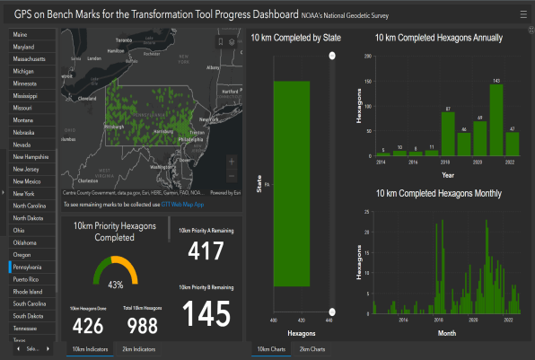
Quality of vertical datum transformation?
GPS on Bench Marks (GPSonBM)
Anyone can collect and provide:
2 OPUS-Static solutions
≥4 hours each
2 photos of each setup
Brief Description w/Ties
Deadline = 30 September 2023
Results increase accuracy of NAVD88<->NAPGD2022 transformation.
Web Map Application
Progress Dashboard

Slide 45
National Spatial Reference System (NSRS)
Geometric Geodesy
Physical Geodesy
Horizontal Datums
Terrestrial Reference Frames
Latitude & Longitude
Ellipsoid Height
State Plane Coordinates
Geopotential Datums
Orthometric Height
Dynamic Height
Surface Gravity
Leveling
To get to these “final products” we use a multitude of scientific methods, including Space Geodesy and Astronomical Geodesy.
And since we’re the Government… can’t forget Political Geodesy!

Slide 46
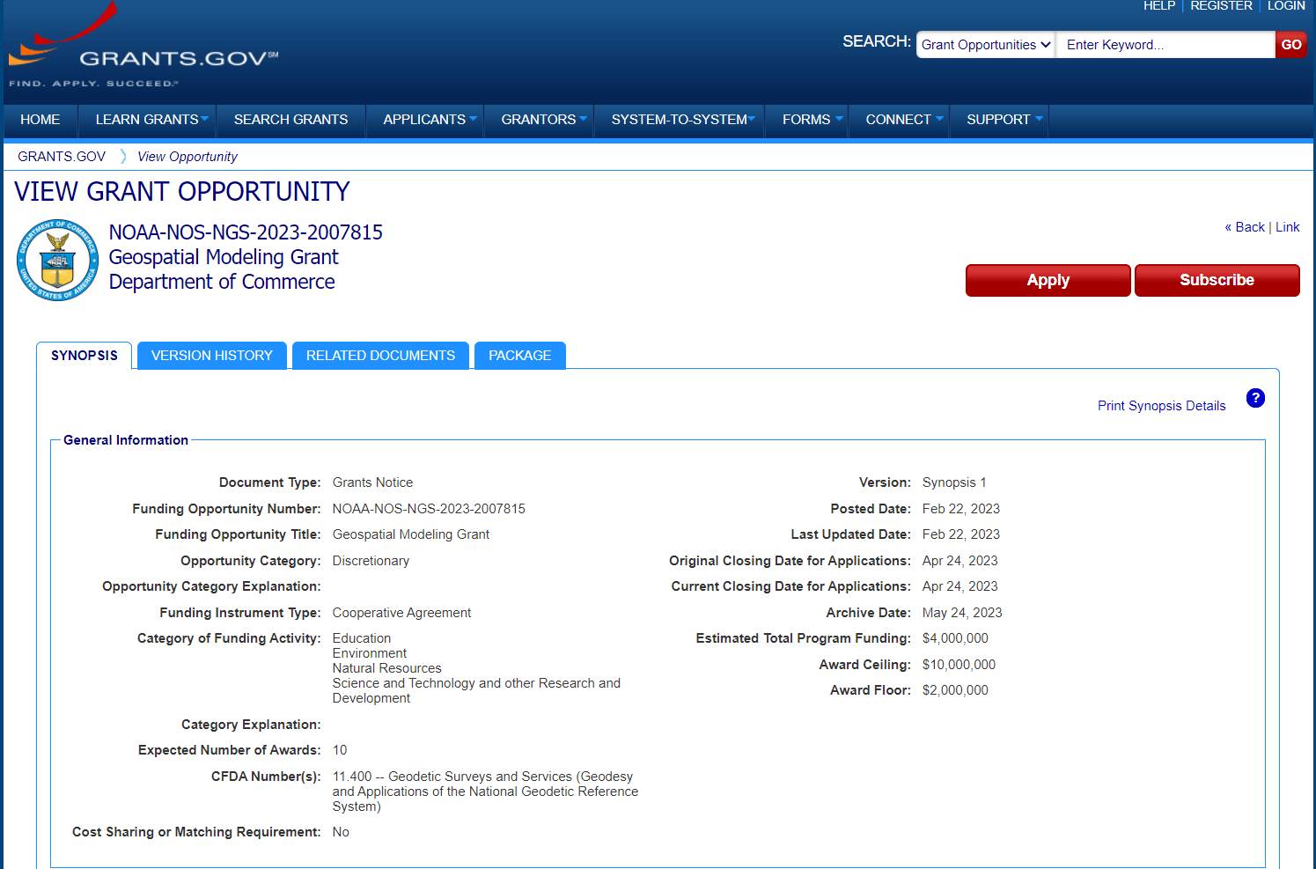
Notes:
Eligible funding applicants for this competition are institutions of higher education, state, local and Indian tribal governments.
The purpose of this notice is for us to solicit grant proposals to implement activities that modernize and improve the National Spatial Reference System (NSRS) and advance the science of geodesy in the United States.
NOAA encourages proposals submitted in response to this announcement to include student collaboration and education.

Slide 47
Jeff Jalbrzikowski, P.S., GISP, CFS
Appalachian Regional Geodetic Advisor
jeff.jalbrzikowski@noaa.gov
240-988-5486
https://www.ngs.noaa.gov/ADVISORS/
use any major search engine: “NGS advisors”

