Slide 1

Using RTN Data in OPUS Projects 5 for GPSonBM
Jeff Jalbrzikowski, P.S., GISP
Appalachian Regional Geodetic Advisor
Dan Gillins, Ph.D., P.L.S.
Acting Chief, Spatial Reference Systems Division

Slide 2
Any references we make to any commercially available hardware or software do not constitute an endorsement or a disapproval of any manufacturers, developers, dealers, or suppliers.
Thanks.

Slide 3

Let’s start with some alphabet soup

Slide 4
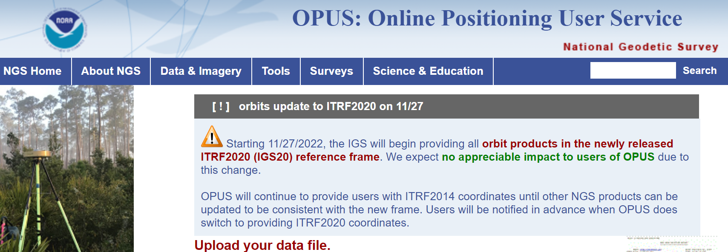
NGS Mission
To define, maintain and provide access to the National Spatial Reference System (NSRS) to meet our Nation’s economic, social, and environmental needs.
access… ? = traditionally → marks/disks/objects
= modern and future → NOAA CORS Network (NCN)
via OPUS
Notes:
Follow up thought
-like it or not, we know that the vast majority of our users are obtaining NSRS coordinates via OPUS
-while that is our plan for the future of primary access, modernized NSRS, as of now the official form of access (specifically to NAVD88) truly is to “touch brass” as they say → meaning occupy a benchmark

Slide 5
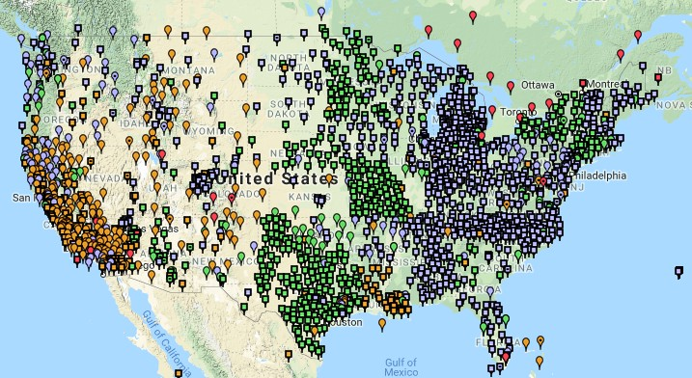

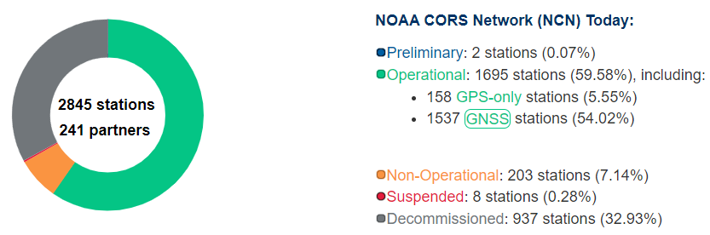
NCN - NOAA CORS Network
1695 sites
241 organizations
Notes:
What does that mean?
Please don’t think of this as us here at NGS being some pointy-haired semantics. We need to make distinctions about CORS when talking about all this. If you haven’t already realized this, you’ll start to catch on today.

Slide 6
RTN - Real Time Network
aka NRTK - Network RTK
A group of GNSS receivers that collect data and send it to server(s), which then deliver corrections to users
Different principles, but all are RTN/NRTK methods:
  VRS - Virtual Reference Station
  MAC - Master-Auxiliary Concept (2 types of corrections possible)
    MAX – Master-Auxiliary Corrections
    i-MAX - Individualized Master-Auxiliary Corrections
  FKP - Flächen Korrektur Parameter
Notes:
→VRS is a Trimble method
→ MAC is a Leica method

Slide 7
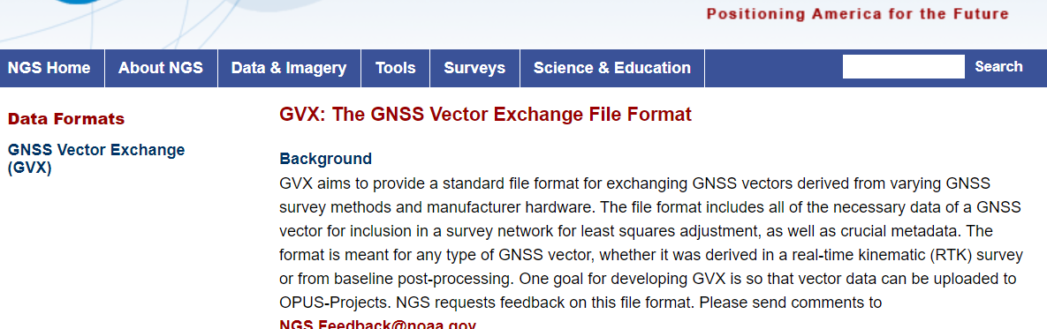
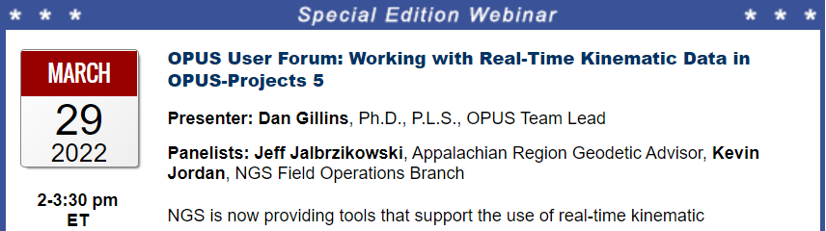
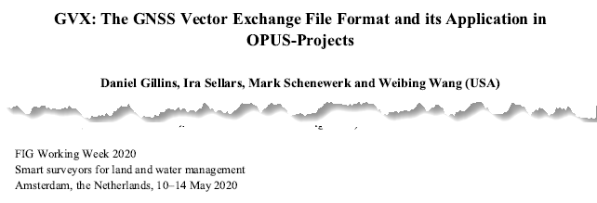
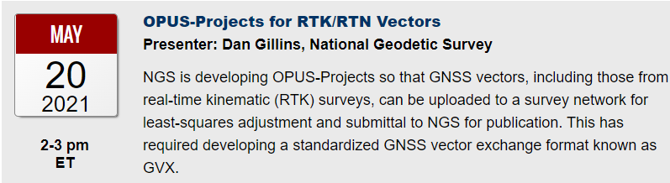
GNSS Vector eXchange (GVX)
Hyperlink to GVX Info Page
Detailed documentation, Schema, and Example File available
Any major search engine: “ngs gvx file format”
Open standard for anyone to use or integrate
GVX is sort of like… RINEX for RTK/RTN data
GVX details?
Check out:

Slide 8
GVX ≈ RINEX for RTK/RTN data
RINEX
GVX
Uncorrected Observations
That’s why we post-process them
Static Observations
One observation per file
Proprietary Format → Open Standard
Export RINEX using your COTS software
Metadata
Antenna, Rx, HI, Point Name, Start Time, SVs at each epoch
Based on ASCII Text File Format
Longtime industry standard
  Way too many to list!
Corrected/Processed Positions
And the Vectors used to create them
RTN, RTK, PP Static, even PPK
Many observations, any mix of above
Proprietary Format → Open Standard
Export GVX using your COTS software
Metadata - same as RINEX, plus…
Project Info, Solution Types, PDOP, Mount Points, Correlation Matrices, QC data
Based on XML File Format
Longtime industry standard
  e.g. LandXML, JXL, MAXML, KML/KMZ

Slide 9







Status of GVX Exporters
…that we know of.
Available Now
Trimble Business Center (TBC) v5.60 - released Nov 2021
Topcon MAGNET Software v7.2 - released Nov 2021
Leica Infinity 4.0.0 - released May 2022
Developers who have expressed interest to us
iGage
Carlson
Emlid
Available, but not fully functional
JAVAD J-field - onboard Triumph-LS device
Notes:
-Please note that this information here can only reflect what we know. If you are a developer working on incorporating GVX into your software… reach out to us! We would be happy to assist you, just as we have assisted some of our other commercial partners named here.
-What would make us happiest is if the list got so long we couldn’t fit in on this slide.
-Oh, and hey, you customers out there… express your desire for GVX to your suppliers/dealers or Support team

Slide 10

Notes:
A question many of you may be asking yourself, why OPUS Projects?
-biggest reason up-front is that it is one path to GPSonBM

Slide 11



OPUS Rapid Static (OPUS-RS)
15 min to 2 hours
1st creates an atmospheric delay model
2nd position calculated via a DGPS static solution
Not integrated with
OPUS Projects
Notes:
Nuff said… let’s move on!

Slide 12
OPUS Static (OPUS-S)
  2 to 48 hours
  Best 3 of 5 baselines
  Sequentially processed
  Reports your peak-to-peak (P2P) average position
5001
5002
CORS
OPUS Solution
Notes:
-OPUS Static takes the best 3 of 5 baselines, sequentially processed, and provides you their peak-to-peak average
sidenote
-we delivered over 1.2 million solutions in 2021, compared to in 2011 when we first broke the 200,000 solutions milestone

Slide 13

OPUS Static (OPUS-S)
  No correlation between your observed marks
  Low Relative Accuracy
  Even if … collected simultaneously
  … and submitted to OPUS simultaneously
  OPUS-S = independent solutions
5001
5002
CORS
OPUS Solution
Notes:
Point being… there is no correlation, or tie, between marks processed by OPUS Static

Slide 14
OPUS Projects (OP)
  Simultaneous processing of your observed marks
  Improved Relative Accuracy
  Requires more field prep and office processing effort
  OP = true network solutions
  And of course, least squares adjustment
Distant CORS
~400-800 km
5001
5002
5003
5004
CORS
OPUS Solution

Slide 15
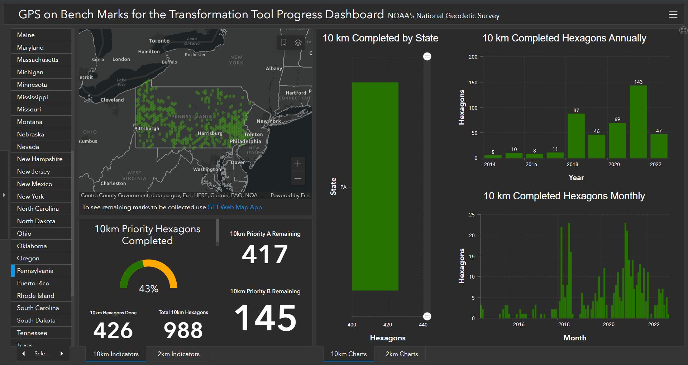
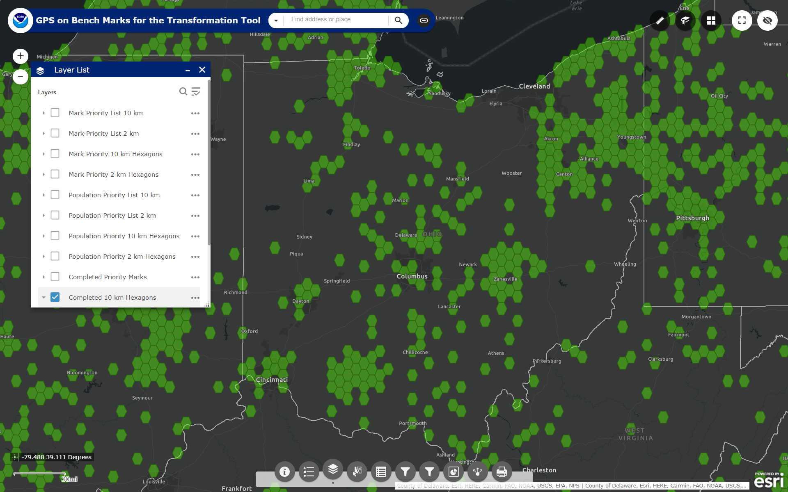

What’s the deal with GPSonBM?
GPS on Bench Marks
Web Map Application
Deadline = 30 September 2023
OPUS Shared Solutions
  2 OPUS-Static, ≥4 hours each
  2 photos of each setup
  Brief Description w/Ties
Progress Dashboard
The struggle is real.
“too much field time”
“we don’t do static”
“poor site, if only we had multi-GNSS”
Notes:
Note here that the Dashboard map is separate from the Web Map Application.
CLICK They are linked, but different tools.
If you got mixed up about this at some point, no worries, you were not the only one.
If we have had this process to submit GPSonBM for years now… why are we now putting out this option for OPUS Projects via GVX?
CLICK

Slide 16
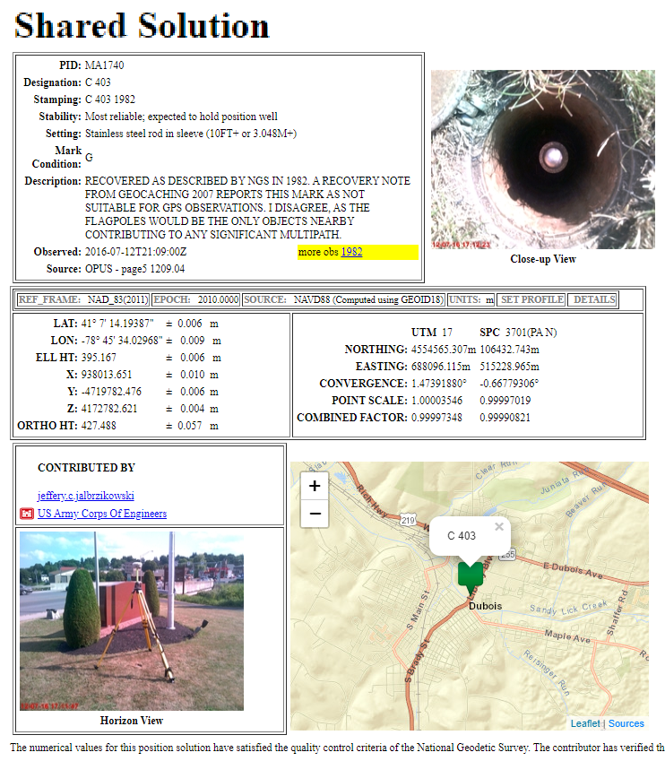
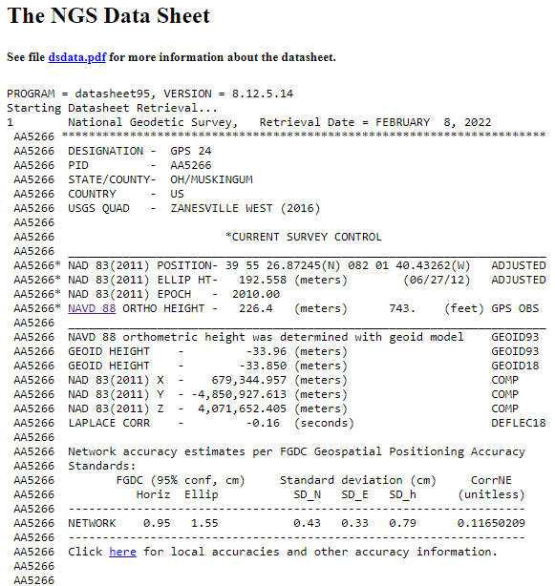
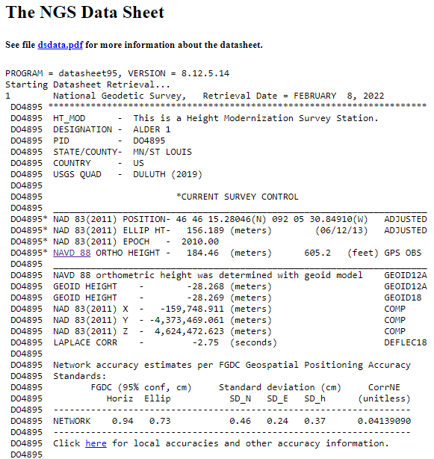
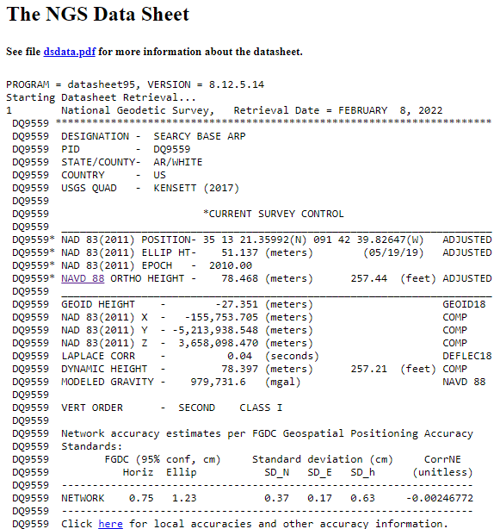
OPUS Shared vs. OPUS Projects
 | OPUS Shared | OPUS Projects (RINEX) | OPUS Projects (GVX)
Minimum Occupations | 4 hours At least 1, maybe 2* | 2 hours At least 2 | 5 minutes At least 3
Processing | OPUS-S (sequential) | PAGES (simultaneous) | Real Time (RTN/NRTK)
Adjustment | None | Least Squares Network | Least Squares Network
Metadata | 2 photos Brief Description | 3 photos, WinDesc files, Logs, & Report | 3 photos, WinDesc files, Logs, & Report
*Need 2 or more GPS datasets in our database, existing data holdings count toward that.

Slide 17
How do I get started with using
RTN data in OPUS Projects for GPSonBM?
RTNonBM?
GVXonBM?
GNSSonBM?

Slide 18
Preparations/Planning
Choose Marks from the Web Map → not every mark is a BM
Reconnaissance and Recovery → is the bridge even still there?
Plan Initial and Repeat/Redundant Occupations
  Repeat start times must differ by >3 hours (even on separate days)
Determine CORS you might end up using in the field
  For the most part you will not get to control that
  Why is this important? → Operational Status, Data Availability, etc.
  Status of CORS (NCN or non-NCN) will affect your workflow
    Let’s look at those different workflows, or GVX scenarios...
Please don’t wing it and hope for the best.
First submit a Survey Project Proposal ☺
Notes:
Please don’t wing it and hope for the best.
Choose Marks from the Web Map (not every mark is a BM)
Plan Initial and Repeat/Redundant Occupations
Repeat start times must differ by >3 hours (even on separate days)
Determine CORS you might end up using in the field
For the most part you will not get to control that

Slide 19
GVX Scenarios in OPUS Projects
CORS + RTN
  CORS are not in NCN
  CORS are not in NCN but are in IDB (have PID/Datasheet)
  CORS are in NCN
Static Base + RTK
  Base (positioned via OPUS) delivering RTK corrections to rover
Static Post-Processed
  Corrected positions determined with your software
  Results (vectors and points) exported to GVX
Any network method is compatible (e.g. VRS, MAC, FKP)
What’s the difference?
Your workflows in OPUS Projects.
What’s the same?
Your workflows in the field.
Notes:
-Sooo… because today’s topic is RTN, we’re going to chop those last 2 items from the slide
CLICK
-Now we’re left with 3 main scenarios of using RTN-GNSS data in OP via GVX
-What makes the difference is that depending on which network station(s) were used in your survey, you will encounter one or more of these scenarios.

Slide 20
1) CORS + RTN a) CORS are not in NCN
Collect field data with Rover(s)
Download non-NCN CORS data
  From your network provider
Upload WinDesc files
Upload non-NCN CORS data to OPUS Projects
  Using OPUS Static and Project ID
Create GVX in your software and upload it
Session Processing
  Aligns your CORS (RTN Base) to NCN
Network Adjustment
  Constrain to NCN CORS
Notes:
Some of you may be thinking though… what does this even mean that the CORS are not in the NCN?
Let’s look at the example of the WVDOT’s Real Time Network

Slide 21
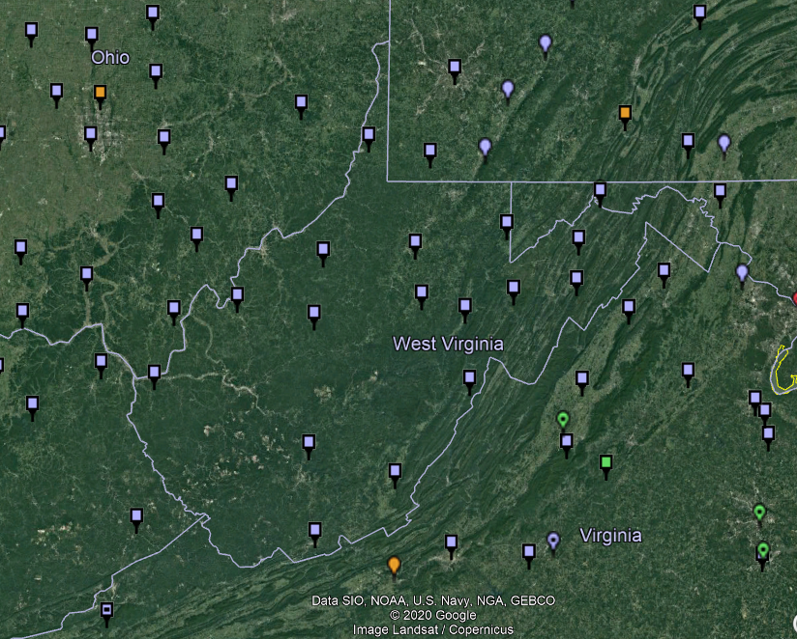
NOAA CORS Network (NCN) in WV

Slide 22
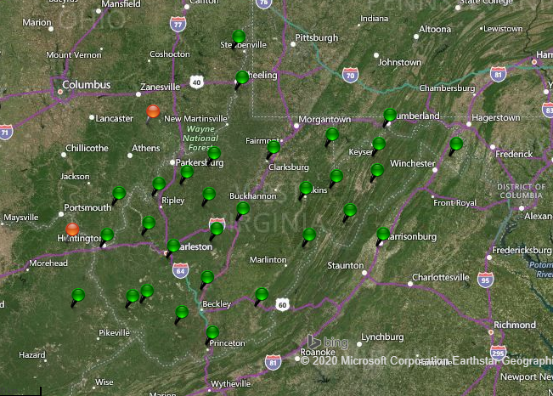
WVDOT CORS Network (and RTN)
Notes:
Just for the sake of discussion, I will point out that the WVDOT’s real time network is based on VRS method

Slide 23
NOAA CORS Network (NCN) in WV

Slide 24
WVDOT CORS Network (and RTN)
non-NCN CORS
Notes:
And now by me flipping back and forth between these, you’ve likely caught on that the stations in red are non-NCN CORS

Slide 25
1) CORS + RTN
a) CORS are not in NCN
Network users typically have access to non-NCN CORS data
  Sometimes called the “Reference Data Shop”
Some network providers do not provide long-term user access
  Anywhere from just 45 days to 365 days
Investigate this during Project Planning
  If non-NCN CORS data is not available…
    NGS cannot help with that
    Contact your network provider for possible access to their archived data
Download non-NCN CORS data
  From your network provider

Slide 26
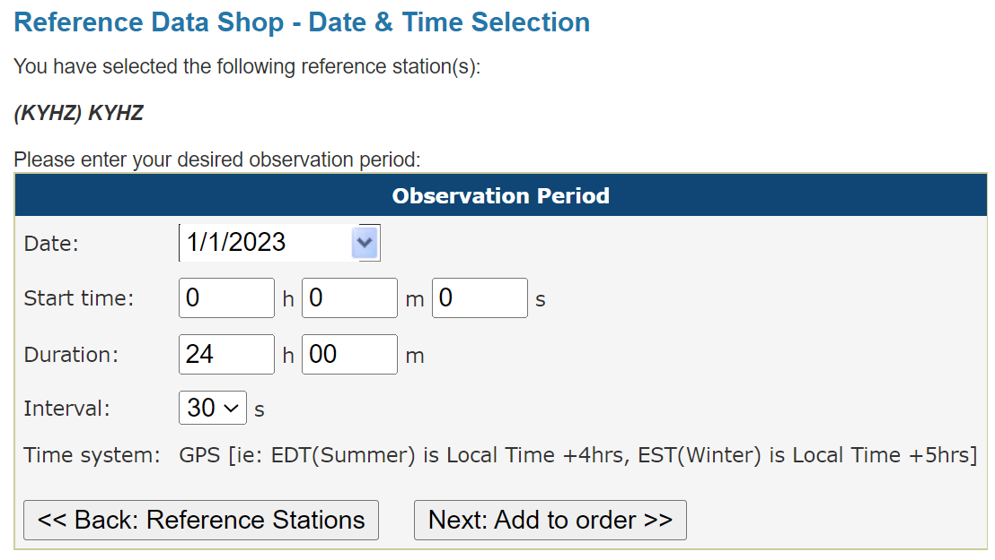
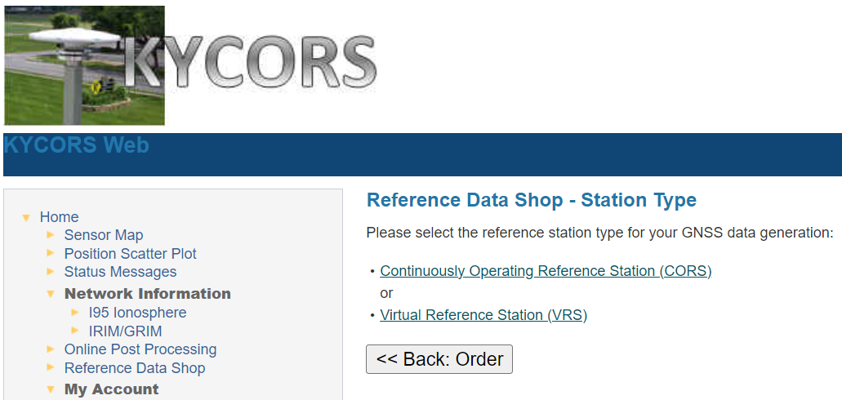
1) CORS + RTN
a) CORS are not in NCN
Notes:
Now we’re looking here not at the WVDOT but the Kentucky Transportation Cabinet network.
This is their web interface, and if I wanted to download some non-NCN CORS data from their network, I’d go into the Reference Data Shop.
For many of the networks, you’ll see both a CORS and a VRS option.
What you want is the CORS data, and the interface will walk thru the rest of the options, you’ll be asked which station(s) you want data from, for date(s), observation interval (HINT… 30 seconds for OPUS!)

Slide 27
1) CORS + RTN b) CORS are not in NCN but have Datasheet/PID (are in IDB)
Collect field data with Rover(s)
Download non-NCN CORS data
  From your network provider
Upload WinDesc files
Upload non-NCN CORS data to OPUS Projects
  Using OPUS Static and Project ID
Create GVX in your software and upload it
Session Processing
  Aligns your CORS (RTN Base) to NCN
Network Adjustment
  Select Constraints (NCN or non-NCN CORS Datasheet)

Slide 28
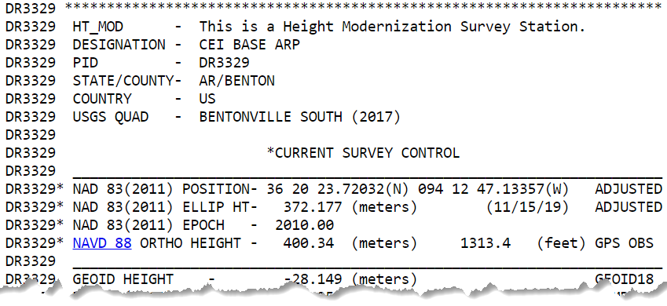
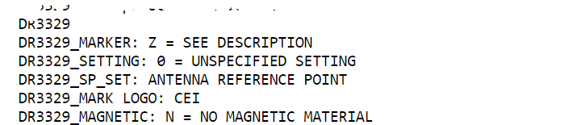
1) CORS + RTN
b) CORS are not in NCN but have Datasheet/PID (are in IDB)
What does that look like?
How do I know?
Consult the NGS Map
or Data Explorer
IDB = Intergrated DataBase

Slide 29
1) CORS + RTN
a) CORS are in NCN
Collect field data with Rover(s)
Create GVX in your software
  Using your field or office software
Upload WinDesc files
Upload GVX to OPUS Projects
  Using OPUS Static and Project ID
  Vectors are automatically linked to NCN CORS
Network Adjustment
    Constrain NCN CORS

Slide 30
CORS + RTN
Regardless of CORS used, whether NCN or non-NCN…
If RTN uses Trimble® VRS™ method, you must log vectors
  VRS = Virtual Reference Station
For GVX to work in OP, vectors must be tied to a PRS/PBS
  PRS = Physical Reference Station
  PBS = Physical Base Station
Should not be a concern for MAC or FKP methods
  Vectors will be tied to PRS/PBS by default
No vectors = No GVX = No OPUS Projects

Slide 31
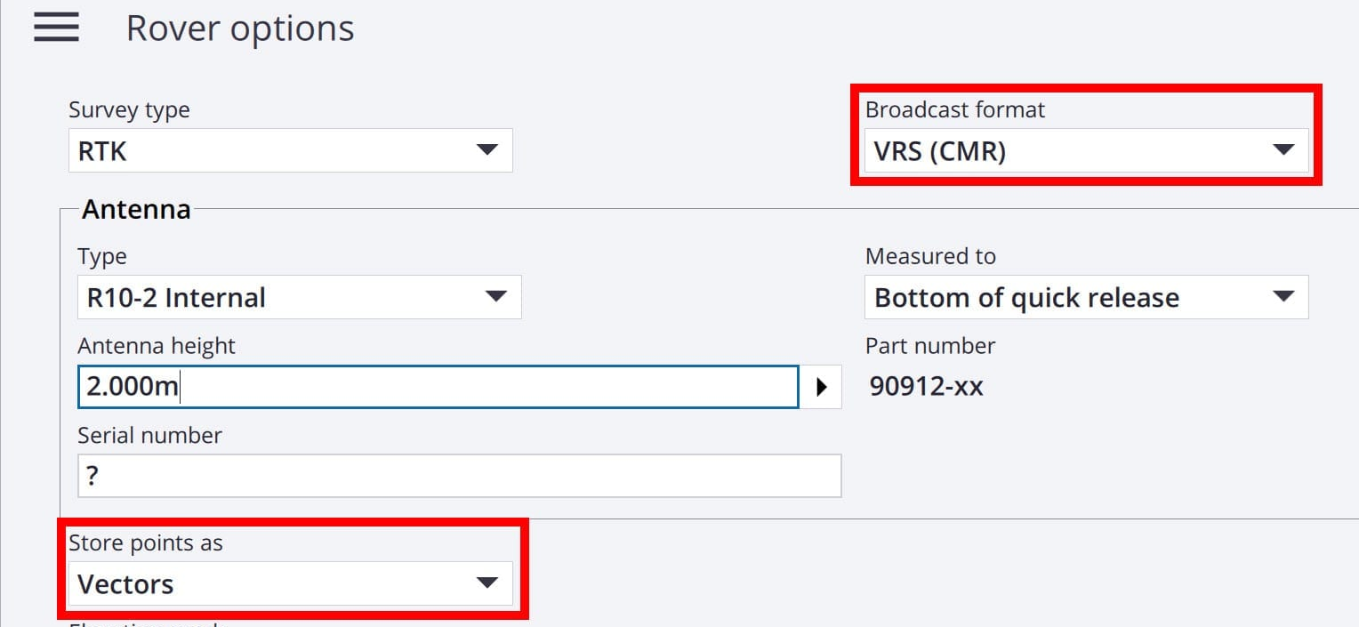
CORS + RTN
Regardless of CORS used, whether NCN or non-NCN…
If RTN uses Trimble® VRS™ method, you must log vectors
GNSS Vector eXchange with VRS means you must:
Store points as Vectors

Slide 32
Exporting a GVX from TBC
Video Demonstration

Slide 33
CORS + RTN for GPSonBM
Regardless of CORS used, whether NCN or non-NCN…
Minimum of 5 minutes mark occupation time
Total of 3 independent occupations
Must agree by 3 cm Horizontal and 5 cm Ellipsoid Height
Must be separated by at least 3 hours
  Yes, even if occupied on different days
Your marks will be included in the NGS IDB → Datasheets
  So long as you results meet requirements and all metadata is included

Slide 34
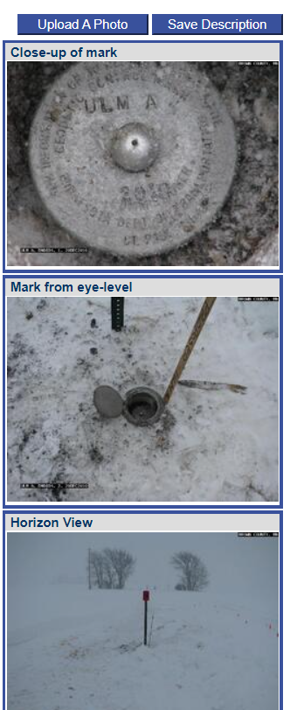
Required Metadata for GVXonBM
WinDesc Files → 1 each of .dsc, .des, .err, .dis, .nbr
  Yes, for the foreseeable future you will need to download, install, and learn how to use WinDesc
3 photos per mark → uploaded to Marks Pages
  close-up
  downward from eye-level
  horizon/setup
Project Report (PDF)
Observation Logs (single PDF)

Slide 35
Closing Thoughts
Redundancy is Your Friend
  Even with static GNSS, your “total time on mark” is the key to accuracy (not longer necessarily occupations)
Beta OPUS Projects is the path to GVX Submissions (as of today)
  Where is it? … instead of www.ngs.noaa.gov navigate to beta.ngs.noaa.gov
  Or simply check the NGS Homepage → Beta Release (under News Bulletins)
In the future, GNSS will become a sub-type of GDX file format
  GDX = Geodetic Data eXchange
  Still an XML based file format
  Goal = one file format for observations from: GNSS, Total Station, Digital Level, Gravimeter
  Yes, this is in conjunction with NSRS Modernization efforts

Slide 36
Resources
Survey Project Proposal Page
WinDesc Tutorial Video
OPUS Projects User Guide (HTML version)
OPUS Projects User Guide (PDF version)
Requirements for Using OPUS-Projects 5 in the 2023 GPSonBM Campaign

