Slide 1
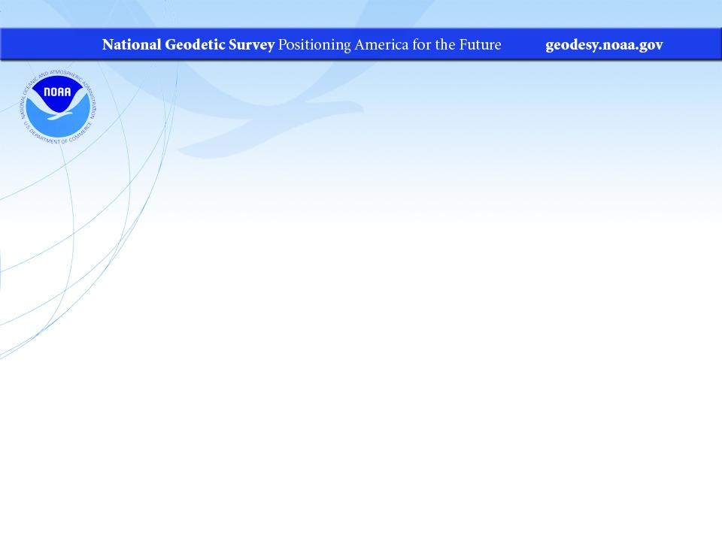
An Overview of the NGS Regional Geodetic Advisors Program
  ASCE UESI Surveying & Geomatics Conference
October 2022
Jeff Jalbrzikowski, P.S., GISP, CFS
Appalachian Regional Geodetic Advisor
jeff.jalbrzikowski@noaa.gov
240-988-5486

Slide 2



Organizational Structure
  -Department of Commerce (DoC)
  -National Oceanic and Atmospheric Administration (NOAA)
  -National Ocean Service (NOS)
  -National Geodetic Survey (NGS)
Notes:
-We are the Federal Government’s oldest scientific agency.
-part of the Executive Branch
-I know it can seem kind of strange that NGS is part of the NOS, but the origins of NGS lie with the C&GS.
-we are a “Program Office” of the NOS
Survey of the Coast – 1807
Coast Survey – 1836
Coast and Geodetic Survey – 1878
NGS since 1970

Slide 3


Organizational Structure
We’re not USGS, we’re NGS
  -Department of Commerce (DoC)
  -National Oceanic and Atmospheric Administration (NOAA)
  -National Ocean Service (NOS)
  -National Geodetic Survey (NGS)
≠
Notes:
-as you can read my slide, I like to point that out because over my 2 years at NGS I’ve seen and heard this misunderstanding quite a bit
-don’t worry! it doesn’t offend us! and we do work closely with USGS, but we are separate agencies within totally different departments of the federal government

Slide 4
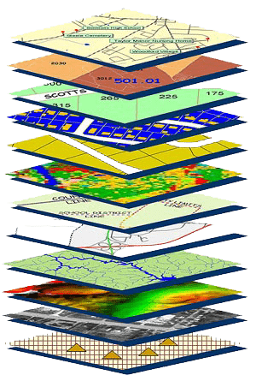
NGS Mission
To define, maintain and provide access to the National Spatial Reference System (NSRS) to meet our Nation’s economic, social, and environmental needs.
NSRS
Notes:
NGS develops and maintains the National Spatial Reference System, a national coordinate system that provides the foundation for transportation, navigation, land record systems, mapping and charting efforts, and a multitude of scientific and engineering applications.
But there are many ancillary programs and products we will also discuss.

Slide 5
National Spatial Reference System
A common and consistent geospatial framework
Without this basic framework, efficient geospatial analysis would be impossible.
Notes:
The primary mission of NGS is, “to define, maintain, and provide access to the NSRS to meet our nations economic, social, and environmental needs”.
NSRS is a consistent geospatial framework, common to all Federal agencies and other users
NSRS supports informed decision-making for mapping and charting, navigation, flood risk determination, transportation, land management, and more
Elements of NSRS include (but are not limited to): latitude, longitude, elevation, gravity, shoreline position + their changes over time …other elements include scale, earth orientation parameters and others
The vertical component of the NSRS currently utilizes the North American Vertical Datum of 1988 (NAVD88)
CLICK

Slide 6
Regional Geodetic Advisor Program
The Advisor serves as a liaison between NGS and its public, academic and private sector constituents within their assigned region. They provide expert guidance and assistance to these constituents who manage the geodetic component of geospatial activities tied to the National Spatial Reference System (NSRS). Geodetic advisors serve as subject matter experts in geodesy and regional geodetic issues, collaborating internally across NGS and NOAA to further the organizations’ missions. They are to maintain awareness of current geodetic science and technology developments, updates and improvements to geodetic reference systems, and application to geospatial activities.
Notes:
The Advisor serves as a liaison between NGS and its public, academic and private sector constituents within their assigned region. They provide expert guidance and assistance to these constituents who manage the geodetic component of geospatial activities tied to the National Spatial Reference System (NSRS). Geodetic advisors serve as subject matter experts in geodesy and regional geodetic issues, collaborating internally across NGS and NOAA to further the organizations’ missions. They are to maintain awareness of current geodetic science and technology developments, updates and improvements to geodetic reference systems, and application to geospatial activities.

Slide 7
Regional Geodetic Advisor Program
The Advisor serves as a liaison between NGS and its public, academic and private sector constituents within their assigned region. They provide expert guidance and assistance to these constituents who manage the geodetic component of geospatial activities tied to the National Spatial Reference System (NSRS). Geodetic advisors serve as subject matter experts in geodesy and regional geodetic issues, collaborating internally across NGS and NOAA to further the organizations’ missions. They are to maintain awareness of current geodetic science and technology developments, updates and improvements to geodetic reference systems, and application to geospatial activities.

Slide 8
Origins…
Network Maintenance Program
  From 1968 until 1984
  Employees based all over the US
  Funded by NGS
  Responsible for 3 or 4 States
    Recording and reporting mark recoveries
    Preservation of marks – coordinate w/municipalities
    Documentation of destroyed marks
    Benchmark Resets → solo leveling!
Also in ’68 were the first three Advisors: LA, NY, AZ
Notes:
All came from trig parties, because easier to teach the leveling to a
Typically travel to one state for a couple weeks or months
Almost totally solo operations → they would run short level runs (resets, etc.) by themselves! Sometimes assisted by other Federal agencies or State office
Managed out of Kansas City Office
Collected data/obs, and sent everything to Rockville office for them to do calcs/comps
They didn’t even have handheld calculators until HP-97
In 1984 the NMP was phased out due to congressional budget cuts
→Some retired, some became … State Advisors

Slide 9
History…
State Geodetic Advisor Program
  1984 until 2016
  Employees based all over the US
    At most, there were 26 (or so)
  Funded partially by NGS
    Cost-sharing between Federal and State
    Most partnerships were with DoT (or similar agency)
  Responsible for 1 State
  Integral to propagation of GPS-based control by the States (HARNs) in 1989
    Data clearly illustrates which States had Advisors

Slide 10
Present!
Regional Geodetic Advisor Program
  Transitioned from State to Regional in 2016
  14 regions across US and Territories
  Federally funded
    No cost-sharing with States, but some do host offices
  Primary outreach staff from NGS to Constituents
    NSRS Modernization
      2 way street!

Slide 11
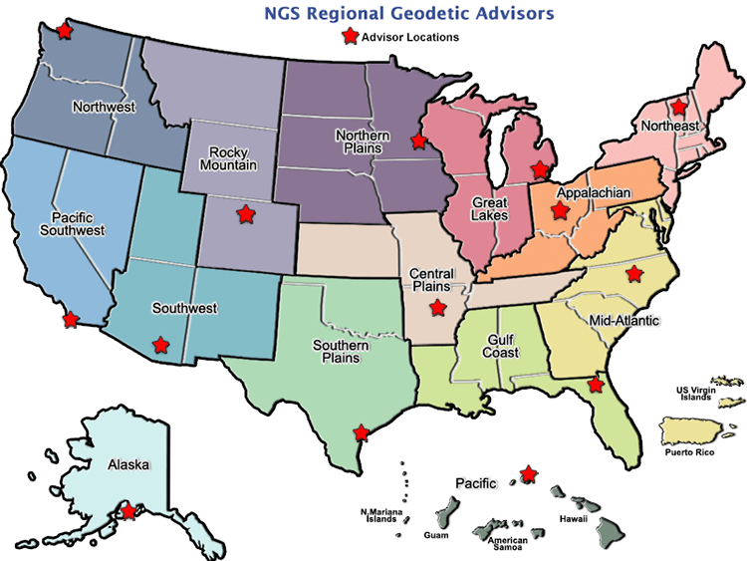

Slide 12
Technical Support
Primarily with respect to the NSRS
  NAVD88 ↔ NGVD29
  SPCS83
  OPUS
  NCN CORS data
But it doesn’t stop there!
  UN-GGIM
  SIRGAS
  NOAA Arctic Program

Slide 13
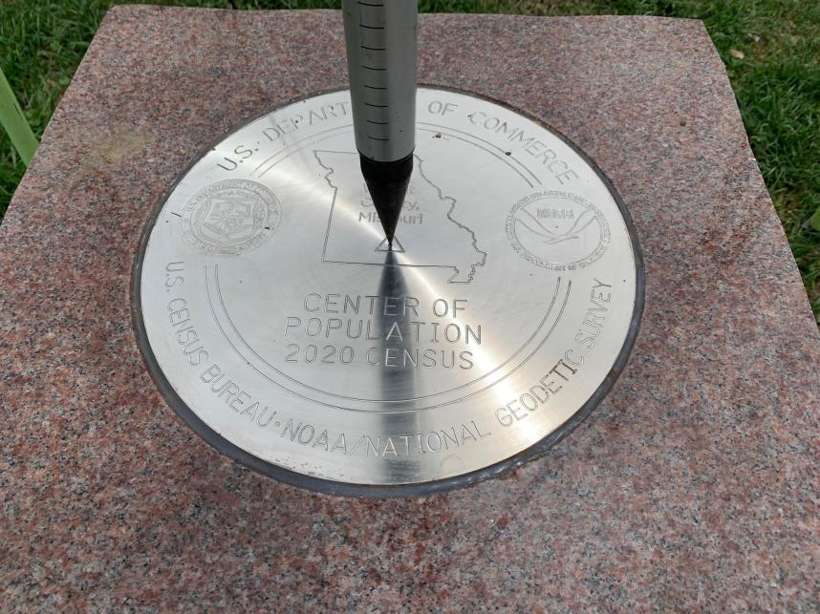
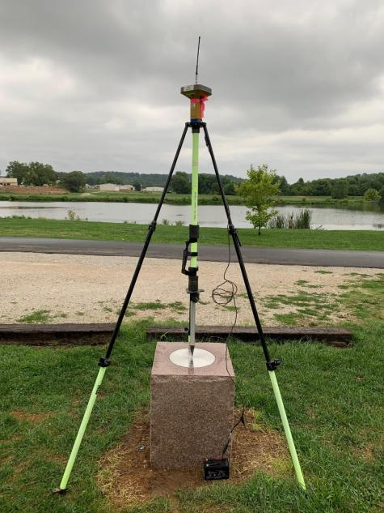
Center of Population of the USA
September 2022
2020 Census CoP = Hartville, MO
Central Plains Advisor – Brian Ward
Notes:
-Joint effort amongst Department of Commerce organizations: NOAA’s NGS and US Census Bureau
-this is the 7th time DoC organizations have partnered to commemorate the census calculation with a CoP mark

Slide 14
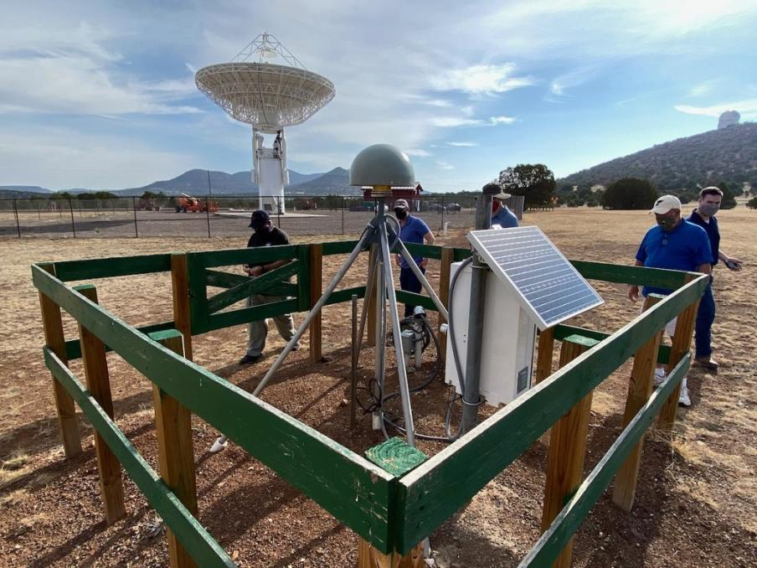
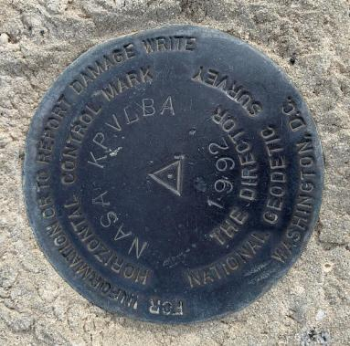
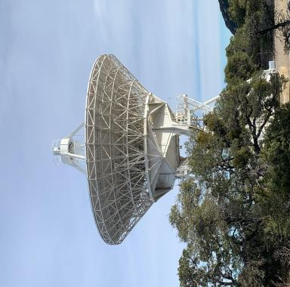
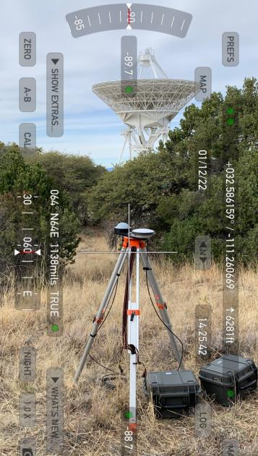
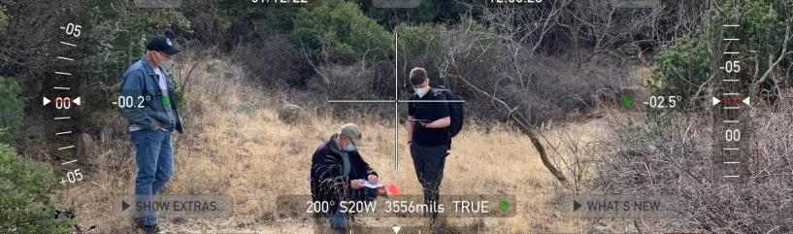
NOAA Foundation CORS Network (NFCN)
March 2022
Kitt Peak National Observatory, AZ Southwest Advisor – Lynda Bell
Notes:
Reconnaissance Team included partners from the Kitt Peak NRAO, the University of Texas’s Applied Research Lab, and the NGS

Slide 15
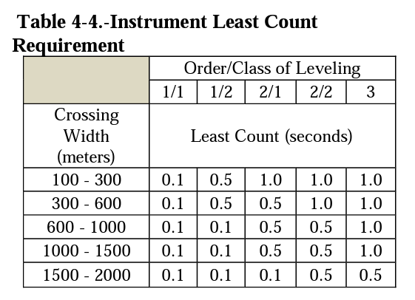
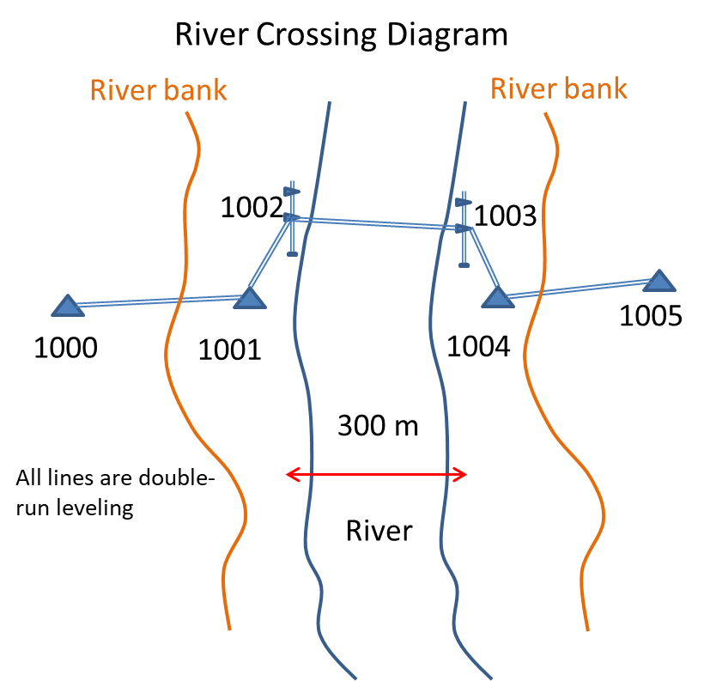
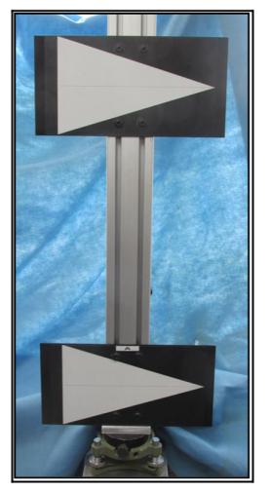
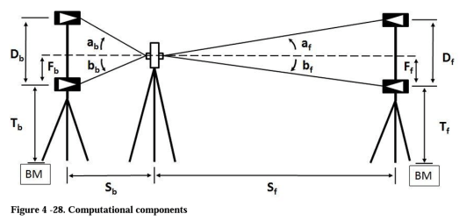
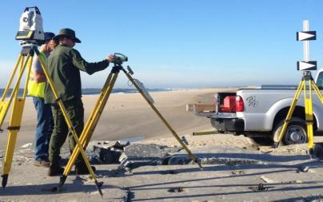
Alternative Methods to Normal Leveling Techniques for River Crossing
2014 to 2017
Target Assembly on Tribrach
Northern Plains Advisor – Dave Zenk
& (now retired) Great Lakes Advisor - John Ellingson

Slide 16
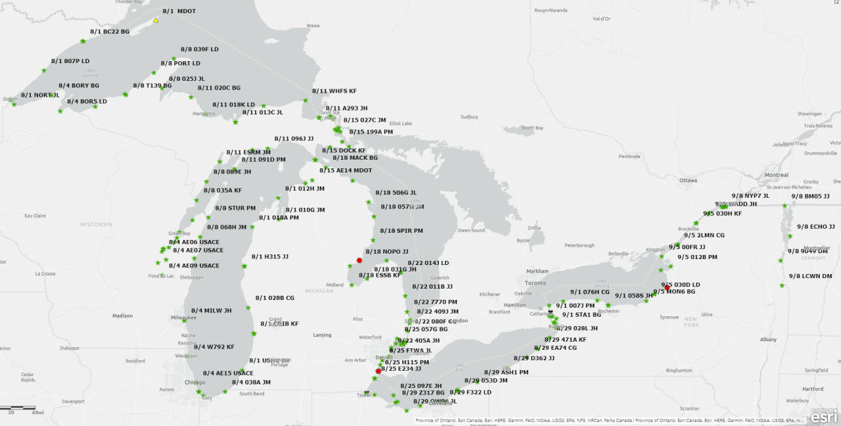
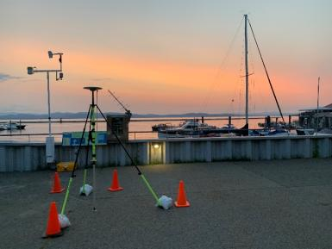
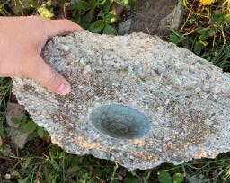
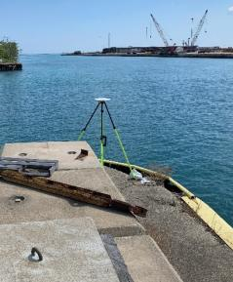
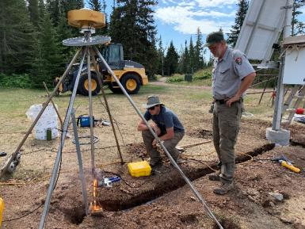
International Great Lakes Datum of 2020
Appalachian Advisor – Jeff Jalbrzikowski
Great Lakes Advisor – Jacob Heck
Northeast Advisor – Dan Martin
Notes:
-a few of us advisors supported NGS Field Operations Branch from the planning to execution of field work

Slide 17
State Geodetic Coordinators
Not an NGS employee, rather:
  State/Commonwealth government
    CORS and/or RTN manager
    DOT survey lead
    Geospatial Information Officer
  Academia
    Professor or Program Director
  Professional society representative
Serves as a liaison between that geospatial community and the NGS
Notes:
-The State Geodetic Coordinator is not employed by NGS and is typically assigned by a state government agency or university.

Slide 18
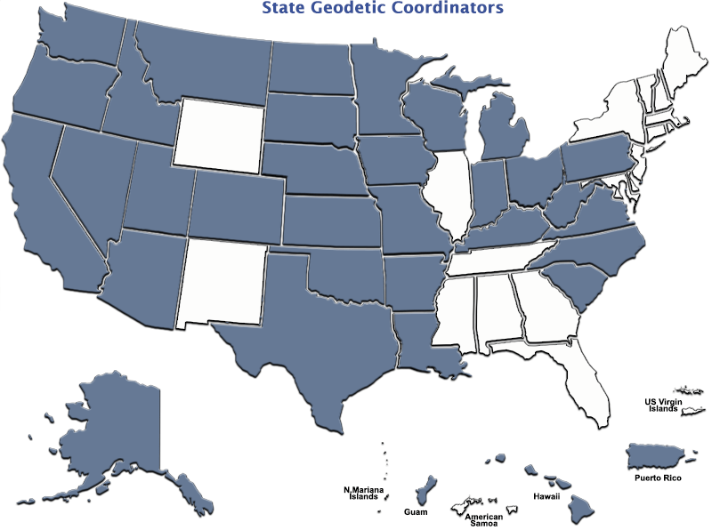

Slide 19
State Geodetic Coordinators
List of states that haven’t designated an SGC
Maine
New Hampshire
Vermont
Massachusetts
Rhode Island
Connecticut
New York
Delaware
Maryland
Illinois
Tennessee
Mississippi
Alabama
Georgia
Florida
New Mexico
Wyoming
US Virgin Islands
American Samoa
…and that’s okay!
Notes:
We don’t designate or appoint, just recognize.

Slide 20

additional Resources
Notes:
This presentation is intended to raise awareness about the upcoming changes and what they mean for floodplain mapping, but you probably have lots of remaining questions and we have a lot of resources online at our website
Please spread the word, and
make an effort to keep yourself and your colleagues informed.
Tell us what content is missing or how we can make it better!

Slide 21
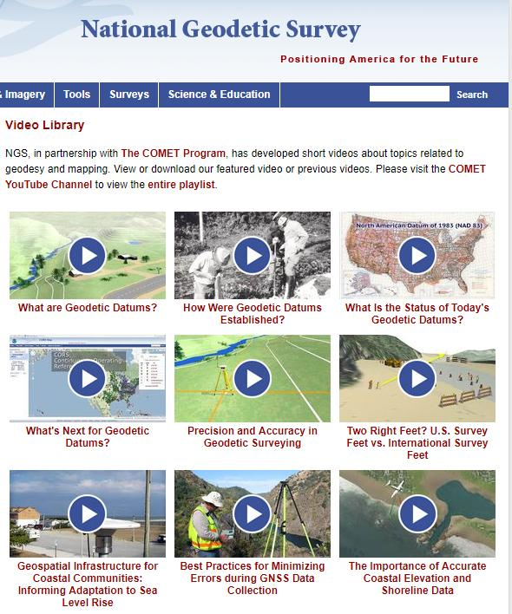
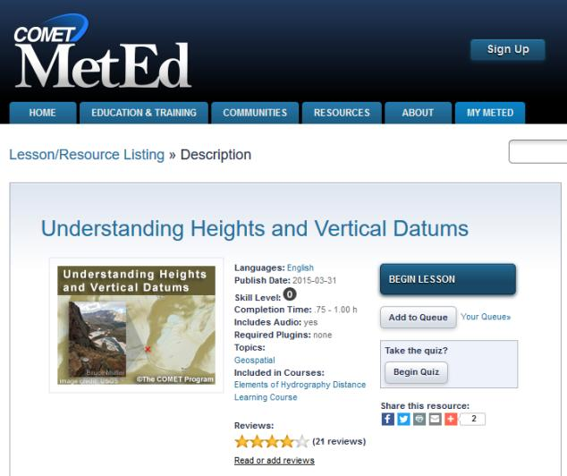
Resources at geodesy.noaa.gov
Educational Videos
<5 minutes
Online Lesson
(via MetEd/COMET)
~1 hour
Notes:
Educational videos and online tutorials –
Our library of lessons and videos are great resources, and will reinforce a lot of information we covered today.
The videos are just 3-5 minutes long.
the lesson is a deeper dive but still only takes an hour.

Slide 22
-use any major search engine: “NGS advisors”
Jeff Jalbrzikowski, P.S., GISP, CFS
Appalachian Regional Geodetic Advisor
jeff.jalbrzikowski@noaa.gov
240-988-5486

