Slide 1



Vertical Datums (of the NSRS)
Past, Present, Future
Jeff Jalbrzikowski, P.S., GISP, CFS
Appalachian Regional Geodetic Advisor
NOAA’s National Geodetic Survey
Ohio GIS Conference
September 20 – 22, 2022

Slide 2
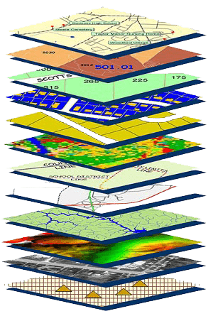
NGS Mission
To define, maintain and provide access to the National Spatial Reference System (NSRS) to meet our Nation’s economic, social, and environmental needs.
NSRS
Notes:
NGS develops and maintains the National Spatial Reference System, a national coordinate system that provides the foundation for transportation, navigation, land record systems, mapping and charting efforts, and a multitude of scientific and engineering applications.
But there are many ancillary programs and products we will also discuss.

Slide 3
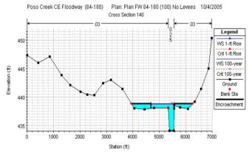
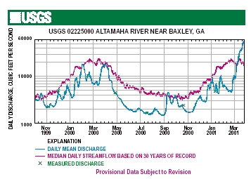

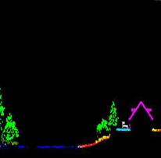
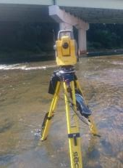
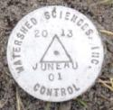
Why does the NSRS matter to me?
Orthometric Datum
Water Level Datum (and Flow Rates)
Ellipsoidal Datum
+
+
Aerial LiDAR/Mapping
Historic Water Levels and Flow Rates
Terrestrial Survey/Cross-Sections
FIRMs require data from disconnected sources.
Dates and datums must be consistently aligned.
Notes:
Example of why we need consistent coordinates (illustrated):
Just in the making of a single FIRM, data collected at different points in time using different methods:
-aerial lidar
-x-section and structure data via survey
-streamflow data/hydrographs
All of these must be reliably aligned and combined with historical data, in both the horizontal and vertical components, to produce a final product in which all of this information is available in one place, to assist professionals like yourselves in appropriate flood mitigation.
→Therefore, Reliable Flood Rate Insurance products rely on the NSRS
In a perfect world…
datums would be parallel and smooth
Surface of Earth would not move

Slide 4
Positional Components of
the NSRS
Geometric
aka “Horizontal”
Latitude, Longitude, Ellipsoid Height
Geopotential
aka Orthometric Height
aka “Elevation”
NAD83
NAVD88
Notes:
-geometric component is latitude, longitude, and ellipsoid height
-geopotential component is combined with the geometric components to calculate an ortho height or capital H

Slide 5
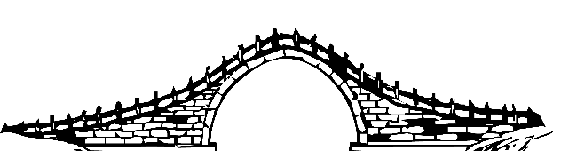
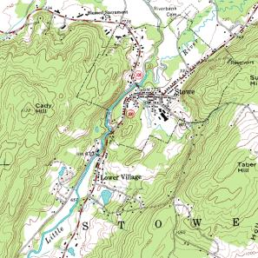
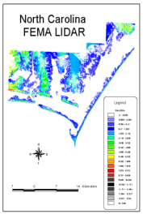
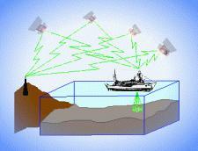
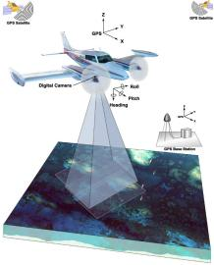
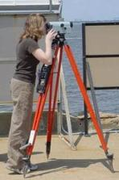
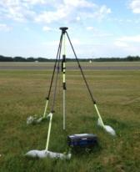
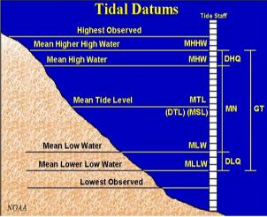
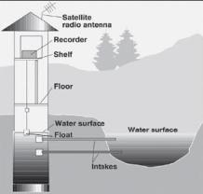
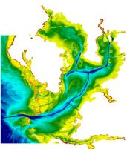
Three types of heights in NSRS
Ellipsoidal
geoid
Orthometric
Raw Hydrographic Surveys
USGS
Topography
NAD83
NAVD88
NGVD29
FEMA NFIP Data & Maps
Engineering and Construction Surveys
Raw GPS Observations
Raw Lidar Data
Water Level or Tidal
NOAA and USACE Hydrography
Shoreline Mapping and Regulatory Boundaries at the Coast
Daily and Extreme Water Levels (Gage)
Notes:
This slide illustrates the 3 categories of vertical datums and examples of where each is directly used They are project and application dependent.
First, we have ellipsoidal datums. Examples include WGS84 and NAD83 (North American Datum of 1983). You will encounter these datums frequently in hydrographic surveys that are vertically referenced with RTK-GPS; any native GPS measurements; and even raw lidar datasets.
Next, we have orthometric datums. These datums are very important because height differences referenced to orthometric datums will allow us to know the direction water will flow, because they have been “gravity-corrected”. The North American Vertical Datum of 1988 (or NAVD 88) is an orthometric datum, which you will see on USGS topographic maps, engineering and development site surveys, and FEMA Flood Insurance Rate Maps.
Finally, we have Tidal Datums, which are derived from water level measurements. They have extremely important applications including daily and extreme water levels; NOAA nautical charts, and shoreline mapping or boundaries along the coast.
*NOAA provides tools (like NCAT and Vdatum) to transform between these different height systems.
The Bridge

Slide 6
Orthometric

Slide 7
National Geodetic Vertical Datum
of 1929
NGVD29
was replaced by

Slide 8
North American Vertical Datum
of 1988
NAVD88
will be replaced by

Slide 9
North American-Pacific Geopotential Datum of 2022
NAPGD2022
(pronounced: nap-jee-dee)

Slide 10
Comparing Heights
or …“digging for datums”

Slide 11

Vertical Datum Visualized
A reference surface that can be used to measure heights in a uniform way.
How much taller is Sally than Jane?
Could measure directly from top of head to top of head.
Or, from floor up to tops of heads and then subtract!
Sally
Jane
X= ?
That’s a relative height, or height difference.
Datum
X = (h Sally) – (h Jane)
That’s a difference in heights above a datum.
Notes:
A vertical reference system is a reference surface that can be used to measure heights in a uniform way.
So, how much taller is Sally?

Slide 12
Datum Difference Visualized
Can still calculate X with a relative height… but it is not accurate, as our reference surface is not the same.
How much taller is Sally than Jane?
Need to know what they’re standing on!
We cannot compare heights that are measured from different reference surfaces.
Sally
Jane
X= ?
NAVD88
Datum 1
NGVD29
Datum 2
X ≠ (h Sally) – (h Jane)
Notes:
-Well, we need to know how tall, or the slope of the hill.
-You cannot compare heights that are measured from different planes of reference.
*If we replace Sally and Jane with an example more related to floodplains:
What if we want to compare a BFE height in 1990 and a BFE height 2010
what if the land has subsided under that base flood elevation over time?
…hold that thought.

Slide 13
Ok Jeff, how do I do that?
…we call that a datum transformation
Notes:
-note that’s the proper technical term, but I’m not going to hound someone who says “conversion”… I slip sometimes too

Slide 14
Terminology - Changing Coordinates
Conversion
    change the type of coordinate
    e.g. NAD83(2011) latitude & longitude → NAD83(2011) SPCS
  Transformation
    change the datum of coordinate
    e.g. NGVD29 height in feet → NAVD88 height in feet
    e.g. NAD 27 latitude & longitude → NAD 83(2011) latitude & longitude
Propagation
    change the epoch of coordinate
    e.g. NAPGD2022 epoch 2020.00 to NAPGD2022 epoch 2027.59
    e.g. NATRF2022 epoch 2020.00 to NATRF2022 epoch 2023.243
Notes:
Historically NGS has been inconsistent with these top two words.
Going forward, we will use them as:
Conversion: Meaning to change the type of coordinate without changing the datum or frame
e.g. change NAD 83(1986) latitude and longitude to NAD 83(1986) State Plane Coordinates
Transformation: Meaning to change the datum or frame, without changing the type of coordinate
e.g. changing an NAD 27 latitude & longitude to an NAD 83(1986) latitude & longitude
So, “NADCON” which transforms coordinates between datums could have been called “NADTRAN.” C’est la vie.

Slide 15
What if time is a factor?
What if stuff moves?
Notes:
-by “stuff” we mean the objects we’re measuring
-if earth is moving, we need o account for that

Slide 16
Epoch Difference Visualized
Can calculate X… but it is not accurate, as the thing to be measured is not the same.
What if Sally and Jane are growing?
2020
Sally
2027
Jane
How much taller is Sally than Jane?
Need to know the epoch of our measurements!
We should not compare heights that are measured at significantly different times.
X= ?
NAPGD2022
X ≠ (h_{2020.00} Sally) – (h_{2027.59} Jane)
Notes:
-Well, we need to know how tall, or the slope of the hill.
-You cannot compare heights that are measured from different planes of reference.
*If we replace Sally and Jane with an example more related to floodplains:
What if we want to compare a BFE height in 1990 and a BFE height 2010
what if the land has subsided under that base flood elevation over time?
…hold that thought.

Slide 17
Terminology - Changing Coordinates
Conversion
    change the type of coordinate
    e.g. NAD83(2011) latitude & longitude → NAD83(2011) SPCS
  Transformation
    change the datum of coordinate
    e.g. NGVD29 height in feet → NAVD88 height in feet
    e.g. NAD 27 latitude & longitude → NAD 83(2011) latitude & longitude
Propagation
    change the epoch of coordinate
    e.g. NAPGD2022 epoch 2020.00 to NAPGD2022 epoch 2027.59
    e.g. NATRF2022 epoch 2020.00 to NATRF2022 epoch 2023.243
Notes:
Historically NGS has been inconsistent with these top two words.
Going forward, we will use them as:
Conversion: Meaning to change the type of coordinate without changing the datum or frame
e.g. change NAD 83(1986) latitude and longitude to NAD 83(1986) State Plane Coordinates
Transformation: Meaning to change the datum or frame, without changing the type of coordinate
e.g. changing an NAD 27 latitude & longitude to an NAD 83(1986) latitude & longitude
So, “NADCON” which transforms coordinates between datums could have been called “NADTRAN.” C’est la vie.

Slide 18
A very brief history of (the most prevalent) U.S. vertical datums

Slide 19
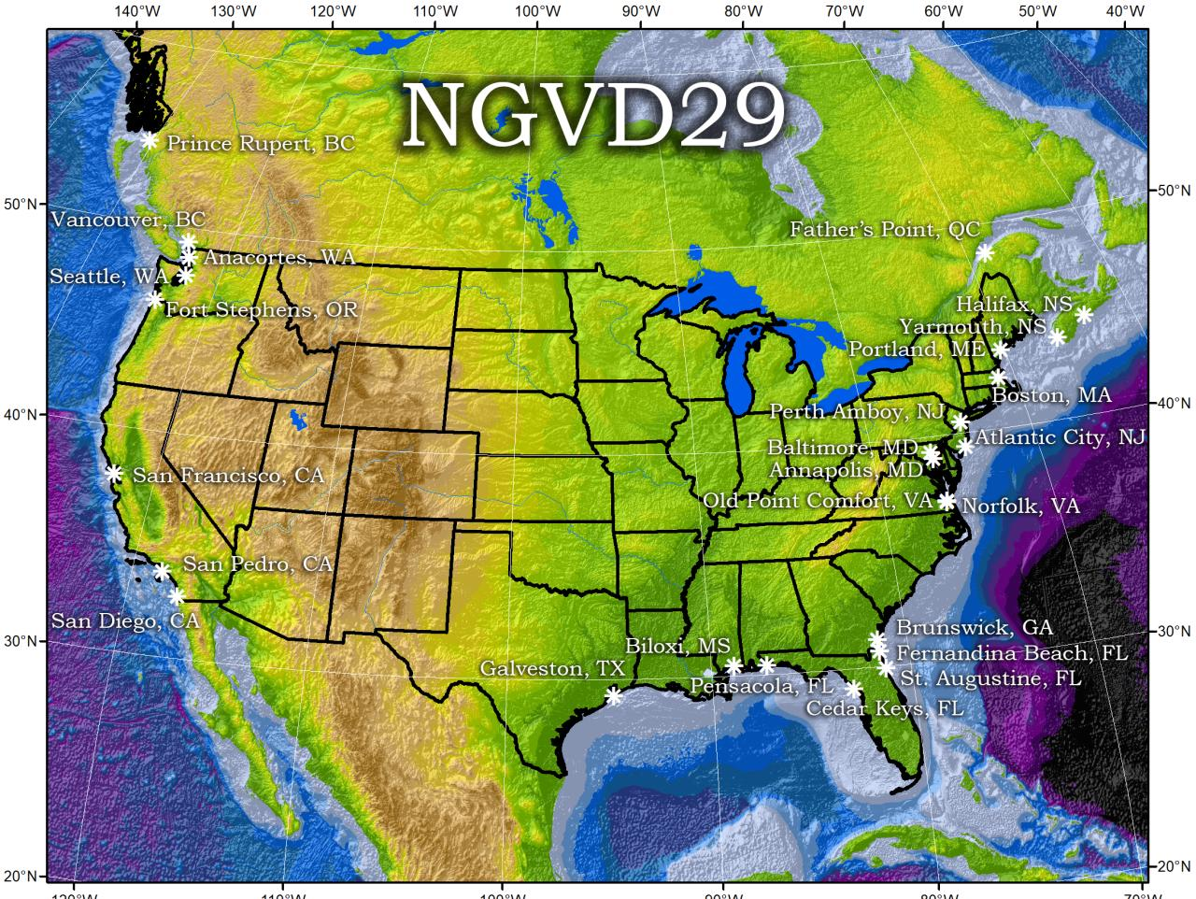
Referenced to 26 tide gauges in the US and Canada

Slide 20
NGVD29 – based on 26 tide gauges
topographic surface
datum zero
surface
  Local Mean Sea Level differs at tide stations due to prevailing winds, ocean current, salinity, seabed topography, etc.
Concept

Slide 21
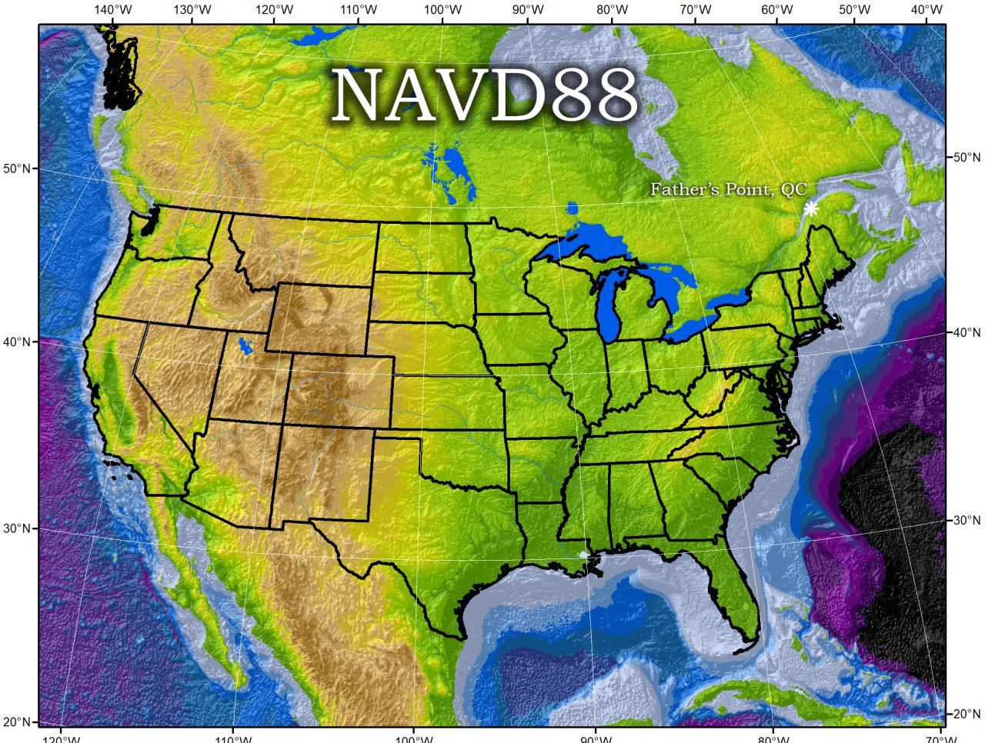
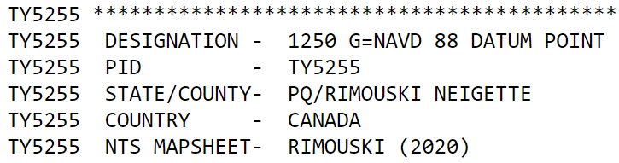
Why one site this time?
removed local sea level variation problem of NGVD29
Referenced to one tidal bench mark in Canada

Slide 22
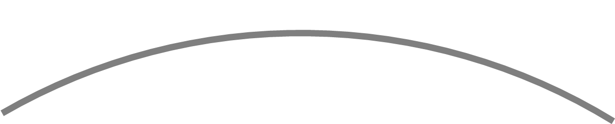
NAVD88 – based on single benchmark
topographic surface
datum zero
surface
Concept
Notes:
-

Slide 23
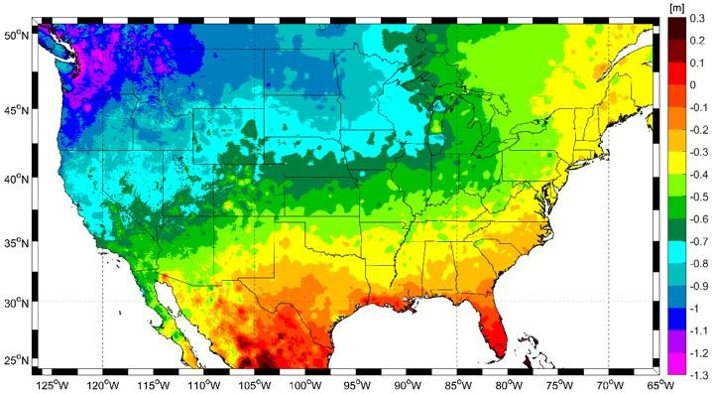
Approximate Error in NAVD88 zero surface
Map is the H=0 surface differenced from satellite gravity data
Notes:
Map highlights the tilt/bias to the zero reference surface, that’s another item that was discovered later on with the advent and proliferation of satellite positioning and remote sensing technology.
How was the map created, that is the NAVD88 zero surface (H=0) overlaid onto a satellite based geoid model, then color shaded by vertical difference

Slide 24
NAVD88 – based on single benchmark
topographic surface
datum zero
surface
  Most, if not all, of this error in alignment was intentional.
  Huh?! It was chosen to minimize the change to contours in USGS quadrangles.
Concept
Notes:
-importantly, the height chosen was to minimize 29→88 differences on USGS topo maps in the eastern U.S. … thus, the “zero height surface” of NAVD 88 was NOT chosen for its closeness to the geoid (but it was close…few decimeters)

Slide 25
Which NAD83 with which geoid?
GEOID18
GEOID12B
NAD83(2011) →
NAD83(2007) →
NAD83(HARN/FBN)
NAD83(CORS96)
GEOID09
GEOID03
GEOID99
GEOID96
Notes:
I’ve gotten this question more than once.
-Does it matter which geoid model I use with which realization of NAD83?
-NGS Answer = yes
-Project-specific answer = maybe note
-I spoke at length with a gentlemen from the Virginia DOT about this, and he did a bunch of comparisons, saw a barely discernable difference… but still the NGS answer is going to be that for a given realization of NAD83, you should use only the corresponding geoid models for your work
-remember NGS is chasing the millimeter… but maybe you aren’t

Slide 26
NAPGD2022
North American-Pacific Geopotential Datum of 2022
GNSS is your “access point”
  no leveling or ties to benchmarks necessary
Global Mean Sea Level (GMSL) based

Slide 27
Gravity → Geoid
You’ve all used a DEM.
(Digital Elevation Model)
Picture a geoid model as a DGM.
(Digital Gravity Model)
-both raster cells of height values
→but represent different things

Slide 28
Geoid - my favorite definition
  “The geoid is the equipotential surface that most closely coincides with the undisturbed mean sea level (and its continuation through the continents).”
    - Sjöberg, L. E., & Bagherbandi, M. (2017). Gravity Inversion and Integration, Theory and Applications in Geodesy and Geophysics. Springer.
  equipotential → equal potential
  potential → as in energy… or gravitational pull

Slide 29
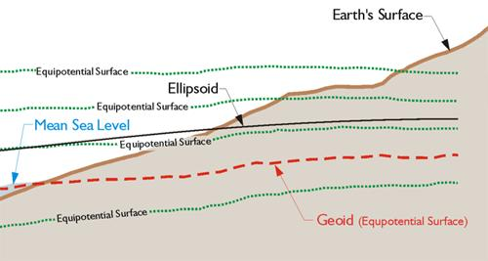
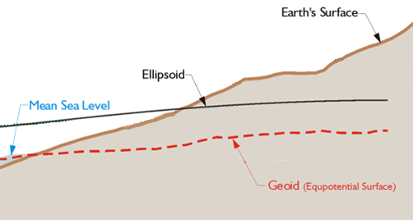
Equipotential Surface
W₀ = 62,636,856.0 m² s⁻²
-GPS for Land Surveyors, by Jan Van Sickle, 4th ed., CRC Press, Taylor & Francis Group, 2015, p. 180. (slightly edited)
Geoids are defined by a specific strength of gravity → W₀
Notes:
Recall our ol’ buddy W sub-naught (W₀)

Slide 30
How do we measure gravity?
  Airborne observations of relative gravity
  collected in a short of a timespan
  full coverage, like aerial photos or lidar
  Terrestrial observations of absolute gravity
  periodic or episodic; repeat every ___ years
  large spacing, a few per state
Notes:
Two major campaigns within GRAV-D
High-resolution snapshot of gravity
airborne observations of relative gravity
collected in as short of a timespan as is realistic
full coverage
Low-resolution “movie” of gravity changes
on-the-ground observations of absolute gravity
periodic or episodic; repeat every ___ years
large spacing, a few per state

Slide 31
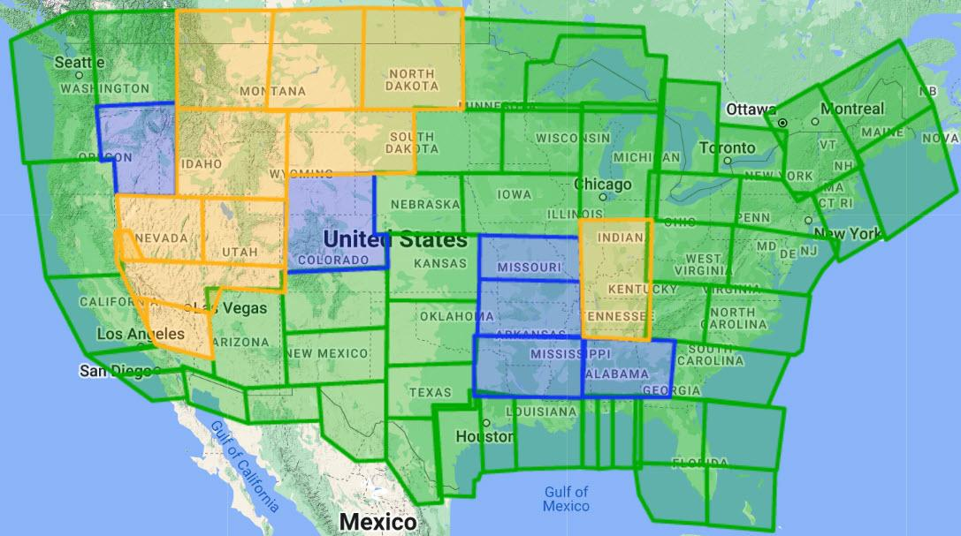
Gravity for the Redefinition of the American Vertical Datum
Green = Complete
Blue = In Processing
Yellow = Underway
White = Planned
10 km data lines
70 km cross lines
20,000 ft altitude
230 kt flight speed
as of Sep 2022:
96% complete

Slide 32
NAVD88 geoids
versus
NAPGD2022 geoids

Slide 33
Two types of geoid models
  Gravimetric
  Hybrid
Notes:
-believe it or not there’s more than 2 types, but the 2 types you’ll see NGS publish are…

Slide 34
Gravimetric → Hybrid
  Gravimetric geoid is created from “scratch” with various types of gravity data
      USGG2003, USGG2009, USGG2012, xGEOID19
  Hybrid geoid is simply a gravimetric geoid then best fit some vertical datum… like NAVD88
      GEOID03, GEOID09, GEOID12B, GEOID18
Notes:
So… all the geoids you’re using to get elevations from your GNSS data

Slide 35
Gravimetric → Hybrid
      USGG2003, USGG2009, USGG2012, xGEOID19
      GEOID03, GEOID09, GEOID12B, GEOID18
best fit to NAVD88
best fit to NAVD88
best fit to NAVD88
best fit to NAVD88
Notes:
So… all the geoids you’re using to get elevations from your GNSS data

Slide 36
Gravimetric vs. Hybrid Geoid
topographic surface
gravimetric geoid
hybrid
geoid
datum zero
surface
Concept

Slide 37
NAVD88 uses a Hybrid Geoid
topographic surface
gravimetric geoid
hybrid
geoid
datum zero
surface
Concept

Slide 38
NAPGD2022 uses a Gravimetric Geoid
topographic surface
gravimetric geoid
datum zero
surface
  Datum zero surface aligned to Global Mean Sea Level (GMSL)
Concept

Slide 39
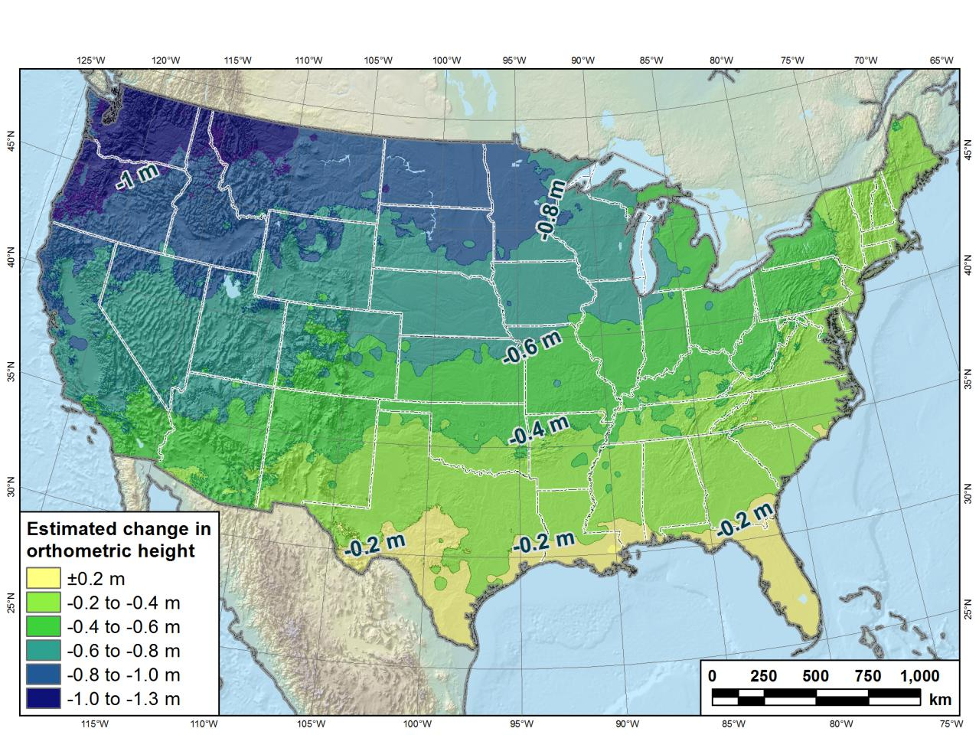
Estimated change in orthometric heights from NAVD88 to NAPGD2022
(NAPGD2022 approximated using xGEOID16B)

Slide 40
Preparing for NAPGD2022
  Inventory heights in your data/datasets
    Have you mix & matched geoid models?
      Are you tracking levees or other flood control?
      Are you managing subsurface utilities?
        Access covers, junction boxes, cleanouts, etc.
      Maybe geoid differences aren’t even significant.
    Know your goals, know your data.

Slide 41
Preparing for NAPGD2022
  Know the epoch of your data/datasets
    consider how you will track this
      full to-the-second timestamp on every feature?
      labeling a year for each dataset?
      something in-between that works for your needs

Slide 42
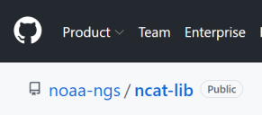
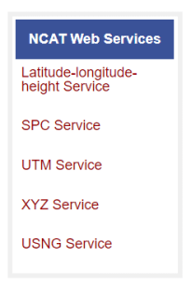
Preparing for NAPGD2022
  Transforming your data
    NCAT - NGS Coordinate Conversion and Transformation Tool
      available now: ASCII upload, Web Services, GitHub
      ask your software provider(s) about integration
        we envision COTS integration most popular method of access
        Industry Workshops held May 2021 and August 2022
          Esri, Trimble, Blue Marble, etc… all the well known names attended
Notes:
Transforming your data
NCAT - NGS Coordinate Conversion and Transformation Tool
available now: ASCII upload and Web Services
ask your software providers about integration
we envision this as most popular method of access
Industry Workshop held last week – esri, trimble, bluemarble, all the major well known names were represented
labeling a year for each dataset?
something in-between that works for your needs

Slide 43

additional Resources
Notes:
This presentation is intended to raise awareness about the upcoming changes and what they mean for floodplain mapping, but you probably have lots of remaining questions and we have a lot of resources online at our website
Please spread the word, and
make an effort to keep yourself and your colleagues informed.
Tell us what content is missing or how we can make it better!

Slide 44
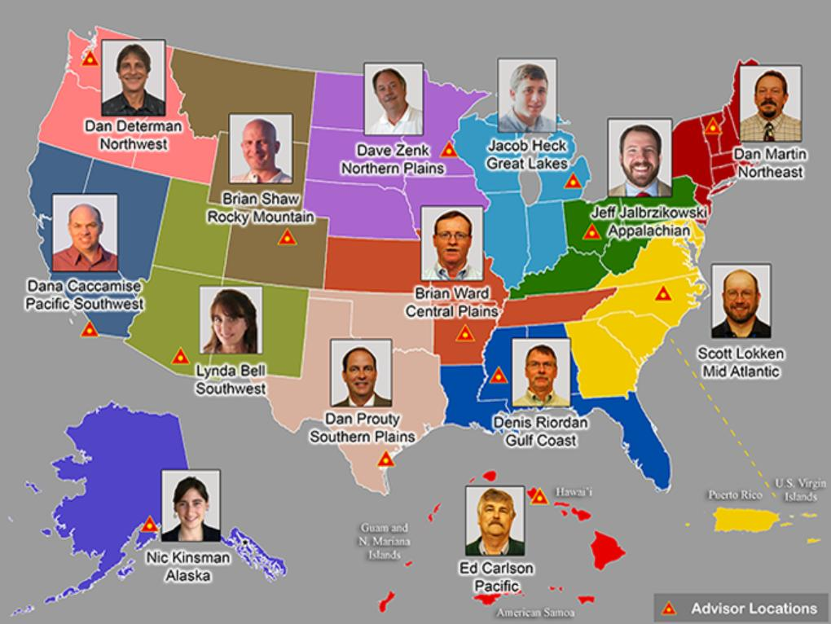

https://www.ngs.noaa.gov/ADVISORS/

Slide 45

State Geodetic Coordinators
Not an NGS employee
Serves as a liaison between the State’s geospatial community and the NGS
Ray Foos at ODOT

Slide 46
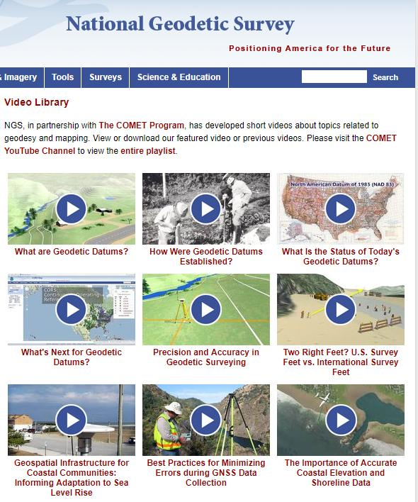

Resources at geodesy.noaa.gov
Educational Videos
<5 minutes
Online Lesson
(via MetEd/COMET)
~1 hour
Notes:
Educational videos and online tutorials –
Our library of lessons and videos are great resources, and will reinforce a lot of information we covered today.
The videos are just 3-5 minutes long.
the lesson is a deeper dive but still only takes an hour.

Slide 47


Email Subscriptions
*Only 1-2 messages per month*
NGS News
  Includes quarterly NSRS Modernization newsletter
Webinar Series
Training
  Primarily surveyor focused
GPS on Benchmarks
Click this icon on homepage
Notes:
Stay abreast of any new information coming from us via Email Subscription –
Sign up for notifications about News, webinars, and training opportunities with NGS.
We also use our News subscription list to send out our quarterly NSRS Modernization Newsletter.

Slide 48
https://www.ngs.noaa.gov/ADVISORS/
-use any major search engine: “NGS advisors”
Jeff Jalbrzikowski, P.S., GISP, CFS
Appalachian Regional Geodetic Advisor
jeff.jalbrzikowski@noaa.gov
240-988-5486

