Slide 1
Upgrading our Nation's Geodetic Infrastructure
or… where would you be without a datum?
Northeast Ohio GIS Symposium Lite
May 2022
Jeff Jalbrzikowski, P.S., GISP, CFS
Appalachian Regional Geodetic Advisor
jeff.jalbrzikowski@noaa.gov
240-988-5486

Slide 2
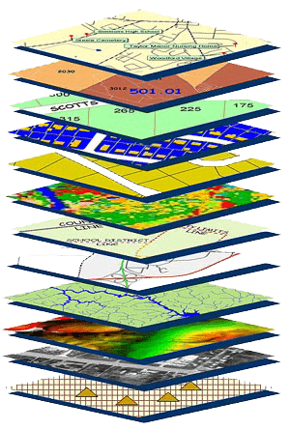
NGS Mission
To define, maintain and provide access to the National Spatial Reference System (NSRS) to meet our Nation’s economic, social, and environmental needs.
NSRS
Notes:
NGS develops and maintains the National Spatial Reference System, a national coordinate system that provides the foundation for transportation, navigation, land record systems, mapping and charting efforts, and a multitude of scientific and engineering applications.
But there are many ancillary programs and products we will also discuss.

Slide 3
Delayed Release of the New Datums
How long will the delay be?
At best, it now looks like a 2025 timeframe.
Will the names stay the same?
Yes, terms containing “2022” such as NATRF2022 and GEOID2022 will remain the same.
I use State Plane Coordinate System (SPCS) zones for all my work, will this affect me?
It sure will, because SPCS83 will be replaced with SPCS2022. NAD83 : SPCS83 :: NATRF2022 : NAD83
hyperlink to the Track Our Progress homepage
hyperlink to the full FAQ

Slide 4
Organizational Structure
-Department of Commerce (DoC)
-National Oceanic and Atmospheric Administration (NOAA)
-National Ocean Service (NOS)
-National Geodetic Survey (NGS)
Notes:
-We are the Federal Government’s oldest scientific agency.
-part of the Executive Branch
-I know it can seem kind of strange that NGS is part of the NOS, but the origins of NGS lie with the C&GS.
-we are a “Program Office” of the NOS
Survey of the Coast – 1807
Coast Survey – 1836
Coast and Geodetic Survey – 1878
NGS since 1970

Slide 5
Organizational Structure
We’re not USGS, we’re NGS
-Department of Commerce (DoC)
-National Oceanic and Atmospheric Administration (NOAA)
-National Ocean Service (NOS)
-National Geodetic Survey (NGS)
≠
Notes:
-as you can read my slide, I like to point that out because over my 2 years at NGS I’ve seen and heard this misunderstanding quite a bit
-don’t worry! it doesn’t offend us! and we do work closely with USGS, but we are separate agencies within totally different departments of the federal government

Slide 6
National Spatial Reference System
A common and consistent geospatial framework
Without this basic framework, efficient GIS analysis would not be possible.
Notes:
The primary mission of NGS is, “to define, maintain, and provide access to the NSRS to meet our nations economic, social, and environmental needs”.
NSRS is a consistent geospatial framework, common to all Federal agencies and other users
NSRS supports informed decision-making for mapping and charting, navigation, flood risk determination, transportation, land management, and more
Elements of NSRS include (but are not limited to): latitude, longitude, elevation, gravity, shoreline position + their changes over time …other elements include scale, earth orientation parameters and others
The vertical component of the NSRS currently utilizes the North American Vertical Datum of 1988 (NAVD88)
CLICK

Slide 7
National Spatial Reference System (NSRS)
A consistent coordinate system that defines
latitude
longitude
height
scale
orientation
gravity
throughout the United States.
…and how these change over time
Notes:
Let’s talk about the NSRS some more before we move on to looking at all of NGS.
This system defines position (latitude, longitude, and elevation), distances and directions between points, strength and direction of gravity (no, it is not simply “straight down”), shoreline, and their “time variants”.
Or how these change over time.
Some documents will reference the National Shoreline as a component of the NSRS., we’ll briefly look at that later.

Slide 8
National Spatial Reference System (NSRS)
These items ARE part of the NSRS
Horizontal Datums (aka Geometric Reference Frames) | Vertical Datums | Great Lakes Datums | Geoid Models | Transformations and Conversions
NAD83 | NAVD88 | IGLD85 | GEOID18 | NCAT
NAD27 | NGVD29 | IGLD55 | GEOID12B | NADCON
USSD | VIVD09 |  | GEOID09 | VERTCON
 | GUVD04 |  | GEOID06 | SPCS83
 | NMVD03 |  | GEOID03 | SPCS27
 | ASVD02 |  | GEOID99
 | PRVD02 |  | GEOID96
 |  |  | ALASKA94
 |  |  | GEOID93
 |  |  | GEOID90
Notes:
Note the US Standard Datum, anyone done any work in the old USSD?
Good example highlighting that the term “NSRS” is used to encompass all historic datums of NGS and its predecessors.
Saw one project during my work with the USACE, in Johnstown, PA, that had original survey records in what turned out to be US Standard Datum.
All those vertical datums below NGVD29, I greyed them out slightly because those are all Caribbean and Pacific Island datums, so in CONUS it’s just those two that you hopefully already use… and hopefully are mostly using NAVD88.

Slide 9
National Spatial Reference System (NSRS)
These items are NOT part of the NSRS
Horizontal Datums (aka Geometric Reference Frames) | Vertical Datums | Geoid Models | Transformations and Conversions
WGS84 | IHRS (by IAG) | EGM2008 | CORPSCON
WGS72 |  | EGM96 | NIMA TR 8350.2
ITRF (International Terrestrial Reference Frame by IERS) |  | OSU91A | Indiana Geospatial Coordinate System (InGCS)
Hyperlink to ITRF station map
Notes:
WGS is a DoD system. Yes, that is the system native to the Global Positioning System, but it isn’t true that you “have to” work in WGS84 to get the most accurate coordinates. I’ve heard people say that.
The Intl. Terrestrial Ref. Frame is a product of the Intl. Earth Rotation and Reference Systems Service. More on that later.
The Intl. GNSS Service Ref. Frame is, well, it’s a reference frame based on that ITRF just mentioned, but with improvements, like a more dense network of stations and is more easily accessible.
The IHRS is an International Height Reference System, which is a product that was formally adopted by the IAG (Intl. Association of Geodesy) in 2015. Not an NGS product but folks from NGS were involved.
OSU geoid, it was a research thing and I don’t know much about it.
The Earth Gravity Models are DoD products just like the WGS products, used around the world by our Nation’s military (I used EGM based height sin Iraq and Afghanistan)… but are not at all tied to NSRS geoids. Future DoD geoid models may have a closer tie to future NGS geoid models.
CorpsCon. Ah yes, Corpscon. Everyone loves Corpscon, unfortunately as convenient as it is it isn’t truly an NGS product and has not been updated in well, a long time, and there are no plans to update it in the future. (confirmed via phone call to AGC personnel on 20FEB2019)
I like Mark Huber, awesome dude, I spent some time with him surveying on some god-forsaken island in the Indian Ocean, but the USACE doesn’t seem to want to support him in funding an update to Corpscon. So it is what it is.
Those regional coordinates systems, like the ORCS in Oregon and that one in Kansas, although they have rigorously defined transformations to the NSRS (which is great, they did it right) they are not part of the NSRS.
NOTE – InGCS is what we’d refer to as a “regional implementation of the NSRS”, meaning there is a strong tie and defined relationshop but we at NGS do not control/publish the InGCS>

Slide 10
Geometric
aka “Horizontal”
Geopotential
aka Orthometric Height
aka “Elevation”
Two Major Components of
the NSRS
Two Major Components of
Modernized NSRS
NAD83
NATRF2022
NAVD88
NAPGD2022
Notes:
-geometric component is latitude, longitude, and ellipsoid height
-geopotential component is combined with the geometric components to calculate an ortho height or capital H

Slide 11
North American Terrestrial Reference Frame of 2022
NATRF2022
(pronounced: nat-ref)

Slide 12
North American-Pacific Geopotential Datum of 2022
NAPGD2022
(pronounced: nap-jee-dee)

Slide 13
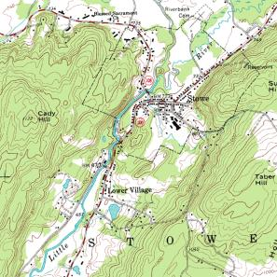
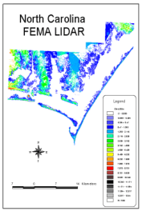
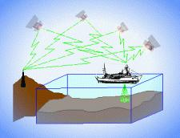
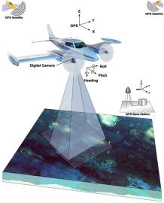
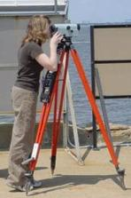
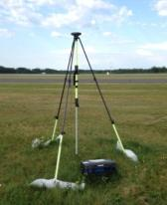
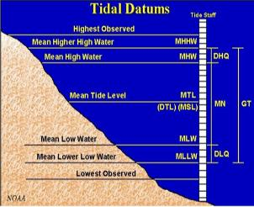
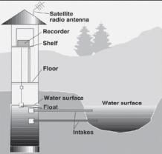
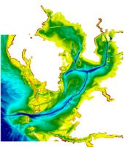
Three types of vertical datums in NSRS
Ellipsoidal
geoid
Orthometric
Raw Hydrographic Surveys
USGS
Topography
FEMA NFIP Data & Maps
Engineering and Construction Surveys
Native GPS Observations
Raw Lidar Data
Water Level or Tidal
NOAA and USACE Hydrography
Shoreline Mapping and Regulatory Boundaries at the Coast
Daily and Extreme Water Levels (Gage)
Notes:
This slide illustrates the 3 categories of vertical datums and examples of where each is directly used They are project and application dependent.
First, we have ellipsoidal datums. Examples include WGS84 and NAD83 (North American Datum of 1983). You will encounter these datums frequently in hydrographic surveys that are vertically referenced with RTK-GPS; any native GPS measurements; and even raw lidar datasets.
Next, we have orthometric datums. These datums are very important because height differences referenced to orthometric datums will allow us to know the direction water will flow, because they have been “gravity-corrected”. The North American Vertical Datum of 1988 (or NAVD 88) is an orthometric datum, which you will see on USGS topographic maps, engineering and development site surveys, and FEMA Flood Insurance Rate Maps.
Finally, we have Tidal Datums, which are derived from water level measurements. They have extremely important applications including daily and extreme water levels; NOAA nautical charts, and shoreline mapping or boundaries along the coast.
*NOAA provides tools (like NCAT and Vdatum) to transform between these different height systems.
The Bridge

Slide 14
Why is gravity important to mapping?
Because water flows downhill (down potential)
Riverine Flooding
Floodplain mapping & management (FEMA NFIP, FIRMs)
Levee and dam maintenance
Irrigation canals and dams
Construction permitting along rivers/coasts
Coastal erosion
Coastal hazards
Storm surges and flooding (FEMA NFIP, FIRMs – Zone VE)
Sea-level change
Future coastal flooding?
Notes:
-Hey Texas has over 3,300 miles of coastline according to NOAA’s Office of Coastal Management!

Slide 15
Why is gravity important to mapping?
Large scale analysis is made possible by consistent vertical datums
How to compare heights in two different datums?
These tasks are made even more complex in areas of regional subsidence
Think of the Harris-Galveston Subsidence District
Some 13 feet of subsidence over last 100 years

Slide 16
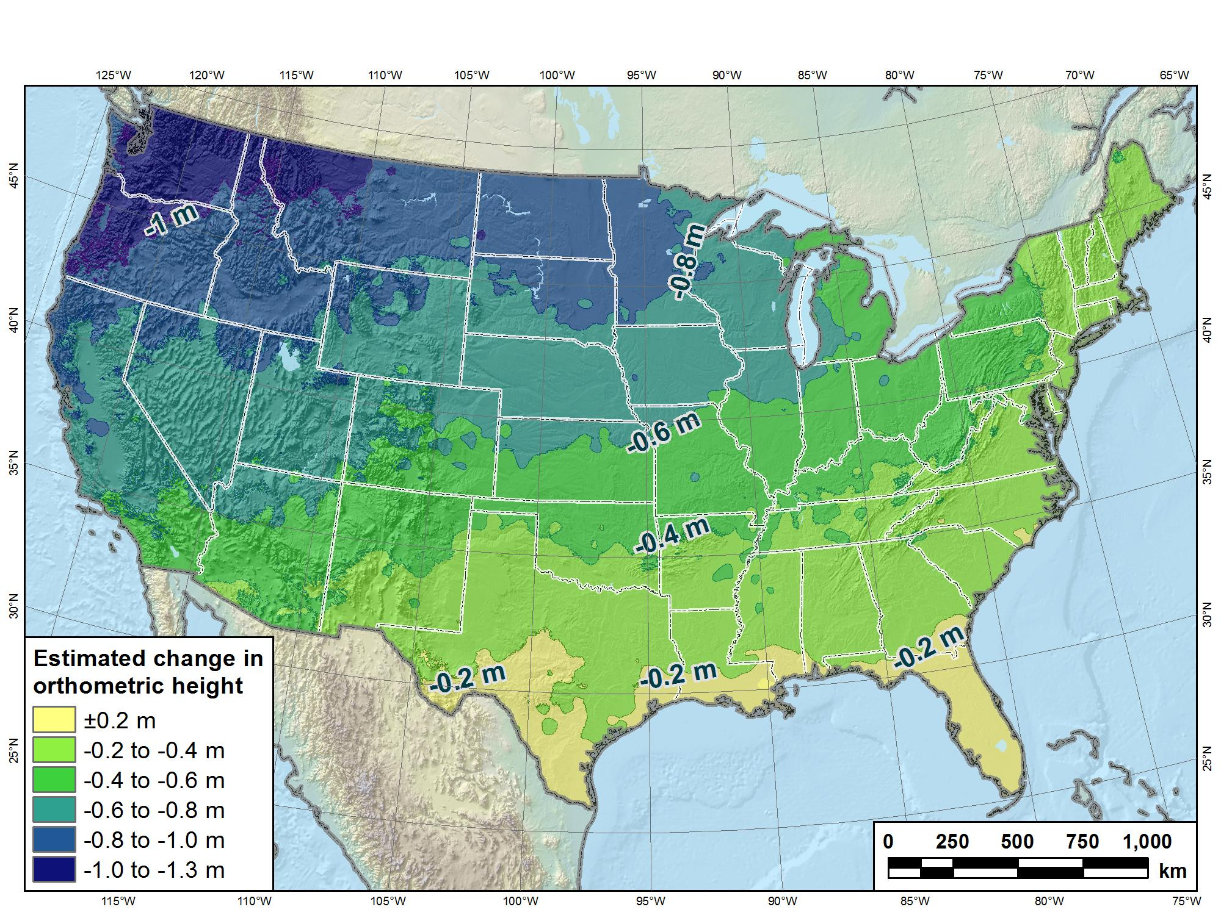
Estimated change in orthometric heights from NAVD88 to NAPGD2022
(NAPGD2022 approximated using xGEOID16B)

Slide 17
Estimated change in orthometric heights from NAVD88 to NAPGD2022
(NAPGD2022 approximated using xGEOID16B)
largest
smallest
Vertical change of about -0.8 to -2.4 feet

Slide 18
In a perfect world…
Datums would be parallel and smooth
transforming would be a simple constant shift
Surface of Earth would not move
some of it is anthropogenic
Everyone would use the same datums
Just imagine!
THIS JUST IN…
WE DON’T LIVE IN A PERFECT WORLD!

Slide 19
NGS Coordinate Conversion And Transformation Tool (NCAT)
Notes:
NCAT includes the functionality of previous NGS tools:
NADCON 5.0
XYZWIN 2.0
UTMS 2.1
SPC83 2.1
USNG 2.3
Includes error estimate of transformation per point.
Available as the single-point graphic seen here, multi-point upload/download, as a downloadable executable fie to run from the DOS prompt, and as web services for inclusion in your own
It’s a great tool. Anyone using

Slide 20
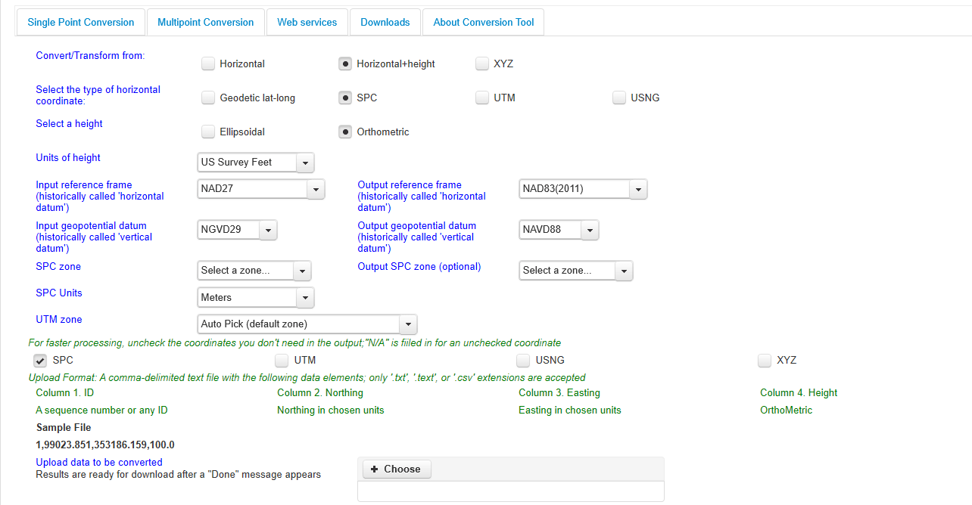
NGS Coordinate Conversion And Transformation Tool (NCAT)
Notes:
NCAT includes the functionality of previous NGS tools:
NADCON 5.0
XYZWIN 2.0
UTMS 2.1
SPC83 2.1
USNG 2.3
Includes error estimate of transformation per point.
Available as the single-point graphic seen here, multi-point upload/download, as a downloadable executable fie to run from the DOS prompt, and as web services for inclusion in your own
It’s a great tool. Anyone using

Slide 21
NCAT is available via web services

Slide 22
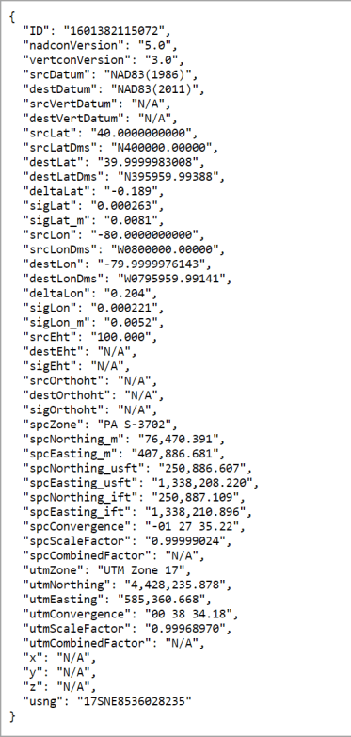
NCAT is available via web services
Note that each operation is a separate service
Struggling?
Contact us.
We can help!

Slide 23
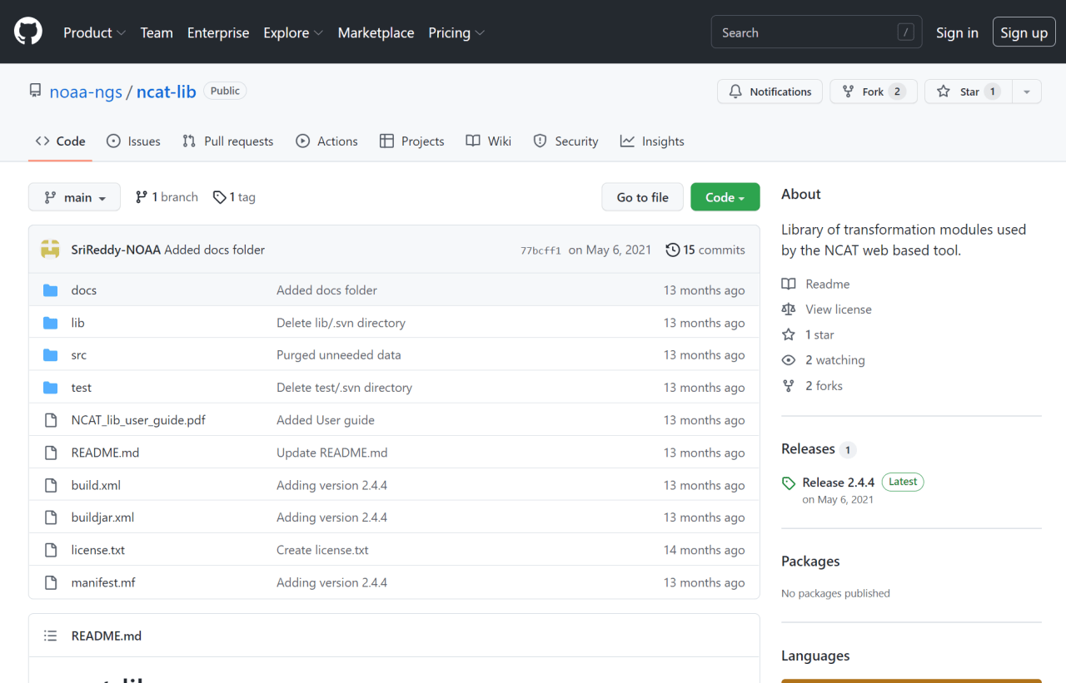
NCAT source code is on GitHub

Slide 24
I’ll be selling these bumper stickers at the next statewide conference ☺
SPCS2022
MAKING EARTH FLAT AGAIN
…ONE ZONE AT A TIME

Slide 25
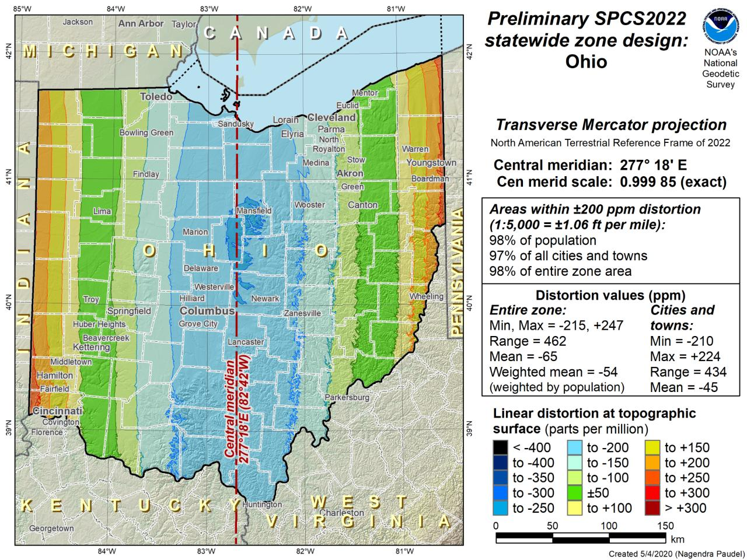

Slide 26
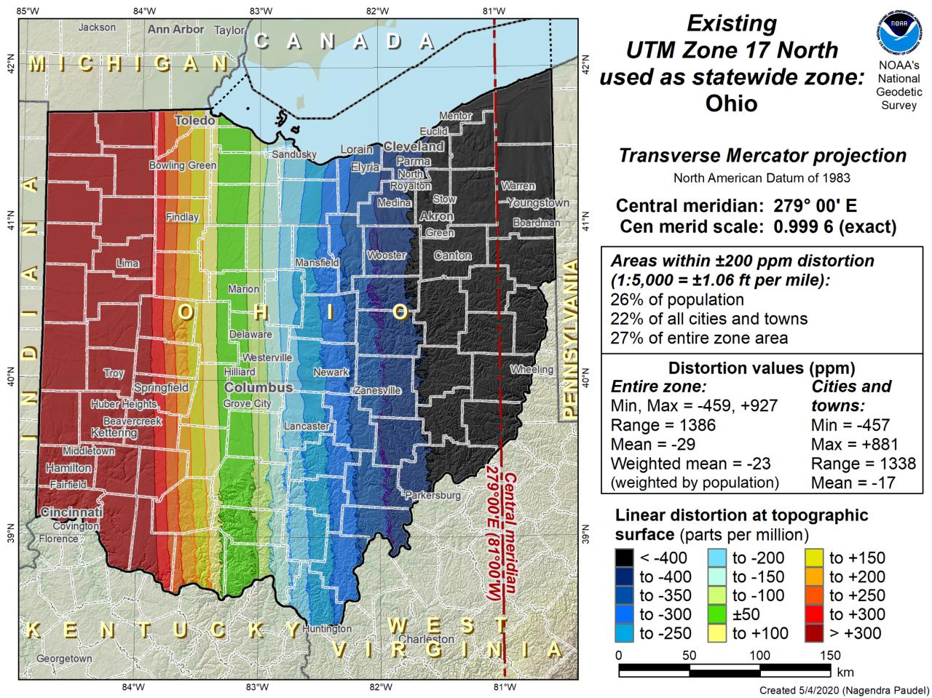

Slide 27
additional Resources
Notes:
This presentation is intended to raise awareness about the upcoming changes and what they mean for floodplain mapping, but you probably have lots of remaining questions and we have a lot of resources online at our website
Please spread the word, and
make an effort to keep yourself and your colleagues informed.
Tell us what content is missing or how we can make it better!

Slide 28
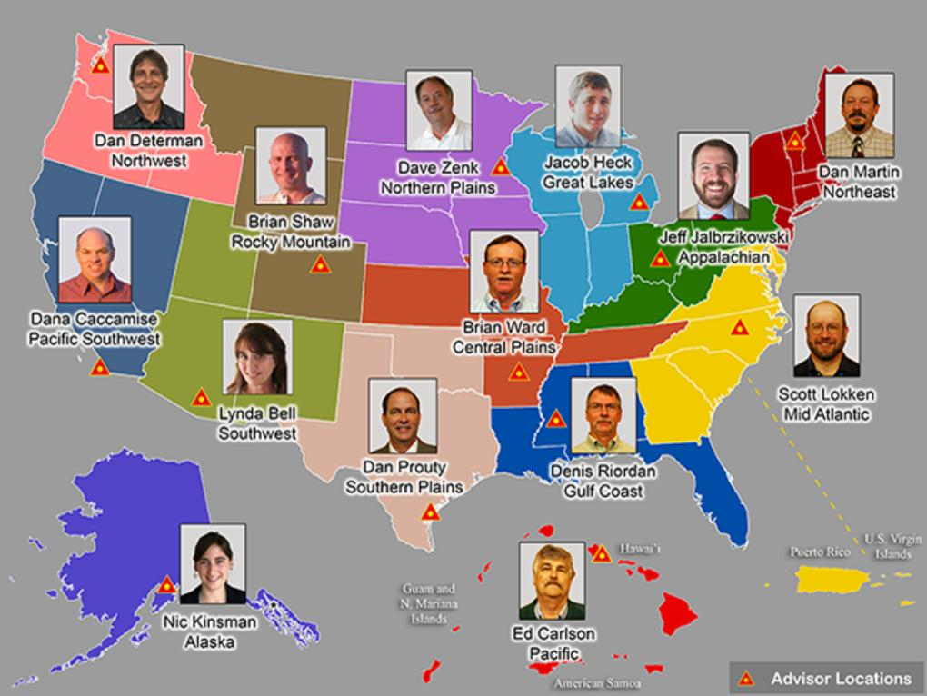
https://www.ngs.noaa.gov/ADVISORS/
Notes:
-14 Regional Advisors, we’ve transitioned from a State-based to a Regional Program
-our advisors homepage up there at the top, also easy to find us by querying any major search engine for “ngs advisors”
-if you know Ross Mackay, he is our Chief Advisor, I report to him…
**ya know, I don’t know why they don’t make him put his photo up here
-we do have one vacant advisor position, that was recently advertised and John up there in Wisconsin is officially retired in oh… 18 days

Slide 29
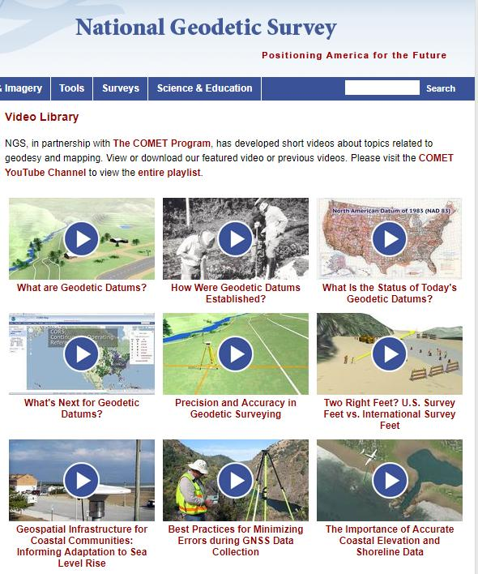
Resources at geodesy.noaa.gov
Educational Videos
<5 minutes
Online Lesson
(via MetEd/COMET)
~1 hour
Notes:
Educational videos and online tutorials –
Our library of lessons and videos are great resources, and will reinforce a lot of information we covered today.
The videos are just 3-5 minutes long.
the lesson is a deeper dive but still only takes an hour.

Slide 30
Email Subscriptions
NGS News
Includes quarterly NSRS Modernization newsletter
Webinar Series
Training
Only 1-2 messages per month
Click this icon on homepage
Recorded Webinar:
NGS Geospatial Resources
with Brian Shaw
Rocky Mountain Regional Advisor
Notes:
Stay informed via Email Subscription –
Sign up for notifications about News, webinars, and training opportunities with NGS.
We also use our News subscription list to send out our quarterly NSRS Modernization Newsletter.
LET’S TAKE A LOOK AT WHERE TO FIND OUR UPCOMING AND RECORDED WEBINARS REAL QUICK
NOTE navigate to the Webinar Series link→ show Upcoming and Recorded

Slide 31
Appalachian Regional Geodetic Advisor
NOAA’s National Geodetic Survey
geodesy.noaa.gov/ADVISORS/
jeff.jalbrzikowski@noaa.gov
cell: 240-988-5486
If you’d like, I have a 3 question survey at
https://www.menti.com/wu77gnhnkd

