Slide 1

Replacing NAD 83
What Does That Mean for the Geospatial Professional?
WVAGP Conference
May 2022
Jeff Jalbrzikowski, P.S., GISP, CFS
Appalachian Regional Geodetic Advisor
jeff.jalbrzikowski@noaa.gov
240-988-5486
Notes:
-hi my name’s Jeff!
-so who am I?
-I’m a surveyor, NGS calls me a geodesist, and my background is in all types of surveying both land and hydrographic. I’ve been with NGS for about 2 years, came here from the USACE (Pittsburgh District), and have also worked for the Bureau of Land Management and various State & local government. Spent almost my entire career with government, and got my start surveying in the military. It’s taken me around the world, but originally I’m from SE Ohio, I’m a university of Akron graduate, and I have an older sister who lives just north up in Flint.

Slide 2
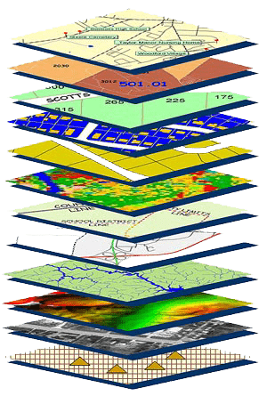
NGS Mission
To define, maintain and provide access to the National Spatial Reference System (NSRS) to meet our Nation’s economic, social, and environmental needs.
NSRS
Notes:
NGS develops and maintains the National Spatial Reference System, a national coordinate system that provides the foundation for transportation, navigation, land record systems, mapping and charting efforts, and a multitude of scientific and engineering applications.
But there are many ancillary programs and products we will also discuss.

Slide 3
What’s going to stay the same?
  NSRS Modernization
What’s going to be different?
Notes:
-so you’ve probably seen that phrase that I have front and center here, NSRS Modernization
-that’s the blanket term we use to refer to not just the new datums but other updates

Slide 4
National Spatial Reference System
A common and consistent geospatial framework to meet the economic, social, and environmental positioning needs of our Nation.
Foundational elements include:
Latitude
Longitude
Height
Gravity
Shoreline Position
…how these change over time
Horizontal Datums | Vertical Datums
Horizontal Datums | Vertical Datums
NAD83 | NAVD88
NAD27 | NGVD29
Elevation
Great Lakes Datums | Geoid Models
Great Lakes Datums | Geoid Models
IGLD85 | GEOID18
IGLD55 | GEOID12B
Notes:
The primary mission of NGS is, “to define, maintain, and provide access to the NSRS to meet our nations economic, social, and environmental needs”.
NSRS is a consistent geospatial framework, common to all Federal agencies and other users
NSRS supports informed decision-making for mapping and charting, navigation, flood risk determination, transportation, land management, and more
Elements of NSRS include (but are not limited to): latitude, longitude, elevation, gravity, shoreline position + their changes over time …other elements include scale, earth orientation parameters and others
The vertical component of the NSRS currently utilizes the North American Vertical Datum of 1988 (NAVD88)

Slide 5
Positional Components of
the NSRS
Geometric
aka “Horizontal”
Latitude, Longitude, Ellipsoid Height
Geopotential
aka Orthometric Height
aka “Elevation”
NAD83
NAVD88
Notes:
-geometric component is latitude, longitude, and ellipsoid height
-geopotential component is combined with the geometric components to calculate an ortho height or capital H

Slide 6
North American Datum
of 1983
NAD83
will be replaced by

Slide 7
North American Terrestrial Reference Frame of 2022
NATRF2022
(pronounced: nat-ref)

Slide 8
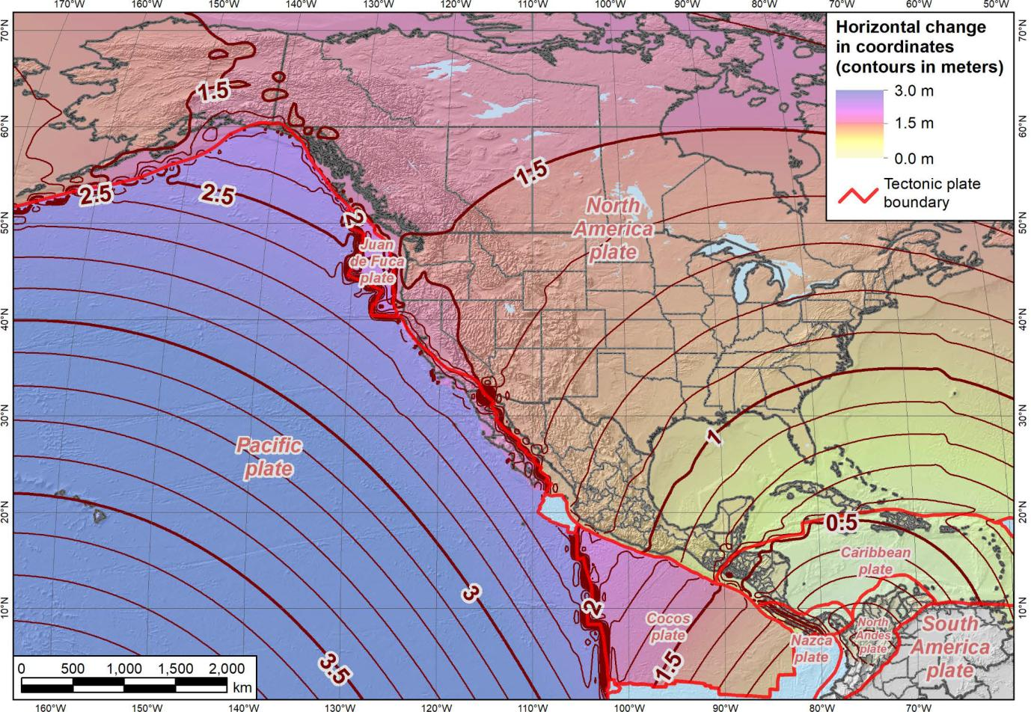
Notes:
-what’s the Magnitude of Horizontal Change?
-we will have tools online to simplify the process of estimating NAD83→NATRF2022
-see the 1.1 and 1.2m contour lines are south and just thru southern WV, so you’ll see a northwesterly shift of less than 4 feet throughout WV, between 3.7 and 3.7 feet

Slide 9
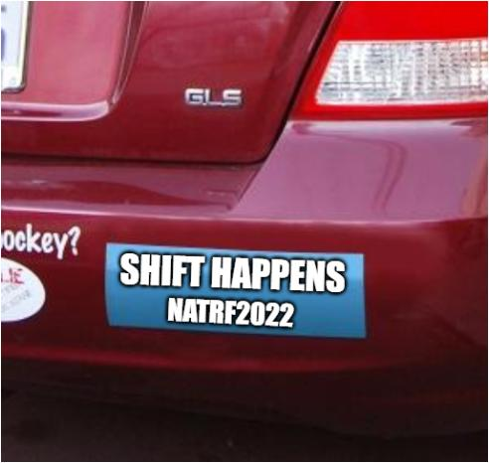

Slide 10
Terrestrial Reference Frame?
Existing, accepted terminology
  International TRF
  first realization of the ITRF was 1992
  NATRF2022 will be based on ITRF2020
“Horizontal Datum” - misnomer for NAD83
Notes:
-Where do you see an Epoch right now in NGS data?
CLICK
Datasheets! there you see the epoch of 2010.0
and of course OPUS Solution Reports!
note that in blue over there on the right you’ll see another epoch, in the ITRF, which I will explain later on

Slide 11
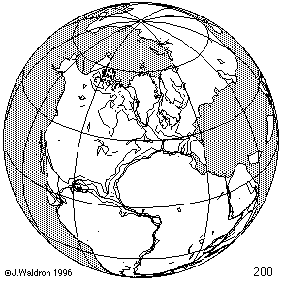
ITRF concept
Watch the grid!
Drift…
Epoch:
Notes:
Ok, now ITRF mentioned a couple slides ago.
Most simplistic way to explain ITRF is to watch this animation.
This is a very loose representation/visualization of what the ITRF is, a characterization only.

Slide 12
ITRF
Frame = constant
NA Plate = rotating
NATRF
Frame = rotating
NA Plate = constant
Notes:
We say “NATRF2022” is “fixed” to the N.A. Plate, making it a “plate fixed” frame
-the frame is constant to itself, but rotating within ITRF, and moving in a different direction than the other 3 frames

Slide 13
ITRF
Frame = constant
NA Plate = rotating
NATRF
Frame = rotating
(relative to ITRF)
NA Plate = constant
(relative to NATRF)
Notes:
We say “NATRF2022” is “fixed” to the N.A. Plate, making it a “plate fixed” frame
-the frame is constant to itself, but rotating within ITRF, and moving in a different direction than the other 3 frames

Slide 14
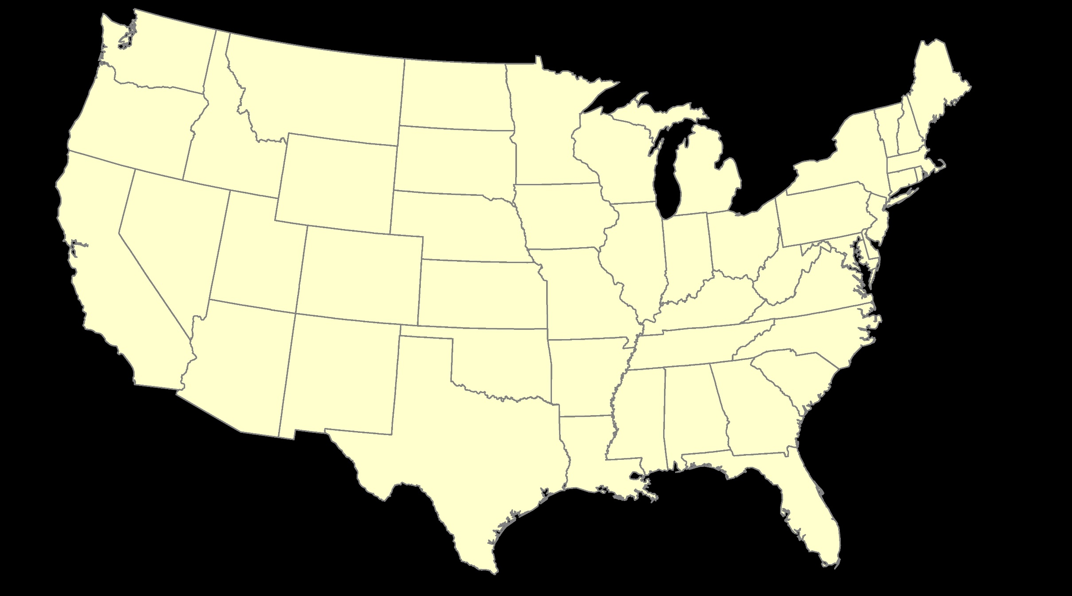
ITRF – constant frame, rotating plate

Slide 15
“Plate-Fixed”
NATRF – rotating frame, constant with plate

Slide 16
ITRF or NATRF – your choice, we’ll provide both

Slide 17
CORS
  How?
Epochs/Time/4D
Notes:
-so you’ve probably seen that phrase that I have front and center here, NSRS Modernization
-that’s the blanket term we use to refer to not just the new datums but other updates

Slide 18
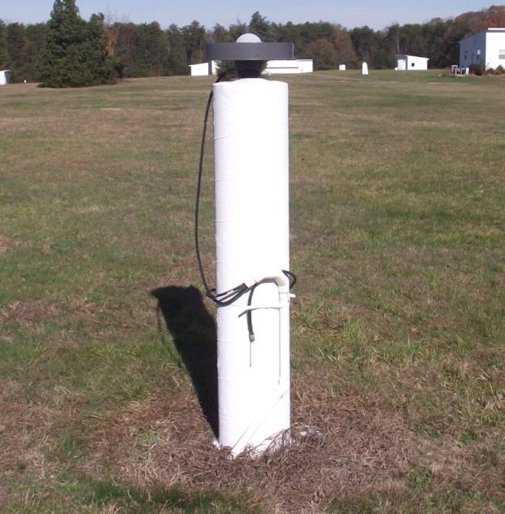
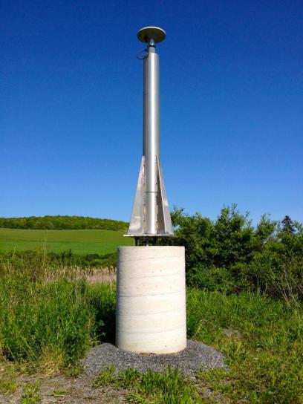
CORS
Terminology – Geodetic Control
Continuously Operating Reference Station
GNSS ANTENNA
RECEIVER
POWER
DATA STORAGE
COMMUNICATIONS
WVTA in Terra Alta
Notes:
Note that the whole pillar could be considered a type of “mark”, being a passive do-nothing structure that holds a “point”, the GRP of this CORS.
But the point, given coordinates computed from all the data collected by that antenna, is probably in here somewhere, as a part of this huge pillar which is effectively one big mark, passive as can be….

Slide 19
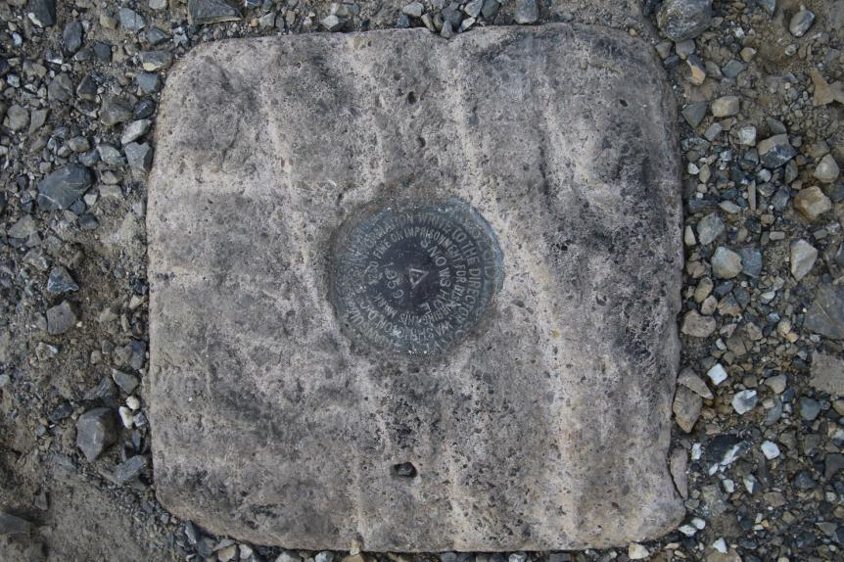
Passive Control
Terminology – Geodetic Control
All marks are passive—they sit there and hold a point
Notes:
All marks are passive!—in that they sit there doing nothing in and of themselves besides holding a point
-This is the only way to tie your data to NGVD29 is to find one of these marks and start a survey from it.
-Primary way to to tie your data toi NAVD88, but GNSS ties are popular
Calibration sites for GNSS technology, Real Time Network validation, and verification of datum transformation tool results.
Monitoring Sites for to enhance velocity models (via repeat/campaign GNSS occupations)
Convenience for local project control, in areas with limited GNSS coverage (e.g. cities, forests), or in the event of GNSS failure (e.g. geomagnetic storms)

Slide 20
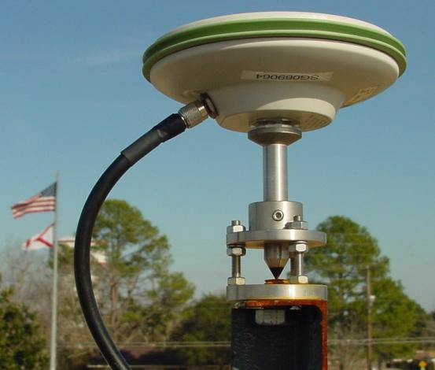
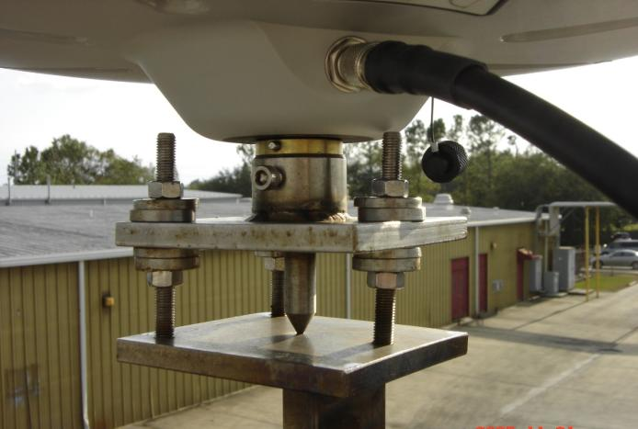
Active Control
Terminology – Geodetic Control
Some marks have permanently installed antennas that enable continuously logged observations
(they still sit there and hold a point)
Notes:
All marks are passive!—in that they sit there doing nothing in and of themselves besides holding a point
This includes the fixed antenna mount that is a part of a CORS.
But, some marks have permanently installed equipment that enable nearly continuous observation and these are called “active” stations.
Access to NAPGD2022 and NATRF2022 for anyone with a GNSS receiver.
More Efficient than conventional leveling for determining orthometric heights.
Convenience in that no need to recover passive control, rather set one’s own and collect GNSS data on it.
So, GPS/GNSS technologies simplify and improve access to, and the accuracy of, our spatial reference system.
→ By adding a 4th dimension to all coordinates (time), marks can serve as more faithful access points.

Slide 21
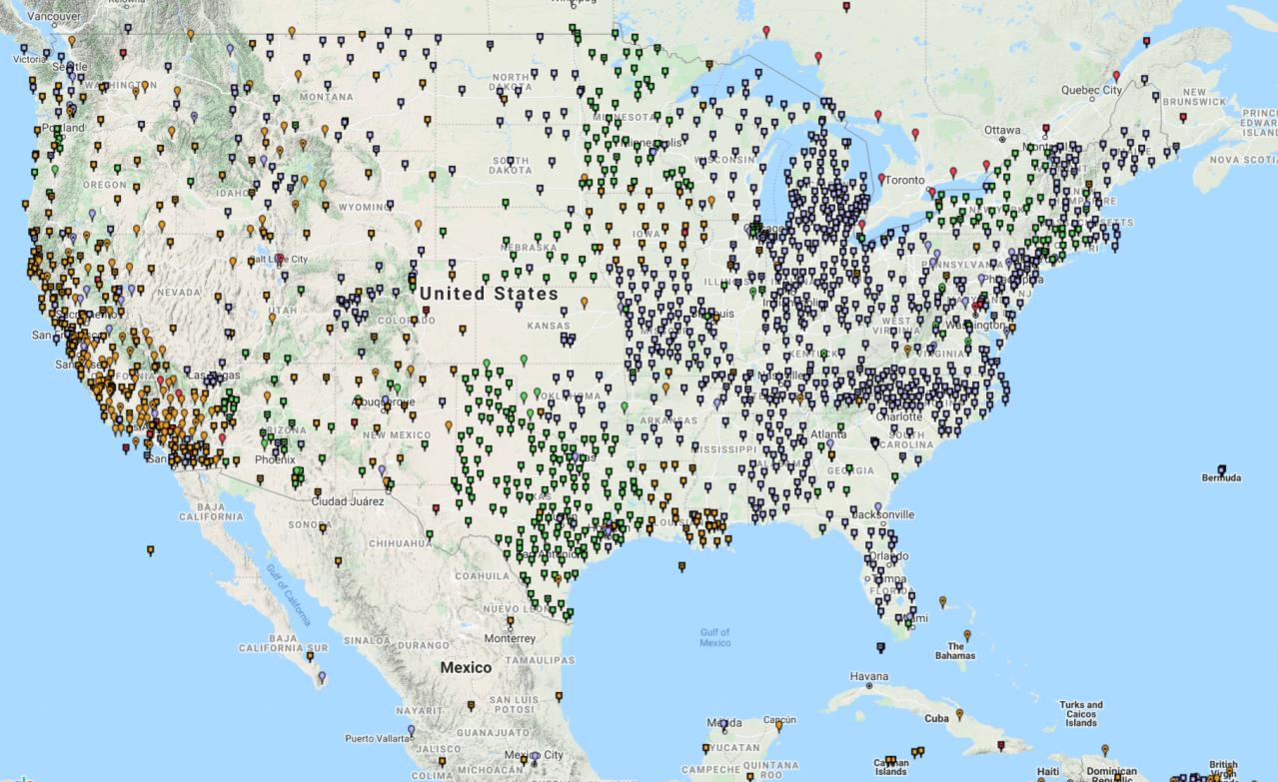
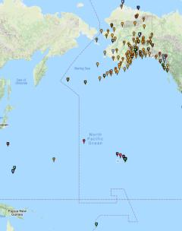
Continuously Operating Reference Stations (CORS)
2000+ sites
200+ organizations
Notes:
-I would like to point out we have a new, official name for the network you see represented on this map,
-The NOAA CORS Network, or NCN
CLICK
-this is neat little graphic with some stats on teh NCN you can find on our website
-below the gaphic youll find a search bar with more information

Slide 22
NOAA CORS Network (NCN)
2000+ sites
200+ organizations
Notes:
-I would like to point out we have a new, official name for the network you see represented on this map,
-The NOAA CORS Network, or NCN
CLICK
-this is neat little graphic with some stats on teh NCN you can find on our website
-below the gaphic youll find a search bar with more information

Slide 23
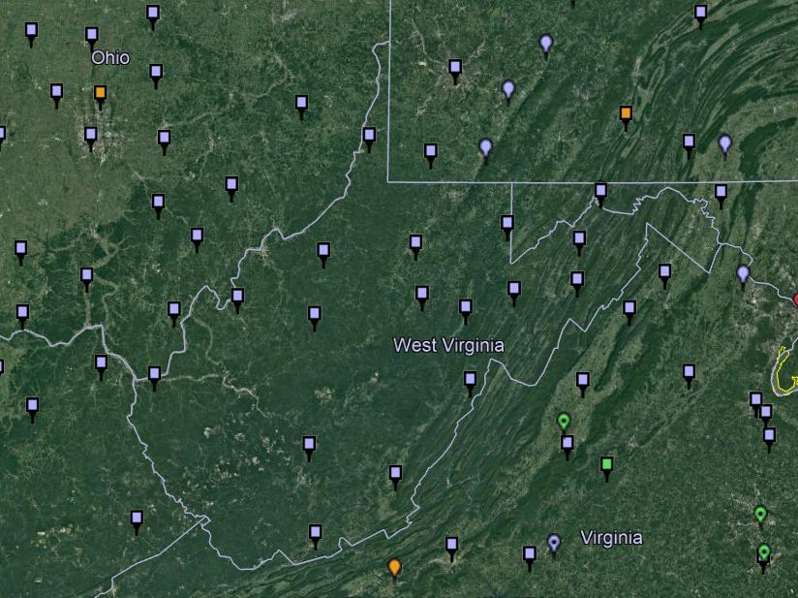
NOAA CORS Network (NCN)
Notes:
where else but the federal government are you going to see two acronyms within one acronym?

Slide 24
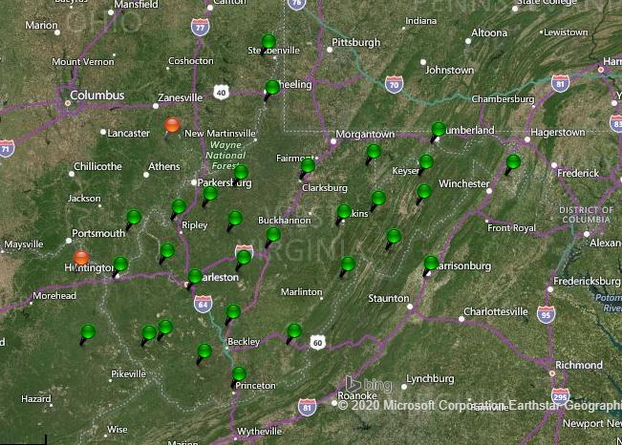
WVDOH CORS Network
Notes:
where else but the federal government are you going to see two acronyms within one acronym?

Slide 25
Terminology – Time/4D
Epoch
eh-puck? ee-pock? … to-may-to, to-mah-to
an instant of time
astronomy & geodesy use a decimal date
  2021.4762 = 23 June 2021 (@ ~7:15pm)
  doesn’t have to be!
  using epochs is important, not format
    It doesn’t have to be in decimal years… just start assigning dates to your data
Notes:
-Where do you see an Epoch right now in NGS data?
CLICK
Datasheets! there you see the epoch of 2010.0
and of course OPUS Solution Reports!
note that in blue over there on the right you’ll see another epoch, in the ITRF, which I will explain later on

Slide 26
Terminology - Changing Coordinates
Conversion
    change the type of coordinate
    e.g. NAD83(2011) latitude & longitude → NAD83(2011) SPCS
  Transformation
    change the datum of coordinate
    e.g. NGVD29 height in feet → NAVD88 height in feet
    e.g. NAD 27 latitude & longitude → NAD 83(2011) latitude & longitude
Propagation
    change the epoch of coordinate
    e.g. NAPGD2022 epoch 2020.00 to NAPGD2022 epoch 2087.2570
    e.g. NATRF2022 epoch 2020.00 to NATRF2022 epoch 2023.243
Notes:
Historically NGS has been inconsistent with these top two words.
Going forward, we will use them as:
Conversion: Meaning to change the type of coordinate without changing the datum or frame
e.g. change NAD 83(1986) latitude and longitude to NAD 83(1986) State Plane Coordinates
Transformation: Meaning to change the datum or frame, without changing the type of coordinate
e.g. changing an NAD 27 latitude & longitude to an NAD 83(1986) latitude & longitude
So, “NADCON” which transforms coordinates between datums could have been called “NADTRAN.” C’est la vie.

Slide 27
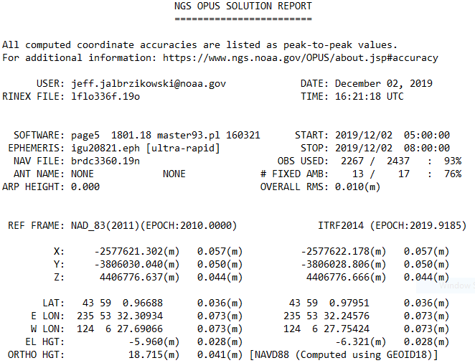
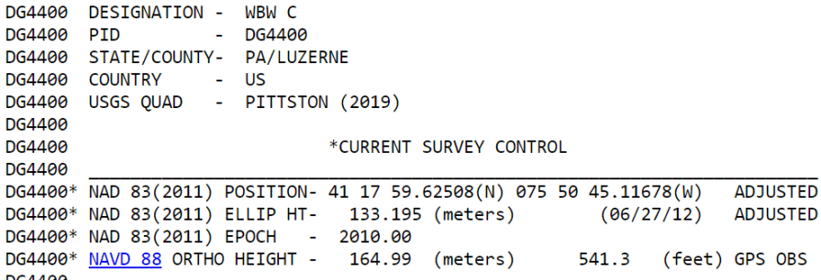
Reference Epoch
Survey Epoch

Slide 28
Reference Epoch
Survey Epoch
  Here above we’re looking at a
  Transformation and Propagation
Notes:
Revisiting this slide,
CLICK
here above we’re looking at a Transformation from ITRF to NAD83(2011)…
and a Propagation from the Survey Epoch of 2019.9185 to the Reference Epoch of 2010.0

Slide 29
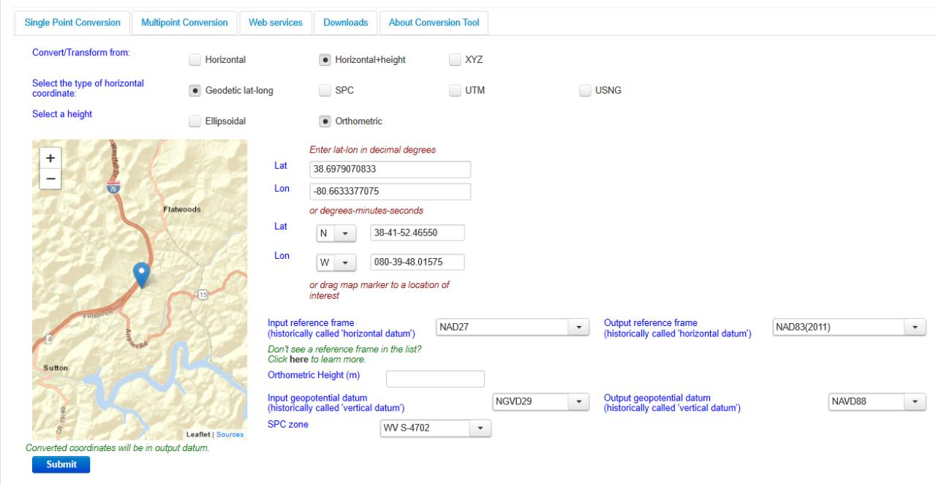
NGS Coordinate Conversion And Transformation Tool (NCAT)
Notes:
NCAT includes the functionality of previous NGS tools:
NADCON 5.0
XYZWIN 2.0
UTMS 2.1
SPC83 2.1
USNG 2.3
Includes error estimate of transformation per point.
Available as the single-point graphic seen here, multi-point upload/download, as a downloadable executable fie to run from the DOS prompt, and as web services for inclusion in your own
It’s a great tool. Anyone using

Slide 30
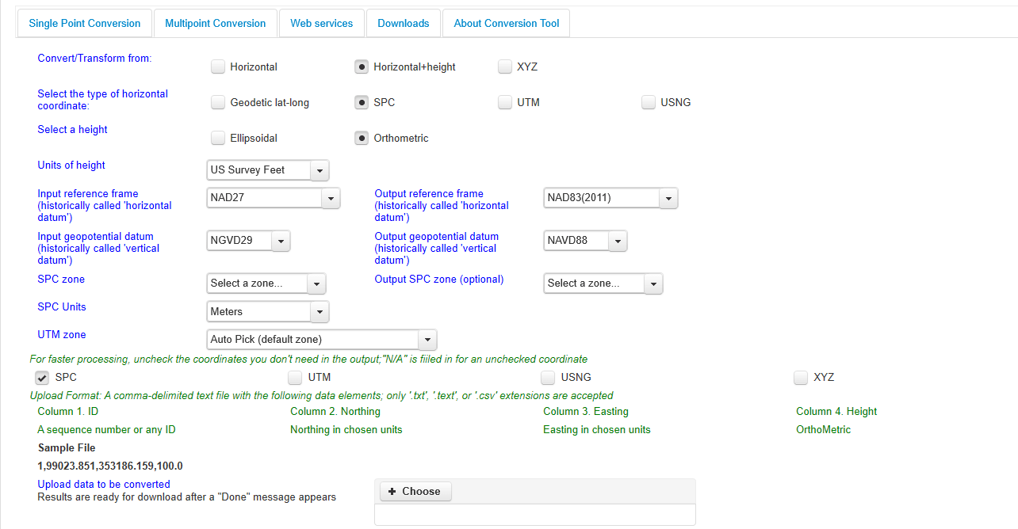
NGS Coordinate Conversion And Transformation Tool (NCAT)
Notes:
NCAT includes the functionality of previous NGS tools:
NADCON 5.0
XYZWIN 2.0
UTMS 2.1
SPC83 2.1
USNG 2.3
Includes error estimate of transformation per point.
Available as the single-point graphic seen here, multi-point upload/download, as a downloadable executable fie to run from the DOS prompt, and as web services for inclusion in your own
It’s a great tool. Anyone using

Slide 31
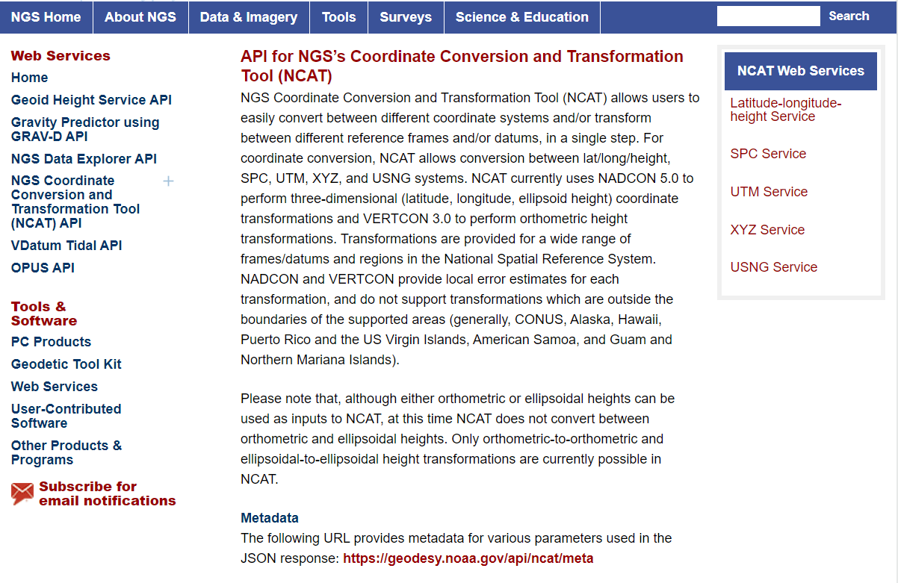
NCAT is available via web services

Slide 32
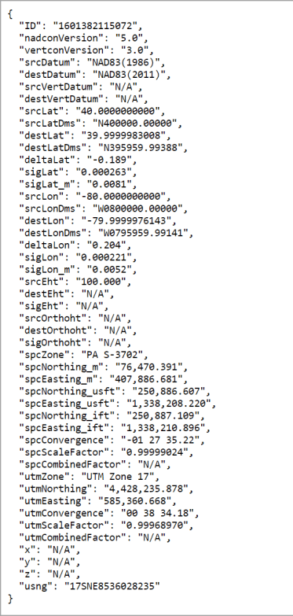
NCAT is available via web services
Note that each operation is a separate service
Struggling?
Contact us.
We can help!

Slide 33
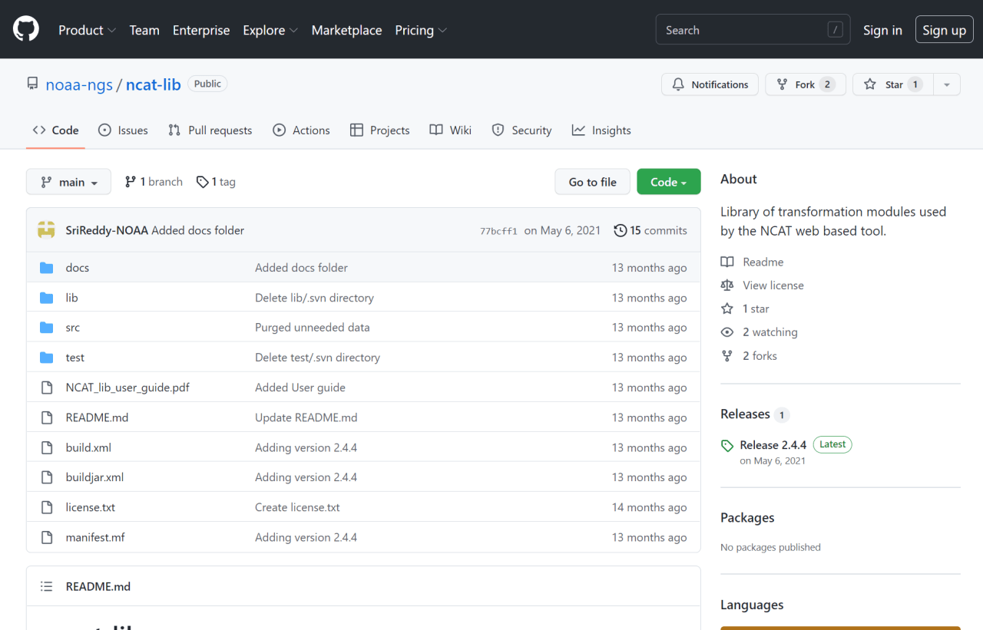
NCAT source code is on GitHub

Slide 34
NGS Coordinate Conversion and Transformation Tool (NCAT)
NGVD29
Please… don’t continue to use NGS VERTCON or USACE CorpsCon
transformation
transformation
NAVD88
NAPGD2022
transformation
NCAT is a container for newest version of VERTCON
It will be upgraded to include NAPGD2022
Notes:
NCAT incorporates the functionality of the old software VERTCON to transform NSRS heights.
NCAT is a container for newest version of VERTCON (v3.0)
It will be upgraded, after the release of the new datums, to include NAPGD2022

Slide 35
I’ll be selling these bumper stickers at the next WVAGP conference ☺
SPCS2022
MAKING EARTH FLAT AGAIN
…ONE ZONE AT A TIME

Slide 36
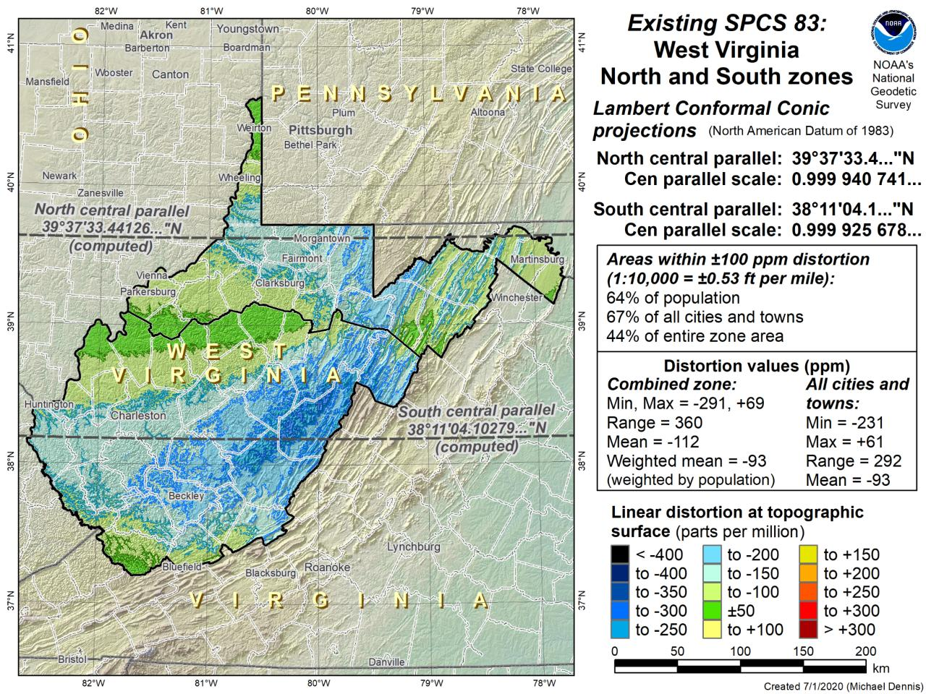

Slide 37
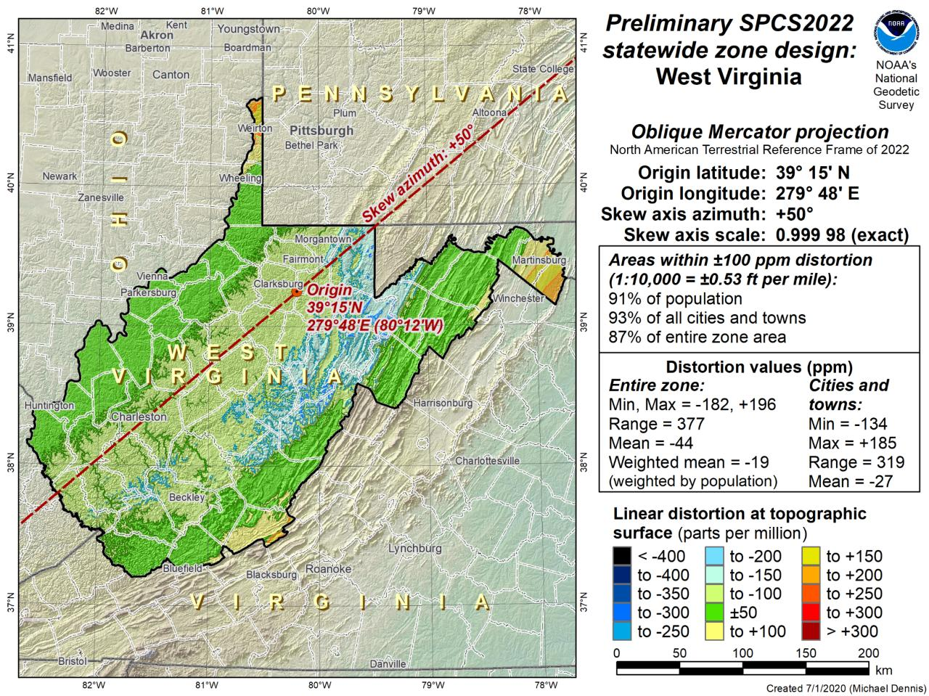
Northings are still North
Eastings are still East

Slide 38

US Survey Foot
and
International Foot
RIP
Paul Barrere
…or Feets Don’t Fail Me Now

Slide 39
The Issue at Hand…
Two versions of same unit in current use
  “New” international foot and “old” U.S. survey foot
  Intl. shorter than US by 2 ppm (0.01 ft per mile)
What’s in a name?
  “U.S. survey” versus “international”
Who is using U.S. survey feet?
  Surveyors exclusively
    Derivative products are then
  But this impacts everyone here.
Notes:
It’s likely everyone watching this webinar knows about the problem: there are two nearly identical versions of the foot in current use in the U.S.;
They differ by 2 parts per million (ppm), or only 0.01 ft per mile, or slightly more than a tenth of an inch in a mile.
Despite (or actually because of) the very small difference, it has become a REAL problem with REAL costs.
What’s in a name? That which we call a “foot” by any other word would smell as… sweet? Maybe that’s not he best analogy for the foot…
“U.S. survey foot” sounds patriotic, is surveyor-centric…
“International foot” sounds like a New World Order, UN sanctioned sort of thing, with perhaps a whiff of socialism…
Is the name really part of the problem? I hope not, but emotion does play a role. We are not entirely rational creatures after all (myself included).
Surveyors are really the only users of the U.S. survey foot (sft). They are also among the very few who even know of its existence. In schools and colleges they only teach students about the official international foot (ift). However, because people use the products created by surveyors, they end up using the sft without even knowing it.
Want to have a conversation about this, get all of us on the same page. So I will present facts to facilitate informed discussion (sprinkled with some opinions…)

Slide 40
What’s impacted?
When does this matter?
  Not typically in lengths/distances
  Published planar coordinate systems
    Why? → large false eastings and northings
Like what?
  SPCS and UTM are very popular and both fall victim to mix-ups
    due to… the large false E/N in their zones
Notes:
It’s likely everyone watching this webinar knows about the problem: there are two nearly identical versions of the foot in current use in the U.S.;
They differ by 2 parts per million (ppm), or only 0.01 ft per mile, or slightly more than a tenth of an inch in a mile.
Despite (or actually because of) the very small difference, it has become a REAL problem with REAL costs.
What’s in a name? That which we call a “foot” by any other word would smell as… sweet? Maybe that’s not he best analogy for the foot…
“U.S. survey foot” sounds patriotic, is surveyor-centric…
“International foot” sounds like a New World Order, UN sanctioned sort of thing, with perhaps a whiff of socialism…
Is the name really part of the problem? I hope not, but emotion does play a role. We are not entirely rational creatures after all (myself included).
Surveyors are really the only users of the U.S. survey foot (sft). They are also among the very few who even know of its existence. In schools and colleges they only teach students about the official international foot (ift). However, because people use the products created by surveyors, they end up using the sft without even knowing it.
Want to have a conversation about this, get all of us on the same page. So I will present facts to facilitate informed discussion (sprinkled with some opinions…)

Slide 41
2 parts per million (ppm)?
1,000,000.00 sft = 999,998.00 ift
10,000,000.00 sft = 9,999,980.00 ift
1,000.00 sft = 999.998 ift (can you measure that?)
International → 1 ft = .3048 m
US → 1 ft = .30480061 m (approx.)
Notes:
It’s likely everyone watching this webinar knows about the problem: there are two nearly identical versions of the foot in current use in the U.S.;
They differ by 2 parts per million (ppm), or only 0.01 ft per mile, or slightly more than a tenth of an inch in a mile.
Despite (or actually because of) the very small difference, it has become a REAL problem with REAL costs.
What’s in a name? That which we call a “foot” by any other word would smell as… sweet? Maybe that’s not he best analogy for the foot…
“U.S. survey foot” sounds patriotic, is surveyor-centric…
“International foot” sounds like a New World Order, UN sanctioned sort of thing, with perhaps a whiff of socialism…
Is the name really part of the problem? I hope not, but emotion does play a role. We are not entirely rational creatures after all (myself included).
Surveyors are really the only users of the U.S. survey foot (sft). They are also among the very few who even know of its existence. In schools and colleges they only teach students about the official international foot (ift). However, because people use the products created by surveyors, they end up using the sft without even knowing it.
Want to have a conversation about this, get all of us on the same page. So I will present facts to facilitate informed discussion (sprinkled with some opinions…)

Slide 42
Remember…
  What’s the goal of NATRF2022?
    Give you the stability in positions that you expect
  That’s the point of Reference Epochs (REs)
    Like the different realizations/versions of NAD83
    REs will be published every 5 or 10 years
      you choose when you update
      in a perfect world, everyone would stay current
Notes:
What’s the goal of the way NATRF2022 was designed, by including EPP2022 and IFVM2022
Does a database of manholes in PA need cm-level coordinate updates on an annual basis? Probably not.

Slide 43
Preparing for NATRF2022
  Two factors will dictate your frequency of coordinate updates
    Your accuracy needs
    The region you work in → tectonic motion
      Do manholes need cm-level updates annually?
      We accommodate that… you choose
      Just because we’re chasing the millimeter… it doesn’t mean you need to.
Notes:
What’s the goal of the way NATRF2022 was designed, by including EPP2022 and IFVM2022
For a database of features in PA
Does a database of manholes in PA need cm-level coordinate updates on an annual basis? Probably not.

Slide 44
Preparing
  Know the epoch of your data/datasets
    consider how you will track this
      full to-the-second timestamp on every feature?
      labeling a year for each dataset?
      something in-between that works for your needs?

Slide 45
Preparing
  Reprocessing your data
    in a perfect world, everyone would reprocess
      what does this mean?
        consider a hydro-enforced DEM
          start over with the raw flight data (GNSS/IMU)
          generate new point clouds
          recreate all the drainage features in new datum
      unrealistic! … and unnecessary for majority users
Notes:
Reprocessing your data
in a perfect world, everyone would reprocess data
consider a final product like you use everyday - a hydro-enforced DEM
starting fresh with the raw GNSS/IMU processing
generate new ellipsoid height point clouds
recreate all the drainage features in new datum
this is totally unrealistic → both from a financial and programmatic perspective

Slide 46
Preparing
  Transforming your data
    NCAT - NGS Coordinate Conversion and Transformation Tool
      available now: ASCII upload, Web Services, GitHub
      ask your software provider(s) about integration
        we envision this as most popular method of access
        Industry Workshop held May 2021
          Esri, Trimble, Blue Marble, etc… all the well known names attended
Notes:
Transforming your data
NCAT - NGS Coordinate Conversion and Transformation Tool
available now: ASCII upload and Web Services
ask your software providers about integration
we envision this as most popular method of access
Industry Workshop held this year – esri, trimble, bluemarble, all the major well known names were represented
labeling a year for each dataset?
something in-between that works for your needs

Slide 47
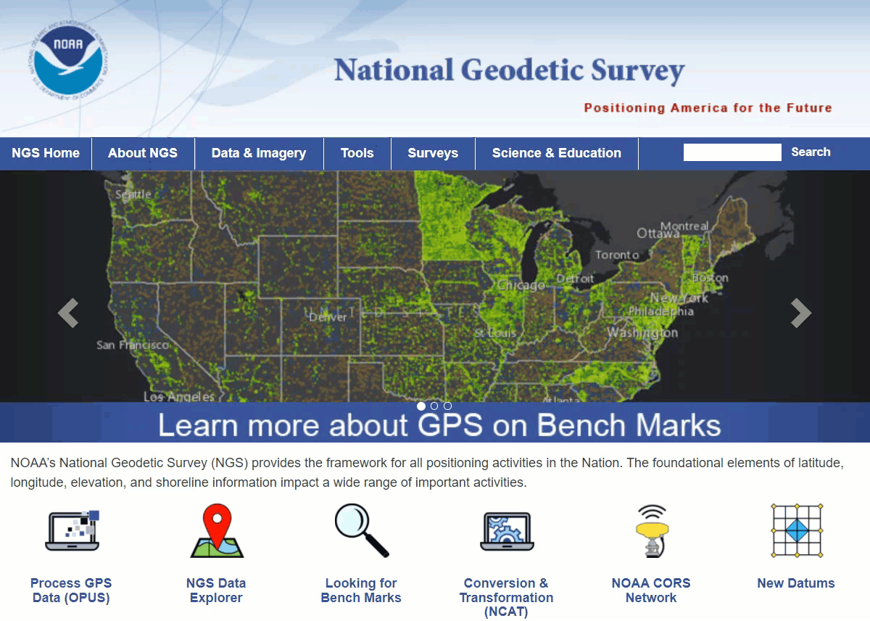
Educational Videos
<5 minutes
Online Lesson
(via MetEd/COMET)
~1 hour
NGS homepage: geodesy.noaa.gov
Notes:
Educational videos and online tutorials –
Our library of lessons and videos are great resources, and will reinforce a lot of information we covered today.
The videos are just 3-5 minutes long.
the lesson is a deeper dive but still only takes an hour.

Slide 48
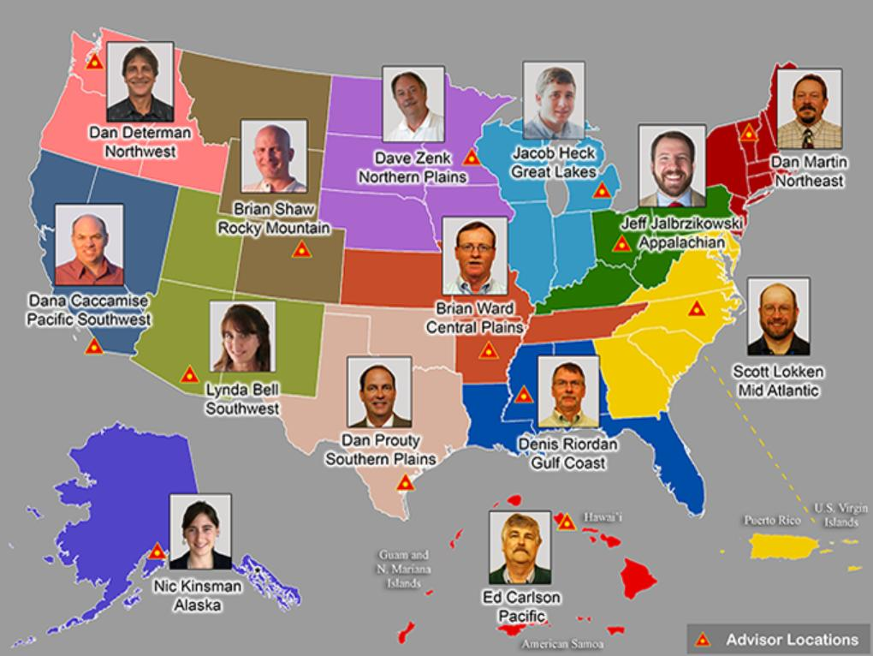

https://www.ngs.noaa.gov/ADVISORS/
Notes:
-14 Regional Advisors, we’ve transitioned from a State-based to a Regional Program
-our advisors homepage up there at the top, also easy to find us by querying any major search engine for “ngs advisors”
-if you know Ross Mackay, he is our Chief Advisor, I report to him…
**ya know, I don’t know why they don’t make him put his photo up here
-we do have one vacant advisor position, that was recently advertised and John up there in Wisconsin is officially retired in oh… 18 days

Slide 49
https://www.ngs.noaa.gov/ADVISORS/
-use any major search engine: “NGS advisors”
Jeff Jalbrzikowski, P.S., GISP, CFS
Appalachian Regional Geodetic Advisor
jeff.jalbrzikowski@noaa.gov
240-988-5486

