Slide 1

RTN/RTK/PPK data in OPUS Projects
Technical Discussion focused on the Current OP User
Maryland Society of Surveyors Spring Technical Conference 2022
April 2022
Jeff Jalbrzikowski, P.S., GISP, CFS
Appalachian Regional Geodetic Advisor
jeff.jalbrzikowski@noaa.gov
240-988-5486

Slide 2
NGS Mission
To define, maintain and provide access to the National Spatial Reference System (NSRS) to meet our Nation’s economic, social, and environmental needs.

Slide 3
Important Info
I am a Federal employee, please understand:
any references I make to any commercially available software do not constitute an endorsement or a disapproval of any manufacturers or vendors/suppliers.
Thanks.

Slide 4


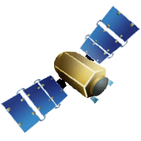
OPUS-RS – 15 min to 2 hours
Rapid-static: OPUS first creates an atmospheric delay model from surrounding CORS data.
  -Atmospheric model
  -Delivered 179,000 solutions in 2021
Not integrated with OPUS Projects

Slide 5
OPUS-S – 2 to 48 hours
  -Best 3 of 5 baselines
  -Delivered 1,268,000 solutions in 2021
  206,000 solutions in 2011
baseline 5
baseline 4
baseline 1
baseline 3
baseline 2

Slide 6
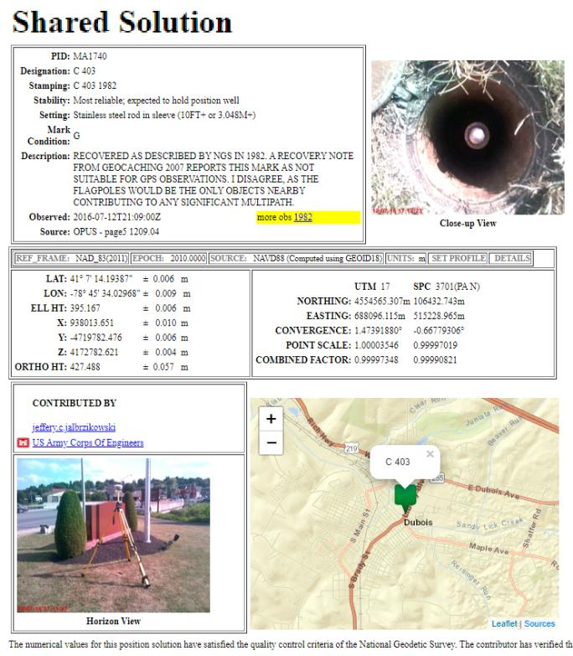
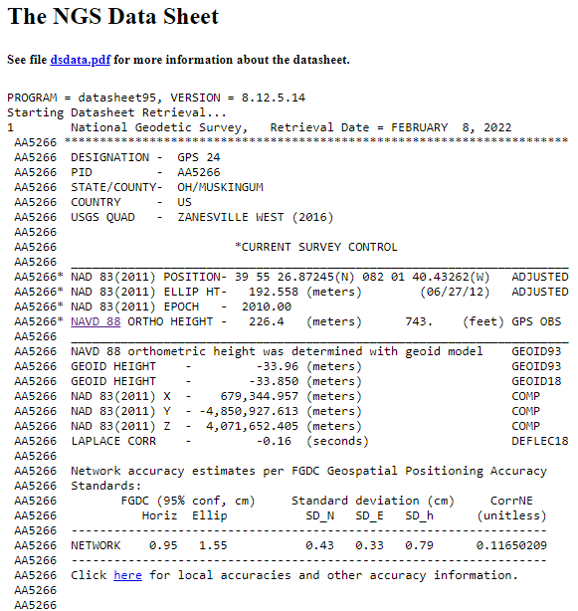
OPUS Share – 4 to 48 hours
  Based on OPUS-S
  2 photos
  Brief description
?
baseline 5
baseline 3
Shared Solution ≠ Datasheet
baseline 1

Slide 7
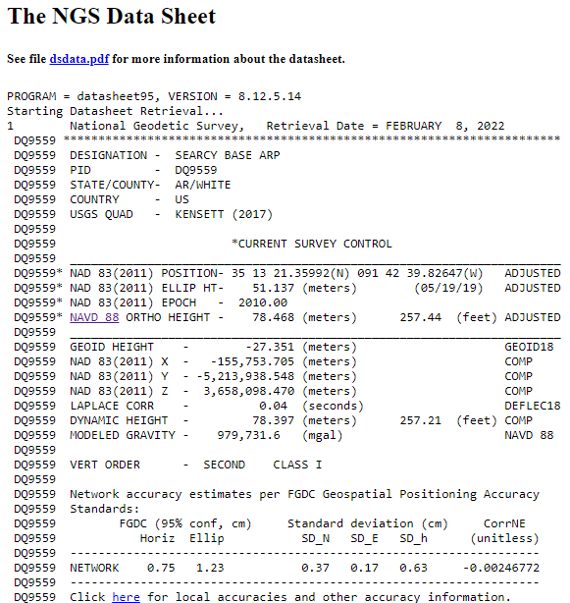

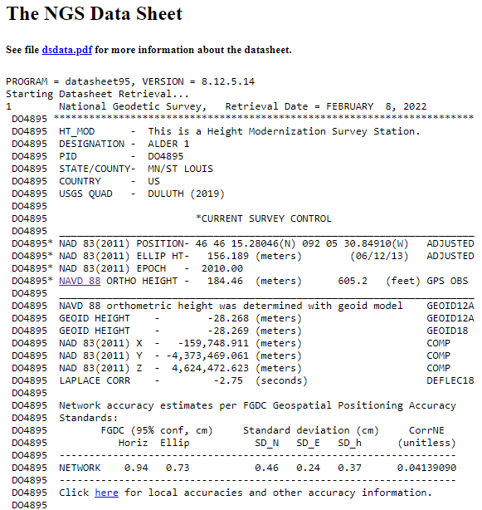
OPUS Projects – 2 to 48 hours
  Based on OPUS-S
  Control network
    Solutions tied together

Slide 8
OPUS Projects
Web-based, nothing to download
Visualize/map your OPUS Solutions
Process multiple marks and multiple occupations, or repeat occupations of single mark
Advantages include:
Data uploading through OPUS
Process using PAGES… without intricacies of PAGES
Graphic visualization versus text Solution Reports
Support for submission to NGS

Slide 9
Example of PAGES output: the b-file
000010*AA*HZTLOBS NGS NATIONAL GEODETIC SURVEY 20130114
000020*10*BOUNDARY MON STRICKLAND NC SC HEIGHT MODERNIZATION 2013 (OP: gps2912f)
000030*12*201301201301MS MARK SCHENEWERK 4NCAA
000040*13*NAD 83(2011) GRS 80 63781370002982572221
000050*25*0001R0143ABLUFMS 004 003
000060*26*BB 0143A -> OP 2013-014-A
000070*27*00011301141641 2000
000080*27*00011301142001 2000
⋮
001900*70*007055 Trimble NavigationDUAL CARRIER PHASE PPSNETR5 4742K10896
001910*70*008055 Trimble NavigationDUAL CARRIER PHASE PPSNETR5 4744K11096
001920*70*009055 Trimble NavigationDUAL CARRIER PHASE PPSNETR5 4829K57356
001930*72*001 AOAD/M_T NONE KW5-0201
001940*72*010 TRM57971.00 NONE 30973141
001950*72*011 TRM57971.00 NONE 30976660
⋮
002040*80*0001BLUFF 34173468578N079034455052W NC
002050*86*0001 20756G N88 -338086 -13052A ANAD_83(2011)
002060*80*0002BOUNDARY MON STRICKLAND NC SC 34173269930N079034661580W NC
002070*86*0002 20728G N88 -338076 -13071A ANAD_83(2011)
002080*80*0004GUY 34164773356N078595524668W NC
⋮
…so yes, OPUS Projects is a big jump into the 21st century!

Slide 10
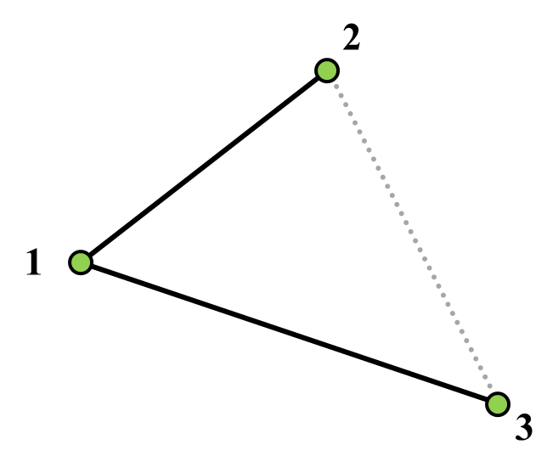
Sequential Baseline vs. Simultaneous Processing
Sequential Baseline Processing
Commercial software
vs.
Simultaneous Session Baseline Processing
NGS software
(PAGES, OPUS Projects)

Slide 11

Why complicate OPUS?
OPUS
Session
Adjustment
CORS5
CORS2
CORS3
CORS1
CORS4
Solution BIGG
Solution SMAL

Slide 12
Why complicate OPUS?
OPUS
Session
Adjustment
CORS5
CORS2
CORS3
CORS1
CORS4
Solution BIGG
Session 228-A
Solution SMAL

Slide 13
Why complicate OPUS?
OPUS
Session
Adjustment
CORS5
CORS2
CORS3
CORS1
CORS4
Solution BIGG
Session 228-A
Solution SMAL
Session 228-B
Session 229-A
Session 229-B

Slide 14
Why complicate OPUS?
OPUS
Session
Adjustment
CORS5
CORS2
CORS3
CORS1
CORS4
Solution BIGG
Session 228-A
Solution SMAL
Session 228-B
Session 229-A
Geodetic Control Network

Slide 15
“What’s the benefit?”
OPUS Projects
OPUS: Good absolute accuracy (NSRS)
Low relative accuracy (site)
Upload 1 file… get results
Share (get OPUS Shared Solution)
OPUS Projects: Great absolute accuracy (NSRS)
High relative accuracy (site)
Upload files, QC, least squares adjust
Submit to NGS (get Datasheets)

Slide 16
Well… how did we get here?

Slide 17
OPUS Projects with Static GPS-only
Ellipsoid Height Accuracy vs. Observation Duration

Slide 18
NGS Products and Services
Not just OPUS
All exist in three environments:
  Development (DEV) - internal testing and development
    same as when you hear a company talk about an “Alpha” product
  Beta - continued internal testing, open for public testing
    key features have already been vetted/tested
  Production - final product, open to public use
    this is what you see first when navigating our website

Slide 19
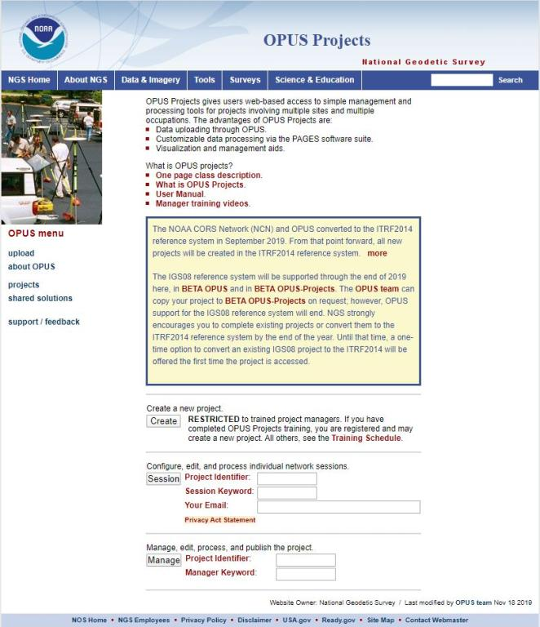
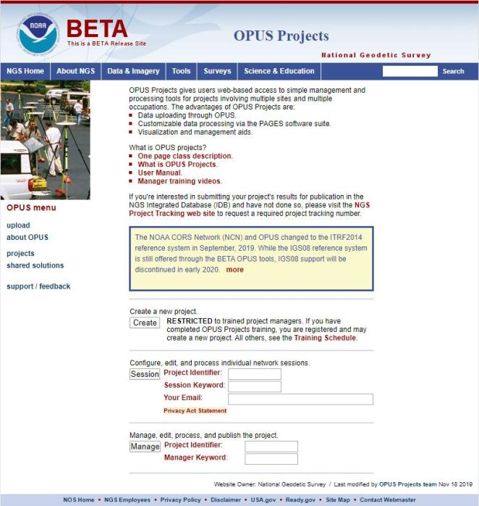
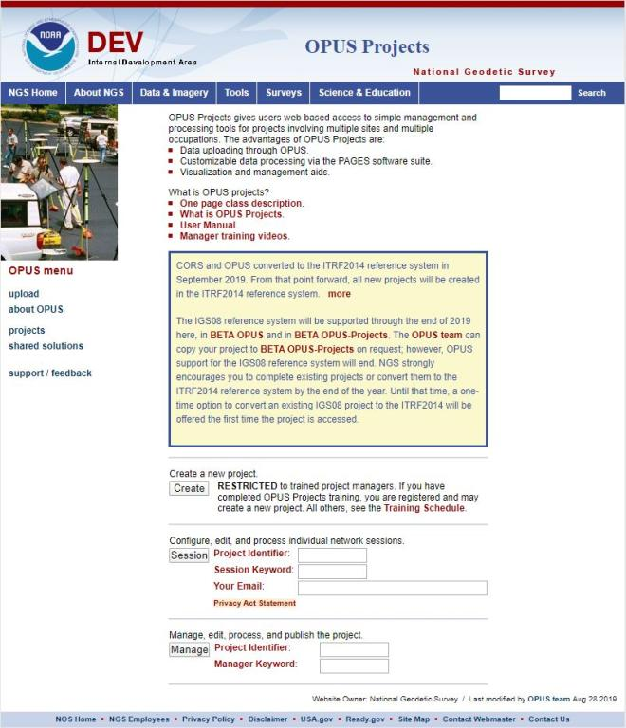
www.ngs.noaa.gov
beta.ngs.noaa.gov
Remember, you won’t see the DEV environment…

Slide 20
Wait… how do I get to the NGS Beta site?

Slide 21
www.ngs.noaa.gov
beta.ngs.noaa.gov

Slide 22
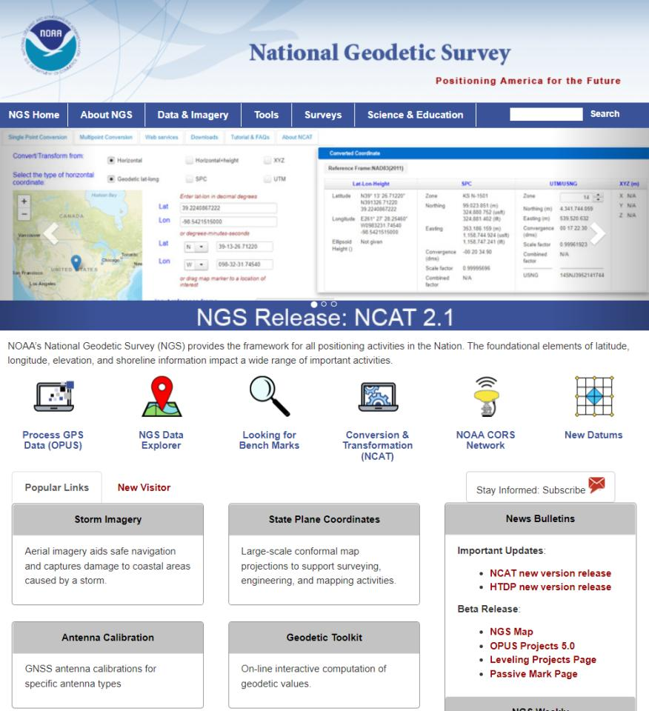

Slide 23
More Overall Important Info
OPUS Projects = OP = OP4 = OPv4.0
Beta OPUS Projects = Beta OP = OP5 = OPv5.0
We have yet to publish any 'hard and fast' rules for the process of submitting with GVX.
We don't yet have formal training on the use of GVX or Beta OP
  Nor is it discussed in OP User Guide (2021)
Just like submitting (aka "bluebooking") with OP → Beta OP requires WinDesc
  Must download the executable & run locally

Slide 24
Even More Overall Important Info
Review and Submit to IDB button in Beta OP is currently nonfunctional → this is intentional
Submit option will be enabled when OPv5.0 is transitioned from Beta to Production
  NGS Modernization Manager and GPSonBM PM: “All users who load all required data into OPv5.0 during the beta testing phase will be allowed to complete their Bluebooking submission for use in the transformation tool after that transition.”
  We are committed. We want you to use it.

Slide 25
Last Overall Important Info
GVX: test an export from your software before you jump in
GVX: we can only help so much
  May need to contact your software support resolution
GVX in Beta OP: few NGS Geodetic Advisors have had the opportunity for training
  Some have little or no experience with RTK/RTN.
  Be patient. Bear with us. Contact me or OP Team.
  We’ll get Scott trained up real soon ☺

Slide 26
OPUS Projects (OP)
OPv4.0 is current version in Production by NGS
  Static data, GPS-only
  Can submit your data to us efficiently (aka “bluebook”)
OPv5.0 is currently in Beta phase
  Supports upload of RTK, RTN, PPK, even your Post-Processed vectors from TBC, MAGNET, Infinity,
    Incumbent on software makers to provide export tools
  Your software does the processing… so any GNSS!
OPv5.1 is only internal to NGS as of now
  Per OPUS IPT → “it works!”

Slide 27
GNSS Vector EXchange (GVX)
just like RINEX…
NGS does not provide a translator/converter
      Note that we never developed a RINEX translator
      OPUS uses TEQC which was created and maintained by UNAVCO
Focus has been encouraging industry to adopt GVX
      Manufacturers provide tools to take their data formats into RINEX
        They are the most familiar with their proprietary formats
      How do you convert from proprietary static data to RINEX?
        TPS2RIN, ConvertToRINEX, JPS2RIN, HCNtoRINEX, Export from Infinity
        TEQC is currently still an option, but it is EoL
        GFZRNX provides similar functions, but it is not free

Slide 28
GNSS Vector EXchange (GVX)
unlike RINEX…
Stores corrected or processed positions
      Real-time corrections → RTK, RTN/NRTK (FKP, MAC/MAX, VRS)
      Post-processed → PPK or Static
      Or it can be a mix of all the above in one file.
Contains vector data
      This is not just ambiguous point records, like an ASCII CSV
Has more required metadata
      Variances and covariances of vector components
      Reference Frame, occupation start/stop, PDOP and other QC info

Slide 29
GNSS Vector EXchange (GVX)
Website: https://www.ngs.noaa.gov/data/formats/GVX/index.shtml
Detailed documentation, Schema, and Example File available
any major search engine: “ngs gvx file format”
Open standard, available for anyone to use or integrate
…think of GVX as RINEX for RTK/RTN data
Collect RTK, RTN, or PPK, data with your GNSS receiver and field software
      NOTE that data must be logged and stored as vectors, not points!
Use your office (or field) software to export vectors to a .gvx file
Upload .gvx to OP5.0

Slide 30





Status of GVX Exporters
Available Now
Trimble Business Center (TBC) v5.60 - released Nov 2021
Topcon MAGNET Software v7.2 - released Nov 2021
Coming Soon, per communications from their developers
Leica Infinity 4.0.0 - said to be released May 2022
iGage X-PAD - no word on timeline
Available, but not totally verified
JAVAD J-field - onboard Triumph-LS device

Slide 31
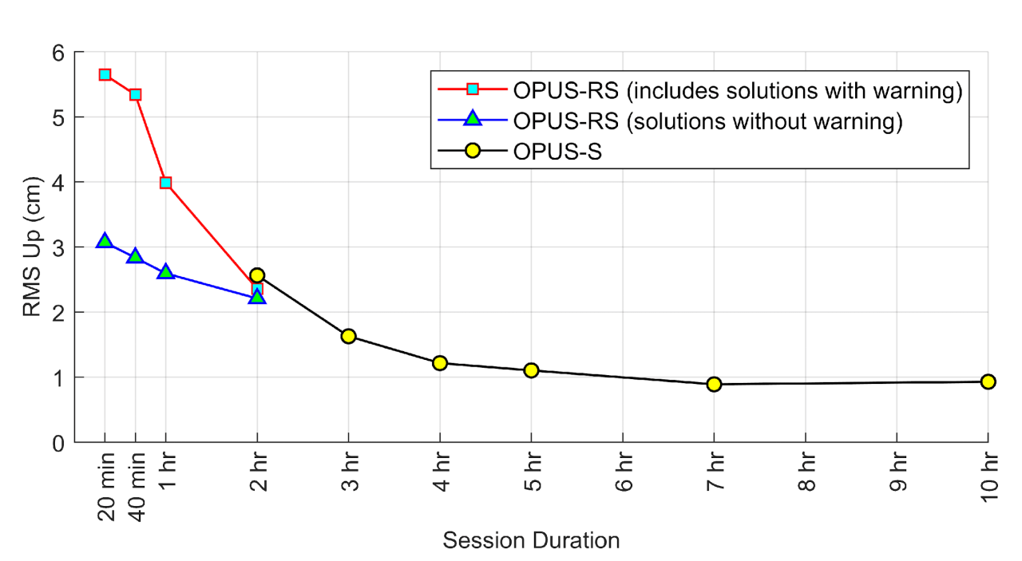
RMSE of Vertical (Ellipsoid) Results
For orthometric (NAVD88) we must account for GEOID18 uncertainty…
2 hours ≈ 6.3 cm or 0.20 feet
OPUS

Slide 32
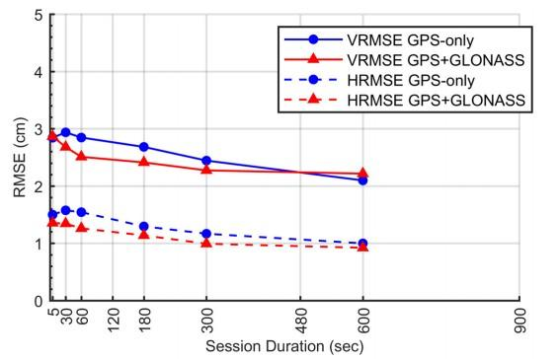



Empirical Evaluation of the Accuracy of RTNs
95% Confidence
± 5.0 cm, vertical
± 2.5 cm, horizontal
Or similar to accuracy of a 2 hours OPUS Static solution!
[Allahyari et al. 2018]

Slide 33
Recommended Number and Duration of Observations for RTN Surveys to Meet Ellipsoid Height Accuracy Standards at 95% Confidence Level in OPUS Projects
Ellipsoid Height Standard |  | Number of Repeat RTN/NRTK Observations |  | Observation Duration
cm | feet | GPS-only | GPS + More GNSS | minutes | epochs
3.5 | 0.11 | 2 | 2 | 5 | 300
3.0 | 0.10 | 3 | 3 | 5 | 300
2.5 | 0.08 | 4 | 3 | 5 | 300
2.0 | 0.07 | 6 | 5 | 5 | 300
Table 11-2 from NGS document still in Draft stage
IMPORTANT CONSIDERATIONS:
This assumes the distance from the rover to the nearest base station in the RTN < 40 km
Start time of observations differ by >3 hours

Slide 34
Static Base + RTK
Your Base must be logging data
  Trimble Access – Survey Style→Base Options→Survey type→RTK and Data Logging; Logging interval→30s
  Leica Captivate – Base Setup→Settings→GNSS raw data logging→ Check the box; “Log data every”→30s; Log data to→ RINEX (Version 3)
Your hardware is processing the satellite data, the results are what you take to OP → yes, GNSS!
No vectors = No GVX = No OPUS Projects

Slide 35
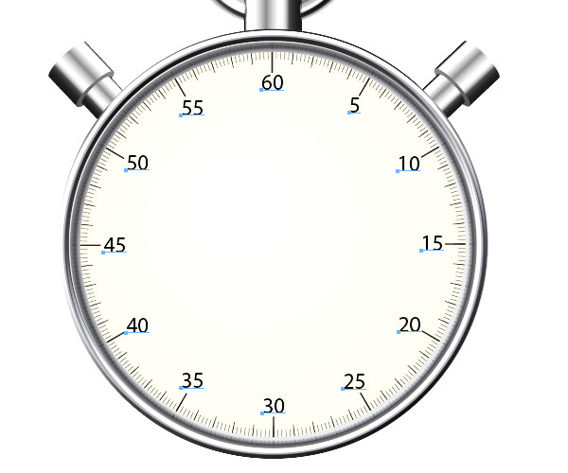
OPUS uses a 30 seconds epoch rate
Also Known As:
logging rate
logging interval
recording interval
sample rate
Main Point:
Do not use 20 seconds
(illustrated in red)

Slide 36
Static Base + RTK
Keep your vectors under 40 km (25 miles)
Base data must be uploaded to OPUS-Static
  All the requirements (≥2 hours, RINEX, 30s interval)
  Longer occupation = better
  Redundancy → generate meaningful statistics
  Orbit/Ephemeris data from OPUS servers
    Rapid will most often provide sufficient results
      First, get the base data into your project
    Processing in OP will use best available IGS orbits
      After the data is in OP → Session Processing
No vectors = No GVX = No OPUS Projects

Slide 37
Static Base + RTK
Rover data
  RT Differential correction uses Broadcast orbits
  Does not change when you upload GVX to OP
No vectors = No GVX = No OPUS Projects

Slide 38
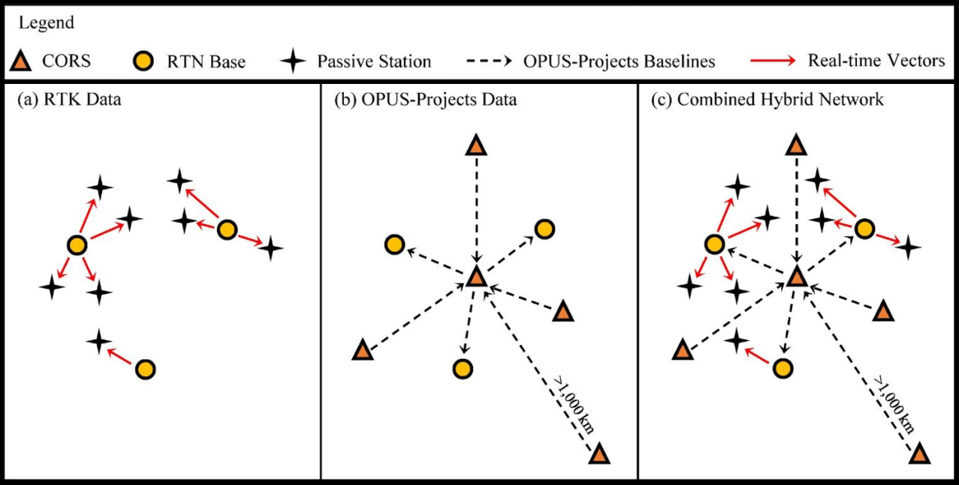
CORS + RTN
CORS used are not in NCN
Collect your RTN data w/Rover(s)
  In a VRS Log your vectors, not just points!
Download non-NCN CORS data
  Consult network provider for guidance/assistance
Upload CORS data to OP via OPUS-S
Download Rover data
Convert to GVX in your software
Upload GVX to OPUS Projects
  Process Sessions
  Adjust Network

Slide 39
CORS + RTN
CORS used are not in NCN
Most, but maybe not all, networks provide registered users with access to non-NCN CORS data
  aka “Reference Data Shop”
Many do not retain this for the long term!
  Varies → 45 days; 60 days; 90 days
Investigate this during Project Planning
  If non-NCN CORS data is gone… it’s gone
    NGS cannot help with that, only the network provider
No vectors = No GVX = No OPUS Projects

Slide 40
CORS + RTN
CORS used not in NCN but have a PID
Collect your RTN data w/Rover(s)
  Log your vectors, not just points!
Download non-NCN CORS data
  Consult network provider for guidance/assistance
Upload CORS data to OP via OPUS-S
Download Rover data
Convert to GVX in your software
Upload GVX to OPUS Projects
  Process Sessions
  Adjust Network – hold IDB coordinates

Slide 41
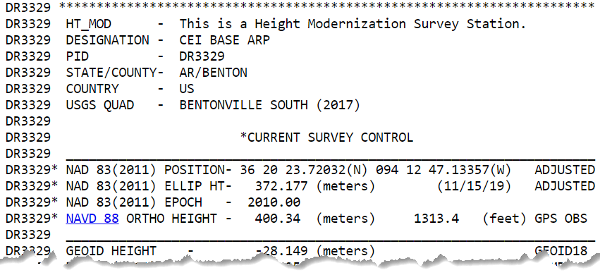
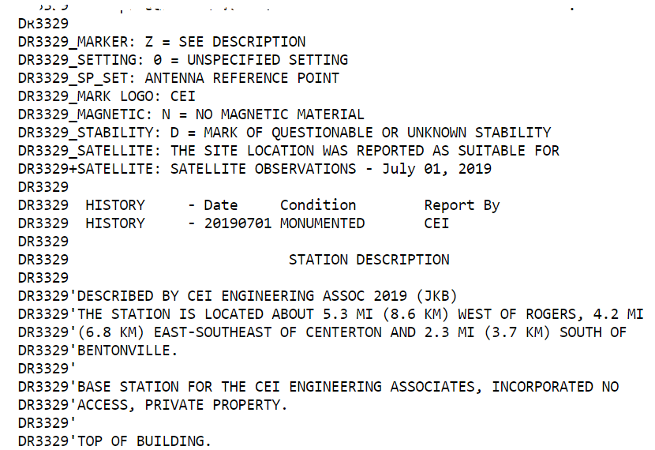
CORS + RTN
CORS used not in NCN but have a PID
but are in IDB
have a Datasheet

Slide 42
CORS + RTN
CORS used are in NCN
Collect your RTN data w/Rover(s)
  Log your vectors, not just points!
Download Rover data
Convert to GVX in your software
Upload GVX to OPUS Projects
  Adjust Network
Enjoy life ☺

Slide 43
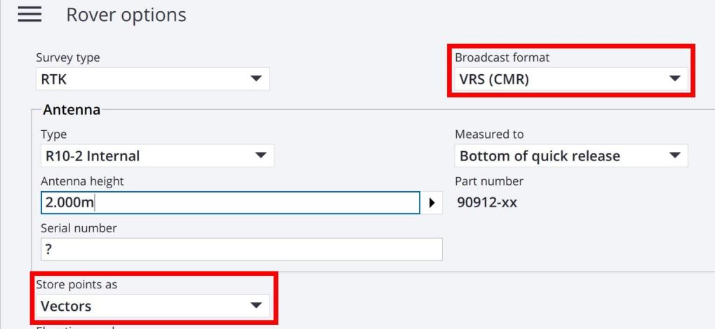
CORS + RTN
Regardless of CORS used…
If RTN uses VRS method, ensure you log vectors
  VRS – Virtual Reference Station
For GVX to work in OP, vectors must be tied to:
  PRS – Physical Reference Station
  PBS – Physical Base Station
Should not be a concern for MAC or FKP methods
  Vectors will be tied to PRS by default
No vectors = No GVX = No OPUS Projects
Screenshot of Trimble Access

Slide 44
Beta OPUS Projects (OP)
OPv5.0 is currently in Beta phase
If you have problems, please:
  Talk to one of our Geodetic Advisors
  Send an email to OP team
  Let us know!
    We can’t address or fix problems we don’t know about

Slide 45

Closing
RTK/RTN is now an option, not a requirement
Redundancy is a surveyor’s best friend
Surveying is still surveying

Slide 46
https://www.ngs.noaa.gov/ADVISORS/
-use any major search engine: “NGS advisors”
Jeff Jalbrzikowski, P.S., GISP, CFS
Appalachian Regional Geodetic Advisor
jeff.jalbrzikowski@noaa.gov
240-988-5486

