Slide 1

NGS Geoids, OPUS, NCAT, etc.
PLSO Annual Conference
February 2022
Jeff Jalbrzikowski, P.S., GISP, CFS
Appalachian Regional Geodetic Advisor
jeff.jalbrzikowski@noaa.gov
240-988-5486

Slide 2
My Background
Licensed Surveyor in OH, PA, and WV (PS)
Certified GIS Professional (GISP)
Certified Floodplain Surveyor (CFS)
BS in Surveying & Mapping, Univ. of Akron
Came to NGS from USACE Pittsburgh District
  primary experience is engineering surveys, including structural deformation, hydrographic/bathymetric, terrestrial lidar, GNSS control, local/legacy datum resolution
Notes:
-joined the NGS almost 2 years ago now
-Spent 9 years prior with USACE on topo, geodetic control, layout, boundary, deformation, lidar, GIS implementation, hydrographic/bathymetric, and contracting aerial acquisitions
-previously survey intern (private sector & BLM), GIS tech., warehouse picker/packer, busboy…
-I like Honda motorcycles, have owned a Honda Shadow, a Victory Vegas, but my favorite bike was a Honda ST1100 that I sold after my frist kid was born

Slide 3
So much more to NSRS Modernization!
New version of PAGES
  Multi-Constellation → GPS, Galileo, GLONASS, Beidou, QZSS, etc.
  Target: 15 minute occupations
OPUS expansion plan
  RTK/RTN: 2020 rollout, already mentioned
  Leveling, Classical (Total Station), Gravity: 2020-2025
  Fully integrated (GPS projects with leveling and gravity? No problem!)
  Ease of submission to NGS for inclusion in the NSRS
New Mark Recovery Tool
  mentioned earlier, search: “NGS mark recovery” and go to Beta
Fully integrated toolkit
  NCAT and VDatum

Slide 4
Using the modernized NSRS
OPUS
  Guidance (such as pre-selected CORSs and assistance in locating marks in project areas)
  Users will decide what control to hold fixed and what epochs they wish to set for the adjustment
    “Preliminary coordinates”
  If submitted to NGS (aka “Shared”), we will harvest your raw GNSS data and use it to compute Final Discrete coordinates
Notes:
it all starts and ends with OPUS

Slide 5
NGS Mission
To define, maintain and provide access to the National Spatial Reference System (NSRS) to meet our Nation’s economic, social, and environmental needs.
Notes:
NGS develops and maintains the National Spatial Reference System, a national coordinate system that provides the foundation for transportation, navigation, land record systems, mapping and charting efforts, and a multitude of scientific and engineering applications.
But there are many ancillary programs and products we will also discuss.

Slide 6
Not just new datums…
  NSRS Modernization
-OPUS enhancements/additions
-new types of coordinates
-new methods for establishing control
-streamlined Bluebooking
-retire the US Survey Foot
Notes:
-so you’ve probably seen that phrase that I have front and center here, NSRS Modernization
-that’s the blanket term we use to refer to not just the new datums but other updates
-another phrase I want to mention are these “Blueprints for 2022”
-just about everything I cover today is mentioned in one of the Blueprints
-the Geodetic Toolkit, what’s that? another term that just refers to all those softwares NGS provides, like PAGES, ADJUST, etc.
-better methods – updating manuals like NGS-58 and 59 for example

Slide 7
What can you do?
Help spread the word
  Engage your
    Surveyors
    Engineers
    GIS Professionals
Reach out to NGS for support
Follow best metadata practices
Educate others
  Share our links and info
Notes:
Coordinate -Spread the word and tell others about NSRS Modernization
→ Ask the agencies, surveyors, and engineers you work with about the preparations they are taking to learn about the upcoming changes
Educate
-Review materials and ask for support from NGS
Prepare
-Lead by example and use the best metadata practices

Slide 8
Preparing for New Datums
  Know the epoch of your data/datasets
    consider how you will track this
      full to-the-second timestamp on every feature?
        GNSS makes this easily possible…
      labeling a year for each dataset?
      something in-between that works for your needs?

Slide 9
Preparing for New Datums
  Transforming your data
    NCAT - NGS Coordinate Conversion and Transformation Tool
      available now: ASCII upload, Web Services, GitHub
      ask your software provider(s) about integration
        we envision this as most popular method of access
        Industry Workshop held May 2021
          Esri, Trimble, Blue Marble, etc… all the well known names attended
Notes:
Transforming your data
NCAT - NGS Coordinate Conversion and Transformation Tool
available now: ASCII upload and Web Services
ask your software providers about integration
we envision this as most popular method of access
Industry Workshop held this year – esri, trimble, bluemarble, all the major well known names were represented
labeling a year for each dataset?
something in-between that works for your needs

Slide 10
Preparing for New Datums
  Reprocessing your data
    in a perfect world, everyone would reprocess
      what does this mean?
        consider an ALTA w/topo
          start over with the onsite GNSS-based control
          reorient all your shots/ties (hopefully linked)
          recreate all the drainage features in new datum
      unrealistic! … and unnecessary for majority users
Notes:
Reprocessing your data
in a perfect world, everyone would reprocess data
consider a final product like you use everyday - a hydro-enforced DEM
starting fresh with the raw GNSS/IMU processing
generate new ellipsoid height point clouds
recreate all the drainage features in new datum
this is totally unrealistic → both from a financial and programmatic perspective

Slide 11
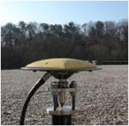
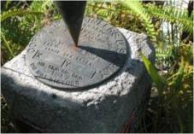
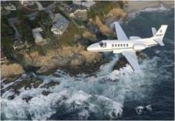
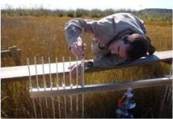
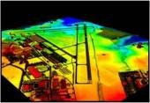
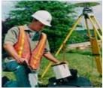
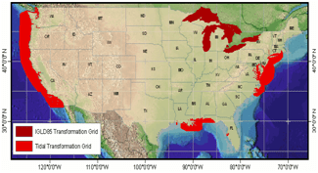
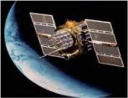
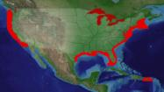
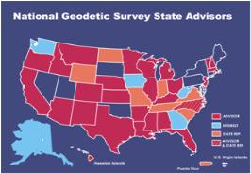
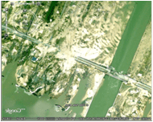

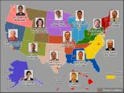
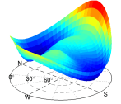
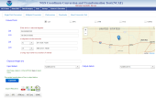

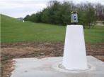
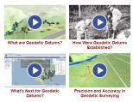
NGS Overview
Modernizing the NSRS
CORS
NHMP
GRAV-D
ECO
NGS Products and Services
ASP
OPUS
VDatum
Orbit Data
National Shoreline
Geodetic Advisors
ERI
Antenna Calibrations
NCAT
CUSP
CBL
Outreach
Notes:
This is not an exhaustive list of NGS programs

Slide 12
NGS Overview
Modernizing the NSRS
CORS
NHMP
GRAV-D
ECO
NGS Products and Services
ASP
OPUS
VDatum
Orbit Data
National Shoreline
Geodetic Advisors
ERI
Antenna Calibrations
NCAT
CUSP
CBL
Outreach
Notes:
This is not an exhaustive list of NGS programs

Slide 13
Aeronautical Survey Program
Interagency Program: FAA and NGS
  Primary Airport Control Station (PACS) and Secondary Airport Control Stations (SACS)
  Airports GIS (AGIS)
  Airport Obstruction Charts (AOC)
Primary function of NGS is to serve as QA and subject-matter expert for ASP surveys that are contracted by airports
Notes:
PACS are occupied with GNSS and tied to the NSRS via simultaneous observations to one CORS, one CBN Station, and two 1st order BMs.
SACS are then tied to the PACS with simultaneous observations.

Slide 14
NGS Overview
Modernizing the NSRS
CORS
NHMP
GRAV-D
ECO
NGS Products and Services
ASP
OPUS
VDatum
Orbit Data
National Shoreline
Geodetic Advisors
ERI
Antenna Calibrations
NCAT
CUSP
CBL
Outreach
Notes:
This is not an exhaustive list of NGS programs

Slide 15
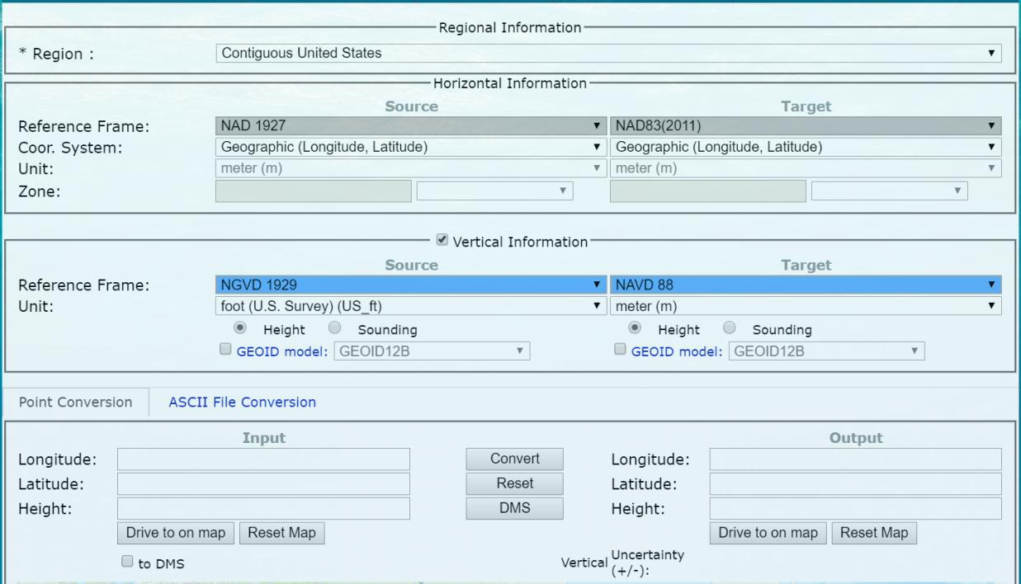
NOAA VDatum - online

Slide 16
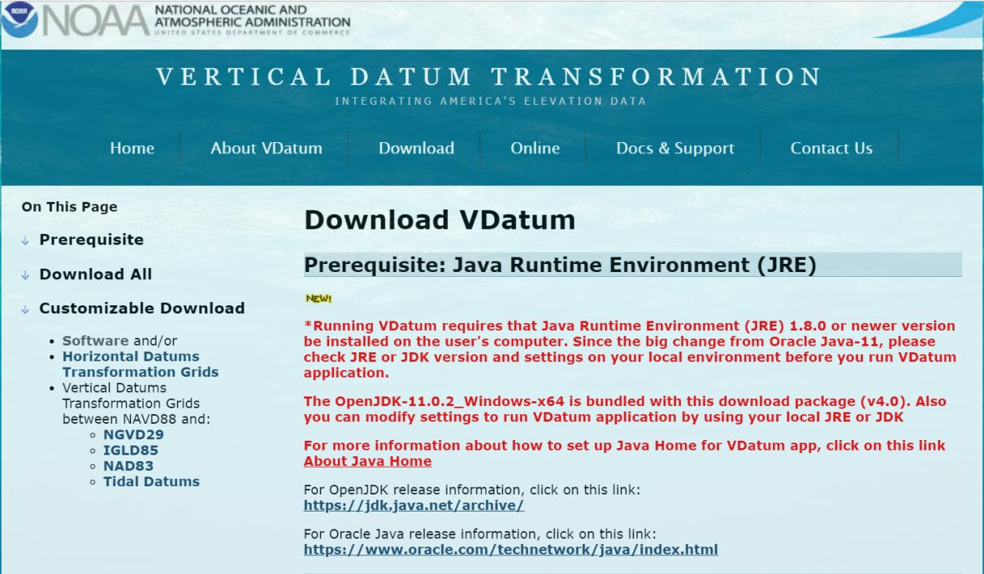
NOAA VDatum - download

Slide 17
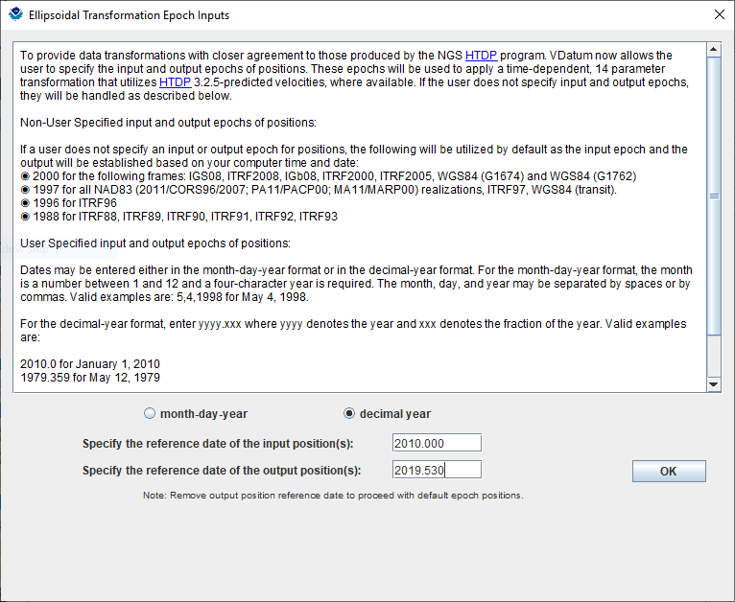
NOAA VDatum - download
Notes:
-cool thing about vdatum is that it incorporates the HTDP (Horzontal Time Dependent Positioning) software
-might not be something most surveyors, in this region anyway, are paying a whole lot of attention to
-but don’t those decimal year things look familiar?
-if you look at any of your OPUS Solution Reports, you’re going to see an epoch date, in the same format, on the right hand side next to the ITRF or IGS coordinates

Slide 18
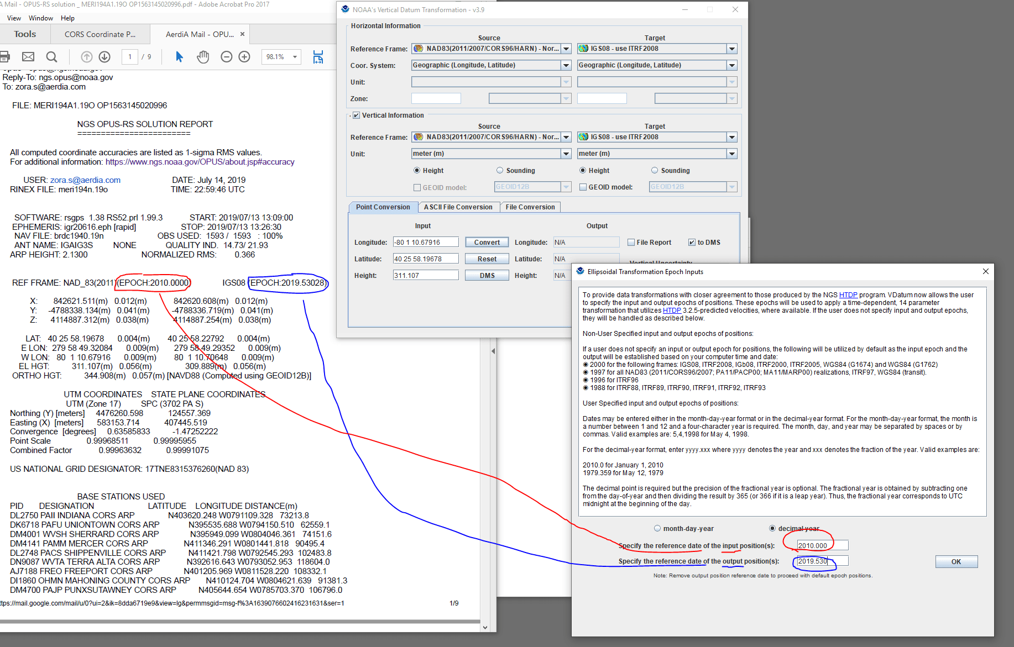
Notes:
-cool thing about vdatum is that it incorporates the HTDP (Horzontal Time Dependent Positioning) software
-might not be something most surveyors, in this region anyway, are paying a whole lot of attention to
-but don’t those decimal year things look familiar?
-if you look at any of your OPUS Solution Reports, you’re going to see an epoch date, in the same format, on the right hand side next to the ITRF or IGS coordinates

Slide 19
Notes:
-cool thing about vdatum is that it incorporates the HTDP (Horzontal Time Dependent Positioning) software
-might not be something most surveyors, in this region anyway, are paying a whole lot of attention to
-but don’t those decimal year things look familiar?
-if you look at any of your OPUS Solution Reports, you’re going to see an epoch date, in the same format, on the right hand side next to the ITRF or IGS coordinates

Slide 20
Notes:
-cool thing about vdatum is that it incorporates the HTDP (Horzontal Time Dependent Positioning) software
-might not be something most surveyors, in this region anyway, are paying a whole lot of attention to
-but don’t those decimal year things look familiar?
-if you look at any of your OPUS Solution Reports, you’re going to see an epoch date, in the same format, on the right hand side next to the ITRF or IGS coordinates

Slide 21
NOAA VDatum Website
vdatum.noaa.gov

Slide 22
NGS Overview
Modernizing the NSRS
CORS
NHMP
GRAV-D
ECO
NGS Products and Services
ASP
OPUS
VDatum
Orbit Data
National Shoreline
Geodetic Advisors
ERI
Antenna Calibrations
NCAT
CUSP
CBL
Outreach
Notes:
This is not an exhaustive list of NGS programs

Slide 23

GPS Orbit Data aka Ephemerides
NGS orbit analysis and computation is performed together with, and as a component of, the International GNSS Service (IGS)
  IGS coordinates the collection of satellite tracking data
  these orbits are what give us post-processed accuracy
Designated with this responsibility by the Civil GPS Service Interface Committee (CGSIC)
If you’re using OPUS, it’s all behind-the-curtain!
Notes:
The CGSIC is an entity of the US Dept of Transportation.
Ephemeris is a table that lists the coordinates/positions of celestial objects (natural/anthro) during a given time period.
The ephemerides (plural term) are the backbone of GNSS-based positioning; precise ephemerides lead to accurate positions.
*but if you get an OPUS error message about orbit availability, this is your issue that you’ve got satellite data but nothing to process it against.

Slide 24
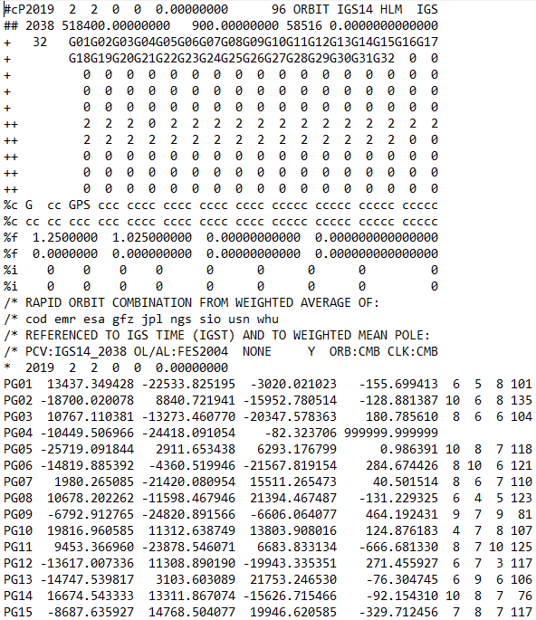
.sp3 file
Link to NGS GPS Calendar
Notes:
-this is an example .sp3 file
-There’s our GPS Week near the top, number 2038.
-See the SV numbers? Just like a RINEX file you’ll see G## for GPS sats.
-R## for Russian, and whatever else I can’t recall.
-On down you can see this is a Rapid Orbit file, satisfactory for most work.
-Then there’s the date/time stamp followed by the positional records.
-There’s a set of those positions logged every 15 minutes, as opposed to every 15 seconds of land-based receiver logging.

Slide 25
NGS Overview
Modernizing the NSRS
CORS
NHMP
GRAV-D
ECO
NGS Products and Services
ASP
OPUS
VDatum
Orbit Data
National Shoreline
Geodetic Advisors
ERI
Antenna Calibrations
NCAT
CUSP
CBL
Outreach
Notes:
This is not an exhaustive list of NGS programs

Slide 26
Emergency Response Imagery
Mission of our Remote Sensing Division
Pre-Storm and Post-Storm photos are taken mostly along the coastal CONUS, and some other disasters natural or human
Supports Dept. of Homeland Security (DHS) and other emergency management organizations (FEMA, State, local, etc.)
Notes:
-Pre and Post photos are taken when possible
-mostly natural disasters, hurricanes
-but have also supported Midwestern Flooding and tornadic events
-notably also responded in NYC and DC on September 11, 2001

Slide 27
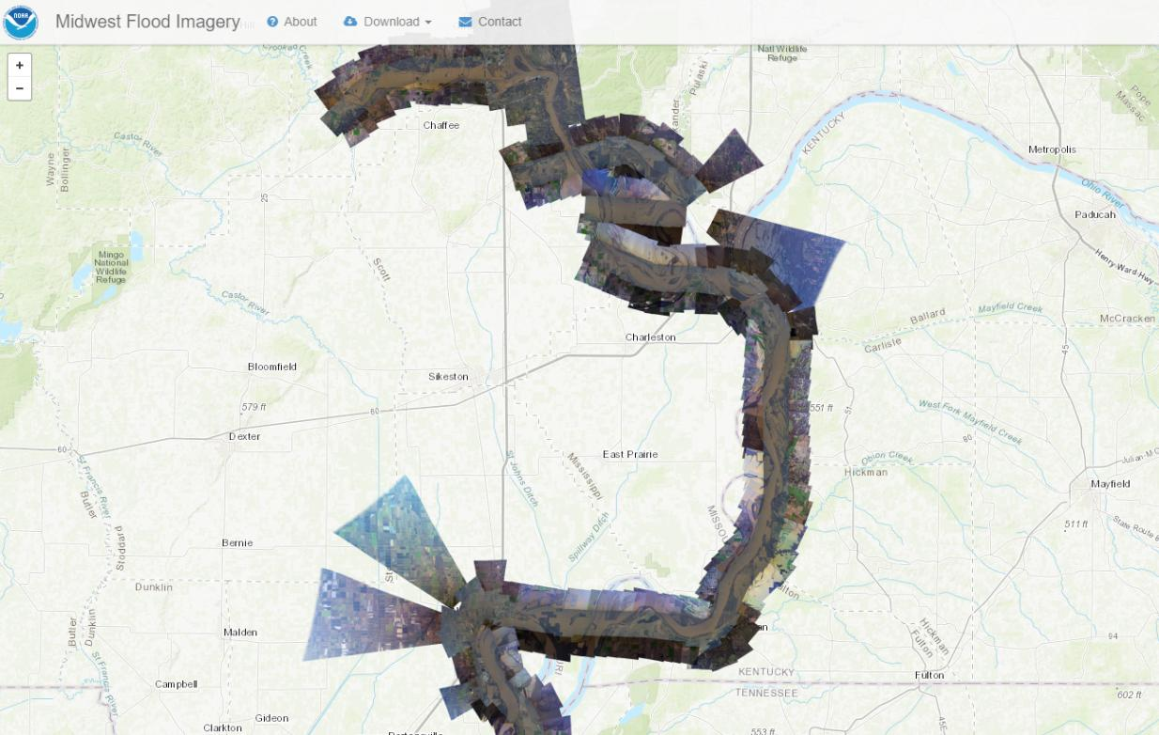
Emergency Response Imagery
Notes:
-Just a quick sample of ERI, over in Kentucky.
-dataset from 2015 flooding along the Mississippi River.
-Screenshot here is over by the Kentucky Bend, New Madrid Bend, whatever you want to call it.

Slide 28
NGS Overview
Modernizing the NSRS
CORS
NHMP
GRAV-D
ECO
NGS Products and Services
ASP
OPUS
VDatum
Orbit Data
National Shoreline
Geodetic Advisors
ERI
Antenna Calibrations
NCAT
CUSP
CBL
Outreach
Notes:
This is not an exhaustive list of NGS programs

Slide 29
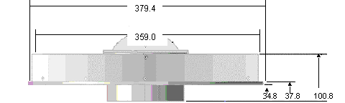
Phase Center Offset - conceptual
Orange dot = mean point of signal reception
Blue dot = Antenna Reference Point (ARP)
Red line = Phase Center Offset (PCO)
Notes:
-the ENU values of that red line, which is 3 dimensional, is different per antenna model
-this diagram is an oversimplification of the

Slide 30
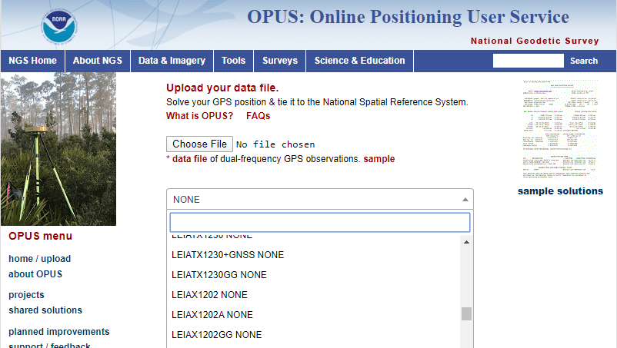
Phase Center Offset
The PCO is one reason it is important to select the correct antenna for OPUS upload!
choose
carefully!
if you have questions… drop me a line
Notes:
-this why it is important to select the correct antenna when using OPUS
-there is another part of the Antenna Calibration, the Phase Center Variation… but that’s a whole other discussion so let’s move on to a video!

Slide 31
NGS Overview
Modernizing the NSRS
CORS
NHMP
GRAV-D
ECO
NGS Products and Services
ASP
OPUS
VDatum
Orbit Data
National Shoreline
Geodetic Advisors
ERI
Antenna Calibrations
NCAT
CUSP
CBL
Outreach
Notes:
This is not an exhaustive list of NGS programs

Slide 32
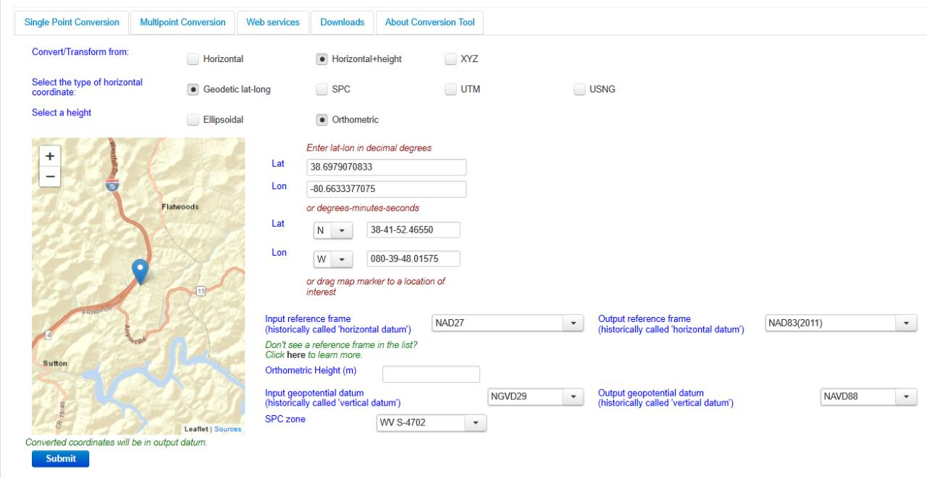
NGS Coordinate Conversion And Transformation Tool (NCAT)
Notes:
NCAT includes the functionality of previous NGS tools:
NADCON 5.0
XYZWIN 2.0
UTMS 2.1
SPC83 2.1
USNG 2.3
Includes error estimate of transformation per point.
Available as the single-point graphic seen here, multi-point upload/download, as a downloadable executable fie to run from the DOS prompt, and as web services for inclusion in your own
It’s a great tool. Anyone using

Slide 33
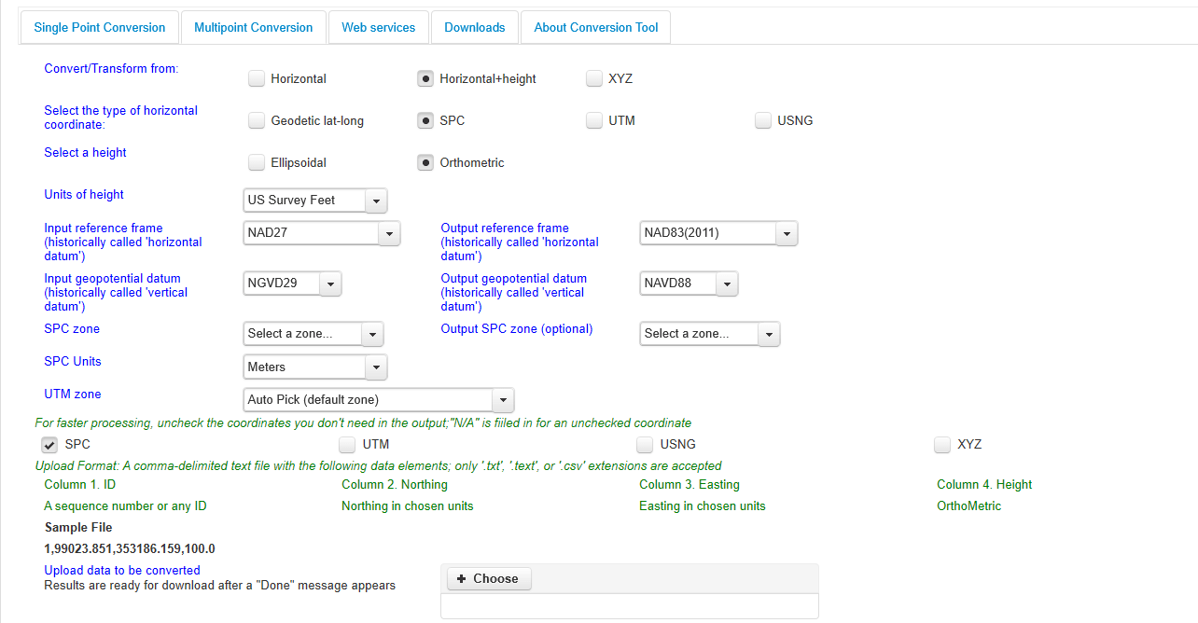
NGS Coordinate Conversion And Transformation Tool (NCAT)
Notes:
NCAT includes the functionality of previous NGS tools:
NADCON 5.0
XYZWIN 2.0
UTMS 2.1
SPC83 2.1
USNG 2.3
Includes error estimate of transformation per point.
Available as the single-point graphic seen here, multi-point upload/download, as a downloadable executable fie to run from the DOS prompt, and as web services for inclusion in your own
It’s a great tool. Anyone using

Slide 34
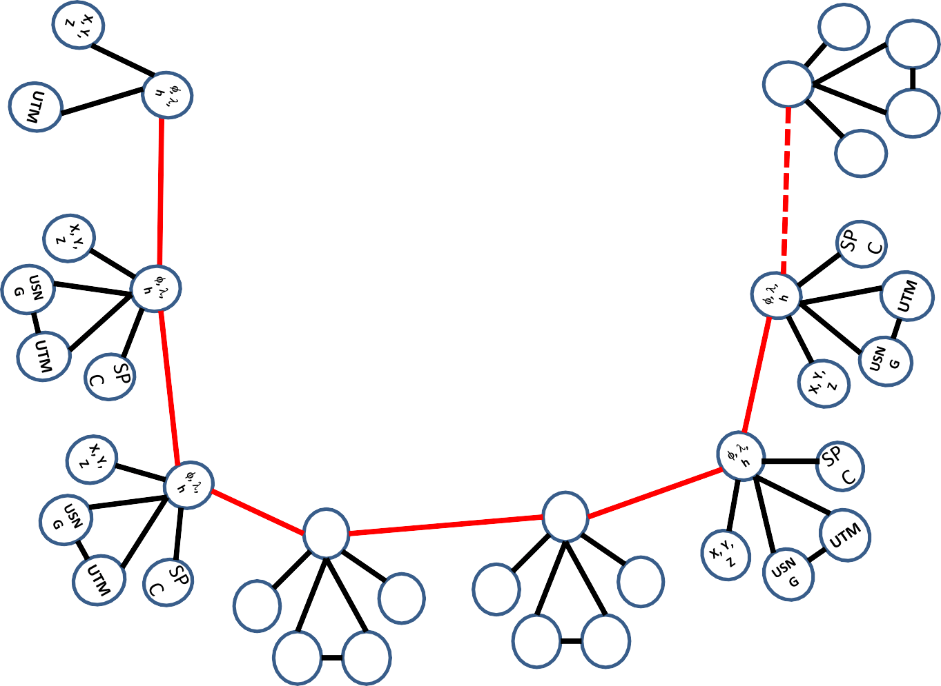
Coordinate Transformation Tool
SP
C
UTM
(NCAT / NADCON 5.0)
2022
φ, λ, h
USSD
USN
G
Relating coordinates: then & now
NAD 83 (2011)
X, Y,
Z
NAD 27
NAD 83 (NSRS2007)
NAD 83 (1986)
NAD 83 (FBN)
φ, λ, h
NAD 83 (HARN)
φ, λ, h
SP C
X, Y, Z
SP C
X, Y, Z
USN G
USN G
UTM
UTM
Notes:
Flow diagram of NCAT at work.
All your input gets converted to ECEF coordinates, then transformed and/or converted, and then gets spit back out in your requested datum/coordinates.

Slide 35
NGS Overview
Modernizing the NSRS
CORS
NHMP
GRAV-D
ECO
NGS Products and Services
ASP
OPUS
VDatum
Orbit Data
National Shoreline
Geodetic Advisors
ERI
Antenna Calibrations
NCAT
CUSP
CBL
Outreach
Notes:
This is not an exhaustive list of NGS programs

Slide 36
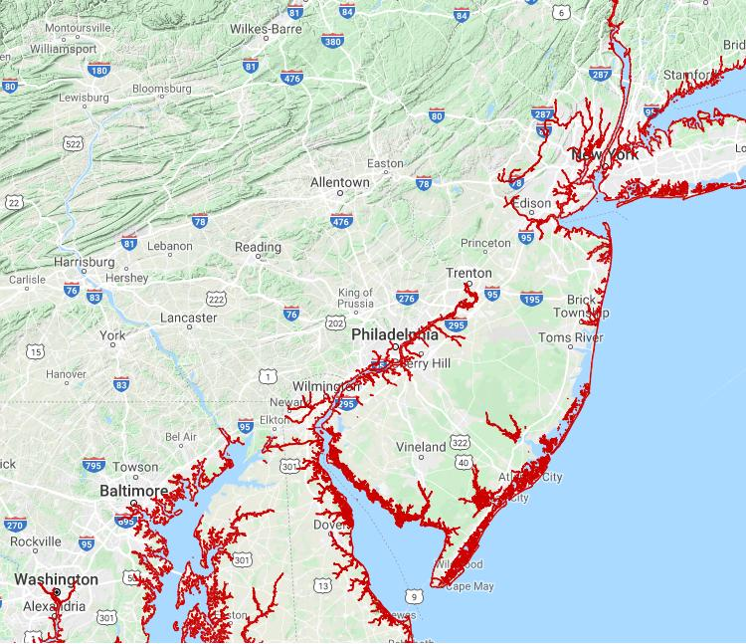
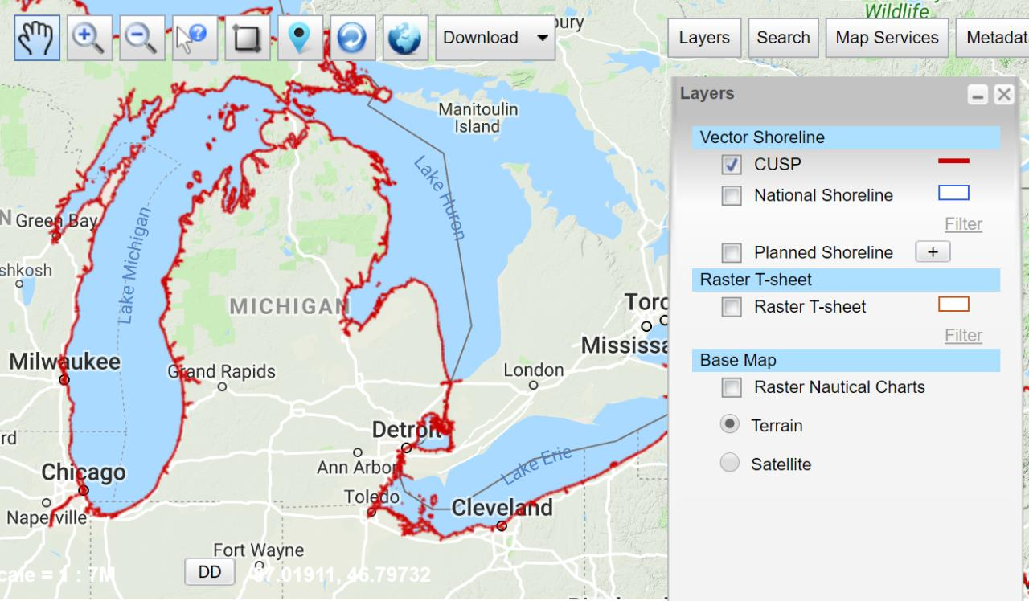
Continually Updated Shoreline Product
Just as the name says… it’s dynamic
Available for download as shapefiles
Developed by image interpretation and/or vertical modeling using water level stations (tide or lake gages)
Referenced to a computed Mean High Water
hyperlink to the CUSP homepage
Notes:
-”continually updated” equals… dynamic!
CLICK
-In typical NGS fashion, there are various ways to navigate to and locate the data, but there’s a screenshot of the NSDE, the NOAA Shoreline Data Explorer
CLICK
-and there’s a quick screenshot of the Delaware River region

Slide 37
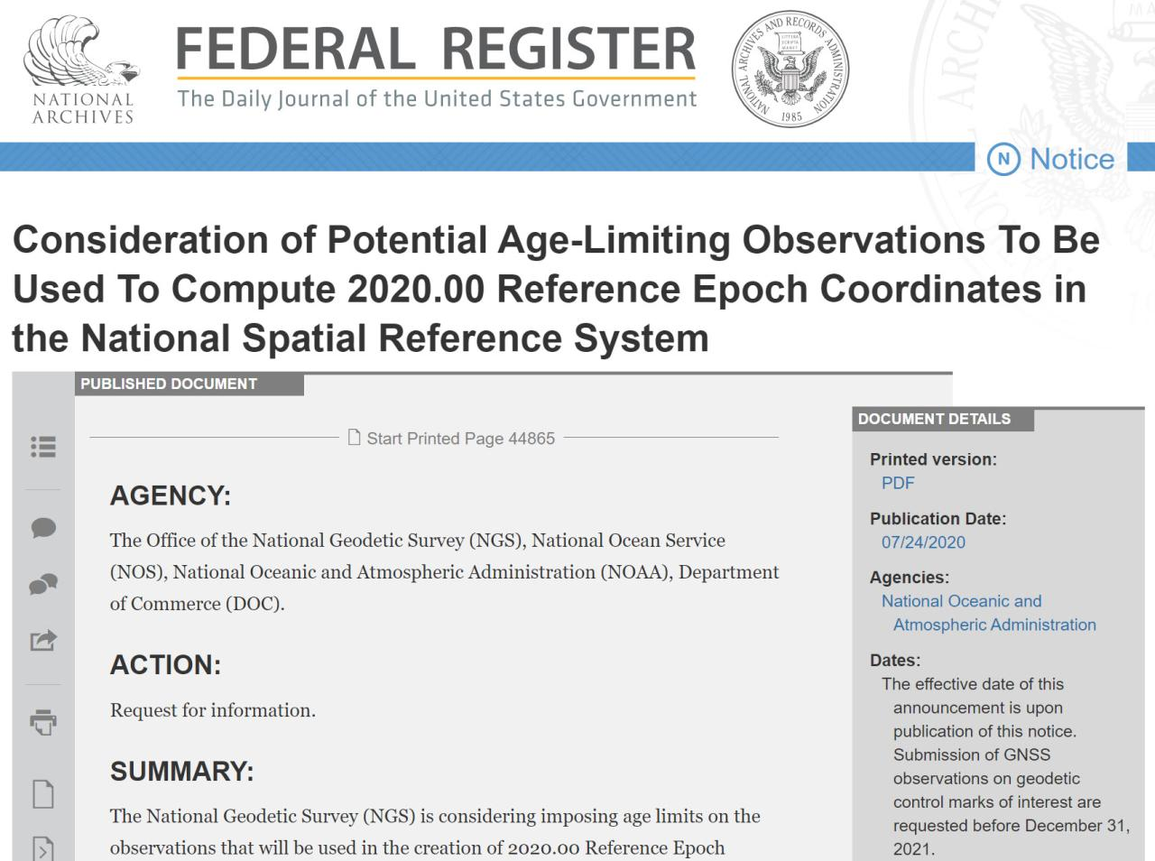

Slide 38
Federal Register Notice summarized
NGS needs to start computing coordinates for the 2020.00 Reference Epoch in January 2022
Marks that you would like to have published in NATRF/NAPGD 2022 need “fresh” data
Why?
  Older data is of lower quality (constellation & orbits)
  Periodic re-surveys are better than decades old data
  Lower accuracy as we move further back in time
hyperlink to FRN: https://www.federalregister.gov/d/2020-16084
Notes:
-at NGS we need to start computing coordinates for the 2020.00 Reference Epoch in January 2022
-What’s this ‘age-limiting’ phrasing? Well, second bullet there, meaning that some GPS data is now considered too old to have meaningful worthiness for inclusion

Slide 39
Federal Register Notice summarized
No decision has been made as to a cutoff date
  FRN says it is unlikely to be <10 years
  Discussions of regional/state-based cutoff dates have been had.
What does this mean as of now?
  Observations prior to 01 January 2010 would not get new coordinates in NATRF/NAPGD2022
What does this look like on a map?
Notes:
-NOTE that this is a decision that has NOT yet been made
-What does this mean to you?
-Observations prior to 01 January 2010 would not get new coordinates
-Let’s take a look at a couple maps…

Slide 40
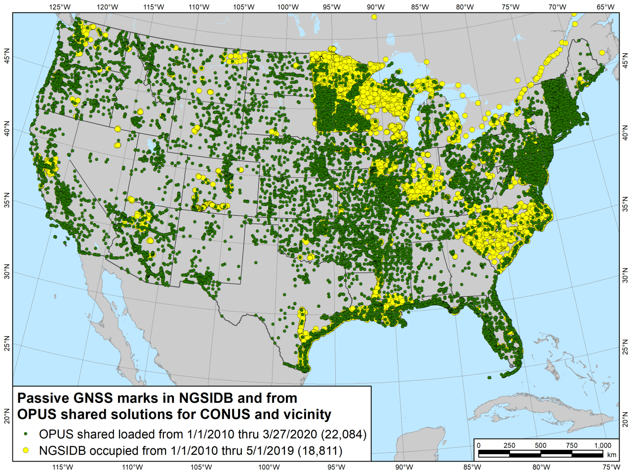
Notes:
-You can see a few areas out west that are very sparse
-Midwest and northeast are pretty well covered

Slide 41
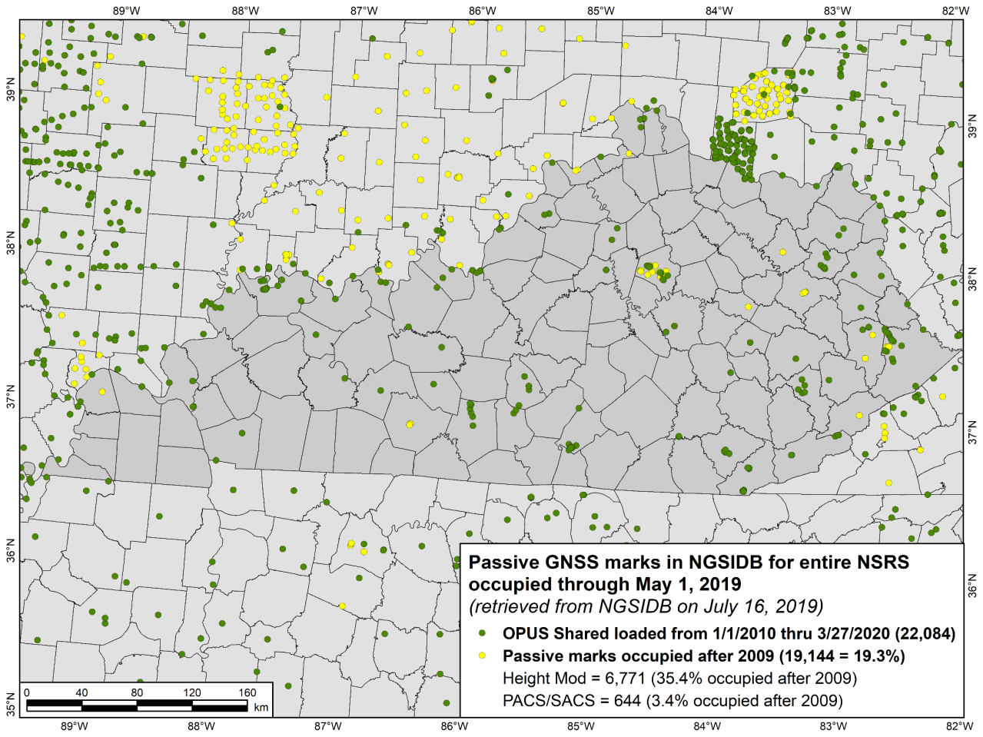
Notes:
-Fayette County looking good, result of the recently collected & published LFUCG (Lexington-Fayette Urban County Government)
-Pikeville area, way over east, has decent coverage
-Based on a cutoff date of 01 January 2010, that leaves 65 counties (of 120 total) with no published passive control in NATRF/NAPGD

Slide 42
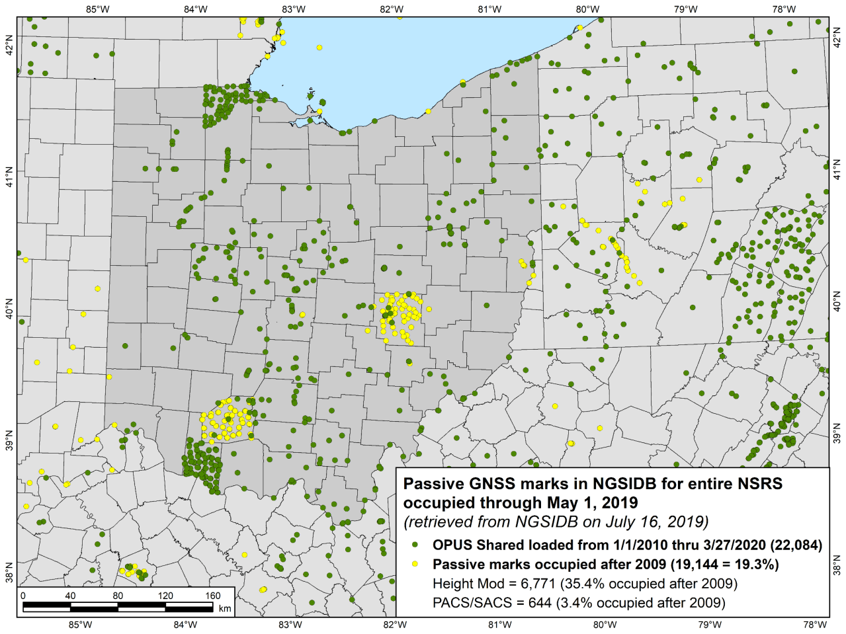
Notes:
-Lucas and Brown Counties are peppered with OPUS Share solutions
-While Highland and Muskingum Counties have recently submitted projects published to the IDB, and both have a few OPUS Shares

Slide 43
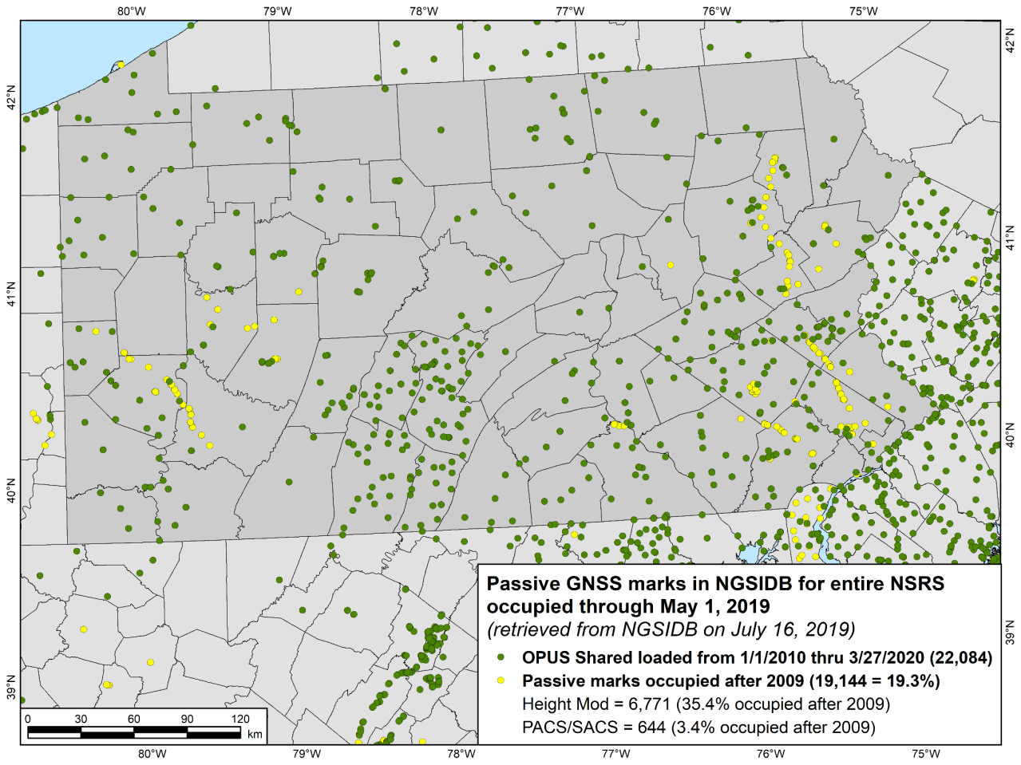
Notes:
-Lucas and Brown Counties are peppered with OPUS Share solutions
-While Highland and Muskingum Counties have recently submitted projects published to the IDB, and both have a few OPUS Shares

Slide 44
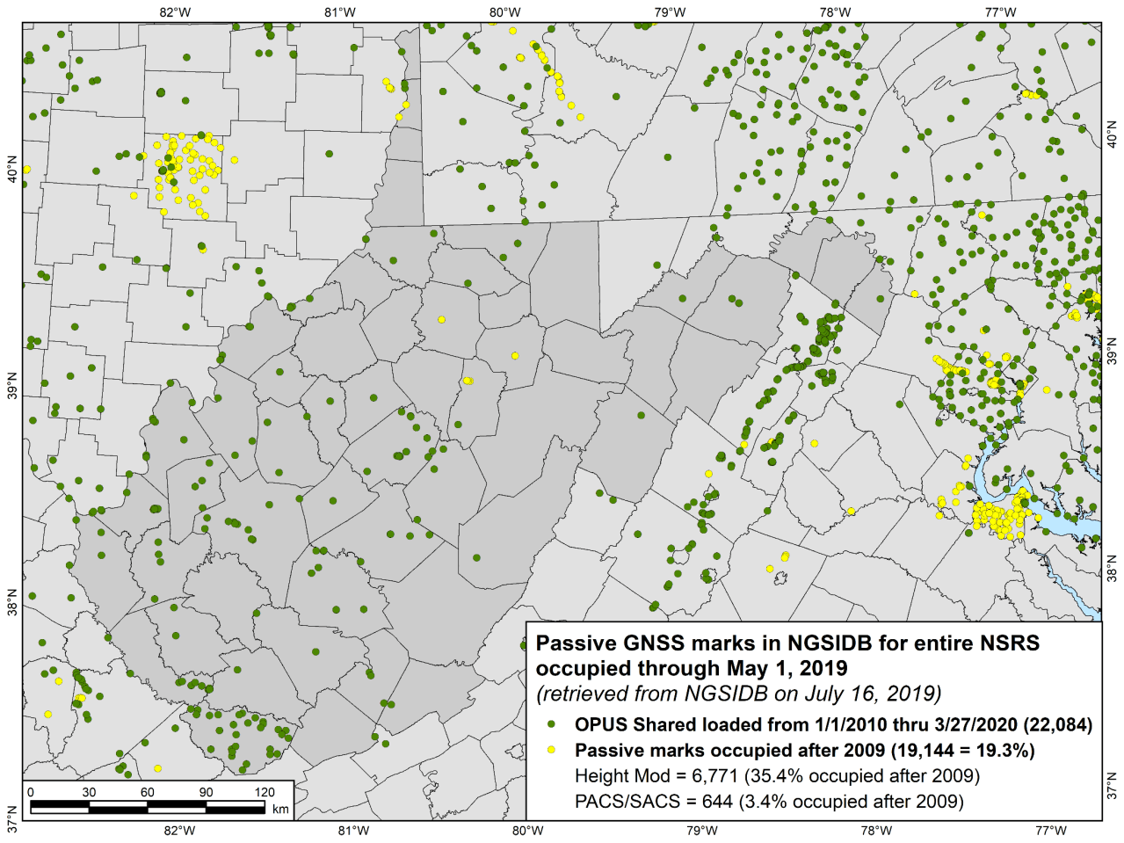
Notes:
-Lucas and Brown Counties are peppered with OPUS Share solutions
-While Highland and Muskingum Counties have recently submitted projects published to the IDB, and both have a few OPUS Shares

Slide 45
How can you improve your area?
What can you do to ensure your control will get coordinates in the new datums on rollout?
Re-observe and submit the data to NGS
  must be submitted by 31 December 2022
Options to submit your GNSS data:
  OPUS Share → 4+ hrs static data; 2 photos; mark ties
    rinse & repeat … as we need redundancy
  OPUS Projects → 2+ hrs data; photos; descriptions
  traditional “bluebook” submittal
Notes:
-OPUS Share requires 4+ hrs static data; 2 photos; and a brief description of reference ties (not a full IDB “from the post office”)
→ NOTE THAT OPUS SHARE OPTION REQUIRES 2 OBSERVATIONS
→ WHY? WE REQUIRE REDUNDANCY FOR ANY OBS THAT GO INTO OUR DATABASE
-OPUS Projects → 2+ hrs data; photos; full IDB style descriptions via WinDesc (*MUST USE WINDESC*)

Slide 46
NGS Overview
Modernizing the NSRS
CORS
NHMP
GRAV-D
ECO
NGS Products and Services
ASP
OPUS
VDatum
Orbit Data
National Shoreline
Geodetic Advisors
ERI
Antenna Calibrations
NCAT
CUSP
CBL
Outreach
Notes:
This is not an exhaustive list of NGS programs

Slide 47
Geoids and Gravity
Notes:
-they go hand-in-hand, like peas and carrots
-the word geoid has different definitions and dates back to the 1820s, including:
--Geometric surface of the Earth which intersects the direction of gravity at right angles and from which the surface of the world ocean is a part.

Slide 48
Geoids and Gravity
or
“Ramblings on the geoid”
Notes:
-they go hand-in-hand, like peas and carrots
-the word geoid has different definitions and dates back to the 1820s, including:
--Geometric surface of the Earth which intersects the direction of gravity at right angles and from which the surface of the world ocean is a part.

Slide 49
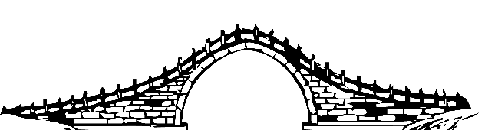
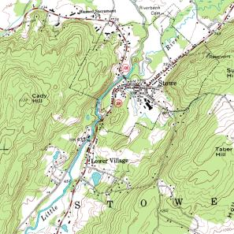
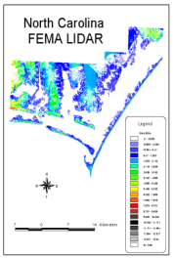
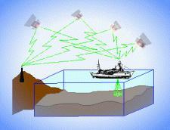
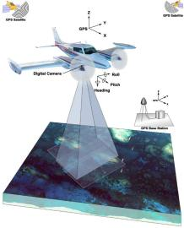
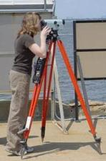
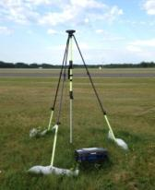
A geoid model is your bridge from…
Ellipsoidal
geoid
Orthometric
Raw Hydrographic Surveys
USGS
Topography
NAD83
NAVD88
NGVD29
FEMA NFIP Data & Maps
Engineering and Construction Surveys
Raw GPS Observations
Raw Lidar Data
Notes:
This slide illustrates the 3 categories of vertical datums and examples of where each is directly used They are project and application dependent.
First, we have ellipsoidal datums. Examples include WGS84 and NAD83 (North American Datum of 1983). You will encounter these datums frequently in hydrographic surveys that are vertically referenced with RTK-GPS; any native GPS measurements; and even raw lidar datasets.
Next, we have orthometric datums. These datums are very important because height differences referenced to orthometric datums will allow us to know the direction water will flow, because they have been “gravity-corrected”. The North American Vertical Datum of 1988 (or NAVD 88) is an orthometric datum, which you will see on USGS topographic maps, engineering and development site surveys, and FEMA Flood Insurance Rate Maps.
Finally, we have Tidal Datums, which are derived from water level measurements. They have extremely important applications including daily and extreme water levels; NOAA nautical charts, and shoreline mapping or boundaries along the coast.
*NOAA provides tools (like NCAT and Vdatum) to transform between these different height systems.
The Bridge

Slide 50
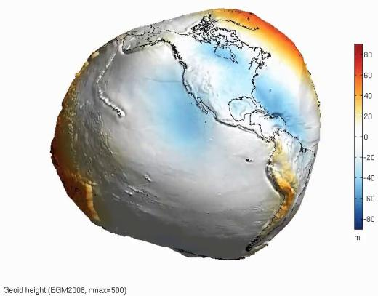
Geoid – an incorrect definition
“The true size and physical shape of the Earth” --social media, etc.
Nope

Slide 51
One textbook geoid definition
“Equipotential surface of the Earth’s gravity field that approximates Mean Sea Level more closely.”
-GPS for Land Surveyors, by Jan Van Sickle, 4th ed., CRC Press, Taylor & Francis Group, 2015, p. 314.
equi-huh?
More closely than what?
Notes:
This is what I was introduced to in school. My point is not to say that this isn’t a solid explanation/definition here, rather to break it apart in an attempt to clarify it. This works, Jan’s book is great, and is updated regularly; I would highly recommend it to any educators or practitioners.

Slide 52
Two more geoid definitions
“The equipotential surface of the Earth's gravity field which best fits, in a least squares sense, global Mean Sea Level.”
-website of the National Geodetic Survey
A surface of constant geopotential.
-some lecture notes of mine…
Notes:
Top one is the definition adopted by NGS.
That explanation of being a least-squares best-fit to MSL helps a lot.

Slide 53
My favorite verbage
  “The geoid is the equipotential surface that most closely coincides with the undisturbed mean sea level (and its continuation through the continents).”
    - Sjöberg, L. E., & Bagherbandi, M. (2017). Gravity Inversion and Integration, Theory and Applications in Geodesy and Geophysics. Springer.
  equipotential – equal potential
  potential – as in energy… or gravitational pull
Notes:
-potential = “currently unrealized ability”

Slide 54
Gravitational Pull
It is not uniform, both strength and direction vary.
Can be defined by a vector
-distance (from ellipsoid) and direction
Notes:
-the fact that gravity varies is the reason we need to build a geoid model to calculate ortho heights from GNSS data
-if gravity didn’t vary then we could all just use ellipsoid heights

Slide 55
Equipotential Surface
A modeled surface to represent the location of equal gravitational force.
It’s an undulating surface, hence the phrase “geoid undulation” often used.
Gravity is acting perpendicular to every point on this surface.
Notes:
-undulating is a good word, because there are no “cliffs” in a geoid model, the smallest “feature” one will find in one of our geoid models is about 50km (30mi)
**much like the rolling hills of West Virginia
-Picture this surface like a DEM, but it’s cell values represent the height above or below the ellipsoid in which gravitational pull is equal.
-if that works for you, then think of a geoid model as a DGM, a Digital Gravity Model

Slide 56
Equipotential Surface
… coincides with the undisturbed mean sea level…

Slide 57
Equipotential Surface
There are an infinite number of equipotential surfaces.
We use the term geoid to refer to one of those surfaces that aligns to a best-known global mean sea level.
Notes:
-the thing to keep in mind in this concept is that there are an infinite number of such surfaces of equal gravitational pull, depending on what the strength of that pull is
-let’s visualize that

Slide 58
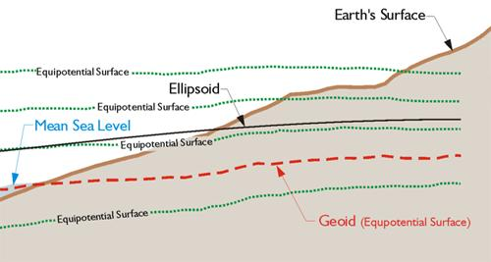
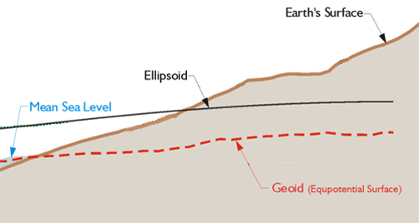
Equipotential Surface
-GPS for Land Surveyors, by Jan Van Sickle, 4th ed., CRC Press, Taylor & Francis Group, 2015, p. 180. (slightly edited)
NAPGD2022 defined by a specific strength of gravity → W₀
Notes:
Recall our ol’ buddy W sub-naught (W₀)

Slide 59
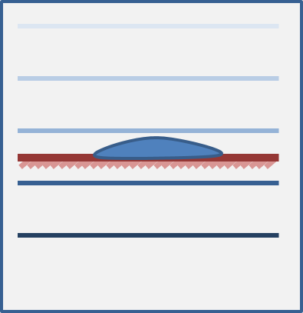
Geopotential
Notes:
-The lines in different shades of blue represent different equipotential surfaces, or different strengths/levels of geopotential.
-The brown line represents the topographic surface, land.
-And there’s a puddle of water there in the middle, the blue drop.
-Imagine pouring water onto a dry lake bed. If the topographic surface is flat, as it is here, the water will simply pool up.
-The water “wants” to get to the lower potential lines, but there’s that dang lake bed in the way.

Slide 60
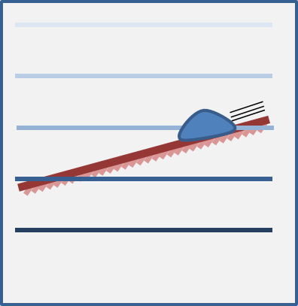
Geopotential
Notes:
-Now we’ve tilted the lakebed, like a hill. The water has a path to move towards lower potential, so it does.
-The water appears to flow because of a difference in height.

Slide 61
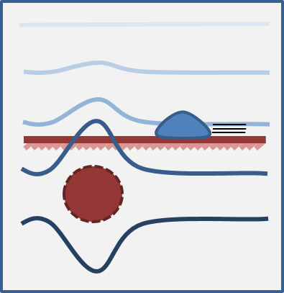
Geopotential
Notes:
-Ok, so here’s our water droplet again, and back on a flat lakebed.
--But now we have this dark red circle over here, which represents a mass anomaly, perhaps an large mineral deposit of some sort.
-This resulting geopotential difference, due to the anomaly, causes water to flow towards lower potential again. This time the water appears to flow because of gravity.
-See how the blue lines, our geopotential lines, bow around the anomaly? The mineral mass increases the pull of gravity so the lines must be drawn that way if they’re drawn to represent equipotential surfaces.

Slide 62
Geopotential
In all scenarios, the water only flows when it has a path to lower geopotential – this is always a combination of gravity and height.
(-∫g dH)
Notes:
Just a reminder that the example used is just that, an example. Water is not going to “flow uphill” due to some huge mineral deposit.

Slide 63
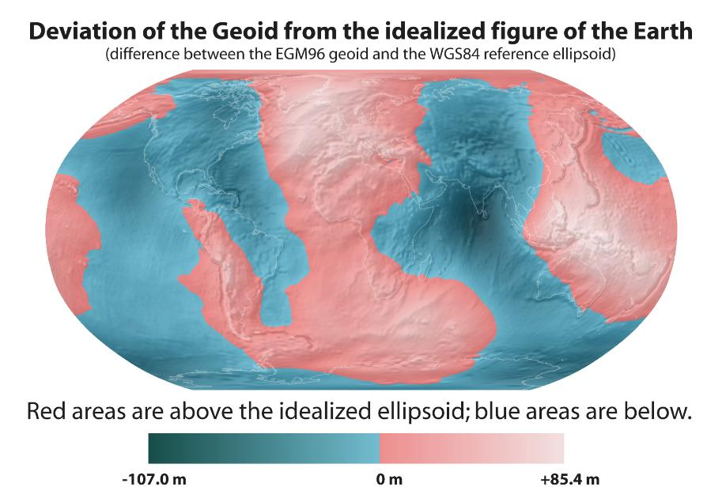
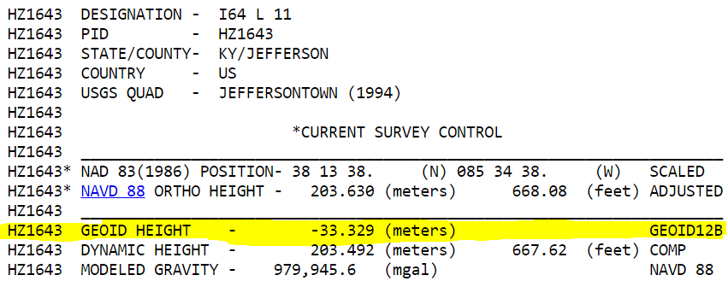
Notes:
Nice graphic, couldn’t leave this out. Note that CONUS is all blue, thus negative geoid height values on any datasheet you look at.
Minimum undulation, the lowest point is -106m, in India
Maximum undulation, the highest point is +85m in Iceland

Slide 64

Orthometric Heights
-GPS for Land Surveyors, by Jan Van Sickle, 4th ed., CRC Press, Taylor & Francis Group, 2015, p. 180. (slightly edited)
Notes:
REPEAT GRAPHIC HERE

Slide 65

Notes:
-So there’s a classic diagram from NGS that helps illustrate the geoid and other equipotential surfaces.
-But what about reality, where we don’t know that distance, P-sub-zero to P?
-In that case, we’ll probably know some other info, so we can use a simple algebraic formula.

Slide 66

Orthometric Heights
H = h + N
Notes:
-Well, if we know lower case h, our height above ellipsoid, and we know capital N, our geoid height or separation value (the difference b/w ellipsoid and geoid surface) then we can calculate our orthometric height.
-We have to do that because we position our gravity readings relative to the NAD83 ellipsoid, typically with GPS-based methods.
-For example, the gravity readings taken during the GRAV-D flights I mentioned earlier, those are positioned with post-processed GPS data.

Slide 67

Orthometric Heights
H = h + N
Notes:
Let’s take a look at a different diagram.

Slide 68

Orthometric Heights
Deflection of the Vertical
DoV (symbolized ε)
ε
H = h + N
ε
-GPS for Land Surveyors, by Jan Van Sickle, 4th ed., CRC Press, Taylor & Francis Group, 2015, p. 180. (slightly edited)
Notes:
-That angle there, the DoV or Deflection of the Vertical, that’s the difference between a line perpendicular to the ellipsoid and a line perpendicular to gravity.
--Picture your plumb bob suspended from an instrument… never mind, nobody uses a plumb bob anymore.--
-Anyway, the plumb bob is pointing down perpendicular to the geoid (gravity at work there), but your GNSS receiver is measuring height perpendicular to the … ellipsoid.
-So we need that DoV value to get accurate GNSS-based orthometric heights.
We know that angle because we know the reciprocal angle epsilon down below, that angle between the plumb line (perpendicular to the geoid) and the line perpendicular to the ellipsoid (our ellipsoid height).

Slide 69

Notes:
-Deflections are used to relate the orientation of a leveled instrument, such as a GNSS receiver or total station, to the horizontal reference frame NAD83.
-Important uses are corrections to zenith distance (vertical angle) measurements, and the conversion between astronomic and ellipsoidal azimuths (the Laplace correction).
-DoV values are maintained in a raster format mush like the geoid models.
-You can find the Laplace correction on a datasheet, below other items like the geoid height and ECEF XYZ coordinates.

Slide 70


Notes:
The DoV is a 2D measurement, so as you can see the modelers build a layer for each direction then they’re merged into one.

Slide 71
NAVD88 geoids
versus
NAPGD2022 geoids

Slide 72
Two types of geoid models
  Gravimetric
  Hybrid
Notes:
-believe it or not there’s more than 2 types, but the 2 types you’ll see NGS publish are…

Slide 73
Gravimetric → Hybrid
  Gravimetric geoid is created from “scratch” with various types of gravity data
      USGG2003, USGG2009, USGG2012, xGEOID19
  Hybrid geoid is simply a gravimetric geoid then best fit some vertical datum… like NAVD88
      GEOID03, GEOID09, GEOID12B, GEOID18
Notes:
So… all the geoids you’re using to get elevations from your GNSS data

Slide 74
Gravimetric → Hybrid
      USGG2003, USGG2009, USGG2012, xGEOID19
      GEOID03, GEOID09, GEOID12B, GEOID18
best fit to NAVD88
best fit to NAVD88
best fit to NAVD88
best fit to NAVD88
Notes:
So… all the geoids you’re using to get elevations from your GNSS data

Slide 75

Gravimetric vs. Hybrid Geoid
topographic surface
gravimetric geoid
hybrid
geoid
datum zero
surface
Concept
Notes:
-importantly, the height chosen was to minimize 29→88 differences on USGS topo maps in the eastern U.S. … thus, the “zero height surface” of NAVD 88 was NOT chosen for its closeness to the geoid (but it was close…few decimeters)

Slide 76
NAVD88 uses a Hybrid Geoid
topographic surface
gravimetric geoid
hybrid
geoid
datum zero
surface
Concept
Notes:
-importantly, the height chosen was to minimize 29→88 differences on USGS topo maps in the eastern U.S. … thus, the “zero height surface” of NAVD 88 was NOT chosen for its closeness to the geoid (but it was close…few decimeters)

Slide 77
NAPGD2022 uses a Gravimetric Geoid
topographic surface
gravimetric geoid
datum zero
surface
  Datum zero surface aligned to Global Mean Sea Level (GMSL)
Concept
Notes:
-importantly, the height chosen was to minimize 29→88 differences on USGS topo maps in the eastern U.S. … thus, the “zero height surface” of NAVD 88 was NOT chosen for its closeness to the geoid (but it was close…few decimeters)

Slide 78
Which NAD83 with which geoid?
GEOID18
GEOID12B
NAD83(2011) →
NAD83(2007) →
NAD83(HARN/FBN)
NAD83(CORS96)
GEOID09
GEOID06 (AK only)
GEOID03
GEOID99
GEOID96
Notes:
I’ve gotten this question more than once.
-Does it matter which geoid model I use with which realization of NAD83?
-NGS Answer = yes
-Project-specific answer = maybe note
-I spoke at length with a gentlemen from the Virginia DOT about this, and he did a bunch of comparisons, saw a barely discernable difference… but still the NGS answer is going to be that for a given realization of NAD83, you should use only the corresponding geoid models for your work
-remember NGS is chasing the millimeter… but maybe you aren’t

Slide 79





















EGM08
Evolution of recent NGS geoid models
USGG2012 GEOID12A/B
GRAV-D
2008
2012
2014
GOCO03s GOCO05S
2015
2016
xGeoid14B
GRACE
xGeoid15B
xGeoid16B
+
GOCE

Slide 80


Slide 81
NGS Overview
Modernizing the NSRS
CORS
NHMP
GRAV-D
ECO
NGS Products and Services
ASP
OPUS
VDatum
Orbit Data
National Shoreline
Geodetic Advisors
ERI
Antenna Calibrations
NCAT
CUSP
CBL
Outreach
Notes:
This is not an exhaustive list of NGS programs

Slide 82
Online Positioning User Service
  OPUS Rapid Static (OPUS-RS)
      dual frequency receiver data
      static sessions only
      30 seconds epoch rate (aka recording interval)
      15 minutes to 2 hours of GPS data
  OPUS Static (OPUS-S)
      same requirements as above
      2 to 48 hours of GPS data
  OPUS Projects (OP) → also Beta OPUS Projects
      adds session processing and network adjustment
      training by NGS required; typically 12 hours
      upload to OPUS with a “Project ID” keyed in Options
Notes:
Currently 4 types of OPUS.
*OPUS only supports GPS constellation data, last I talked to the OPUS developer the plan for incorporation of other constellations is Jan 2021.
Rapid Static – files uploaded that are 15 minutes to 2 hours in duration are processed using an NGS software called “RSGPS”
Static - files that are 2 to 48 hours in duration are processed using an NGS software called PAGES Your coordinates are the average of three independent, single-baseline solutions,
OP and Beta OP - these are not a different processing software, just a way to tie multiple OPUS-Static solutions together and use least squares methods to adjust them all as a coherent network
**the Beta serves as a testing bed for the developers to roll out new features or improvements and get feedback from users

Slide 83

30 seconds epoch rate

Slide 84



OPUS-RS – 15 min to 2 hours
Rapid-static: OPUS first creates an atmospheric delay model from surrounding CORS data.
  -Atmospheric model
  -Delivered 179,000 solutions in 2021
Notes:
OPUS-RS or Rapid Static performs two calculations.
1st - creates an atmospheric delay model from surrounding CORS data (white circle)
2nd - Your position is determined via a differential GPS static solution

Slide 85
How does OPUS-RS work?
Selects three to nine “best” CORS based upon:
    Having common satellite visibility with the user data.
    50 < distance <250 km from the user's mark.
    Orientation relative to the user's mark.
The star represents the user’s
mark; the triangles are CORS.
No CORS farther than 250 km
from the user's mark will be
included.
A minimum of three, and
no more than nine CORS are used.
s
>250km
250km
Notes:
Base stations are chosen by quadrant.

Slide 86

How does OPUS-RS work?
In addition, user's mark must be no more than 50 km from the (convex) polygon created by the selected CORS.
If the user’s mark is more than 50 km outside this
polygon, alternate CORS will be considered.
If none can be found, the processing will abort.
Notes:
-Graphic shows five CORS and their resulting polygon
-If rover outside polygon from < 50 km, a warning will be placed at the top of the solution. Check Quality indicators and RMS to ensure a good solution.
-If rover outside polygon >50 km, and there’s no other CORS witin 250km, user will receive Convex Hull error and will not receive solution.

Slide 87
OPUS-S – 2 to 48 hours
  -Best 3 of 5 baselines
  -Delivered 1,268,000 solutions in 2021
  206,000 solutions in 2011
baseline 5
baseline 4
baseline 1
baseline 3
baseline 2
Notes:
-OPUS Static takes the best 3 of 5 baselines and provides you their peak-to-peak average
-1.2 million solutions delivered in 2021, compared to in 2011 when we first broke the 200,000 solutions milestone
CLICK FOR SECOND NUMBER

Slide 88
“peak to peak” error ranges, explained:
LAT: 59 42 33.45847 0.003(m)
W LON: 151 27 27.92482 0.007(m)
EL HGT: 503.684(m) 0.032(m)
ORTHO HGT: 494.346(m) 0.055(m)
baseline 5
position:
averaged from the 3 most coherent baselines
ranges:
a bounding box enclosing 3 most coherent baselines
LON range
for ORTHO HGT, geoid model uncertainty is added
LAT range
ORTHO HGT range
CORS baseline 1
EL HGT range
=
baseline 3
baseline 4
baseline 2
2 outermost baselines are ignored
JGE, 2015
Notes:
As explained earlier, an OPUS solution is actually an average of three independent, single-baseline solutions, each computed by double-differenced, carrier-phase measurements from one of three nearby CORS. While they are “independent” meaning they are run separately, they could all suffer from any single-point-of-failure buried within your data file, metadata, or orbit/tropo/other models or tools.
OPUS attempts 5 solutions, chooses the 3 which form the smallest “peak-to-peak” box and discards the other two. ⬅ explain, is this smallest in a 3D sense, or is horizontal only?
To provide orthometric height accuracy, we add to the ellipsoid height range a slop factor from the geoid model.

Slide 89
Static vs. Rapid Static
 | Static | Rapid Static
Input | 2-48 hours | 15 minutes-2 hours
Output | normal, extended, XML Shared, Projects | normal, extended, XML
Accuracy (95%confidence) | 1-2 cm horizontal 3-6 cm ellipsoidal height | 1-2 cm horizontal 4-8 cm ellipsoidal height
Network Geometry | 3 CORS, preferably within 1000 km of rover | 3-9 CORS, surrounding & within 250 km of rover
Availability | global | 90% of CONUS (subject to geometry, above)

Slide 90

RMSE of Horizontal Results
Notes:
-what’s the takeaway on RS?
-if you get a warning, you may want to reconsider

Slide 91
RMSE of Vertical Results
Notes:
-what’s the takeaway on RS?
-if you get a warning, you may want to reconsider

Slide 92


OPUS Share – 4 to 48 hours
  Based on OPUS-S
  2 photos
  Brief description
?
baseline 5
baseline 3
Shared Solution ≠ Datasheet
baseline 1

Slide 93


OPUS Projects – 2 to 48 hours
  Based on OPUS-S
  Control network
    Solutions tied together
Notes:
Ties your observations together via multi-baseline processing and least squares adjustment

Slide 94
OPUS Projects
Web-based access, nothing to download
Visualize/map your OPUS Solutions
Manage multiple Projects at once
Processing for multiple marks and multiple occupations, or repeat occupations of single mark
Advantages include:
Data uploading through OPUS
Process using PAGES… without learning PAGES (GUI)
Graphic visualization versus text Solution Reports
Support for Bluebooking!

Slide 95

OPUS Projects – enter a Project ID
Project ID
for OP
Notes:
-orange box highlights on the OPUS upload where the user keys in a “project id”

Slide 96
Why complicate OPUS?
OPUS
Session
Adjustment
CORS3
CORS5
CORS2
CORS1
CORS4
solution HATFIELD
solution MCCOY
Notes:
OPUS solutions are independent of each other, but they may be indirectly related …
Marks might “share” their environment (similar atmosphere over both).
Data might “share” the same GNSS constellation geometry.
OPUS solutions may “share” some or all of the same CORS.
Etc.
These correlations can increase with project size.

Slide 97
Why complicate OPUS?
OPUS
Session
Adjustment
CORS3
CORS5
CORS2
CORS1
CORS4
solution HATFIELD
solution MCCOY
session 001
Notes:
Combining your data logically can improve results:
Neutral atmosphere (tropo) corrections can be improved which, in turn, can help with other things like phase ambiguity resolution.
Common mode effects, like baselines connecting the same CORS common to different marks, can be de-correlated.
OPUS Projects tries to logically group data together:
Data from the same mark are associated with that mark.
Marks simultaneously occupied are grouped into sessions. Session processing improve consistency and accuracy.
-Session processing is NGS jargon meaning the processing of two or more GPS data files whose contents were collected approximately simultaneously to estimate the coordinates of the marks at which the data were collected with respect to one or more marks chosen to act as reference stations

Slide 98
Why complicate OPUS?
OPUS
Session
Adjustment
CORS3
CORS5
CORS2
CORS1
CORS4
solution HATFIELD
solution MCCOY
session 001
session 002
session N
Notes:
These concepts can be extended to other marks and other sessions.

Slide 99
Why complicate OPUS?
OPUS
Session
Adjustment
CORS3
CORS5
CORS2
CORS1
CORS4
solution HATFIELD
solution MCCOY
session 001
session 002
session N
network adjustment
Notes:
Ultimately, combining session solutions into an adjustment can improve accuracy for the entire network.

Slide 100
Typical OP Network Diagram
CORS
CORS
"Hub” design recommended
Hub CORS to marks ≤ ~100 km
Use multiple CORS
Add one very long baseline from Hub to CORS, to improve tropospheric modeling
OPUS-Projects does session baseline processing
24hr
Hub
24hr
CORS
>2hr
>2hr
24hr
CORS

Slide 101

What’s in it for you?
OPUS solutions = pretty good… but each treated as independent and assumes “perfect” CORS
Sessions = simultaneously-observed marks processed together in sessions increases consistency
Adjustments = interlinking sessions through least squares increases accuracy

Slide 102
OPUS-Projects can’t work magic.
  does not make a project plan obsolete.
  does not make field logs obsolete.
  does not make mark descriptions obsolete.
  does not make mark photos obsolete.
  does not make remove sky obstructions.
  does not make bad data good.
  does not make processing decisions as well as you.
  does not quality control processing results as well as you, the Professional Surveyor
Notes:
We can’t “spin straw into gold”.
-but if that’s what everyone wanted then I bet Mark could program us all right out of existence

Slide 103
Bluebooking a Project now
geodesy.noaa.gov/ project_tracking/
GPS survey
data files
photos
descriptions
etc.
Process data using vendor software or PAGE-NT.
Construct bluebook files using software and editor.
Run ADJUST.
review and publish to IDB

Slide 104
Bluebooking with OPUS Projects in the future
geodesy.noaa.gov/ project_tracking/
GPS survey
data files
photos
descriptions
etc.
Process data using vendor software or PAGE-NT.
Construct bluebook files using software and editor.
Run ADJUST.
review and publish to IDB
Available now!
(with certain caveats)
Upload to OPUS-Projects
Process in OPUS-Projects

Slide 105
But wait… there’s more!
Coming soon…

Slide 106

Hybrid Control Networks = Static + RTK/RTN
OPUS for RTK/RTN-GNSS
Notes:
OPUS-RTK/RTN … it’s coming, planned release date of Jan 2020. I’ve seen the Development/Alpha version
1 - Download RTN data from a data collector to software.
2 - Then, identify which base stations were chosen by the RTN as references during the survey.
3 - Go download the static data logged at the RTN base stations on the day(s) of the RTN survey.
4 - Upload this static data, preferably as 24-h files, to OPUS-Projects.

Slide 107
“What’s the benefit?” they say…
OPUS for RTK/RTN-GNSS
Run least squares adjustment(s) of the combined Static and RTN vectors
Hold NCN CORS (and possibly other published coordinates) in adjustments
Check quality of results
Submit survey project to NGS for review and publication in national database
…you’ll be able to Bluebook RTK/RTN data!
Notes:
-planned rollout date of Jan 2020.
-I said RTN vectors a lot there, so really important to keep in mind that to do any of this, you will need to be logging your vectors!
-if you’re using the ODOT network, or the KYCORS, and all you’re doing id

Slide 108
Sidebar: What is this GVX thing?
GNSS Vector EXchange (GVX)
Website: https://www.ngs.noaa.gov/data/formats/GVX/index.shtml
Detailed documentation, Schema, and Example File available
any major search engine: “ngs gvx file format”
…think of GVX as RINEX for RTK/RTN data
Collect RTK, RTN, or PPK, data with your GNSS receiver and field software
  Data must be logged and stored as vectors, not points!
Use your office (or field) software to export vectors to a .gvx file
Upload .gvx to OP5.0

Slide 109
What happened to GPSonBM?
The program continues!
All submittals up until 31 Dec 2022 will be incorporated into the NAVD88→NAPGD2022 Transformation Tool
How do I get a mark included?
  collect/submit 2+ OPUS Shared Solutions
Tracking map (AGOL)
  NGS committed to biweekly updates
Notes:
-This is the last chance for the community to increase the accuracy of this transformation

Slide 110
Mark Recovery – mobile browser compatible
use your smartphone to submit recovery
Any major search engine:
  “NGS survey mark recovery”
beta.ngs.noaa.gov/cgi-bin/recvy_entry_www.prl
Try it out! Give us feedback!
NGS.Feedback@noaa.gov
Notes:
-INCLUDES A DIRECT PHOTO UPLOAD
--CURRENTLY HAVE A FEATURE TO SEARCH YOUR CURRENT AREA

Slide 111


Mark Recovery – mobile browser compatible

Slide 112

additional Resources
Notes:
This presentation is intended to raise awareness about the upcoming changes and what they mean for floodplain mapping, but you probably have lots of remaining questions and we have a lot of resources online at our website
Please spread the word, and
make an effort to keep yourself and your colleagues informed.
Tell us what content is missing or how we can make it better!

Slide 113


https://www.ngs.noaa.gov/ADVISORS/
Notes:
-14 Regional Advisors, we’ve transitioned from a State-based to a Regional Program
-our advisors homepage up there at the top, also easy to find us by querying any major search engine for “ngs advisors”
-if you know Ross Mackay, he is our Chief Advisor, I report to him…
**ya know, I don’t know why they don’t make him put his photo up here
-we do have one vacant advisor position, that was recently advertised and John up there in Wisconsin is officially retired in oh… 18 days

Slide 114

Regional Geodetic Advisor Program
geodesy.noaa.gov/ADVISORS/
query any major search engine: “ngs advisors”
Notes:
Transitioned from a State to a Regional program in 2016. States no longer provide funding if they desire to have an Advisor, but NGS reorganized the personnel to support regions rather than single States.
Kentucky has appointed a State Geodetic Coordinator

Slide 115

State Geodetic Coordinators
Not an NGS employee
Serves as a liaison between the State’s geospatial community and the NGS
Erik Baldwin over at Bluefield State College
Notes:
-The State Geodetic Coordinator is not employed by NGS and is typically assigned by a state government agency or university.
-Wes Virginia we’ve got Eric over at Bluefield --- contact info.

Slide 116


State Geodetic Coordinators
Not an NGS employee
Serves as a liaison between the State’s geospatial community and the NGS
Stepehn at PennDOT and Brian over at PSU

Slide 117

State Geodetic Coordinators
Not an NGS employee
Serves as a liaison between the State’s geospatial community and the NGS
Ray Foos over at ODOT

Slide 118

State Geodetic Coordinators
Not an NGS employee
Serves as a liaison between the State’s geospatial community and the NGS
Brian Bunch over at the Kentucky Infrastructure Authority (KIA)
Notes:
-The State Geodetic Coordinator is not employed by NGS and is typically assigned by a state government agency or university.
-Kentucky we’ve got Brian over at the KIA --- contact info.

Slide 119
State Geodetic Coordinators
Not an NGS employee, rather:
  State/Commonwealth government
    RTN manager
    DOT survey lead
    Geospatial Information Officer
  Academia
    Professor or Program Director
  Professional society representative
Serves as a liaison between the State’s geospatial community and the NGS
Notes:
-The State Geodetic Coordinator is not employed by NGS and is typically assigned by a state government agency or university.
-West Virginia has not requested a State Geodetic Coordinator

Slide 120



Blueprints for the Modernized NSRS
…your best source for information on modernization
All three were revised in 2021
Geometric
Sep 2017; Rev. Apr 2021
NOAA TR NOS NGS 62
Geopotential
Nov 2017; Rev. Feb 2021
NOAA TR NOS NGS 64
Working in the modernized NSRS
Apr 2019; Rev. Feb 2021
NOAA TR NOS NGS 67
Notes:
Here’s the front cover of the three blueprint documents, and know that for each given topic these are your best source for information on modernization.
They’ve been written by teams, reviewed, re-written, re-reviewed, and ...
CLICK
…all three will have been re-released, with new titles, in 2021. The revisions were to solidify some items originally called out as To Be Determined, and the rename was to make it clear that 2022 would no longer be the target date.
*Blueprint Part 1 re-release may nor may not have been published by the time of this webinar, but it will be soon. I’ll show you how to find these at the end of today’s webinar.

Slide 121


Resources at geodesy.noaa.gov
Educational Videos
<5 minutes
Online Lesson
(via MetEd/COMET)
~1 hour
Notes:
Educational videos and online tutorials –
Our library of lessons and videos are great resources, and will reinforce a lot of information we covered today.
The videos are just 3-5 minutes long.
the lesson is a deeper dive but still only takes an hour.

Slide 122

Educational Videos
<5 minutes
Online Lesson
(via MetEd/COMET)
~1 hour
NGS homepage: geodesy.noaa.gov
Notes:
Educational videos and online tutorials –
Our library of lessons and videos are great resources, and will reinforce a lot of information we covered today.
The videos are just 3-5 minutes long.
the lesson is a deeper dive but still only takes an hour.

Slide 123


Email Subscriptions
*Only 1-2 messages per month*
NGS News
  Includes quarterly NSRS Modernization newsletter
Webinar Series
Training
GPS on Benchmarks
Click this icon on homepage
Notes:
Stay abreast of any new information coming from us via Email Subscription –
Sign up for notifications about News, webinars, and training opportunities with NGS.
We also use our News subscription list to send out our quarterly NSRS Modernization Newsletter.

Slide 124
https://www.ngs.noaa.gov/ADVISORS/
-use any major search engine: “NGS advisors”
Jeff Jalbrzikowski, P.S., GISP, CFS
Appalachian Regional Geodetic Advisor
jeff.jalbrzikowski@noaa.gov
240-988-5486

Slide 125
www.ngs.noaa.gov
beta.ngs.noaa.gov

