Slide 1
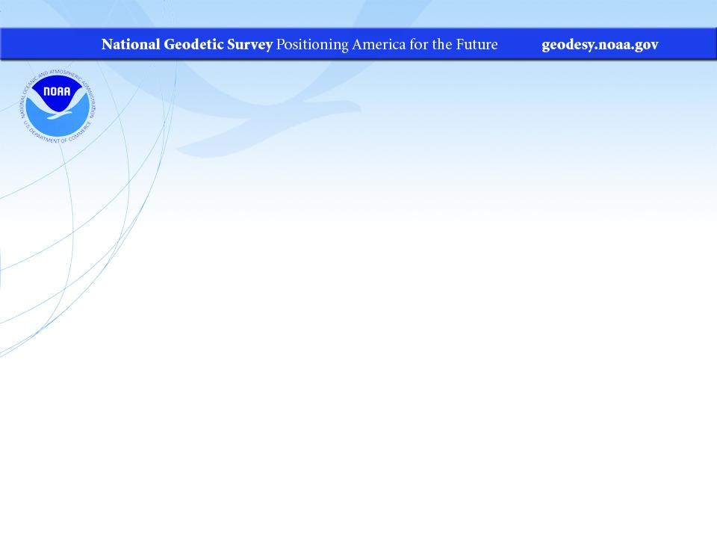
NGS Overview and New Datums
WVSPS Annual Convention
February 2022
Jeff Jalbrzikowski, P.S., GISP, CFS
Appalachian Regional Geodetic Advisor
jeff.jalbrzikowski@noaa.gov
240-988-5486

Slide 2
My Background
Licensed Surveyor in OH, PA, and WV (PS)
Certified GIS Professional (GISP)
Certified Floodplain Surveyor (CFS)
BS in Surveying & Mapping, Univ. of Akron
Came to NGS from USACE Pittsburgh District
  primary experience is engineering surveys, including structural deformation, hydrographic/bathymetric, terrestrial lidar, GNSS control, local/legacy datum resolution
Notes:
-joined the NGS almost 2 years ago now
-Spent 9 years prior with USACE on topo, geodetic control, layout, boundary, deformation, lidar, GIS implementation, hydrographic/bathymetric, and contracting aerial acquisitions
-previously survey intern (private sector & BLM), GIS tech., warehouse picker/packer, busboy…
-I like Honda motorcycles, have owned a Honda Shadow, a Victory Vegas, but my favorite bike was a Honda ST1100 that I sold after my frist kid was born

Slide 3
So… NAD83 and NAVD88 are scheduled to be replaced
Who’s nervous?
Who’s ready?
Who’s already working in ITRF?
Notes:
-soooo… NAD83 and NAVD88 are scheduled to be replaced by these new-fangled datums
CLICK
-who’s nervous
CLICK
-Who’s ready
CLICK
-Who’s already working in ITRF?
-alright, I appreciate your candid feedback, let’s get into it

Slide 4



Organizational Structure
  -Department of Commerce (DoC)
  (~47,000 employees)
  -National Oceanic and Atmospheric Administration (NOAA)
  -National Ocean Service (NOS)
  -National Geodetic Survey (NGS)
  (~175 employees)
Notes:
-We are the Federal Government’s oldest scientific agency.
-part of the Executive Branch
-I know it can seem kind of strange that NGS is part of the NOS, but the origins of NGS lie with the C&GS.
-we are a “Program Office” of the NOS
Survey of the Coast – 1807
Coast Survey – 1836
Coast and Geodetic Survey – 1878
NGS since 1970

Slide 5


Organizational Structure
We’re not USGS, we’re NGS
  -Department of Commerce (DoC)
  (~47,000 employees)
  -National Oceanic and Atmospheric Administration (NOAA)
  -National Ocean Service (NOS)
  -National Geodetic Survey (NGS)
  (~175 employees)
≠
Notes:
-as you can read my slide, I like to point that out because over my 2 years at NGS I’ve seen and heard this misunderstanding quite a bit
-don’t worry! it doesn’t offend us! and we do work closely with USGS, but we are separate agencies within totally different departments of the federal government

Slide 6
NGS Mission
To define, maintain and provide access to the National Spatial Reference System (NSRS) to meet our Nation’s economic, social, and environmental needs.
Notes:
NGS develops and maintains the National Spatial Reference System, a national coordinate system that provides the foundation for transportation, navigation, land record systems, mapping and charting efforts, and a multitude of scientific and engineering applications.
But there are many ancillary programs and products we will also discuss.

Slide 7
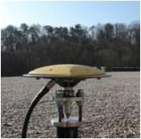
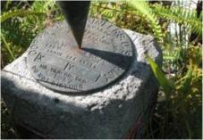

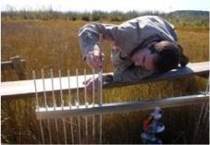
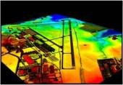
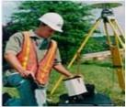
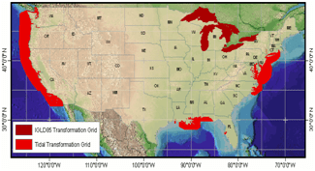

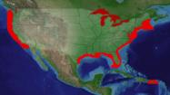
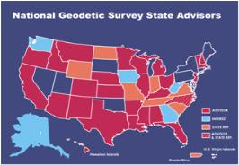
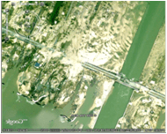

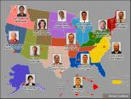
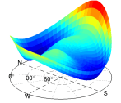
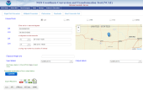

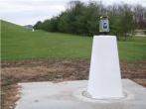
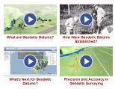
NGS Overview
Modernizing the NSRS
CORS
NHMP
GRAV-D
ECO
NGS Products and Services
ASP
OPUS
VDatum
Orbit Data
National Shoreline
Geodetic Advisors
ERI
Antenna Calibrations
NCAT
CUSP
CBL
Outreach
Notes:
This is not an exhaustive list of NGS programs

Slide 8
NGS Overview
Modernizing the NSRS
CORS
NHMP
GRAV-D
ECO
NGS Products and Services
ASP
OPUS
VDatum
Orbit Data
National Shoreline
Geodetic Advisors
ERI
Antenna Calibrations
NCAT
CUSP
CBL
Outreach
Notes:
This is not an exhaustive list of NGS programs

Slide 9
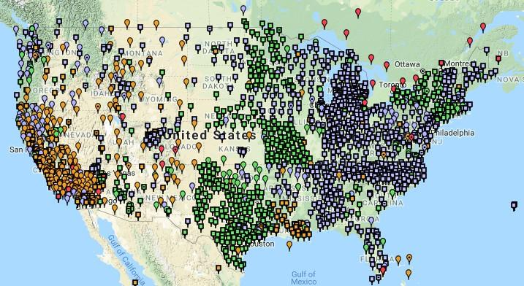
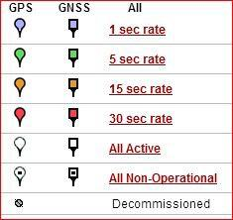
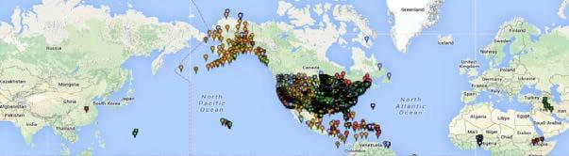
Continuously Operating Reference Station (CORS)
2000+ sites
~225 organizations
Notes:
-If you are not familiar with CORS, these are GNSS receivers that collect data 24/7, and the data is posted on NGS website for anyone to download.
-I’ve got some statistics up there, but the NOAA CORS Network is ever changing, with frequent additions and decommissionings

Slide 10
NOAA CORS Network (NCN)
2000+ sites
~225 organizations
Notes:
-I would like to point out we have a new, official name for the network you see represented on this map,
-The NOAA CORS Network, or NCN

Slide 11
NGS Overview
Modernizing the NSRS
CORS
NHMP
GRAV-D
ECO
NGS Products and Services
ASP
OPUS
VDatum
Orbit Data
National Shoreline
Geodetic Advisors
ERI
Antenna Calibrations
NCAT
CUSP
CBL
Outreach
Notes:
This is not an exhaustive list of NGS programs

Slide 12
National Height Modernization Program
“…the establishment of accurate, reliable heights using GNSS technology in conjunction with traditional leveling, gravity, and modern remote sensing information…”
propagation and long-term monitoring of control thru static GPS campaigns, GPS on BMs, and digital leveling
combined with gravity and lidar data
Notes:
*monitoring for subsidence

Slide 13
National Height Modernization Program
Funded partners
States engaged in HM without Federal funding
Spatial Reference Centers
Regional Leaders
Other funded partners
Notes:
This is an old graphic, but a decent illustration of where the activity was.

Slide 14
National Height Modernization Program
supports various Federal Programs
  FEMA: Flood Hazard Mapping Program (FIRM, etc.)
  USACE: Levee & Dam Safety Programs, etc.
  USGS: National Geospatial Program (3DEP, NHD+, etc.)
and countless non-Federal programs
still an active program but there have not been any grants in many years
Notes:
-still technically active program
…but really between this and the next slide these were what led to the new datums

Slide 15
NGS Overview
Modernizing the NSRS
CORS
NHMP
GRAV-D
ECO
NGS Products and Services
ASP
OPUS
VDatum
Orbit Data
National Shoreline
Geodetic Advisors
ERI
Antenna Calibrations
NCAT
CUSP
CBL
Outreach
Notes:
This is not an exhaustive list of NGS programs

Slide 16
Gravity for the Redefinition of the American Vertical Datum
Two major campaigns within GRAV-D
High-resolution snapshot of gravity
  airborne observations of relative gravity
  collected in as short of a timespan as is realistic
  full coverage
Low-resolution “movie” of gravity changes
  on-the-ground observations of absolute gravity
  periodic or episodic; repeat every ___ years
  large spacing, a few per state
Notes:
-airborne gravimetry functions as the bridge for blending terrestrial/surface gravity data with satellite gravity data
**-the airborne snapshot is like a one-time deal
-airborne estimated cost of ~$39 million
-satellite data is global, airborne data is continental, terrestrial/surface is spot-shots or gridded
GRAV-D is one of the programs that will make the NSRS modernization possible, the NAPGD2022 relies on it. More on NAPGD2022 later.

Slide 17
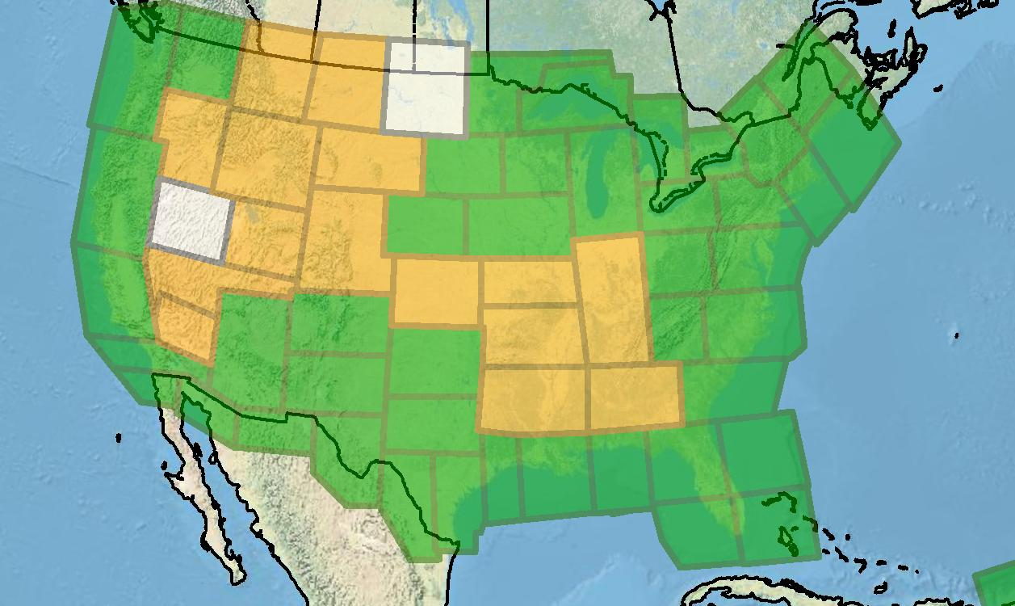
Gravity for the Redefinition of the American Vertical Datum
Green = Complete
Blue = In Processing
Yellow = Underway
White = Planned
10 km data lines
70 km cross lines
20,000 ft altitude
230 kt flight speed
As of DEC2019:
81% complete
Notes:
230 kts = 265 mph
-can’t say they’re “ahead of schedule” as they had been for quite some time, but it was no fault of the team
-they got stuck for 3 weeks due to hail damage of one of the aircrafts

Slide 18
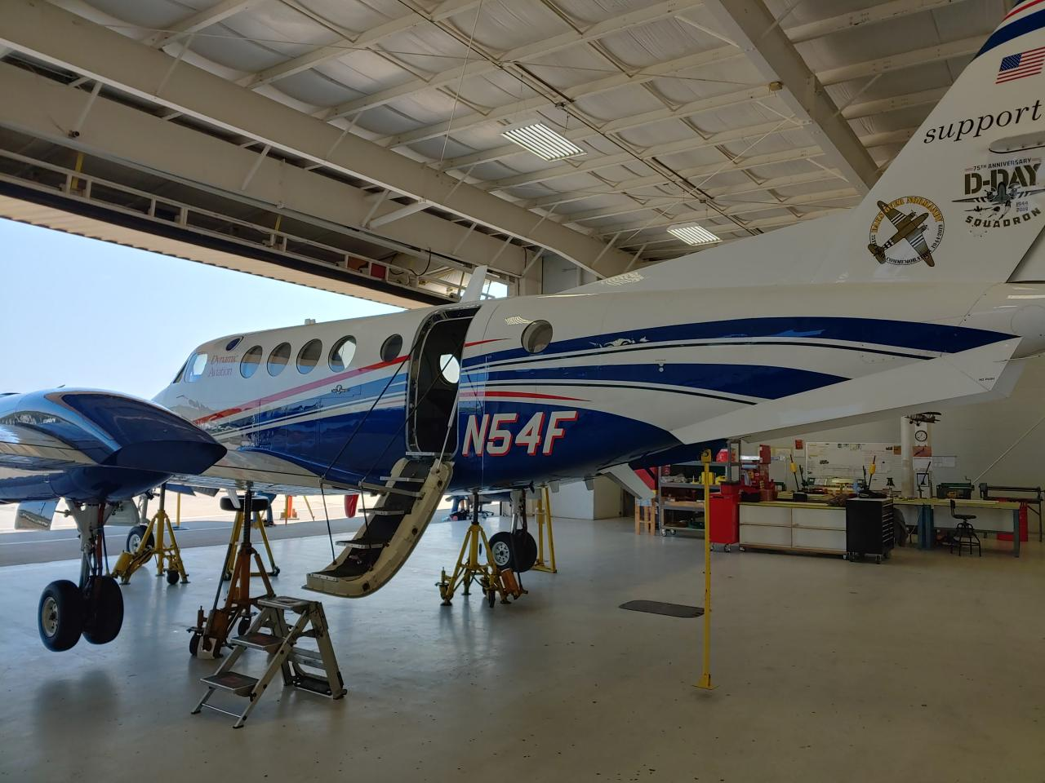
Dynamic Aviation’s King Air 200T
Notes:
That’s the name of the air services contractor, Dynamic Aviation.

Slide 19

NOAA’s Gulfstream IV-SP
Notes:
NOAA’s Gulfstream IV-SP, which is primarily a so-called “hurricane hunter” that you may have seen on social media or the news.

Slide 20
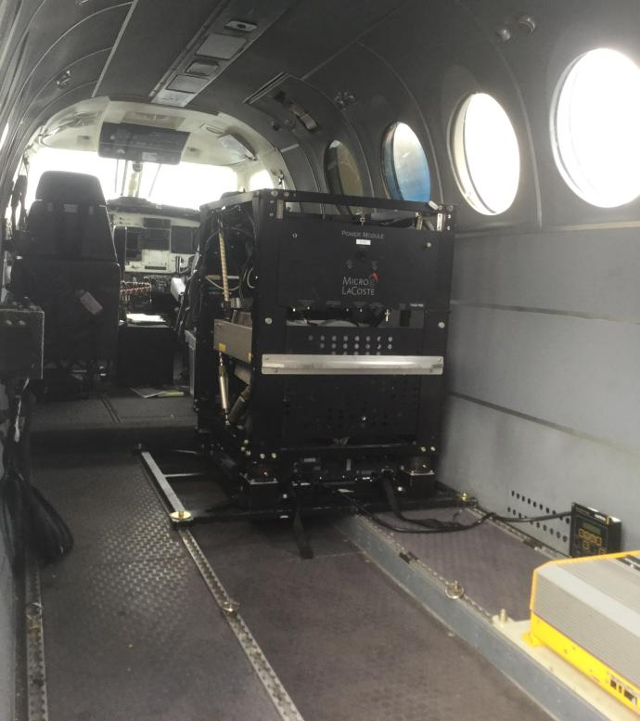
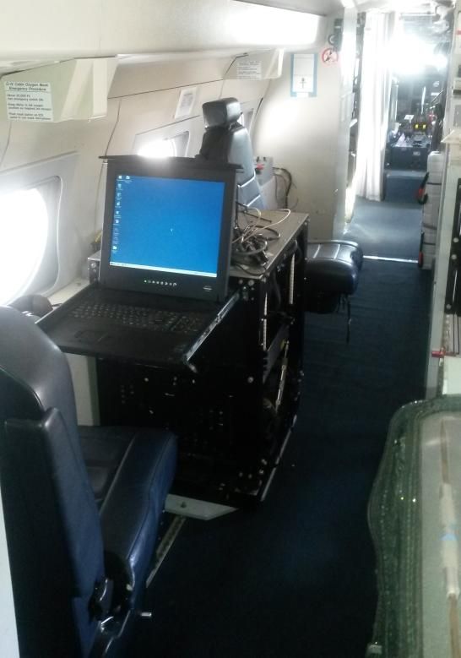
Gravimeters in the Aircraft
in the King Air
in the Gulfstream IV
Notes:
On the left is a TAGS gravimeter in the King Air and on the right is another one shown mounted in the Gulfstream IV

Slide 21
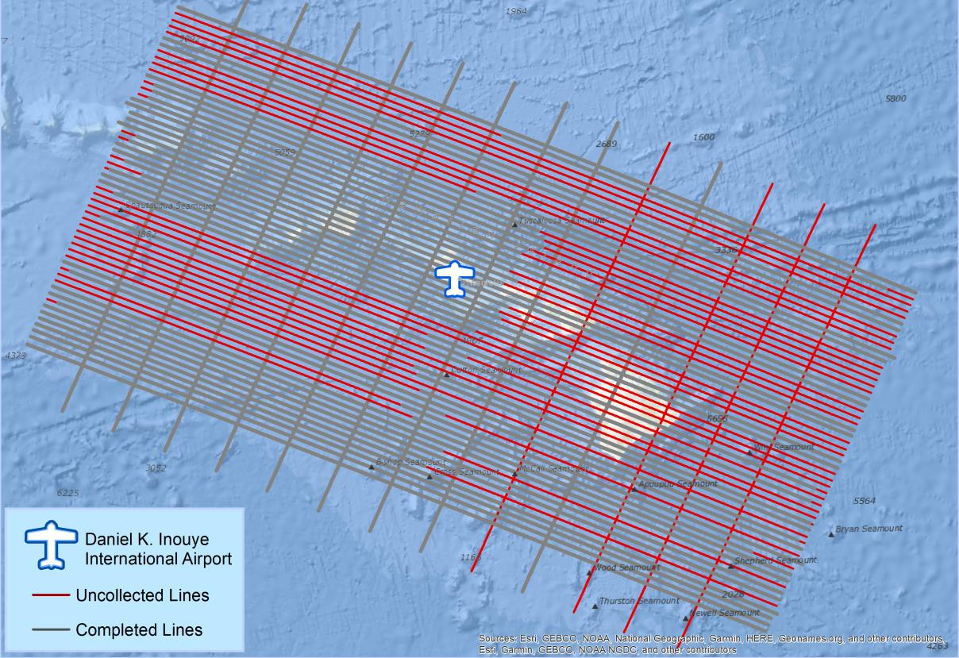
What does a flight plan look like?
Notes:
So just for scale, there’s an overlay of the flight plan for Hawaii

Slide 22
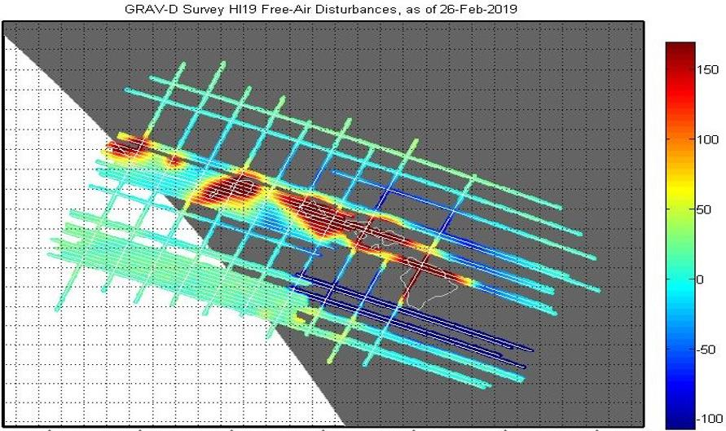
What does processed data look like?
mGal
mGal = milligal
Notes:
This graphic shows the difference between Observed gravity and theoretical (normal) gravity if the earth was actually shaped like a homogeneously dense ellipsoid.
What’s a milligal? Well, it’s a thousandth of a gal of course! It’s a unit of acceleration, 1 centimeter per second squared (1 cm/s²), named after Galileo.

Slide 23
NGS Overview
Modernizing the NSRS
CORS
NHMP
GRAV-D
ECO
NGS Products and Services
ASP
OPUS
VDatum
Orbit Data
National Shoreline
Geodetic Advisors
ERI
Antenna Calibrations
NCAT
CUSP
CBL
Outreach
Notes:
This is not an exhaustive list of NGS programs

Slide 24
Online Positioning User Service
  OPUS Rapid Static (OPUS-RS)
      dual frequency receiver data
      static sessions only
      30 seconds epoch rate (aka recording interval)
      15 minutes to 2 hours of GPS data
  OPUS Static (OPUS-S)
      same requirements as above
      2 to 48 hours of GPS data
  OPUS Projects (OP)
      adds session processing and network adjustment
      training by NGS required; typically 12 hours
      upload to OPUS with a “Project ID” keyed in Options
Notes:
Currently 4 types of OPUS.
*OPUS only supports GPS constellation data, last I talked to the OPUS developer the plan for incorporation of other constellations is Jan 2021.
Rapid Static – files uploaded that are 15 minutes to 2 hours in duration are processed using an NGS software called “RSGPS”
Static - files that are 2 to 48 hours in duration are processed using an NGS software called PAGES Your coordinates are the average of three independent, single-baseline solutions,
OP and Beta OP - these are not a different processing software, just a way to tie multiple OPUS-Static solutions together and use least squares methods to adjust them all as a coherent network
**the Beta serves as a testing bed for the developers to roll out new features or improvements and get feedback from users

Slide 25
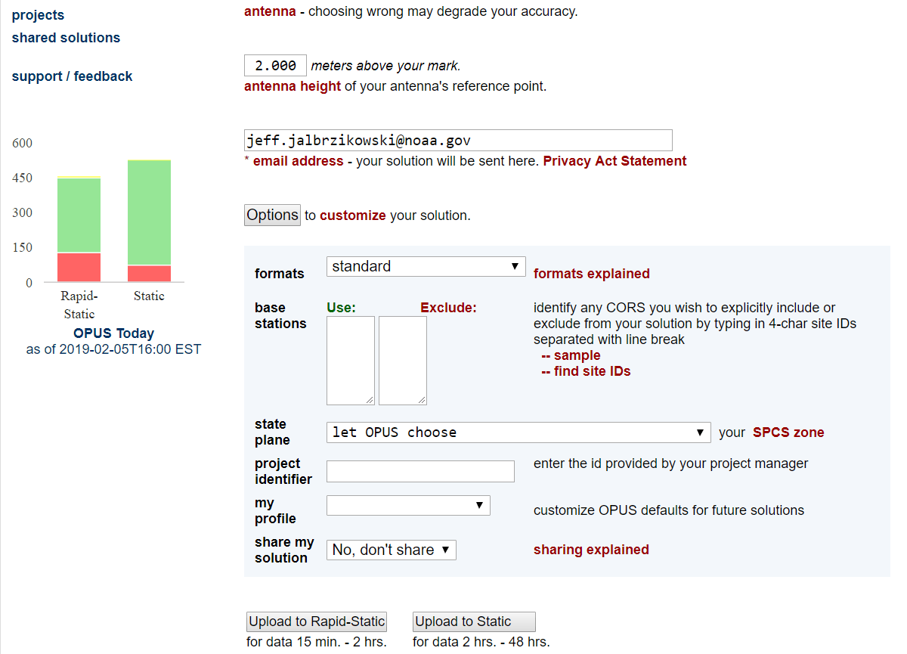
a note on OPUS “my profile”
be careful!
Notes:
-be careful when using this, many folks experience their profile options being used even though they don’t select it
**-right above that is where you’d key in a Project ID to send a Solution to OPUS projects
-talk more about that tomorrow, great product

Slide 26
NGS Overview
Modernizing the NSRS
CORS
NHMP
GRAV-D
ECO
NGS Products and Services
ASP
OPUS
VDatum
Orbit Data
National Shoreline
Geodetic Advisors
ERI
Antenna Calibrations
NCAT
CUSP
CBL
Outreach
Notes:
This is not an exhaustive list of NGS programs

Slide 27
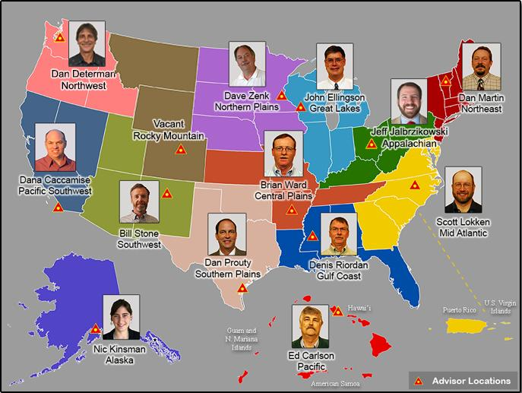
https://www.ngs.noaa.gov/ADVISORS/
Notes:
- 14 Regional Advisors, we’ve transitioned from a State-based to a Regional Program
-if you know Ross Mackay, he is our Chief Advisor, I report to him…
**ya know, I don’t know why they don’t make him put his photo up here
-we do have one vacant advisor position, that was recently advertised and John up there in Wisconsin is officially retired in oh… 18 days

Slide 28
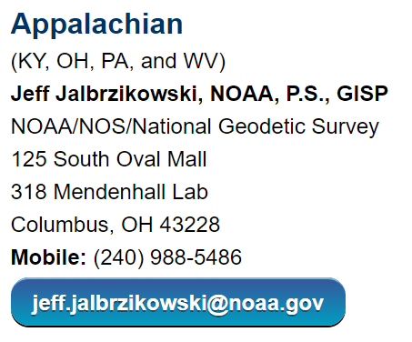
Regional Geodetic Advisor Program
www.ngs.noaa.gov/ADVISORS/
query any major search engine: “ngs advisors”
Notes:
Transitioned from a State to a Regional program in 2016. States no longer provide funding if they desire to have an Advisor, but NGS reorganized the personnel to support regions rather than single States.
Kentucky has appointed a State Geodetic Coordinator

Slide 29
State Geodetic Coordinators
Not an NGS employee, rather:
  State/Commonwealth government
    RTN manager
    DOT survey lead
    Geospatial Information Officer
  Academia
    Professor or Program Director
  Professional society representative
Serves as a liaison between the State’s geospatial community and the NGS
Notes:
-The State Geodetic Coordinator is not employed by NGS and is typically assigned by a state government agency or university.
-West Virginia has not requested a State Geodetic Coordinator

Slide 30
NGS Overview
Modernizing the NSRS
CORS
NHMP
GRAV-D
ECO
NGS Products and Services
ASP
OPUS
VDatum
Orbit Data
National Shoreline
Geodetic Advisors
ERI
Antenna Calibrations
NCAT
CUSP
CBL
Outreach
Notes:
This is not an exhaustive list of NGS programs

Slide 31
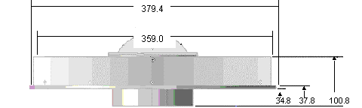
Phase Center Offset - conceptual
Orange dot = mean point of signal reception
Blue dot = Antenna Reference Point (ARP)
Red line = Phase Center Offset (PCO)
Notes:
-the ENU values of that red line, which is 3 dimensional, is different per antenna model
-this diagram is an oversimplification of the

Slide 32
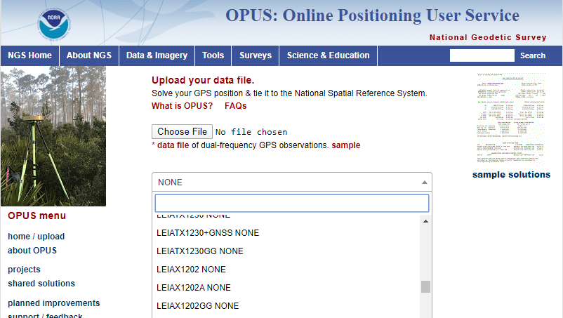
Phase Center Offset
The PCO is one reason it is important to select the correct antenna for OPUS upload!
choose
carefully!
if you have questions… drop me a line
Notes:
-this why it is important to select the correct antenna when using OPUS
-there is another part of the Antenna Calibration, the Phase Center Variation… but that’s a whole other discussion so let’s move on to a video!

Slide 33
NGS Overview
Modernizing the NSRS
CORS
NHMP
GRAV-D
ECO
NGS Products and Services
ASP
OPUS
VDatum
Orbit Data
National Shoreline
Geodetic Advisors
ERI
Antenna Calibrations
NCAT
CUSP
CBL
Outreach
Notes:
This is not an exhaustive list of NGS programs

Slide 34
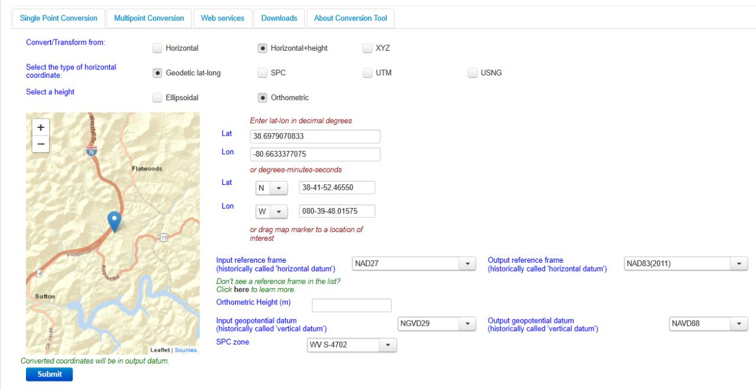
NGS Coordinate Conversion And Transformation Tool (NCAT)
Notes:
NCAT includes the functionality of previous NGS tools:
NADCON 5.0
XYZWIN 2.0
UTMS 2.1
SPC83 2.1
USNG 2.3
Includes error estimate of transformation per point.
Available as the single-point graphic seen here, multi-point upload/download, as a downloadable executable fie to run from the DOS prompt, and as web services for inclusion in your own
It’s a great tool. Anyone using

Slide 35
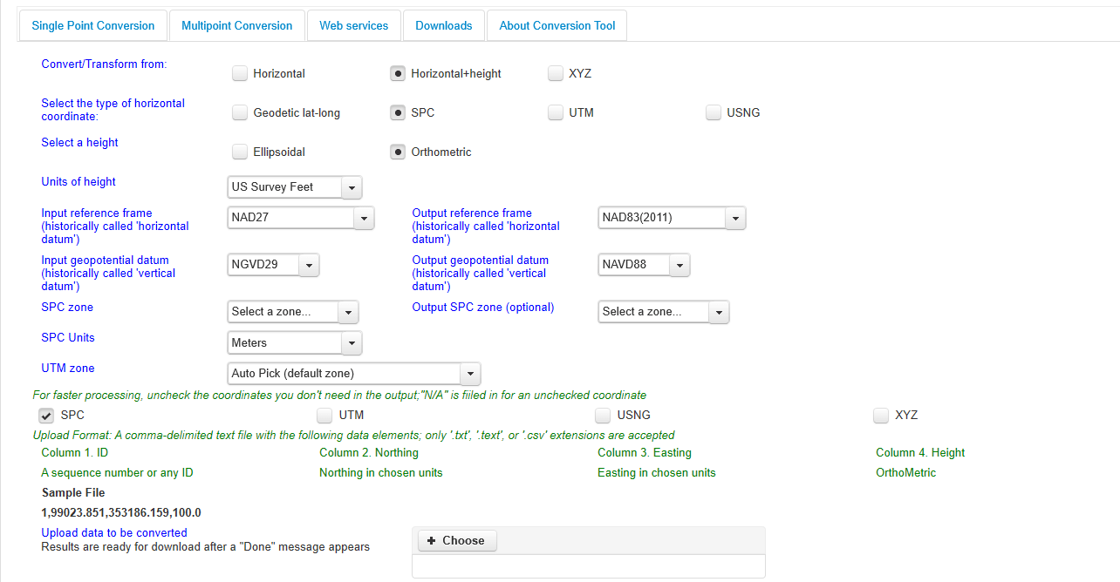
NGS Coordinate Conversion And Transformation Tool (NCAT)
Notes:
NCAT includes the functionality of previous NGS tools:
NADCON 5.0
XYZWIN 2.0
UTMS 2.1
SPC83 2.1
USNG 2.3
Includes error estimate of transformation per point.
Available as the single-point graphic seen here, multi-point upload/download, as a downloadable executable fie to run from the DOS prompt, and as web services for inclusion in your own
It’s a great tool. Anyone using

Slide 36
NGS Overview
Modernizing the NSRS
CORS
NHMP
GRAV-D
ECO
NGS Products and Services
ASP
OPUS
VDatum
Orbit Data
National Shoreline
Geodetic Advisors
ERI
Antenna Calibrations
NCAT
CUSP
CBL
Outreach
Notes:
This is not an exhaustive list of NGS programs

Slide 37
Calibration Base Lines - CBL
Three types of CBL defined by NGS
  Primary CBL (PCBL): in Woodford, VA at NGS TTC; it is open for use to organizations like the PLSO
  Federal CBL (FCBL): established with EDM checked at the NGS PCBL and IAW NOAA TM NGS-8
      2 in West Virginia: Marshall County Airport, Byrd L&D
  Cooperative CBL (CCBL): established with EDM checked on an FCBL and IAW that same NGS-8 manual
Notes:
-PCBL is open for use during typical M-F duty hours. Although an appointment is not required, I would recommend calling or emailing before planning a trip.
-2 total FCBLs in WV, one in Marshall County and one at Richard C Byrd Locks & Dam.

Slide 38
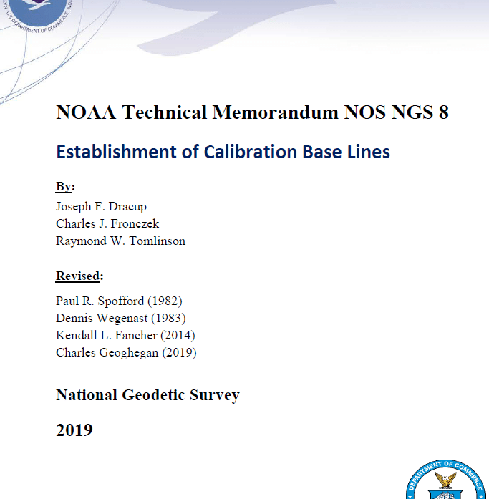
Calibration Base Lines - CBL
NGS commitment to the CBL Program:
  A minimum of one FCBL per State
  Establishment procedures document
  Public access to the CBL database
  Software to process your observations
  Verification and re-measurement data review
  Technical support (Advisors or other personnel)
https://www.ngs.noaa.gov/CBLINES/
Notes:
-we just published a new TM on establishing CBLs this past July!
-don’t ask me what’s new right now, because I can’t remember off the top of my head
-but we’re committed to the program even though some regions indicate extremely low use of the CBLs

Slide 39
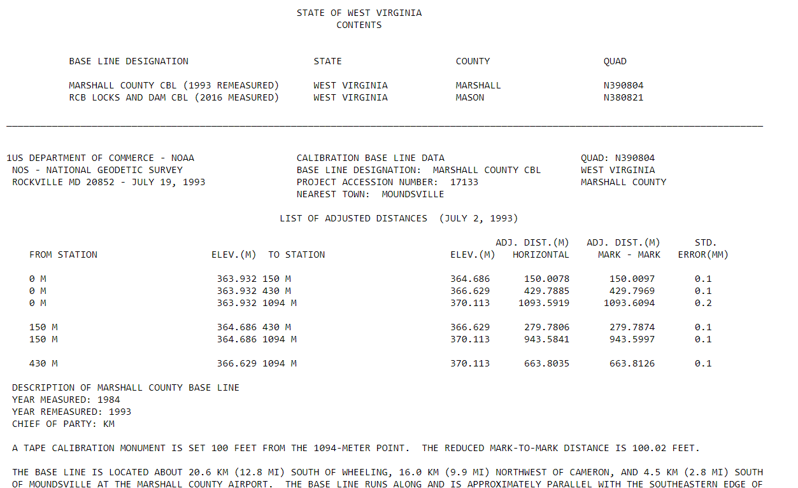
CBL Datasheets
Notes:
-these CBL datasheets, downloaded as a statewide list in ASCII format, were the longtime only way to retrieve CBL info
CLICK

Slide 40
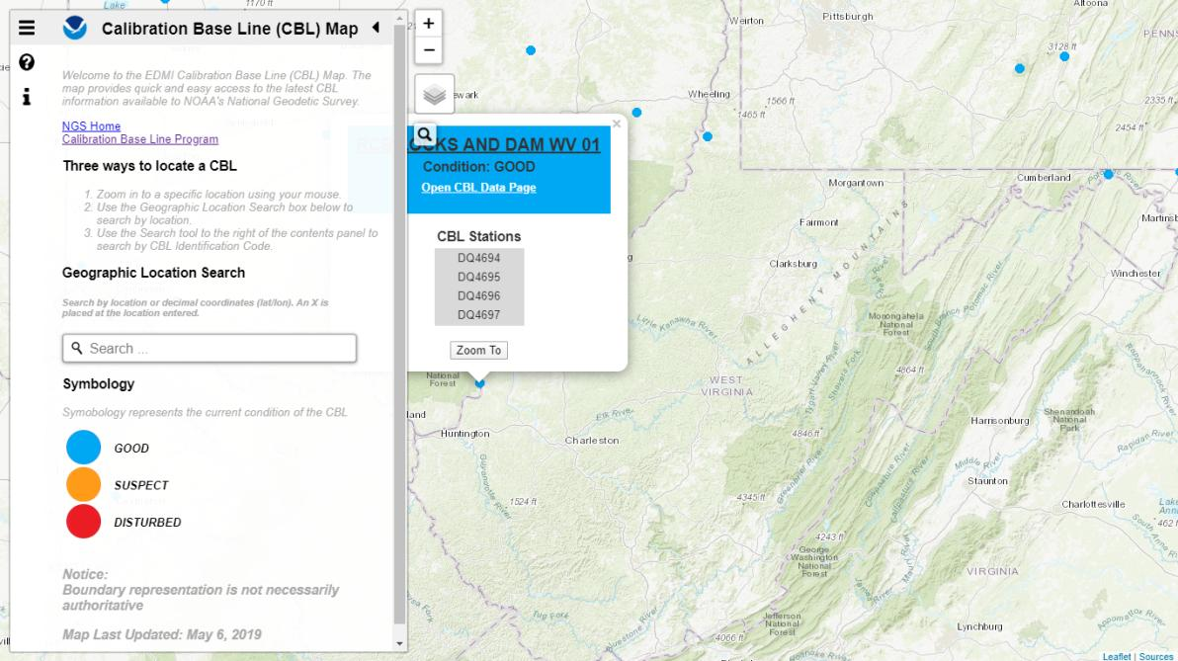
Beta CBL Map Viewer
https://www.ngs.noaa.gov/CBLINES/
Notes:
-But now we have this slick map navigation interface!
-it’s linked right now from our CBL page
-as I wrap up my discussion of CBLs: who has used a CBL in the past year?
-… 5 years?
-… ever?

Slide 41
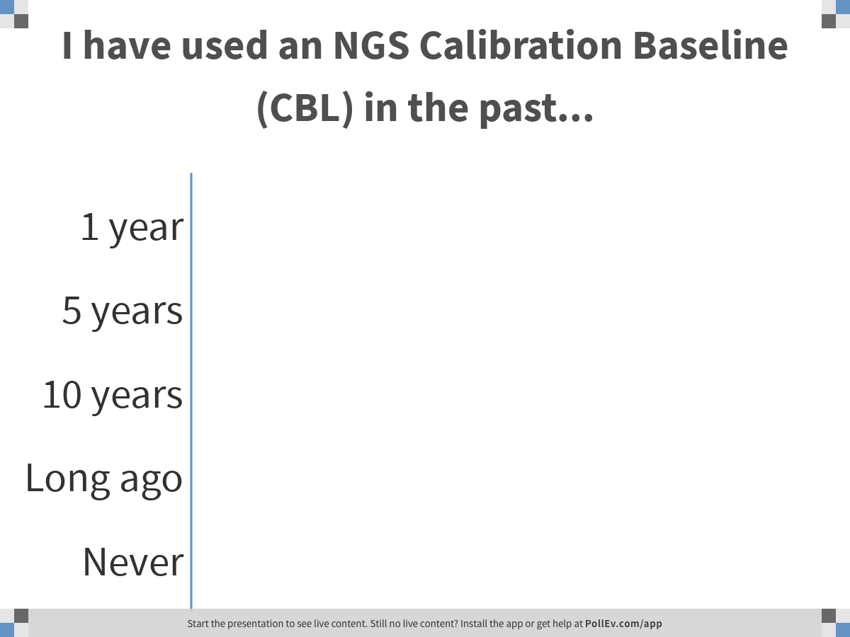
Notes:
Poll Title: I have used an NGS Calibration Baseline (CBL) in the past...
https://www.polleverywhere.com/multiple_choice_polls/dhyINY2hWjQ8bSNmxW7nC

Slide 42
NGS Overview
Modernizing the NSRS
CORS
NHMP
GRAV-D
ECO
NGS Products and Services
ASP
OPUS
VDatum
Orbit Data
National Shoreline
Geodetic Advisors
ERI
Antenna Calibrations
NCAT
CUSP
CBL
Outreach
Notes:
This is not an exhaustive list of NGS programs

Slide 43
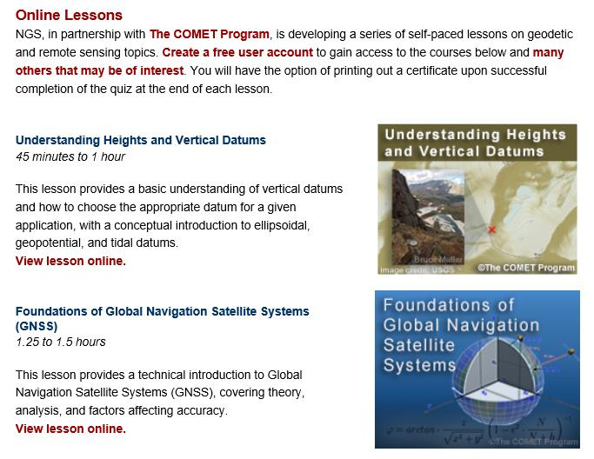
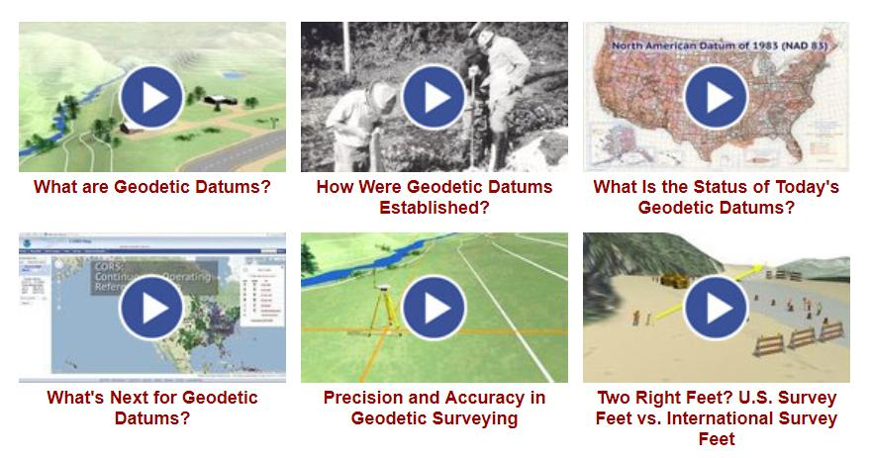
Outreach & Educational Resources
Notes:
-Just a few clicks from our homepage… Let’s take a quick look.
--www.ngs.noaa.gov
-up on top you click Science & Education→Video Library
-once you get there you’ve got 12 videos on geodesy all under 5min
-Now, to go a little further, and get deeper in, on that same page you’ll click Online Lessons
within the those lessons we have everything from 5 minute videos to hour long quiz-based lessons.
-I believe we have a new lesson coming to that section this year, but I’m not positive

Slide 44
NGS Mission
To define, maintain and provide access to the National Spatial Reference System (NSRS) to meet our Nation’s economic, social, and environmental needs.
Notes:
REPEAT SLIDE HERE: REVISITING THE NGS MISSION before we delve deeper into NSRS Modernization
NGS develops and maintains the National Spatial Reference System, a national coordinate system that provides the foundation for transportation, navigation, land record systems, mapping and charting efforts, and a multitude of scientific and engineering applications.
But there are many ancillary programs and products we will also discuss.

Slide 45
National Spatial Reference System (NSRS)
A consistent coordinate system that defines
latitude
longitude
height
scale
orientation
gravity
throughout the United States.
…and their time variants
Notes:
Let’s talk about the NSRS some more before we move on to looking at all of NGS.
This system defines position (latitude, longitude, and elevation), distances and directions between points, strength and direction of gravity (no, it is not simply “straight down”), shoreline, and their “time variants”.
Or how these change over time.
Some documents will reference the National Shoreline as a component of the NSRS., we’ll briefly look at that later.

Slide 46
National Spatial Reference System (NSRS)
These items ARE part of the NSRS
Horizontal Datums (aka Geometric Reference Frames) | Vertical Datums | Great Lakes Datums | Geoid Models | Transformations and Conversions
NAD83 | NAVD88 | IGLD85 | GEOID18 | NADCON
NAD27 | NGVD29 | IGLD55 | GEOID12B | VERTCON
USSD | VIVD09 |  | GEOID09
 | GUVD04 |  | GEOID06 | SPCS83
 | NMVD03 |  | GEOID03 | SPCS27
 | ASVD02 |  | GEOID99
 | PRVD02 |  | GEOID96
 |  |  | ALASKA94
 |  |  | GEOID93
 |  |  | GEOID90
Notes:
Note the US Standard Datum, anyone done any work in the old USSD?
Good example highlighting that the term “NSRS” is used to encompass all historic datums of NGS and its predecessors.
Saw one project during my work with the USACE, in Johnstown, PA, that had original survey records in what turned out to be US Standard Datum.
All those vertical datums below NGVD29, I greyed them out slightly because those are all Caribbean and Pacific Island datums, so in CONUS it’s just those two that you hopefully already use… and hopefully are mostly using NAVD88.

Slide 47
National Spatial Reference System (NSRS)
These items are NOT part of the NSRS
Horizontal Datums (aka Geometric Reference Frames) | Vertical Datums | Geoid Models | Transformations and Conversions
WGS84 | IHRS (by IAG) | OSU91A | CORPSCON
WGS72 |  | EGM96 | Appendix B.6 of DMA TR 8350.2 (WGS 84)
ITRF (Intl. Terrestrial Reference Frame by IERS) |  | EGM2008 | Oregon Coordinate Reference System (ORCS)
IGS (Intl. GNSS Service reference frame) |  |  | The Kansas Regional Coordinate System
Hyperlink to ITRF station map
Notes:
WGS is a DoD system. Yes, that is the system native to the Global Positioning System, but it isn’t true that you “have to” work in WGS84 to get the most accurate coordinates. I’ve heard people say that.
The Intl. Terrestrial Ref. Frame is a product of the Intl. Earth Rotation and Reference Systems Service. More on that later.
The Intl. GNSS Service Ref. Frame is, well, it’s a reference frame based on that ITRF just mentioned, but with improvements, like a more dense network of stations and is more easily accessible.
The IHRS is an International Height Reference System, which is a product that was formally adopted by the IAG (Intl. Association of Geodesy) in 2015. Not an NGS product but folks from NGS were involved.
OSU geoid, it was a research thing and I don’t know much about it.
The Earth Gravity Models are DoD products just like the WGS products, used around the world by our Nation’s military (I used EGM based height sin Iraq and Afghanistan)… but are not at all tied to NSRS geoids. Future DoD geoid models may have a closer tie to future NGS geoid models.
CorpsCon. Ah yes, Corpscon. Everyone loves Corpscon, unfortunately as convenient as it is it isn’t truly an NGS product and has not been updated in well, a long time, and there are no plans to update it in the future. (confirmed via phone call to AGC personnel on 20FEB2019)
I like Mark Huber, awesome dude, I spent some time with him surveying on some god-forsaken island in the Indian Ocean, but the USACE doesn’t seem to want to support him in funding an update to Corpscon. So it is what it is.
Those regional coordinates systems, like the ORCS in Oregon and that one in Kansas, although they have rigorously defined transformations to the NSRS (which is great, they did it right) they are not part of the NSRS.

Slide 48
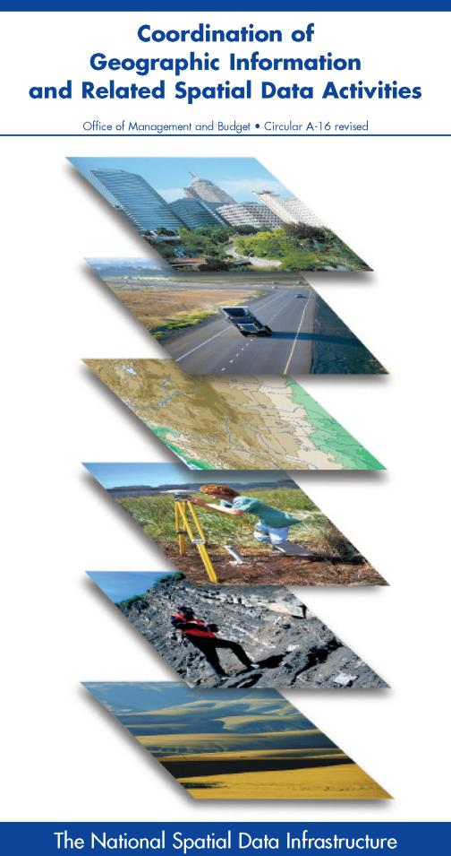
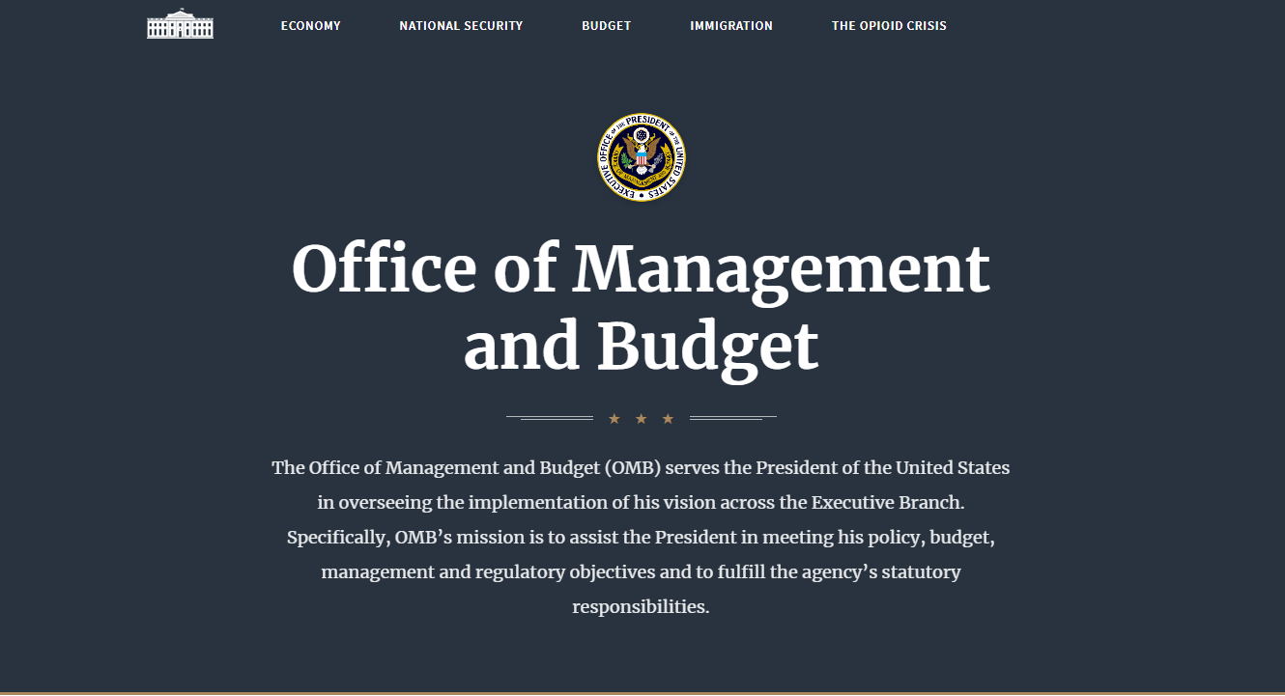
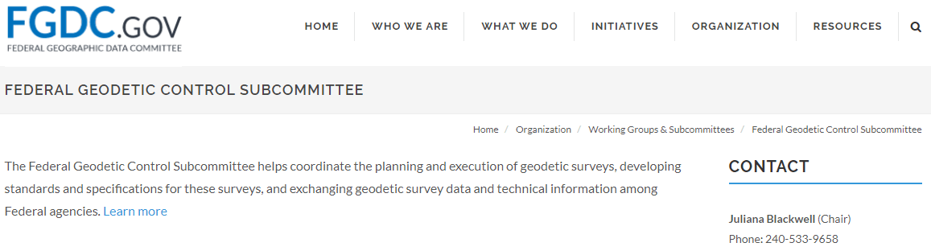

NSRS … do I have to use it?
OMB Circular A-16
  requires all Federal civilian agencies to utilize geodetic control for their geospatial activities
  places NOAA in responsible charge of that control
  NGS has defined that control as the NSRS
  FGCS has issued requirements, via FRNs, to reference data to the most recent components of the NSRS
            1989 FRN designated NAD 83
            1993 FRN designated NAVD 88
Hyperlink to NAVD88 FRN
Hyperlink to NAD83 FRN
Notes:
-This is an acronym heavy slide, not much I can do, that’s the government way!
-What’s the OMB Jeff?
-It’s an agency within the Executive Office of the President, they too are part of the Executive Branch of Gov’t just like us at NGS within the Dept of Commerce
-The OMB has published this document, “Circular A-16”
CLICK
-you can see the title there at the top, perhaps you’ve seen this cover before
*-those Federal folks in attendance, I sure hope you have!-*
-the overarching goal of A-16 is preventing the waste of Gov’t funds on duplication of geospatial efforts
CLICK
There’s four really important takeaways from OMB A-16.
1 - it’s Federal policy at one of the highest levels that Federal agencies (civilian agencies not the military/DoD/Intelligence) must utilize geodetic control for all geospatial activities
*Why not DoD, NGA, and the Intelligence agencies? Well, they have their own DoD Directive that requires them to tie everything to WGS84 and EGM08.*
2 – A-16 defines NOAA as being in responsible charge of geodetic control
3 - NOAA dictates NGS as the lead agency and NGS defines that control as “the NSRS” (term adopted in 1994). Why create that term? One phrase to outlive trends & technology, reduce the need to keep spending time and money re-writing policy and documentation every time we create a new datum name.
CLICK
4 – The FGCS…what’s that?, the Federal Geodetic Control Subcommittee, which is a part of the FGDC, the Federal Geographic Data Committee, and the best comparison I can make to the everyday is that it’s the organization for Federal agencies that mirrors what NSPS is to PSLS.
-…anyway, the FGCS has issued requirements via FRNs, or Federal Register Notices
CLICK
-…for agencies to reference all their geospatial data to the most recent components of the NSRS
CLICK

Slide 49
NSRS … do I have to use it?
Not necessarily, but it’s a great idea!
States may mandate use (does West Virginia?)
All Federal spatial data and GIS activities financed directly or indirectly, in whole or in part, by Federal funds are required to be tied to the NSRS
If you want to get involved in survey contracting with the Federal Government it’s a necessity
Notes:
-We give you efficient ways to check the accuracy of GNSS surveys, via the CORS and OPUS.
-but we’re not the datum police
-Aerial imagery overlays, doesn’t it make you feel good when a topo lines up pretty well with statewide imagery & lidar?
**-I have seen information indicating that FEMA/USGS will be flying statewide lidar sometime in the next year, all that 3DEP data will be in SPCS, tied to the NSRS via CORS
CLICK
-interesting tidbit I picked up from a meeting on Friday: for anyone who’s been paying attention to the politics & bureaucracy of government geospatial efforts, the Geospatial Data Act of 2018 includes provisions for “repercussions” for agencies who do not comply with this requirement
**-important though that will not be enforced until 5 years after the GDA, so late 2023
PREPARE NOW!

Slide 50
Not just new datums…
  NSRS Modernization
Replace NAD83
Replace NAVD88
Re-invent Bluebooking
Improve Geodetic Toolkit
Better Surveying Methods
Blueprint for 2022, Part 1
Blueprint for 2022, Part 2
Blueprint for 2022, Part 3
Notes:
-so you’ve probably seen that phrase that I have front and center here, NSRS Modernization
-that’s the blanket term we use to refer to not just the new datums but other updates
-another phrase I want to mention are these “Blueprints for 2022”
-just about everything I cover today is mentioned in one of the Blueprints
-the Geodetic Toolkit, what’s that? another term that just refers to all those softwares NGS provides, like PAGES, ADJUST, etc.
-better methods – updating manuals like NGS-58 and 59 for example

Slide 51

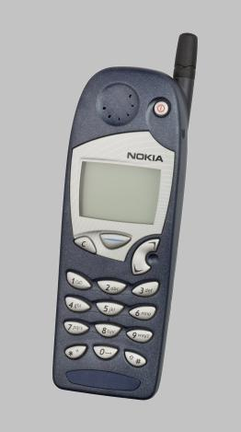
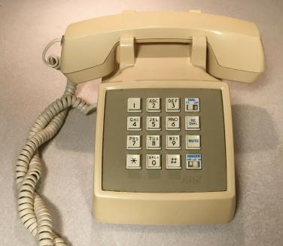
Evolution of the NSRS
NAD27
NAD83 (1986)
NAD83 (2011)
Notes:
NAD27
-like the dial of a rotary phone, you were out there spinning a theodolite around, running resections and solar shots to get a position… am I right?
-and you’d get a position, but it might not be that great, and if you set a mark then everybody wanted your data, like sharing the old party lines
NAD83(1986)
-we brought in a more accurate network, it was easier to access
-you were using an early total station and data collector, just like pushing the buttons on a touchtone phone
NAD83(2007/2011)
-the network was maturing with more CORS just like the cell towers
-just as cell phones were becoming ubiquitous, so too was the use of OPUS

Slide 52
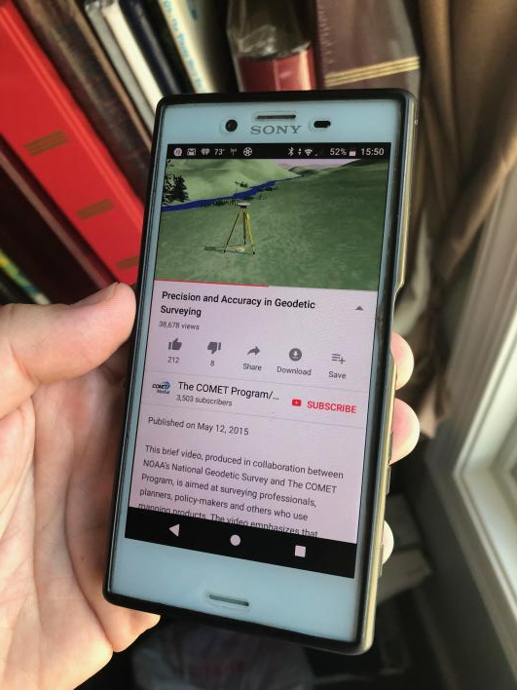
Modernized NSRS is our “smartphone”
You resisted it for a while…
It was a little cumbersome to get used to…
But soon you were hooked!
Notes:
-so if you think about the NSRS that way, then NATRF2022 is our smartphone, in more ways than one, right?
-some folks were excited to get a smartphone, but some (show of hands?) were reluctant to embrace the idea… kind of like this whole NSRS Modernization deal huh?
-some of us are excited for this development and some folks, well some are ready to retire as soon as NGS rolls this out, am I right?

Slide 53
Two Major Components of
Modernized NSRS
Geometric (LLh)
Latitude, Longitude, Ellipsoid Height
Geopotential (H)
Orthometric Height
Notes:
-geometric component is latitude, longitude, and ellipsoid height
-geopotential component is combined with the geometric components to calculate an ortho height or capital H

Slide 54
North American Datum
of 1983
NAD83
will be replaced by

Slide 55
North American Terrestrial Reference Frame of 2022
NATRF2022
(pronounced: nat-ref)

Slide 56
Reference Frame ≈ Datum
Reference Frame is a more scientifically appropriate way of saying “datum”
could be debated that “datum” was misused in NAD83(2011)
you will continue to see NGS use the phrase “New Datums” for 2022
Notes:
-for sanity and brevity’s sake…
-could be debated that “datum” was misused for many years in ellipsoidal coordinates
-even though the geometric/horizontal portion will officially be titled a “reference frame”

Slide 57
Datum Defined
The adopted standard latitude and longitude of a given station, together with the adopted standard azimuth of a line from that station.
e.g. Meade’s Ranch and it’s azimuth mark, Waldo
Source: Proceedings of the 14th General Conference of the International Geodetic Association (IAG) - ”Report on Geodetic Operations in the United States”, O.H. Tittmann, Superintendent of the USC&GS
Notes:
--Also table/podium example

Slide 58
Reference Frame Defined
A point of view or a ‘frame of reference’.
If your reference frame is North America, you are standing somewhere within North America, seeing how other places move from your point of view.
Notes:
--Also table/podium example

Slide 59
Why replace NAD83?
Main driver: Global Navigation Satellite System (GNSS)
ACCESS
  GNSS equipment is fast, inexpensive, reliable
  Reduces reliance on physical control marks
ACCURACY
  Insensitive to distance-dependent errors
  Immune to instability; active control via CORS
CONSISTENCY
Eliminates systematic errors in current datums
Aligned with global reference frame
Notes:
GNSS is a more generic term that encompasses the American GPS constellation and all other positioning satellite constellations
ACCESS
-relying on ”passive control” network that is thinning in density every day
-when you go out to recover an old BM, how often does it end up in a nearby, useful location? no need in the modernized NSRS environment, OPUS will be your access
ACCURACY – proximity to the “true” value, remember PRECISION is repeatability (we’ve already nailed that)
-insensitive to distance dependent errors, will not include triangulation or leveling methods
-the primary monuments, the CORS, are tracking their own movement so there’s a reduced the need for you to wonder if that monument has been disturbed or subsided
CONSISTENCY
-eliminating systematic errors in current datums, primarily the “tilt” in NAVD88 and the misalignment of the origin point of NAD83
-aligned with the global reference frames of our international UN/IUG partners
-the vertical datum will be globally aligned, not continental, thus the geometric and vertical framework are tightly coupled

Slide 60
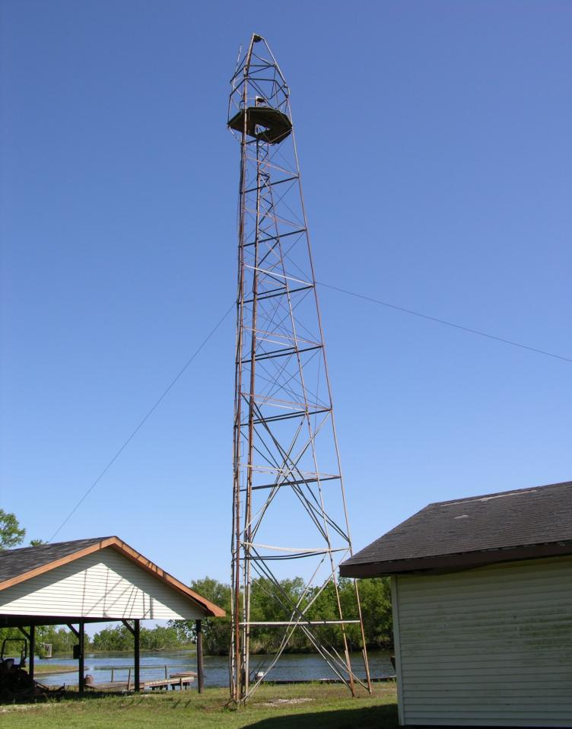
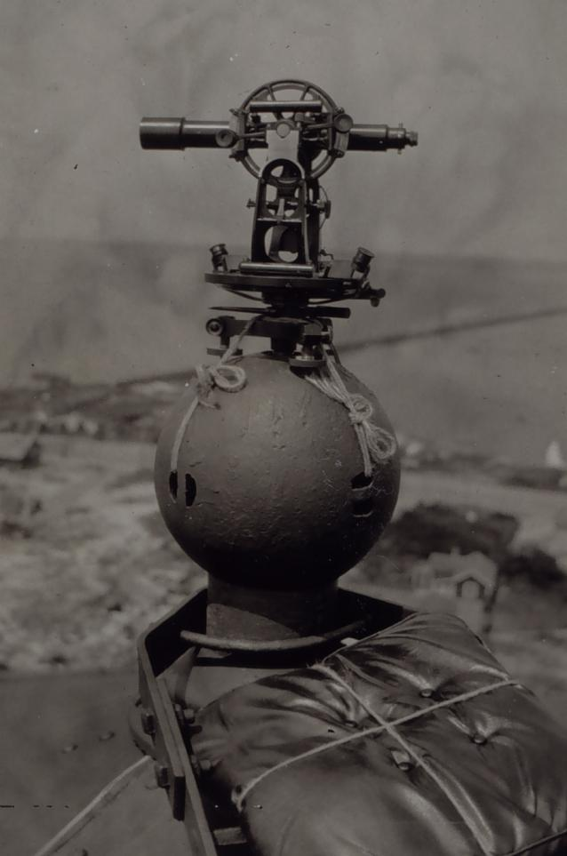
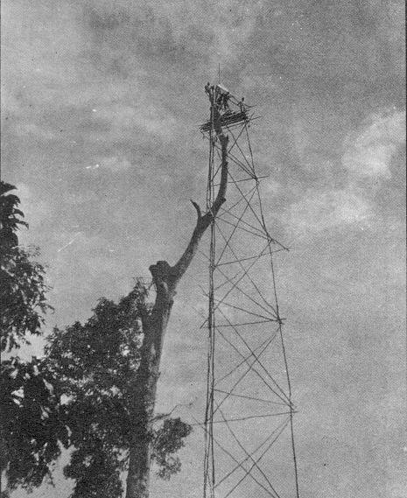
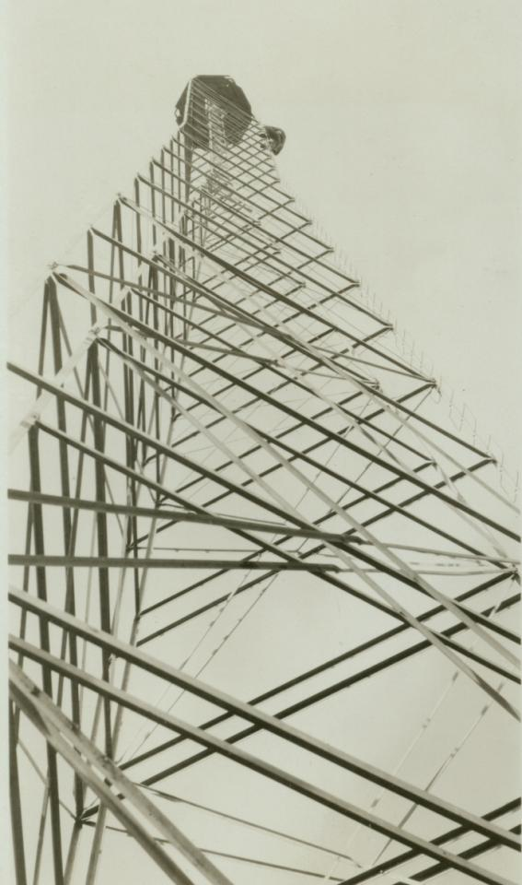
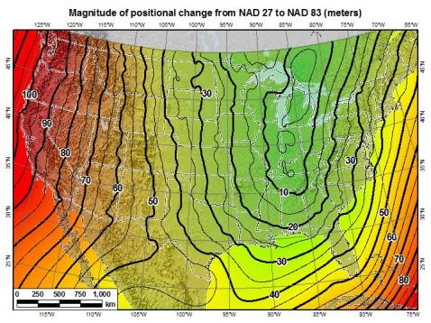
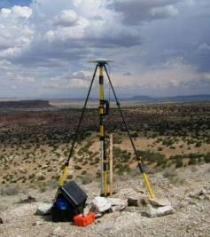
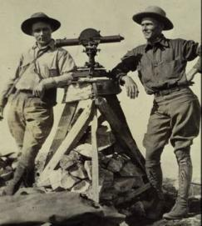
A very brief history of U.S. horizontal & geometric datums
GNSS
triangulation
NAD83(HARN/199#)
US Standard Datum
NAD83(HARN/199#)
NAD83(2007)
NATRF2022
NAD83(1986)
NAD83(2011)
NAD27
+
+
+
+
+
+
+
time
tens of meters
few 0.1m
few 0.01m
few 0.01m
<10 m
~2m
shift
Notes:
-so you can see the change from USSD to NAD27 was under 10 meters mostly
-anyone work with USSD? it was similar to NAD27 in being based on the Clarke 1866 ellipsoid, but was realized from data based on a mix of regional datums… hence the large shift to NAD27
-then look at the change from NAD27 to 83, tens of meters…why because we switched the origin from where??
-Meade’s Ranch Kansas…
-to… Center Mass of the earth
CLICK
-then it was just iterative improvements as new realizations of NAD83 were published
**-NAD83(2011) was more about maintaining alignment with CORS than making accuracy improvements
-so based on that, anyone know why we have such a comparably large shift moving to NATRF2022??? … shifting Center Mass again!
-and we’ll cover that in detail shortly

Slide 61

Notes:
-that’s a 129 foot wooden tower, or rather set of towers just like the Bilby.
-up in Ohio somewhere
-anyone guess what the big white tarps are for?
-wind screen, to block the inner tower where the instrument sits from heavy winds
-theres a nice shot of the instrument that these crews would have been using, a Parkhurst theodolite

Slide 62
Replacing NAD83
develop four "plate-fixed" reference frames
remove non-geocentricity of NAD83
align to ITRF2020 at epoch 2020.00
remove most of tectonic plate rotation from ITRF2020 via Euler Pole Parameters
Shift and Drift…
Notes:
-four geodetic tasks to this part of modernizing the NSRS
-note that afterthought at the bottom “shift and drift”

Slide 63
Replacing NAD83
develop four "plate-fixed" reference frames
remove non-geocentricity of NAD83
align to ITRF2020 at epoch 2020.00
remove most of tectonic plate rotation from ITRF2020 via Euler Pole Parameters
Shift and Drift…

Slide 64
Four “Plate-Fixed” Reference Frames
North American Terrestrial Reference Frame of 2022
(NATRF2022)
Pacific Terrestrial Reference Frame of 2022
(PATRF2022)
Caribbean Terrestrial Reference Frame of 2022
(CATRF2022)
Mariana Terrestrial Reference Frame of 2022
(MATRF2022)
Notes:
-We refer them as “plate-fixed” because the frame moves with the plate, to minimize time-based coordinate shift. We’ll cover that in more detail, I have some slides I put together that I guarantee you’ll understand it, if not I’ll buy you a beer later. No, not really.

Slide 65

Notes:
-there’s four reference frames because there are four major tectonic plates within the NGS Area of Responsibility.
-As the National Geodetic Survey, we’re part of the DoC so we must cater to all US States and Territories
-thus we’ve got four tectonic plates in our Area of Operations, so four Ref Frames
-But…

Slide 66
Four “Plate-Fixed” Reference Frames
North American Terrestrial Reference Frame of 2022
(NATRF2022)
Pacific Terrestrial Reference Frame of 2022
(PATRF2022)
Caribbean Terrestrial Reference Frame of 2022
(CATRF2022)
Mariana Terrestrial Reference Frame of 2022
(MATRF2022)
Notes:
-… remember if you’re only working in this region, or anywhere east of the Mississippi, all you really need to be concerned with is NATRF
CLICK

Slide 67
Replacing NAD83
develop four "plate-fixed" reference frames
remove non-geocentricity of NAD83
align to ITRF2020 at epoch 2020.00
remove most of tectonic plate rotation from ITRF2020 via Euler Pole Parameters
Shift and Drift…
Notes:
-NON-geocentricity… well the goal was a geocentric NAD but it was the 80s, so they were off a little bit

Slide 68

Non-geocentricity?
Geocentric:
  relating to, measured from, or as if observed from the earth's center of mass
The goal was to accomplish that… but didn’t.
Notes:
-what does it mean to be geocentric, cute little diagram here illustrates pretty well
-why does this matter?
-Gravity
-all those satellites orbiting around the earth maintain their orbits due to gravity

Slide 69

Non-geocentricity of NAD83
ITRF2020
GRS80 ellipsoid
NAD83
GRS = Geodetic Reference System
Notes:
-we’re going to back up and get to the non-egocentricity, stay with me here
-so there’s a nice little ellipse representing the shape of the GRS80 reference ellipsoid
CLICK
-what’s GRS80? well, it’s a reference system (being a reference ellipsoid, a gravity model, and more).
-GRS80 in itself is not a datum, although you will see/hear some folks misinterpret that
CLICK
-now once you take that reference system/ellipsoid and you tie it to the origin of your choice… badabing!
-now you’ve got a datum (or reference frame)
CLICK
-in this case, we’re talking about that blue which is symbolizing an ellipsoid with it’s origin locked to the Center Mass of the earth
-which represents the ITRF2020
-you may be thinking “jeff what is the ITRF?”… don’t worry we’ll get there for now the concept is more important
CLICK
-so now let’s look at how NAD83 compares, the orange there, see it’s shape is the same GRS80 ellipsoid… but with a different origin point
-not quite aligned to CM, but close… not bad, it was the 80s maaaan, they did the best they could!
-jokes aside, a pretty amazing feet to have only “missed the mark” by a few meters, they didn’t have the satellite technology or computer power we have back in the late 70s when the calcs for NAD83 were being run
-props to those folks!
CLICK

Slide 70
Non-geocentricity of NAD83
ITRF2020
GRS80 ellipsoid
NAD83
Notes:
--zooming in to setup for next slide—
-Let’s zoom in a little to examine that situation

Slide 71
Non-geocentricity of NAD83
Earth’s
Surface
h₁₄
h₈₃
NAD83
origin
ITRF2020
origin
~2.2 meters
GRS80
ellipsoid
Notes:
-so there’s one quarter of both the NAD83 and ITRF2020 ellipsoid
CLICK
-important to note that both are using the same geometry (size, shape), the GRS80 ellipsoid, just with a different origin
CLICK
-so that dark red [maroon if you will] arrow there on the bottom left, it symbolizes and greatly exaggerates the difference between those origins
CLICK

Slide 72
Non-geocentricity of NAD83
Earth’s
Surface
h₂₂
NAD83
ITRF2020
NATRF2022
GRS80
ellipsoid
Shift…
Notes:
-and we’ll visualize the plan to remove the non-egocentricity of NAD83 with a little animation
CLICK
-our orange NAD83 ellipsoid shift over to match up with out blue ITRF ellipsoid
-and now there we see the result in red, our new NATRF2022 ellipsoid
CLICK
-what do I like to point out here?
-we’re still utilizing the GRS80 reference ellipsoid as the basis for NATRF2022
-why? because the size and shape, well the scientists nailed it on that one, like I said earlier they just didn’t quite get the CM
CLICK

Slide 73


Geometric change due to ellipsoid non-geocentricity
Horizontal (Lat, Lon)
Ellipsoidal (h)
Shift…
Notes:
-Estimate of shift from NAD83(2011) epoch 2010.00 to NATRF2022 epoch 2020.00
-so this represents the positional shift due to non-geocentricity that we’re addressing/fixing
-now remember this is the Geometric component only, so the graphic on the right illustrates a somewhat constant shift because it is representing Ellipsoidal shift, not Orthometric
-Look at the size of those arrows, based on the scale bar there we’re looking at about 1 meter-ish lat,lon shift and somewhere around the same ellipsoidally around here
-REMEMBER, this is easy to address compared to geoid/ortho heights!

Slide 74
Replacing NAD83
develop four "plate-fixed" reference frames
remove non-geocentricity of NAD83
align to ITRF2020 at epoch 2020.00
remove most of tectonic plate rotation from ITRF2020 via Euler Pole Parameters
Shift and Drift…
Notes:
We’ll talk about that ‘plate fixed’ later.
Now wait a minute Jeff, what is the IGS? You just explained the ITRF and told us about that!!
IGS Reference Frame is pretty much equivalent to the ITRF, created by the Intl. GNSS Service, of which NGS is a contributing partner.
The Intl. GNSS Service, let’s take a look at their website for a minute.
-pronounced “oiler” poles

Slide 75


International Terrestrial Reference Frame
(ITRF)
International Earth Rotation and Reference Systems Service (IERS)
International Union of Geodesy and Geophysics (IUGG)
Notes:
-so I mentioned global reference frames
-ITRF is the internationally recognized standard
-who realizes the ITRF? well, NGS contributes to the realization but
CLICK
-The IERS is in responsible charge of defining, realizing and promoting the ITRF
-and the ITRF was formally adopted by the…yes, more acronyms
CLICK
IUGG some years ago

Slide 76
International Terrestrial Reference Frame
The stable coordinate system that allows us to measure change over space, time and evolving technologies.
An accurate, stable set of station positions and velocities.
Network measurements interconnected by co-location of different space geodetic techniques.
“Approximately represents the motions of the tectonic plates with respect to the Earth's deep interior”… huh?
Notes:
What is the International Terrestrial Reference Frame
(ITRF)?
You’ve heard me mention the ITRF, but if you’ve been paying attention to OPUS Solution Reports you may’ve noticed the ITRF2014 coordinates over on the right hand side
Let’s try to visualize the ITRF. Last bullet,

Slide 77

ITRF concept
Watch the grid!
Drift…
Notes:
Ok, now ITRF mentioned a couple slides ago.
Most simplistic way to explain ITRF is to watch this animation.
This is a very loose representation/visualization of what the ITRF is, a characterization only.

Slide 78

Epoch?
eh-puck? ee-pock? … to-may-to, to-mah-to
  an instant of time or a date selected as a point of reference
Notes:
*****for 2022, everywhere I use the term ITRF2014 may end up being ITRF2020*****
-we’re aligning to 2020.000 because the goal is to finalize the datum for 2022, and it takes time to process the data and run the calculations, hence aligned to the 2020.000 epoch

Slide 79
Replacing NAD83
develop four "plate-fixed" reference frames
remove non-geocentricity of NAD83
align to ITRF2020 at epoch 2020.00
remove most of tectonic plate rotation from ITRF2020 via Euler Pole Parameters
(pronounced: “oiler”)
Shift and Drift…
Notes:
We’ll talk about that ‘plate fixed’ later.
Now wait a minute Jeff, what is the IGS? You just explained the ITRF and told us about that!!
IGS Reference Frame is pretty much equivalent to the ITRF, created by the Intl. GNSS Service, of which NGS is a contributing partner.
The Intl. GNSS Service, let’s take a look at their website for a minute.
-pronounced “oiler” poles

Slide 80
The wrong question, circa 2022:
“What’s the position of that point?”
The right question, circa 2022:
“What’s the position of that point, on some specific date?”
Drift…
Notes:
-why??
-because of that word down there: drift

Slide 81
Two types of drift
Tectonic Plate Rotation
    horizontal
Everything Else
    residual motions left after rotation
    regional linear motions
    localized subsidence or uplift
simple to model
complex
Notes:
-there’s two types of drift you’ll see

Slide 82
Tectonic Plate Rotation
    horizontal
simple to model
Notes:
-there’s two types of drift you’ll see

Slide 83
Euler Pole Parameters
of 2022
EPP2022

Slide 84

Plate Rotation visualized
Drift…
Notes:
-these are ground-level horizontal velocities
-the arrows illustrate the positions and velocities of CORS plotted in ITRF2014
-our scale is on the left there, with that arrow representing 20mm of motion per year
-so right thru Ohio it’s a little cluttered but we’re seeing arrows about that length so about 2cm/20mm per yr
-what do we notice about the direction of these arrows?
-they look rotational, don’t they?
CLICK HERE
-Note the arrows in California do not conform to the rotation… those are CORS on a different PLATE which is moving in a different direction
CLICK HERE
-so when you look at those arrows you can see the rotation, but the point of rotation is obviously off the map, way down below the screen right?
-that point is what’s known as an Euler Pole

Slide 85

Euler Poles and “Plate-Fixed”
  In the ITRF, many tectonic plates have a dominant motion: rotation
  Euler Pole - point about which a plate rotates (yellow star)
NATRF2022 Euler Pole
Notes:
We say “NATRF2022” is “fixed” to the N.A. Plate, making it a “plate fixed” frame
-the frame is constant to itself, but rotating within ITRF, and moving in a different direction than the other 3 frames

Slide 86
Euler Poles and “Plate-Fixed”
ITRF
Frame = constant
NA Plate = rotating
NATRF
Frame = rotating
NA Plate = constant
Notes:
We say “NATRF2022” is “fixed” to the N.A. Plate, making it a “plate fixed” frame
-the frame is constant to itself, but rotating within ITRF, and moving in a different direction than the other 3 frames

Slide 87
Euler Poles and “Plate-Fixed”
ITRF
Frame = constant
NA Plate = rotating
NATRF
Frame = rotating
(relative to ITRF)
NA Plate = constant
(relative to NATRF2022)
Notes:
We say “NATRF2022” is “fixed” to the N.A. Plate, making it a “plate fixed” frame
-the frame is constant to itself, but rotating within ITRF, and moving in a different direction than the other 3 frames

Slide 88

ITRF – constant frame, rotating plate

Slide 89
“Plate-Fixed”
NATRF – rotating frame, constant with plate

Slide 90
ITRF or NATRF – your choice, just use EPP

Slide 91
EPP – Euler Pole Parameters
Latitude
Longitude
Rotation Speed
yellow star off west coast of S. America
Notes:
-our EPP are that green arrow from the last slide
-the lat,lon being that ol’ yellow star

Slide 92
CORS Velocities in ITRF2020
Drift…

Slide 93

CORS Velocities in NATRF2022
Think of this map as ITRF2020 + EPP2022
Still SomeDrift…
Notes:
These velocities the motion that is left after removing Euler Pole rotation via it’s defining parameters, known simply as Euler Pole Parameters or EPP
These small bare visible arrows in our region are residual velocities leftover after modeling that Euler pole, which will then be modeled into the IFDM for NATRF2022.

Slide 94
ITRF2020 + EPP2022 = --TRF2022
Rotation of the
North American Plate
NATRF2022
CATRF2022
PATRF2022
MATRF2022
Rotation of the
Caribbean Plate
ITRF2020
Rotation of the
Pacific Plate
Rotation of the
Mariana Plate
EPP2022
Notes:
-So it all starts with ITRF
-OPUS is already running all your processing in ITRF, take a look at one of your recent solution reports and you’ll see ITRF2020 coordinates on the right hand side (or IGS/IGb08)
-Not just North America, Each plate gets a set of EPP associated with it, as each plate is rotating around a different Euler Pole

Slide 95
ITRF2020 + EPP2022 = --TRF2022
Rotation of the
North American Plate
NATRF2022
EPP2022
ITRF2020
Notes:
BUT
-if you’re only working in this region you only need to be concerned with NATRF2022

Slide 96
Two types of drift
Tectonic Plate Rotation
    horizontal
Everything Else
    residual motions left after rotation
    regional linear motions
    localized subsidence or uplift
simple to model
complex
Notes:
-there’s two types of drift you’ll see

Slide 97
Everything Else
    residual motions left after rotation
    regional linear motions
    localized subsidence or uplift
Still SomeDrift…
complex
Notes:
-there’s two types of drift you’ll see

Slide 98
Intra-Frame Deformation Model of 2022
IFDM2022

Slide 99
Concept of goal of IFDM
Longitude (Easting) History of DI4044
Trend: -1.7 mm / year
RED IS NATRF2022
COORDINATE
Still Some Drift…
Trend: -14.3 mm / year
BLUE IS ITRF COORDINATE
2004 2006 2008 2010 2012 2014 2016 2018
Notes:
First look at that blue line, that is the velocity of DI4044 if we graph it’s easting coordinate in ITRF over 10+ years.
So look at the reddish line, that’s the longitude/easting of PID DI4044 after the EPP (rotation) is modeled and factored in, but before the IFDM is applied.
This is the velocity of the point in NATRF2022
Rotation of plate removed. It is not constant because the point still suffers small “intra-frame” velocities.
Such IFVs will be captured in a model by NGS.
The intent of the IFDM is to remove even that movement to better support coordinate comparisons, etc.

Slide 100
CORS Velocities in NATRF2022
Think of this map as ITRF2020 + EPP2022
Still SomeDrift…
Notes:
These velocities the motion that is left after removing Euler Pole rotation via it’s defining parameters, known simply as Euler Pole Parameters or EPP
These small bare visible arrows in our region are residual velocities leftover after modeling that Euler pole, which will then be modeled into the IFDM for NATRF2022.

Slide 101

IFDM goal = model all velocities
Think of this map as ITRF2020 + EPP2022 + IFDM2022
Notes:
-model all velocities… within the frame

Slide 102
Still Some Drift…
  Everything in the world moves
  Coordinates will be associated with the actual date when the data was collected!
  Velocities at all marks can be estimated using this Intra-Frame Deformation Model (IFDM)
  IFDM goal being to move collected data thru time to Reference Epochs for coordinate comparisons/analysis

Slide 103
Intra-Frame Deformation Model
A model of all residual velocities, after removal of tectonic rotation via EPP:
  Horizontal residual motion
  Total vertical motion (ellipsoid heights)
  Replaces / Improves upon HTDP
Given t₁ and t₂, compute Δλ, Δϕ, Δh at any point, accounting for all motions
Likely be built upon CORS data, geodynamic models and InSAR, but not yet finalized
Notes:
-Model of all residual/leftover horizontal velocities after applying those EPPs
HTDP hasn’t been updated, but the IFDM will be even better than HTDP.
That bottom bullet is what the current plan is stating

Slide 104
EPP2022 – Euler Pole Parameters – Simple Rotation
  Three parameters: lat, lon, rotation speed
  Horizontal only: just latitude and longitude
  Changes the frame: ITRF2020 + EPP2022 = NATRF2022
  Does not change the epoch
IFDM2022 – Intra-Frame Deformation Model - Complex
  Complex set of parameters
  Residual horizontal motion: all the motion leftover after Euler Pole rotation
  All vertical motion: localized subsidence or uplift
  Changes the epoch
  Does not change the frame: “intra” = on the inside; within

Slide 105
EPP2022
IFDM2022
Two new tools that will make time dependent geodetic control practical
They work together to account for the Drift…

Slide 106
Example of application of EPP and IFDM
It’s 2039 and you are working in San Diego using NATRF2022
And you want to compare your work to another survey from 2028
Important: This slide only covers geometric coordinates.
…the catch is, that survey was done in PATRF2022
PATRF2022
ep. 2028.048
EPP2022
(PA)
ITRF2020
ep. 2028.048
EPP2022
(NA)
NATRF2022
ep. 2028.048
IFDM2022
(PA)
IFDM2022
(NA)
PATRF2022
ep. 2039.704
EPP2022
(PA)
ITRF2020
ep. 2039.704
EPP2022
(NA)
NATRF2022
ep. 2039.704

Slide 107
Alright Jeff... enough jibba-jabba, what’s the impact?

Slide 108

Notes:
-what’s the Magnitude of Horizontal Change?
-we will have tools online to simplify the process of estimating NAD83→NATRF2022
-see the 1.1 and 1.2m contour lines are south and just thru Northern OH, so you’ll see a northwesterly shift of less than 4 feet throughout the vast majority of Ohio, between 3.7 and 4 feet

Slide 109

What’s that going to look like?
PHOTO = NAD83
RED = NAD83 shoreline data
GREEN = shoreline transformed to NATRF2022
Notes:
RED: NAD 83 coastline against NAD 83 imagery
GREEN: Coastline shifted into NATRF2022 but the imagery remains on NAD 83

Slide 110

If you’re only working in this region…
North American Terrestrial Reference Frame of 2022
(NATRF2022)
Notes:
-remember, we covered 4 reference frames but if you’re just working in this region, you only have to be concerned with NATRF
-almost everything I’ve covered thus far is in this TR or Technical Report available on our website

Slide 111
Two Major Components of
Modernized NSRS
Geometric (LLh)
Latitude, Longitude, Ellipsoid Height
Geopotential (H)
Orthometric Height
Notes:
-geometric component is latitude, longitude, and ellipsoid height
-geopotential component is combined with the geometric components to calculate an ortho height or capital H

Slide 112
North American Vertical Datum
of 1988
NAVD88
will be replaced by

Slide 113
North American-Pacific Geopotential Datum of 2022
NAPGD2022
(pronounced: nap-jee-dee)

Slide 114
A brief history of (the most prevalent) U.S. vertical datums

Slide 115

NGVD29
Referenced to 26 tide gauges in the US and Canada
Notes:
It turns out that MSL is a close approximation to another surface, defined by gravity, called the geoid, which is the true zero surface for measuring elevations. Because we cannot directly see the geoid surface, we cannot actually measure the heights above or below the geoid surface. We must infer where this surface is by making gravity measurements and by modeling it mathematically. For practical purposes, we assume that at the coastline the geoid and the MSL surfaces are essentially the same. Nevertheless, as we move inland we measure heights relative to the zero height at the coast, which in effect means relative to MSL.
Definition: NGVD29 – The National Geodetic Vertical Datum of 1929…
The Sea Level Datum of 1929 was the vertical control datum established for vertical control surveying in the United States of America by the General Adjustment of 1929. The datum was used to measure elevation or altitude above, and depression or depth below, mean sea level (MSL).
Mean sea level was measured at 26 tide gauges: 21 in the United States and 5 in Canada. The datum was defined by the observed heights of mean sea level at the 26 tide gauges and by the set of elevations of all bench marks resulting from the adjustment. The adjustment required a total of 66,315 miles (106,724 km) of leveling with 246 closed circuits and 25 circuits at sea level.
Since the Sea Level Datum of 1929 was a hybrid model, it was not a pure model of mean sea level, the geoid, or any other equipotential surface. Therefore, it was renamed the National Geodetic Vertical Datum of 1929 (NGVD 29) in 1973. The NGVD 29 was subsequently replaced by the North American Vertical Datum of 1988 (NAVD 88) based upon the General Adjustment of the North American Datum of 1988.

Slide 116
NGVD29 – based on 26 tide gauges
Concept

Slide 117

Referenced to a single tide gauge in Canada
Why one gage fixed this time?
removed local sea level variation problem of NGVD29
But it did introduce possibility of cross-continent error build-up…
Father Point Lighthouse, Quebec
Notes:
Definition: The surface of equal gravity potential to which orthometric heights shall refer in North America
One height held fixed [at 6.271 meters along the plumb line below the geodetic mark] at “Father Point” (Rimouski, Canada).
By fixing the geopotential value at the origin point, it was possible to ensure that the origins of IGLD 85 and NAVD 88 aligned.
But perhaps more importantly, the height chosen was to minimize 29→88 differences on USGS topo maps in the eastern U.S. … thus, the “zero height surface” of NAVD 88 was NOT chosen for its closeness to the geoid (but it was close…few decimeters)
Use of one fixed height removed local sea level variation problem of NGVD 29
*It should be pointed out that while the datum was defined in such a way as to be usable on the North American continent, it was never actually adopted in Canada. It can be used there, but it’s not their official civilian datum.
Note that the designation of the vertical control point at Father Point is “1250 G=NAVD 88 DATUM POINT” for PID# TY5255 and is not available from the publicly accessible NGSIDB.

Slide 118

NAVD88 – based on single tide gauge
Concept

Slide 119

Approximate Error in NAVD88 "zero elevation” (H=0)
Map is the H=0 surface overlaid onto satellite gravity data
Notes:
Map highlights the tilt/bias to the zero reference surface, that’s another item that was discovered later on with the advent and proliferation of satellite positioning and remote sensing technology.
How was the map created, that is the NAVD88 zero surface (H=0) overlaid onto a satellite based geoid model, then color shaded by vertical difference

Slide 120



Why Replace NAVD88?
tilt in the "zero surface” (intended to be flat)
subsidence, uplift, freeze & thaw of BMs
limited availability of undisturbed marks
Approximate Error in NAVD88 "zero surface”
Notes:
-so there is a zero surface or an “elevation equals zero” plane, and when designed, the intent was for it to be parallel to the topographic surface… but mistakes were made

Slide 121

Passive marks may lie still… but they still may lie!
(small instability x long time = large inaccuracy)
Notes:
Last leveling USGS ran in the area they quantified 6.2 feet of subsidence by 2016.

Slide 122
Replacing NAVD88
primary access via GNSS and geoid (think OPUS)
accurate continental gravimetric geoid (1-2 cm)
aligned with:
  NATRF2022 (or CATRF, PATRF, MATRF)
  global mean sea level (GMSL)
monitor time-varying nature of gravity (NGS Geoid Monitoring Service GeMS)
Notes:
The goal stated in the NGS strategic plan is to achieve 2cm accuracy vertically with a 15 minutes GPS session.
Note the datum will be aligned to global mean sea level, not continental as with previous datums
Like I”d said, the community wants an easier to access, no need to go recover a BM, nationwide datum. GNSS is the most efficient way to accomplish that, which mean geoid-based ortho heights, which means gravity observations.
So let’s talk about that.

Slide 123
Two types of geoid models…
  Gravimetric
  Hybrid
Notes:
So… all the geoids you’re using to get elevations from your GNSS data

Slide 124
Gravimetric → Hybrid
  Gravimetric geoid is created from “scratch” with various types of gravity data
      USGG2003, USGG2009, USGG2012, xGEOID19
  Hybrid geoid is simply a gravimetric geoid warped to fit some vertical datum… like NAVD88
      GEOID03, GEOID09, GEOID12B, GEOID18
Notes:
So… all the geoids you’re using to get elevations from your GNSS data

Slide 125
Gravimetric → Hybrid
      USGG2003, USGG2009, USGG2012, xGEOID19
      GEOID03, GEOID09, GEOID12B, GEOID18
best fit to NAVD88
best fit to NAVD88
best fit to NAVD88
best fit to NAVD88
Notes:
So… all the geoids you’re using to get elevations from your GNSS data

Slide 126

Notes:
GNSS Users get an ellipsoid height calculated from GNSS satellite data.
Ultimately we need an orthometric height (height in relationship to the geoid) to know where water will flow
Problem: we need to know the difference between the ellipsoid height and geoid (aka geoid height or undulation)
In the past this geoid height was calculated by NGS using large scale leveling and GNSS campaigns. Then provided to users through a realization of NAVD-88
The new NGS vertical datum North American-Pacific Geopotential Datum of 2022 will be based on gravimetric calculations rather than traditional leveling surveys

Slide 127

Calculating N_{g} is not easy!
First you need a gravity field
  data collected from different distances away from Earth
Next calculate gravity anomaly, or ∆g
Then, just solve Stokes’ integral!
R is the mean radius of the earth
ɣ0 is mean surface gravity on ellipsoid
S is a geometric function of position
…there’s a catch
Need to know ∆g over entire surface of the earth
Notes:
To get Geoid Heights we need a well defined gravity field with gravity observed at multiple distances away from the earths surface.
Then we can calculate the gravity anomaly (difference between observed gravity and normal gravity). Requires complete coverage of the area you want to model.
Fancy Math happens (Stokes Formula)
Geoid Model provides height correctors at given latitude, longitude and ellipsoid heights.

Slide 128
Calculating N_{g} is not easy!
First you need a gravity field
  data collected from different distances away from Earth
Next calculate gravity anomaly, or ∆g
Then, just solve Stokes’ integral!
R is the mean radius of the earth
ɣ0 is mean surface gravity on ellipsoid
S is a geometric function of position
…there’s a catch
Need to know ∆g over entire surface of the earth
Notes:
-so… you likely remember this slide from earlier
CLICK
-Let’s get back to that gravity field item there

Slide 129







Building a Gravity Field Model
Long Wavelengths (> 250 km)
GRACE/GOCE/Satellite Altimetry
+
Intermediate Wavelengths (20km to 300 km)
Airborne Observations
+
Short Wavelengths (< 100 km)
Terrestrial/Surface Observations and Predicted Gravity from Topography
Notes:
-that gravity/geopotential field
-gravity data used to create NAPGD will come from all of these sources
-The airborne observations are all a part of the GRAV-D program already discussed
-A relative gravity campaign of terrestrial was performed countrywide in the early 2000s. It was, as far as I was told, this one dude who just rode around the country hitting up all the major gravity points in the Intl Gravity Standardization Network of 1971.

Slide 130

GRACE - 2 Satellites measuring separation
Notes:
-I borrowed this graphic from The Weather Channel, they have a whole episode of a show called Secrets of the Earth that was all about gravity

Slide 131

GRAV-D – airborne relative gravimeters
Notes:
-just we covered earlier, here’s another aircraft used by the GRAVD team
-Gulfstream Turbo Commander AC-695A

Slide 132

Terrestrial Gravimeter - Relative
Notes:
CG-6 by Scintrex
Scintrex essentially bought out others
I think it was about 75k when I asked

Slide 133

Terrestrial Gravimeter - Relative

Slide 134

Terrestrial Gravimeter - Absolute
Notes:
Absolute meter
Approx 300k

Slide 135

Terrestrial Gravimeters - Absolute and Relative
Notes:
Why are you showing us all this Jeff?
Well, NGS is already getting asked by 3-4 States, including the KYTC, about contributing to the gravity database… which hasn’t even been finalized yet.
I believe that if you’re early on in your career you will have some exposure to the terrestrial gravity survey process.

Slide 136
Individual Components of NAPGD2022
Global Model of the geopotential field
  GM2022
Geoid undulation models by region
  GEOID2022 aka “0 elevation”
Deflection of the Vertical (DoV) models by region
  DEFLEC2022
Surface Gravity models by region
  GRAV2022
Notes:
GM2022 - a spherical harmonic model of Earth’s external gravitational potential (energy)
-these items each will have both a static version and a dynamic version that will be published
So all those models work together to get you a 2cm height with a 15 minutes GNSS session

Slide 137


Slide 138

Sea Level Change and the Geoid
Notes:
Is that what we want? Continuously changing elevations?
No, not many folks anyway. It’s too dynamic for almost everyone’s purposes/

Slide 139

Sea Level Change and the Geoid
Notes:
Is this what we want?
Stable ground elevations even though global water levels are rising?
No, think about flood mapping of coastal areas? This would make it extremely difficult to maintain FEMA NFIP and other flood-related programs.

Slide 140

Sea Level Change and the Geoid
Notes:
The illustrated strategy will be adopted at NGS. Again, a graphic characterization of this approach
What this means is that NGS will adopt Scenario 2, decouple geoid, until the geoid and GMSL have diverged by some threshold amount, currently defined as 20cm.
When that threshold is reached a new geoid will be defined and held fixed until reaching next threshold. In this way, the impact of the change of GMSL is accounted for in the heights of the NSRS, while the appearance of stability is maintained for “decades at a time” (BP2 Section 14).
If we calculate how long that might be based on existing rates of sea level rise of 3ish mm/yr then we’re talking about 50 years

Slide 141

Estimated change in orthometric heights from NAVD88 to NAPGD2022
(NAPGD2022 approximated using xGEOID16B)

Slide 142
Estimated change in orthometric heights from NAVD88 to NAPGD2022
(NAPGD2022 approximated using xGEOID16B)
Vertical change of about -0.6 to -2.0 feet
Notes:
Previously estimated values are matching xGEOIDs!
I have that estimate down there, and that’s true except for that little area, not sure what that’s all about, hard to get answers from the Geoid Team since the shutdown. They’re behind schedule but working frantically to get back on track.

Slide 143

North American-Pacific Geopotential Datum of 2022
(NAPGD2022)
Notes:
-I already mentioned Blueprint Part 1, geopotential coordinates are covered in detail oin Blueprint part 2
-also easy to find on our website

Slide 144
How can I prepare?
Where did this all start?
What’s the benefit to me?
How is all this possible?
Well, besides learning a whole new set of terminology and methods…

Slide 145
How can surveyors prepare?
Get familiar with terms, ask now, be ready
Set/occupy RTN Validation Stations (OPUS)
Research your published control
    pre-1995 will NOT get new coordinates (GPS only)
Use OPUS Projects to re-observe/process
Notes:
-that second bullet, RTN Validation Stations, what I’m getting at is you can set yourself a mark at your office or wherever, get 4+ hours of static data on it, process via OPUS (Share if desired!), then regularly check into it with the receivers you’re using with ODOT VRS.

Slide 146

What’s the benefit?
  Reduce all definitional & access-related errors in geometric reference frame to 1 cm when using 15 min of GNSS data
  aka “Replace NAD83”
  Reduce all definitional & access-related errors in orthometric heights in geopotential datum to
  2 cm when using 15 min of GNSS data
  aka “Replace NAVD88”
https://geodesy.noaa.gov/web/about_ngs/info/tenyearfinal.shtml
Notes:
-it’s outlined in our 2013 strategic plan
What you get is more accurate positions and faster. (sure, most of you are using RTN for a lot, but static has its place)
We’re on track to achieve the goal of obtaining a 2cm by 1cm error ellipse with only 15 minutes of static GPS data.
Is that going to include other constellations, such as GLONASS and Galileo satellites? Yes, the Geodetic Research Division is already working to re-write software to include orbit data for those other constellations. (Jan 2021 is target)

Slide 147

How is all this possible?
CORS
Co-location of space geodetic instruments worldwide that feed into ITRF development
Teamwork with other geodetic organizations
Research and Development
Testing
Science, dude!
Notes:
-co-location and good distribution
-teamwork with other agencies like the IERS, the IUGG mentioned earlier

Slide 148
Terminology - Geodetic Stations
Most frequently encountered types:
CORS = Continuously Operating (GNSS) Reference Station
CORGS = Continuously Operating Relative Gravimeter Station
DORIS = Doppler Orbitography and Radiopositioning Integrated by Satellite Station
SLR = Satellite Laser Ranging Station
VLBI = Very Long Baseline Interferometry Station
All have a Geodetic Reference Point (GRP)
  “Coordinates” = “Coordinates of the GRP at that station”
  Site with multiple types = Co-location Site
  Co-location Survey = tie the Station GRPs at a given Site
    “this is where the magic happens”
Notes:
The five most frequently encountered types of geodetic station are:
CORS
where GNSS = Global Navigation Satellite System (GPS, Galileo, etc.)
All have a Geodetic Reference Point (GRP), so to be specific:
“Coordinates of this station” = “Coordinates of the GRP at this station”
Note that only CORS and CORGS are continuous stations, though DORIS might also be continuous
SLR and VLBI are actually just “frequently observed”
By tying the various Station GRPs at a given Site, via conventional surveying methods, we can do something quite amazing…

Slide 149





Co-location Site
NASA Goddard Space Flight Center, Greenbelt MD, USA
  GNSS, SLR, VLBI, DORIS
Notes:
Example of a co-location of space-based geodetic instruments
The field survey crew at NGS TTC perform high-precision “co-location surveys” to tighten the relationship between these different instruments
Doppler Orbitography and Radiopositioning Integrated by Satellite

Slide 150
Co-location Site
NASA Goddard Space Flight Center, Greenbelt MD, USA
  GNSS, SLR, VLBI, DORIS
Notes:
Example of a co-location of space-based geodetic instruments
The field survey crew at NGS TTC perform high-precision “co-location surveys” to tighten the relationship between these different instruments
Doppler Orbitography and Radiopositioning Integrated by Satellite

Slide 151
GNSS
Global Navigation
Satellite System
via
*generic term that means any or all of:
GPS, GLONASS, Galileo, BDS, etc.
Notes:
United States' Global Positioning System (GPS)
Russia's Global Navigation Satellite System (GLONASS)
China's BeiDou Navigation Satellite System (BDS)
European Union's Galileo
-some will even include Japan's Quasi-Zenith Satellite System (QZSS) and the Indian Regional Navigation Satellite System (IRNSS), but they are both currently regional systems

Slide 152


CORS
Continuously Operating Reference Station
Notes:
And there’s our CORS we discussed earlier
GNSS is a general term – the Global Positioning System (GPS) was the first such system
Trilateration is used to estimate the position of ground tracking stations and satellites
Contributes to orientation of ITRF
Most common way for users to access the ITRF is through GNSS

Slide 153
Co-location Site
NASA Goddard Space Flight Center, Greenbelt MD, USA
  GNSS, SLR, VLBI, DORIS
Notes:
Example of a co-location of space-based geodetic instruments
The field survey crew at NGS TTC perform high-precision “co-location surveys” to tighten the relationship between these different instruments
Doppler Orbitography and Radiopositioning Integrated by Satellite

Slide 154
SLR
Satellite Laser Ranging

Slide 155


  SLR
Source: NASA
Source: Geoscience Australia
Notes:
SLR is the observatory telescope looking thing, but there’s a laser in there somewhere that is, for simplification’s sake, the biggest darn EDM you’ve seen.
-fire a very short pulse that is reflected back and we measure the round trip Time Of Flight.
-speed of light is constant, measuring ToF can be converted to the round-trip distance.
-distance measurement can achieve sub-cm accuracy (instrument precisions in the 1-2.5mm range)
There’s also LLR Lunar Laser Ranging, with the moon as a reflector.
Two-way travel time of laser reflection is used to estimate position of station and satellite
Orbits can be estimated very well, centimeters
Only SGT to contribute to estimate of Earth center of mass

Slide 156


  NASA SLR satellite LAGEOS - only 60 cm diameter!
Source: NASA
  SLR
Source: NASA, McGarry
Notes:
graphic here illustrates simultaneous tracking and ranging of same satellite by multiple stations
top right is a retroreflector on an unknown satellite
top left is an image of the LAGEOS satellite, a satellite by NASA just for SLR,
LAser GEOdynamics Satellite-1
almost unreal to me that it’s 60cm, or less than 2 feet in diameter, flying around the eath and we can take millimeter level measurement to it with a laser!
-regular calibrations are made to a target constructed of two flat metal panels ~130 metres away
-the panels are precisely surveyed, as a part of these IERS Site Surveys and regularly resurveyed to account for temperature variations.

Slide 157
Co-location Site
NASA Goddard Space Flight Center, Greenbelt MD, USA
  GNSS, SLR, VLBI, DORIS
Notes:
Example of a co-location of space-based geodetic instruments
The field survey crew at NGS TTC perform high-precision “co-location surveys” to tighten the relationship between these different instruments
Doppler Orbitography and Radiopositioning Integrated by Satellite

Slide 158
VLBI
Very Long Baseline Interferometry

Slide 159

quasi-stellar object
VLBI
epoch₁
quasar
radio telescopes
baseline
epoch₂
Notes:
Quasar?
Quasi-Stellar Object – millions of light years away
idea being → something that is really far away.. like having al ong backsight… doesn’t get much longer than that
Quasars emit radio waves, and these big radio telescopes (aka satellite dishes) pickup those waves. The two radio telescopes are of course connected by high=speed communication.
And the timing of the received signals is correlated by very accurate hydrogen maser atomic clocks. accurate to 1 second per Million years
And more science from there!
Up to ~12,000 km baselines with mm accuracy
Contributes to the orientation and scale of the ITRF

Slide 160
Co-location Site
NASA Goddard Space Flight Center, Greenbelt MD, USA
Notes:
Example of a co-location of space-based geodetic instruments

Slide 161
DORIS
Doppler Orbitography and Radiopositioning Integrated by Satellite

Slide 162

Source: CNES, France
Doppler Orbitography and Radiopositioning Integrated by Satellite
Notes:
Doppler Orbitography and Radiopositioning Integrated by Satellite (DORIS)
These are radio antennas, vertically polarized for any of my fellow hams out there, so similar in shape to any typical “whip” antenna you’d see on a car. Well not anymore they all have those little shark fin antennas but whatever.
In this system, we’re transmitting radio signals from Earth up to the satellites… kind of consider it the opposite of GNSS right?
Ground station emits radio signal - doppler shift is used to estimate position and velocity of satellite
increases accuracy of precise orbit determinations
National Centre for Space Studies (CNES) is the French government space agency.
Contributes to orientation and scale of ITRF

Slide 163




Co-location Site Survey
Example of Co-located Space Geodetic Techniques (SGTs)
All four SGTs represented here.
Generic concept of “co-location survey”, typically more complex!
Notes:
The field survey crew at NGS TTC perform high-precision “co-location surveys” to tighten the relationship between these different instruments
These co-location surveys are performed on a 5 year intervals, or if any site changes are made. For IGS and ITRF to be closer to equivalent, these co-location surveys would need to be sub-mm accuracy.
There’s our own Steve B. at Kokee Park Geophysical Observatory in Hawai’i, DORIS (left) and VLBI (right)
And there he is again … but I don’t know where that one is!
Now remember, that what Steve is out there surveying in is the GRP for each piece of equipment, that’s the whole object of the Site Survey is to relate all the SGT instruments together in a highly accurate network

Slide 164


Altogether now!
Space Geodetic Techniques (SGT) work together to create a well-defined, robust reference frame that improves positioning for users globally.

Slide 165
Not just new datums…
  NSRS Modernization
-OPUS enhancements/additions
-new types of coordinates
-new methods for establishing control
-streamlined Bluebooking
-retire the US Survey Foot
Notes:
-so you’ve probably seen that phrase that I have front and center here, NSRS Modernization
-that’s the blanket term we use to refer to not just the new datums but other updates
-another phrase I want to mention are these “Blueprints for 2022”
-just about everything I cover today is mentioned in one of the Blueprints
-the Geodetic Toolkit, what’s that? another term that just refers to all those softwares NGS provides, like PAGES, ADJUST, etc.
-better methods – updating manuals like NGS-58 and 59 for example

Slide 166

Blueprint for 2022, Part 3
Notes:
-the new coordinate types, along with methodologies and more are covered in Blueprint Part 3
-both of which are on our website and very easy to find via search engine, contact me if you can’t find it

Slide 167
Let’s look at some new terminology

Slide 168
NOAA CORS Network (NCN)
As of 2019, this is the official name of the national network of CORS whose data are managed by NGS
  Historically referred to as “CORS” or “the CORS”
Remember, not all CORS are in the NCN
  For example: the WVDOH CORS Network, not all of those Stations are in the NCN
CORS = Continuously Operating Reference Station
Notes:
where else but the federal government are you going to see two acronyms within one acronym?

Slide 169

NOAA CORS Network (NCN)
Notes:
where else but the federal government are you going to see two acronyms within one acronym?

Slide 170

WVDOH CORS Network
Notes:
where else but the federal government are you going to see two acronyms within one acronym?

Slide 171
GPS Month
A span of four consecutive GPS weeks, where the first GPS week in the GPS month is an integer multiple of 4
  GPS Month 0 = GPS Weeks 0, 1, 2 and 3
  GPS Month 1 = GPS Weeks 4, 5, 6 and 7
  GPS Month 2 = GPS Weeks 8, 9, 10, and 11
  GPS Month 3 = GPS Weeks 12, 13, 14, and 15
  You get the idea…

Slide 172
New Types of Coordinates

Slide 173
Five types of coordinates in Modernized NSRS
Name | Generally on… | Description
Reported | Passive | “Quick and Dirty”. Smartphone accuracy.
Preliminary | Passive | Computed by you with OPUS using your data. Unchecked by NGS.
Final Discrete | Passive | Most accurate. Time-dependent. Computed by NGS every four weeks.
Final Running | CORS | Continuous time-dependent CORS coordinates. Checked by NGS every day.
Reference Epoch | Passive and CORS | Modeled from Final Discrete, Final Running, IFDM2022 and GeMS. Computed by NGS every five years.
Notes:
-is this necessary or does Dr. Dru just like to name things??
-it is necessary to accomplish what the community said they wanted during the early time period of public presentations on the new datums

Slide 174
Reported Coordinates
  These are from any source in which the coordinate is directly reported to NGS without the data necessary for NGS to replicate the coordinate.
  Compares to:
    SCALED – like on a datasheet
    HD_HELD – like on a datasheet
    Smartphone/Device GNSS
    From NCAT or VDatum
    Coordinates from and RTK/RTN rover without data files
Notes:
-whats NCAT again? The NGS Coordiante Conversion and Transformation Tool, it’s online now with fully NADCON functionality and VERTCON currently in Development. I’ve seen that, it’s nice additions.

Slide 175


Reported Coordinates

Slide 176
Preliminary Coordinates
  These are coordinates at survey epoch that have been computed from OPUS, but not yet quality checked and loaded into the National Spatial Reference System Database (NSRS DB).
  Compares to:
    OPUS Solution Report – NGS does not QC these
    OPUS-Projects results – only QC’d if submitted
  Note:
    These are the only coordinates a user will get directly from OPUS
Notes:
-rather self-explanatory, being results from OPUS Static or Rapid Static
-OPUS Projects results are not QC’d either, they only are if ther are submitted

Slide 177
Final Discrete Coordinates
  These are coordinates computed by NGS using submitted data and metadata, checked, adjusted, and referenced to a single survey epoch for loading into the NSRS DB.
    Represent the best estimate of the time-dependent coordinates at any given mark
  What will the Survey Epochs be?
    GNSS: GPS Month
      Stand-alone occupations, RTK/RTN, Campaigns, etc.
    Leveling: Calendar Year; Annually
      Will be adjusted to GNSS-based orthometric heights
Notes:
-leveling projects to be submitted for inclusion in the NSRS will require GNSS ties
-perhaps any leveling you do in the future OPUS tool for that, no final decision made yet

Slide 178
Final Running Coordinates
  These are the only type which will have a published coordinate at any epoch.
    Generally will only be available at CORSs
    Will be generated by a “fit” to daily processed data
    Another new term!
      We’ll refer to these as the Coordinate Function

Slide 179
Daily Epochs?!?
It seems unlikely that the majority of surveyors will embrace these (e.g. 2028.048, 2039.074 from last slide)
To mitigate that, NGS will issue “snapshots” of the NSRS every five years
  We’re calling these Reference Epochs
  These will be estimates of coordinates at specific 5 year intervals - based on historic coordinates and the IFDM2022
Beginning with 2020.00
  Each “snapshot” will be published 2-3 years after the reference epoch, so the 2020.00 Reference Epoch Coordinates get published by the end of calendar year 2022… thus the name/date of 2022
Notes:
-the NSRS Modernization team believes that it is “unlikely”
-above items are geometric only, the Geoid Monitoring Service (GeMS) will address geopotential

Slide 180
Reference Epoch Coordinates
  These are coordinates which have been estimated by NGS based on time-dependent (final discrete and final running) coordinates, at an Official NSRS Reference Epoch (ONRE).
  Compares to:
    NAD 83(2011) epoch 2010.00 on a Datasheet
  When will NGS compute these?
    Every 5 years, on a timeline of 2-3 years post-date
    2020.00 coordinates will be computed in 2022
    2025.00 coordinates will be computed in 2027
Notes:
-the NSRS Modernization team believes that it is “unlikely” that the majority of surveyors will embrace the daily epochs
-to mitigate that, NGS will issue “snapshots” of the NSRS every five year
-We’re calling these Reference Epochs
-These will be estimates of coordinates at specific 5 year intervals - based on historic coordinates and the IFDM2022
-Beginning with 2020.00 each “snapshot” will be published 2-3 years after the reference epoch, so the 2020.00 Reference Epoch Coordinates get published by the end of calendar year 2022… thus the name/date of 2022

Slide 181
Let’s visualize some of these new things.
Notes:
Let’s visualize some of these new types of coordinates, as compared to current NGS practice.

Slide 182
Assume “h” was determined four different times:
1990: 2.100
1994: 2.110
2002: 2.190
2009: 2.180
h
2.250
2.200
2.150
2.100
2.050
2.000
1990
‘95
‘00
‘05
‘10
‘15
‘20
‘25
‘30
time

Slide 183
h
In today’s NSRS, a height is held fixed until replaced. So plotting the height of these coordinates as seen on an NGS Datasheet over time would look like this:
2.250
2.200
2.150
2.100
2.050
2.000
1990
‘95
‘00
‘05
‘10
‘15
‘20
‘25
‘30
time
Notes:
-but we don’t want to do this.

Slide 184
All measurements have error. Shown here are the same
Values of “h”, but with their error estimates.
1990: 2.100 +/- 0.0375 (3.75 cm)
1994: 2.110 +/- 0.0250 (2.50 cm)
2002: 2.190 +/- 0.0200 (2.00 cm)
2009: 2.180 +/- 0.0250 (2.50 cm)
h
2.250
2.200
2.150
In the Modernized NSRS these time-dependent
coordinates, estimated at the actual date when
the surveys took place, will be called
Final Discrete Coordinates
2.100
2.050
2.000
1990
‘95
‘00
‘05
‘10
‘15
‘20
‘25
‘30
time
Notes:
-only considered valid coordinate for that time

Slide 185
The IFDM2022 will (statistically)
align to these Reference Epoch Coordinates.
In the Modernized NSRS we will also have an estimate of
crustal motion from IFDM2022
h
2.250
2.200
2.150
2.100
Combining Final Discrete Coordinates
with IFDM2022 allows NGS to estimate Reference Epoch Coordinates
2.050
2.000
1990
‘95
‘00
‘05
‘10
‘15
‘20
‘25
‘30
time

Slide 186
h
2.250
2.200
2.150
2.100
2.050
In the absence of new survey data, error estimates will
grow through time.
2.000
1990
‘95
‘00
‘05
‘10
‘15
‘20
‘25
‘30
time
Notes:
-one thing very important to note, look at those error bars and how they expand over time
-this is because all 3 of those points are calculated per IFDM, not new/fresh occupations

Slide 187
The (in)ability of current approach to
properly inform users of the height of
this mark can be seen in blue.
2.250
2.200
2.150
2.100
2.050
2.000
1990
‘95
‘00
‘05
‘10
‘15
‘20
‘25
‘30

Slide 188
State Plane Coordinate System of 2022
SPCS2022

Slide 189

Bumper Stickers I’ll be selling in Booth #22 tomorrow afternoon ☺

Slide 190
SPCS2022 stakeholders
State groups that formally interface with NGS
  Departments of transportation
  Cartographer/GIS office
  Professional surveying, engineering, GIS societies
  Colleges/universities with geospatial curriculum
Can submit requests and proposals for designs
  Requests are for designs by NGS
  Proposals are designs by stakeholders
Stakeholder input must be unanimous
Notes:
A major component of SPCS2022 are stakeholders
Stakeholders have a role in helping define (and maintain) SPCS2022
A major stakeholder group is state DOTs, along with other geospatial groups as listed here
There is a formal process for stakeholders to submit REQUESTS and PROPOSALS for SPCS2022
Stakeholders must consist of one of the STATE groups listed, and
Input must be unanimous for NGS to act
NGS cannot act on input from individuals; they should work through a stakeholder group

Slide 191
General SPCS2022 characteristics
Distortion design requirements
  Linear distortion minimized at topographic surface
  (not at ellipsoid surface)
  Purpose: to reduce difference between projected “grid” and actual “ground” distances
Other characteristics
  Default designs (if no consensus stakeholder input)
  Statewide and “layered” zones
  Positive east longitudes
  Low-distortion projections (LDPs)
  “Special use” zones
Notes:
Will go over main general characteristics of SPCS2022 (not enough time to go into detail)
This is based on final SPCS2022 Policy & Procedures (not yet published but most decisions have been made on content)
Final policy & procedures created based in part on public response to the FRN
A key element of SPCS2022 is linear distortion (“scale error”) design requirements
Linear distortion is the difference between a “grid” distance (between the projected coordinates of a pair of points) and the true horizontal “ground” distance (at the topographic surface of the Earth)
SPC2022 zones are designed to minimize linear distortion at the topographic surface, NOT at the ellipsoid surface (as was done for SPCS 83 and 27)
Other relevant characteristics are listed; each will be discussed in this presentation

Slide 192


Linear distortion with respect to ellipsoid
Projection axis
Projection surface (secant)
Ellipsoid distance
Grid distance > ellipsoid distance
Ellipsoid distance
Ellipsoid surface
This design approach used for SPCS 27 and 83 (minimizes distortion with respect to ellipsoid)
Grid distance < ellipsoid distance

Slide 193










Changing projection axis to reduce distortion variation
Topographic surface
Grid distance = ground distance at many points
Projection axis
Ellipsoid height of surface not constant:
h₁ ≠ h₂
h₂
h₁
Only way to reduce variation in distortion is to change projection axis location.
IMPORTANT: For large areas, there is no single defining ellipsoid height, h, for scaling the projection.
Ellipsoid surface
This design approach is being used for SPCS2022 (minimizes distortion with respect to topography)

Slide 194



“Non-intersecting” conformal map projection
Topographic surface
Grid distance = ground distance at a point
Grid distance = ground distance at a point
Projection axis
Non-intersecting
Grid distance ≈ ground distance over finite distance
Purpose is to reduce linear distortion at “ground” (topographic surface).
But distortion can vary considerably across area of interest.
Ellipsoid surface
Notes:
-This is the base format of this type of non-intersecting conformal map projection
-Note the yellow dots indicated where grid = ground, so let’s look back at the small-zone LDP format, and notice the abundance of yellow dots.

Slide 195
Default SPCS2022 zones
To ensure all states and U.S. territories covered
  For complete system if no consensus stakeholder input
  Nearly same as SPCS83 but with some changes
  Almost all zone projection types and extents the same
Modify existing zones to meet SPCS2022 policy
  Scale redefined with respect to topographic surface
  Minor changes to parameters to meet requirements
NGS will create a statewide zone for all states

Slide 196
Zone “layers” and LDPs
Each state may have max of THREE zone “layers”
  One layer must be statewide zone (designed by NGS)
  Other layers have two or more zones (“multi-zone”)
  Only one layer can have discontinuous coverage
Multi-zone layer can consist of LDPs
  Designed by stakeholder “contributing partners”
  Minimum zone width 50 km (if height range < 250 m)
OR 10 km (if height range > 250 m)
  LDP coverage can be discontinuous

Slide 197

Alaska statewide “base” layer
Alaska zone layers
1. Statewide layer

Slide 198

Alaska complete “intermediate” layer
Alaska zone layers
1. Statewide layer
2. “Intermediate” layer (complete state coverage)
198

Slide 199


Alaska with THREE SPCS2022 layers
Alaska zone layers
1. Statewide layer
2. “Intermediate” layer (complete state coverage)
3. LDP layer (partial state coverage)
199

Slide 200
SPCS2022 deadlines
Consensus input per SPCS2022 procedures
  Requests for designs done by NGS
  Proposals for designs by contributing partners
Submittal of approved designs
  Proposal must first be approved by NGS
  Designs must be complete for NGS to review
Later requests will be for changes to SPCS2022
by March 31, 2020 for requests and proposals
by March 31, 2021 for submittal of approved designs

Slide 201
SPCS2022 in West Virginia
We have received no requests from WV
Regardless, NGS will design a single statewide Zone that covers the entire State
  This will enable State agencies, etc., to maintain all GIS data within one zone
Is there a need for the two North and South Zones?
If the performance of the single zone is better than the existing N-S Zones… why have both?
Notes:
Organizations can choose what is best for their needs… best of both worlds!

Slide 202

US Survey Foot
and
International Foot
…or Feets Don’t Fail Me Now
Notes:
RIP Paul Barrere!

Slide 203
The problem
Two versions of same unit in current use
  “New” international foot and “old” U.S. survey foot
  “New” shorter than “old” by 2 ppm (0.01 ft per mile)
  A real problem with real costs
What’s in a name?
  “U.S. survey” versus “international”
Who is using U.S. survey feet?
  Surveyors exclusively, in most (not all) states
  But it impacts everyone
Notes:
It’s likely everyone watching this webinar knows about the problem: there are two nearly identical versions of the foot in current use in the U.S.;
They differ by 2 parts per million (ppm), or only 0.01 ft per mile, or slightly more than a tenth of an inch in a mile.
Despite (or actually because of) the very small difference, it has become a REAL problem with REAL costs.
What’s in a name? That which we call a “foot” by any other word would smell as… sweet? Maybe that’s not he best analogy for the foot…
“U.S. survey foot” sounds patriotic, is surveyor-centric…
“International foot” sounds like a New World Order, UN sanctioned sort of thing, with perhaps a whiff of socialism…
Is the name really part of the problem? I hope not, but emotion does play a role. We are not entirely rational creatures after all (myself included).
Surveyors are really the only users of the U.S. survey foot (sft). They are also among the very few who even know of its existence. In schools and colleges they only teach students about the official international foot (ift). However, because people use the products created by surveyors, they end up using the sft without even knowing it.
Want to have a conversation about this, get all of us on the same page. So I will present facts to facilitate informed discussion (sprinkled with some opinions…)

Slide 204

2 parts per million (ppm)
1,000,000.00 sft = 999,998.00 ift
10,000,000.00 sft = 9,999,980.00 ift
International → 1 ft = .3048 m
US → 1 ft = .30480061 m (approx.)
  frequently calculated by $\frac{1200}{3937}$
Notes:
It’s likely everyone watching this webinar knows about the problem: there are two nearly identical versions of the foot in current use in the U.S.;
They differ by 2 parts per million (ppm), or only 0.01 ft per mile, or slightly more than a tenth of an inch in a mile.
Despite (or actually because of) the very small difference, it has become a REAL problem with REAL costs.
What’s in a name? That which we call a “foot” by any other word would smell as… sweet? Maybe that’s not he best analogy for the foot…
“U.S. survey foot” sounds patriotic, is surveyor-centric…
“International foot” sounds like a New World Order, UN sanctioned sort of thing, with perhaps a whiff of socialism…
Is the name really part of the problem? I hope not, but emotion does play a role. We are not entirely rational creatures after all (myself included).
Surveyors are really the only users of the U.S. survey foot (sft). They are also among the very few who even know of its existence. In schools and colleges they only teach students about the official international foot (ift). However, because people use the products created by surveyors, they end up using the sft without even knowing it.
Want to have a conversation about this, get all of us on the same page. So I will present facts to facilitate informed discussion (sprinkled with some opinions…)

Slide 205
What’s impacted?
When does this matter?
  Not typically in lengths/distances
  But in published planar coordinate systems
Like what?
  SPCS and UTM are very popular and both fall victim to mix-ups
Why?
  Large false eastings and northings
Notes:
It’s likely everyone watching this webinar knows about the problem: there are two nearly identical versions of the foot in current use in the U.S.;
They differ by 2 parts per million (ppm), or only 0.01 ft per mile, or slightly more than a tenth of an inch in a mile.
Despite (or actually because of) the very small difference, it has become a REAL problem with REAL costs.
What’s in a name? That which we call a “foot” by any other word would smell as… sweet? Maybe that’s not he best analogy for the foot…
“U.S. survey foot” sounds patriotic, is surveyor-centric…
“International foot” sounds like a New World Order, UN sanctioned sort of thing, with perhaps a whiff of socialism…
Is the name really part of the problem? I hope not, but emotion does play a role. We are not entirely rational creatures after all (myself included).
Surveyors are really the only users of the U.S. survey foot (sft). They are also among the very few who even know of its existence. In schools and colleges they only teach students about the official international foot (ift). However, because people use the products created by surveyors, they end up using the sft without even knowing it.
Want to have a conversation about this, get all of us on the same page. So I will present facts to facilitate informed discussion (sprinkled with some opinions…)

Slide 206




Who is responsible for standards?
National Institute of Standards and Technology
Notes:
Today, the National Institute of Standards and Technology (NIST) is responsible for defining and establishing standards. It is within their authority.
NIST is a bureau of the Department of Commerce (DOC)
The National Oceanic and Atmospheric Administration (NOAA) is also a bureau of DOC.
The National Geodetic Survey (NGS) is a program office in NOAA. It’s actually within the National Ocean Service (NOS) in NOAA.
It may seem odd to show NGS here along with NIST, but there is a reason for it, as you will soon see.

Slide 207
Adopted International Foot in 1959
1 foot = 0.3048 meter exactly (1 yard = 0.9144 m)
New foot definition adopted by NASA predecessor
National Bureau of Standards created
Adopted as “new” foot for entire U.S.
1901
1933
1952
1954
1959
With one little exception…
New foot definition adopted by ANSI predecessor
International nautical mile
1,852 m exact
Notes:
With increasing measurement precision and global trade, it became necessary to adopt a more precise definition of the foot, and one that agreed with international usage.
A motivation for a new definition of the foot was in gage-block standardization for precise machine shop work used by industry. It was a practical solution to a practical problem. Note this has nothing whatsoever to do with surveying.
The new (international) foot definition was 1 ft = 0.3048 m (exact), and is the same to this day (it will not change). The adoption of the ift was a gradual process (as such things often are):
1959. NSB officially adopts ift for the entire U.S., with one little notable exception…

Slide 208
With one little exception…
“Any data expressed in feet derived from and published as a result of geodetic surveys within the United States will continue to bear the following relationship as defined in 1893: 1 foot = 1200/3937 meter
The foot unit defined by this equation shall be referred to as the U.S. Survey Foot and it shall continue to be used, for the purpose given herein, until such a time as it becomes desirable and expedient to readjust the basic geodetic survey networks in the United States, after which the ratio of a yard, equal to 0.9144 meter, shall apply.”
Notes:
Federal Register Notice (1959) establishing ift and (temporary) sft
Official adoption of ift (1 ft = 0.3048 m) nationwide.
Temporary exception granted for geodetic surveys (including State Plane coordinates), to accommodate C&GS.
Mandates that ift shall be adopted after readjustment of U.S. geodetic network. This is not a “recommendation” or a “suggestion.” At the time this was published, “shall” was used in legal documents as mandatory (nowadays the usage of “shall” as mandatory is discouraged in legal documents).
Co-issued and signed by NBS and C&GS directors.
This FRN delayed full adoption of the ift, and promoted continued use of the sft for all surveying (not just geodetic surveys), and it is how we got into the situation we are in today.

Slide 209
More Federal Register Notices
Surveying and mapping only (pending analysis, never resolved)
Proposed permanent use of U.S. Survey Foot
Restatement that metric used for U.S.
International vs. U.S. Survey Foot
1975
1977
1988
1989
1990
NGS goes entirely metric (for NAD 83)
NAD 83 announced
International foot used for “engineering”
U.S. survey foot used for “mapping and land measurement”
We readjusted the basic geodetic network!
Notes:
Other FRNs relevant to the ift vs. sft issue:
1975. states that the ift is used for “engineering” and the sft is used for “mapping and land measurement”, which by itself creates problems (since engineering and surveying are often done together for projects, so which should be used?).
1977. NGS policy on publication of plane coordinates based on NAD 83, stating that NGS will officially adopt the metric system. This effectively (but probably inadvertently) allowed NGS to side step the requirement of ending use of the sft, as required in the 1959 FRN.
NOTE: In the webinar, I inadvertently mischaracterized the 1975 FR as saying the ift was “exact” and the sft was “approximate.” What that FRN actually says is that conversions in a previous (1968) FRN were only for the ift, and were therefore approximate for sft conversions. The 1975 FRN provides the exact sft conversions as a correction/clarification to the 1968 FRN. My apologies for any confusion this may have caused.

Slide 210

Out of order, chaos
A foot still in limbo
2008 - NIST “Guide to the
Use of the SI”
U.S. survey foot still used
  but never officially permanently adopted
Repeats 1975 FRN ideas
about the two feet:
  International ft used for engineering
  U.S. ft used for surveying & mapping
At odds with very idea of “standards”
Notes:
After nearly 100 years of relative order in standards of measure (from the Mendenhall Order of 1893 to release of NAD 83 in 1986), a new chaotic situation was created by perpetuating the sft.
Despite a misguided effort in the 1988 FRN to make the sft “official”, it is still an unofficial nominally “temporary” unit, stuck in standards “limbo”
Latest NIST publication that discusses this (2008) notes that sft is still used, even though it has not been officially and permanently adopted.
Saying that ift is used for engineering and sft for surveying and mapping is absurd. The two are not mutually exclusive. Surveying is almost always a part of civil engineering projects.

Slide 211

Oops!
Problem created and perpetuated by NGS
In 1959. Then in 1986. And again in 2016…
Notes:
NGS must take the bulk of responsibility for this situation.
NBS (NIST) accommodated us in 1959. Yes, NIST allowed it, but it was at the behest of NGS.
NGS perpetuated the problem by avoiding the required remedy in 1986.
We just recently perpetuated it again, in 2016, when we helped write template draft NSRS (National Spatial Reference System) legislation or “model law.”
Done cooperatively with NSPS and AAGS (American Association for Geodetic Surveying)
Explicitly allows selection of ift or sft for those states that want SPCS coordinates in feet.
This was a mistake. NGS went along with this mechanically because we had become inured to the absurd existence of dual feet. The idea of getting rid of the sft did not even occur to us at the time this draft legislation was prepared. Now we want to fix the problem we created.

Slide 212
What are the choices?
Do nothing (i.e., NGS stays “metric” only)
  States choose whatever foot they want
  Both feet will creep back into NGS products & services
Officially adopt U.S. survey foot for specific things
  U.S. survey foot for surveying and mapping
  International foot for engineering (and everything else)
Use international foot for everything
  Support only foot = 0.3048 meter after 2022
Use U.S. survey foot for everything (highly unlikely)
Go entirely metric (ideal situation, but also unlikely)
Notes:
There are five options for moving forward:
Do nothing. This one is interesting, because a number of people have recently proposed a solution where NGS just goes metric, and every state uses whatever foot they want. What they don’t seem to realize is that is exactly what we are doing now! NGS went metric in 1977. But customers wanted to get coordinates in feet, so we provided them. Which meant we had to make sure and give them the type of foot they wanted (even though some locations within sates use a different foot than other parts of states, as mentioned previously). The same thing would most definitely happen again for SPCS2022 if we tried to only give metric coordinates. So the situation would be exactly the same as now.
Officially adopt U.S. survey foot for specific things. This was what was proposed in the 1988 FRN. It would formally perpetuate a dual foot system in the U.S., making it even more entrenched. We would be stuck with a dual foot anti-standard.
Use international foot for everything. This is what NGS proposes. Only one foot after 2022, with same definition as ift. It is the only viable means of using a single foot definition for future work. Legacy work will always use appropriate units (of which there are many types such as chains and rods).
Use U.S. survey foot for everything. As discussed previously, this is extremely unlikely, so much so that it’s safe to say it is impossible. The ift is simply too well established in a vast majority of the economy. Surveying is a tiny minority, so it is not reasonable to expect the sft to prevail, even if the sft is used for surveying in most states.
Go entirely metric. This is my personal very strong preference! This is also the preference of most (all?) people at NGS and NIST. But alas it appears much too big a lift for NGS, and even for NIST at this time. Maybe some day in the not-too-distance future (but remember what happened when we tried to go metric in the late 70s). At least SPCS2022 parameters will all be defined in meters! On a positive note, of the people who have provided feedback so far on this topic, more are in favor of going metric than are of keeping the sft (although a large majority opted for the ift).

Slide 213
NGS proposal
Only one foot after 2022 (1 foot = 0.3048 meter)
  Make official through NIST
  NO option for U.S. survey foot in NATRF/SPCS2022
NGS will help with the transition
  Will fully support backward compatibility
  Use “correct” foot for SPCS83 and SPCS27
  Automatically done by NGS products and services
Guiding ideas
  Of all changes in 2022, this is the least significant
  About the future, not the past
Notes:
NGS proposes that there be only ONE official definition of the foot after 2022, and if done will be accomplished through NIST.
Considering getting rid of word “international”, and just call it the “foot” (that is how it is handled in some software, such Esri’s). People just seem to not like the “international” label. Maybe call if the “American freedom foot.” But seriously, dropping a descriptor solidifies the idea that there is only one foot in the U.S. Keeping the descriptor implies there is more than one foot.
Have NO option for sft after 2022. It will only be used for the past (legacy applications).
NGS will help!
We will try to make the change as simple and painless as possible.
Our products and services will automatically support backward compatibility.
Idea here is that we are trying to make things better by fixing a long-standing problem for the future (not the past). Yes, there will be some difficulties. But at least they will diminish over time. If we do nothing, these problems will never go away.
If you think changing from sft to ift is a big problem, then perhaps you don’t quite understand the other changes that are coming in 2022:
The change from sft to ift is really just a small (2 ppm) scale change. That is smaller than the change in scale for SPCS2022 zones, and that is only PART of the change that will occur for State Plane.
Coordinates in NSRS2022 will change with time. In fact, the entire frame will be time-dependent. Assumptions about control coordinates never changing will have to be abandoned.
The “vertical” datum will be replaced with a geopotential datum based on a gravimetric geoid (rather than leveling). This, too, will have a time-dependent component.
There will be changes in how GNSS, leveling, and total station survey surveys are performed, reduced, processed, and adjusted.
By comparison, the change from sft to ift is so miniscule that it is well within the noise of the other changes.
In short, if you think the change in foot definition is too difficult, then its hard to see how you could deal with these other much larger and vastly more complex changes.

Slide 214
Putting our best “foot” forward…
NGS created problem, will help fix it
  Fully support backward compatibility (NAD83, NAD27)
  Unit change minor compared to other 2022 changes
  Contact us at NGS.Feedback@noaa.gov
Federal Register Notice – 17 October 2019
  Deprecate US Survey Foot on 31 December 2022
  After, use International conversion (1 ft = 0.3048 m)
  Drop “International” refer to unit simply as “foot”
  Comment period open thru 02 December 2019
  Follow-up webinar was 12 December - recorded
Notes:
In closing, I want to reiterate that NGS essentially created this problem, and now we want to help fix it. Yes, we are coming at this some 30+ years late, but there is no better time to do this than when we are updating the entire NSRS. A change in the foot definition will be a minor part of the overall changes that will occur when we make the transition to a modernized NSRS in 2022. NGS will do everything we can to make a foot change – and all the other 2022 changes – as simple and painless as possible. Remember, the idea here is not change for its own sake, but change to make things better. And these changes will make things better.
I encourage you to provide questions and comments to NGS.Feedback@noaa.gov. If this change for the foot goes forward, there will also be opportunities for comments as part of issuing an FRN.
I remind you, again, that this is about the future, not the past. The past will always exist and will not change. But the future is something we can change, and make better. Please remember our heroes, and the incredible work they put into establishing standards for weights and measures. Their eyes were also on the future, and we are the beneficiaries of their vision.
For those of you who are surveyors (as I am), this is more than about how you practice surveying today, wherever you may work, and whatever type of surveying you do. For those who want to retain the U.S. survey foot, I implore you to please consider the larger picture, and the future. That future will be inherited by the young surveyors, GIS professionals, and all other U.S. citizens. We should strive to do well by them, and for them.

Slide 215
Using the modernized NSRS
OPUS
  Guidance (such as pre-selected CORSs and assistance in locating marks in project areas)
  Users will decide what control to hold fixed and what epochs they wish to set for the adjustment
    “Preliminary coordinates”
  If submitted to NGS (aka “Shared”), we will harvest your raw GNSS data and use it to compute Final Discrete coordinates
Notes:
it all starts and ends with OPUS

Slide 216
Using the modernized NSRS
GNSS is the only entry for now
Leveling and Total Station surveys will need some GNSS if you wish to submit your survey to NGS for inclusion in the NSRS database
    Some GNSS is fine; e.g. RTK or RTN
    No decision yet on whether OPUS Projects will operate if with no GNSS in a project

Slide 217
So much more to NSRS Modernization!
New version of PAGES
  Multi-Constellation → GPS, Galileo, GLONASS, Beidou, etc.
  Target: 15 minute occupations
OPUS expansion plan
  RTK/RTN: 2020 rollout, see demo tomorrow
  Leveling, Classical (Total Station), Gravity: 2020-2025
  Ease of submission to NGS for inclusion in the NSRS
New Mark Recovery Tool
  current draft version in Beta
Fully integrate conversions and transformations
  NCAT and VDatum

Slide 218
What new tools are already live?
VERTCON 3.0 – functionality now in NCAT
Mark Recovery – mobile browser compatible
GEOID18 – latest, greatest, and last hybrid
GPSonBM – updated tracking map (AGOL)
    for NAVD88→NAPGD2022 transformation
Notes:
-so you’ve probably seen that phrase that I have front and center here, NSRS Modernization
-that’s the blanket term we use to refer to not just the new datums but other updates
-another phrase I want to mention are these “Blueprints for 2022”
-just about everything I cover today is mentioned in one of the Blueprints
-the Geodetic Toolkit, what’s that? another term that just refers to all those softwares NGS provides, like PAGES, ADJUST, etc.
-better methods – updating manuals like NGS-58 and 59 for example

Slide 219
Mark Recovery – mobile browser compatible
use your smartphone to submit recovery
Any major search engine:
  “NGS survey mark recovery”
beta.ngs.noaa.gov/cgi-bin/recvy_entry_www.prl
Try it out! Give us feedback!
NGS.Feedback@noaa.gov
Notes:
-INCLUDES A DIRECT PHOTO UPLOAD
--CURRENTLY HAVE A FEATURE TO SEARCH YOUR CURRENT AREA

Slide 220


Mark Recovery – mobile browser compatible

Slide 221
https://www.ngs.noaa.gov/ADVISORS/
-use any major search engine: “NGS advisors”
Jeff Jalbrzikowski, P.S., GISP, CFS
Appalachian Regional Geodetic Advisor
jeff.jalbrzikowski@noaa.gov
240-988-5486

Slide 222


