Slide 1

OPUS Adds New Functionality
OPUS User Forum
Tuesday, June 22 2021
Philippe Hensel
Project Analysis Branch Chief

Slide 2

A walk through the land of OPUS
And a new, exciting destination to your travels!
Some new twists and turns
Familiar roads

Slide 3
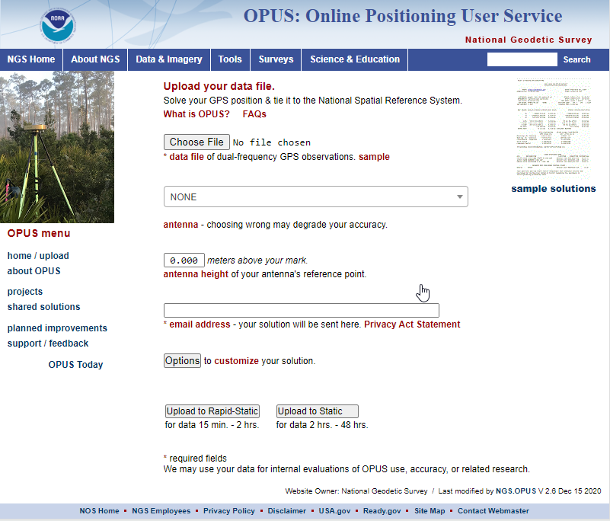
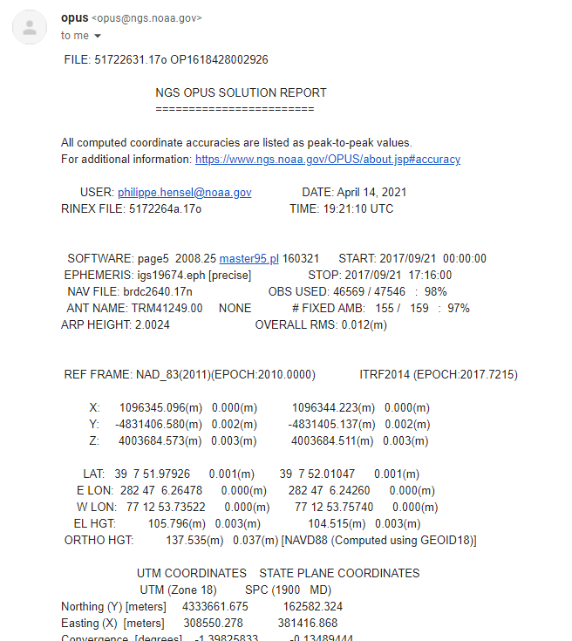
Single GPS observation file
OPUS–S > 2 hrs
OPUS–RS 15 min – 2 hrs
OPUS main page
Single OPUS solution

Slide 4
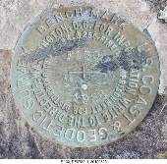
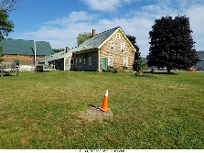
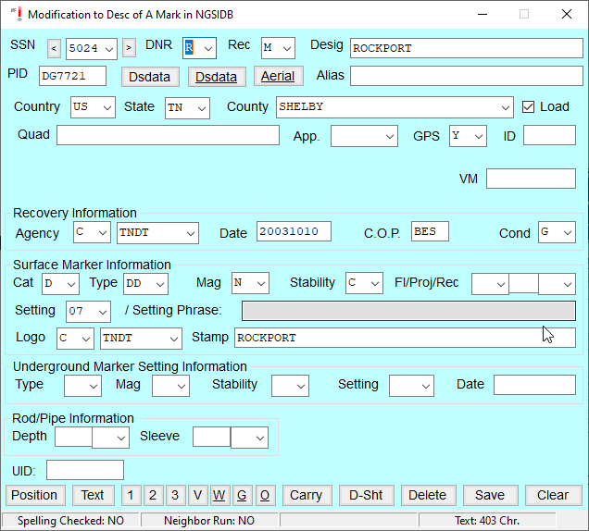
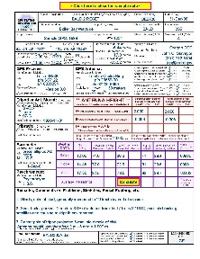

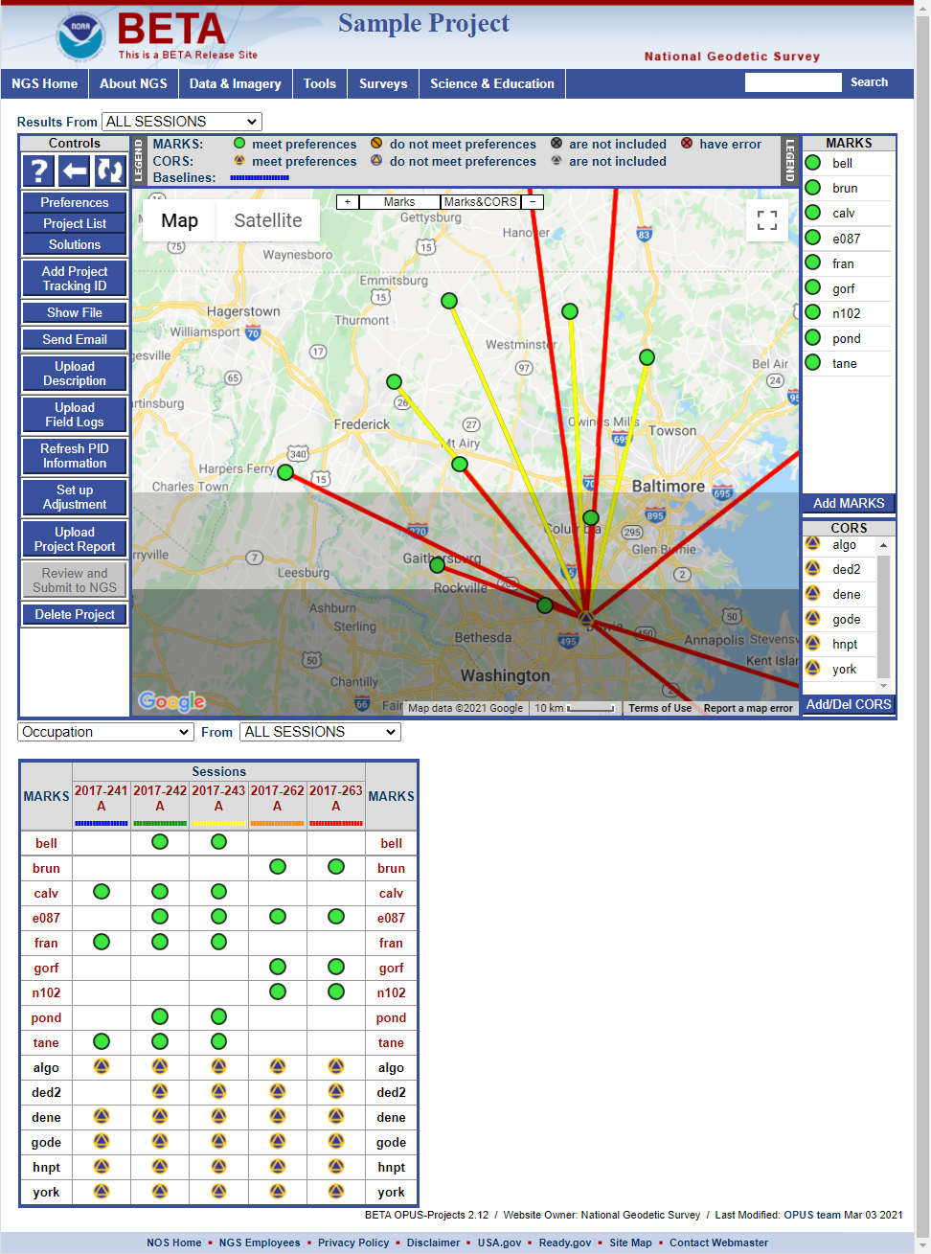


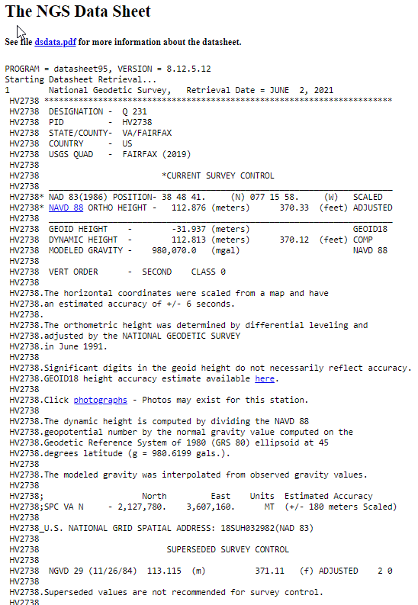
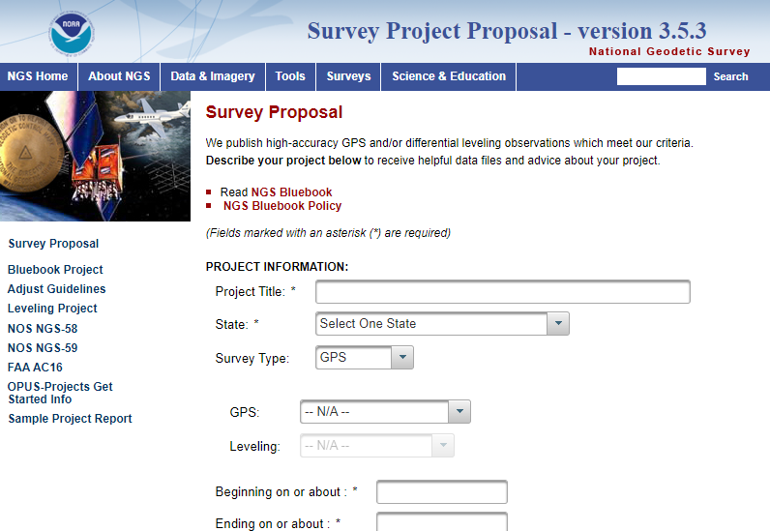
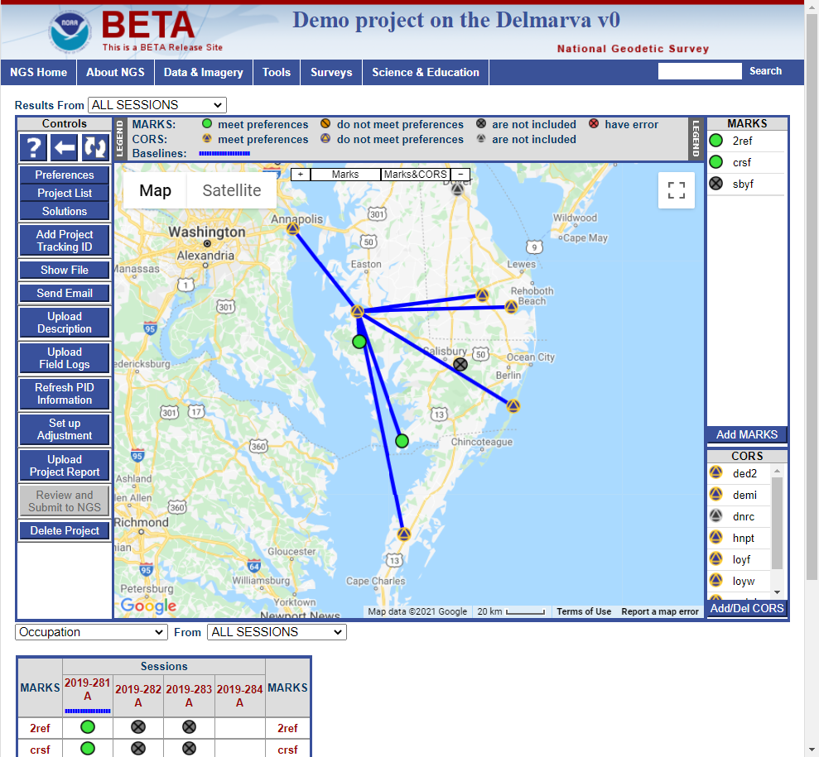
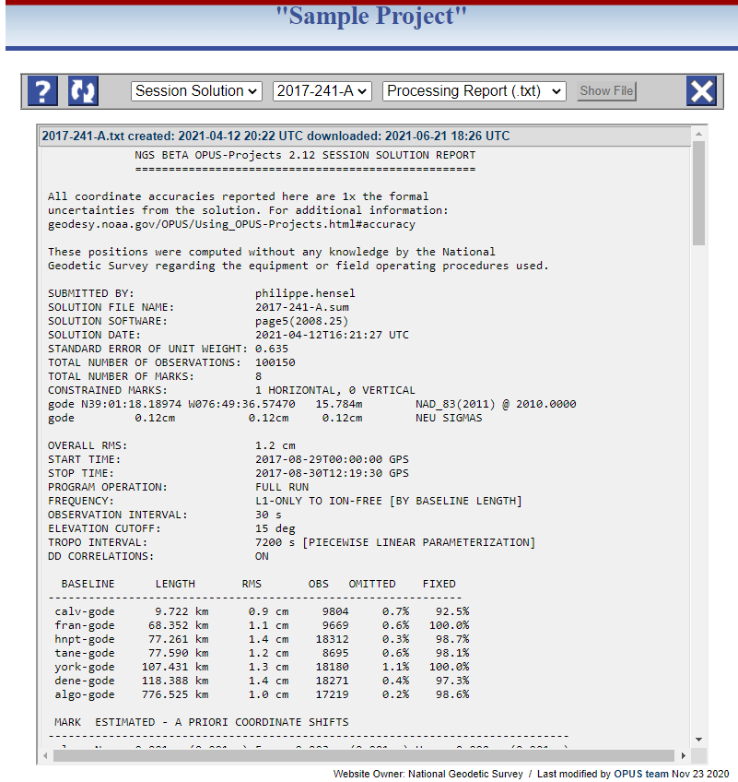
Multiple simultaneous observations
Session 2
Session 1
Upload descriptions, field logs, photos, report
OPUS main page
OPUS solutions for each occupation
OPUS Projects Session Solution
OPUS Projects Network Adjustments
OPUS Projects
New/updated survey control!

Slide 5


OPUS Projects 4.0 and Bluebooking
Before:
After:
FCGS
Blue Book
You had to know BB file formats, you had to know how to resolve errors
You are freed from having to learn & understand BB files!
Let OPUS Projects do the heavy lifting so you can fly!

Slide 6
What the new OPUS-Projects will do for you
Automatically selects recommended session processing defaults
Arranges data files into intuitive (simultaneously observed) sessions
Selects appropriate CORSs/IGS stations to control your project*
Suggests appropriate Session Processing
Suggests appropriate Preliminary Network Adjustment
Suggests appropriate sequence of Final Network Adjustments
Allows you to upload all files needed for submission to NGS
*Currently, you still have to add a distant CORS for best tropospheric modeling

Slide 7
What OPUS-Projects won’t do for you.
OPUS-Projects does not make a project proposal obsolete.
OPUS-Projects does not make field logs obsolete.
OPUS-Projects does not make mark descriptions obsolete.
OPUS-Projects does not make mark photos obsolete.
OPUS-Projects does not make obstructed marks GNSS-able.
OPUS-Projects does not make bad data good.
OPUS-Projects does not automate all processing decisions but it will make good suggestions.
OPUS-Projects does not quality control results as well as you.

Slide 8
OP4.0
Session 1
Project Planning
Survey Mark 1 GPS File 1
Survey Mark 2 GPS File 1
Survey Project Proposal
Survey Mark 3 GPS File 1
Preliminary Adjustments
Preliminary Adjustments
Survey Mark 4 GPS File 1
Network Adjustment
NGS Survey Project Proposal Review
Session 2
Survey Mark 1 GPS File 2
No Project ID
Survey Mark 2 GPS File 2
Survey Mark 3 GPS File 2
Survey Mark 4 GPS File 2
Preliminary Adjustments
Preliminary Adjustments
Support ALL USERS of OP, but especially the new pathway to the IDB
Create new, comprehensive User Guide & associated training materials
Data upload & session processing is very similar to previous versions
With the association of a NGS Project Tracking ID, you unlock the advanced features, enabling you to submit your project to NGS for publication
Session 3
OPUS
Session Baseline Processing
Survey Mark 1 GPS File 3
Survey Mark 2 GPS File 3
With Project ID
Survey Mark 3 GPS File 3
Survey Mark 4 GPS File 3
Survey Mark 1 All Field Logs
OPUS Solutions
Survey Mark 2 All Field Logs
Preliminary Adjustments
Preliminary Adjustments
Survey Mark 3 All Field Logs
OP4.0 Project
Preliminary Adjustment
Survey Mark 4 All Field Logs
Survey Mark 1 Description
Preliminary Adjustments
Preliminary Adjustments
Survey Mark 2 Description
QA/QC
Horizontal Fee Adjustment
Survey Mark 3 Description
Survey Mark 4 Description
Preliminary Adjustments
Survey Mark 1 Photos
Preliminary Adjustments
Horizontal Constrained Adjustment
Survey Mark 2 Photos
Survey Mark 3 Photos
Survey Mark 4 Photos
NGS Publication
Preliminary Adjustments
Preliminary Adjustments
Vertical Free Adjustment
Project Report
Preliminary Adjustments
Preliminary Adjustments
NGS Datasheets
Vertical Constrained Adjustment
Steps that remain unchanged from previous versions of OPUS Projects
Optional steps available with advanced features of OPUS Projects 4.0

Slide 9
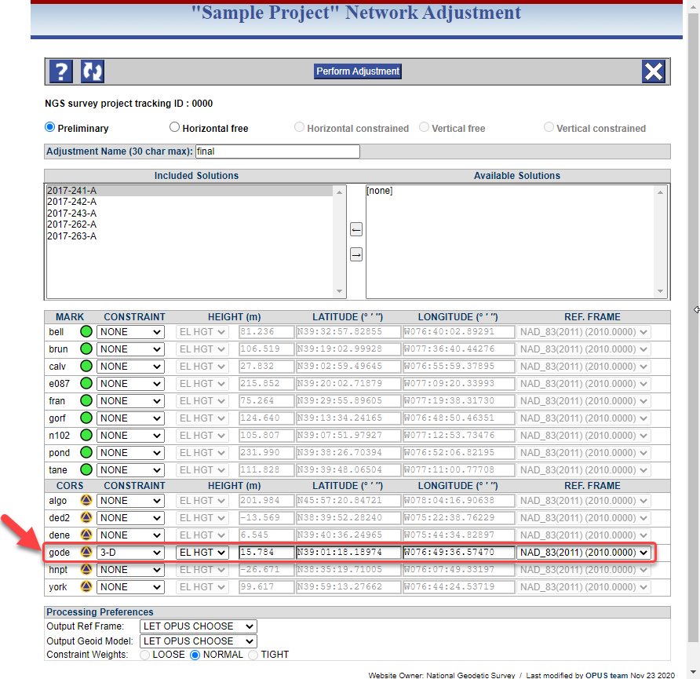
Five Sequential Network Adjustments
Preliminary Network Adjustment:
Minimally constrained (geometric)
Only the hub is constrained 3D
GPSCOM is used to combine and adjust all selected sessions into a single network solution in the ITRF*
*And then transform it into the selected output reference frame, per user preferences

Slide 10


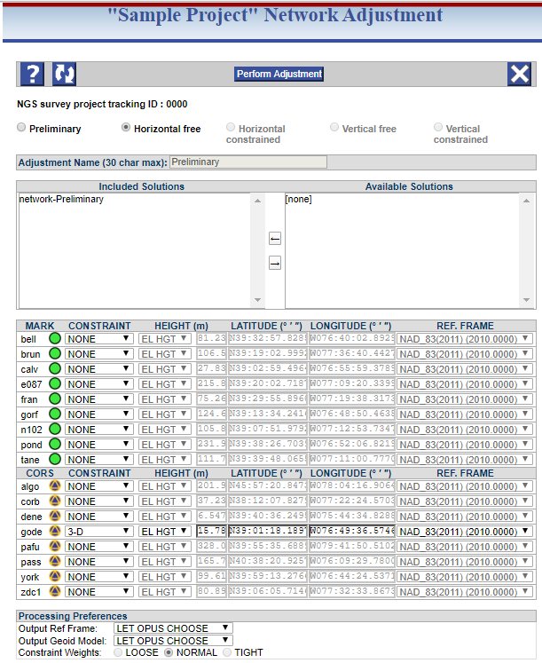
Five Sequential Network Adjustments
Horizontal Free Network Adjustment:
Minimally constrained (geometric –same as Preliminary Adjustment)
Check to make sure project is internally consistent geometrically (lat/lon/EH)
Only the hub is constrained 3D
OP uses ADJUST to process output from Preliminary Adjustment

Slide 11
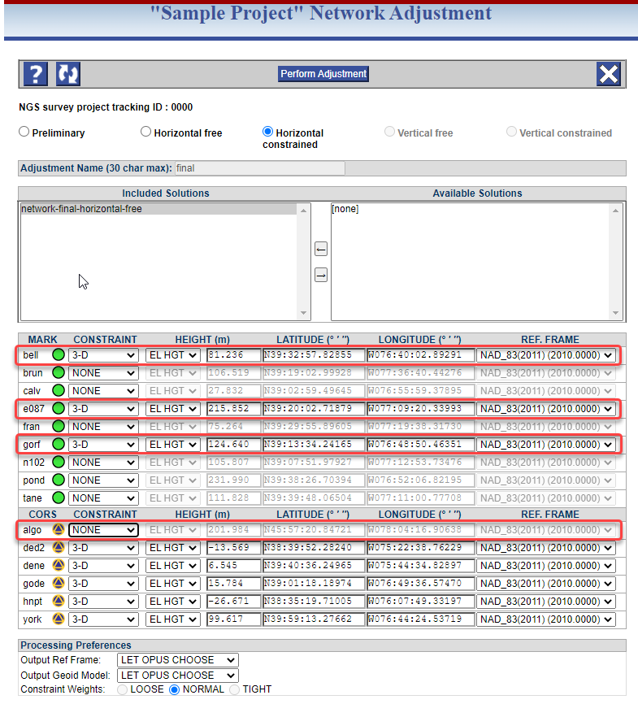
Five Sequential Network Adjustments
Horizontal Constrained Network Adjustment:
This step propagates the reference frame from the constrained marks to the unconstrained marks
Fully constrained geometric adjustment
All user marks with published coordinates in the chosen reference frame are constrained
Distant CORS is NOT constrained

Slide 12
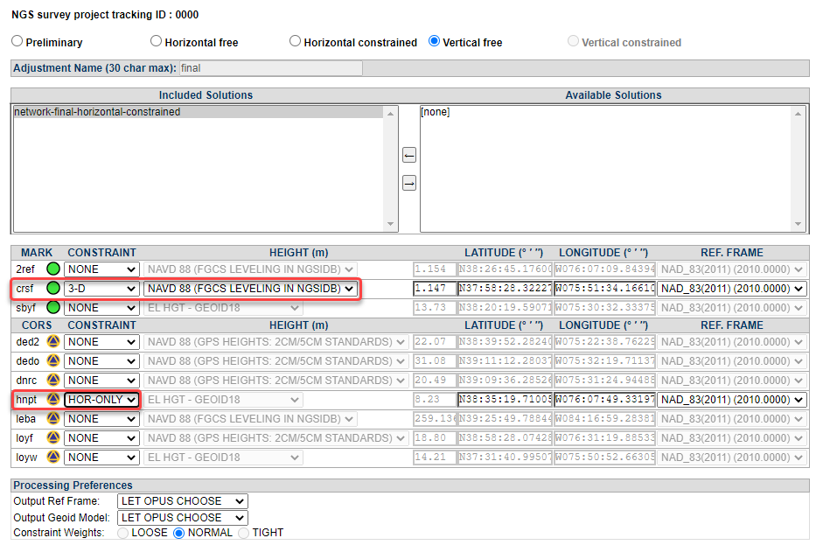
Five Sequential Network Adjustments
Vertical Free Network Adjustment:
Similar in idea to Horizontal Free, this step is used for quality control with respect to the vertical orthometric height
Minimally constrained orthometric height adjustment
One mark held constrained VERT-ONLY
Hub is held constrained HOR-ONLY

Slide 13
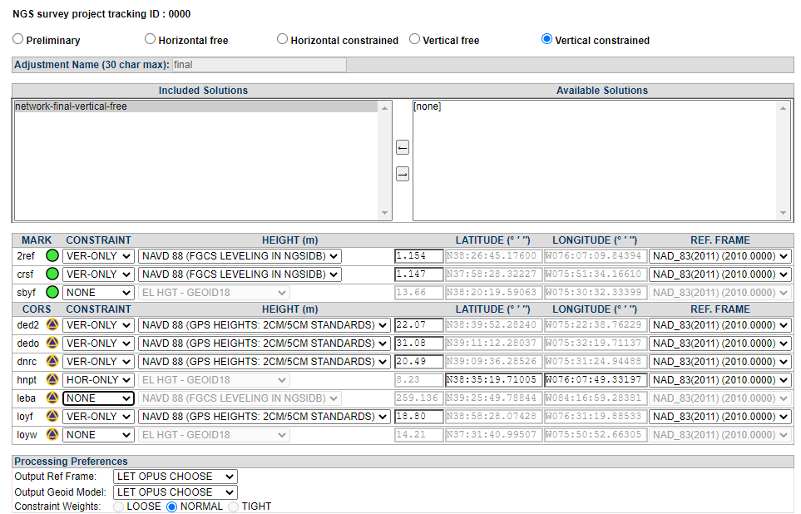
Five Sequential Network Adjustments
Vertical Constrained Network Adjustment:
This step propagates the vertical datum from the vertically constrained marks to the vertically unconstrained marks
Fully constrained orthometric height adjustment
All marks with published orthometric heights in the selected datum are held constrained
Distance CORS is NOT constrained

Slide 14
Work Flow for OPUS Projects 102… in 12 easy steps!
Project Development
Create Project in OP
Load files into project
Preliminary Network Solution
Mark Recovery, Photos
Mark Descriptions
QA/QC OPUS solutions
Network Solutions
Project Proposal
Field Campaign
Session Processing
Submit to NGS
Traditional steps in OP
New steps in OP4.0 training

Slide 15
Where we are today
The User Guide has been completed and is in the final formatting stages for imminent publication
OP4.0 has passed all internal systems testing and is being prepared for imminent release to production
New training modules have been developed and will be available soon.

