Slide 1

OPUS-Projects for RTK/RTN Vectors
(OPUS-Projects 5.0)
Dan Gillins, Ph.D., P.L.S.
Geodesist, National Geodetic Survey
May 20, 2021

Slide 2
Acknowledgements
“OPUS-Projects 5.0” Development Team:
Ira Sellars
Mark Schenewerk
Weibing Wang
Jay Howard
Ryan Hippenstiel & staff in FOB for collecting RTN/RTK data

Slide 3
Outline
Background on recent and ongoing developments for OPUS-Projects
Case Studies on Accuracies of RTNs
GNSS Vector Exchange (GVX) File Format
Demo development to OPUS-Projects 5.0
  RTN-only case study
  RTN+static GPS case study
  Single-base RTK and post-processed vectors from Trimble Business Center (TBC) case study

Slide 4
Development Phases of OPUS-Projects
DEV (internal)
OPUS-Projects 5.0
BETA (open to public)
OPUS-Projects 4.0
PRODUCTION
OPUS-Projects 3.x
Run adjustments in ADJUST
Streamlined for Publishing Survey via NGS in IDB
Upload GNSS vectors for adjustment
Allows inclusion of RTK/RTN vectors
Will move to BETA soon
Moving to production soon
Session processing using PAGES
Network adjustments using GPSCOM
Future Intentions
OPUS 6.0
Supports modernized NSRS
Leveling
Classical
Relative gravity

Slide 5
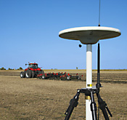
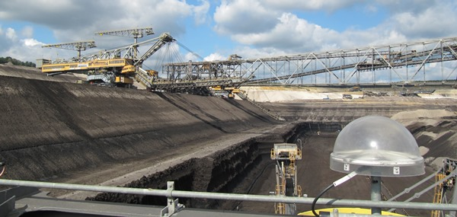
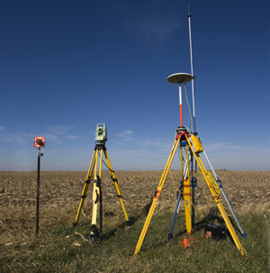
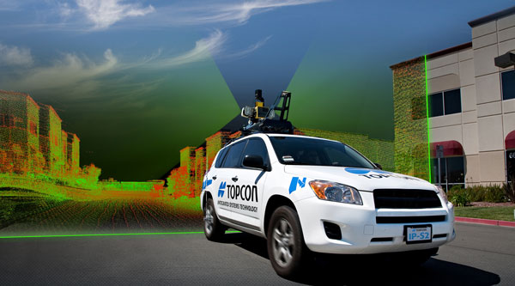
Real-Time Kinematic (RTK) Surveying
Conventional RTK
  Stationary single “base” station
  Transmits precise coordinates and GNSS observables to moving “rover”
  < 10-20 km baseline length
Applications
  Survey engineering
  Mobile mapping
  Precision agriculture
  Mining
  Construction
Base
Rover
www.alberding.eu
www.gcfarm.com
www.steckbeck.net
www.positionpartners.com.au
http://www.gcfarm.com/siteart/precision-farming/case-accuguide.jpg

Slide 6
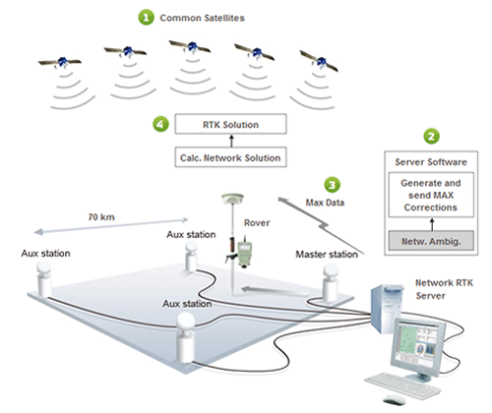
Real-Time Networks
Virtual Reference Stations (VRS)
Master-Auxiliary Concept (MAC)
Vector “tails” referenced to virtual base station
Base station position is variable
Vector “tails” connected to physical base station
Base station position is fixed
RTN Base
RTN Base
MUST store data as vectors!!
VRS
Control
Center
(Landau et al. 2002)
RTN Base
(Leica 2005)
Notes:
VRS
1.) Rover sends approx. position to RTN control center
2.) Control center assigns this position as the location of an imaginary base station and interpolates corrections at this virtual location
3.) These interpolated corrections are used to generate corrected pseudo-observables that are “transmitted” from the virtual base to the rover to be processed using conventional single-base RTK algorithms to solve for precise geodetic coordinates at the rover (Wang et al. 2010)
MAC
1.) The rover transmits an uncorrected point position to the central server, and then the server searches and selects a “cell” of reference stations for generating corrections
2.) The phase ranges from all selected stations are reduced to a common ambiguity level, and dispersive and nondispersive errors for each frequency and satellite-receiver pair are computed relative to the master station
3.) The residual corrections between the auxiliary stations and the master station, as well as the full corrections and published coordinates at the master station are transmitted to the rover. The rover then interpolates the received corrections and network information to derive its precise position (Janssen 2009).

Slide 7
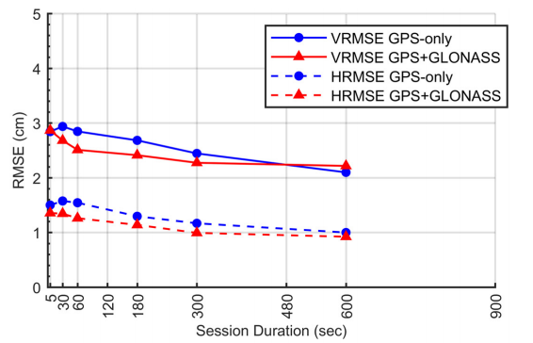
Empirical Evaluation of the Accuracy of RTNs
95% Confidence
± 5.0 cm, vertical
± 2.5 cm, horizontal
Or similar to accuracy of a 2-h OPUS-S solution!
Ellipsoid Height
Horizontal
[Allahyari et al. 2018]

Slide 8
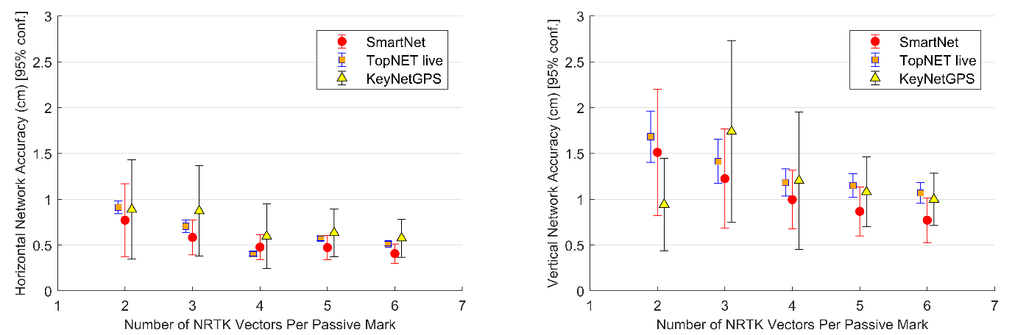
Formal Error Propagation via Survey Network Least Squares Adjustment
[Gillins et al. 2019]

Slide 9
Accuracy Table for RTNs
Vertical Accuracy Standard (cm) |  | Number of Repeat Network RTK Occupations |  | Occupation Duration
cm | ft | GPS-only | GPS+more (GNSS) | minutes | epochs
3.5 | 0.11 | 2 | 2 | 5 | 300
3.0 | 0.10 | 3 | 3 | 5 | 300
2.5 | 0.08 | 4 | 3 | 5 | 300
2.0 | 0.07 | 6 | 5 | 5 | 300
* Assumes the distance from the rover to the nearest base station in the RTN < 40 km

Slide 10
Pros and Cons of RTNs
Benefits | Concerns
FAST. Could reduce field observations from several hours to just a few minutes | RTN may not be aligned with the National Spatial Reference System
Can evaluate data quality in real time | Ideally, survey should be tied to CORS network
Easy to obtain additional observations | More prone to multipathing errors
Only a single receiver (i.e., rover) is needed during a session | Baselines must be kept short (i.e., < 40 km)

Slide 11
Problem Statement
NGS does not have a simple mechanism for accepting data resulting from Real-time Kinematic (RTK) surveys
RTK surveys are very popular (more than static surveys)
  Highly efficient—measurements done in seconds to minutes
RTK vectors and metadata are generally stored in a proprietary format (not open or standardized)
RTNs may or may not be aligned with the NSRS

Slide 12
Objectives
Develop a standard file format for GNSS vectors
Develop OPUS-Projects so that GNSS vectors from RTK surveys can be uploaded, checked, adjusted, and submitted to NGS
Develop tools for surveyors to combine vectors from RTK surveys with static GNSS data

Slide 13
GNSS Vector EXchange Format (GVX)
Website: https://www.ngs.noaa.gov/data/formats/GVX/index.shtml
Detailed documentation
Schema (XSD)
Example vector file
GVX is written in Extensible Markup Language (XML)
Designed to store and carry data in plain text format
Flexible representation of arbitrary data structures
Extensible – new elements can be added later without breaking applications
Both machine-readable and human-readable
Schemas can be used to define “must haves” and “should haves”

Slide 14
GNSS Vector EXchange Format (GVX)
Timeline
Solicited internal and external feedback for GVX since 8/2019
Introduced to industry in 10/2019; solicited feedback
Addressed all comments and feedback
Released version 1.0 on February 4, 2021
Contents:
SOURCE_DATA and PROJECT_INFORMATION
REFERENCE_SYSTEM
EQUIPMENT
SURVEY_SETUP
POINT
GNSS_VECTOR
SESSION

Slide 15










Industry Invited to Provide Feedback
Released GVX v. 1.0 released to industry on February 4, 2021
Over 30 people attended mtg

Slide 16
GVX Flow Chart

Slide 17
OPUS-Projects 5.0
Inclusion of previously processed GNSS vectors
  Single-base RTK vectors
  Network RTK vectors
  Vectors processed in other software
Automatically “weights” uploaded vectors in a network least squares adjustment
Final adjustment results can be submitted to NGS for publication
Will be released to BETA soon!

Slide 18
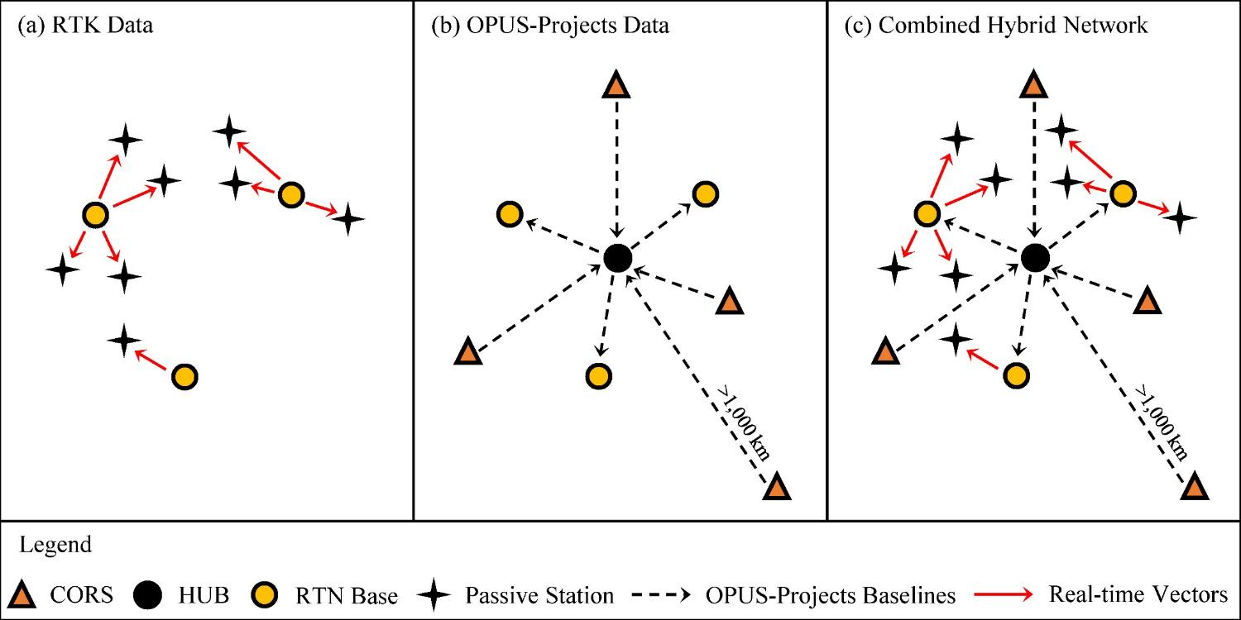
Design for OPUS-Projects and GVX
GVX file (from RTK survey or baseline processing in other software)
OPUS-Projects (from static GNSS session processing)
500-800 km
500-800 km
RTK Base or “From” Mark
RTK Rover or “To” Mark
Vector
Vector in GVX File
[Adapted from Weaver et al. 2018]

Slide 19
Demonstration

Slide 20
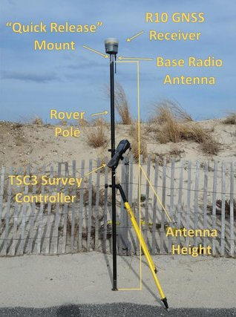
Case Study 1&2: RTN Survey
Survey of 9 passive marks using Trimble KeyNetGPS Network in Maryland
Collected 5-min., GPS+GLONASS observations using full network corrector
  Trimble R10
  VRS method with vectors tied to a physical reference station (PRS)
Results stored in Trimble’s proprietary JXL file format
JXL file converted to GVX file format
Static GNSS data logged at all physical reference stations during the days of the survey downloaded from KeyNetGPS server
  6 RTN base stations
  Note 2 additional RTN base stations are also CORS (BACO, UMBC)
Notes:
Open test project and discuss its contents, session processing already done, etc.
Discuss project preferences and epochs used versus duration
Upload GVX files for 3 days
Discuss symbols for lines, points, etc.
Discuss how PRS works, how it auto attaches, etc. as the surveyor does his/her work
Discuss how all vectors are “grouped” by baseline, and it doesn’t matter what the surveyor names their points
Zoom in and note that vectors attached to the CORS and other RTN base stations (automatically)
Show GVX table and discuss how it is arranged by baseline
Show statistics table for GVX
Discuss contents of the baseline webpage –go to baseline with high P2P
Remove the one vector – show how to disable it and save; show in table
Run adjustments; explain results and go over VVHU and outputs
Submit survey

Slide 21
Future Work
Collect and respond to feedback from Beta testing of OPUS-Projects 5.0
Update the User Manual for OPUS-Projects
Write new specifications for establishing geodetic control with RTK/RTN data

Slide 22
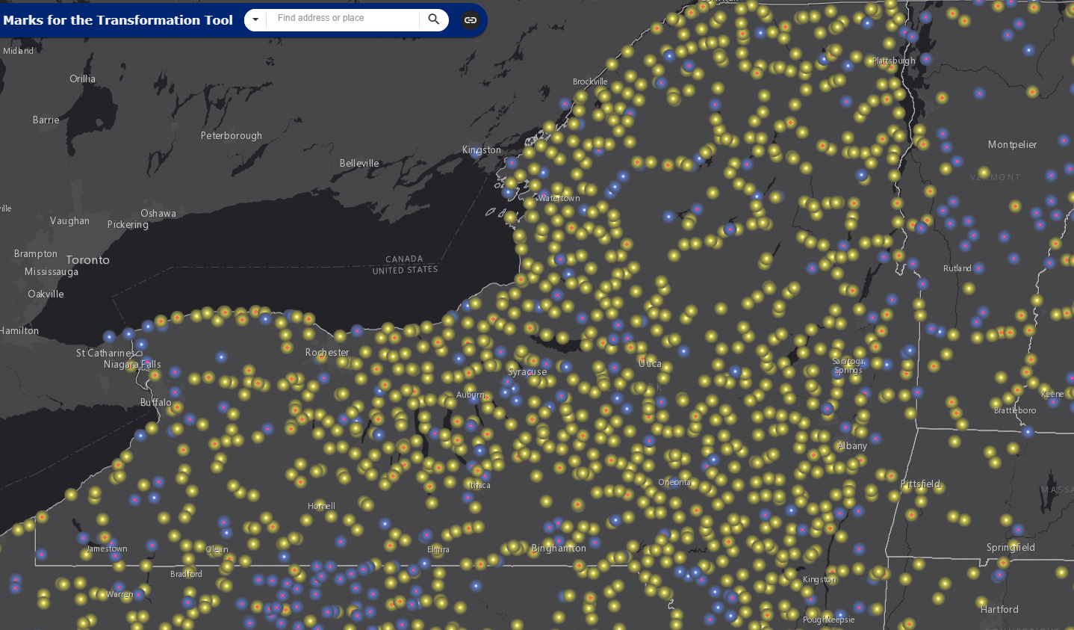
Conclusions
Geodetic coordinates at cm-level accuracy can be achieved with an RTN
  (3) 5-min. GNSS occupations: h < 3.0 cm at 95% confidence
  (5) 5-min. GNSS occupations: h < 2.0 cm at 95% confidence
OPUS-Projects 5.0 allows users to upload GNSS vectors
  Will be released soon! Stay tuned
Results can be submitted to NGS for review and publication
  Efficient collection of GNSS data on bench marks
  Height modernization surveys
  Establishment of geodetic control

Slide 23
Questions?
Dan Gillins
Daniel.Gillins@noaa.gov

Slide 24
For More Technical Details, Refer to…
Gillins, D.T., Kerr, D., and Weaver, B. (2019). “Evaluation of the Online Positioning User Service for Processing Static GPS Surveys: OPUS-Projects, OPUS-S, OPUS-Net, and OPUS-RS,” J. Surv. Eng. (ASCE), 145(3):05019002.
Gillins, D.T., Heck, J., Scott, G., Jordan, K., and Hippenstiel, R. (2019). “Accuracy of GNSS Observations from Three Real-time Networks in Maryland, USA,” Proc. 2019 FIG Working Week, Hanoi, Vietnam, April 2019, 15 pp.
Park, J., Kim, S., Shahbazi, A., Gillins, D., and Dennis, M. (2018). “Evaluation of Static GPS Surveying Campaigns Processed in OPUS-Projects,” Final Technical Report FY17 NA293P, National Geodetic Survey, 58 pp.
Jamieson, M., and Gillins, D.T. (2018). “Comparative Analysis of Online Static GNSS Post-Processing Services.” J. Surv. Eng. (ASCE), 144(4):05018002.
Allahyari, M., Olsen, M., Gillins, D.T., and Dennis, M. (2018). “A Tale of Two RTNs: Rigorous Evaluation of GNSS Survey Observations in Real-time Networks,” J. Surv. Eng. (ASCE), 144(2):05018001.
Weaver, B., Gillins, D.T., and Dennis, M. (2018). “Hybrid Survey Networks: Combining Real-time and Static GNSS Observations for Optimizing Height Modernization,” J. Surv. Eng. (ASCE), 10.1061/(ASCE)SU.1943-5428.0000244, 144(1):05017006.
Gillins, D., and Eddy, M. (2017). “Comparison of GPS Height Modernization Surveys using OPUS-Projects and Following NGS-58 Guidelines,” J. Surv. Eng. (ASCE)., 143(1):05016007.

