Slide 1
Blueprint for the Modernized NSRS, Part 3:
Working in the Modernized
National Spatial Reference System (NSRS)
Dru Smith
NSRS Modernization Manager
NOAA’s National Geodetic Survey

Slide 2
Outline
Introductory material
Delay / Updated Timeline
Refresher
Foundational changes at NGS
Shift and Drift
EPP2022 and IFVM2022
Reference epoch coordinates (RECs) and survey epoch coordinates (SECs)
Other New Types of Coordinates
OPUS and the Data Delivery System
Terminology
Case Studies: Using the modernized GNSS

Slide 3
Introductory Material

Slide 4
Acknowledgments
The 2021 update to Blueprint for the Modernized NSRS, Part 3 is the result of significant TEAM efforts over 12 months
BP3 2021 Update Team
Godfred Amponsah, Ed Carlson, Michael Dennis, Dan Determan, John Galetzka, Benjamin Gavin, Daniel Gillins, David Grosh, Dave Hatcher, Ryan Hippenstiel, Jeff Jalbrzikowski, Kevin Jordan, Boris Kanazir, Nic Kinsman, Scott Lokken, Dan Martin, Phillip McFarland, Jeff Oyler, Dan Roman, Galen Scott, Jon Sellars, Brian Shaw, Dru Smith, Jeff Steele, William Stone, Brian Ward, Amy Whetter, Jason Woolard
Plus the dozens of others who wrote the 2019 version
And the people at 5 different agencies who reviewed this update!
It is a team document, with input from dozens of individuals from inside and outside of NGS

Slide 5
Bottom Line, Up Front
If you do geospatial work in the USA…
and you work in the National Spatial Reference System..
every product you’ve ever made…
every survey…
every map…
every lidar point cloud…
every image…
every DEM…
WILL have outdated coordinates on it in the next few years.
Let’s talk about what this means, why it is happening, and how it will affect things going forward

Slide 6
What is BP3?
BP3 is a companion to BP1 (geometric) and BP2 (geopotential), both released in 2017 and updated in 2021
It is about “re-inventing bluebooking”
It’s about how NGS will provide the frames/datum in the future
It’s about how YOU will use the frames/datum in BP1 and BP2

Slide 7
What I’ll be skipping…
Blueprint for the Modernized NSRS, Part 3 will take 1-1.5 hours to cover
Not included today:
What is…
NGS and its mission
The NSRS
Bluebooking
GRAV-D
ITRF
Why we are modernizing
All of these topics have been covered extensively in multiple forums in the last few years

Slide 8
Updated Timeline or The reason the title “Blueprint for 2022” was renamed “Blueprint for the Modernized NSRS”

Slide 9
Timeline
In 2007, NGS assumed we would be done by 2018
By 2013, a finish of 2022 seemed correct
By 2020 four issues derailed that date:
Government shutdowns
Final clarity on the complexity of the task
Loss of personnel without backfill
“2020”
In June 2020, NGS issued a “delay” message that the modernized NSRS would not be released in 2022
Actual date? Unknown. When we know, you’ll know.
Notes:
A friend called 2020 “the longest decade of our lives”

Slide 10
Refresher

Slide 11
“Modernizing the NSRS” means…
Replacing NAD 83
Replacing NAVD 88
Re-inventing Bluebooking
Improving the Geodetic Toolkit
Better Surveying Methodologies
Blueprint for the Modernized NSRS, Part 1
Blueprint for the Modernized NSRS, Part 2
Blueprint for the Modernized NSRS, Part 3
Notes:
There are actually 3 “NAD 83”s, NAD 83(2011), NAD 83(PA11) and NAD 83(MA11)
There are also many more vertical datums than NAVD 88 in the NSRS, each one for specific states or territories that have no line of sight to CONUS/Alaska

Slide 12
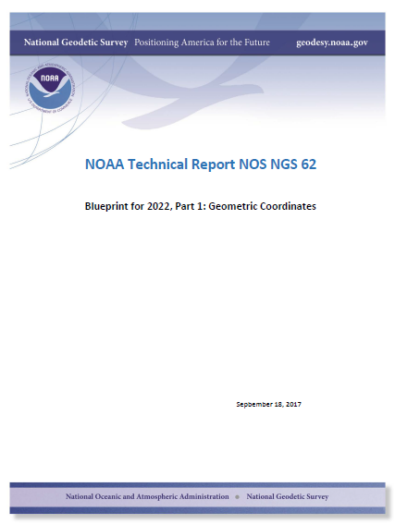
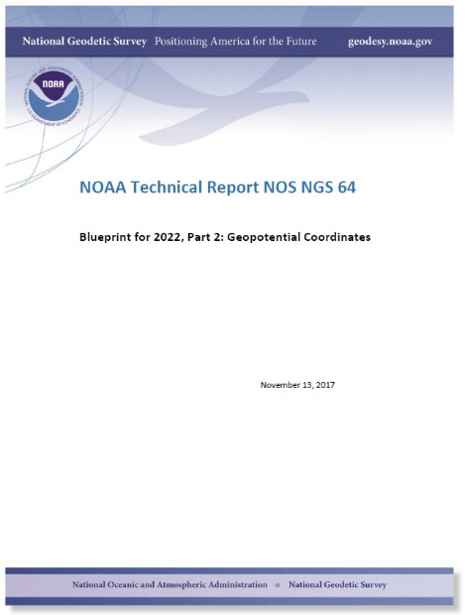
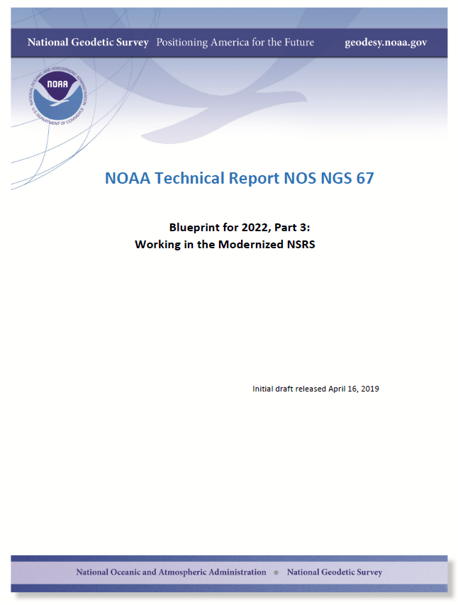
Modernizing the NSRS
The “blueprint” documents: Your best source for information
All three have been updated and will be released in early 2021
Geometric:
Sep 2017
NOAA TR NOS NGS 62
Geopotential:
Nov 2017
NOAA TR NOS NGS 64
Working in the modernized NSRS:
April 2019
NOAA TR NOS NGS 67
Mar 2021?
Feb 2021
Feb 2021

Slide 13
Replacing NAD 83
The Old:
NAD 83(2011)
NAD 83(PA11)
NAD 83(MA11)
The New:
The North American Terrestrial Reference Frame of 2022
(NATRF2022)
The Caribbean Terrestrial Reference Frame of 2022
(CATRF2022)
The Pacific Terrestrial Reference Frame of 2022
(PATRF2022)
The Mariana Terrestrial Reference Frame of 2022
(MATRF2022)

Slide 14
Replacing NAVD 88
The Old:
NAVD 88
PRVD 02
VIVD09
ASVD02
NMVD03
GUVD04
IGLD 85
IGSN71
GEOID12B
DEFLEC12B
The New:
The North American-Pacific Geopotential Datum of 2022 (NAPGD2022)
Will include:
GEOID2022
DEFLEC2022
GRAV2022
DEM2022
More
Orthometric
Heights
Normal
Orthometric
Heights
Dynamic
Heights
Gravity
Geoid
Undulations
Deflections of
the Vertical

Slide 15
The preeminence of ITRF
Rotation of the
North American Plate
The North American Terrestrial Reference Frame of 2022
(NATRF2022)
The Caribbean Terrestrial Reference Frame of 2022
(CATRF2022)
The Pacific Terrestrial Reference Frame of 2022
(PATRF2022)
The Mariana Terrestrial Reference Frame of 2022
(MATRF2022)
Rotation of the
Caribbean Plate
ITRF2014
Rotation of the
Pacific Plate
Rotation of the
Mariana Plate
EPP2022
EPP for “Euler Pole Parameters”
(a way of describing a plate’s rotation)

Slide 16
Foundational Changes at NGS

Slide 17
The NSRS database replaces the NGS IDB
The NSRS database is a geospatial database
Observations will be translated into geospatial formats (e.g. GeoJSON) and moved
Metadata will be moved (e.g. PID, Designation, Stamping)
Old coordinates will be frozen and moved
No attempt to “NADCON/VERTCON” them into the new system
New coordinates will be computed from observations
RECs and SECs (see later)

Slide 18
The NOAA CORS Network (NCN) gets modernized
Long standing issues will be addressed
Multi-constellation GNSS support
GPS, Galileo, GLONASS, etc.
Station Selection Criteria (NCN and IGS)
Has been called “NCN Station Quality Metrics” or “CORS Grading” previously.
Identifying the best stations for you to use as control
Non-linear coordinate function support
Faster corrections after earthquakes
Automated checks for stations that have either drifted out of spec over time or which quickly jumped out of spec
Ending confusion about GRP, ARP, Phase Center, MON, etc.

Slide 19
Shift and Drift

Slide 20
Shift
One of the two major changes you’ll see in the modernized NSRS is a shift in coordinates
Latitude, Longitude, Ellipsoid Height: -2 to +4 meters
Non-geocentricity of NAD 83
Orthometric Height: -0.5 to +2.0 meters
Bias and tilt in NAVD 88
Other shifts will occur in non-CONUS, non-Alaska regions of the USA
There will be outliers!
“Old” unsurveyed points might be off by meters if they’ve moved!

Slide 21
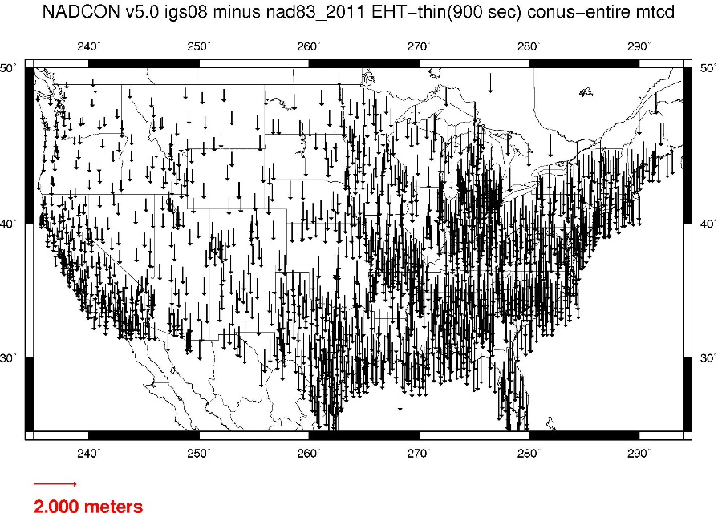
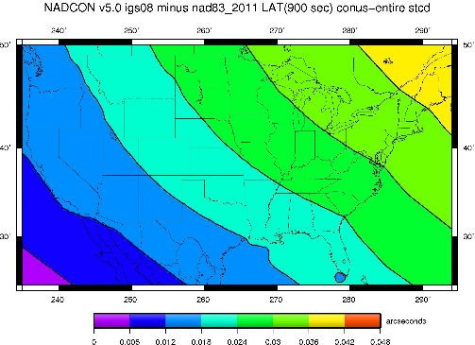
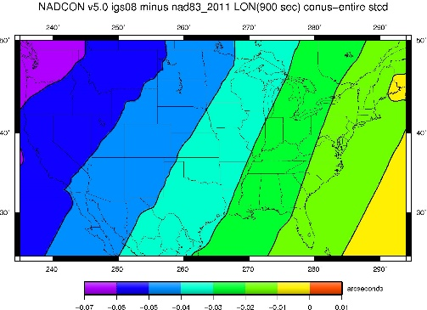
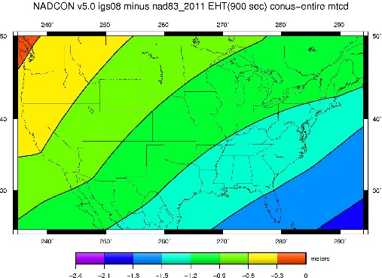
NAD 83(2011) epoch 2010.0 to NATRF2022 epoch 2020.00 (estimate)

Slide 22
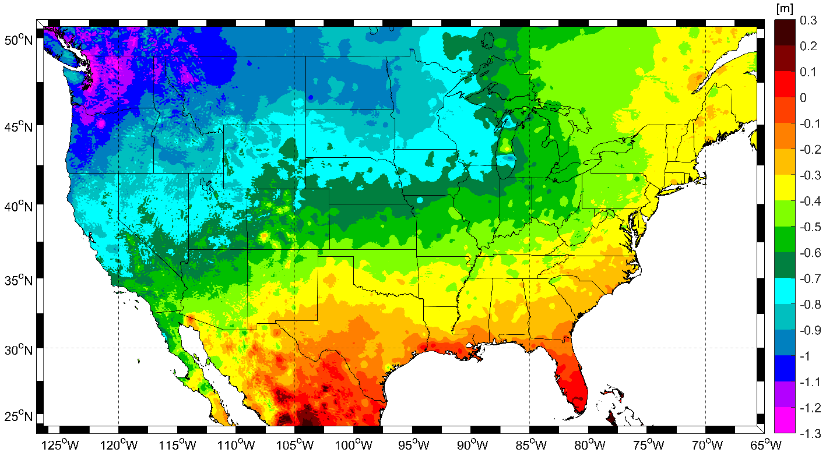
NAVD 88 to NAPGD2022 epoch 2020.00 (estimate)

Slide 23
Drift
The second major change you’ll see in the modernized NSRS is a drift in coordinates
Everything in the world moves
(Stage whisper: it’s rarely just a smooth “drift”, but “every type of motion of all marks in the NSRS” doesn’t rhyme with “shift”)
Two types of “Drift” (AKA “every type of motion…”)
Tectonic rotation (affects latitude and longitude only)
Residual motion
Everything left over after accounting for tectonic rotation, including all vertical motion

Slide 24
The wrong question, in the near future:
“What is the height of that point?”
The right question, in the near future:
“What is the height of that point, on some specific date?”
And its related questions:
“What is its past motion?”
“Can you predict its future motion?”

Slide 25
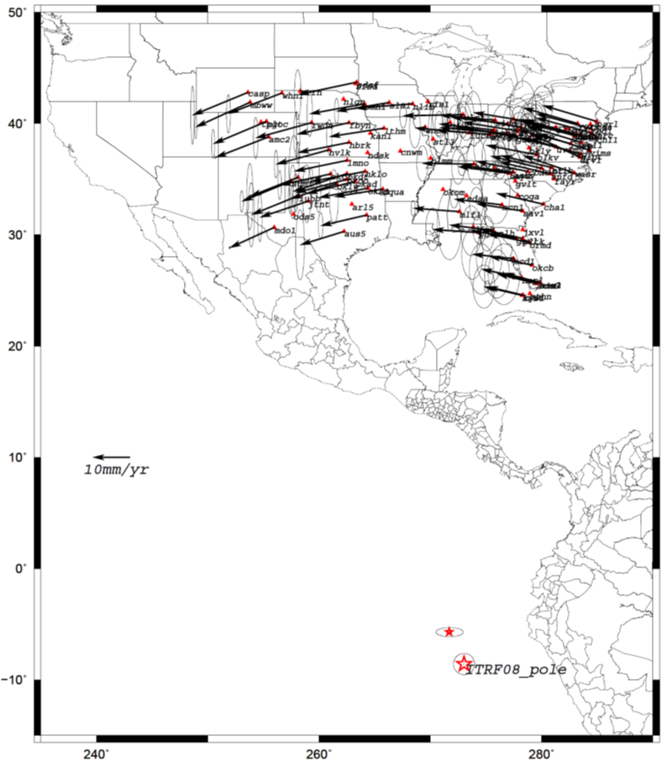
Tectonic rotation
In the ITRF, many tectonic plates have one dominant motion: rotation
Plus plenty of other motions
The point about which a continent rotates is called its “Euler Pole”
So, if you work in the ITRF:
Frame (ITRF) = not rotating
N.A. Plate = rotating
It is a fairly simple matter to reverse this and define a rotating frame in which the plate is not rotating.
So, if you work in NATRF2022:
Frame (NATRF2022) = rotating (relative to ITRF)
N.A. Plate = not rotating (relative to NATRF2022 frame)
We say “NATRF2022” is “fixed” to the N.A. Plate, making it a “plate fixed” frame

Slide 26
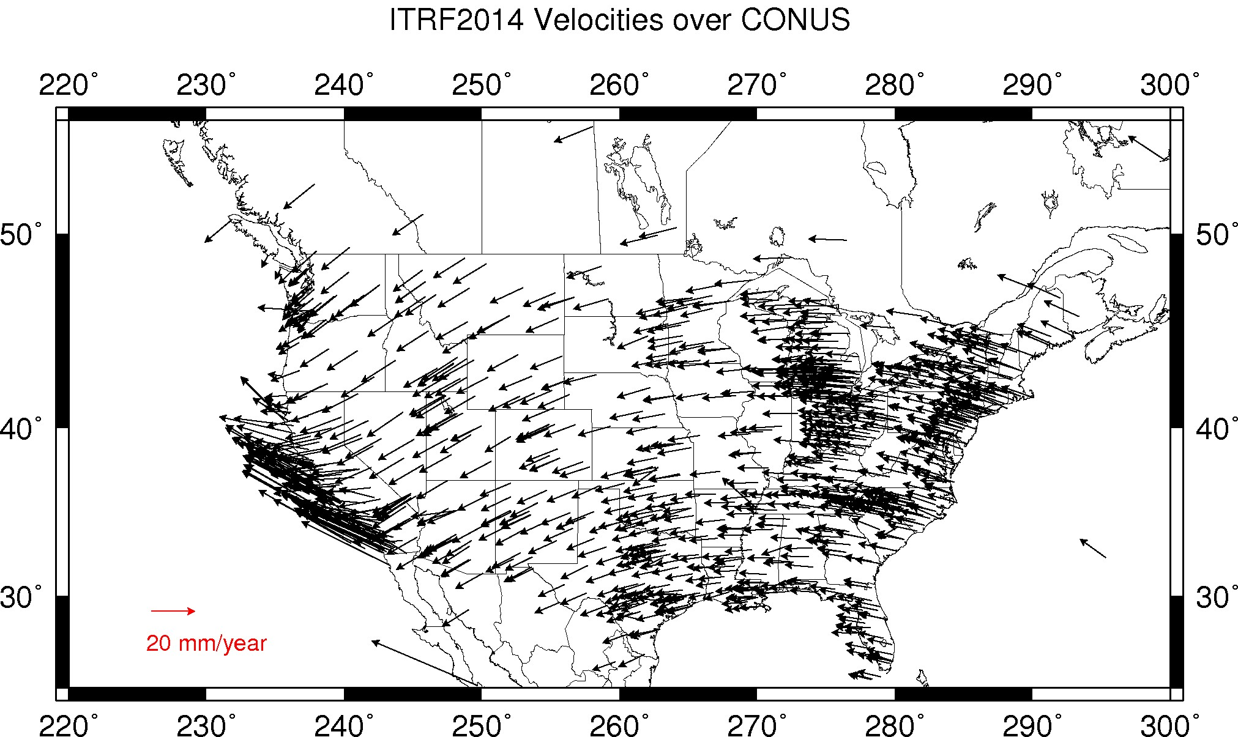
Velocities at CORSs in ITRF2014

Slide 27
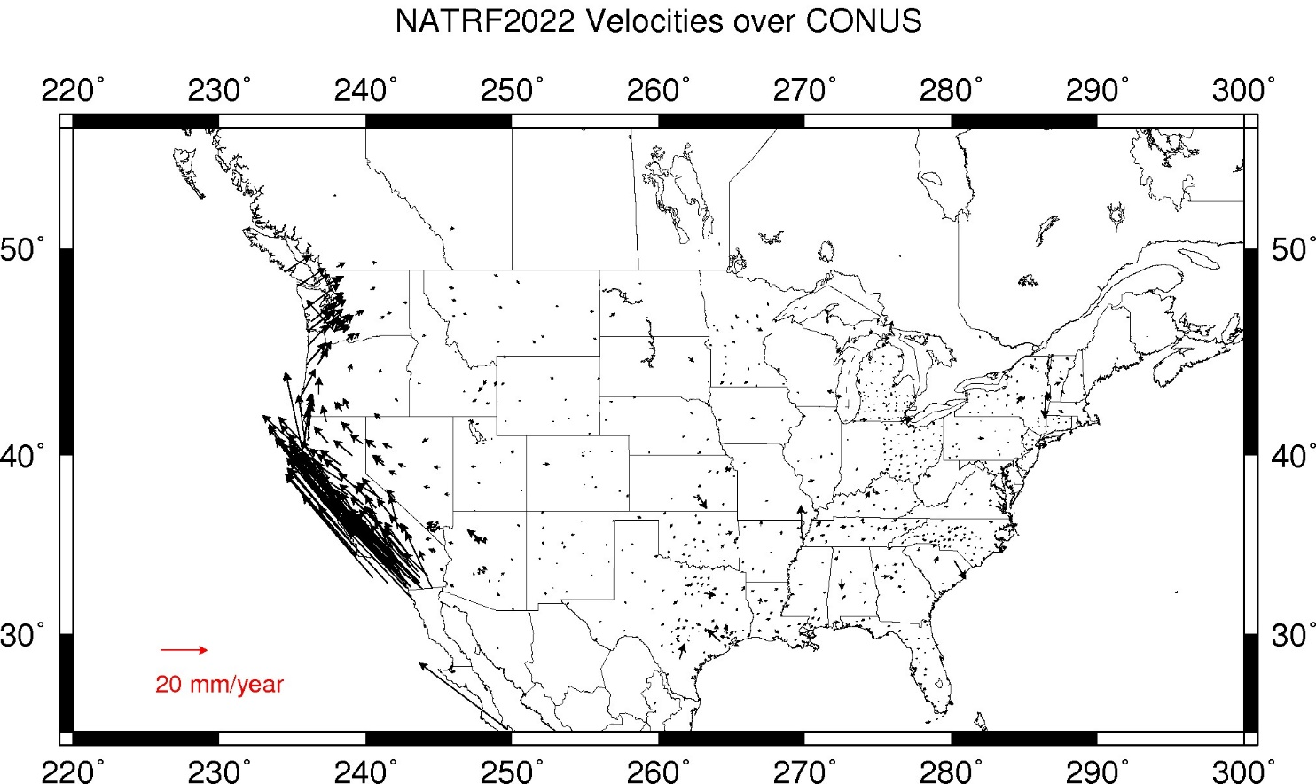
Velocities at CORSs in NATRF2022

Slide 28
Shift and Drift: Summary
Shift
Drift
When?
Why?
How much?
Who?
Once, at rollout
Correcting systematic errors in the current datums
Decimeters-to-meters of one-time immediate coordinate changes
Will affect everyone
Impact will grow as time goes on
Embracing the dynamic planet upon which we live
Centimeters of persistent annual coordinate changes (plus potential meter-level jumps from earthquakes)
Can mostly be ignored or mitigated through NGS’s creation of plate-fixed frames and reference epoch coordinates

Slide 29
EPP2022 and IFVM2022: The two tools that make time dependent geodetic control useable

Slide 30
EPP2022 and IFVM2022
Remember this from an earlier slide?
Two types of “Drift” (AKA “every type of motion…”)
Tectonic rotation (affects latitude and longitude only)
Residual motion
Everything left over after accounting for tectonic rotation, including all vertical motion
Tectonic Rotation: EPP2022
Residual Motion: IFVM2022

Slide 31
The two parts of drift
The plate rotation is simple (3 parameters per plate)
Captured in EPP2022
Horizontal (latitude/longitude) only
Changes the frame
ITRF2020 to NATRF2022, PATRF2022, CATRF2022 & MATRF2022
Doesn’t change the epoch
The residual motions (after removing plate rotation) are complex
Captured in IFVM2022
Residual horizontal motion
All vertical motion
Changes the epoch
Doesn’t change the frame
IFVM = “Intra-frame” velocity model

Slide 32
EPP2022 and IFVM2022 as equations
EPP2022
IFVM2022
N = NATRF2022
I = ITRF2020
t₀ = 2020.00
$${\left[\begin{matrix}X\left(t\right) \\ Y\left(t\right) \\ Z\left(t\right)\end{matrix}\right]}_{N}=R_{N,I}\left(t,t_{0}\right){\left[\begin{matrix}X\left(t\right) \\ Y\left(t\right) \\ Z\left(t\right)\end{matrix}\right]}_{I}$$
$${\left[\begin{matrix}φ\left(t_{2}\right) \\ λ\left(t_{2}\right) \\ h\left(t_{2}\right)\end{matrix}\right]}_{I}={\left[\begin{matrix}φ\left(t_{1}\right) \\ λ\left(t_{1}\right) \\ h\left(t_{1}\right)\end{matrix}\right]}_{I}+{\left[\begin{matrix}δφ\left(t_{1},t_{2}\right) \\ δλ\left(t_{1},t_{2}\right) \\ δh\left(t_{1},t_{2}\right)\end{matrix}\right]}_{I}$$
Changes the frame
Changes the epoch
But not the epoch
But not the frame
Describes differences in X, Y, Z
between frames at a common epoch
Describes differences in φ, λ, h
between epochs in a common frame

Slide 33
Example
Important: This slide only covers geometric coordinates.
It’s 2039 and you are working in San Diego using NATRF2022
You need to compare your work against a competitor’s survey
Done in 2028, using PATRF2022
XYZ
PATRF2022
ep. 2028.048
EPP2022
XYZ
ITRF2020
ep. 2028.048
EPP2022
XYZ
NATRF2022
ep. 2028.048
XYZ2PLH
XYZ2PLH
XYZ2PLH
φλh
PATRF2022
ep. 2028.048
φλh
ITRF2020
ep. 2028.048
φλh
NATRF2022
ep. 2028.048
IFVM2022*
IFVM2022
IFVM2022*
φλh
PATRF2022
ep. 2039.704
φλh
ITRF2020
ep. 2039.704
φλh
NATRF2022
ep. 2039.704
XYZ2PLH
XYZ2PLH
XYZ2PLH
XYZ
PATRF2022
ep. 2039.704
EPP2022
XYZ
ITRF2020
ep. 2039.704
EPP2022
XYZ
NATRF2022
ep. 2039.704
Notes:
This slide shows how EPP2022 changes frames (at the XYZ level), IFVM2022 changes epochs (at the πηι/λαμδα/h level), and that the master IFVM2022 model will be stored in ITRF2020, but derivative versions will exist in N/P/M/C)ATRF2022 to avoid unnecessarily long treks through the master copy.

Slide 34
Reference epoch coordinates (RECs) and Survey epoch coordinates (SECs): Two official NSRS coordinates “published” by NGS from the NSRS database
Notes:
“Published” is used here as a nod to historic usage. It means that NGS will compute coordinates, load them into the database and users will be able to “get a datasheet” (now: “gets information from the data delivery system”) about the mark.

Slide 35
A two-track approach to coordinates
Reference Epoch Coordinates
Survey Epoch Coordinates
An estimated “snapshot” of the entire network
Every 5 or 10 years
Similar to NAD 83(2011) epoch 2010.00
Answers: what were a mark’s coordinates when it was last surveyed?
Multiple SECs can show changes over time

Slide 36
RECs and SECs
What are they?
How should they be used?
How are they computed?
Adjustment Windows

Slide 37
Assume “h” was determined four different times:
1995: 2.210
1999: 2.200
2007: 2.140
2014: 2.145
2.250
2.200
h
2.150
2.100
2.050
2.000
‘95
‘00
‘05
‘10
‘15
‘20
‘25
‘30
time

Slide 38
All measurements have error. Shown here are the same
Values of “h”, but with their error estimates.
1995: 2.210 +/- 0.0375 (3.75 cm)
1999: 2.200 +/- 0.0250 (2.50 cm)
2007: 2.140 +/- 0.0200 (2.00 cm)
2014: 2.145 +/- 0.0250 (2.50 cm)
2.250
2.200
h
2.150
2.100
In the modernized NSRS these time-dependent
coordinates, estimated at (or very near) the actual date when
the surveys took place, will be called
survey epoch coordinates (SECs)
2.050
2.000
‘95
‘00
‘05
‘10
‘15
‘20
‘25
‘30
time

Slide 39
In today’s NSRS, a height is held fixed until replaced.
So plotting the height as seen on a datasheet over time might look like this:
2.250
2.200
h
2.150
2.100
2.050
2.000
‘95
‘00
‘05
‘10
‘15
‘20
‘25
‘30
time

Slide 40
In the modernized NSRS we will also have an estimate of
3-D mark motion (estimated from crustal motion) called IFVM2022
IFVM2022 (intra-frame velocity model) will be fairly coarse, showing broad regional estimates of mark motion through time
2.250
In general, IFVM2022 will not fit perfectly through SECs
2.200
h
2.150
2.100
2.050
2.000
‘95
‘00
‘05
‘10
‘15
‘20
‘25
‘30
time

Slide 41
Combining the same observations that were used to create SECs with IFVM2022 allows NGS to estimate reference epoch coordinates (RECs)
2.250
2.200
h
2.150
2.100
2.050
2.000
‘95
‘00
‘05
‘10
‘15
‘20
‘25
‘30
time

Slide 42
In the absence of new survey data, error estimates will
grow through time.
2.250
2.200
h
2.150
2.100
2.050
2.000
‘95
‘00
‘05
‘10
‘15
‘20
‘25
‘30
time

Slide 43
Side note: As each new REC set is created beyond the first, a NADCON expansion will occur, which will be identical to expanding IFVM2022 between the two REC sets. The IFVM2022 model should fit RECs better than SECs (but still not perfectly).
2.250
Can, with equal accuracy, be considered “NADCON” or “IFVM2022 between these two reference epochs”
2.200
h
2.150
Will be incorporated into
NCAT and VDatum
2.100
2.050
2.000
‘95
‘00
‘05
‘10
‘15
‘20
‘25
‘30
time

Slide 44
The (in)ability of current approach to
properly inform users of the height of
this mark can be seen in green below.
2.250
2.200
h
2.150
2.100
2.050
2.000
‘95
‘00
‘05
‘10
‘15
‘20
‘25
‘30
time

Slide 45
Example 2
Important: This slide only covers geometric coordinates.
It’s 2043 and you are working in San Diego using NATRF2022 (epoch 2040.00)
You need to compare your work against a competitor’s survey
Done in 2024, using PATRF2022 (epoch 2020.00)
XYZ
PATRF2022
ep. 2020.00
EPP2022
XYZ
ITRF2020
ep. 2020.00
EPP2022
XYZ
NATRF2022
ep. 2020.00
XYZ2PLH
XYZ2PLH
XYZ2PLH
φλh
PATRF2022
ep. 2020.00
φλh
ITRF2020
ep. 2020.00
φλh
NATRF2022
ep. 2020.00
IFVM2022*
NADCON*
NADCON*
NADCON
IFVM2022
IFVM2022*
φλh
PATRF2022
ep. 2040.00
φλh
ITRF2020
ep. 2040.00
φλh
NATRF2022
ep. 2040.00
XYZ2PLH
XYZ2PLH
XYZ2PLH
XYZ
PATRF2022
ep. 2040.00
EPP2022
XYZ
ITRF2020
ep. 2040.00
EPP2022
XYZ
NATRF2022
ep. 2040.00
Notes:
This slide shows how EPP2022 changes frames (at the XYZ level), IFVM2022 changes epochs (at the πηι/λαμδα/h level), and that the master IFVM2022 model will be stored in ITRF2020, but derivative versions will exist in N/P/M/C)ATRF2022 to avoid unnecessarily long treks through the master copy.

Slide 46
RECs and SECs: How NGS will create them
Complicated topic, of limited interest to users of NSRS
Here’s how our work will impact your work:
Your data will be adjusted into SECs and RECs
Adjustments, especially SECs, will be done in “adjustment windows”
GNSS: 4 weeks (tentative)
Leveling: 1 year (tentative)
Gravity: Unclear
NGS will appreciate and encourage redundant observations on marks within adjustment windows.

Slide 47
Other New Types of Coordinates

Slide 48
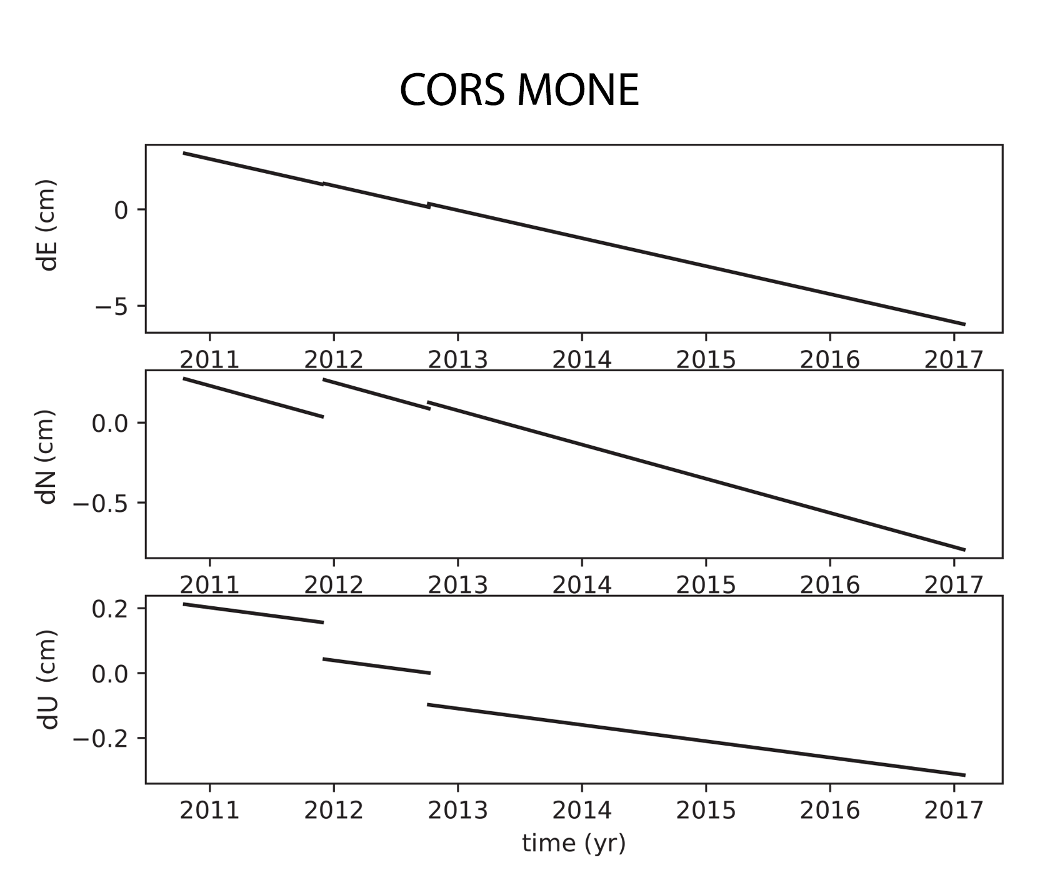
New Types of Coordinates
Active
Coordinate functions in time, generated by NGS, and not associated with a specific epoch. As these coordinates are computed by NGS (or adopted by NGS) they are considered “part of the NSRS”.
Generally will only be available at each CORS
Also being called the coordinate function
Which will be generated by a “fit” to daily processed data

Slide 49
New Types of Coordinates
Reported
Coordinates directly reported to NGS without the data necessary for NGS to replicate or evaluate them. These coordinates are neither “part of the NSRS” nor “tied to the NSRS”.
Scaled
From NCAT or Vdatum
NGS Coordinate Conversion and Transformation Tool (NCAT)
Hand Held / Smartphone
Reported directly from an RTK rover without data files

Slide 50
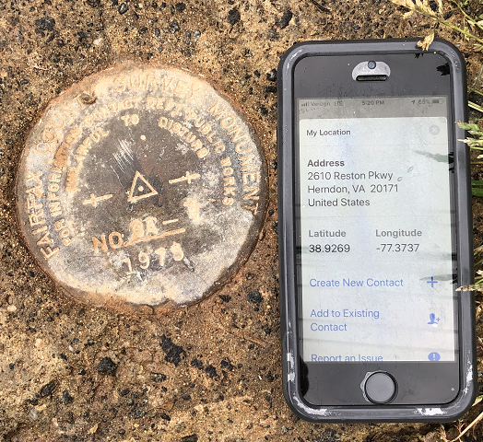
Reported Coordinates

Slide 51
New Types of Coordinates
OPUS
Coordinates computed by OPUS that have not been evaluated by anyone at NGS.
As these coordinates are not computed by NGS they are not considered “part of the NSRS”.
However, if NGS-provided OPUS recommendations are followed, they may be “tied to the NSRS”
User-computed values, such as they might get today from either OPUS-S or OPUS-Projects
“OPUS” coordinates are the only coordinates a user will get directly from OPUS

Slide 52
Five types of coordinates
Name | Generally on… | Description
Reported | Passive control | “Quick and Dirty”. Smartphone accuracy.
OPUS | Passive control | Computed by you with OPUS using your data. Unchecked by NGS.
Survey epoch | Passive control | Time-dependent. Computed by NGS.
Active | Active control | Continuous time-dependent CORS coordinate functions.
Reference epoch | Passive and Active | Computed by NGS every five or ten years.

Slide 53
OPUS and the Data Delivery System (DDS)

Slide 54
OPUS and the DDS
Use OPUS 6.0 if you wish to:
Use the DDS if you wish to:
Report a mark to NGS
Turn a RINEX file into a coordinate (much like OPUS-S today)
Upload a project, reduce the data, adjust it, get OPUS coordinates and submit your data to NGS to turn into RECs and SECs
Supports GNSS (including BYOV*), Classical (Total Station), Leveling and Relative gravity observations
Find marks near you
and add them to a project if you like
Get information about a mark or station (like datasheets today, but much better)
Query the NSRS Database for anything (orbits, observations, reports, etc.) but especially if it’s a spatial query:
Show me every mark with ‘WAS’ in the designation, occupied with GPS between 1995 and 2005, leveled on any date after 2000, within 50 km of a CORS and over 10 km from a state border…go!
* Bring your own vectors, whether from industry
software, historic databases or RTK/RTN

Slide 55
OPUS Coordinates
Whether or not you use the “-S module” or the “-Projects module”, your final coordinates from OPUS 6.0 will be labeled OPUS coordinates
Additionally, if you follow OPUS recommendations, you will see
“Tied to the NSRS”
If you do not follow OPUS recommendations, you will see
“Not tied to the NSRS”
But you will still get coordinates, and they will be called OPUS coordinates
OPUS coordinates will not be labeled: “Part of the NSRS”
That is reserved for NGS-computed coordinates (SECs, RECs and ACs) in the NSRS database

Slide 56
OPUS Recommendations
OPUS will recommend:
What control to use, what weights to use, etc.
When recommending active control
Will use the (upcoming) station selection criteria
Emphasizing high quality, available data at stable stations
When recommending passive control
Will probably recommend active control first, if appropriate
Then, will likely limit recommendations by date of most recent occupation, REC or SEC uncertainty estimates or other factors
Notes:
You are free to adopt all/some/none of these recommendations. But if you don’t adopt ALL of them, you will not get OPUS coordinates that are “tied to the NSRS”.

Slide 57
OPUS: Submitting
Unlike traditional “Bluebooking”, future submissions to NGS:
Will not be your completed projects and coordinates
But will come from those completed projects
Will be the raw observations you loaded to your project
Which will then be used in the computation of RECs and SECs
Submitted with a simple “submit” button
Not the more arduous “Bluebooking” process
Without your submissions, passive control will become outdated with growing error bars
PLEASE always submit your projects.

Slide 58
OPUS: Sharing
Your OPUS work can be shared with the world
This is different from submitting to NGS!
This is similar to today’s “OPUS Share” feature
Request to share your results and:
OPUS will create a summary of your OPUS work (whether from a single RINEX file or a massive project)
That summary will be formatted with graphs, maps and other info into a single web page
That web page will be stored on NGS web servers and assigned a random URL for you to share with whom you like.

Slide 59
Survey data
OPUS
Did you follow OPUS recommendations?
yes
no
OPUS Coordinates that are
“tied to the NSRS”
OPUS Coordinates that are
“not tied to the NSRS”
yes
Did you submit your data to NGS?
no
Do you want to “share” your results with the world?
yes
no
NGS will use your survey data in future REC and SEC adjustments
NGS will not use your survey data in future REC and SEC adjustments
Unique, public URL for this survey which you can share with anyone
Your results are shown to you on screen or via email only

Slide 60
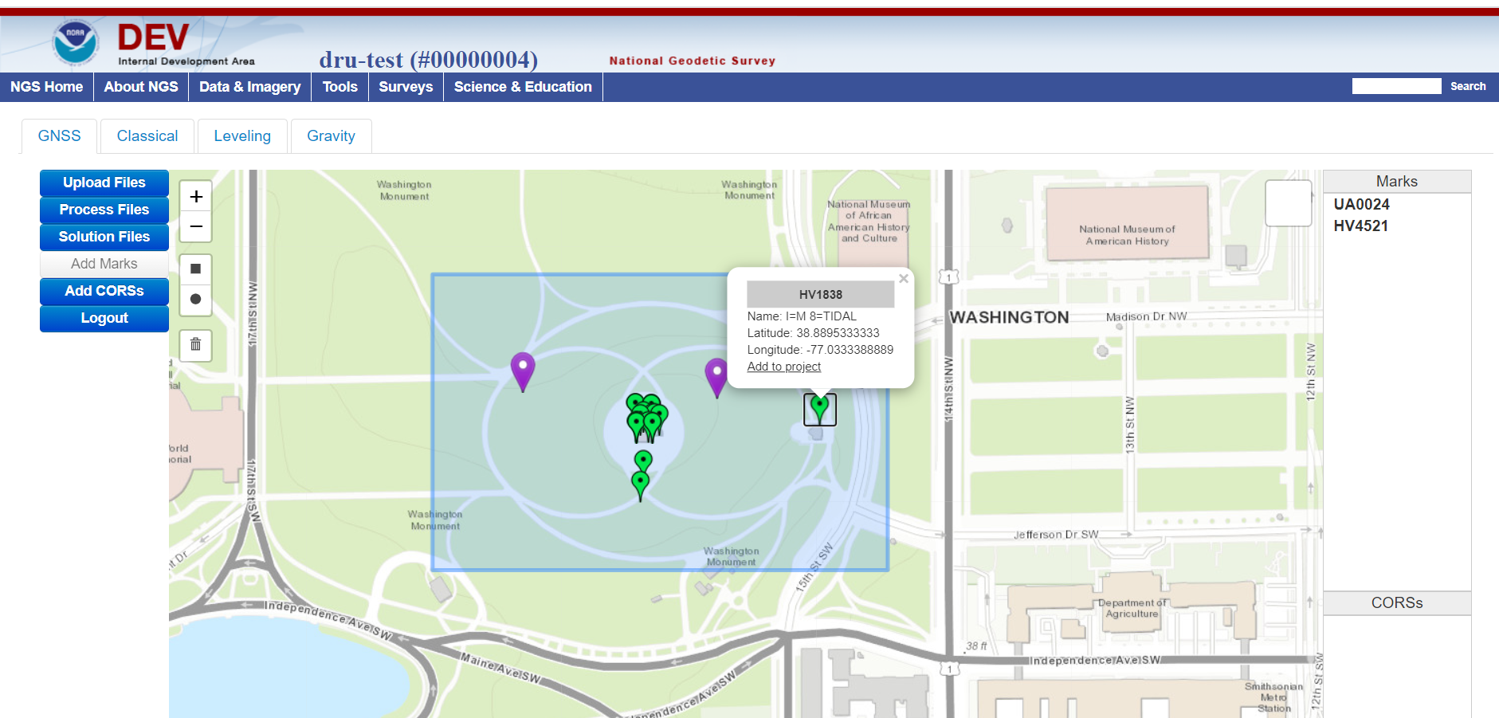
A sneak peak at how projects will look
Notes:
Note the simple add/remove function to put marks into and out of the project.
Note the four tabs to upload and process four types of geodetic control data.

Slide 61
OPUS: Common Data Formats
OPUS will only accept data in one unique format, per instrument type
NGS is developing each of these (except RINEX)
In coordination with the IAG’s GeodesyML initiative
NGS is working with instrument manufacturers to adopt these
Data/Instrument type | Name of format | Notes
Raw GNSS | RINEX (3.* preferred, 2.* allowed for now)
GNSS vectors | GVX | Released Feb 2021
Leveling (raw & reduced) | LVX (tentative name) | Expected release in 2021
Classical Angles/Distances (raw & reduced) | CVX (tentative name) | Expected release in 2021
Relative gravity | RGX (tentative name) | Expected release in 2021

Slide 62
Terminology

Slide 63
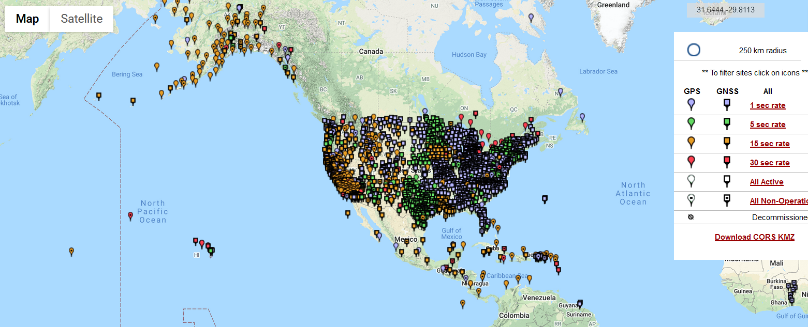
The NOAA CORS Network (NCN)
As of 2019, this is the official name of the network managed at NGS
Historically referred to as “CORS” or “the CORS”

Slide 64
ARP vs GRP
The purpose of a CORS can be debated
But at NGS: the continuous collection of GNSS data for the express purpose of determining the continuous coordinates of a unique, permanent, antenna-independent point at each CORS
Such a point is called the Geometric Reference Point, or GRP
Not to be confused with the Antenna Reference Point, or ARP
Which is part of each antenna, not a permanent, unique physical part of a CORS
Identification of GRPs has begun
Coordinates on a CORS will eventually be fully transitioned to be “coordinates of the GRP of the CORS”. Right now they are…unclear.

Slide 65
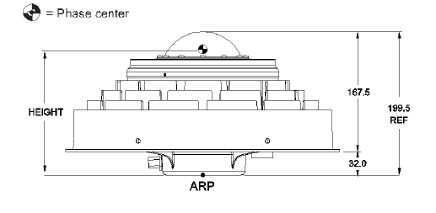
The NCN – ARP/GRP issues
In a perfect world, the ARP and GRP will physically coincide at a CORS while an antenna is mounted at that CORS
Without endorsement, consider the NovAtel GNSS-750

Slide 66
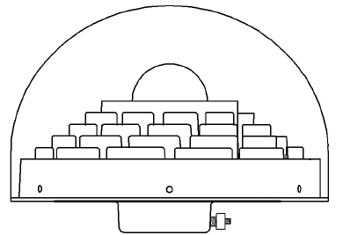
The NCN – ARP/GRP issues
The ARP is on the lowest non-removable plane of the antenna, usually coinciding with the axis of attachment
The GRP is:
a unique point that is part of a particular station
the point to which any coordinate functions of the station should* refer.
identified by the operator of each station
(for a CORS) part of the fixed (=non-removable) part of the antenna mount
In this example, we find it convenient to identify the GRP as the point on the axis of attachment which will coincide with the lowest non-removable plane of the antenna when the antenna is mounted.
* MUCH easier said than done!!!

Slide 67
The NCN – ARP/GRP issues
When the antenna goes away, so does the ARP
Leaving the GRP

Slide 68
Use Cases

Slide 69
Use Cases
BP3 contains four examples (use cases) of how today’s work becomes tomorrow’s work, in the modernized NSRS
Flood Mapping
Passive Control for a Multi-year Corridor Project
Transitioning Data to the Modernized NSRS
Leveraging the Modernized NSRS for Airport and Other Infrastructure Monitoring
For more details, attend next month’s webinar

Slide 70
Thank you!

Slide 71
Questions?

Slide 72
Initial NADCON Master Grids
Once the 2020.00 geometric REC adjustment project has been completed and loaded into the NSRS DB, NADCON will be expanded. Master grids will be created as below.
Region | Old Datum | New Reference Frame
CONUS | NAD 83(2011) epoch 2010.00 | *ATRF2022 epoch 2020.00
Alaska | NAD 83(2011) epoch 2010.00 | *ATRF2022 epoch 2020.00
Hawaii | NAD 83(PA11) epoch 2010.00 | *ATRF2022 epoch 2020.00
PR / VI | NAD 83(2011) epoch 2010.00 | *ATRF2022 epoch 2020.00
American Samoa | NAD 83(PA11) epoch 2010.00 | *ATRF2022 epoch 2020.00
Guam / CNMI | NAD 83(MA11) epoch 2010.00 | *ATRF2022 epoch 2020.00
* Why isn’t this specified? Because by design, NATRF2022, PATRF2022, CATRF2022, MATRF2022 and ITRF2020 are all identical at epoch 2020.00. They will drift apart after that! But the initial jump into 2020.00 via NADCON will land you at the exact same coordinates no matter which of the five frames you choose.

Slide 73
Latter NADCON Master Grids
Once the first geometric REC adjustment project beyond 2020.00 has been completed and loaded into the NSRS DB, NADCON will be expanded. Master grids will be created in specific frames for specific regions:
Region | Frame for master NADCON grids
CONUS | NATRF2022
Alaska | NATRF2022
Hawaii | PATRF2022
PR / VI | CATRF2022
American Samoa | PATRF2022
Guam / CNMI | MATRF2022
However, once the master grids are made, they can be transformed with exact accuracy into grids in different frames. For example, in the region “CONUS”, the master grid connects REC coordinates in NATRF2022. However, it is a simple matter (using EPP2022) to have it connect to PATRF2022. This flexibility will be built into tools such as NCAT and VDatum.

Slide 74
Initial VERTCON Master Grids
Once the 2020.00 geometric REC adjustment project and the 2020.00 orthometric REC adjustment project has been completed and loaded into the NSRS DB, VERTCON will be expanded. Master grids will be created as below.
Region | Old Datum | New Geopotential Datum
CONUS | NAVD 88 | NAPGD2022 epoch 2020.00
Alaska | NAVD 88 | NAPGD2022 epoch 2020.00
Hawaii | N/A | NAPGD2022 epoch 2020.00
PR | PRVD 02 | NAPGD2022 epoch 2020.00
VI | VIVD 09 | NAPGD2022 epoch 2020.00
American Samoa | ASVD 02 | NAPGD2022 epoch 2020.00
Guam | GUVD 04 | NAPGD2022 epoch 2020.00
CNMI | NMVD 03 | NAPGD2022 epoch 2020.00
Unlike NADCON there is no choice on what the destination (geopotential datum) will be.

