Slide 1

Measuring Sticks, Gravity Meters, and Fancy Clocks –
How They’ll Contribute to our New National Height System
NIST Time and Frequency Monthly Seminar
November 2020
Derek van Westrum, Ph.D.
NOAA’s National Geodetic Survey
geodesy.noaa.gov

Slide 2

Me
I’m Derek van Westrum
I grew up in Golden, Colorado
I attended the University of Colorado for a good, long while
15 years at Micro-g LaCoste making gravity meters
6 years as physicist with NOAA’s National Geodetic Survey
I climb 14ers
Hi, I’m Derek!

Slide 3
This Talk…
…is about height systems in the US, and in particular, about a new one that’s on the way. These affect elevations on maps and much, much more. I’ll kinda go in this order:
Datum info on maps – “14ers” as examples
NOAA’s old height system for the nation
Why we obviously need a new one
A seemingly unrelated discussion of the shape of the Earth
NOAA’s new height system for the nation
An actual, practical example
The future: dealing with change and hooking up clocks!

Slide 4
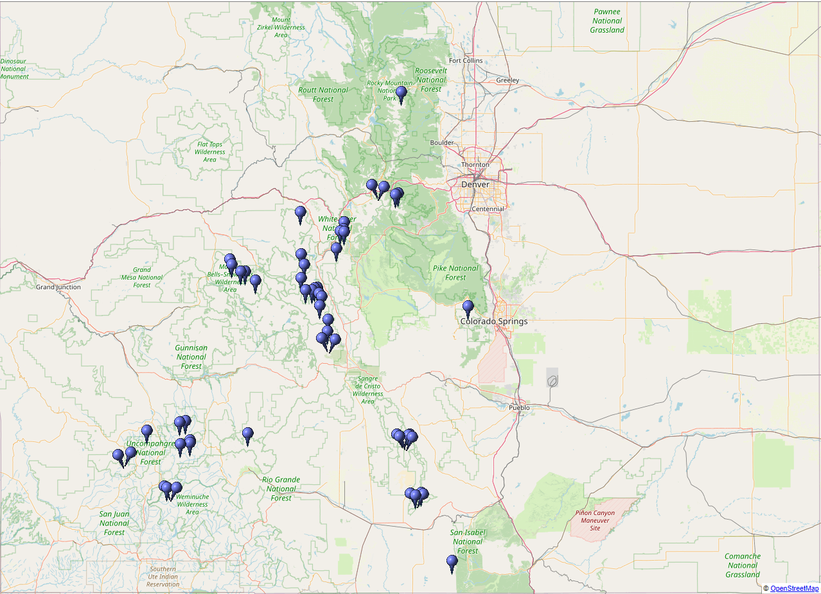
Colorado has 57* Peaks with Summit Elevations of at Least 14,000 Feet
Highest: Mt Elbert, 14,440 ft
Lowest: Sunshine Peak, 14,007 ft
* Don’t get me started on what constitutes a “peak”… Some say there are 53, others 58! It’s surprisingly subjective…

Slide 5
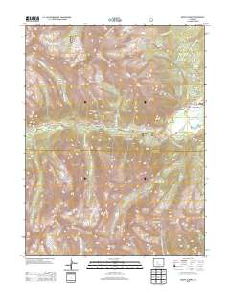
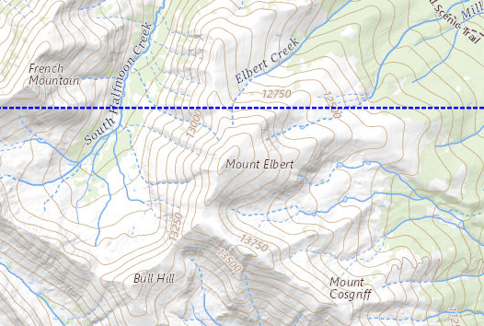
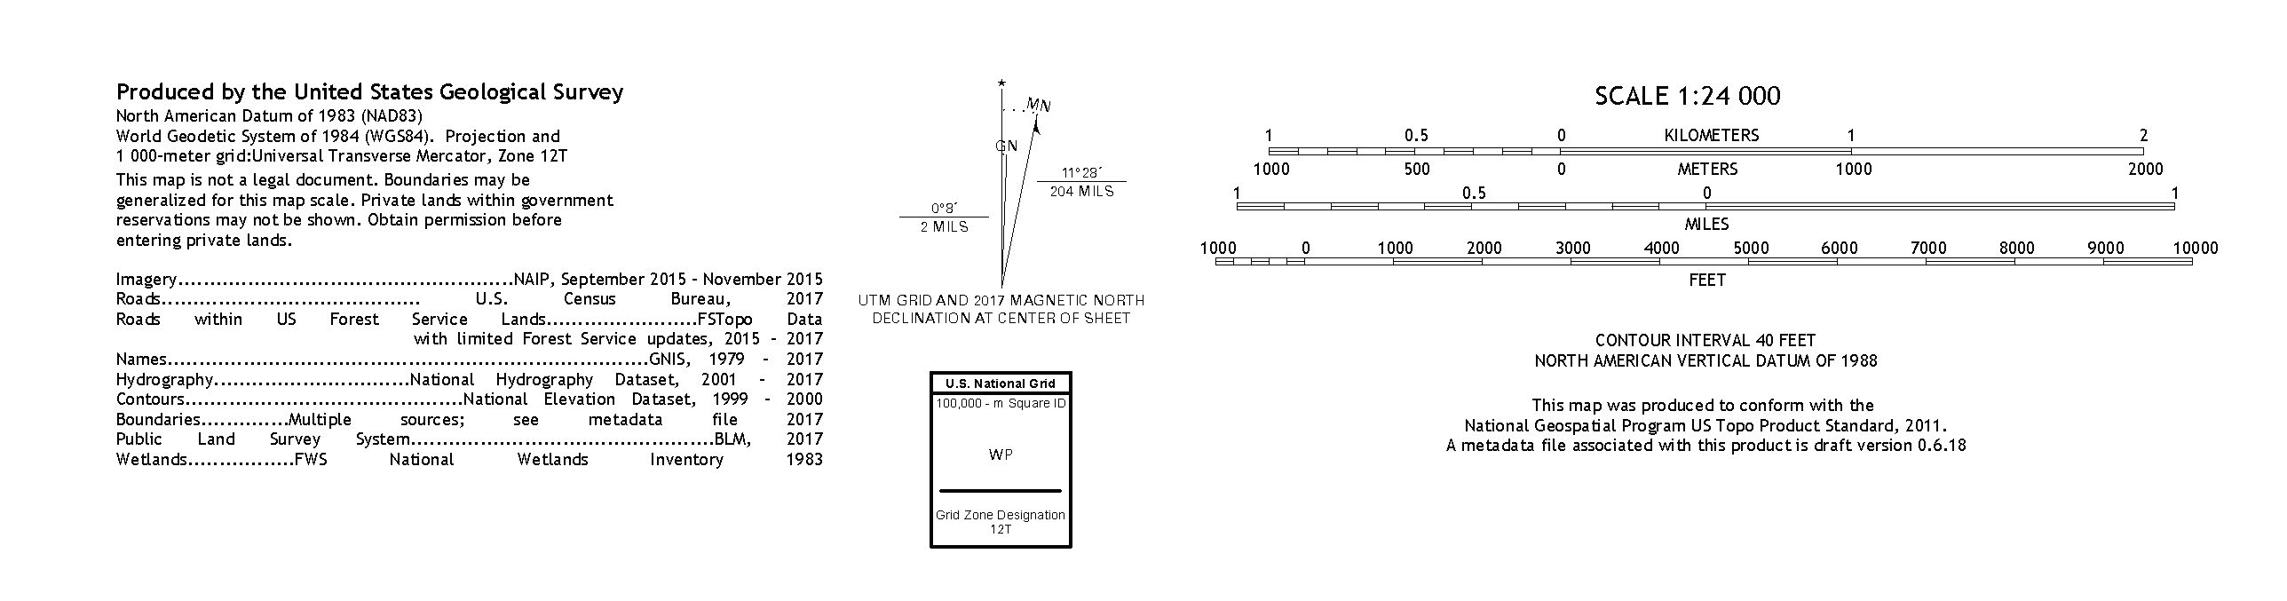
Vertical Datum Information on Topo Maps
A decent topographic map will include information on its datums.
This USGS example (Mount Elbert, CO) indicates the vertical datum is NAVD88.
Even blown up, that’s some fine print, huh?

Slide 6
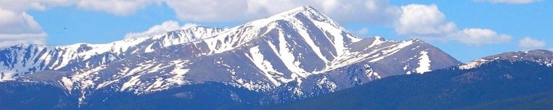
How High was Mt Elbert When?...
NGVD29* elevation = 14433 feet
NAVD88 elevation = 14440 feet
The mountain didn’t change (that much…) – the datum defining its elevation did.
So what’s a Datum? It’s what we call zero, or where we start from.
Who gets to pick? How? Why?
*National Geodetic Vertical Datum 2019

Slide 7
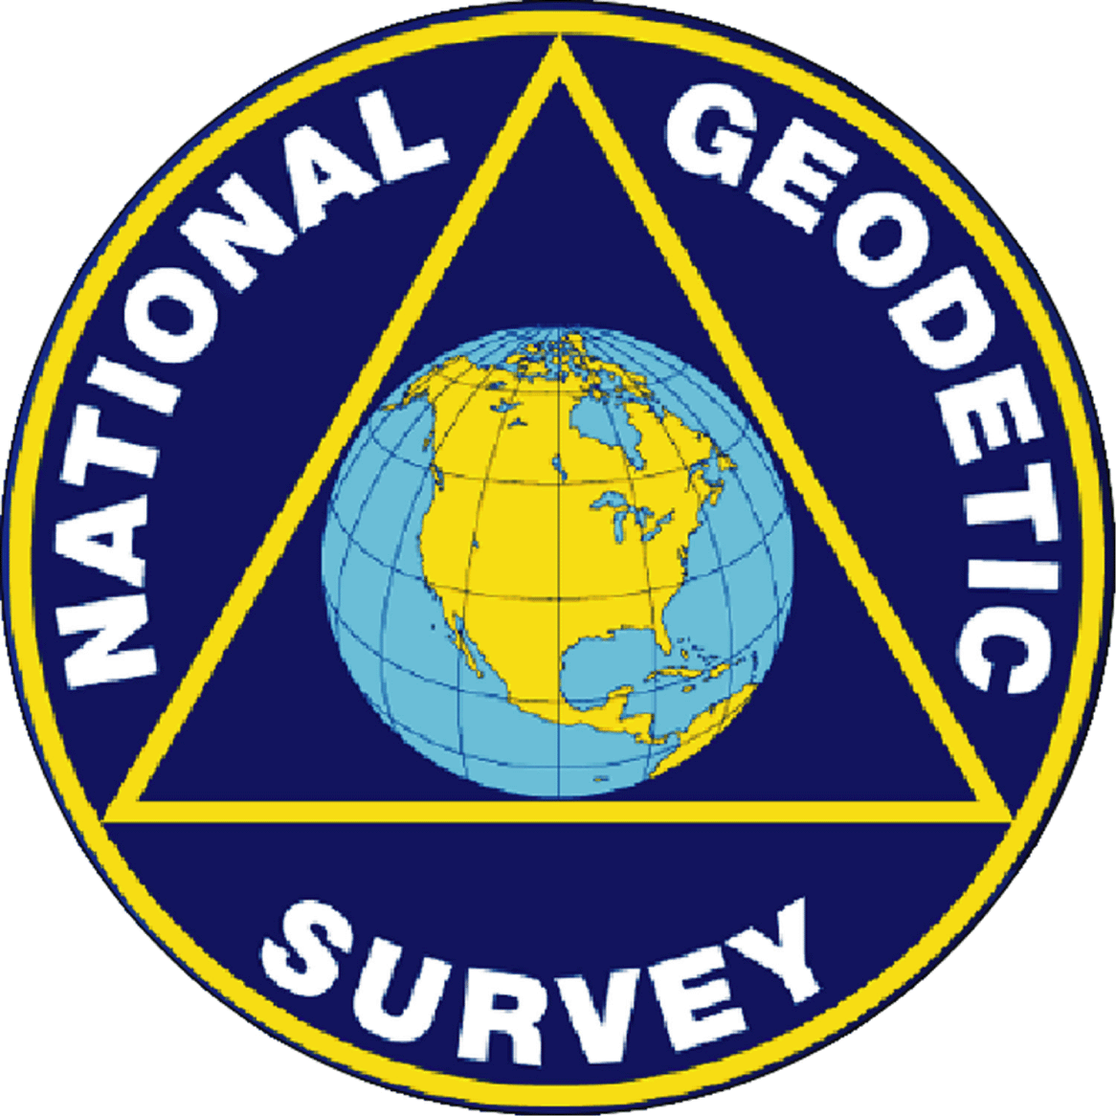





NGS Does! Our Mission Statement:
To define, maintain, and provide access to the National Spatial Reference System (NSRS) to meet our nation’s economic, social, and environmental needs.
The NSRS is a consistent coordinate system that defines latitude, longitude, height, scale, gravity, and orientation throughout the United States, for all federal agencies.
Nautical charts, among many other geospatial applications
Topographic Maps and interior water data for the nation
Emergency Response Imagery, Flood zones
NSRS gravity data for the geospatial mission of NGA
Levee Safety Program
Aeronautical Data Quality Assurance

Slide 8

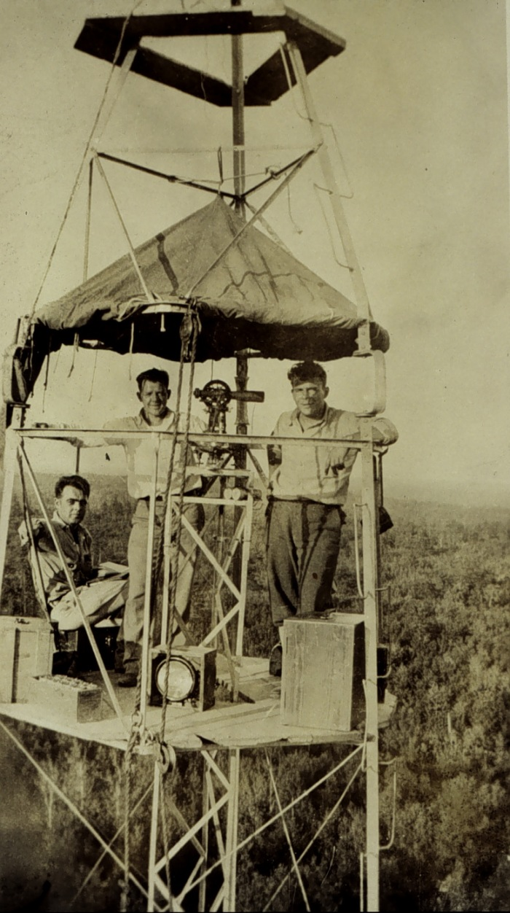
Where does NAVD88 Come From? The Story of “The Old Man and The Sea (Level)”
The National Geodetic Survey, our Nation's first civilian scientific agency, was established by President Thomas Jefferson in 1807 as the Survey of the Coast. Its mission was, and still is, to survey the U.S. coastline and create nautical charts of the coast to help increase maritime safety. As the nation grew westward surveys of the U.S. interior began. In 1878 the agency was given a new name, the U.S. Coast and Geodetic Survey (USC&GS), which it maintained until 1970. At that point, the National Geodetic Survey became part of the National Oceanic and Atmospheric Administration, NOAA.
The ocean seems like a good place to call zero for land heights, right?

Slide 9
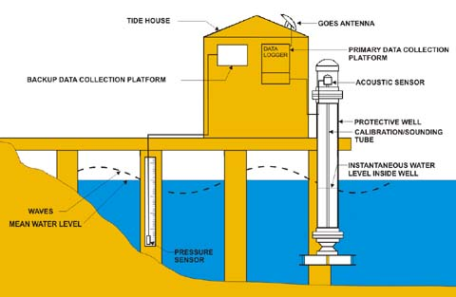
Tide Gauges: Finding Sea Level
Walk down to the shore, average out the high and low tides, make a mark on a post, et voila*:
We’ve got a datum!
Annoyingly, because of currents and salinity, sea level isn’t actually the same height everywhere…
*”voila” is a French word meaning “observe closely for 19 years, literally”

Slide 10
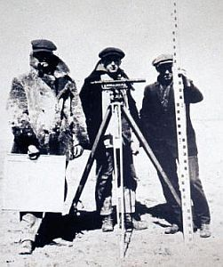
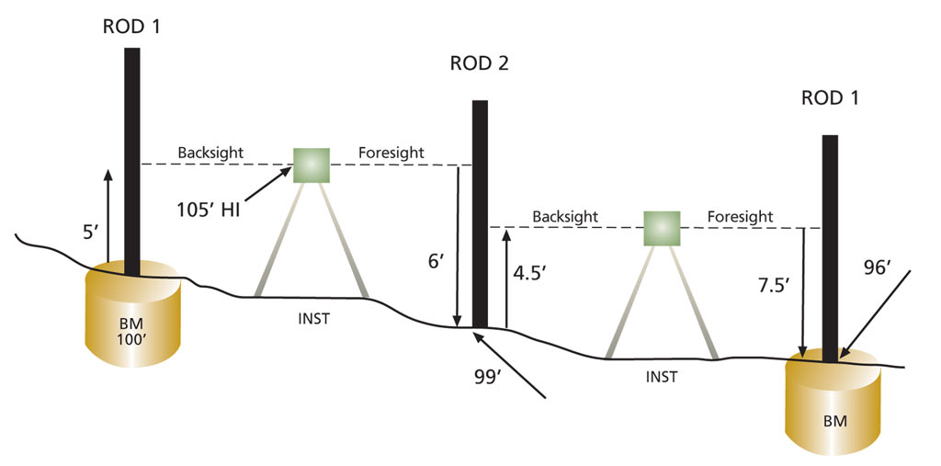
Leveling: How High Above Sea Level?
You’re digging these jackets, aren’t you?
Once you have a zero line, start walking inland with rulers
“Simply” keep track of accumulated height differences.
“First order” accuracy: 0.7mm/√km*
*This is still the best way to get accurate height differences between fixed points (for now…)

Slide 11
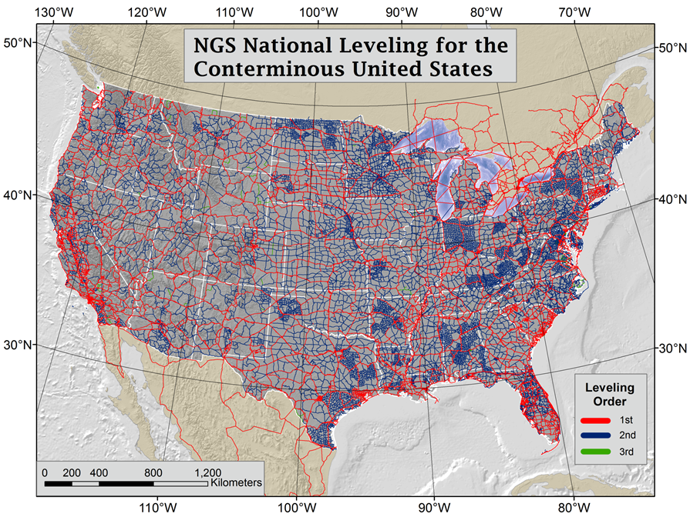
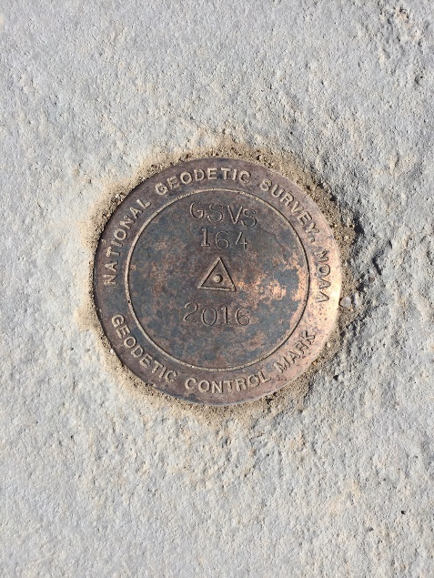
You can do a lot of leveling…
  Massive leveling and gravity campaign across the country yielded measurements at >500,000 benchmarks

Slide 12
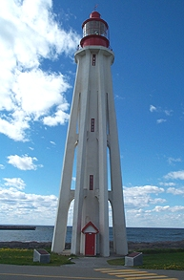
“Old Man and The Sea (Level) cont.”
NAVD88, the current vertical datum, is still based on sea level
“…a leveling network on the North American Continent, ranging from Alaska, through Canada, across the United States, affixed to a single origin point on the continent”:
Tide Station & Location = Pointe-au-Pere, Rimouski, Quebec, Canada
PID = TY5255
GSD* Designation = 54L071
Bench Mark = 1250 G
Height above Local Mean Sea Level ≡ 6.271m
So, the US (and Canada) picked a convenient bench mark, defined its elevation to be 6.271 meters above the mean sea level, and that locked all the other bench marks to their new heights

Slide 13
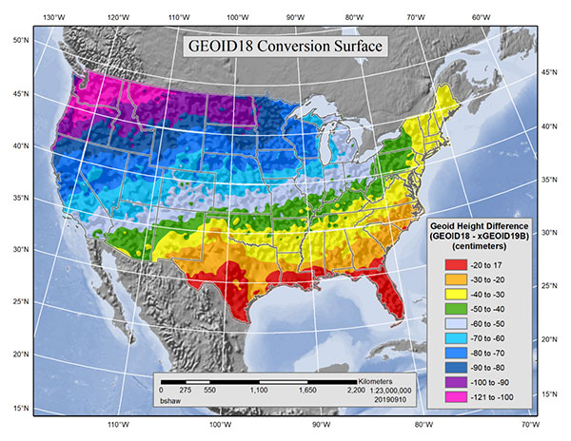
Problems with NAVD88 (Part 1!)
We now know that it has an annoying, systematic “tilt” with respect to “sea level”* across the country
(Looking ahead: this is a plot of the estimated error in the current datum. Correcting this error will change local heights by about this much)
*and remember: sea level isn’t quite level to begin with…

Slide 14
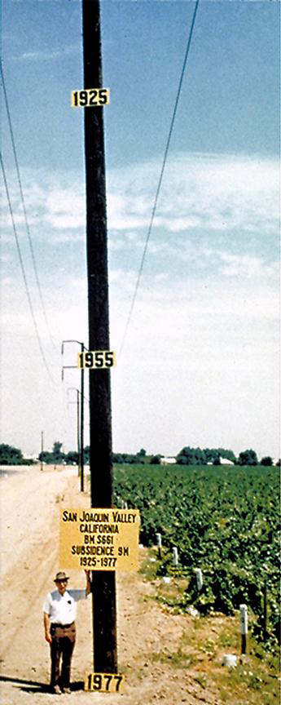
And more Problems with NAVD88
Benchmarks change (height, especially) or disappear with time:
  Hydrology – subsidence from ground water usage 10s of meters in California!
  Cryospheric – uplift from glacial isostatic adjustment (post-glacial rebound). 1-3 cm/year up north
  Earthquakes, volcanoes
  Pesky vandals…
NAVD88 is only realized at the benchmarks it occupies. “New” points, or local survey control, must be leveled from an existing benchmark
So yeah, we’re going to need a fancy new sea level

Slide 15
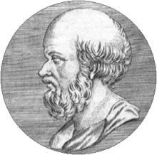
Let’s Start from Scratch
Try to say my name one times fast!
How do we best measure and describe the shape of the Earth?
Through a series of successive models:
~forever: The Earth is Flat. Most everyone not paying attention.
~200 BC: The Earth is a Sphere. Eratosthenes used wells to prove this, and calculated its radius to ~10%.
~1675 CE: The Earth is an Ellipsoid. Cassini (1666) noticed Jupiter appears elliptical, and Richer (1672) noticed his pendulum had a longer period near the equator => Huygens thought about it, and Newton used physical principles to explain why the Earth is actually an ellipsoid* due to its rotation
Is that the final word?
*To pile on: such an ellipsoid is technically referred to as an “oblate spheroid”.

Slide 16
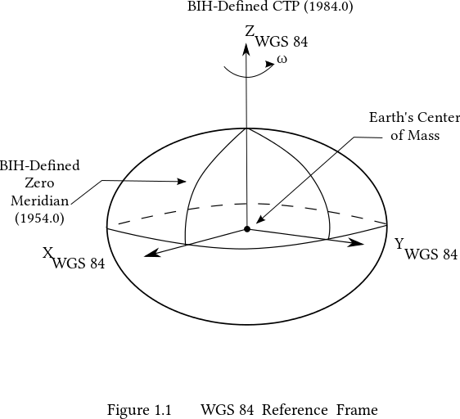
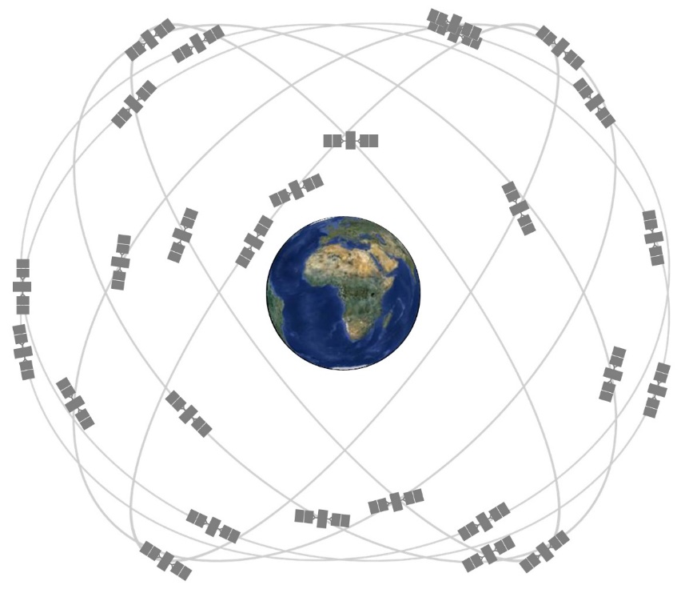
From Afar: GPS and the Ellipsoid
Way out at the altitudes of GPS satellites (~20,000km), the Earth does indeed look like a perfect ellipsoid with a simple shape and a uniform density of 2.67g/cm³ .
GPS allows for very accurate (~1cm!) location determinations relative to this mathematically well-defined Ellipsoid.
The ellipsoid model currently used by GPS is WGS84. Its origin is located at the CM of the Earth.

Slide 17
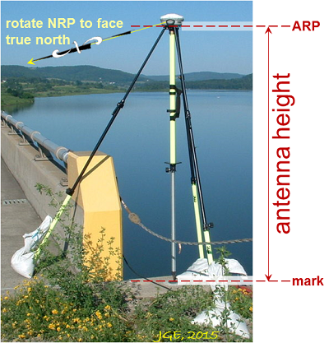
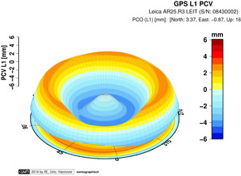
1cm, Really? GPS and Your Ellipsoidal Position
Well, first you need a well calibrated, survey grade antenna.
Calibrated by numerous, quick rotations to locate the phase center to ~1mm
Survey observations a minimum of 2-4 hours, preferably ~24 hours
each antenna model has unique biases
Notes:
Mention that the geoid is not an ellipsoid shape, but lumpier. Only 170m_pp though!

Slide 18
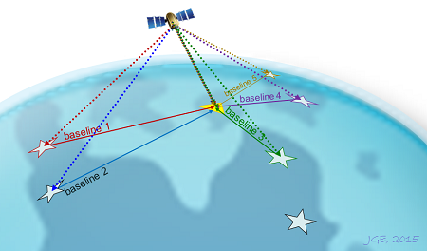
Networked GPS and Your Ellipsoidal Position
NGS OPUS SOLUTION REPORT
========================
All computed coordinate accuracies are listed as peak-to-peak values.
For additional information: https://www.ngs.noaa.gov/OPUS/about.jsp#accuracy
USER: joe.evjen@noaa.gov DATE: December 05, 2016
RINEX FILE: 5947299r.16o TIME: 18:45:47 UTC
SOFTWARE: page5 1209.04 master95.pl 160321 START: 2016/10/25 17:14:00
EPHEMERIS: igs19202.eph [precise] STOP: 2016/10/25 21:49:00
NAV FILE: brdc2990.16n OBS USED: 11436 / 12254 : 93%
ANT NAME: TRM57971.00 NONE # FIXED AMB: 82 / 83 : 99%
ARP HEIGHT: 2.0 OVERALL RMS: 0.010(m)
REF FRAME: NAD_83(2011)(EPOCH:2010.0000) IGS08 (EPOCH:2016.8164)
X: -2833371.235(m) 0.013(m) -2833372.332(m) 0.013(m)
Y: -1541100.973(m) 0.015(m) -1541099.963(m) 0.015(m)
Z: 5484647.219(m) 0.026(m) 5484647.459(m) 0.026(m)
LAT: 59 42 33.45847 0.003(m) 59 42 33.44896 0.003(m)
E LON: 208 32 32.07518 0.007(m) 208 32 31.98492 0.007(m)
W LON: 151 27 27.92482 0.007(m) 151 27 28.01508 0.007(m)
EL HGT: 503.684(m) 0.032(m) 504.134(m) 0.032(m)
ORTHO HGT: 494.346(m) 0.055(m) [NAVD88 (Computed using GEOID12B)]
UTM COORDINATES STATE PLANE COORDINATES
UTM (Zone 05) SPC (5004 AK 4)
Northing (Y) [meters] 6620045.124 636606.995
Easting (X) [meters] 586771.176 417957.136
Convergence [degrees] 1.33177427 -1.25880956
Point Scale 0.99969227 0.99998247
Combined Factor 0.99961346 0.99990364
US NATIONAL GRID DESIGNATOR: 5VNG8677120045(NAD 83)
BASE STATIONS USED
PID DESIGNATION LATITUDE LONGITUDE DISTANCE(m)
DM7460 AC61 CHICKENM61AK2006 CORS ARP N640145.332 W1420432.948 688041.0
DP9272 MCES MCNEIL CANYON ELE CORS ARP N594445.882 W1511528.107 11973.1
DL7665 AC39 SHUYAKISSPAK2006 CORS ARP N583634.993 W1522338.579 133691.6
NEAREST NGS PUBLISHED CONTROL POINT
UW5506 LOOKOUT MTN N594233.480 W1512727.891 0.8
Next, you merge your observations with a network of permanent Continuously Operating Reference Stations (CORSs)
A least-squares adjustment, NGS’s Online Positioning User Service (OPUS), provides ellipsoidal heights to a few cm.
Notes:
Mention that the geoid is not an ellipsoid shape, but lumpier. Only 170m_pp though!

Slide 19
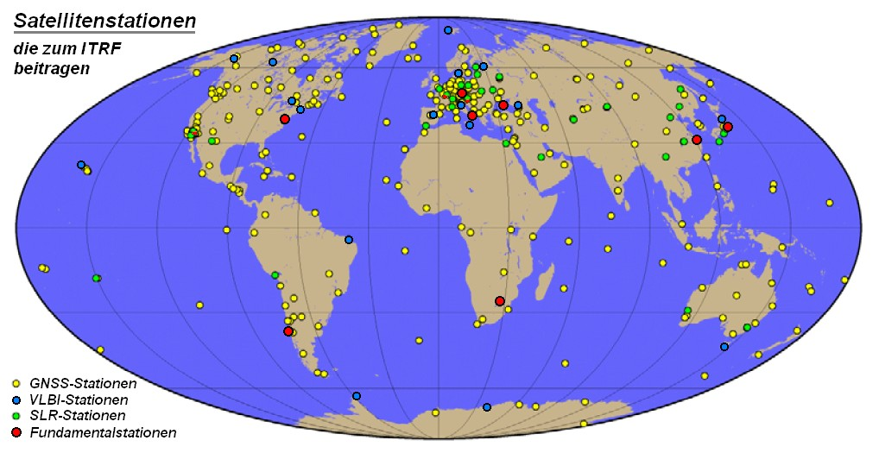
Aside: The Position of the Network Stations Themselves?…
The International Terrestrial Reference Frame (ITRF14) is maintained by The International Earth Rotation and Reference Systems Service (IERS)
The ITRF is positioned relative to the International Celestial Reference Frame (ICRF- think extragalactic quasars) and is used to define the positions of ~150 stations worldwide
These stations, in turn, define the position of the GPS satellites’ orbits
In the US, densification of the ITRF is done through a network adjustment of additional, continuously operating reference stations (CORSs) in the NOAA CORS Network (NCN)
These CORSs are what allow for the accurate determination of your observations
Notes:
Mention that the geoid is not an ellipsoid shape, but lumpier. Only 170m_pp though!

Slide 20
But Closer Up, Gravity Tweaks Things…
Okay, so far away the Earth is an ellipsoid, and we can get good positions relative to that…
But closer up, the Earth obviously has mountains and valleys. Even if there was so much water that it covered all the land, the shape would be irregular. This is because the mass of the Earth isn’t distributed evenly – gravity is stronger in some places compared with others. The underwater mountains would pull water towards “peaks” until water stopped flowing.
By the way, the resulting surface is “level” everywhere.
~1820: Laplace, Gauss, Bessel, Stokes (and others) developed the mathematics that allowed them to precisely declare that Earth is actually best described as a lumpy blob => Geodesy.

Slide 21
Earth’s Gravity Field, W
W = const defines a surface of constant gravity potential, or equipotential
Water doesn’t flow along such a surface – remember, they’re level.
There are infinitely many level surfaces. They are not necessarily parallel to each other, but never intersect.
Up close they’re lumpy blobs, but farther out they become more and more ellipsoidal.
Plumb lines are always perpendicular to every surface they intersect.
The one equipotential surface that, on average, best matches sea level is known as the geoid ≡ W₀, our fancy new sea level
Notes:
Mention that the geoid is not an ellipsoid shape, but lumpier. Only 170m_pp though!

Slide 22
Understanding “Potential”
Imagine pouring water onto a dry lake bed. If everything is level it will simply pool up. It would “like” to get to lower potential (darker lines), but the lake bed is in the way.
If the lake bed is tilted (it’s now the side of a hill), the water can move towards lower potential (towards darker lines). Water appears to flow because of a change in height
If the lake bed appears flat, but there is a mass anomaly under one end, the resulting geopotential difference causes water to flow to lower potential (again, from light to dark lines). It appears to flow because of gravity.
In all scenarios, water only flows when it has a path to lower geopotential – this is always a combination of gravity and height, g x H.
Notes:
Mention that the geoid is not an ellipsoid shape, but lumpier. Only 170m_pp though!

Slide 23
All These Surfaces Globally…
The actual, really jaggedy, surface of the earth – with mountains and canyons and climbing walls – that we see and want to map!
The Ellipsoid, that GPS sees
The Geoid (easy to see if you look at the ocean surface)

Slide 24

…And All These Surfaces Locally
Cool, so what’s my elevation?

Slide 25
H = h-N! That’s awesome. Thanks fancy new sea level!
“You” are Here
Earth’s Surface
Ellipsoid Height, h
From GPS
Orthometric Height, H
Mean Sea
Level
Alaska
Ellipsoid
Geoid Height, N
From NGS
Geoid
h - N = H
Note: Geoid height is negative in coterminous US, but is positive in most of Alaska

Slide 26
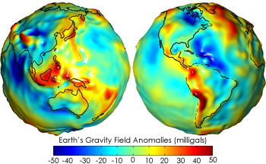

A few, minor, details….
Your tax dollars at work!
Getting N isn’t trivial…
  You’ve got to know the difference in true surface gravity from what you’d expect if the earth was a perfect ellipsoid. This is referred to as the gravity anomaly, ∆g.
  Then solve Stokes’ integral:
  Which also means you need to know ∆g over the entire surface of the earth (or, at least a continental-sized chunk of it…)
  (R is the mean radius of the earth, ɣ₀ is mean surface gravity on an equivalent ellipsoidal earth, S is an analytic (geometrical) function of position.)
And then, once you know N_{G} “everywhere”, you still need to be able to communicate it somehow…

Slide 27
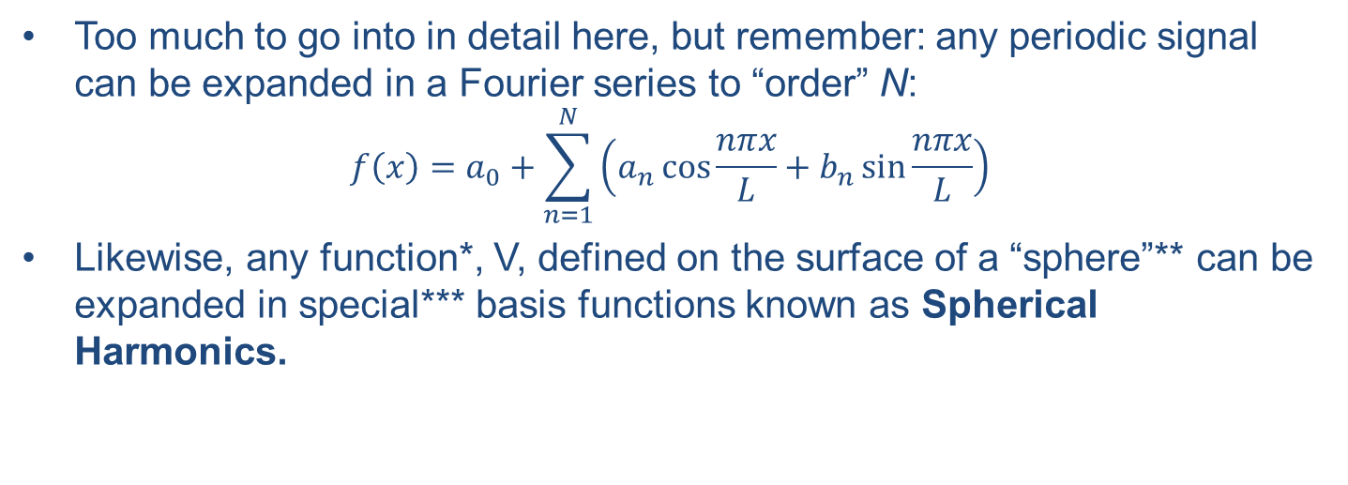
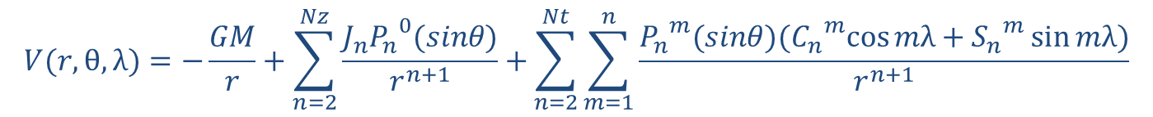
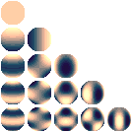
…which is where Spherical Harmonics come in
For our model, m and n go up to 2159! There are a lot of terms…
Like a Fourier decomposition, there are low-order, long wavelength terms, and successively higher-order, shorter wavelength terms.
n = 0
n = 1
n = 2
n = 3
n = 4
n = 5
* must be an “harmonic function”
**sphere or ellipsoid…
***feel free to confuse “special” and “spatial”

Slide 28
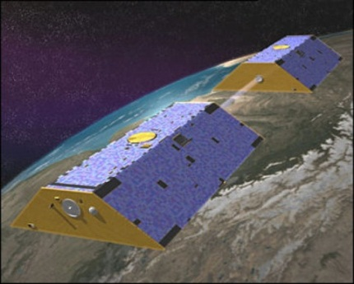
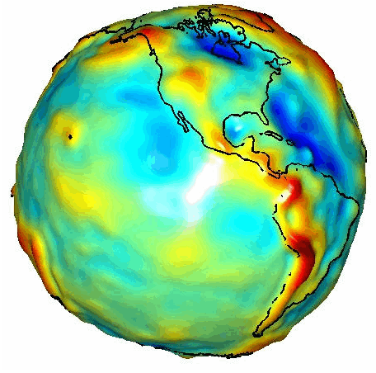
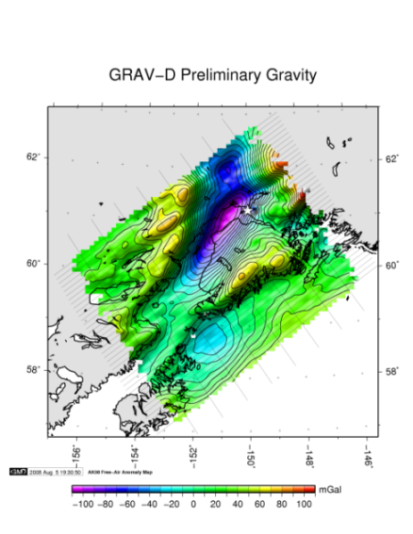
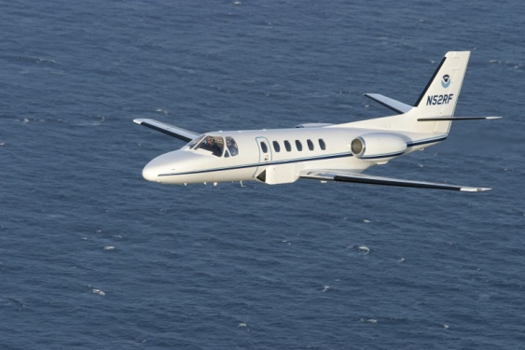
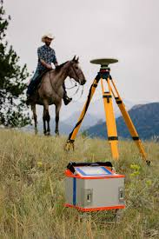
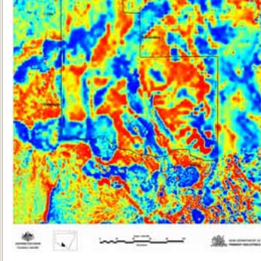
How to Build a Gravity Field, Δg
Long Wavelengths
(≥ 250 km)
GRACE/GOCE/Satellite Altimetry
+
Intermediate Wavelengths
(500 km to 20 km)
Airborne Measurement
+
Short Wavelengths
(< 100 km)
Surface Measurements and
Predicted Gravity from Topography

Slide 29
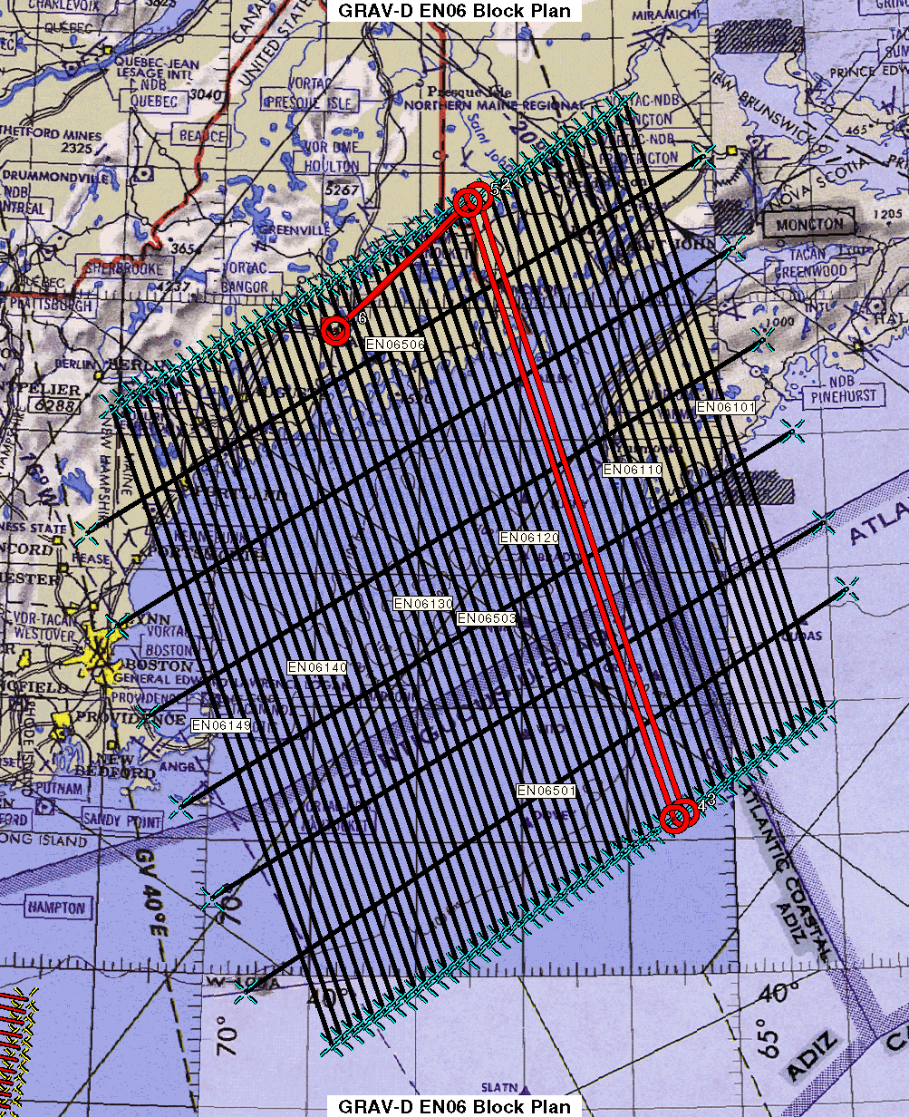
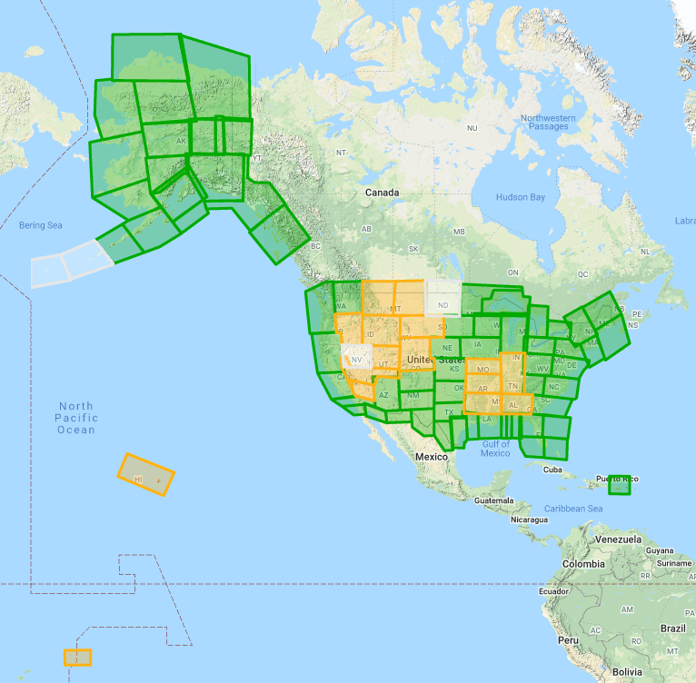
GRAV-D Status November 2020: 83%
Data lines spaced 10 km apart
Cross lines spaced 60-80 km apart (QC purposes)
Flight altitude 20,000 ft
Nominal speed 220-250 kts

Slide 30
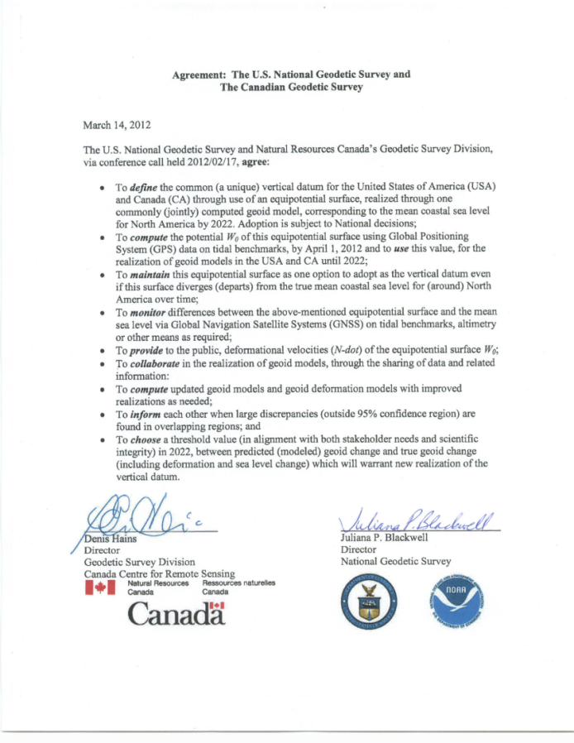
Wait, one last detail!
We still have to pick the W value that best matches “sea level”. This will define which geopotential surface is the geoid.
That’s the fancy new sea level, right there*
W₀ ≡ 62,636,856.0 m²s⁻²
(Note: W₀ ~ GM_{e}/R_{e}. The above definition effectively defines the combination of the gravitational constant and the mass and radius of the Earth, convenient for North America.)
The North American-Pacific Geopotential Datum of 2022 (NAPGD2022) will contain information for:
  N, the geoid undulation (GEOID2022 – purely gravity)
  Gravity anomalies (GRAV2022)
  Orthometric heights
  Deflections of the vertical (DEFLEC2022)
  & other gravity field information (GM2022)
*Subject to change in roughly 2025…

Slide 31
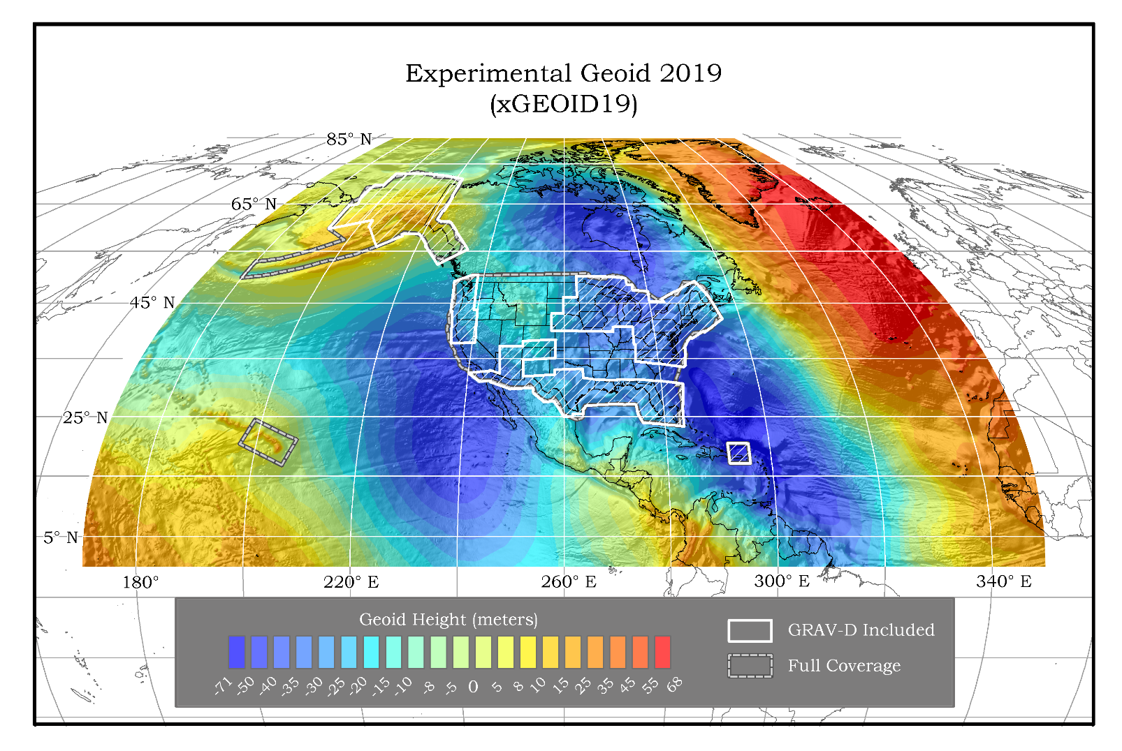
A Preview of the latest Geoid Model
Think of this as a picture of how sea level undulates – even under land masses.
Available on the Website: http://beta.ngs.noaa.gov/GEOID/xGEOID/

Slide 32
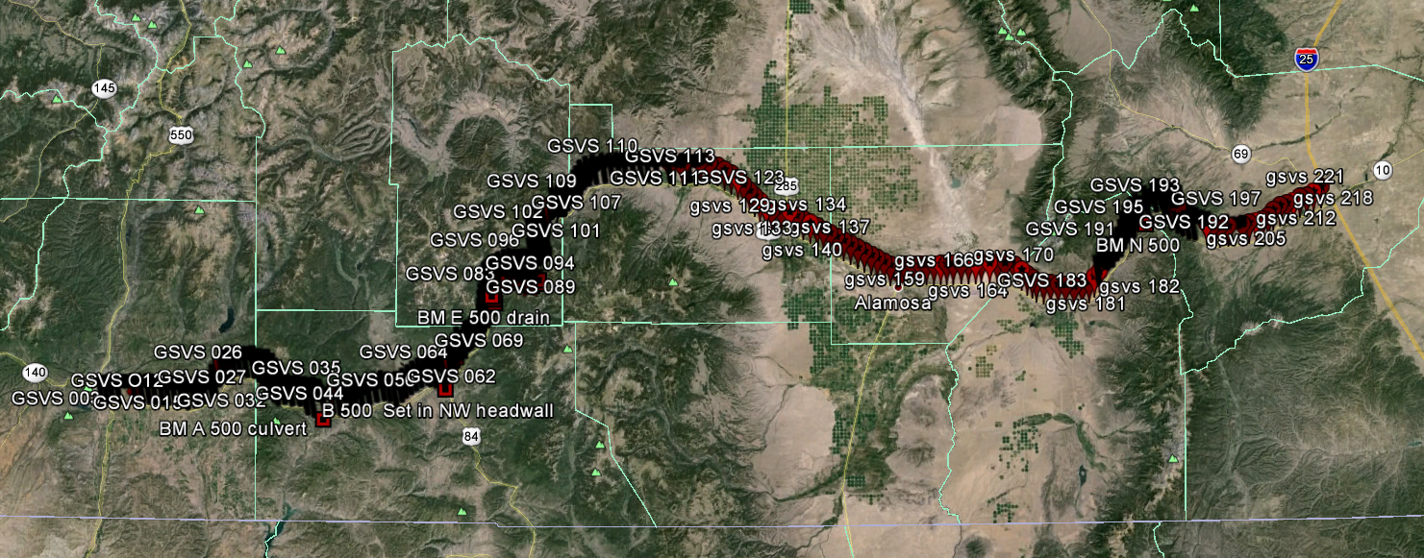
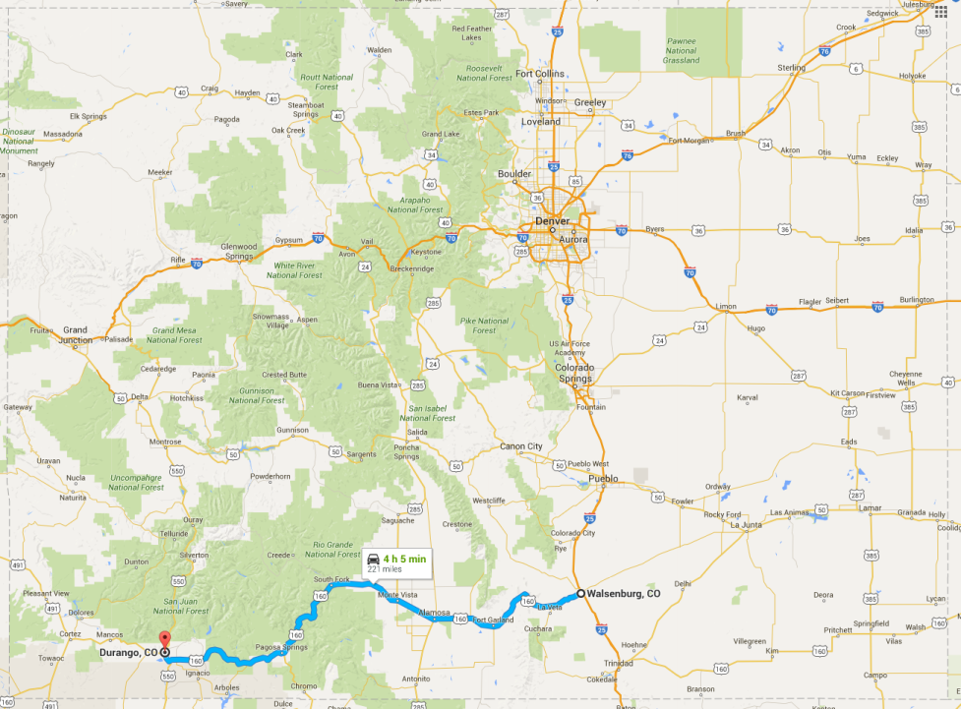
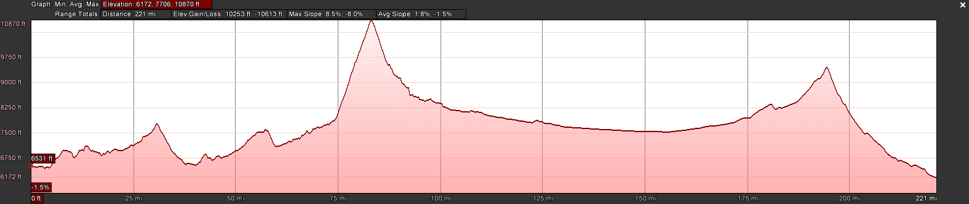
Ground Truth Surveys
Is this really all going to work? Yep! We’ve tested it in a series of ground-truth experiments.
After Texas and Iowa, the third (and likely final) survey took place along US160, from Durango to Walsenburg, in southern Colorado in the summer of 2017.
High elevation and rugged topography. “Worst case” for geoid modeling.
Variation from 6,000’ (MSL) to 11,000’, over two passes. 223 bench marks
In Colorado: ~4cm geoid accuracy
”A Geoid Slope Validation Survey (2017) in the Rugged Terrain of Colorado, USA” accepted for publication in Journal of Geodesy

Slide 33
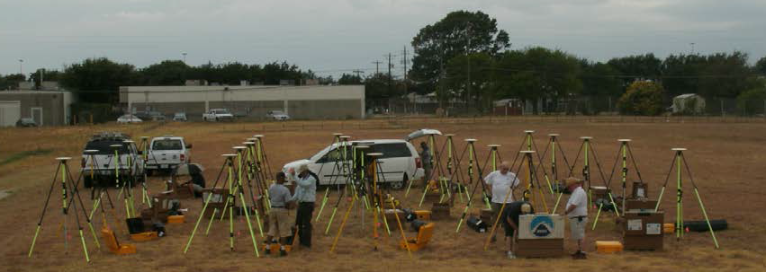
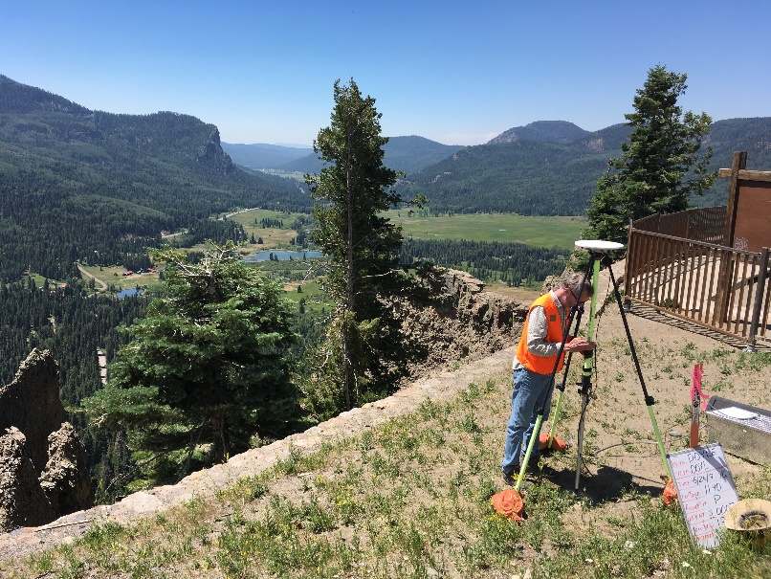
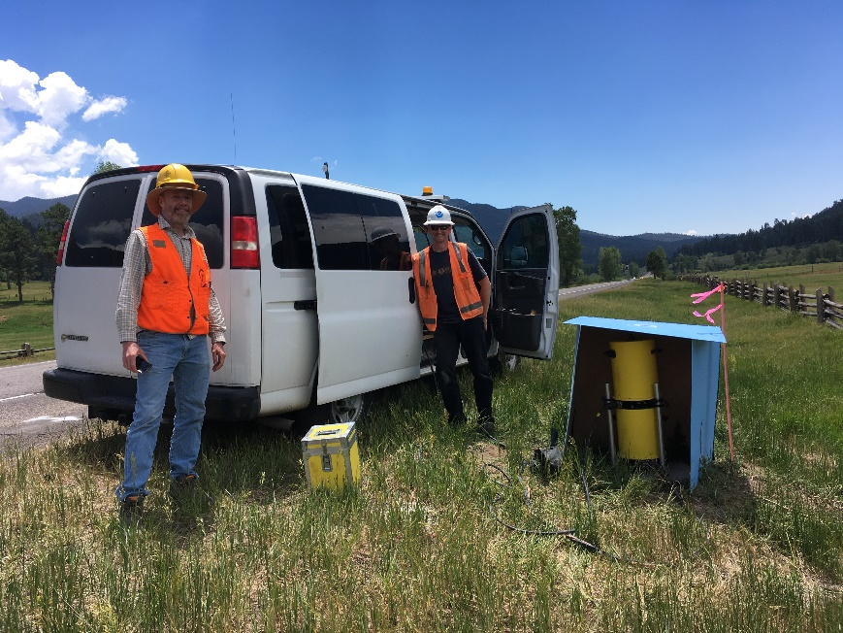
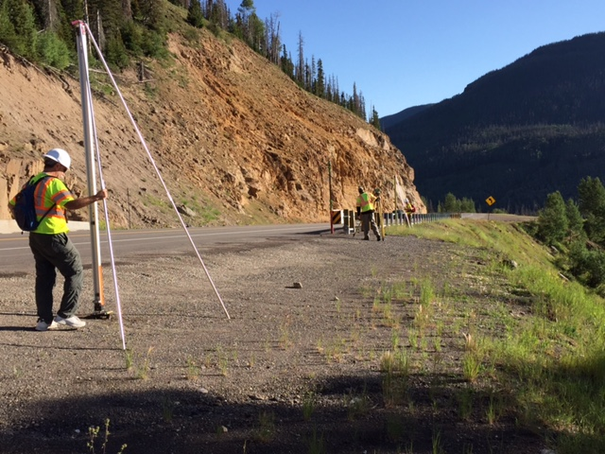
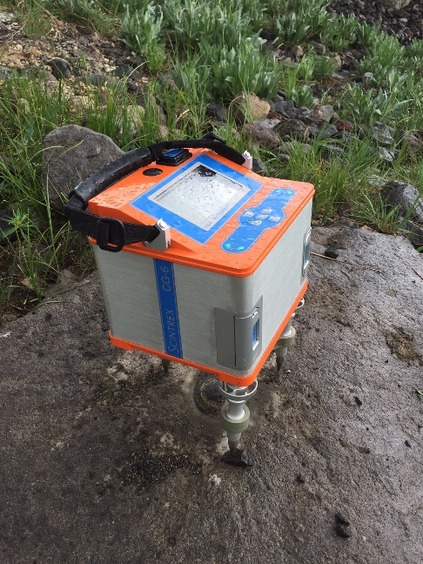
Survey Techniques: GPS, Leveling, Gravity*
* Not shown: “Astrogeodetic Deflection of the Vertical”…

Slide 34
Deflection of the Vertical
GPS provides ellipsoidal position (lat, lon)
Astro-geodetic Camera measures the “deflection of the vertical” (difference from normal to ellipsoid and local plumb line)
Camera knows what stars it “should” see normal to the ellipsoid at a specific time and location. DoV is difference between that and with what is actually “straight up”
Slope = Vector sum of North and East deviations of camera axis
Ellipsoid
Geoid
Geoid Slope

Slide 35
Important Stuff: What the new Datum means for Mt. Elbert
NAVD88 elevation = 14440 feet
NAPGD2022 elevation ≈ 14438 feet

Slide 36
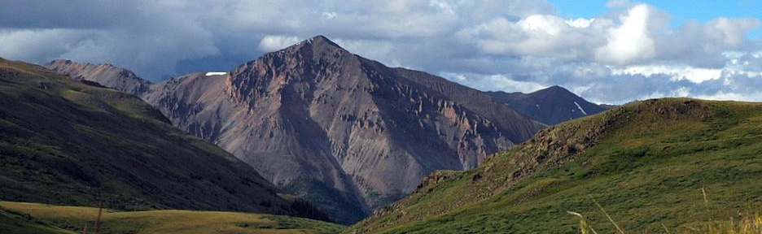
And for Wee Sunshine Peak?
NGVD29 elevation = 14001 feet
NAVD88 elevation = 14007 feet
NAPGD2022 elevation = 14005?* feet
*asterisk, asterisk, caveat, hedge…

Slide 37
An Actual, Important Example: Shorelines
Okay, 14ers are fun and all, but please tell me there’s actually more to this.
Yes, precise height determination is critical in low lying areas near water.
A tiny change in height can be a huge change in horizontal distance.
And tiny changes in gravity can cause water to flow where you don’t expect it to.

Slide 38
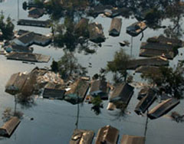
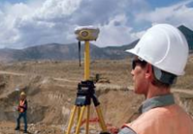
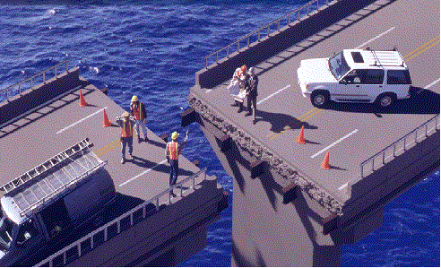
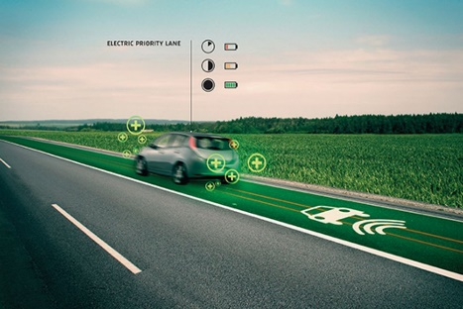
What life will be like with the new Datum:
Vastly improved flood plain mapping
  Water “sees” and flows due to differences in gravity. These are mapped directly
  Critical importance in low-lying, flat communities
Revolutionize professional surveying
  No more need for installing and locating bench marks
  Absolute, consistent positioning autonomously, anywhere
Impacts on infrastructure
  Any application requiring precise positioning - bridges, tunnels, railways, agriculture, navigation - will be easier and more accurate
Fundamental support for new technologies
  “Smart Highways” for autonomous vehicles
Notes:
Brad likes this slide!
Smart cities, underground utilities
Smartphone: if you want to talk about smart utiltiies, need meter level accuracy; but for precision navigation
This admin = all about jobs and the economy
Blue Economy = getting goods in and out of ports, how do you move massive goods, precision navigation. Blue Economy also generates tourism: sancutaries, safe beaches.
Tools we’re using:
- We are working with NASA and NSF to create new national infrastructure called Foundation CORS.

Slide 39

Going Forward: Atomic “Optical” Clocks
Einstein’s theory of general relativity indicates that when any clock is operated at a location “higher” than another it will be observed to run faster.
$$\frac{Δf}{f}=\frac{gΔh}{c2}$$
Both time and water feel the same thing – it’s like poetry…

Slide 40
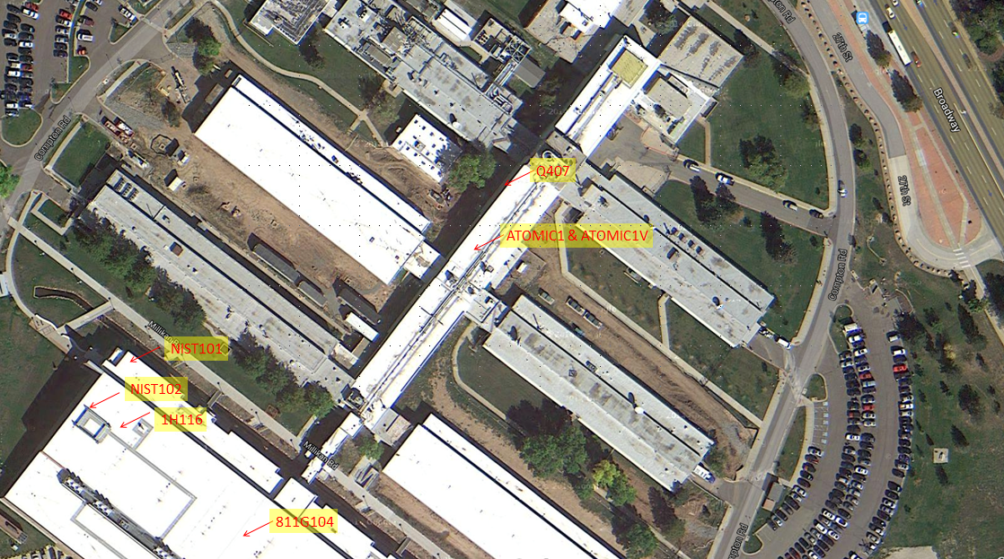

NGS and NIST/JILA Geopotential Collaborations
NIST Geopotential Survey 2015
JILA/NIST Geopotential Survey 2018
11 surveyed sites between the two locations, all referenced to Q407 on north side of Bldg 1

Slide 41




NGS and NIST/JILA Geopotential Collaborations cont.
First Order Leveling (0.7mm/√km)
Absolute gravity (4 $μ$Gal) and gravity gradients in each lab
Leveling from NIST into the sub-basement at JILA
Tying to Q407, Bldg 1
FG5 gravity meter in Jun Ye’s lab (JILA)

Slide 42

NGS and NIST/JILA Geopotential Collaborations cont.
GPU values to ±0.002 gpu and fractional frequency uncertainties of 3x10⁻¹⁹
Final report as NOAA Technical Memorandum NOS NGS 77 (covers both 2015 and 2018 projects)
Station | Geopotential (gpu) | ∆f/f x10¹⁶
ATOMIC1 | -1.3326 | -1.478
ATOMIC1V | -0.0914 | -0.010
NIST101 | 7.2958 | 8.123
NIST102 | 21.418 | 23.827
1H116 | 7.2879 | 8.114
811G104 | 7.2834 | 8.109
JILA STS135V | -4.4726 | -4.976
JILA S1B60H | -10.9432 | -12.176
JILA S1B60V1 | -9.5804 | -10.660
JILA S1B60V2 | -9.6150 | -10.698
JILA X1B21 | -12.140 | -13.508
1 gpu = 10 m²/s² = 1 kGal-m.

Slide 43

The Future! Networked Optical Clocks
Comparisons of clocks will require precise knowledge of geopotential differences between sites. The IAG is working on a ~1cm geoid worldwide…
…but links between “identical” clocks at different locations will also give an instant measure of the difference in geopotential: “chronometric leveling”
“Inland Tide Gauges”
Clocks accurate to 1 part in 10¹⁸ can differentiate between heights of 1cm
The goal for these clocks is 1 part in 10²⁰ (or 100µm)!
Linking has been demonstrated over 100s of km, but not 1000s (intercontinental distances) yet
Practical in 5 years? 10 years?
*This will likely be the best way to get accurate height differences between fixed points in the future!

Slide 44
Summary
Fancy New Sea Level, NAPGD2022, arrives sometime around 2025.
It will give you accurate heights anywhere, good to a few cm or better.
It will be awesome.
Oh, and we could make good use of some nice clocks…

Slide 45

Thank you!
Questions, comments?
Please don’t hesitate to contact me: derek.vanwestrum@noaa.gov
And go climb a 14er - while they last!
Summit of Quandary Peak. December, 2013

Slide 46
Extra Slides…

Slide 47

OMG - We almost forgot! What will this mean for Denver’s Mile High Capitol Step?
The new datum is higher than the old one, so to be a mile above “sea level” that mark will have to move up a step or two. It just so happens to be really close to the original engraved step (from 1909)!

