Slide 1

NADCON 5, VERTCON 3 and NCAT 2
Dru Smith
Krishna Tadepalli
Andria Bilich
NOAA’s National Geodetic Survey

Slide 2
Outline
Brief history of NGS toolkit
Brief review of NADCON 5.0 release 20160901
VERTCON 3.0 release 20190601
NCAT 2.0

Slide 3
Brief info about the NGS toolkit

Slide 4
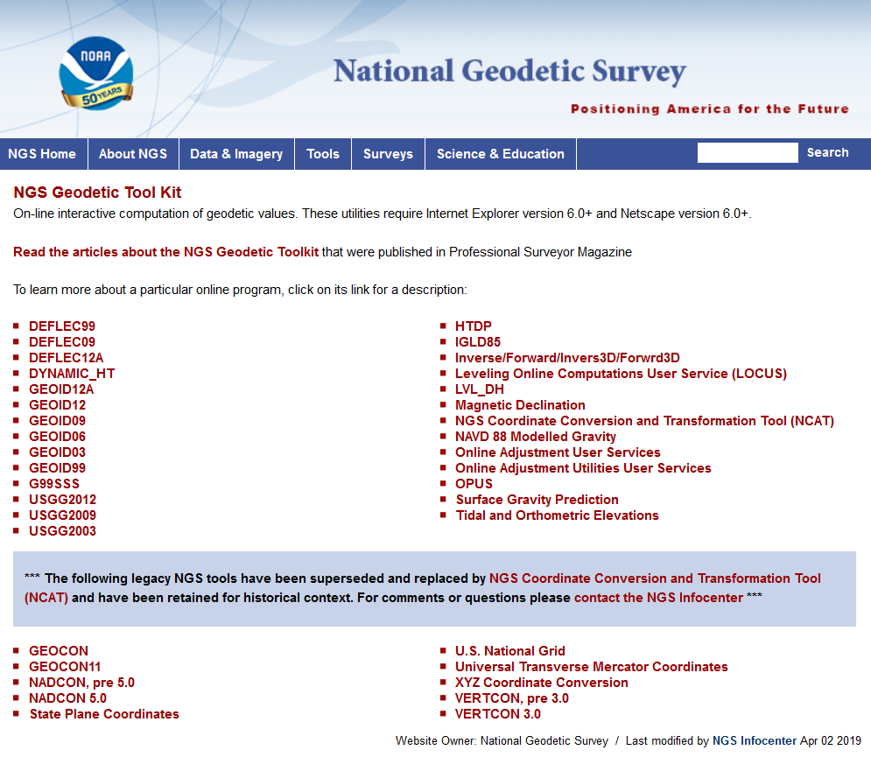
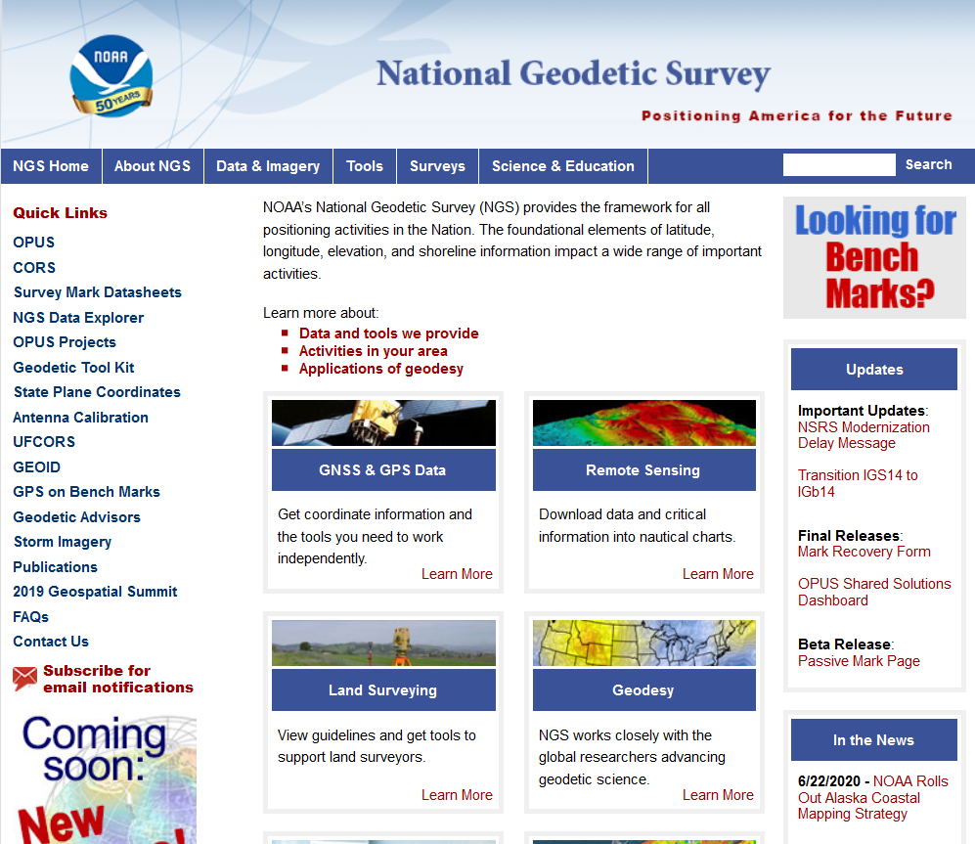
NGS Toolkit

Slide 5
Improve the Toolkit
  The Old:
  VERTCON
  NADCON
  All Hybrid Geoid Models
  All Gravimetric Geoid Models
  All Hybrid DOV Models
  All Gravimetric DOV Models
  14 parameter transformations in HTDP
  XYZWIN
  UTMS
  USNG
  GGPCGP
  SPC83
  DYNAMIC_HT
  IGLD85
  CALIBRATE
  Translev
  WinDESC
  LOCUS
  LOOP
  MTEN4
  “Tidal and Orthometric Elevations”
  INVERSE
  FORWARD
  INVERS3D
  FORWRD3D
  The Old:
  “Online Adjustment User Services”
  GEOCON
  GEOCON11
  LVL_DH
  ConvbinConvascii
  ENHANCEMENTS
  Gethvlist
  INTERORB
  TOLADD
  Surface Gravity Prediction in the Conterminous USA
  NAVD 88 Gravity Computations
  HTDP (geodynamics)
  Magnetic Declination
  CORPSCON
Integrate into
NCAT/VDatum
Deprecate
Replace
w/ GRAV2022
Integrate into
OPUS
Replace w/ IFVM2022
Move to “exo-NGS”
software page
Integrate into NSRS Database
  The New:
  EPP2022
  IFVM2022
  SPCS2022
  GEOID2022
  GRAV2022
  More…
Integrate into one new piece of code

Slide 6
Brief refresher on NADCON 5.0 release 20160901
A complete webinar on NADCON 5.0 release 20160901 was presented on September 8, 2016
and was recorded and available at:
https://www.ngs.noaa.gov/web/science_edu/webinar_series/Nadcon5.shtml

Slide 7
NADCON 5.0 release 20160901
Replaces all previous versions of NADCON, GEOCON or GEOCON11
Transforms latitude, longitude and (if applicable) ellipsoid heights

Slide 8
Summary of transformations
Region | Chronological list of supported datums/datum realizations for each region
CONUS | USSD | NAD 27 | NAD 83(1986) | NAD 83(HARN) | NAD 83(FBN)* | NAD 83(NSRS2007) | NAD 83(2011) epoch 2010.00
Alaska (St Paul) | SP1897 | SP1952 | NAD 83(1986) | NAD 83(1992) | NAD 83(NSRS2007) | NAD 83(2011) epoch 2010.00
Alaska (St George) | SG1897 | SG1952 | NAD 83(1986) | NAD 83(1992) | NAD 83(NSRS2007) | NAD 83(2011) epoch 2010.00
Alaska (St Lawrence) | SL1952 | NAD 83(1986) | NAD 83(1992) | NAD 83(NSRS2007) | NAD 83(2011) epoch 2010.00
Alaska (other) | NAD 27 | NAD 83(1986) | NAD 83(1992) | NAD 83(NSRS2007) | NAD 83(2011) epoch 2010.00
Hawaii | OHD | NAD 83(1986) | NAD 83(1993) | NAD 83(PA11) epoch 2010.00
PR / USVI | PR40 | NAD 83(1986) | NAD 83(1993) | NAD 83(1997) | NAD 83(2002) | NAD 83(NSRS2007) | NAD 83(2011) epoch 2010.00
Guam / CNMI | GU63 | NAD 83(1993) | NAD 83(2002) | NAD 83(MA11) epoch 2010.00
Am. Samoa | AS62 | NAD 83(1993) | NAD 83(2002) | NAD 83(PA11) epoch 2010.00
Two neighboring red entries will have an ellipsoid height transformation, in addition to latitude and longitude
* The NAD 83(FBN) realization only exists in 19 states within CONUS. In the other 29 states and D.C.,
the transformation connects NAD 83(HARN) directly to NAD 83(NSRS2007)

Slide 9
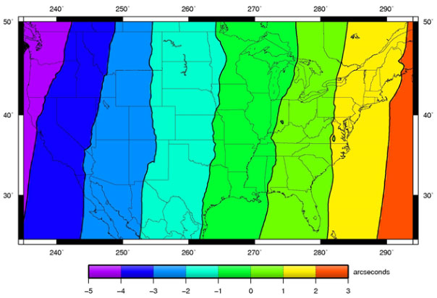
NAD 27 / NAD 83(1986) / Longitude / CONUS

Slide 10
VERTCON 3.0 release 20190601

Slide 11
“VERTCON 2.1” meant…
The grid of NGVD 29 / NAVD 88 transformations
  CONUS only
The FORTRAN code to read and interpolate that grid
The compiled FORTRAN code, as an .exe file
Notes:
There are actually 3 “NAD 83”s, NAD 83(2011), NAD 83(PA11) and NAD 83(MA11)
There are also many more vertical datums than NAVD 88 in the NSRS, each one for specific states or territories that have no line of sight to CONUS/Alaska

Slide 12
“VERTCON 3.0” means
The project “VERTCON 3.0”, which created:
  The build software “VERTCON 3.0” which was run to create:
    A set of transformation grids and transformation uncertainty grids called “VERTCON 3.0 release 20190601”
  Instructions on how to implement “VERTCON 3.0 release 20190601” inside NCAT and VDatum
VERTCON 3.0 does not stand alone. Its functionality is accessed only through NCAT and VDatum via the instructions which operate upon the grids.
  Instructions example: “use biquadratic interpolation”
Notes:
There are actually 3 “NAD 83”s, NAD 83(2011), NAD 83(PA11) and NAD 83(MA11)
There are also many more vertical datums than NAVD 88 in the NSRS, each one for specific states or territories that have no line of sight to CONUS/Alaska

Slide 13
History

Slide 14
Historical Overview
From 1807 until 1899
  Local leveling, tied to a single tide gage
1899, 1903, 1907, 1912
  First coast-to-coast (CONUS) networks
  1st through 4th “general adjustment” of continental leveling network
    Could each be called a “vertical datum”
    Not well documented
    No data in the IDB
    Not part of the VERTCON 3.0 project

Slide 15
Historical Overview
1929
  Sea Level Datum of 1929
    Renamed National Geodetic Vertical Datum of 1929 (NGVD 29) in 1973
1963
  Guam Vertical Datum of 1963 (GUVD 63)
    The only other vertical datum in the IDB prior to NAVD 88
Indeterminate years..
  “Local Tidal” heights turned in to NGS.

Slide 16
Historical Overview
1991
  NAVD 88
    No official report, but lots of related documentation
October 1992
  VERTCON 1.0
    No public documentation. Very short lived.
May 1994
  VERTCON 2.0
    New grid, different than VERTCON 1.0
2003
  VERTCON 2.1
    Same grid as VERTCON 2.0

Slide 17
Historical Overview
2009
  American Samoa Vertical Datum of 2002 (ASVD 02)
  Northern Mariana Vertical Datum of 2003 (NMVD 03)
  Guam Vertical Datum of 2004 (GUVD 04)
2011
  Virgin Islands Vertical Datum of 2009 (VIVD 09)
2012
  Puerto Rico Vertical Datum of 2002 (PRVD 02)
Note that Hawaii has never had an official vertical datum in the NSRS

Slide 18
VERTCON 3.0 vs 2.1 in CONUS
VERTCON 2.1 reflected all NGVD 29/NAVD 88 data as of 1994
NGS continued to load new NAVD 88 heights from 1994-2019
  New or superseded, very few had any time tag
VERTCON 3.0 built “regional updates” to the VERTCON 2.1 grid
  To respect existing grid, but
  To allow for large systematic changes for the 23 years of new data

Slide 19
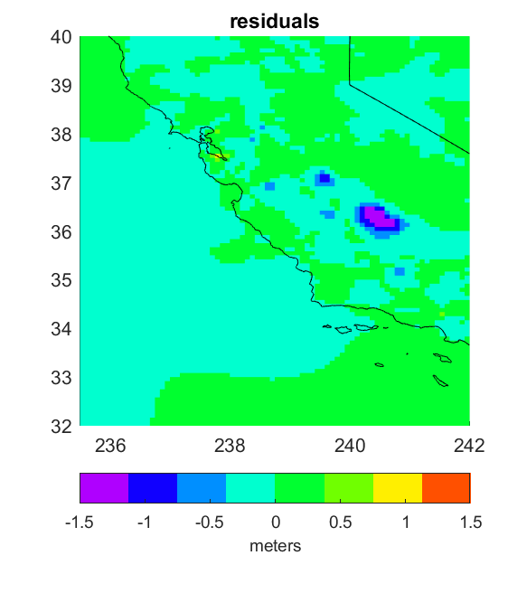
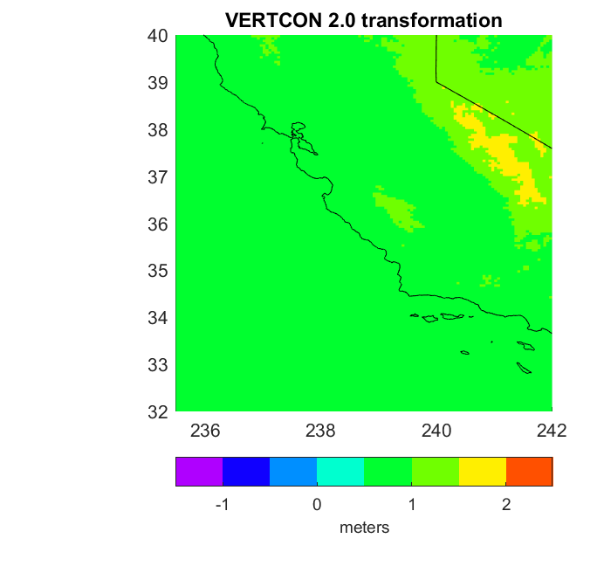
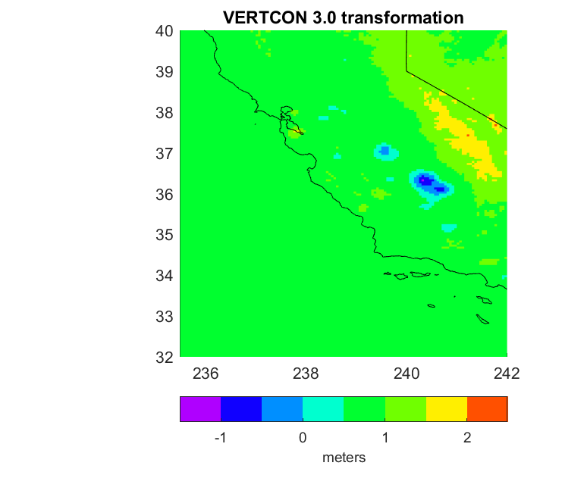
CONUS: Remove / Compute / Restore

Slide 20
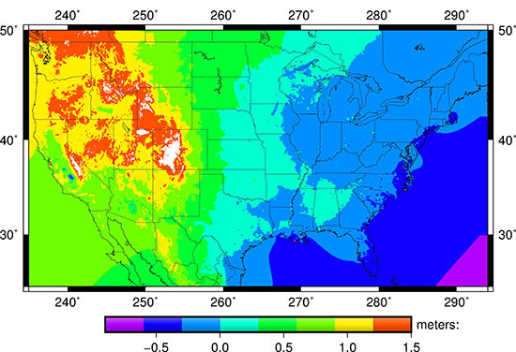
NGVD 29 / NAVD 88 / CONUS

Slide 21
Goals

Slide 22
Goals for VERTCON 3.0 project
Create build software capable of supporting “…to NAPGD2022 epoch 2020.00” transformations
Improve current vertical datum transformation support for CONUS/NGVD 29/NAVD 88
  While minimizing disruption for those who’ve been using VERTCON 2.0/2.1
Expand current vertical datum transformation support beyond CONUS/NGVD 29/NAVD 88, if possible
Document everything meticulously

Slide 23
Issues

Slide 24
Issues: Realizations
NAVD 88 has not had nationwide “realizations” like NAD 83
  Thus datasheets for three bench marks may have these lines:
AA3501* NAVD 88 ORTHO HEIGHT - 48.543 (meters) 159.26 (feet) ADJUSTED
AA0706* NAVD 88 ORTHO HEIGHT - 3.648 (meters) 11.97 (feet) ADJUSTED
AA7459* NAVD 88 ORTHO HEIGHT - 128.748 (meters) 422.40 (feet) ADJUSTED
  Without any way to know that these heights were computed from leveling in 2001, 1982 and 2012 respectively

Slide 25
Issues: Other
Last published datasheet height disagreed with last height loaded into database
“Local Tidal” heights lacking metadata
Mislabeled NGVD 29 heights in Alaska
Height sources needed to be considered before data could be gridded
  Trig heights, and others acted as outliers

Slide 26
Error estimates
VERTCON 3.0 release 20190601 contains geographically dependent error estimates
  Different from 2.1 which said “about 2 cm” as the accuracy for the entirety of CONUS

Slide 27
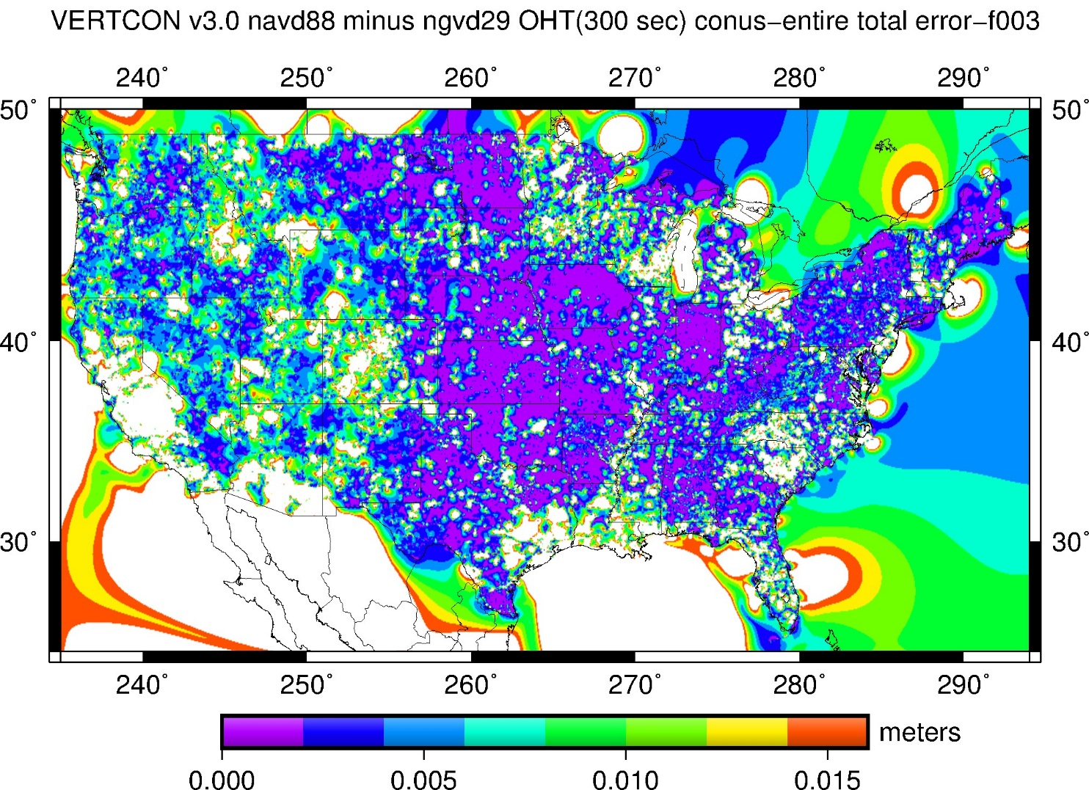
Error estimates : NGVD 29 / NAVD 88 / CONUS

Slide 28
Summary
VERTCON 3.0 release 20190601 supports these transformations:
Old Datum | New Datum | Region
NGVD 29 | NAVD 88 | CONUS
NGVD 29 | NAVD 88 | ALASKA
LT | PRVD 02 | PR
LT | VIVD 09 | VI
LT | ASVD 02 | AS
LT | NMVD 03 | CNMI
GUVD 63 | GUVD 04 | GUAM

