Slide 1

Blueprint for 2022, Part 3:
Working in the Modernized
National Spatial Reference System (NSRS)
Dru Smith
NSRS Modernization Manager
NOAA’s National Geodetic Survey

Slide 2
Outline
Acknowledgements
BLUF
What I’ll be skipping…
Refresher / Shift and Drift
  Replace NAD 83
  Replace NAVD 88
EPP2022 and IFVM2022
Reference Epoch Coordinates from Time-Dependent Coordinates
Terminology
Using the modernized GNSS
Miscellaneous

Slide 3
Acknowledgments
Blueprint for 2022, Part 3 is the result of significant TEAM efforts over 18 months
  GNSS Standard Operating Procedure (SOP) Team
    Choi, Roman, Jalbrzikowski, Sun, Dennis, Prusky, Gillins, W. Wang, Saleh, Yoon, Damiani, Kanazir, Evjen, Sellars, Schenewerk, Caccamise, Heck, Hilla, Bilich, McFarland
  Leveling Standard Operating Procedure (SOP) Team
    Zenk, Kanazir, Dennis, Breidenbach, Fancher, Hanson, Hensel, Paudel, Ward, Zilkoski, Gillins, Geoghegan
  BP3 Writing Team
    Kinsman, Kanazir, Hensel, Jordan, Stone, Vogel, Heck, Dennis, Fromhertz, Winester, Zenk, Silagi, Roman, Grosh, Ahlgren
It is a team document, with input from dozens of individuals around NGS

Slide 4
Bottom Line, Up Front
If you do geospatial work in the USA…
and you work in the National Spatial Reference System..
every product you’ve ever made…
  every survey…
  every map…
  every lidar point cloud…
  every image…
  every DEM…
  WILL have the wrong coordinates on it in 3 years.
  Let’s talk about what this means, why it is happening, and how it will affect things going forward

Slide 5
What is BP3?
BP3 is a companion to BP1 (geometric) and BP2 (geopotential), both released in 2017
  It is about “re-inventing bluebooking”
  It’s about how NGS will provide the frames/datum in the future
  It’s about how YOU will use the frames/datum in BP1 and BP2

Slide 6
What I’ll be skipping…
Blueprint for 2022, Part 3 will take 1-1.5 hours to cover
Not included today:
  What is…
    NGS and its mission
    The NSRS
    Bluebooking
    GRAV-D
    ITRF
  Why we are modernizing in 2022
All of these topics have been covered extensively in multiple forums in the last few years

Slide 7
Refresher

Slide 8
“Modernizing the NSRS” means…
Replacing NAD 83
Replacing NAVD 88
Re-inventing Bluebooking
Improving the Geodetic Toolkit
Better Surveying Methodologies
Blueprint for 2022, Part 1
Blueprint for 2022, Part 2
Blueprint for 2022, Part 3
Notes:
There are actually 3 “NAD 83”s, NAD 83(2011), NAD 83(PA11) and NAD 83(MA11)
There are also many more vertical datums than NAVD 88 in the NSRS, each one for specific states or territories that have no line of sight to CONUS/Alaska

Slide 9
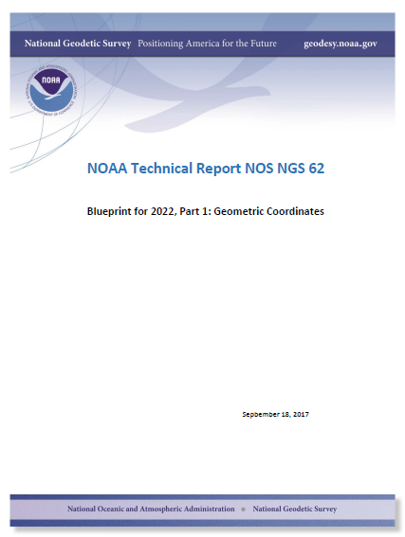
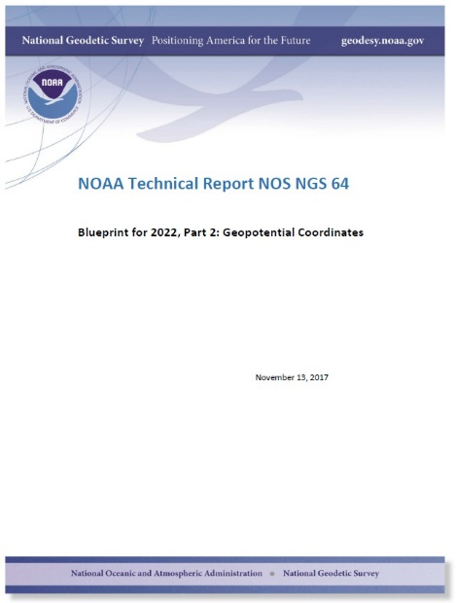
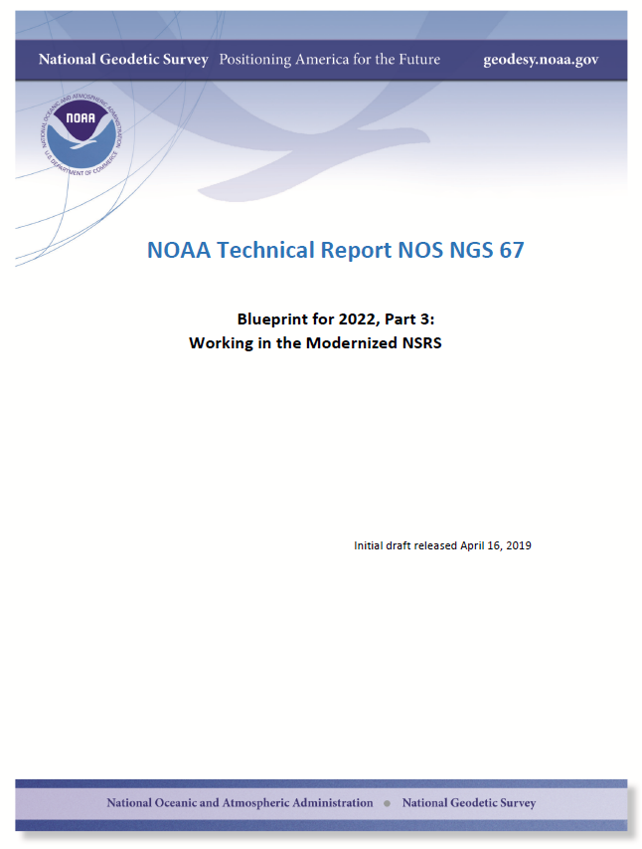
Modernizing the NSRS
The “blueprint” documents: Your best source for information
Geometric:
Sep 2017
NOAA TR NOS NGS 62
32 pages
Geopotential:
Nov 2017
NOAA TR NOS NGS 64
41 pages
Working in the modernized NSRS:
April 2019
NOAA TR NOS NGS 67
77 pages

Slide 10
Replacing NAD 83
The Old:
NAD 83(2011)
NAD 83(PA11)
NAD 83(MA11)
The New:
The North American Terrestrial Reference Frame of 2022
(NATRF2022)
The Caribbean Terrestrial Reference Frame of 2022
(CATRF2022)
The Pacific Terrestrial Reference Frame of 2022
(PATRF2022)
The Mariana Terrestrial Reference Frame of 2022
(MATRF2022)

Slide 11
Replacing NAVD 88
  The Old:
  NAVD 88
  PRVD 02
  VIVD09
  ASVD02
  NMVD03
  GUVD04
  IGLD 85
  IGSN71
  GEOID12B
  DEFLEC12B
  The New:
  The North American-Pacific Geopotential Datum of 2022 (NAPGD2022)
  Will include:
  GEOID2022
  DEFLEC2022
  GRAV2022
  DEM2022
  More
Orthometric
Heights
Normal
Orthometric
Heights
Dynamic
Heights
Gravity
Geoid
Undulations
Deflections of
the Vertical

Slide 12
The preeminence of ITRF
Rotation of the
North American Plate
The North American Terrestrial Reference Frame of 2022
(NATRF2022)
The Caribbean Terrestrial Reference Frame of 2022
(CATRF2022)
The Pacific Terrestrial Reference Frame of 2022
(PATRF2022)
The Mariana Terrestrial Reference Frame of 2022
(MATRF2022)
Rotation of the
Caribbean Plate
ITRF2014
Rotation of the
Pacific Plate
Rotation of the
Mariana Plate
EPP2022
EPP for “Euler Pole Parameters”
(a way of describing a plate’s rotation)

Slide 13
Shift and Drift

Slide 14
Shift
One of the two major changes you’ll see in 2022 is a shift in coordinates
  Latitude, Longitude, Ellipsoid Height: -2 to +4 meters
    Non-geocentricity of NAD 83
  Orthometric Height: -0.5 to +2.0 meters
    Bias and tilt in NAVD 88
  Other shifts will occur in non-CONUS, non-Alaska regions of the USA
  There will be outliers!
    “Old” unsurveyed points might be off by meters if they’ve moved!

Slide 15
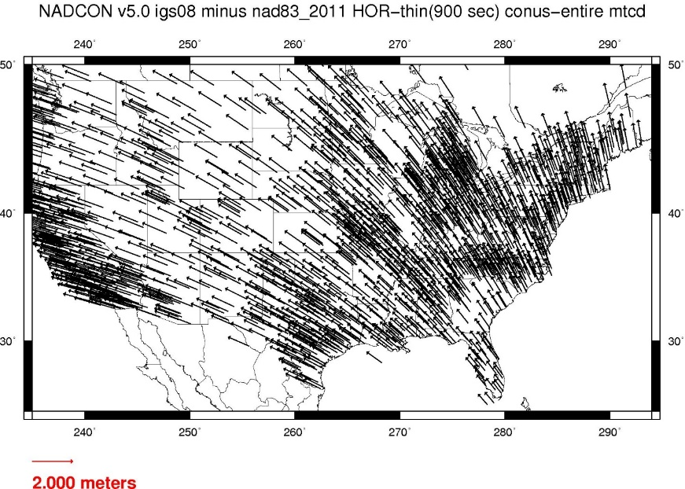
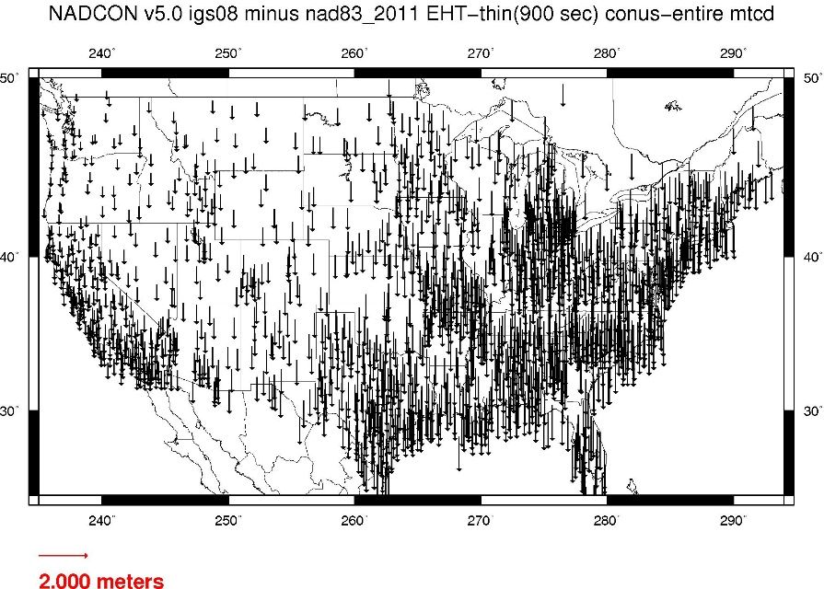
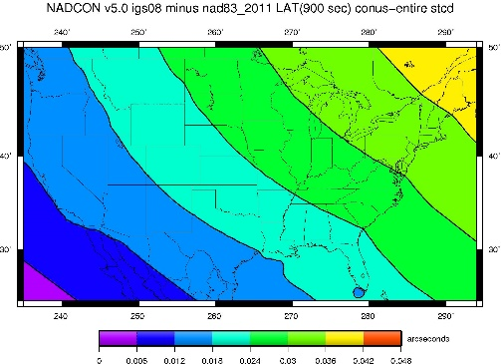
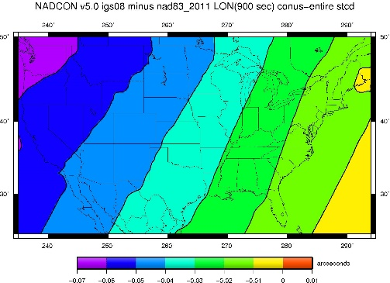
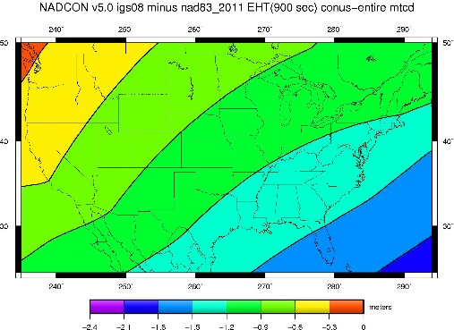
NAD 83(2011) epoch 2010.0 to
NATRF2022 epoch 2020.00 (estimate)

Slide 16
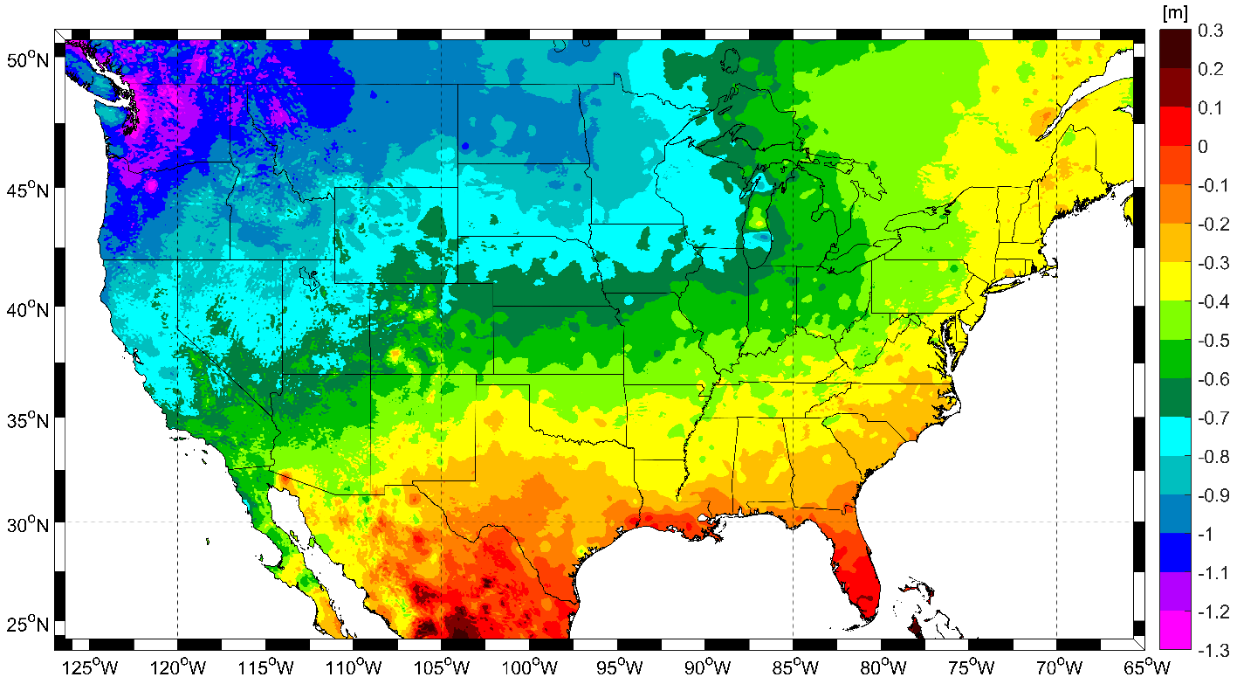
NAVD 88 to NAPGD2022 epoch 2020.00 (estimate)

Slide 17
Drift
The second major change you’ll see in 2022 is a drift in coordinates
  Everything in the world moves
  Coordinates will be associated with the actual date when the data was taken!

Slide 18
The wrong question, circa 2022:
“What is the latitude of that point?”
The right question, circa 2022:
“What is the latitude of that point, on some specific date?”

Slide 19
Drift
The second major change you’ll see in 2022 is a drift in coordinates
  Everything in the world moves
  Coordinates will be associated with the actual date when the data was taken!
  Velocities at all marks can be estimated
    Using a new tool, called the Intra-Frame Velocity Model (IFVM2022)
  Two things will mitigate the pain of time-dependent coordinates:
    “Plate Fixed” frames
    “Reference Epoch” coordinates

Slide 20
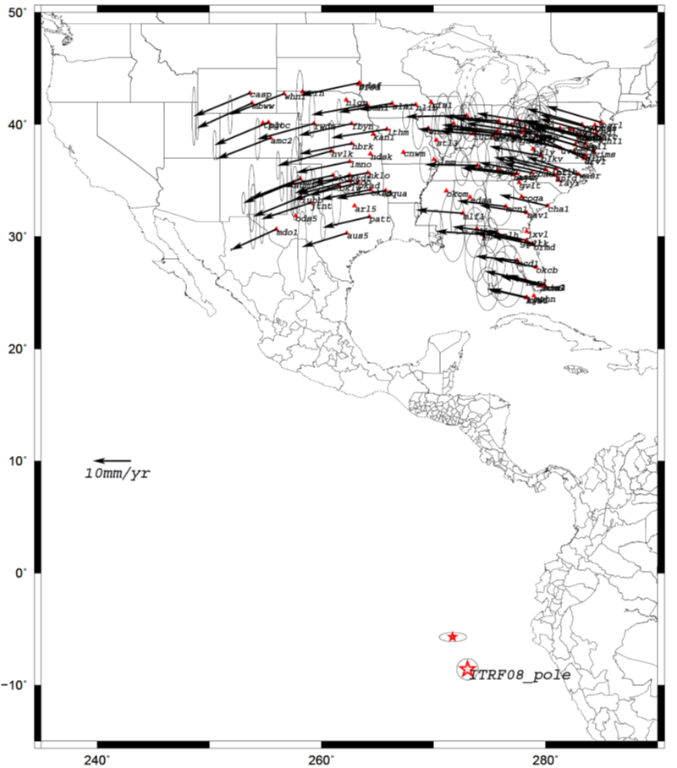
Euler Poles and “Plate Fixed”
  In the ITRF, many tectonic plates have one dominant motion: rotation
    Plus plenty of other motions
  The point about which a continent rotates is called its “Euler Pole”
  In summary:
    Under ITRF
      Frame = constant
      N.A. Plate = rotating
  It is a fairly simple matter to reverse this and define a rotating frame in which the plate is not rotating.
    Under NATRF2022:
      Frame = rotating (relative to ITRF)
      N.A. Plate = constant (relative to NATRF2022 frame)
  We say “NATRF2022” is “fixed” to the N.A. Plate, making it a “plate fixed” frame

Slide 21
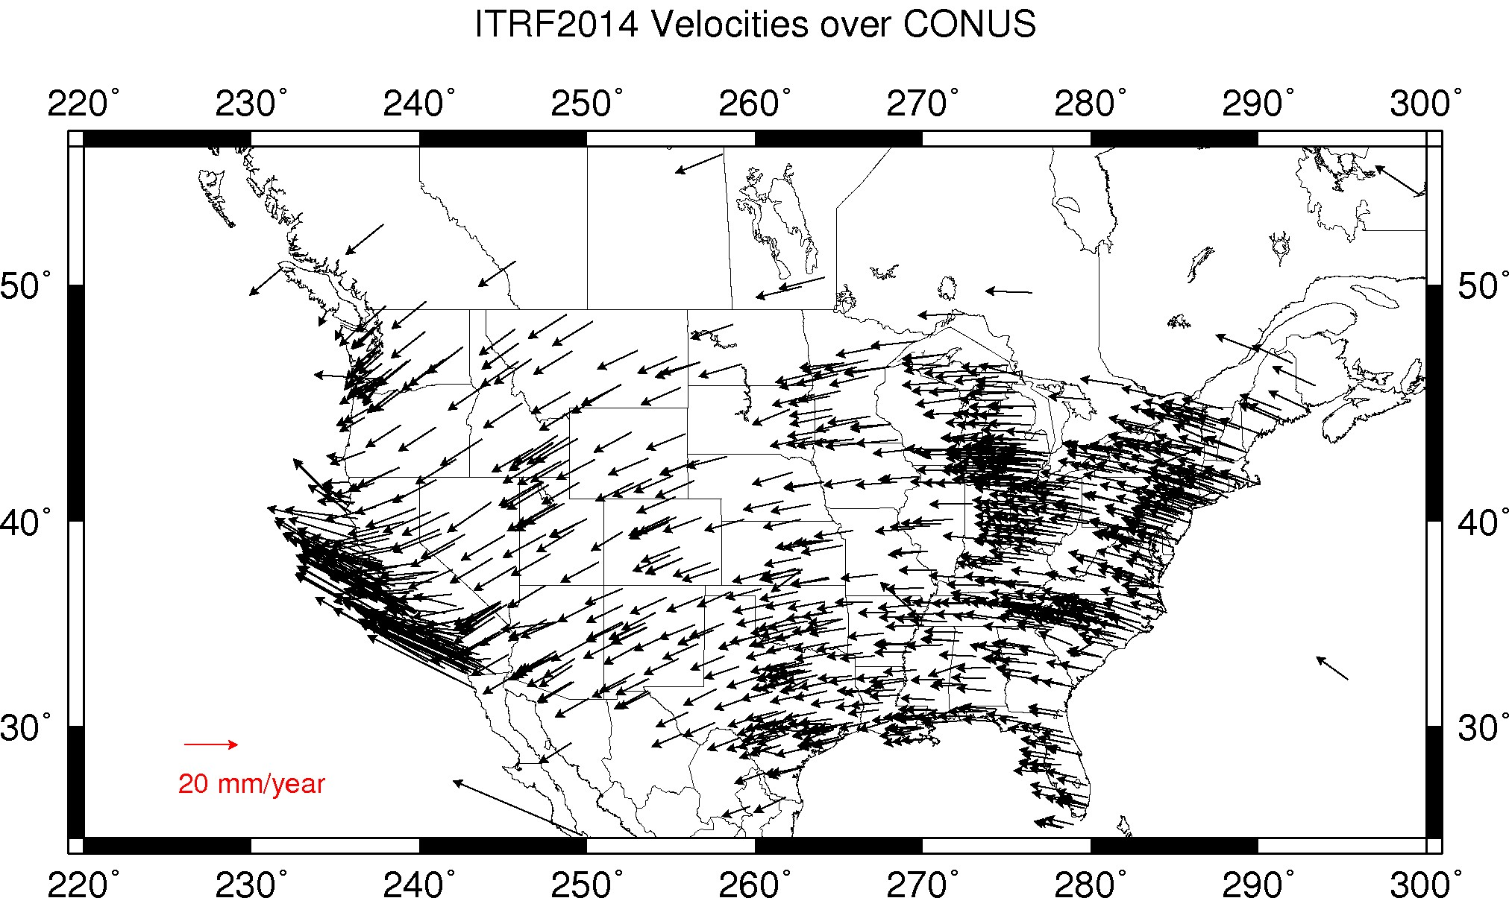
CORS Velocities – ITRF2014

Slide 22
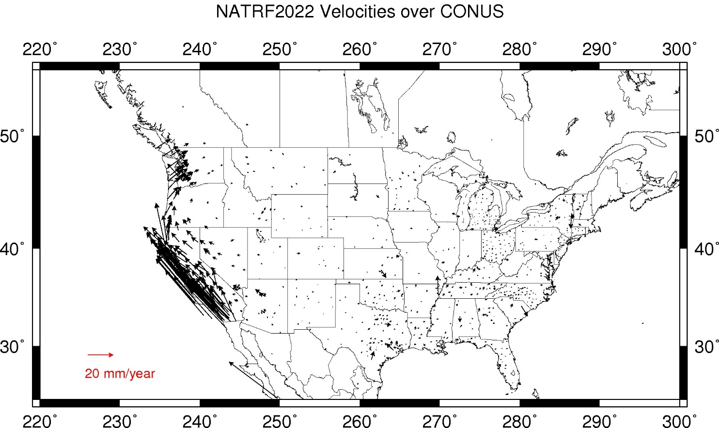
CORS Velocities – NATRF2022

Slide 23
EPP2022 and IFVM2022:
The two tools that make time dependent geodetic control useable

Slide 24
There’s really two drifts
The plate rotation is simple (3 parameters per plate)
  Captured in EPP2022
  Horizontal (latitude/longitude) only
  Changes the frame
    ITRF2014 to NATRF2022, PATRF2022, CATRF2022 & MATRF2022
  Doesn’t change the epoch
The residual motions (after removing plate rotation) are complex
  Captured in IFVM2022
  Residual horizontal motion
  All vertical motion
  Changes the epoch
  Doesn’t change the frame
    IFVM = “Intra-frame” velocity model

Slide 25
Example
Important: This slide only covers geometric coordinates.
It’s 2039 and you are working in San Diego using NATRF2022
You need to compare your work against a competitor’s survey
  Done in 2028, using PATRF2022
PATRF2022
ep. 2028.048
EPP2022
ITRF2014
ep. 2028.048
EPP2022
NATRF2022
ep. 2028.048
IFVM2022
IFVM2022
PATRF2022
ep. 2039.704
EPP2022
ITRF2014
ep. 2039.704
EPP2022
NATRF2022
ep. 2039.704

Slide 26
Reference Epochs
It seems highly unlikely that surveyors will embrace coordinates with such diversity of epochs
To mitigate that, NGS will issue “snapshots” of the NSRS every five years (called “Reference Epochs”)
  Estimates of coordinates at specific 5 year intervals, based on historic time-dependent coordinates and the IFVM2022
    …and the Geoid Monitoring Service (GeMS), for non-geometric quantities
Beginning with 2020.00
  Each “snapshot” will be published 2-3 years after the reference epoch
    Thus the 2020.00 Reference Epoch Coordinates get published by the end of calendar year 2022

Slide 27
Reference Epoch Coordinates from
Time-Dependent Coordinates

Slide 28
Assume “h” was determined four different times:
1990: 2.100
1994: 2.110
2002: 2.190
2009: 2.180
2.250
2.200
h
2.150
2.100
2.050
2.000
1990
‘95
‘00
‘05
‘10
‘15
‘20
‘25
‘30
time

Slide 29
All measurements have error. Shown here are the same
Values of “h”, but with their error estimates.
1990: 2.100 +/- 0.0375 (3.75 cm)
1994: 2.110 +/- 0.0250 (2.50 cm)
2002: 2.190 +/- 0.0200 (2.00 cm)
2009: 2.180 +/- 0.0250 (2.50 cm)
2.250
2.200
h
2.150
In the modernized NSRS these time-dependent
coordinates, estimated at the actual date when
the surveys took place, will be called
“Final Discrete Coordinates”
2.100
2.050
2.000
1990
‘95
‘00
‘05
‘10
‘15
‘20
‘25
‘30
time

Slide 30
In today’s NSRS, a height is held fixed until
replaced. So plotting the height as seen on a datasheet
over time would look like this:
2.250
2.200
h
2.150
2.100
2.050
2.000
1990
‘95
‘00
‘05
‘10
‘15
‘20
‘25
‘30
time

Slide 31
In the modernized NSRS we will also have an estimate of
crustal motion from IFVM2022
2.250
2.200
h
2.150
2.100
Combining Final Discrete Coordinates
with IFVM2022 allows
NGS to estimate Reference Epoch Coordinates
2.050
2.000
1990
‘95
‘00
‘05
‘10
‘15
‘20
‘25
‘30
time

Slide 32
2.250
2.200
The IFVM2022 model will (statistically)
match reference epoch coordinates.
This will allow for the elimination of a
stand-alone “NADCON” product for
coordinates after 2020.0, instead relying
entirely upon IFVM2022
h
2.150
2.100
2.050
2.000
1990
‘95
‘00
‘05
‘10
‘15
‘20
‘25
‘30
time

Slide 33
2.250
2.200
h
2.150
2.100
In the absence of new survey data, error estimates will
grow through time.
2.050
2.000
1990
‘95
‘00
‘05
‘10
‘15
‘20
‘25
‘30
time

Slide 34
The (in)ability of current approach to
properly inform users of the height of
this mark can be seen in green below.
2.250
2.200
h
2.150
2.100
2.050
2.000
1990
‘95
‘00
‘05
‘10
‘15
‘20
‘25
‘30
time

Slide 35
Example (v2)
It’s 2039 and you are working in San Diego using NATRF2022 (epoch 2035.00)
You need to compare your work against a competitor’s survey
  Done in 2028, using PATRF2022 (epoch 2025.00)
PATRF2022
ep. 2025.00
EPP2022
ITRF2014
ep. 2025.00
EPP2022
NATRF2022
ep. 2025.00
IFVM2022
This would’ve been a “NADCON” function in the past
IFVM2022
PATRF2022
ep. 2035.00
EPP2022
ITRF2014
ep. 2035.00
EPP2022
NATRF2022
ep. 2035.00

Slide 36
Terminology

Slide 37
The NOAA CORS Network (NCN)
As of 2019, this is the official name of the network managed at NGS
  Historically referred to as “CORS” or “the CORS”

Slide 38
ARP vs GRP
The purpose of a CORS can be debated
  But at NGS: the continuous collection of GNSS data for the express purpose of determining the continuous coordinates of a unique, permanent, physical point on each CORS
    Such a point is called the Geometric Reference Point, or GRP
    Not to be confused with the Antenna Reference Point, or ARP
      Which is part of each antenna, not a permanent, unique physical part of a CORS
  Identification of GRPs has begun
    Coordinates on a CORS will eventually be fully transitioned to be “coordinates of the GRP of the CORS”. Right now they are…unclear.

Slide 39
GPS Month
A span of four consecutive GPS weeks, where the first GPS week in the GPS month is an integer multiple of 4
  GPS Month 0 = GPS weeks 0, 1, 2 and 3
  GPS Month 1 = GPS weeks 4, 5, 6 and 7
  Etc.

Slide 40
New Types of Coordinates

Slide 41
Five types of coordinates
Name | Generally on… | Description
Reported | Passive | “Quick and Dirty”. Smartphone accuracy.
Preliminary | Passive | Computed by you with OPUS using your data. Unchecked by NGS.
Final Discrete | Passive | Most accurate. Time-dependent. Computed by NGS every four weeks.
Final Running | CORS | Continuous time-dependent CORS coordinates. Checked by NGS every day.
Reference Epoch | Passive and CORS | Modeled from Final Discrete, Final Running, IFVM2022 and GeMS. Computed by NGS every five years.

Slide 42
New Types of Coordinates
Reported
  “These are from any source where the coordinate is directly reported to NGS without the data necessary for NGS to replicate the coordinate.”
    Scaled
    From NCAT or Vdatum
      NGS Coordinate Conversion and Transformation Tool (NCAT)
    Hand Held / Smartphone
    Reported directly from an RTK rover without data files

Slide 43
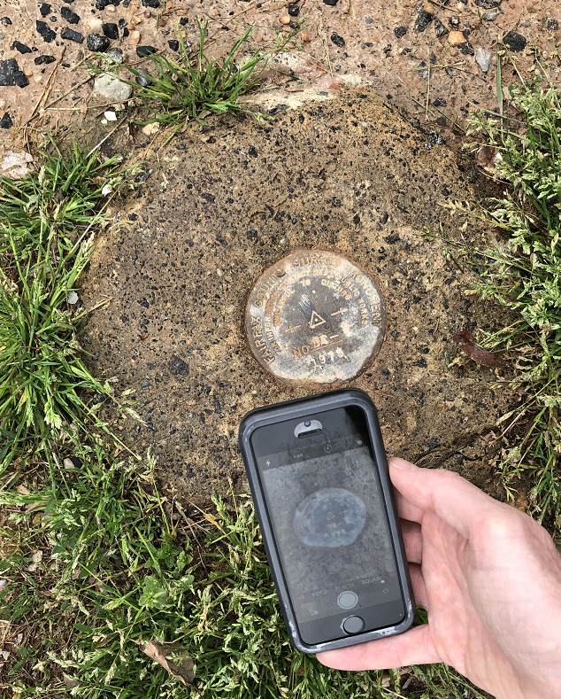
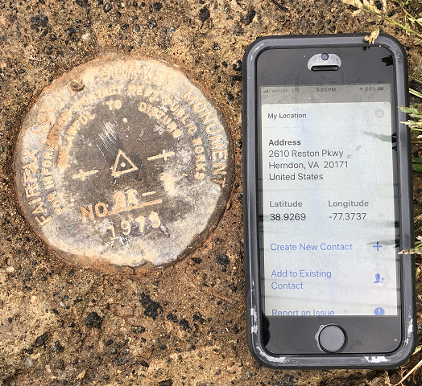
Reported Coordinates

Slide 44
New Types of Coordinates
Preliminary
  “These are coordinates at survey epoch that have been computed from OPUS, but not yet quality checked and loaded into the National Spatial Reference System Database (NSRS DB).”
    User-computed values, such as they might get today from either OPUS-S or OPUS-Projects
    “Preliminary” coordinates are the only coordinates a user will get directly from OPUS

Slide 45
New Types of Coordinates
Reference Epoch
  “These are coordinates which have been estimated by NGS, from time-dependent (final discrete and final running) coordinates, at an Official NSRS Reference Epoch (ONRE)”
    NAD 83(2011) epoch 2010.00 (sort of) would’ve fallen under this category
    These will be computed by NGS every 5 years
      On a schedule 2-3 years past ONRE
        2020.00 coordinates will be computed in CY 2022
        2025.00 coordinates will be computed in CY 2027

Slide 46
New Types of Coordinates
Final Discrete
  “These are coordinates computed by NGS using submitted data and metadata, checked and adjusted and referenced to a single survey epoch.”
    These represent the best estimates NGS has of the time-dependent coordinates at any mark
    Survey epochs:
      GNSS: Each GPS Month
        Stand-alone occupations, RTK/RTN, Campaigns, etc
      Leveling: Annually
        Orthometric heights: Leveling adjusted to GNSS-based orthometric heights

Slide 47
New Types of Coordinates
Final Running
  “Of all types of coordinates on a mark, these are the only ones which will have a coordinate at any time.”
    Generally will only be available at each CORS
      Also being called the coordinate function
      Which will be generated by a “fit” to daily processed data

Slide 48
Using the modernized NSRS
OPUS
  Will include stand-alone GNSS (like “OPUS-S” and “OPUS-RS”)
  Will include mark discovery, recovery and reporting
  Will include project management and analysis for:
    GNSS (including RTK and RTN!)
    Leveling
    Classical
    Gravity
    All in one project!
  Will have a “submit to NGS” button which replaces “bluebooking”

Slide 49
Using the modernized NSRS
OPUS
  Guidance (such as pre-selected CORSs and assistance in locating marks in project areas)
  Users will decide what control to hold fixed and what epochs they wish to set for the adjustment
    “Preliminary coordinates”
  If submitted to NGS, we will harvest your raw data and use it to compute Final Discrete coordinates

Slide 50
Using the modernized NSRS
GNSS is your only entry (for now)
  Leveling and Classical surveys will need some GNSS if you wish to submit your survey to NGS for inclusion in the NSRS database
    Some GNSS = RTK or RTN is fine
    No decision yet on whether OPUS will operate if projects have no GNSS
      If it does, this tends to encourage reliance upon passive control
        which is “so 90’s”
          (1890s!)

Slide 51
So much more…
New version of PAGES
  GPS, Galileo, GLONASS, Beidou, QZSS, etc.
  Target: 15 minute occupations
OPUS expansion plan
  RTK/RTN: 2019
  Leveling, Classical, Gravity: 2020-2025
  Fully integrated (GPS projects with leveling and gravity? No problem!)
  Ease of submission to NGS for inclusion in the NSRS
New Mark Recovery Tool
  Smart-phone enabled. In beta now! beta.ngs.noaa.gov/cgi-bin/recvy_entry_www.prl
Fully integrated toolkit
  NCAT and VDatum

Slide 52
Thank you!

Slide 53
Questions?

