Slide 1
Welcome!
A few things before we get started…
Assn. of State Floodplain Managers (ASFPM) members can get Continuing Education Credits for attending this webinar
Consider inviting a National Geodetic Survey Speaker to upcoming meetings or conferences with attendees that would be interested in learning more about this topic
On May 6-7, 2019 NGS will host the 2019 Geospatial Summit in Silver Spring, Maryland
– In person or by webinar –
Notes:
Hello everyone!
We’ve reached out and invited members of the Association of State Floodplain Managers to today’s webinar. Special thanks to ASFPM’s Coastal Committee, to STARR II (Strategic Alliance for Risk Reduction) and to everyone else who helped us spread the word. I know that for many of you on the line today this may be your very first National Geodetic Survey webinar, so welcome! We are very excited to have so many people interested in today’s presentation topic.
For awareness, this is part of a monthly webinar that focuses on National Geodetic Survey products and services.
We use these webinars as an opportunity to share information w/ stakeholders, but also to gather feedback from users.
If there is time for questions at the end we will take questions, but if we run out of time please still submit questions in the text box or email them to us as we like to ensure we are able to respond to all requests for additional information associated with today's presentation.
Video recordings are made of all webinars for later viewing.
Due to the nature of today’s topic ASFPM members can get CECs for participating if you stay on for the duration of the webinar (certificate by email).
No way that I can cover everything in today’s presentation, especially given the diverse backgrounds of our audience today, therefore I like to highlight opportunity for speakers and the upcoming Geospatial Summit.
Will highlight more opportunities like this at the end of the webinar today.

Slide 2
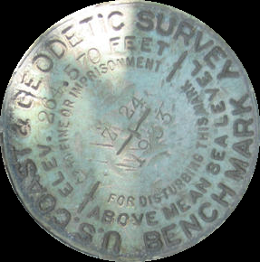
Vertical Datum Changes for Floodplain Mapping
NAVD 88 No More:
A Modernized Vertical Datum for the Future
NGS Webinar
November 15, 2018
Nicole Kinsman, Ph.D.
NGS Regional Geodetic Advisor
Alaska and US Arctic
Notes:
Our talk title today is a bit clunky, but captures what we will be talking about
and vs. for → value of these changes to flood plain community was prime motivation
Alternate title = NAVD 88 no more
Describe why NAVD88 is going away,
Preview what is to replace it,
Provide resources for learning more.
Two ways I’d like to set the stage:
Me.
Background in coastal processes and hazard mapping
Became a geodesist by necessity → work developing things like inundation products for a State agency highlighted the need for improved reference frames.
What does geodesy have to do with flood mapping?
Geodesy is the science of determining where the heck things are in space and time; during a flood you need to know where the water is relative to the land and relative to critical infrastructure ➔ all this is requires a sounds positional framework if you are going to set insurance rates or make critical evacuation calls that could save human lives.
On the title slide I have shown a bench mark to highlight how our understanding and ability to provide accurate and consistent heights has evolved. While this mark is still a useful tool, it reveals itself to be an artifact of the past in three ways:
Says “above mean sea level” -> but local MSL is not the same everywhere
Stamped height assumes fixed position -> but we know the earth is in motion and the land moves up and down on human and engineering scales
agency has changed names
→ Because of these things, we now recognize this bench mark to be an reliable narrator when it comes to elevation.

Slide 3
Today’s Topic: When Vertical Datums let us Down
Insufficient Metadata
Inconsistent Access/Heights
‘Stale’ Elevations
… and what NGS is doing about it.
OUTLINE
Vertical Datums
Outline of Changes
Case Studies
Practical Guidance
Extra Resources
Notes:
What NGS is doing to remedy the situation in our ongoing mission to maintain the very best possible height system for the nation.
I’ll start with a basic intro to the National Geodetic Survey, vertical datums in general, and explain why NAVD 88 heights matter to the floodplain management community.
Then, I’ll explain the upcoming changes to the National Spatial Reference System, with emphasis on the vertical component and what will replace NAVD 88
Beyond just telling you that these changes will enhance floodplain mapping, I will walk you through a few case studies from Alaska that will show the direct benefits of the coming changes
I will present you with some practical guidance specific to things like BFEs which will be increasingly useful as we approach NAVD 88 replacement.
Finally, I’ll show you were you can find extra resources to learn about how coordination, education and preparation will help make the transition away from NAVD 88 as smooth as possible.

Slide 4
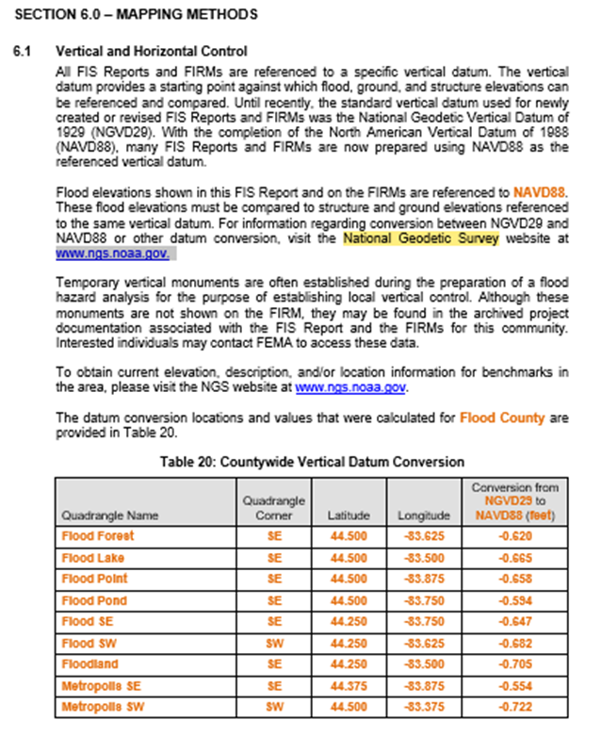
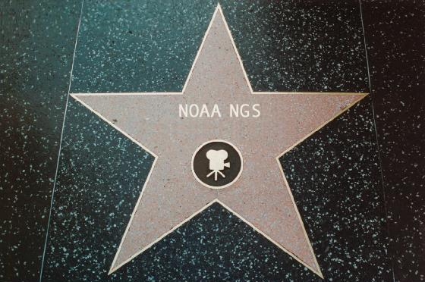
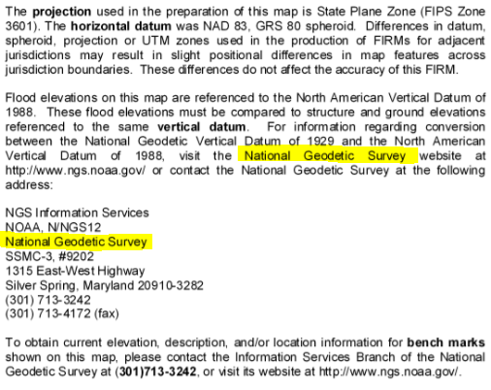
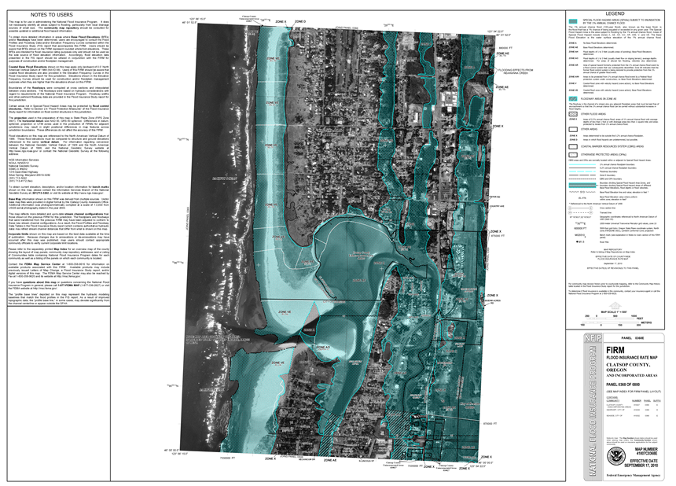
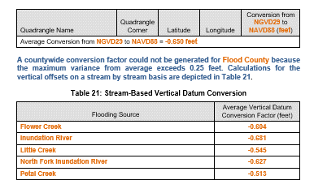
National Geodetic Survey
Notes:
For You may recognize NGS from such illustrious appearances as section 6.1 of Template: Flood Insurance Study (FIS) Report (Nov 2016)
or the “NOTE THE USERS” section of your favorite FIRM

Slide 5
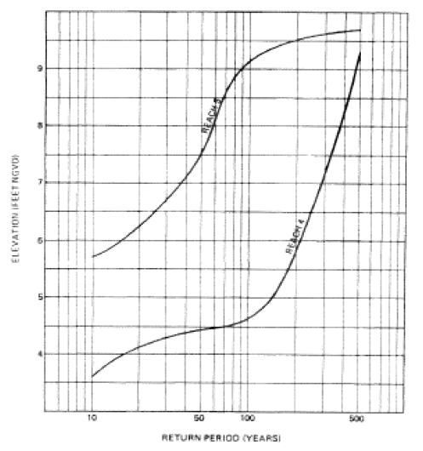
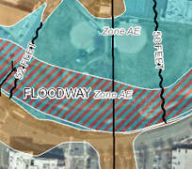
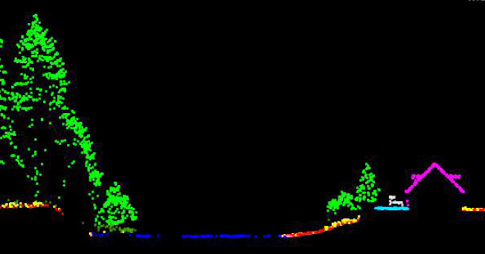
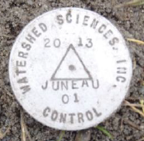
The National Spatial Reference System (NSRS)
A common and consistent geospatial framework to meet the economic, social, and environmental positioning needs of our Nation.
Foundational elements include:
Latitude • Longitude • Elevation • Gravity • Shoreline Position
+ changes over time
+
+
=
Reliable FIRMs require data from disparate sources and dates be consistently aligned
Notes:
The primary mission og NGS is to define, maintain, and provide access to the NSRS
NSRS is a consistent geospatial framework, common to all Federal agencies and other users
NSRS supports informed decision-making for mapping and charting, navigation, flood risk determination, transportation, land management, and more
Elements of NSRS include (but are not limited to): latitude, longitude, elevation, gravity, shoreline position + changes over time
→includes North American vertical datum of 1988
Example of why we need consistent coordinates (illustrated):
Just in the making of a single FIRM, data collected at different points in time using different methods (aerial lidar, stream hydrograph, elevation certificates) must be reliably aligned and combined with historical data (in both horizontal and vertical) to produce a final product in which all of this information is available in one place to assist the planner in appropriate flood mitigation.
→Reliable Flood Rate Insurance products rely on the NSRS

Slide 6
A vertical datum is a reference surface that can be used to measure heights in a uniform way.
Sally
Jane
?
How much taller is Sally?

Slide 7
A vertical datum is a reference surface that can be used to measure heights in a uniform way.
Sally
Jane
?
How much taller is Sally?
Need to know how tall the hill is!
… you cannot compare heights that are measured from different planes of reference.
Notes:
If we replace Sally and Jane with an example more related to floodplains:
if we want to compare a BFE height in 1990 and a BFE height 2010
what if the land has subsided under that base flood elevation over time?
…hold that thought.

Slide 8
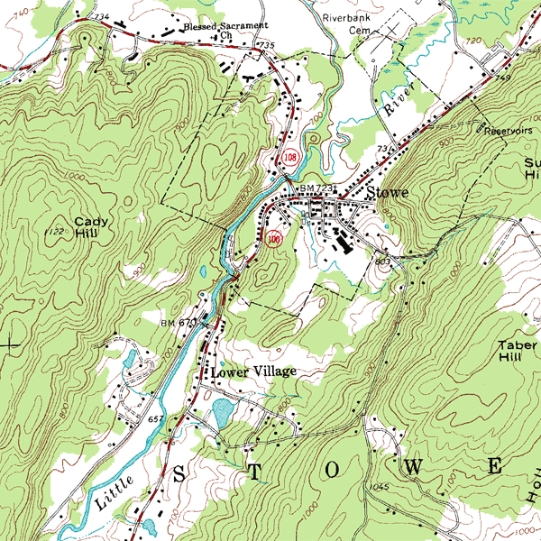
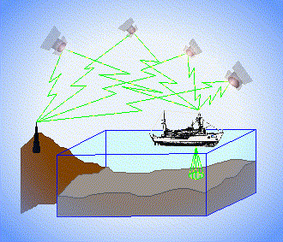
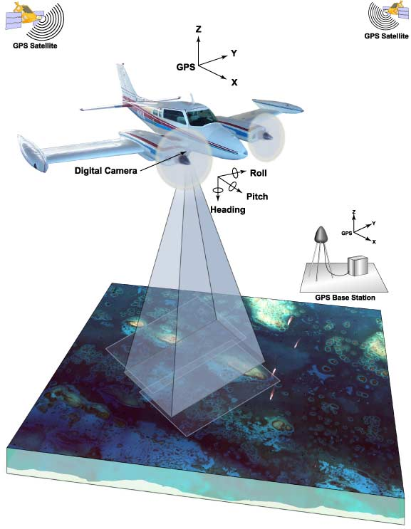
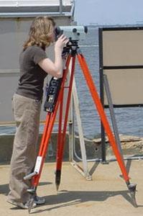
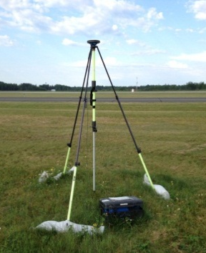
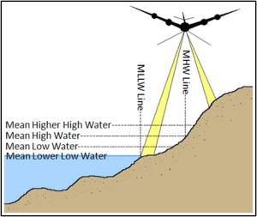
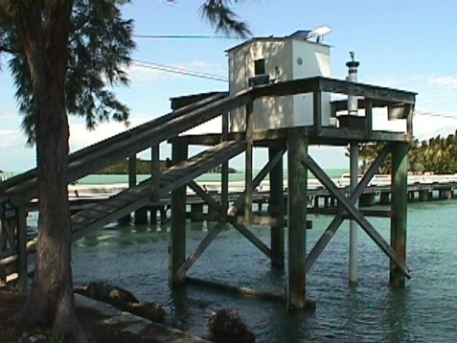
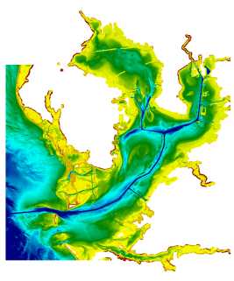
3 Categories of Vertical Datums
Orthometric
Ellipsoidal
Raw Hydrographic Surveys vertically referenced with RTK-GPS
USGS
Topography
FEMA Flood Insurance Rate Maps
Engineering and Development Site Surveys
Native GPS measurements
Raw Lidar
Tidal
NOAA Bathymetry (MLLW)
Shoreline Mapping (MHW) and Regulatory Boundaries at the Coast
Daily and Extreme Water Levels
Notes:
Slide illustrates 3 categories and examples of where each is directly used (project and application dependent).
First, we have ellipsoidal datums. Examples include WGS84 or the North American Datum of 1983. You will encounter these datums frequently in hydrographic surveys that are vertically referenced with RTK-GPS; any native GPS measurements; and even raw lidar datasets.
Next, we have orthometric datums. These datums are very important because height differences referenced to orthometric datums will allow us to know the direction water will flow (have been “gravity-corrected”). The North American Vertical Datum of 1988 (or NAVD 88) is an orthometric datum, which you will see on USGS topographic maps, engineering and development site surveys, and FEMA Flood Insurance Rate Maps.
Finally, we have Tidal Datums, which are derived from water level measurements. They have extremely important applications including daily and extreme water levels; NOAA nautical charts, and shoreline mapping or boundaries along the coast.
NOAA provides tools (like NCAT and Vdatum) to transform between these different height systems.

Slide 9
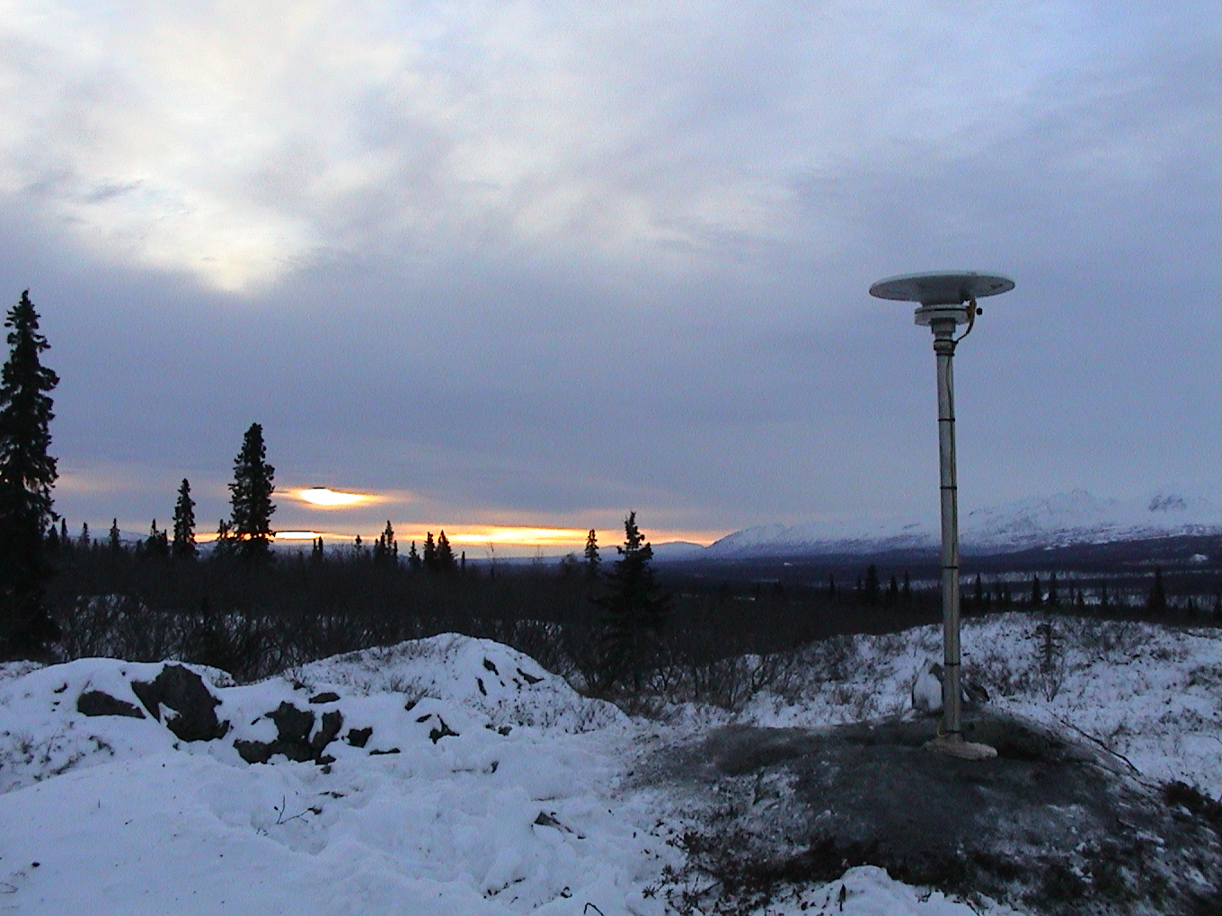
From NAVD 88 to NAPGD 2022
Modernization of the National Spatial Reference System

Slide 10
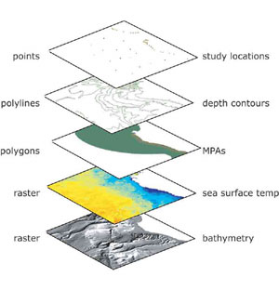
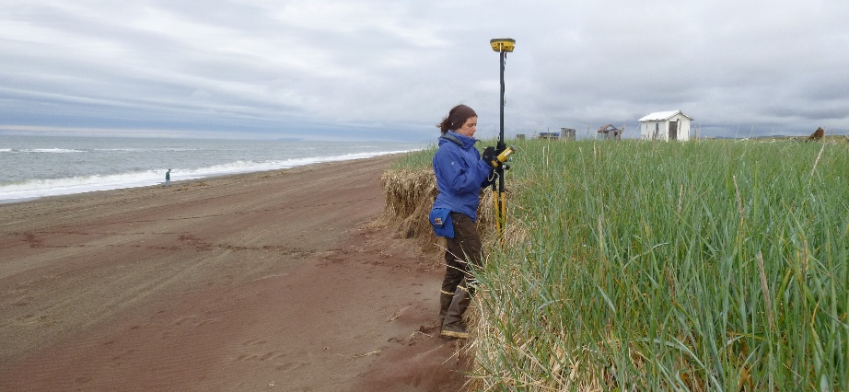
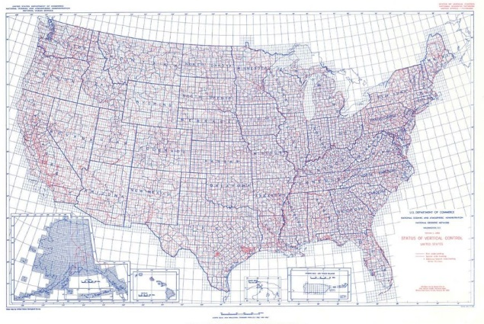
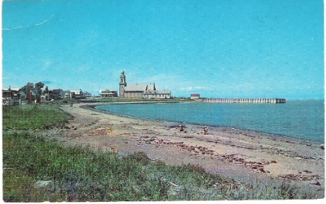
NSRS Considerations – The 4 C’s
Requirements
Expectations
CONSISTENCY
CONVENIENCE
Semi-CONSTANT Coordinates
COHERENCE with Sea Level
stamped with elevation
Notes:
For a reference system to be useful to the public it must be CONSISTENT (possess spaciotemporal reliability and repeatability) and CONVENIENT (readily accessible by users).
Additionally, as a society we have also adopted an expectation that our spatial reference system is defined in a manner that provides some level of CONSTANCY (that objects considered to be stationary have fixed coordinates and/or heights). We have also come to expect that heights and depths are relative to some definition of sea level, and this COHERENCE with a natural equipotential surface also ensures that water will flow from higher to lower height values.
As NGS continues to fulfil our primary mission of defining, maintaining, and providing access to the NSRS, we have recognized the need to modernize the current NSRS in tandem with advances in geodesy, geophysics, and technology (especially GPS/GNSS); to meet evolving requirements and expectations of the NSRS. Decisions about how to best modernize the NSRS must achieve improved consistency (especially between passive and active control) and convenience while not fully departing from expected characteristics that are part of the fabric of how our Nation uses precise positions.

Slide 11
The NSRS of Today (simplified)
Primary elements:
Horizontal North American Datum of 1983 - NAD 83(2011) coordinates
Vertical North American Vertical Datum of 1988 - NAVD88 orthometric heights
These elements are geodetic datums that define the shape and size of the earth to enable precise positioning
System based on connections to published passive control
Notes:
simplify the NSRS down to its primary elements:
The horizontal component is the North American Datum of 1983 - NAD 83(2011).
The vertical component is the North American Vertical Datum of 1988, from which we get NAVD88 orthometric heights.
This system was defined on and based on connections to published passive control or physical survey markers you can find in the ground.

Slide 12
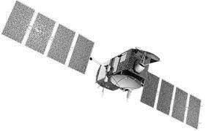
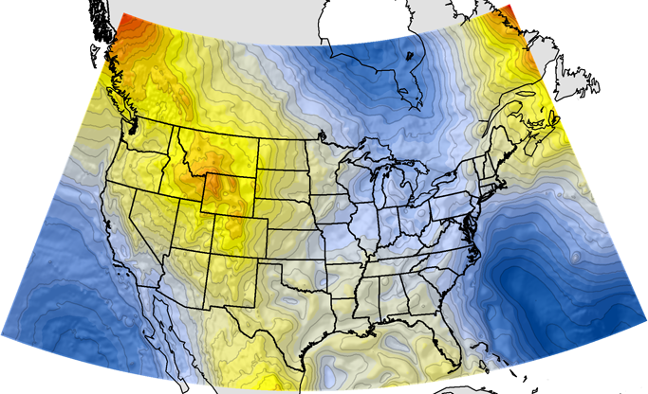
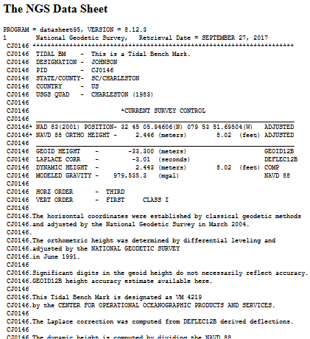
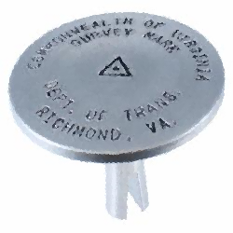
NGS Supports Access to NAVD88 Heights
GEOID12B
official path
Notes:
As I mentioned before, an important part of the NGS mission is to provides access to the NSRS.
Accessing NSRS today - Over time, and with advances in technology, there are now two paths to access NSRS or NAVD 88 heights.
Path (1) Since the NSRS is presently defined by a network of passive control, NGS provides primary access to the NSRS at published passive control (in IDB), at preset this remains the ‘official’ gateway to NSRS position.
Path (2) NGS also supports GPS/GNSS-enabled access to the NSRS (via OPUS). For GPS/GNSS-enabled access to NSRS heights, NGS maintains geoid models, which are necessary to convert GPS measurements (ellipsoid-based) into real-world elevations. The current geoid model (GEOID12B) that is used to access NSRS orthometric heights (NAVD88) is a hybrid geoid, a surface of constant gravity potential that has been warped to align with published values on bench marks.
→ Because of this warping, in an ideal (static) world, these two pathways lead you to the same coordinates.

Slide 13
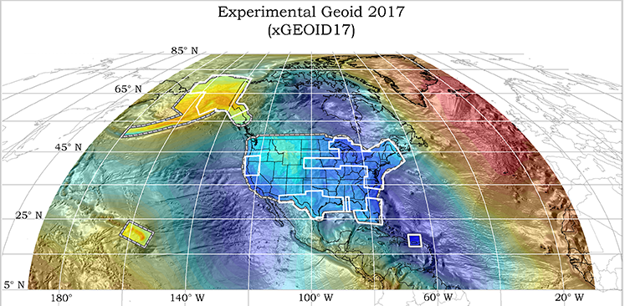
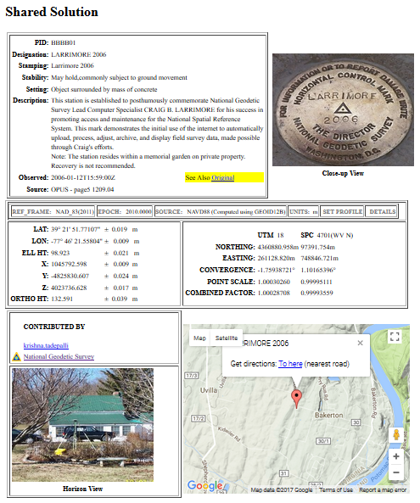
NGS Will Support Access to NAPGD 2022 Heights
GEOID 2022
official path
Notes:
In 2022 we are switching the official access path to NSRS coordinates
Active geodetic control (CORS) and a ‘pure’ or un-warped geoid model will replace passive geodetic control (bench marks)
GPS/GNSS will be the official gateway to the NSRS
GRAV-D project for a refined gravimetric geoid for the US that will enable access to orthometric heights w/in 2 cm accuracy using GPS/GNSS (no warp to published heights)
Transition: While the prevalence of active control will reduce our reliance of passive control, it will still have its place.
(next slide)

Slide 14
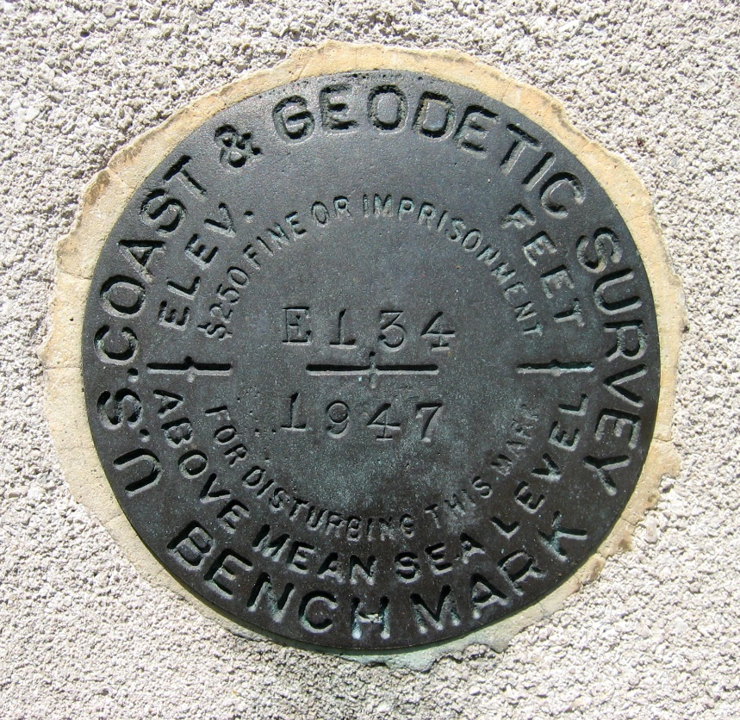
Continued Role of Passive Control
Calibration sites for GNSS technology, Real Time Network validation, and verification of datum transformation tool results.
Sites for monitoring motion to enhance velocity models (via repeat/campaign GNSS occupations)
Convenience for local project control, in areas with limited GNSS coverage (e.g. cities, forests), or in the event of GNSS failure (e.g. geomagnetic storms)
Notes:
GNSS technologies simplify and improve access to and accuracy of our spatial reference system.
→ By adding a 4th dimension to all coordinates (time) = marks can serve as more faithful access points

Slide 15
The NSRS of Tomorrow (2022)
Primary elements:
The geometric North American Terrestrial Reference Frame of 2022 (NATRF2022) plus the Caribbean, Pacific, and Mariana plates
The North American-Pacific Geopotential Datum of 2022 (NAPGD2022)
New reference system is:
Time-dependent and geocentric
Defined by relationships to a global/international ideal frame
Primarily accessed via GPS technology and a newly refined semi-dynamic geoid model
Notes:
What is replacing NAVD 88? (NAPGD 2022)
While the focus today is on NAVD 88, I’m going to talk about the effort to replace both NAD 83 and NAVD 88 because in many ways they are connected.
First, we are replacing the horizontal datum - NAD 83 - with four new reference frames:
North American Terrestrial Reference Frame of 2022 (NATRF2022);
Caribbean Terrestrial Reference Frame of 2022 (CATRF2022);
Pacific Terrestrial Reference Frame of 2022 (PATRF2022); and
Mariana Terrestrial Reference Frame of 2022 (MATRF2022)
NSRS Modernization - Second, we are replacing the vertical datum - NAVD 88 - with a new geopotential datum.
It will be called the North American-Pacific Geopotential Datum of 2022 or NAPGD2022.
It will include a new geoid model - GEOID2022 along with a few other products.
Again, to get more technical details: there is a technical publication called Blueprint 2 and an accompanying recorded webinar.
In addition to its new names and new primary elements, the modernized NSRS has other significant changes.
It is geocentric and defined by relationships to a global/international ideal frame;
This direct relationship to ITRF/IGS will improve the spatial framework for GNSS-based technology, such as UAS/UAVs
It is time-dependent, meaning coordinates in the new system will reflect where that position is at a specific epoch in time.
This introduction of time-dependency provides better ways to assess to mark stability and use the NSRS to monitor gradual change such as subsidence or uplift.
Primarily accessed via GPS technology and a newly refined semi-dynamic geoid model
Accessing the datums via GPS will take advantage of advances in technology and increase convenience of access to NSRS while simultaneously reducing our dependence on physical marks in the ground that were deteriorating over time.
Again, the semi-dynamic geoid model will allow us to account for gradual change in the earth’s surface caused by things like subsidence or uplift.
Notable Improvements (in no order):
Removes nation-wide tilt and bias in the present vertical datum
Time-dependency provides better ways to access to mark stability and use the NSRS to monitor gradual change such as subsidence or uplift
New vertical datum aligns with international neighbors such as Canada, facilitating precise positioning in border areas
GPS gateway opens consistent NSRS access to remote and isolated parts of the United States
More systematic ties between NAPGD2022 and tidal datums will significantly improve the quality of geospatial data in coastal environments with sea level trends
Direct relationships to ITRF/IGS improve the spatial framework for GNSS-based technology, such as UAS/UAVs

Slide 16
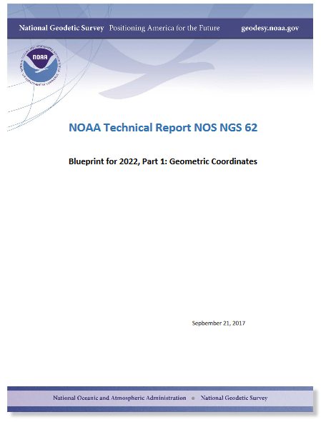
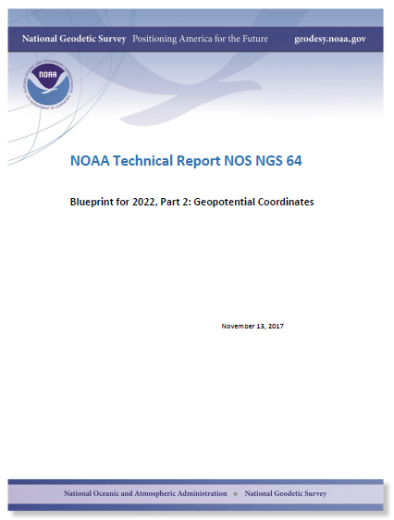
Details Available in Blueprints for 2022
Part 1:
Geometric Coordinates
Part 2:
Geopotential Coordinates
(In preparation) Part 3:
Working in the Modernized NSRS
… or check out related past webinars.
Notes:
Changes are still 4 years away, but users can get a sneak peak at the future in the Blueprints for 2022 Technical Report Series.
Part 2 = vertical focus. An informal summary of the contents is provided here to pique further interest.
Crack it open! Let NGS know what you think.

Slide 17
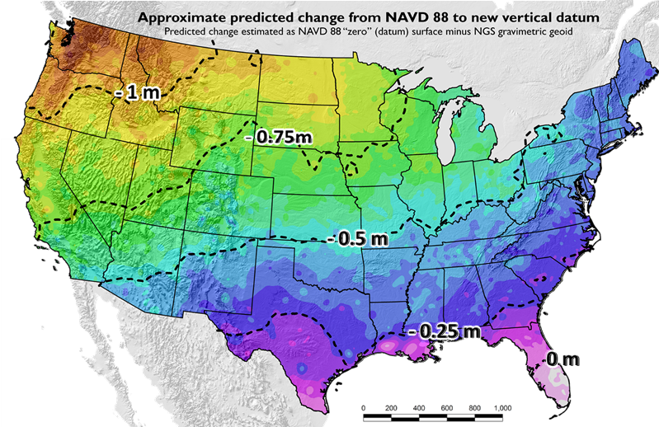
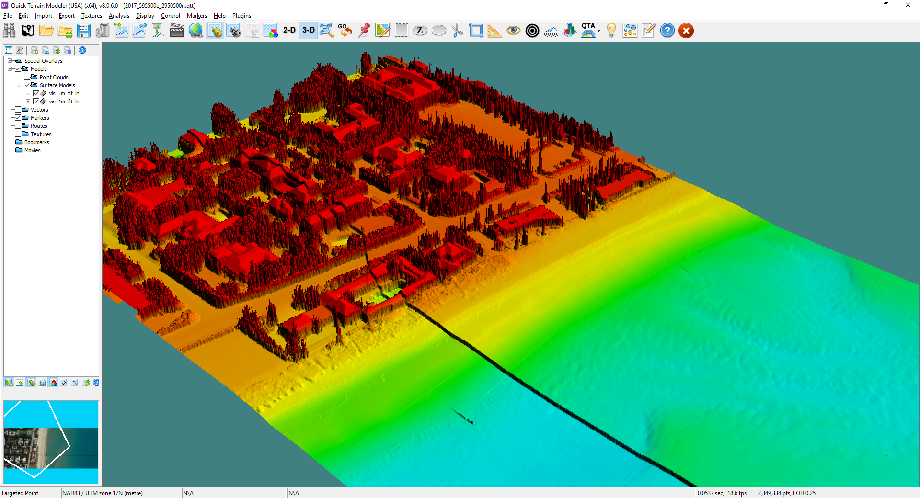
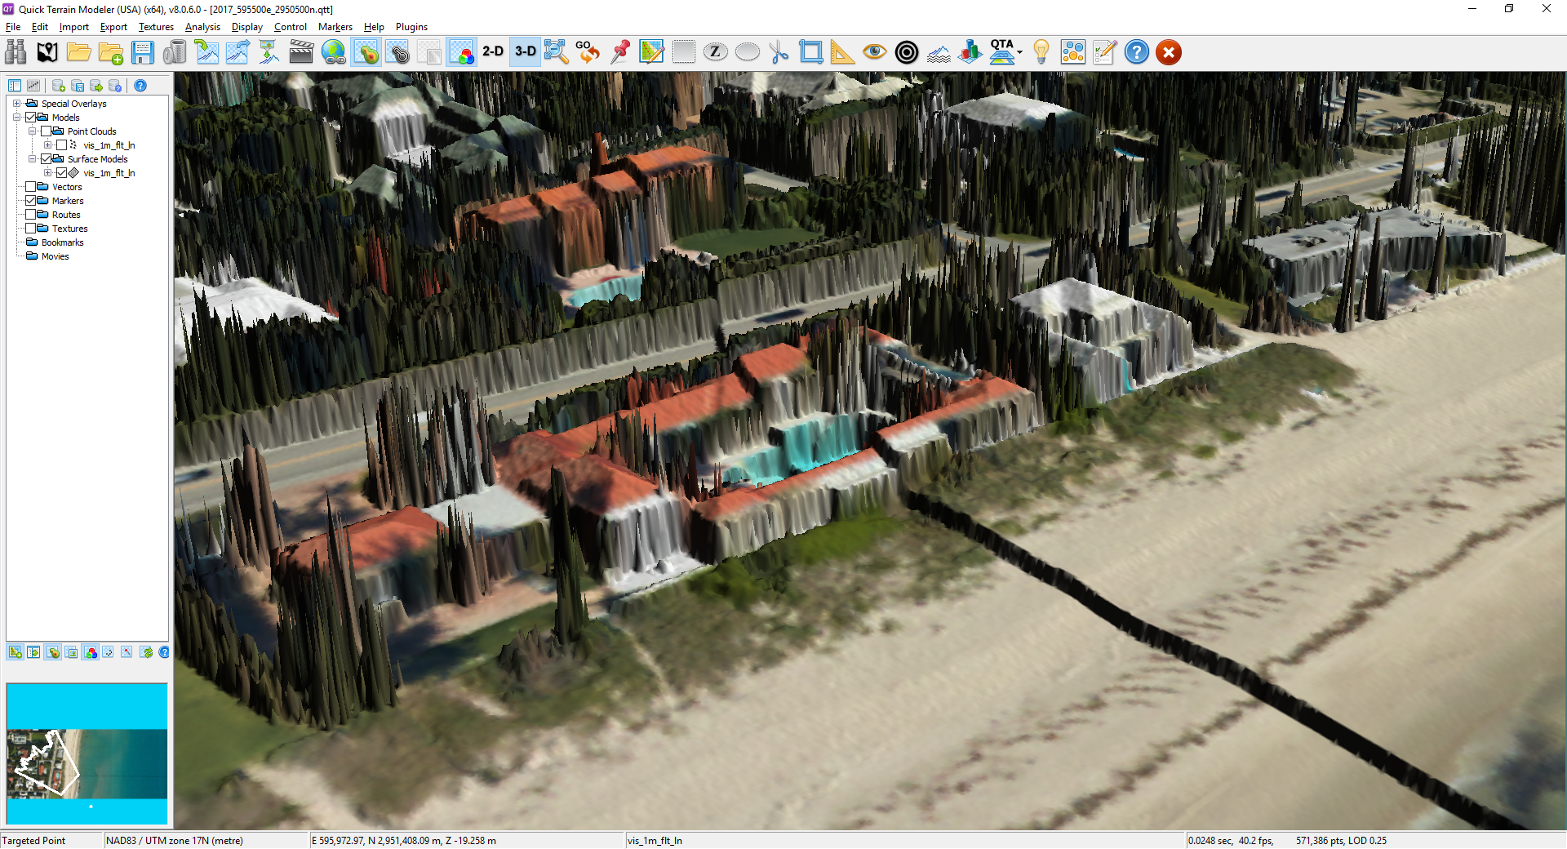
NSRS Modernization: Vertical Change
GEOID12B (NAVD88)
Updates available online from the New Datums website and Modernization News
xGEOID17
Vertical offset of more than 1 meter
https://geodesy.noaa.gov/datums/newdatums/index.shtml
Notes:
Coordinates will change
There will be a 0 to 1.5 meter shift in your vertical coordinates depending on where you are in the country (corrects a tilt and bias present in NAVD 88).
This offset could have implications if you try and mix data from sources in the old and new vertical datums
See the offset with the DEM
See the offset in the orthophotography
Do you want to see what the offset is for your area?
Maps and materials are online
You can also use our experimental geoid tool. Every year, we come out with our latest experimental geoid that incorporates new gravity data that is improving our geoid model from the one we use today.

Slide 18
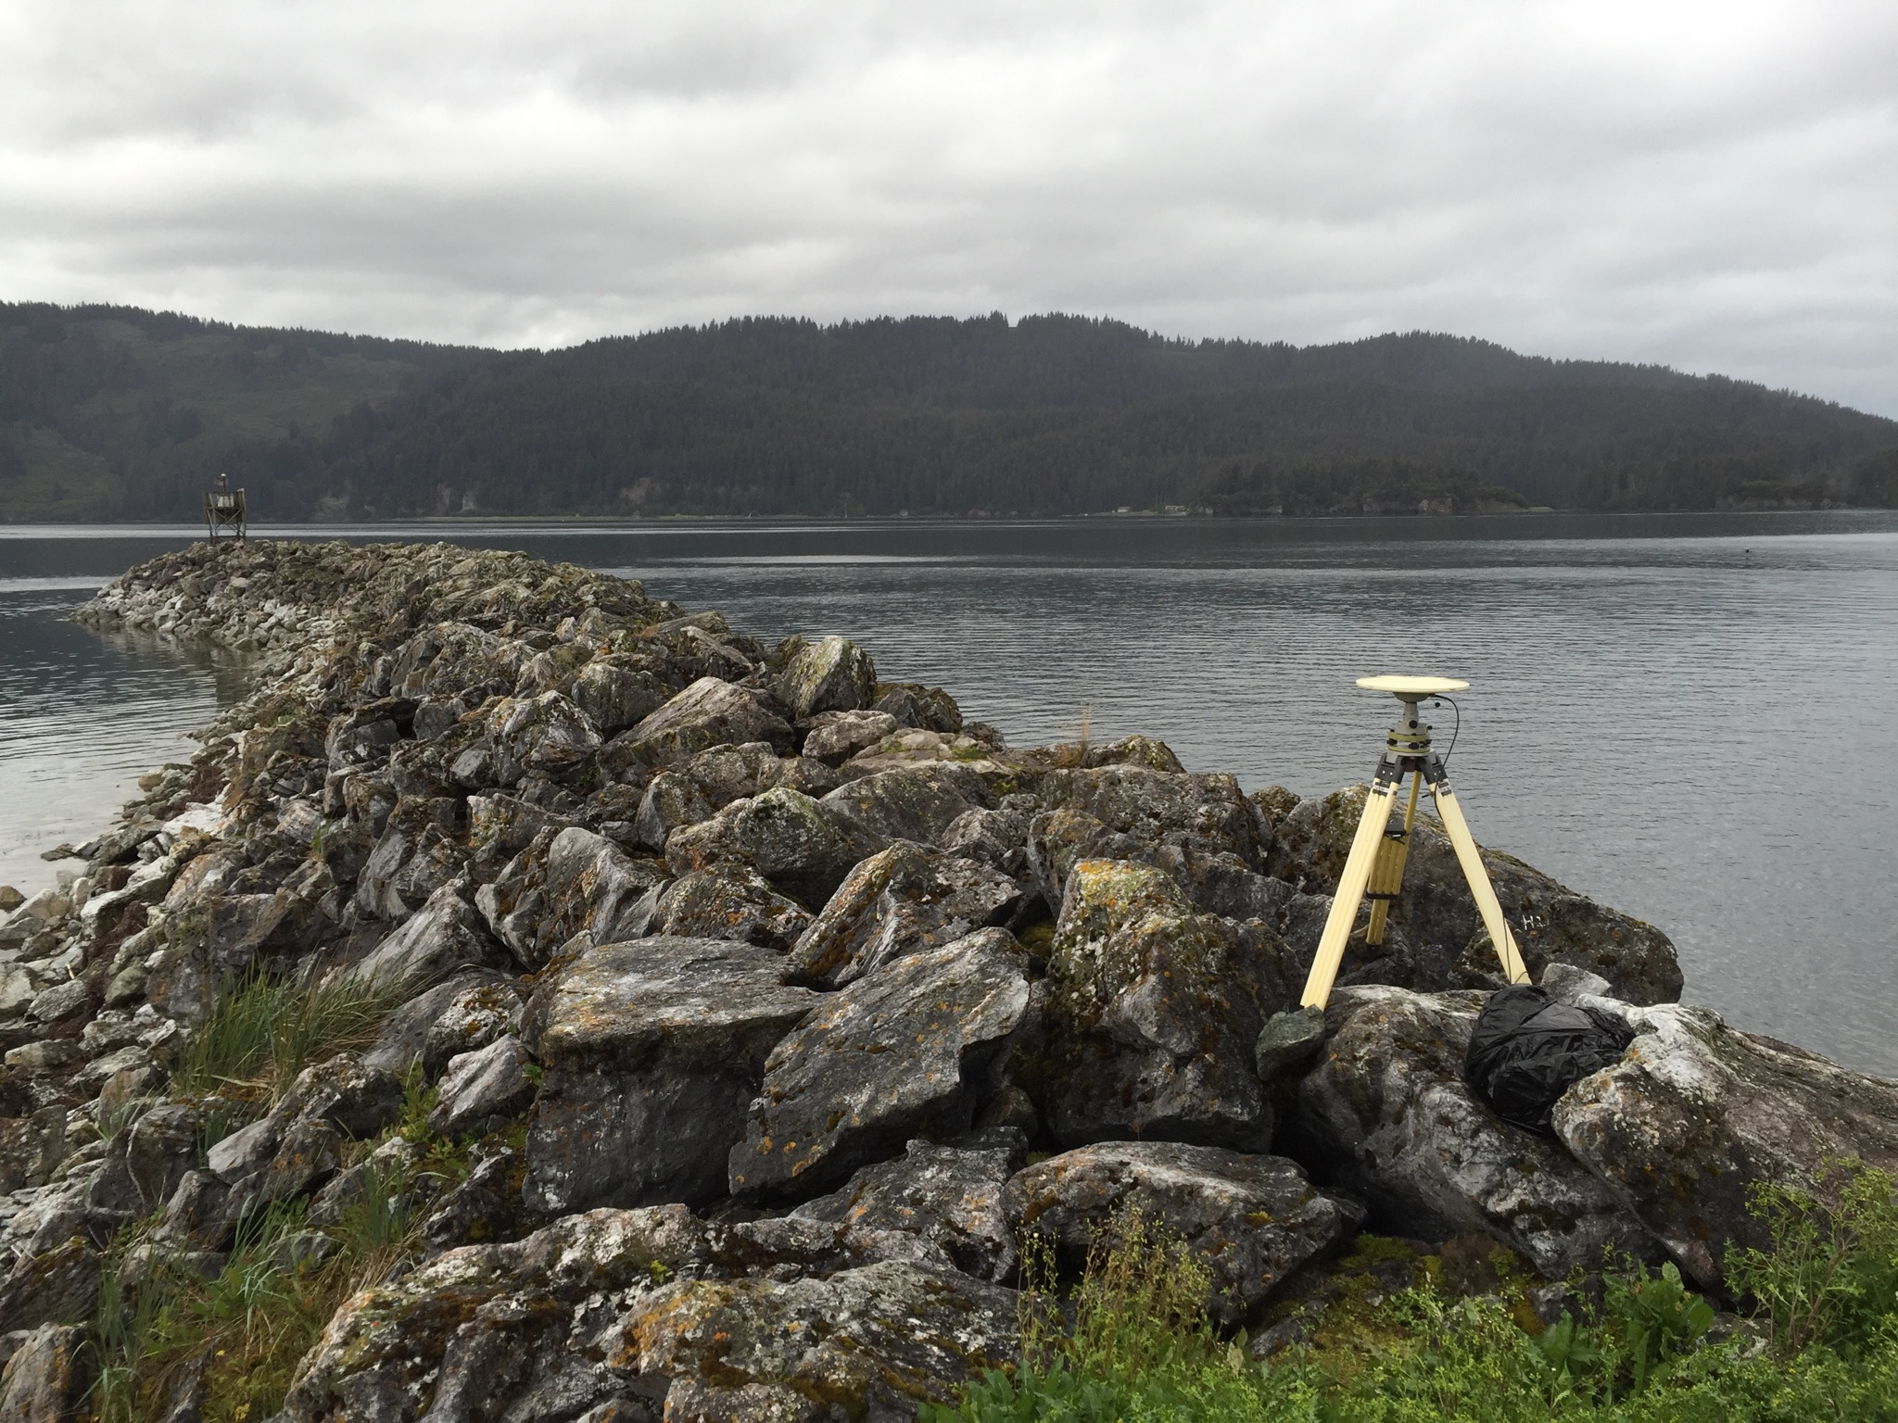
ALASKA Case Studies
Illustrative
Notes:
*** I just explained to you how we are modernizing NSRS and told you that it is a good thing for floodplain mapping, but now I am going to show you why with some case studies***
Alaska is a great illustrative end-member.
The issues posed by datums with limited time-dependency shown in the following examples are measurable and apparent, but they are relevant to areas nationwide because these changes are happening everywhere (at slower and less-apparent rates) and they reinforce why NSRS modernization is critical for improved flood mapping, particularly in areas experiencing changes in local relative sea level.

Slide 19
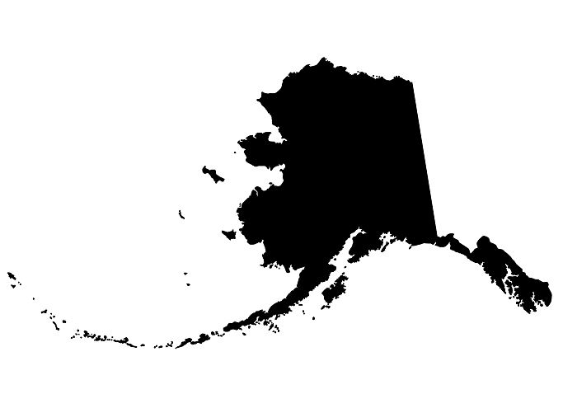
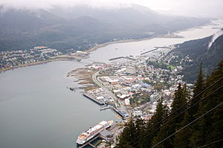
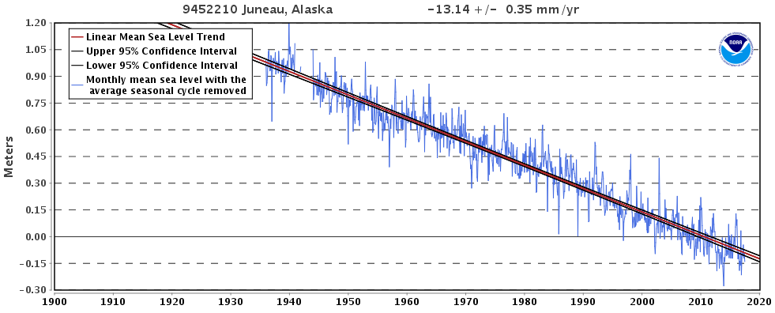
CaSe File: Juneau, AK
2015 Population:
32,756
Notes:
Juneau:
Bottom plot is the Negative RSL trend in Juneau, sea is falling relative to the land b/c even though the sea is rising globally, the land is rising even faster and outpacing the ocean

Slide 20
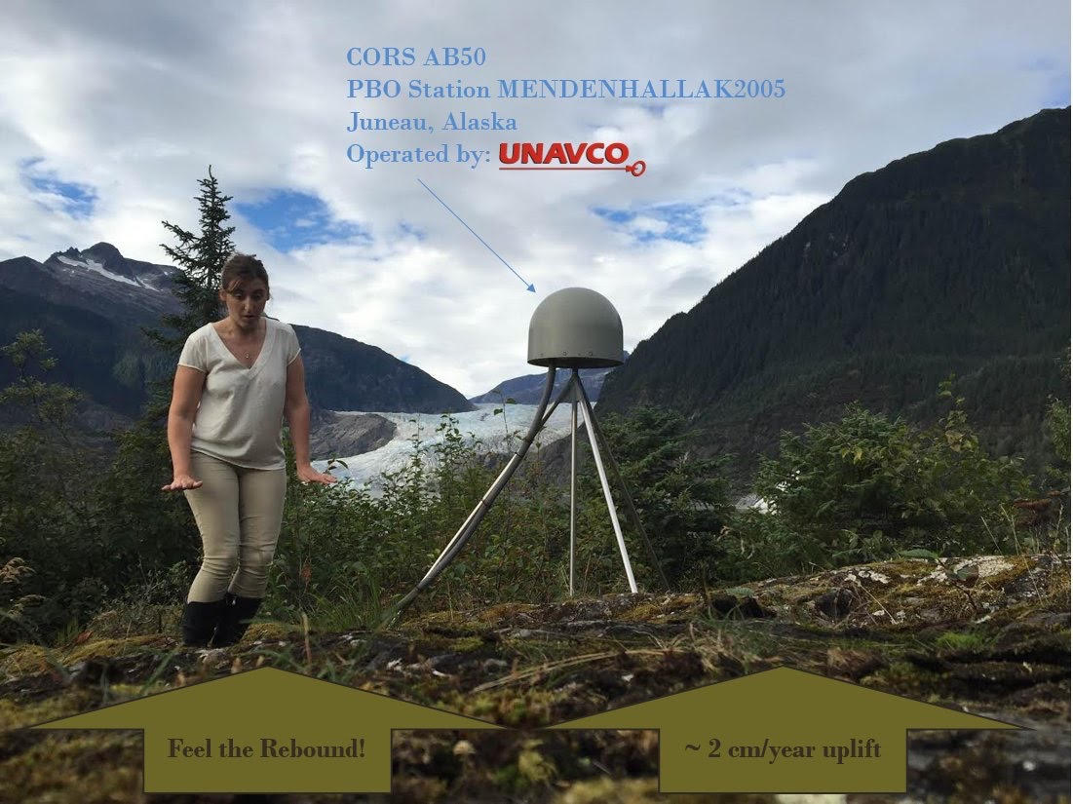
CaSe File: Juneau, AK
Notes:
Largest component due to isostatic rebound of the crust as terrestrial glaciers melt.
Rapid uplift monitored with continuous GNSS site at Mendenhall Glacier.

Slide 21
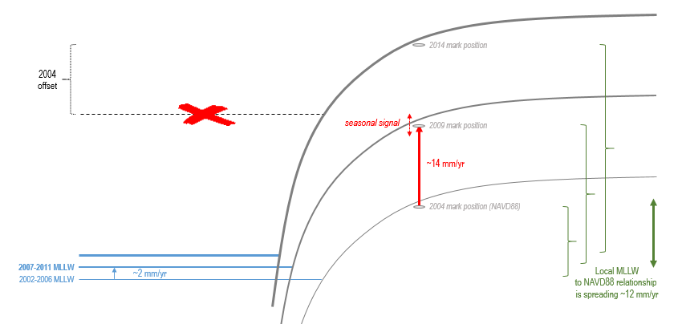
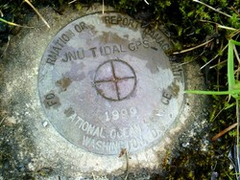
CaSe File: Juneau, AK
*** When and how you access or transform to NAVD88 matters ***
Notes:
**Juneau rates have been generalized for illustrative purposes in this figure**
Note on transforming between tidal and orthometric heights:
Local sea level is rising (in blue)
Land is rising faster (in red)
Vertical relationship between tidal and ‘terrestrial’ datums changes (increasing here as shown in green) through time such that if you applied the 2004 relationship 10 years later, the expected position of local MLLW would be significantly off (shown with red x)
Thought experiment in the creation of a new FIRM:
Mark shown has an official NAVD88 height published in IDB in 2004.
→ Just 10 years later, a surveyor uses this published height value to complete a NAVD88 elevation certificate.
→ A lidar contractor delivers a new 2014 DEM for Juneau and uses the same mark for control with a NAVD88 height value based on a GPS occupation of the mark (processed with OPUS). Are the surveyor and the lidar contractor working in a consistent vertical datum?

Slide 22
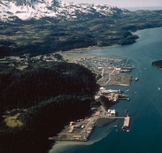
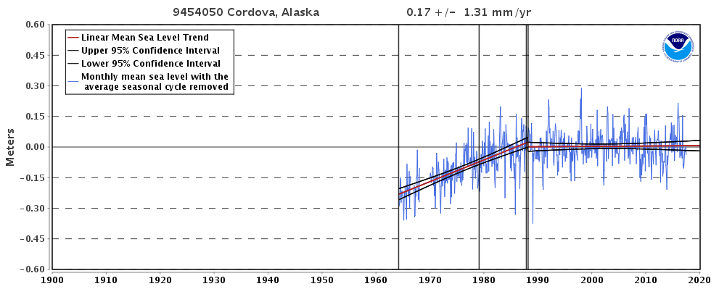
CaSe File: Cordova, AK
2010 Population: 2,239
Prior FIS: 1979-2015
New FIS Effective: 12/16/2015
Notes:
Cordova:
Complex RSL trend, positive to steady… why?
Note: record starts in 1964 (see next slide for answer).

Slide 23
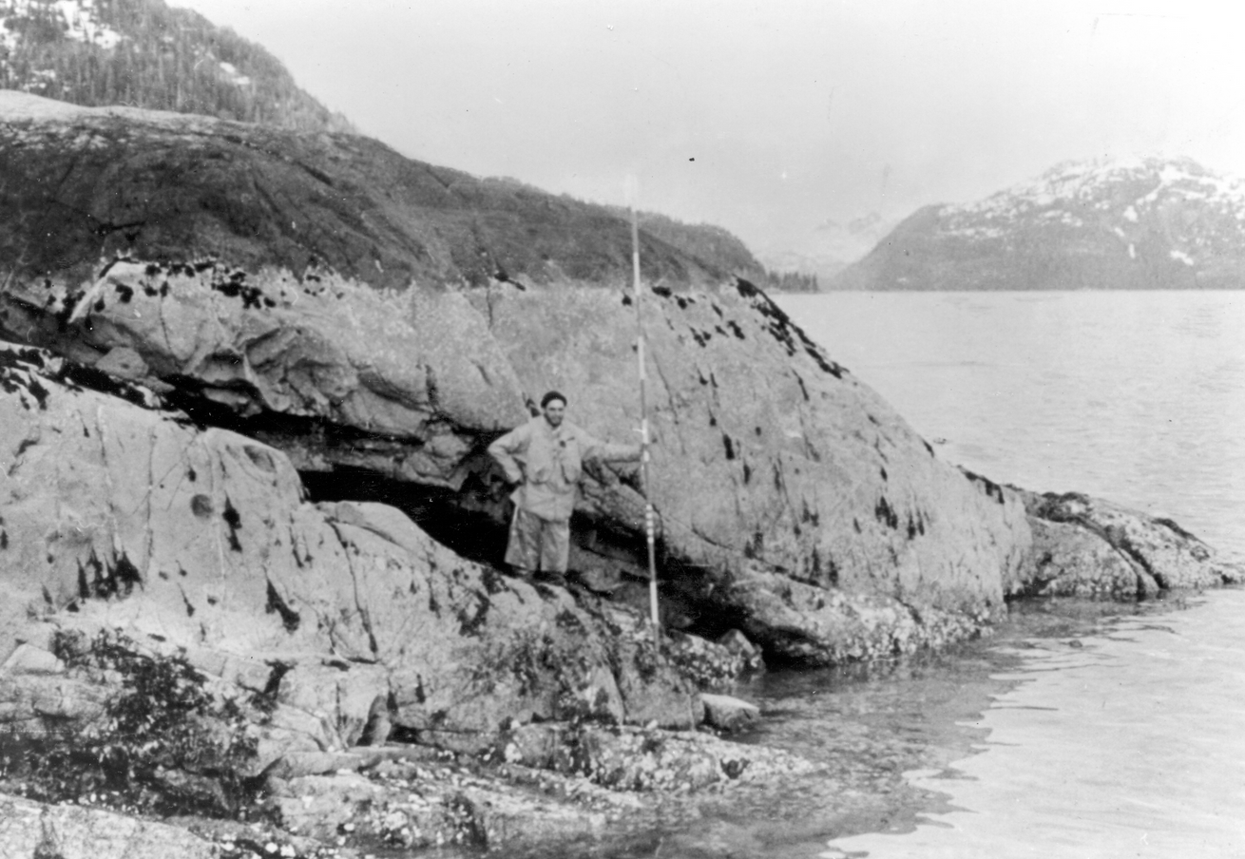
CaSe File: Cordova, AK
USGS Professional Paper 531-I
Notes:
Alaska Earthquake March 27, 1964. Barnacle line clearly marked by upper limit of light-gray barnacles and desiccated rockweed in dark patches and by the lower growth limit of dark-gray encrusting lichens of the splash zone. Uplift of 3.2 feet in Whale Bay in western Prince William Sound (not far from Cordova).
Photo was taken at 3-foot tide stage. June 22, 1964. Figure 6, U.S. Geological Survey Professional paper 543-I.
= Cordova experienced post-seismic adjustment following the 1964 quake = accelerated RSL rise (unfortunately coinciding with a period of major development in Cordova).

Slide 24
CaSe File: Cordova, AK
BFE in 1979 FIS/FIRM: “18 feet relative to MLLW”
(illustration not to scale)
Fred
Local MLLW in 1994 (1960-78 NTDE)
Fred obtains an Elevation Certificate in Cordova in 1994:
18.1’ MLLW (1960-78 tidal epoch) ← Above BFE
Notes:
Thought Experiment
*******NOTE: BFE in Cordova is relative to local MLLW, not NAVD88***********

Slide 25
CaSe File: Cordova, AK
BFE in 1979 FIS/FIRM: “18 feet relative to MLLW”
(illustration not to scale)
Susan
Fred
Local MLLW in 2004 (1983-2001 NTDE)
Fred obtains an Elevation Certificate in Cordova in 1994:
18.1’ MLLW (1960-78 tidal epoch) ← Above BFE
A decade later (2004), his next door neighbor Susan hires a surveyor to get an Elevation Certificate:
17.9’ MLLW (1983-2001 tidal epoch) ← Below BFE?
Notes:
Thought Experiment
Talk about Susan, 10 years later (water up and land down in this time → risk of flood is increasing for both houses)
Note: Susan’s house is actually up small hill from Fred’s

Slide 26
CaSe File: Cordova, AK
BFE in 1979 FIS/FIRM: “18 feet relative to MLLW”
(illustration not to scale)
Susan
Fred
Local MLLW in 2004 (1983-2001 NTDE)
Fred obtains an Elevation Certificate in Cordova in 1994:
18.1’ MLLW (1960-78 tidal epoch) ← Above BFE
A decade later (2004), his next door neighbor Susan hires a surveyor to get an Elevation Certificate:
17.9’ MLLW (1983-2001 tidal epoch) ← Below BFE?
Notes:
Thought Experiment:
Fred is “out” of flood zone due to his grandfathered elevation, but Susan in “in” (she is not really, because these elevations are not relative to the same FIS datum)
→ No one in this scenario paid attention to the tidal epoch of the MLLW datum
FEMA guidance says that “BFE stays fixed even if there is subsidence.” (a bit ambiguous if BEF is relative to a non-fixed datum)
Susan’s EC is NOT to the same datum as the BFE, but perhaps Susan’s EC reflects her true risk, and Fred just got lucky with timing?
→ This is not how we want to be calculating elevations for the purposes of informed flood preparedness.

Slide 27
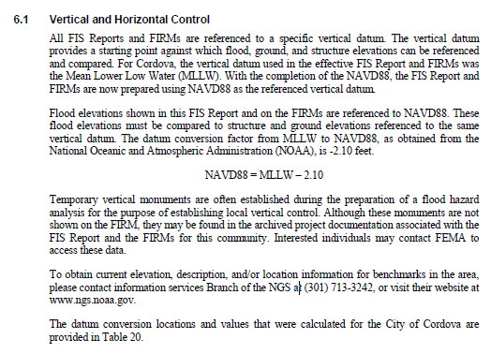
CaSe File: Cordova, AK
2015 FIS
Based on NOAA tidal BM records; this conversion value is for NAVD88 to Local MLLW (1983-2001)
Can this equation be used to update all Cordova MLLW Elevation Certificates to NAVD88?
Notes:
The Cordova 1979 FIS was updated in 2015.
The FIS was updated for BFEs relative to NAVD88, and a conversion value was provided that does not specify tidal epoch.
If this equation is used on Susan’s EC, her elevation is now ‘correct’
If this equation is applied to Fred’s EC, does he have a NAVD88 EC compliant with the new FIS?
How would the local Flood Plain Manager know the difference when going through process of Elevation Certificate updates?
---- REINFORCES THE IMPORTANCE OF METADATA ----

Slide 28
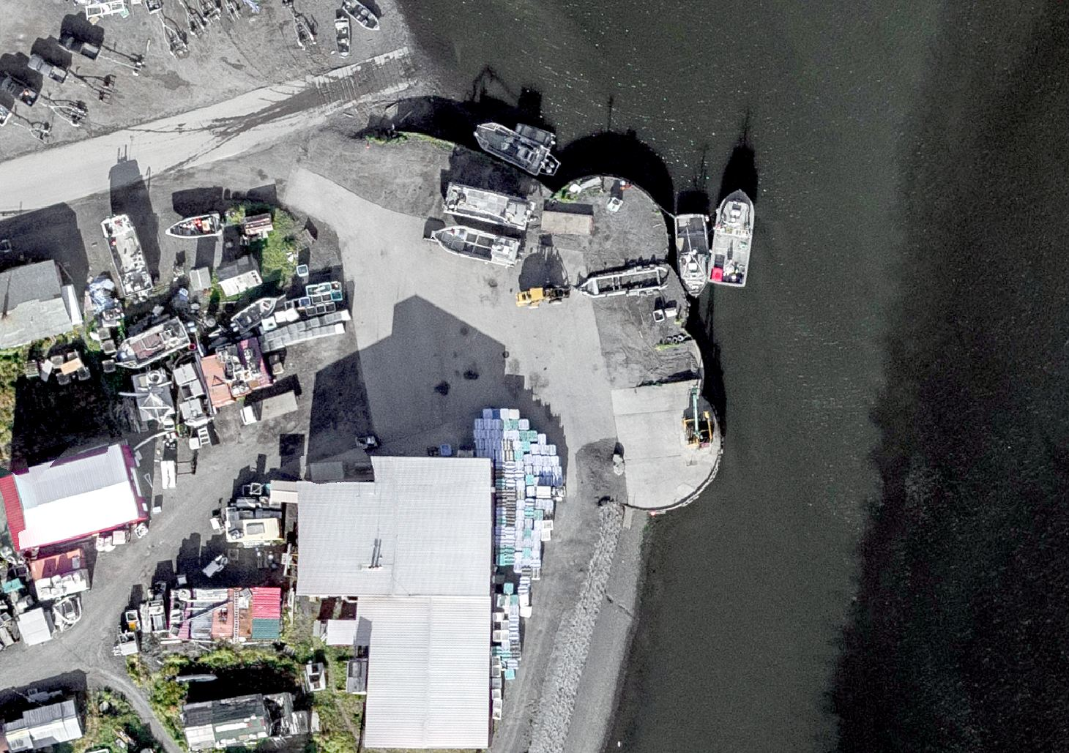
DOCUMENTATION OF DATUMS (metadata)
Practical Guidance on

Slide 29
Use Complete Nomenclature
NAD83
NAVD88
MLLW
Notes:
METADATA - you must document the datum you are referencing, but the datum itself is not enough.
Particularly in time leading up to 2022!

Slide 30
Use Complete Nomenclature
NAD83(2011) epoch 2010.00
H. Datum
Realization/Adjustment
Reference Epoch
NAVD88 (GRS80, Geoid12B)
V. Datum
Reference Ellipsoid
Geoid Model
MLLW(9452210; 1960-78 #2128)
Tidal Datum
NOAA Tide Station
National Tidal Datum Epoch & Published Sheet Number (if available)
Notes:
Note: exact content and format may vary; these general recommendations are specific to projects with a vertical emphasis.
Also keep a record of source/date of survey whenever possible, even before 2022.
Start now: Also keep a record of source/date of survey whenever possible, even before 2022.

Slide 31
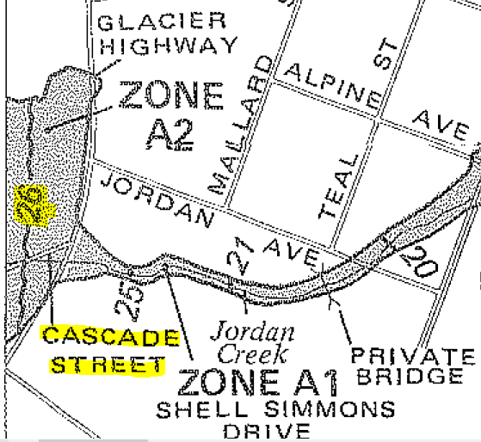
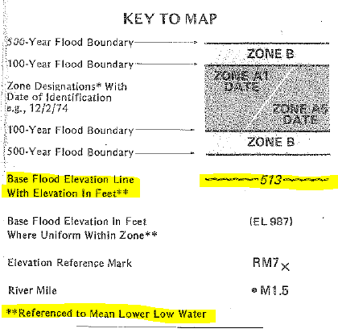
CaSe File: METADATA
1995 EC Form
1981 FIRM - JUNEAU
Notes:
Discuss that we have made improvements over time, as seen in old Elevation Certificate Forms (this one from Juneau)
Old form issue w/o enough metadata
This is very common issue in Alaska
Insurer takes datum label on EC at face value
Conversion value may not exist OR may demonstrate that datum is mis-labeled by resulting in an unreasonable elevation
Defer to licensed surveyor for interpretation or property requires a re-survey

Slide 32
Section B & C – FIRM Information
Notes:
New EC
Note extra space to add information about source; if you look in the instructions, licensed professionals completing this form are not restricted to just this space and they may provide attachments if extra explanation is necessary.

Slide 33
Some pro tips:
If local passive control are used in the FIS, retain a record of:
Monument stampings/locations
PIDs or other unique IDs
Position at time of FIS survey (with complete metadata)
If you do any transformations, keep a record of the parameters and the name and version number if a tool was used (like VDatum)
In areas of uplift/subsidence, inquire about source/”vintage” of heights
For NAVD88, which realization?
For Tidal Datums, what tidal epoch?
FEMA EC guidance provides for the use of OPUS reports; OPUS solutions of 4+ hours in duration on marks of significance can be archived w/ NGS as an ‘OPUS Shared Solution’ with minimal extra effort.

Slide 34
Training and Resources
Additional
Notes:
This presentation is intended to raise awareness about the upcoming changes and what they mean for floodplain mapping, but you probably have lots of remaining questions and we have a lot of resources online at our website
Please spread the word, and
make an effort to keep yourself and your colleagues informed.
Tell us what content is missing or how we can make it better!

Slide 35
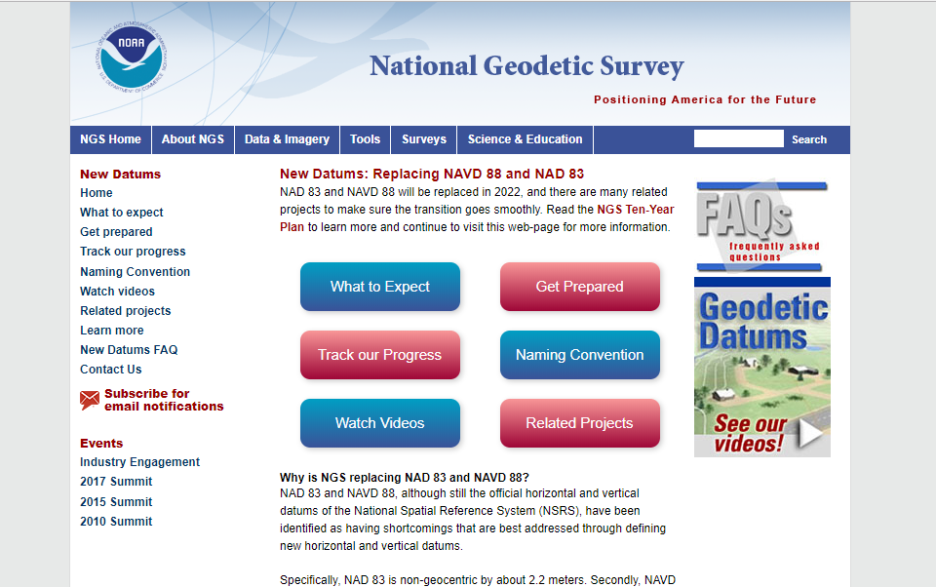
Resources from geodesy.noaa.gov
Click icon on home-page
Notes:
I’m going to highlight a few online resources, beginning with our new datums web site.
Visit our site. It has information today, and we’ll continue to update it.

Slide 36
Online Resources from ngs.noaa.gov
Notes:
You can also access our science and education resources from the drop down menu on our main page

Slide 37
Educational Videos & Online Tutorials
Videos are ~3-5 minutes
Vertical Datums Tutorial is ~1 hour
Notes:
Educational videos and online tutorials –
Our library of lessons and videos are great resources, and will reinforce a lot of information we covered today.
The videos are just 3-5 minutes long, and
the lesson is a deeper dive but still only takes an hour.

Slide 38
NGS Regional Advisor Program
NGS Regional Advisor Program
Notes:
Consult with your local NGS life-line.
Regional geodetic advisors are located around the country for questions / support.
We also have State Coordinators.

Slide 39
Email Subscriptions
Stay informed!
NGS News
Includes quarterly NSRS Modernization newsletter
NGS Webinar
NGS Training
Only 1-2 messages / month
Click icon
on home-page
Notes:
Email Subscription –
Sign up for notifications about News, webinars, and training opportunities with NGS.
We use our News subscription list to send out our quarterly NSRS Modernization Newsletter, too.

Slide 40
What can everyone do?
Be aware and help spread the word about upcoming NSRS modernization:
Proactively ask agencies, surveyors, and engineers about what preparations they are taking to learn about and prepare for the upcoming changes
Reach out to NGS for support as needed
Lead by example and exercise best metadata practices
Notes:
Coordinate
Spread the word and tell others about NSRS Modernization
Educate
Review materials and ask for support from NGS
Prepare
Lead by example and use best metadata practices

Slide 41
Get Prepared
More active NSRS users
Metadata, metadata, metadata..
Use current datums / realizations
Keep original (“raw”) GNSS observation files
Notes:
More active NSRS users
Metadata, metadata, metadata..
Require/provide complete metadata for all mapping contracts.
How did they get the positions/heights? Document it!
Lead by example and use best metadata practices
Use current datums / realizations.
NAD 83(2011) epoch 2010.00
USGG12 (gravimetric geoid) / GEOID12B(hybrid geoid)
NAVD 88 (get off of NGVD 29)
Keep original (“raw”) GNSS observation files. This will improve quality of future transformations.

Slide 42
Ongoing NOAA/FEMA Coordination
Feedback on the New Datums
Kimberly Pettit, FEMA GIS Coordinator
Prepared with Paul Rooney
2017 Geospatial Summit
April 24 to 25, 2017
https://www.ngs.noaa.gov/geospatial-summit/presentations/fema.shtml
Assessment
Preparations to-date
Advantages and challenges
Concerns
Necessary transition tools, products, and services
Outreach priorities
watch online
Notes:
We are coordinating with other Federal Agencies - since Federal mapping agencies must use the NSRS, we’ve made a particular effort to engage federal agencies
Our director chairs the Federal Geodetic Control subcommittee (FGCS), and they will adopt the new datums in 2022
We hosted Geospatial summits in 2010, 2015 and most recently in 2017.
We asked federal agencies to share their requirements and concerns.
Check out what FEMA share by visiting our website.
Anticipate involvement by FEMA at upcoming Summit in 2019

Slide 43
NOAA/FEMA Coordination
Cooperative Pilot Study (2011):
National Geodetic Survey,
North Carolina Floodplain Mapping Program,
North Carolina Geodetic Survey, and
Federal Emergency Management Agency
Key Outcomes:
Recommendation of FEMA implementation plan to account for coordinate and height shifts.
Improved relative positional accuracies and greater understanding of height uncertainties will enhance quality of flood mapping.
Notes:
NOAA/FEMA – Working with FEMA to implement the new datums is incredibly important.
In 2011 we commissioned an socio-economic benefit study that found improved floodplain maps are of tremendous value to the nation.
This study was a huge driver in getting funding for our GRAVD project.
We completed a pilot study in 2010 in North Carolina
Made recommendation that FEMA create an implementation plan to account for coordinate and height shifts.
Found that improved relative positional accuracies and greater understanding of height uncertainties will enhance quality of flood mapping.
We recognize there will be challenges, but we really are looking to work with FEMA and all of you to make the transition work as well as possible.

Slide 44
Thank You
Notes:
NGS is not pulling the rug out from under you, we are re-leveling and bracing the subfloor for longevity.
Geodesy and the NSRS critical to floodplain mapping
Ellipsoidal, orthometric, and tidal vertical datums each have a role…
NAVD 88 is going to be replaced in 2022
By NAPGD 2022, part of larger NSRS Modernization effort (2022).
Replacement is in 2022, but the time to prepare is now.
The tools you use today will be expanded for 2022
Tools for accessing NSRS (OPUS, CORS, Data Explorer)
Tools for transformations (NCAT and VDATUM), and
they all require good metadata (lead by example!)

